Slide 1
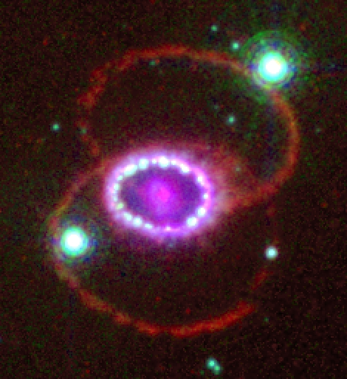
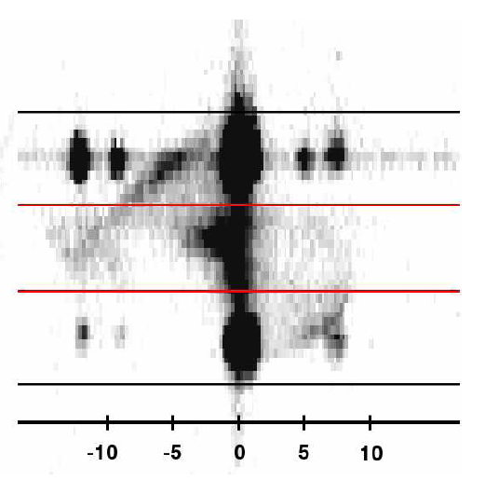
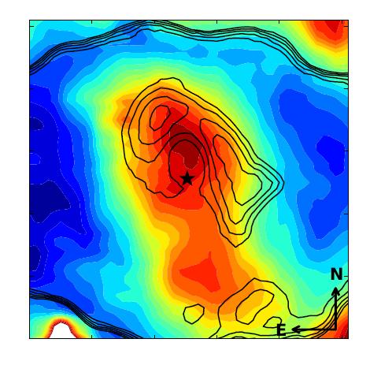
SN 1987A Exciting Physics
Bruno Leibundgut (ESO)
Claes Fransson (Stockholm)
Josefin Larsson (Stockholm)
Katia Migotto (Stockholm)
Anders Jerkstrand (Belfast)
Jason Spyromilio (ESO)

Slide 2
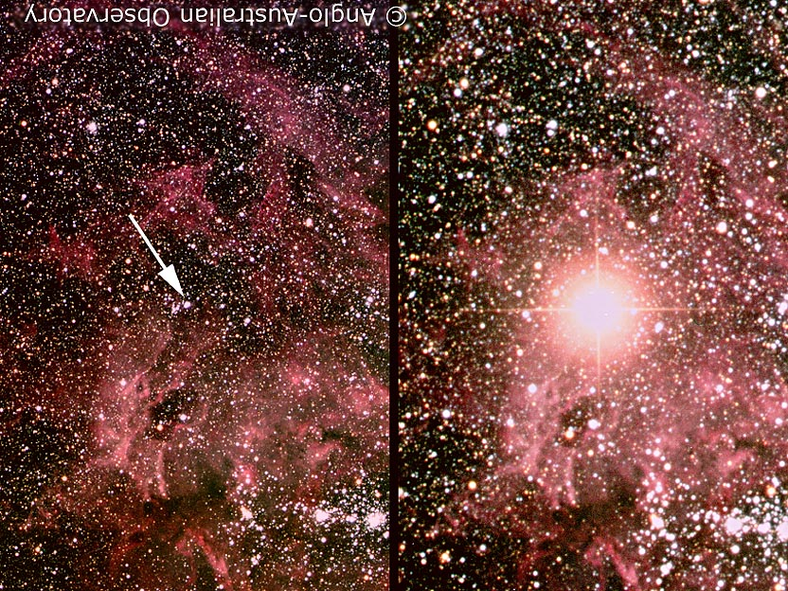
Earliest portrait of SN 1987A
Before February 1987
~24 February 1987
© Anglo-Australian Telescope

Slide 3
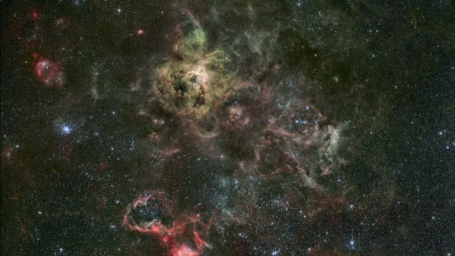
Introducing SN 1987A

Slide 4
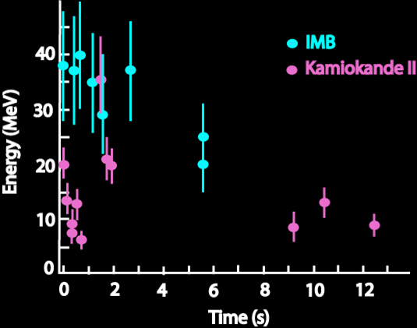
Uniqueness of SN 1987A
Neutrino detection
direct evidence of core collapse and formation of a neutron star (or black hole)
Naked-eye supernova after >350 years
detection of X-rays and γ-rays very early
mixing and direct nucleosynthetic products
monitoring with HST, VLT, Gemini, Chandra, XMM, ATCA, Herschel, Spitzer, ALMA
Progenitor star observed before explosion
insight into stellar evolutionary channel leading to a supernova surprise → blue supergiant!

Slide 5
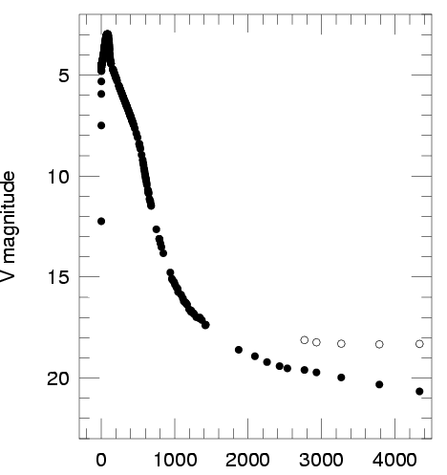
Uniqueness of SN 1987A
18
23
28
Fornax distance
33
Suntzeff

Slide 6
Properties of Sk -69 202
Luminosity ~ 10⁵ L
Temperature ~ 15 000 K
Radius ~ 40 R
About 6 M in the core (He and beyond)
Main sequence mass ~20 M
→ early B/late O star

Slide 7
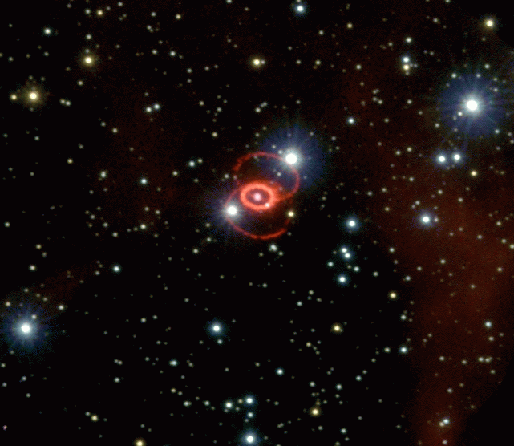
Uniqueness of SN 1987A
Spatially resolved
separate circumstellar environment (rings) from the ashes of the explosion (ejecta)
Signatures of an asymmetric explosion
polarimetry, ‘mystery spot’, spectral line evolution (‘Bochum event’)
Nisenson et al. 1987
Hanuschik & Thimm 1988

Slide 8
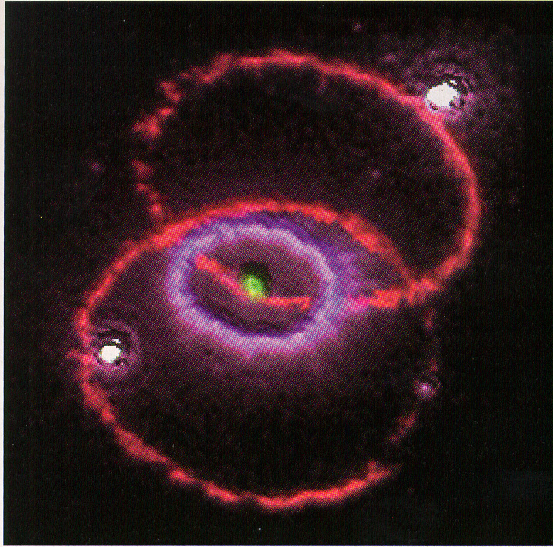
The exciting SN 1987A today (11216 days since explosion – 29 years old)
Fluorescing rings
Shocks
outer ejecta reached the inner ring
Radioactively heated material
inner ejecta
Dust
in and around the supernova

Slide 9
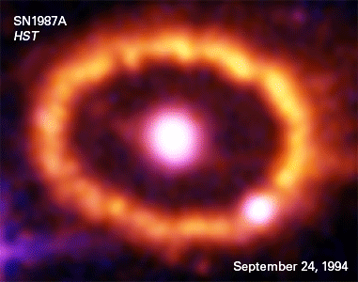
Energy escape from a (core-collapse) supernova
SN 1987A the best observed supernova ever
Suntzeff (2003)
(also Fransson et al. 2007)

Slide 10
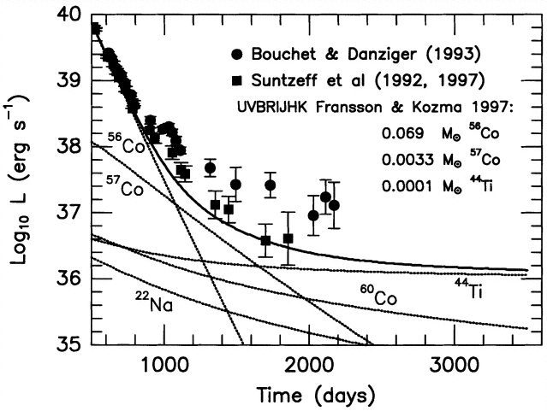
What can drive SN emission at late phases?
Freeze-out
recombination of atoms at long time-scales

Slide 11
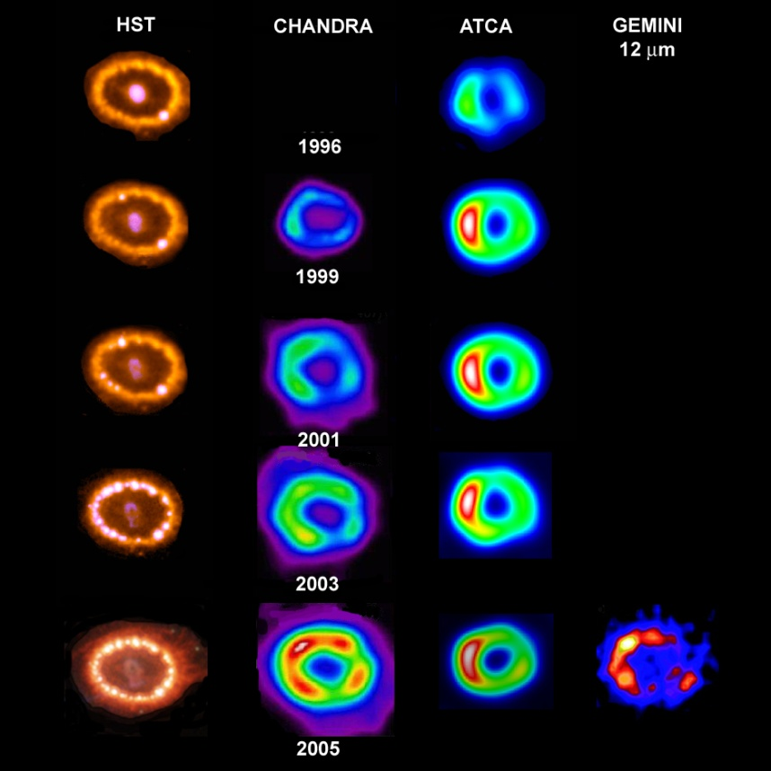
Optical, X-rays and Radio
Park et al
Manchester et al

Slide 12
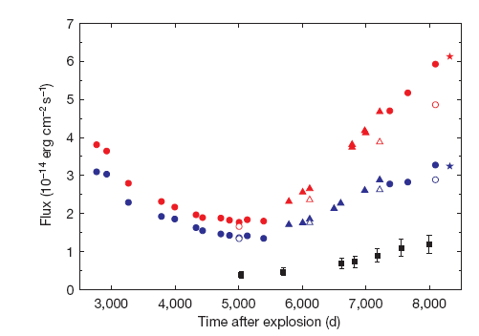
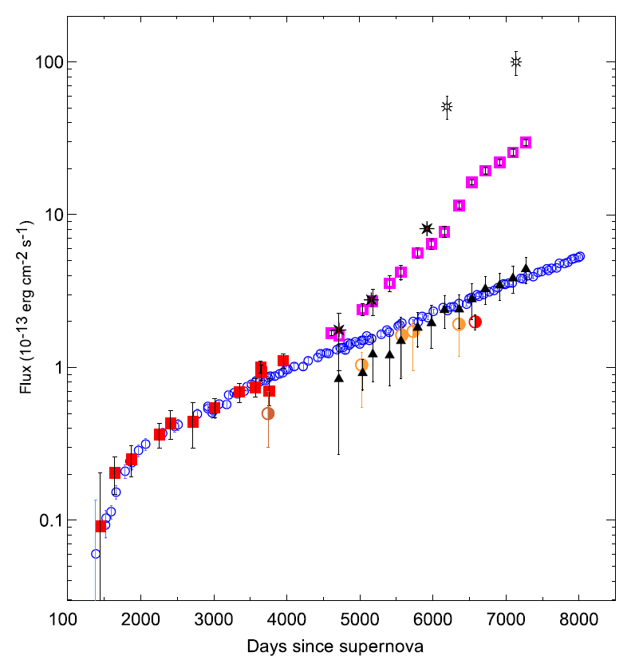
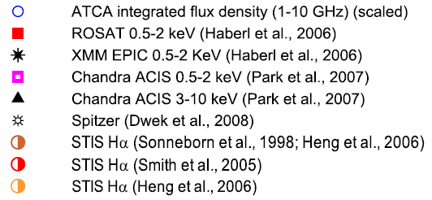
SN 1987A brightening at all wavelengths
Larsson et al. 2011
Zanardo et al. 2010

Slide 13
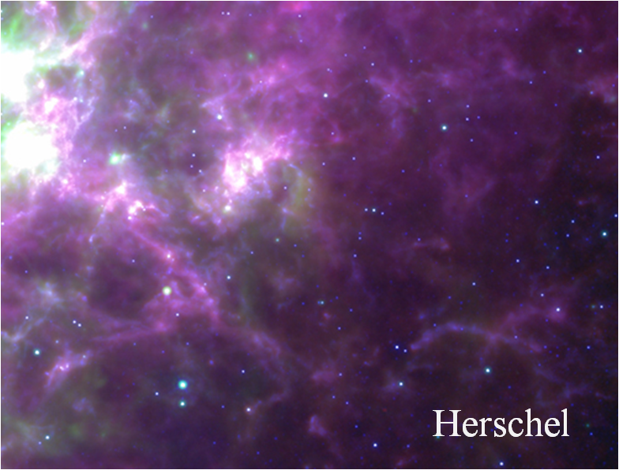
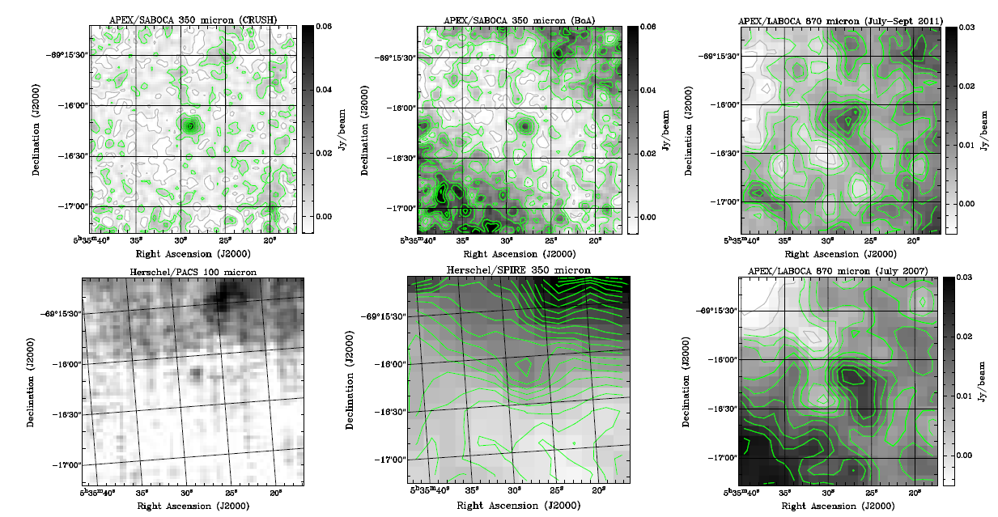
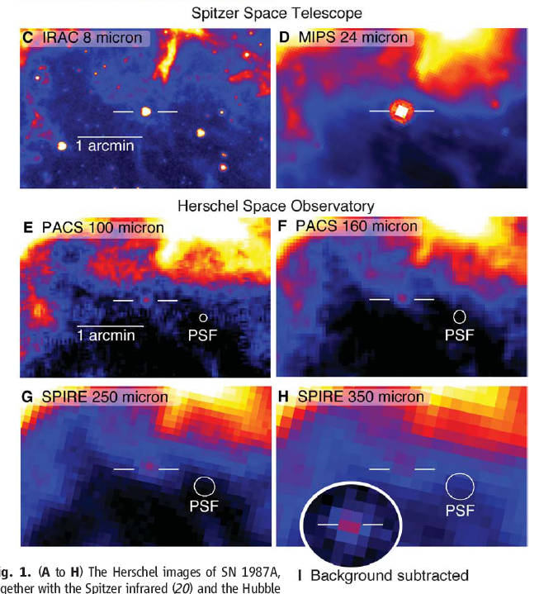
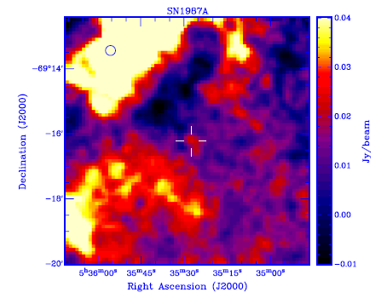
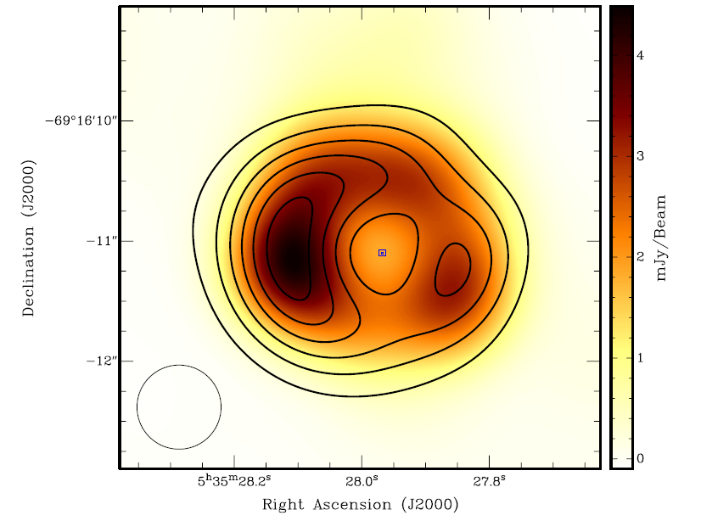
Exciting developments
Detections by Spitzer and Herschel
Detection at mm wavelengths
Start to resolve the radio image
Lakićević et al. 2012
0.87mm - APEX
3mm
3cm (contours)
Lakićević et al. 2011
Lakićević et al. 2012
Matsuura et al. 2011

Slide 14
Dust in SN 1987A
Synchrotron emission from the ring
Thermal dust in the inner ejecta
Indebetouw et al. 2014

Slide 15
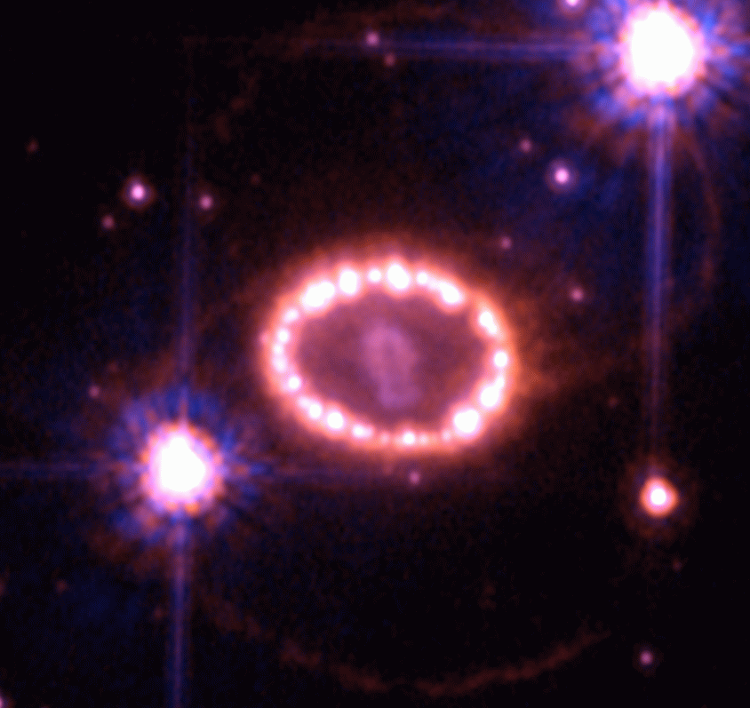
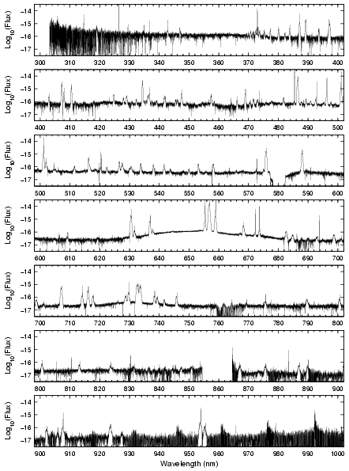
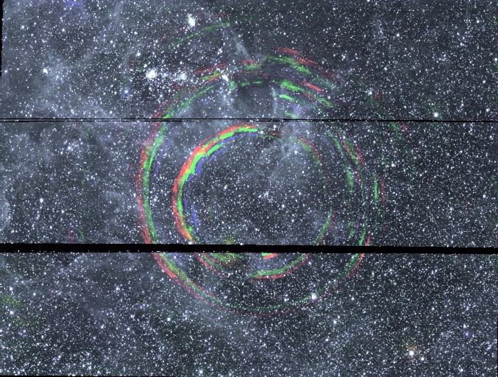
The complex SN 1987A @ 27 years
Combination of several emission sites
inner ejecta
shocked ejecta
shocked inner ring
ionised inner ring
outer rings
light echoes
Courtesy P. Challis, CfA

Slide 16
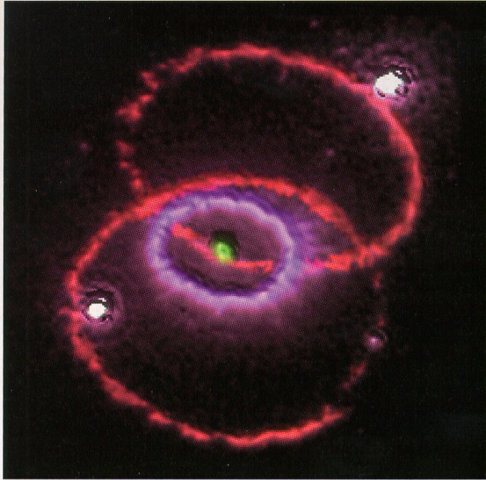
The different emission sites in SN 1987A
SN ejecta
radioactively heated material (‘inner ejecta’)
X-ray heated ejecta
dust
Rings
density enhancements in equatorial (?) plane
shock physics
forward shock (into the ring)
reverse shock (into the ejecta)

Slide 17
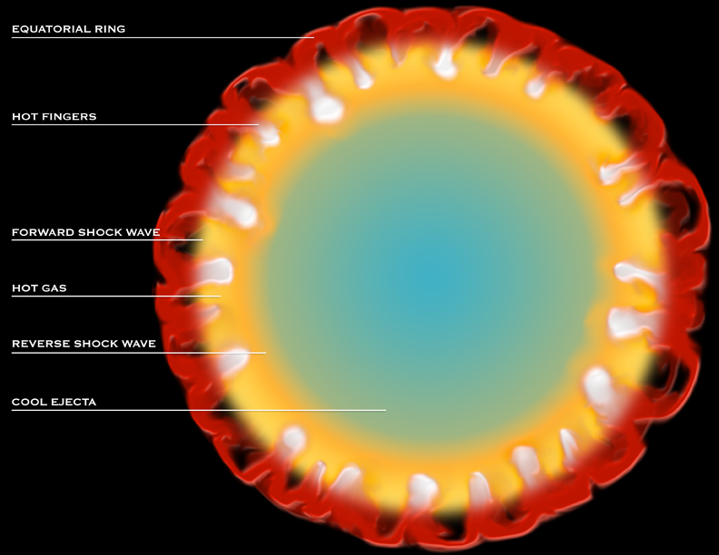
McCray

Slide 18
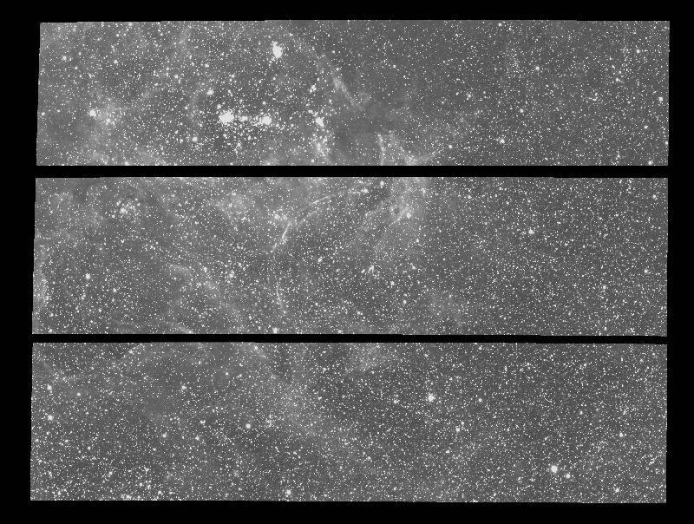
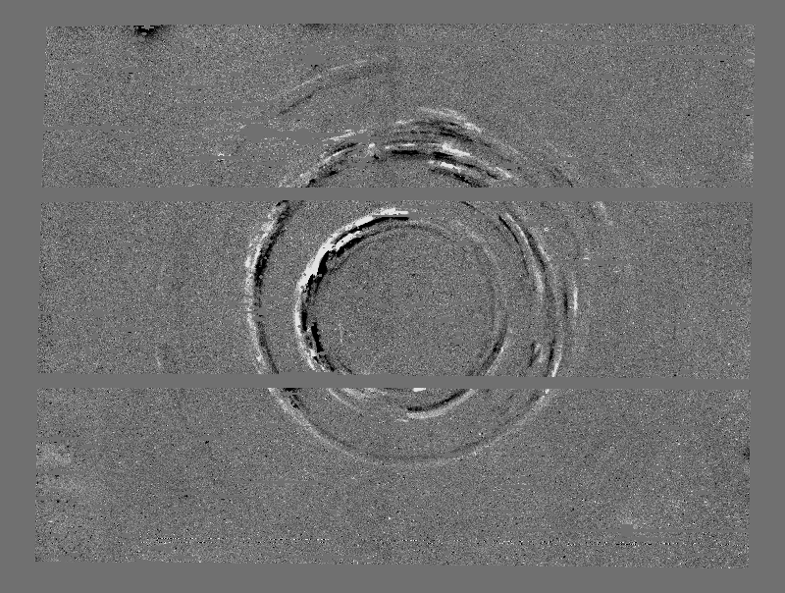
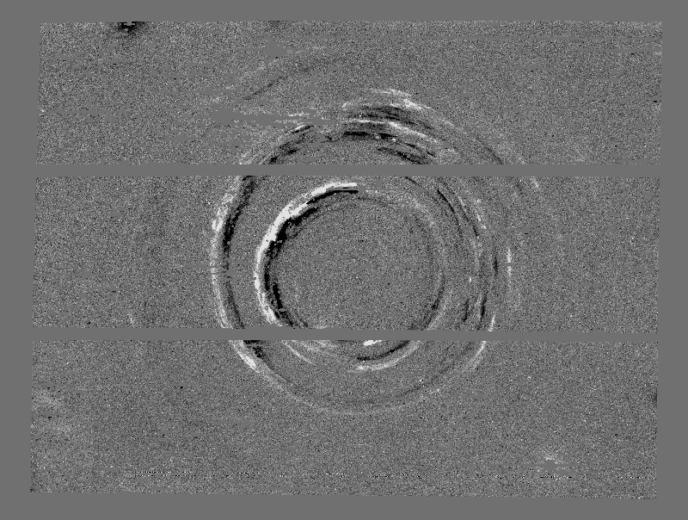
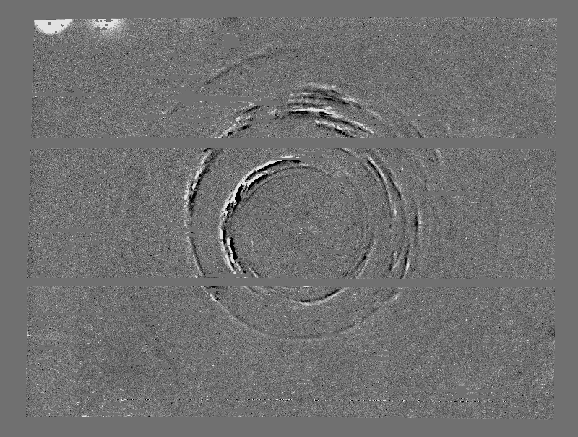
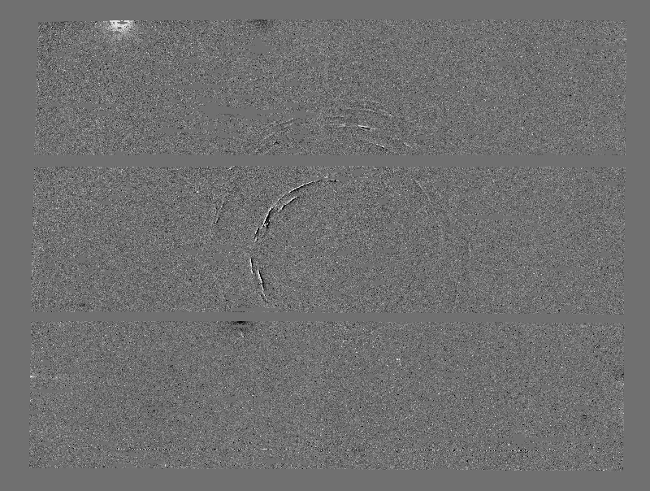
The hidden SN 1987A
2001 – 2001
2002 – 2001
2003 – 2001
2004 – 2001
1 arcmin
Rest et al. 2006

Slide 19
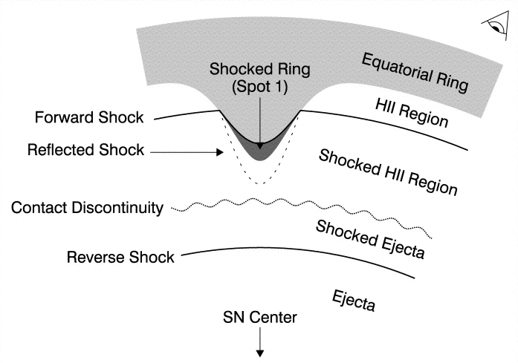
The ring collision
Dominating at all wavelengths
shock emission increasing for the past 13 years
Emission from the stationary ring
narrow lines (FWHM ≈ 10 km/s)
known since 1987 - fading
Shocked ring region (forward shock)
intermediate lines (~300 km/s)
Reverse shock
ejecta (>11000 km/s)

Slide 20
The emission line components
4
Hα
2002
2000
3
Flux
2
1
0
-20000
-15000
-10000
-5000
0
5000
10000
15000
20000
velocity (km/s)
Fransson et al. 2013

Slide 21
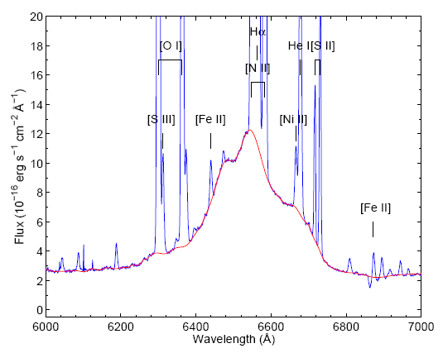
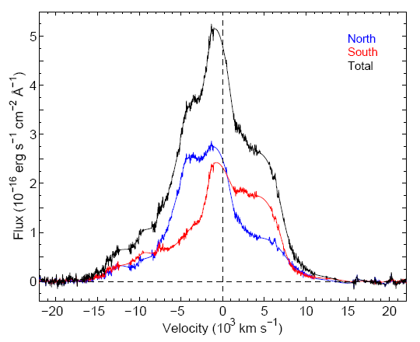
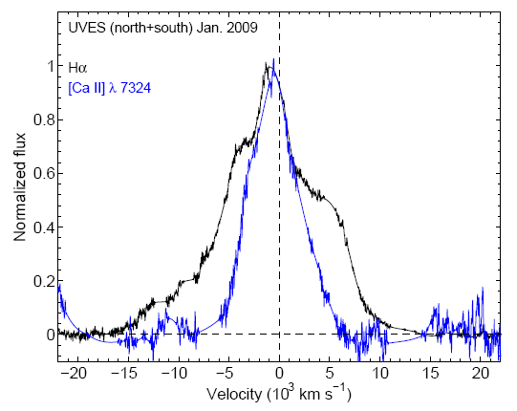
Hydrogen in SN 1987A
‘Clean Hα’
Flux increase by 4 to 6 from 2000 to 2007
v_{max}>11000 km/s
larger than possible in equatorial ring
anisotropic expansion
Day 7976
26 Dec 2008
Day 7998
Fransson et al. 2013

Slide 22
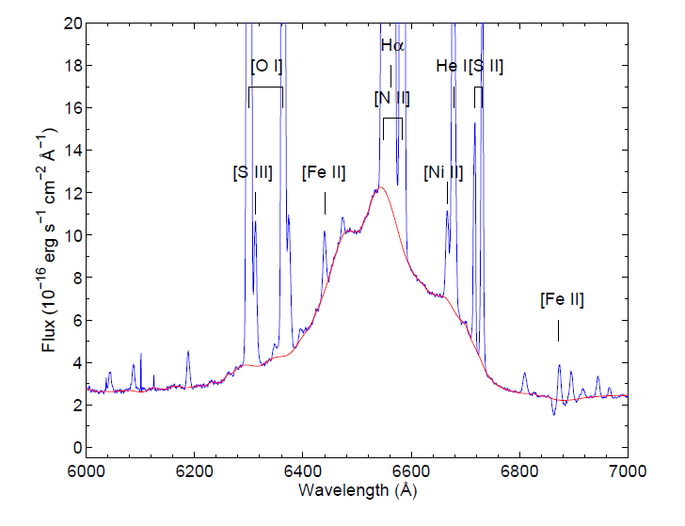
Hα in SN 1987A
7976 days
26 Dec 2008
Fransson et al. 2013

Slide 23
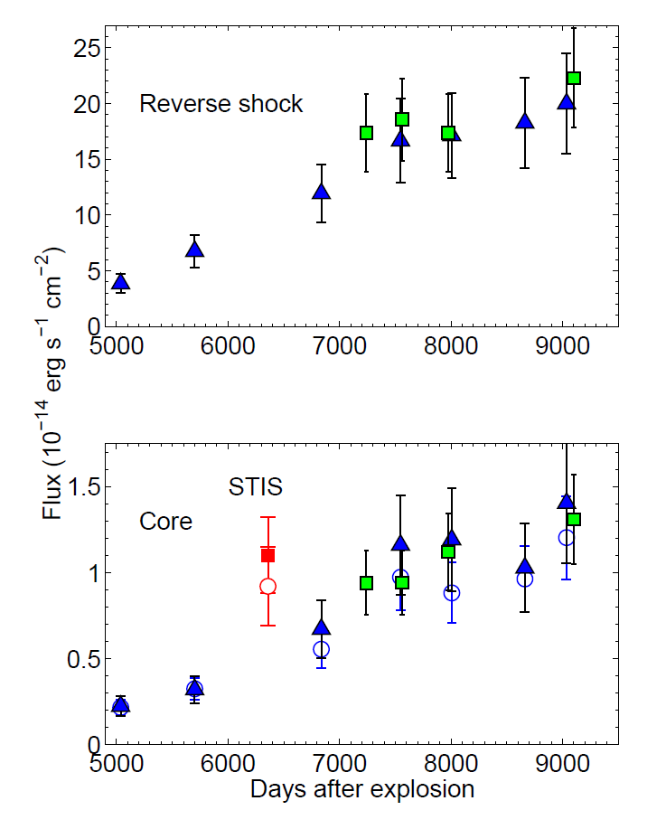
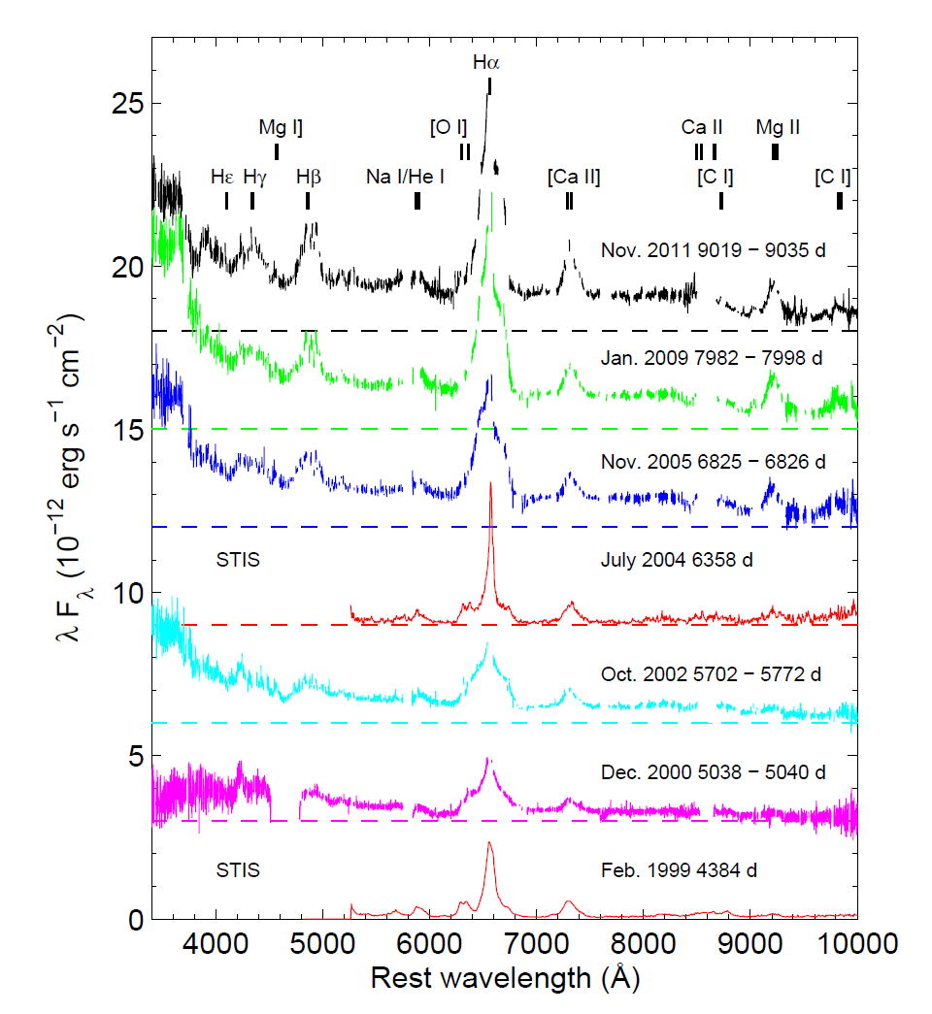
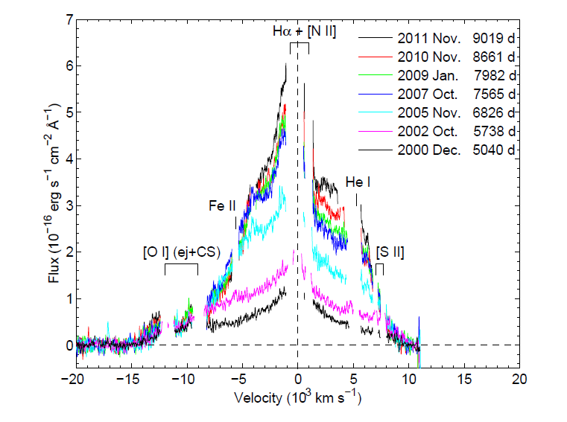
Evolution of Hα
Combination of FORS, UVES and STIS data

Slide 24
Emission outside the ring
Fransson et al. 2015

Slide 25
Destruction of the ring
Ring emission has peaked
Shock is dissolving the ring between 2020 and 2030
shocked
Fransson et al. 2015
unshocked

Slide 26
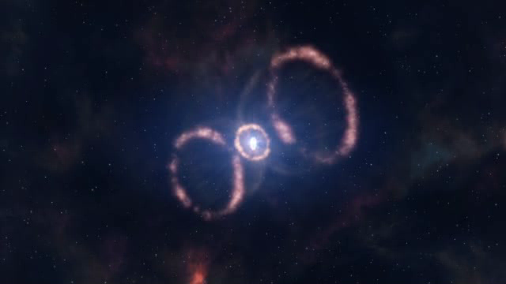
How this could look like

Slide 27
Summary
SN 1987A is as interesting as ever
ring collision is in full swing
forward shocks in the ring
reverse shock in the debris (outer ejecta)
shocked material can be analyzed through the X-rays and the coronal lines
now heating the inner ejecta as well
first direct look at an explosion
resolved inner ejecta (iron core) are the immediate reflection of the explosion mechanism
confirmation of the standing accretion shock instability (SASI) → neutrino convection in the explosion

Slide 28
More to come
Complete destruction of the ring
Illuminating the outside
beyond the inner ring
Detailed mapping of the inner ejecta
details on explosion mechanics and distribution of synthesized material
dust formation
where is the dust that formed early on?
what is the dust composition?
what will be lost due to the external illumination?
Where is the neutron star?
limits uncomfortable for the theory

Slide 29
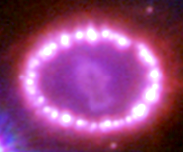
No sign yet of a neutron star
Collapse to a black hole?

Slide 30
SN 1987A will be the first supernova that we can observe forever.
L. Woltjer

