Slide 1
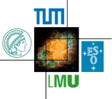

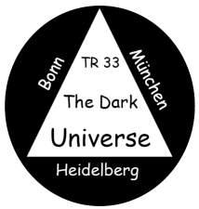
Type Ia supernovae in the near-infrared: nickel all over
Bruno Leibundgut
Suhail Dhawan
Jason Spyromilio
Kate Maguire

Slide 2
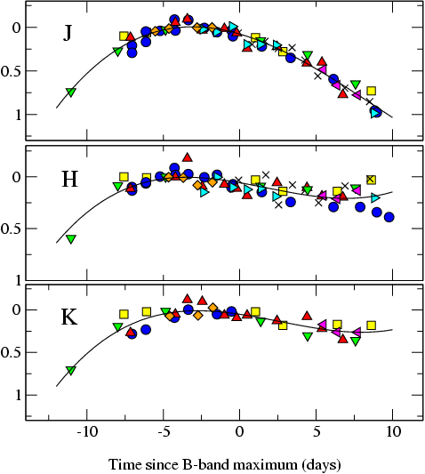
The promise of the (near-)infrared
Extinction is much reduced in the near-IR
  A_{H}/A_{V} ≅ 0.19 (Cardelli et al. 1989)
SNe Ia much better behaved
SN m₁₅(B)
= 1980N (1.29)
= 1986G (1.79)
= 1998bu (1.05)
= 1999aw (0.81)
= 1999ee (0.94)
= 2000ca (1.01)
= 2001el (1.15)
Krisciunas et al. (2004)
Mark Phillips

Slide 3
Others find this too
Light curves in the near-IR very uniform at peak, but large differences at later times
SN 2006mr
SN 2005ke
SN 2007on
Kattner et al. 2012

Slide 4
Large literature sample
Scatter minimal at first maximum in
Y (1.04μm), J (1.24μm),
H (1.63μm) and
K (2.14μm)
~90 objects in J and H
  58in Y, 22 in K
Mostly Carnegie SN Project data
(Contreras et al. 2010, Stritzinger et al. 2011)
Dhawan et al. 2014

Slide 5
Infrared light curves
Dhawan et al. 2014

Slide 6
NOT after maximum
4 days
14 days
30 days
Dhawan et al. 2014
maximum
minimum
second maximum

Slide 7
Late decline (t>40 days)
Dhawan et al. 2014

Slide 8
Correlations
Phase of the second maximum appears to be a strong discriminator among SNe Ia

Slide 9
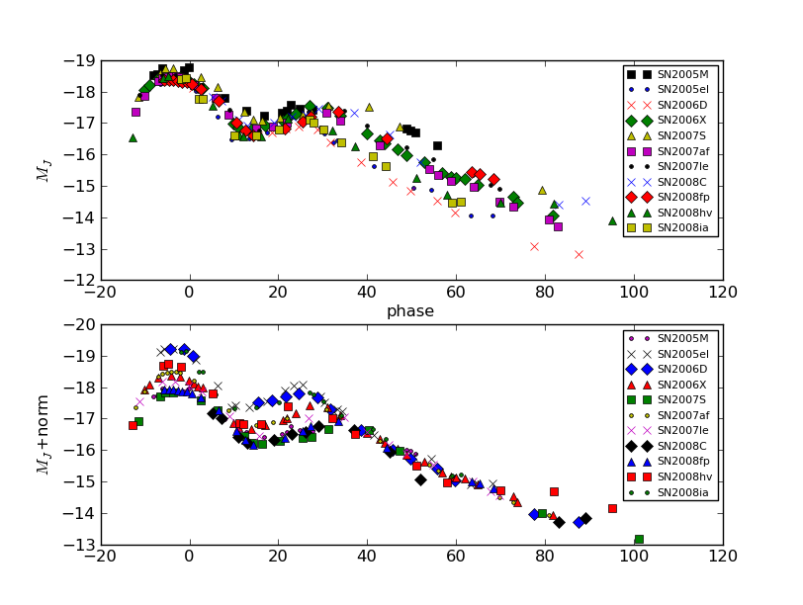
Correlations
Luminosity of late decline and the phase of the second maximum are linked

Slide 10
Correlations with the optical
Biscardi et al. 2012
Dhawan et al. 2014
IR properties correlate with optical decline rate
Phase of secondary maximum strongly correlated Δm₁₅

Slide 11
Correlation with optical colour
Phase of second maximum and beginning of the Lira relation are also tightly linked
Dhawan et al. 2014
Phillips et al. 1999

Slide 12
Consistent picture emerging
Second peak in the near-IR is the result of the recombination of Fe++ to Fe+ (Kasen 2006)
  he predicted a later second
  maximum for larger Ni masses
Optical colour evolution faster for objects with lower nickel mass
(Kasen & Woosley 2007)
Ejecta structure uniform
  late declines very similar
higher luminosity indicates a higher Ni mass
later secondary peak also indicates higher Ni mass
Ni mass and (optical) light curve parameters correlate (Scalzo et al. 2014)

Slide 13
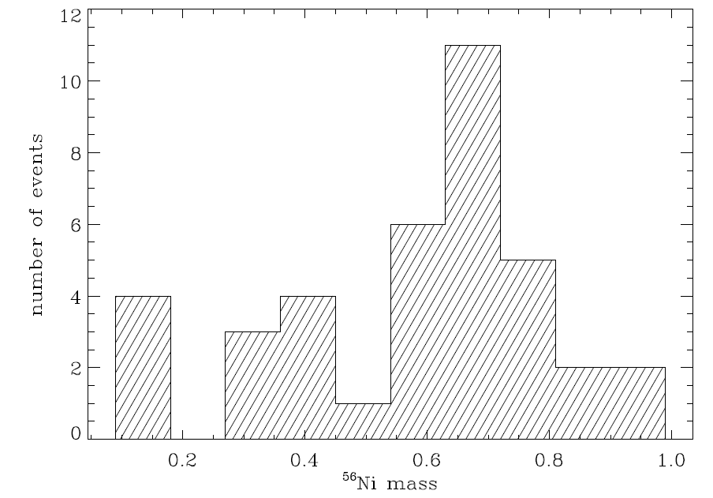
Nickel masses directly?
Correlate phase of second maximum with observed nickel masses
  avoid ‘detour’ through optical light curve shape parameter (Δm₁₅)
Stritzinger 2005
38 well-observed SNe Ia
Scalzo et al. 2014
SNFactory

Slide 14
Absorption-free subsample
Select SNe with
E(B-V)<0.1
Pseudo-bolometric light curves (UBVRIYJH)
L_{bol} (10⁴³ erg s⁻¹)
Dhawan et al., in prep
t₂(days)

Slide 15
Nickel masses
Using a timing parameter for nickel masses
  completely independent on reddening and multiple light curves
Explore different methods to calculate the nickel mass
(currently still all Chandrasekhar-mass progenitors
Dhawan et al., in prep

Slide 16
Summary
Nickel seems the dominant parameter for the light curves of SNe Ia
  phase of second maximum, start of uniform B-V colour evolution (Lira law), optical light curve shape (Δm₁₅), luminosity of the late decline phase
Second maximum in the IR light curves strong parameter for SN Ia characterisation → simple way to measure nickel mass

