Slide 1



Observational Constraints
Bruno Leibundgut

Slide 2
Progenitors
Core collapses
missing high-mass progenitors
distinction between C/O cores and ONeMg cores
where is the exact lower mass limit?
Smartt 2015

Slide 3
Progenitors
Core collapses
Binary evolution → ‘free for all’
any meaningful constraints?
very little information on companion stars
e.g. SN 1993J
Maund et al. 2004
Aldering et al. 1994

Slide 4
Progenitors
Thermonuclear
white dwarfs about 30 magnitudes fainter than supernova → direct detection unlikely
look for companions (binaries!)
possible detection for a SN Iax
Bloom et al. 2012
McCully et al. 2015

Slide 5
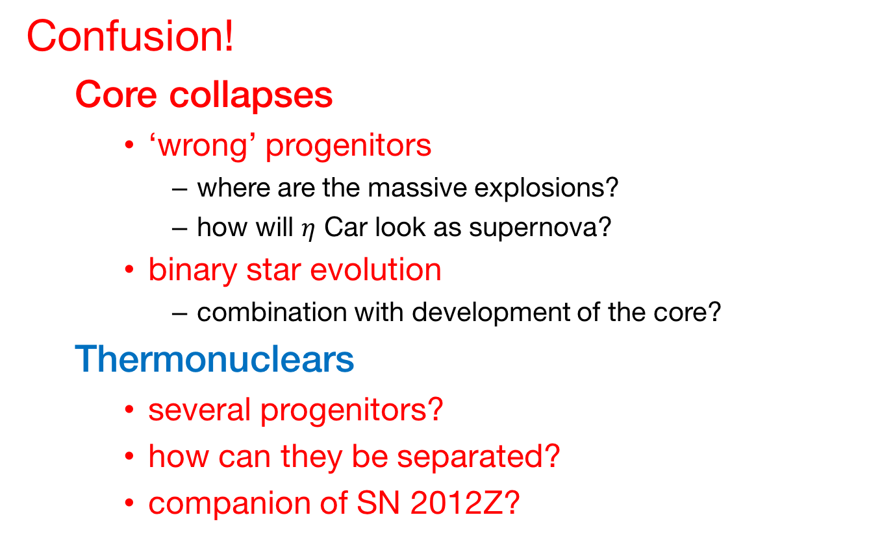
Progenitors
Confusion!
Core collapses
‘wrong’ progenitors
where are the massive explosions?
how will $η$ Car look as supernova?
binary star evolution
combination with development of the core?
Thermonuclears
several progenitors?
how can they be separated?
companion of SN 2012Z?

Slide 6

Explosions
Asymmetries
directly observed
Fransson et al. 2015
Si I
Larsson et al. 2016
H$α$
J. Larsson
Notes:
contours show 30%, 50%, and 70% of the maximum in the line

Slide 7
Explosions
[S III] 9069 and 9531 Å
Asymmetries
in remnants (Cas A)
Milisavljevic & Fesen 2015

Slide 8
Explosions
Boggs et al. 2015
SN 1987A
Asymmetries
Elemental distributions
Ti
Cas A
Grevenstette et al. 2014
Notes:
Cas A: red Fe (Chandra), green Si/Mg (Chandra), blue Ti (NuSTAR)

Slide 9
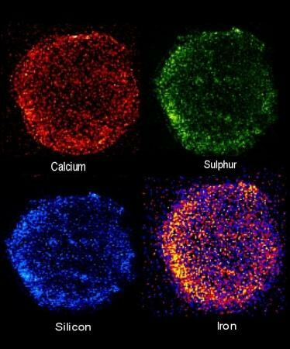
Explosions
No asymmetries for thermonuclears
Tycho (Chandra)

Slide 10
Explosions
Separate physics from ‘weather’ (core evolution from stellar atmosphere)
classification system not really helpful
sub-classes not necessarily distinct physics
separate relevant topics
explosion mechanisms
compact remnants
influence of binaries
remaining H and He envelope → Ib/c
circumstellar interaction
depends on individual stellar evolution → IIn

Slide 11
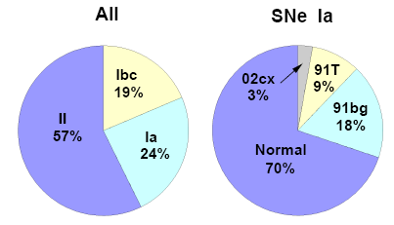
Explosions
Taubenberger 2017
Thermonuclears
variations on a theme
critical parameters?
nickel mass
ejecta mass
explosion energy(?)
explosion mechanism?
progenitor evolution?
Li et al. 2010

Slide 12
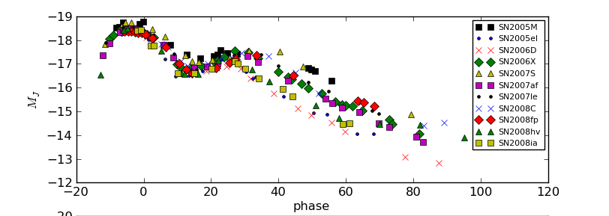
Explosions
Thermonuclears
Second peak in the near-IR is the result of the recombination of Fe⁺⁺ to Fe⁺ (Kasen 2006)
Uniform ejecta structure
late declines very similar
higher luminosity indicates higher ⁵⁶Ni mass
later secondary peak also indicates higher Fe/Ni mass
Ni mass and (optical) light curve parameters correlate (Scalzo et al. 2014)

Slide 13
Luminosity function of SNe Ia
Use the phase of the second maximum to derive the bolometric peak luminosity
calibrated on a sample of reddening-free SNe Ia
apply to reddened objects
Dhawan et al. 2016

Slide 14
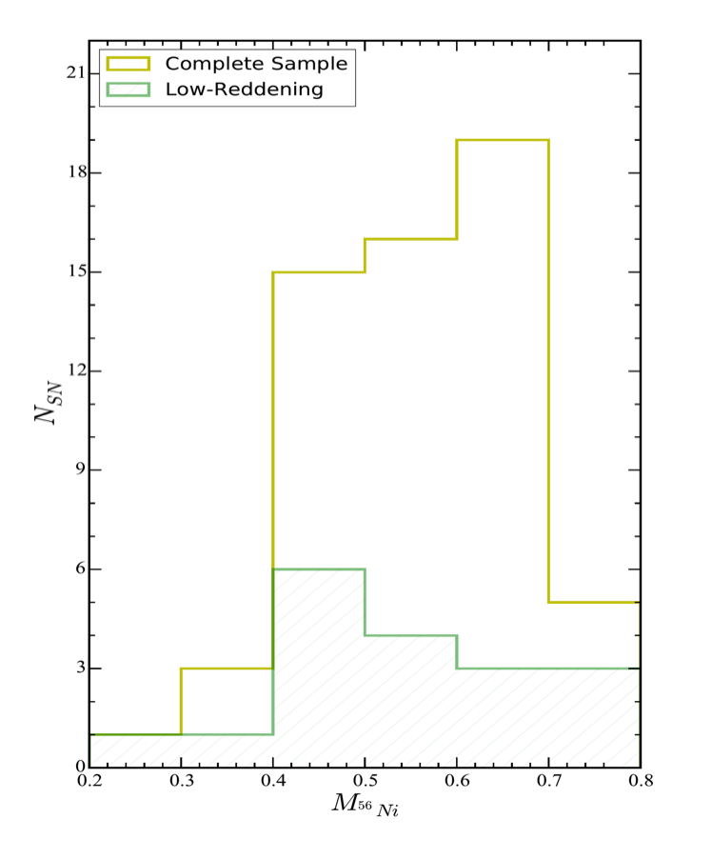
Luminosity function of SNe Ia
SN 2014J test passed
Potential to determine the luminosity function and Ni distribution
Dhawan et al. 2016

Slide 15
Fast-declining SNe Ia
Two groups?
separation in
bolometric luminosity
phase of NIR first peak
luminosity of NIR first peak
lack of second second NIR maximum
Dhawan et al., in prep

Slide 16
Summary
Core Collapses
no more spherical cows
missing important explosions
asymmetries point to explosion mechanism(s)
sub-classes of limited usefulness
Thermonuclears
order in chaos? → how?
unclear what sub-classes tell us
diversity through progenitor evolution?
explosion mechanisms?
compact progenitors
nickel masses, ejecta masses

