Slide 1
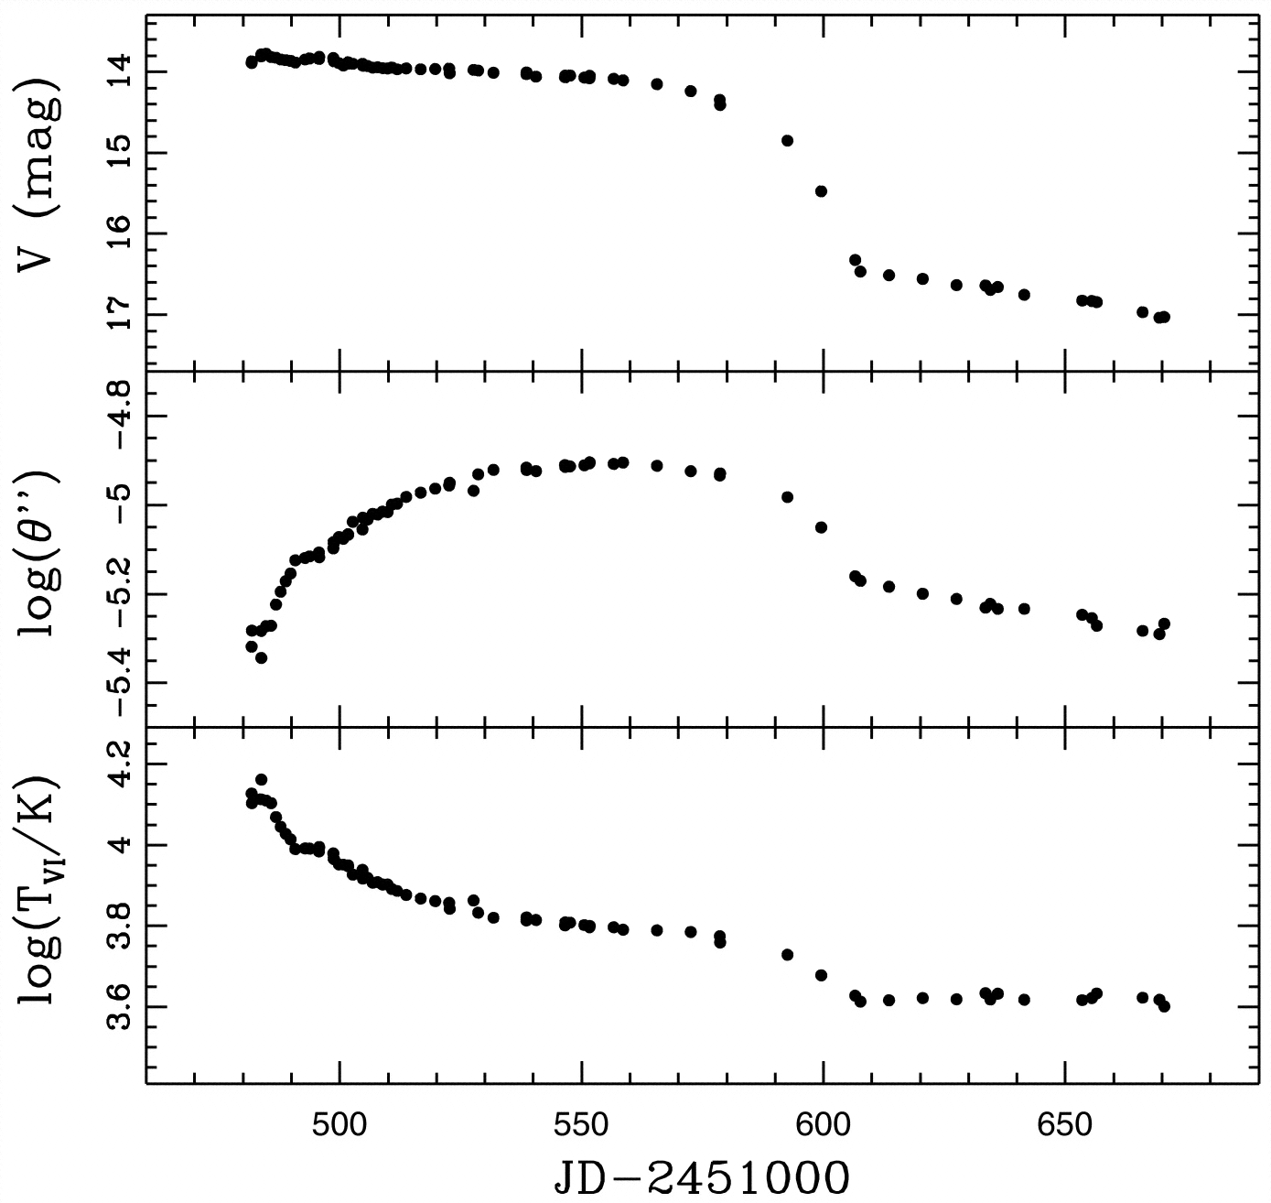

Distances to core-collapse supernovae
Hamuy et al. (2001)
Elisabeth Gall (QUB/MPA), Rubina Kotak (QUB), Bruno Leibundgut (ESO), Stefan Taubenberger (ESO/MPA), Wolfgang Hillebrandt (MPA), Markus Kromer (Stockholm)

Slide 2
Extragalactic Distances
Many different methods
Galaxies
Mostly statistical
Secular evolution, e.g. mergers
Baryonic acoustic oscillations
Supernovae
Excellent (individual) distance indicators
Three main methods
(Standard) luminosity, aka ’standard candle’
Expanding photosphere method
Angular size of a known feature

Slide 3
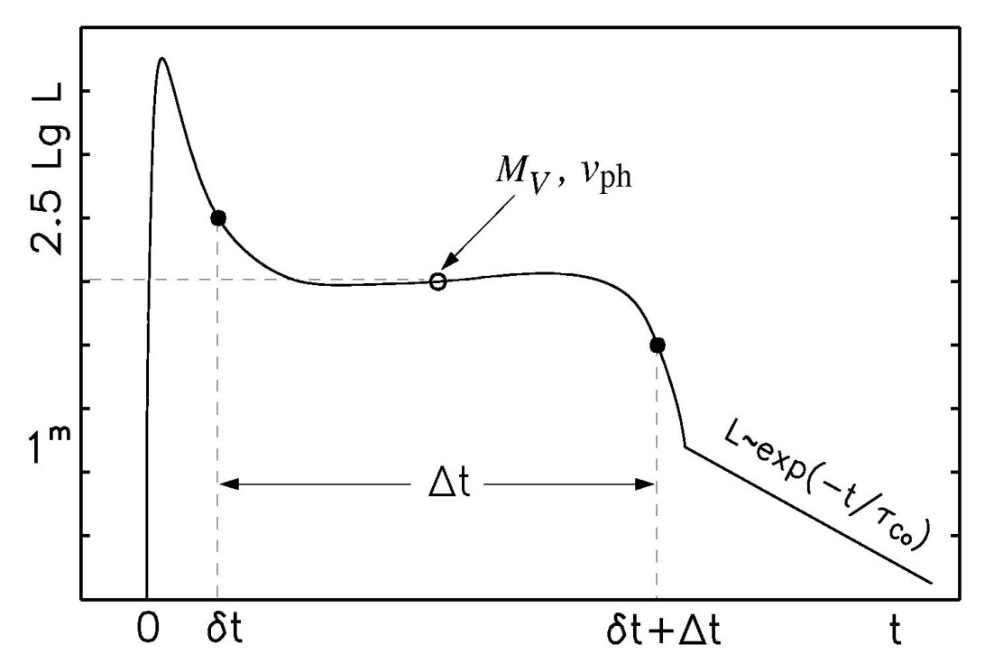
Physical parameters of core collapse SNe
Light curve shape and the velocity evolution can give an indication of the total explosion energy, the mass and the initial radius of the explosion
Observables:
length of plateau phase Δt
luminosity of the plateau L_{V}
velocity of the ejecta v_{ph}
E ∝Δt⁴·v_{ph}⁵·L⁻¹
M∝Δt⁴·v_{ph}³·L⁻¹
R ∝Δt⁻²·v_{ph}⁻⁴·L²

Slide 4
Expanding Photosphere Method
Modification of Baade-Wesselink method for variable stars
Assumes
Sharp photosphere → thermal equilibrium
Spherical symmetry → radial velocity
Free expansion
Kirshner & Kwan 1974

Slide 5
Photosphere Expansion
Measured from absorption lines
formed close to the photosphere
not hydrogen lines → Fe II
remove redshift (from galaxy spectrum)
Colour
K-corrections (redshift)
Gall 2016

Slide 6
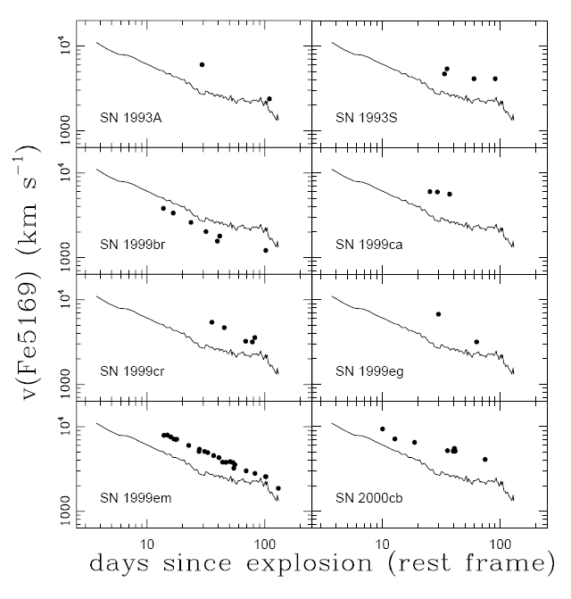
Photosphere Expansion
luminosity
radius
temperature
Hamuy et al. (2001)
Elmhamdi et al. (2003)

Slide 7
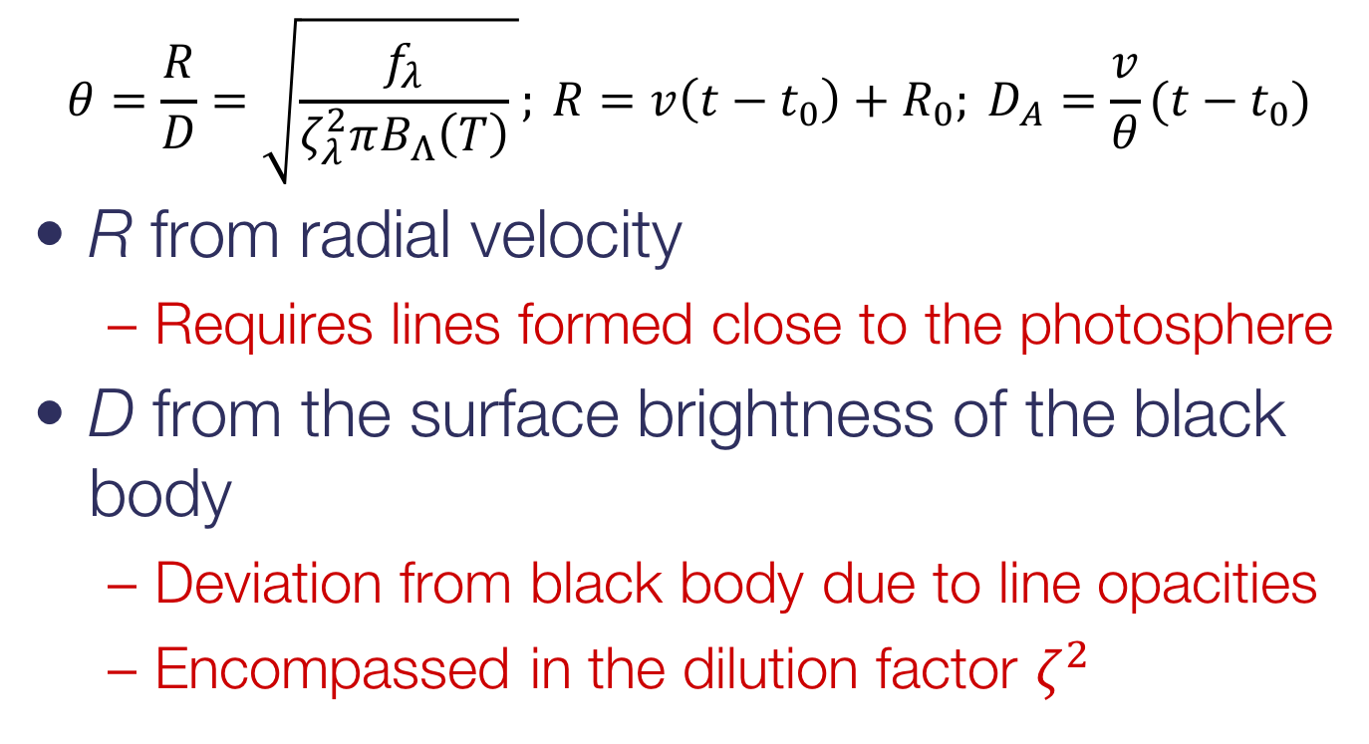
Expanding Photosphere Method
$$θ=\frac{R}{D}=\sqrt{\frac{f_{λ}}{ζ_{λ}^{2}πB_{Λ}\left(T\right)} }; {R=v\left(t−t_{0}\right)+R_{0}; D}_{A}=\frac{v}{θ}(t−t_{0})$$
R from radial velocity
Requires lines formed close to the photosphere
D from the surface brightness of the black body
Deviation from black body due to line opacities
Encompassed in the dilution factor $ζ^{2}$

Slide 8
Expanding Photosphere Method
Multiple filters
Influence of known date of explosion
Gall et al., in prep.

Slide 9
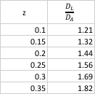
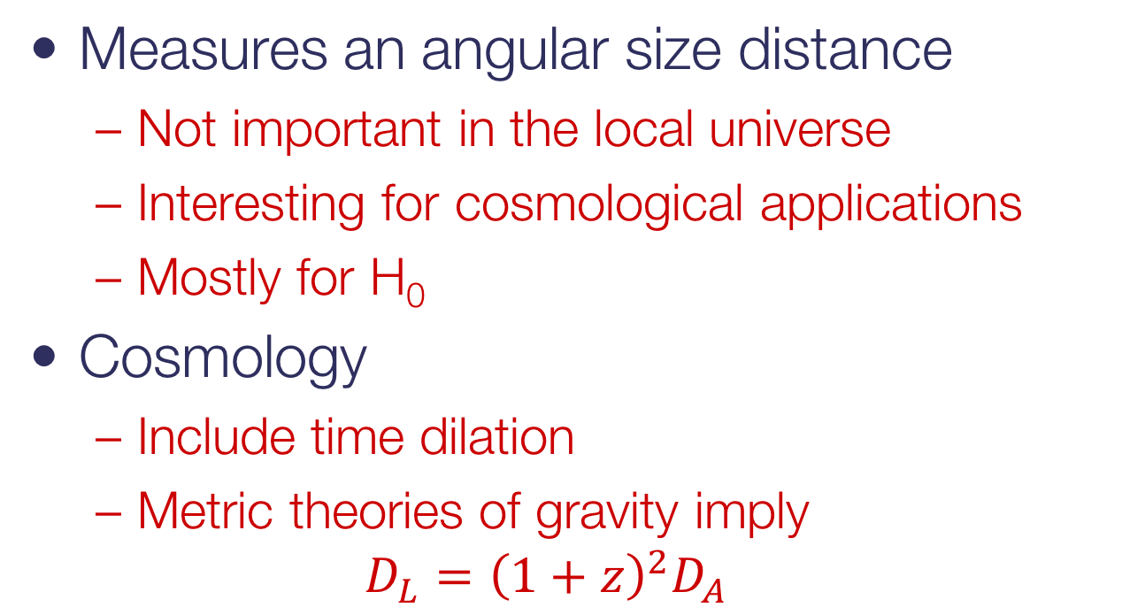
Expanding Photosphere Method
Measures an angular size distance
Not important in the local universe
Interesting for cosmological applications
Mostly for H₀
Cosmology
Include time dilation
Metric theories of gravity imply
$$D_{L}={\left(1+z\right)}^{2}D_{A}$$

Slide 10
Expanding Photosphere Method
Principle difficulties
Explosion geometry/spherical symmetry
Uniform dilution factors?
Develop tailored spectra for each supernova → Spectral-fitting Expanding Atmosphere Method (SEAM)
Absorption
Observational difficulties
Needs multiple epochs
Spectroscopy to detect faint lines
Accurate photometry

Slide 11
Hubble Diagram
Independent of distance ladder
Gall et al., in prep

Slide 12
Standardizable Candle Method
Introduced by Hamuy & Pinto (2002)
Normalised luminosity during the plateau phase of SNe IIP
Normally at 50 days after explosion
Used widely for SNe IIP
Nugent et al. 2006
Poznanski et al. 2009
Olivares et al. 2010
Maguire et al. 2010
Polshaw et al. 2015
Hamuy & Pinto 2002

Slide 13
Standardizable Candle Method
Straightforward simple method
Only few observations required
Issues
Need to know explosion time
Often not too obvious from observational data
Measurement during a ’faint’ epoch
Plateau and not maximum
Spectroscopy often difficult
Faint phase and faint lines
Attempts to use prominent hydrogen lines

Slide 14
Distance to SN 2013eq (z=0.041)
Use EPM and CSM to measure distance to same supernova
EPM provides explosion date to be used by CSM
Gall et al. 2016

Slide 15
Testing GR
Gall et al., in prep

