Slide 1

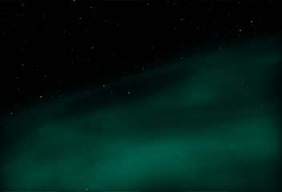

Different views on nucleosynthesis and excellence
Bruno Leibundgut

Slide 2
Inside vs. Outside
𝛄-rays
direct detection of nuclear decays
direct measurement of Ni mass
distribution of radioactive material
Optical (“bolometric”)
energy balance
Arnett’s rule → Ni mass
indirect inference of energy source
complication: radiation transport
direct detection of atomic transitions

Slide 3
The Gospel
⁵⁶Fe

Slide 4
Expectations
Calculations from different explosion models
Summa et al. 2013
0.1
photon energy (MeV)
1.0

Slide 5
Expectations
Light curves
Summa et al. 2013
Distance: 1 Mpc

Slide 6
Searching – SN 1991T
2nd brightest SN Ia since SN 1972E
(SN 1986G was slightly brighter, but heavily extinct)
first COMPTEL SN
discovered one week after launch of the Compton Gamma-Ray Observatory
?
Lichti et al. 1994
Morris et al. 1995

Slide 7
Searching – SN 1991T
Complication
3C273 at only 1.4 degrees
PSF ~2 degrees
Morris et al. 1995

Slide 8
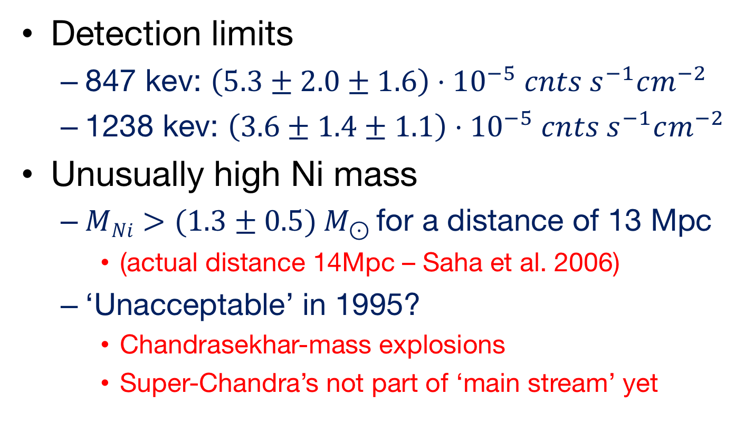
Searching – SN 1991T
Detection limits
847 kev: $\left(5.3±2.0±1.6\right)⋅{10}^{−5} cnts s^{−1}cm^{−2}$
1238 kev: $\left(3.6±1.4±1.1\right)⋅{10}^{−5} cnts s^{−1}cm^{−2}$
Unusually high Ni mass
$MNi>(1.3±0.5) M_{⊙}$for a distance of 13 Mpc
(actual distance 14Mpc – Saha et al. 2006)
‘Unacceptable’ in 1995?
Chandrasekhar-mass explosions
Super-Chandra’s not part of ‘main stream’ yet

Slide 9

Searching – SN 1998bu
Heavily obscured SN Ia
light echoes observed
Upper limits on Co 𝛄-rays
847 keV: $3.1⋅{10}^{−5} cnts s^{−1}cm^{−2} \left(2σ\right)$
1238 keV: $2.3⋅{10}^{−5} cnts s^{1} cm^{−2} (2σ)$
Georgii et al. 2002

Slide 10
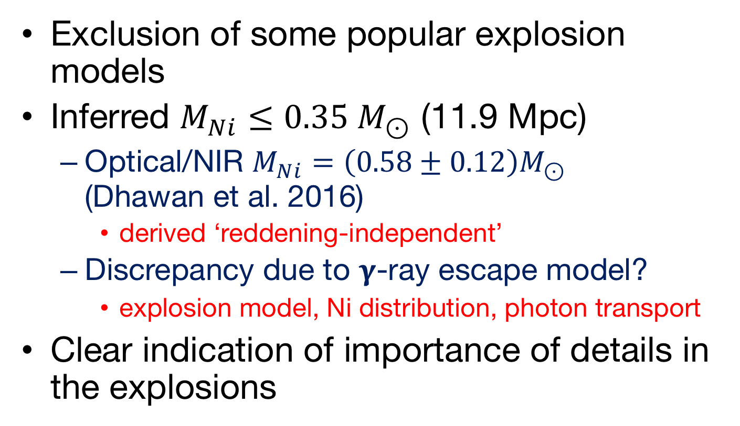
Searching – SN 1998bu
Exclusion of some popular explosion models
Inferred $M_{Ni}≤0.35 M_{⊙}$ (11.9 Mpc)
Optical/NIR $M_{Ni}=\left(0.58±0.12\right)M_{⊙}$ (Dhawan et al. 2016)
derived ‘reddening-independent’
Discrepancy due to 𝛄-ray escape model?
explosion model, Ni distribution, photon transport
Clear indication of importance of details in the explosions

Slide 11
Searching – SN 2011fe
Isern et al. 2013
Nearest SN Ia since SN 1972E
Distance (M101): 6.4 Mpc
Search for early Ni
INTEGRAL observations pre optical maximum
Exclude any surface nickel
What about the late-time data? Published?

Slide 12
Finding SN 2014J
Closest SN Ia in over 70 years
M82: Distance 3.3 Mpc
Heavily reddened

Slide 13
Finding SN 2014J
First clear detection of cobalt decay lines
Integration from 17 to 164 days after explosion
Diehl et al. 2014

Slide 14
Finding SN 2014J
Temporal evolution
Diehl et al. 2014
847 keV
1238 keV

Slide 15

Finding SN 2014J
Surprise – detection of Ni → Co decay lines 17 days after explosion
requires about $0.06 M_{⊙}$ nickel on the outside
Diehl et al. 2015

Slide 16
Finding SN 2014J
If Ni distributed uniformly, i.e. a shell
line broading expected → not observed
Radial symmetry needs to be broken
indications on asymmetry in the explosion

Slide 17
So what about the outside?
Very indirect
Many more supernovae
Much larger data samples
Statistical anaylses

Slide 18
Type Ia Supernovae
Variations on a theme
critical parameters?
nickel mass
ejecta mass
explosion energy(?)
explosion mechanism?
progenitor evolution?
Taubenberger 2017

Slide 19
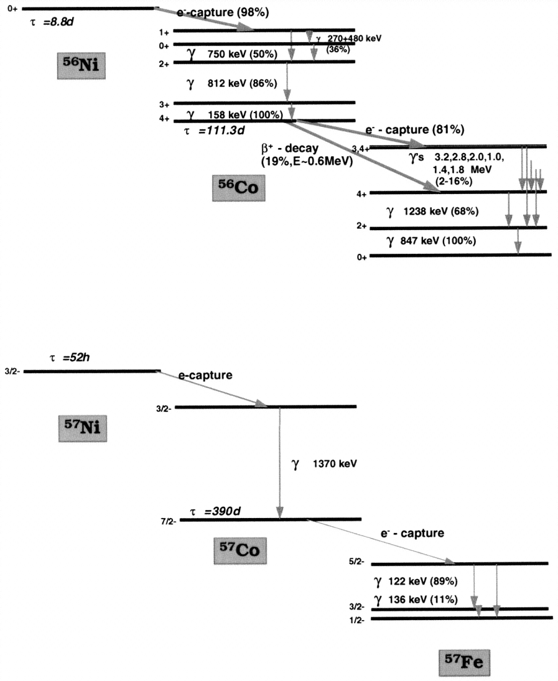
Radioactivity
Isotopes of Ni and other elements
conversion of γ-rays and positrons into heat and optical photons
Contardo (2001)
Diehl and Timmes (1998)

Slide 20
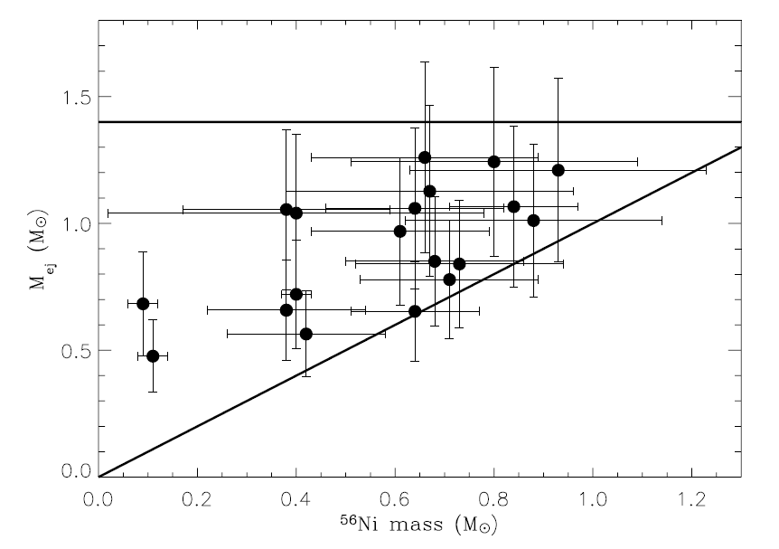
Ejecta masses
Large range in nickel and ejecta masses
no ejecta mass at 1.4M
factor of 2 in ejecta masses
some rather small differences between nickel and ejecta mass
Stritzinger et al. 2006

Slide 21
Ejecta masses
Scalzo et al. 2014

Slide 22
Nickel masses
Bolometric light curve analysis with 39 SNe Ia
Scalzo et al. 2018

Slide 23
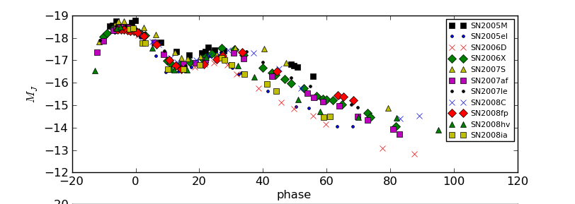
SNe Ia in the NIR
Consistent picture emerging
Second peak in the near-IR is the result of the recombination of Fe⁺⁺ to Fe⁺ (Kasen 2006)
Uniform ejecta structure
late declines very similar
higher luminosity indicates higher ⁵⁶Ni mass
later secondary peak also indicates higher Fe/Ni mass
Ni mass and (optical) light curve parameters correlate (Scalzo et al. 2014)

Slide 24
Luminosity function of SNe Ia
Use the phase of the second maximum to derive the bolometric peak luminosity
calibrated on a sample of reddening-free SNe Ia
SNe with E(B-V)<0.1
pseudo-bolometric light curves (UBVRIYJH)
apply to reddened objects
Dhawan et al. 2016

Slide 25
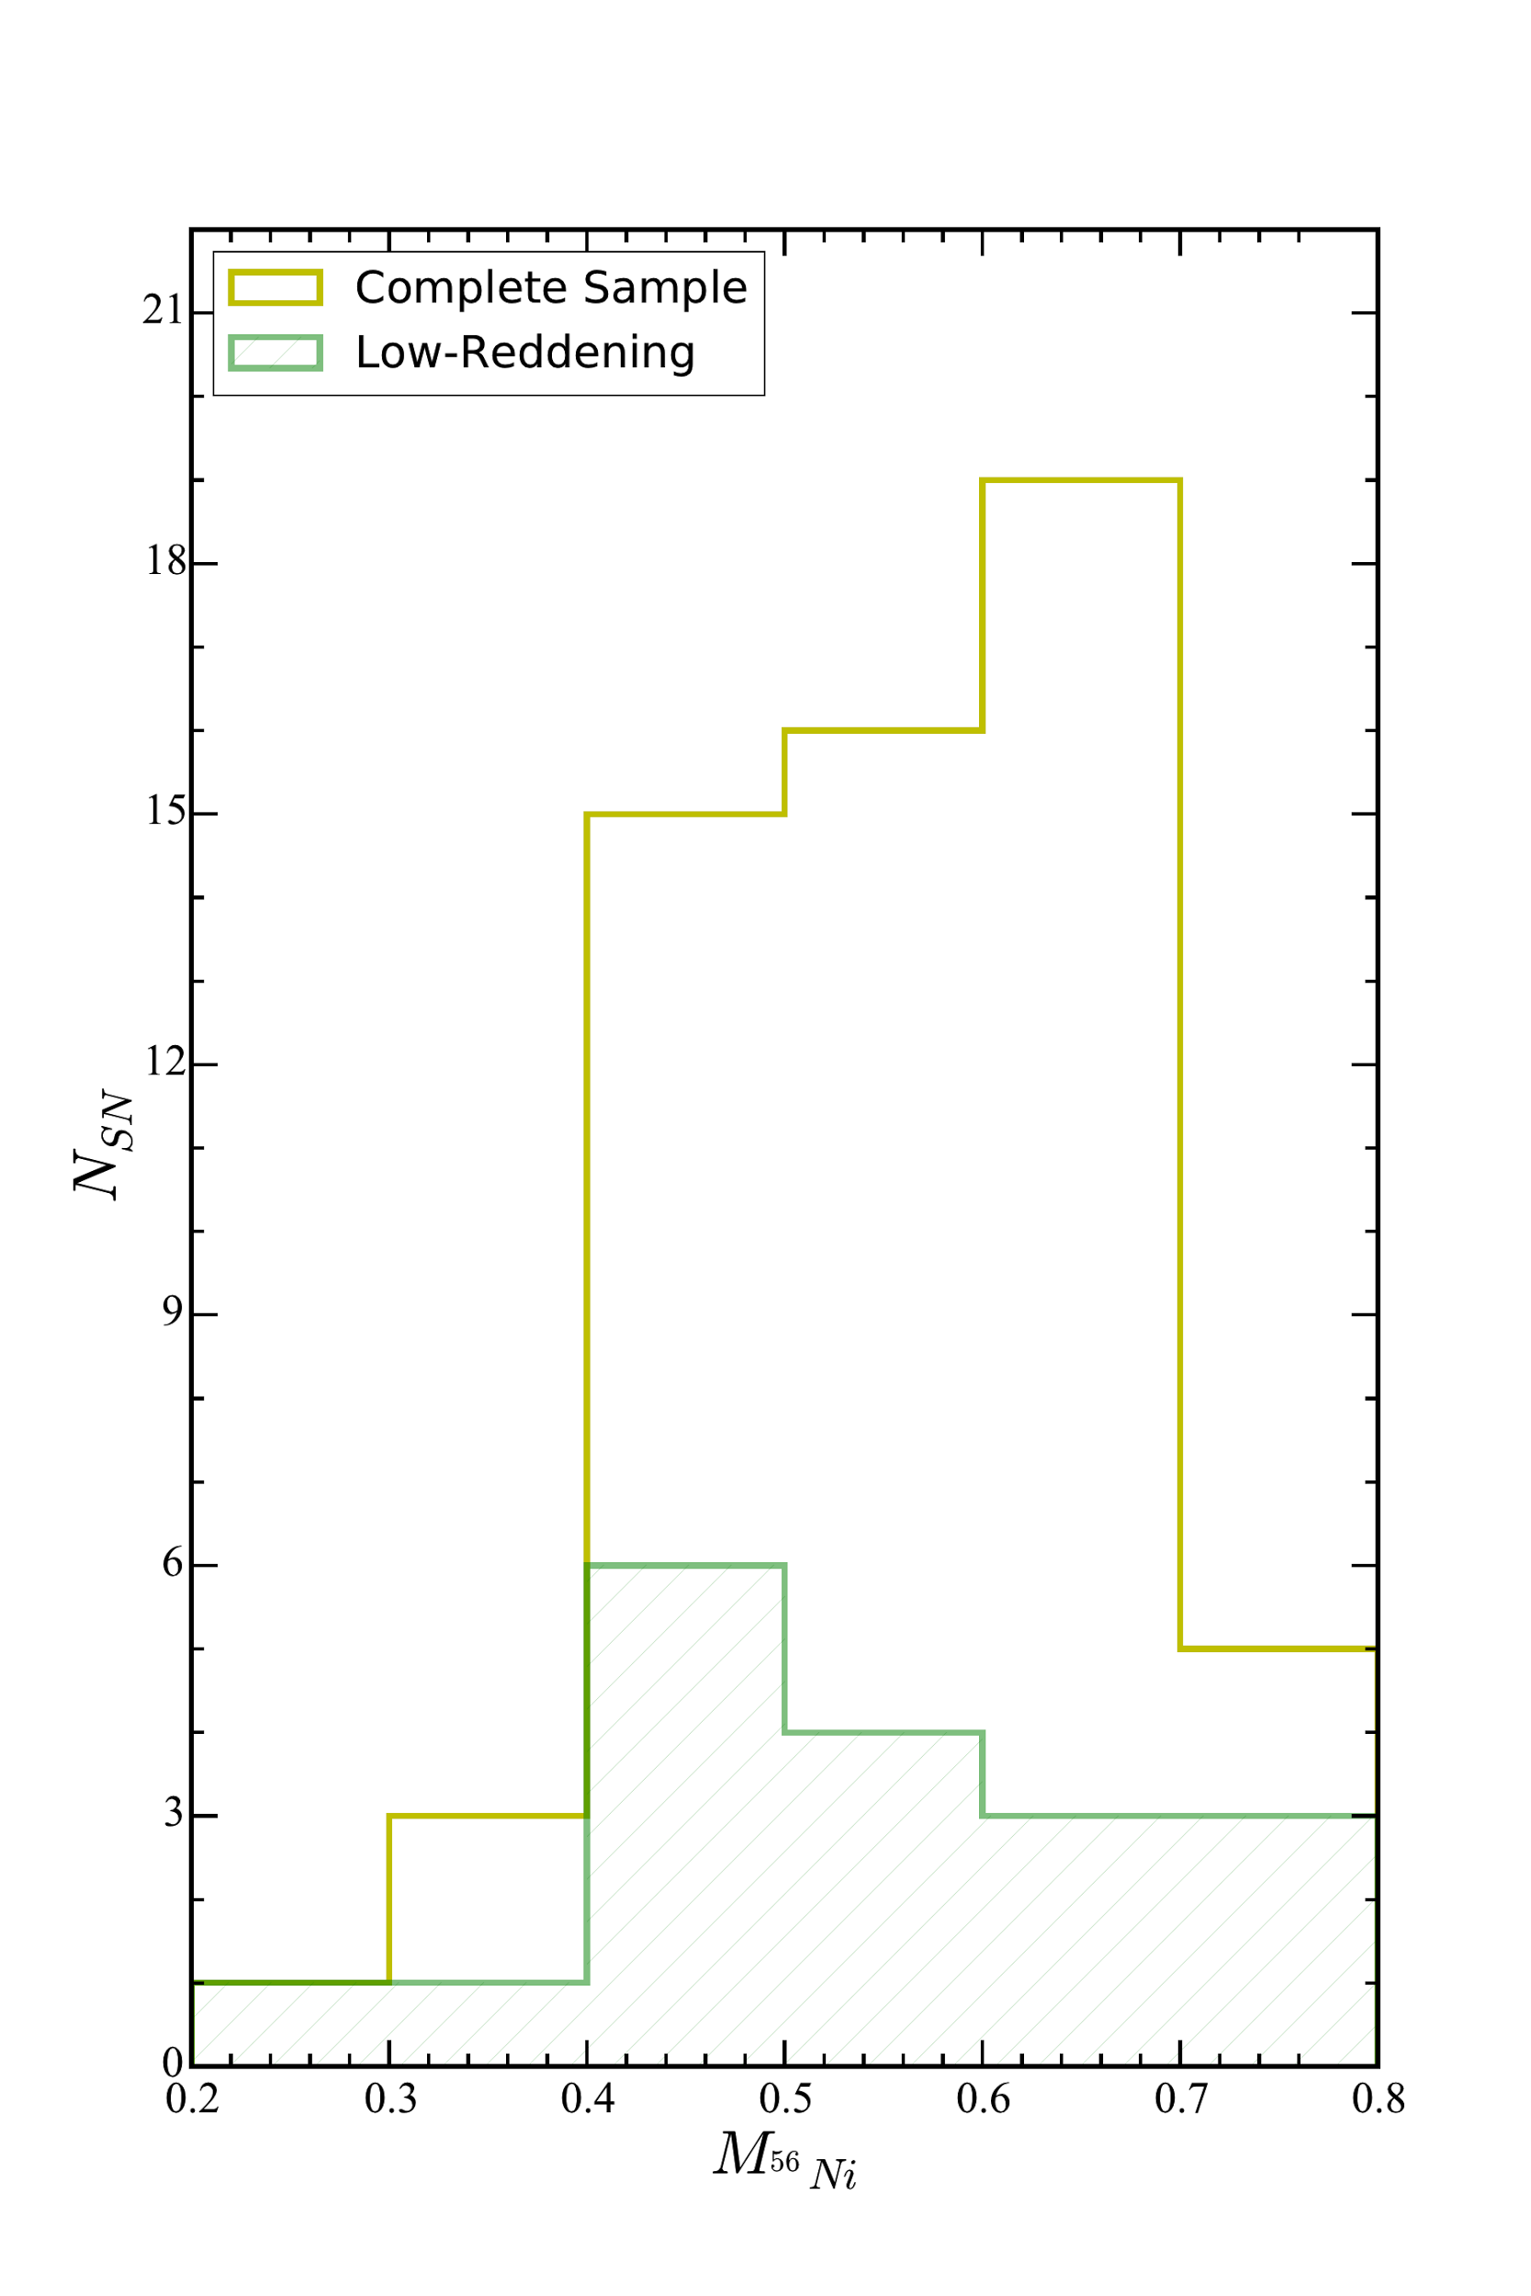
Luminosity function of SNe Ia
SN 2014J test passed
Potential to determine the luminosity function and Ni distribution
Dhawan et al. 2016

Slide 26

Coda: SN 2014J
Stable nickel detected
NIR nickel line at 1.939𝛍m 450 days after maximum
Estimated $M_{Ni}\left(stable\right)≈\left(0.53±0.018\right)M_{⊙}$ roughly 10% of all nickel
Dhawan et al. 2014
[Ni II]
[Fe II]
[Co II]

Slide 27
Excellence in 2016

Slide 28
Roland’s foresight (2016)

Slide 29
…and another one

Slide 30
‘Universe’ to ‘Origins’
Decided to leave a gap in the evolution from energy (early universe) to life
no nuclear astrophysics
Exciting science topics need to be accommodated in other topics
multi-messenger astrophysics
gravitational waves, neutrinos
neutron star mergers, supernovae

Slide 31
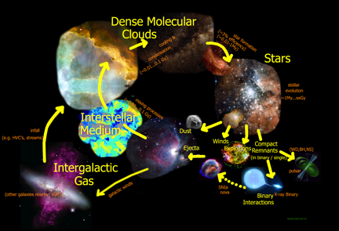
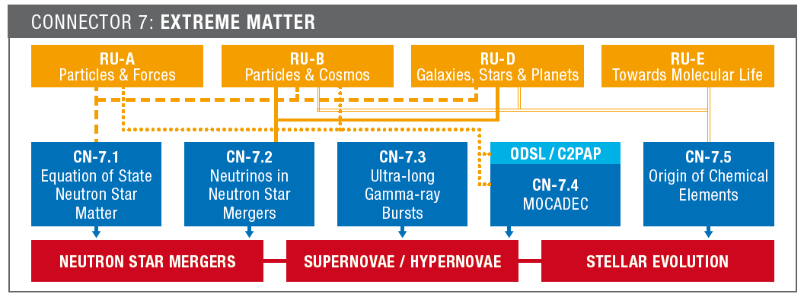
Cosmic Nucleosynthesis Universe vs. Origins
Across the Entire Cycle of Matter: Nuclear Astro-Physics
Observations
Modeling
Laboratory
Experiments

