Slide 1
Future Strategies for
OIR Astronomy
Bruno Leibundgut
(ESO)

Slide 2
OIR Astronomy
Part of the multi-wavelength universe
  central region for many processes
McCray et al. 1995
A Strategy for Ground-Based Optical and Infrared Astronomy

Slide 3
Bright Present and Future
A plethora of facilities
  Optical-Infrared ground-based telescopes up to 40m aperture
    surveys, interferometry, synoptic programmes
  mm and sub-mm telescopes
    ALMA, NOEMA, SMA, APEX, Planck, Herschel, SOFIA
  Radio telescopes of all sizes covering many frequencies
  Space-based telescopes
    Gaia, HST, JWST, Euclid, WFIRST-AFTA
    Spitzer, Kepler, CoRoT, Cheops, TESS, PLATO, SVOM, …
  X-ray sky available through
    XMM/Newton, Chandra, eROSITA and Athena
  Gamma-ray sky
    INTEGRAL, MAGIC, HESS, CTA

Slide 4
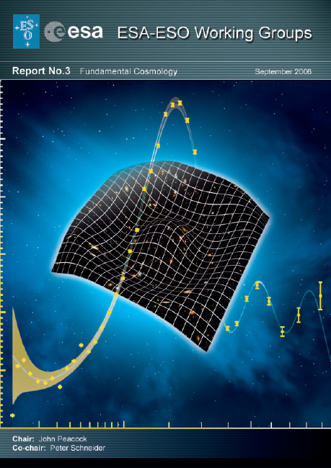
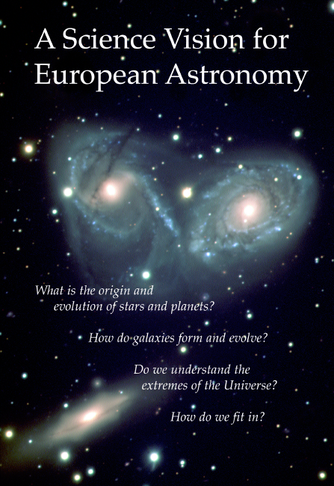
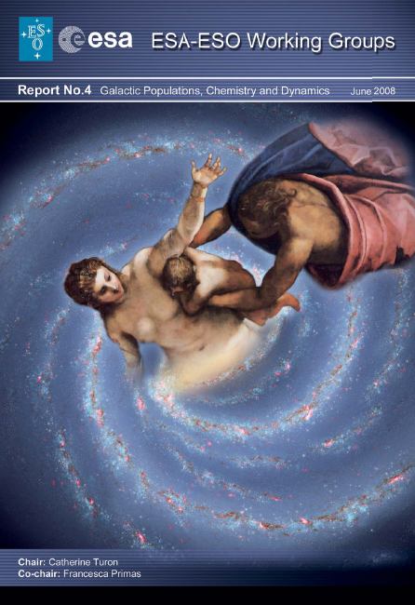
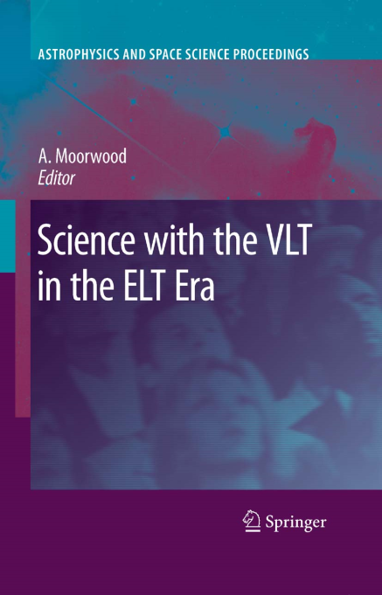
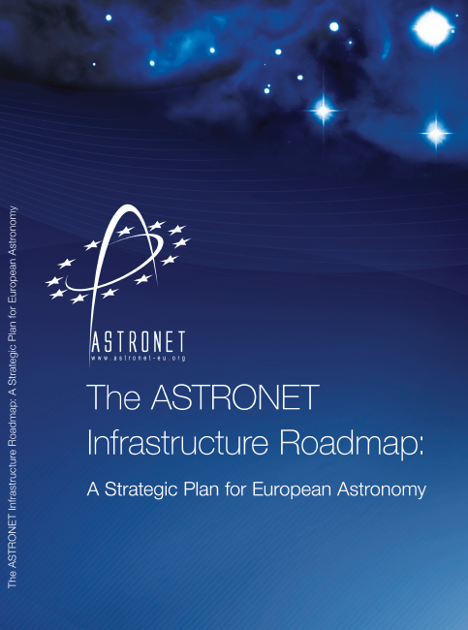
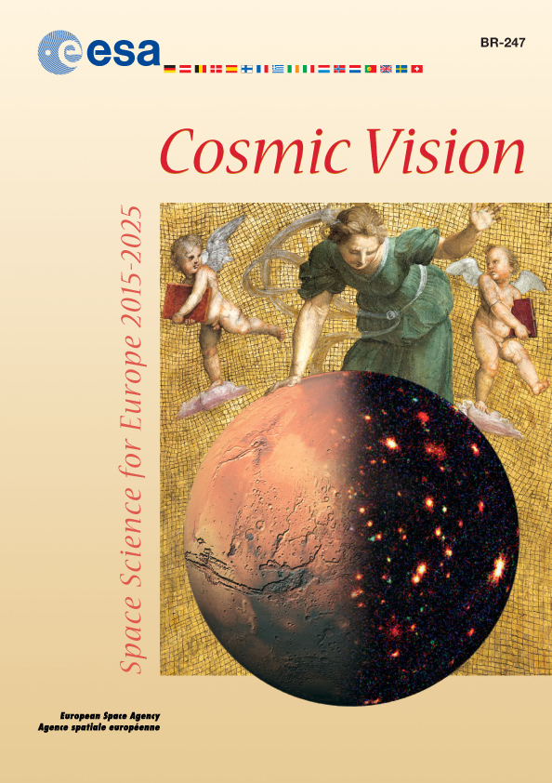
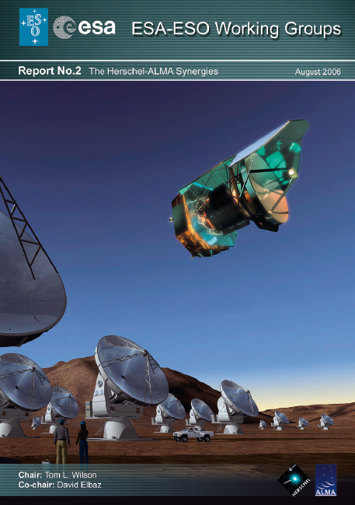
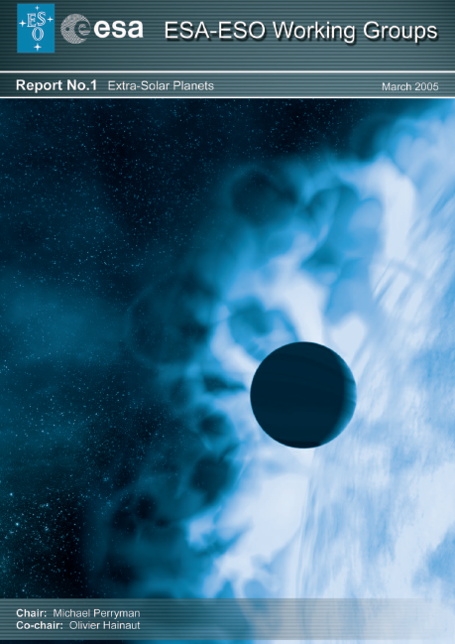
Science Themes
Similar for most observatories
Defined in several communities
  Astronet Science Vision(2007) and Roadmap (2008)
  → recent updates (2013 and 2014, respectively)
  ESA Cosmic Vision
  National decadal reviews
  Special publications
    ESA-ESO working group reports
    Specific fields (e.g. Connecting quarks with the Cosmos)
    Various reviews specific by wavelength

Slide 5
Major Science Topics
Nature of Gravity
  strong gravity → Galactic Centre
  weak gravity → Dark Matter, Dark Energy
Stars and Galaxies
  formation, evolution, baryon cycle
Other Worlds
  characterisation of exo-planets and exo-planetary systems
Transient Sky
  variability as signature of physical processes
  discovery enabled through many (near-)all-sky surveys

Slide 6
European Science Vision (2007)
  How do stars form?
  Do we understand stellar structure and evolution?
  What is the life-cycle of the interstellar matter and stars?
  How do planetary systems form and evolve?
  What is the diversity of planetary systems in the Galaxy?
  How did the Universe begin?
  What is Dark Matter and Dark Energy?
  Can we observe strong gravity in action?
  How do supernovae and gamma-ray bursts work?
  How do black hole accretion, jets and outflows work?
  What do we learn from energetic radiation and particles?
  How did the Universe emerge from its Dark Ages?
  Where are most of the metals throughout cosmic time?
  How were galaxies assembled?
  How did our Galaxy form?

Slide 7
European Science Vision (2007)
  How do stars form?
  Do we understand stellar structure and evolution?
  What is the life-cycle of the interstellar matter and stars?
  How do planetary systems form and evolve?
  What is the diversity of planetary systems in the Galaxy?
  How did the Universe begin?
  What is Dark Matter and Dark Energy?
  Can we observe strong gravity in action?
  How do supernovae and gamma-ray bursts work?
  How do black hole accretion, jets and outflows work?
  What do we learn from energetic radiation and particles?
  How did the Universe emerge from its Dark Ages?
  Where are most of the metals throughout cosmic time?
  How were galaxies assembled?
  How did our Galaxy form?
Changes from 1995 to 2007
(in black)

Slide 8
OIR in the 2020s
Exquisite angular resolution
  40m telescopes, interferometry
Deep (all-)sky information
  LSST and Euclid
Deep infrared observations possible
  JWST
Dynamic Milky Way and Local Group
  Gaia and spectroscopy

Slide 9
OIR in the 2020s
Thousand of planet candidates
  Transient searches
    WASP, HAT, CoRoT, Kepler, NGTS, Cheops, PLATO
System to follow-up alerts from other wavelengths and messengers
  Optical surveys
    Pan-STARRS, Zwicky Transient Factory, LSST
  X-rays, radio
  Gravitational waves and neutrinos

Slide 10
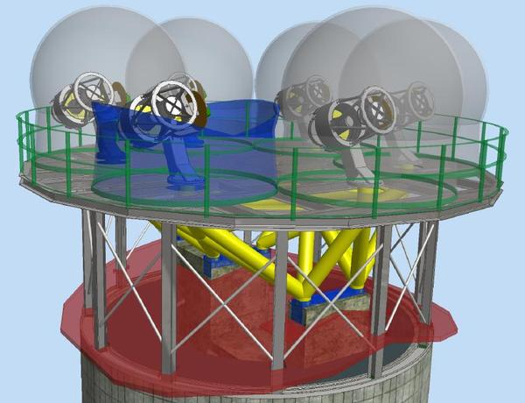
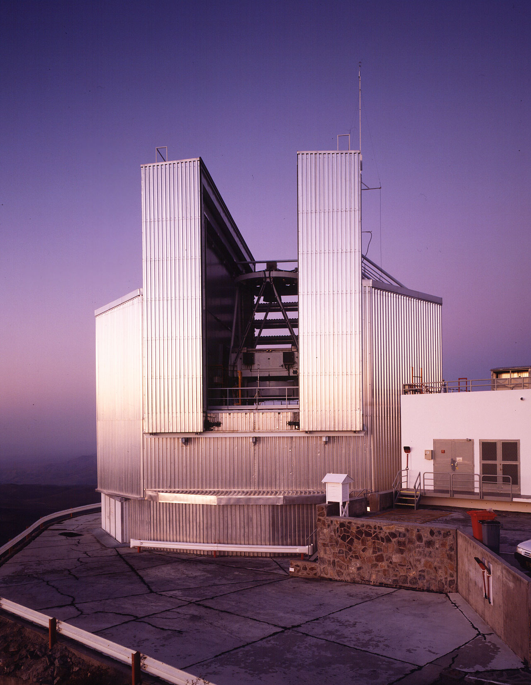
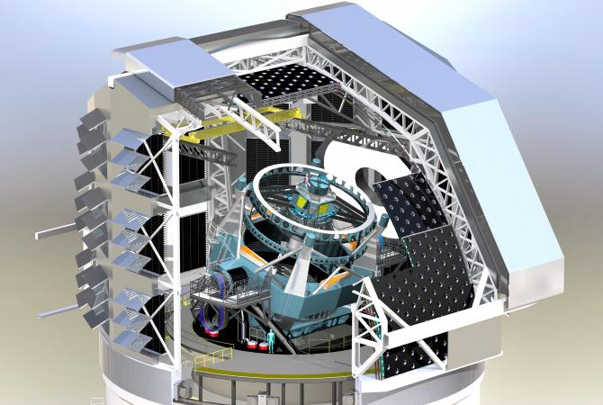
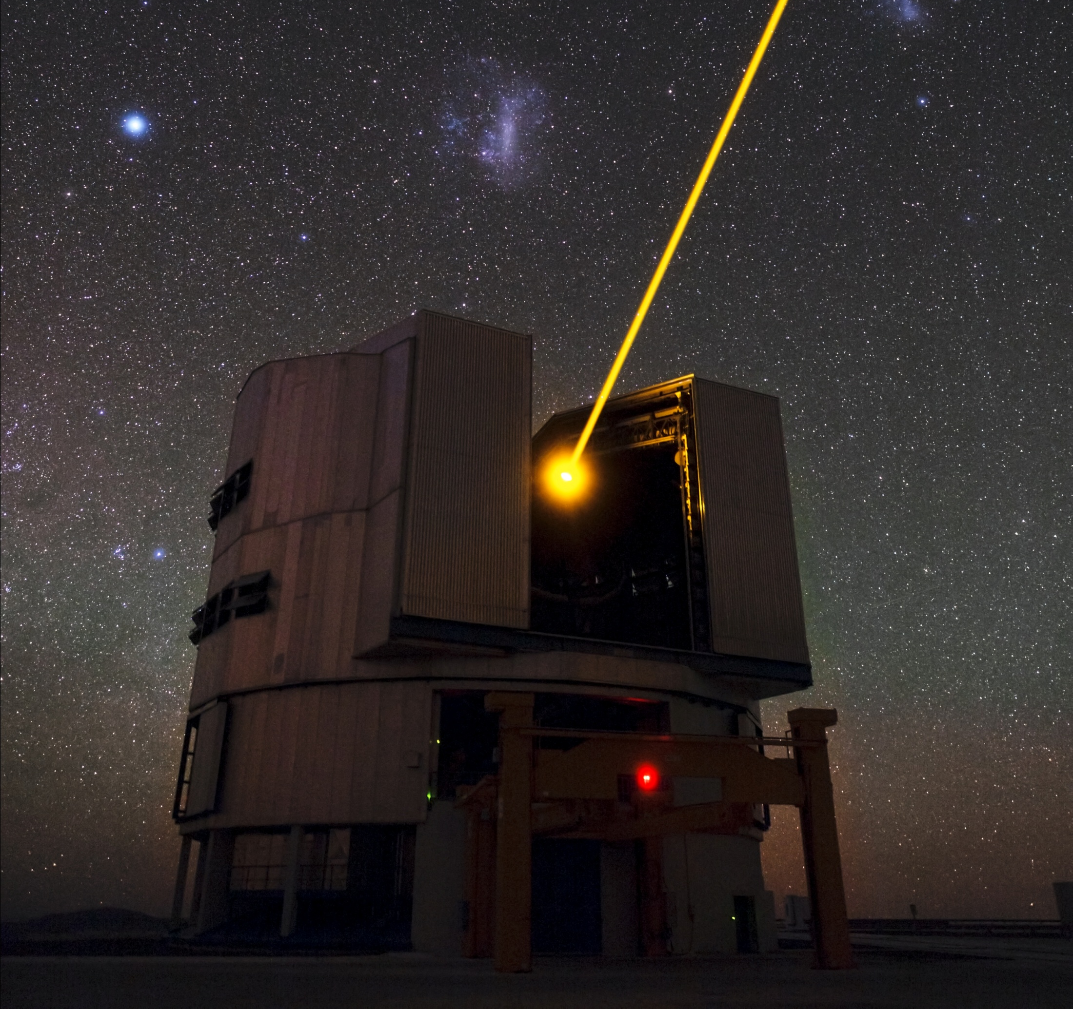
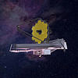
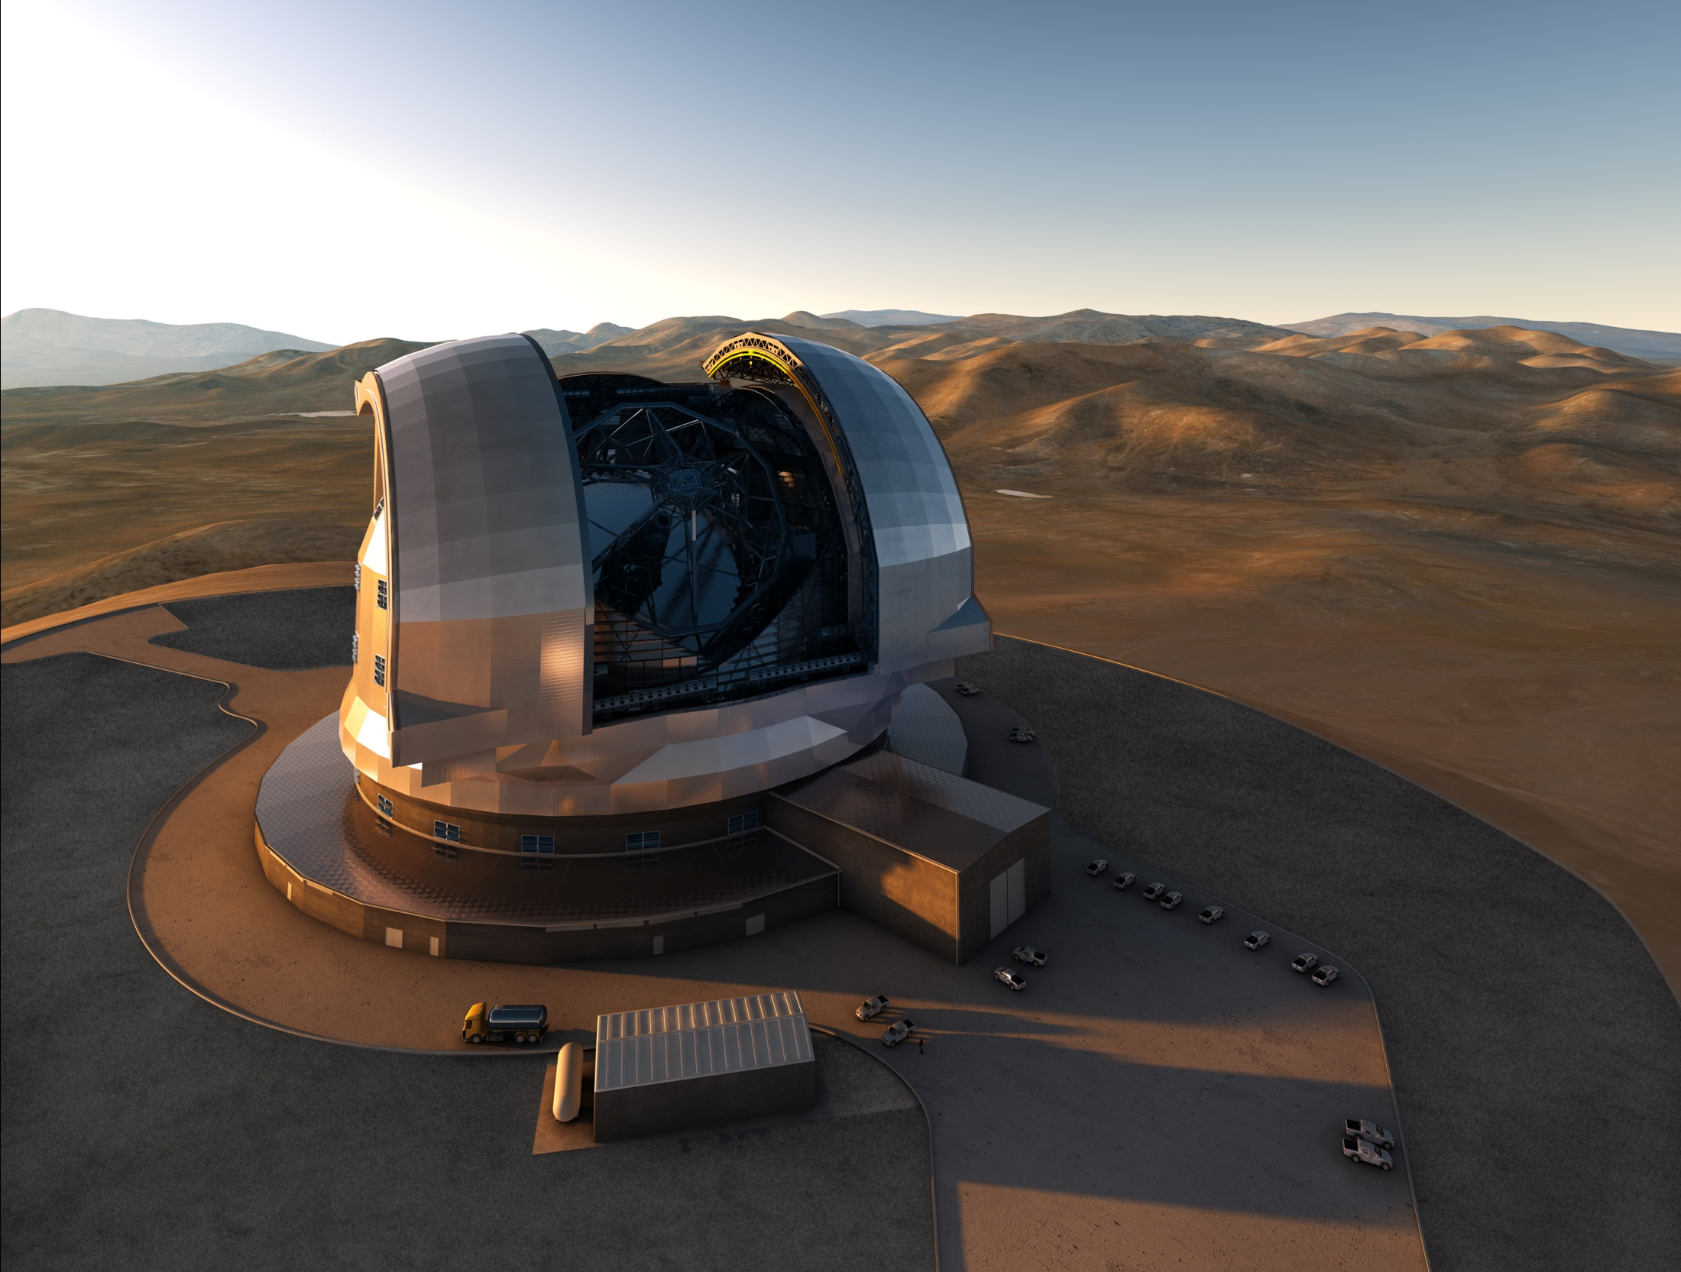
Transients in the 2020s
FoV:
10-30°
m<21
Alerts from many different sources:
gravitational waves, neutrinos,
electromagnetic searches
m<23
m>23
Flexibility

Slide 11
Planets in the 2020s
Complementarity of the different methods
  radial velocities, direct imaging, transits
  needed for full characterisation of masses, densities, atmospheres, formation scenarii
  Cheops, PLATO, HARPS, ESPRESSO,
  NIR spectrograph
Coordination of the different facilities will be essential

Slide 12
Strategic Changes
Move towards a systems approach
  Big problems need coordinated observations
    Milky Way dynamics
    → Gaia astrometry plus velocities and abundances
    Cosmology
    → EUCLID and redshifts
    Particle Physics
    → messengers and electromagnetic follow-up
  Several astrophysical problems need observations across the electromagnetic spectrum
    High-energy astrophysics
    Complex astrophysical sites
    → e.g. star formation regions, SN remnants, galaxy clusters, distant universe

Slide 13
Future Strategies
Facilities are part of observational system
  Ground-space coordination (next talk)
  Coordinated observations at many telescopes
    Multi-wavelength programmes
      ALMA - optical synergies
        star/planet formation, distant universe
      radio - optical synergies
        non-thermal and thermal universe
    Exo-planet search and characterisation
      timed photometry, spectroscopic monitoring,
      multi-wavelength observations (planet-star contrast!)
    Milky Way structure and local dwarf galaxies
      spectroscopic follow-up of the photometric catalogues
      (SDSS, Gaia)

Slide 14
Future Strategies
“Guidelines” for OIR observatories
  Flexibility
    adapt to new topics and discoveries
  Uniqueness
    explore features of your observatory others don’t have
      e.g. interferometry (VLTI)
    provide unique capabilities for simultaneous coverage of large wavelength ranges
      e.g. observations of Comet Shoemaker-Levy 9 or Hale-Bopp
  Complementarity
    spectral follow-up of imaging surveys
    monitoring of special objects
    complementarity to space missions
  Supplementarity
    support observations for other facilities
Coordination

Slide 15
Future Strategies
“Internet Astrophysics”
  Most research based on databases
  Coordinated programmes produce coherent data
  Context for many new observations
  Open Data proven to be key to success
    SDSS, 2MASS/DENIS, Kepler, eventually LSST
    observatory data archives
Make data available to the whole community
  Easy to find
  Easy to understand
  Easy to use

Slide 16
OIR Observational System of the 2020s
Flagship facilities
  ALMA, ELTs, JWST, LSST, EUCLID, (SKA, ATHENA)
Archives
  Planck, Gaia, HST, Spitzer, Herschel, Kepler, XMM-Newton, INTEGRAL, Chandra, observatory archives
  Literature
General user facilities (with some specialisation?)
  6-10m telescopes (16 ground-based)
    “people’s observatories”
    large variety of instrumentation, also interferometry
    built-in flexibility
    main resource for follow-up work
  2-4m telescopes
    pick your specialisation
    dedicate telescope to specific science question

Slide 17
ESO – an integrated system
ALMA and E-ELT
  Flagship facilities
VLT
  Unique capabilities
    interferometry → VLTI special session on Friday
    large instrument complement, flexibility, modern operations model
La Silla/4m telescopes
  Transients: NTT; exo-planets: 3.6m;
  multi-object spectroscopy: VISTA;
  platform for smaller experiments: La Silla
ESO Archive
  Rich resource of optical data
    large coherent data sets from surveys
    advanced data products

Slide 18
Recently in another community …

Slide 19
Astronomy in the 2020s
OIR sky measured to ~25 mag
Thousands of transient alerts per day
Matching capabilities at (almost) all other wavelengths
  angular resolution
  sensitivity
  sky coverage
Astroparticle detections
Diverse astronomical community with considerable overlap with other sciences (chemistry, biology)

Slide 20
OIR Future Strategies
Flexibility
  Astrophysics covers many topics and techniques
  Completeness of instrumentation
  Reaction to interesting new events, object and topics
Coordination
  Instrumentations programmes at different facilities
    either through a large pool or through collaboration between observatories
  Planning between ground and space
  Time allocation between observatories
Operations
  inbuilt flexibility
  archive → open distribution of data

Slide 21
