Slide 1
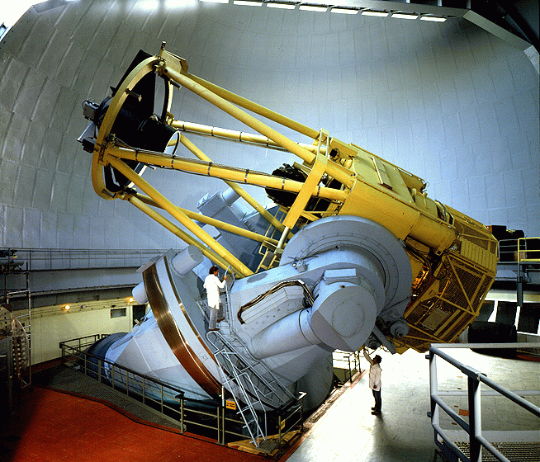
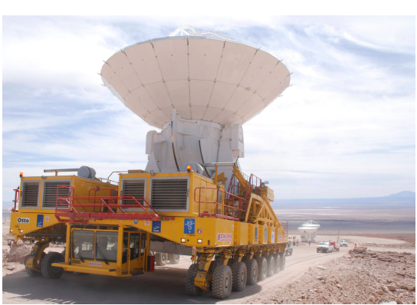
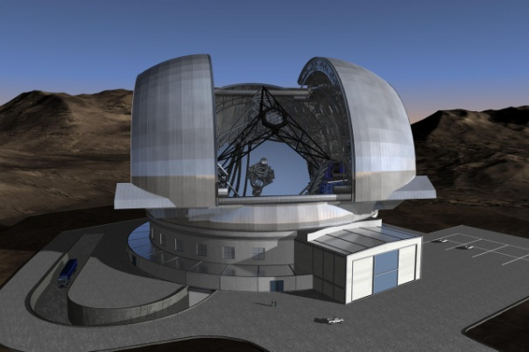
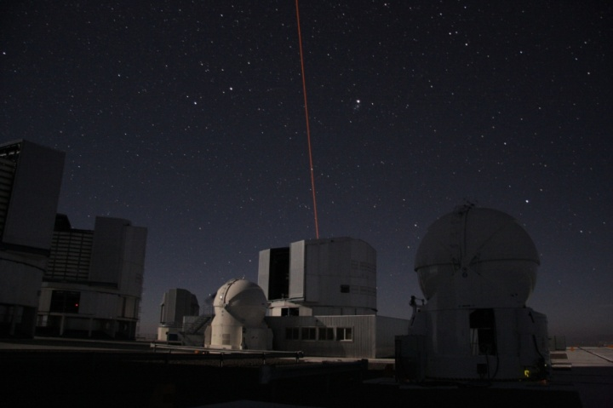
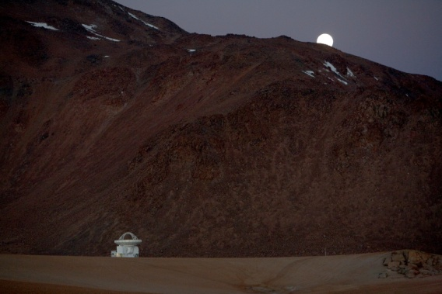
Astrophysics for the Next Decade
Bruno Leibundgut (ESO)

Slide 2
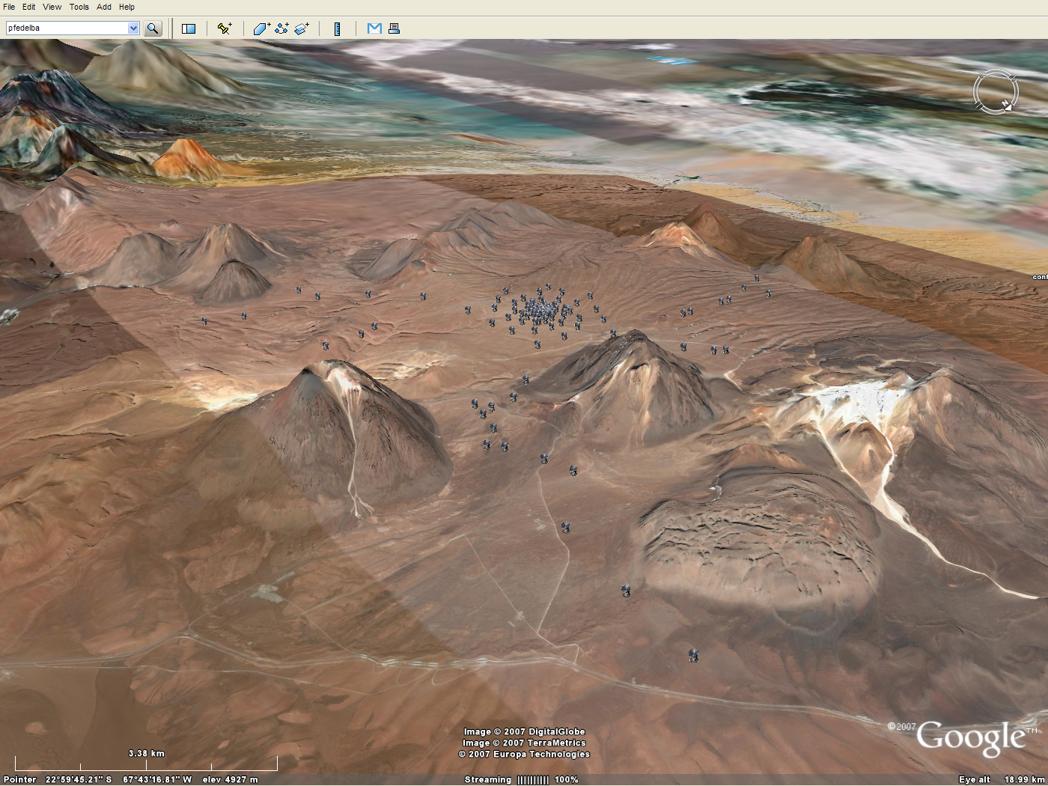
2

Slide 3
Astrophysics in a Golden Age
Full coverage of electro-magnetic spectrum
MAGIC/HESS →Fermi/INTEGRAL → XMM/Chandra/Swift/Rossi XTE → Galex → HST/Gaia → ground-based optical/IR → Spitzer → Herschel → Planck → IRAM/JCMT/APEX/ALMA → radio telescopes
Large archive collections (e.g. ROSAT, ISO, ESO, HST, MAST)
Astro-particles joining in
cosmic rays, neutrinos, gravitational waves, dark matter searches

Slide 4
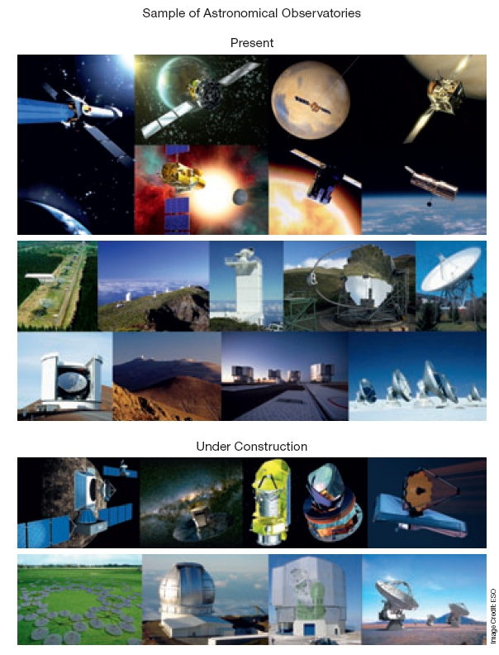
Fantastic opportunities

Slide 5

Astrophysics in a Golden Age
International Year of Astronomy
Fantastic boost in the public
Increased awareness
Strong public support
Continued interest
Connected to the ‘big’ questions
Where do we come from?
What is our future?

Slide 6
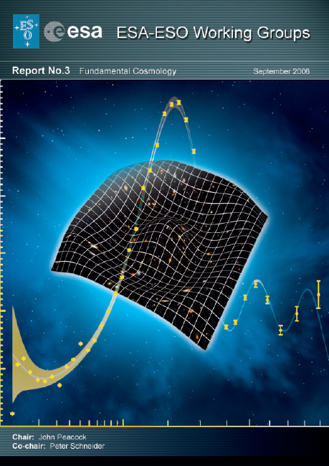
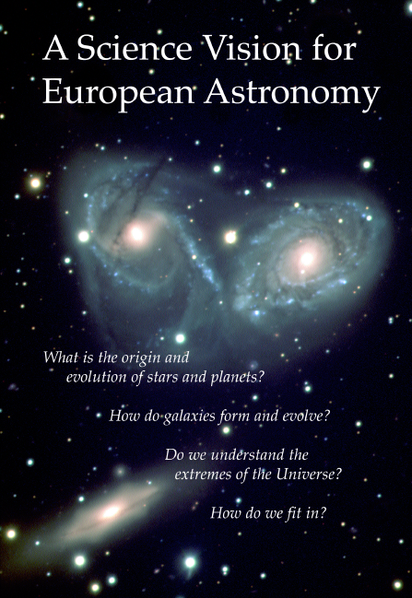
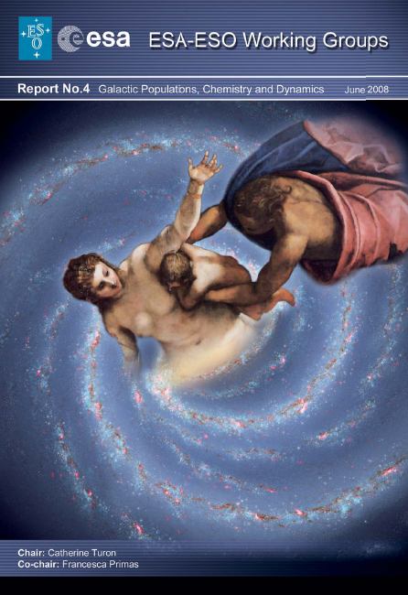
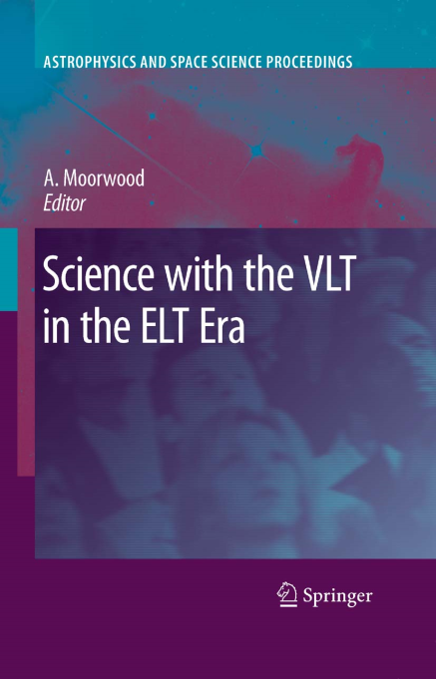

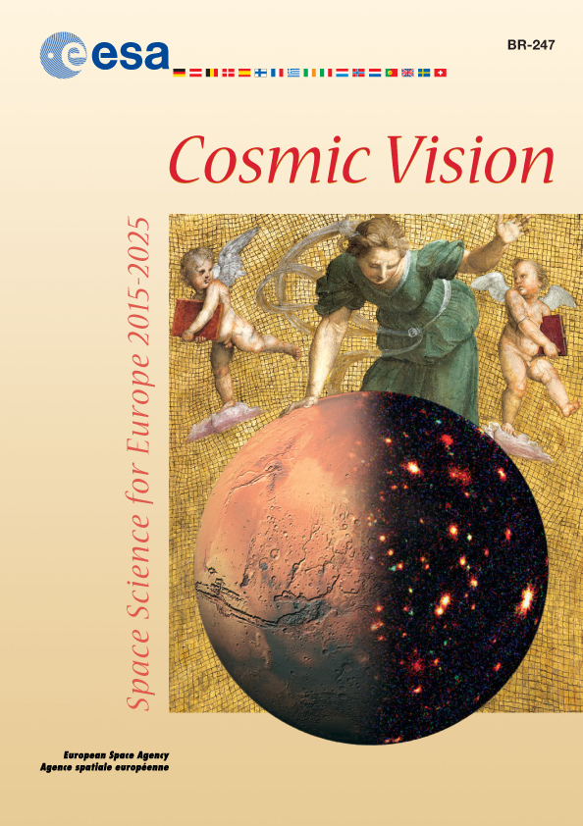
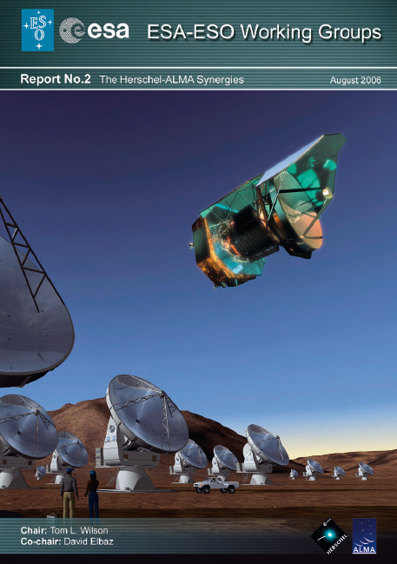
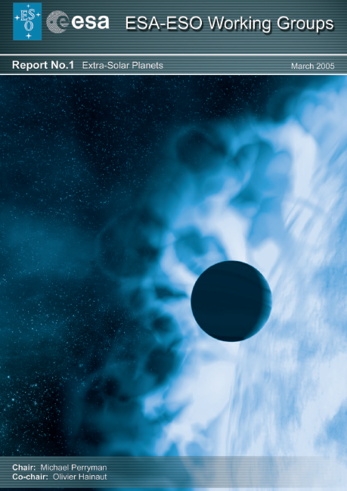
Research themes
Similar for most observatories
Defined in several community for a
Astronet Science Vision and Roadmap
ESA Cosmic Vision initiative
National decadal reviews
Special publications
ESA-ESO working group reports
Specific fields (e.g. Connecting quarks with the Cosmos)

Slide 7
Science themes
What matters in the universe?
Planets, planets, planets
How did stars and planets form?
The Milky Way our Home
Our own black hole
How galaxies form and evolve?
Fashions and other transients
When opportunity knocks

Slide 8
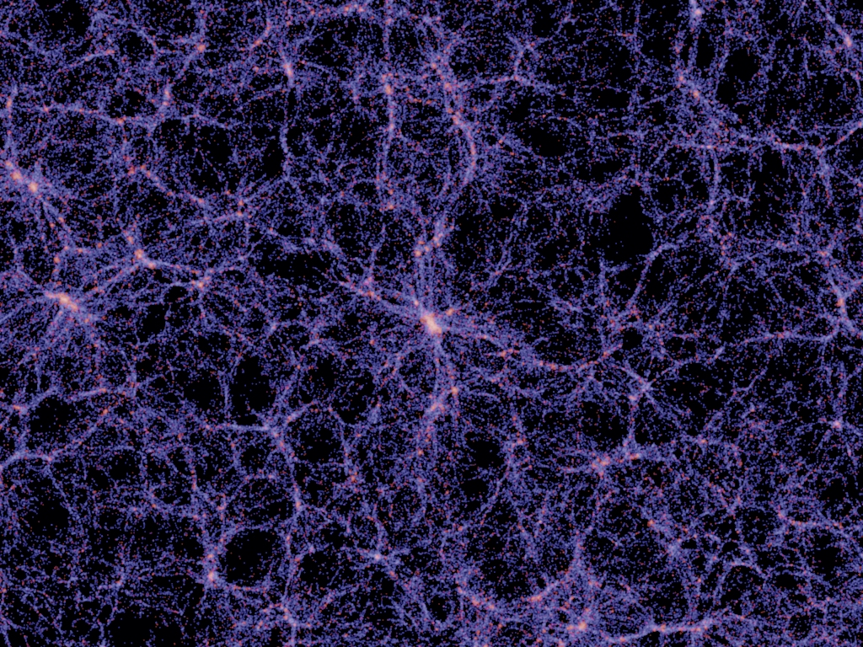
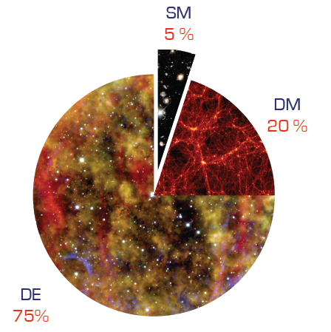
What matters in the Universe?
Characterisation of dark matter and dark energy
Requires large samples
Multi-year and (often) multi-telescope projects
BAO (SDSS, 2dF, WiggleZ, BOSS, HETDEX)
Weak lensing (SNLS)
Supernovae (SNLS, ESSENCE, SDSS-II, SN Factory, LOSS, PanSTARRS, DES, LSST)
Galaxy clusters (REFLEX, NORAS, SPT, DES,, eROSITA, LSST)
Redshift distortions (VVDS, VIPER)
Millenium simulation (Springel et al.)

Slide 9
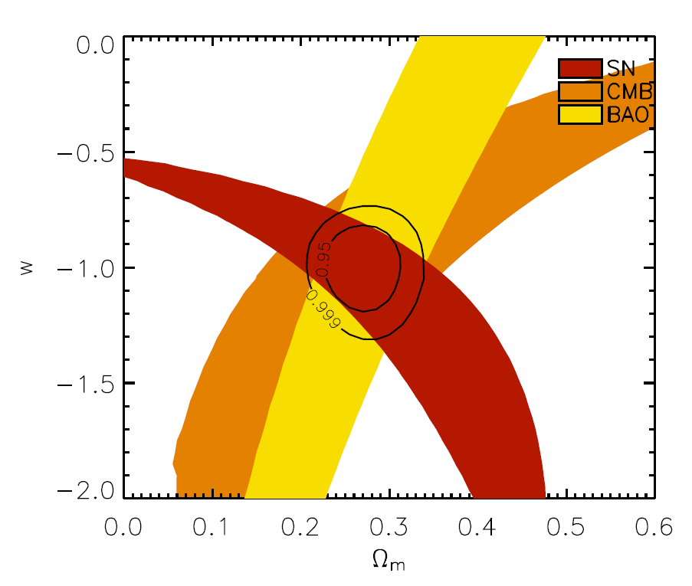
Dark Energy
Weak lensing, BAO, supernovae, clusters
Important: massive surveys and large sky coverage
Current state of the art with 4m telescopes (2dF, SDSS, WiggleZ, VIPERS)
EUCLID → ground-based follow-up/calibrations
spectroscopic calibration of the photo-z
spectroscopic follow-up of supernovae
spectroscopic follow-up for cluster members
optical imaging for photo-z
FMOS (Subaru), LSST, HETEX, LAMOST
8-10m telescopes
Direct measurement of expansion dynamics
Important: high spectral resolution and stability
CODEX at E-ELT
Davis et al. (2008)

Slide 10
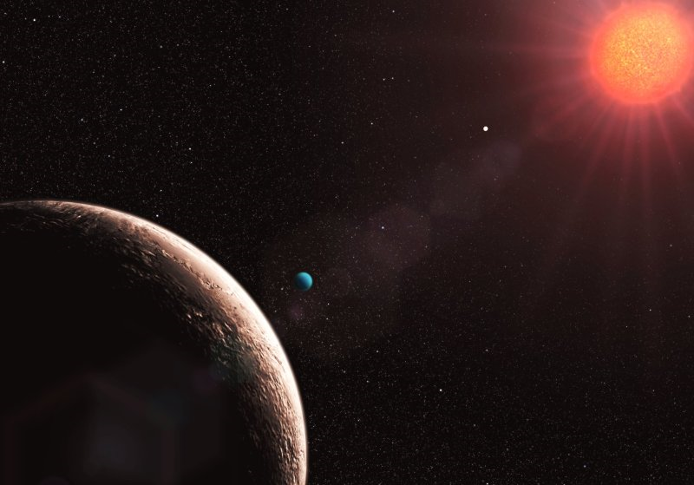
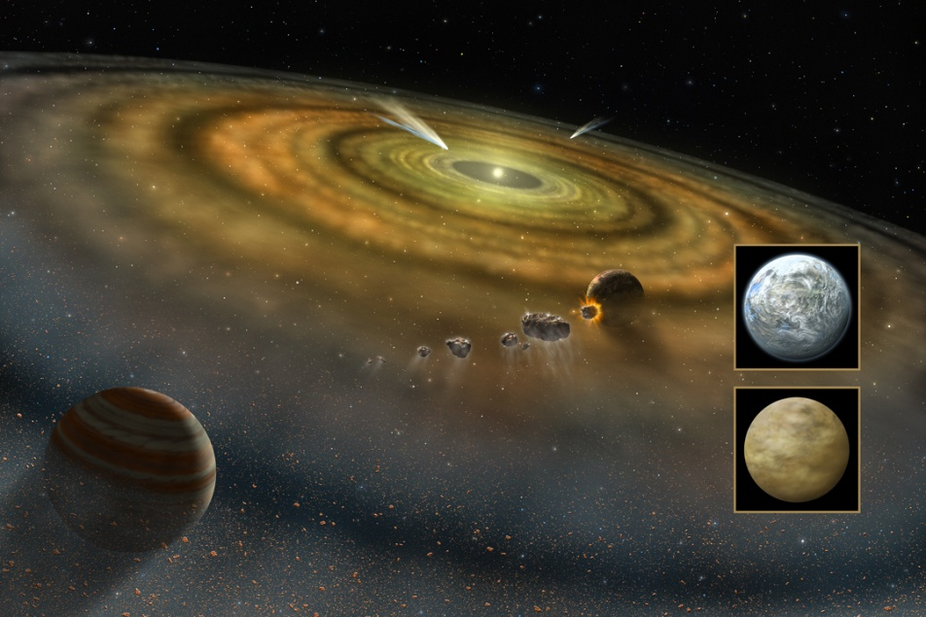
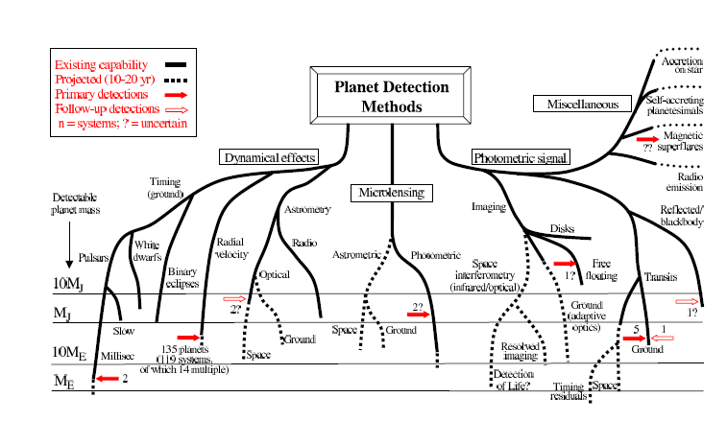
Planets, planets, planets
Planets everywhere
Radial velocities
Direct imaging
Transits
Characterisation
Planetary systems, masses, chemical composition, temperatures

Slide 11
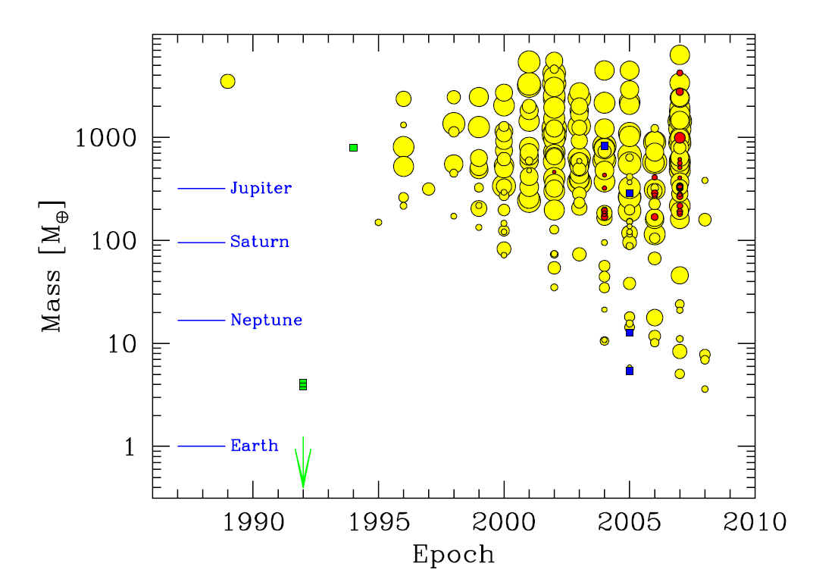
Planets
Radial velocities
Important: time series and high-resolution spectroscopy
complementary with space missions (CoRoT, Kepler)
Currently done with 1m to 10m telescopes
HARPS/HARPS-N, HIRES, UVES
ESPRESSO (VLT) and CODEX (E-ELT)
Direct imaging
Important: spatial resolution and IR
large telescopes (>8m) with adaptive optics or interferometry (or space telescopes)
HST, NACO (VLT), NIRI (Gemini), Keck AO, SPHERE (VLT), GPI (Gemini), MATISSE (VLTI) and EPICS (E-ELT), JWST, ELTs
Transits
Important: time series and accurate photometry
Mostly space missions (photometric stability) and long, uninterrupted time series (CoRoT, Kepler, PLATO)
Spectroscopy follow-up (HST, 4m to 8m telescopes)
OSIRIS (GTC)
Udry et al. (2009) Science with the VLT in the ELT Era

Slide 12
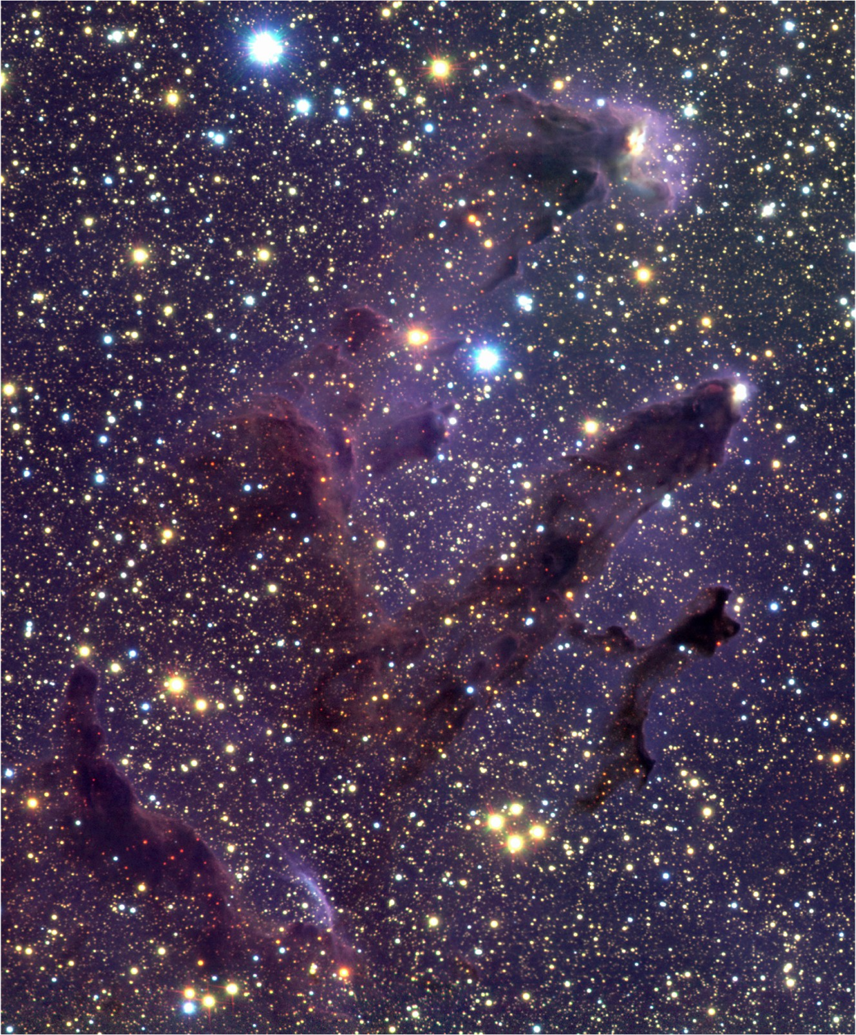
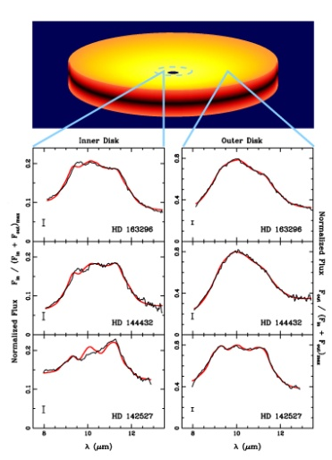
How did stars and planets form?
Star formation shrouded in dust
Transition from absorbing cloud to self-luminous object
Planetary and debris disks as cradles for planets
Chemical composition of disks
Observations
Thermal IR, sub-mm and mm observations
Importance of spatial resolution
McCaughrean and Andersen (2002)
Van Boekel 2004

Slide 13
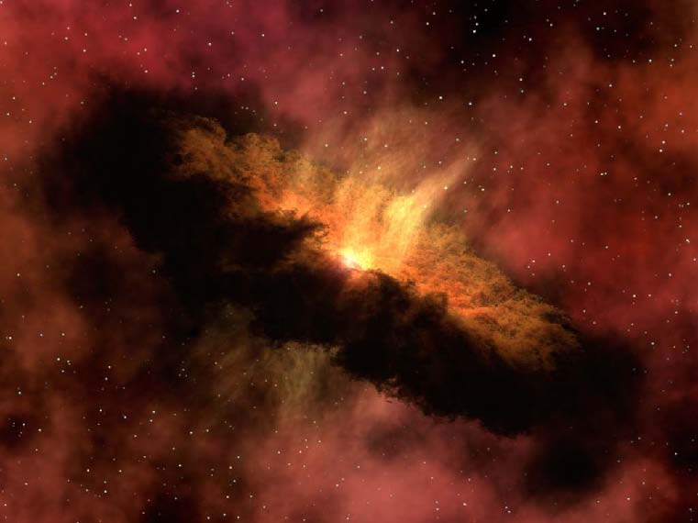
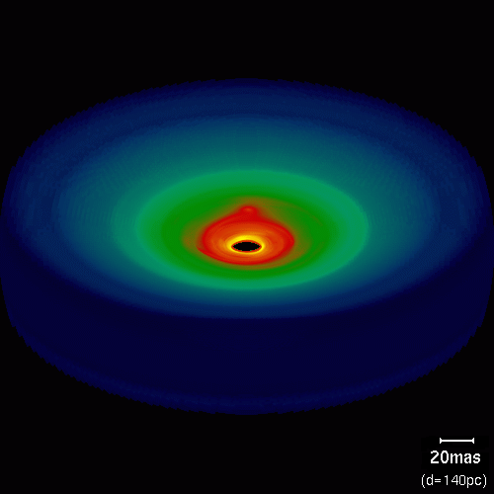
Star and planet formation
Observing the warm cores of molecular clouds
Important: spatial resolution and large wavelength coverage
IR observations with large (>8m) telescopes, CanariCam (GTC), VLTI (MATISSE) JWST, ELTs
ALMA will be the champion for this field
Wolf & Klahr 2005

Slide 14
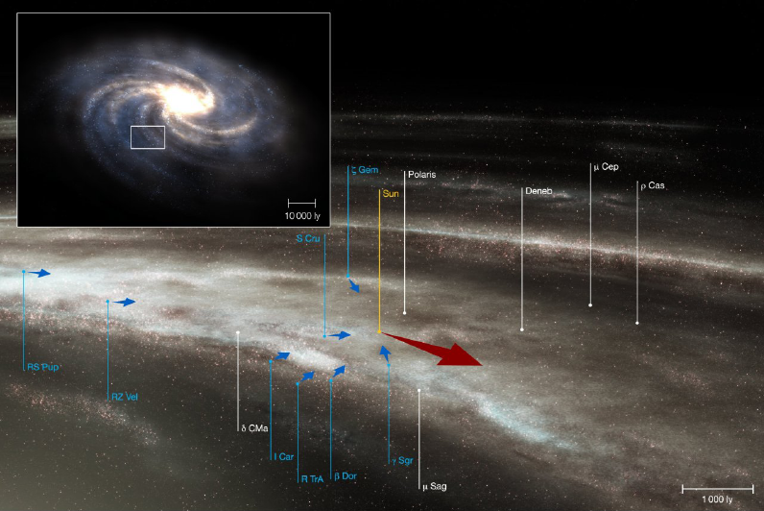
The Milky Way – our home
Radial velocity study of 14000 F and G stars over two decades years
Plus photometry and Hipparcos parallaxes
Spiral arms
Gas flows, stellar distribution
Bulge composition, Galactic Centre
Distribution of massive stars

Slide 15
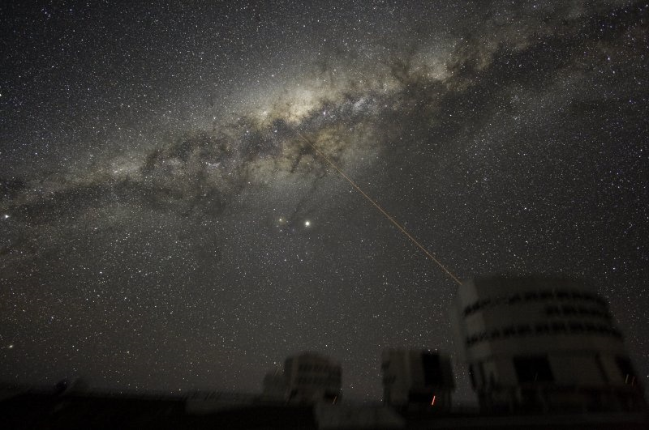
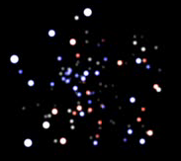
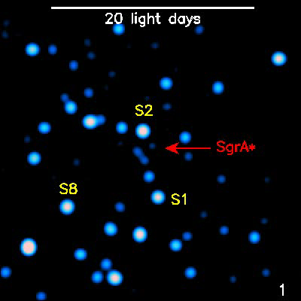
Our own black hole
Mass determination through stellar orbits
Structure around the black hole revealed through flashes
Coordinated studies with other wavelengths

Slide 16
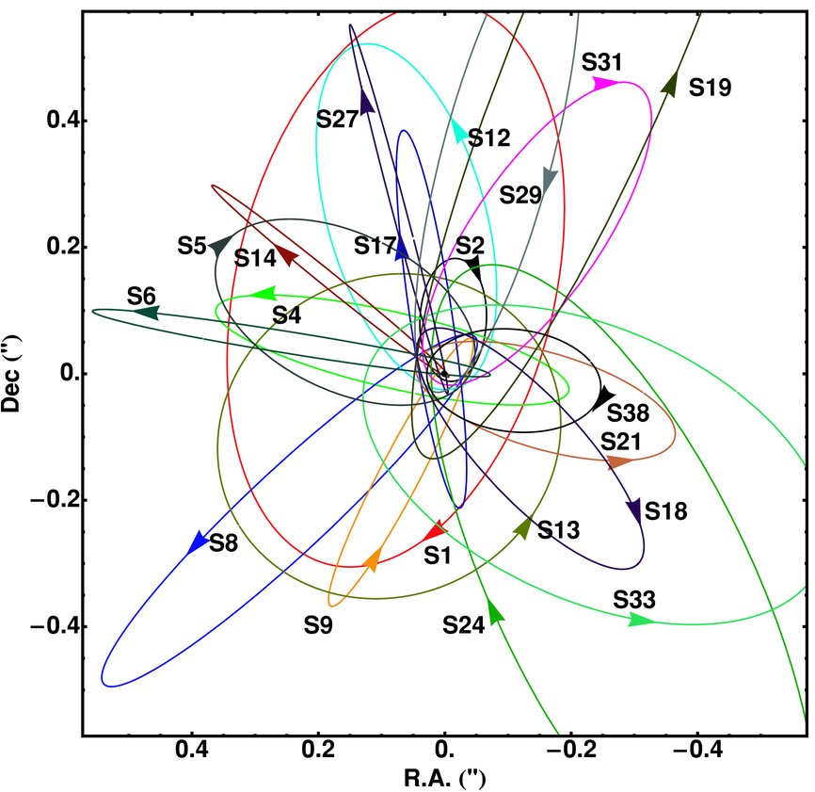
Galactic Centre
Determine the black hole event horizon
Schwarzschild radius ≈9 microarcseconds
Measure gravity in the strong regime
Probing the spacetime geometry
Important: IR observations and spatial resolution → large telescope (>8m) with AO and interferometry
NACO, Keck AO, GEMS (Gemini), GRAVITY (VLTI), ELTs
Gillessen et al. (2009)

Slide 17
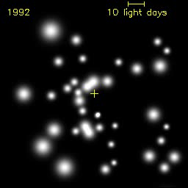
Das Milchstrassenzentrum

Slide 18
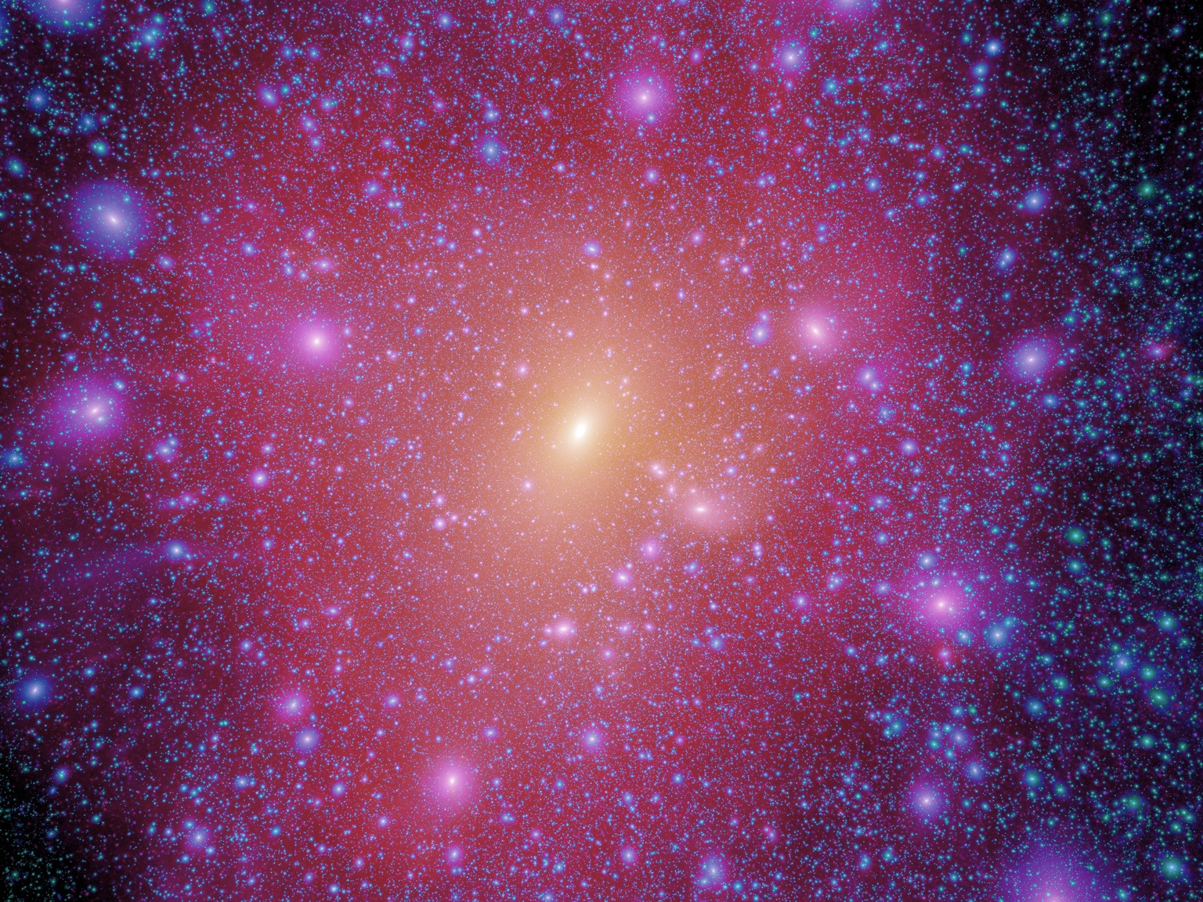
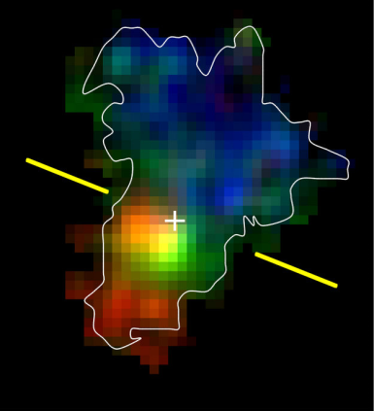
How did galaxies form and evolve?
Characterisation of the Lyman-break galaxies
Galaxy population at z>3
Discovery of compact, old galaxies at z>1
“red and dead”, “red distant galaxies”
Characterisation of galaxies at high z
Internal kinematics
Earliest observable stellar agglomerations
Ly-α emitters
Millenium simulation (Springel et al.)

Slide 19
The distant universe
Build up of the Hubble sequence
Star forming vs. passive galaxies
Important: deep wide-field imaging and massive spectroscopic surveys
SuprimeCam (Subaru), VST, VISTA, VIMOS upgrade, FMOS (Subaru)
Internal physics and morphologies of galaxies at 1<z<3
Important: high spatial resolution and spatially resolved spectroscopy
HST, NACO, SINFONI, OSIRIS (GTC), MUSE, KMOS, HAWK-I with AO, JWST, E-ELT
Objects at very high redshifts (‘first light’)
Search for Ly-α emitters, IGM at high z
Important: deep surveys, spectroscopic follow-up
SuprimeCam (Subaru), X-Shooter, NACO, OSIRIS (GTC), LRIS (Keck), DEIMOS (Keck), HAWK-I with AO, MUSE, KMOS, EMIR (GTC), JWST, E-ELT
Based on Bergeron (2009) Science with the VLT in the ELT Era

Slide 20
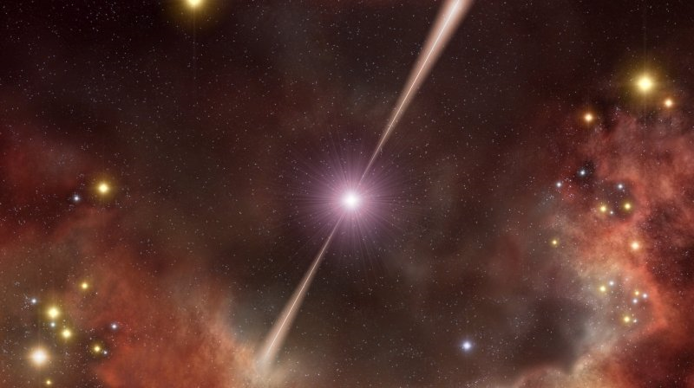
Fashions and other transient phenomena
ESO top ten cited papers are all supernovae and GRBs
This is more a sign of fashion than sound physics
AGNs – topic of the 4m telescopes
Topic for 8m telescopes?
Metal-poor stars – originally 8m (e.g. First Stars programme)
And now?

Slide 21
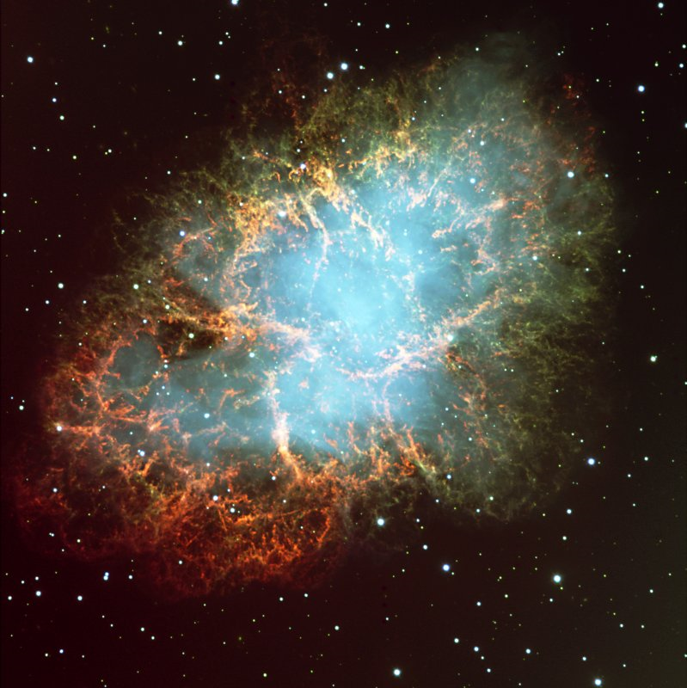
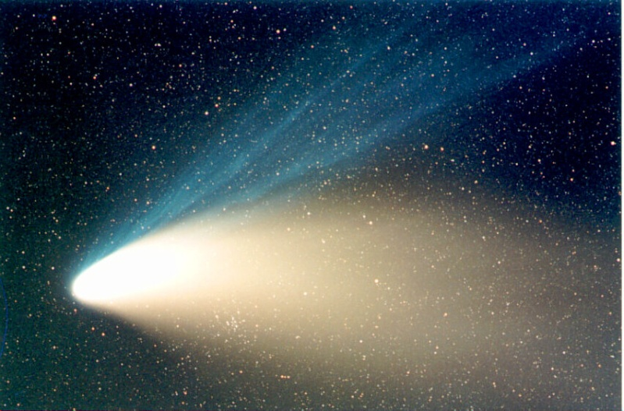
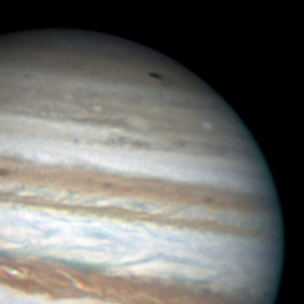
When opportunity knocks
Unique objects
SN 1987A
One in a century object?
Comets
Hale-Bopp, Hyakutake, 73P/Schwassmann-Wachmann 3, Shoemaker-Levy 9, Halley
Near-Earth objects
Solar system event
Spots on Jupiter
Volcano eruption on Io?
Formation of new large spot on Jupiter?
Wesley, 35cm

Slide 22
Metrics

Slide 23
The telescope landscape
There are many large optical and infrared telescopes
3 telescope planned with d>20m
Telescope diameter | In operation | Construction or Planned
d>10m | 4
7m < d < 10m | 9 | LSST
5m < d < 7m | 6 | JWST
3m < d < 5m | 16 | VISTA, LAMOST, Discovery Telescope

Slide 24
Role of 8-10m telescopes
Workhorses of optical/IR astronomy
Distributed resource
Access for many astronomers
Develop specific strengths
E.g. time series, large samples
Examples are the 4m telescopes over the past decade
AAT/2dF, CFHT/Legacy Survey, ESO 3.6m/HARPS, WHT/SAURON and PN.S

Slide 25
Complementarity
Follow up of imaging surveys
UKIDSS, VST, VISTA, LSST/PanSTARRS
ESA Cosmic Vision → EUCLID/PLATO
Follow up of sources detected at other wavelengths
Herschel, Fermi, XMM/Chandra, JWST, eROSITA
ALMA/SMA follow-up/complement

Slide 26
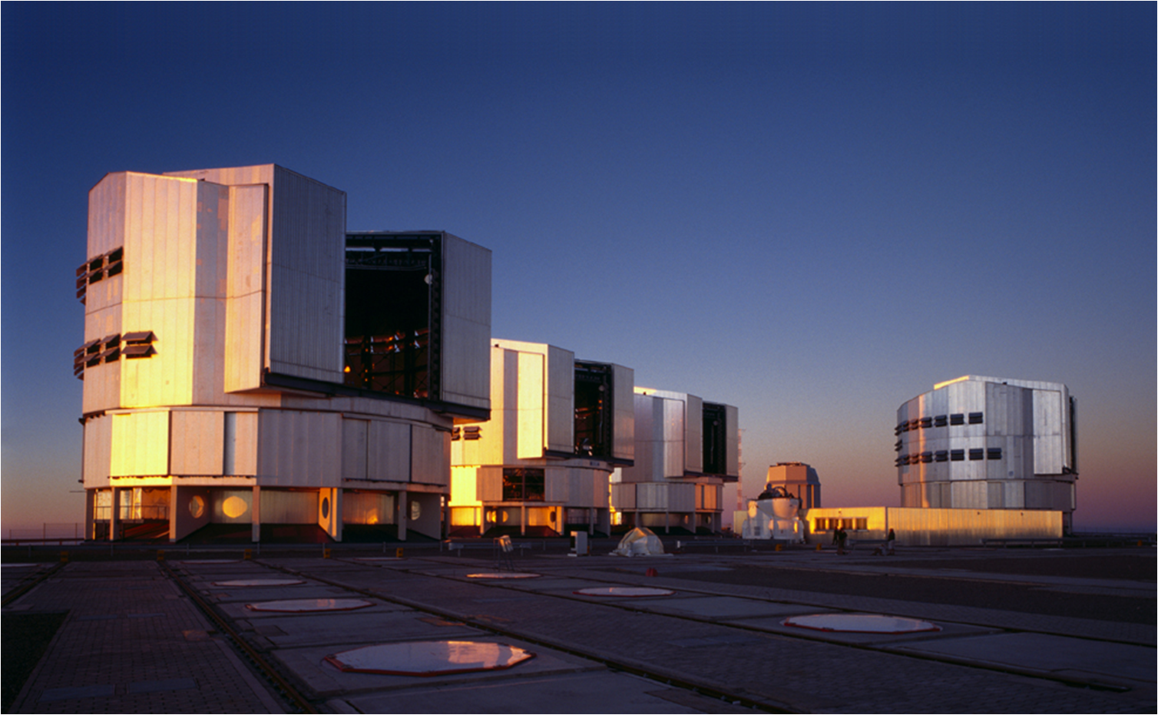
La Silla Paranal
VLT
Continue operations with new instruments
FORS2, ISAAC, UVES, FLAMES, NACO, SINFONI, CRIRES, VISIR, HAWK-I, VIMOS, X-Shooter, KMOS, AOF, MUSE, SPHERE
MIDI, AMBER, PRIMA, GRAVITY, MATISSE
La Silla
Continue operations with long-term programmes
HARPS, EFOSC2, SOFI, visitor instruments

Slide 27
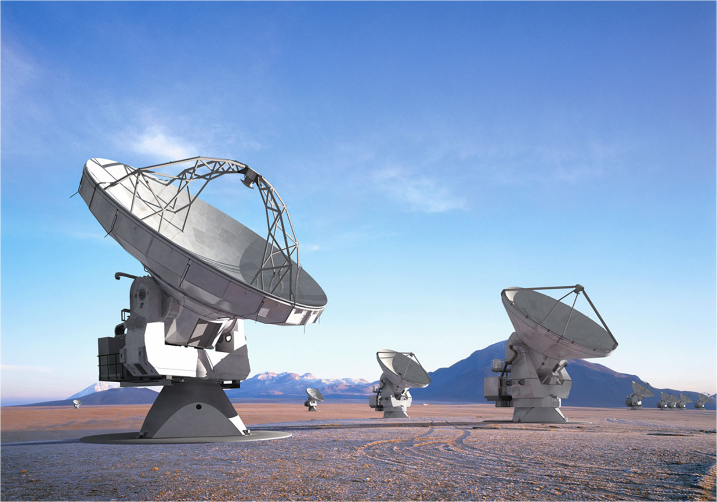
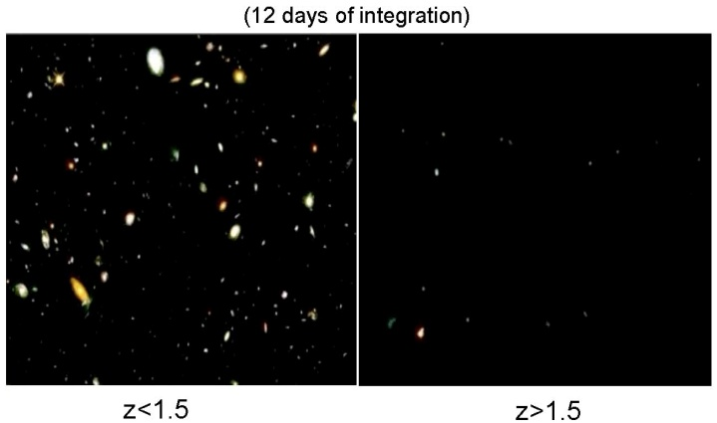
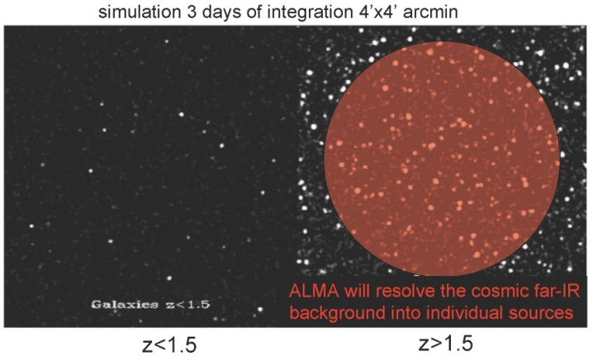
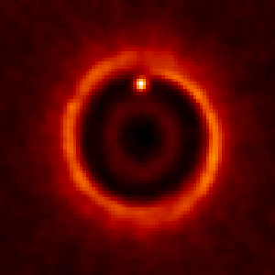

ALMA
Science requirements
Detect CO and [CII] in Milky Way galaxy at z=3 in < 24 hr
Dust emission, gas kinematics in proto-planetary disks
Resolution to match Hubble, JWST and 8-10m with AO
Complement to Herschel
Specifications
66 antennas (54x12m, 12x7m)
14 km max baseline (< 10mas)
30-1000 GHz (10–0.3mm), up to 10 receiver bands
HST
ALMA
5AU
850 GHz

Slide 28
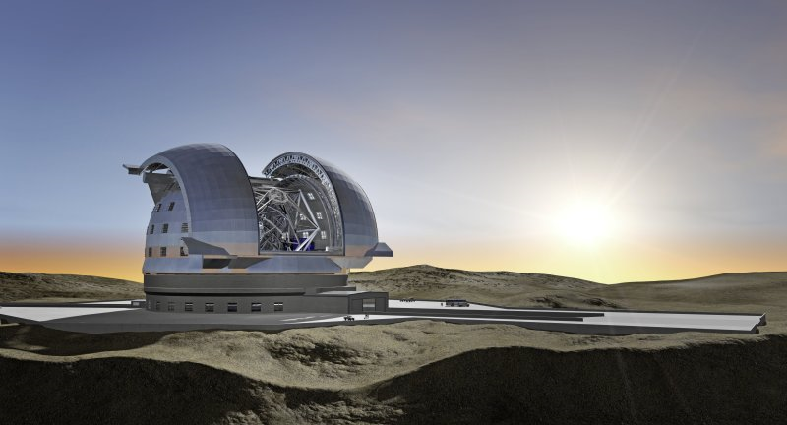
E-ELT
Detailed design study
Baseline 42m primary mirror
Adaptive optics built-in
Industry strongly engaged
Study complete in 2010
Project
Builds on entire expertise at ESO and in the member states
Construction 2011-2018
Synergy: JWST/ALMA/SKA

Slide 29

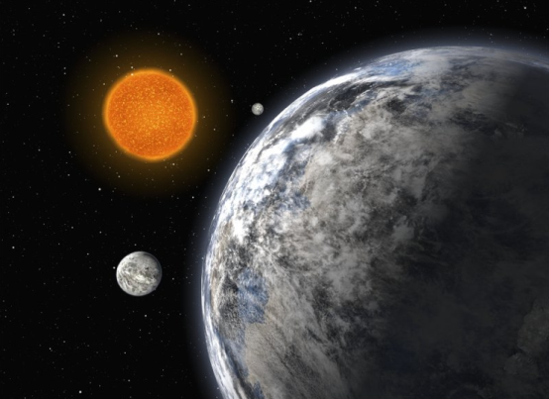
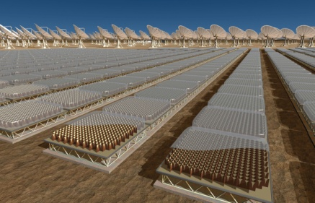
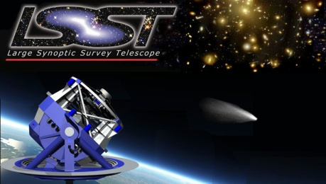
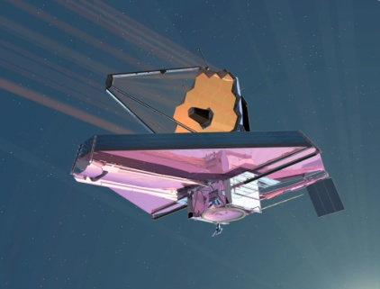
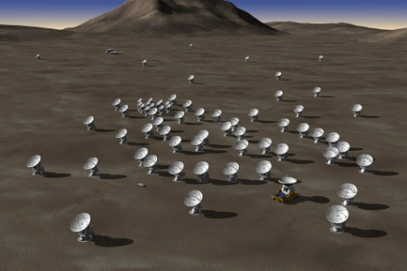
The Science
Contemporary Science: Exo-planets, planet formation, resolved stellar populations beyond the Local Group, Black Holes, the physics of high redshift galaxies, the expansion of the universe, ...
Synergies with other top facilities: ALMA, JWST, survey telescopes, SKA, ...
Discoveries: opening new parameter space in spatial resolution and sensitivity, ...
SKA
JWST
ALMA
European Extremely Large Telescope - ESO User committee April 2009

