Slide 1
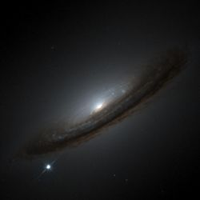

$H0$ and the never-ending story of the expansion rate of the Universe
Bruno Leibundgut
ESO

Slide 2
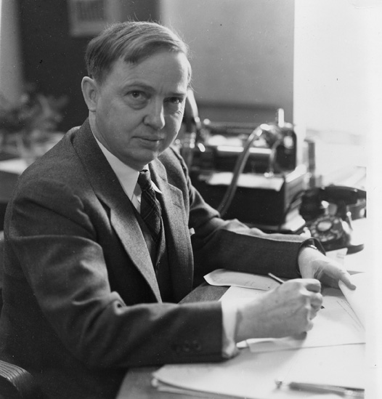
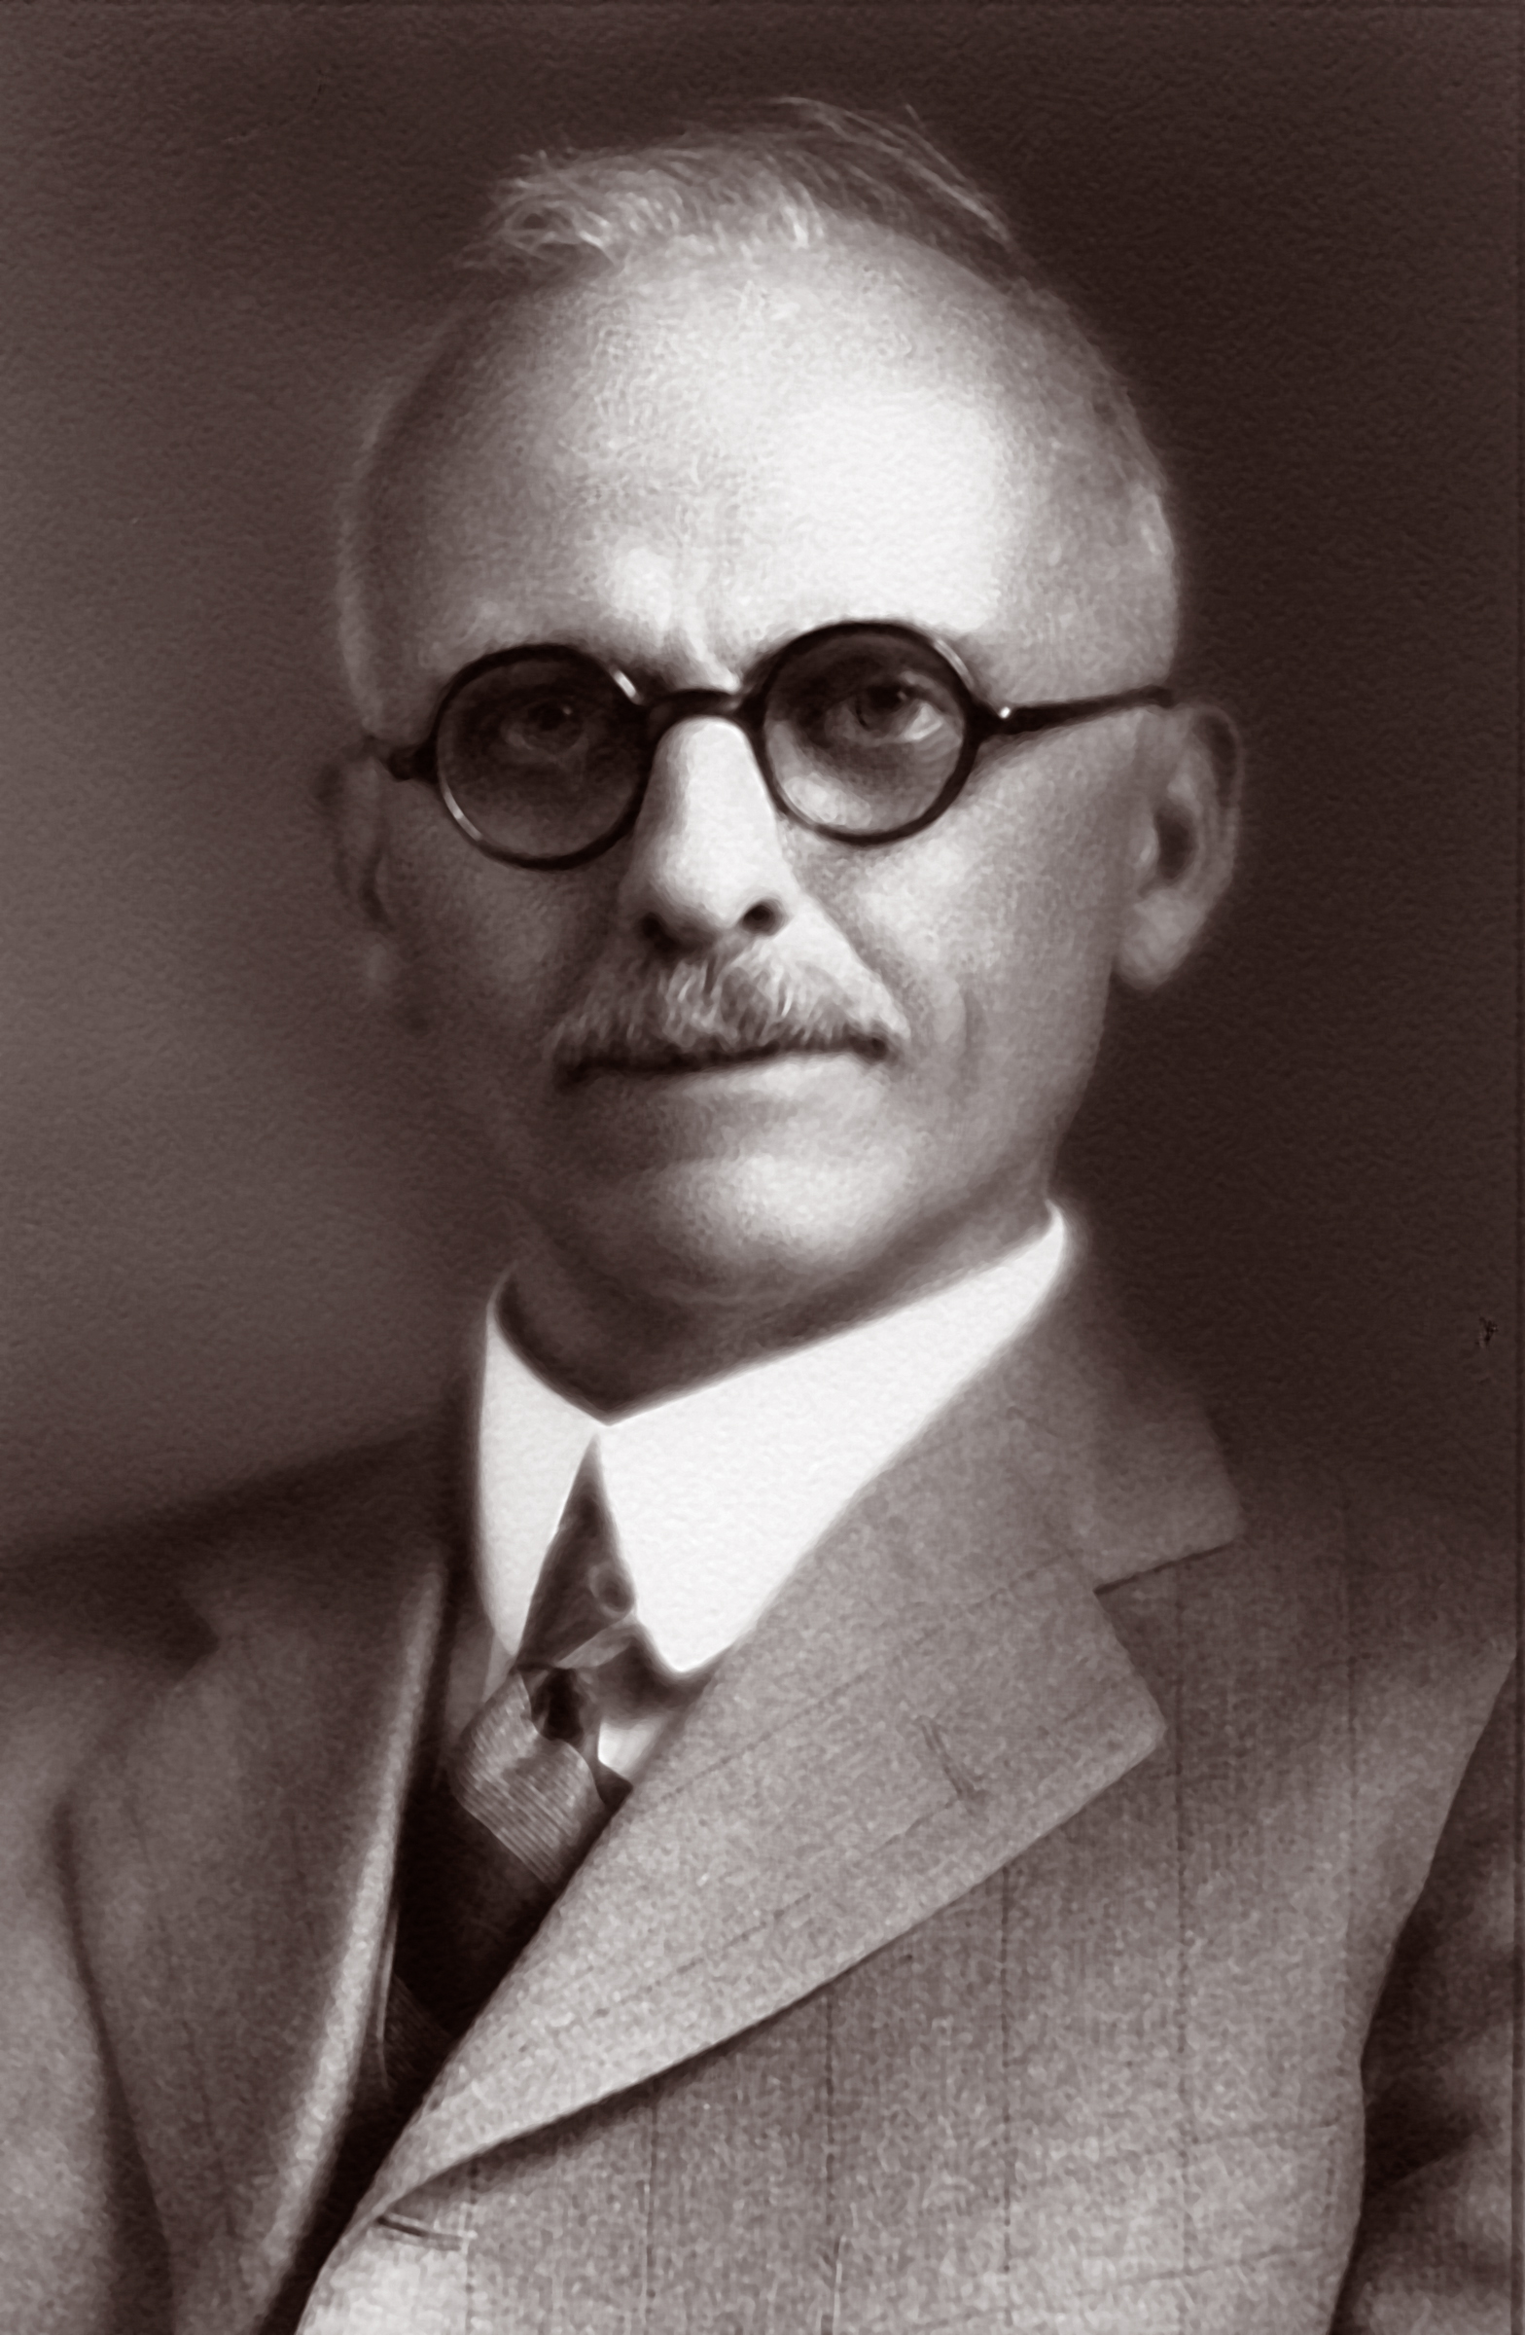
Great Debate: What is the size of the Universe?
Presentations at the Annual Meeting of the National Academy of Sciences in Washington DC, 26. April 1920
Harlow Shapley vs. Heber Curtis
http://incubator.rockefeller.edu/geeks-of-the-week-harlow-shapley-heber-curtis/

Slide 3
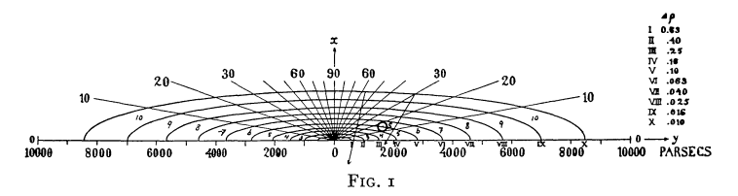
Models of the Milky Way
Wikipedia
Jacobus Kapteyn (1922)
based on stellar counts in selected areas
Kapteyn contributed many stars in the southern hemisphere

Slide 4
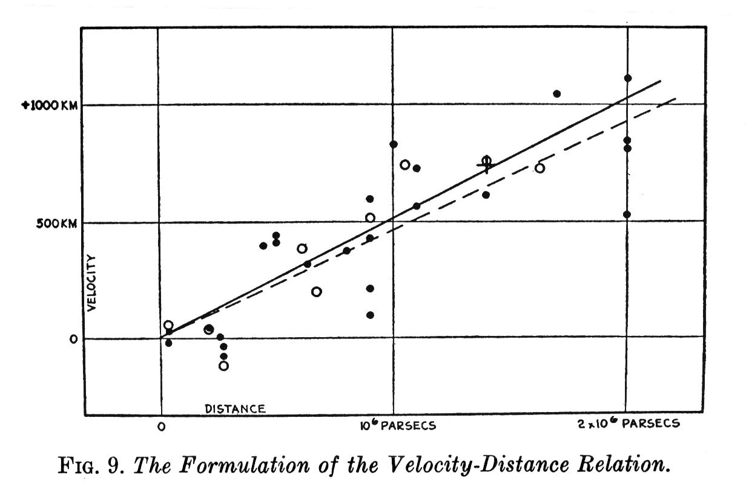
Background
Expanding universe
→ expansion rate critical for cosmic evolution
STScI
Hubble 1929

Slide 5
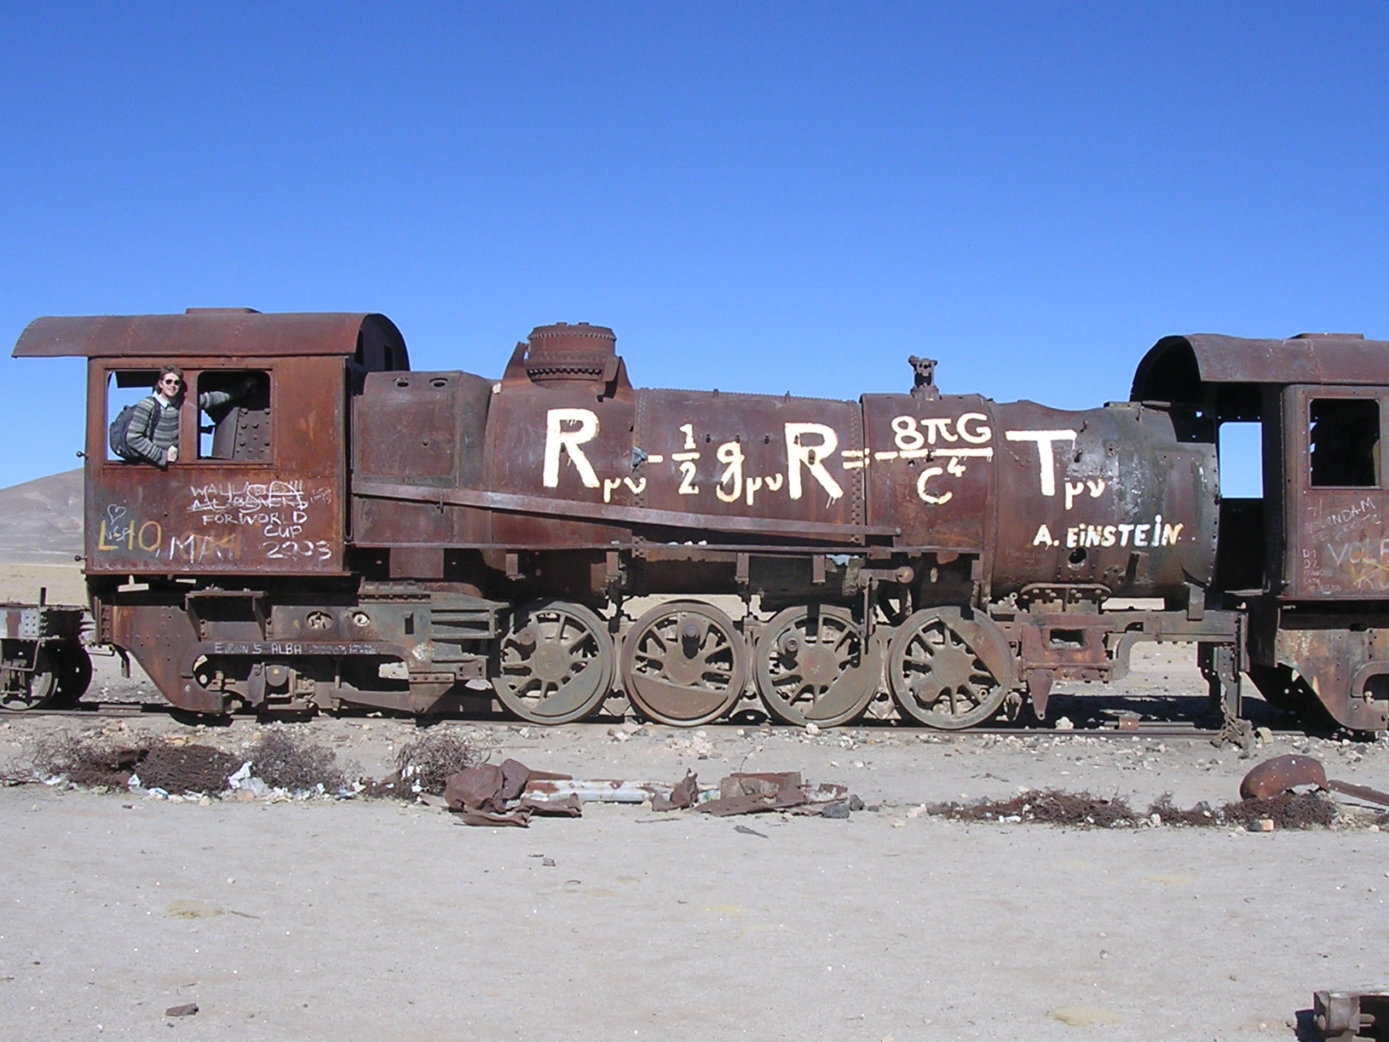
Leading Theory of the Universe

Slide 6
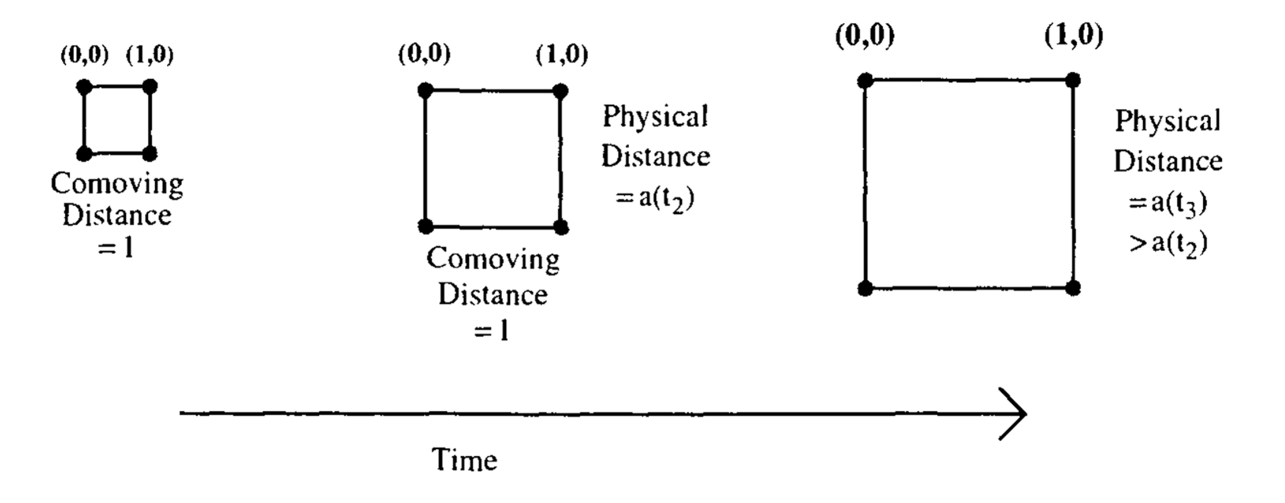
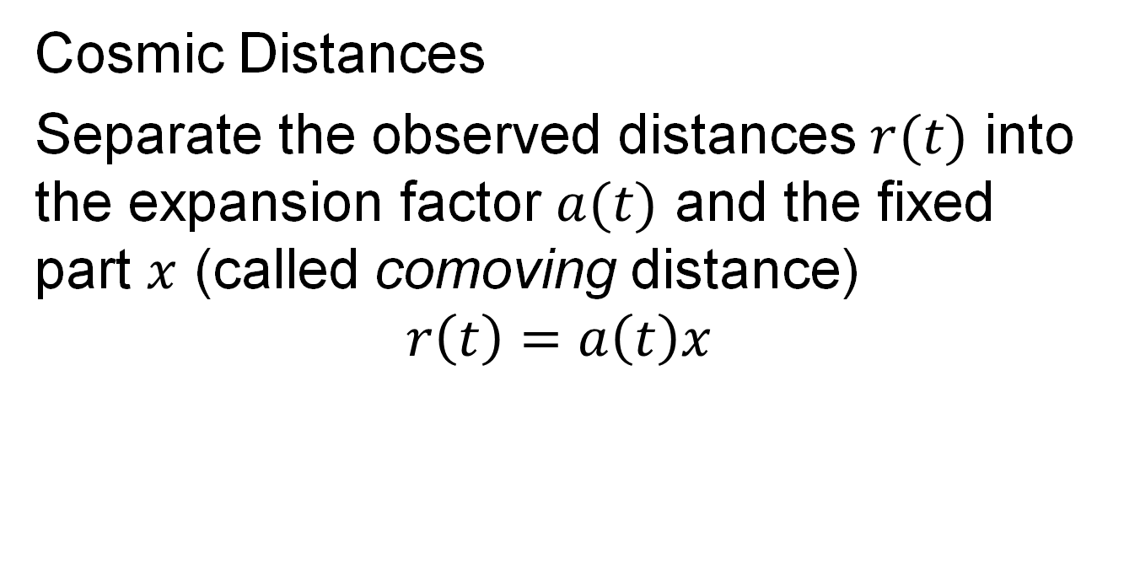
Dealing with an expanding Universe
Cosmic Distances
Separate the observed distances $r(t)$ into the expansion factor $a(t)$ and the fixed part $x$ (called comoving distance)
$$r\left(t\right)=a\left(t\right)x$$
x
x

Slide 7
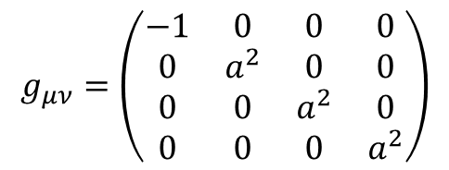
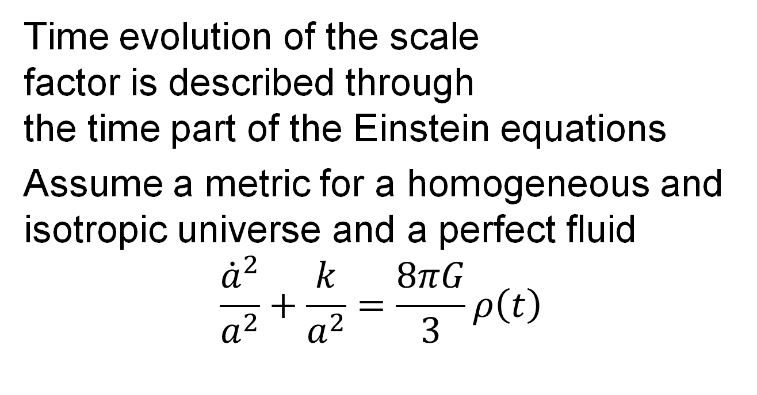
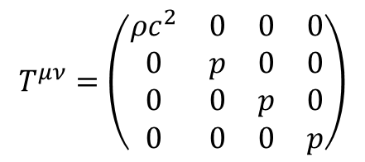
Friedmann Equation
Time evolution of the scale factor is described through the time part of the Einstein equations
Assume a metric for a homogeneous and isotropic universe and a perfect fluid
$$\frac{{\dot{a}}^{2}}{a^{2}}+\frac{k}{a^{2}}=\frac{8πG}{3}ρ\left(t\right)$$
$$g_{μν}=\left(\begin{matrix}−1 & 0 & 0 & 0 \\ 0 & a^{2} & 0 & 0 \\ 0 & 0 & a^{2} & 0 \\ 0 & 0 & 0 & a^{2}\end{matrix}\right)$$
$$T^{μν}=\left(\begin{matrix}ρc^{2} & 0 & 0 & 0 \\ 0 & p & 0 & 0 \\ 0 & 0 & p & 0 \\ 0 & 0 & 0 & p\end{matrix}\right)$$

Slide 8
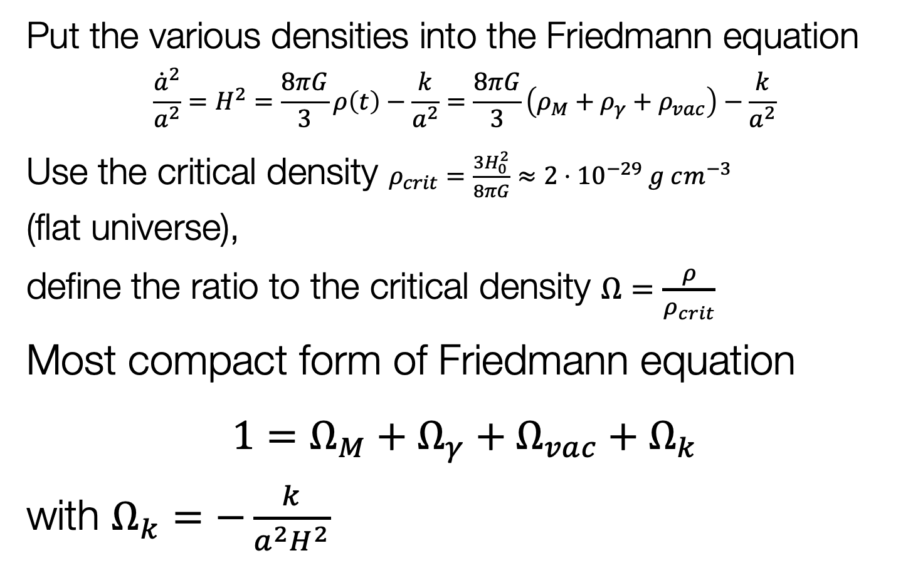
Friedmann Equation
Put the various densities into the Friedmann equation
$$\frac{{\dot{a}}^{2}}{a^{2}}=H^{2}=\frac{8πG}{3}ρ\left(t\right)−\frac{k}{a^{2}}=\frac{8πG}{3}\left(ρ_{M}+ρ_{γ}+ρ_{vac}\right)−\frac{k}{a^{2}}$$
Use the critical density $ρ_{crit}=\frac{3H_{0}^{2}}{8πG}≈{2⋅10}^{−29} g cm^{−3}$ (flat universe), define the ratio to the critical density $Ω=\frac{ρ}{ρ_{crit}}$
Most compact form of Friedmann equation
$1=Ω_{M}+Ω_{γ}+Ω_{vac}+Ω_{k}$
with $Ω_{k}=−\frac{k}{a^{2}H^{2}}$

Slide 9
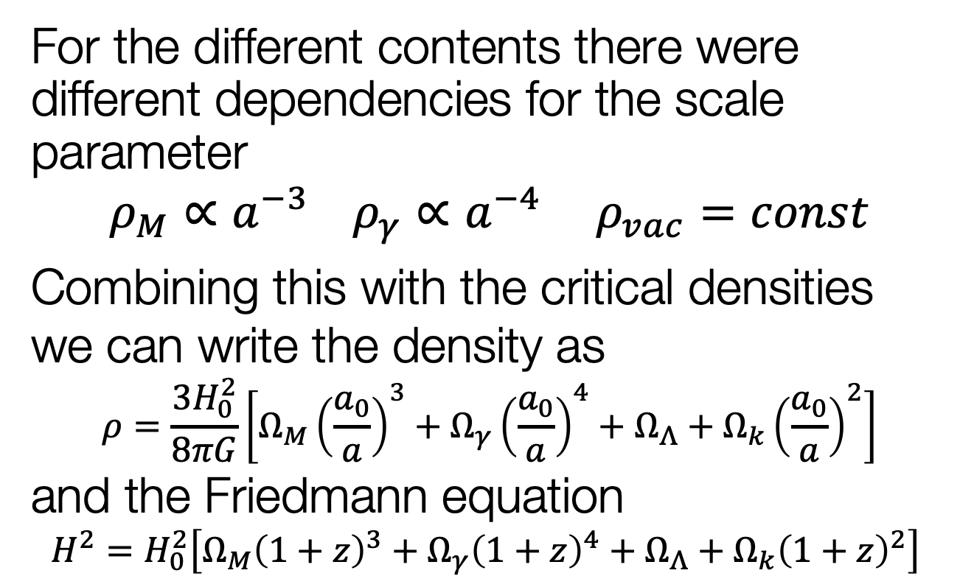
Dependence on Scale Parameter
For the different contents there were different dependencies for the scale parameter
$$ρ_{M}∝a^{−3} ρ_{γ}∝a^{−4} ρ_{vac}=const$$
Combining this with the critical densities we can write the density as $$ρ=\frac{3H_{0}^{2}}{8πG}\left[Ω_{M}{\left(\frac{a_{0}}{a}\right)}^{3}+Ω_{γ}{\left(\frac{a_{0}}{a}\right)}^{4}+Ω_{Λ}+Ω_{k}{\left(\frac{a_{0}}{a}\right)}^{2}\right]$$ and the Friedmann equation
$$H^{2}=H_{0}^{2}\left[Ω_{M}{\left(1+z\right)}^{3}+Ω_{γ}{\left(1+z\right)}^{4}+Ω_{Λ}+Ω_{k}{\left(1+z\right)}^{2}\right]$$

Slide 10

History of $H0$
Expansion rate by G. Lemaître (1927)
Footnote!

Slide 11
Intermezzo Age of the Universe
Matter-dominated universe has the following age
age of the Earth: 4.5⋅10⁹ years
oldest stars: ~1.2⋅10¹⁰ years
H₀ (km/s/Mpc) | t₀ (yr)
500 | 1.30⋅10⁹
250 | 2.61⋅10⁹
100 | 6.52⋅10⁹
80 | 8.15⋅10⁹
70 | 9.32⋅10⁹
60 | 1.09⋅10¹⁰
50 | 1.30⋅10¹⁰
30 | 2.17⋅10¹⁰

Slide 12
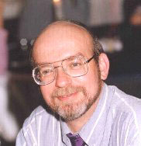



History of $H_{0}$
J. Huchra
$$2.6⋅{10}^{9}years$$
$$6.5⋅{10}^{9}years$$
https://www.cfa.harvard.edu/~dfabricant/huchra/hubble/

Slide 13


History of $H_{0}$
$$6.5⋅{10}^{9}years$$
$$13⋅{10}^{9}years$$

Slide 14

History of $H_{0}$
A. Riess

Slide 15
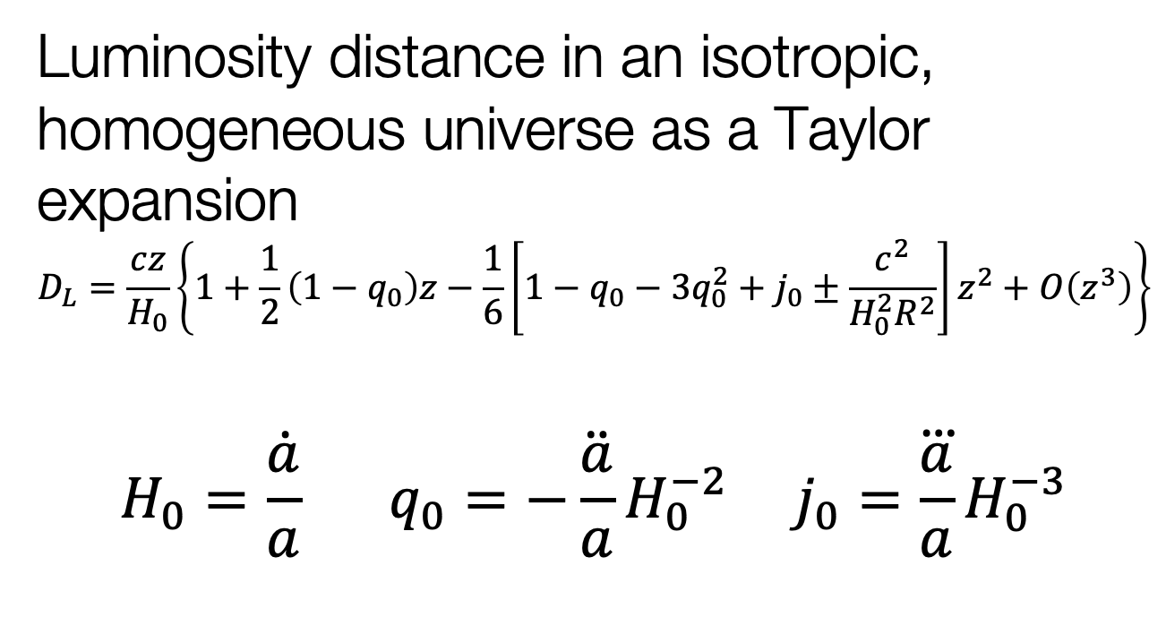
Expansion of the Universe
Luminosity distance in an isotropic, homogeneous universe as a Taylor expansion
$$D_{L}=\frac{cz}{H_{0}}\left\{1+\frac{1}{2}\left(1−q_{0}\right)z−\frac{1}{6}\left[1−q_{0}−3q_{0}^{2}+j_{0}±\frac{c^{2}}{H_{0}^{2}R^{2}}\right]z^{2}+O\left(z^{3}\right)\right\}$$
$$H_{0}=\frac{\dot{a}}{a} q_{0}=−\ddot{\frac{a}{a}}H_{0}^{−2} j_{0}=\frac{\overset{⃛}{a}}{a}H_{0}^{−3}$$
Hubble- Lemaître Law
deceleration
jerk/equation of state
ApJ 1961

Slide 16
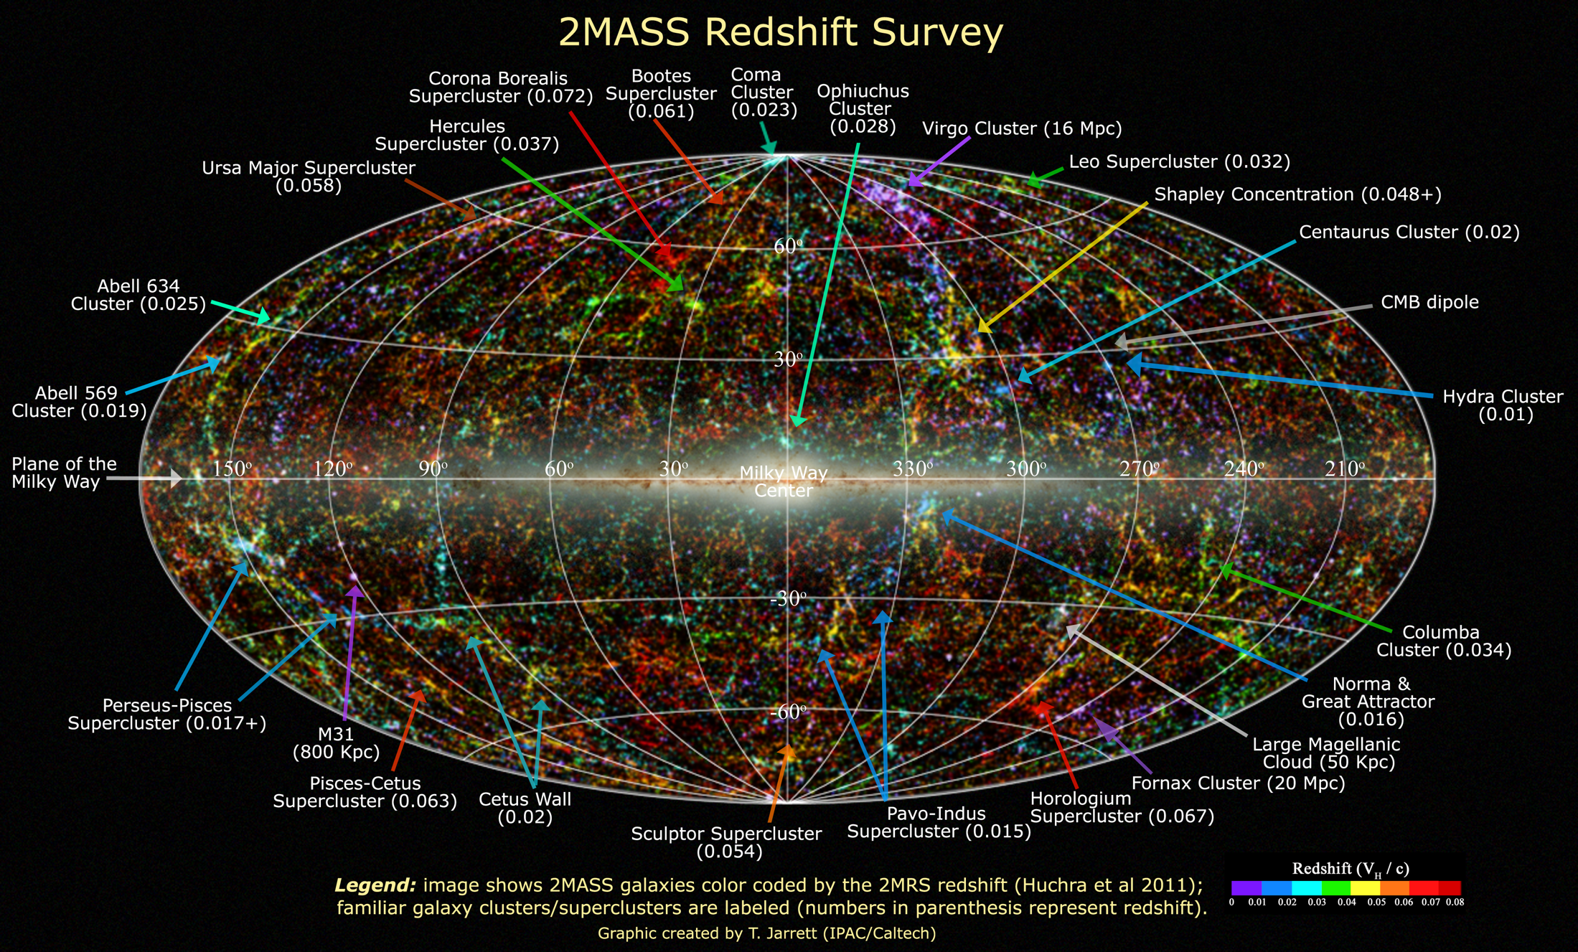
Extragalactic Distances
Required for a 3D picture of the (local) universe

Slide 17
Extragalactic Distances

Slide 18
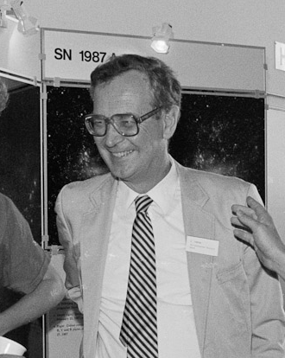

Measuring $H_{0}$
Classical approach
→ distance ladder to reach (smooth) Hubble flow
Sandage & Tammann 1974

Slide 19
Hubble Constant
Three different methods
Distance ladder
Calibrate next distance indicator with the previous
Physical methods
Determine either luminosity or length through physical quantities
Sunyaev-Zeldovich effect (galaxy clusters)
Expanding photosphere method in supernovae
Physical calibration of thermonuclear supernovae
Geometric methods, e.g. masers
Global solutions
Use knowledge of all cosmological parameters
Cosmic Microwave Background

Slide 20
Classical Distance Ladder
Primary distance indicators (within the Milky Way)
trigonometric parallax
proper motion
apparent luminosity
main sequence
red clump stars
RR Lyrae stars
eclipsing binaries
Cepheid stars
Jacoby et al. 1992

Slide 21
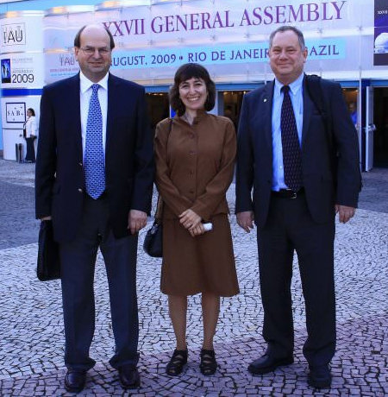
Classical Distance Ladder
Secondary distance indicators (beyond the Local Group)
Important check
Large Magellanic Cloud
Tully-Fisher relation
Fundamental Plane
Supernovae (mostly SN Ia)
Surface Brightness Fluctuations
Gruber Cosmology Prize
Freedman & Madore 2010
Notes:
Jeremy Mould
Wendy Freedman
Robert Kennicutt

Slide 22
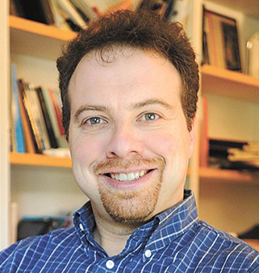
Hubble Constant
Calibration of M(SN Ia @ max)
Distance ladder
Adam Riess

Slide 23
Hubble Constant
Supernova Ia Hubble diagram

Slide 24

$H_{0}$ with Supernovae
Local calibrators (calibrate the Cepheid L-P rel.)
Large Magellanic Cloud
1% accuracy with eclipsing binaries (Pietrzyński et al. (2019)
Maser in NGC 4258
3% accuracy (Humphreys et al. 2013)
geometric distances (parallaxes) to nearby Cepheids
Extinction
absorption in the Milky Way and the host galaxy
corrections not always certain
Peculiar velocities of galaxies
typically around 300 km/s

Slide 25
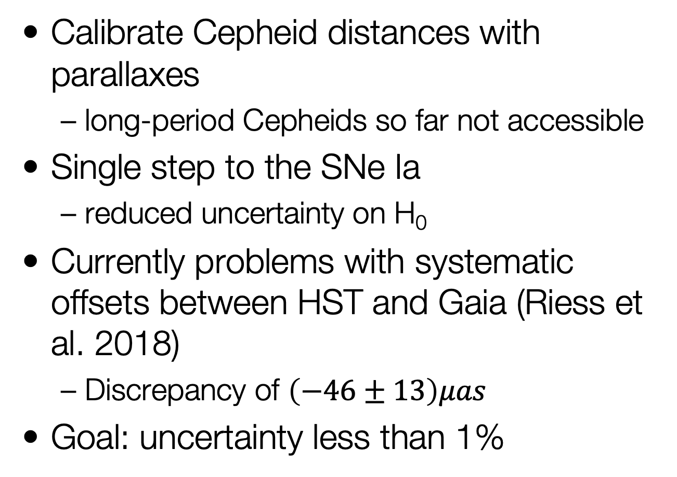

Gaia and $H0$
Calibrate Cepheid distances with parallaxes
long-period Cepheids so far not accessible
Single step to the SNe Ia
reduced uncertainty on H₀
Currently problems with systematic offsets between HST and Gaia (Riess et al. 2018)
Discrepancy of $\left(−46±13\right)μas$
Goal: uncertainty less than 1%

Slide 26
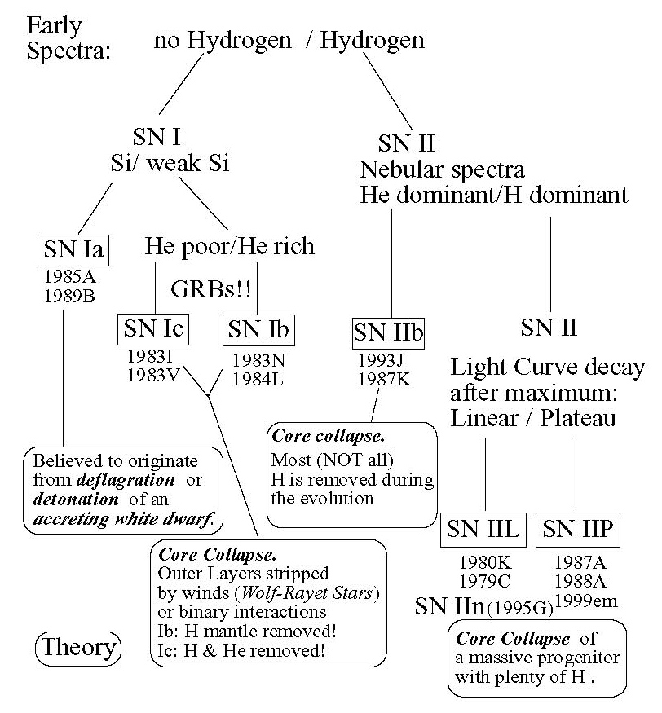
SN Classification

Slide 27
Type Ia Supernovae
Variations on a theme
critical parameters?
nickel mass
ejecta mass
explosion energy(?)
explosion mechanism?
progenitor evolution?
Taubenberger 2017

Slide 28
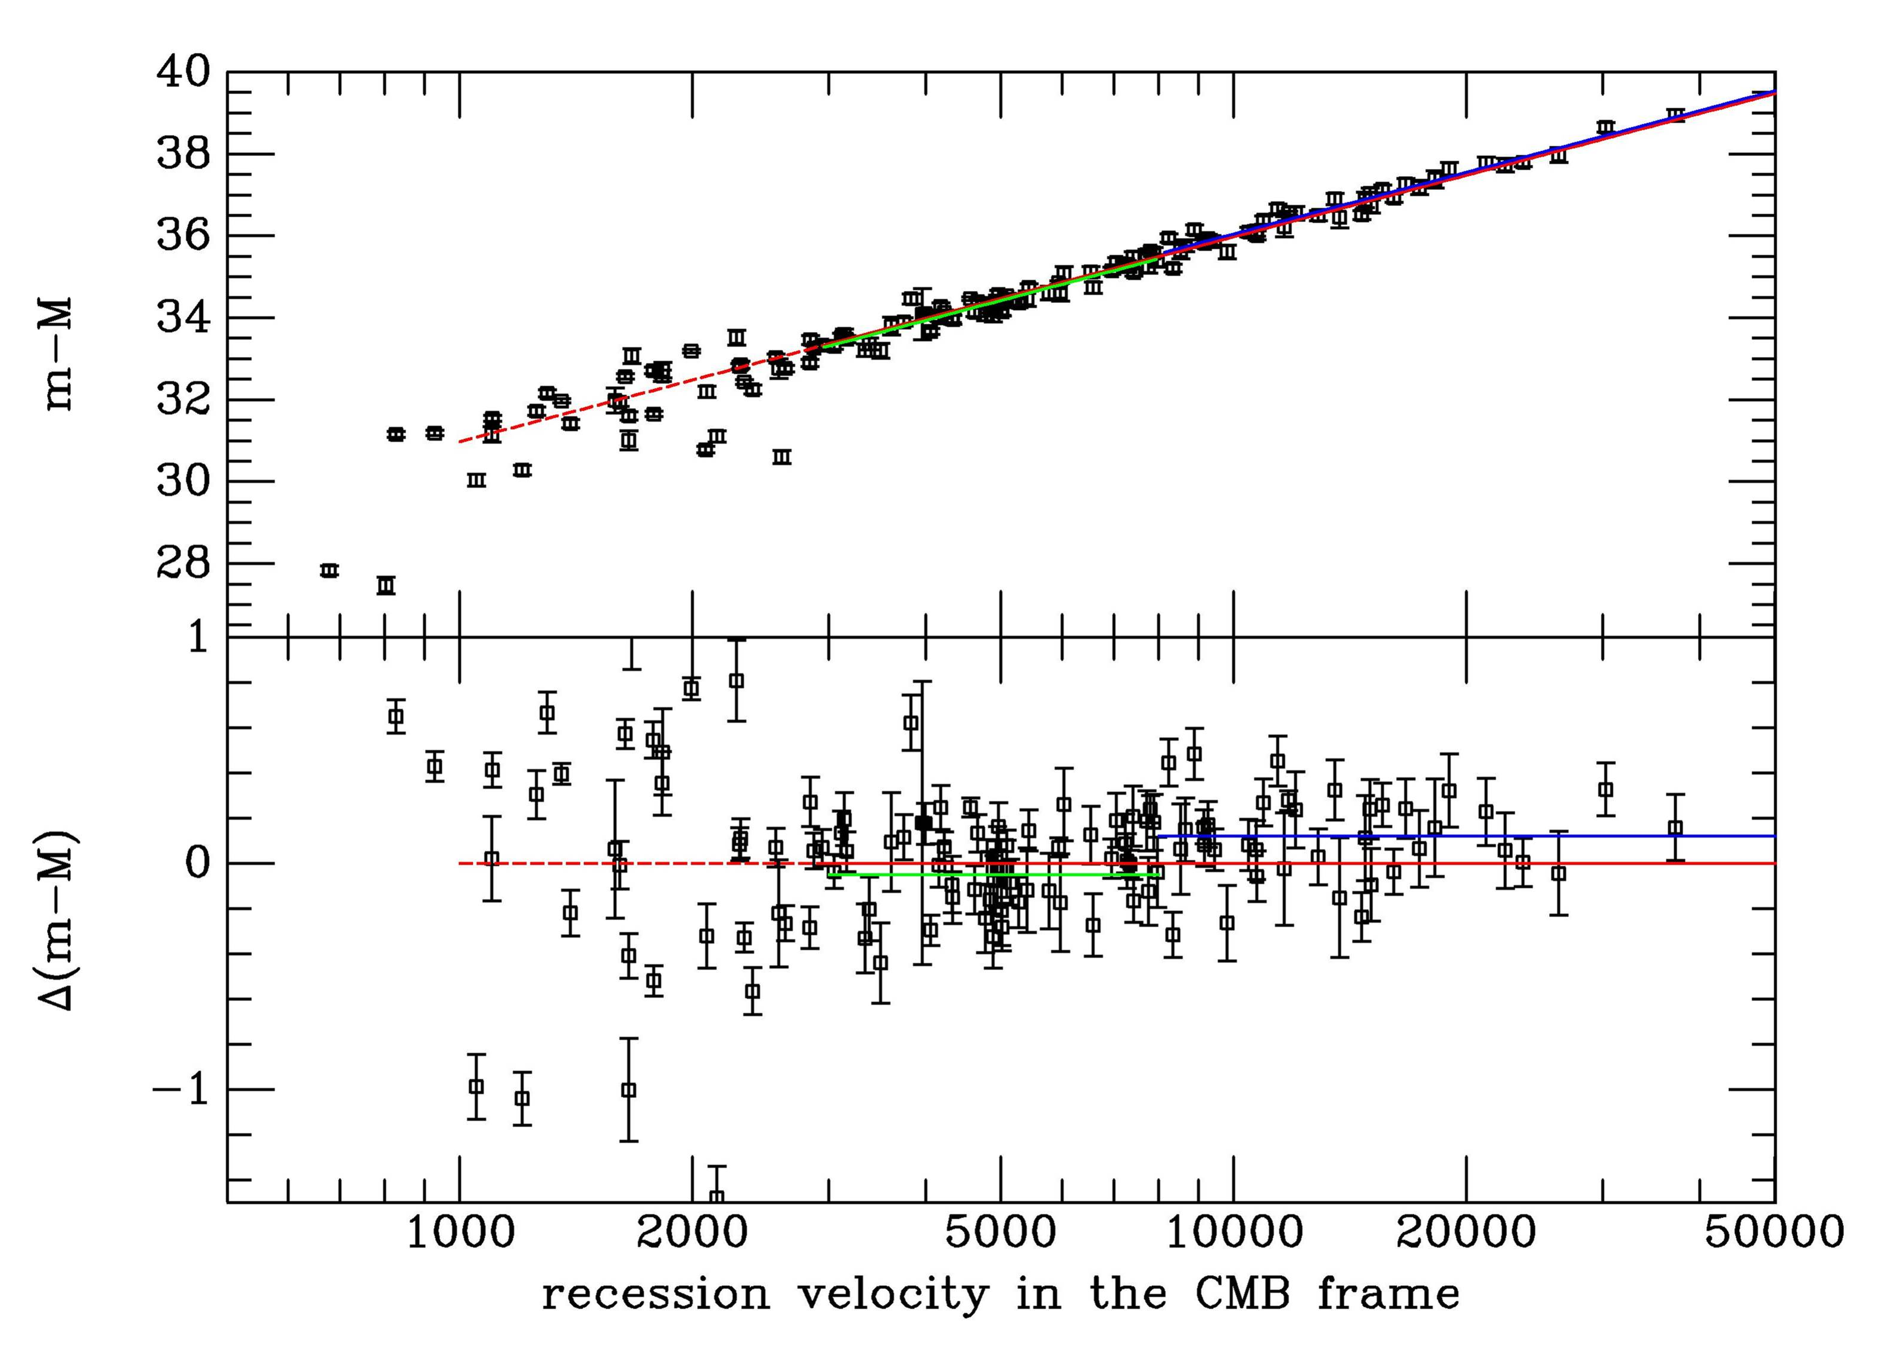

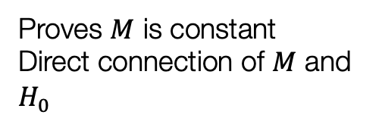
Hubble Constant
SN Hubble diagram
$$m−M=5\log{v+25−5\log{H_{0}}}$$
Proves $M$ is constant
Direct connection of $M$ and $H_{0}$
Leibundgut

Slide 29
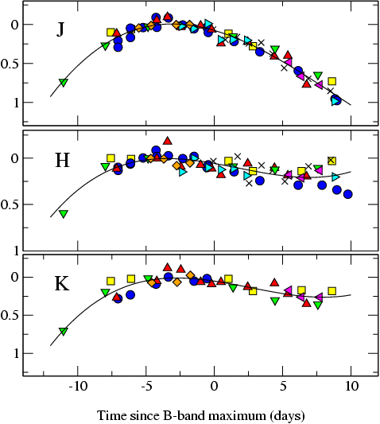

The Promise of the (Near-)Infrared
Extinction is much reduced in the near-IR
$AH/AV ≅ 0.19$ (Cardelli et al. 1989)
SNe Ia much better behaved
SN m₁₅(B)
= 1980N (1.29)
= 1986G (1.79)
= 1998bu (1.05)
= 1999aw (0.81)
= 1999ee (0.94)
= 2000ca (1.01)
= 2001el (1.15)
Krisciunas et al. (2004)
Mark Phillips

Slide 30

Current Status (NIR)
9 calibrators + 27 Hubble flow SNe
Dhawan et al. 2018
$$H_{0}=(72.8±1.6\left(stat\right)±2.7 \left(syst\right)) km s^{−1} Mpc^{−1}$$

Slide 31
Infrared SN Hubble Diagrams
Burns et al. 2018
NIR Hubble diagram becoming competitive
H
B

Slide 32
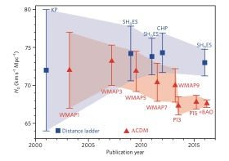
Problem solved?
New discrepancy between the measurements of the local H₀ (distance ladder) and early universe (CMB)
Indication of an incomplete model of cosmology?
Freedman 2017

Slide 33
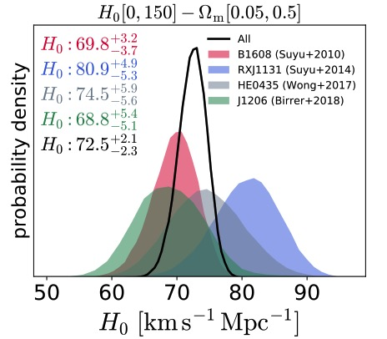
Promising Results from strong lensing
Time delays in lensed quasars
Birrer et al. 2018

Slide 34
Gravitationslinsen
Sherry Suyu (J. Wiedersich / TUM)
H0LICOW collaboration
Wong et al. 2020

Slide 35
…and another attempt
University of Chicago
Tip of the Red Giant Branch

Slide 36
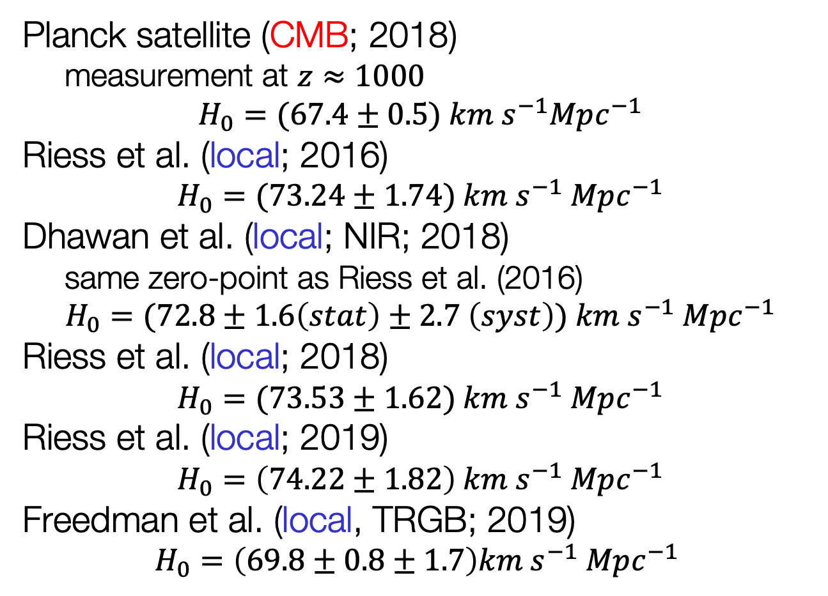
Hubble Constant(s)
Planck satellite (CMB; 2018)
measurement at $z≈1000$
$$H_{0}=(67.4±0.5) km s^{−1}Mpc^{−1}$$
Riess et al. (local; 2016)
$$H_{0}=(73.24±1.74) km s^{−1} Mpc^{−1}$$
Dhawan et al. (local; NIR; 2018)
same zero-point as Riess et al. (2016)
$$H_{0}=(72.8±1.6\left(stat\right)±2.7 \left(syst\right)) km s^{−1} Mpc^{−1}$$
Riess et al. (local; 2018)
$$H_{0}=(73.53±1.62) km s^{−1} Mpc^{−1}$$
Riess et al. (local; 2019)
$$H_{0}=\left(74.22±1.82\right) km s^{−1} Mpc^{−1}$$
Freedman et al. (local, TRGB; 2019)
$$H_{0}=\left(69.8±0.8±1.7\right)km s^{−1} Mpc^{−1}$$

Slide 37
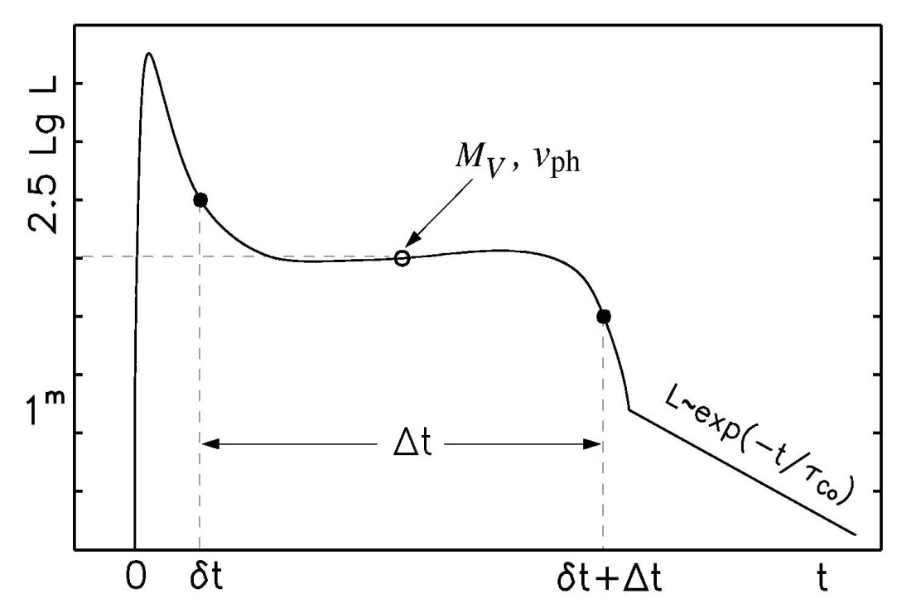
Physical parameters of core collapse SNe
Light curve shape and the velocity evolution can give an indication of the total explosion energy, the mass and the initial radius of the explosion
Observables:
length of plateau phase Δt
luminosity of the plateau L_{V}
velocity of the ejecta v_{ph}
E ∝Δt⁴·v_{ph}⁵·L⁻¹
M∝Δt⁴·v_{ph}³·L⁻¹
R ∝Δt⁻²·v_{ph}⁻⁴·L²

Slide 38
Expanding Photosphere Method
Modification of Baade-Wesselink method for variable stars
Assumes
Sharp photosphere → thermal equilibrium
Spherical symmetry → radial velocity
Free expansion
Kirshner & Kwan 1974

Slide 39
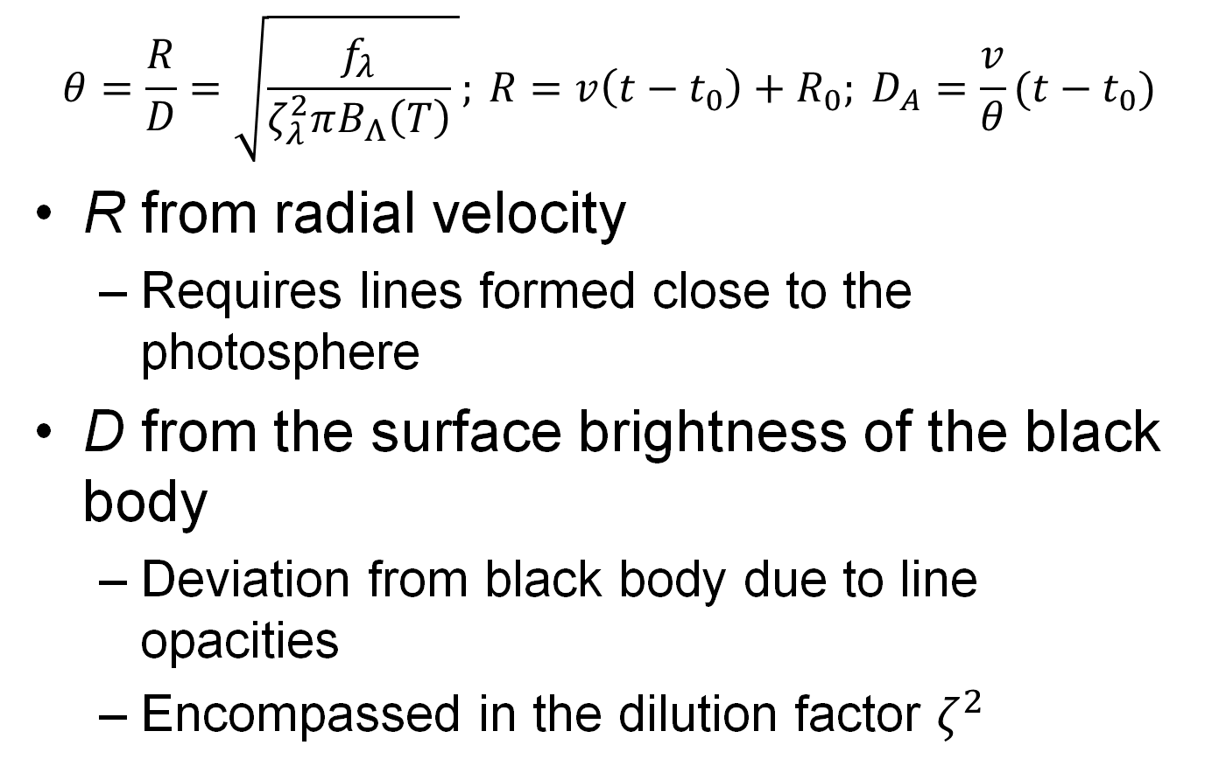
Expanding Photosphere Method
$$θ=\frac{R}{D}=\sqrt{\frac{f_{λ}}{ζ_{λ}^{2}πB_{Λ}\left(T\right)} }; {R=v\left(t−t_{0}\right)+R_{0}; D}_{A}=\frac{v}{θ}(t−t_{0})$$
R from radial velocity
Requires lines formed close to the photosphere
D from the surface brightness of the black body
Deviation from black body due to line opacities
Encompassed in the dilution factor $ζ^{2}$

Slide 40



Expanding Photosphere Method
$$\frac{Θ}{v}=\frac{1}{D_{A}}(t−t_{0})$$
It’s all in the data...
Gall et al. 2018
$$Θ/v$$
$$Θ/v$$
t-t₀
t-t₀

Slide 41
Preliminary Results
Consistent results
not independent as local calibration required
Gall et al. 2018

Slide 42
Expanded Photosphere Method Reloaded
Use individual atmospheric models for the spectral fits
use of the TARDIS radiation transport model
absolute flux emitted
Accurate explosion date
accurate zero point
At least 5 epochs per supernova

Slide 43
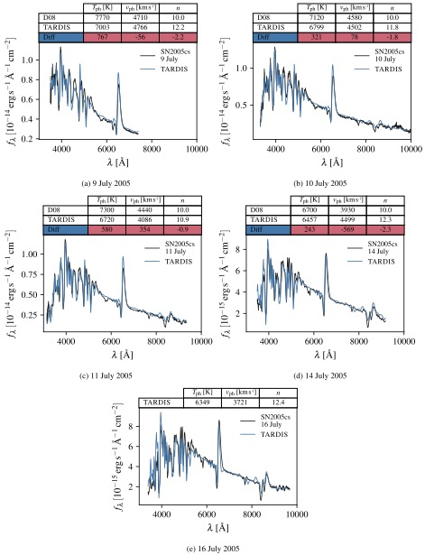
Atmosphere Models
TARDIS fits for different epochs
Vogl et al. 2020

Slide 44
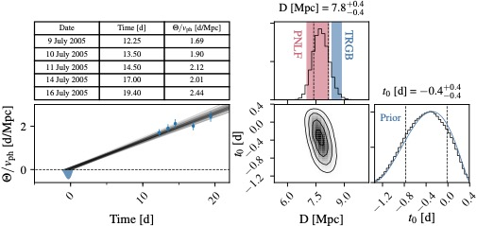

Distance Determination
Slope is inverse distance: $\frac{Θ}{v}=\frac{1}{D_{A}}(t−t_{0})$
Vogl et al. 2020

Slide 45
adH0cc
“accurate determination of H0 with core-collapse supernovae”
Use the Expanding Photosphere Method to ~30 Type II supernovae in the Hubble flow (0.03<z<0.1)
Independent of distance ladder
no parallaxes, no Cepheids, no Type Ia supernovae
FORS2 Large Programme over 3 semesters
6 epochs spectroscopy and photometry per supernova
8 SNe followed in first semester (P104)
currently on hold
SNFactory data
about 15 SNe with 0.01<z<0.05

Slide 46
adH0cc
Critical observables
time of explosion
spectral coverage
before max until well into the plateau
photometry
simulatenously to spectroscopy
C. Vogl 2020

Slide 47
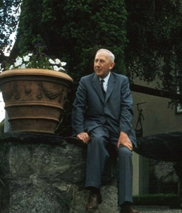
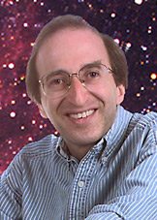
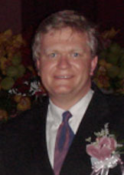
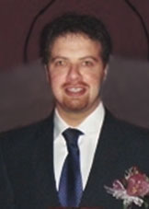
Conclusions
Hubble constant sets absolute scale (and age) of the universe
Past conflicts resolved
Age of Universe is bigger than age of the Earth
recognition of different stellar populations
Age of Universe bigger than oldest stars
cosmological constant

Slide 48
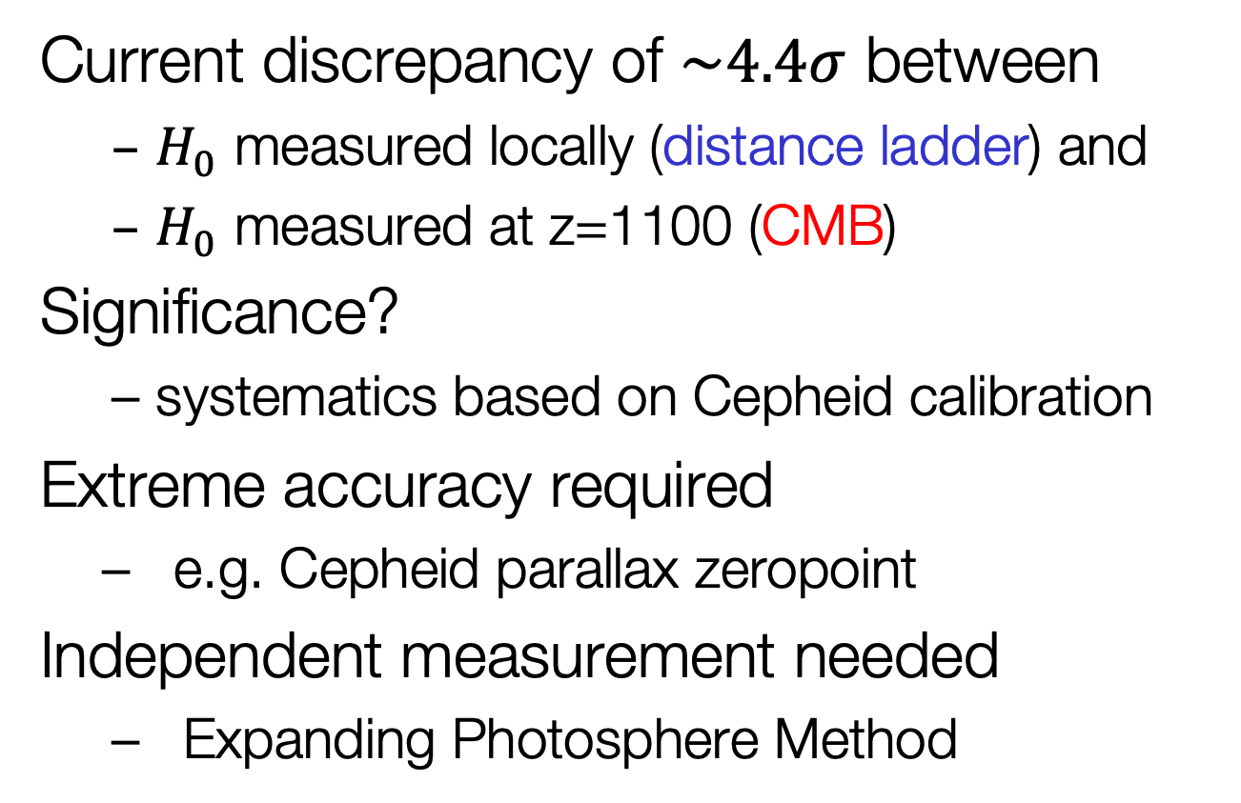
Conclusions
Current discrepancy of $\sim 4.4σ$ between
$H_{0}$ measured locally (distance ladder) and
$H_{0}$ measured at z=1100 (CMB)
Significance?
systematics based on Cepheid calibration
Extreme accuracy required
e.g. Cepheid parallax zeropoint
Independent measurement needed
Expanding Photosphere Method

