Slide 1
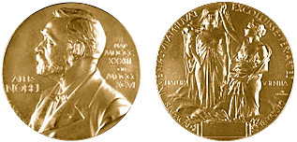
Supernova cosmology: legacy and future
Bruno Leibundgut
ESO

Slide 2

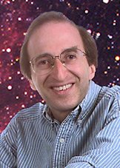
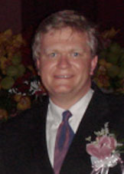
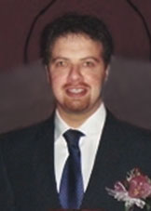
Congratulations!
"for the discovery of the accelerating expansion of the Universe through observations of distant supernovae"

Slide 3
What do we want to learn about supernovae?
What explodes?
  progenitors, evolution towards explosion
How does it explode?
  explosion mechanisms
Where does it explode?
  environment (local and global)
  feedback
What does it leave behind?
  remnants
  compact remnants
  chemical enrichment
Other use of the explosions
  light beacons
  distance indicators
  chemical factories

Slide 4
What do we want to learn about supernovae?
What explodes?
  progenitors, evolution towards explosion
How does it explode?
  explosion mechanisms
Where does it explode?
  environment (local and global)
  feedback
What does it leave behind?
  remnants
  compact remnants
  chemical enrichment
Other use of the explosions
  light beacons
  distance indicators
  chemical factories
deep imaging
late phases?
deep imaging/
integral-field spectroscopy
deep imaging
high resolution spectroscopy
faint object photometry
faint object spectroscopy

Slide 5
Supernova Cosmology
Required observations
  light curve
  spectroscopic classification
  redshift
Required theory
  cosmological model
  (supernova explosions and light emission)
Required phenomenology
  calibrations (photometric systems)
  normalisations (light curve fitters)

Slide 6
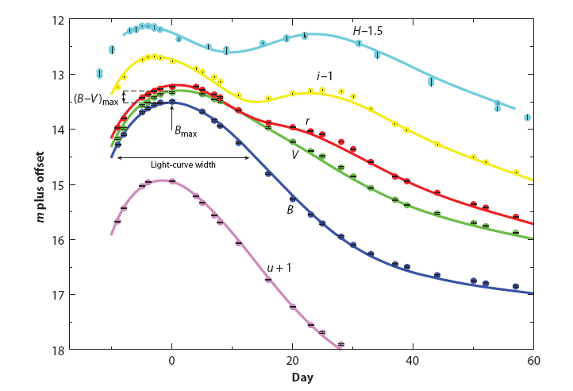
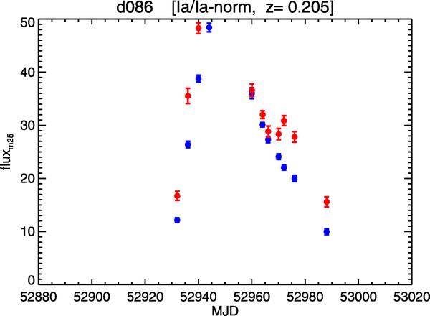
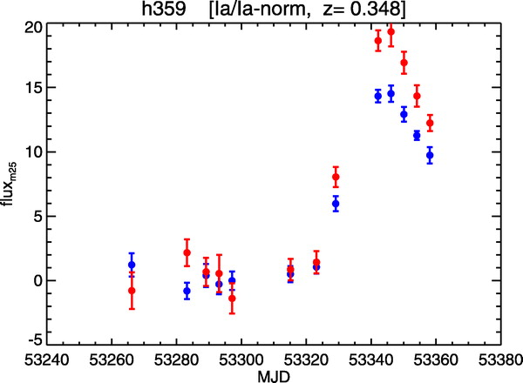
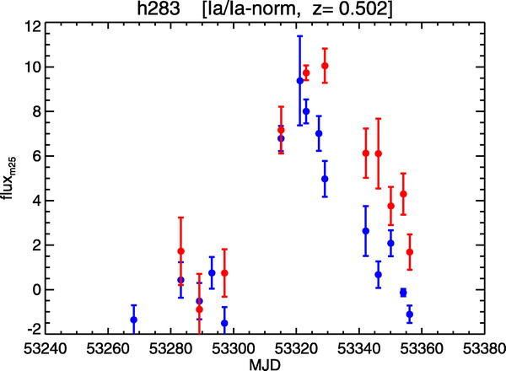
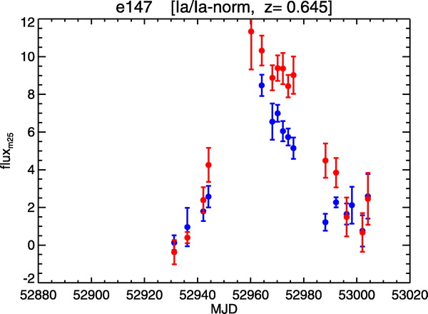
Required observations
Light curves
SN 2007af
Stritzinger et al., in prep
Miknaitis et al. 2007
Miknaitis et al. 2007

Slide 7
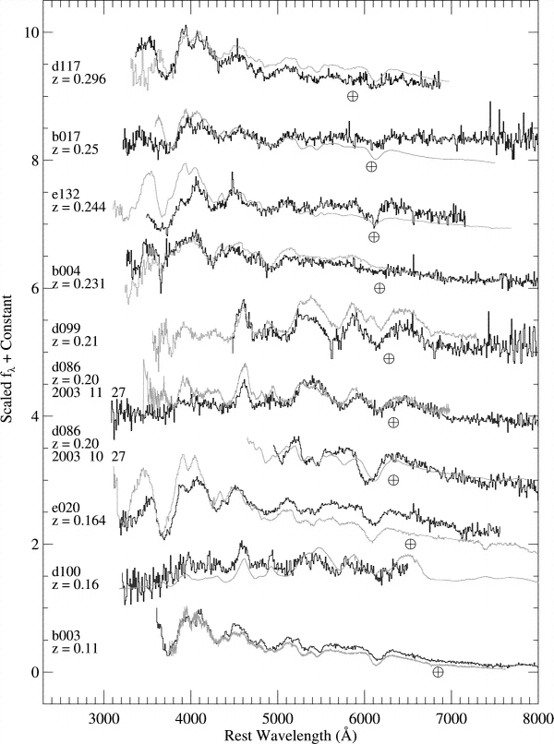
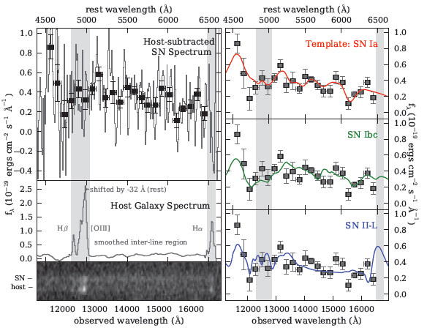
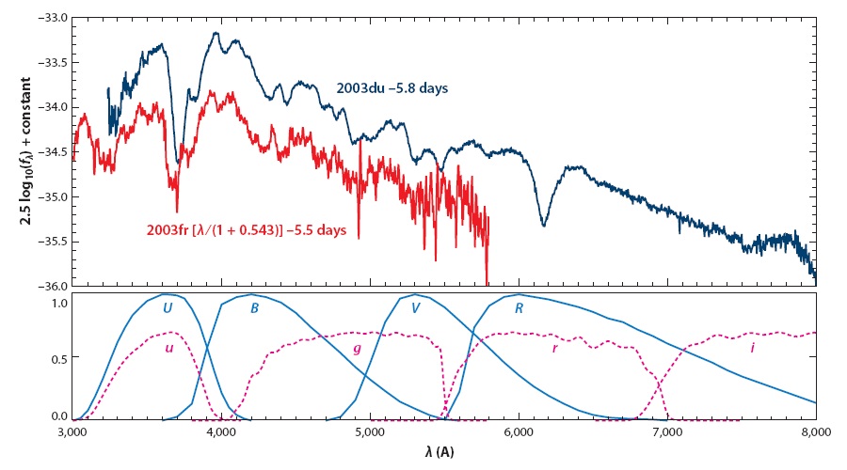
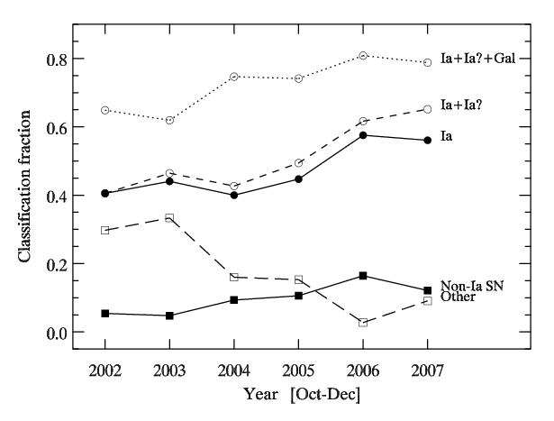
Required observations
Matheson et al. 2007
Spectroscopic
classification
Rodney et al. 2012
Blondin et al., in prep.

Slide 8
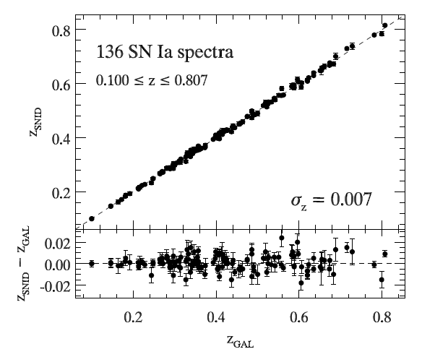
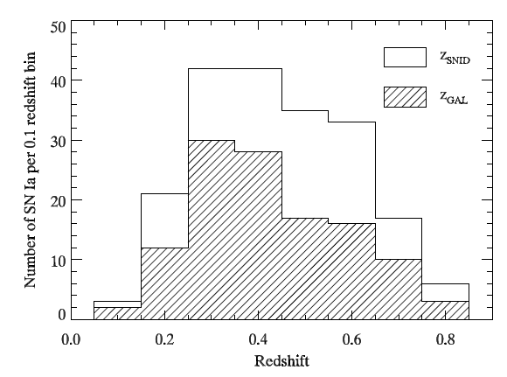
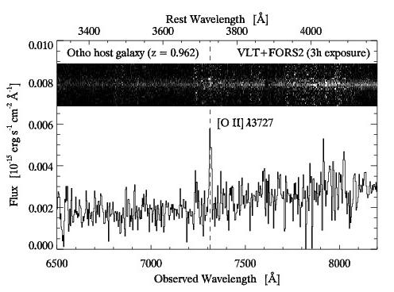
Required observations
Redshifts
Blondin et al., in prep.
Blondin et al., in prep.
Courtesy: Stéphane Blondin

Slide 9
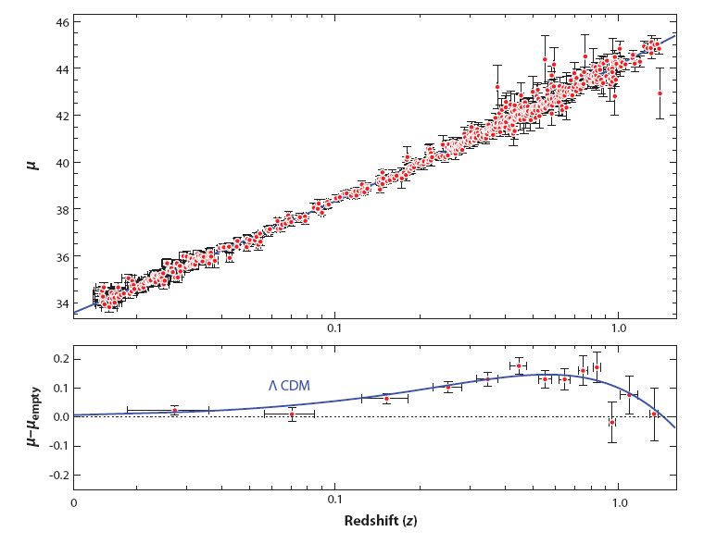
Supernova Cosmology
Published data sets as of January 2011
Union2 data set (557 SNe Ia)
Goobar & Leibundgut 2011

Slide 10
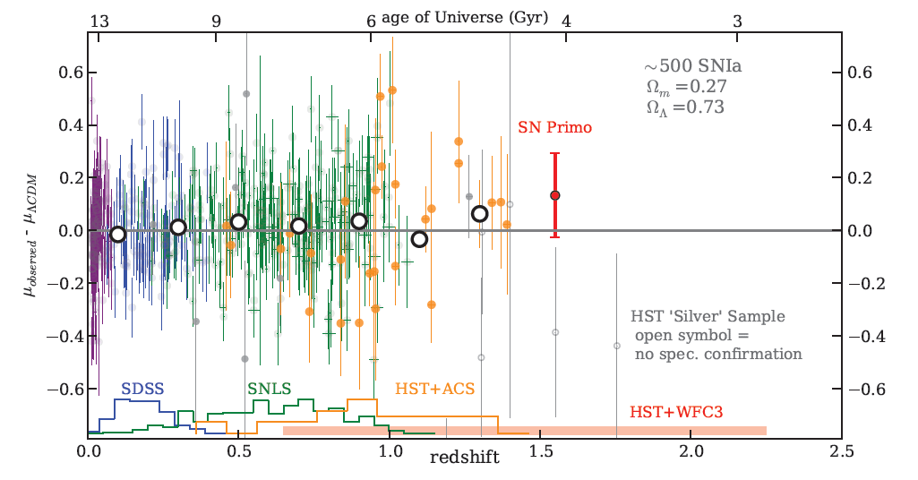
A more recent Hubble diagram
Rodney et al. 2012

Slide 11
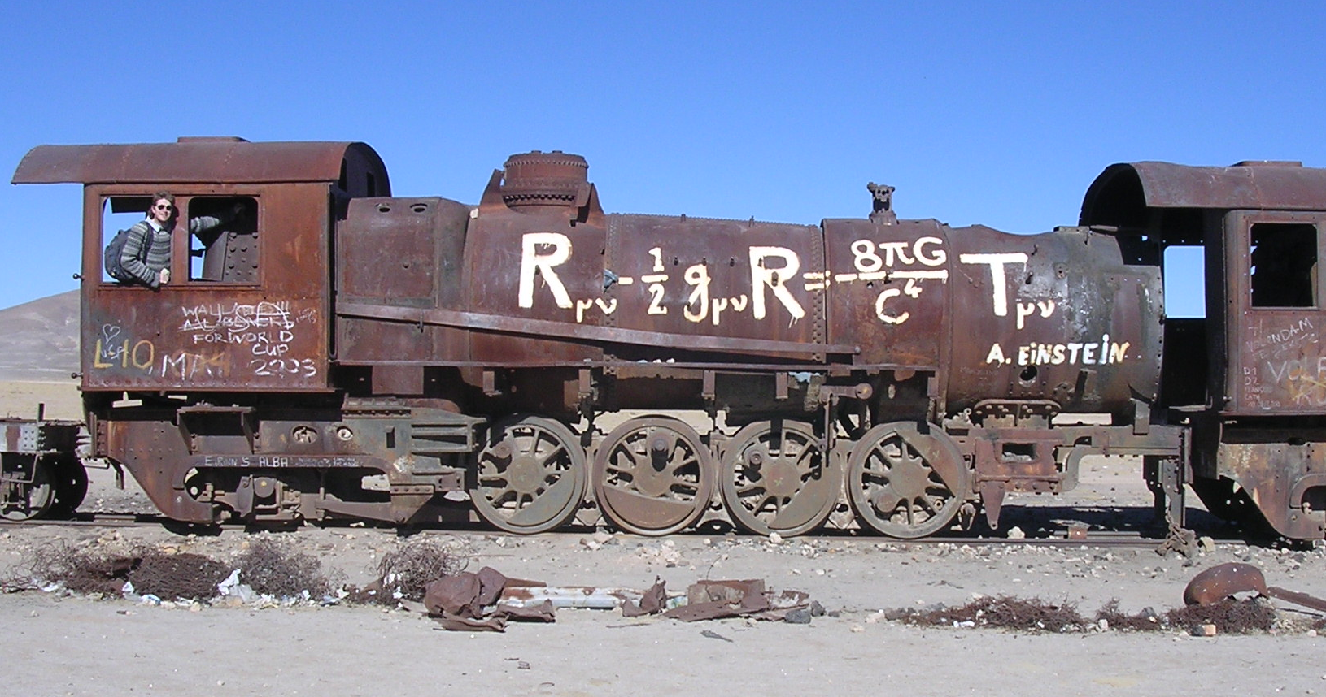
Cosmological model
Theory of Gravity

Slide 12
Cosmological model
Assume isotropy and homology
  Friedmann-Lemaître model
for an example of a model-independent interpretation see Sandra Benitez-Herrera’s talk

Slide 13
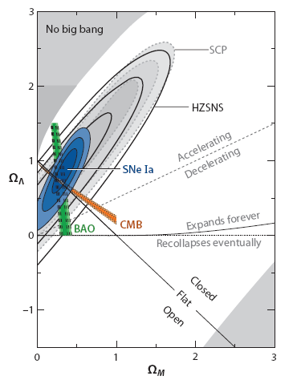
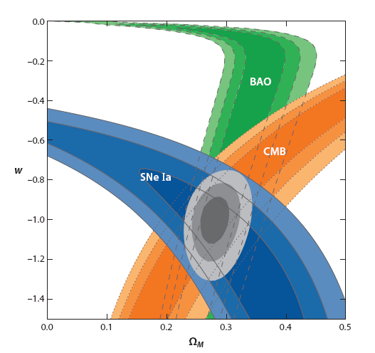
et voilà ...
10 years of progress
Goobar & Leibundgut 2011

Slide 14
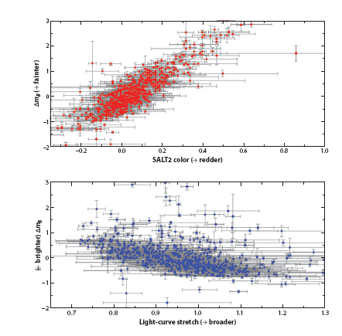
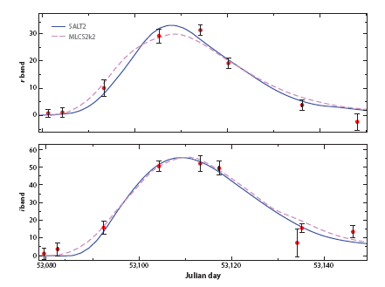
Required phenomenology
photometric calibration
  see Marek Kowalski’s talk
normalisation
  (“standardisable
  candle”;
  “standard crayon”)
  different light curve
  fitters
    Δm₁₅,SALT, SiFTO,
    MLCS
Goobar & Leibundgut 2011
SNLS SN04D2gp
z=0.732

Slide 15
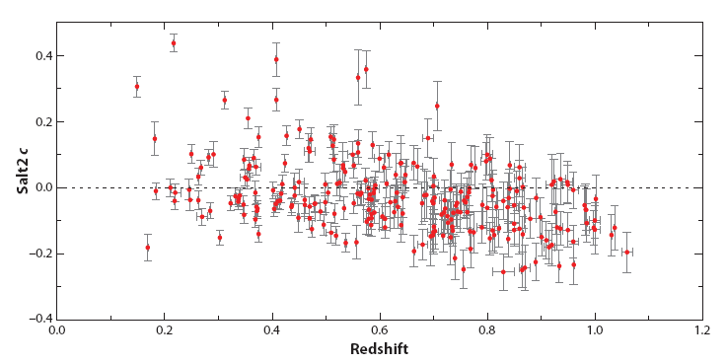
Required phenomenology
Checks
  selection effects? evolution?
Goobar & Leibundgut 2011

Slide 16
Systematics
Current questions
  calibration
  restframe UV flux
    redshifted into the observable window
  reddening and absorption
    detect absorption
      through colours or spectroscopic indicators
    correct for absorption
      knowledge of absorption law
  light curve fitters
  selection bias
    sampling of different populations
  gravitational lensing
  brightness evolution

Slide 17
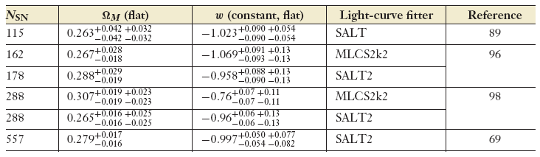
Supernova cosmology
ω firmly established
  general agreement between different experiments
Astier et al. 2006
Wood-Vasey et al. 2007
Kessler et al. 2009
Amanullah et al. 2010
580
SALT2
Suzuki et al. 2011

Slide 18
What next?
Already in hand
  >1000 SNe Ia for cosmology
  constant ω determined to 5%
  accuracy dominated by systematic effects
Missing
  good data at z>1
    light curves and spectra
  good infrared data at z>0.5
    cover the restframe B and V filters
    move towards longer wavelengths to reduce absorption effects
  I-band Hubble diagram
    Freedman et al.
    Nobili et al.

Slide 19
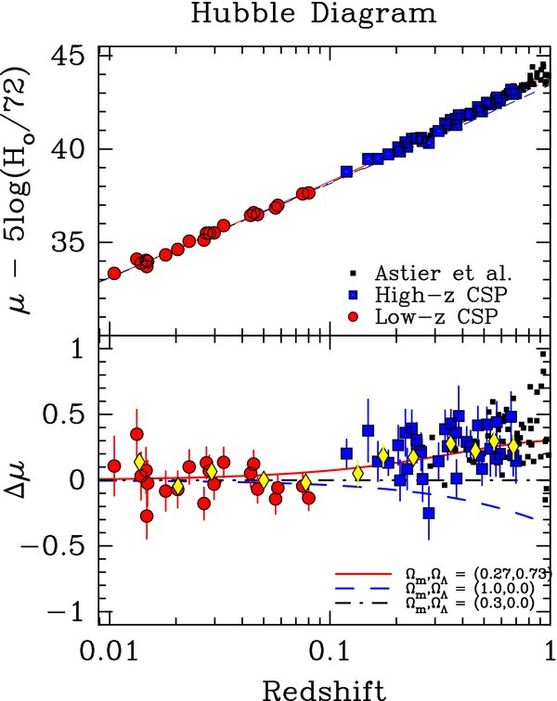
I-band Hubble diagram
Freedman et al. 2009
Currently only 35 SNe Ia
Union2 data set (557 SNe Ia)
Goobar & Leibundgut 2011

Slide 20
Supernova Cosmology – do we need more?
Test for variable ω
  required accuracy ~2% in individual distances
  can SNe Ia provide this?
    can the systematics be reduced to this level?
    homogeneous photometry?
    further parameters (e.g. host galaxy metalicity)
    handle >100000 SNe Ia per year?
Euclid
  3000 SNe Ia to z<1.2 with IR light curves (deep fields) → I-band Hubble diagram
  16000 SNe discovered

Slide 21
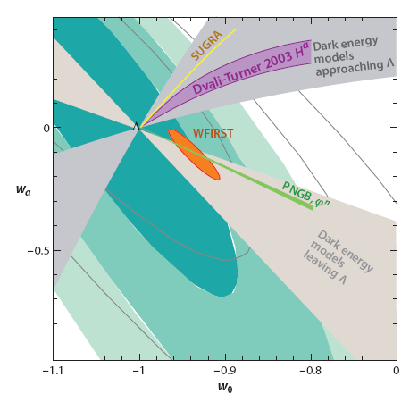
Cosmology – more?
Goobar & Leibundgut 2011
(courtesy E. Linder and J. Johansson)

Slide 22


Distant SNe with
CANDELS and CLASH
Multi-cycle HST Treasury Programs
PIs: S. Faber/H. Fergusson
PI: M. Postman
HST MCT SN Survey
PI: A. Riess
SN discoveries and target-of-opportunity follow-up
SNe Ia out to z≈2
Determine the SN rate at z>1 and
constrain the progenitor systems

Slide 23
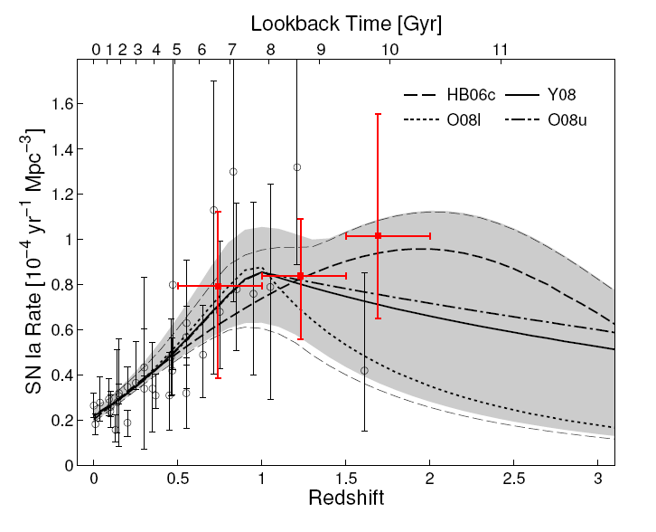
SN rates and what they can tell us
Graur et al. 2011

Slide 24
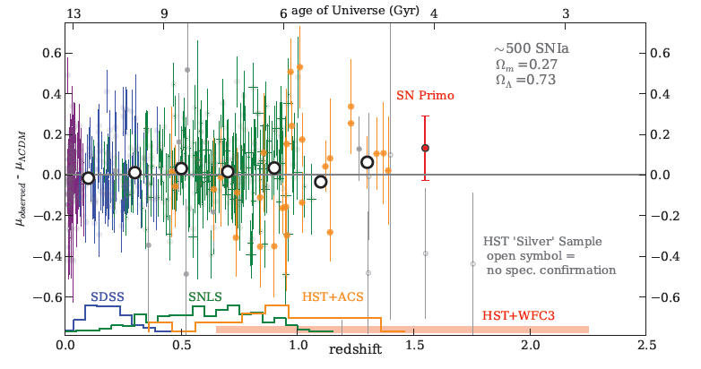
SNe at z>1
First SN Ia at z=1.55 “Primo”
Rodney et al. 2012

Slide 25
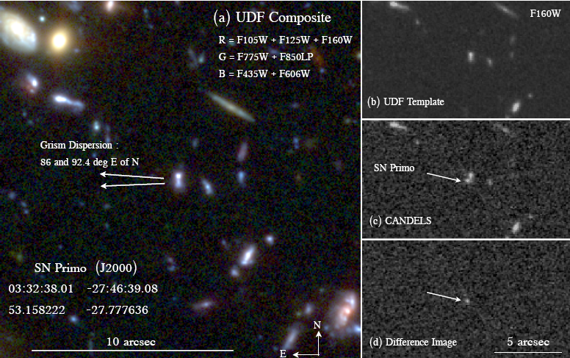
Discovery
Rodney et al. 2012

Slide 26
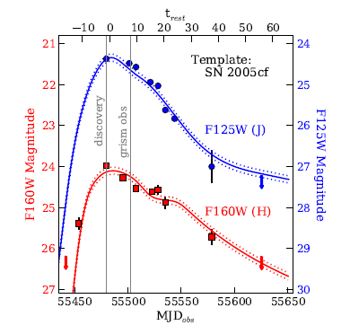
Light curve
WFC3 IR light curves
Rodney et al. 2012

Slide 27
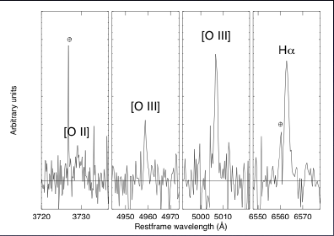
Spectroscopy
VLT spectrum of host galaxy
  X-shooter (Frederiksen et al., in prep.)

Slide 28
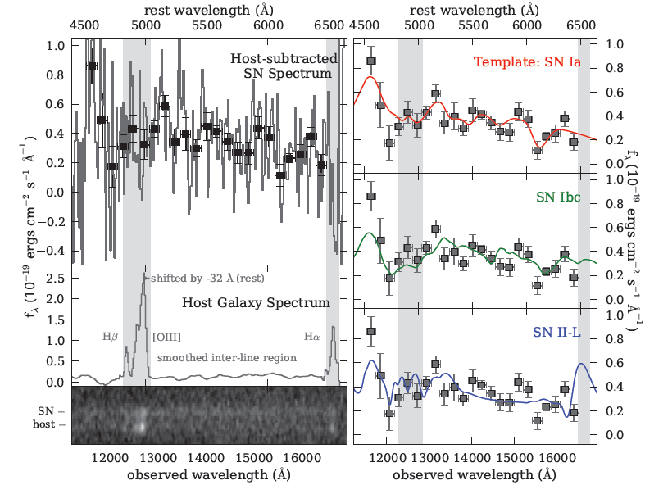
Spectroscopy
SN spectroscopy with ACS grism
Rodney et al. 2012

Slide 29
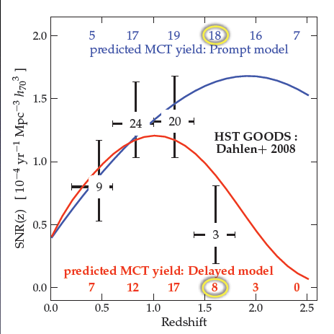
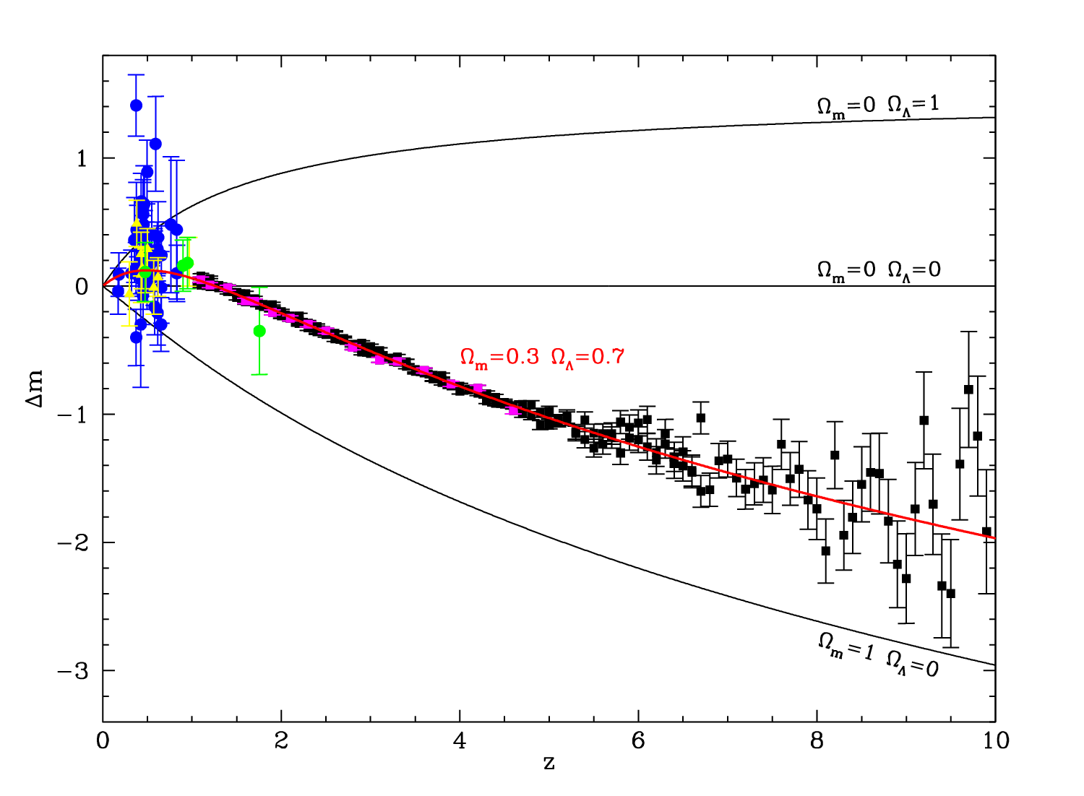
Distant SNe
Steve Rodney; MCT SN Survey
can we do this?
  plot assumes:
    100m OWL
    SNe Ia out to
    z=5 (?)
    SN II can be
    used as good
    distance
    indicators
Della Valle et al. 2005

Slide 30
Distant SNe
Fill the redshift range z>1
  (will this not have been done by 2020?)
Courtesy: Stéphane Blondin

Slide 31
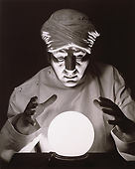
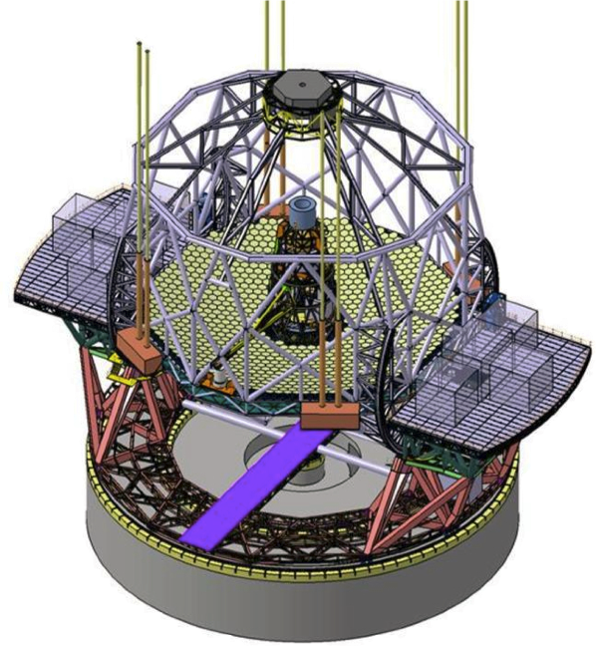
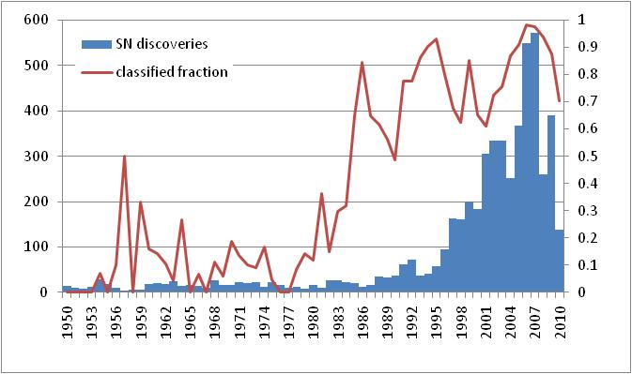
Predicting the future ...
What will we know about
supernovae 10 years from now?
  ~5400 SNe reported until end of 2009
  expect up to
  100000 SNe (?)
  for the coming
  decade
    PanSTARRS,
    PTF/PTF2,
    LSST

Slide 32
Summary
Concentrate on λ not covered so far
  particular IR is interesting
    reduced effect of reddening
    better behaviour of SNe Ia(?)
Understand the SN zoo
  many (subtle?) differences observed in recent samples (PanSTARRS and PTF)
    subluminous and superluminous
    see S. Taubenberger’s poster for a prominent example (SN 2009dc)
  understand potential evolutionary effects
    spectroscopy important → PESSTO
    DES?, LSST?, Euclid follow-up?

