Slide 1
An independent way to measure extragalactic distances
SN 2019vew
ZTF/PanSTARRS
Vogl et al. 2020
Bruno Leibundgut (ESO)
C. Vogl 2020

Slide 2
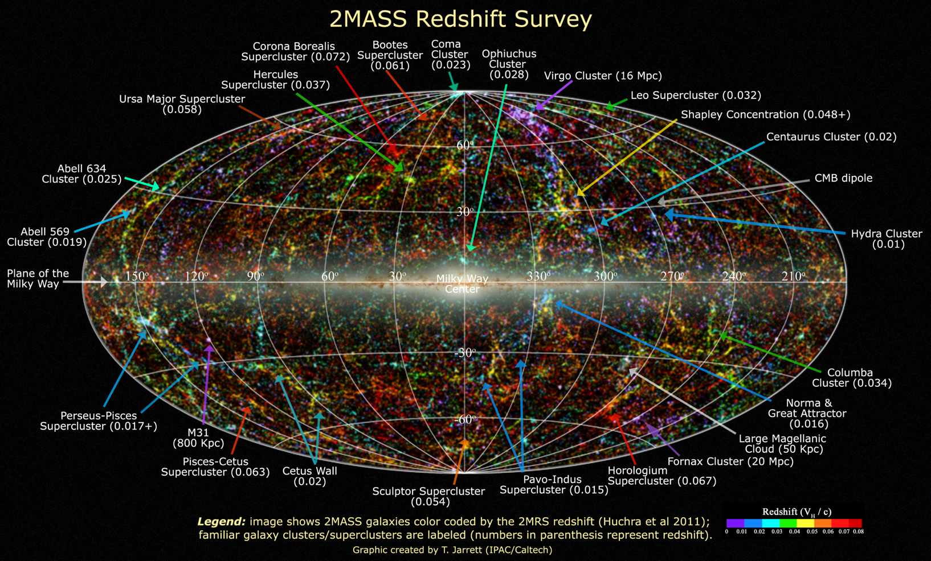
Extragalactic Distances
Required for a 3D picture of the (local) universe

Slide 3
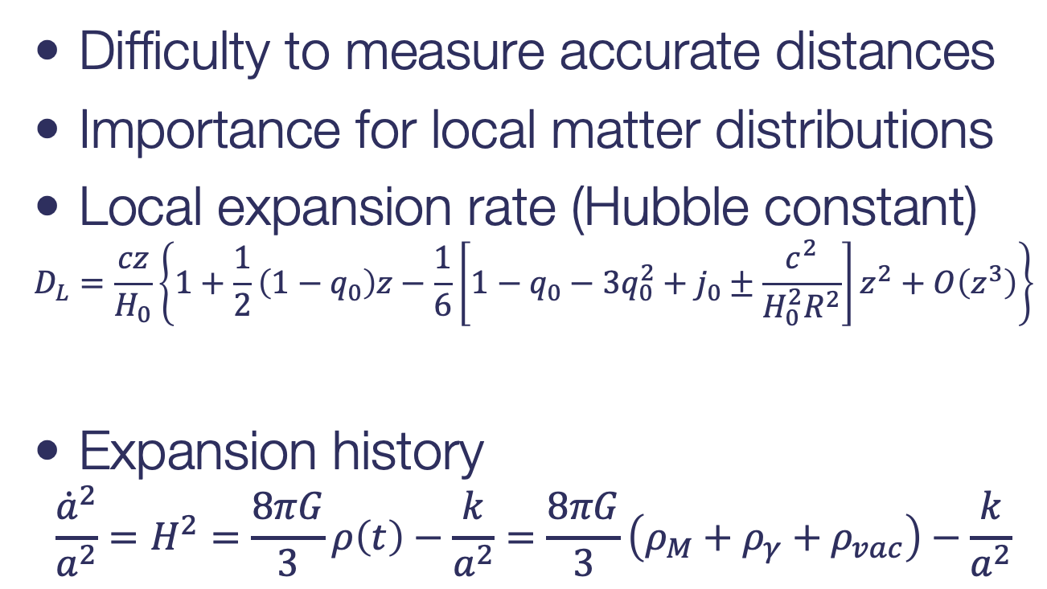
Extragalactic Distances
Difficulty to measure accurate distances
Importance for local matter distributions
Local expansion rate (Hubble constant)
$$D_{L}=\frac{cz}{H_{0}}\left\{1+\frac{1}{2}\left(1−q_{0}\right)z−\frac{1}{6}\left[1−q_{0}−3q_{0}^{2}+j_{0}±\frac{c^{2}}{H_{0}^{2}R^{2}}\right]z^{2}+O\left(z^{3}\right)\right\}$$
Expansion history
$$\frac{{\dot{a}}^{2}}{a^{2}}=H^{2}=\frac{8πG}{3}ρ\left(t\right)−\frac{k}{a^{2}}=\frac{8πG}{3}\left(ρ_{M}+ρ_{γ}+ρ_{vac}\right)−\frac{k}{a^{2}}$$
Hubble- Lemaître Law
deceleration
jerk/equation of state

Slide 4
Extragalactic Distances

Slide 5
Local Flows
Inhomogeneous mass distribution in the local Universe
Pomarède et al. 2020

Slide 6
Hubble Constant(s)
Riess et al. 2019
Planck 2018

Slide 7
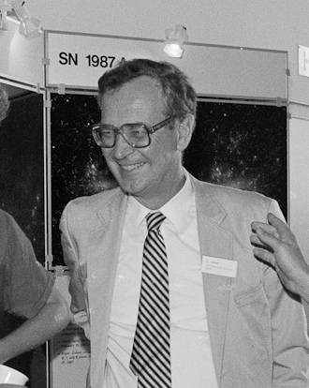

Measuring $H_{0}$
Classical approach
→ distance ladder to reach (smooth) Hubble flow
Sandage & Tammann 1974

Slide 8
Extragalactic Distances
Many different methods
Galaxies
Mostly statistical
Secular evolution, e.g. mergers
Baryonic acoustic oscillations
Supernovae
Excellent (individual) distance indicators
Three main methods
(Standard) luminosity, aka ’standard candle’
Expanding photosphere method
Angular size of a known feature

Slide 9
Hubble Constant
Three different methods
Distance ladder
Calibrate next distance indicator with the previous
Physical methods
Determine either luminosity or length through physical quantities
Lens delays
Sunyaev-Zeldovich effect (galaxy clusters)
Expanding photosphere method in supernovae
Physical calibration of thermonuclear supernovae
Geometric methods, e.g. masers
Global solutions
Use knowledge of all cosmological parameters
Cosmic Microwave Background

Slide 10
Classic Distance Ladder
Primary distance indicators (within the Milky Way)
trigonometric parallax
proper motion
apparent luminosity
main sequence
red clump stars
RR Lyrae stars
eclipsing binaries
Cepheid stars
Jacoby et al. 1992

Slide 11
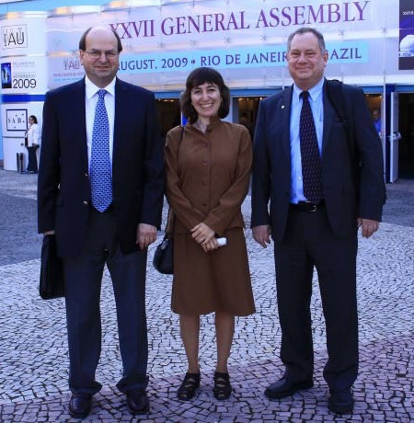
Classic Distance Ladder
Secondary distance indicators (beyond the Local Group)
Important check
Large Magellanic Cloud
Tully-Fisher relation
Fundamental Plane
Supernovae (mostly SN Ia)
Surface Brightness Fluctuations
Gruber Cosmology Prize
Freedman & Madore 2010
Notes:
Jeremy Mould
Wendy Freedman
Robert Kennicutt

Slide 12
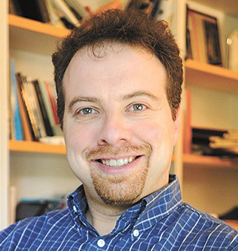
Hubble Constant
Calibration of M(SN Ia @ max)
Distance ladder
Adam Riess

Slide 13
Hubble Constant
Supernova Ia Hubble diagram

Slide 14
Problem solved?
University of Chicago
New discrepancy between the measurements of the local H₀ (distance ladder) and early universe (CMB)
Indication of an incomplete model of cosmology?
Freedman et al. 2019

Slide 15
Gravitational Lenses
Sherry Suyu (J. Wiedersich / TUM)
H0LICOW collaboration
Wong et al. 2020

Slide 16
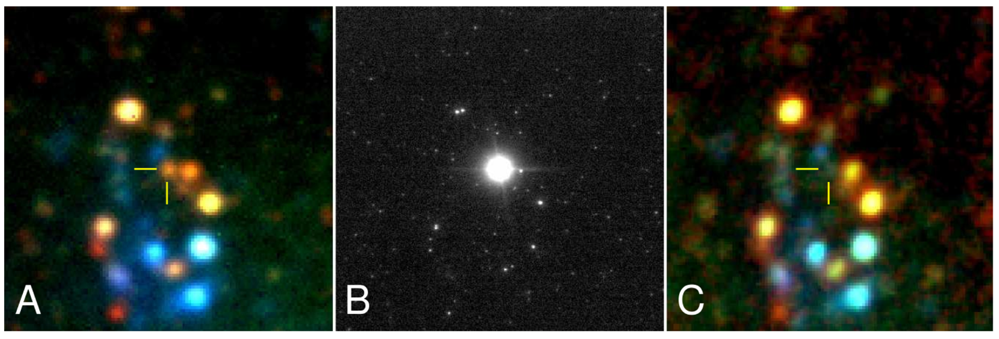
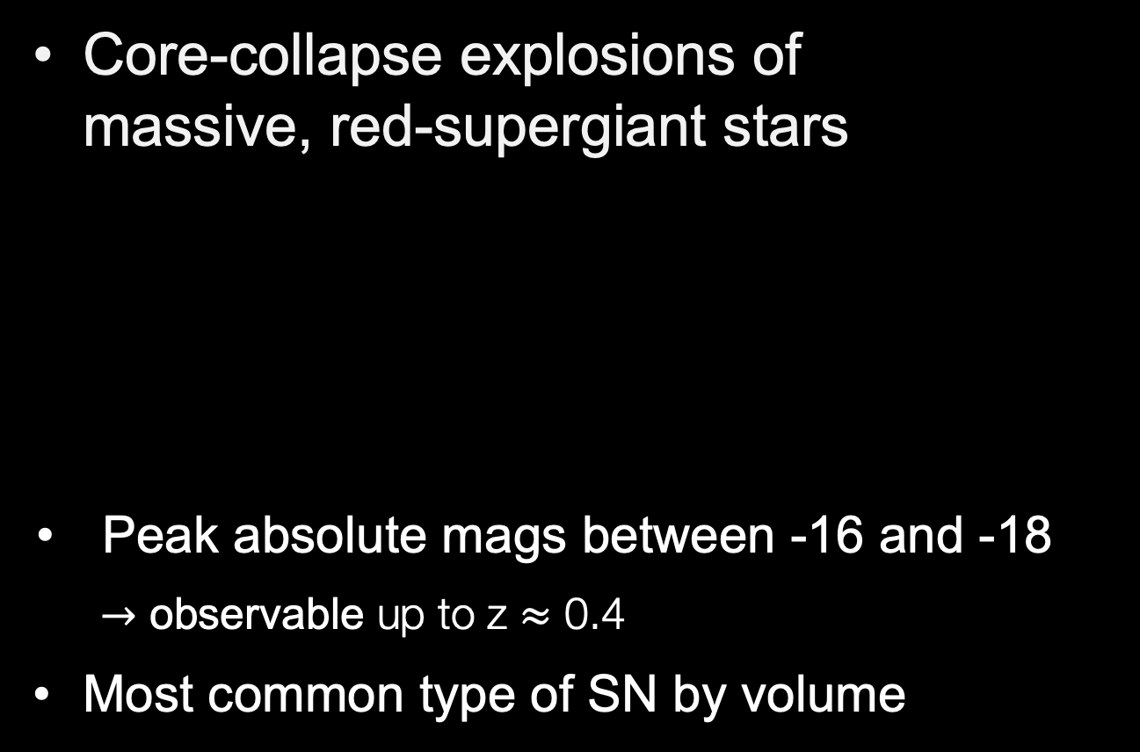
Type II Supernovae
Core-collapse explosions of massive, red-supergiant stars
Peak absolute mags between -16 and -18
$→$ observable up to z $≈$ 0.4
Most common type of SN by volume
Mattila et al. 2010

Slide 17
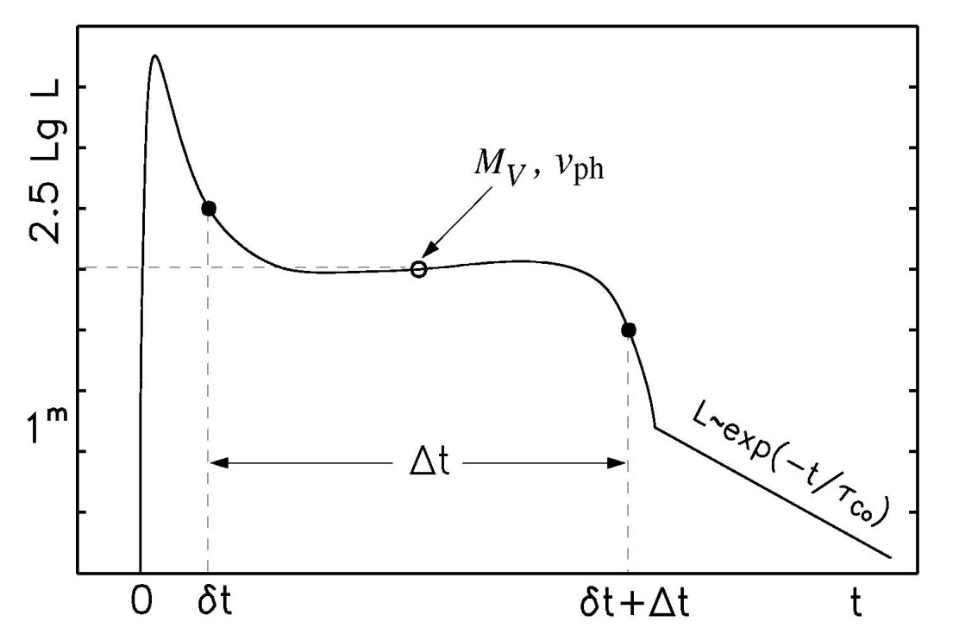

Physical parameters of core collapse SNe
Light curve shape and the velocity evolution can give an indication of the total explosion energy, the mass and the initial radius of the explosion
Observables (e.g. Popov 1993):
length of plateau phase Δt
luminosity of the plateau L_{V}
velocity of the ejecta v_{ph}
$E∝Δt^{4}⋅v_{ph}^{5}⋅L^{0.4}$
$M∝Δt^{4}⋅v_{ph}^{3}⋅L^{0.4}$
$R∝Δt^{−2}{⋅v}_{ph}^{−4}⋅L^{−0.8}$

Slide 18
Expanding Photosphere Method
Modification of Baade-Wesselink method for variable stars
Assumes
Sharp photosphere → thermal equilibrium
Spherical symmetry → radial velocity
Free expansion
Kirshner & Kwan 1974

Slide 19
Expanding Photosphere Method
Line formation in the expanding ejecta
P Cygni line profile
absorption indicates photospheric position
Stéphane Blondin

Slide 20
Spectral Evolution
Changing spectra with time as deeper and deeper layers of the supernova are exposed
SN 2006bp
Quimby et al. 2007

Slide 21
Photospheric Velocity
Evolution from higher to lower expansion velocities
deeper layers within a freely expanding envelope
SN 2006bp; Quimby et al. 2007

Slide 22
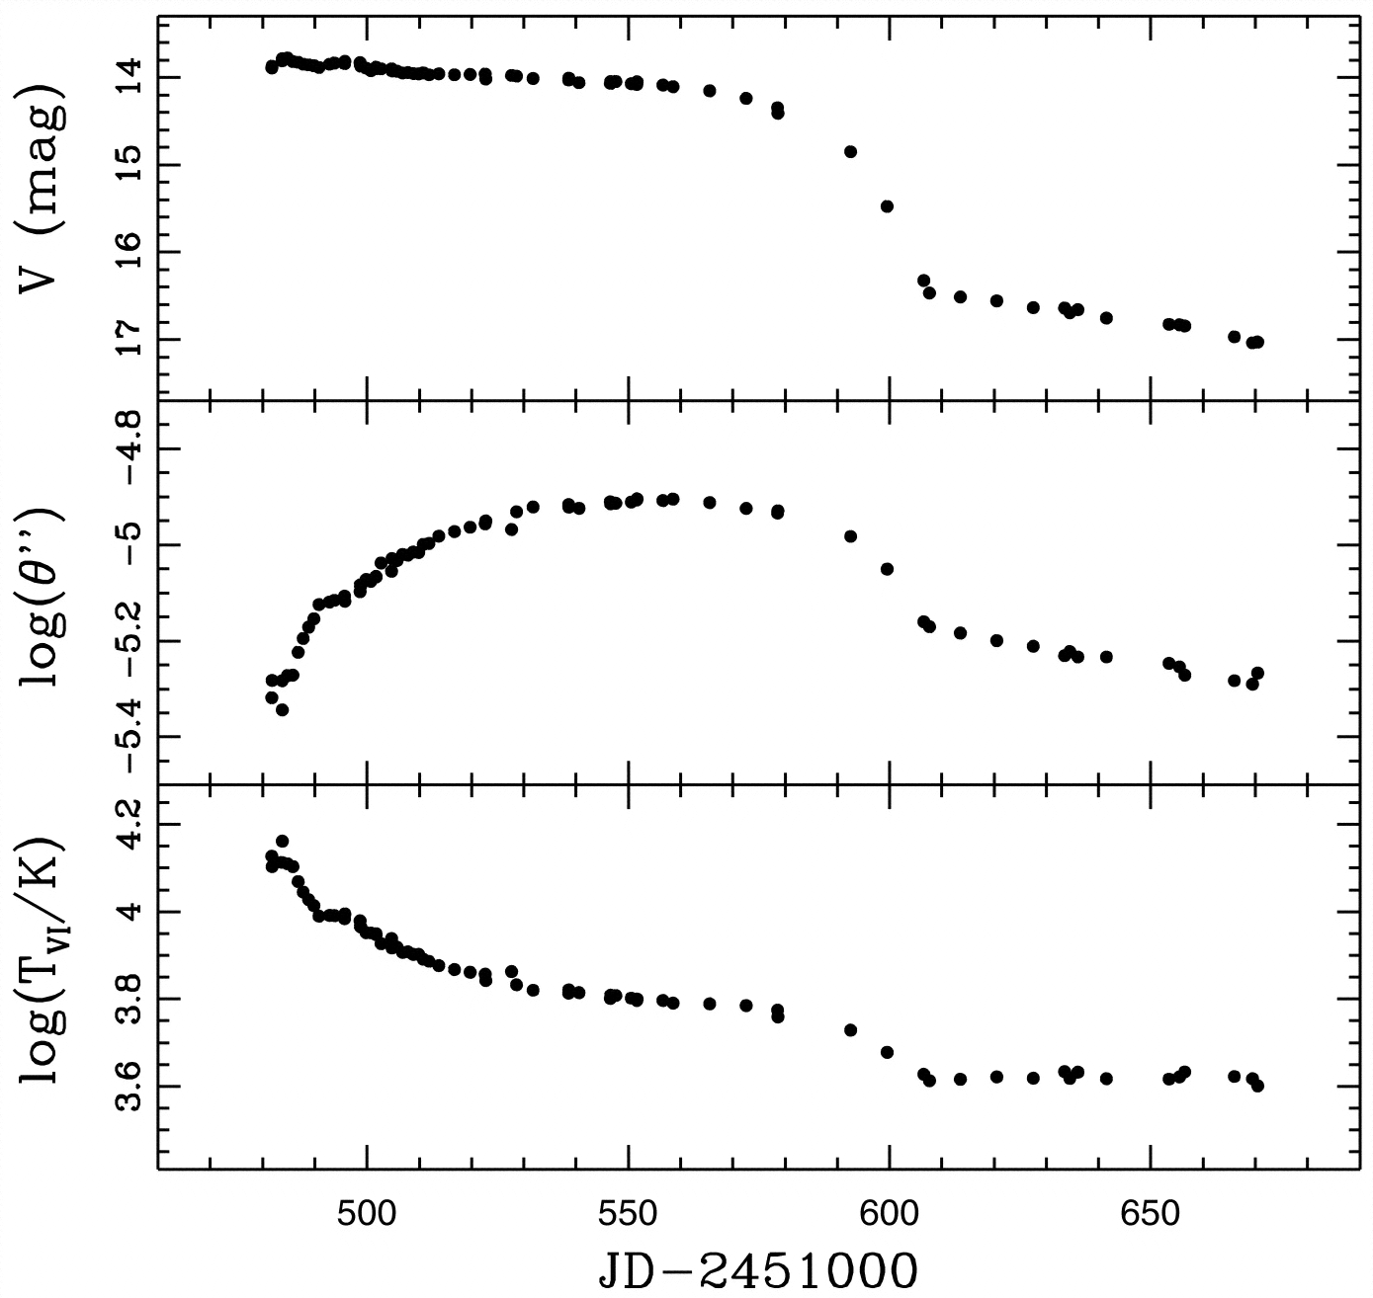
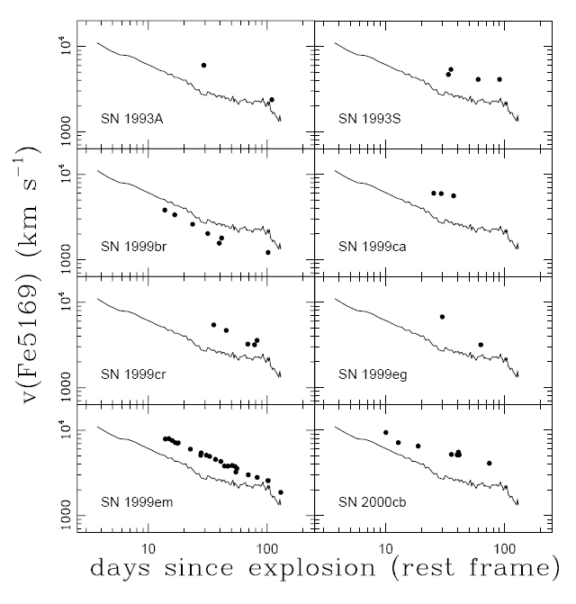
Photosphere Expansion
Hamuy et al. (2001)
Elmhamdi et al. (2003)
luminosity
radius
temperature

Slide 23
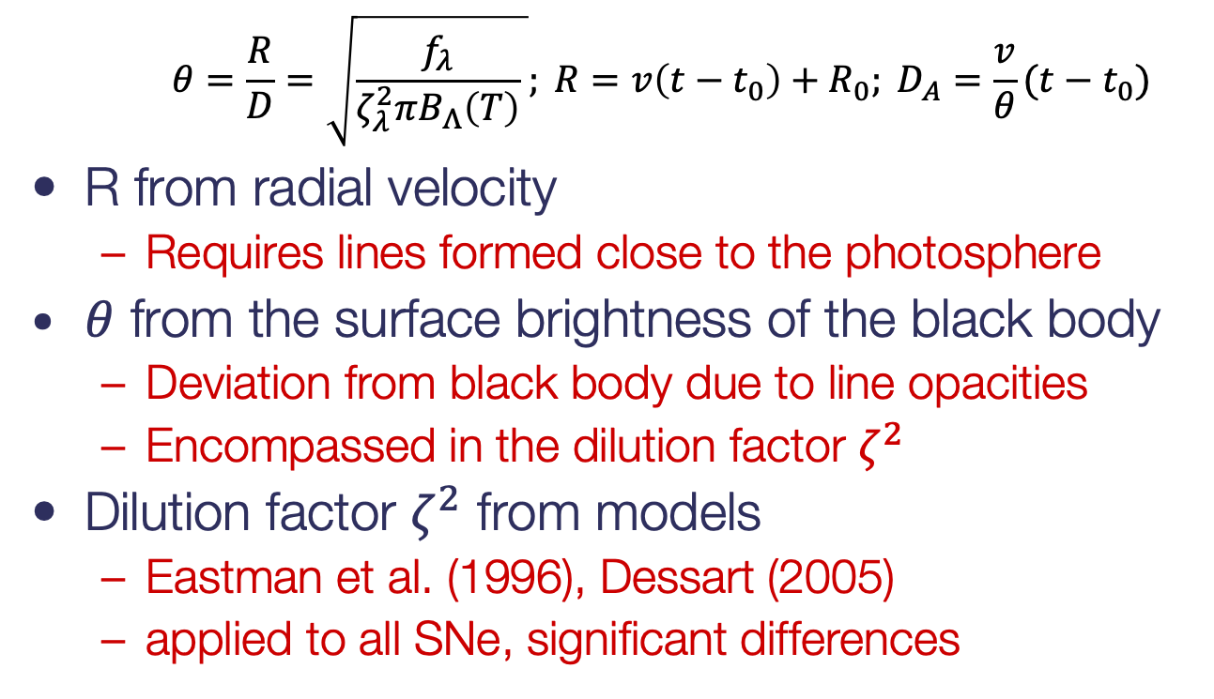
Expanding Photosphere Method
$$θ=\frac{R}{D}=\sqrt{\frac{f_{λ}}{ζ_{λ}^{2}πB_{Λ}\left(T\right)} }; {R=v\left(t−t_{0}\right)+R_{0}; D}_{A}=\frac{v}{θ}(t−t_{0})$$
R from radial velocity
Requires lines formed close to the photosphere
$θ$ from the surface brightness of the black body
Deviation from black body due to line opacities
Encompassed in the dilution factor $ζ^{2}$
Dilution factor $ζ^{2}$ from models
Eastman et al. (1996), Dessart (2005)
applied to all SNe, significant differences

Slide 24
Dilution Factors
Depend on the models and filters
Dessart & Hillier 2005
Vogl et al. 2019

Slide 25
SN 2013eq
z=0.042
Gall et al. 2016

Slide 26
SN 2013eq
Two different dilution factors applied
Hamuy et al. 2001 (H01)
Dessart & Hillier 2005 (D05)
Both give a good distance to SN 1999em, e.g. Jones et al. (2009)
H01
D05

Slide 27


Expanding Photosphere Method
$$\frac{Θ}{v}=\frac{1}{D_{A}}(t−t_{0})$$
It’s all in the data...
Gall et al. 2018
$$Θ/v$$
$$Θ/v$$
t-t₀
t-t₀

Slide 28
…not good enough
Data not constraining for accurate distances
Gall et al. 2018

Slide 29
Expanding Photosphere Method
Main difficulties
Explosion geometry/spherical symmetry
Uniform dilution factors?
Develop tailored spectra for each supernova → Spectral-fitting Expanding Atmosphere Method (SEAM)
Absorption
Observational difficulties
Needs multiple epochs
Spectroscopy to detect faint absorption lines
Accurate photometry

Slide 30
Expanded Photosphere Method Reloaded
Use individual atmospheric models for the spectral fits
use of the TARDIS radiation transport model
absolute flux emitted
Accurate explosion date
accurate zero point
At least 5 epochs per supernova

Slide 31
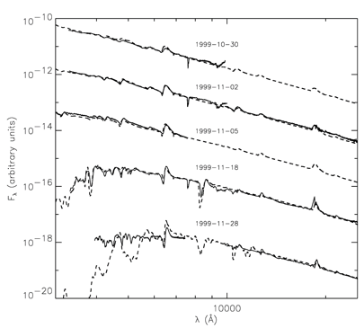


Distances from spectral fits
Spectral-fitting Expanding Atmosphere Method
Baron et al. (95, 96, 2004, 2007), Lentz et al. 2001, Mitchell et al. 2002
Tailored Expanding Photosphere Method
Dessart et al. (2006, 2008)
X, ρ, Lλ, …
$$D_{L}=\sqrt{\frac{L}{4π F}}$$
Baron et al. 2004

Slide 32

TARDIS
Kerzendorf & Sim 2014
bound-free, free-free, collisional processes
Monte Carlo RT
high optical depths
(τ = 20-30)
Blackbody
Inner
Boundary
NLTE and thermal structure
relativistic transport
But: Developed for Type Ia SNe not Type II
Vogl et al. 2019

Slide 33








Parameter determination
Vogl 2020
X_{Fe},…
v_{ph}
T_{ph}
L_{λ}
Current method:
Optimization by hand and eye (e.g., Dessart & Hillier 2006, 2008)
Advantages:
efficiency
uses spectroscopist’s knowledge
Drawbacks:
not reproducible
no uncertainties
infeasible for large datasets

Slide 34
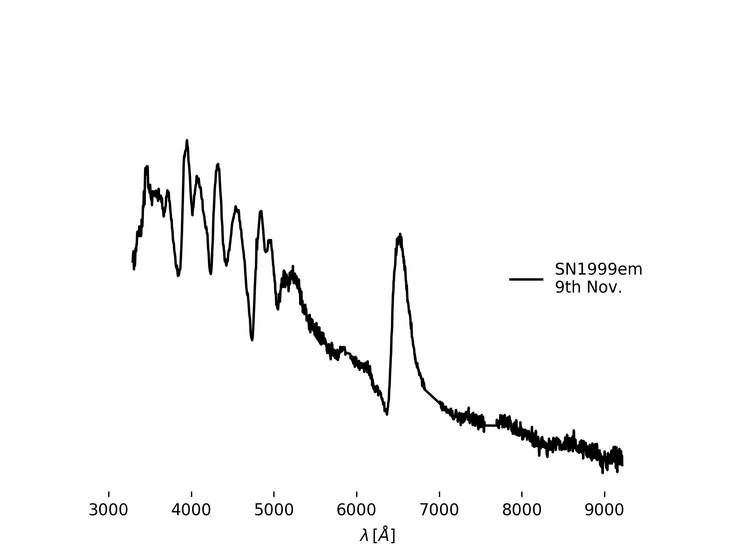



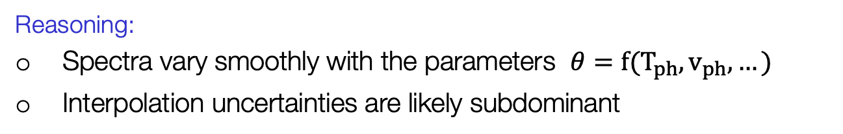
Spectral emulation
~ 1 day per simulation
Vogl 2020
Emulate instead of simulate
e.g. Heitmann et al. 2009, Czekala et al. 2015, Lietzau 2017
Reasoning:
Spectra vary smoothly with the parameters $θ=f(T_{ph}, v_{ph}, …)$
Interpolation uncertainties are likely subdominant

Slide 35
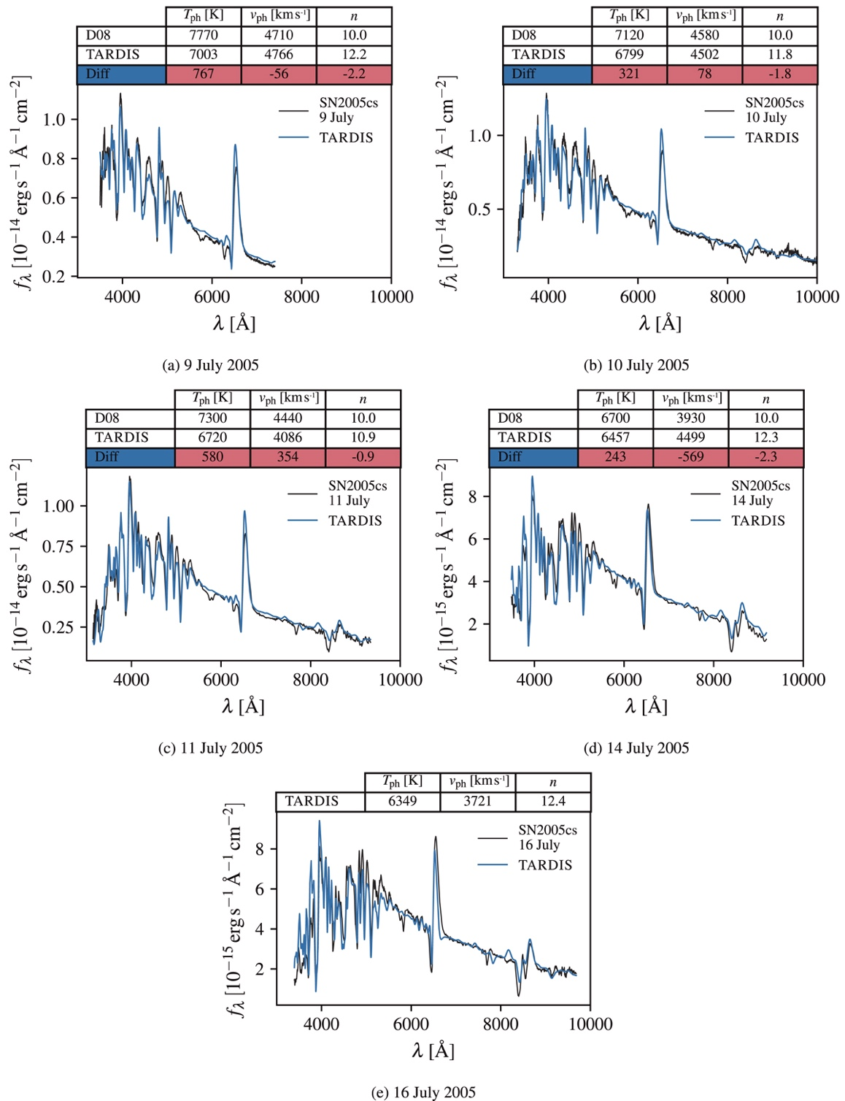
Atmosphere Models
TARDIS fits for different epochs
Vogl et al. 2020

Slide 36
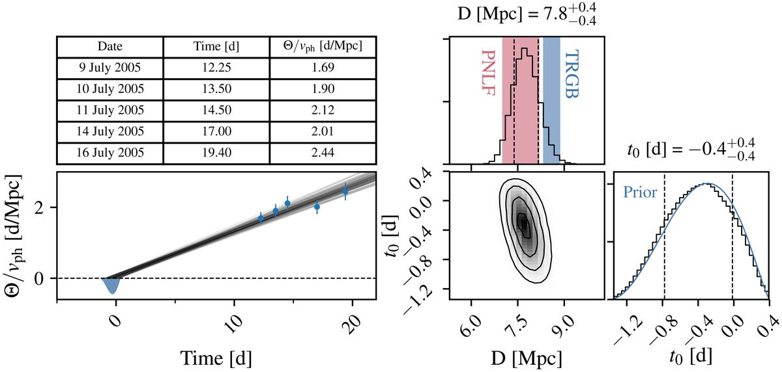

Distance Determination
Slope is inverse distance: $\frac{Θ}{v}=\frac{1}{D_{A}}(t−t_{0})$
Vogl et al. 2020

Slide 37
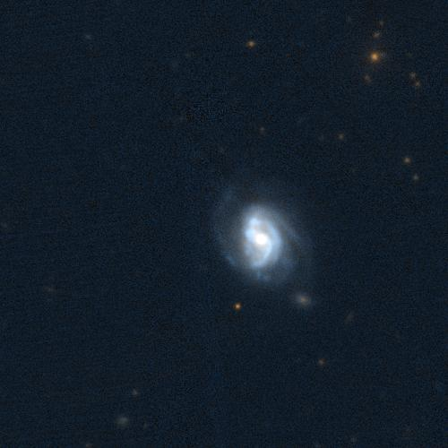
Measuring distances
iPTF13bjx
💥

Slide 38
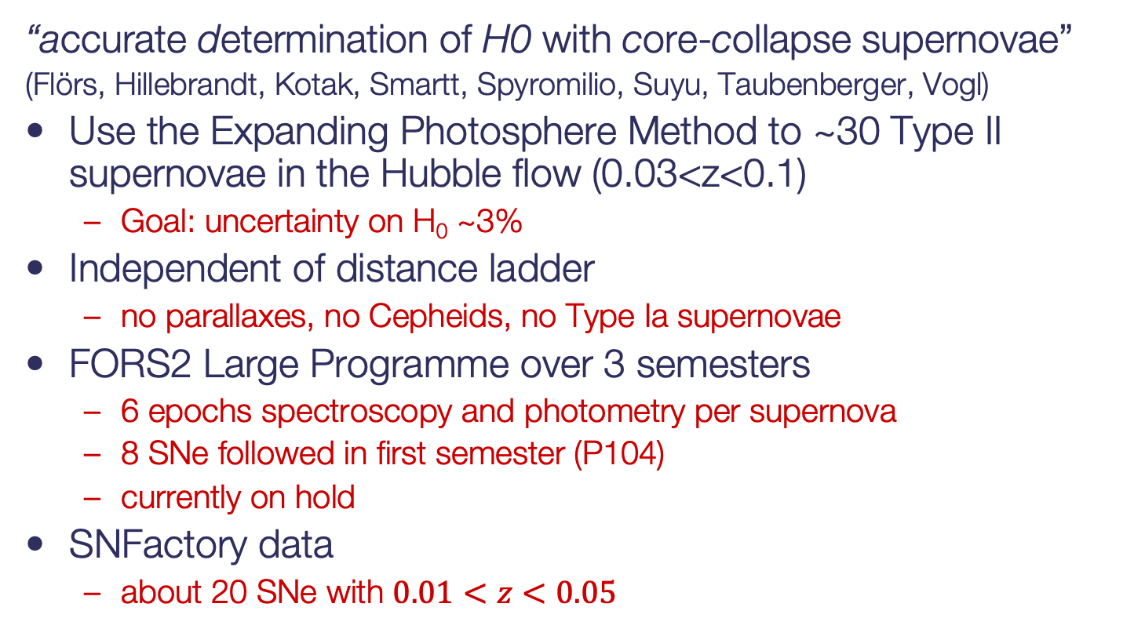
adH0cc
“accurate determination of H0 with core-collapse supernovae”
(Flörs, Hillebrandt, Kotak, Smartt, Spyromilio, Suyu, Taubenberger, Vogl)
Use the Expanding Photosphere Method to ~30 Type II supernovae in the Hubble flow (0.03<z<0.1)
Goal: uncertainty on H₀ ~3%
Independent of distance ladder
no parallaxes, no Cepheids, no Type Ia supernovae
FORS2 Large Programme over 3 semesters
6 epochs spectroscopy and photometry per supernova
8 SNe followed in first semester (P104)
currently on hold
SNFactory data
about 20 SNe with $0.01<z<0.05$

Slide 39
adH0cc
Combination of existing data sample from the SN Factory

Slide 40
adH0cc
Critical observables
time of explosion
spectral coverage
before max until well into the plateau
photometry
simultaneously with spectroscopy
C. Vogl 2020

Slide 41
Summary
Significant progress in spectral fitting
Christian Vogl’s PhD thesis
Vogl et al. 2019, 2020
Importance of the data sampling
explosion dates!
sufficient coverage of the spectral evolution
Redshift range
reach the Hubble flow (z>0.03)
1-stop method to measure H₀
independent of distance ladder
other cosmological parameters (densities)

