Slide 1


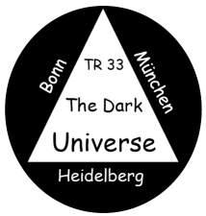
Recent results on supernova cosmology
Bruno Leibundgut

Slide 2
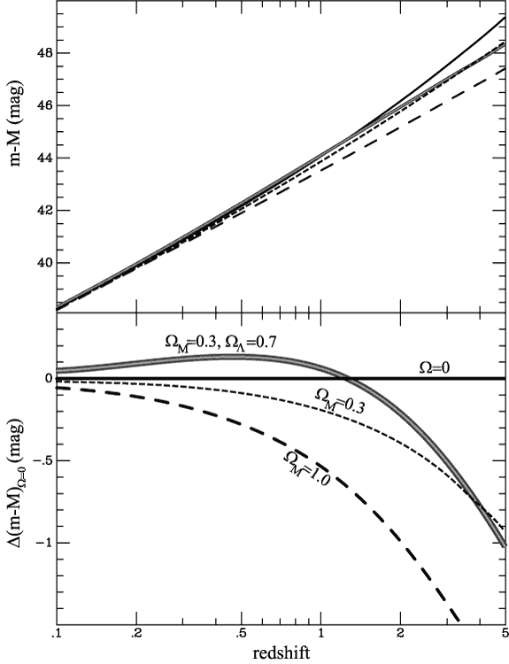
SN Projects
SN Factory
Carnegie SN Project
SDSSII
PanSTARRS
PTF
ESSENCE
CFHT Legacy Survey
Carnegie SN Project
Higher-z SN Search
HST SN Treasury
Euclid/LSST
WFIRST 2.4
Plus the local searches:
LOTOSS, CfA, ESC

Slide 3
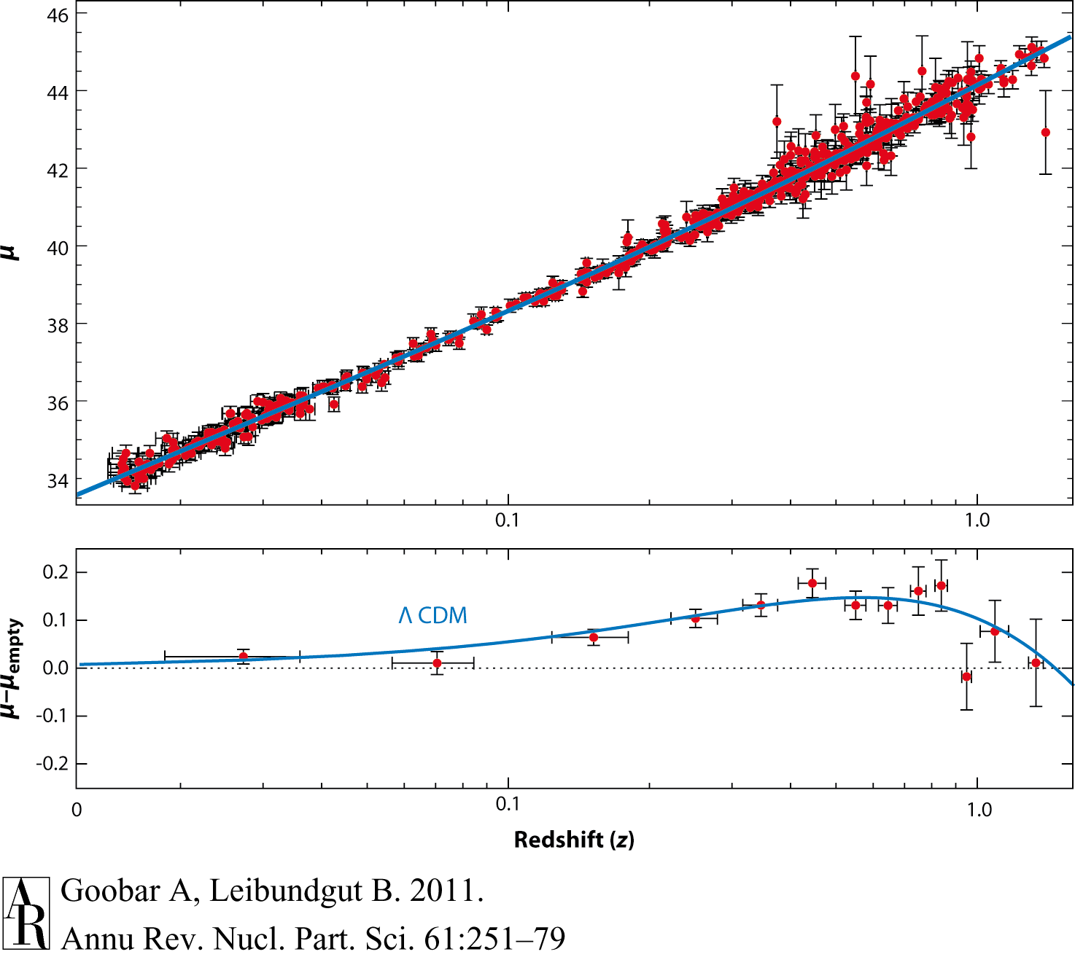
Supernova Cosmology 2011
Goobar & Leibundgut 2011
560 SNe Ia

Slide 4
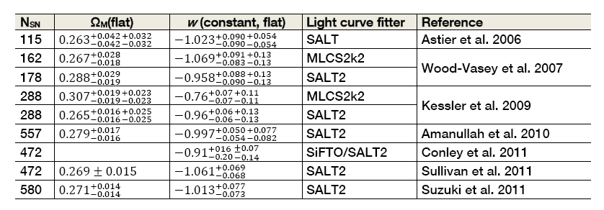
Supernova cosmology
ω firmly established
general agreement between different experiments

Slide 5
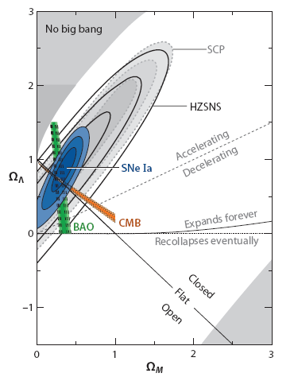
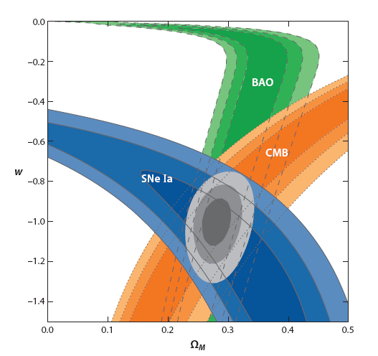
15 years of progress
Goobar & Leibundgut 2011

Slide 6
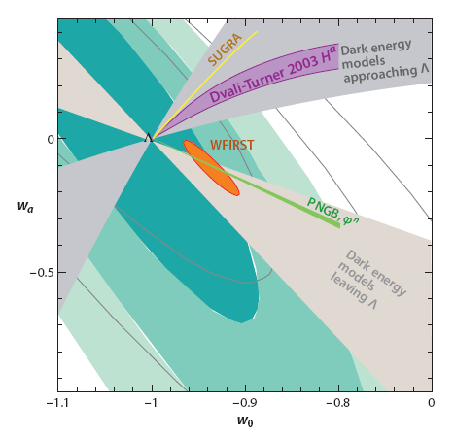
Cosmology – more?
Goobar & Leibundgut 2011
(courtesy E. Linder and J. Johansson)

Slide 7
Systematics
“[T]he length of the list indicates the maturity of the field, and is the result of more than a decade of careful study.”
Contamination
Photometry
K-corrections
Malmquist bias
Normalisation
Evolution
Absorption
Local expansion field

Slide 8
What next?
Already in hand
>1000 SNe Ia for cosmology
constant ω determined to 5%
accuracy dominated by systematic effects

Slide 9
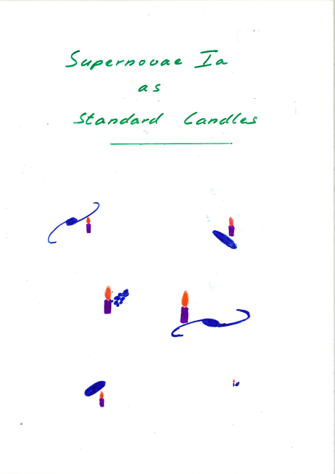
Type Ia SNe are not standard candles
They are not even standardizable
Maybe some of them can be normalised to a common peak luminosity
Paradigm 1

Slide 10
Why no standard candle?
Large variations in
luminosity
light curve shapes
colours
spectral evolution
polarimetry
Some clear outliers
what is a type Ia supernova?
Differences in physical parameters
Ni mass

Slide 11
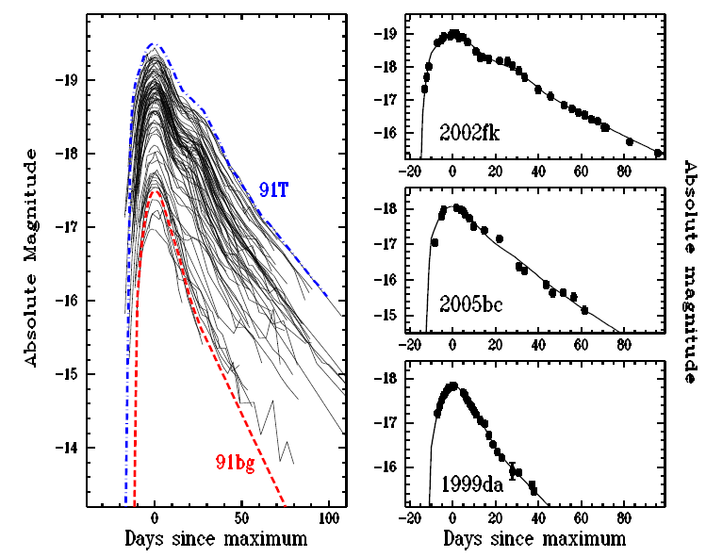
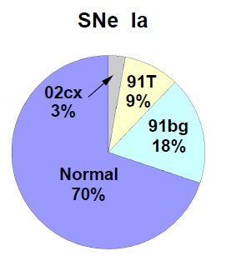
Luminosity distribution
Li et al. 2010

Slide 12
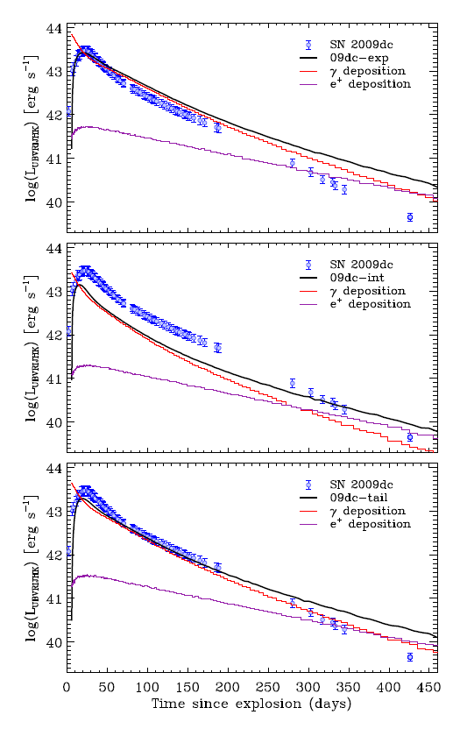
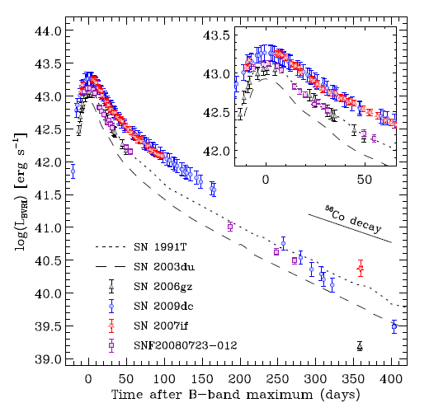
Super-luminous SNe Ia
core collapse with 1.6M ⁵⁶Ni within 3M envelope
Unclear nature
Luminosity drops at late phases
Model with a circumstellar shell from a double-degenerate merger
rescaled W7 with
circumstellar interaction
Taubenberger et al. 2013
1M ⁵⁶Ni with
flat density profile
Taubenberger et al. 2013

Slide 13
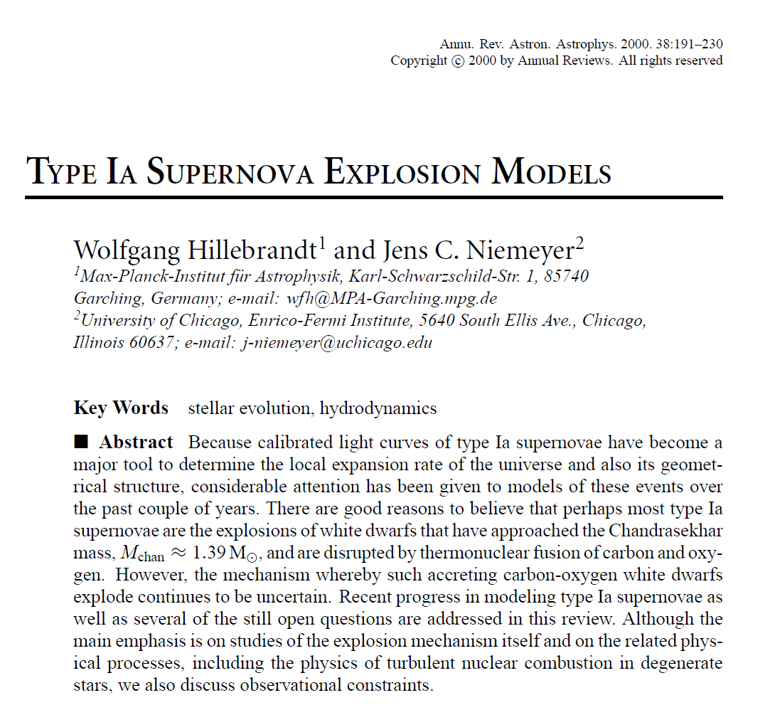
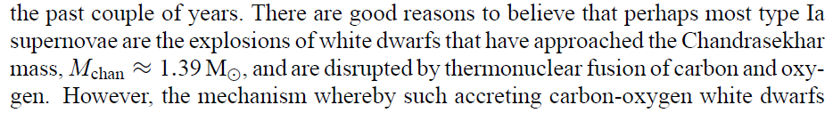
Type Ia SNe do not all come from Chandrasekhar-mass white dwarfs
“Type Ia Supernova progenitors are not Chandrasekhar-mass white dwarfs” (2012)
Paradigm 2

Slide 14
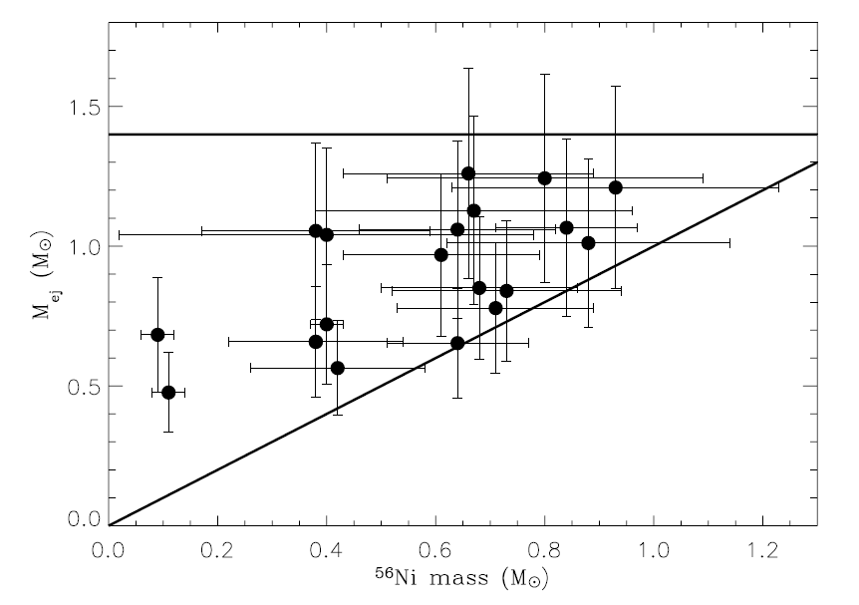
Ejecta masses
Large range in nickel and ejecta masses
no ejecta mass at 1.4M
factor of 2 in ejecta masses
some rather small differences between nickel and ejecta mass

Slide 15
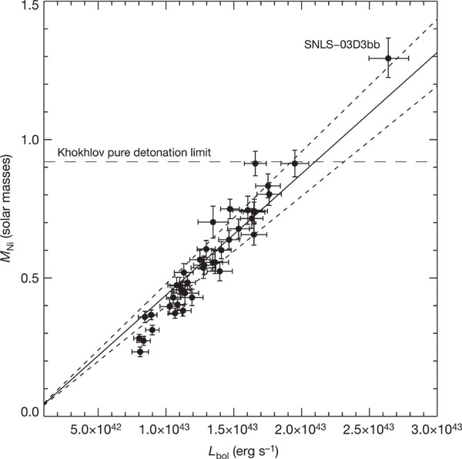
Ejecta masses
Super-Chandrasekhar explosions?
also SN 2006gz, 2007if, 2009dc
inferred Ni mass > 1 M
Howell et al. 2006

Slide 16
Type Ia supernova cosmoloy
Excellent distance indicators!

Slide 17
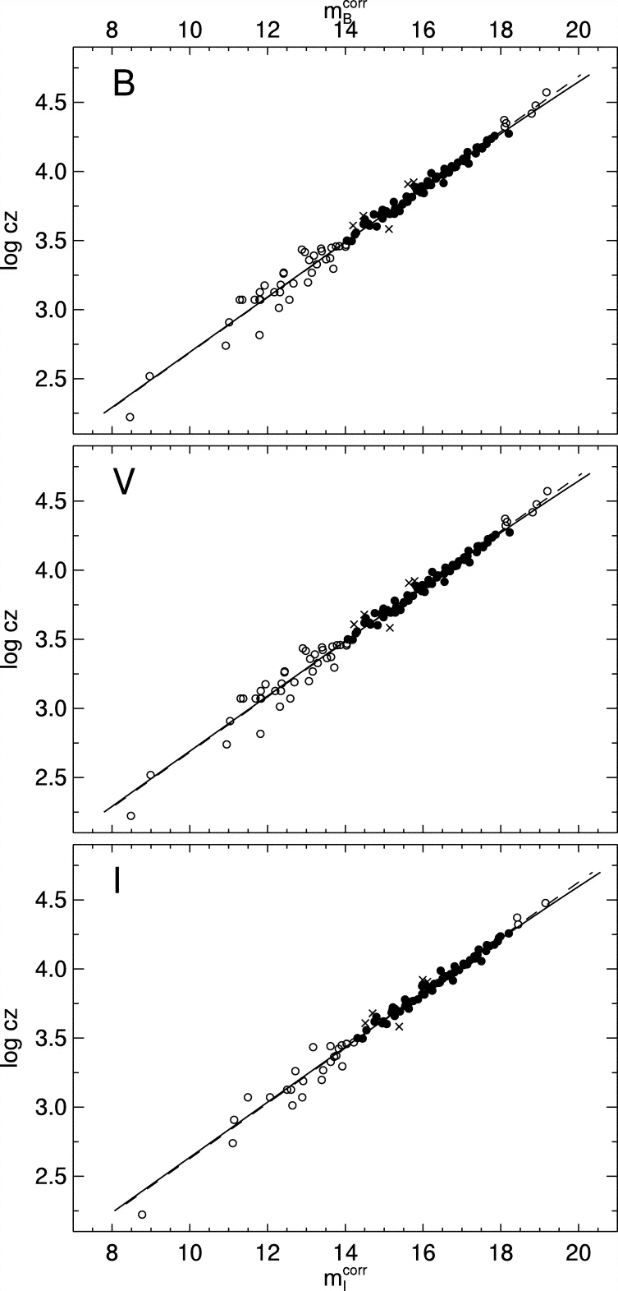
SN Ia Hubble diagram
Excellent distance indicators
Experimentally verified
Work of several decades
Reindl et al. 2005

Slide 18
What next?
Already in hand
>1000 SNe Ia for cosmology
constant ω determined to 5%
accuracy dominated by systematic effects
Missing
good data at z>1
light curves and spectra
good infrared data at z>0.5
cover the restframe B and V filters
move towards longer wavelengths to reduce absorption effects
restframe near-infrared Hubble diagram
Nobili et al. 2005, Freedman et al. 2009, Barone-Nugent et al. 2012, Kattner et al. 2012

Slide 19
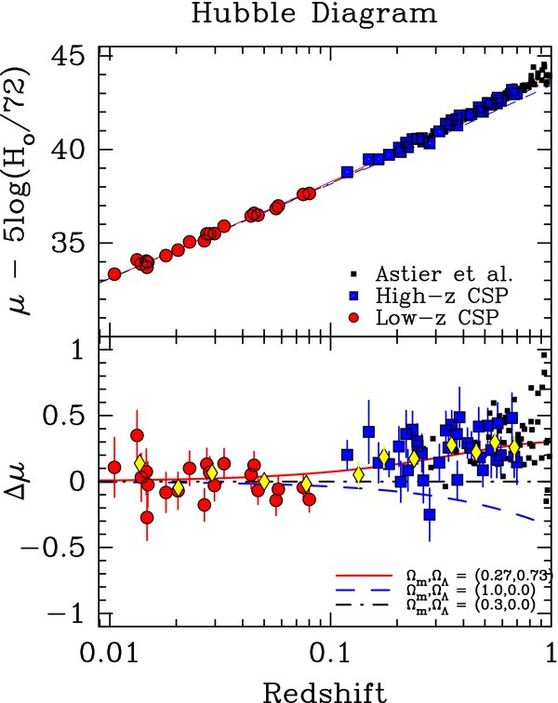
I-band Hubble diagram
Freedman et al. 2009
Currently only 35 SNe Ia
Goobar & Leibundgut 2011
560 SNe Ia

Slide 20
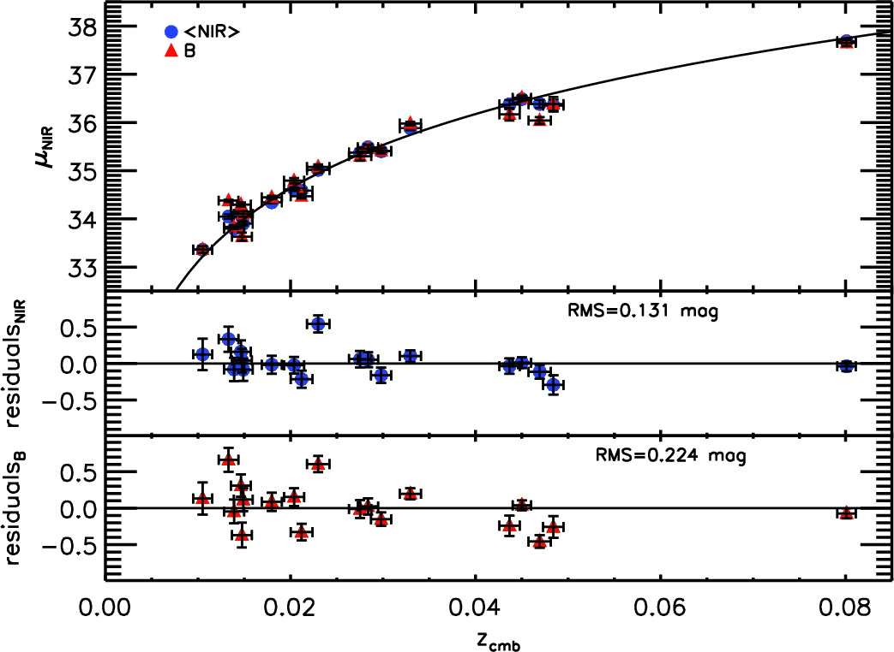
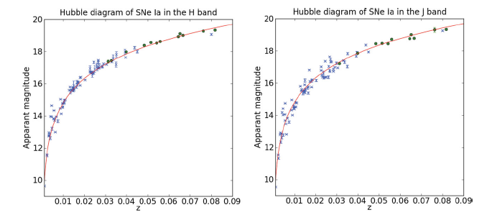
J- and H-band Hubble diagrams
(YJH)
Kattner et al. 2012
Barone-Nugent et al. 2012

Slide 21
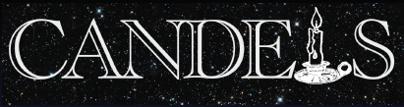

Distant SNe with CANDELS and CLASH
Multi-cycle HST Treasury Programs
PIs: S. Faber/H. Fergusson
PI: M. Postman
HST MCT SN Survey
PI: A. Riess
SN discoveries and target-of-opportunity follow-up
SNe Ia out to z≈2
Determine the SN rate at z>1 and constrain the progenitor systems

Slide 22
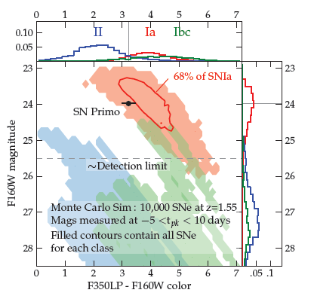
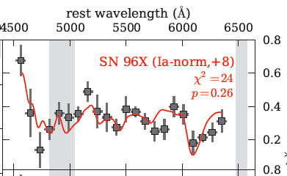
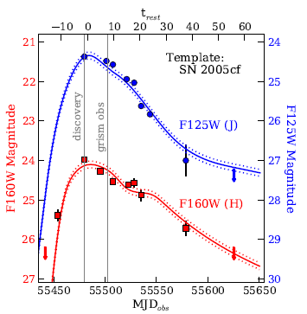
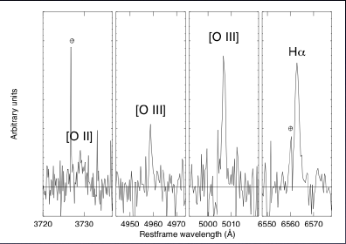
4 arguments for a SN Ia @ z=1.55
color and host galaxy photo-z
host galaxy spectroscopy
light curve consistent with normal SN Ia at z=1.55
SN spectrum consistent

Slide 23
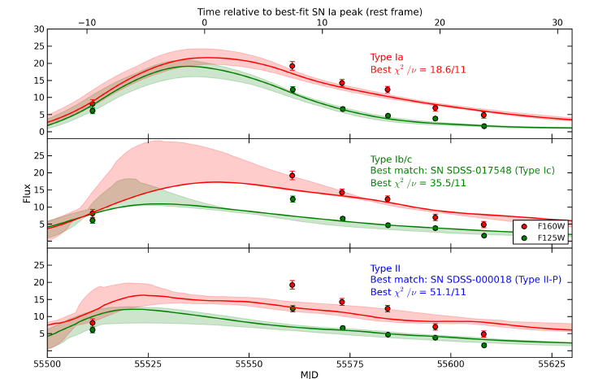
SNe Ia at z>1
SN Ia at z=1.91
SN UDS10Wil
Jones et al. 2013

Slide 24
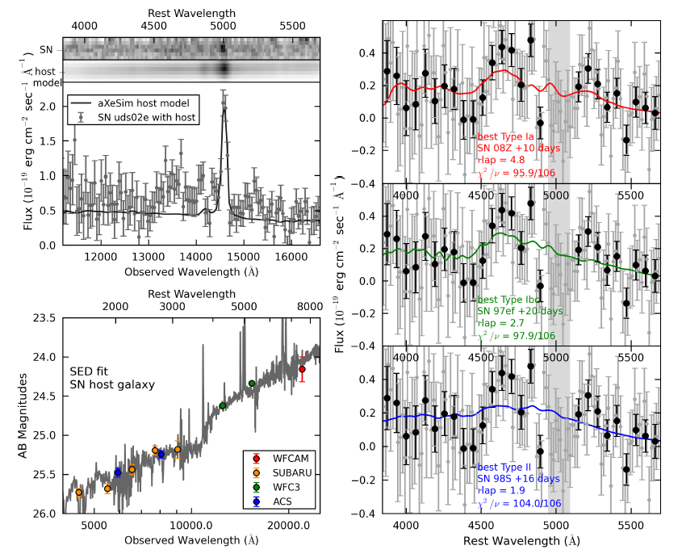
SN UDS10Wil at z=1.91

Slide 25
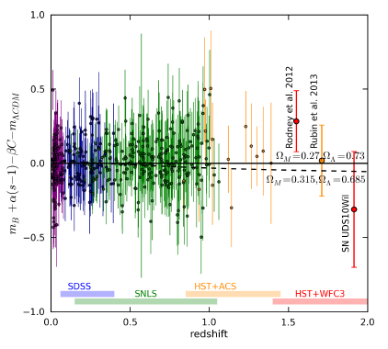
SNe at z>1
Jones et al. 2013

Slide 26
Supernova Cosmology – do we need more?
Test for variable ω
required accuracy ~2% in individual distances
can SNe Ia provide this?
can the systematics be reduced to this level?
homogeneous photometry?
further parameters (e.g. host galaxy metalicity)
handle >100000 SNe Ia per year?
Euclid
3000 SNe Ia to z<1.2 with IR light curves (deep fields) → restframe I-band Hubble diagram
16000 SNe discovered

Slide 27
Summary
Concentrate on λ not covered so far
particular IR is interesting
reduced effect of reddening
better behaviour of SNe Ia
Understand the SN zoo
many (subtle?) differences observed in recent samples (PanSTARRS and PTF)
subluminous and superluminous
understand potential evolutionary effects
spectroscopy important → PESSTO
DES, LSST, Euclid follow-up?

