Slide 1
Supernova Surveys
Bruno Leibundgut
ESO

Slide 2
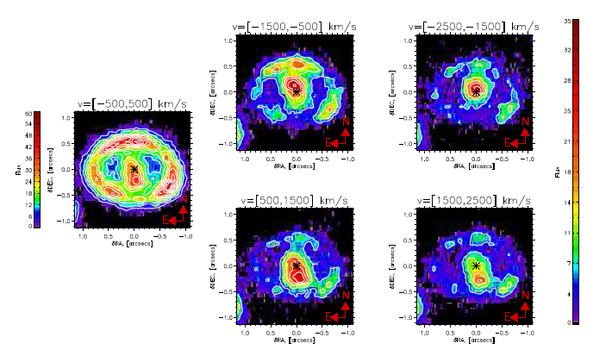
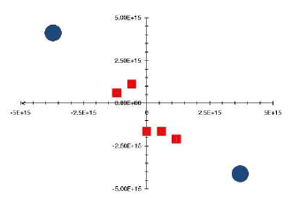
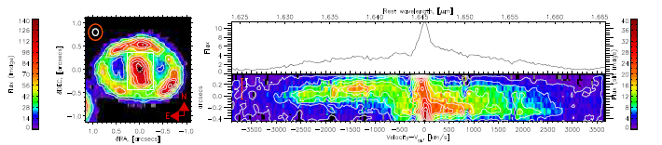
One-slide SN 1987A
Kjær et al. (arXiv:1003.5684)
inner ejecta resolved and mapped in [Si I] and [Fe II] as well as He I lines

Slide 3
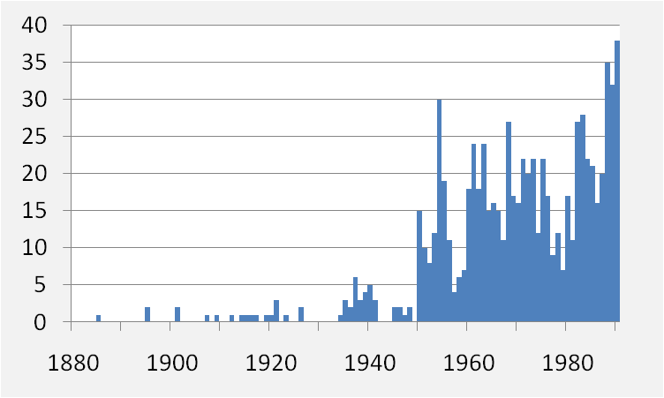
Some past supernova surveys
Historical surveys
Zwicky/Caltech/Palomar/POSS
first systematic searches with the 18” Schmidt
only provider of SNe for a long time
Asiago (Rosino)/Zimmerwald (Wild)
spawned from the Caltech search
Rev. Evans, McNaught
extremely successful amateur searches
Las Campanas search (Tammann/Sandage – 1984-1986)
very limited success (20 SNe in 2 years)
no rate paper every published
Berkeley automated search
first automated search (from Leuschner Observatory)
Calan/Tololo SN search (Maza/Hamuy/Phillips/Suntzeff - 1990s)
successful search with photographic plates and CCD follow-up observations
coordinated spectroscopy
basis for SN cosmology by providing the nearby sample (Hamuy et al. 2006)

Slide 4
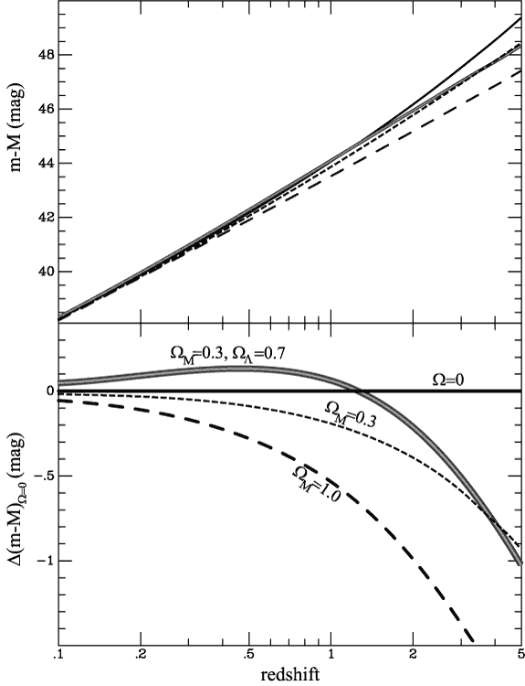
Current SN Surveys
SN Factory
Carnegie SN Project
SDSSII
ESSENCE
CFHT Legacy Survey
Higher-z SN Search
(GOODS)
Plus the local searches:
LOTOSS, CfA, ESC

Slide 5
Nearby supernova surveys
Nearby – z<0.03
mostly focused on prominent, large galaxies
“stellar explosions → look where the stars are”
amateurs
many, over long periods
well organised (e.g. finding charts, networks, Web pages)
still find interesting objects, often find them early
LOSS/LOTOS
KAIT (first Leuschner then Lick)
running for over 15 years (11 years with KAIT – Weidong Li)
>1000 SNe discovered – all types
best nearby sample for SN rates
results are being published
Smith et al. 2010, Leaman et al. 2010, Li et al. 2010ab

Slide 6
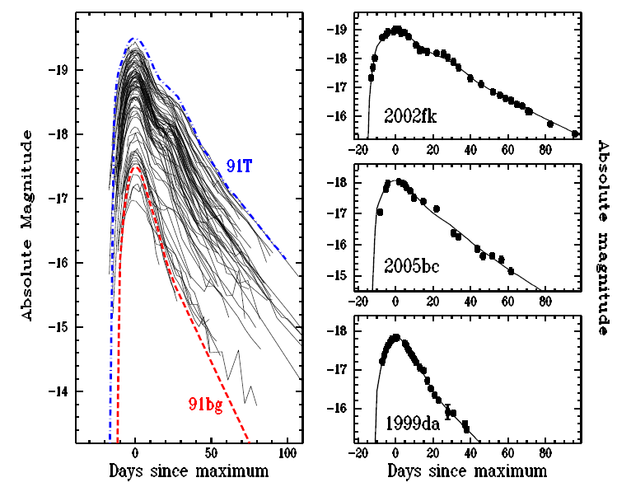
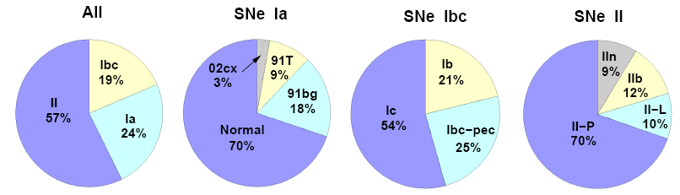
Lick Observatory Supernova Search
Total | Ia | Ibc | II | no classification
929 | 372 | 144 | 399 | 14
 | 40.0% | 15.5% | 42.9% | 1.6%
Optimal sample
726 | 274 | 116 | 324 | 12
 | 37.7% | 16.0% | 44.6% | 1.6%
Volume limited sample (80Mpc – Ia; 60Mpc – Ibc and II)
180 | 74 | 25 | 81
Leaman et al. 2010
Li et al. 2010

Slide 7
Nearby SN surveys
Nearby (cont.)
Center for Astrophysics
follow-up of interesting objects – all types
active for the past 2 decades
many individual and peculiar objects
most extensive nearby SN Ia sample
critical for the cosmology (e.g. Riess et al. 1999, Jha et al. 2003, Hicken et al. 2009)
Carnegie Supernova Project – CSP
nearby and distant SN follow-up
all types
including on IR light curves
Hamuy et al. 2006, Phillips et al. 2007, Folatelli et al. 2010

Slide 8
Nearby SN surveys
ROTSE-III
Akerlof et al. 2003
SN Factory
see talk by Childress
600 SNe in two years
mostly unpublished
Quest (Palomar/La Silla)
continuation of SN Factory search in southern sky
CHASE
new search providing mostly bright supernovae (e.g. 2010ev)
Catalina Real-Time Transient Survey
covers 26000 □°
62 SNe in six months
publish events through VOEvents
Drake et al. 2009

Slide 9
Nearby SN surveys
Palomar Transient Factory
see Mark Sullivan’s talk
>500 SNe in one year
most not reported to IAU
several peculiar objects detected
Avishai Gal-Yam’s talk
‘unbiased’ statistics
PanSTARRS-1
started this year
expect 26000 core-collapse SNe year⁻¹
most not reported
Young et al. 2008

Slide 10
Distant SN surveys
Intermediate 0.03<z<0.3
SDSS
see Bob Nichol’s talk
Kessler et al. 2009
CSP
Freedman et al. 2009
Distant z>0.3
Danish distant SN Search
Danish 1.54m telescope on La Silla
two year search
1 Type Ia (Norgaard-Nielsen et al. 1989), 1 Type II (Hansen et al. 1989)
Supernova Cosmology Project
several projects (NOAO, AAT, CTIO 4m)
started 1991
Perlmutter et al. 1995, 1997, 1999, Knop et al. 2003
High-z SN Search Team
CTIO 4m
started 1995
Schmidt et al. 1998, Riess et al. 1998, Tonry et al. 2003

Slide 11
Distant SN surveys
CFHT SN Legacy Survey
CFHT+MegaCam
4 filters, six years, rolling search all year
Astier et al. 2006, Howell et al. 2006, Sullivan et al. 2006ab and many more
ESSENCE
2 filters, six years, search during 3 months per year
Miknaitis et al. 2007, Wood-Vasey et al. 2007, Foley et al. 2008, 2009
GOODS HST SN Search/SHOES/PANTS
highest-z SNe Ia so far (z>1.2)
Riess et al. 2004, 2007, 2009, Strolger et al. 2004

Slide 12
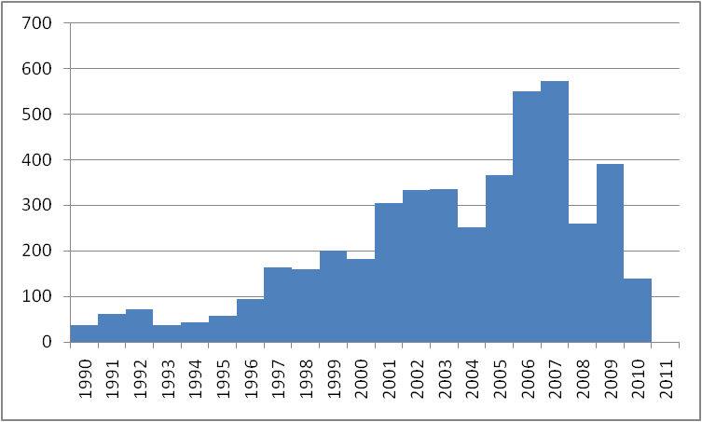
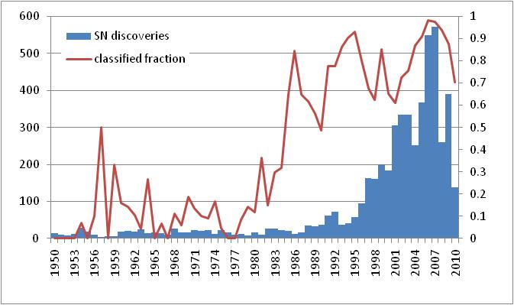
Some thoughts on current status
Current SN discovery rate substantial
During the past decade more SNe were observed than during the millennium before (half-point is late 2003)
Current searches are extremely effective
not all supernovae are reported to the IAU any longer
effectively much higher statistics in the last few years
Most reported supernovae are classified

Slide 13
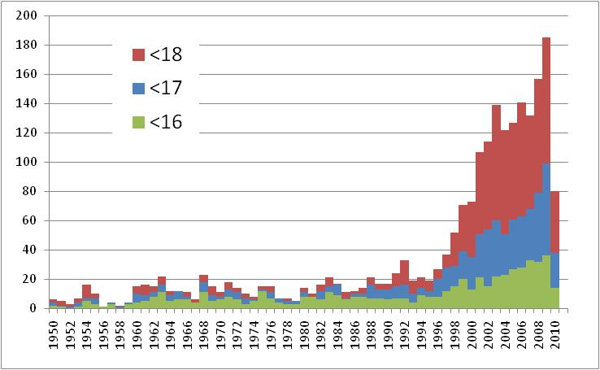
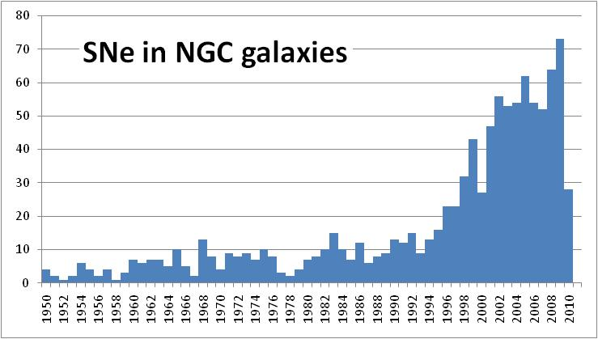
Nearby supernovae
More bright supernovae discovered

Slide 14
Surveys targeting SN progenitors
SPY
search for white dwarf binaries that will merge within a Hubble time
VLT-FLAMES Survey of Massive Stars
Smartt/VanDyk HST/Keck/VLT programs to detect massive stellar progenitors
X-ray surveys
Roelofs et al. 2008 – failed in this case, but still promising
X-ray all sky surveys – eROSITA?

Slide 15
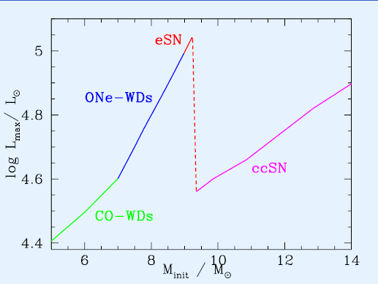
Direct observations of SN progenitors
m=26
m=30
Naively:
white dwarf: M≈10mag
giant: M≈-4mag
Observable distances (assume m=26)
white dwarf: D≈16kpc (100kpc for m=30)
giant: D≈10Mpc (60Mpc for m=30)
56Mpc
350Mpc
45Mpc
280Mpc
35Mpc
220Mpc
Poelarends et al. 2008
28Mpc
180Mpc

Slide 16
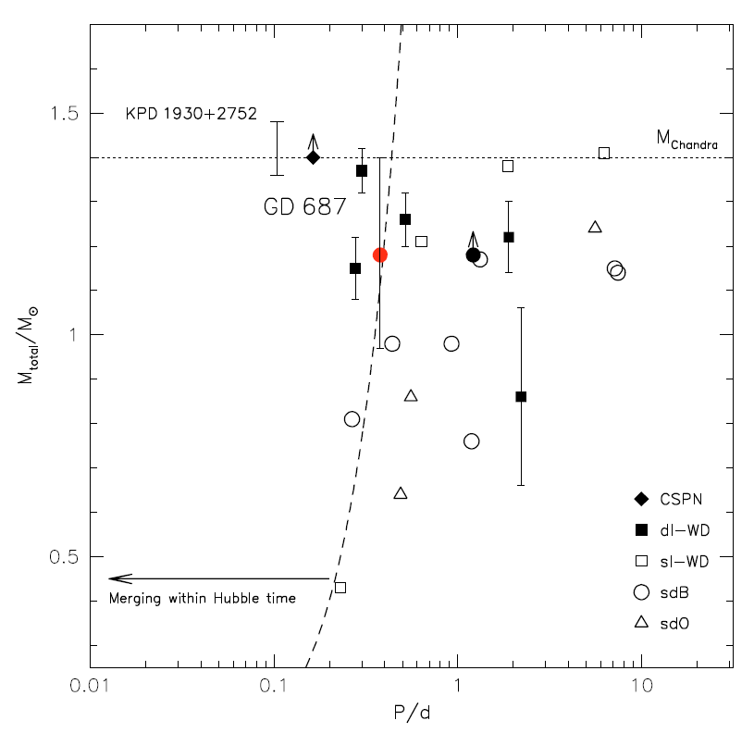
Supernova Progenitor surveY
~1000 white dwarfs checked for radial velocity changes → search close binaries
are there double degenerate white dwarfs in the solar neighbourhood?
discovered ~100 double degenerate systems
Napiwotzki et al. 2007 Geier et al. 2010

Slide 17
Other searches for SN signatures
υ-surveys
heavily discussed in the υ community
science case for various current and future υ detectors (e.g. AMANDA or ICECube)
IR surveys (VVV, VIDEO, UltraVista)
just started – too early to tell

Slide 18
Future surveys
Several searches/surveys continue:
Amateurs, LOSS, CfA, CHASE, PTF, PanSTARRS-1
New surveys
SkyMapper
1.35m telescope, 4 filters, 1250 □° ‘rolling’
expect ~400 SNe per year
IR follow-up organised
to start seriously next year
GAIA transient sources
expect ~6000 transients during mission

Slide 19
Future distant surveys
CANDELS/CLASH
part of two HST multi-cycle treasury programs
z>1.5 SNe for rates
see Enikö Regös’ talk
Riess et al.
DES
several hundred SNe Ia
see Bob Nichol’s talk
Bernstein et al. 2008
PanSTARRS-4/LSST
>100000 supernovae per year
EUCLID/JDEM
EUCLID: SNe not main driver (weak lensing and BAO)
details by Bob Nichol
JDEM: BAO and supernovae
expect several thousand SNe

Slide 20
Cosmology - do we need more?
Already in hand
>1000 SNe Ia for cosmology
constant ω determined to 5%
accuracy dominated by systematic effects
reddening, correlations, local field, evolution
Test for variable ω
required accuracy ~2% in individual distances
can SNe Ia provide this?
can the systematics be reduced to this level?
homogeneous photometry?
further parameters (e.g. host galaxy metalicity)
handle >100000 SNe Ia per year?

Slide 21
More supernovae
Increase in interesting supernovae
many more general searches
remove paradigms
possible through the technological progress
detectors, data storage, data handling and processing
Need to keep the overview
Improved understanding
hints on explosion physics
statistical samples
progenitor environments – ‘short fuse’ required
rates → clues on progenitor systems

Slide 22
More supernovae
(Do we need a definition of what is a supernova?)
Do we need a central SN database?
collect all SN discoveries?
IAU database outdated and not capable to supported most new searches
Follow-up observations
classification
critical to explore the physics
explosions
nucleosynthesis
asymmetries
peculiarities
masses

Slide 23
See you next year
Supernovae and their host galaxies
Sydney, 20-24 June 2011
Some topics to be covered include
• the many different paths to a supernova explosion
• the progenitors of supernovae
• supernova remnants
• supernova rates
• the relationships between the properties of supernovae and the properties of their host galaxies
• supernovae as tracers of star formation
• unusual supernovae
• unexplained transients
• current and future transient surveys

