Slide 1
Supernova Cosmology 2010
Bruno Leibundgut
European Southern Observatory

Slide 2
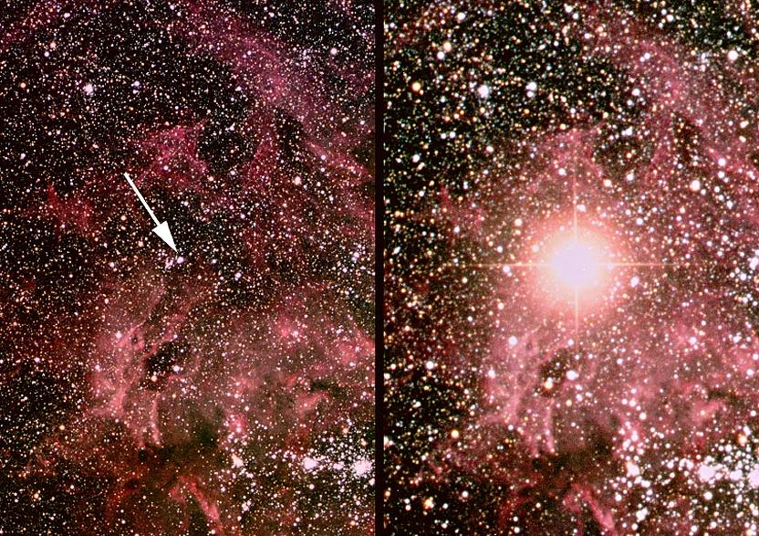
Supernova!
SN 1987A
© Anglo-Australian Telescope

Slide 3
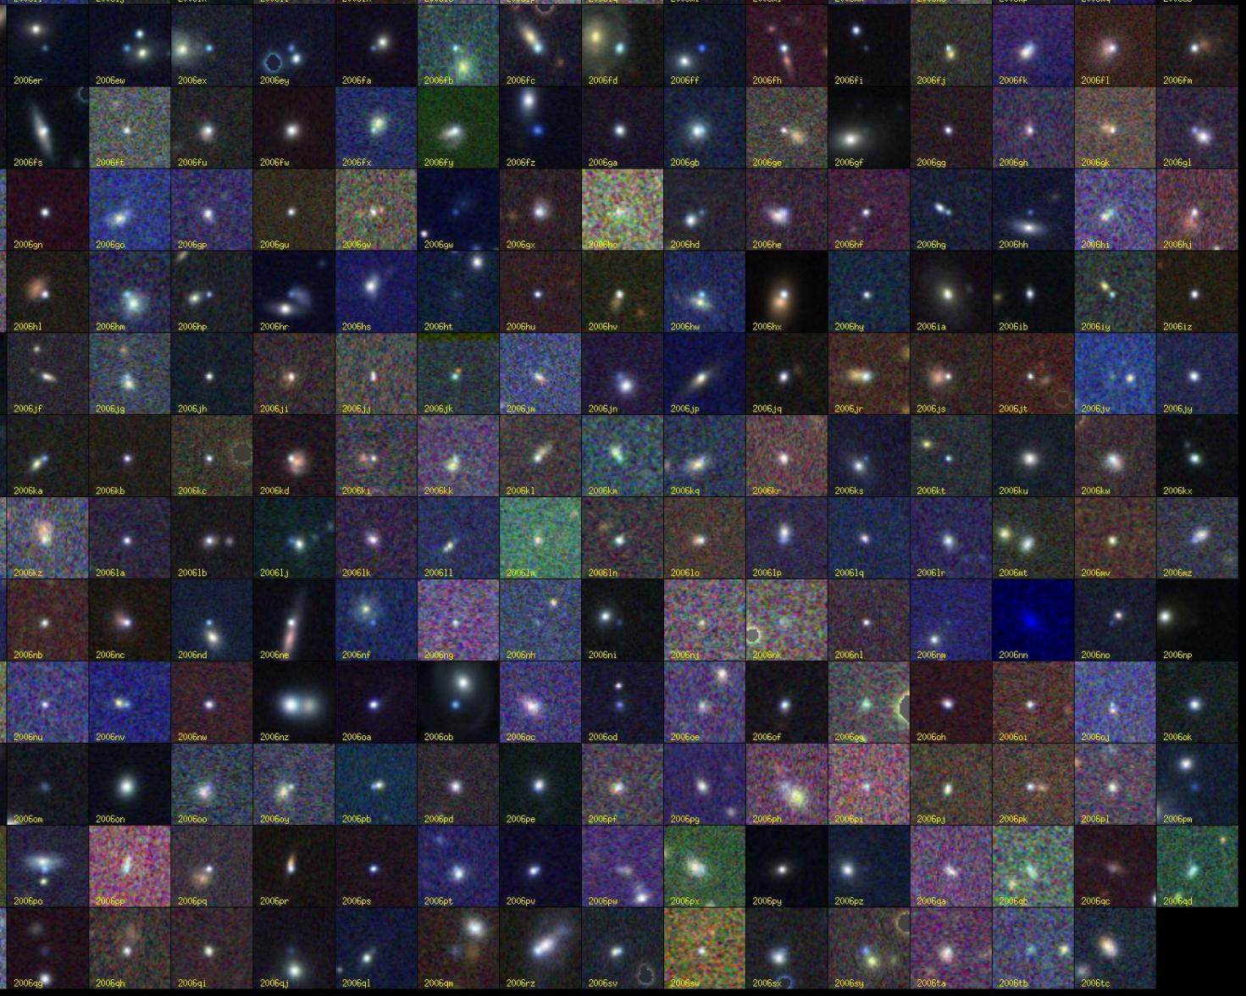
Supernovae!
© SDSSII

Slide 4
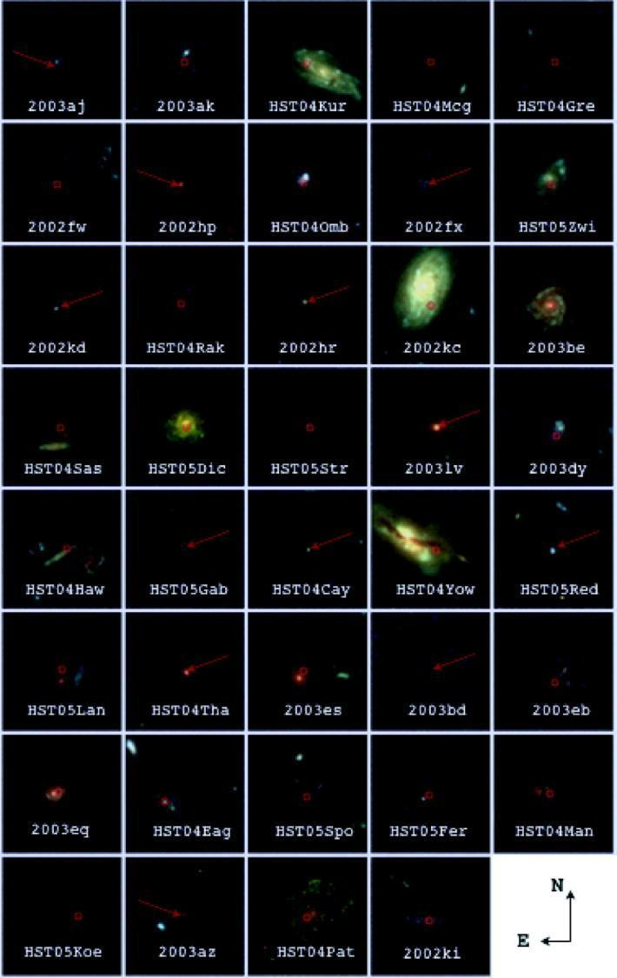
Supernovae!
Riess et al. 2007

Slide 5
Astrophysics
To measure cosmological parameters (distances) you need to
understand your source
understand what can affect the light on its path to the observer (‘foregrounds’)
know your local environment

Slide 6
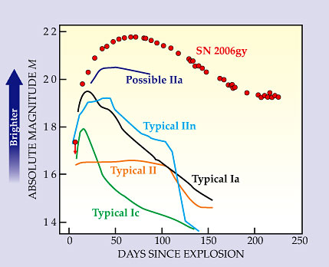
Supernova classification based on maximum light spectroscopy
Thermonuclear supernovae
Core-collapse supernovae
hydrogen
no
yes
silicon
yes
no
Ia
Ib/c
II
Tycho’s SN SN 1991T
SN 1991bg
SN 1992A
SN 1998bu
SN 2001el
SN 2002bo
SN 2002cx
SN 2005hk
IIb
SN 1979C
SN 1980K
SN 1987A
SN 1999em
SN 2004dt
helium
SN 1993J
Smith et al. 2007
no
yes
Ic
Ib
SN 1994I
SN 1996N
SN 2004aw
SN 1983N
GRBs
SN 1998bw
SN 2003dh
SN 2006aj

Slide 7
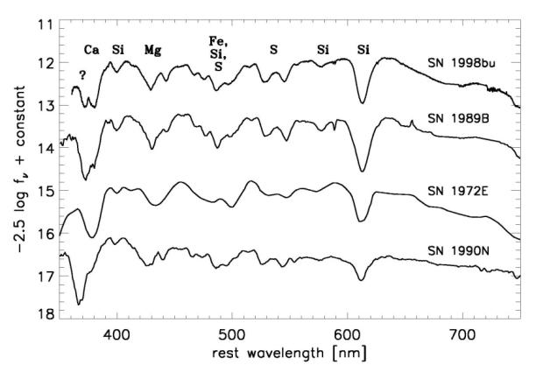
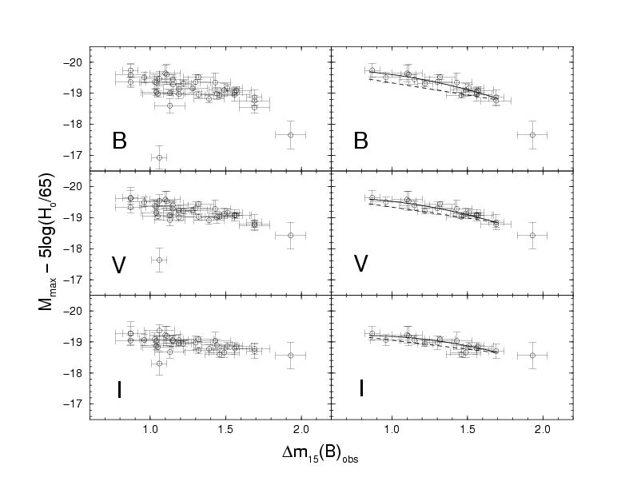
Supernovae as ‘standard candles’
Uniform appearance
light curves
individual filters
bolometric
colour curves
reddening?
spectral evolution
peak luminosity
correlations
Jha 2005
Phillips et al. 1999

Slide 8
Systematics
Contamination
Photometry
K-corrections
Malmquist bias
Normalisation
Evolution
Absorption
Local expansion field
“[T]he length of the list indicates the maturity of the field, and is the result of more than a decade of careful study.”

Slide 9
Systematics
Contamination
Photometry measurement
K-corrections
Malmquist bias
Normalisation source
Evolution
Absorption path
Local expansion field local environment

Slide 10
Know your source
Type Ia Supernovae
complicated source
interesting physics
progenitor systems

Slide 11
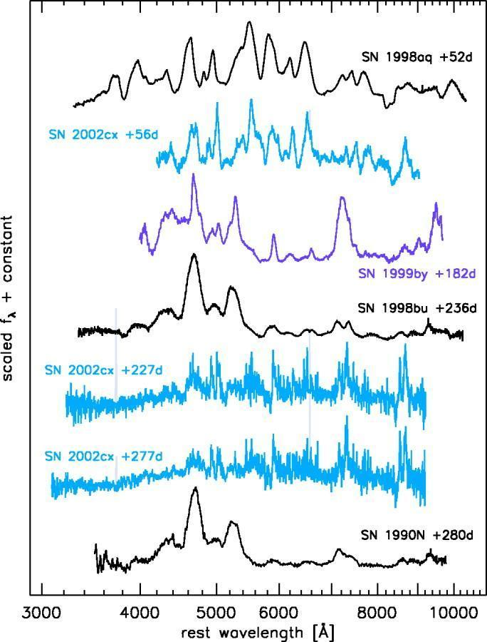
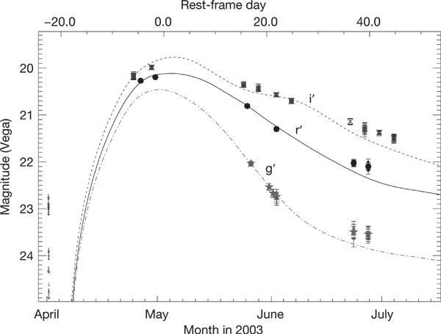
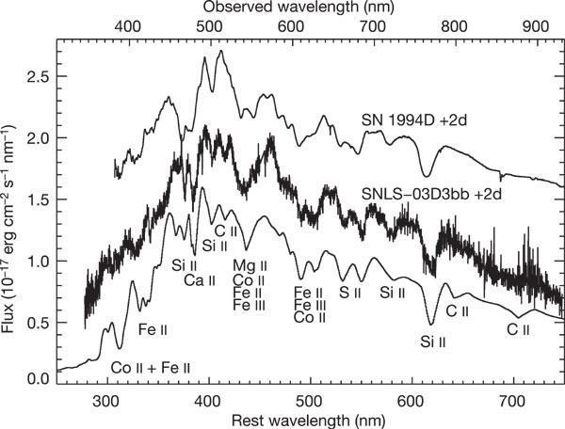
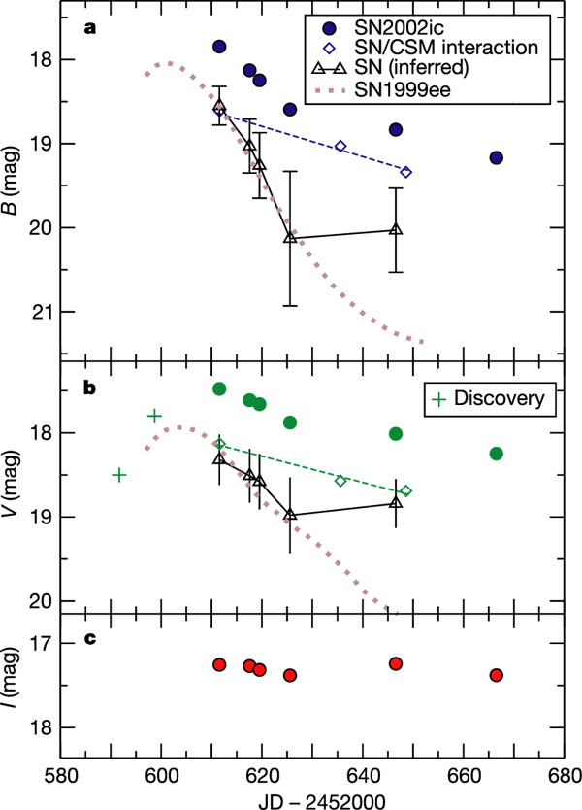
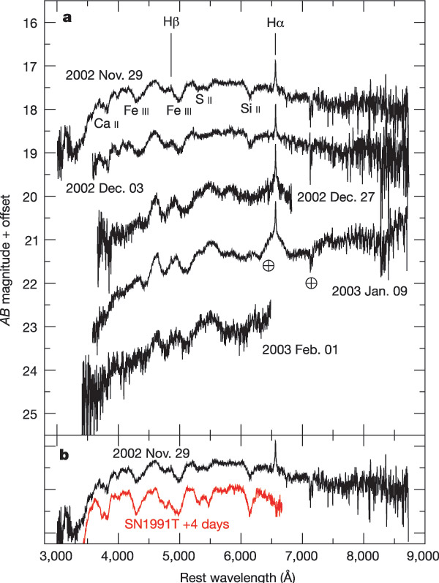
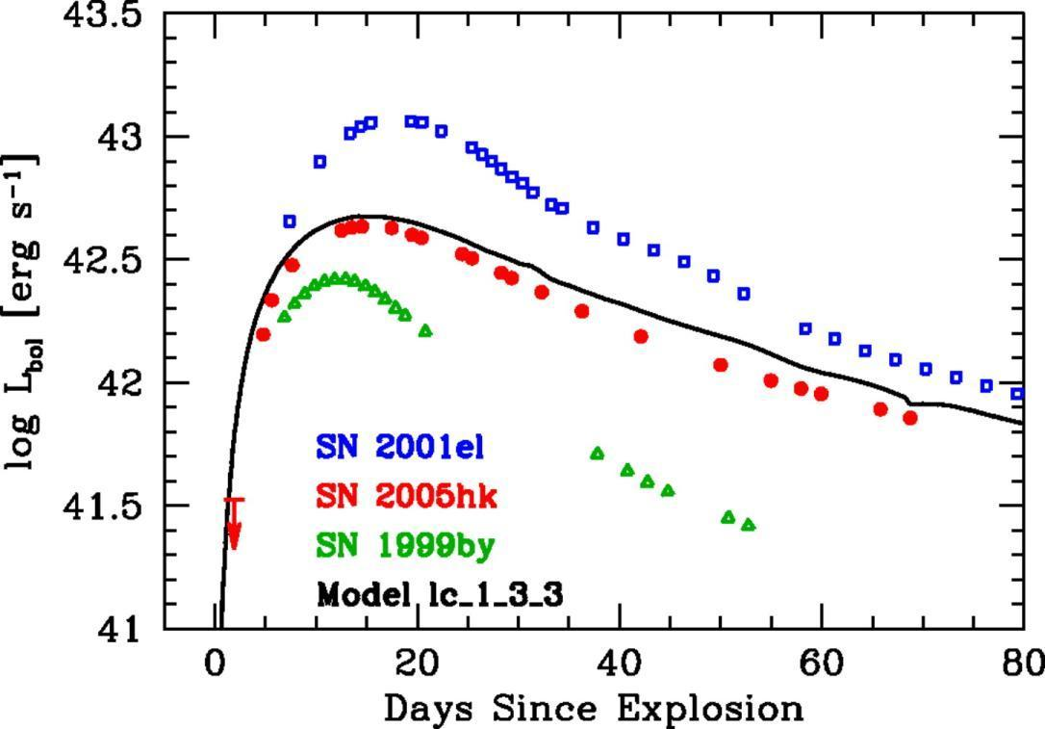
What is a SN Ia?
Peculiar cases abound …
SN 1991T, SN 1991bg
SN 1999aa, SN 1999ac
SN 2000cx, SN 2002cx
SN 2002ic
SN 03D3bb
SN 2005hk
and more
Phillips et al. 2007
Howell et al. 2006
Howell et al. 2006
Jha et al. 2006
Hamuy et al. 2003

Slide 12
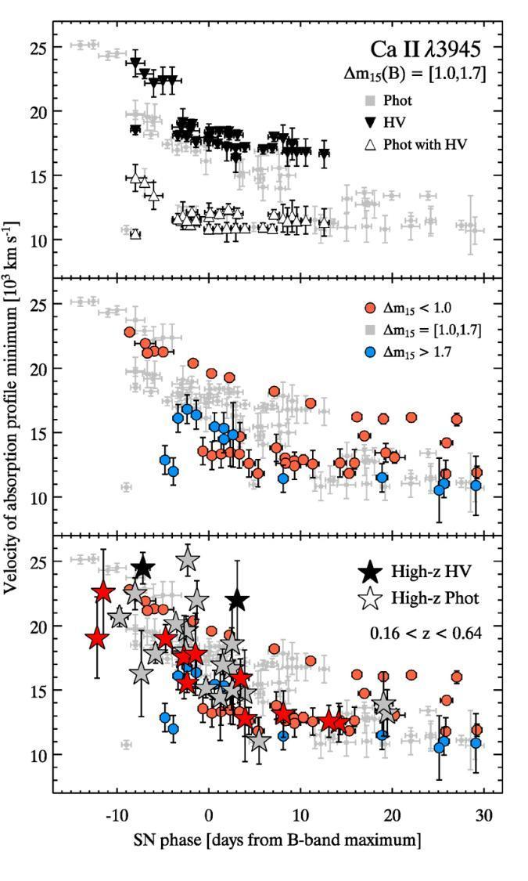
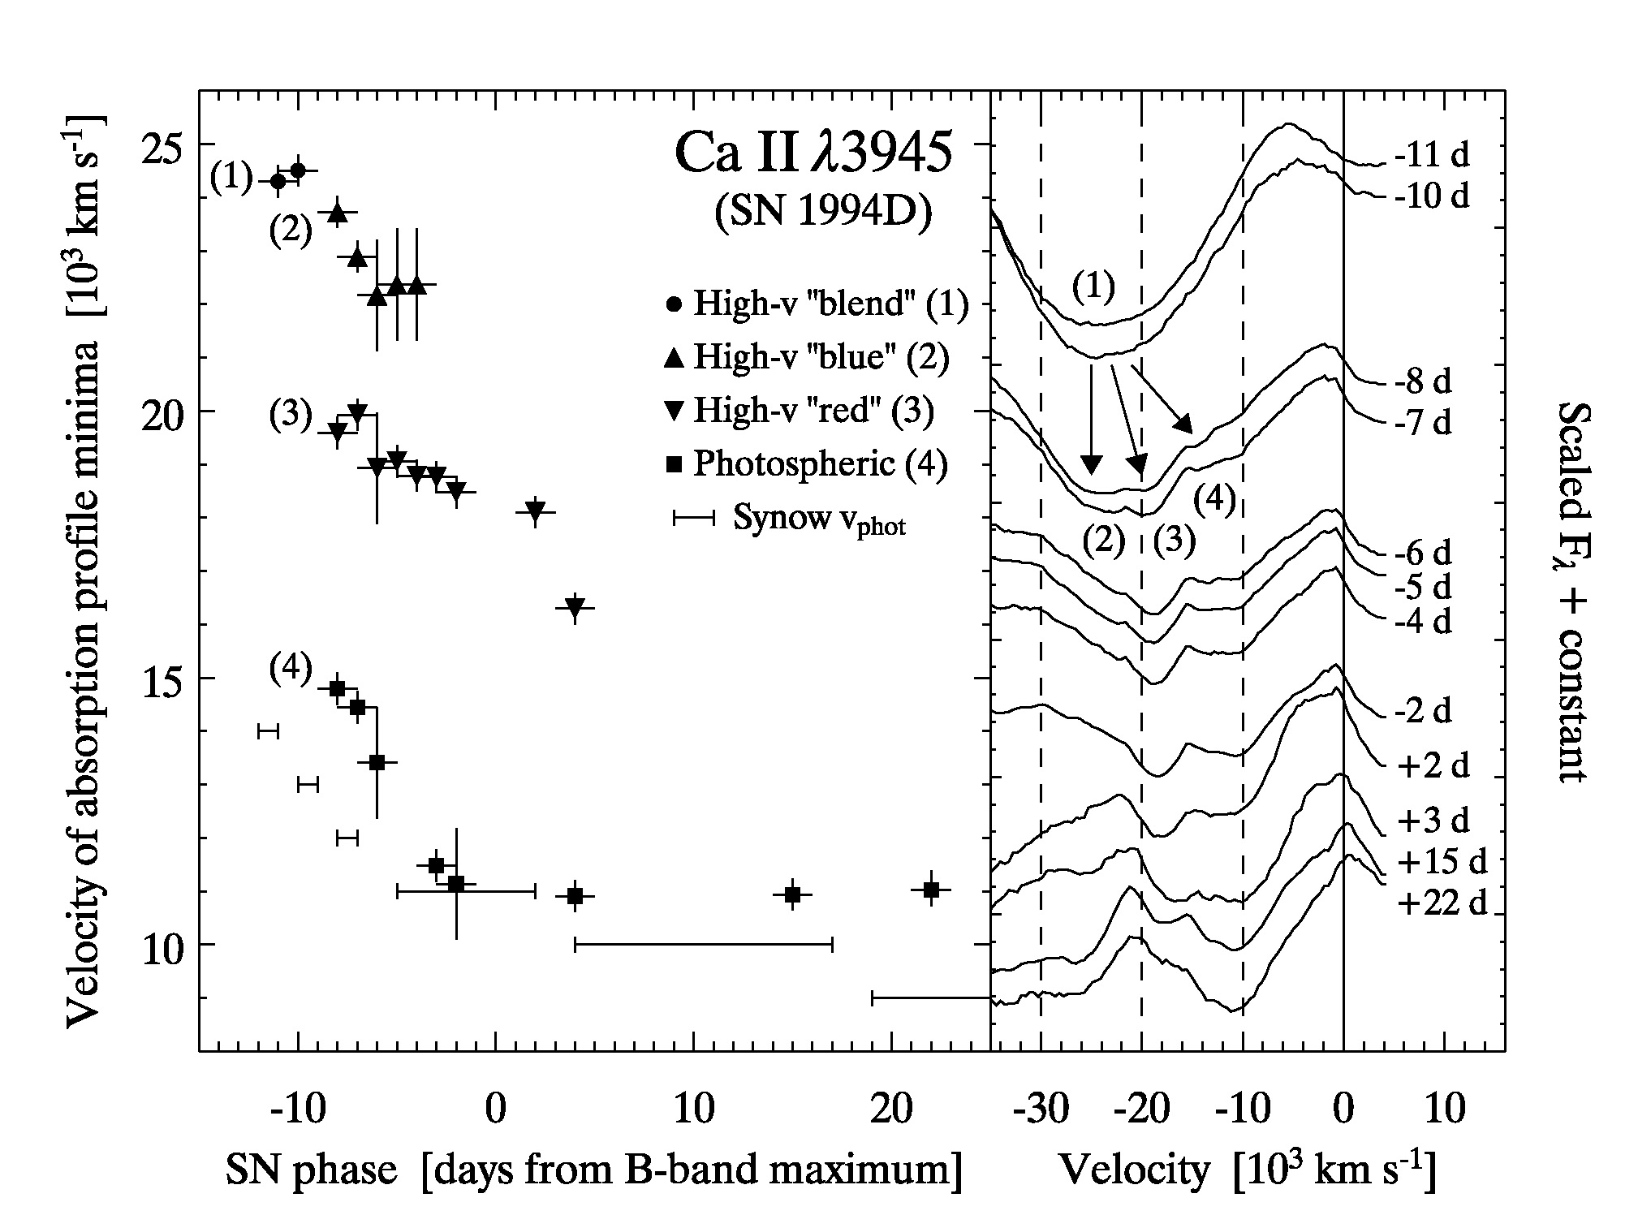
also at higher redshifts …
Blondin et al. 2006
also Garavini et al. 2007
Bronder et al. 2008

Slide 13
Know your source
Type Ia Supernovae
complicated source
interesting physics
progenitor systems
determine the global parameters of the explosions
fuel → nickel mass → distribution in the ejecta
total mass
explosion energy

Slide 14
Global explosion parameters
Determine the nickel mass in the explosion from the peak luminosity
large variations (up to a factor of 10)
Possibly determine
total mass of the explosion or
differences distribution of the nickel, i.e. the ashes of the explosion or
differences in the explosion energies

Slide 15
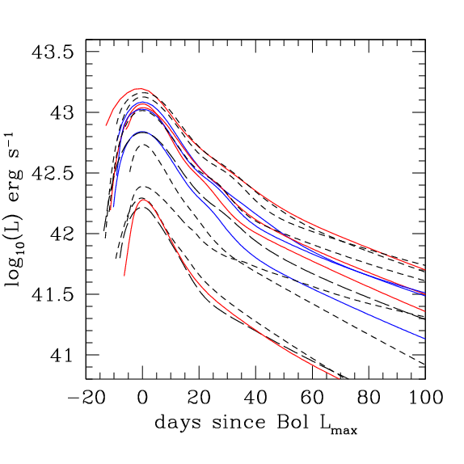
Bolometric light curves
Stritzinger

Slide 16
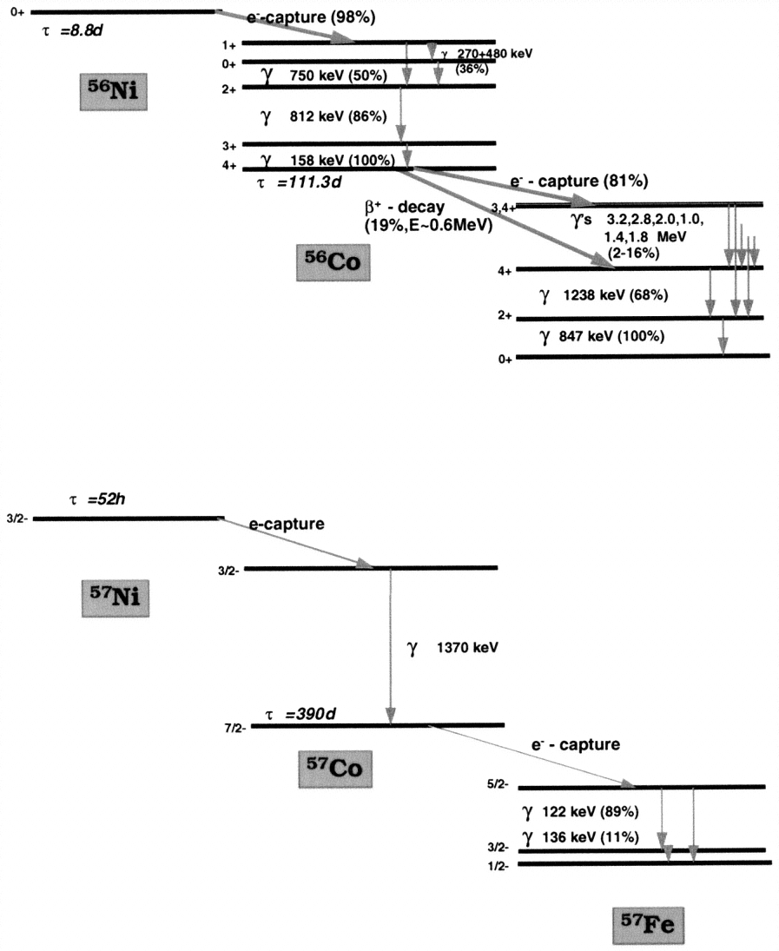
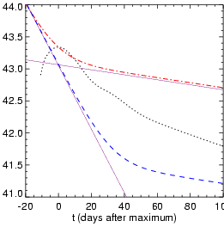
Radioactivity
Isotopes of Ni and other elements
conversion of γ-rays and positrons into heat and optical photons
Contardo (2001)
Diehl and Timmes (1998)

Slide 17
Determining H₀ from models
Hubble’s law
Luminosity distance
Ni-Co decay

Slide 18
H₀ from the nickel mass
Hubble law
Luminosity distance
Arnett’s rule
Ni-Co decay
and rise time
α: conversion of nickel energy into radiation (L=αE_{Ni})
ε(t): energy deposited in the supernova ejecta
Need bolometric flux at maximum F and the redshift z as observables
Stritzinger & Leibundgut (2005)

Slide 19
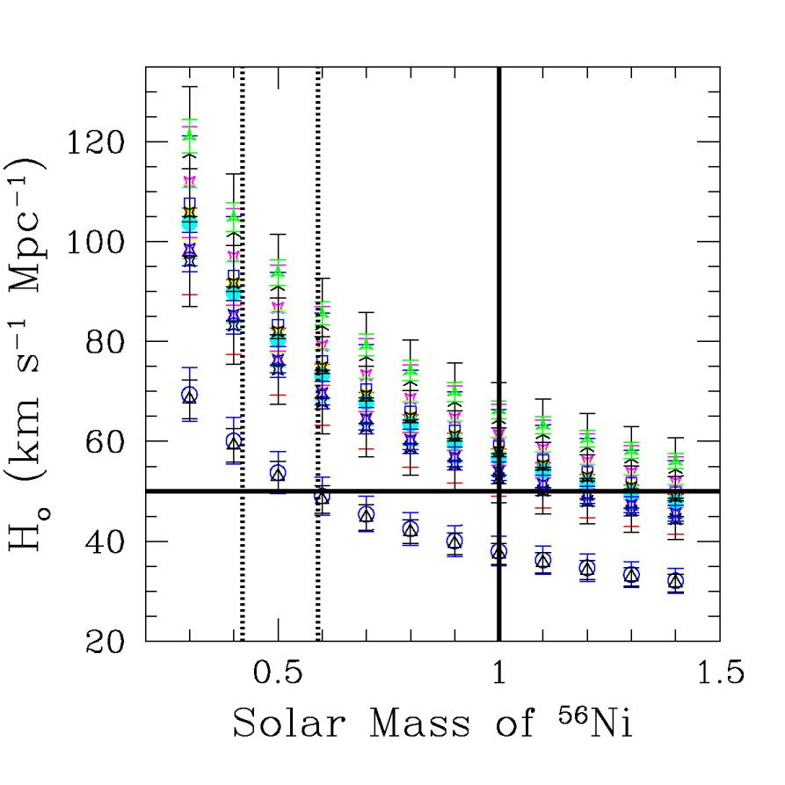
H₀ and the Ni mass
Individual SNe follow the M^{-½}
dependency.
Problem:
Since they have individual Ni masses it is not clear which one to apply!

Slide 20
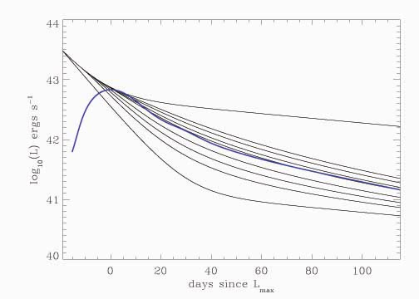
Ejecta masses from light curves
γ-ray escape depends on the total mass of the ejecta
v: expansion velocity
κ: γ-ray opacity
q: distribution of nickel
Stritzinger et al. 2006

Slide 21
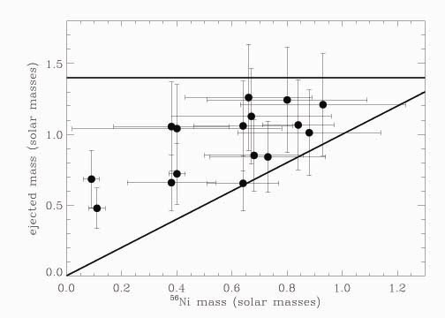
Ejecta masses
Large range in nickel and ejecta masses
no ejecta mass at 1.4M
factor of 2 in ejecta masses
some rather small differences between nickel and ejecta mass
Stritzinger et al. 2006

Slide 22
Type Ia Supernovae
Individual explosions
differences in explosion mechanism
deflagration vs. delayed detonations
3-dimensional structures
distribution of elements in the ejecta
high velocity material in the ejecta
explosion energies
different expansion velocities
fuel
amounts of nickel mass synthesised
progenitors
ejecta masses?

Slide 23
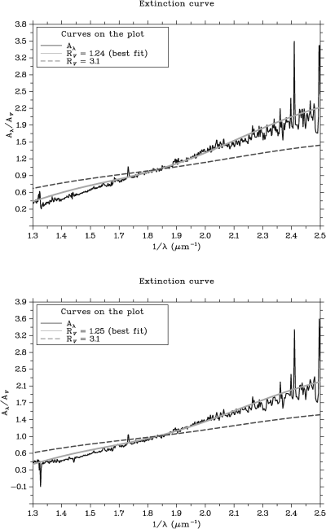
Know what happens on the way
Do we know the reddening law?
indications from many SNe Ia that R_{V}<3.1
e.g. Krisciunas et al., Elias-Rosa et al.
free fit to distant SNe Ia gives R_{V}≈2
Guy et al., Astier et al.
Hubble bubble disappears with R_{V}≈2
Conley et al., Wang
Need good physical understanding for this!
Elias-Rosa et al. (2007)

Slide 24
Varying dust properties in nearby SN hosts
SN2001el
SN2006X
Wang et al.
SN2003cg
Krisciunas et al.
But for high-z SNe it is assumed all SNe hosts have same dust properties!
Elias-Rosa et al.

Slide 25
Are SNe Ia standard candles?
No!
large variations in
light curve shapes
colours
spectral evolution
polarimetry
some clear outliers
what is a type Ia supernova?
differences in physical parameters
Ni mass
ejecta mass

Slide 26
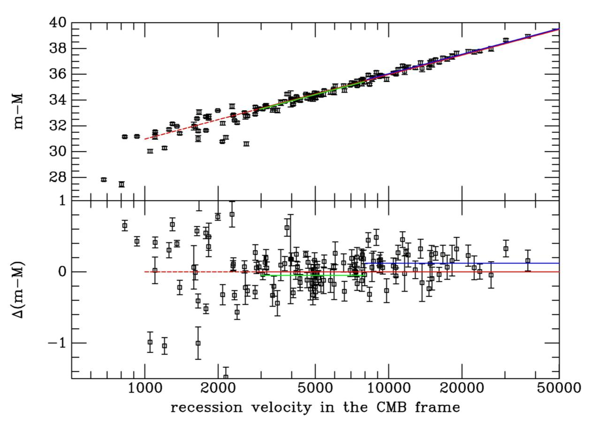
Distance indicator!

Slide 27
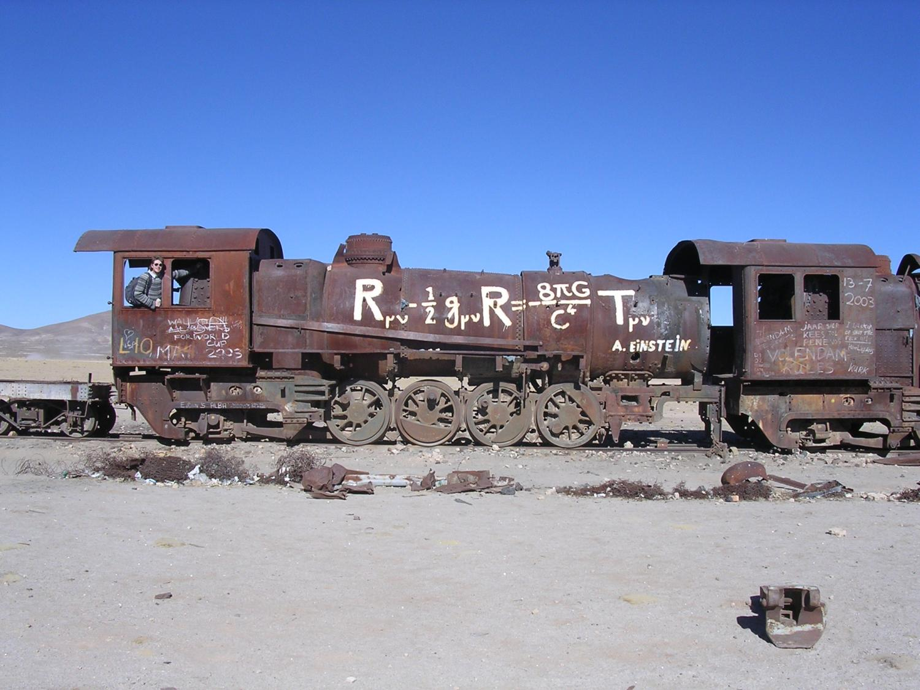

Slide 28
Friedmann cosmology
Assumption:
homogeneous und isotropic universe
Friedmann-Robertson-Walker-Lemaître metric:
Ω_{M}: matter density
Ω_{k}: curvature
Ω_{Λ}: cosmological constant

Slide 29
Ω=0
Scale factor ‘Mean distance between galaxies’
Ω=1
Ω>1
− 14
− 9
− 7
Time
today
billion years

Slide 30
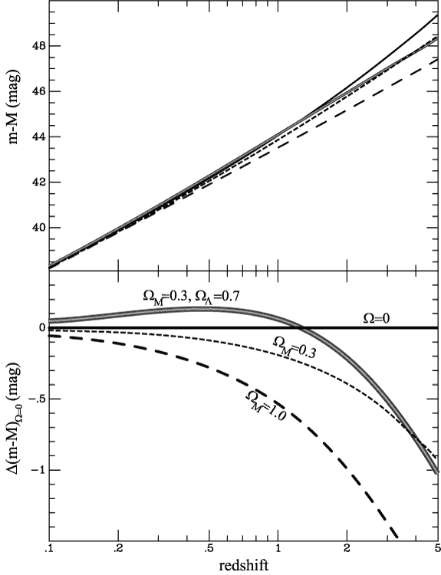
Where are we …
SN Factory
Carnegie SN Project
SDSSII
ESSENCE
CFHT Legacy Survey
Higher-z SN Search
(GOODS)
SNAP/Euclid/LSST
Plus the local searches:
LOTOSS, CfA, ESC

Slide 31
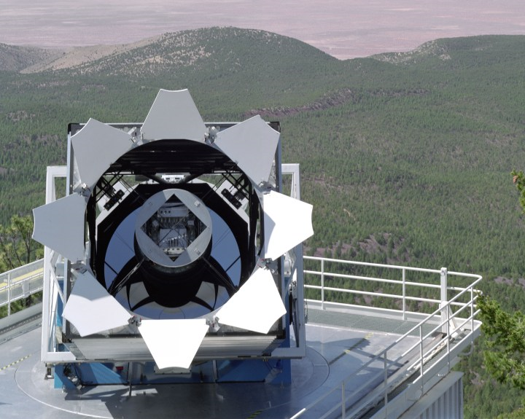
SDSS-II Supernova Search
World-wide collaboration to find and characterise SNe Ia with 0.04 < z < 0.4
Search with Sloan 2.5m telescope
Spectroscopy with HET, ARC, Subaru, MDM, WHT, Keck, NTT
Goal: Measure distances to 500 SNe Ia to bridge the intermediate redshift gap

Slide 32
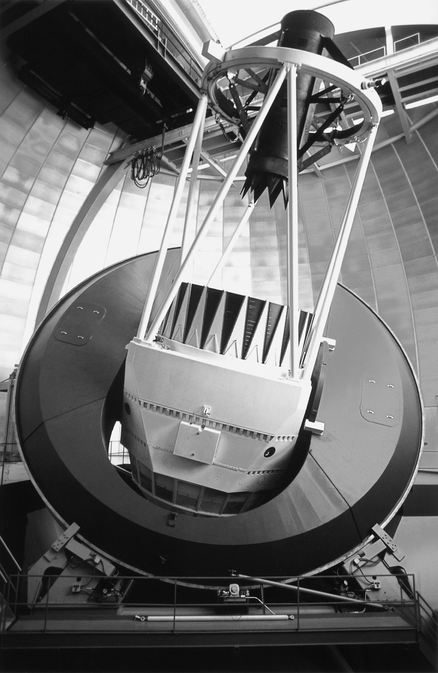
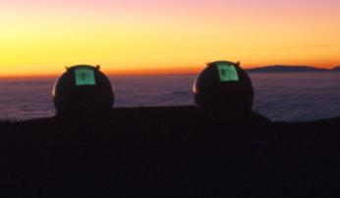
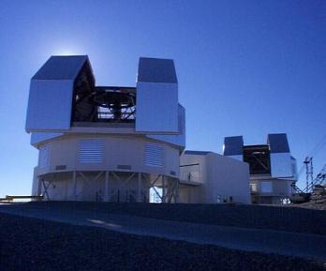
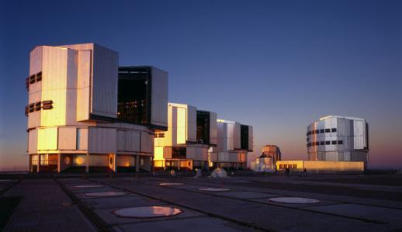
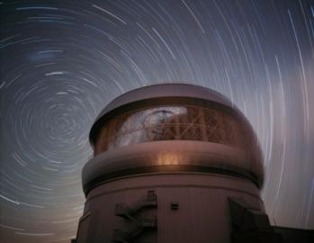
ESSENCE
World-wide collaboration to find and characterise SNe Ia with 0.2 < z < 0.8
Search with CTIO 4m Blanco telescope
Spectroscopy with VLT, Gemini, Keck, Magellan
Goal: Measure distances to 200 SNe Ia with an overall accuracy of 5% → determine ω to 10% overall

Slide 33
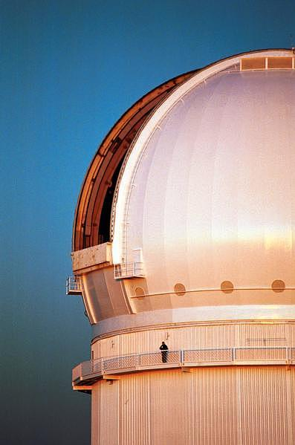
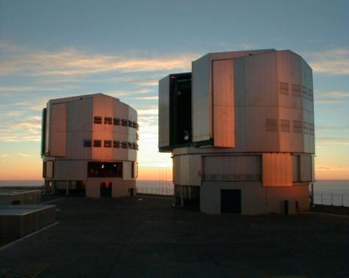
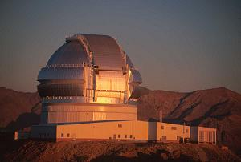
SNLS – The SuperNova Legacy Survey
World-wide collaboration to find and characterise SNe Ia with 0.2 < z < 0.8
Search with CFHT 4m telescope
Spectroscopy with VLT, Gemini, Keck, Magellan
Goal: Measure distances to 700 SNe Ia with an overall accuracy of 5% → determine ω to 7% overall

Slide 34
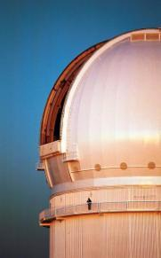
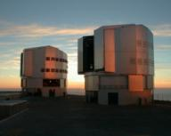


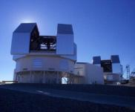
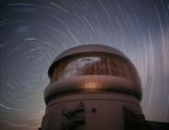
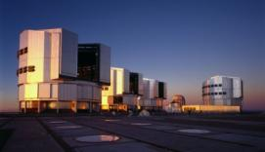
Current surveys
SNLS
Astier et al. 2006 – 71 distant SNe Ia
various papers describing spectroscopy (Lidman et al. 2006, Hook et al. 2006, Garavini et al. 2007, Bronder et al. 2008, Ellis et al. 2008, Ballande et al. 2009), rise time (Conley et al. 2006), SN rates (Sullivan et al. 2007, Graham et al. 2008) and individual SNe (Howell et al. 2006, 2009)
ESSENCE
Wood-Vasey et al. 2007 – 60 distant SNe Ia
Miknaitis et al. 2007 – description of the survey
Davis et al. 2007 – comparison to exotic dark energy proposals
spectroscopy (Matheson et al. 2005, Blondin et al. 2006, Foley et al. 2008, 2009)
time dilation (Blondin et al. 2008)
“other”: Becker et al. (2007 – TNOs) Boutsia et al. (2009 – AGNs)

Slide 35
Cosmological results
No changes compared to previous data sets
flat
Kowalski et al. 2008

Slide 36
Cosmology results
SNLS 1st year (Astier et al. 2006)
71 distant SNe Ia
flat geometry and combined with BAO results
Ω_{M} = 0.271 ± 0.021 (stat) ± 0.007 (sys)
w = -1.02 ± 0.09 (stat) ± 0.054 (sys)
ESSENCE 3 years (Wood-Vasey et al. 2007)
60 distant SNe Ia
plus 45 nearby SNe Ia, plus 57 SNe Ia from SNLS 1st year
flat geometry and combined with BAO
w = -1.07 ± 0.09 (stat) ± 0.13 (sys)
Ω_{M} = 0.27 ± 0.03

Slide 37
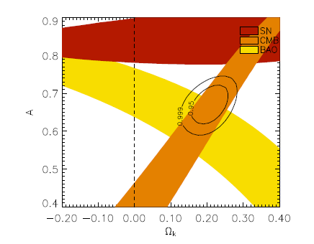
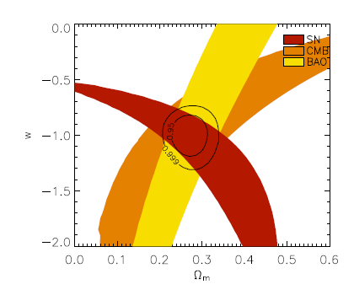
Comparison to other models
Davis et al. 2007
flat ΛCDM
DGP model
standard Chaplygin gas
variable ω

Slide 38
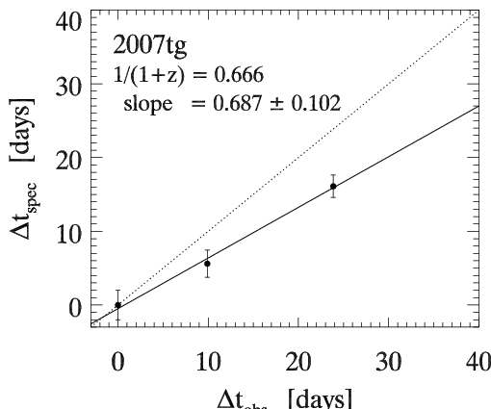
Time dilation
Spectroscopic clock in the distant universe
(z ~ 0.5)
Observed Wavelength [Å]
Δt_{obs} [days]
Blondin et al. (2008)

Slide 39
Zeitdilatation
‘Tired Light’ can be excluded beyond doubt (Δχ²=120)
Blondin et al. (2008)

Slide 40
Where are we?
Already in hand
about 1000 SNe Ia for cosmology
constant ω determined to 5%
accuracy dominated by systematic effects
reddening, correlations, local field, evolution
Test for variable ω
required accuracy ~2% in individual distances
can SNe Ia provide this?
can the systematics be reduced to this level?
homogeneous photometry?
handle 250000 SNe Ia per year?

Slide 41
Why are we not done yet?
Problems with the following items:
Intrinsic SN Ia colours
Reddening law
Sample contamination
“demographics” or “secondary evolution”
systematics
Further work:
Evaluation of the supernova properties
Reconstruction of the expansion history
Combination with other cosmological measurements
Comparison with exotic cosmology models

Slide 42
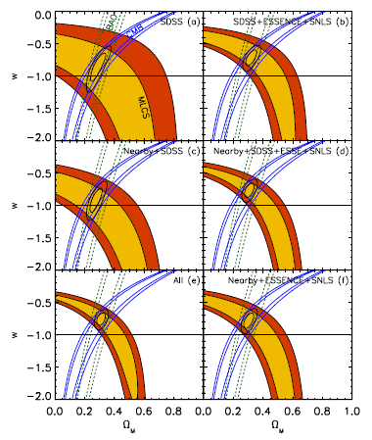
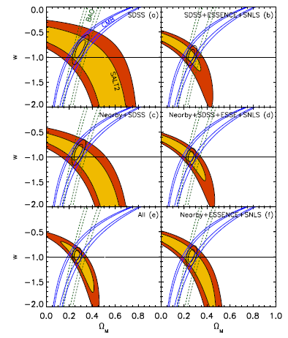
Comparison of different fitters
MLCS2k2
SALT2
Kessler et al. 2009

Slide 43
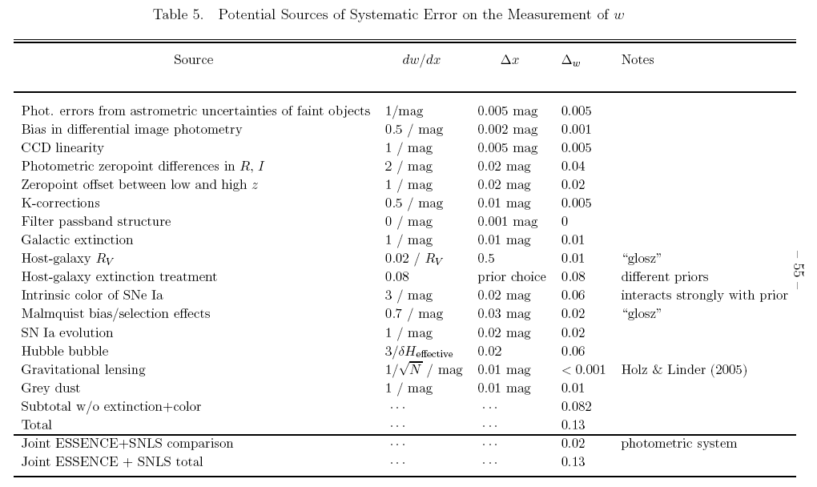
Systematics table
Wood-Vasey et al. 2007

Slide 44
The equation of state parameter ω
General luminosity distance
with and
ω_{M}= 0 (matter)
ω_{R}= ⅓ (radiation)
ω_{Λ}= -1 (cosmological constant)

Slide 45
Time variable ω?
Wood-Vasey et al. 2007

Slide 46
Model-independent reconstruction of the expansion history
Following Mignone & Bartelmann (2008)
Interpolate the expansion history with suitable functions
Assume a simply connected topology of the universe, homogeneous and isotropic, Robertson-Walker-Lemaître metric, and a smooth expansion rate
Makes use of Volterra integral equations of second kind solved by Neumann series
Smooth the SN distances to average out errors
Compare the resulting expansion history with known models

Slide 47
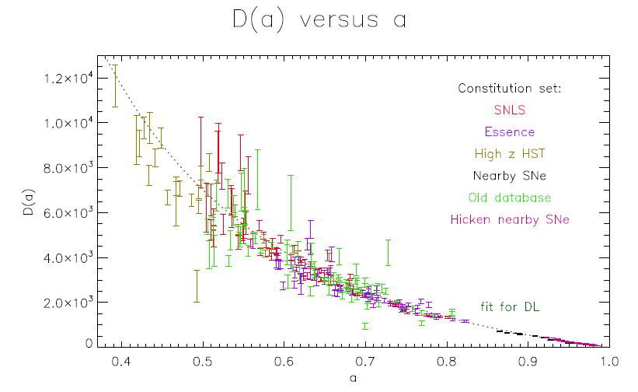
Application to SN data
Master thesis by Sandra Benitez (MPA) (supervision Fritz Röpke and Wolfgang Hillebrandt)

Slide 48
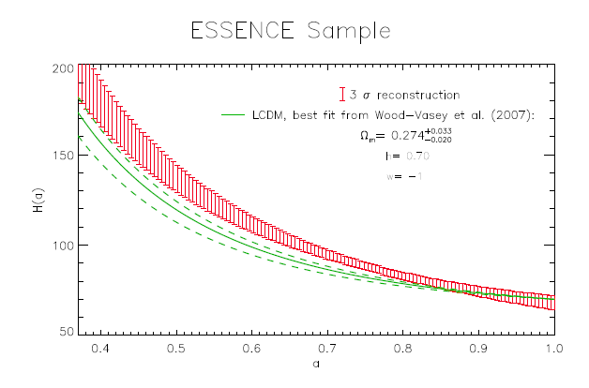
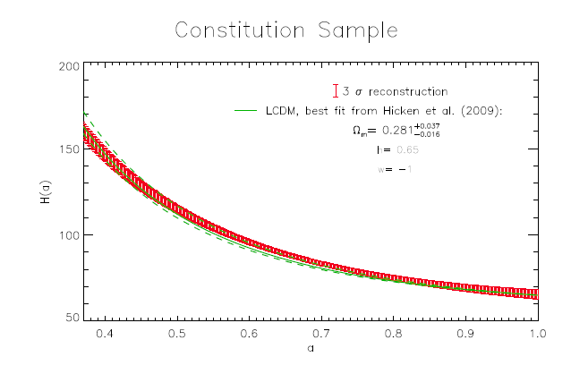
Not all is well with these data ...
Benitez 2009

Slide 49
Work to do
Collecting thousands of supernovae may be fun, but for future cosmology applications we
need to understand photometry
accuracy requirements strongly increased
need to understand their variations
simple correlations may work, but are ad hoc
need to solve the reddening problem
go to rest-frame IR?
JWST will show whether this works
Euclid offers a fantastic possibility here
understand another ‘dark’ component of the universe (dust)

Slide 50
Cosmology summary
Many SNe Ia measured
We are waiting for the next results
Full sample of ESSENCE project (~200 SNe Ia)
Three-year sample of SNLS (~300 SNe Ia)
Full six-year sample of SNLS (~500 SNe Ia)
Full three-year sample from SDSS (~500 SNe Ia)
No changes in the cosmological results
Improved error bars
Further improved treatment of systematics
SNe Ia further tested
No differences found so far

