Slide 1
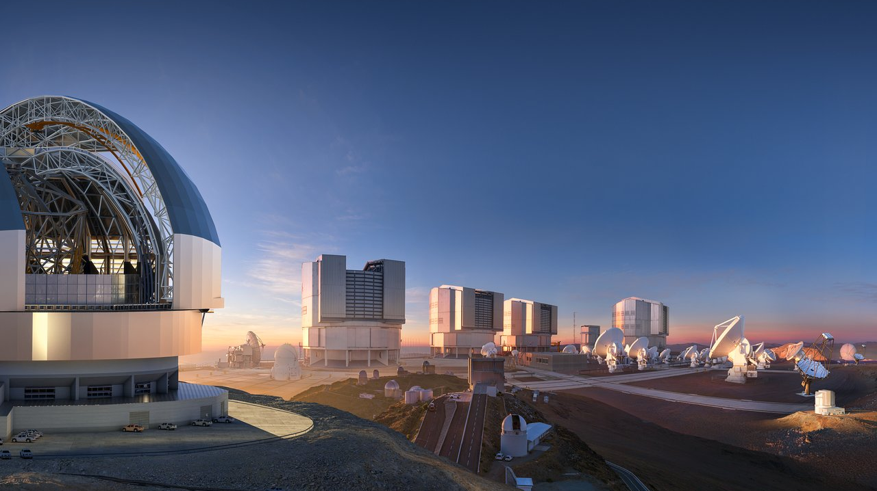
ESO’s Future Plans Bruno Leibundgut

Slide 2
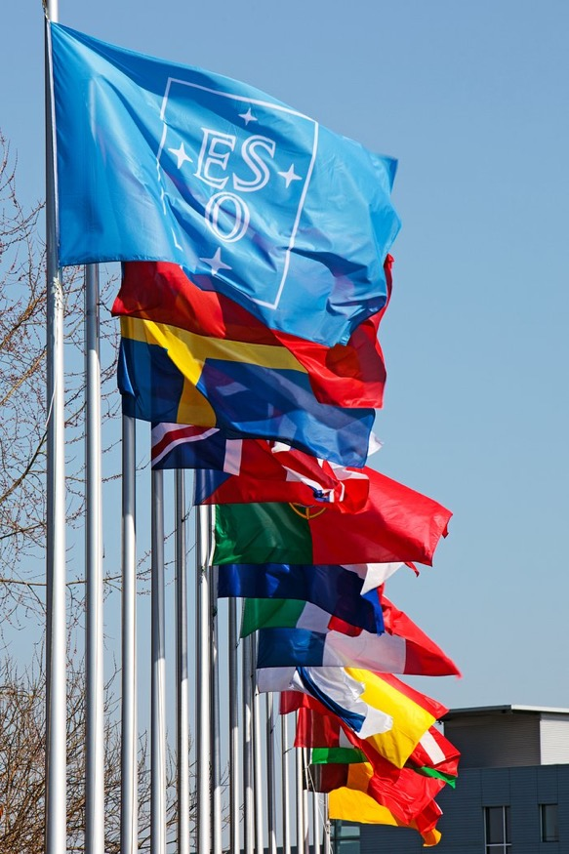
European Southern Observatory
ESO’s Mission
Develop + operate world-class observing facilities for astronomical research
Organise collaborations in astronomy
1962
ESO created by 5 Member States: BE, FR, DE, SE, NL
Goal: build a large telescope in southern hemisphere
Became the 3.6-m telescope on Cerro La Silla (1976)
Currently 16 Member States
Austria, Belgium, Czech Republic, Denmark, Finland, France, Germany, Ireland, Italy, Netherlands, Poland, Portugal, Spain, Sweden, Switzerland, United Kingdom
~30% of world’s astronomers
Host state: Chile
Strategic partner: Australia (until 2027)
Notes:
By pooling together resources in a stable organizational structure guaranteed to exist long-term, the collective can achieve more than any one part, and everyone wins in the long-term
IGO offers long-term financial planning and stability and certainty for science community; provides a known target of opportunity to work towards (e.g. 2nd generation ELT and 3rd gen VLT instrumentation)

Slide 3
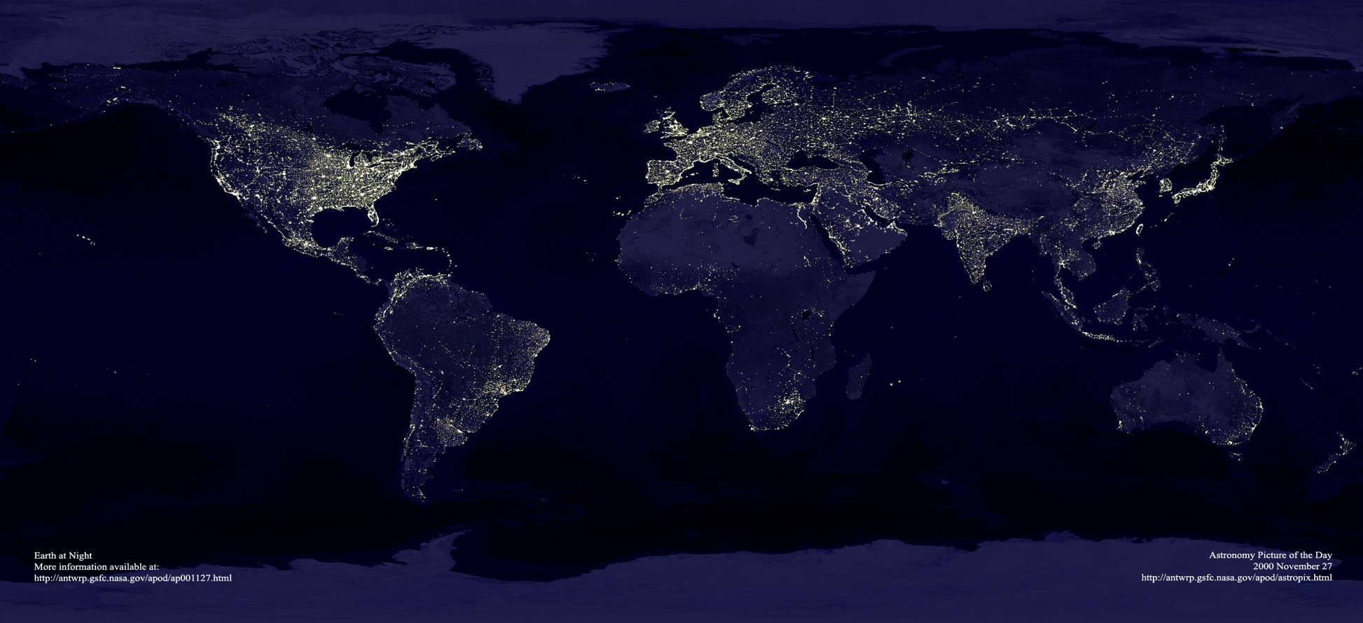
European Southern Observatory
Garching bei München
Chajnantor
Paranal
La Silla
Santiago

Slide 4
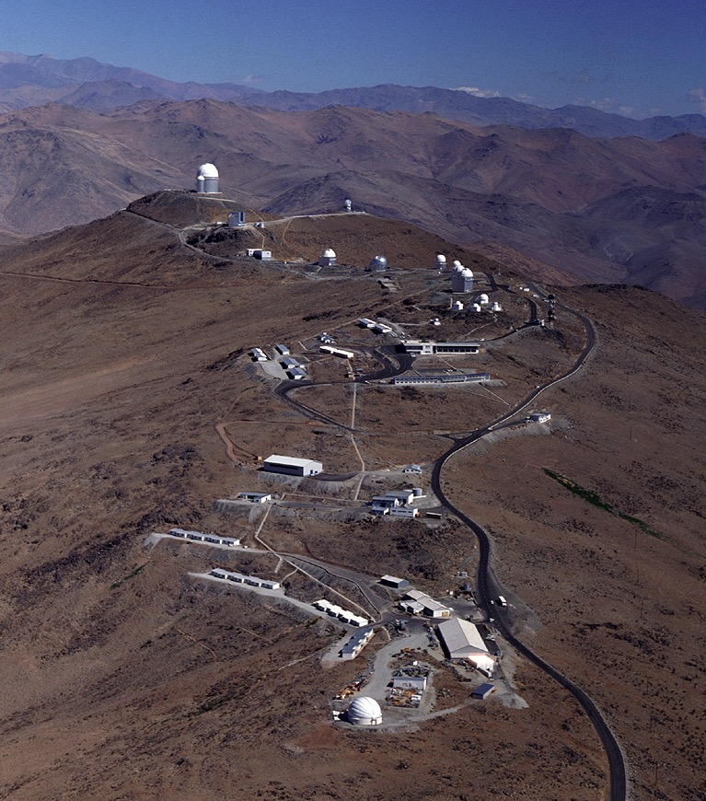
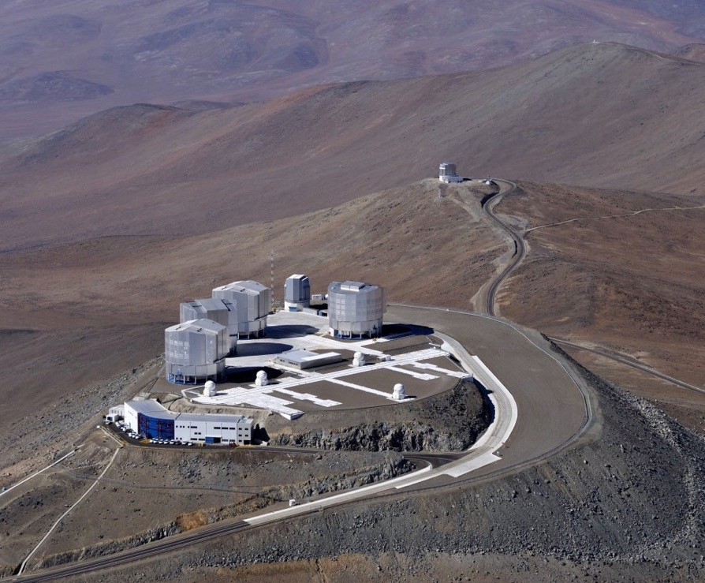

European Southern Observatory
La Silla and Paranal observatories in operation:
4 x 8m UTs, 4 x ATs for interferometry, (2 survey telescopes), 3.6m and NTT
La Silla
Paranal

Slide 5
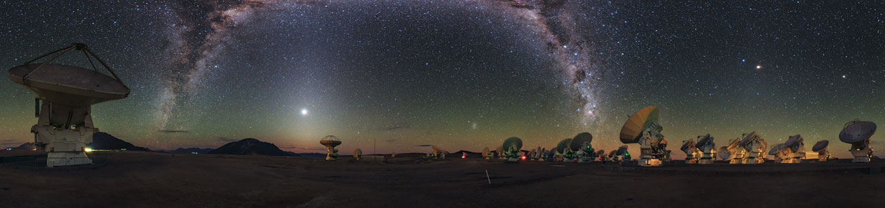
European Southern Observatory
La Silla and Paranal observatories in operation:
4 x 8m UTs, 4 x ATs for interferometry, 2 survey telescopes, 3.6m and NTT
Atacama Large Millimetre Array (ALMA)

Slide 6
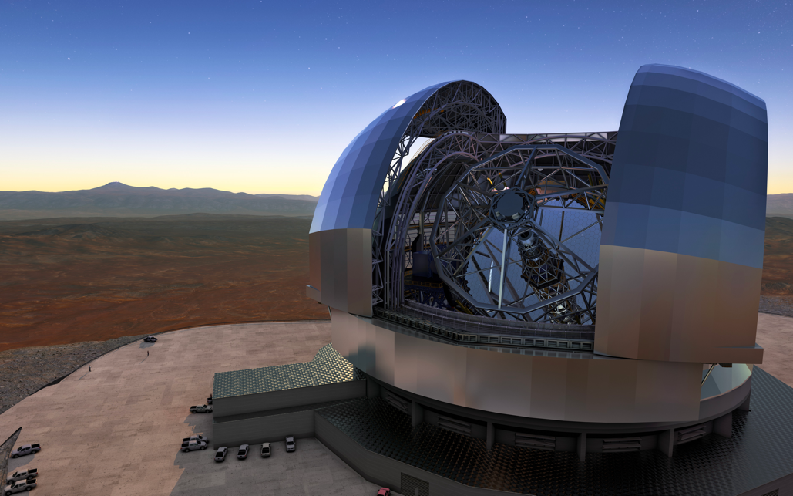
European Southern Observatory
La Silla and Paranal observatories in operation:
4 x 8m UTs, 4 x ATs for interferometry, 2 survey telescopes, 3.6m and NTT
Atacama Large Millimetre Array (ALMA)
Public data archive
ESO Extremely Large Telescope

Slide 7
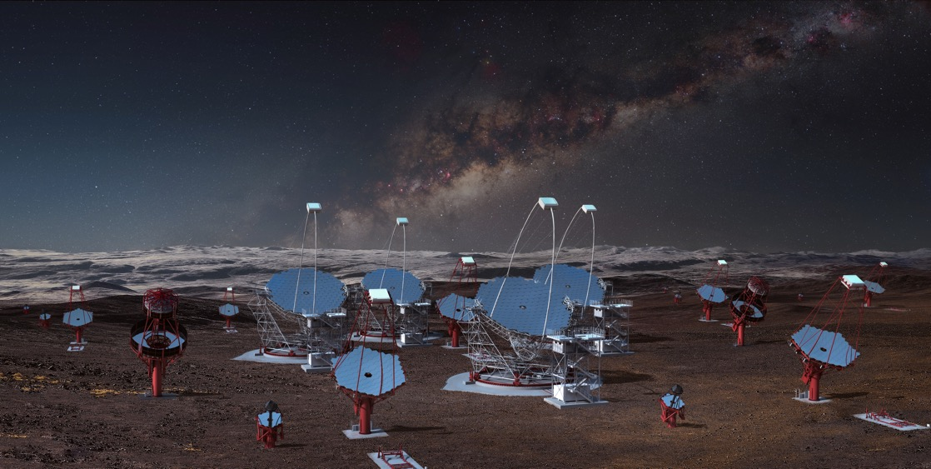
European Southern Observatory
La Silla and Paranal observatories in operation:
4 x 8m UTs, 4 x ATs for interferometry, 2 survey telescopes, 3.6m and NTT
Atacama Large Millimetre Array (ALMA)
Public data archive
ESO Extremely Large Telescope
Cherenkov Telescope Array (South)

Slide 8
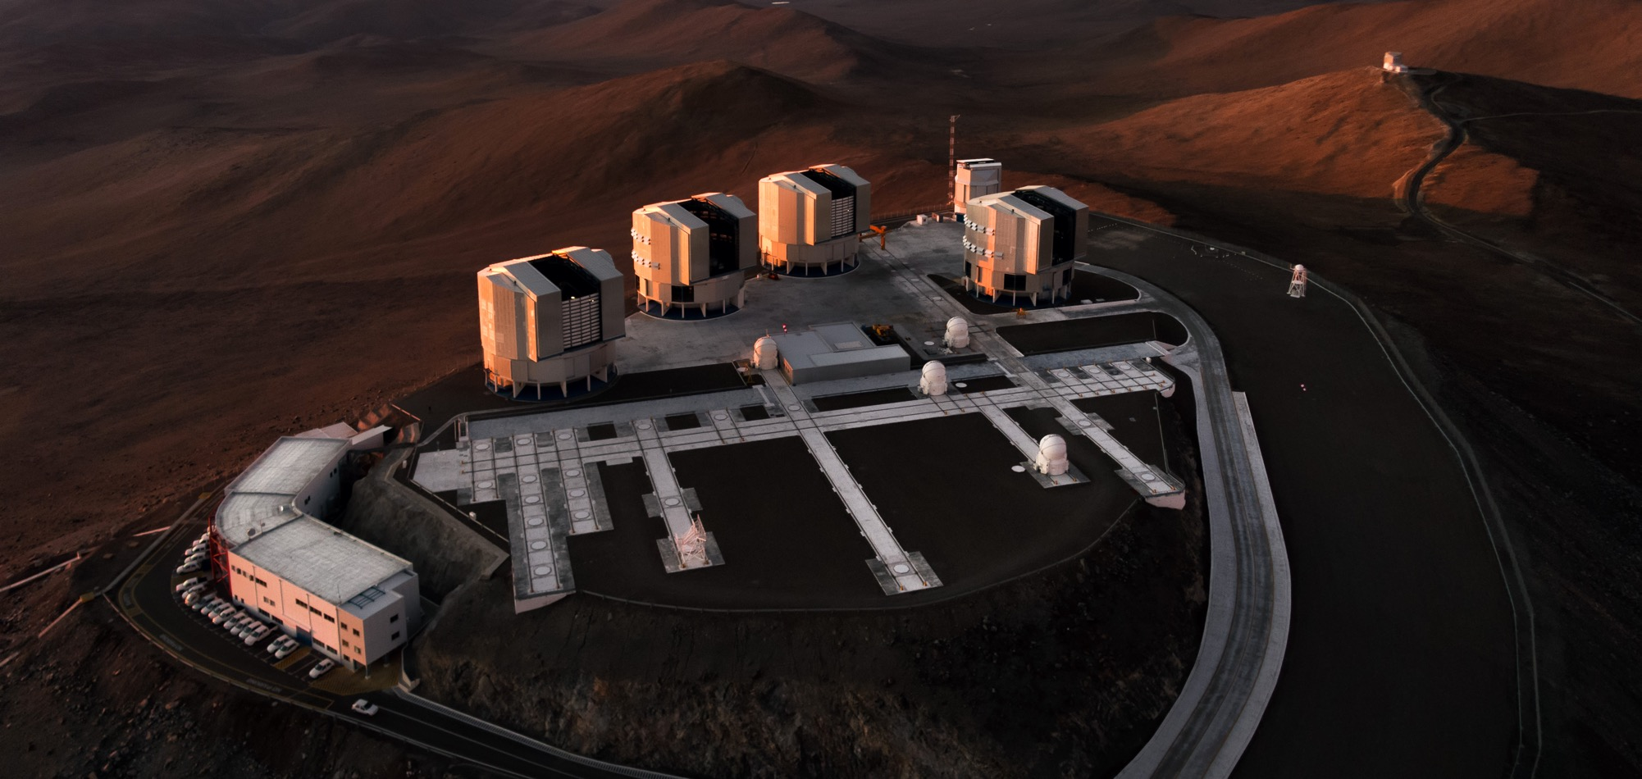
News from Paranal instrumentation

Slide 9
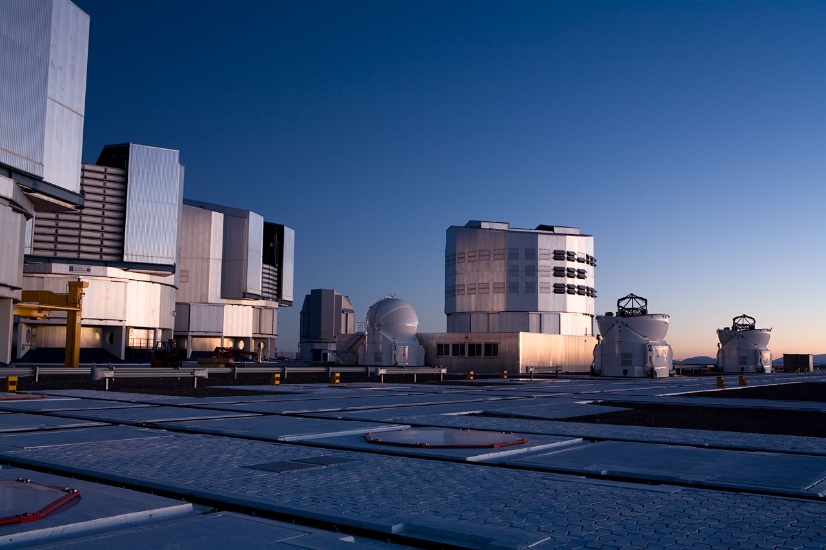
La Silla Paranal Facilities
VLT
Instrumentation operating, in assembly and planned
Covers the available optical infrared wavelengths 300nm to 20μm
Angular resolution from seeing limit to 50 μ-arcseconds
FORS2, UVES, FLAMES, VISIR, HAWK-I, X-Shooter, AOF, KMOS, MUSE, SPHERE, ESPRESSO, CRIRES, ERIS, MOONS, MAVIS, CUBES
VLTI
PIONIER, GRAVITY(+), MATISSE
VISTA
VIRCAM → 4MOST
NTT
EFOSC2, SOFI, SOXS
3.6m
HARPS, NIRPS

Slide 10
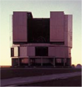
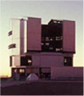
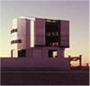
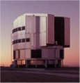
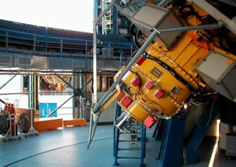
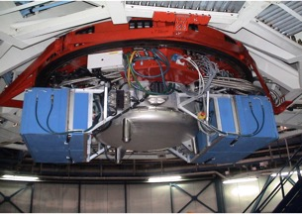
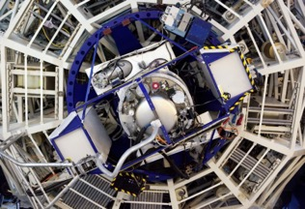
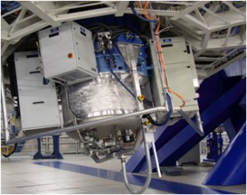
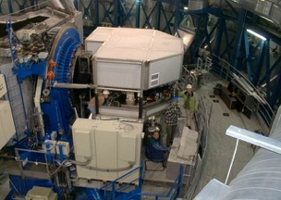
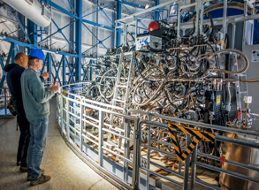
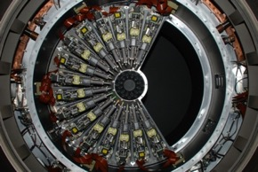
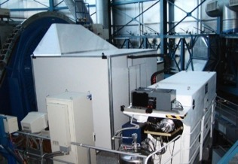
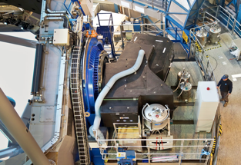
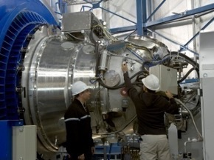
VLT Instruments 2022
UT1
UT2
UT3
UT4
FORS2
VISIR
X-SHOOTER
ERIS
UVES
CRIRES
MUSE
KMOS
FLAMES
SPHERE
HAWK-I

Slide 11
VLT Optical/Near-IR coverage

Slide 12
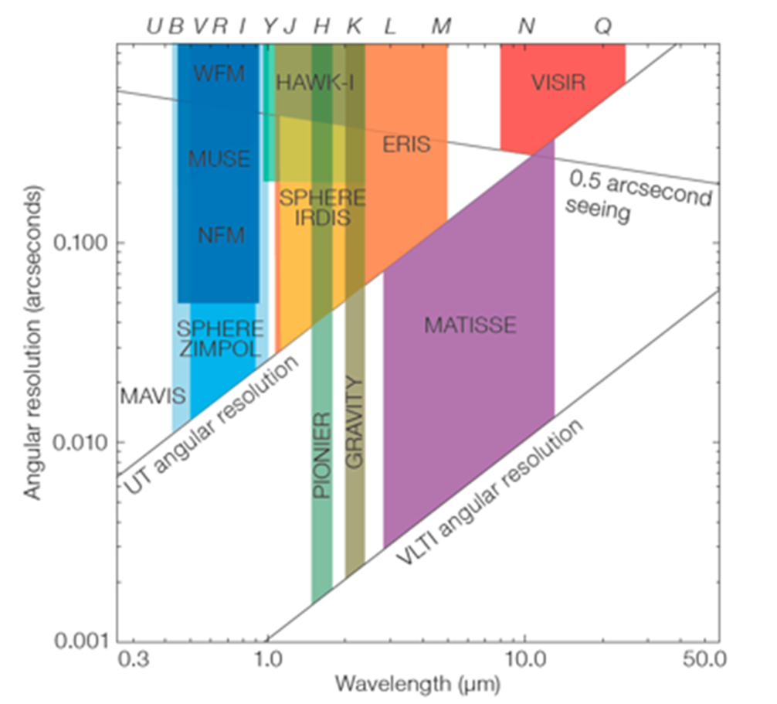
VLT/I Optical/Near-IR Coverage

Slide 13
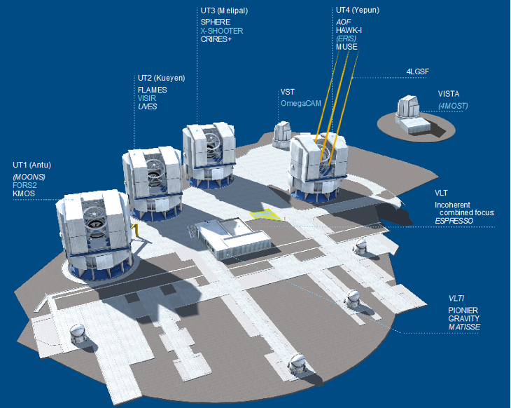
VLT/I in 2023

Slide 14
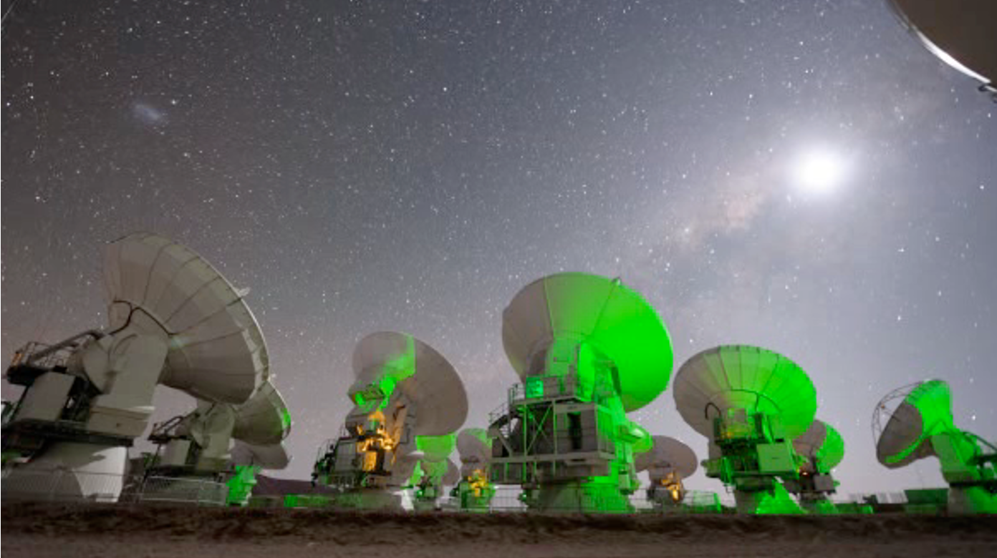
Atacama Large Millimeter Array
Observe the cold universe
wavelengths from 300μm to 1.3mm (1 THz to 200 GHz)
Global Partnership
Europe (ESO), North America (USA/NSF and Canada/NRC), East Asia (Japan/NINS, Taiwan/NSC/ASIAA, South Korea/KASI)
66 antennas located at 5000m altitude
50 12m antennas
12 7m + 4 12m antennas (compact array)

Slide 15

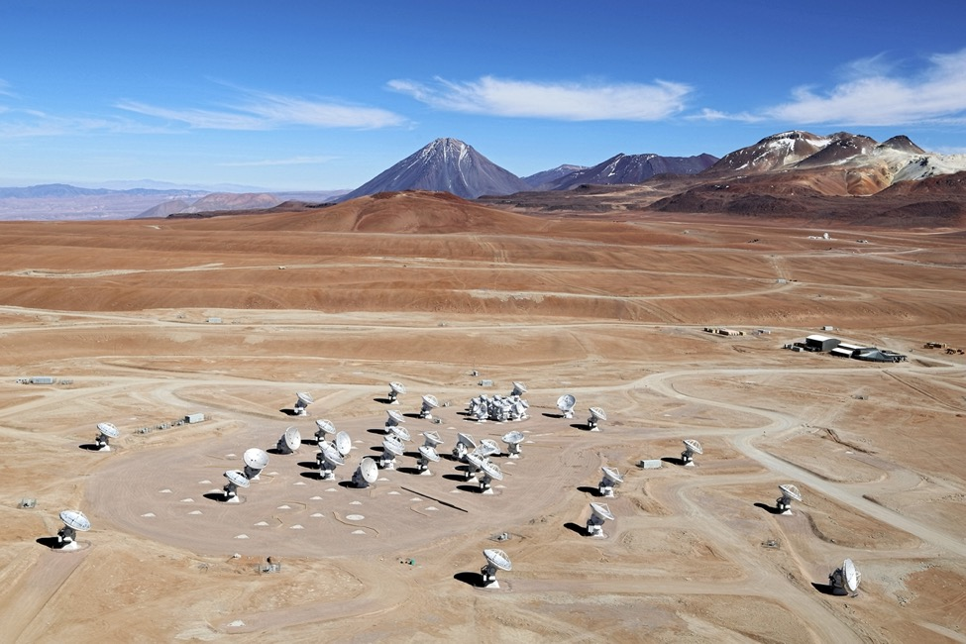


The ALMA observatory
Partnership: ESO (37.5%), NSF (37.5%), NINS (25%)
JAO established by the executives to run the on-site part of the observatory
Off-site operations at the ALMA Support Centres
ALMA Director leads the entire observatory

Slide 16
ALMA offsite activities at ESO
Operations:
Technical maintenance support
SW development & maintenance
ALMA archive
ALMA Regional Centre (ARC) provides science operations support, including user support
The European ARC is led by ESO and has contributions from several nodes across Europe
On-going development projects at ESO:
Band 2 receivers in pre-production
New Generation Observing Tool (incl rescue project)
Contribution to Wide-band Sensitivity Upgrade (WSU) planned

Slide 17
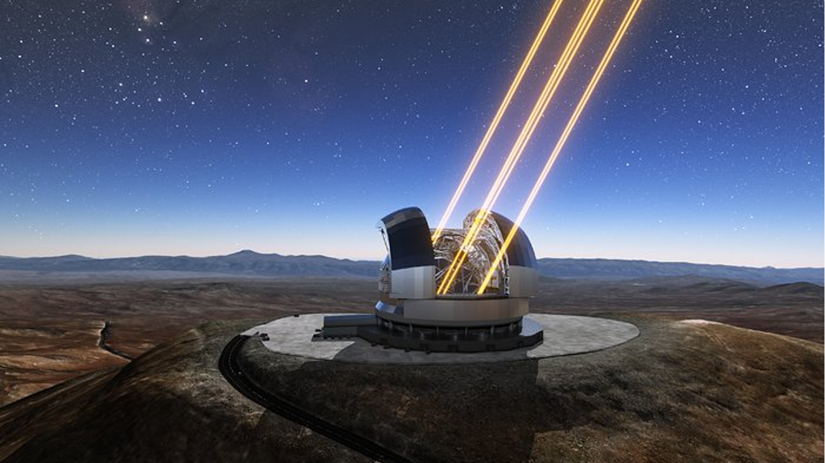
ESO's upcoming Extremely Large Telescope
Notes:
Here, on the nearby peak Cerro Armazones, we are also building “the world’s biggest eye on the sky” — ESO’s Extremely Large Telescope. This telescope will have a 39-m diameter primary mirror, consisting of 798 hexagonal segments, each measuring about 1.5 m across. The ELT will be able to gather 20 times more light than a single VLT Unit telescope.
Its dome is 80 m tall, and one needs 30 minutes to walk from the entrance of the dome to the top via the set of stairs and walkways on the inner side of the dome.

Slide 18
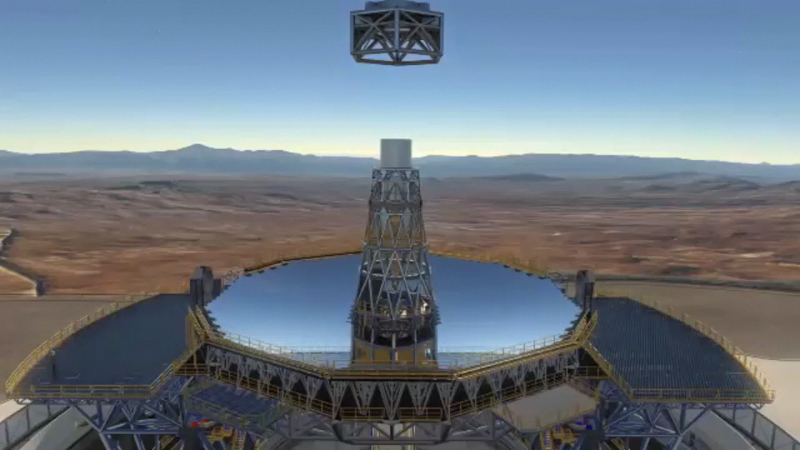

ELT Optomechanics

Slide 19
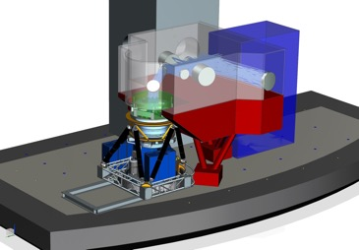
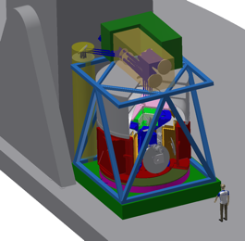
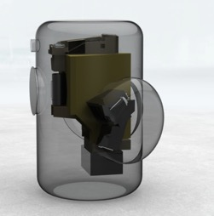
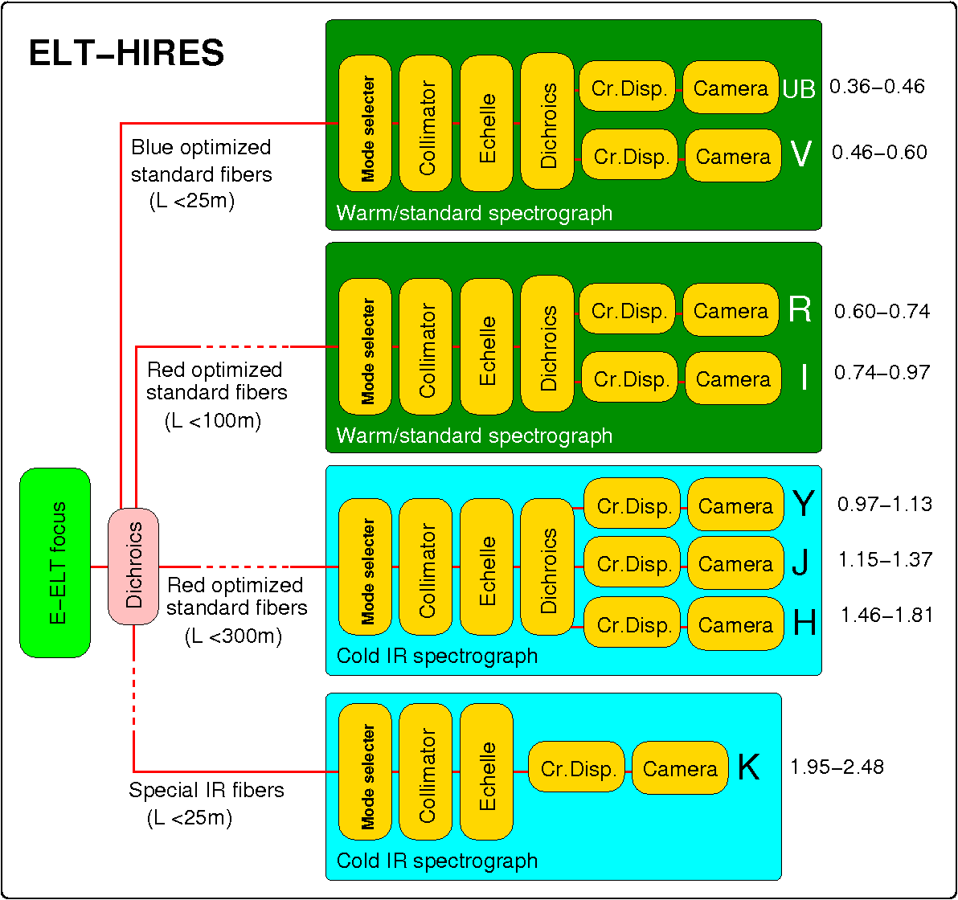
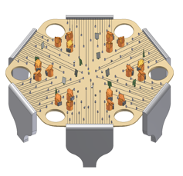
ELT Instrumentation Programme
First generation instruments (2024-25)
MICADO+MORFEO
Imager and single slit spectrograph
HARMONI
Integral Field Spectrograph
METIS
Mid-IR imager and spectrograph
Second generation instruments (completed Phase A)
ANDES
High resolution spectrograph
MOSAIC
Multi-object spectrograph
PCS
Extreme AO imager and spectrograph

Slide 20
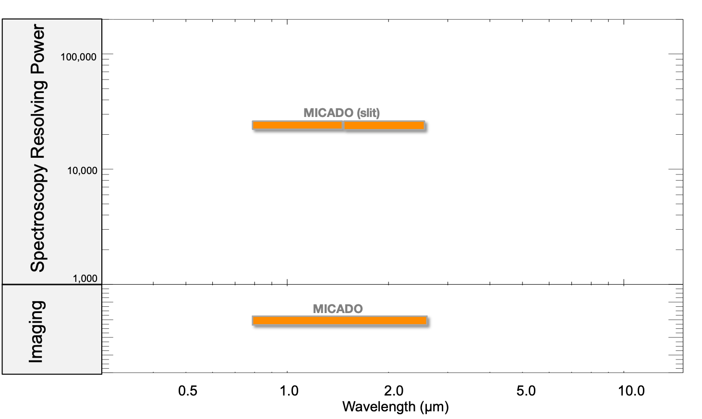
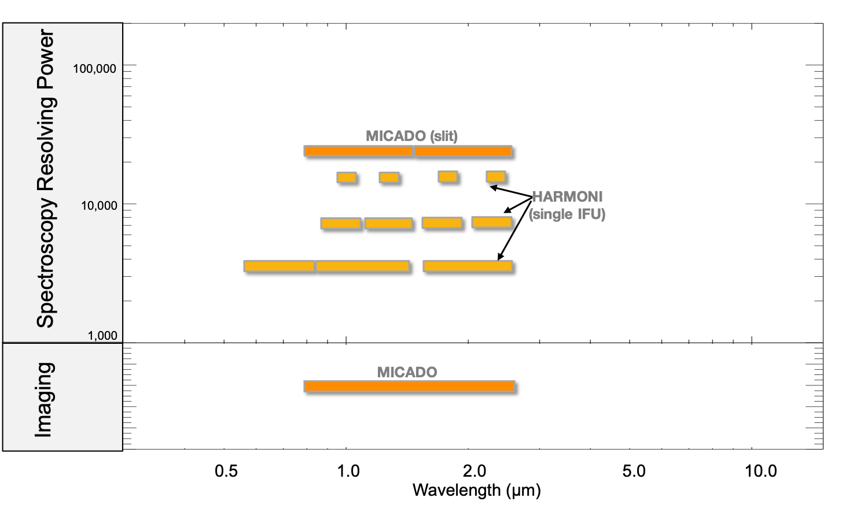
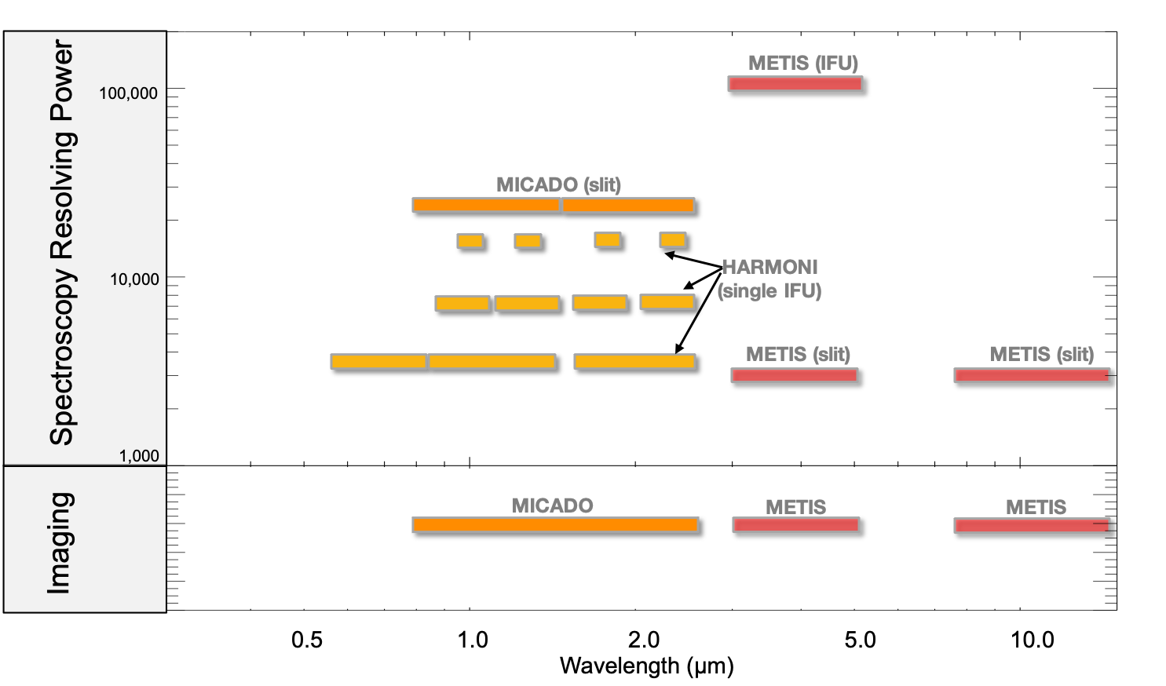
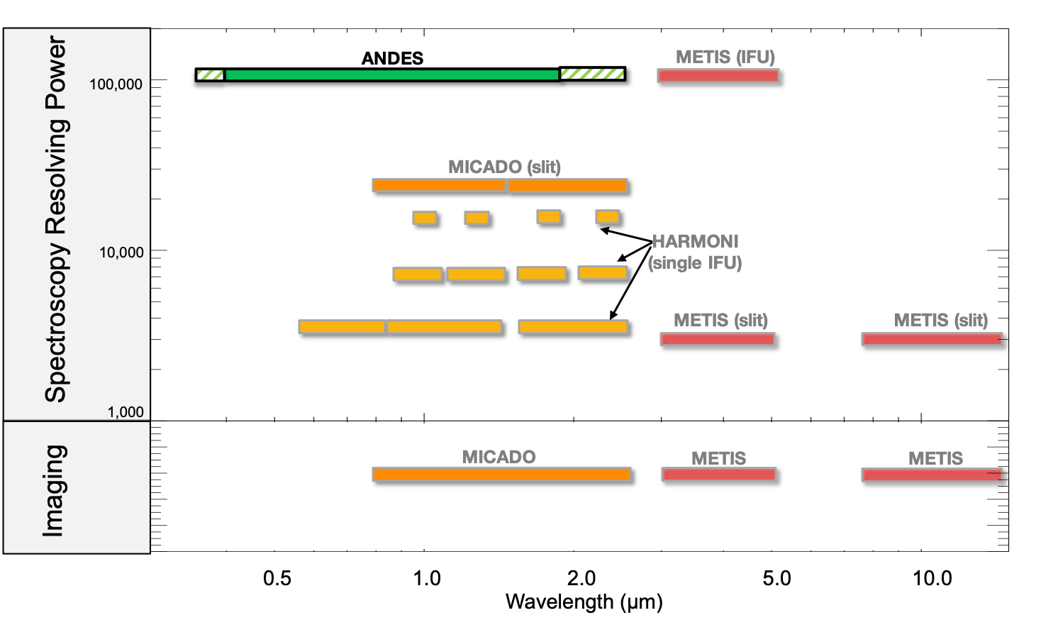
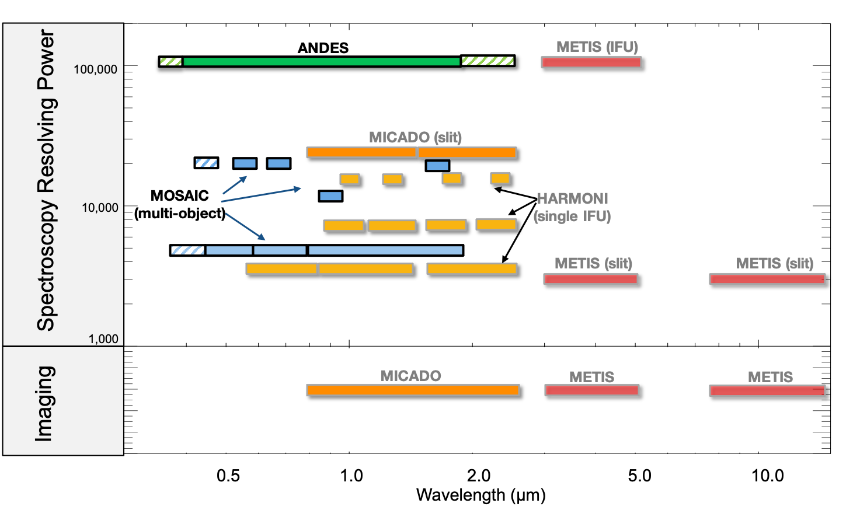
ELT Capabilities

Slide 21
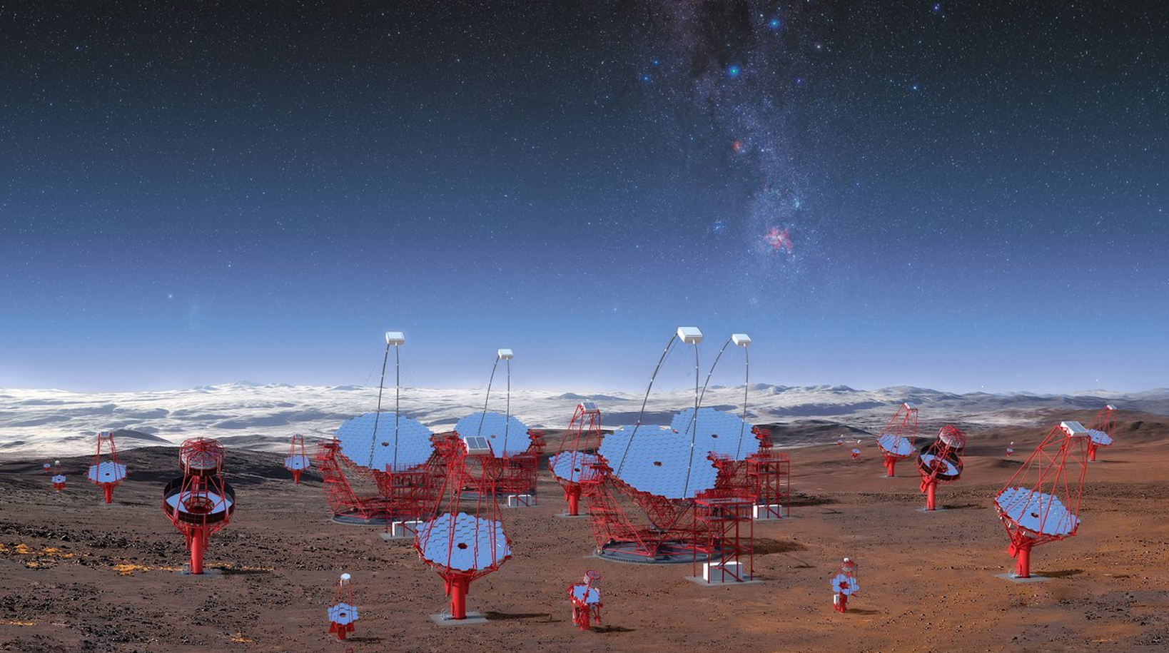

Cerenkov Telescope Array - South

Slide 22
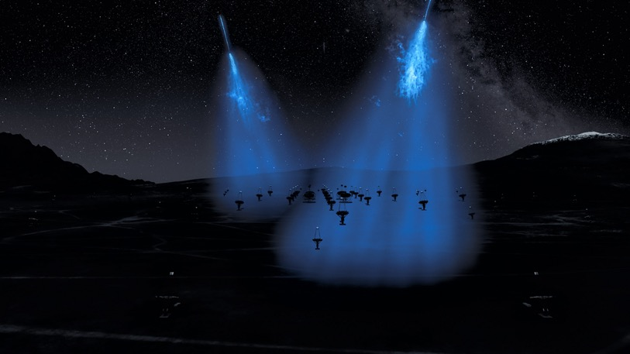
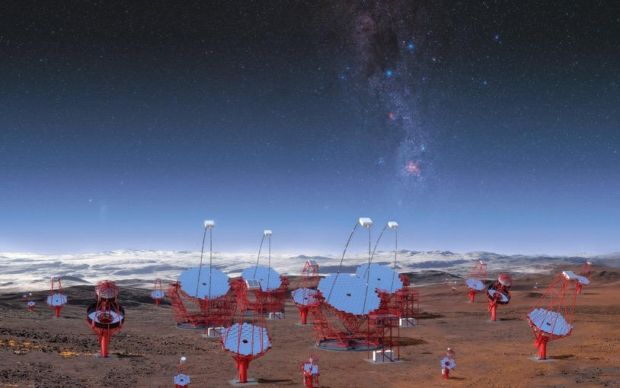
Čerenkov Telescope Array - South
CTA-Southern array to be hosted and operated by ESO in the Paranal-Armazones area
ESO is 8% partner of CTAO
Offers important operational and scientific synergies
Infrastructure construction ongoing
Construction of CTA may formally start in 2023

Slide 23
Notes:
The telescopes that ESO and its international partners have designed, built, and operate, enable astronomers to observe the Universe across a large portion of the electromagnetic spectrum.
These abilities will be further expanded once the Cherenkov Telescope Array South, the world’s largest and most sensitive gamma-ray observatory, which will be hosted and operated by ESO at Paranal, joins the team.

Slide 24
ESO Opportunities
Flexibility
large instrumentation complement
Uniqueness
explore special features of our observatories
e.g. interferometry (VLTI)
provide unique capabilities for simultaneous coverage of large wavelength ranges
e.g. observations of Comet Shoemaker-Levy 9 or Hale-Bopp, AT2019gfo/GW170817
Complementarity
spectral follow-up of imaging surveys
monitoring of special objects

Slide 25

ESO – an integrated system
ALMA and ELT: flagship facilities
VLT: unique capabilities
Interferometry → VLTI
Large instrument complement, adaptive optics, flexibility, modern operations model
La Silla/4m telescopes: dedicated
Transients: NTT; SOXS
Exo-planets: 3.6m; HARPS/NIRPS
Multi-object spectroscopy: 4MOST@VISTA
Platform for smaller experiments: La Silla
ESO and ALMA Archives
Rich resources of optical/NIR and sub-mm data
Large coherent data sets from surveys
Advanced data products

Slide 26
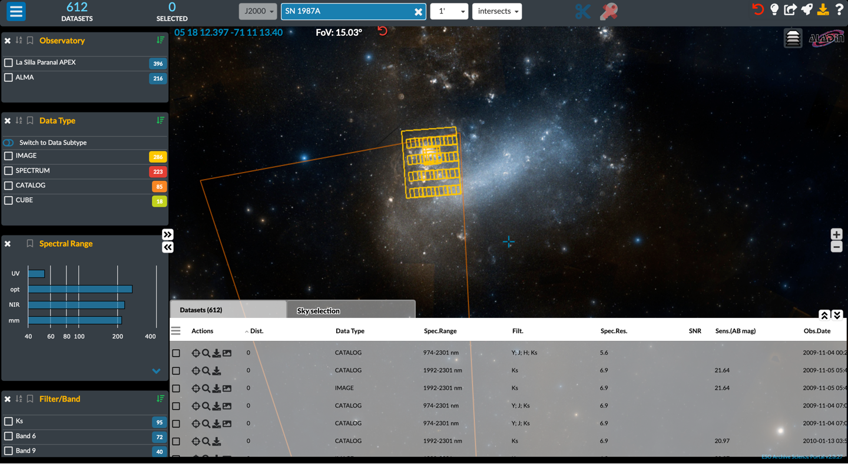
Data Curation/Archives
Increasing importance of data products
Community expects uniform data products for surveys
Legacy
GAIA, ESO surveys, EUCLID, PLATO
Archives most useful, when data can be applied to science questions (“science-ready data”)
Data access
Importance of data discovery
Synergies between ESA and ESO archives
ESASky:
ESO portal to LPO and ALMA data
Coordination of some developments

Slide 27
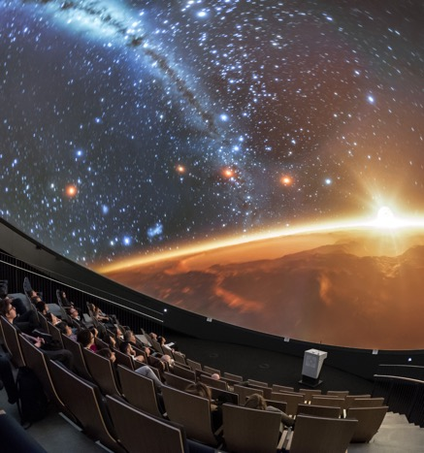
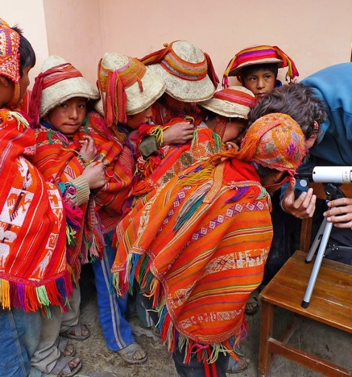
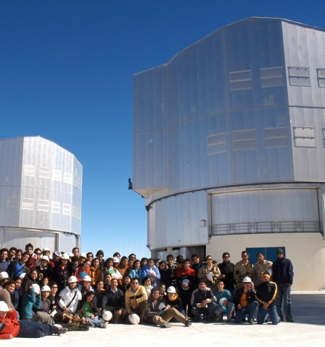
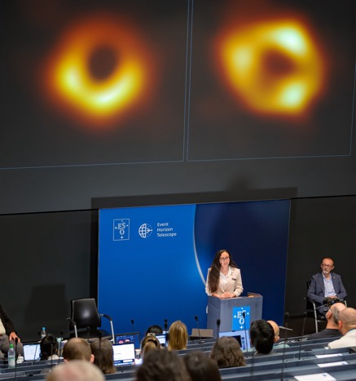
Reaching out
ESO disseminates scientific and engineering breakthroughs of ESO’s community at large and brings the public closer to science
Organise public visits to ESO observatories
New model in conceptual development
Foster engagement in STEM fields at the ESO Supernova Planetarium & Visitor centre
Broaden support to local communities

Slide 28
