Slide 1
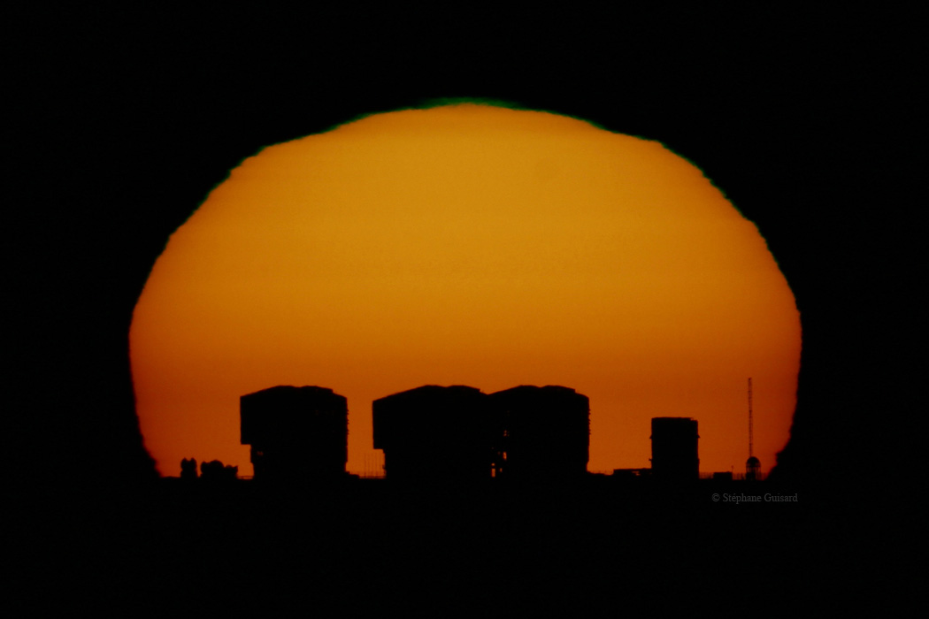
ESO Today and Tomorrow

Slide 2
European Southern Observatory
Mission
Develop and operate world-class observing facilities for astronomical research
Organize collaborations in astronomy
Intergovernmental treaty-level organization
Founded in 1962, by 5 countries
Finland joined in 2004
Currently 14 member states
Observatories in Chile
Optical/infrared: La Silla and Paranal
Sub-mm: APEX and ALMA partnerships: Chajnantor
HQ in Garching and Office in Santiago

Slide 3
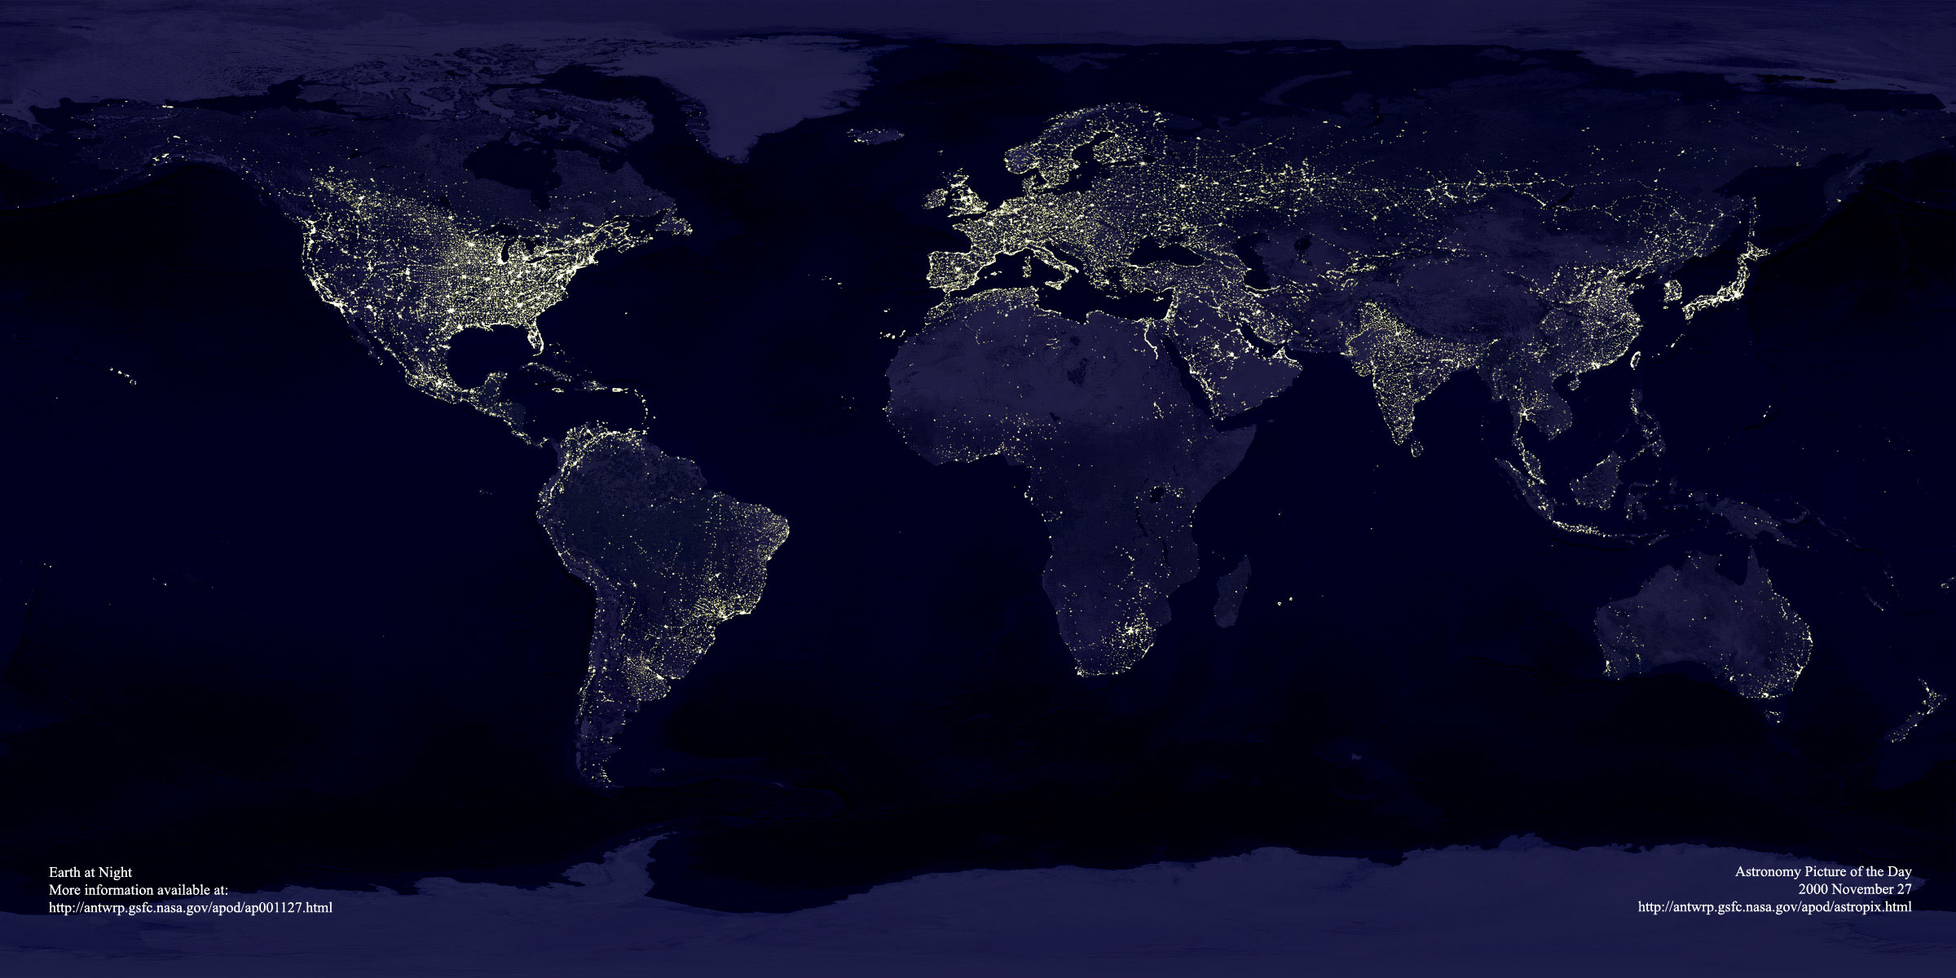
ESO’s world
ESO’s sites
Garching bei München
Chajnantor
Paranal
La Silla
Santiago

Slide 4
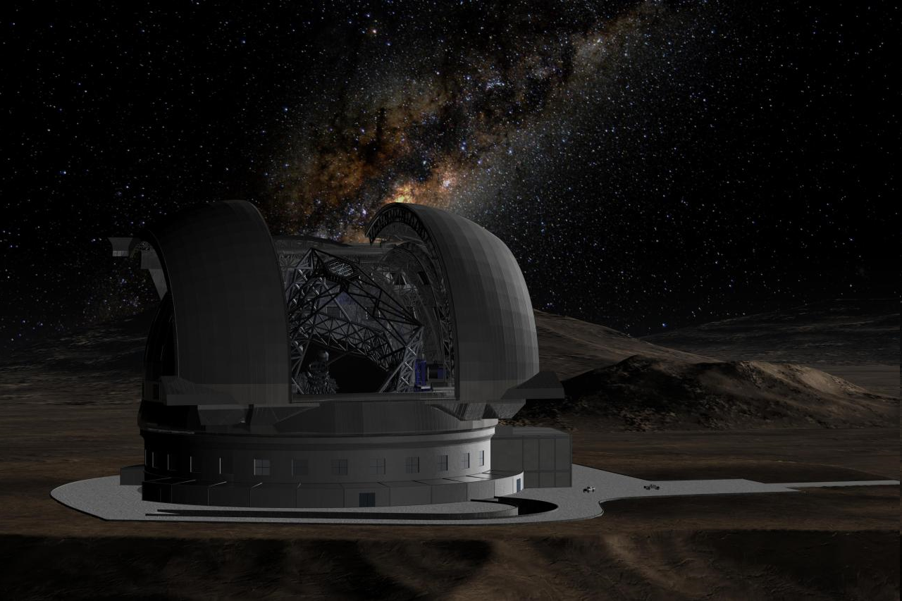
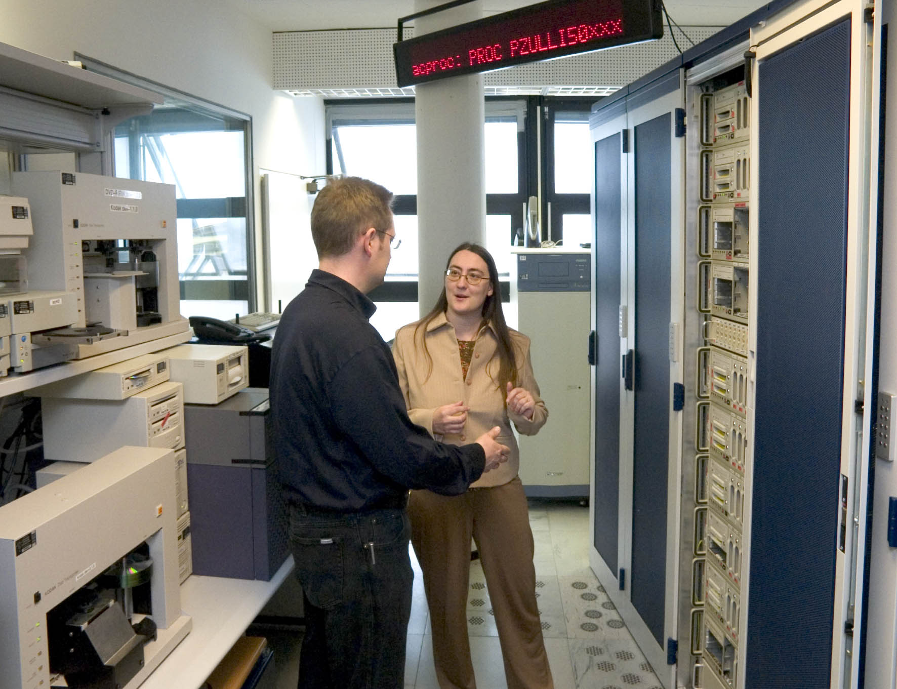
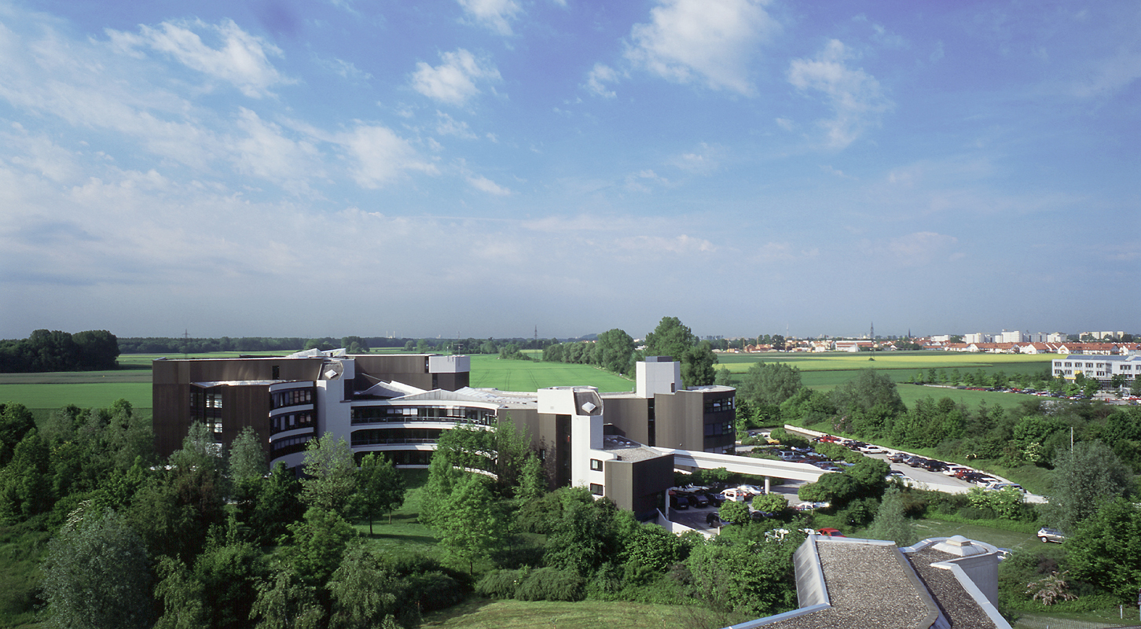
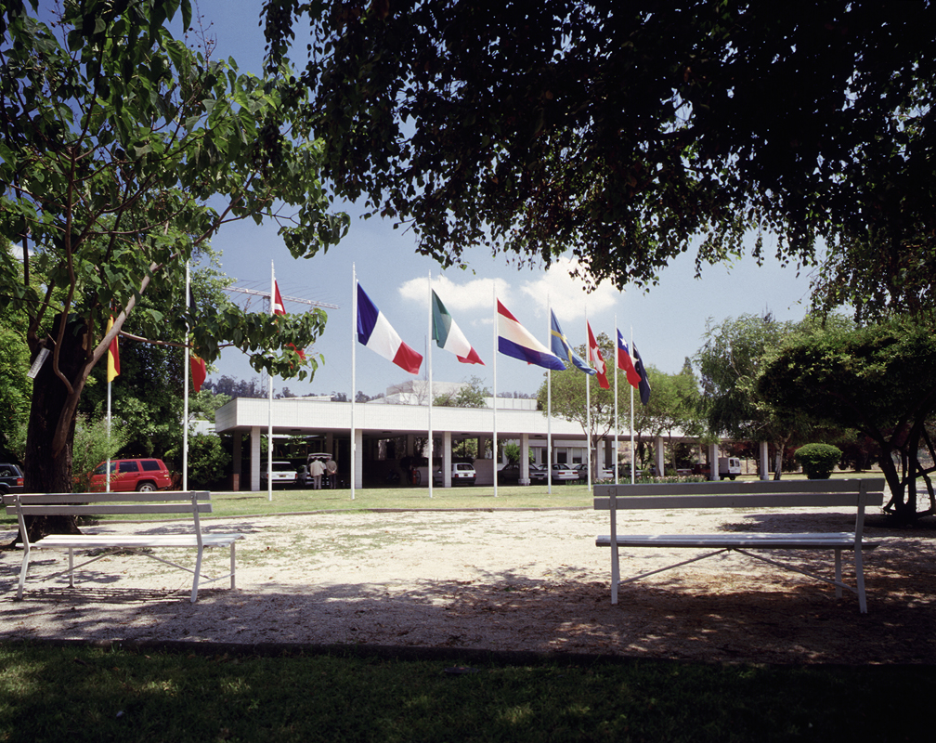
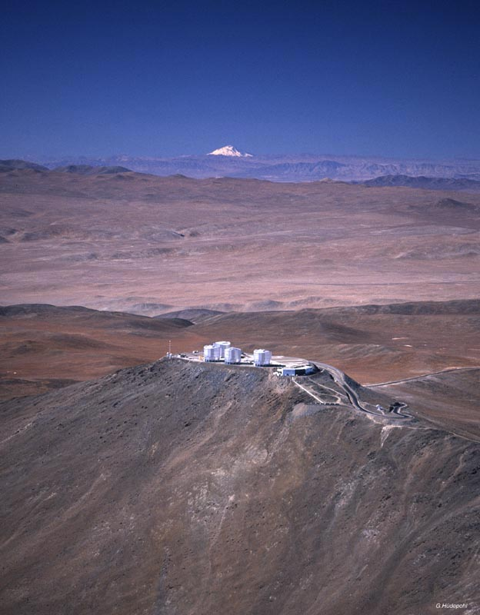
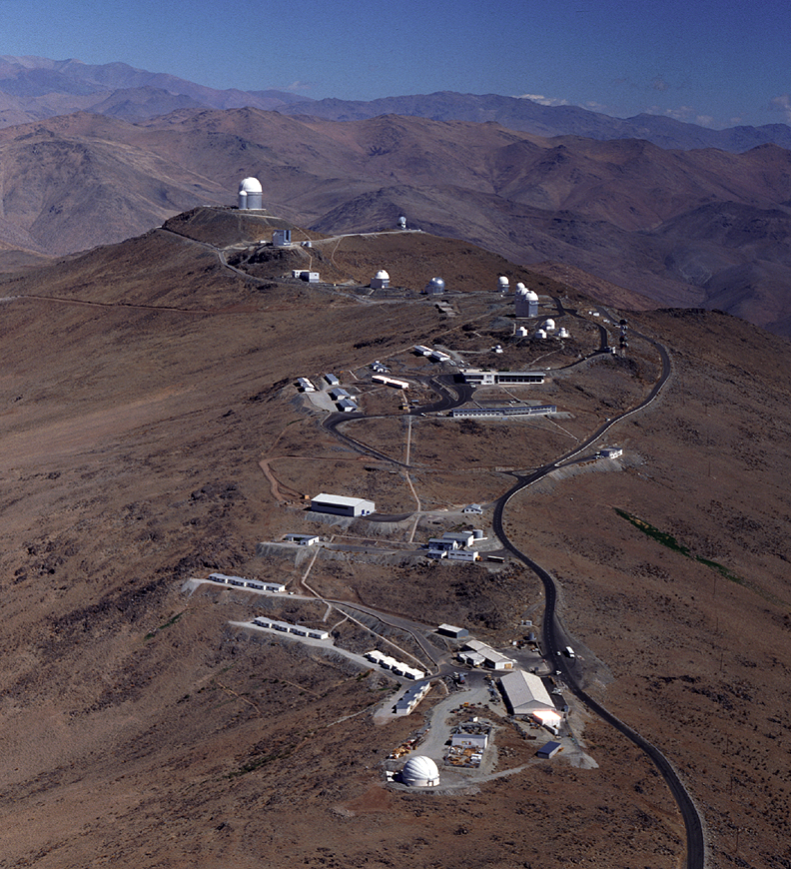
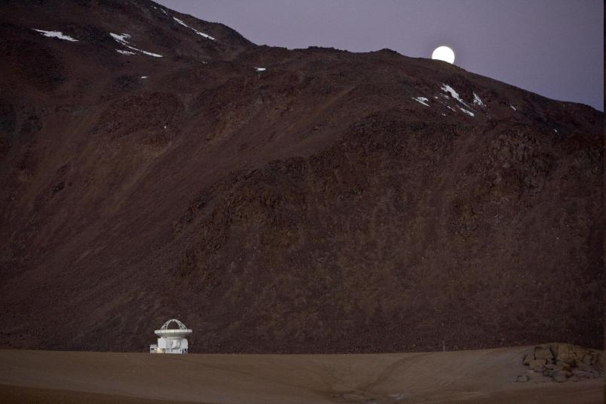
ESO Today
La Silla and Paranal Observatory in full operations (8 telescopes in 2010, plus four telescopes for interferometry)
APEX operating on Chajnantor
ALMA under construction (early science in 2011, full operations in 2013)
Operational data archive
European Extremely Large Telescope in design phase
Headquarters in Garching, Germany
Representation in Santiago, Chile

Slide 5
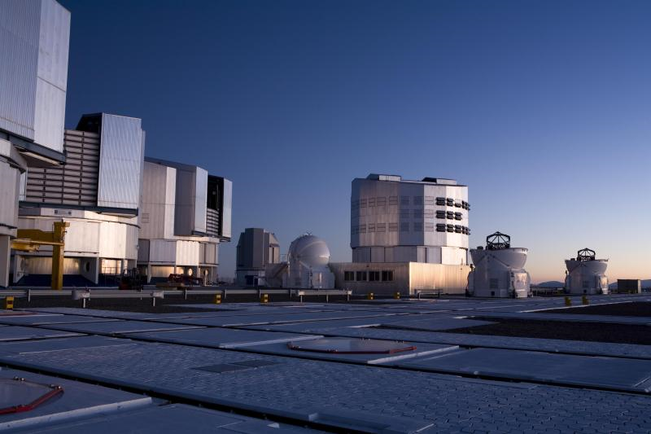
La Silla Paranal
VLT/I (Paranal)
Instrumentation operating, in assembly and planned
Covers the available optical infrared wavelengths 300nm to 20μm
Angular resolution from seeing limit to 50 μ-arcseconds
FORS2, ISAAC, UVES, FLAMES, NACO, SINFONI, CRIRES, VISIR, HAWK-I, VIMOS, X-Shooter, laser guide star facility KMOS, MUSE, SPHERE, Adaptive Optics Facility
MIDI, AMBER, PRIMA, GRAVITY, MATISSE
VISTA/VIRCAM
VST/ΩCam

Slide 6
La Silla Paranal
La Silla
Continue operations with long-term programmes
HARPS, EFOSC2, SOFI, FEROS, WFI, visitor instruments
APEX
Covers sub-mm and mm wavelengths 0.3 to 3 mm
SHFI (Swedish Heterodyne Facility Instrument), LABOCA, SABOCA, APEX-SZ, CHAMP+

Slide 7
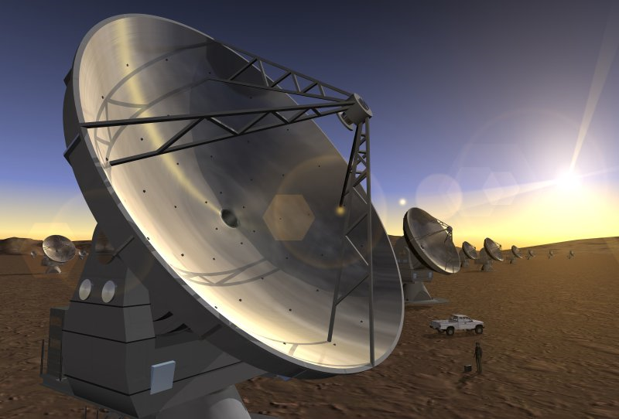
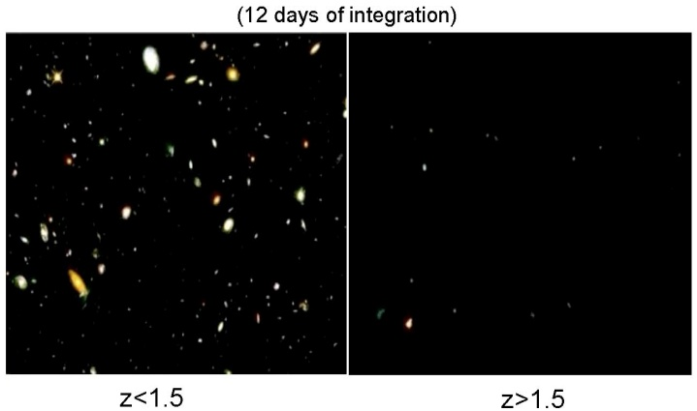
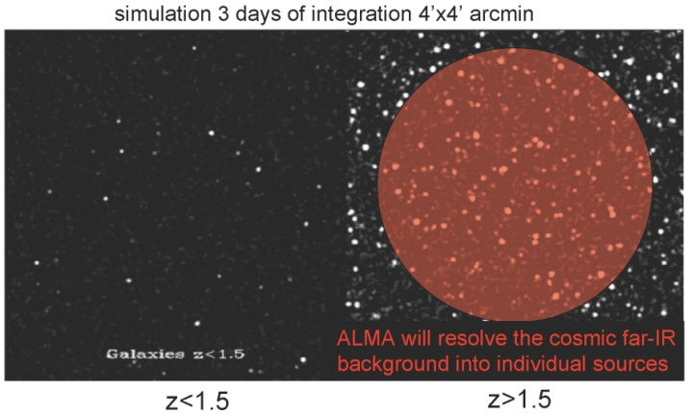
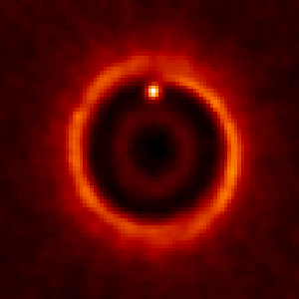

ALMA
Science requirements
Detect CO and [CII] in Milky Way galaxy at z=3 in < 24 hr
Dust emission, gas kinematics in proto-planetary disks
Resolution to match Hubble, JWST and 8-10m with AO
Complement to Herschel
Specifications
66 antennas (54x12m, 12x7m)
14 km max baseline (< 10mas)
30-1000 GHz (10–0.3mm), up to 10 receiver bands
HST
ALMA
5AU
850 GHz

Slide 8
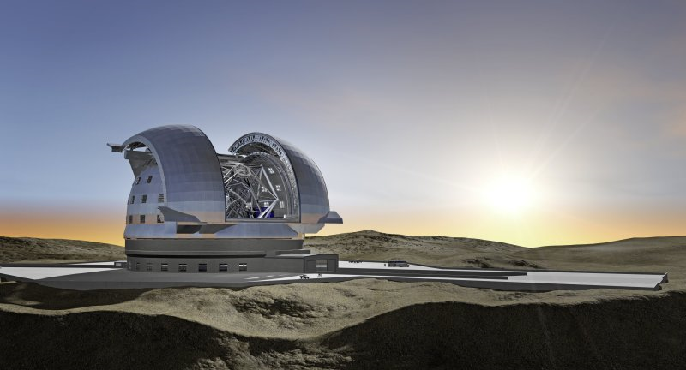
E-ELT
Detailed design study
Baseline 42m primary mirror
Adaptive optics built-in
8 instrument studies and 2 adaptive optics modules studied
Industry strongly engaged
Study complete in 2010
Project
Builds on entire expertise at ESO and in the member states
Construction 2011-2018
Synergy: JWST/ALMA/SKA

Slide 9
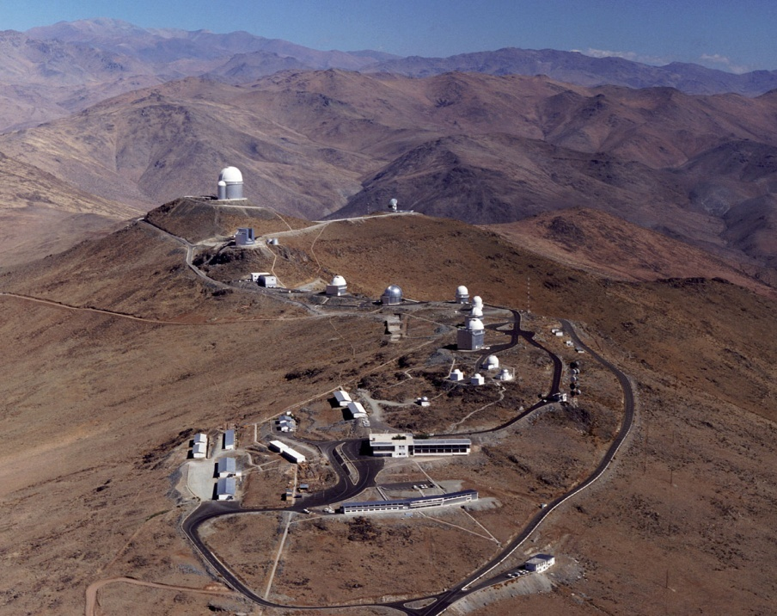
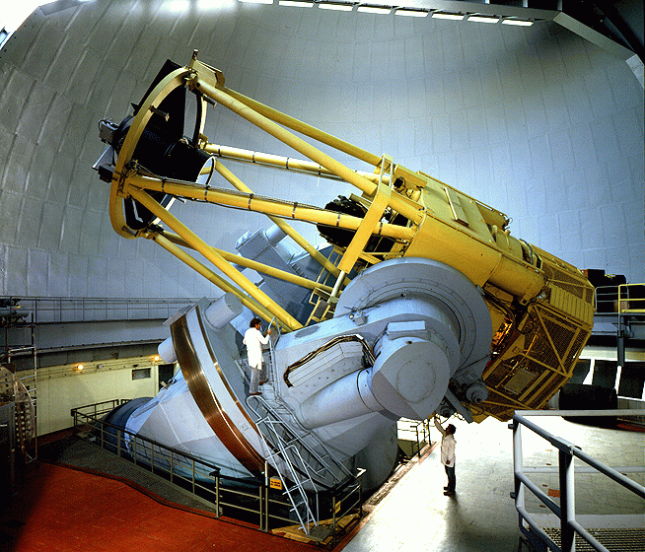
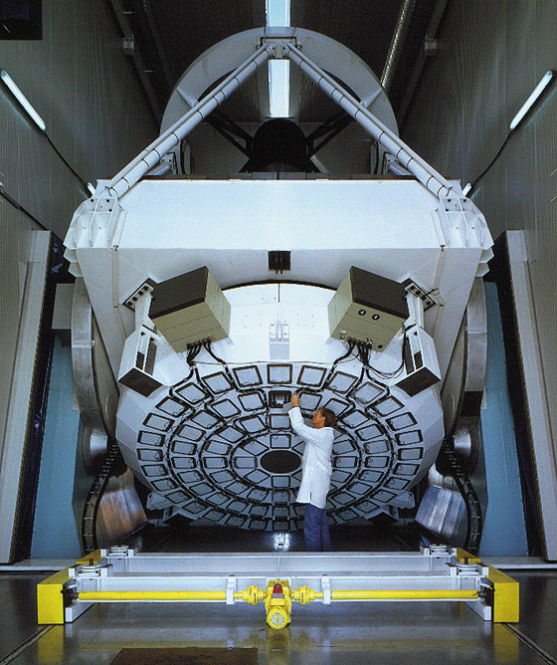
La Silla
Medium-size telescopes
3.6m: HARPS for exo-planet searches
3.5m NTT: EFOSC2, SOFI & visitor instruments
2.2m: WFI & FEROS in partnership with MPG
Small telescopes
Closed/funded externally

Slide 10
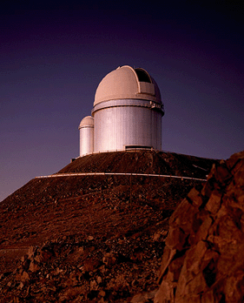
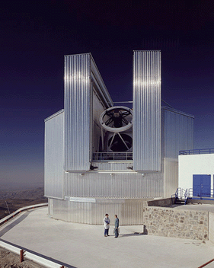
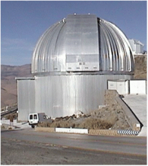
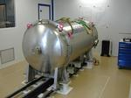
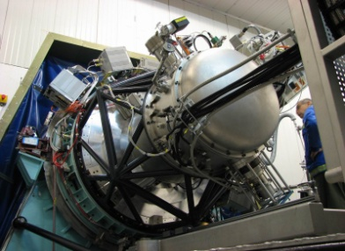
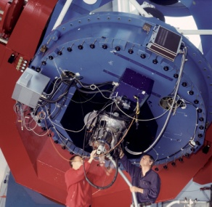
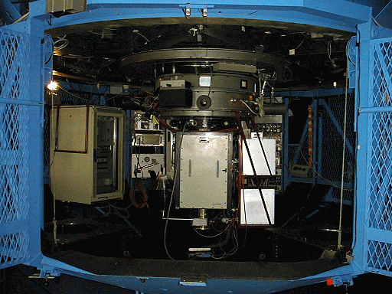
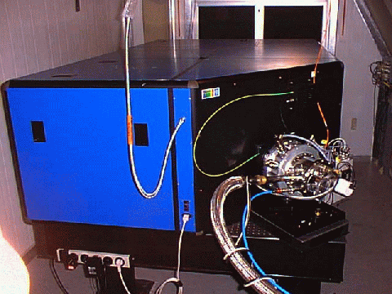
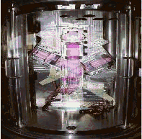
La Silla: 5 Operational Instruments
3.6m
NTT
2.2m
HARPS
SOFI
WFI
EFOSC2
FEROS
GROND

Slide 11
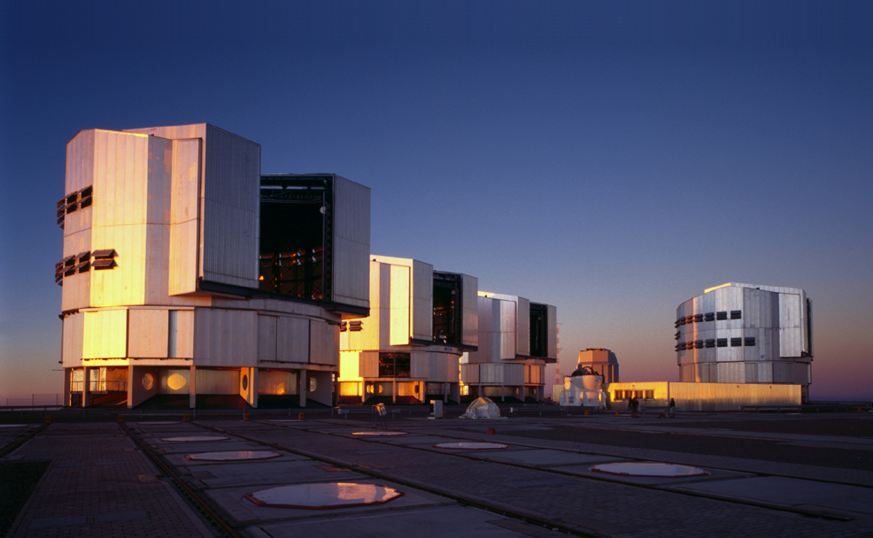
Paranal

Slide 12
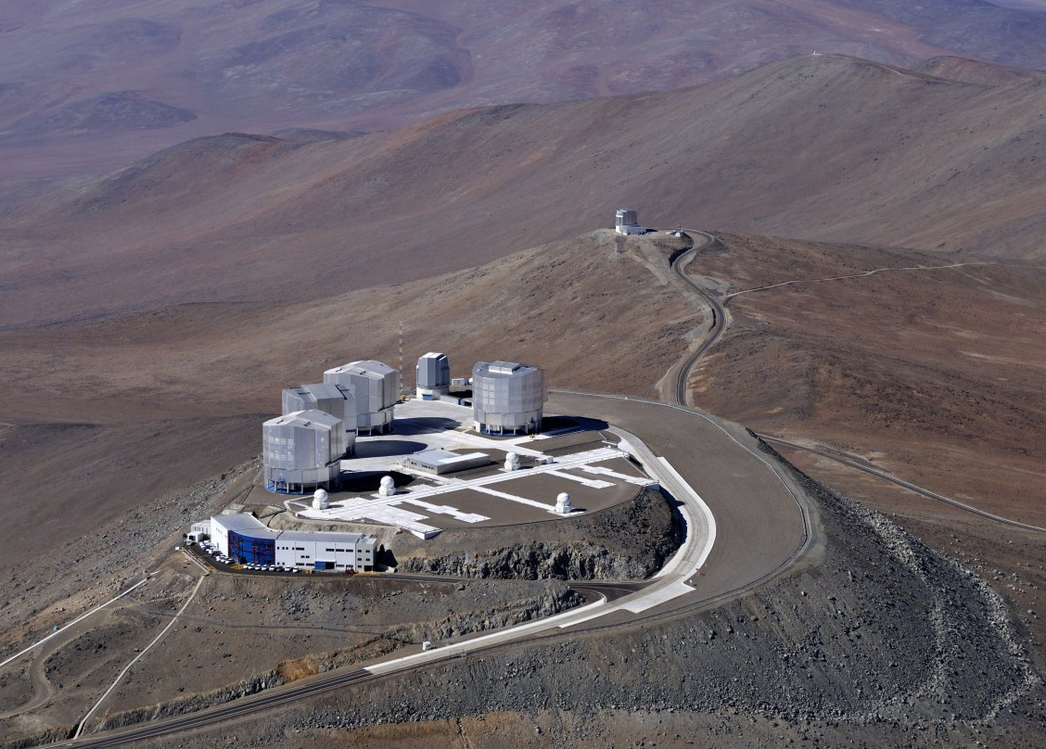

Slide 13
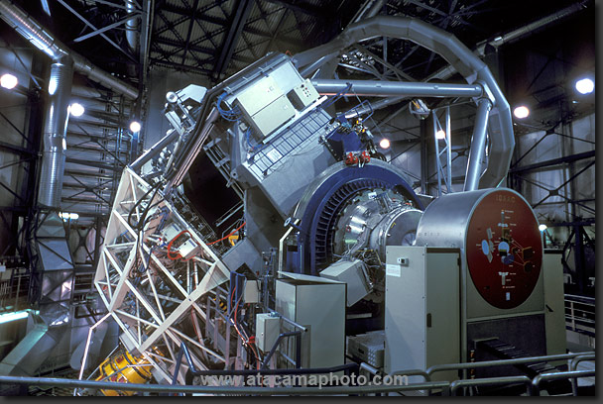

Slide 14
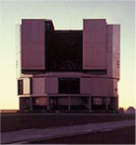
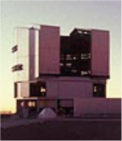
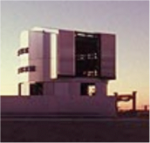
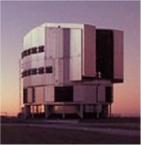
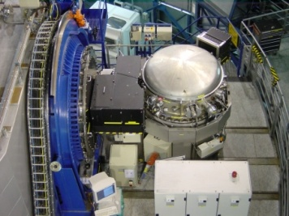
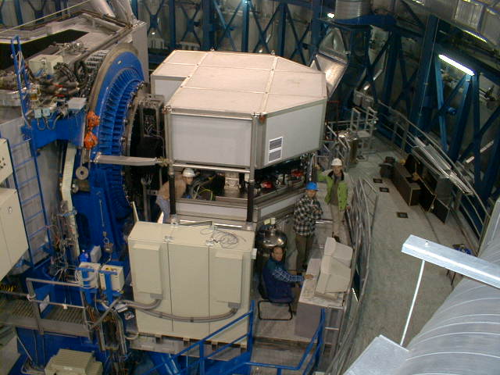
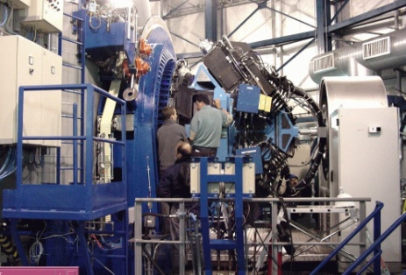
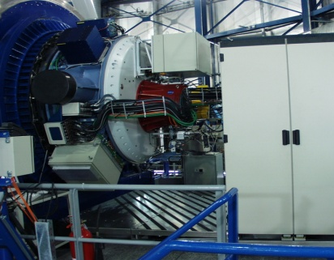
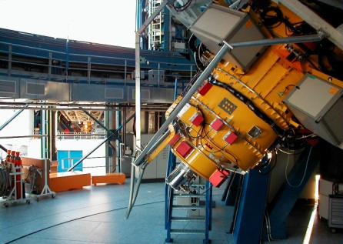
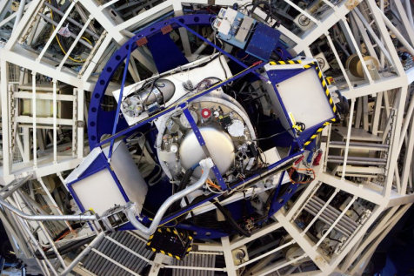
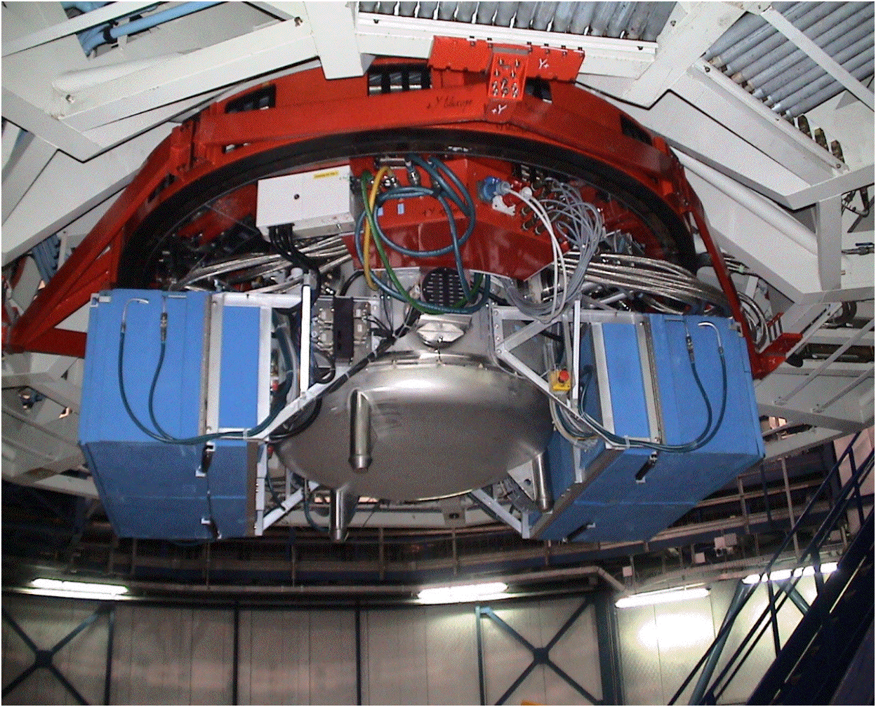
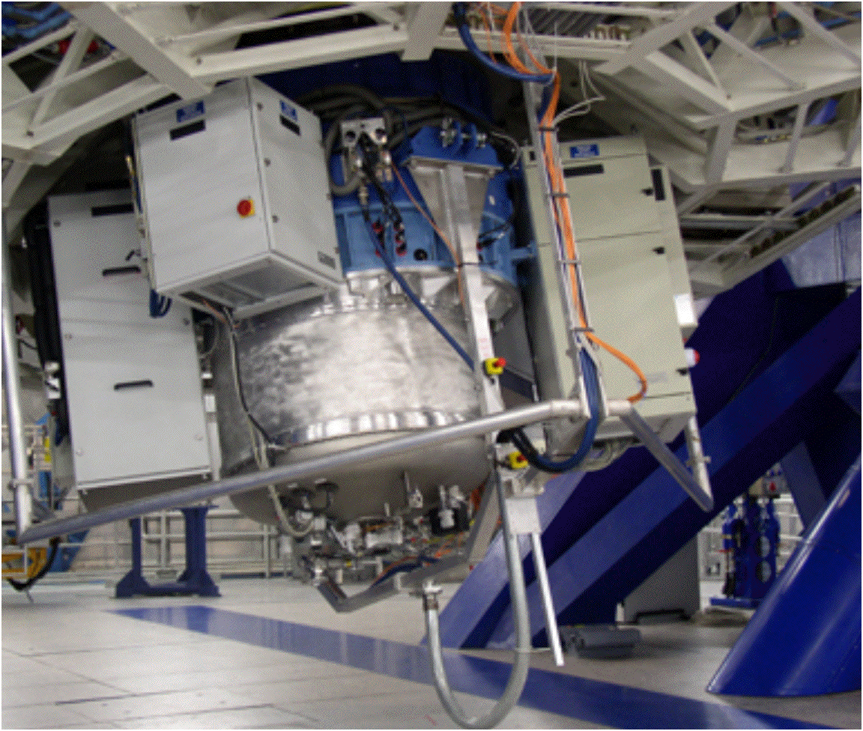
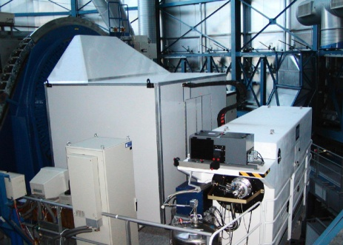
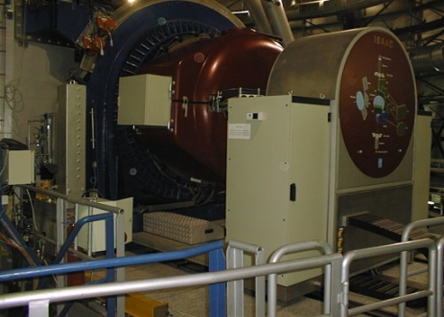
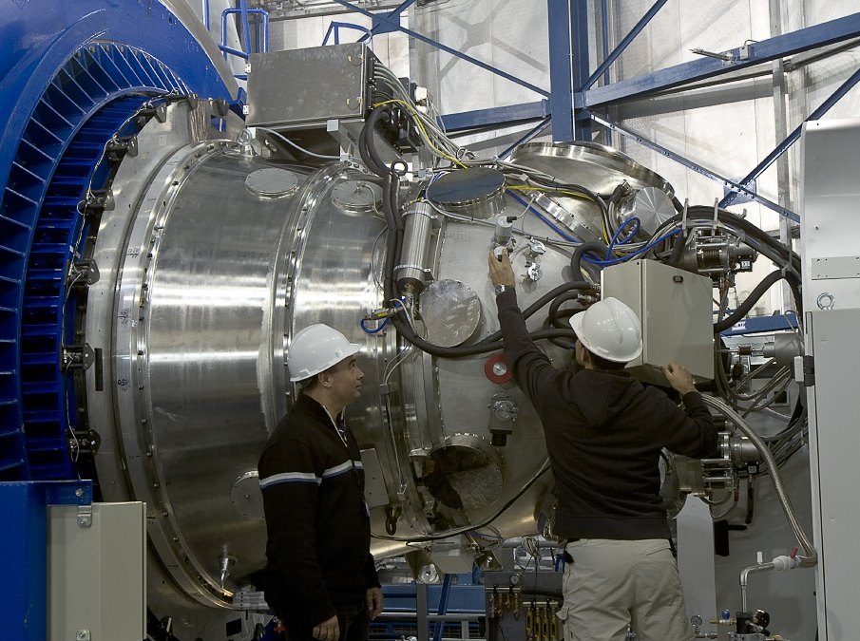
VLT Instruments
CRIRES
UVES
VIMOS
NACO
FORS2
X-shooter
VISIR
SINFONI
FLAMES
ISAAC
HAWK-I

Slide 15
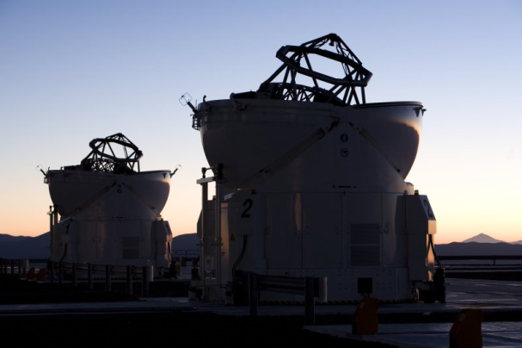
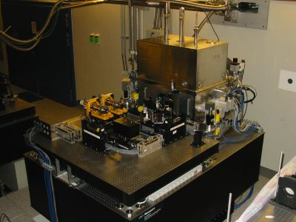
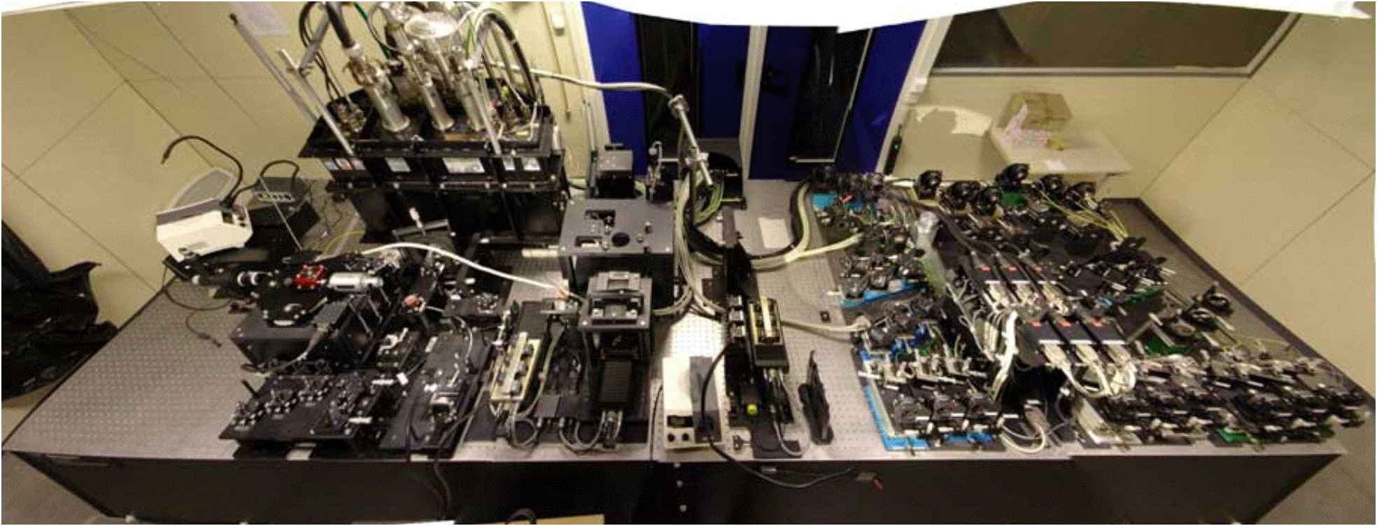
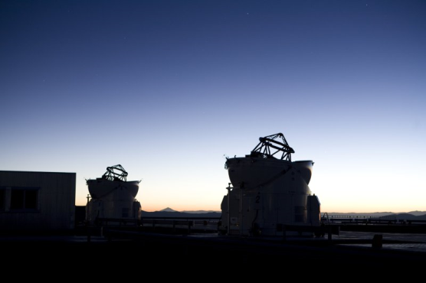
VLTI Instruments
MIDI
AMBER

Slide 16
Multipurpose Facilities
Telescopes can be used for many scientific applications
same instruments observe the solar system and the most distant objects
applications range from the hottest to the coldest, the densest to the least bound material
detection and characterisation of particles
The universe is our laboratory

Slide 17
Monikäyttöiset instrumentit
Teleskoopeilla laaja tieteellinen käyttöalue
Samoilla instrumenteilla havaitaan oman aurinkokuntamme kohteita, mutta myös maailmankaikkeuden kaukaisimpia kohteita
Kohteet kuumista kylmiin, tiheistä harvarakenteisisiin
Hiukkasten havainnointi ja karakterisointi
Tähtitieteen laboratorio on maailmankaikkeus

Slide 18
Top list of ESO science
Galactic Centre
Supermassive black hole
Extrasolar planets
First images of exo-planets
Lightest known planets
First direct spectrum of an exo-planet
Accelerating Universe
Spectroscopy of distant supernovae
Gamma-Ray Bursts/Supernovae
Explosion physics
Tracers of the distant universe

Slide 19
Other top science from ESO
Metal-poor stars
Tracing the chemical enrichment
Finding the oldest known stars
Stellar populations in nearby galaxies
Measuring stars beyond the Local Group
Massive galaxies in the distant Universe
Puzzles in galaxy formation
Varying physical constants?
Measure the fine-structure constant over time
Testing the cosmological model
Cosmic background temperature

Slide 20
More top science
Detecting and imaging the tori around AGN
Measure the geometric shape of stars
Determine the size of stars
E.g. Cepheids to calibrate the period-luminosity relation
Star formation
Debris disks, chemistry in circumstellar disks
Measure the structure of the Milky Way
Local spiral arm
Bulge, disk and halo, run-away stars
Solar System objects
Comets, asteroids, weather on Titan

Slide 21
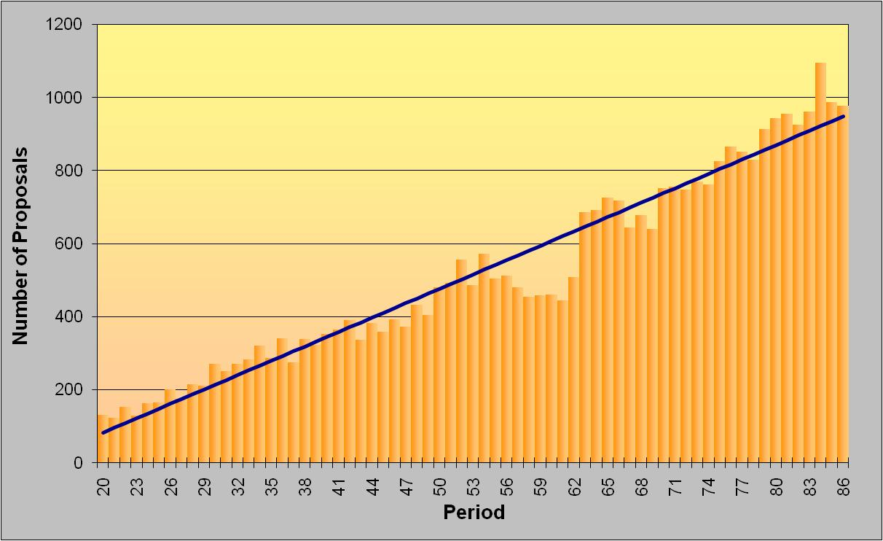
Proposal submission
1977
2010

Slide 22

ESO Publication Statistics
available at http://www.eso.org/sci/libraries/edocs/ESO/ESOstats.pdf

Slide 23

ESO and other Observatories

Slide 24


Black hole at the Galactic Centre
Mass determination through stellar orbits
Structure around the black hole revealed through flashes
Coordinated studies with other wavelengths
Multi-year study
use of AO instruments (SHARP on NTT, ISAAC NACO, SINFONI on VLT)

Slide 25

Flashes from the black hole
Variable IR emission from Sgr A٭
Detection of H, K_{S} and L’ emission in quiescence and also flares
Consistent within (<10) milli-arcseconds of Sgr A٭
Discovery in 2002 not possible due to proximity of S2

Slide 26

Flashes from the black hole
Variable IR emission from Sgr A٭
Detection of H, K_{S} and L’ emission in quiescence and also flares
consistent within (<10) milli-arcseconds of the location of Sgr A٭
Discovery in 2002 not possible due to proximity of S2
Flare duration between 30 and 90 minutes
substructure detected in the flares → periodicity

Slide 27


The ESO exo-planet machinery
HARPS at 3.6m telescope
best radial velocity machine at a 4m telescope (supported by UVES on VLT)
extremely stable spectrograph
NACO
adaptive optics supported imaging and spectroscopy
VLTI
highest spatial resolution for follow- up observations of known systems
NACO/SINFONI/FORS2
transit measurements, atmospheres of exo-planets

Slide 28
ESO results on exo-planets
Most radial velocity detections through HARPS
lowest-mass planets known so far
rocky planets, earth-mass planets
planetary systems
First direct image of a planet
around a brown dwarf
now innermost planet directly imaged (β Pic)
Combination with transits
characterization of planets
mass, density, temperatures

Slide 29

A planet with 1.9M⊕ and one in the habitable zone
Gliese 581

Slide 30



First image of an exo-planet
Red object near a brown dwarf
NACO observations (with the IR wavefront sensor) of a brown dwarf (2MASSWJ1207334-393254)
Brown dwarf with ~25 M_{Jup} at 70 pc in the TW Hydrae association (age ~8 Myr)
JHK_{S}L’ imaging and H-band spectroscopy with NACO
Chauvin et al., A&A, 425, L29

Slide 31

β Pic planet
Planet within the massive dust disk
Orbit only a few AU
NACO imaging
Lagrange et al. 2009, A&A, 493, L21

Slide 32

Imaged planets

Slide 33
Science (1)
Science highlights
First direct spectrum of an exo-planet with NACO
Metal-poor stars confirmed in dwarf galaxies (Fornax, Sculptor, Carina and Sextans) → Milky Way halo could have been built from dwarfs (FLAMES/UVES)
Observing proposals
P85: Schedule prepared, applicants notified Dec 2009
P86: Call for Proposals released 26 Feb
33

Slide 34

Accelerating Universe
Contribution of most of the early photometry and spectroscopy of High-z SN Search Team
difference between a 4m and a 8m telescope
Riess et al. 1998, AJ, 116, 1009
Leibundgut & Sollerman 2001

Slide 35
Gamma-Ray Bursts
Identification relies on optical data
redshifts, explosion energies, explosion physics
Cosmological probes
the most distant observable stars
light houses to measure the intergalactic medium
tracers of chemical enrichment?
Very short duration
required special instrumentation and software to observe adequately

Slide 36


SN/GRB connection
Spectral signatures of supernovae appear in Gamma-Ray Bursts
GRB 030329/SN2003dh (earlier GRB 980425/SN 1998bw)
UVES spectrum found z=0.1685, i.e. second closest known GRB – “cosmological” GRB
FORS1 and 2 observations of afterglow (starting April 3 until May 1)
Hjorth et al. 2003, Nature, 423, 847
Della Valle et al. 2003, A&A, 406, L33

Slide 37

GRBs as background light bulbs
Identification of absorber systems towards GRBs
use high-resolution spectroscopy during the GRB afterglow
use narrow-band or IFU imaging after the GRB has faded
detect the absorber system in its own light
First attempt for GRB 021004
two absorption systems identified in UVES spectra z=1.38 and z-1.60
z=1.38
z=1.60
Vreeswijk et al. 2003, A&A, 409, L5

Slide 38
GRBs as background light bulbs
GRB 021004
one potential emitter identified at an impact parameter of 16” (corresponds to 135kpc at z=1.38)
line would be [O III] (choice of narrow-band filter)
star formation rate of 13±2 M yr⁻¹ (conversion of [O III] flux to Hα and then to star formation rate)

Slide 39


Rapid Response Mode (RRM)
UVES observations of
GRB 060418
10 minutes
after the initial
Swift trigger
Many metal line systems
at 3 redshifts.
[Zn/Fe] >> QSO abs.

Slide 40


Gamma-Ray Bursts
Most distant stellar objects ever observed
redshifts 6.7 and 8.2 (tentative)
lookback time of nearly 12.5 billion years (or 95% of the age of the universe)
VLT equipped with rapid response mode
allows to observe a gamma-ray burst 10 minutes after detection
i
z
J
GRB080913

Slide 41

Most distant stellar object yet observed – GRB 090423
Tanvir et al., Nature submitted
Optical drop-out, bright in the near-infrared
Rapid decline

Slide 42


GRB 090423
ISAAC
SINFONI
Spectroscopy 17 hours after outburst
Lyman break indicates a redshift of z≈8.2

Slide 43


Do we understand the physical laws that govern the universe?
Do we have the correct theory of gravity?
Are there other forces out there?

Slide 44


Searching for other earths
HARPS is the most successful planet finder right now
Almost all low-mass planets found with HARPS
lowest mass planet found (1.9 M⊕)

Slide 45


The Survey Telescopes
VISTA in operations since April 2010
VST still in construction
Expected completion end 2010
Science
Multi-year program of large public surveys
Coordinated by ESO
Develops European survey capability
VST
VISTA

Slide 46

VISTA
Science Verification finished
NGC 253 and Orion
Public Surveys started
VHS, VVV, VIDEO, VIKING, VMC, UltraVISTA

Slide 47

FORS and HAWK-I

Slide 48




Chajnantor
APEX
12m sub-millimeter antenna, operated by ESO @ Sequitor
MPG (50%), Sweden (23%) and ESO (27%)
ALMA
Transformational science
66 antennas at 5050m
Operations support at 2950m
Global partnership with North America East Asia & Chile
APEX
OSF
OSF

Slide 49

Chajnantor
Three facility and three `PI` instruments on APEX
Watch out for ALMA
early science in 2011
be prepared

Slide 50

Chajnantor
15 km
28 km
APEX & ALMA Antennas 5050 m
Operations Support Facility 2950m
Toconao

Slide 51


Slide 52

Llano Chajnantor (5000 m)

Slide 53

View from Licancabur

Slide 54




ALMA
Partnership with North America and East Asia
NRAO/AUI, NAOJ/NINS, ESO
European deliverables include
25 12m antennas and 2 transporters
High frequency receivers (Band 7 and 9)
Buildings at OSF (incl. Residencia) and in Vitacura
Antenna foundations, long-term power supply

Slide 55
ALMA
Science requirements
Detect CO and [CII] in Milky Way galaxy at z=3 in < 24 hr
Dust emission, gas kinematics in proto-planetary disks
Resolution to match Hubble, JWST and 8-10m with AO
Complement to Herschel
Specifications
66 antennas (54x12m, 12x7m)
14 km max baseline (< 10mas)
30-1000 GHz (10–0.3mm), up to 10 receiver bands
HST
ALMA
5AU
850 GHz

Slide 56
ALMA
Progress
Nearly all European deliverables on track
Closure phase with three antennas at the AOS
Santiago Central Office building nearing completion
Multi-fuel turbine being procured
First two European antennas mechanically integrated
Concern
Antenna delivery schedule: under close scrutiny

Slide 57




Closure phase
Commissioning and Science Verification started on Jan 22, 2010
Leonardo Testi: Kiel, May 2010
57

Slide 58






ALMA 2009

Slide 59
ALMA Early Science
16 antennas with four frequency bands
Baselines up to 1 km
Up to 1/3 of the time used for this
Call for proposals towards the end of 2010
Deadline probably around February 2011
Observations start September 2011
ALMA Band | Frequency Range (GHz) | Wavelength range (mm)
3 | 84-116 | 3.6-2.6
6 | 211-275 | 1.4-1.1
7 | 275-373 | 1.1-0.8
9 | 602-720 | 0.5-0.4

Slide 60

ALMA 2013

Slide 61




Some Recent Images

Slide 62
E-ELT
Design study
First prototype mirror segments produced
ESO M1 phasing method tested successfully on GTC
Instrument studies
Final reviews of 8 instrument studies and two adaptive optics modules complete
Results and SWG input presented to STC in April
Extraordinary STC Meeting on 16 June to discuss the first generation of E-ELT instruments
Site selection
Council selected Armazones as baseline site

Slide 63

Proposing for ESO time
Deadline for P87 proposals: 30 September 2010

Slide 64
Structure of the ESO OPC
Observing Programmes Committee
4 scientific categories
Cosmology (A)
Galaxies and Active Galactic Nuclei (B)
Interstellar Medium, Star Formation and Planetary Systems (C)
Stellar Evolution (D)
13 panels
3 for category A
2 for category B
4 each for categories C and D

Slide 65
Proposal types
5 proposal types all handled by OPC
normal programmes
short programmes
large programmes
Coordinated VLT/XMM projects
Target of Opportunity
calibration programmes
all considered by the OPC
Director Discretionary Time
submission any time
decided by ESO Director General

Slide 66
ESO proposals
Pressure factor typically high
typical oversubscription for ESO telescopes is >3
often reaching 5 and in certain periods/RA ranges 8 or higher
Large Programmes have an acceptance rate of about 20% or less
Pressure on ToO proposals is extremely high
GRBs, supernovae, novae, stellar occultations by TNOs, microlensing,

Slide 67
Finnish proposals
Only few proposals received
P86: 13 proposals requesting 37 nights
FORS2, NACO, VISIR, UVES, X-shooter; SOFI, EFOSC2
P85: 13 proposals (1 LP) asking for 40 nights
FORS2, SINFONI, NACO; LABOCA, SABOCA, SFHI; HARPS, SOFI, EFOSC2
1.3% of the total time requested!
Success rate fairly high (comparable and/or higher than for other countries)
1977
2010

Slide 68

High pressures
Some right ascensions are already in high demand

Slide 69
Call for Proposals
Important document
contains a lot of relevant information
especially important for first-time users
contains many useful links to instrumentation and other useful information
binding document, if proposal is approved

Slide 70

Call for Proposals
Everybody must read

Slide 71
Call for Proposals
Find the appropriate instrument

Slide 72
What makes a proposal successful?
Exciting science
providing a clear progress in our understanding of some phenomenon
A neat idea
unusual method, new idea, new approach, unique observation or experiment
Clear language
presentation of an exciting story, which is interesting for many people
cover all questions somebody may have
information to the point

Slide 73
What makes a proposal successful?
A consistent story
the proposal is complete and provides all information
quantitative arguments for the amount of time requested
Good Luck!

Slide 74
ESO Archive
The ESO data archive
is a rich source of excellent data
abstracts of previous proposals available
data public one year after they have been delivered to the PI
great way to compete with your competitor, if they got observing time
easy retrieval and selection of calibration data

Slide 75
Get involved
Participate in OPC
Participate in other ESO activities
get to know the organisation better
active interactions with ESO people
Have a lively scientific exchange with the (European) astronomical community
conferences, workshops
regularly publish your results

Slide 76
Get involved
Participate in OPC
Participate in other ESO activities
get to know the organisation better
active interactions with ESO people
Have a lively scientific exchange with the (European) astronomical community
conferences, workshops
regularly publish your results

Slide 77





ESO’s goals for next five years
Best science from La Silla Paranal Observatory
Second generation instruments (VLT/VLTI)
Key surveys with VST and VISTA
Long-term programs for unique science on La Silla
Prepare for ALMA science with APEX
Deliver ALMA on time and budget
Design the world-leading E-ELT and secure funding for construction and operations

