Slide 1
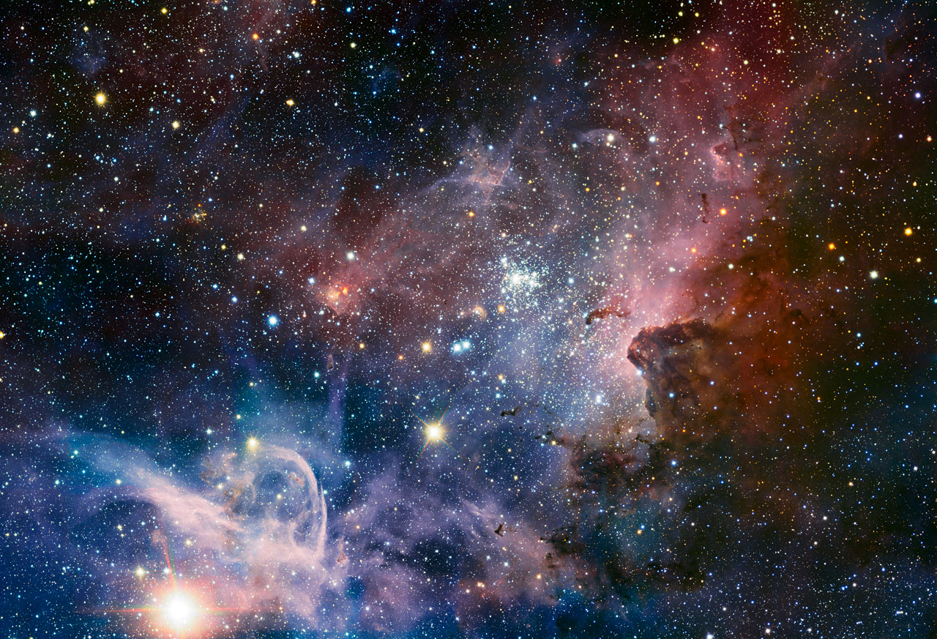
ESO 2013

Slide 2
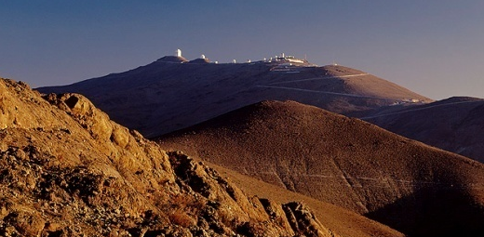
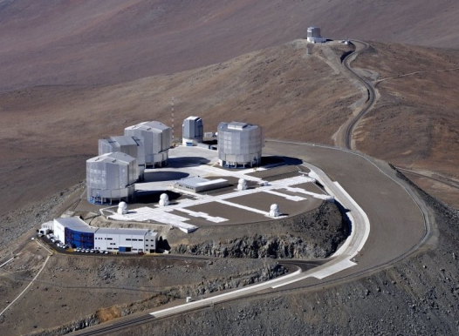
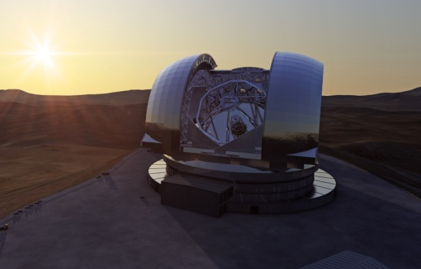
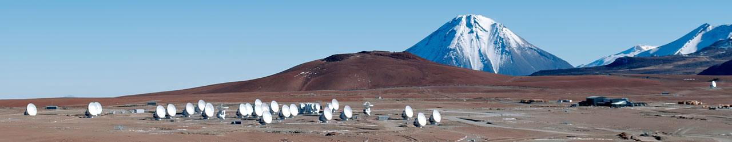
ESO’s Programme
Visual/infrared light
  La Silla telescopes
  VLT, VLTI, VISTA and VST on Paranal
  E-ELT to come on Armazones
  Instrumentation development
Submillimeter radio waves
  APEX operations
  ALMA construction and development
  Both at Chajnantor, in partnerships

Slide 3
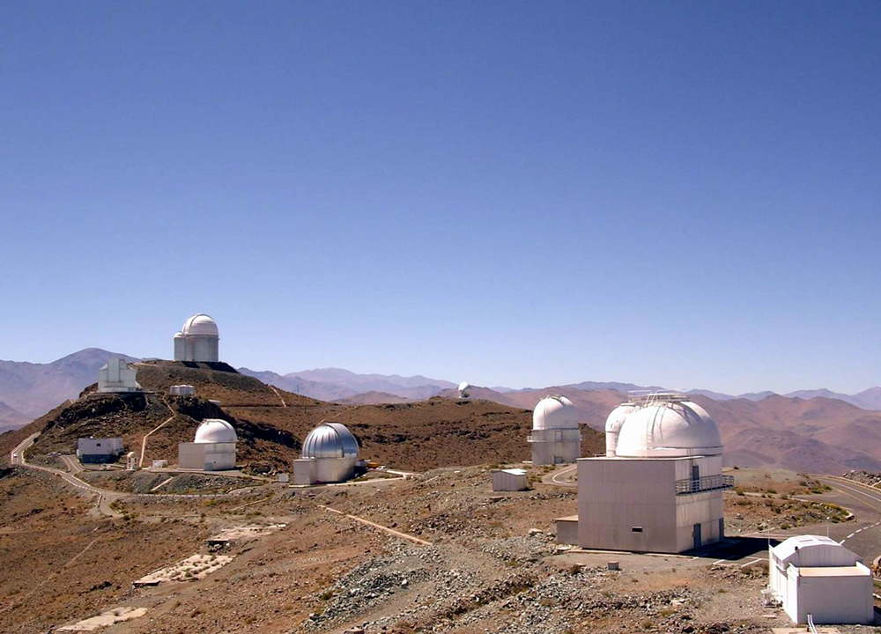
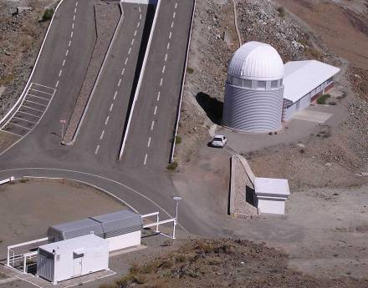
La Silla
Swiss
1.2m
3.6m
Tarot-S
NTT
Danish
1.54m
REM
Schmidt
2.2m

Slide 4
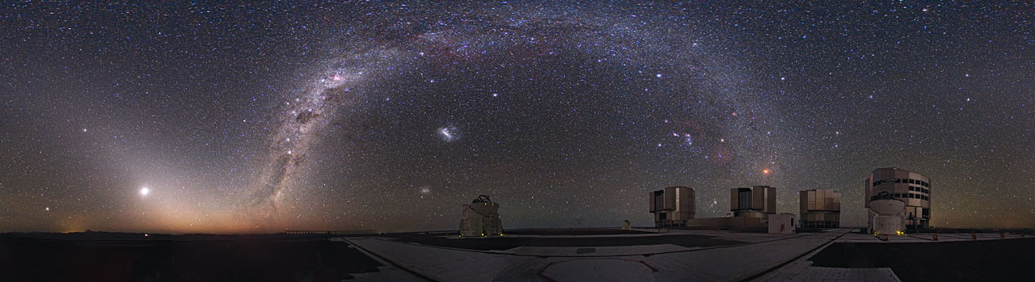
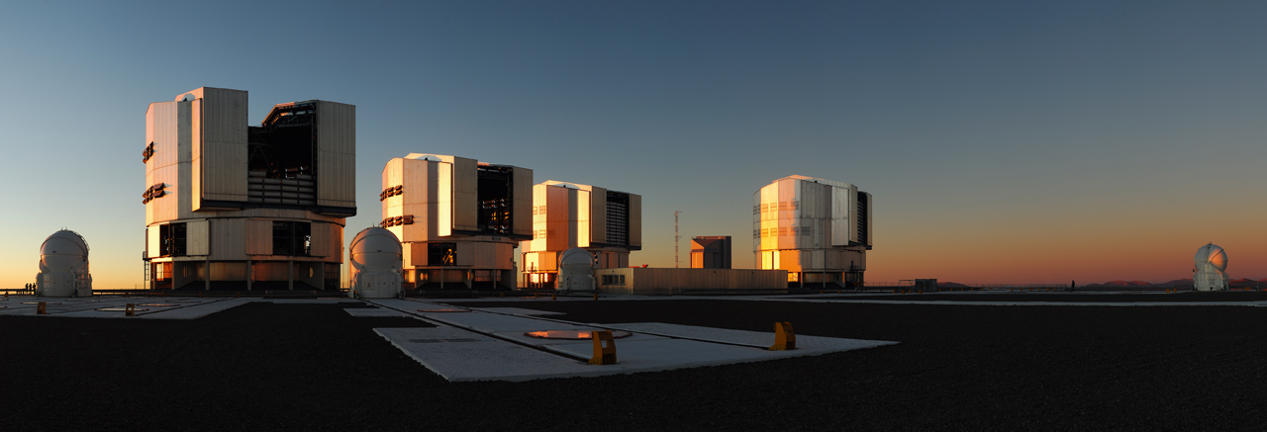
Paranal
Notes:
The Milky Way arches across this rare 360-degree panorama of the night sky above the Paranal platform, home of ESO’s Very Large Telescope. The image was made from 37 individual frames with a total exposure time of about 30 minutes, taken in the early morning hours. The Moon is just rising and the zodiacal light shines above it, while the Milky Way stretches across the sky opposite the observatory.
The open telescope domes of the world’s most advanced ground-based astronomical observatory are all visible in the image: the four smaller 1.8-metre Auxiliary Telescopes that can be used together in the interferometric mode, and the four giant 8.2-metre Unit Telescopes. To the right in the image and below the arc of the Milky Way, two of our galactic neighbours, the Small and Large Magellanic Clouds, can be seen.

Slide 5
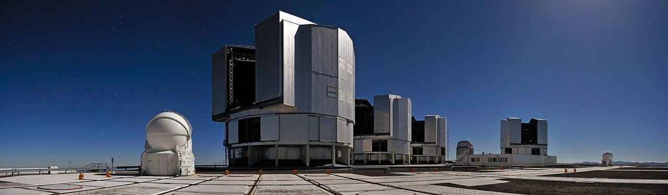
Observing Programmes
Observing proposals
  ~900 proposals per semester (incl ~50 DDT)
    La Silla, Paranal, APEX
  Observing Programmes Committee
    Two meetings/year; 13 sub-panels
    Time allocated on scientific merit
Separate process for ALMA
  ~500 proposals for 33.75% ESO share

Slide 6
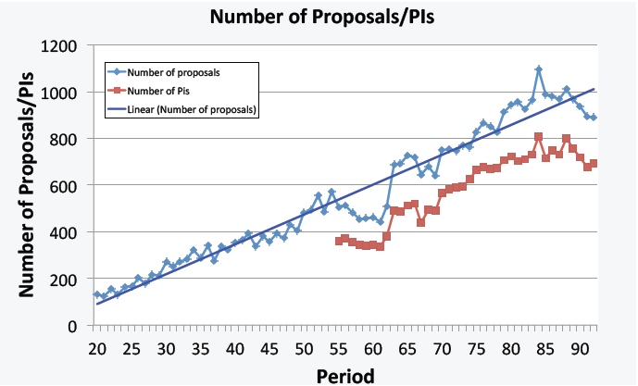
Evolution of proposal submissions
1977
2013

Slide 7
Proposal submission
892 in P91
788 last day
157 last hour
9 last 10m
G-S Shoulder
Notes:
LN06 – choose counts.
Add dates on which zero proposals added.
Do cumulative counts.
Do comparison plots.

Slide 8
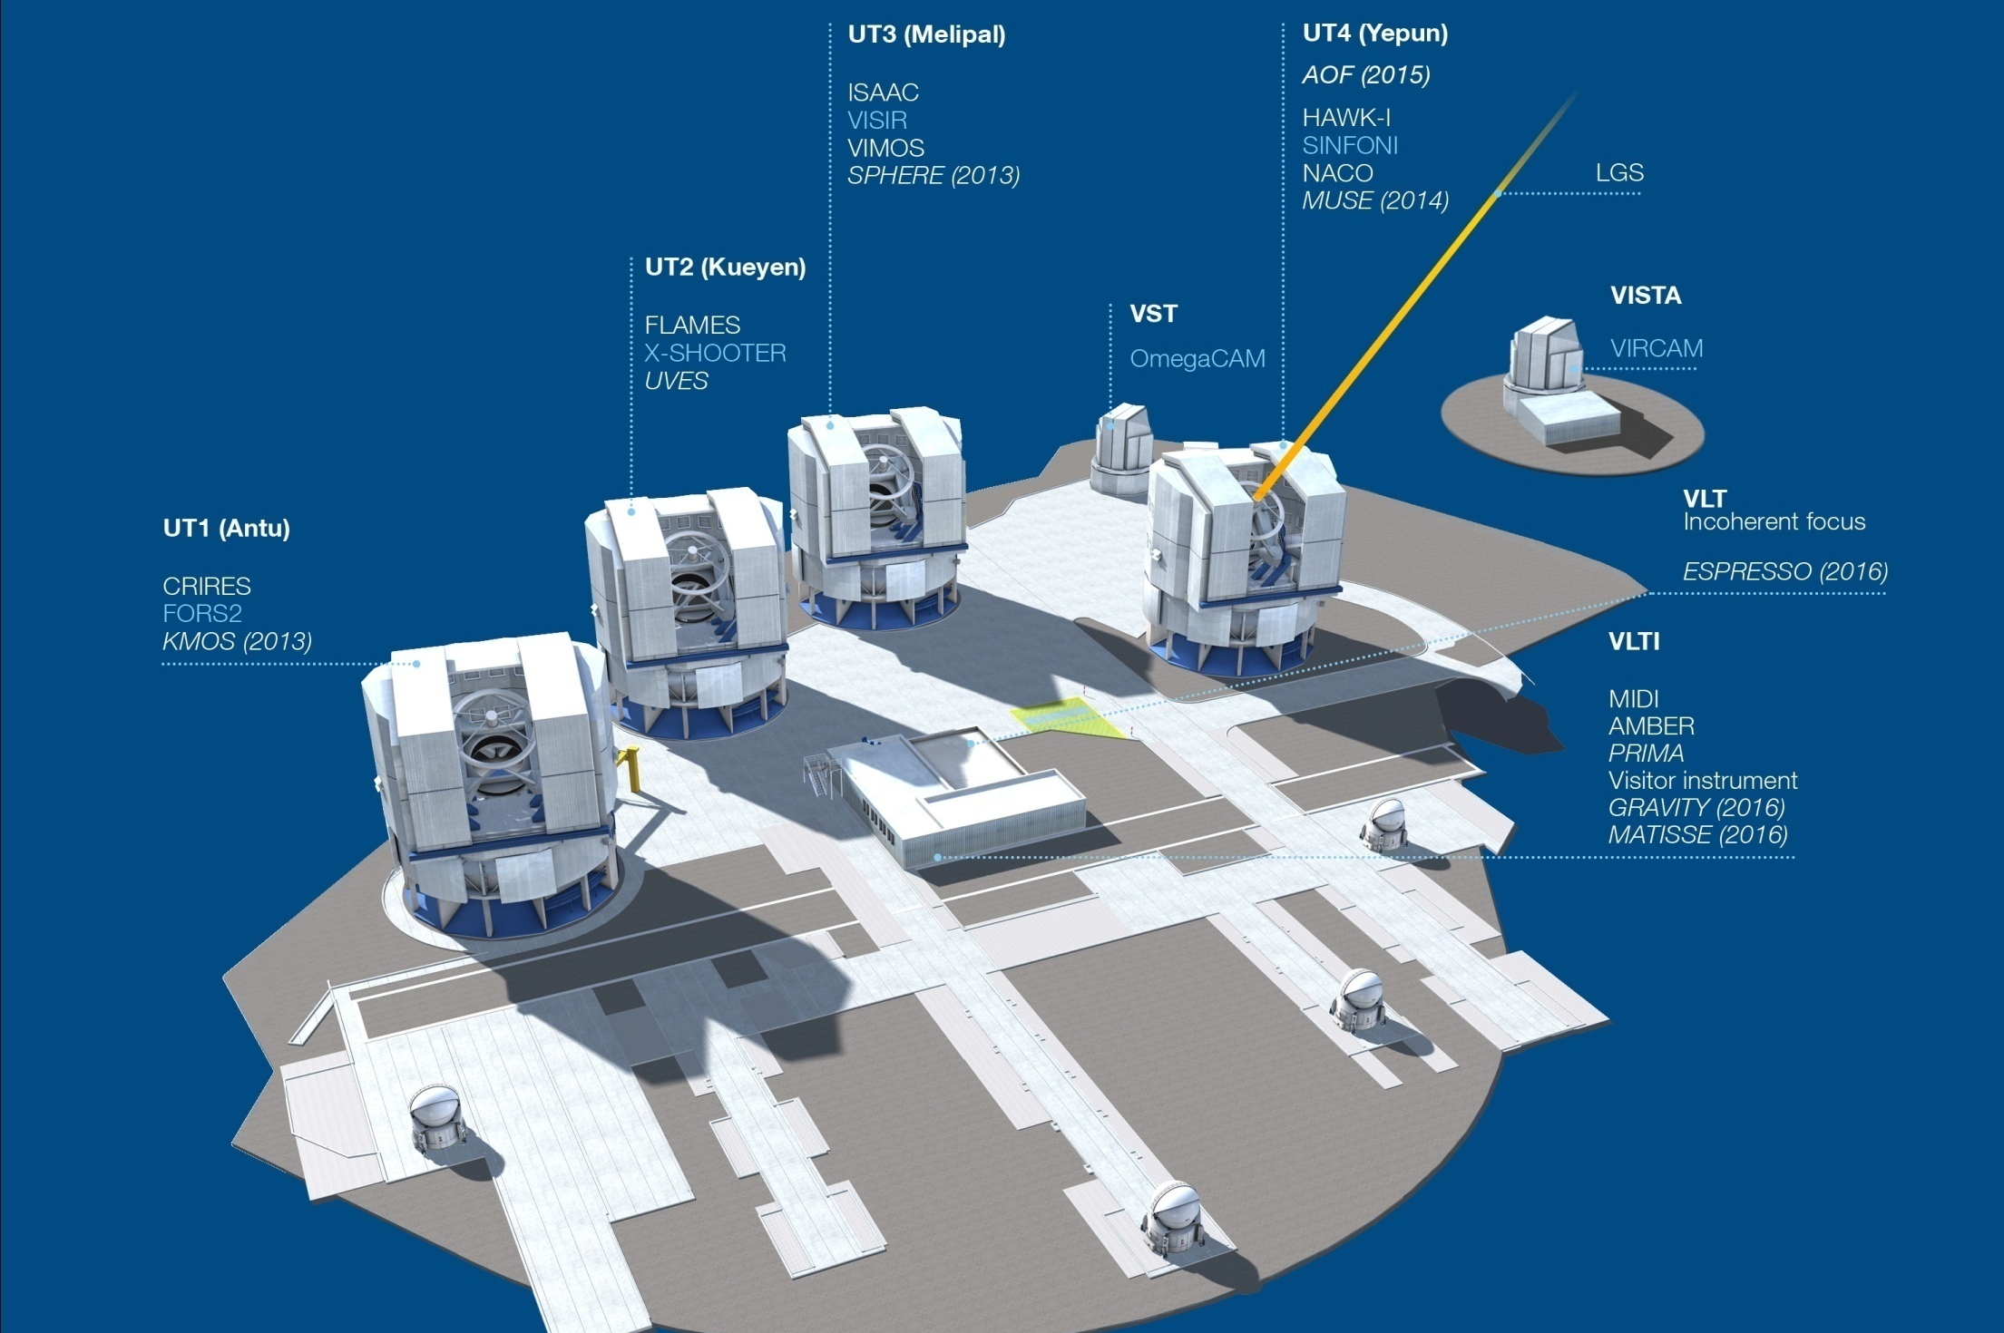
Integrated System

Slide 9
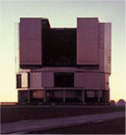
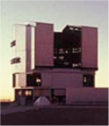
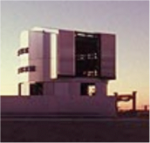
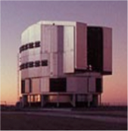
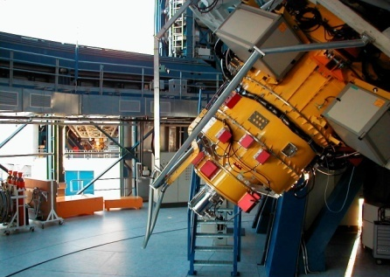
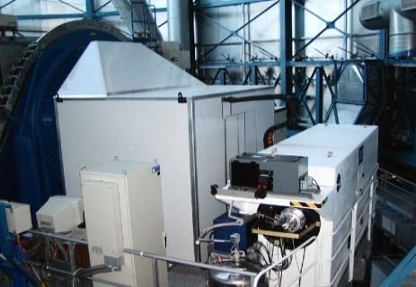
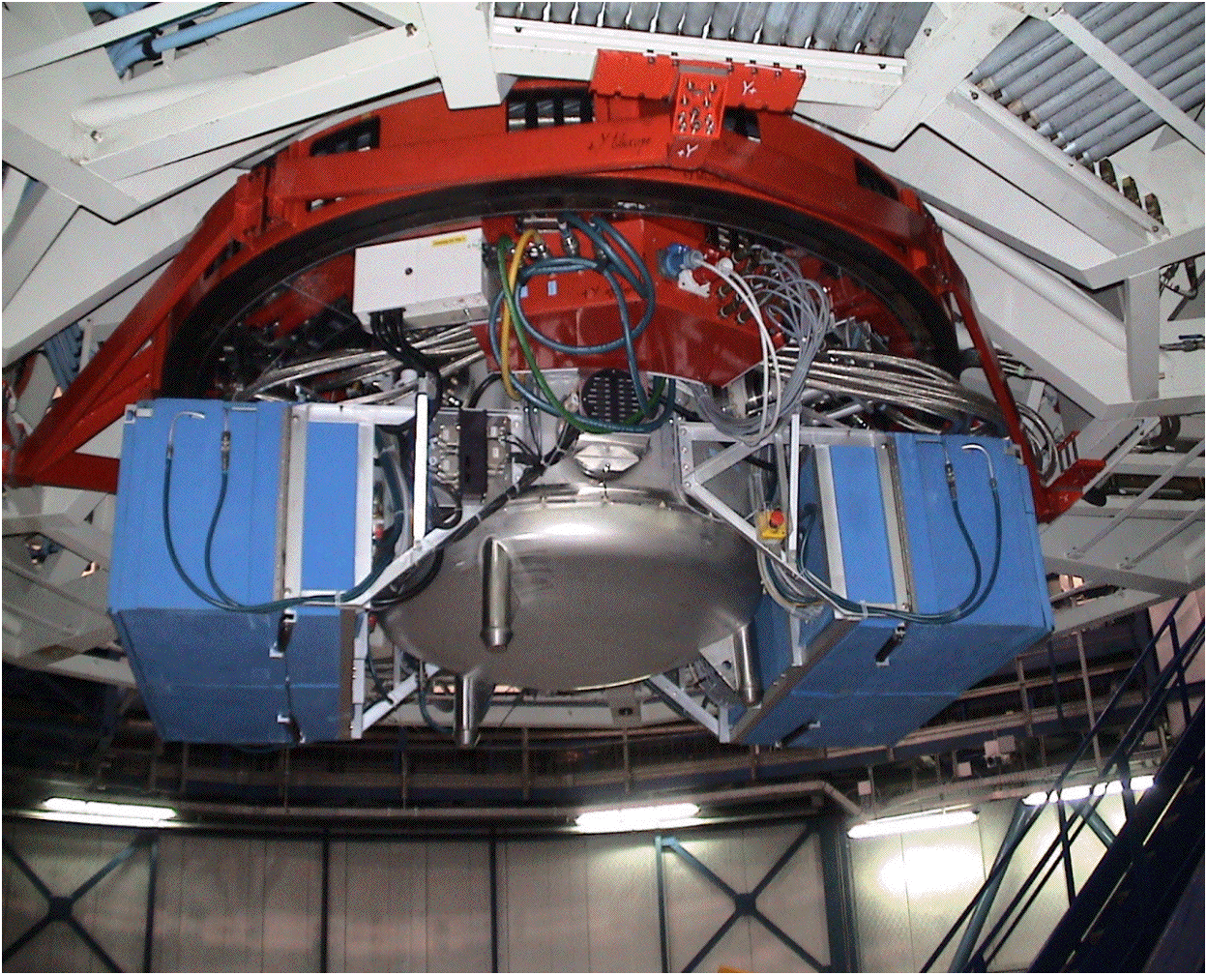
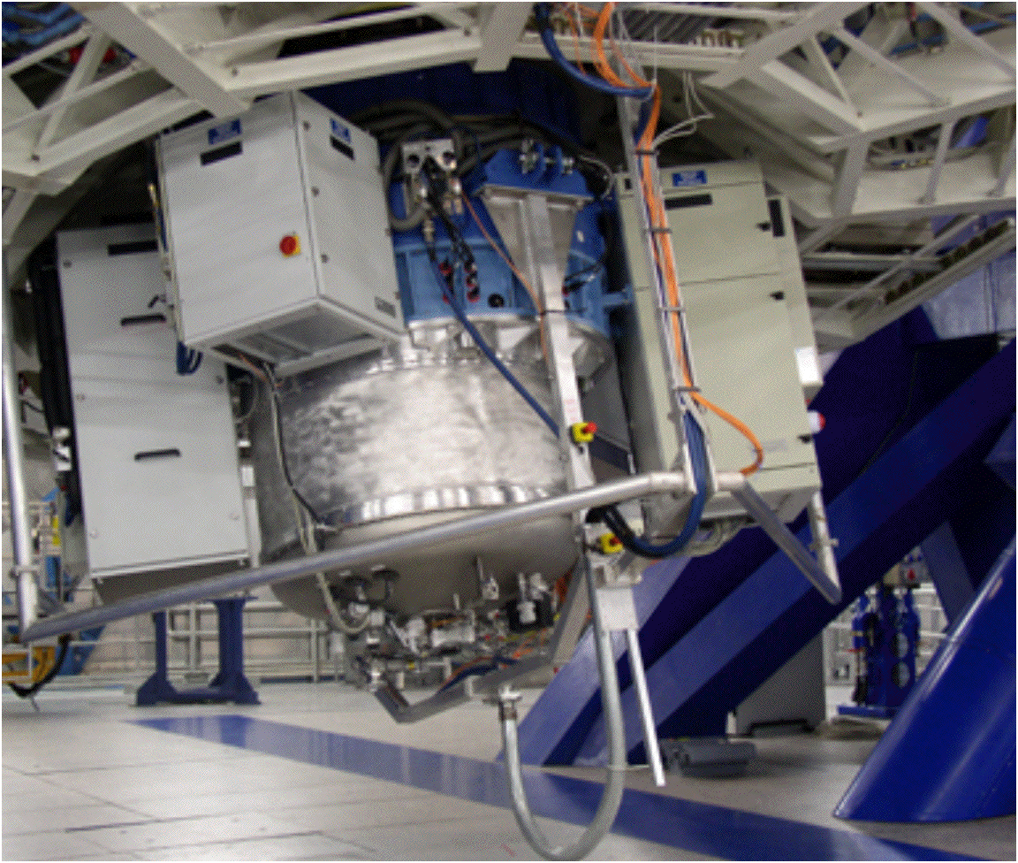
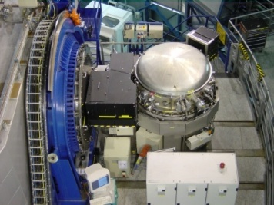
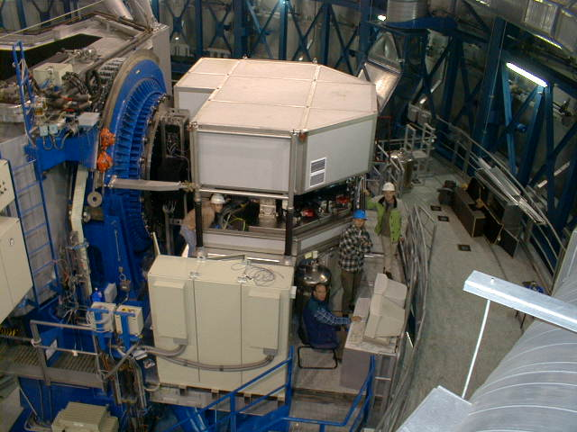
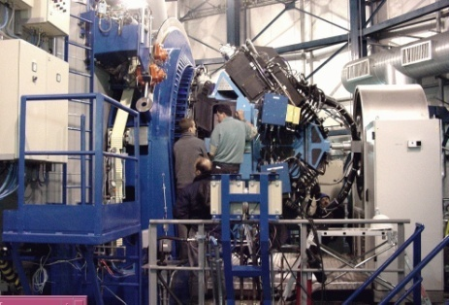
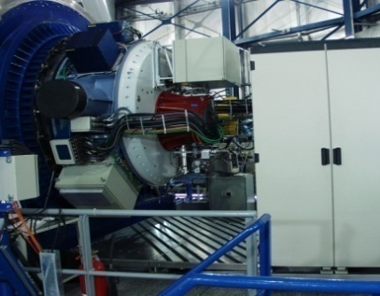
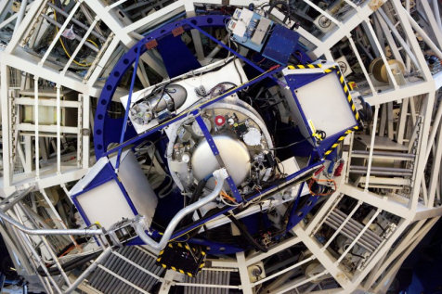
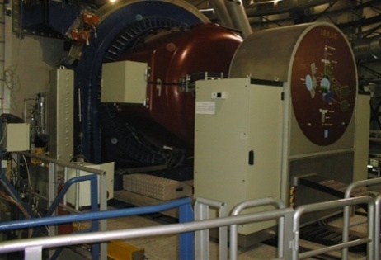
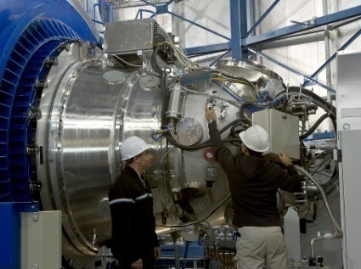
VLT Instruments
FORS2
FLAMES
VISIR
SINFONI
CRIRES
UVES
VIMOS
NACO
X-shooter
ISAAC
HAWK-I

Slide 10
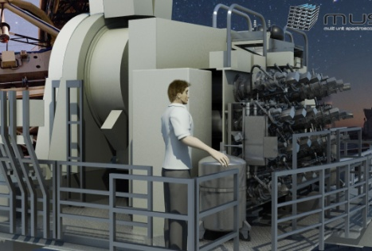
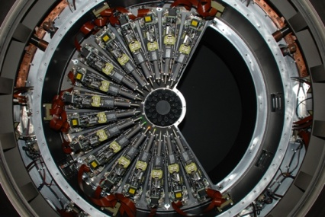
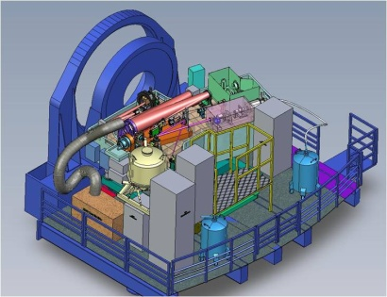
VLT Instruments 2013/4
FORS2
FLAMES
X-shooter
SINFONI
CRIRES
UVES
VIMOS
MUSE
KMOS
VISIR
SPHERE
HAWK-I

Slide 11
VISIR Upgrade: AQUARIUS
24 stars in Omega centauri
Problems with AQUARIUS detector
  noise, linearity, QE
High-priority lab testing
  AQUARIUS suffers from Excess Low Frequency Noise (ELFN)
    Each pixel has its own ELFN, not correlated
    Cannot be reduced by read modes, clocking or bias changes
    Is proportional to detector output signal
    Always there, seen in past generation of detectors, but not noticed because of high chop rates
Likely that fast chopping solves noise problem (e.g. drift scan or focal plane chopper)
Solutions are being worked on

Slide 12
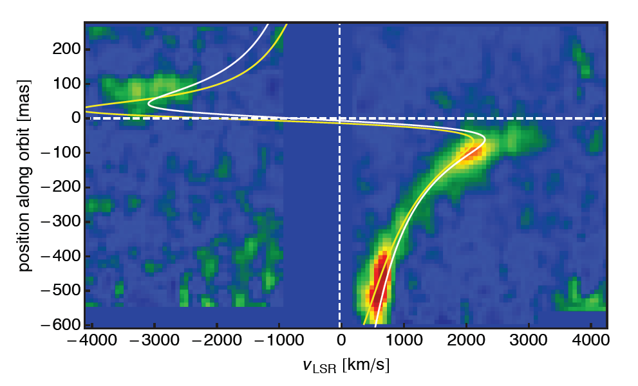
News from the Galactic Centre
Cloud passing close to the black hole
  periastron near 2000 R_{S} (about 20 light hours)
  first material already passed periastron
  periastron passage ~2014.25
Gillessen et al. 2013

Slide 13
VIMOS Public Surveys
VIMOS Call for Letters of Intent for Public Spectroscopic Surveys
  No projects approved in first round (2010/2011)
    most interesting RA ranges blocked by ongoing LPs
    upgrade of instrument ongoing
Timescale
    Call for Letters of Intent → July 2013
    Deadline for Letters of Intent → 15 October 2013
    Evaluation → November/December 2013
    Inform applicants → January 2014
    Proposal deadline P94 → 31 March 2014
    Start survey(s) → P94 October 2014

Slide 14
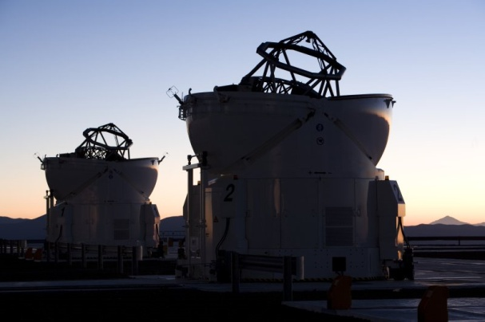
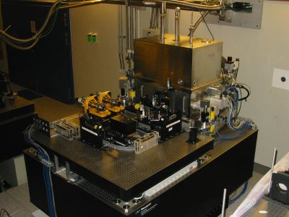
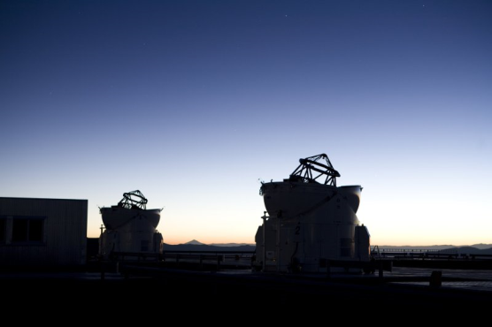
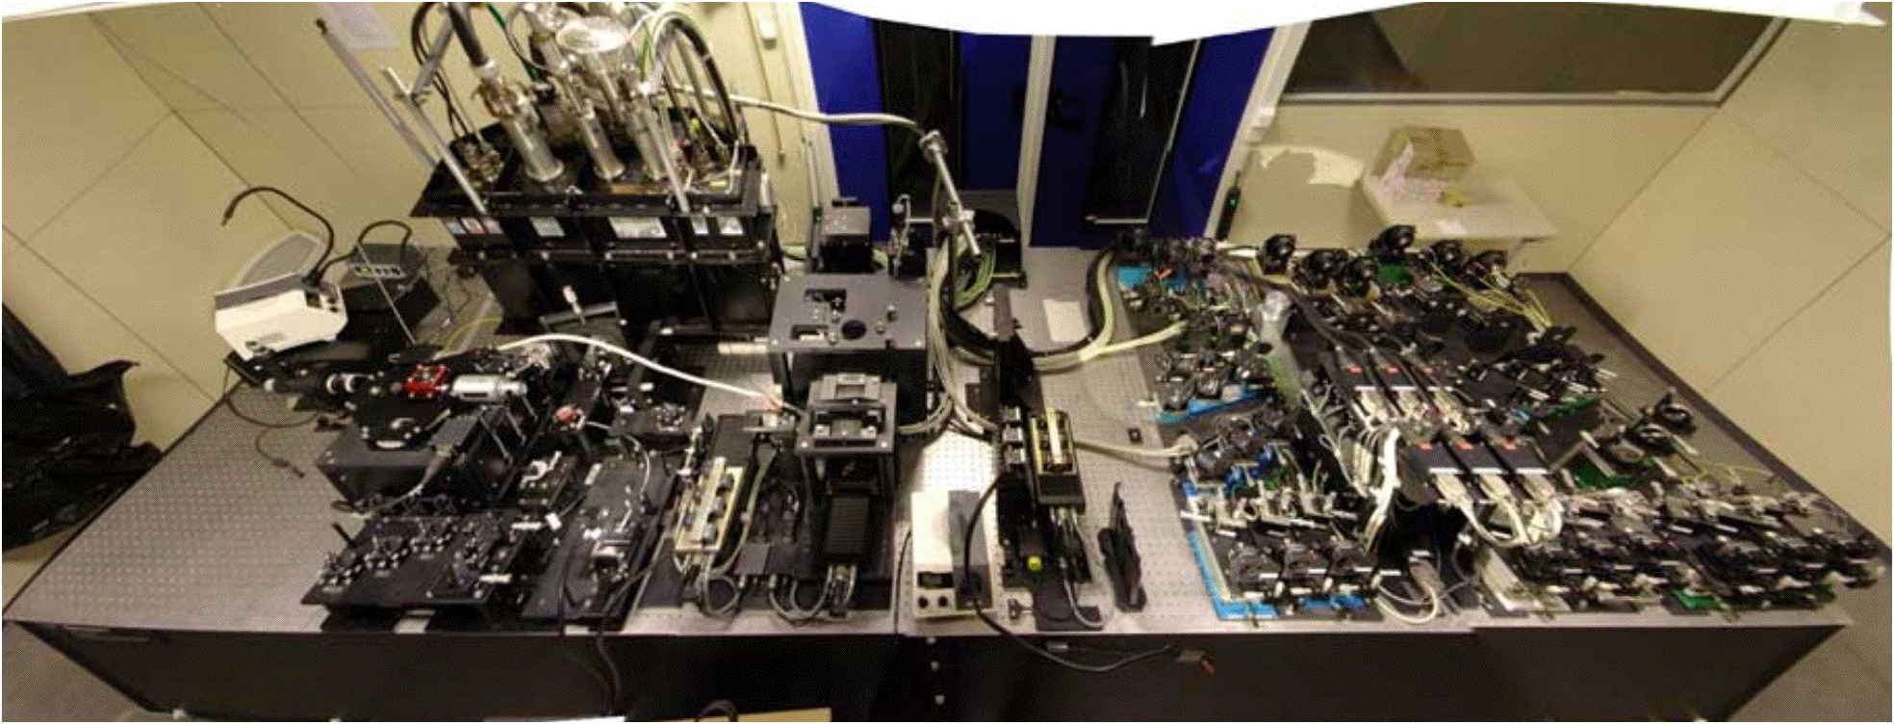
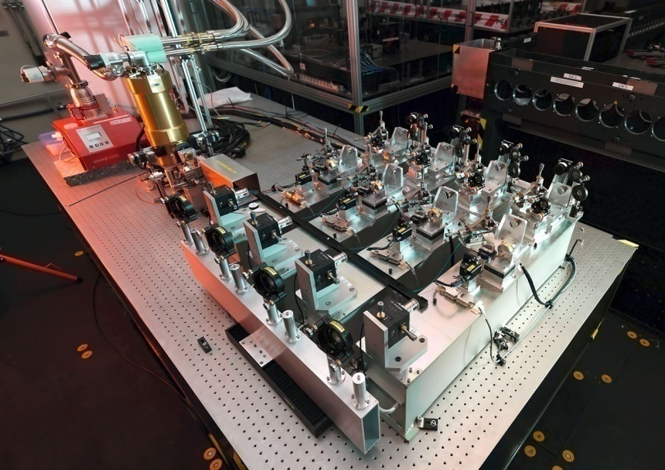
VLTI Instruments
MIDI
AMBER
PIONIER

Slide 15
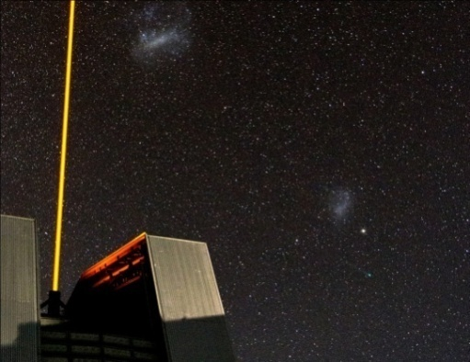
VLT/I Instrument Programme
ESO development programme
  Detectors, controllers, edge-sensors
  Advanced adaptive optics systems
  Innovative powerful lasers (PARLA)
Infrastructure upgrades
  Adaptive Optics Facility on UT4 in 2015
  Key components for VLTI (e.g., NAOMI: AO for ATs)
Most instruments built by consortia of institutes
  ESO pays hardware costs (~1/3 of total)
  Consortia provide personnel costs; compensated in Guaranteed Time

Slide 16
PRIMA
Encountered a severe technical hurdle
  general issue with metrology
Astrometry between bright sources in engineering mode in September
  Understand how much of the current astrometry error budget has been removed and to get a much clearer view of the way forward
After this study a formal stage gate review will be held to consider the technical, financial and programmatic implications
Establish a strategy to deal effectively with potentially conflicting drivers
  Ensure success of GRAVITY and MATISSE
  Ensure all stakeholders involved

Slide 17
2nd Generation Instrumentation
VLT instruments in development
  ESPRESSO: High-resolution ultra-stable spectrograph at incoherent combined focus (can use all UT’s; 2016)
  CUBES: blue-optimized spectrograph
    depends on Brazil
  ERIS: AOF imager and spectrograph (2017)
VLTI instruments in development
  GRAVITY: K Band, 4 tel. astrometry near GC (2014)
  MATISSE: L, M, N band, 4 tel. image/spec (2015)
Additional VLT instruments planned
  Phase A completed: MOONS (wide-field MOS)

Slide 18
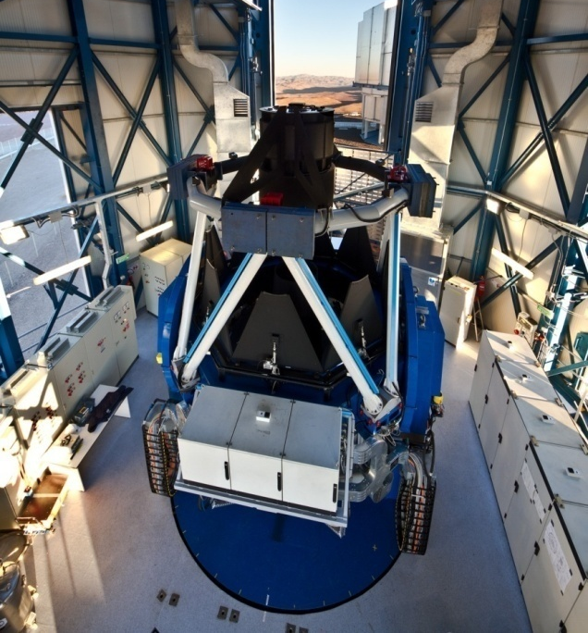
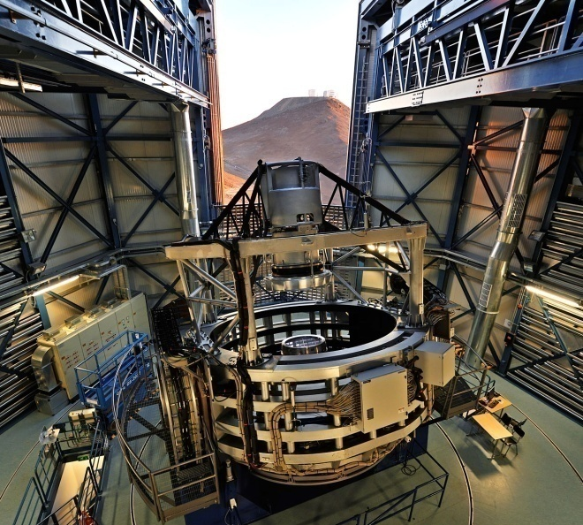
Survey Telescopes
VST 2.6m for optical
  Operations start Oct 2011
  Three+ years of public surveys
VISTA 4.1m for infrared
  Operations start Apr 2010
  Five+ years of public surveys
  Pipeline data reduction done outside ESO
  Wide-field MOS (4MOST) proposed for 2018+
VISTA
VST

Slide 19
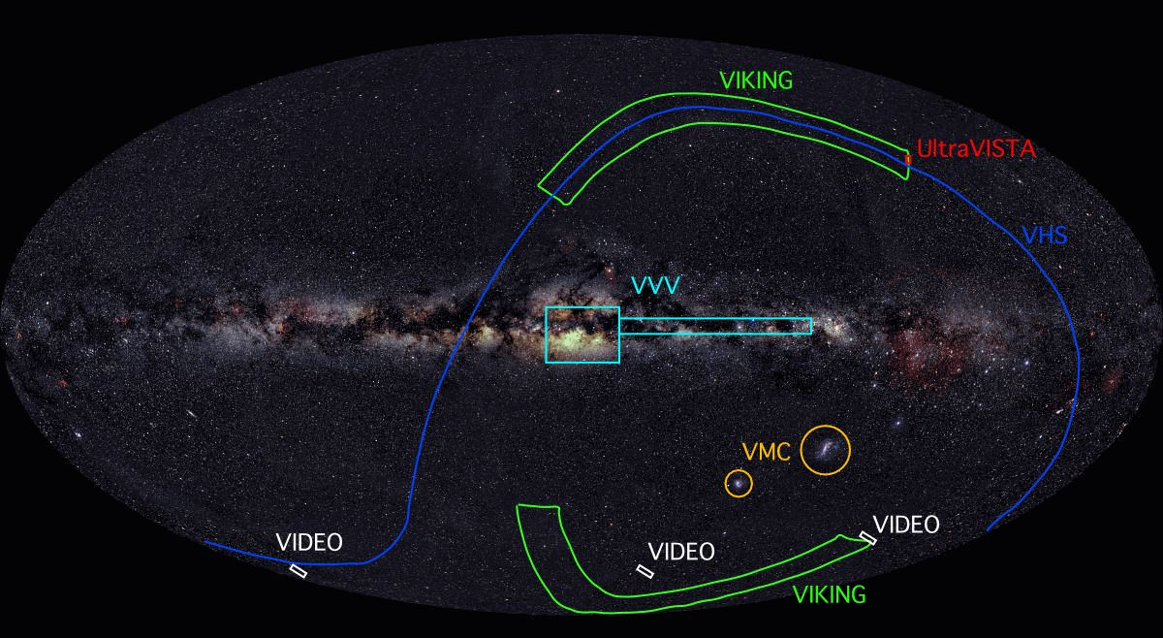
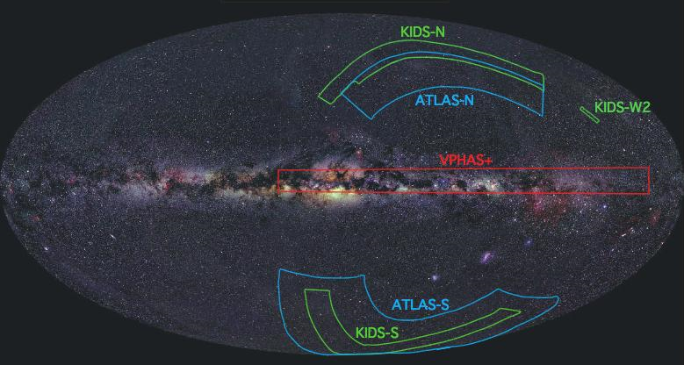
Imaging Public Surveys
VISTA
VST

Slide 20
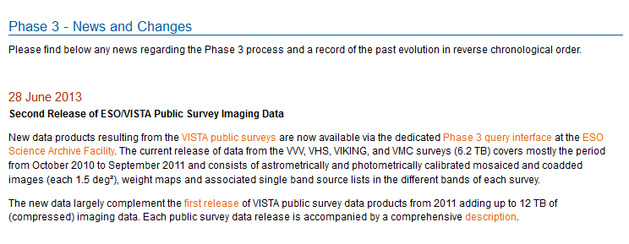
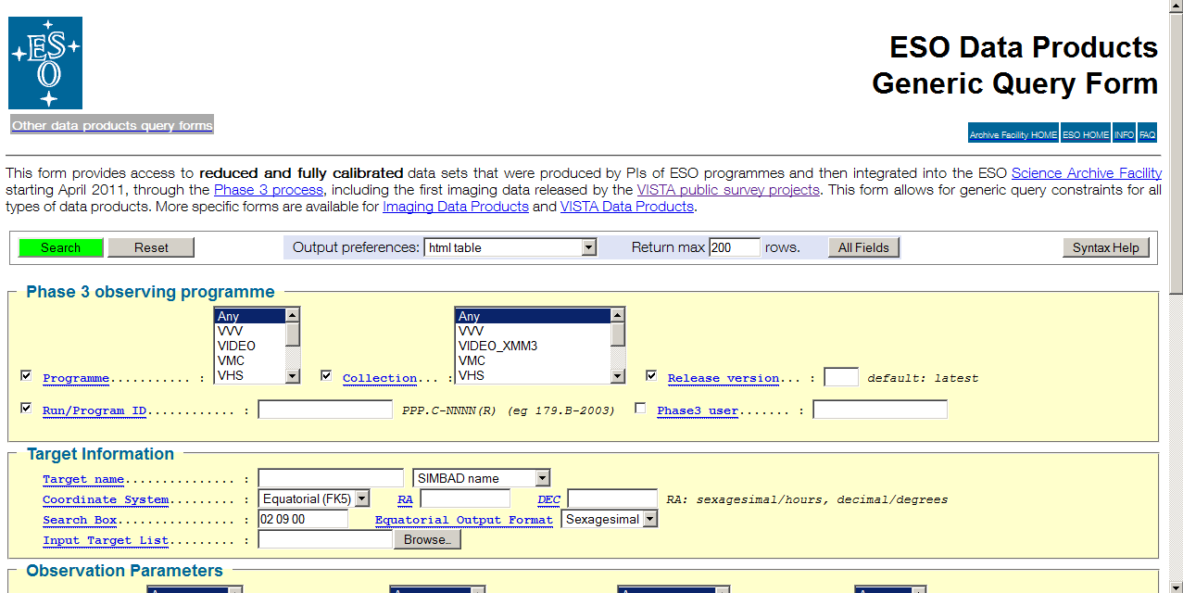
VISTA second data release

Slide 21
VLT White Paper Process
Provide a scientific vision for the VLT in the
E-ELT era
  first draft presented at ESO@50 conference (September 2012)
  discussed with STC (April 2013)
  formulate a new version for discussion with the STC and the community next year
Roadmap of the next VLT/I instruments until 2020
Re-assessing the VLTI implementation plan to fully prepare for GRAVITY and MATISSE.

Slide 22
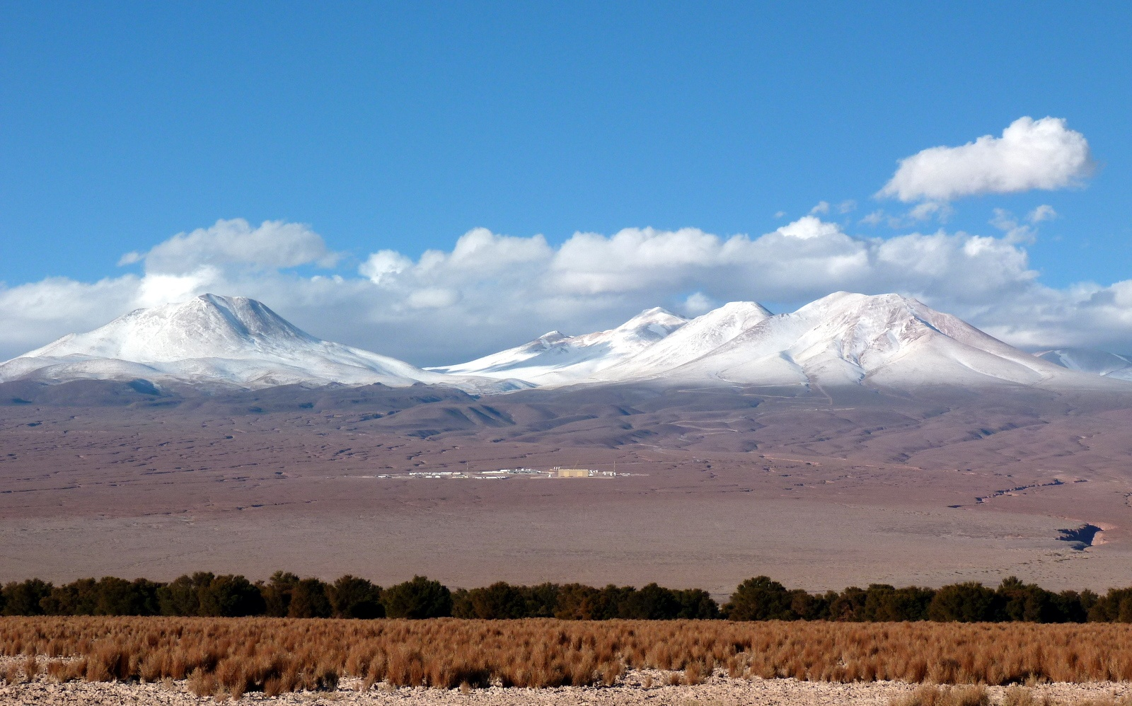

Slide 23
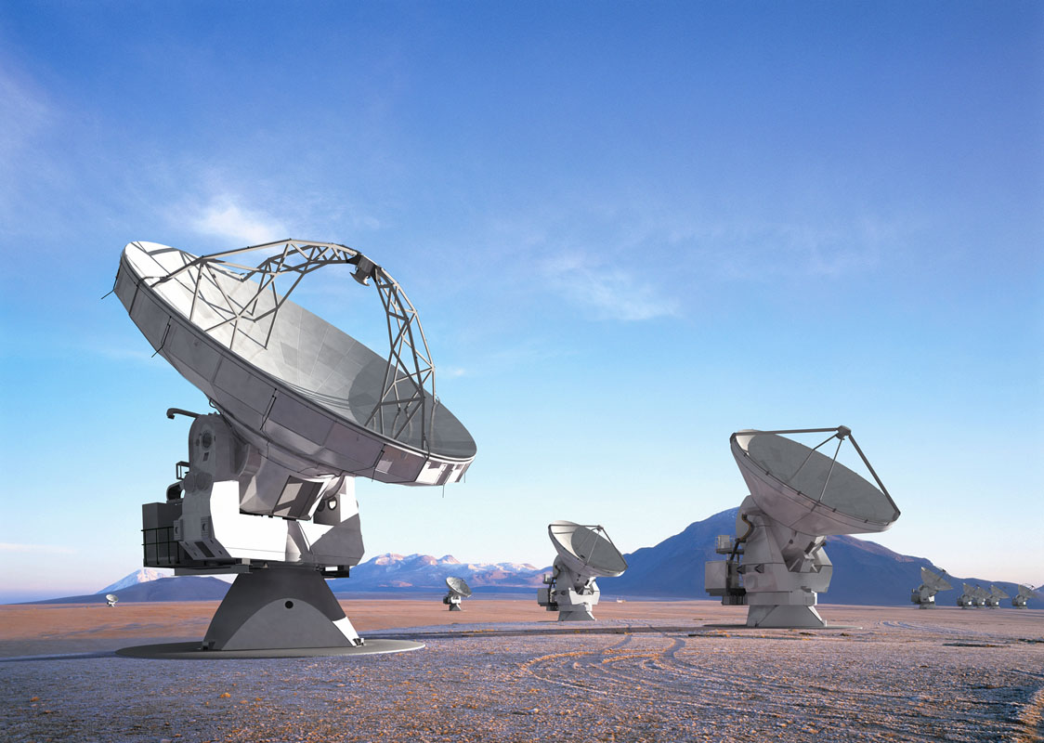
ALMA 2013
(a dream in 2010)

Slide 24
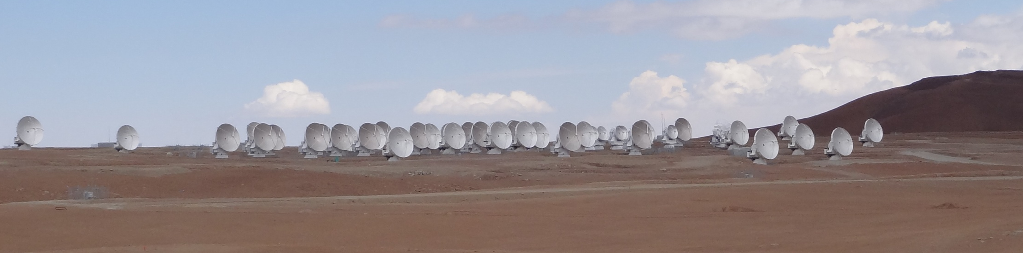
ALMA 2013 - reality
Cycle 0 and Cycle 1 produced stunning science results
The First Year of ALMA Science conference held in Puerto Varas (Chile) 12-15 December 2012
Cycle 1 to continue until May 2014
  With 32 12m antennas and partial Compact Array
Cycle 2 deadline in December 2013
  Definition of capabilities ongoing

Slide 25
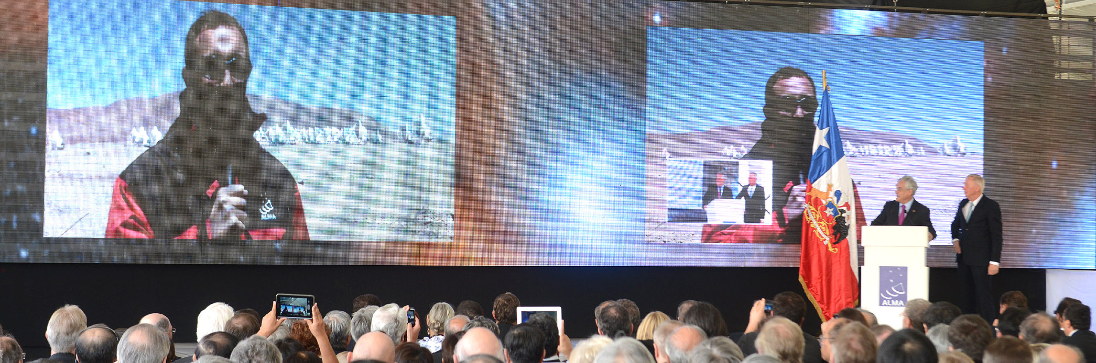
ALMA Inauguration
Major milestone for astronomy and science
  Attended by 500⁺ persons and media representatives

Slide 26
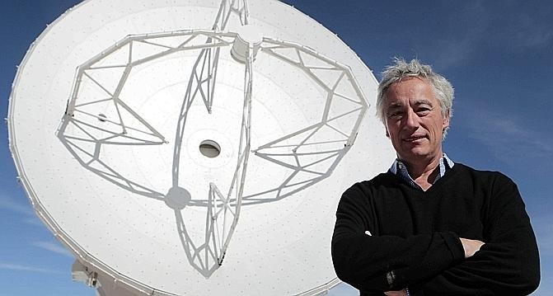
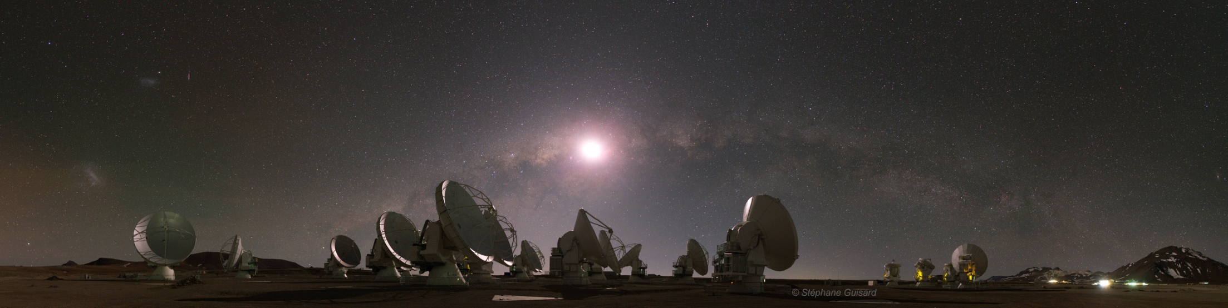
ALMA status
Construction nearly complete
  22 AEM antennas accepted
    3 to go
  All Front End deliveries
  completed
  Permanent Power System in operation
  Residencia design finished, location agreed
    Construction 2014/2015

Slide 27
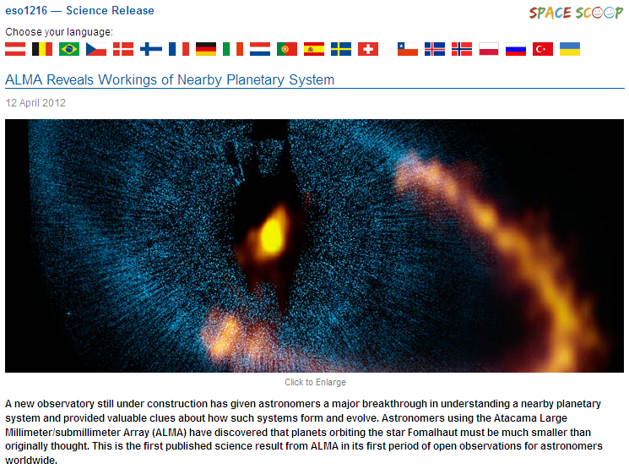






ALMA Science Results

Slide 28

Distant galaxies with ALMA
Follow-up of mm sources discovered with the South Pole Telescope (SPT)
  Detected many high-redshift galaxies (<z>=3.5)
  860μm ALMA imaging (Cycle 0 – 16 antennas)
    47 candidates → several clearly lensed sources
    Integration times 1 minute
    2 objects at z=5.7 with high star formation rate > 500 M yr⁻¹
Viera et al. Nature 2013; Hezaveh et al. ApJ 2013
Notes:
Figure 1 | Near-infrared and ALMA submillimetre-wavelength images of
SPT targets. Images are 80380. We show 10 sources for which we have
confirmed ALMA spectroscopic redshifts, deep near-infrared (NIR) imaging,
and well-resolved structure in the ALMA 870 mmimaging; source names are in
blue in each panel. The greyscale images are NIR exposures from the Hubble
Space Telescope Wide Field Camera 3 (HST/WFC3, co-added F160W and
F110W filters), the Very Large Telescope Infrared Spectrometer and Array
Camera (VLT/ISAAC: Ks band) or the Southern Astrophysical Research
Telescope Ohio State Infrared Imager/Spectrometer (SOAR/OSIRIS: Ks band),
and trace the starlight fromthe foreground lensing galaxy. The NIR images are
shown with logarithmic stretch, and each panel shows at bottom left in black
the telescope/instrument used to obtain the image. The red contours areALMA
870 mmimaging showing the background source structure, clearly indicative of
strong lensing from galaxy-scale haloes. In all cases, the contours start at 5s and
are equally spaced up to 90% of the peak significance, which ranges from 12 to
35. Spectroscopic redshifts of the background sources are shown in red in each
panel, above the NIR telescope/instrument names. The ALMA exposures were
approximately 2-min integrations, roughly equally divided between the
compact and extended array configurations. The resulting resolution is 0.50.
SPT 0103–45 shows a rare lensing configuration of one lens and two
background sources at different redshifts, one visible with ALMA and one with
HST. SPT 0346–52, with a CO-derived redshift of z55.656, is among the
highest-redshift starbursts known.

Slide 29

Distant galaxies with ALMA
Secure redshifts for many sources
  ALMA 3mm spectroscopy
  Integration times about 10 minutes
    Lines detected of ¹²CO, ¹³CO, Ci, H₂O
Viera et al. Nature 2013
Weiss et al. ApJ 2013
Notes:
Figure 2 | ALMA 3 mm spectra of 26 SPT sources. The vertical axis is
observed flux density in units of mJy, with 30 mJy offsets between sources for
clarity. Spectra are continuum-subtracted. The strong CO lines are indicative of
dust-enshrouded active star formation. The spectra are labelled by source and
redshift. Black labels indicate unambiguous redshifts (18), with the subset in
bold font (12) having been derived from the ALMA data alone. Sources labelled
in blue (5) are plotted at the most likely redshift of multiple options, based on
the dust temperature derived from extensive far-infrared photometry. Three
sources with no lines detected are placed at z=1.85, in the middle of the
redshift range for which we expect no strong lines, and labelled in red. Total
integration times for each source were roughly ten minutes. The synthesized
beamsize ranges from 7”x5” to 5”x3” over the frequency range of the search,
which is inadequate to spatially resolve the velocity structure of the lensed
sources. Transitions of species detected in at least one source are indicated by
vertical lines. Rotational transitions of the 12CO (solid) and 13CO (dashed)
isotopologues are shown in grey. Water lines are marked by blue dashed lines,
ionized water lines by red dashed lines, and atomic carbon ([CI]) by the green
dashed line.

Slide 30

Formation of supermassive stars
Infrared Dark Cloud SDC335.579-0.272
  5500±800 M complex
  Two massive star forming cores
M1: M core
  mass infall rate: M/yr
  will yield 750±300 M in a freefall time (3 10⁴ years)
Perreto et al. 2013
ALMA
N₂H⁺(1-0)
Spitzer
ALMA

Slide 31

Outlook on ALMA’s future
ALMA is now in a consolidation phase, focusing at completing construction
Additional capabilities will be added in the coming years in Cycle 2, 3 and towards Full Science
  Polarization, Solar, Long baselines, additional bands
APEX Extension/ARO
  Submm Survey Telescopes
Full Science & Development
  Expected from 2014/2015

Slide 32
ALMA Development ESO
Underlying concepts
  Work with institutes in ESO Member States
  Develop a strategy based on science priorities from the user community
Procedures and policies
  Competitive open Calls for Studies to develop science cases, designs, limited R&D in synergy with European/national/institute funding
  Mature study results are brought to ALMA for implementation as projects
Overarching goal
  Future key science requires: expanded frequency range, improved sensitivity, efficiency in spectral scans

Slide 33

E-ELT

Slide 34
E-ELT Programme
Funding comes from
  Regular ESO income
  Additional contributions from 14 Member States
  Accession of Brazil (entrance fee + annual contributions)
E-ELT Programme approved in Dec 2012
  When required two-thirds majority (10 MS) was reached
  13 Member States have now committed
    695 MEUR pledged for E-ELT Construction
    Not counting extra funding in MS for instrumentation development

Slide 35

E-ELT Construction
Spending on major items authorized once 90% of cost-to-completion pledged (975 MEUR)
  Reached once Brazil ratifies Accession Agreement
Baseline procurement plan is being implemented
  CfT for construction of road and platform in May 2013
    Contract award planned for Nov 2013
  CfT for construction of dome & main structure in 2013
    Contract award planned for Nov 2014

Slide 36
E-ELT Instrumentation
Instrumentation
  Science cases developed in collaboration with the
  E-ELT Project Science Team
  Two first-light instruments (in Phase B)
    ELT-CAM (MICADO)
    ELT-IFU (HARMONI)
  Next three (top level requirements in definition)
    ELT-MIR (METIS)
    ELT-MOS
    ELT-HIRES
Construction philosophy
  Follows ‘VLT model’ of consortia working closely with ESO

Slide 37
Perspective through 2025
Keep the Paranal Observatory world-leading
  White Paper process
  Integrated system of VLT, VLTI, VISTA, VST...
  Add the E-ELT on Armazones to this system
Further develop ALMA on Chajnantor
  Initial steps defined (e.g., Band 5)
  New development studies
Continue successful partnership with community
  Student and fellowship programme
  Construction of instrumentation
  Data archive including science products
  Smaller telescopes and targeted experiments on La Silla

Slide 38

Scientific Productivity
http://www.eso.org/sci/libraries/edocs/ESO/ESOstats.pdf

Slide 39

Science Newsletter
Migration from eNews to a full fledged
Science Newsletter
Started March 2013
Editor: Jeremy Walsh

Slide 40

ESO Fellowships
Brochure appeared in March
  Collected all articles by
  Fellows in the Messenger over
  past 10 years
  Very good feedback
http://www.eso.org/public/products/ brochures/fellows/

Slide 41

Director for Science
Position of Director for Science open
  deadline 8 September

