Slide 1


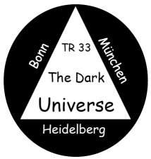
Type Ia Supernovae as Distance Indicators
Bruno Leibundgut

Slide 2
What do we want to learn about supernovae?
What explodes?
  progenitors, evolution towards explosion
How does it explode?
  explosion mechanisms
Where does it explode?
  environment (local and global)
  feedback
What does it leave behind?
  remnants
  compact remnants
  chemical enrichment
Other use of the explosions
  light beacons
  distance indicators
  chemical factories

Slide 3
What do we know about supernovae Ia?
What explodes?
  progenitors, evolution towards explosion
    white dwarfs (?), several channels
How does it explode?
  explosion mechanisms
    several channels
      deflagrations, detonations,
      delayed detonations,
      He detonations,
      mergers
What does it leave behind?
  remnants
    Tycho, LMC
  compact remnants
    none, companion (?)
  chemical enrichment
    the usual suspects

Slide 4
What do we know about supernovae Ia?
Where does it explode?
  environment (local and global)
    some with CSM (?)
    all galaxy morphologies
    dependencies on host galaxies?
  feedback
    little
Other use of the explosions
  light beacons
    little use as background source
  distance indicators
    ha!
  chemical factories
    no significant dust

Slide 5
It is time to give up some cherished paradigms

Slide 6
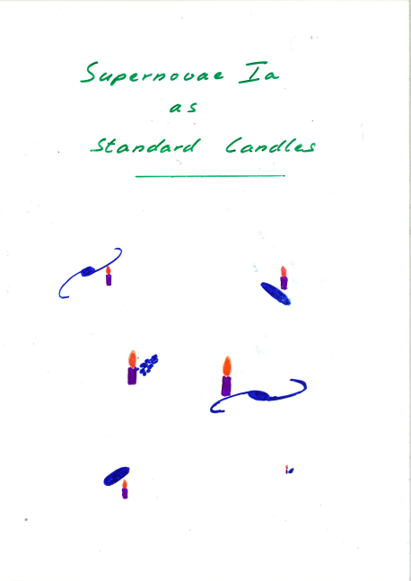
Type Ia SNe are not standard candles
They are not even standardizable
Maybe some of them can be normalised to a common peak luminosity
Paradigm 1

Slide 7
Why no standard candle?
Large variations in
  luminosity
  light curve shapes
  colours
  spectral evolution
  polarimetry
Some clear outliers
  what is a type Ia supernova?
Differences in physical parameters
  Ni mass

Slide 8
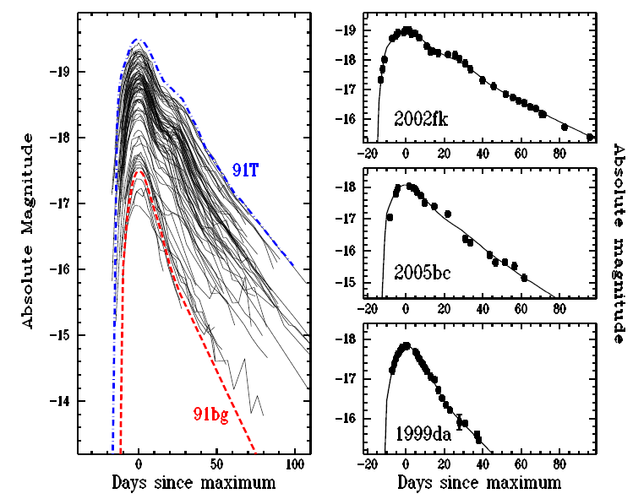
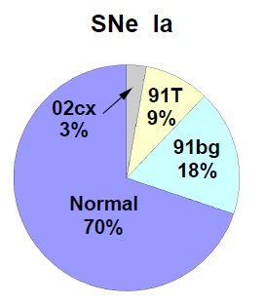
Luminosity distribution
Li et al. 2010

Slide 9
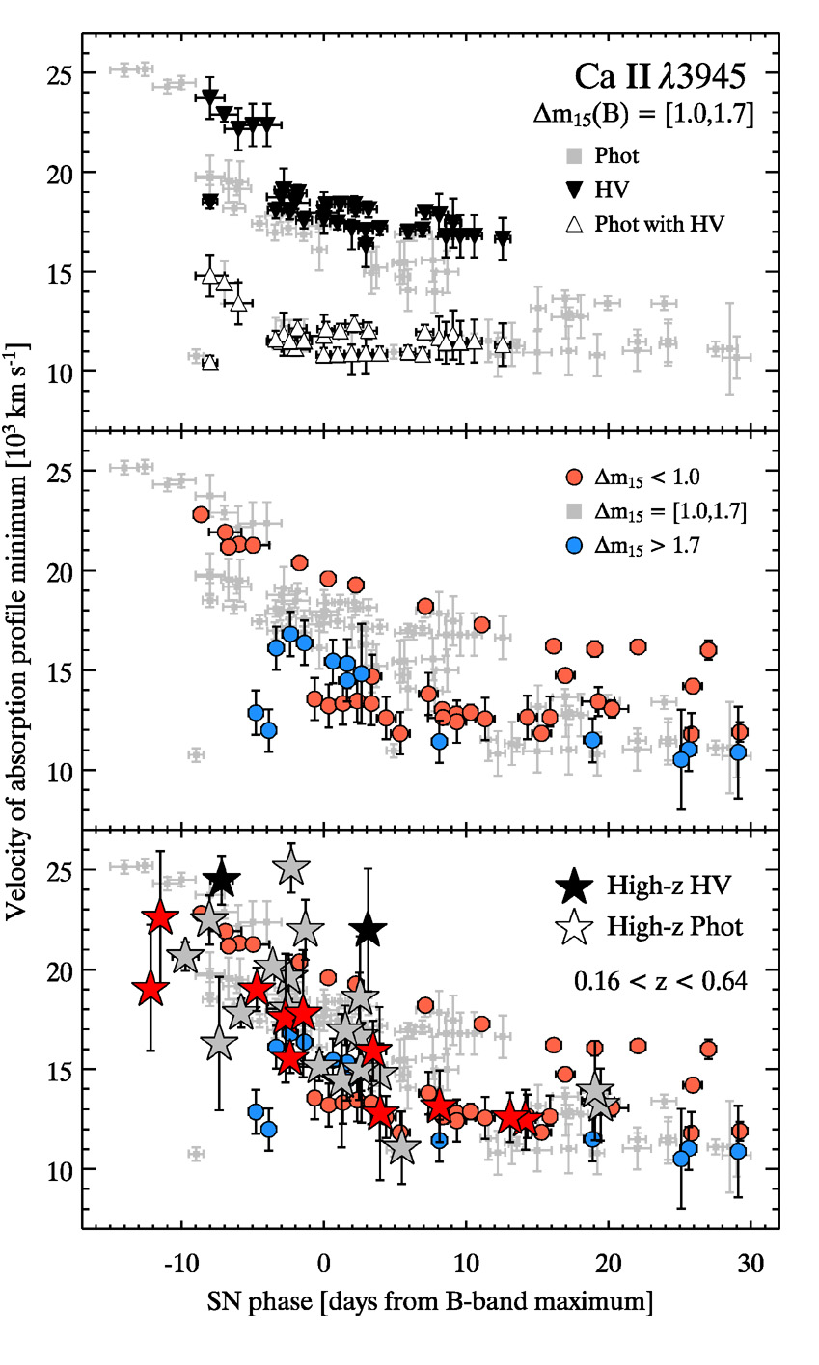
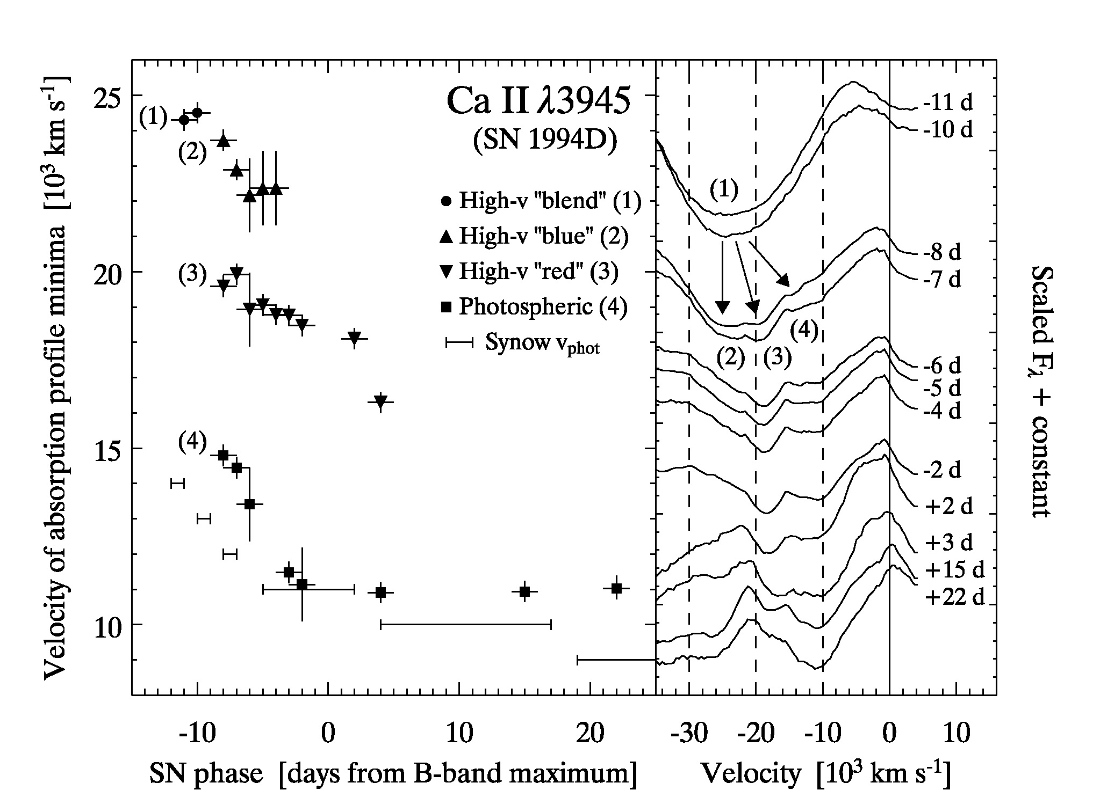
Spectral evolution
Blondin et al. 2006
also Garavini et al. 2007
Bronder et al. 2008

Slide 10
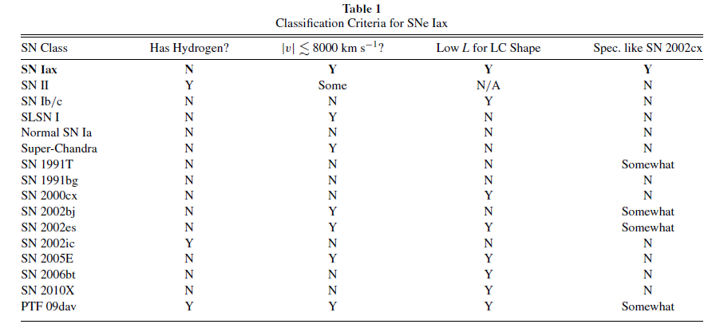
What is a SN Ia?
What is the standard candle?
Foley et al. 2013

Slide 11
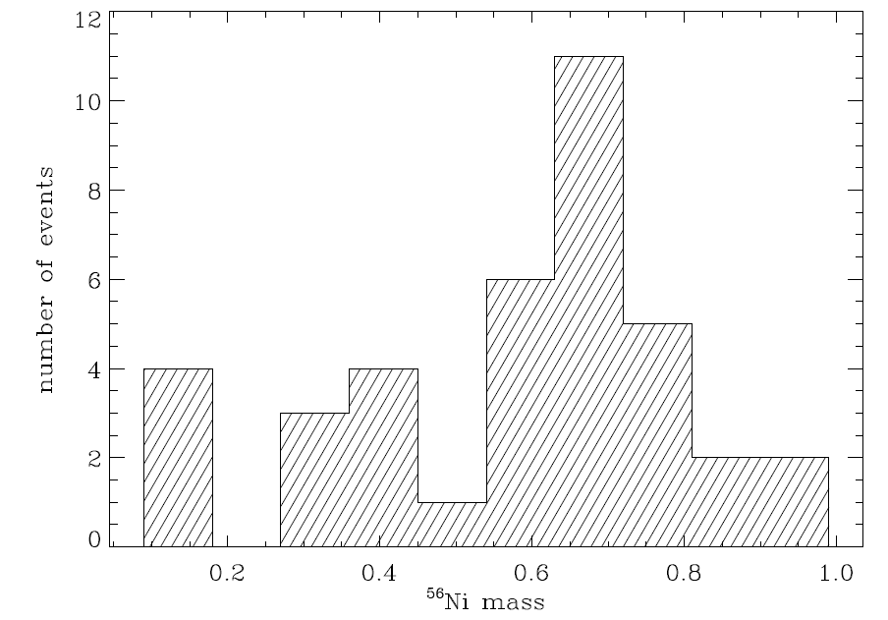
Ni masses from bolometric light curves
Stritzinger 2005
38 well-observed SNe Ia
How can this be a standard candle?

Slide 12
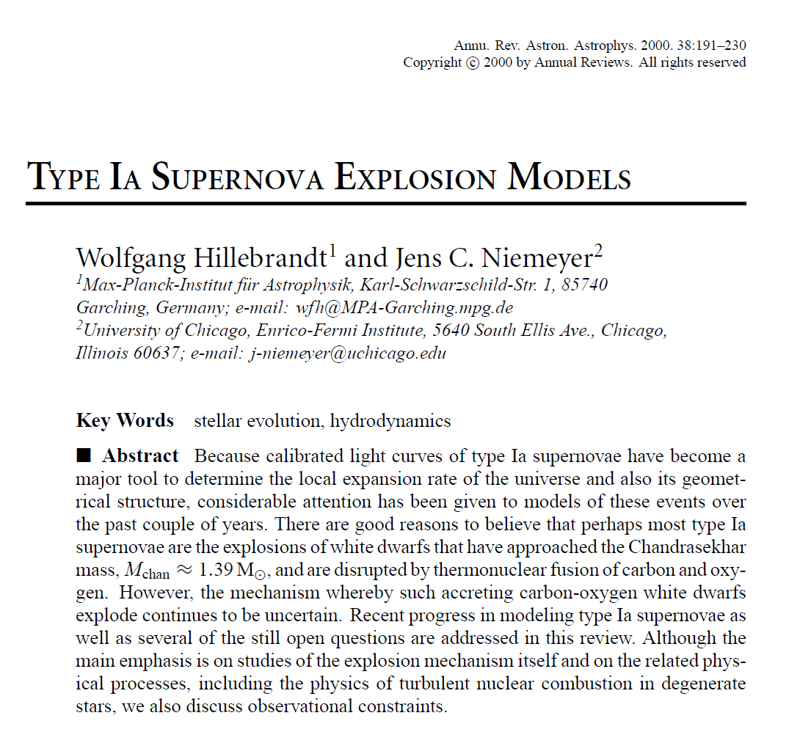
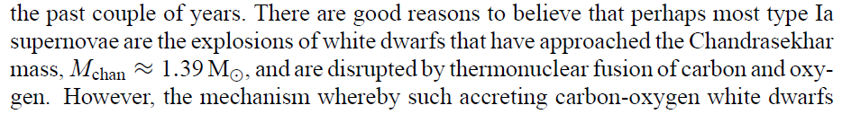
Type Ia SNe do not all come from Chandrasekhar-mass white dwarfs
Paradigm 2

Slide 13
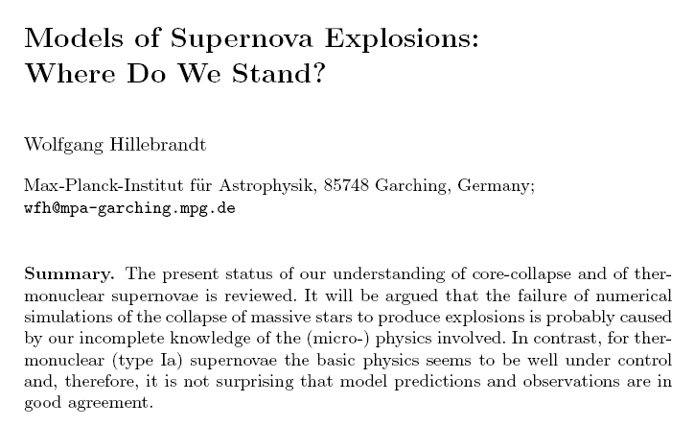
Supernova theory
(2003)
  “Type Ia Supernova progenitors are not Chandrasekhar-mass white dwarfs” (2012)

Slide 14
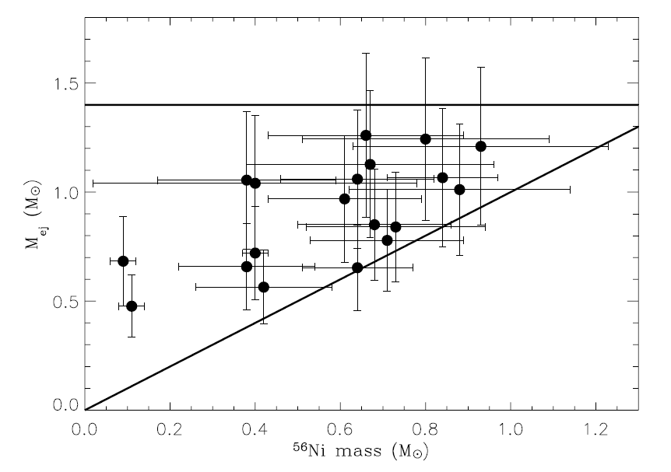
Ejecta masses
Stritzinger et al. 2006

Slide 15
Ejecta masses
Large range in nickel and ejecta masses
  no ejecta mass at 1.4M
  factor of 2 in ejecta masses
  some rather small
  differences
  between
  nickel and ejecta
  mass

Slide 16
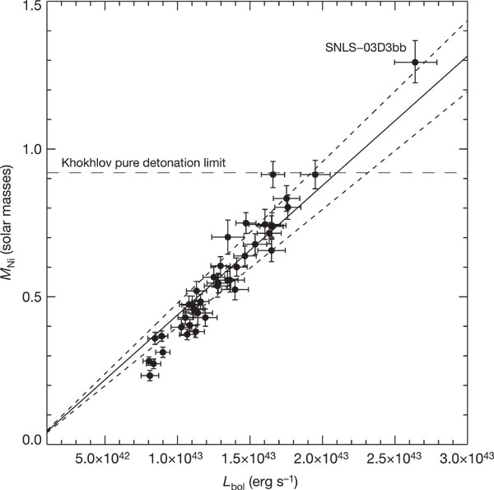
Ejecta masses
Super-Chandrasekhar explosions?
  also
  SN 2006gz, 2007if,
  2009dc
  inferred Ni mass > 1 M
Howell et al. 2006

Slide 17
SNe Ia are not a homogeneous class
Proliferation of information
  Large samples produce many peculiar and special objects
  Difficulty to assess what are generic features of the class and what are peculiar modifications to the norm
    Subluminous
    Superluminous
    CSM/no CSM
    Environmental effects
What should we give up?
  multiple progenitor channels
  multiple explosion mechanisms
  uniform metalicity
Paradigm 3

Slide 18
SN Ia Correlations
Warning!
Historic slide
Luminosity vs. decline rate
  Phillips 1993, Hamuy et al. 1996, Riess et al. 1996, 1998, Perlmutter et al. 1997, Goldhaber et al. 2001
Luminosity vs. rise time
  Riess et al. 1999
Luminosity vs. color at maximum
  Riess et al. 1996, Tripp 1998, Phillips et al. 1999
Luminosity vs. line strengths and line widths
  Nugent et al. 1995, Riess et al. 1998, Mazzali et al. 1998
Luminosity vs. host galaxy morphology
  Filippenko 1989, Hamuy et al. 1995, 1996, Schmidt et al. 1998, Branch et al. 1996

Slide 19
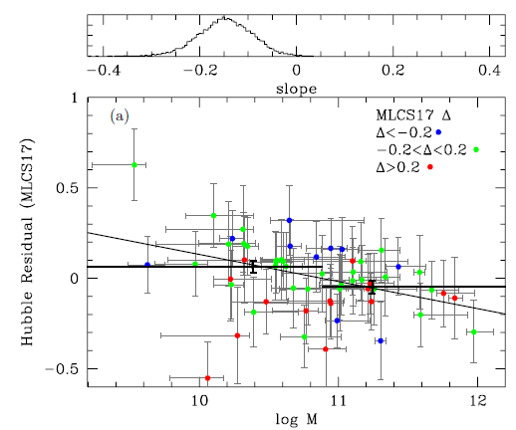
SN Ia Correlations
Luminosity with host galaxy mass and star formation
  Hicken et al. 2009, Kelly et al. 2010, Lampeitl et al. 2010, Sullivan et al. 2010
Kelly et al. 2010

Slide 20
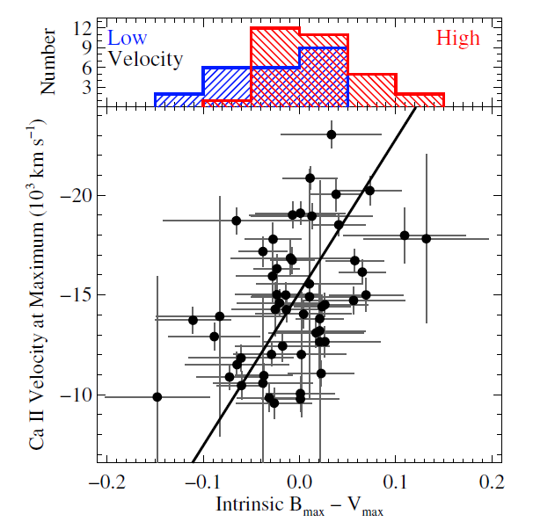
SN Ia Correlations
Expansion velocity with colour
Foley 2012

Slide 21
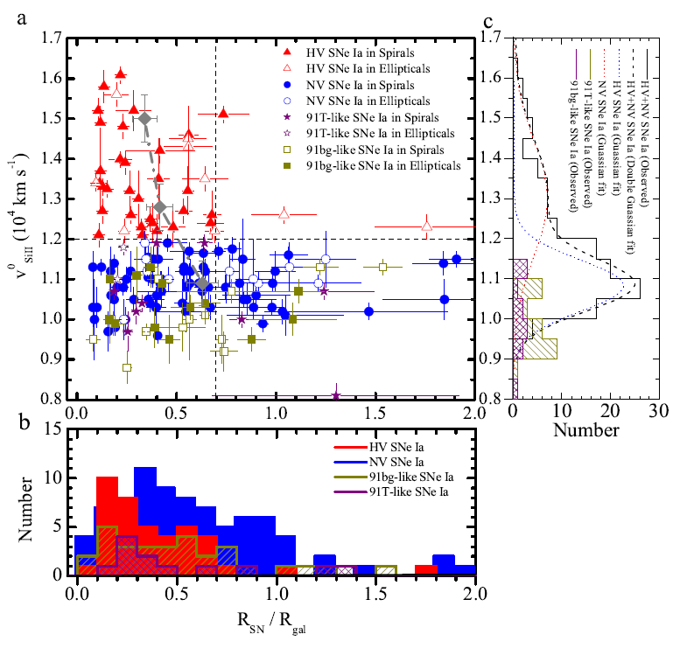
SN Ia Correlations
Expansion velocity with position within host galaxy
Wang et al. 2013

Slide 22
Type Ia Supernovae
Complicated story
  observational diversity
  many models
  need more constraints

Slide 23
Type Ia Supernovae as distance indicators
Excellent distance indicators!

Slide 24
Supernova cosmology
Stellar explosions
  systematics!
SNe Ia currently the best known individual cosmic distance indicator
  ~5-10% accuracy on
  individual SN
Absolute calibration relies on external sources
  Cepheids

Slide 25
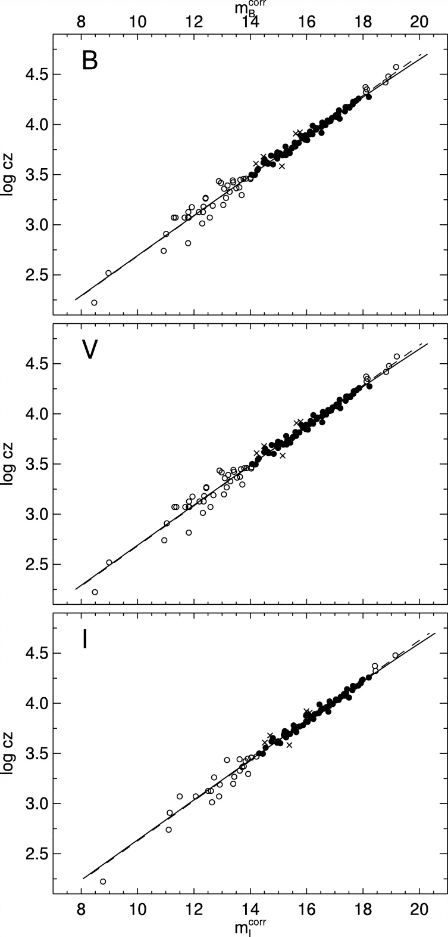
SN Ia Hubble diagram
Excellent distance indicators
Experimentally verified
Work of several decades
Best determination of
the Hubble constant
Reindl et al. 2005

Slide 26
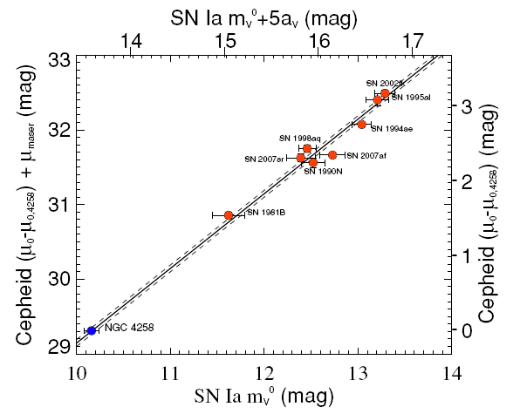
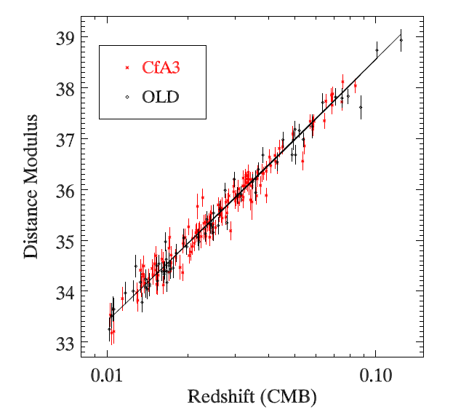
H₀ from supernovae
Measure the local Hubble diagram
Calibrate the luminosity of the distance indicator
  Cepheids
    LMC
    NGC 4358
  nearby SNe Ia
Riess et al. 2011
Hicken et al. 2009

Slide 27
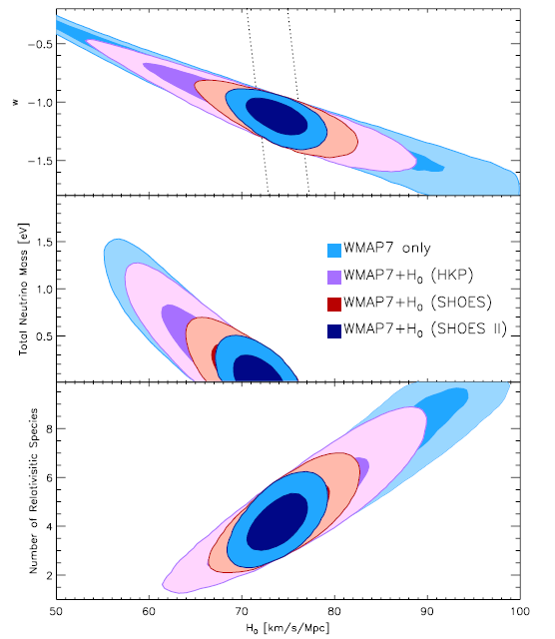
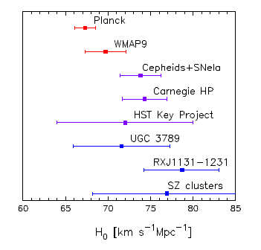
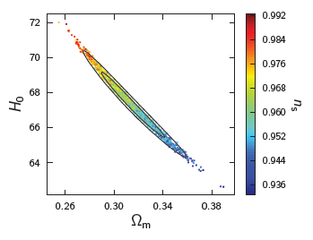
The importance of H₀
Sets the absolute scale
  size and age of the universe
In combination with
CMB measurements
  constrains w
  neutrino mass
  number of relativistic
  species
Riess et al. 2011
Planck 2013

Slide 28
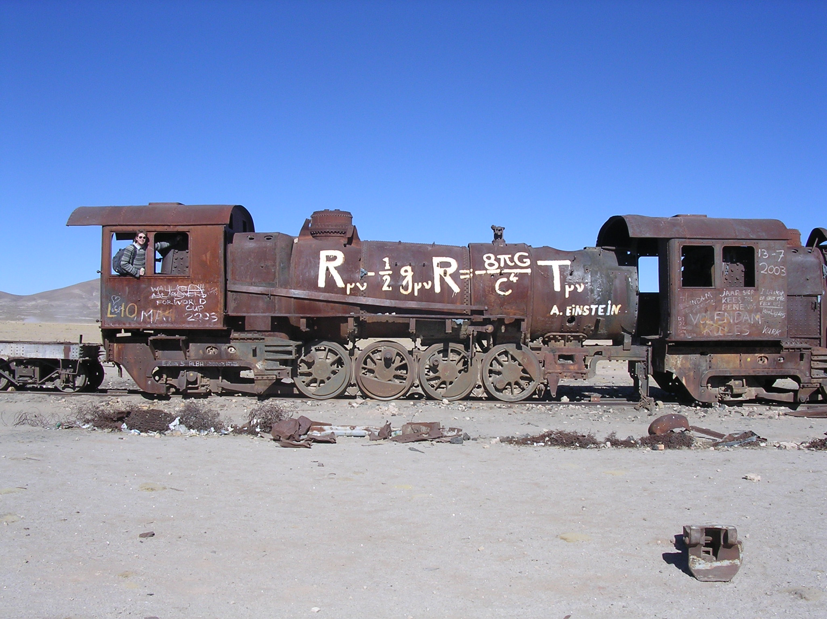
Supernova Cosmology

Slide 29
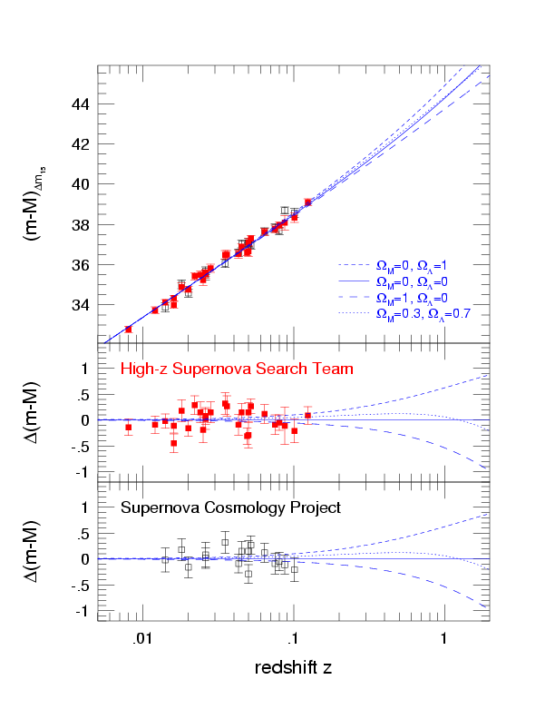
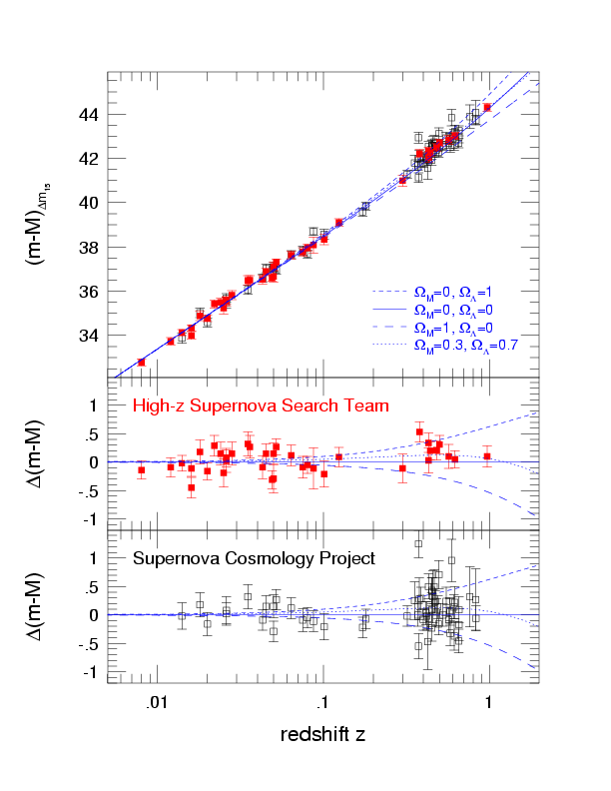
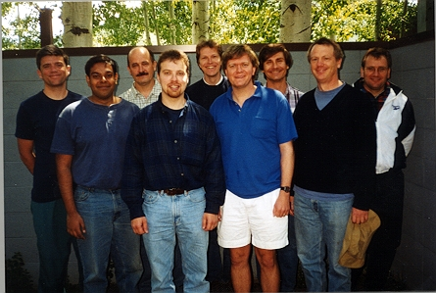
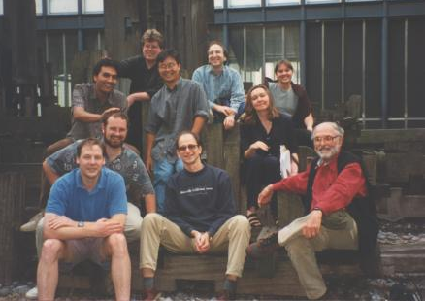
The SN Hubble Diagram

Slide 30
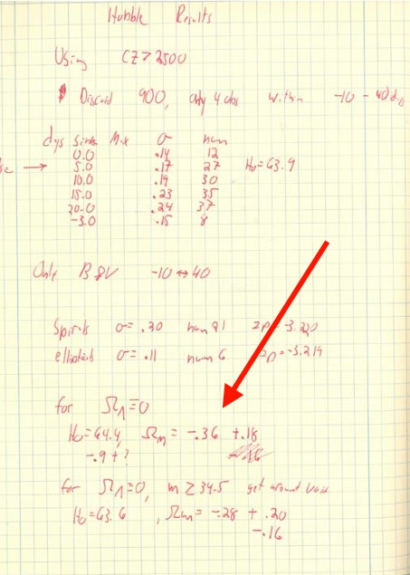
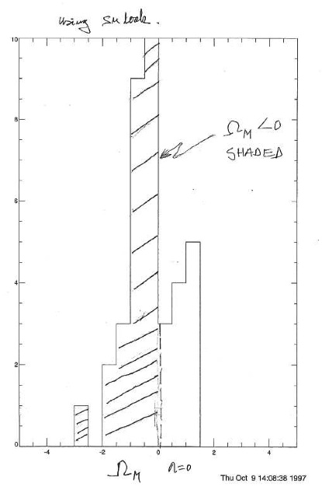
Absurd result
negative matter density
Riess
Goldhaber

Slide 31
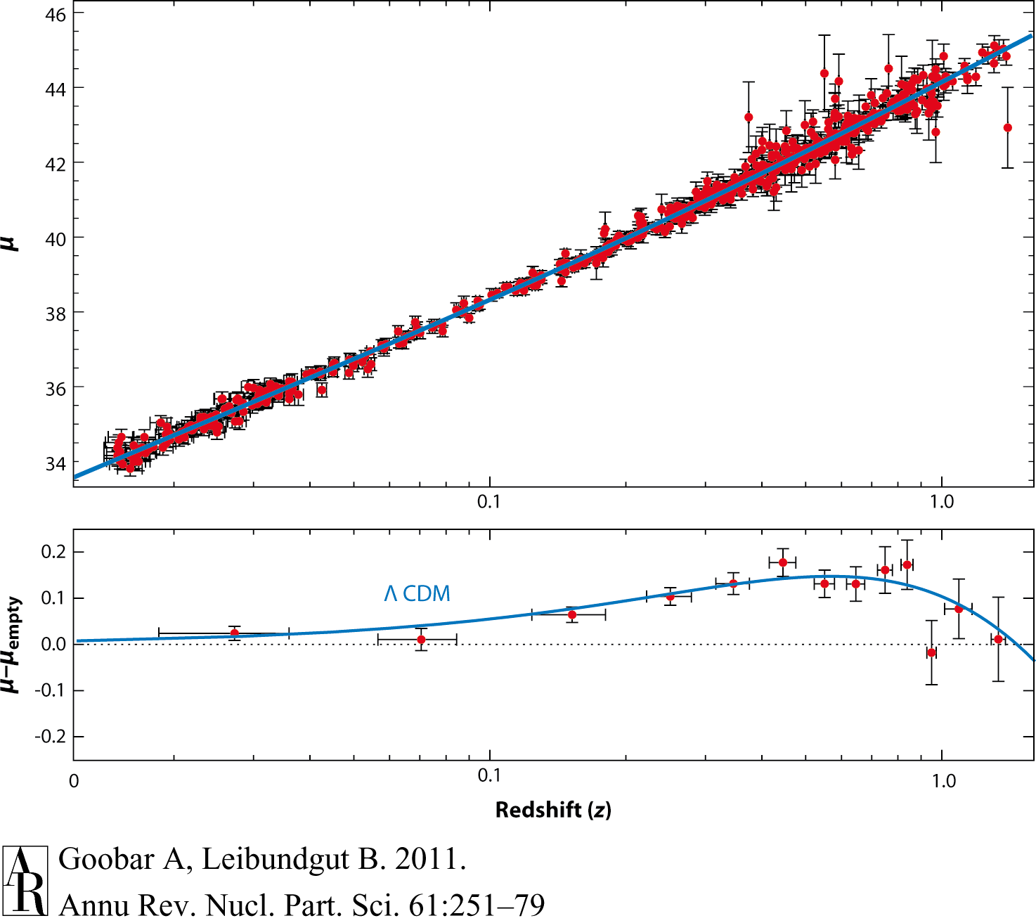
Supernova Cosmology 2011
Goobar & Leibundgut 2011
560 SNe Ia

Slide 32
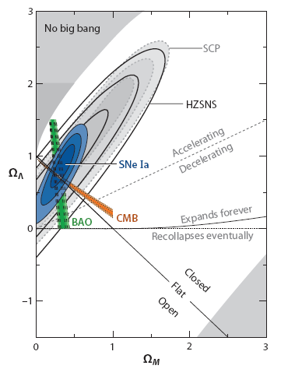
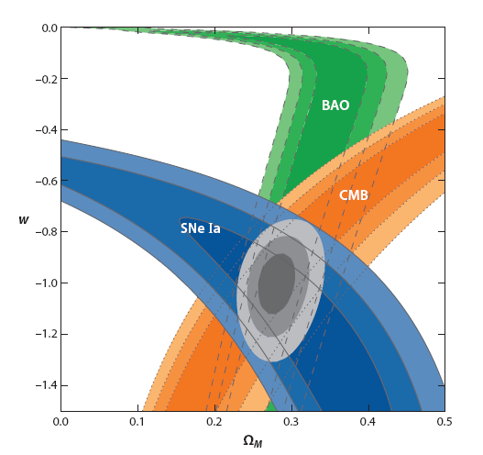
et voilà ...
10 years of progress
Goobar & Leibundgut 2011

Slide 33
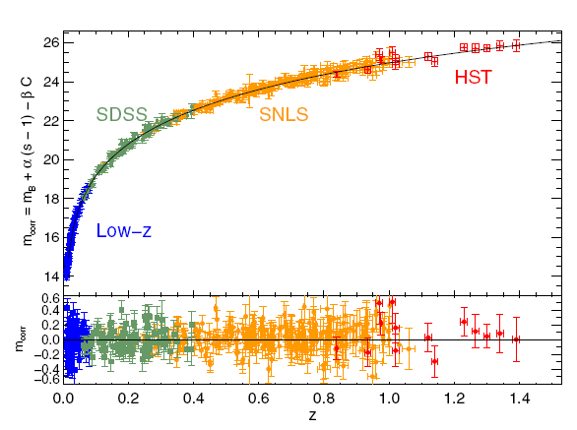
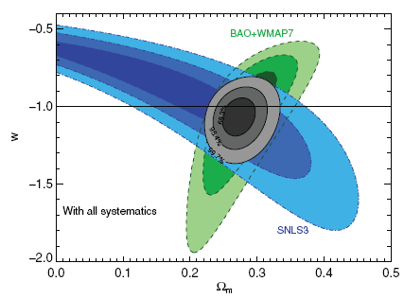
Recent SNLS results
Sullivan et al. 2011
Conley et al. 2011

Slide 34
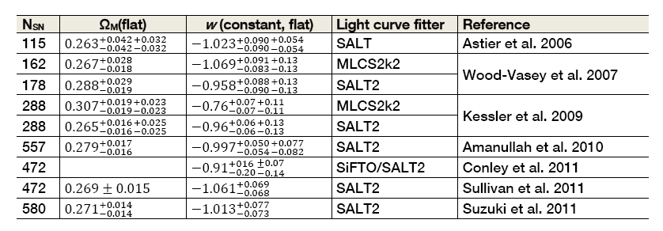
Supernova cosmology
ω firmly established
  general agreement between different experiments

Slide 35
Systematics
“[T]he length of the list indicates the maturity of the field, and is the result of more than a decade of careful study.”
Contamination
Photometry
K-corrections
Malmquist bias
Normalisation
Evolution
Absorption
Local expansion field

Slide 36
Systematics
Current questions
  calibration
  restframe UV flux
    redshifted into the observable window
  reddening and absorption
    detect absorption
      through colours or spectroscopic indicators
    correct for absorption
      knowledge of absorption law
  light curve fitters
  selection bias
    sampling of different populations
  gravitational lensing
  brightness evolution

Slide 37
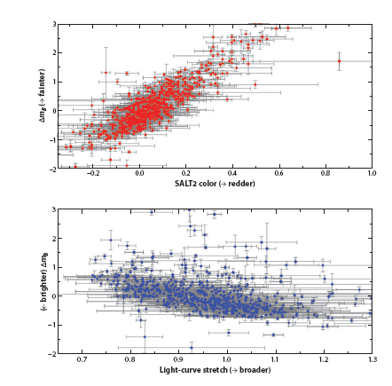
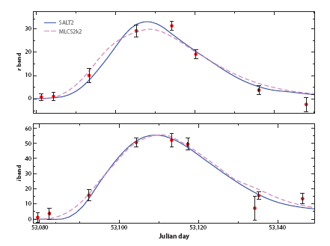
Required phenomenology
photometric calibration
normalisation
  (“standardizable
  candle”;
  “standard crayon”)
  different light curve
  fitters
    Δm₁₅,SALT, SiFTO,
    MLCS
Goobar & Leibundgut 2011
SNLS SN04D2gp
z=0.732

Slide 38
What next?
Already in hand
  >1000 SNe Ia for cosmology
  constant ω determined to 5%
  accuracy dominated by systematic effects
Missing
  good data at z>1
    light curves and spectra
  good infrared data at z>0.5
    cover the restframe B and V filters
    move towards longer wavelengths to reduce absorption effects
  restframe near-infrared Hubble diagram
    Nobili et al. 2005, Freedman et al. 2009,
    Barone-Nugent et al. 2012, Kattner et al. 2012

Slide 39
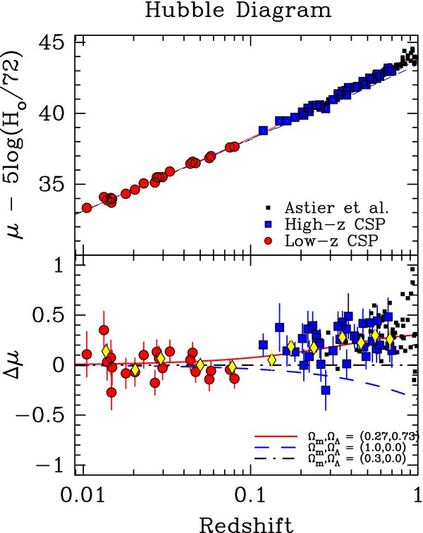
I-band Hubble diagram
Freedman et al. 2009
Currently only 35 SNe Ia
Goobar & Leibundgut 2011
560 SNe Ia

Slide 40
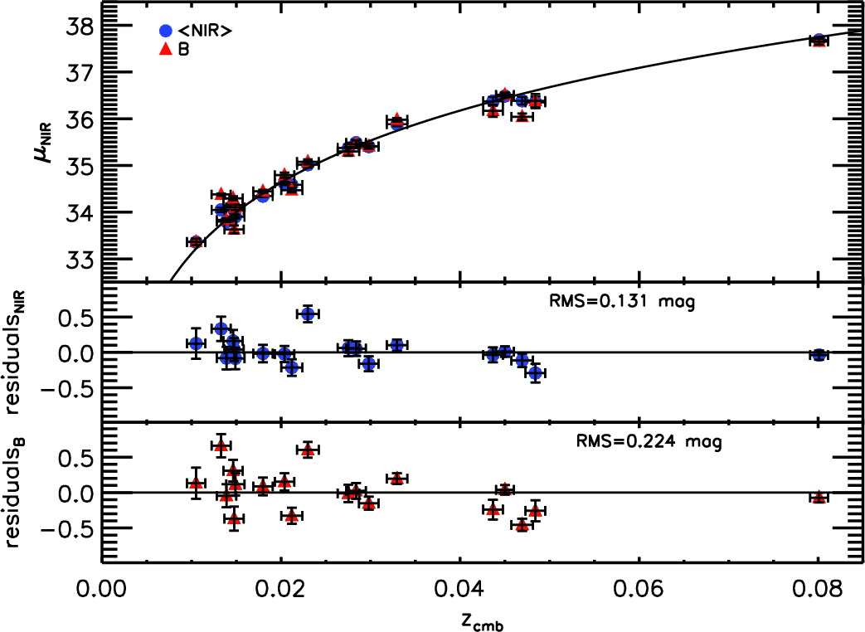
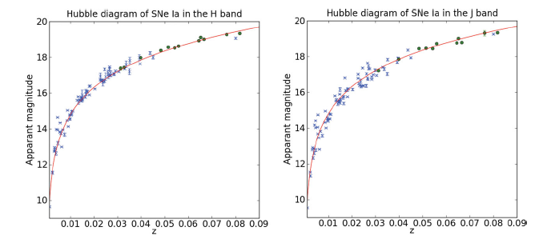
J- and H-band Hubble diagrams
(YJH)
Kattner et al. 2012
Barone-Nugent et al. 2012

Slide 41
Supernova Cosmology – do we need more?
Test for variable ω
  required accuracy ~2% in individual distances
  can SNe Ia provide this?
    can the systematics be reduced to this level?
    homogeneous photometry?
    further parameters (e.g. host galaxy metalicity)
    handle >100000 SNe Ia per year?
Euclid
  3000 SNe Ia to z<1.2 with IR light curves (deep fields) → restframe I-band Hubble diagram
  16000 SNe discovered

Slide 42
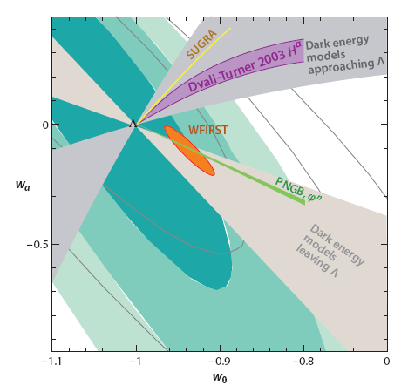
Cosmology – more?
Goobar & Leibundgut 2011
(courtesy E. Linder and J. Johansson)

Slide 43


Distant SNe with
CANDELS and CLASH
Multi-cycle HST Treasury Programs
PIs: S. Faber/H. Fergusson
PI: M. Postman
HST MCT SN Survey
PI: A. Riess
SN discoveries and target-of-opportunity follow-up
SNe Ia out to z≈2
Determine the SN rate at z>1 and
constrain the progenitor systems

Slide 44
SNe Ia at high redshifts (z>1.5)
ratio (Ω_{DE}/Ω_{M})₀=2.7; (Ω_{DE}/Ω_{M})_{z=1.5}=0.173
with w₀=-1±0.2 and w_{a}=-1±1; w=w₀+w_{a}(1-a)
within these uncertainties the observed magnitudes change less than 0.1m
  direct test for evolution!
at z>1.5 age of the universe is <4Gyr
  low-mass stars are still on the main sequence
  SN Ia progenitors from more massive progenitor stars
  constrain progenitor models of SNe Ia

Slide 45
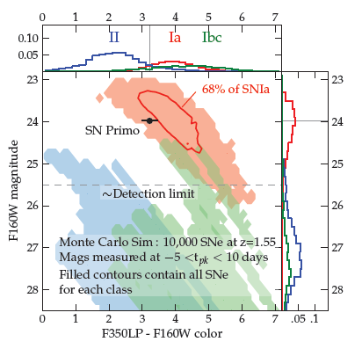
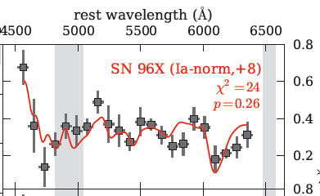
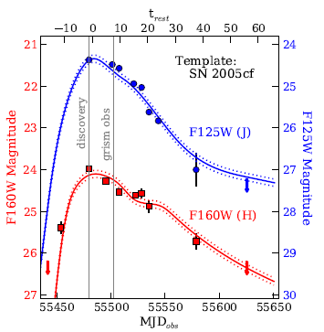
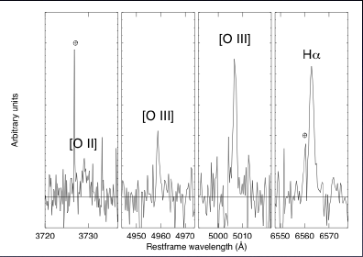
4 arguments for a SN Ia @ z=1.55
  color and host galaxy photo-z
  host galaxy spectroscopy
  light curve consistent with
  normal SN Ia at z=1.55
  SN spectrum consistent

Slide 46
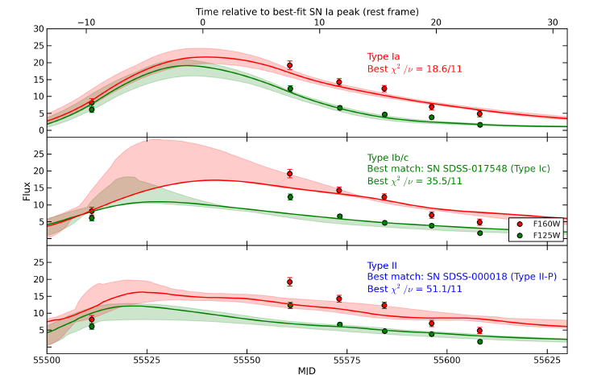
SNe Ia at z>1
SN Ia at z=1.91
SN UDS10Wil
Jones et al. 2013

Slide 47
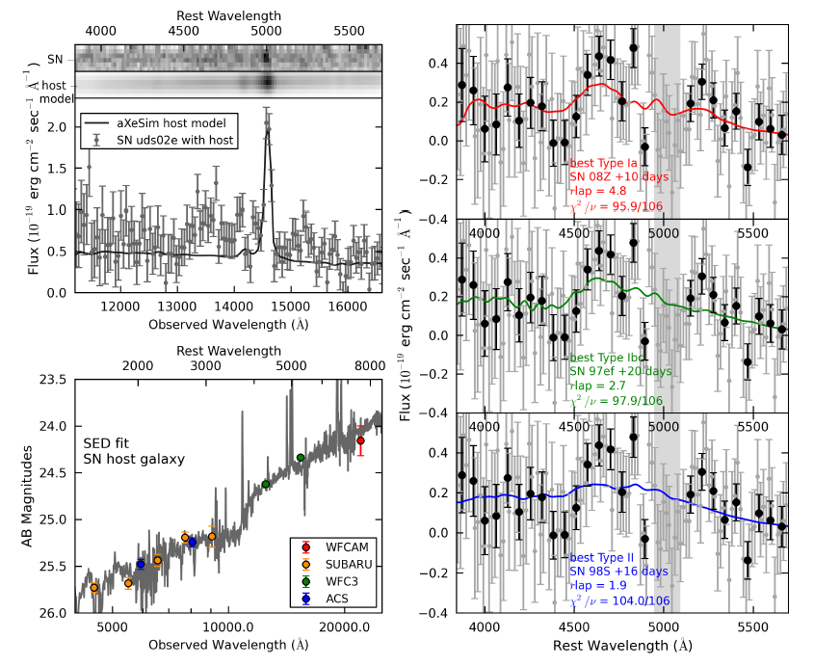
SN UDS10Wil at z=1.91

Slide 48
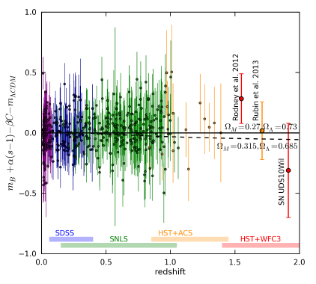
SNe at z>1
Jones et al. 2013

Slide 49
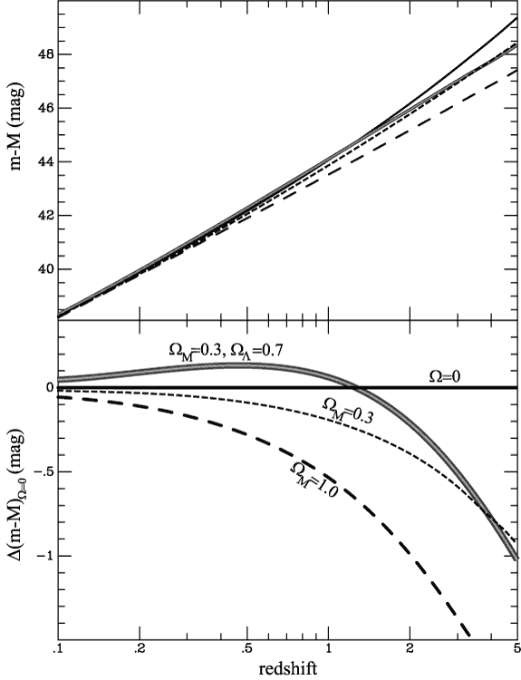
Where are we …
SN Factory
Carnegie SN Project
SDSSII
ESSENCE
CFHT Legacy Survey
Higher-z SN Search
(GOODS)
Euclid/WFIRST/LSST
Plus the local searches:
LOTOSS, CfA, ESC

Slide 50
Summary
Concentrate on λ not covered so far
  particular IR is interesting
    reduced effect of reddening
    better behaviour of SNe Ia(?)
Understand the SN zoo
  many (subtle?) differences observed in recent samples (PanSTARRS and PTF)
    subluminous and superluminous
  understand potential evolutionary effects
    spectroscopy important → PESSTO
    DES?, LSST?, Euclid follow-up?

