Slide 1
Two brief examples for machine learning
Scikit-learn package: machine learning with Python
Web page: https://scikit-learn.org/stable/
Installed on our muc machines together with Python3.
Also needed: NumPy and matplotlib. See: https://www.scipy.org/
Example data sets as txt files on www.eso.org/~bwolff/ML/
Six QC parameters from molecfit fits to KMOS telluric standard stars: fitrms_avg, fitrms_rms,
fit_improv_avg, fit_improv_rms, h2o_avg, and h2o_rms.
Observations from 2018 (+ a few 2019) and 2013.
Also two Python scripts: not executable but can be used to copy and paste into Python interpreter.

Slide 2

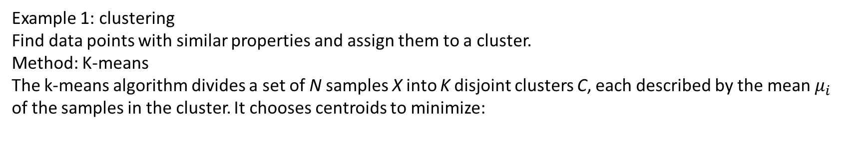
Example 1: clustering
Find data points with similar properties and assign them to a cluster.
Method: K-means
The k-means algorithm divides a set of N samples X into K disjoint clusters C, each described by the mean $μ_{i}$
of the samples in the cluster. It chooses centroids to minimize:
Example session:
> python3
>>> import numpy as np
>>> X_orig = np.loadtxt('tellmod_2018_orig.txt’) # 2018 data, original data set
>>> X = np.loadtxt('tellmod_2018_norm.txt’) # same, but parameter values normalized to 1
>>> X.shape # 2D array: 638 data points, 6 parameters
>>> X # print first and last data points
>>> X_orig # (to see how the arrays look like)
>>> from sklearn import cluster # import cluster package from scikit-learn
>>> k_means = cluster.KMeans(n_clusters=5) # initialize method with 5 clusters
>>> k_means.fit(X) # do a “fit” to the data, this associates each data point to a cluster
>>> k_means.labels_ # print labels for each data point (integers from 0 to 4)
>>> import matplotlib.pyplot as plt # plot results
>>> fig, ax = plt.subplots()
>>> ax.scatter(X_orig[:,4], X_orig[:,5], c=k_means.labels_) # plot h2o_rms vs. h2o_avg, colours set according to label
>>> plt.show() # show figure in pop-up, close window to continue
>>> fig, ax = plt.subplots() # another figure
>>> ax.scatter(X_orig[:,2], X_orig[:,3], c=k_means.labels_) # plot fit_improv_rms vs. fit_improv_avg
>>> plt.show()

Slide 3
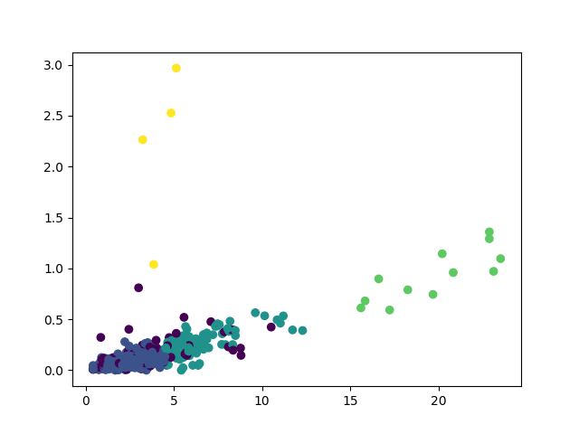
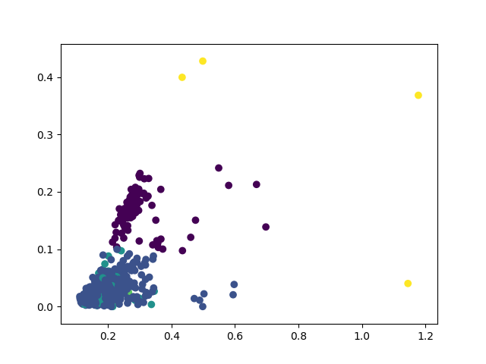
The plots look like:
(actual colors may vary due to random starting points for algorithm)
h2o_rms vs. h2o_avg:
fit_improv_rms vs. fit_improv_avg:

Slide 4
Example 2: outlier detection
Method: using decision trees (if-then-else clauses)
Example session (continue from previous session):
>>> from sklearn.ensemble import IsolationForest
>>> iso = IsolationForest(contamination=0.03) # specify 3% outliers in data set
>>> iso.fit(X[:,2:4]) # fit only fit_improv_avg and fit_improv_rms parameters
>>> scores = iso.predict(X[:,2:4]) # assign labels to data set
>>> scores # integer numbers: 1 means inlier, -1 outlier
>>> fig, ax = plt.subplots()
>>> ax.scatter(X_orig[:,2], X_orig[:,3], c=scores) # plot with colour coding according to in-/outlier labels
>>> plt.show()
>>> y = np.loadtxt('tellmod_2013_norm.txt’) # load 2013 data set
>>> y_orig = np.loadtxt('tellmod_2013_orig.txt')
>>> scores_2013 = iso.predict(y[:,2:4]) # use learned properties from previous fit to detect outliers in 2013
>>> fig, ax = plt.subplots()
>>> ax.scatter(y_orig[:,2], y_orig[:,3], c=scores_2013)
>>> plt.show()
^D # to exit Python interpreter
Exercise: fit all 6 parameters with 1% contamination

Slide 5
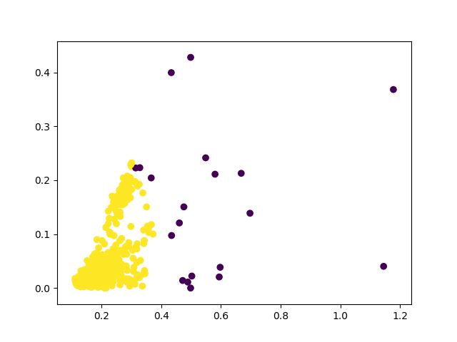
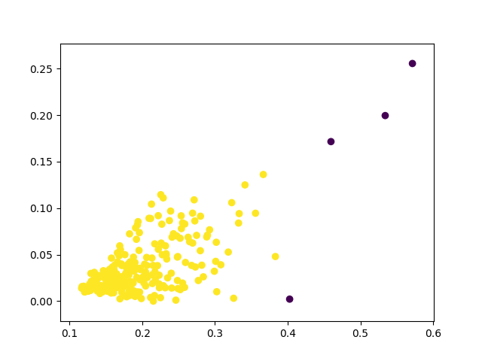
The plots look like:
Training data set (2018):
Applying learned features to 2013 data:

