Slide 1
KMOS in a nutshell
24 movable IFUs, each 2.8”x2.8”, 0.2” spatial sampling
7.2’ diameter FOV
wavelength coverage: 0.8 um to 2.5 um
five spectral bands: IZ, YJ, H, K, HK
R = 3400, 3600, 4000, 4200, 2000
three spectrographic channels,
each with one spectrograph and one detector,
one channel for eight IFUs

Slide 2
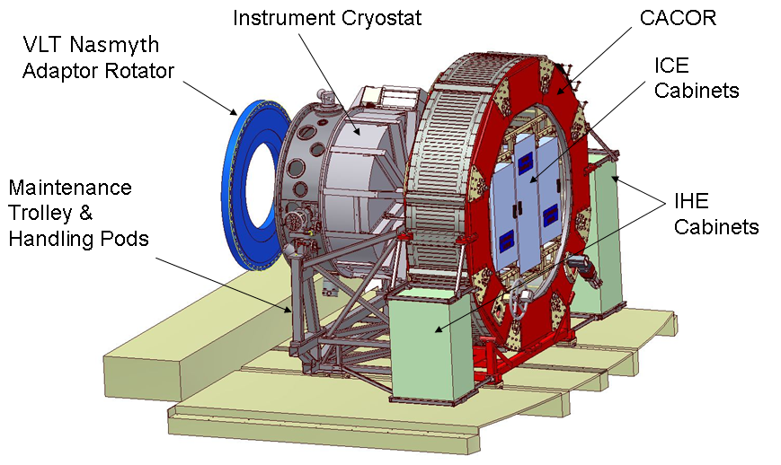
KMOS instrument overview

Slide 3
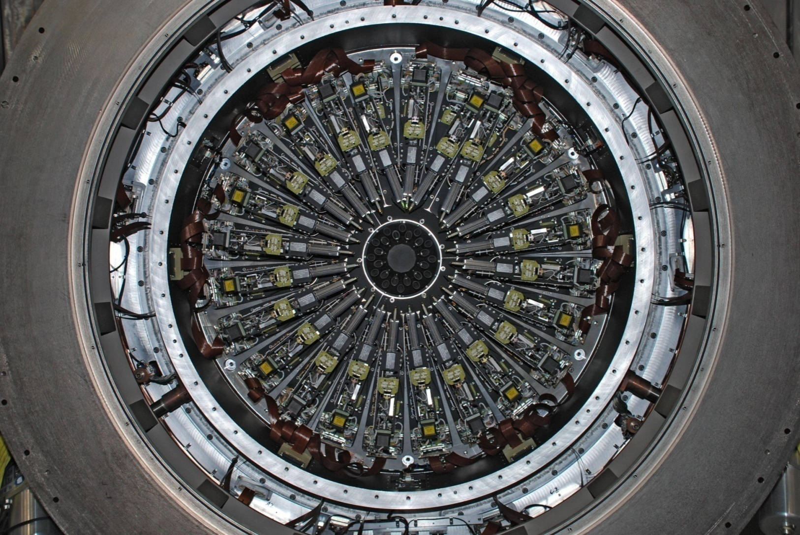
KMOS IFU arms

Slide 4
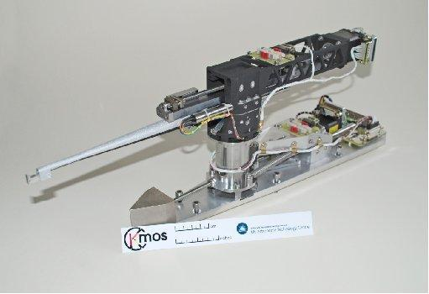
IFU pick-off arm

Slide 5
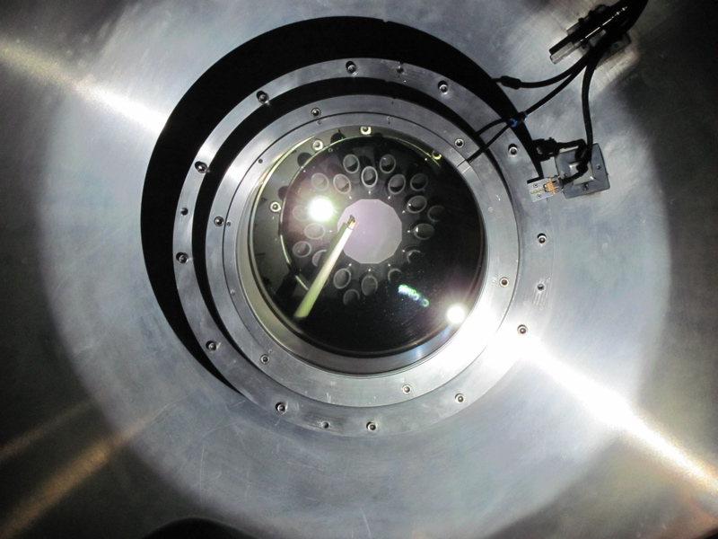
IFU arm stuck

Slide 6
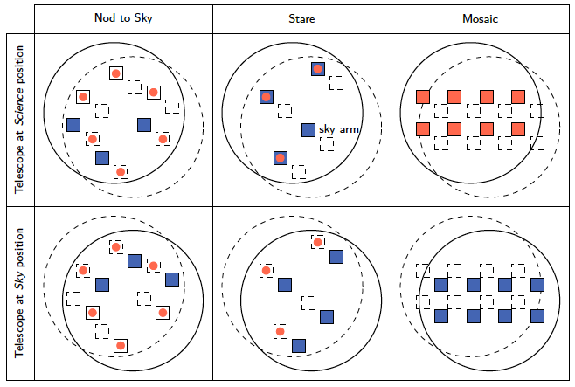
KMOS observing modes

Slide 7
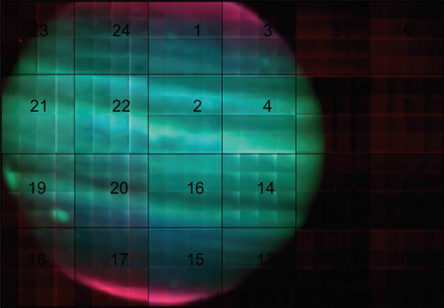
KMOS mosaic mode example

Slide 8
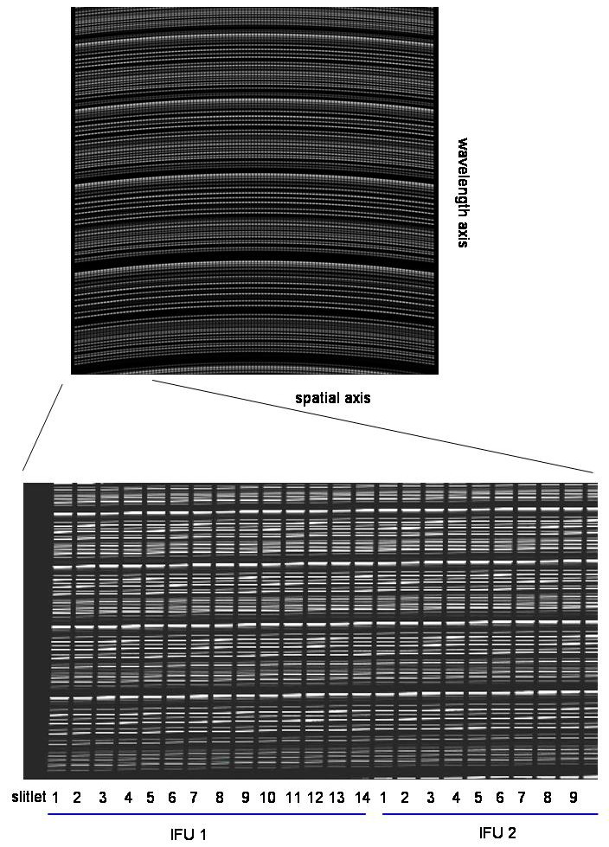
Raw data:
Fits file with 3 extensions
8 IFUs per detector
2048 x 2048 pixel each
48 MB file size

Slide 9
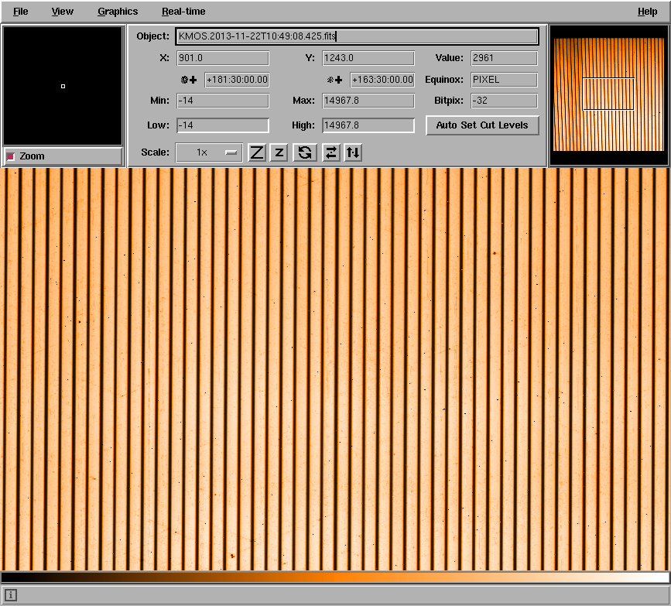
Flat-field

Slide 10
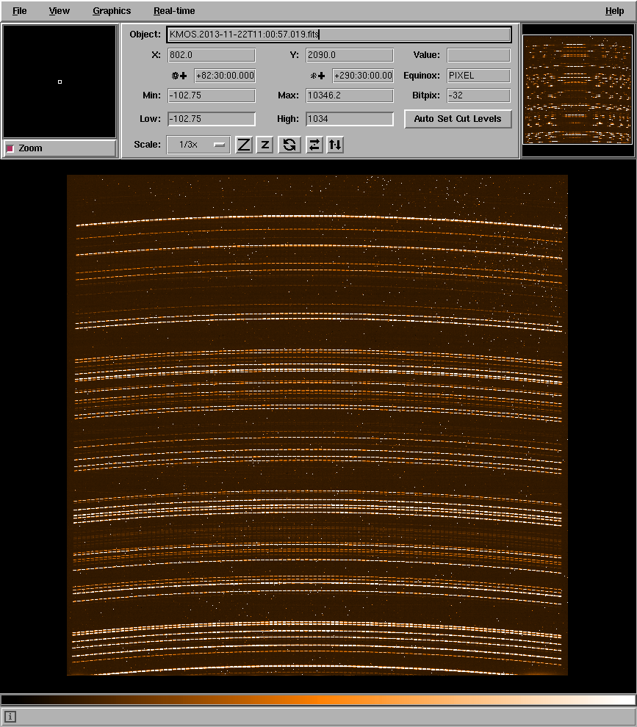
Arc lamp

Slide 11
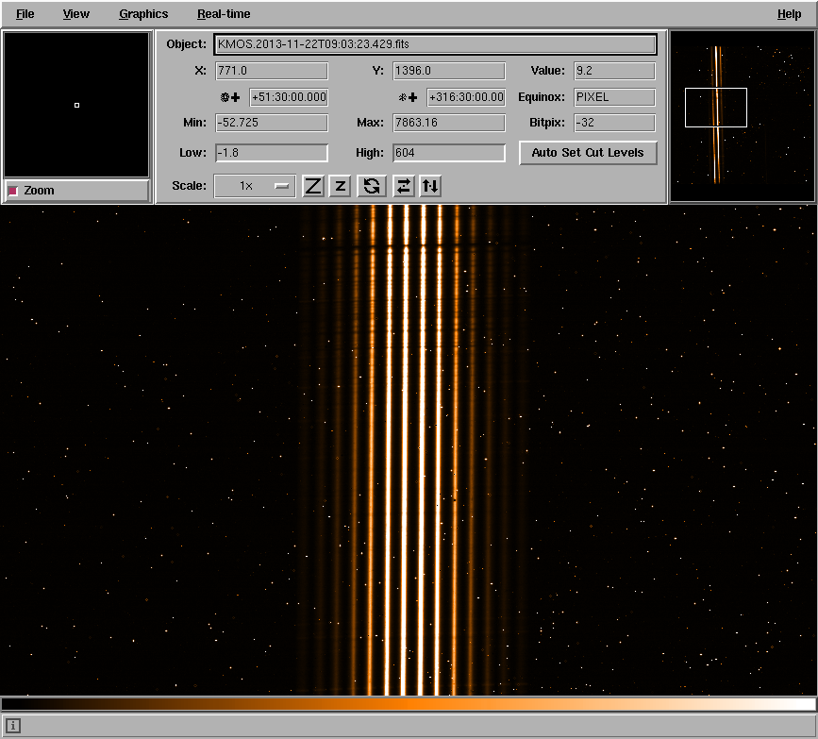
STD star exposure

Slide 12
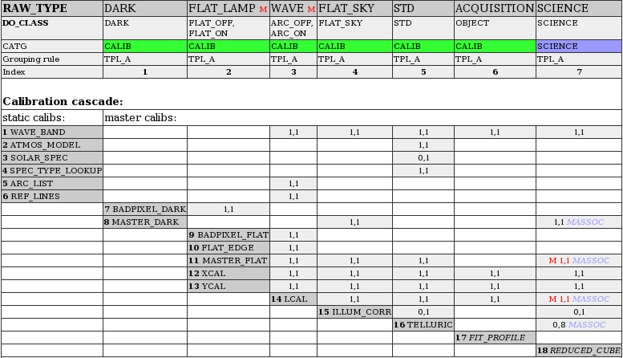
Calib Map

Slide 13
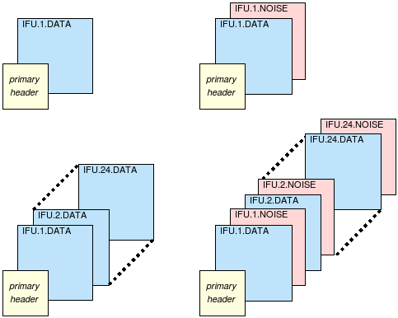
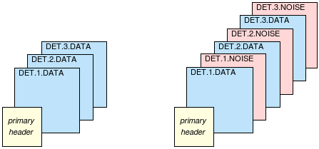
Format of pipeline products
Per detector:
Per IFU:

Slide 14
Parameter Multiplicity: Detector Split
Median Dark
DIT=10s
Det 1
Det 2
DIT=20s
Det 1
QC Parameter
AB Level: Set Up
Detector Split
Det 2
Det 3
…
Det 3

Slide 15
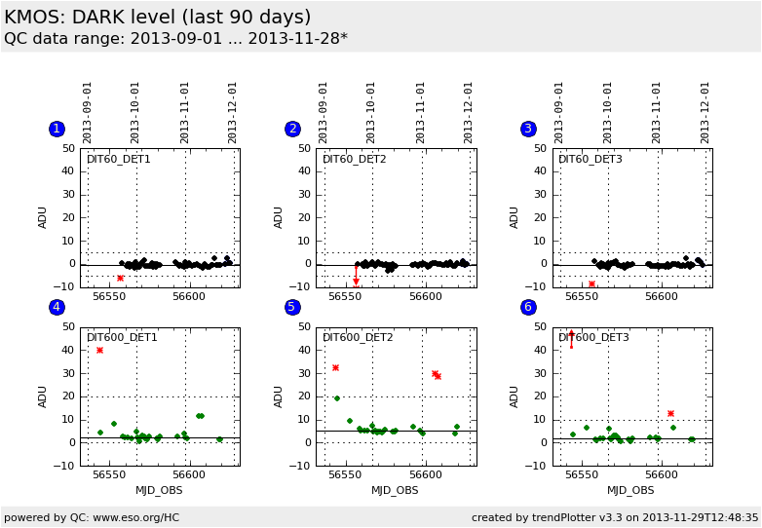
HC: Dark level

Slide 16
KMOS flat/arc lamp calibrations
File DPR.TYPE Grating Filter Rotator Angle
KMOS.2013-07-07T14:25:53.201.fits WAVE,OFF HK Block
KMOS.2013-07-07T14:28:58.579.fits WAVE,LAMP HK HK -60.000
KMOS.2013-07-07T14:29:53.699.fits WAVE,LAMP HK HK 0.000
KMOS.2013-07-07T14:30:49.073.fits WAVE,LAMP HK HK 60.000
KMOS.2013-07-07T14:31:44.345.fits WAVE,LAMP HK HK 120.000
KMOS.2013-07-07T14:32:38.493.fits WAVE,LAMP HK HK 180.000
KMOS.2013-07-07T14:33:32.764.fits WAVE,LAMP HK HK 240.000

Slide 17
Parameter Multiplicity: Rotator Angle Split
FF position
H
Angle=0
Angle=60
K
…
AB Level: Set Up
Rotator Angle Split
Detector Split
QC Parameter
Angle=300
Det 1
Det 2
Det 3
…
…
…

Slide 18
QC1 Database with rotator angle split
pipefile | det_index (=1, 2, 3) | slit_edge_x_0 | rot_angle_0 | …
 |  | slit_edge_x_1 | rot_angle_1
 |  | slit_edge_x_2 | rot_angle_2
 |  | slit_edge_x_3 | rot_angle_3
 |  | slit_edge_x_4 | rot_angle_4
 |  | slit_edge_x_5 | rot_angle_5
 |  | slit_edge_x_6 | rot_angle_6

Slide 19
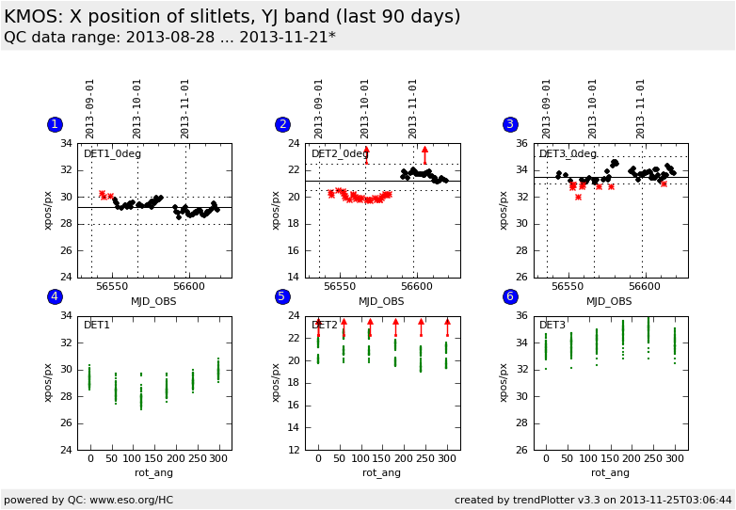
HC: FF position

Slide 20
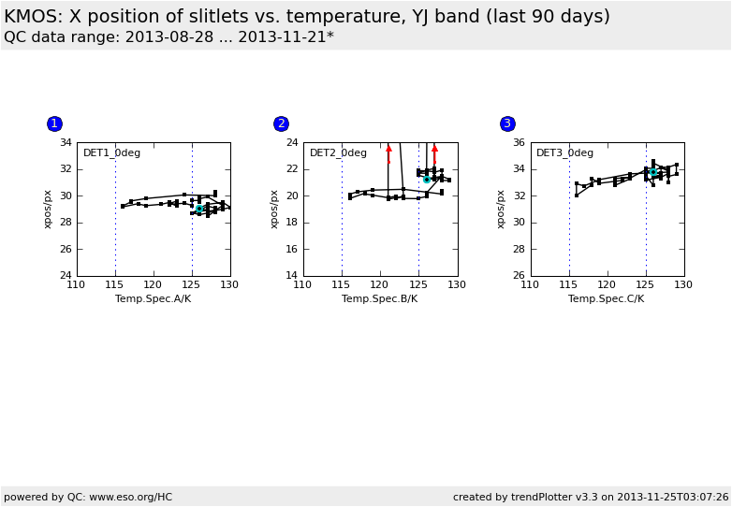
HC: FF position vs. temperature

Slide 21
Parameter Multiplicity: IFU Split
IFU efficiency
H
IFU 1
IFU 2
K
IFU 1
QC Parameter
AB Level: Set Up
IFU Split
IFU 2
…
…
IFU 24
…

Slide 22
QC1 Database with IFU split
pipefile | det_index (=1 always) | throughput_ifu_01 | …
 |  | throughput_ifu_02
 |  | …
 |  | throughput_ifu_24

Slide 23
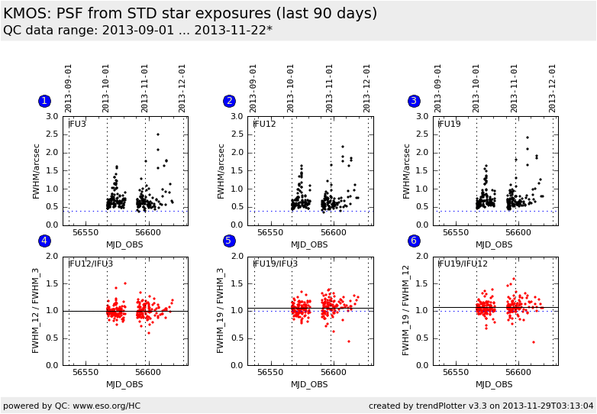
HC: IFU PSF

