Slide 1
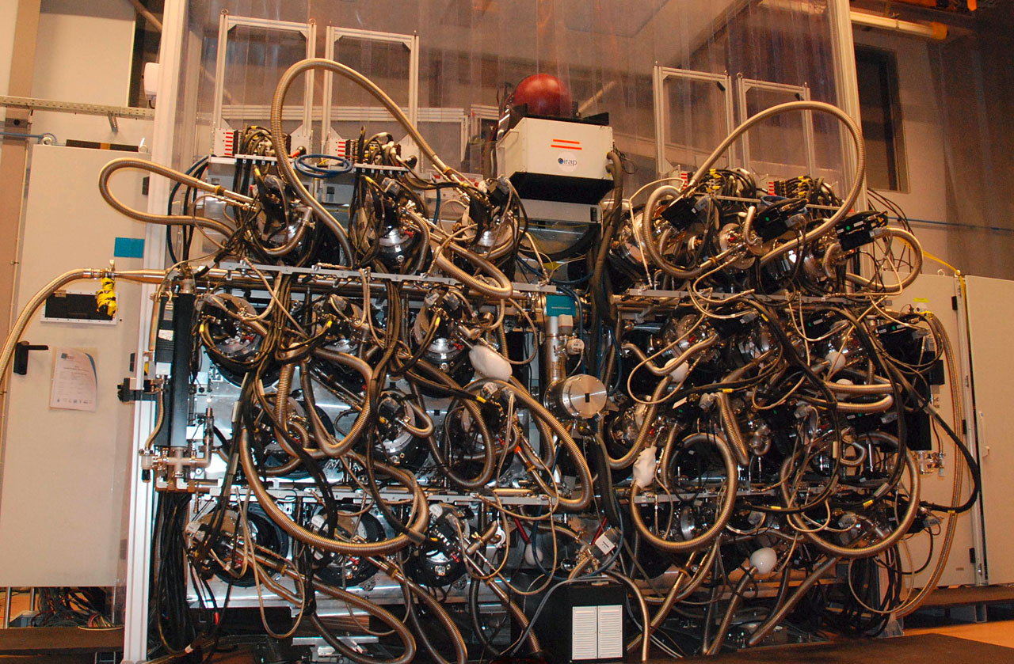
MUSE
The Multi Unit Spectroscopic Explorer
Muse Consortium: CRAL Lyon AIP Potsdam, ESO, ETH Zurich, IRAP Toulouse, Leiden, IAG Gottingen
Project kick-off: 2005-01-18
PDR: 2007-07-17
FDR: 2009-03-12
PAE: 2013-09-10
Instrument integration
and Commissioning:
2014-01-29 – 02-20

Slide 2
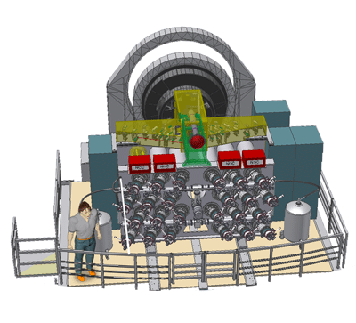
MUSE on the UT4 Nasmyth B platform
Calibration Unit
Fore-optics
system
Electronics
cabinets
IFUs
Cooling system

Slide 3
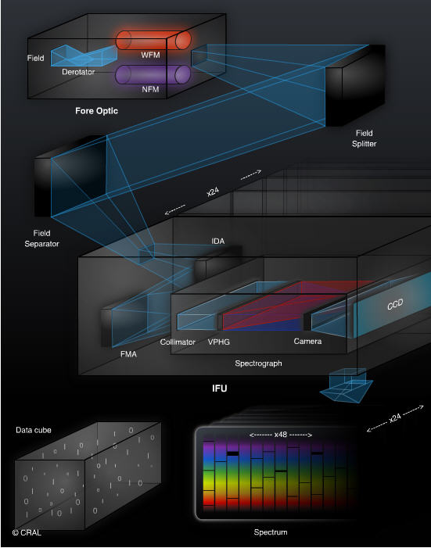

Slide 4
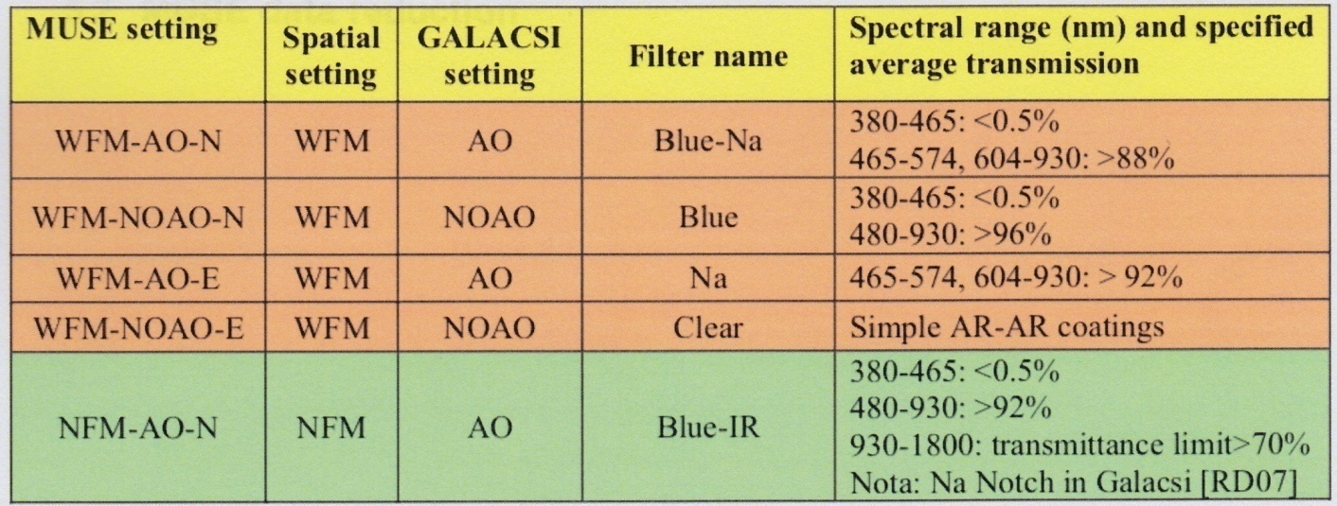
MUSE capabilities and observing modes
Characteristics and observing capabilities:
Wavelength range 480-930 nm (nominal)
465-930 nm (extended)
Resolving power 1770 (480 nm) – 3590 (930 nm) (WFM)
1740 (480 nm) - 3450 (930 nm) (NFM)
Detector 4k x 4k MIT/LL CCD
Field of view 59.9’’x60.0’’ (WFM)
7.42’’x7.43’’ (NFM)
Spatial sampling 0.2’’x0.2’’ (WFM)
0.025’’x0.025’’ (NFM)
Observing modes

Slide 5
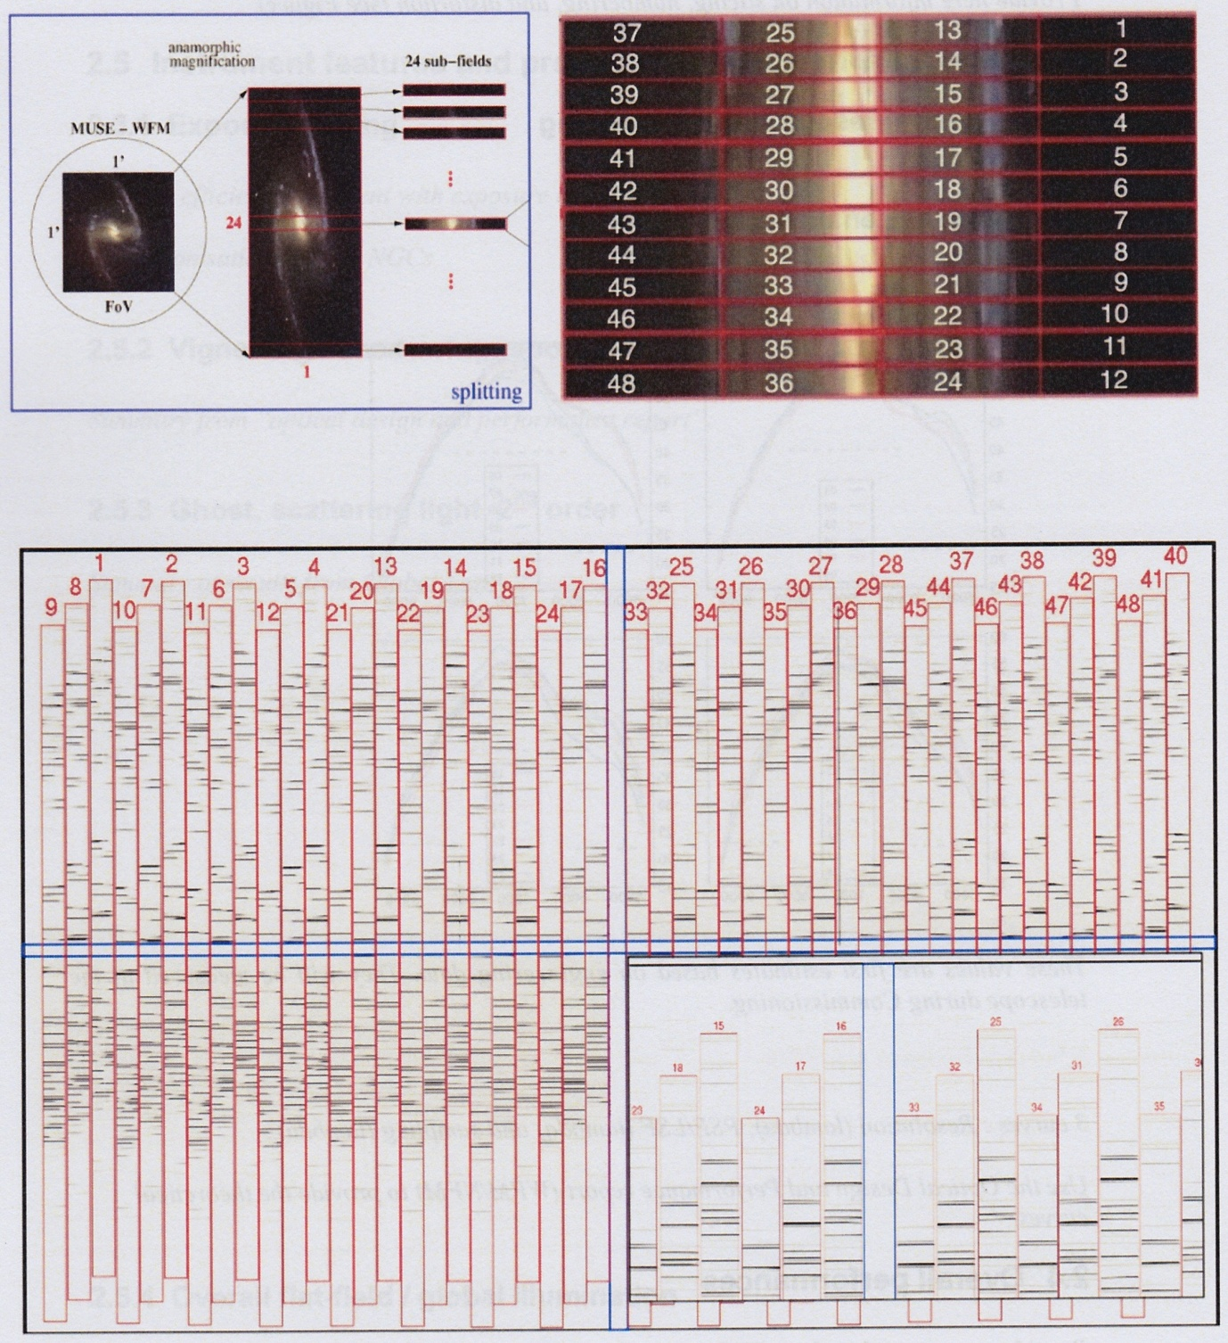
IFU layout and
spatial/spectral format

Slide 6
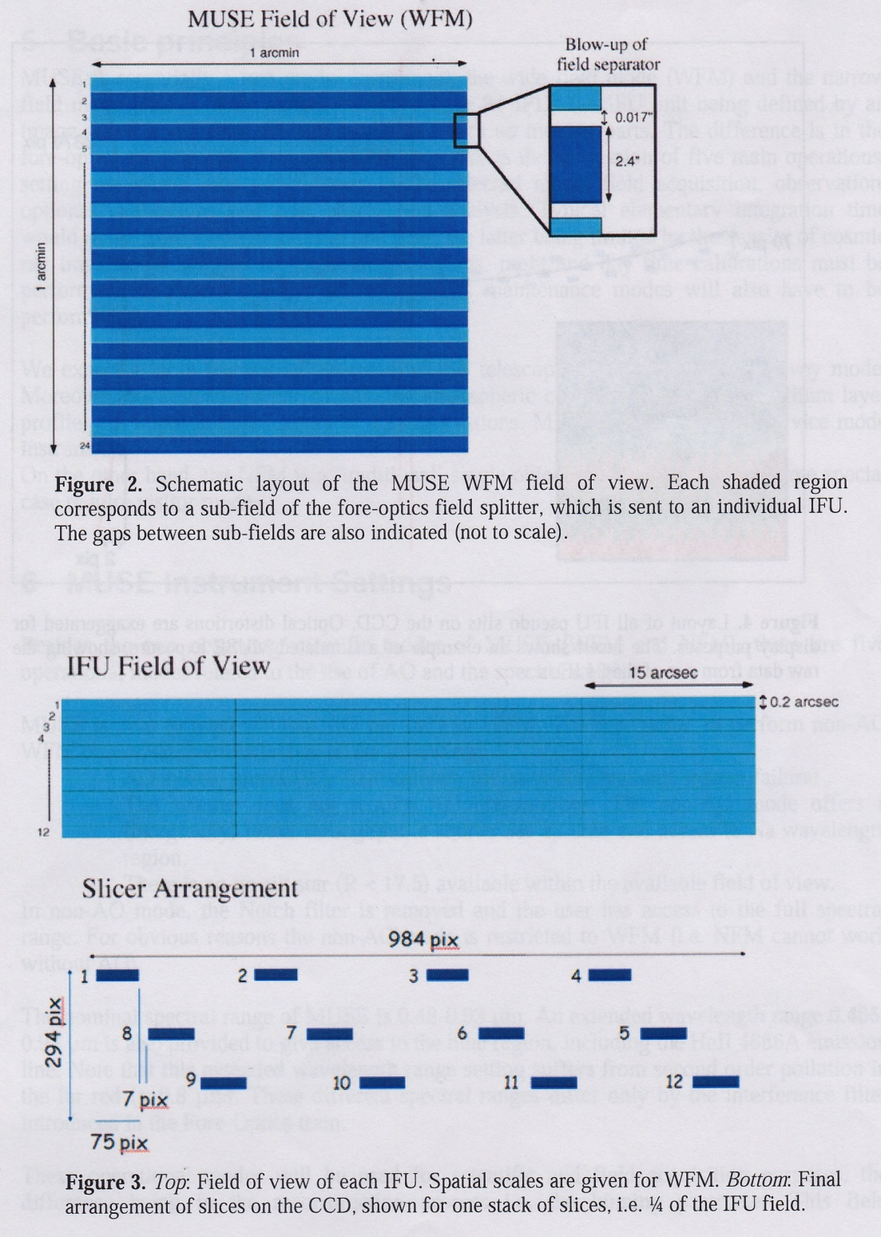

Slide 7
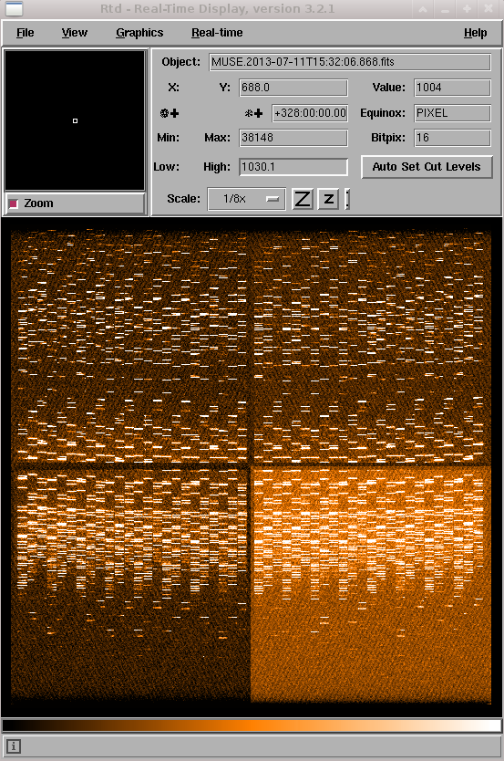
Raw Arc Frame
0.9 GB

Slide 8
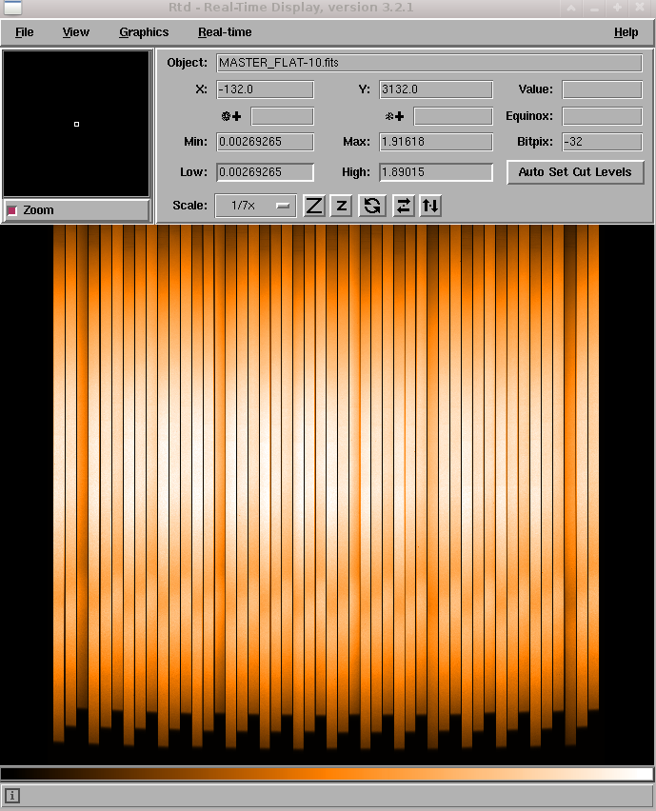
Master flat frame recipe: muse_flat time performance:
-nifu=-1, 2.5 min
-nifu=0, 12 min products:
24 x MASTER_FLAT
24 x 0.2 GB or merged MASTER_FLAT
5 GB
24 x TRACE_TABLE

Slide 9
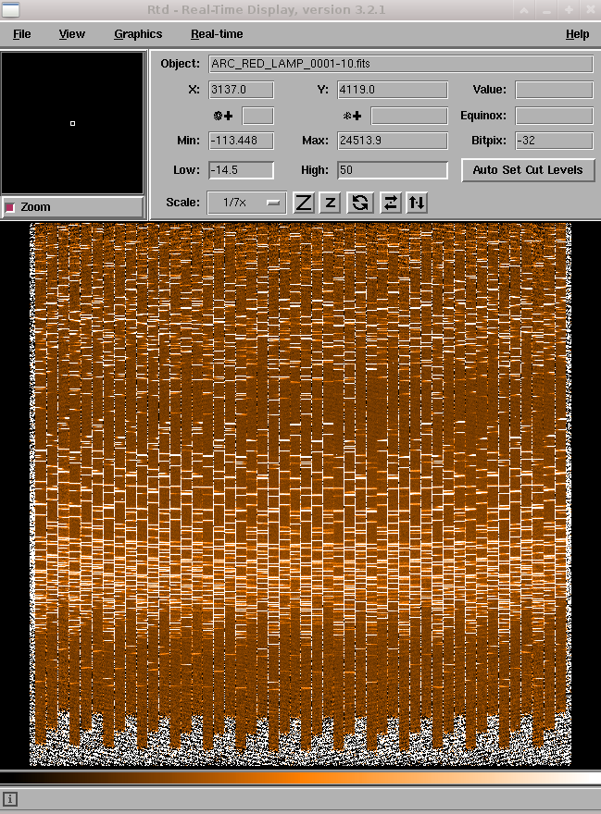
Master arc frame recipe: muse_wavecal time performance:
-nifu=-1, 6 min
-nifu=0, 32 min products:
24x reduced master arc image
24x0.2 GB
24x wavelength calib. table

Slide 10
Data format
Raw data
Pipeline Product
X 72
X 24
X 24
data
DQ
stat
fitsMerge
......
…..
…..
data
DQ
stat
0.9 GB
24 x 0.2 GB
5 GB

Slide 11
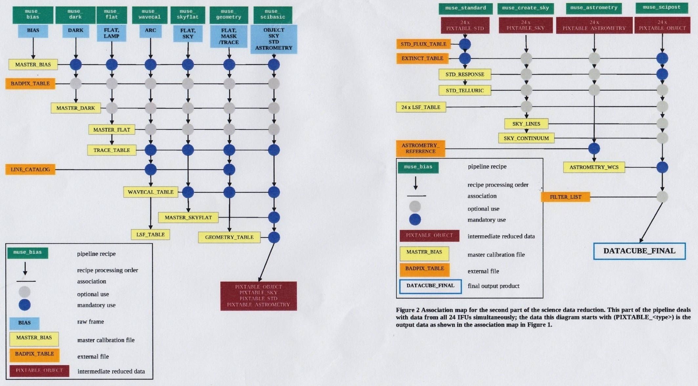
Calibration cascade

Slide 12
QC Parameters
MASTER_BIAS - per channel / per quadrant
MASTER-FLAT - per channel / per slice
TRACE_TABLE - per channel
WAVECAL_TABLE – per channel / per slice

