Slide 1

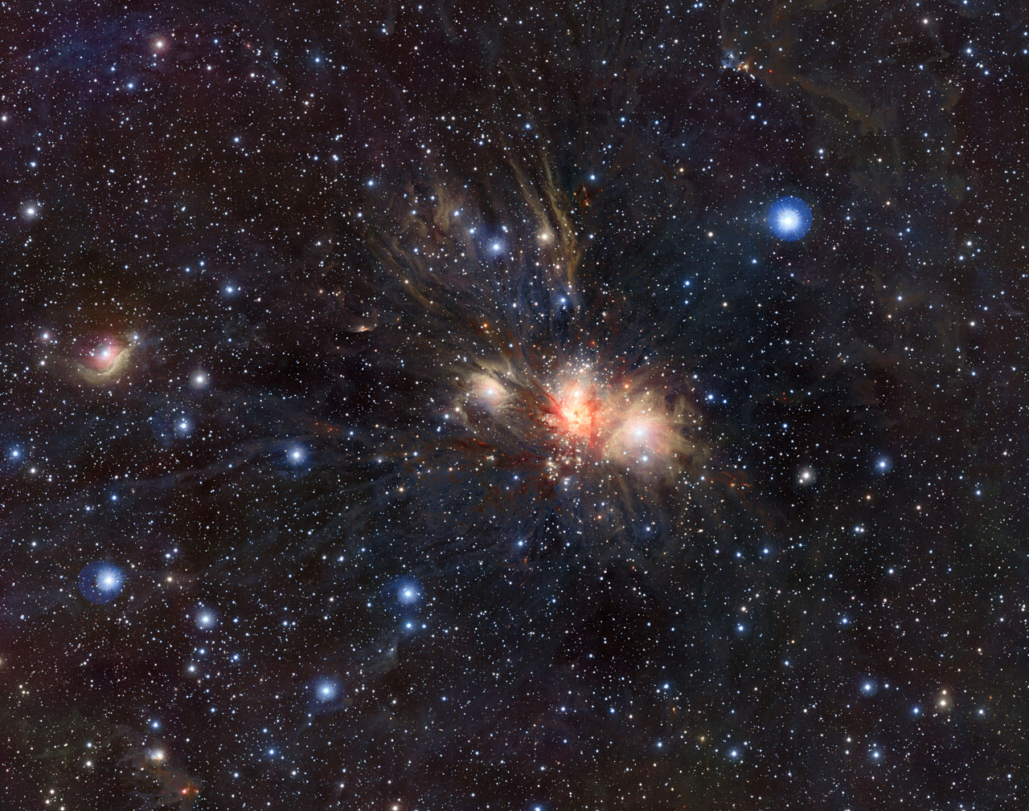
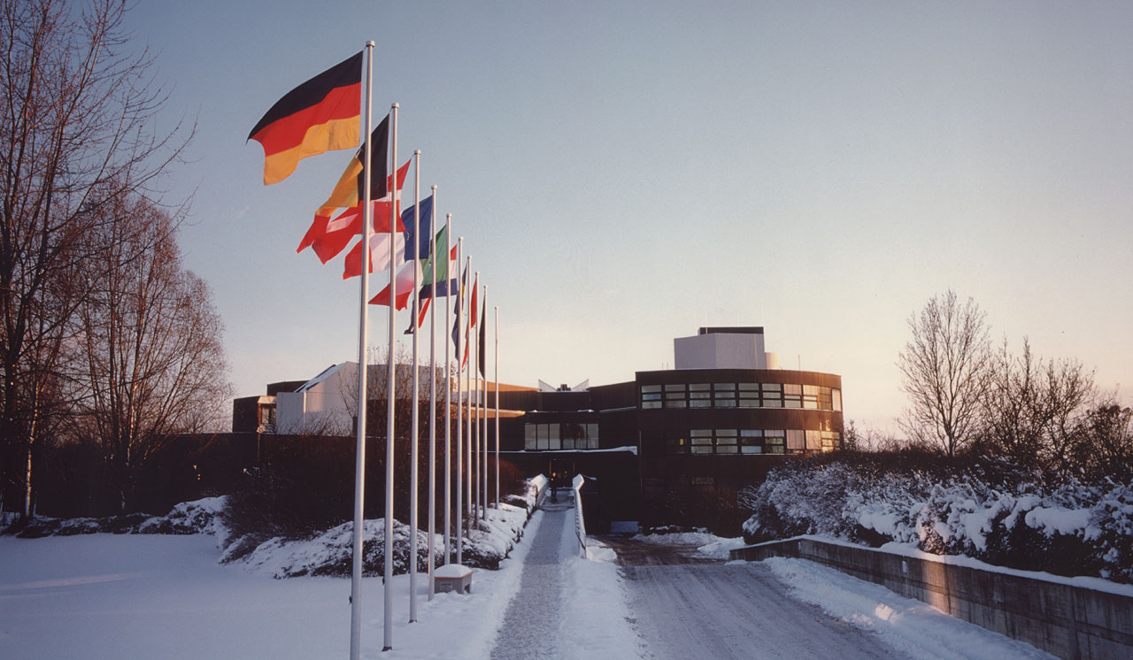
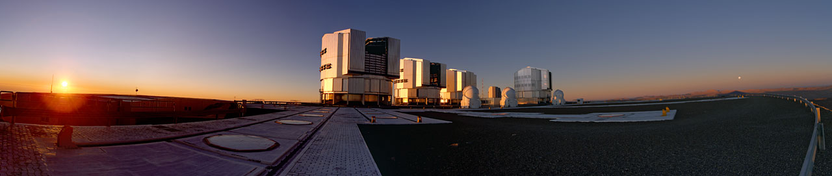
European Southern Observatory
ESO is the foremost intergovernmental astronomy organisation in Europe and the world’s most productive astronomical observatory

Slide 2
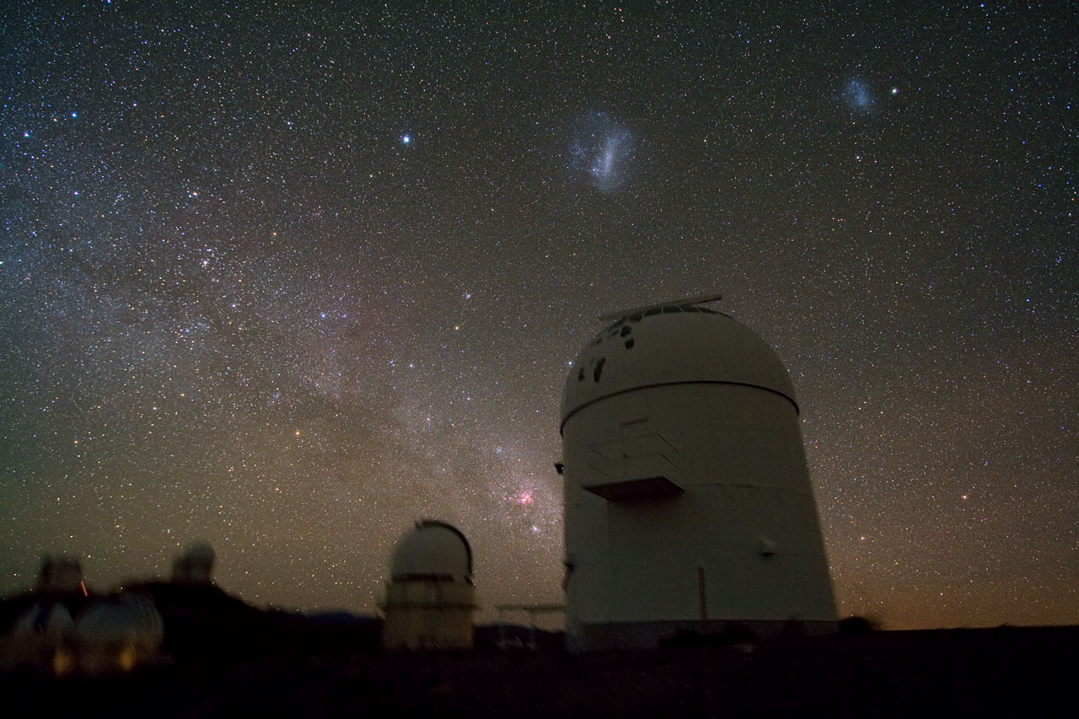
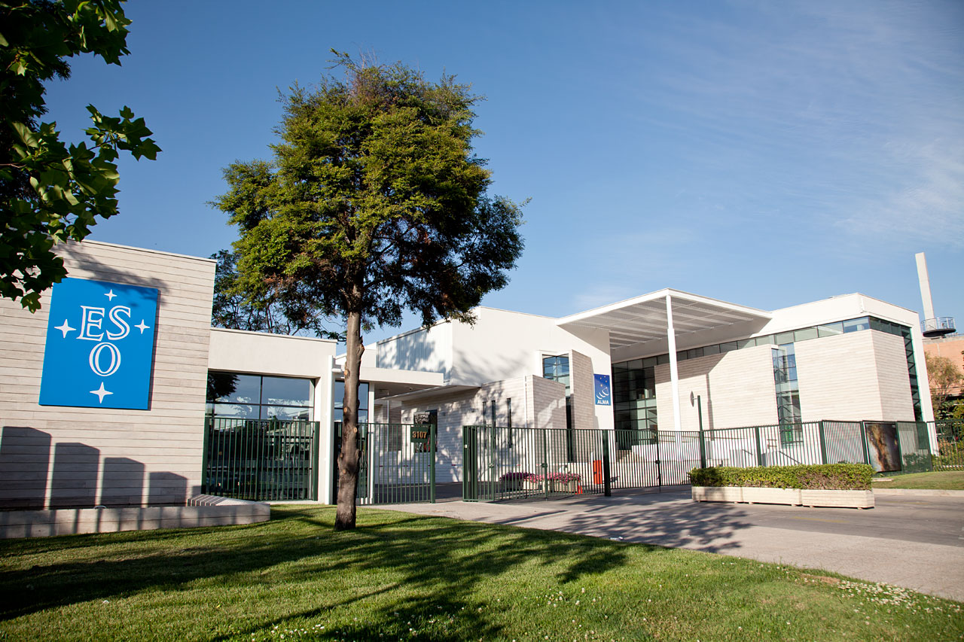
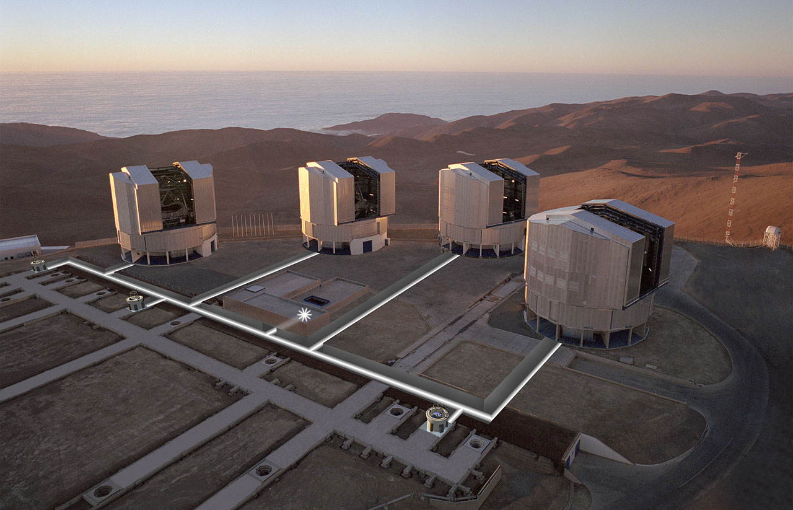
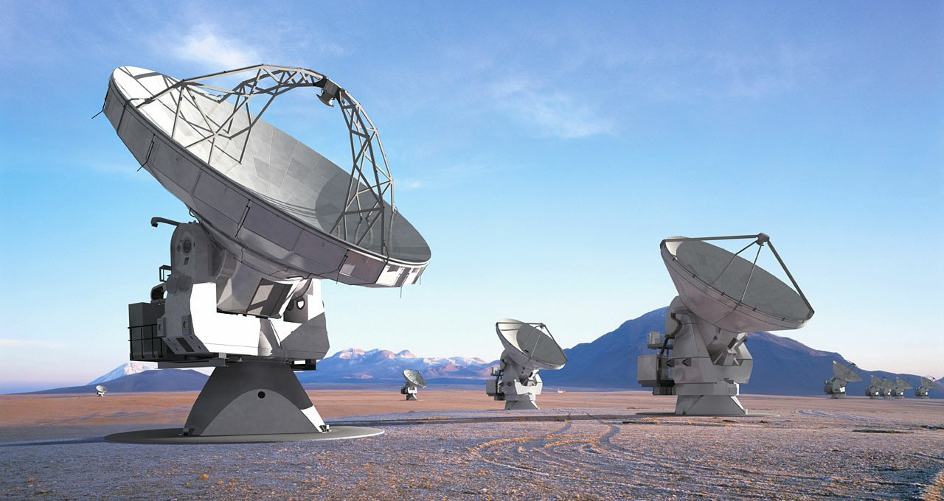
Vitacura, Santiago
La Silla, Atacama, IV Region
Paranal, VLT,
Atacama,
II Region
ALMA, Chajnantor, II Region
ESO is supported by 15 Countries, among which Brazil has been recently added,
(Austria, Belgium, Brazil, the Czech Republic, Denmark, Finland, France, Germany, Italy, the Netherlands, Portugal, Spain, Sweden, Switzerland and the United Kingdom)
and is already operating four sites in Chile.

Slide 3
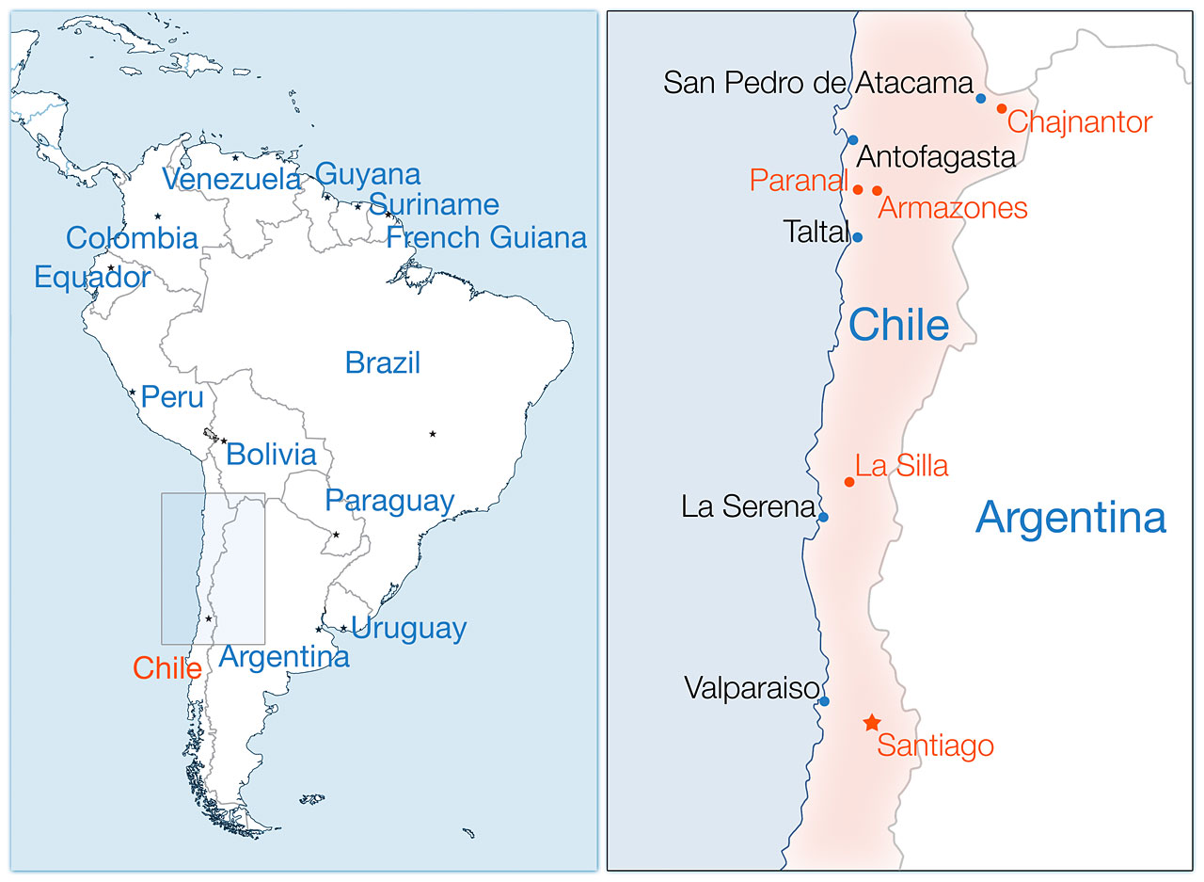
ESO in Chile

Slide 4
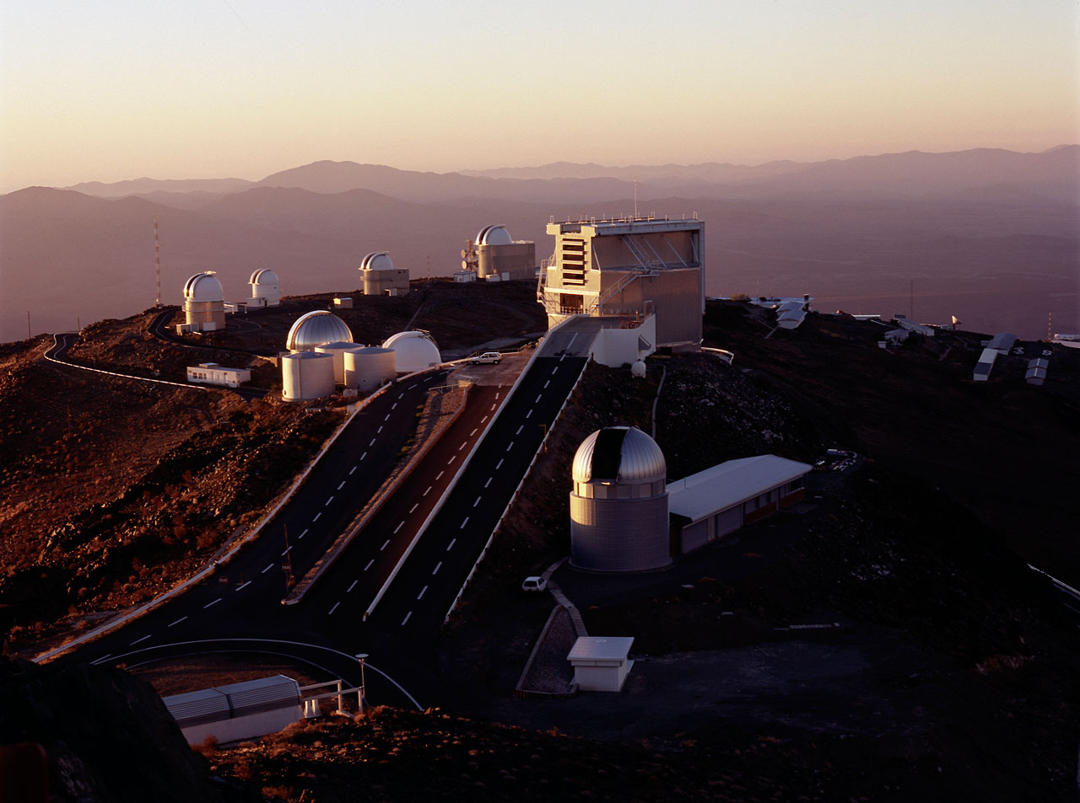
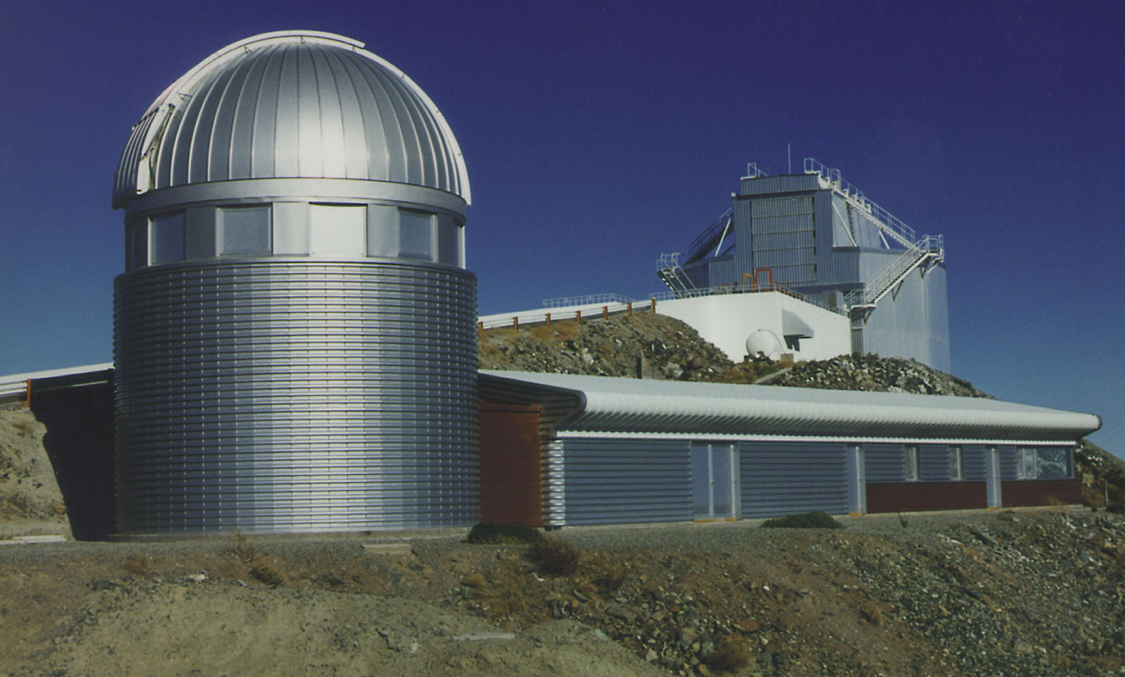
La Silla : ESO first observatory, inaugurated in 1969
La Silla is equipped with medium-sized and small optical telescopes, including the most successful exoplanet hunter.
La Silla, 42 years after its initial operation, remains at the forefront of astronomy, and is one of the most scientifically productive observatories in the world.

Slide 5

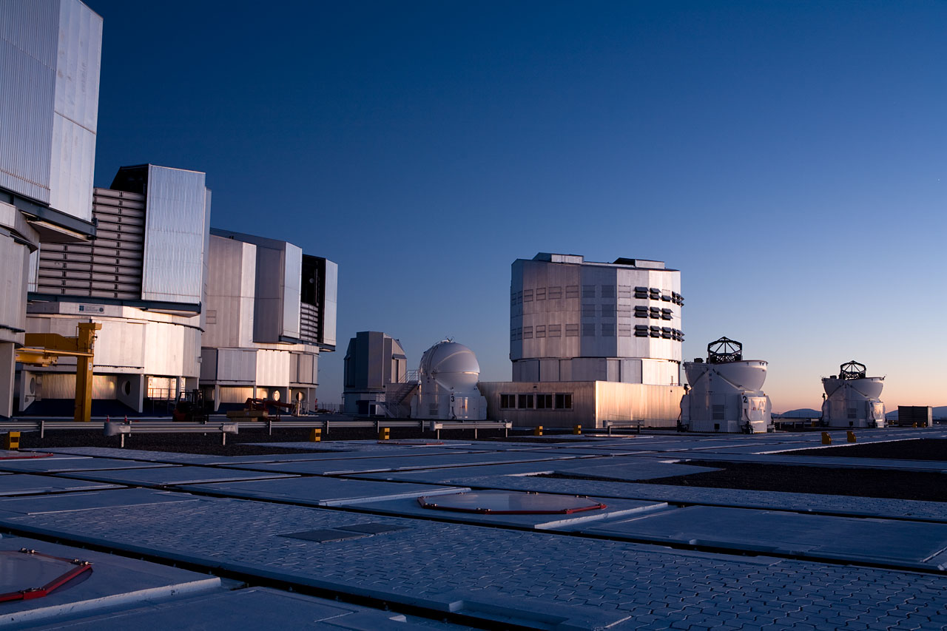
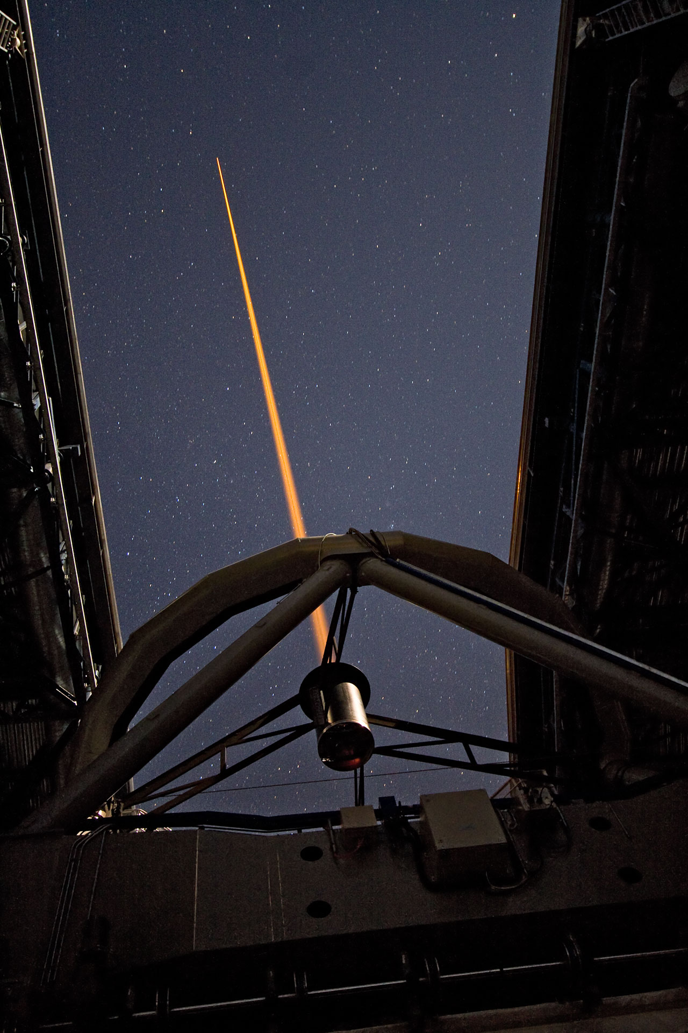
Paranal VLT : The world’s most advanced optical instrument, a formidable science machine
The Paranal VLT is the most productive individual ground-based facility: leads to the publication of on average of more than one peer-reviewed scientific paper per day.
The VLT consists of an array of four telescopes, each with a main mirror of 8.2-m diameter, that can observe together or individually and of several smaller telescopes dedicated to interferometry, making it the largest facility of its kind.

Slide 6
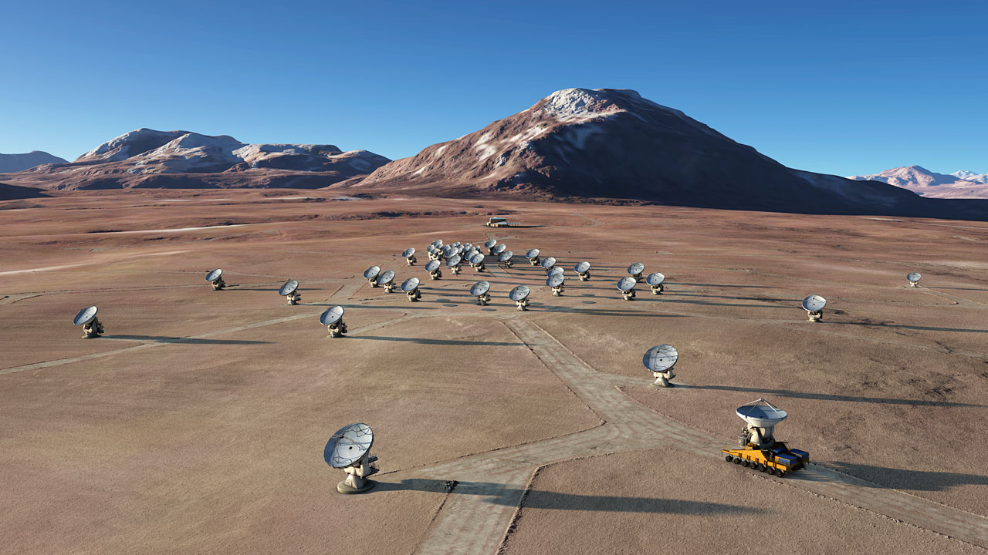
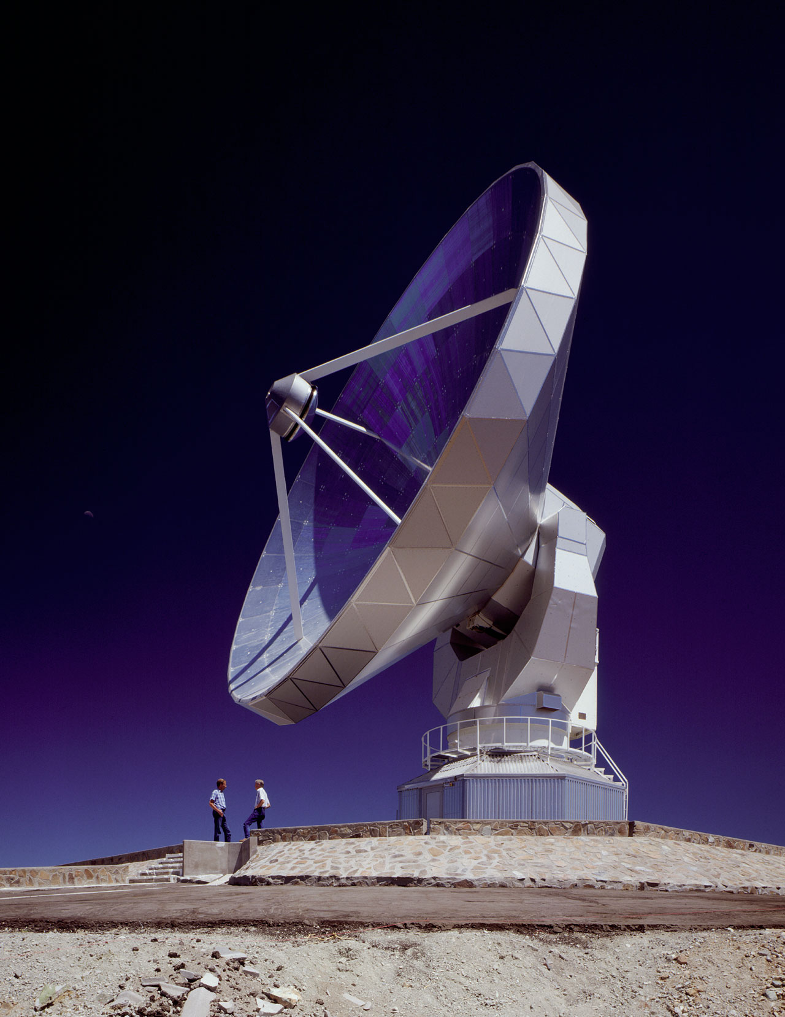
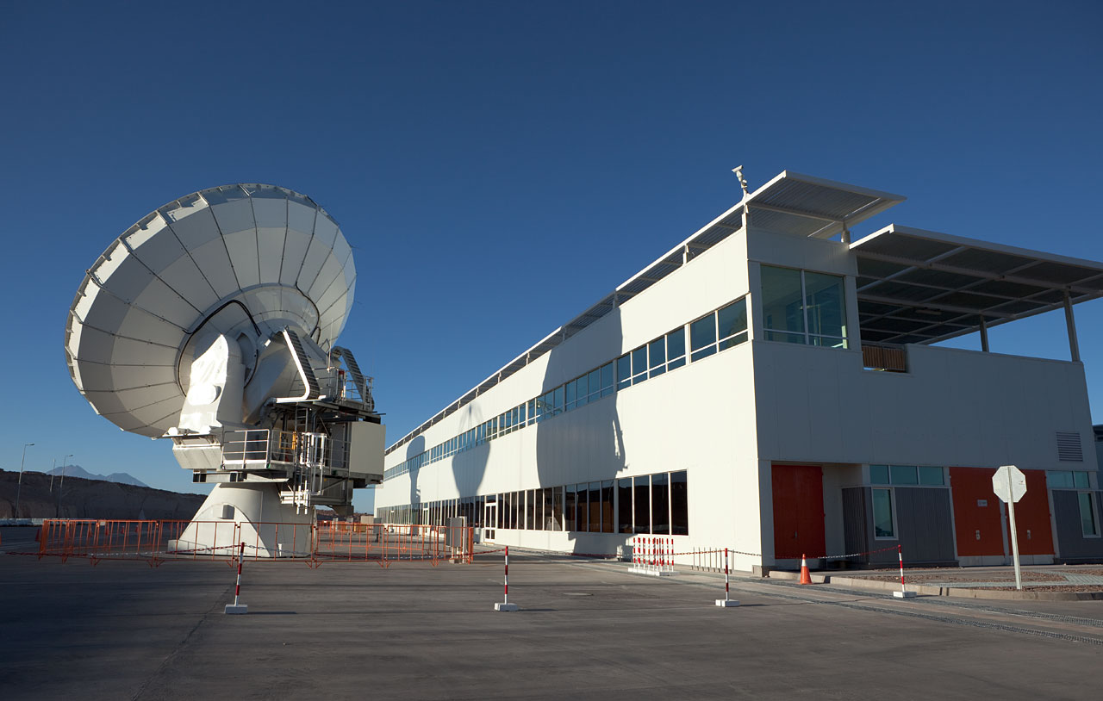
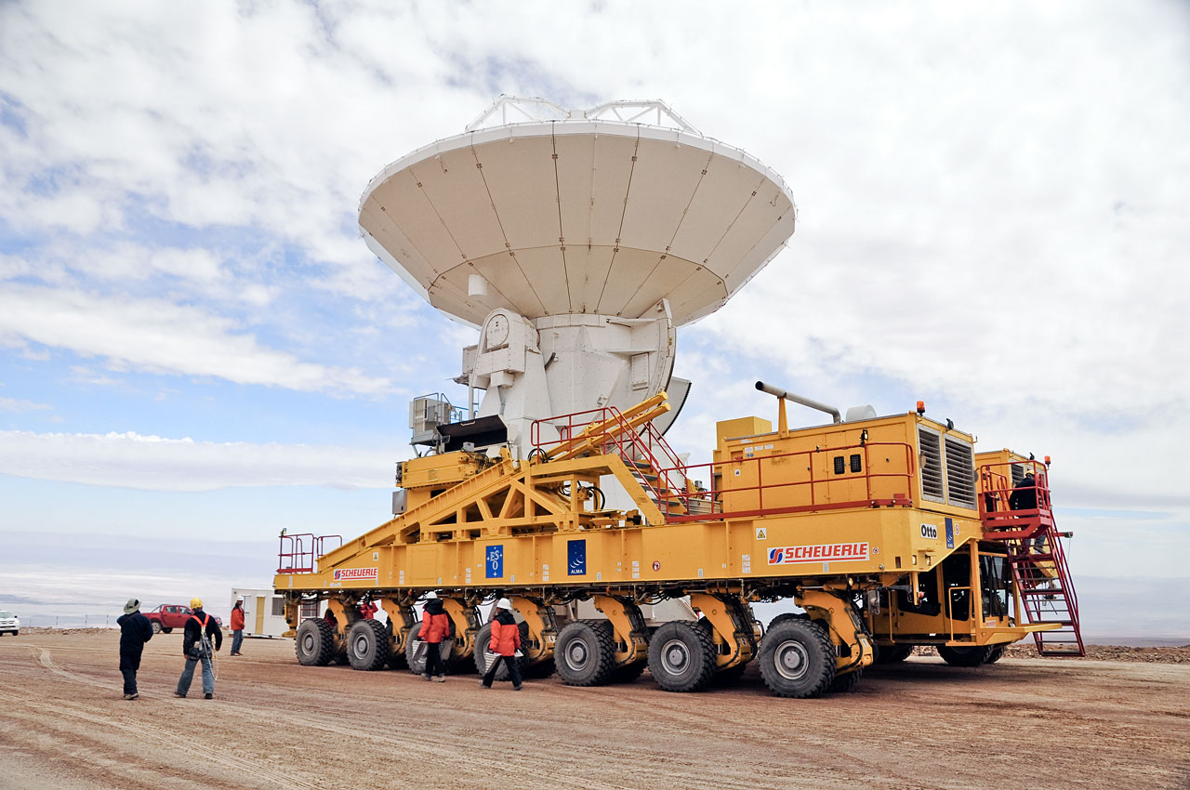
ESO as the European partner, together with USA and Japan are currently completing the ALMA construction at Chajnantor (66 giant 12-metre and 7-metre diameter antennas at 5100m altitude), north edge of Atacama II Region.

Slide 7
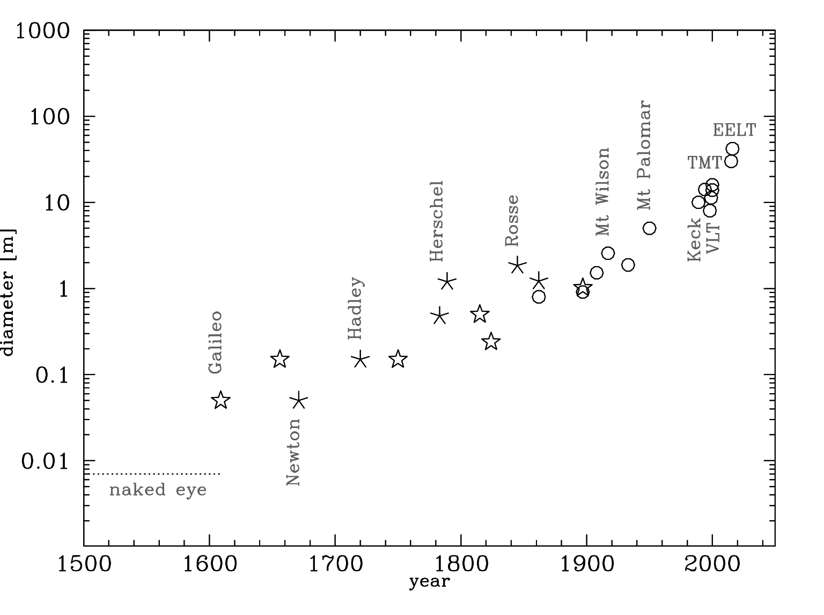
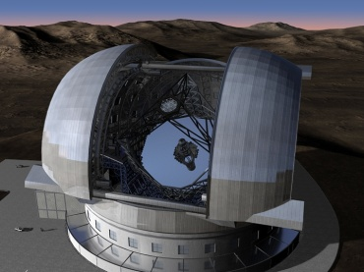
Astronomy is about big questions ...
How do planets form and how does life develop on them?
How does the solar system work?
What is the universe made of? Have we found all its constituents?
Do we understand the physical laws that govern the universe?
How did the universe originate?
Telescopes diameter – Calendar year
... and the answers require big instruments
E-ELT

Slide 8
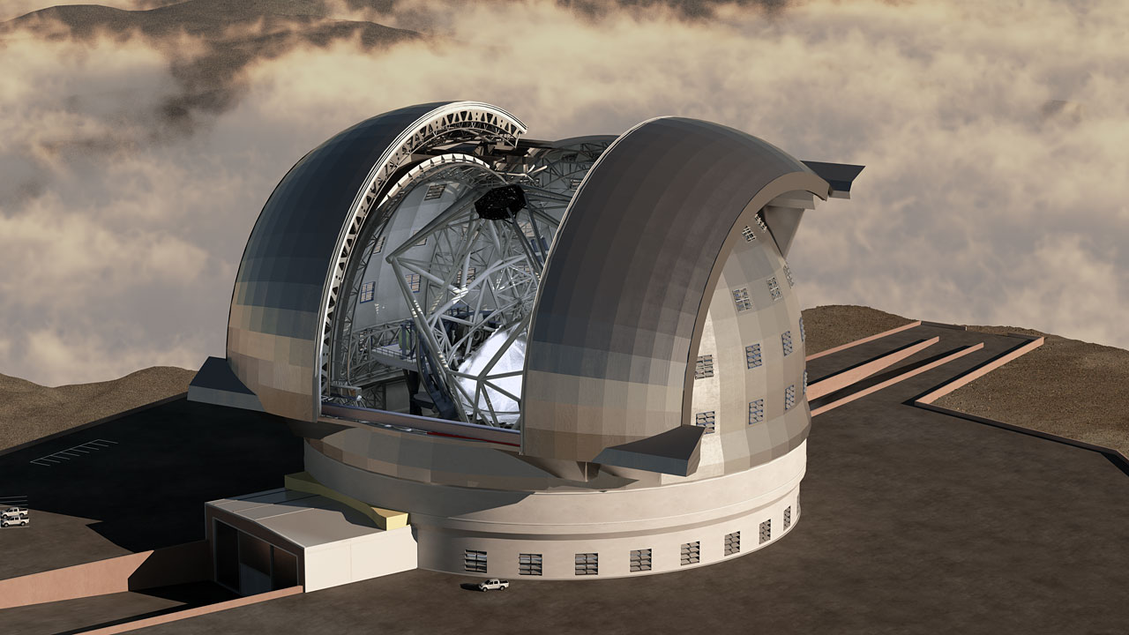
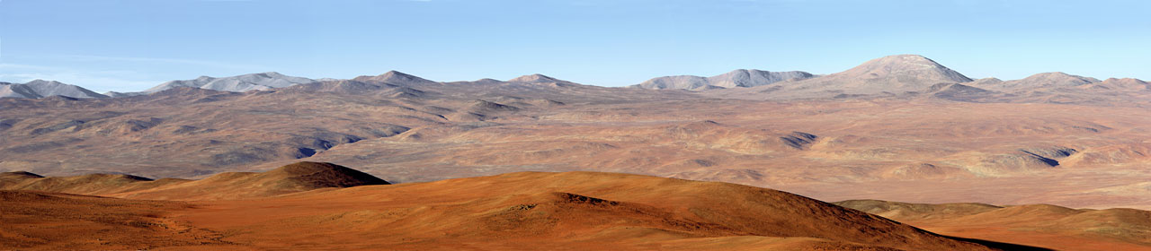
ESO is planning to build the European Extremely Large Telescope (E-ELT), the biggest telescope of the world, at Cerro Armazones, 20km east from Paranal.
Armazones
Paranal

Slide 9
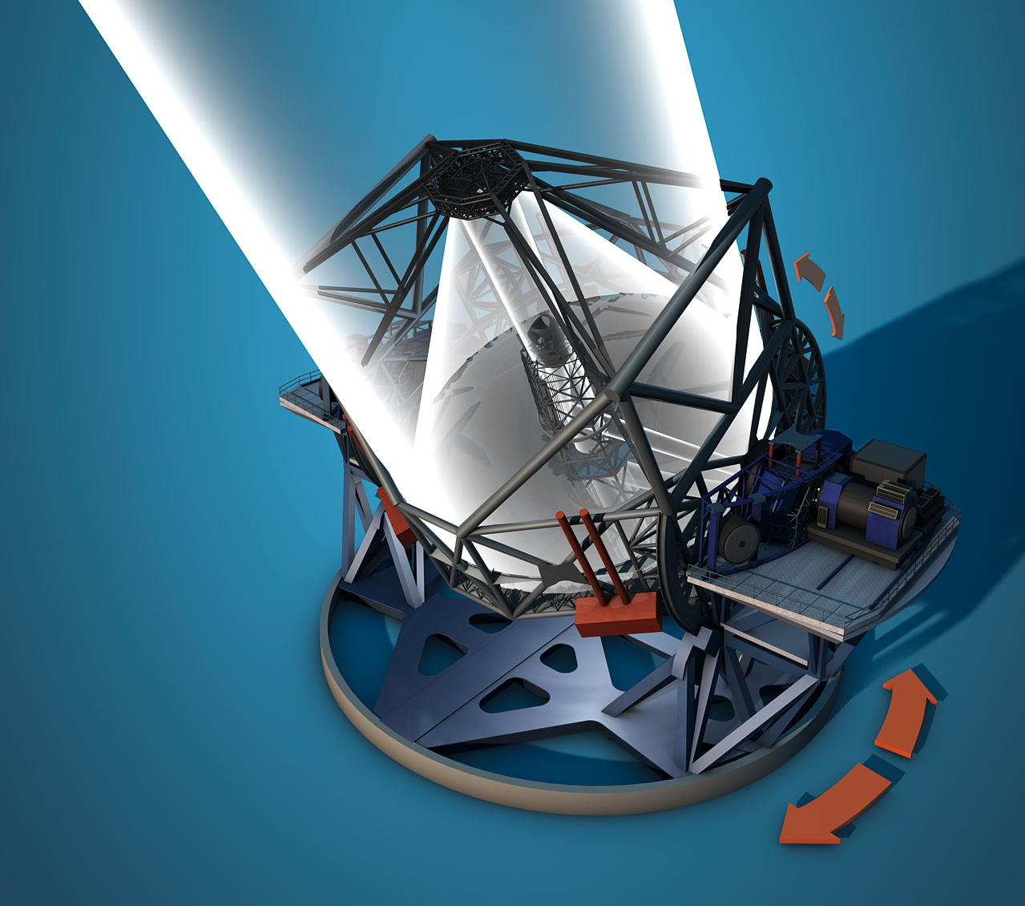
The adaptive mirror adjusts its shape a thousand times a second to correct for distortions caused
by atmospheric
turbulence
E-ELT
Primary mirror
Altitude cradles for inclining the telescope
984 pcs
1.45m each
Active optics system keeps the primary mirror in its optimal shape against all environmental factors such as gravity (at different telescope inclinations), wind, telescope axis deformations, thermal disturbances, etc.
Laser
beams
The 5500-ton telescope system can turn through
360 degrees on azimuth level

Slide 10
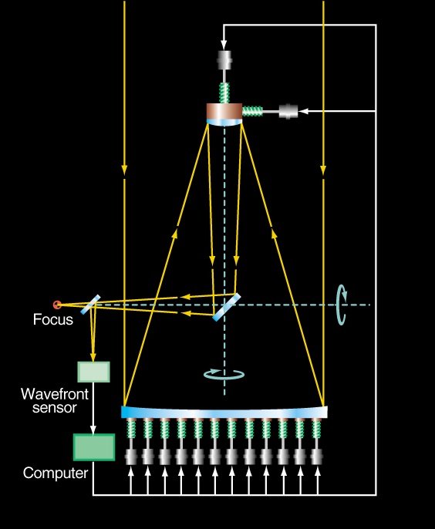
Primary mirror Active Optics principle
Closed control loop with:
Measurement of wavefront error generated by the telescope itself
Integration times of 30 sec to partially average out errors introduced by the atmosphere
Modal analysis using optical aberrations and elastic modes of the flexible meniscus mirrors
Correction of the errors by the optical elements of the telescope
Rigid-body movements of the mirrors
Deformation of the mirrors by adjusting the support forces

Slide 11
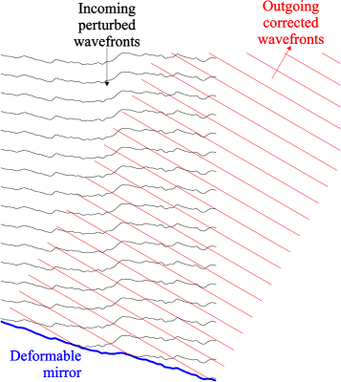
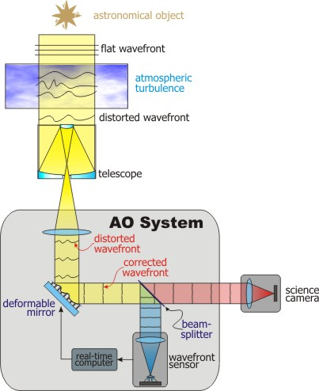
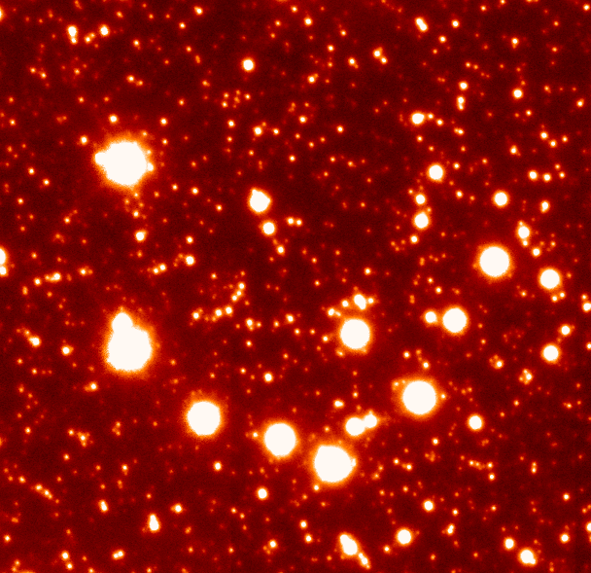
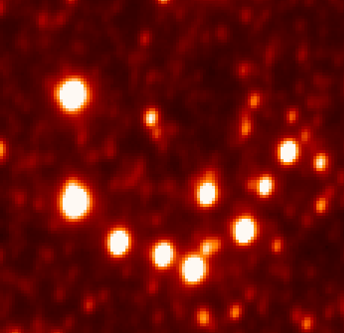
Adaptive Optics mirror
operating principle
With Adaptive Optics
Without Adaptive Optics

Slide 12
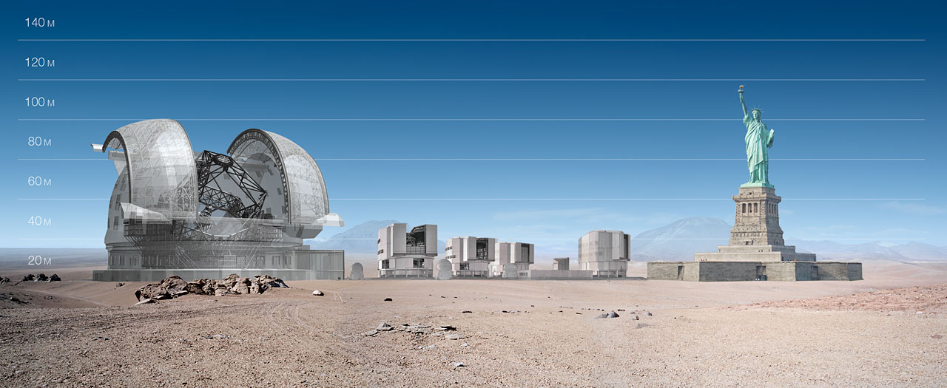
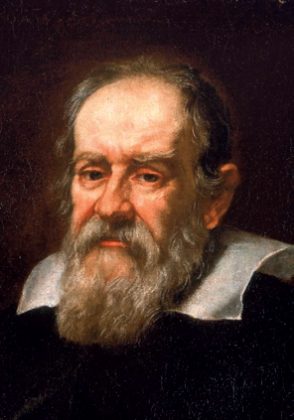
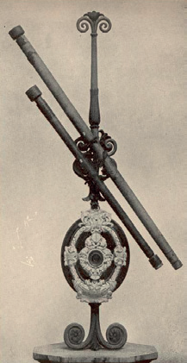
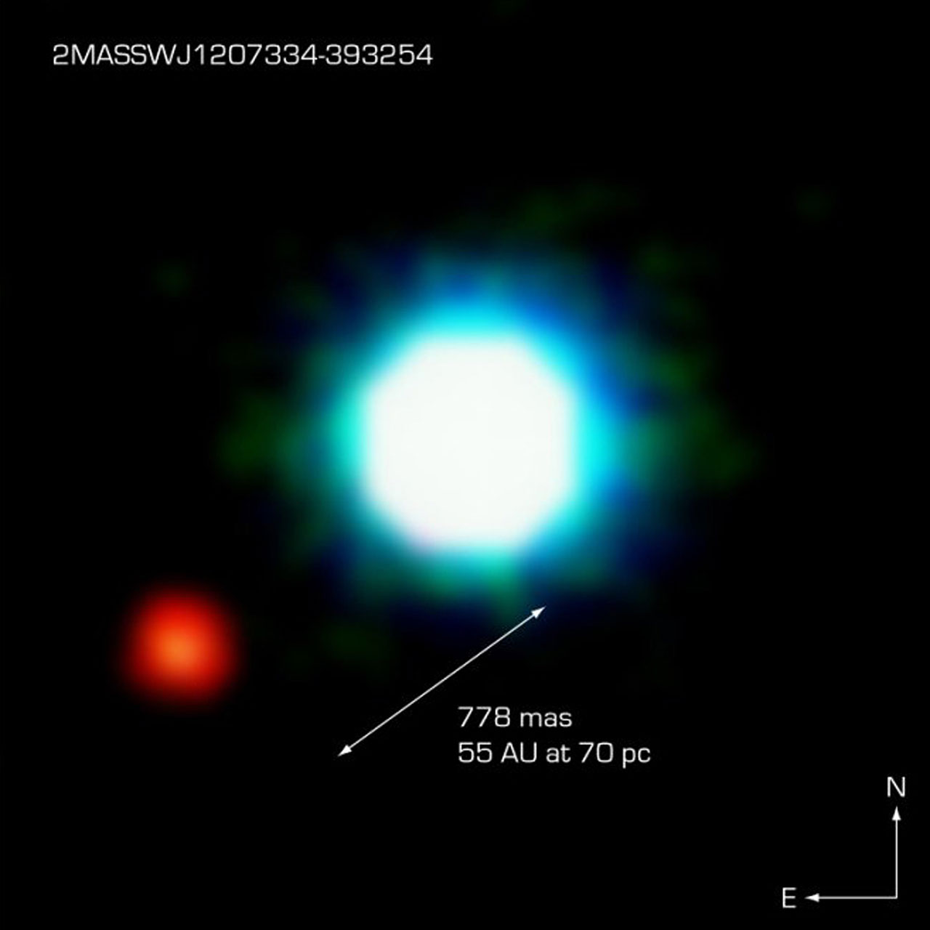
Size comparisons
VLT
Paranal Telescopes
E-ELT
Statue of Liberty
The E-ELT may revolutionise our perception of the Universe, much as Galileo’s telescope did, 401 years ago, when he first pointed a telescope to the sky
It will tackle the biggest scientific challenges
of our time, and aim for a number of notable firsts, including tracking down Earth-like planets around other stars in the “habitable zones” where life could exist

Slide 13
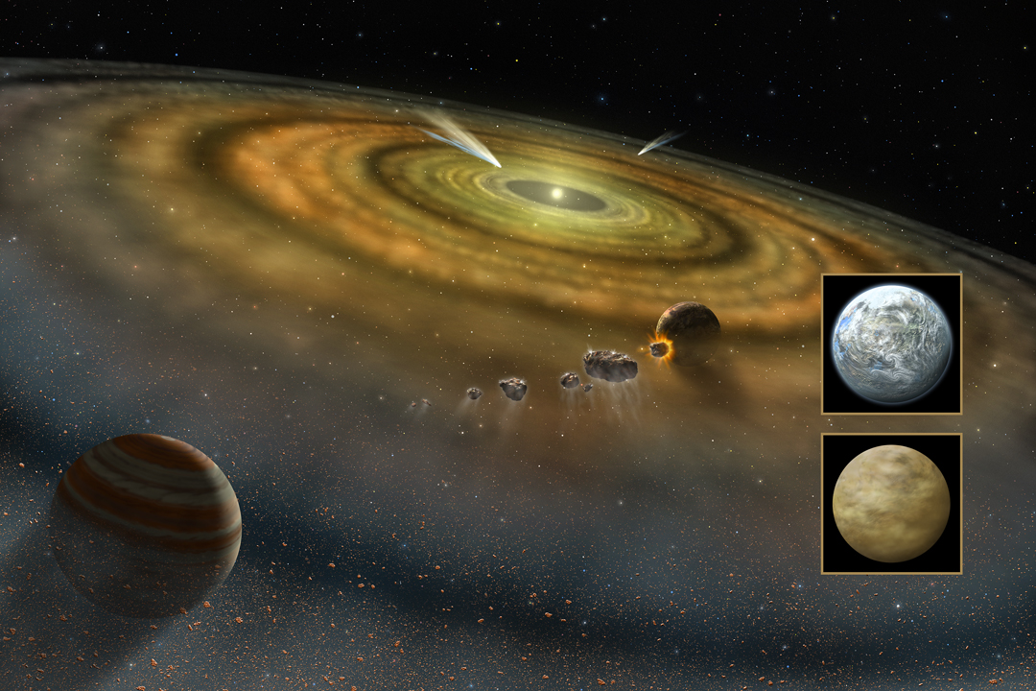
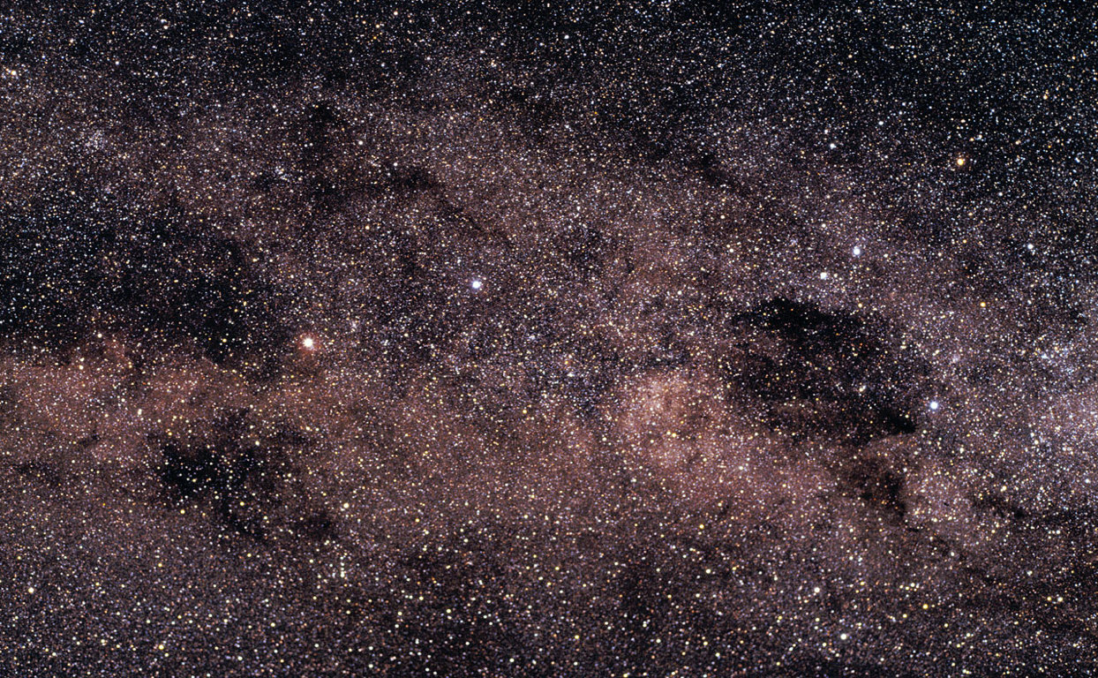
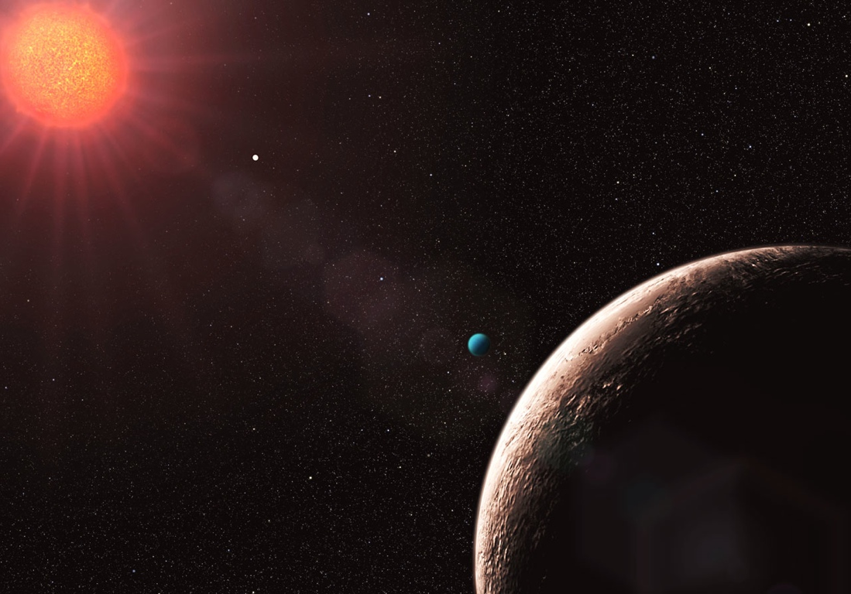
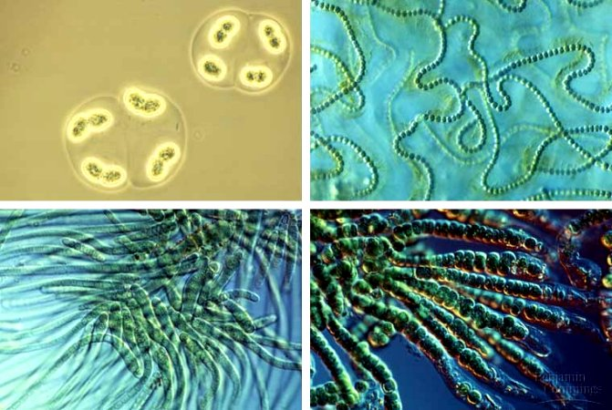
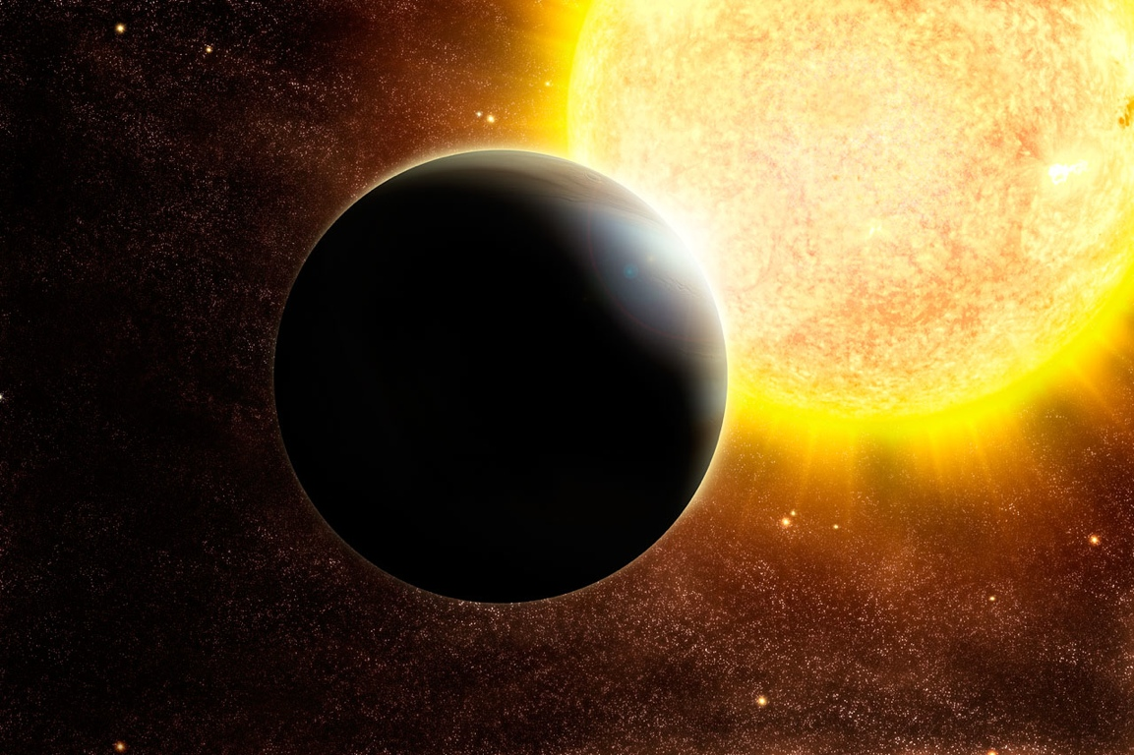
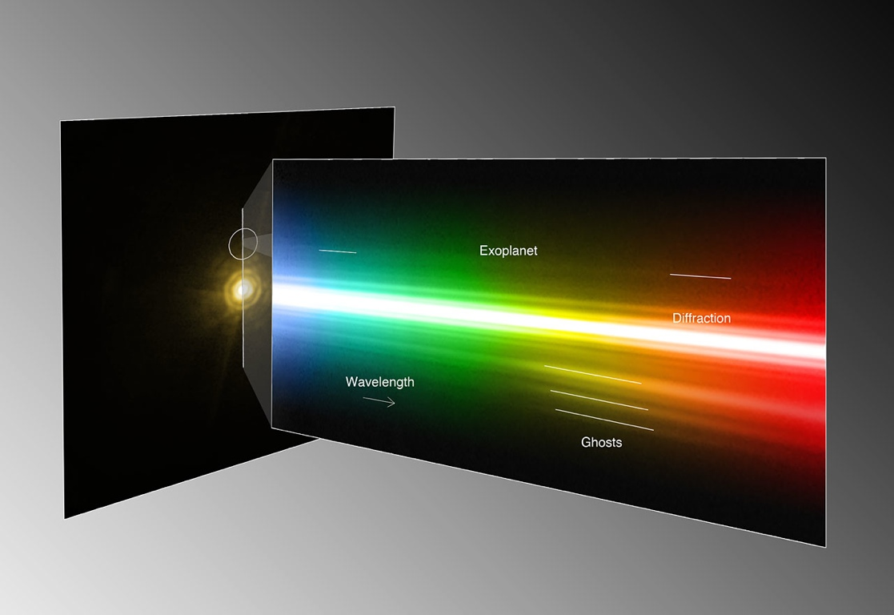
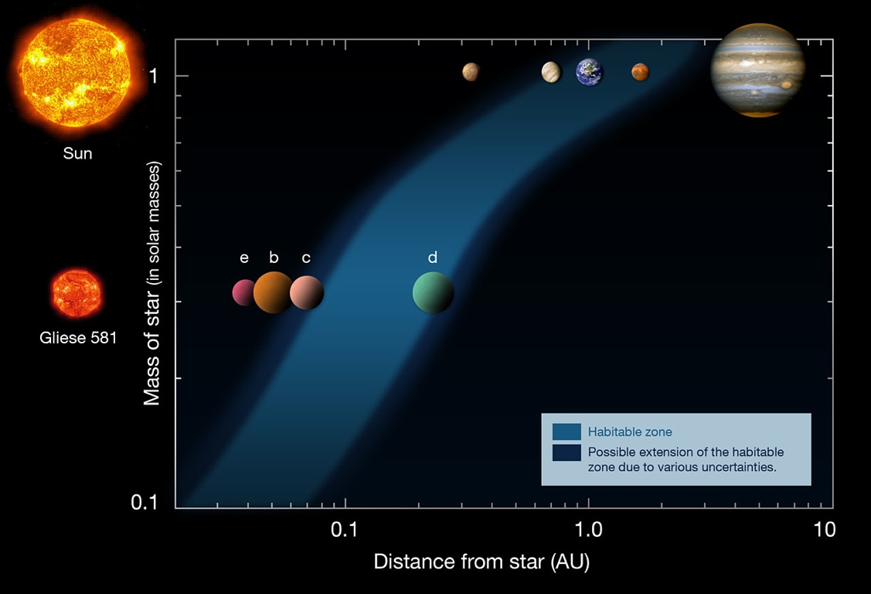
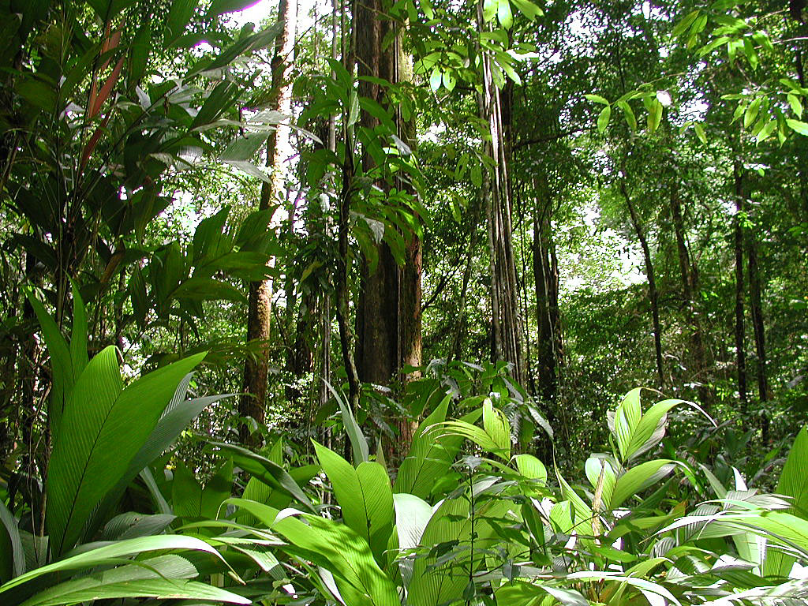
One top goal of the E-ELT is to find and to characterise exo-planets...
... it is the first telescope ever that can explore Earth-twins...
... with ultimately the chance to find life beyond the Solar system.
Notes:
Over 500 planets beyond the solar system are known today.
Most of them are exotic (as lower left): they are the size of Jupiter but very close to their stars (a year last a few days for them).
Until now we can find, but only barely characterise these exoplanets.
The E-ELT is designed (is large enough) not only to find exotic planets, but also Earth-twins. Further, it will be able to take spectra of their atmospheres, and so to search for bimomarkers, i.e. traces of life.
This is the first time that mankind has the technology to do so.
Bottom graph, the Sun is at top left, and in the blue “flow” (the habitable zone) you see the Earth.
The red star is rapresenting other star, and on the right you see other planets that have already been discovered, some in the habitable zone.
At the left of the habitable zone there is no water because it evaporates, while on the right side of the blue habitable zone there is no water because it freeze/ice.
With the E-ELT we’ll be able not only to “see these planets”, but also to make spectroscopy of their atmosphere to look for O2, O3 and H2O.

Slide 14
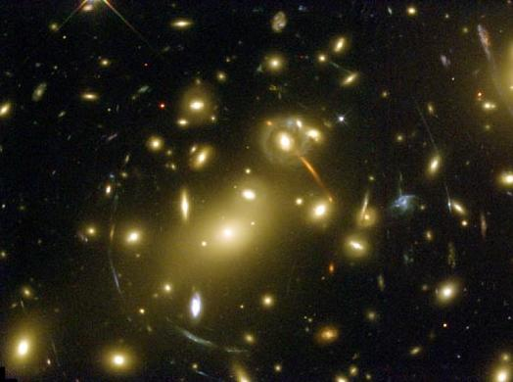
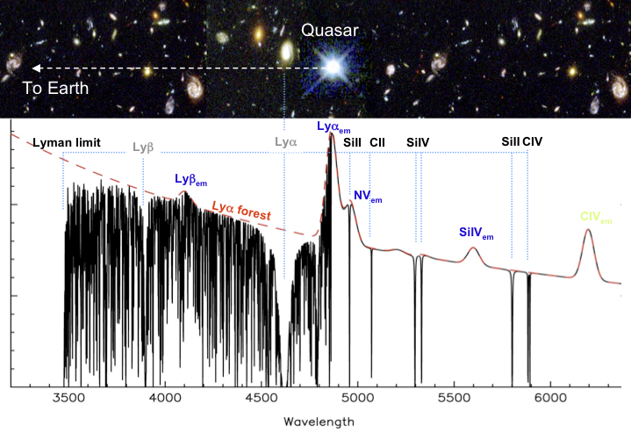
Another top goal of the E-ELT are fundamental physics...
...the E-ELT will be able to test whether todays physics were valid 10 billion years ago...
... and it will be able to trace the expansion history of the universe, providing clues about the mysterious dark energy.
Notes:
The E-ELT will be able to measure precisely the different atomic transition in a given element (like Iron or Magnesium) in very distant objects (objects that are up to 10 billion light year ago). The relative wavelengths of these transitions are compared to todays values, measured in the laboratory: if they differ, the fine structure constant, i.e. fundamental physics, must have evolved during the evolution of the universe. We want to understand if the fundamental physics laws are the same of billions of years ago.
After the big bang the universe accelerated to then decelerate. Now it seems it is accelerating again due to the supernoave behaviour.
The E-ELT will measure the expansion velocity of many objects at different look-back times. It will repeat that experiment 10 years later, and by comparing the velocities, get the *acceleration* of the universe as a function of the universe history. I.e. we will be able to reconstruct the expansion history of the universe which is mostly driven by the mysterious dark energy.
We’ll be able to appreciate variation of the expansion speed of km/s in cm/sec.
These projects illustrate the very high interest not only of astronomers, but also of physicists for this project.

Slide 15
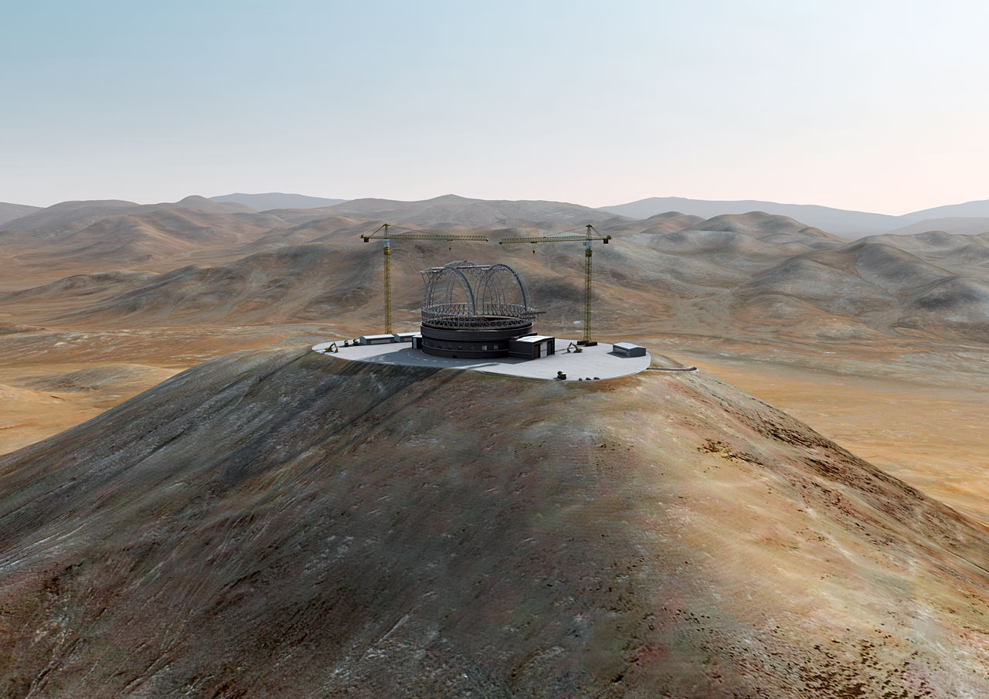
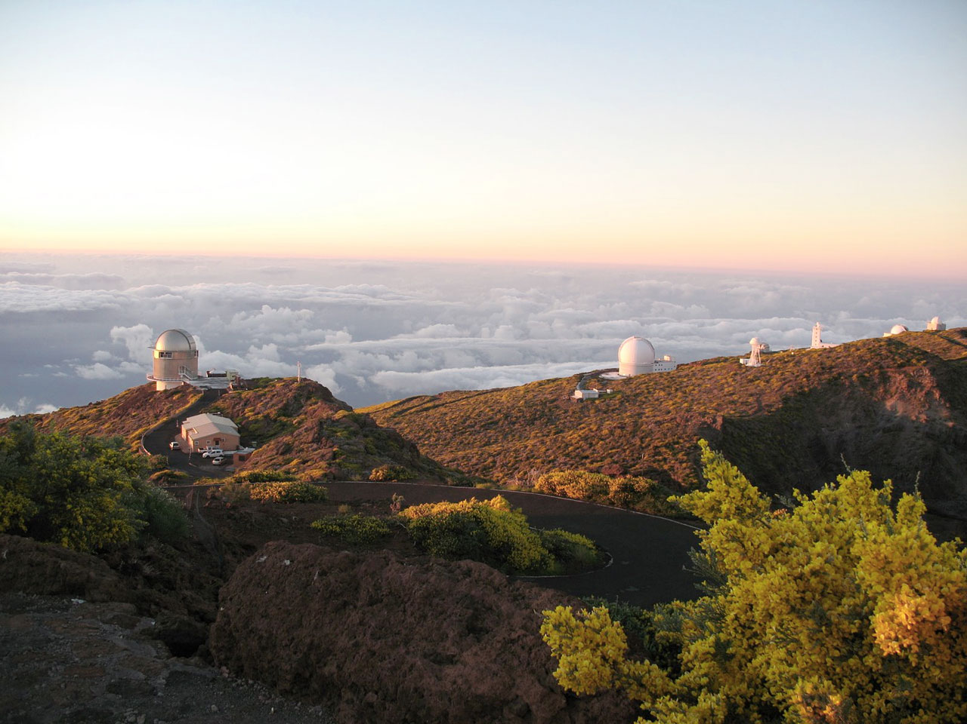
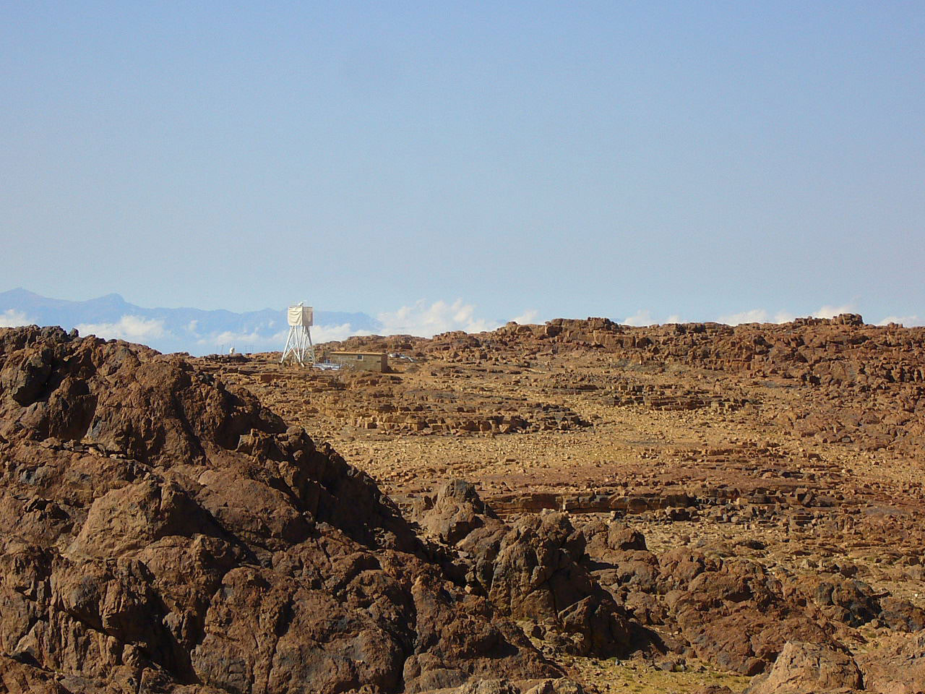
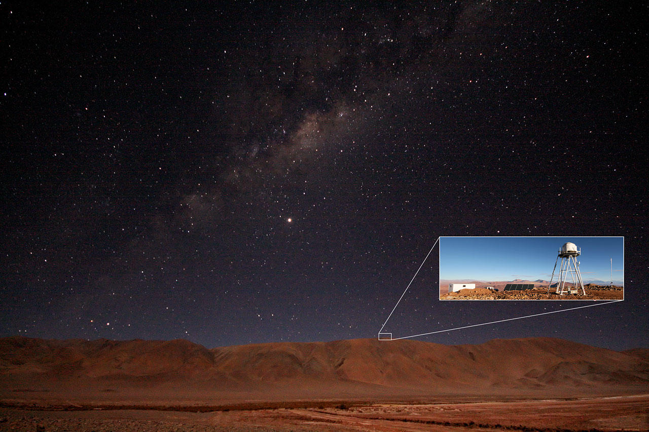
E-ELT Site selection
Cerro Armazones of Chile was selected after thorough evaluation of the offered conditions and terms from different candidate countries such as:
Spain,
La Palma
Morocco, Aklim
Argentina, Cerro Macon
Final Member States approval for the construction is expected within 2011

Slide 16
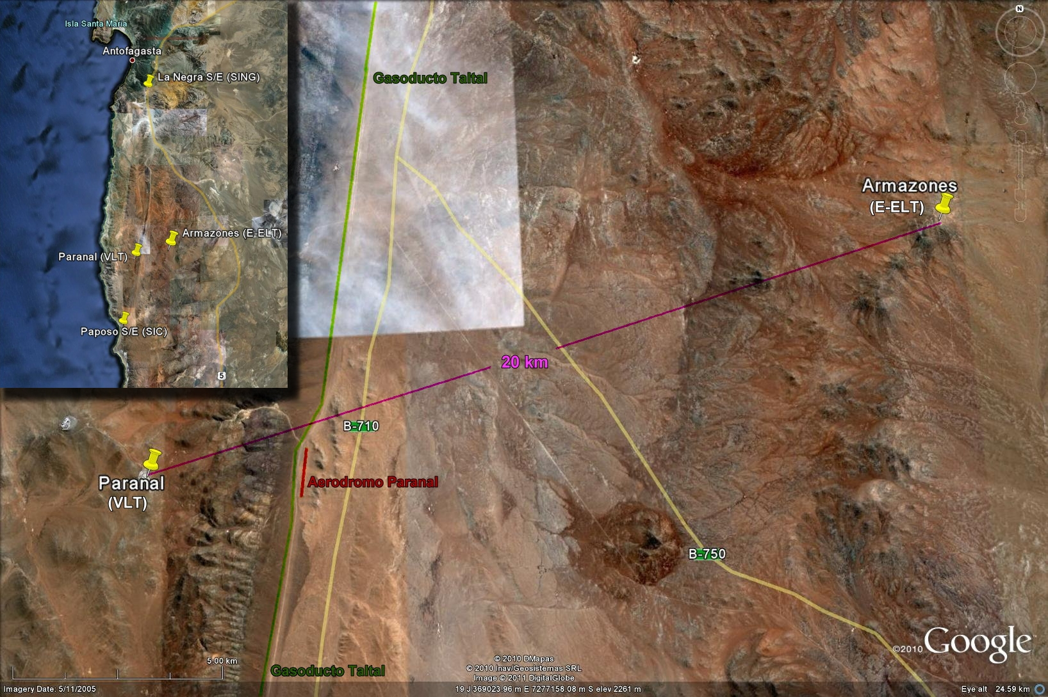
Paranal and Armazones Locations

Slide 17
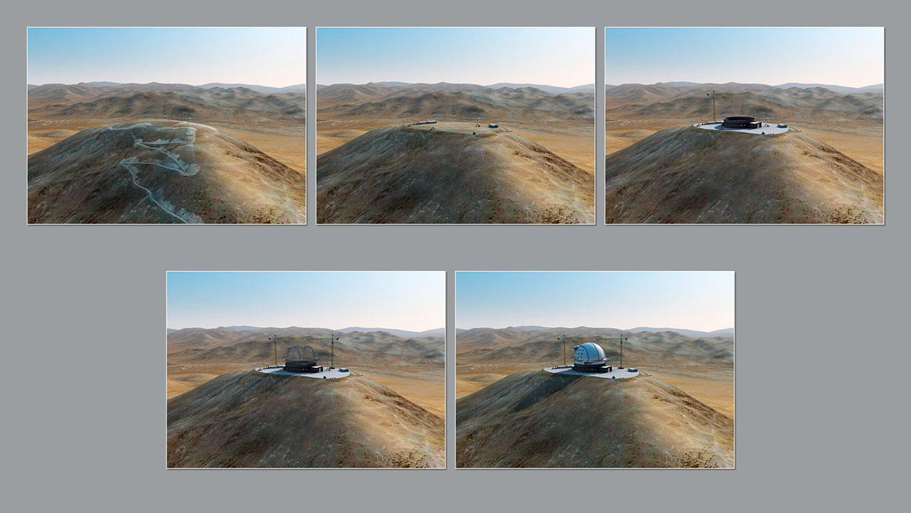
E-ELT construction project planning
2011
2012
2014
2016
2020
Although 20km away from Paranal, E-ELT will be part of the
“La Silla Paranal Observatory”
and will share the infrastructure with VLT.

Slide 18
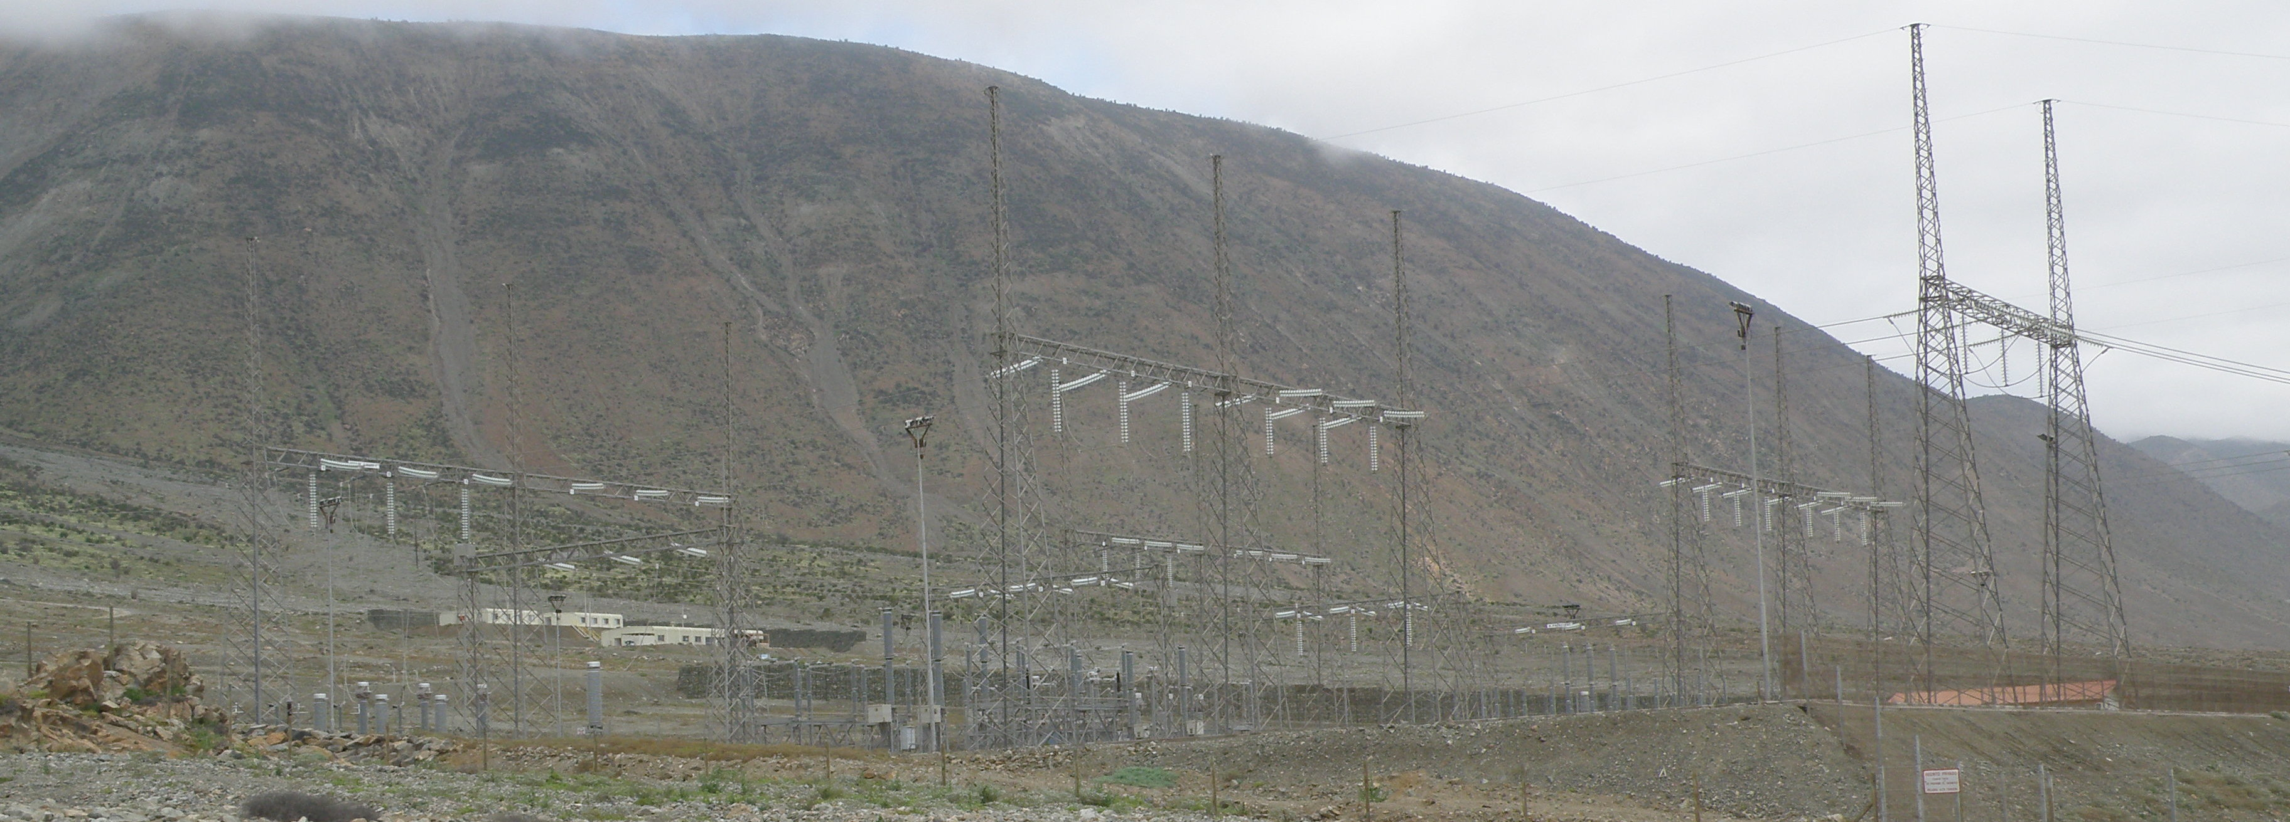
Project: GRID ELECTRICITY SUPPLY to the ESO VLT and E-ELT Observatory
Existing electricity requirements of VLT at Paranal and forthcoming needs of E-ELT at Armazones warrant a grid connection for the electric energy supply of the “ESO VLT and E-ELT Observatory”

Slide 19
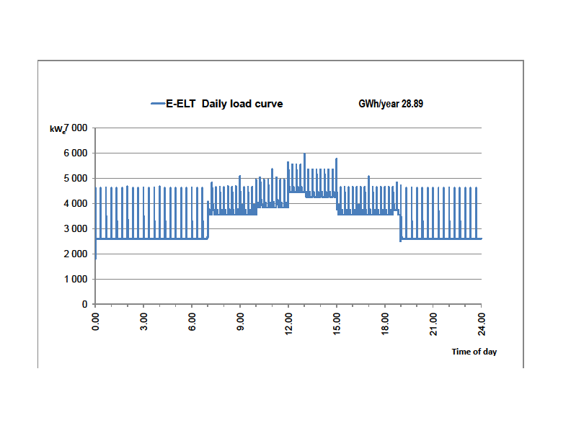
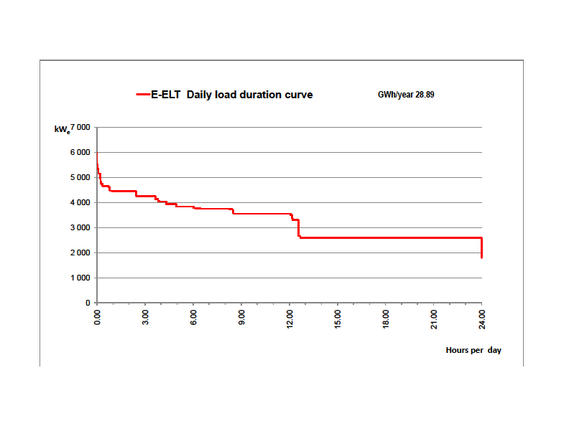
Electric power needs of the E-ELT at Armazones are peculiar (active load peaks up to 2MW) and quite high (up to 6MW)
Local use of flywheels or STATCOM’s seems to be necessary
And they shall be combined with those of the existing telescopes at Paranal (VLT)

Slide 20
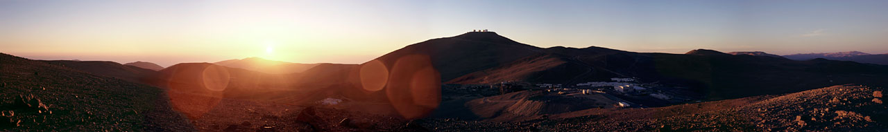
Resulting in total estimated power needs:
 | Paranal (VLT) | Armazones (E-ELT) | Total
Instantaneous peak power | 2.5 MVA | 10.0 MVA | 12.5 MVA
Max power demand | 1.8 MVA | 6.0 MVA | 7.8 MVA
Yearly energy consumption | 10 GWh/y | 30 GWh/y⁽¹⁾ | 40 GWh/y⁽¹⁾
ESO internal distribution voltage | 10 kV | 15 kV⁽²⁾
Notes: (1): Estimated needs. During construction period remarkably lower power
needs are expected.
(2): 15 kV is the preferred value. Other values can be accepted if they
provide technical or standardization advantages
Notes:
IEV 726-06-03: instantaneous peak power (in a transmission line) the maximum instantaneous power passing through a given transverse cross-section of a transmission line during the interval of interest
IEV 691-02-02 : demand the magnitude of an electricity supply, expressed in kilowatts or kilovoltamperes

Slide 21


Standby Power System
A power generating station is currently operating at Paranal, which is used to supply the Paranal area power demand.
This station is currently comprised of:
one multi-fuel turbine-generator set (rated about 2.6 MW_{e} at the site)
three diesel-generator sets (3x 856 kW_{e})
all generators are directly connected to the MV (10 kV) distribution network of Paranal.
This facility, upgraded if necessary, will be used as standby power generation system for both Paranal (VLT) and Armazones (E-ELT) after the connection of the Observatory to the grid.

Slide 22

Grid connection indicative single line diagram
Grid line shall be connected to an open switchyard substation to be build at Paranal downhill area.
The main HV transformer will step the voltage down to the Armazones voltage level.
Paranal shall be connected through two 5MVA 15/10kV transformers, so as to keep the ability to provide power to Armazones using the standby generators in case of grid failure.
Armazones MV S/S shall be build at Armazones summit area.
Underground cables lines are preferred for the Paranal–Armazones connection, to minimise the environmental impact.
For the same reason underground cables will connect Paranal S/S to the Paranal Operating Site.

Slide 23





ESO has already
outlaid remarkable amounts from international funds for its sites in Chile and plans for even higher outlays for its future projects. Construction and operation of the sites require a lot of working positions, most of which are occupied by Chileans.
International visitors, from specialized engineers up to Ministers, Prime Ministers or even Presidents are frequently coming to Chile, to the ESO facilities or due to ESO activities.

Slide 24




Side benefits
Chile becomes a country hosting top science activities, the world centre for astronomical research
ESO supports Chilean Astronomy
Folks are visiting the Chilean observatories
Observatories have attracted the movie industry
Nostalgia de la Luz (2010)
Quantum of solace

Slide 25





Provided Brochure

Slide 26
ESO Web page for this presentation
You can find copy of this presentation and of the brochure at:
www.eso.org/public/industry/projects.html

Slide 27

Draft Preliminary Inquiry
Those of you interested in participating to the preliminary inquiry, please send an email confirming your interest, within next 30th June 2011, to: Mr. Yves Wesse, ywesse@eso.org
For the contractors interested in participating to the preliminary Inquiry, we will organize visit to the Paranal Observatory and visit the site.

Slide 28

Many thanks for your attention
P-DKA-110204 V01.000

