Slide 1
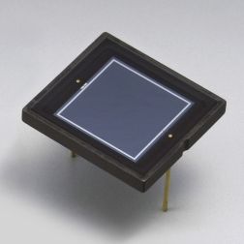
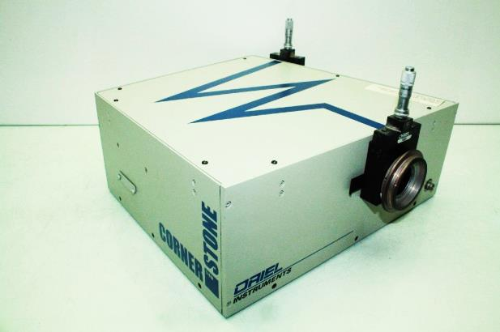
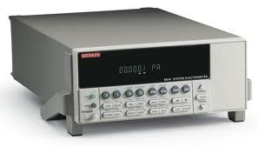
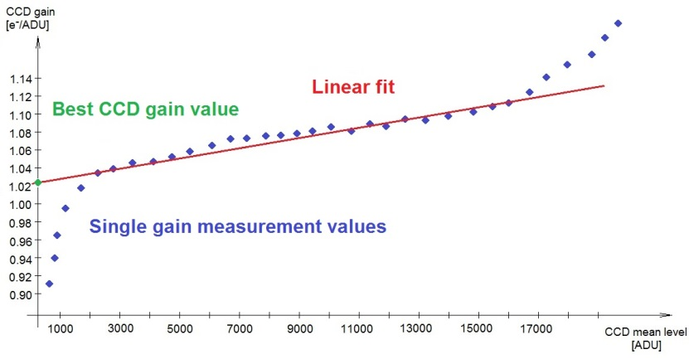
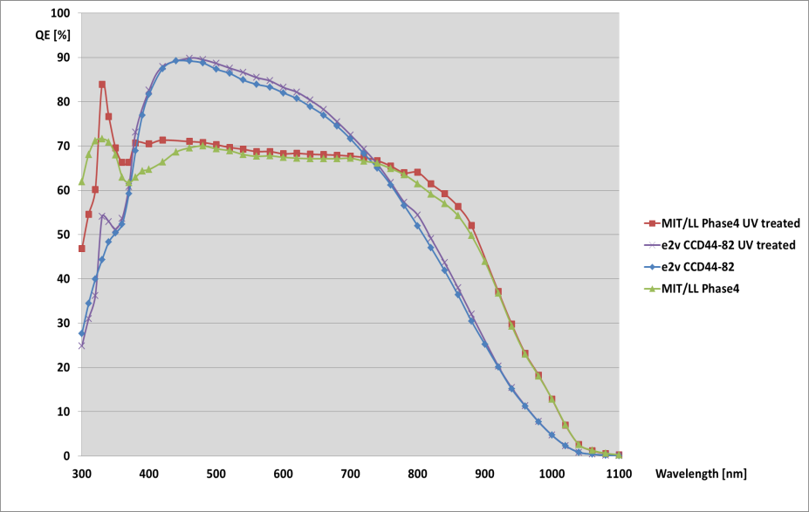
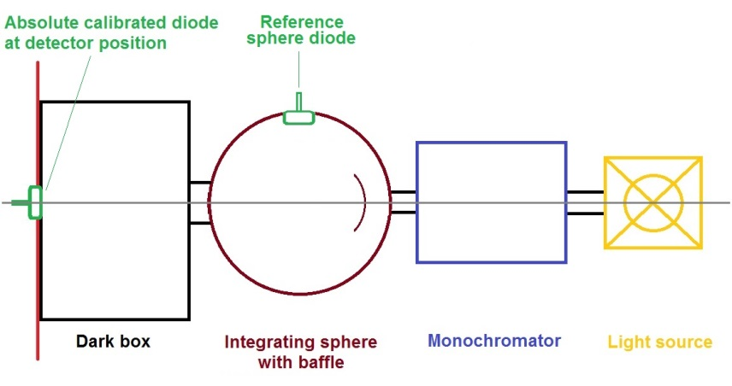
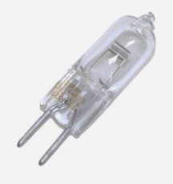
Step 1: Correct absolute calibrated photo-diode
How to achieve precision UV-QE measurements at optical detectorS ?
Step 1: UV sensitive absolute (correct) calibrated
Hamamatsu S1337-1010BQ photo-diode
Step 2: Correct calibrated high sensitive electrometer for pA diode
current measurements
Step 3: Calibrated double monochromator
Step 4: Cross-calibration of sphere diode with detector plane diode with current regulated
Osram HLX 64641 halogen light source
and BONN shutter
Step 5: Correct CCD gain calculation
Step 6: Repeated automatic QE CCD measurements
Resulting error in UV approx. 2-3%
Scientific Detector Workshop, Oct 7-11, 2013

Slide 2
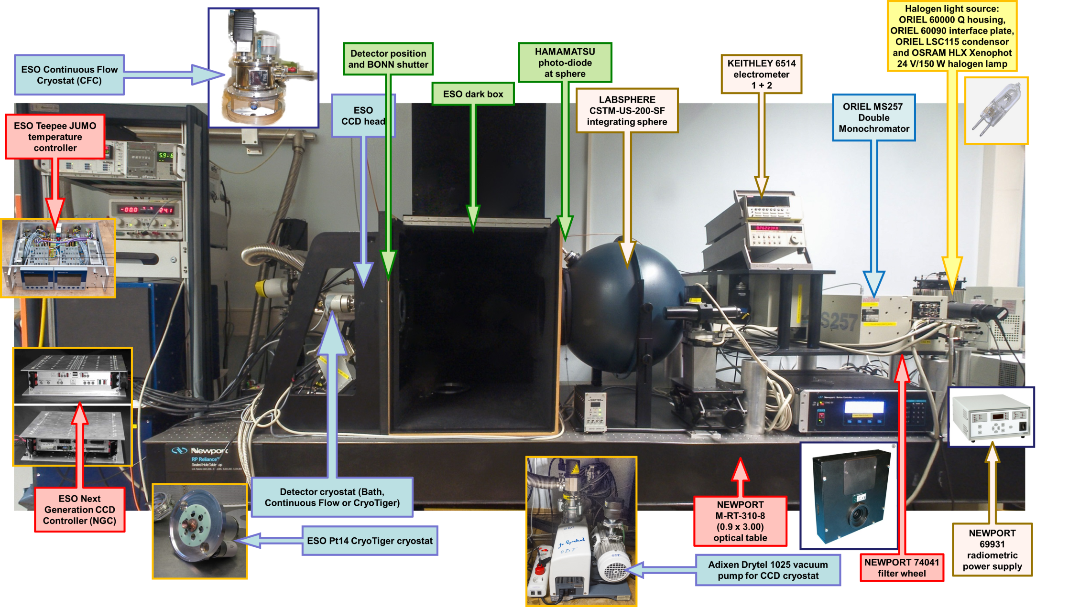
With a fully automated detector test bench
How to achieve precision UV-QE measurements at optical detectorS ?
Scientific Detector Workshop, Oct 7-11, 2013

