Slide 1
The accretion history of the halo of M31 as probed by its globular cluster population
Avon Huxor et al.
Astrophysics Group
HH Wills Physics Laboratory
University of Bristol
UK
Zentrum für Astronomie
Mönchhofstr. 12-14
69120 Heidelberg
Germany
From May 2011
Notes:
The presentation will include:
goals of the Research Programme
work carried out to date
future work, i.e. the programme to completion
PURPOSE:
The aim of the presentation is to report to the members of the C.A.R., the goals of my Research Programme (MSc by Research), the work carried to date and the programme to completion.
CONTENT:
background theory
Post-AGB stars
dust in evolved stars
O-rich
C-rich
binarity and disks
where is the O-rich dust?
project description
goal of the project
use developed realistic models of the dust emission from post-AGB stars using a radiation transport code to, comparing with observational constraints, determine where is the located the O-rich material.
thesis: the O-rich material is located in stable circumbinary disc
schedule of work
radiative transfer code
ray tracing method
monte-carlo method
interpret and analyze the result
constraint models results with observational SEDs and images
Results
fits SEDs vs observations
observed images vs models images
case studies
a detailed understanding of exceptional objects may be useful for uncovering and evaluating the key physical processes involved in a class of objects
hd 44179
…
programme to completation
Structure:
Introduction
Purpose and context
Overview of main points
tell them what you are going to say
Main poits
Point1
development and explanation of ideas
examples
restatement of the point
Point 2 (…)
Summary and Conclusion
reinstatement and review of main points
conclusions and implications

Slide 2
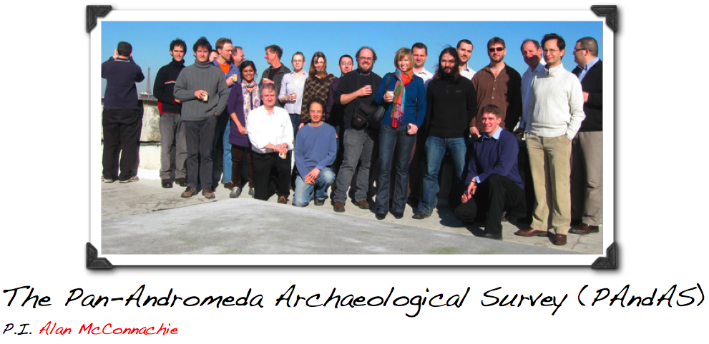
PAndAS

Slide 3
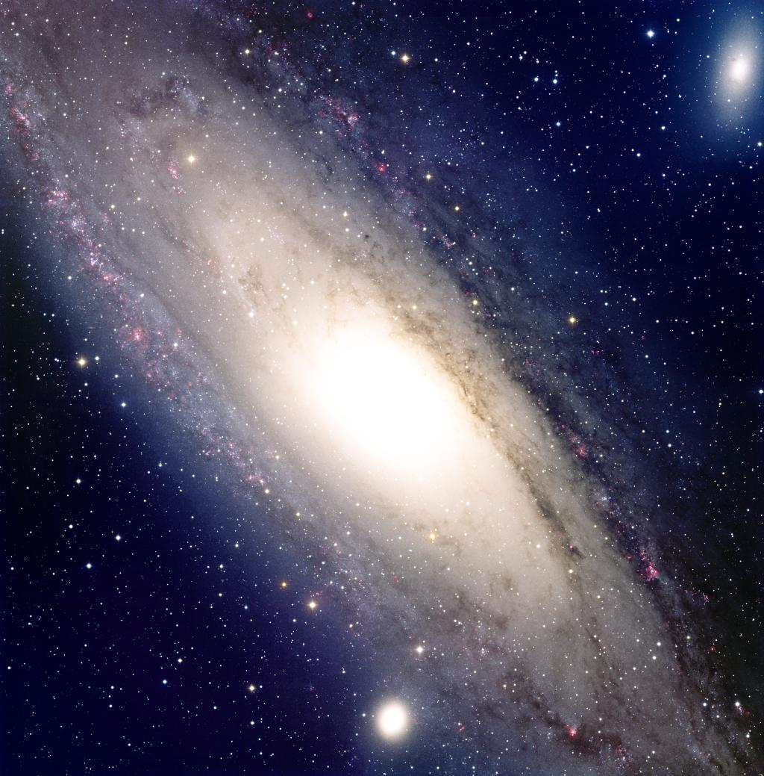
Motivations
Use of Globular clusters as probes of the history of M31
  GCs form in major SF events that accompany galaxy formation and also wet mergers.
  And accretion of dwarfs will add the dwarfs GCs to the hosts population.
With M31 we can also use analysis of resolved stellar pops to understand its history
  GCs can be used in concert with field stars
  If we can to tie GC population to history, might be able to use GCs (integrated properties) to understand more distant galaxies

Slide 4
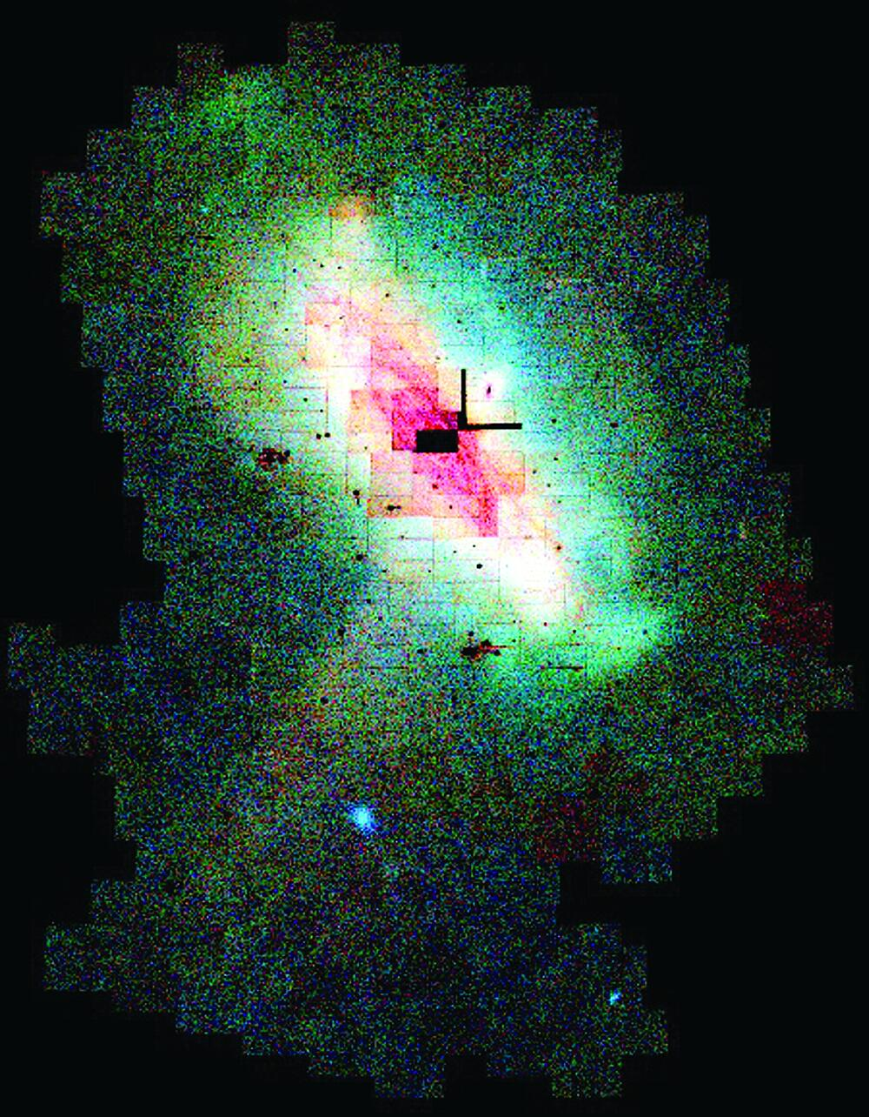
INT-WFS survey area
INT-WFS was a wide-field survey in V and i’, using INT/WFC.
> 40 square degrees
Superseded by the PAndAS survey

Slide 5
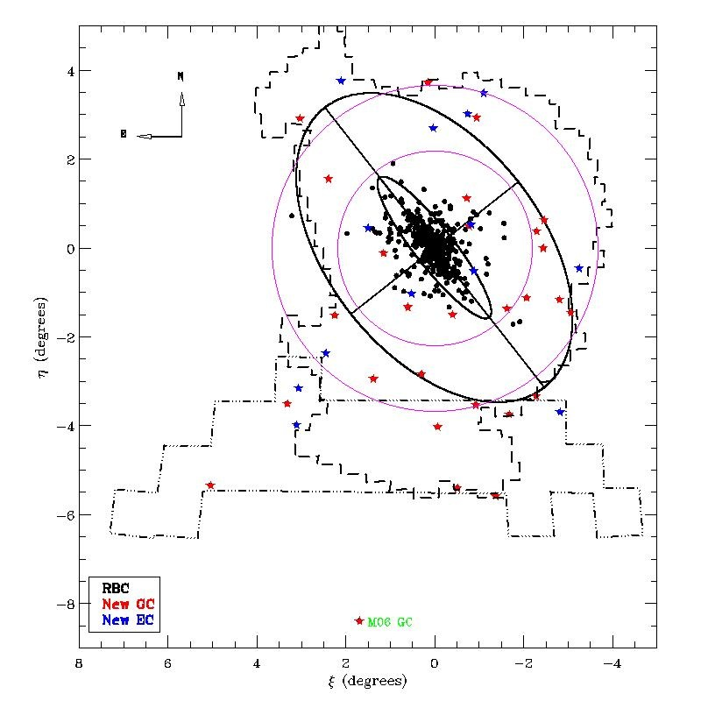
INT-WFS survey area
Early ‘sample’ comprised INT-WFS coverage, plus overlapping initial CFHT/MegaCam fields.
Provided cluster sample for Huxor et al. 2011

Slide 6
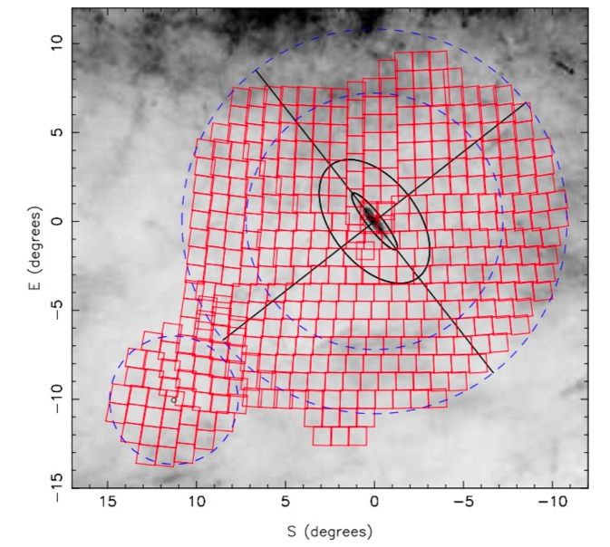
PAndAS survey area
PAndAS is a wide-field survey in g and i, using CFHT MegaCam.
Built on earlier INT-WFS related MegaCam programs (2002-2006)
PAndAS proper: a total of 226 hours (41 nights), giving a final coverage of ~400 square degrees

Slide 7
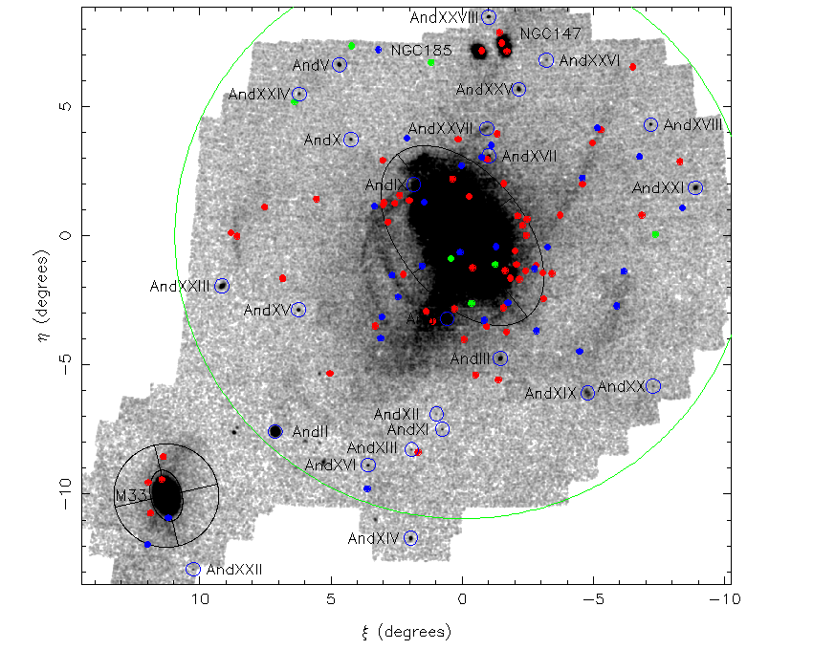
Some New GCs
Red: compact GC
Blue: extended GC
Green: candidate GC
Clusters go to edge of survey
New GCs for N147/N185
Association of clusters with stellar substructure
Latest photometry provisional, but excellent work by PhD student Cherie Fishlock

Slide 8
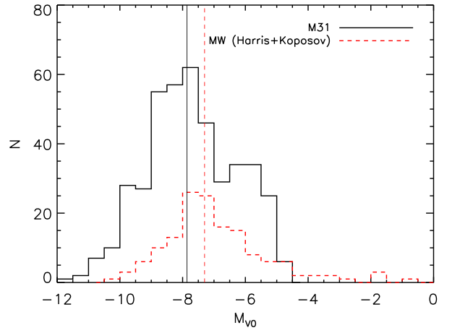
GC Luminosities
M31 appears to have a somewhat brighter peak than the MW But this is very dependent on the reddenings (from Fan++ 2010).
Suggestion of a second peak at M_{V0} ~ -6.0.

Slide 9
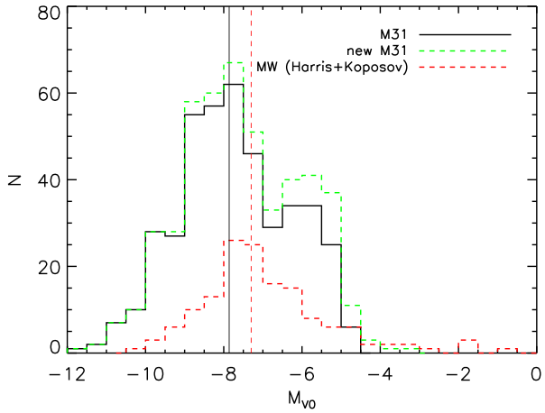
GC Luminosities
M31 appears to have a somewhat brighter peak than the MW But this is very dependent on the reddenings (from Fan++ 2010).
Suggestion of a second peak at M_{V0} ~ -6.0.
New data (with warning) strengthens second peak.

Slide 10
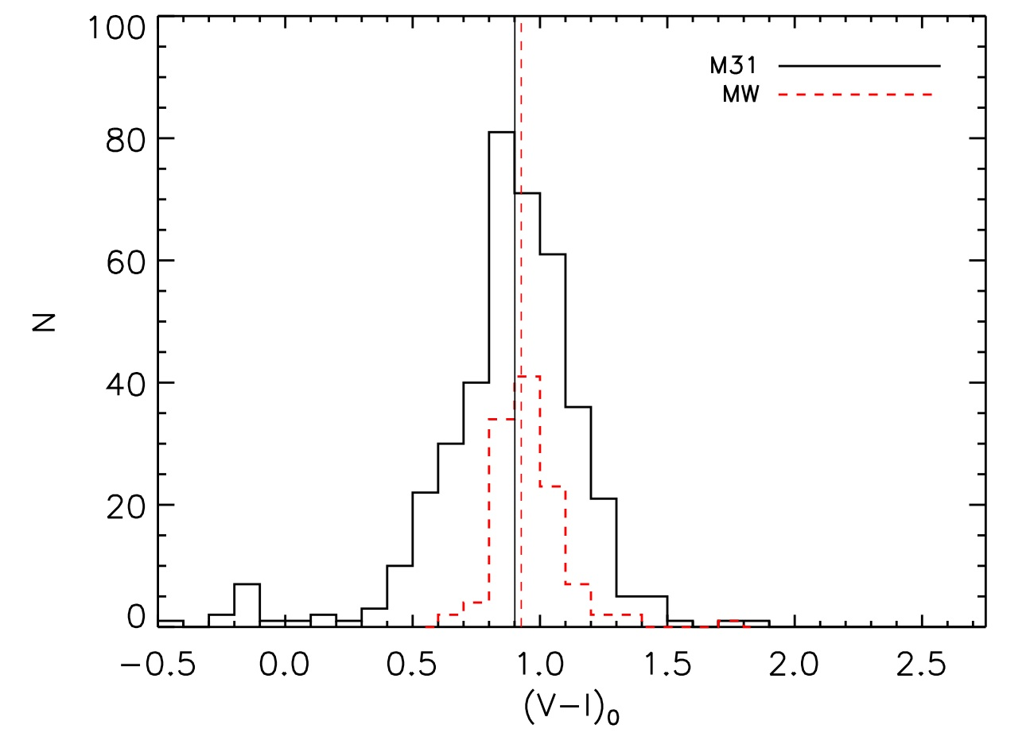
Colour
(V-I) colours very similar to the MW.

Slide 11
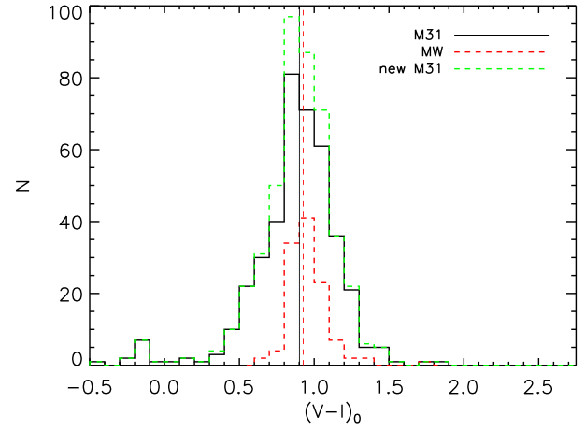
Colour
(V-I) colours very similar.
New data concurs

Slide 12
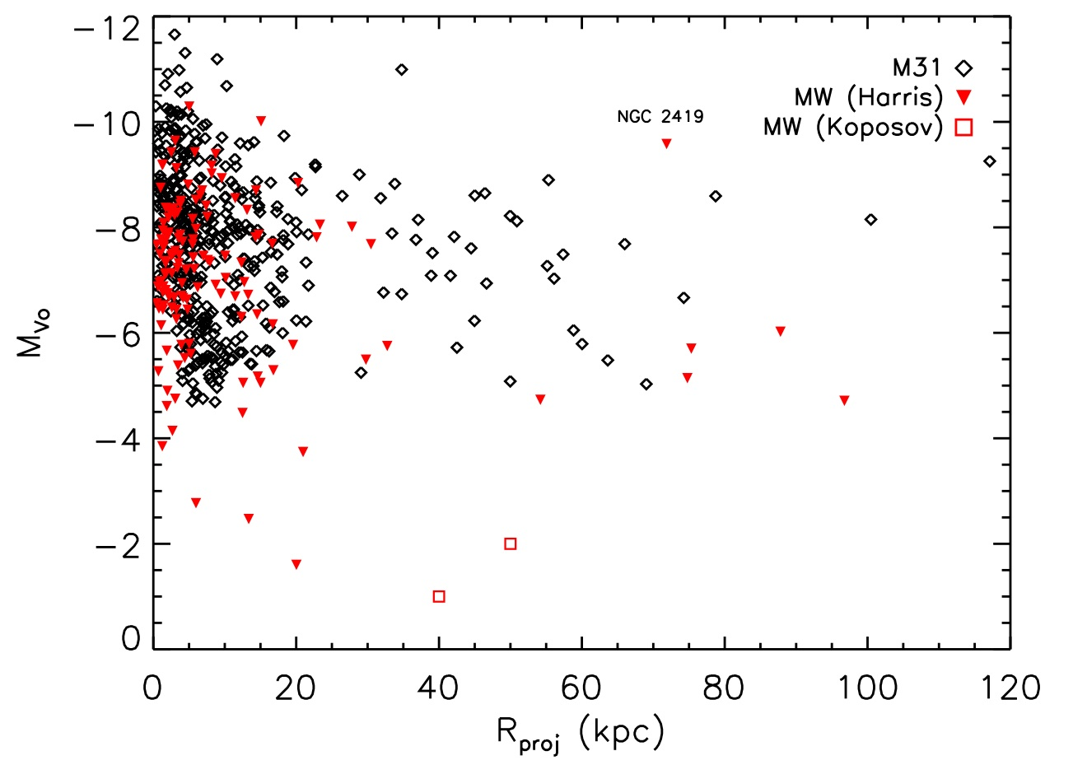
Luminosity against distance to host
M31 has a population of luminous GCs in the outer halo. The only MW counterpart is the unusual cluster NGC2419
We miss the very faint clusters in M31 (M_{V0} > -4)

Slide 13
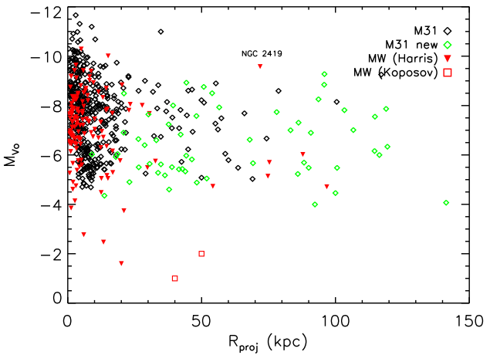
Luminosity against distance to host
M31 has a population of luminous GCs in the outer halo. The only MW counterpart is the unusual cluster NGC2419
We miss the very faint clusters in M31 (M_{V0} > -4)
New data follows same pattern.

Slide 14
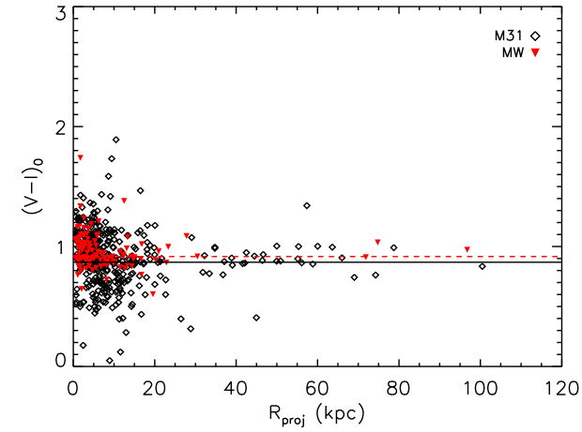
Colour against distance to host
Colors in outer halo are uniformly blue, and similar to the MW halo.

Slide 15
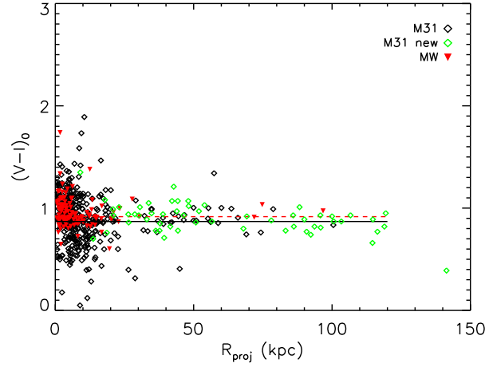
Colour against distance to host
Colors in outer halo are uniformly blue, and similar to the MW halo.
New data consistent with this result, with hints that that more metal-rich population starts < 50 kpc.

Slide 16
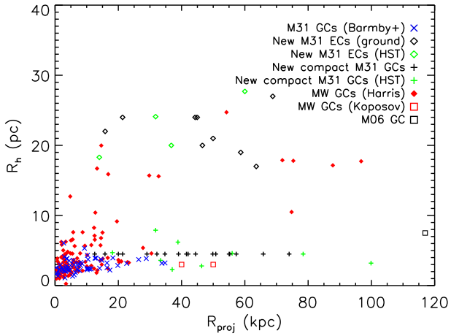
Half-light radii
M31 and MW appear quite different. MW has no compact GCs at large R_{proj.}
Suggestion of bimodal distribution in R_{eff} in M31 halo with few from 8 - 15 pc. Compact vs Extended?

Slide 17
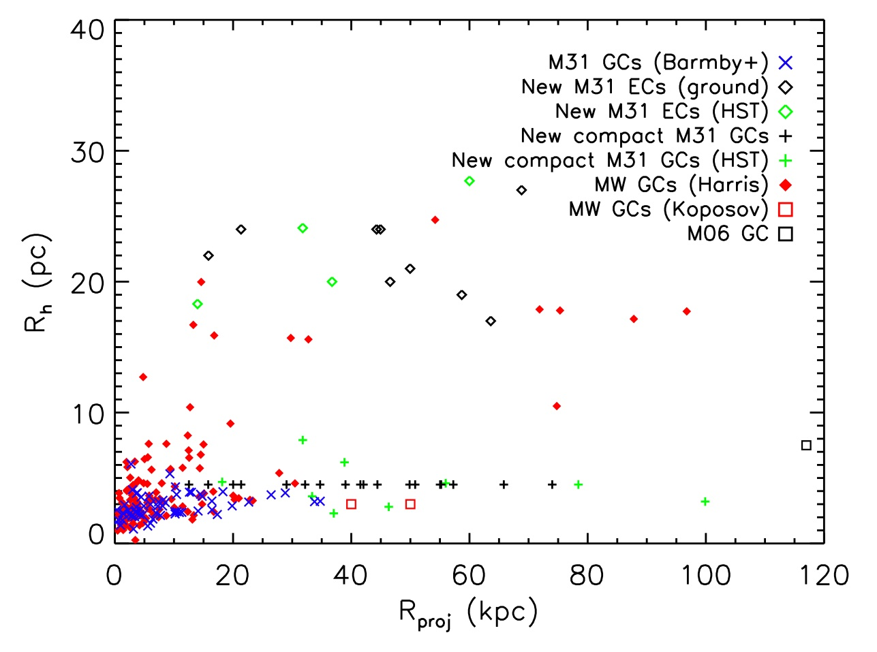
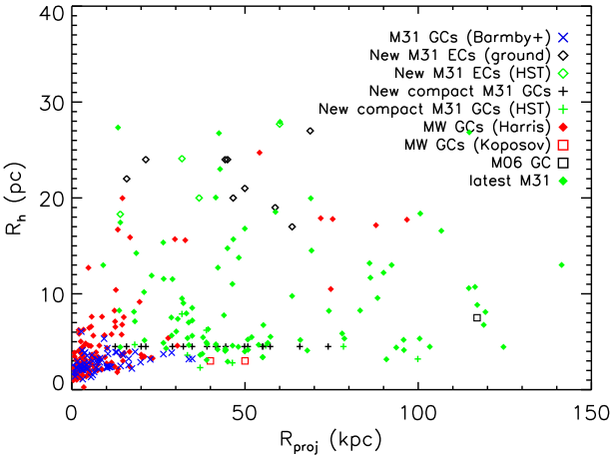
Half-light radii
M31 and MW appear quite different. MW has no compact GCs at large R_{proj.}
Suggestion of bimodal distribution in R_{eff} in M31 halo with few from 8 - 15 pc. Compact vs Extended?
New data reveals many extended clusters, but fills in gap in R_{eff}.

Slide 18
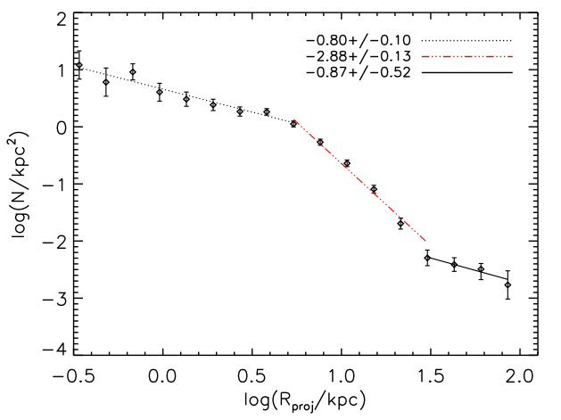
GC surface density profile
Using conventional R^{1/4} fit, we see a break in the outer slope.
Not seen before.
[shallower inner slope known, and likely due to detection problems in central region, and cluster disruption]

Slide 19
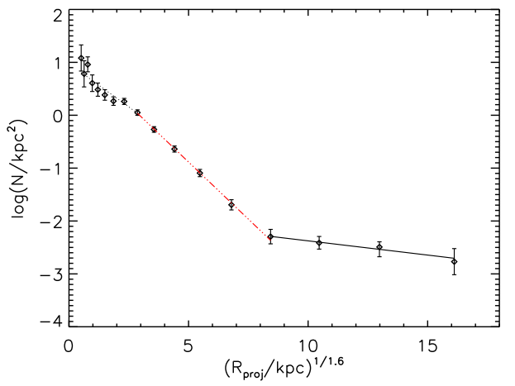
GC surface density profile
Using best empirical fit from Battistini et al. (1993), R^{1/1.6} we get excellent fit, despite much amended dataset

Slide 20
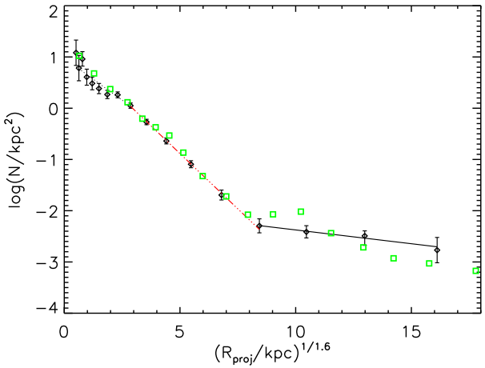
GC surface density profile
New data consistent, with much larger number of clusters.
Outer region starting to show suggestions of ‘substructure’.

Slide 21
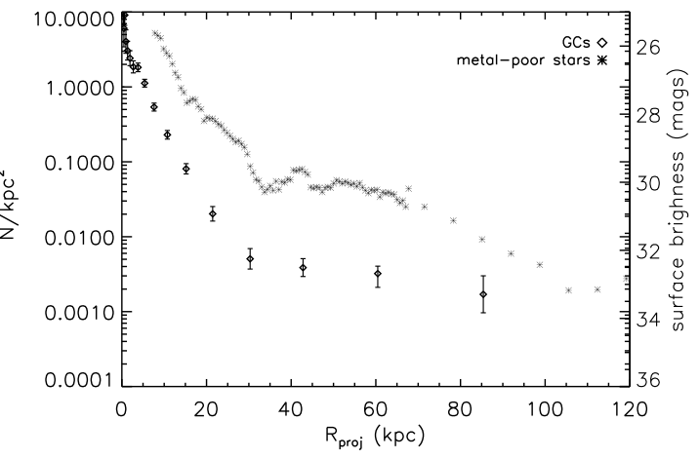
GC surface density profile
GCs and stars follow similar profile.
New data even has a bump at R_{proj} ~ 40 kpc.
Suggestive of a common origin?

Slide 22
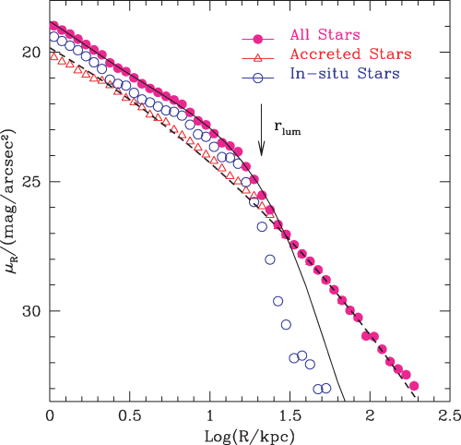
Comparison with models
Abadi et al. (2005)
Numerical simulations of mergers produce a ‘luminous radius’ r_{lum}, beyond which stars mostly accreted.
We have different slopes in our data, but qualitative similarity with break in M31 profiles.

Slide 23
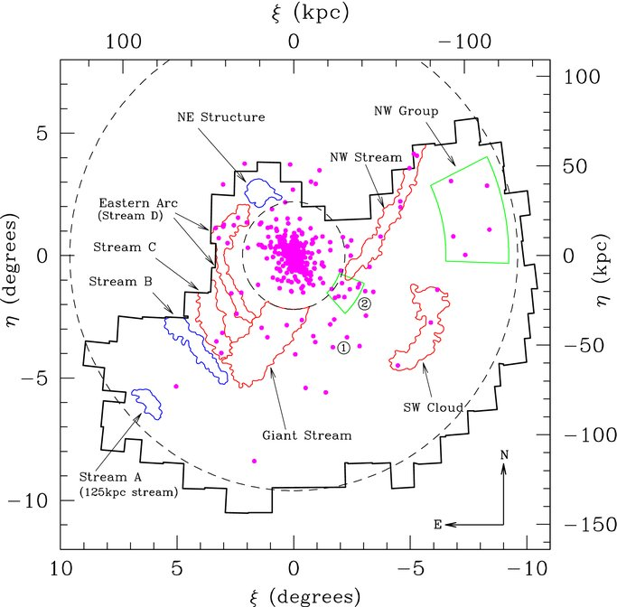
GCs and substructure
GCs lay on stellar substructure.
Mackey et al (2010) applied a Monte Carlo technique and found a < 1% chance that clusters would lie on the stellar over-densities (> 3.5 σ over local background).

Slide 24
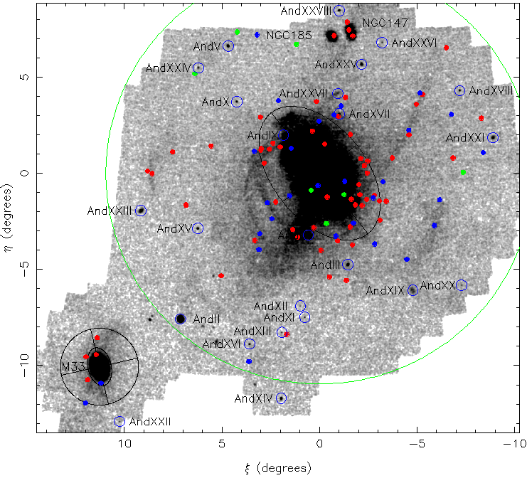
Velocities
Most R_{V}s to date are in the inner halo, where substructure more confusing
New data taken in outer halo, and being reduced
As a taster, 2 R_{V}s in the SW cloud from GMOS
HEC-14 -426 ±12 km/s
HEC-15 -405 ± 5 km/s
HEC14
HEC15

Slide 25
Concluding remarks
M31 has an extensive GC system, to the edge of our survey
Will the bimodal GCLF service close reanalysis?
Evidence suggest that most (if not all) the outer halo clusters are accreted along with their original host dwarf galaxies
  Spatial correlation with stellar substructure
  The break in the GC profile appears to be a signature of this (but hard to see at large distances?)
  Extended clusters preferentially found in dwarfs (e.g. NGC 6822, Scl-dE1)?
The differences in the halo cluster population of M31 w.r.t the MW: the compact halo clusters, the luminous halo clusters, the extended clusters, must be telling us something about:
  The number of merger/accretion events
  The type/mass of satellites

Slide 26
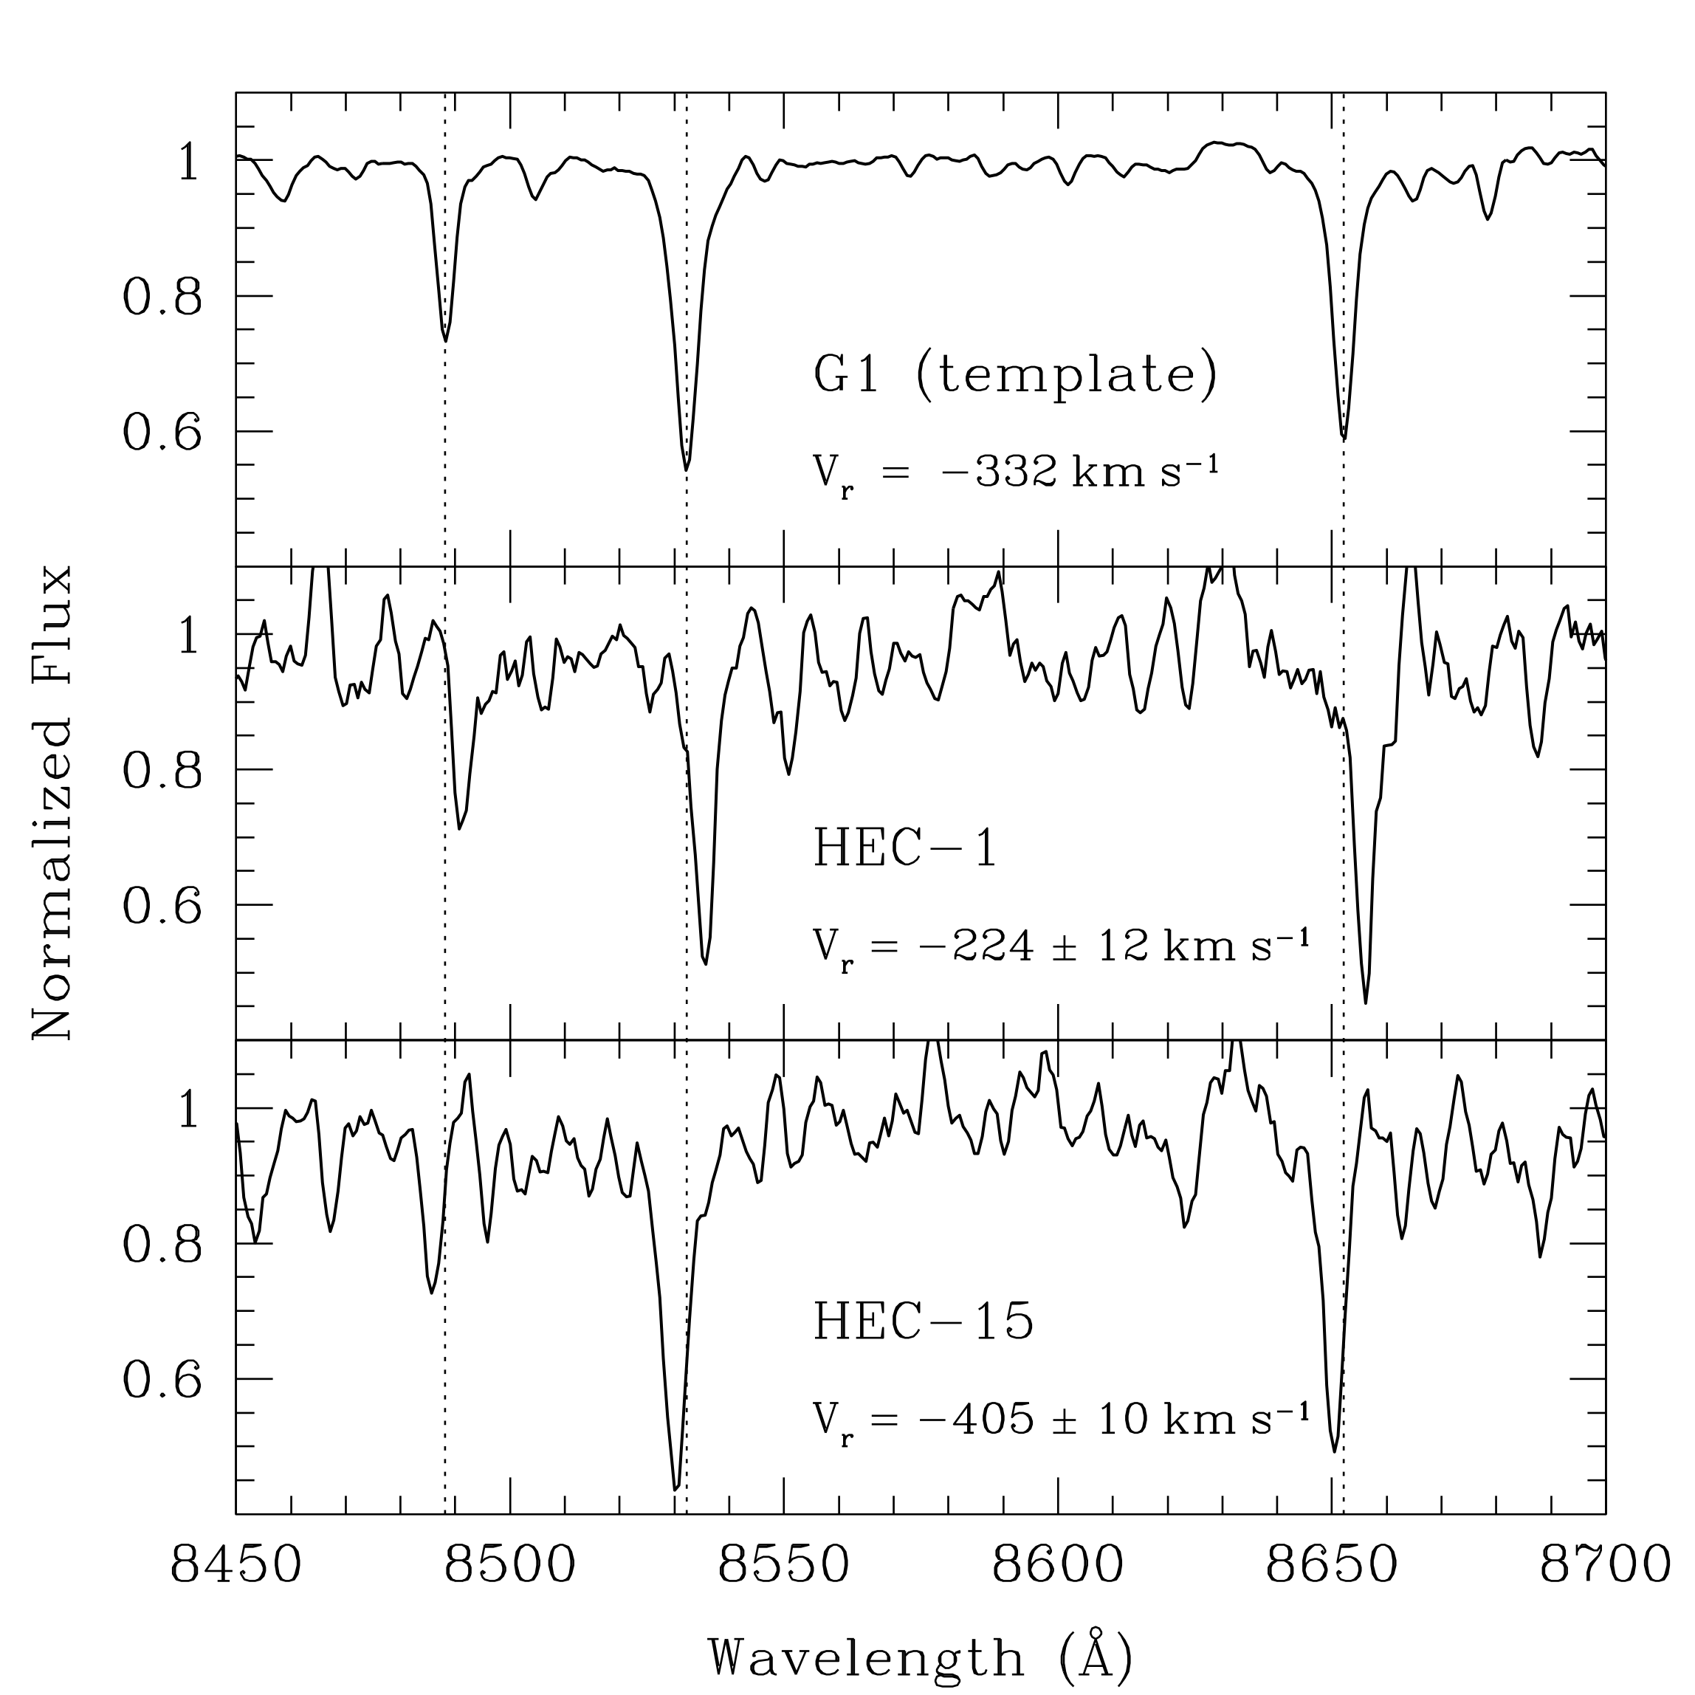
GMOS
GMOS observations of ECs, for R_{V}s

Slide 27
Conclusion
WHT/ISIS spectroscopy, 2009B: 3 nights, 15 targets, PI Huxor
  KPNO-4m spectroscopy, 2009B: 5 nights, 18 targets, PI Ferguson
  WHT/ISIS spectroscopy, 2010B: 3 nights, 17 targets, PI Huxor
  Gemini/GMOS spectroscopy, 2010B: 6 hours, 4 targets, PI Mackey
  HST/ACS imaging, Cycle 19: Two proposals pending (13, 15 targets).
  Gemini/GMOS spectroscopy, 2011B: Proposal pending (13 targets)
In initial use, the system already pointed to its potential. The bulk of the galaxies of interest were in the right-hand peak. But when displayed with the 2 parameters of magnitude and colour, a second peak revealed itself (left of main peak)
These all looked very similar in size and morphology and stood out.
This group of objects were new to me. Showing them to a colleague revealed them to be Blue Compact Dwarfs.
A personal, if not community, discovery.

Slide 28
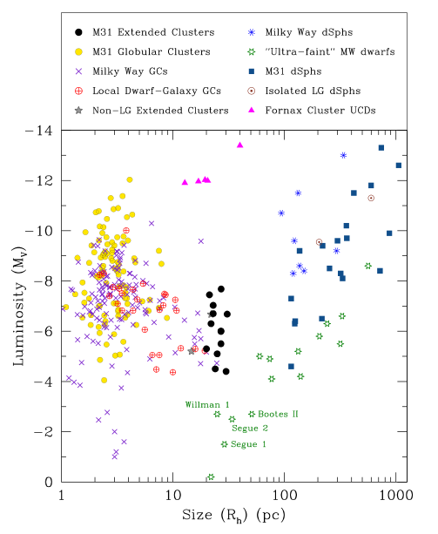
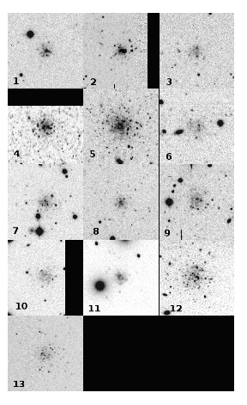
Extended Clusters
More recent extended
clusters more Pal-like but first three still notable

