Slide 1
The (New) Phase Space of Optical Transients
[Astronomy on the Cusp]
[The Next Big Thing]
S. R. Kulkarni
Caltech Optical Observatories

Slide 2
Wide-field Astronomy
Resurgence driven by technological innovation
Many projects
  CSS, PTF, PS-1, SkyMapper
  VST, ODI
  CFH, DES, HSC
  LSST
Exciting frontier: Transients

Slide 3
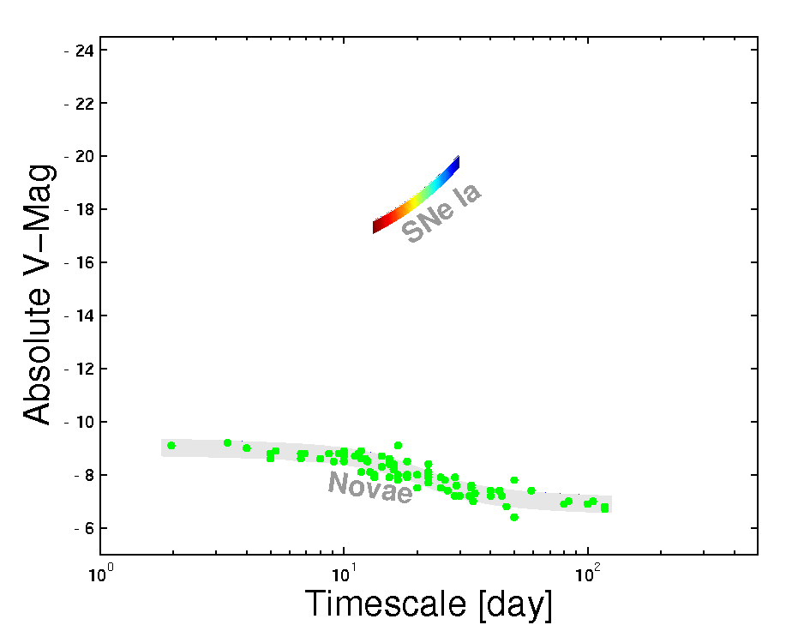
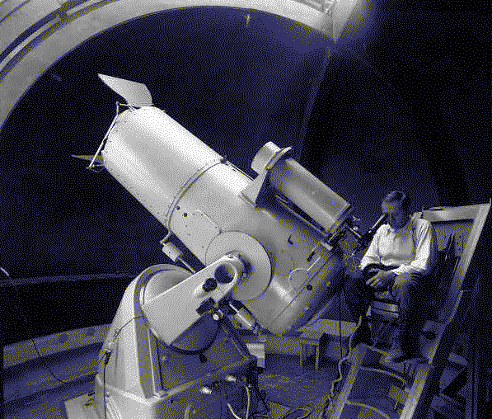
Notes:
It wasn’t hardly centuries ago that mankind thought the universe was unchanging. The discovery of transients has now led us to believe that the universe changes not only on month and weeks but also days, hours and minutes!
In Ay 1, or any introduction to cosmic explosions, two classes of optical transients are introduced - novae and supernovae. our understanding about them has grown in leaps and bounds in the past two decades. And for good reason. They are both easy to find and Novae are faint but plentiful, supernovae are rare but bright. Since the time of Hubble, this curious gap has been noted, and we have asked, are there are hitherto an undiscovered class of transients? Let us quantify this gap next.

Slide 4

(From Today to LSST)

Slide 5

A Sideways revolution

Slide 6
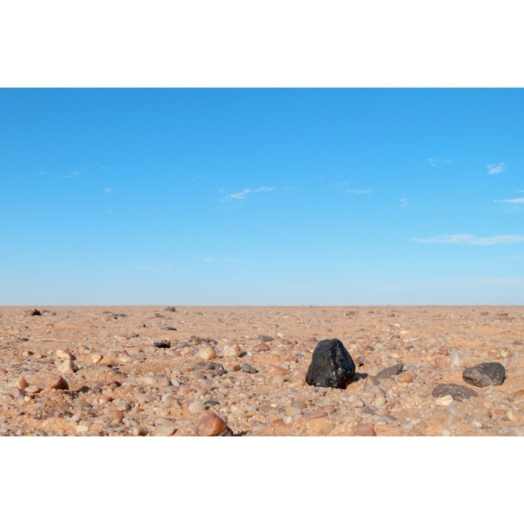
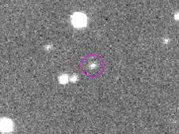
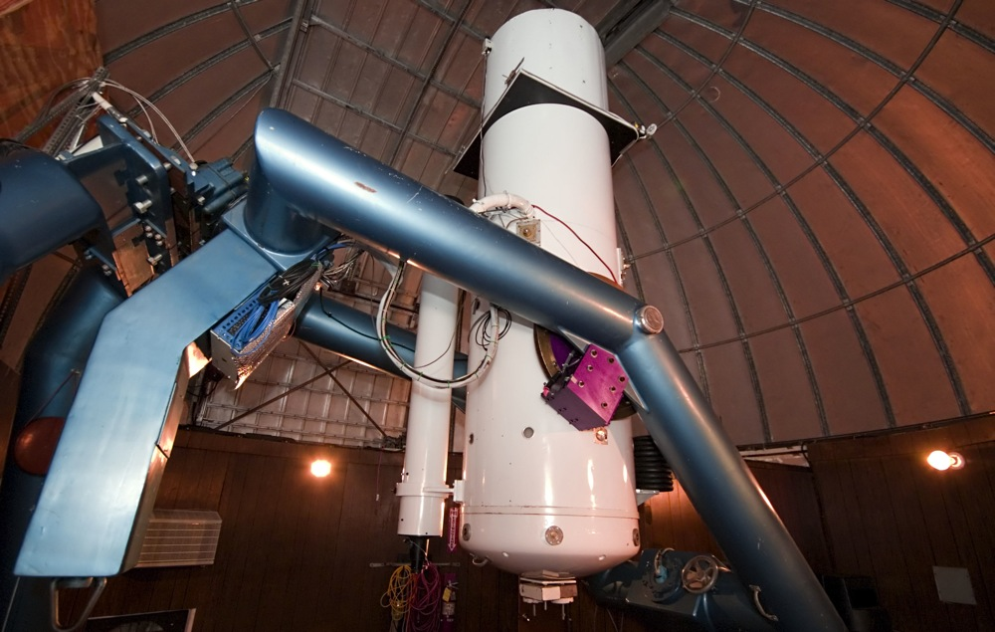
CatCat
Catalina Sky Survey
(Focus: Asteroids)

Slide 7
Transients: The next big thing
But need end-to-end planning

Slide 8
Notes:
It wasn’t hardly centuries ago that mankind thought the universe was unchanging. The discovery of transients has now led us to believe that the universe changes not only on month and weeks but also days, hours and minutes!
In Ay 1, or any introduction to cosmic explosions, two classes of optical transients are introduced - novae and supernovae. our understanding about them has grown in leaps and bounds in the past two decades. And for good reason. They are both easy to find and Novae are faint but plentiful, supernovae are rare but bright. Since the time of Hubble, this curious gap has been noted, and we have asked, are there are hitherto an undiscovered class of transients? Let us quantify this gap next.

Slide 9
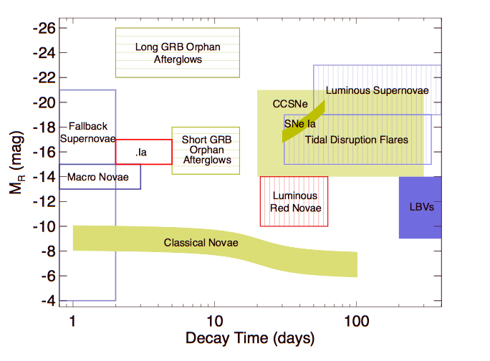
Notes:
It wasn’t hardly centuries ago that mankind thought the universe was unchanging. The discovery of transients has now led us to believe that the universe changes not only on month and weeks but also days, hours and minutes!
In Ay 1, or any introduction to cosmic explosions, two classes of optical transients are introduced - novae and supernovae. our understanding about them has grown in leaps and bounds in the past two decades. And for good reason. They are both easy to find and Novae are faint but plentiful, supernovae are rare but bright. Since the time of Hubble, this curious gap has been noted, and we have asked, are there are hitherto an undiscovered class of transients? Let us quantify this gap next.

Slide 10
Frontier Fields
Ultra-high energy cosmic rays
  GZK cutoff (proton-photon pion production)
High Energy Neutrino Astronomy
TeV Sources
  Pair production on CMB photons
GW Sources (100 Hz band)
  eLIGO (2009), aLIGO (2013)

Slide 11
It is not about detecting transients or issuing alerts

Slide 12


Slide 13






Slide 14
NO TRANSIENT LEFT BEHIND

Slide 15
Palomar Transient Factory
(Focus: Transients)
(END-to-end Planning)

Slide 16
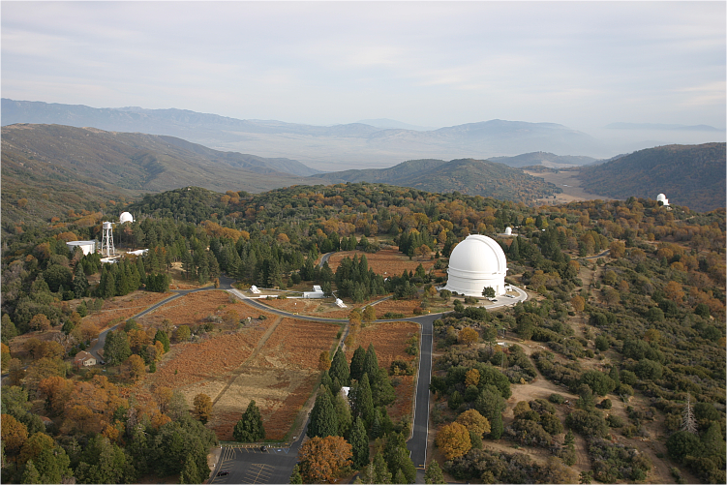
P60
classification telescope
P48
survey telescope
P200
Spectroscopy

Slide 17
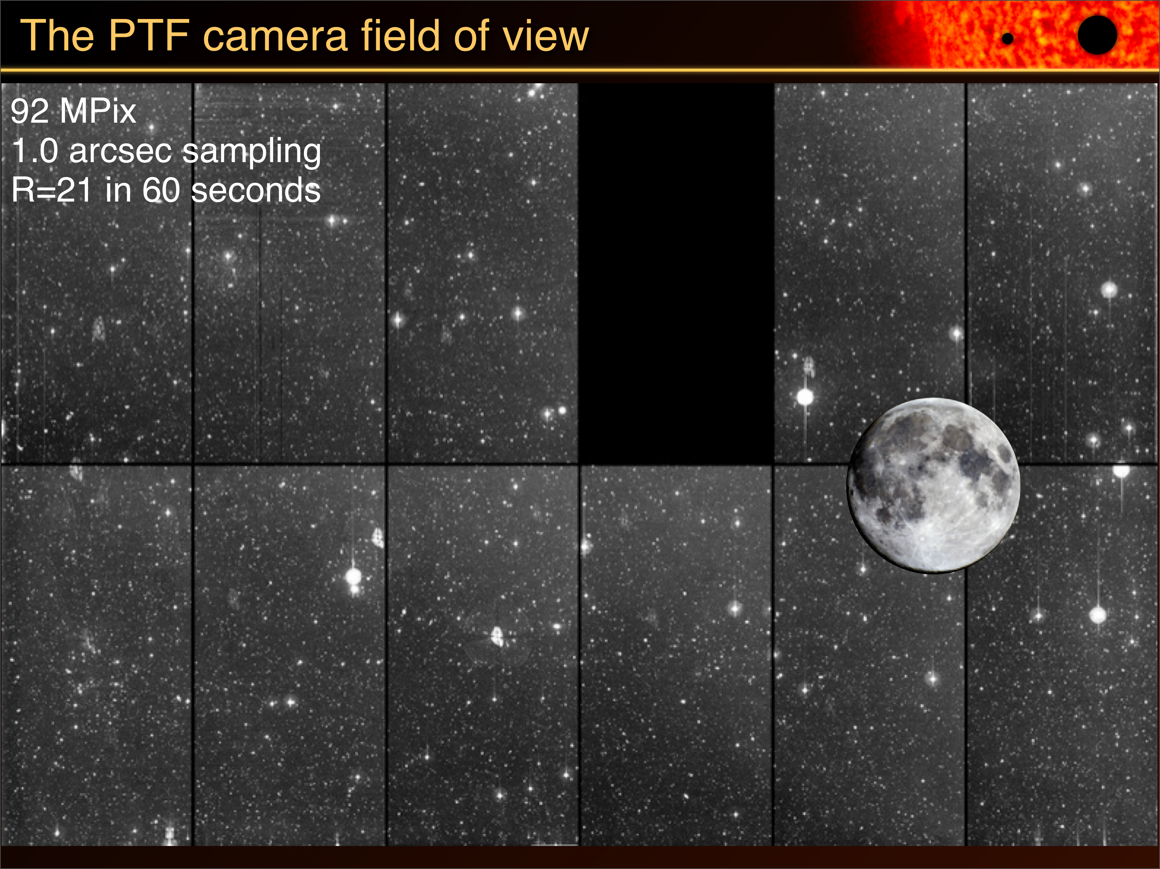

Slide 18
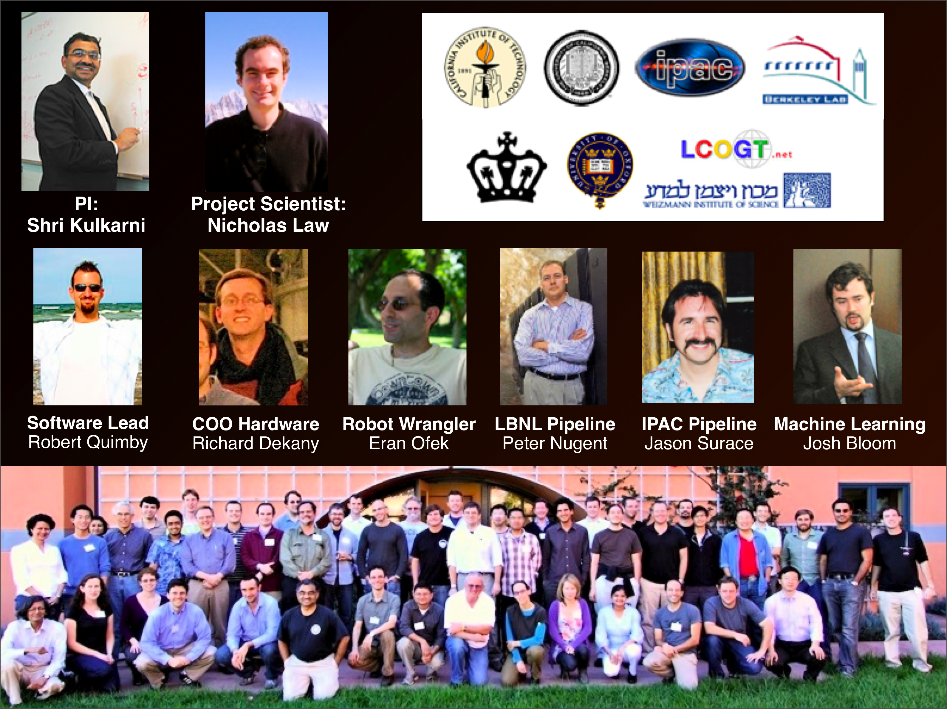

Slide 19
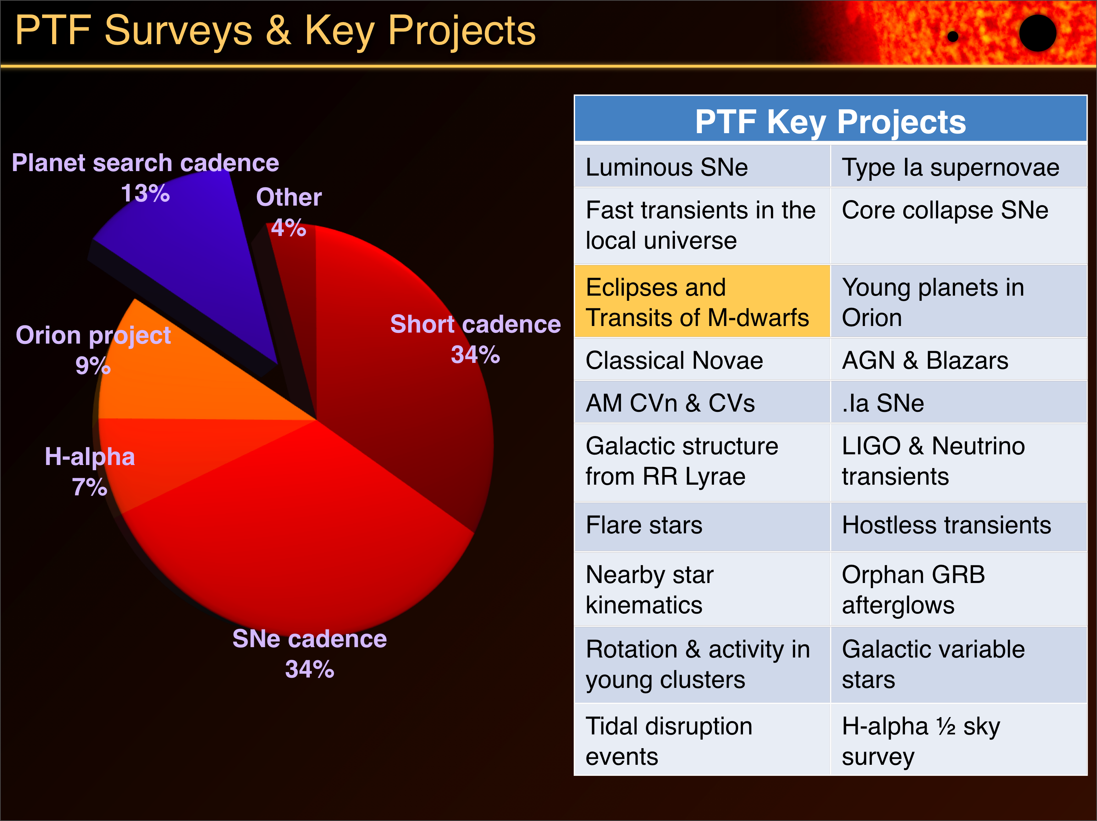

Slide 20
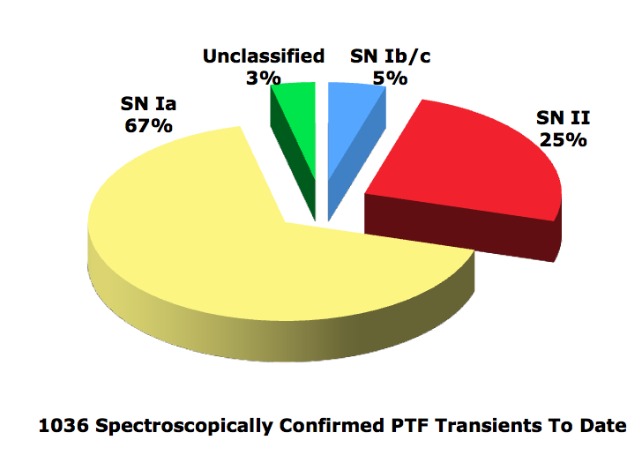
PTF haul (to date)

Slide 21
Kasliwal 2011 (PhDT)

Slide 22
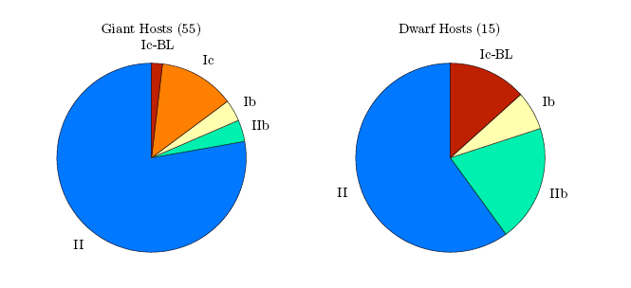
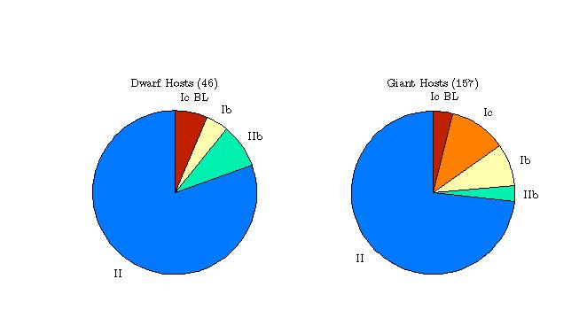
Results | PTF year 2 increases sample
2009:
Arcavi et al. 2010
2010:

Slide 23
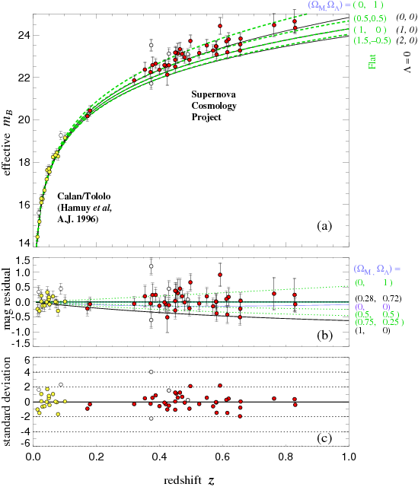
Supernovae for Cosmography

Slide 24
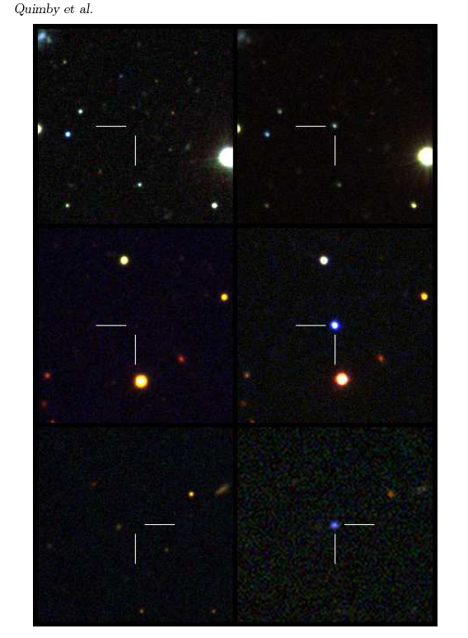
A new class of supernovae (Luminous SN of type Ic)
Quimby

Slide 25
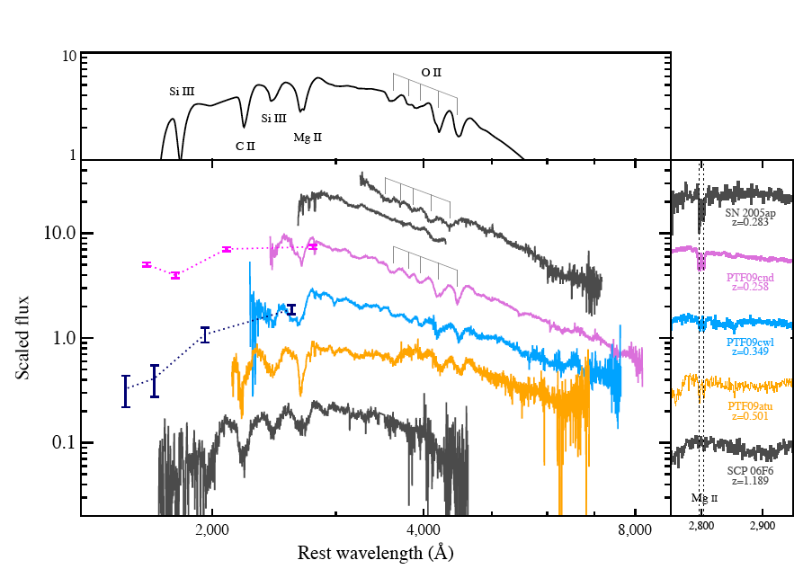

Slide 26
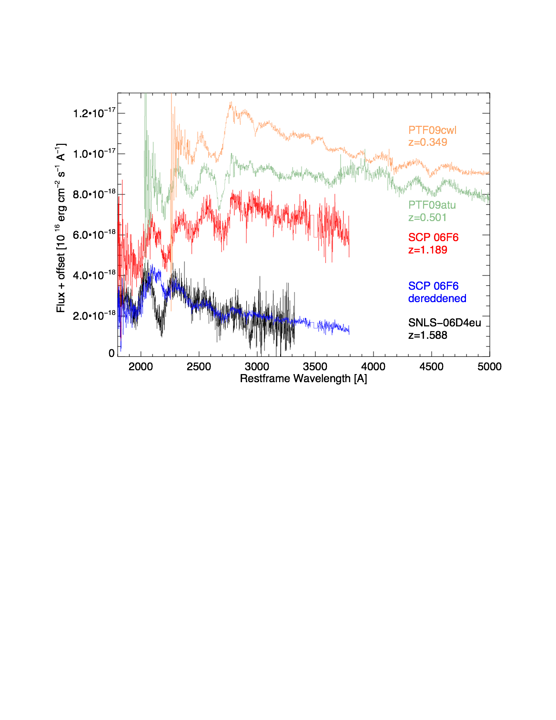

Slide 27
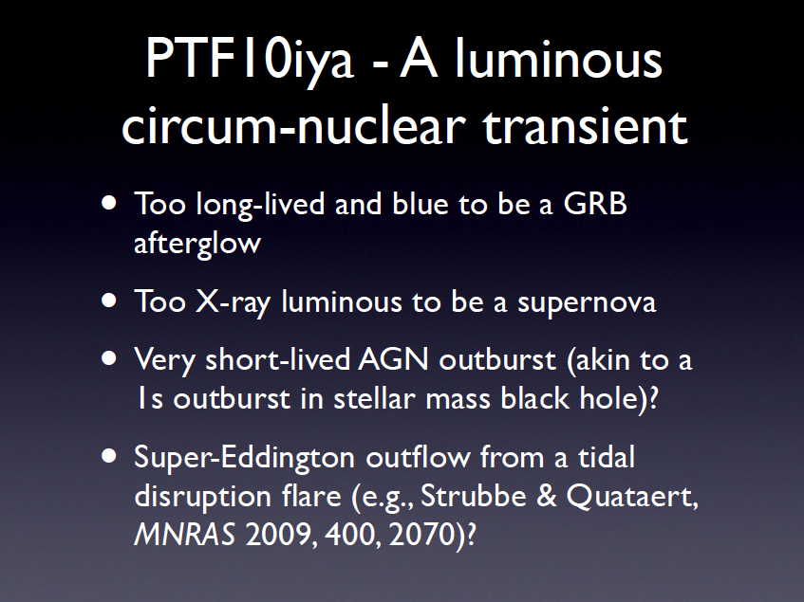

Slide 28
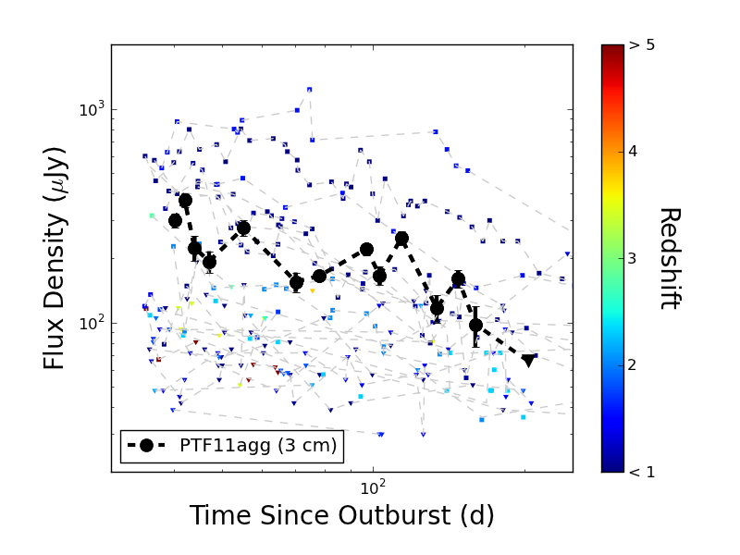
PTF11agg
(Orphan afterglow or dirty fireball)

Slide 29
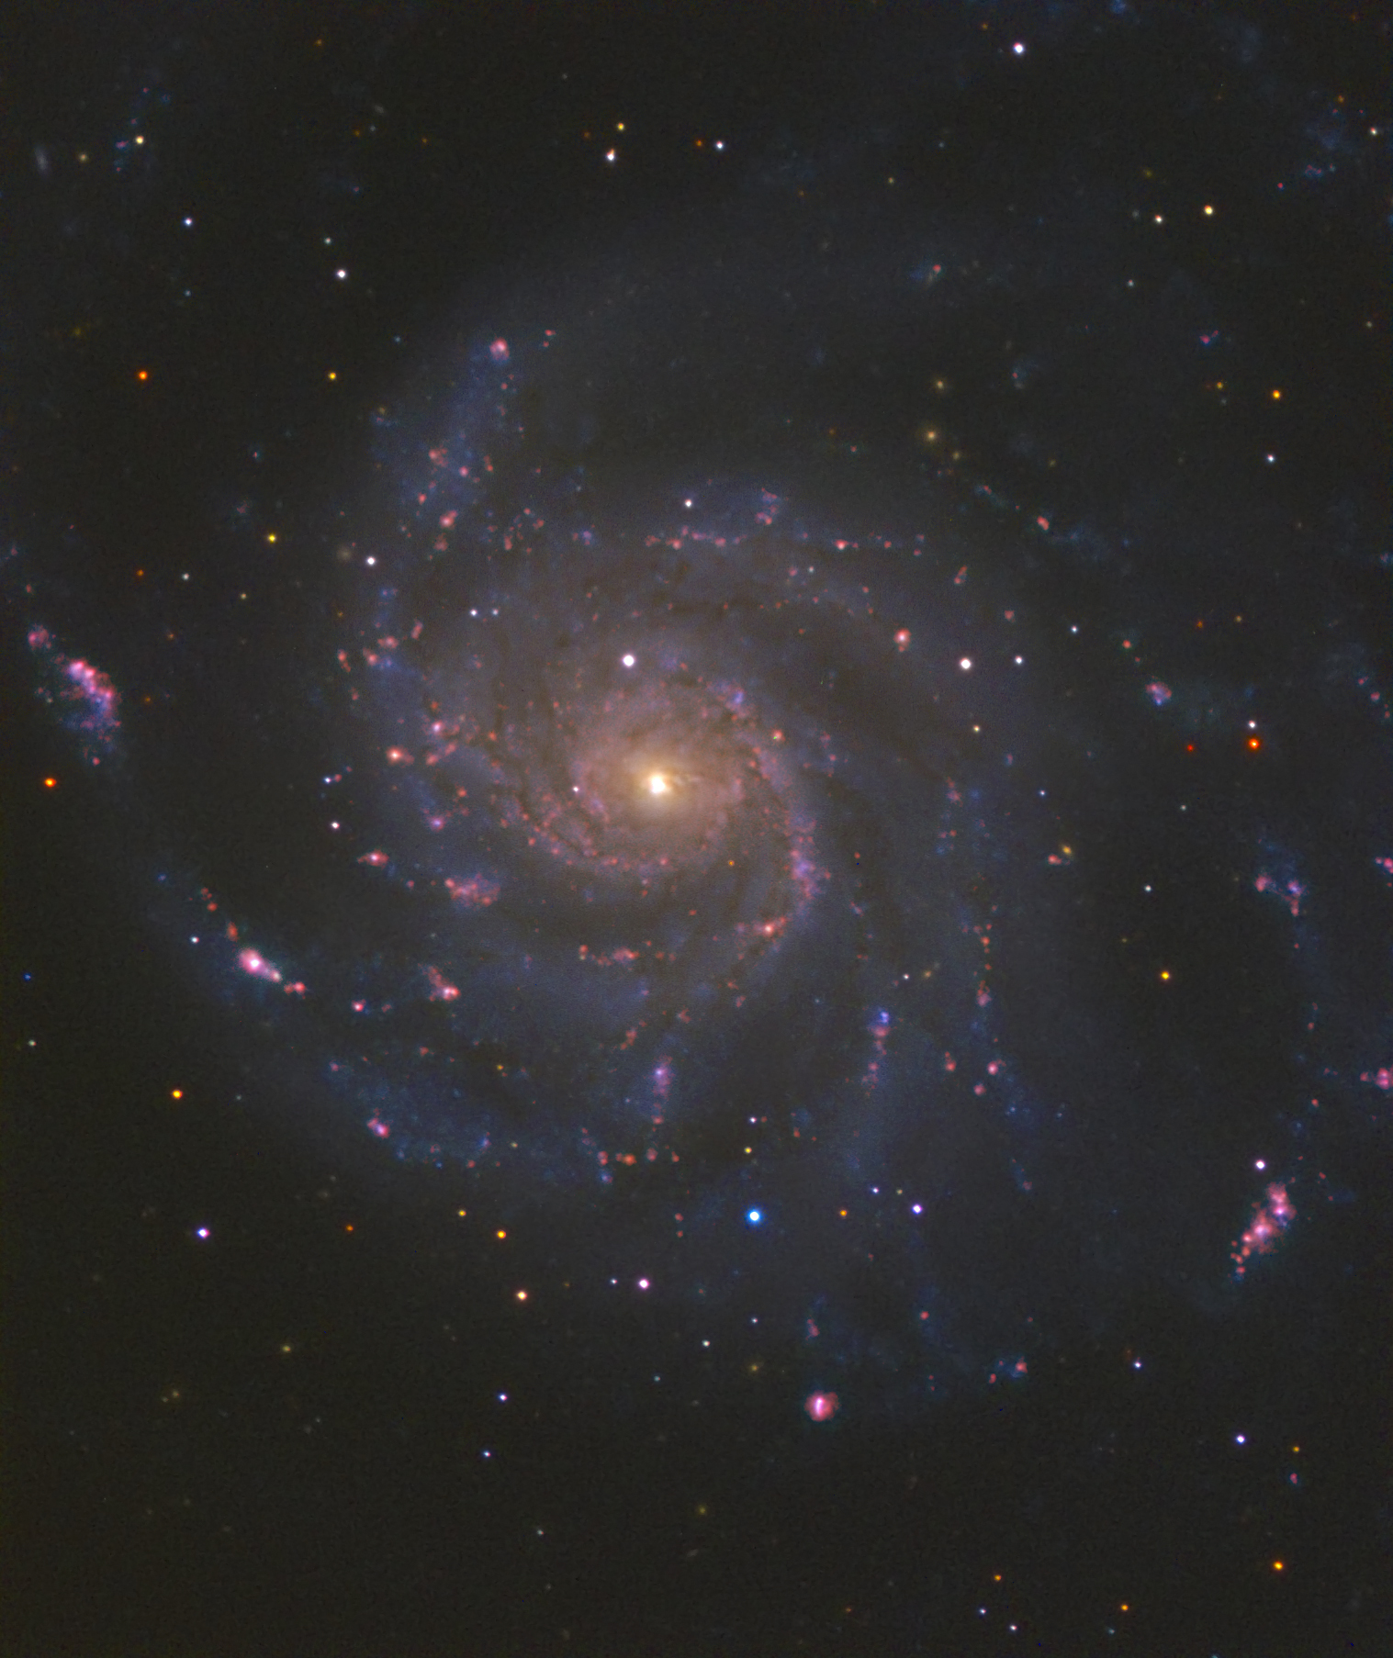
PTF11kly: Nearest, youngest Ia

Slide 30
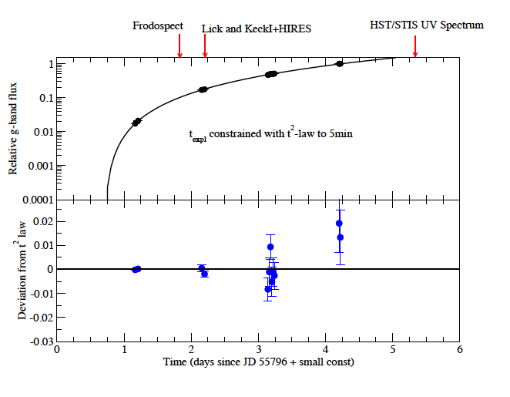
PTF11kly: Young!
R

Slide 31
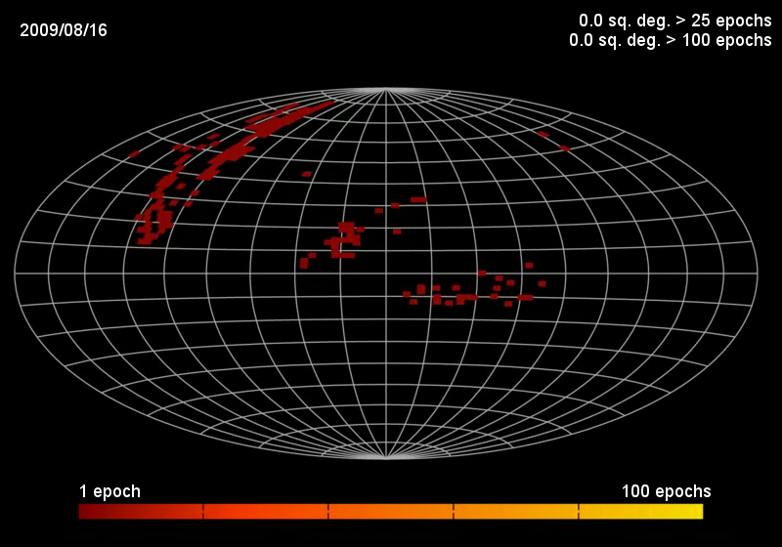

Slide 32
What next?
S. R. Kulkarni

Slide 33
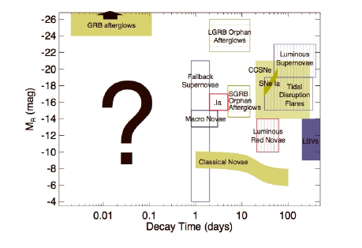
Short timescale is terra incognito

Slide 34


Slide 35

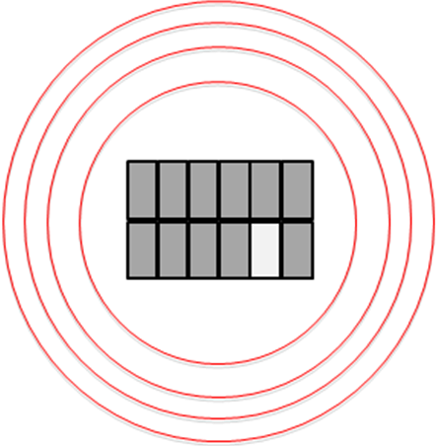
A 40-square degree imager
(PTF-2)
PTF
Palomar Sky Survey Photographic Plate

Slide 36
I. Transient Classification

Slide 37
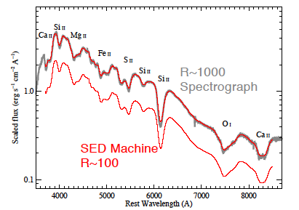
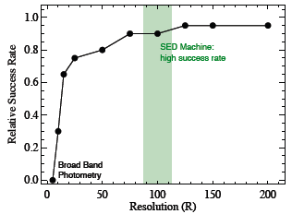
Low Resolution is adequate for typing

Slide 38
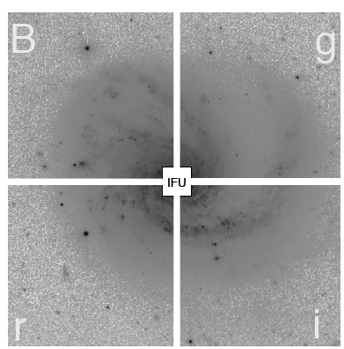
The SED Machine
45 arcsec
7 arcminute
PI: Nick Konidaris, PS: Robert Quimby
In collaboration with NCU-Taiwan

Slide 39
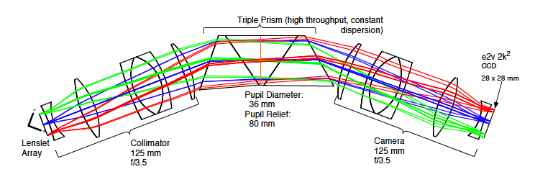
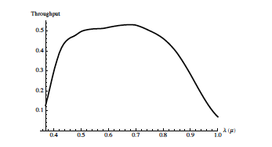
High Throughput

Slide 40
II. Photometric Engine

Slide 41
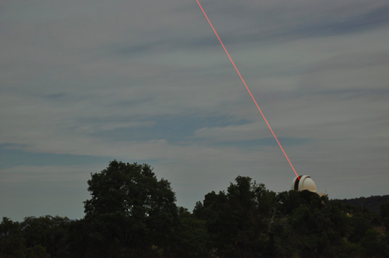
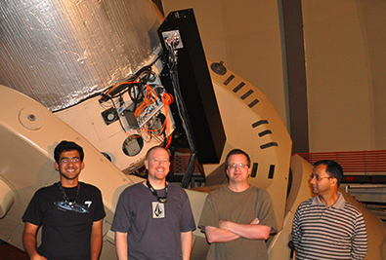

(AO+)Photometric Machine

Slide 42
III.A Dedicated UV satellite
(Less is More)

Slide 43
Dedicated UV minisatellite
A 20-cm UV satellite dedicated to follow up NGTF events
  Shock breakout
  Distinguish thermal vs non-thermal
  Further discrimination within SN class
  Diagnostics for Galactic sources (CV, IP)

Slide 44
Short timescale is terra incognito

Slide 45
Food for some thought

Slide 46
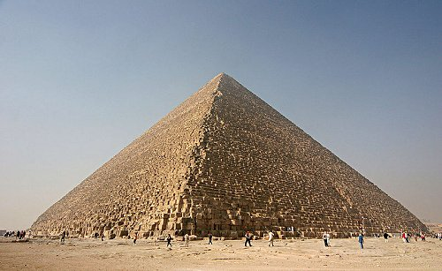
Ancient (Impressive)

Slide 47
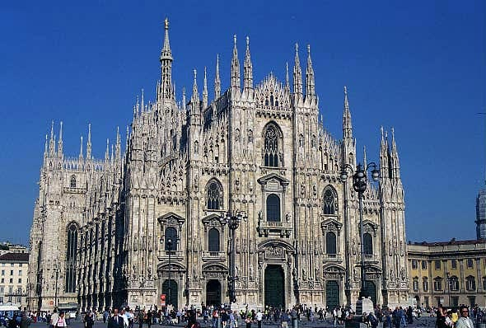
Cathedrals

Slide 48
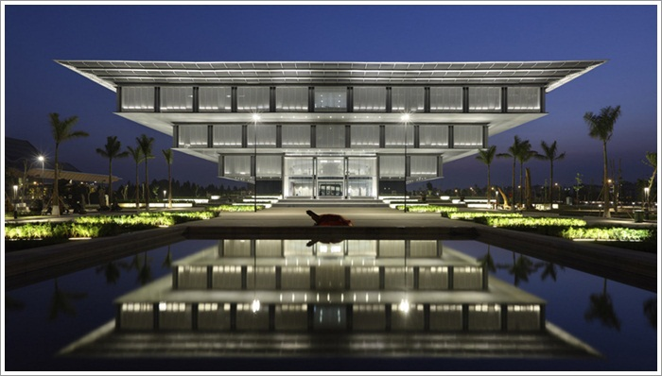
Inverted (Pretty)

Slide 49
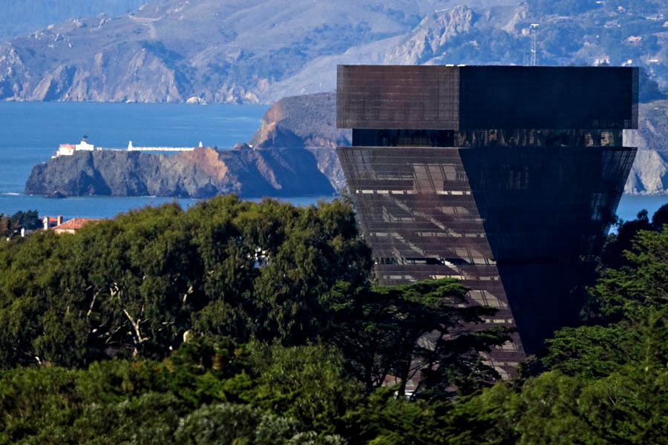
Inverted (Exciting)

