Slide 1
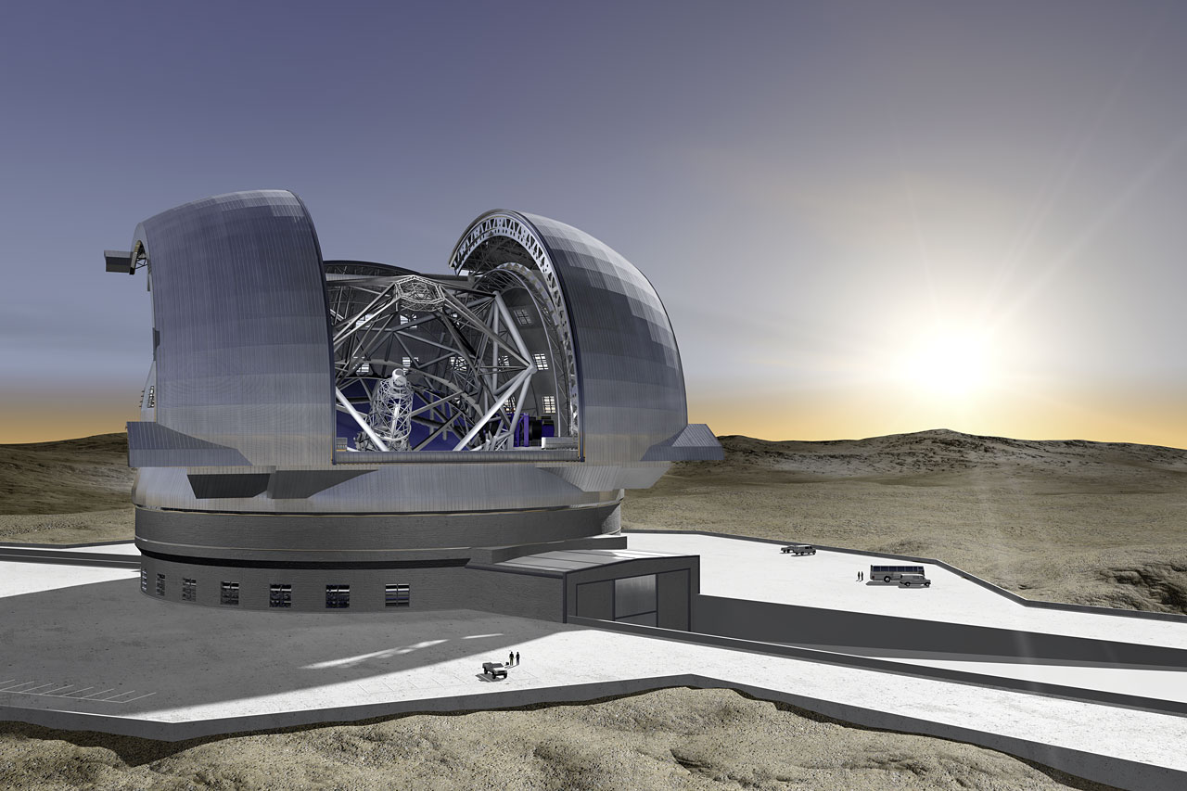




Exoplanets, ELTs
nd surveys
Anne-Marie Lagrange
Institut de Planétologie et d’Astrophysique de Grenoble, France
Thanks to:
J.L. Beuzit, A. Boccaletti, A. Cassain, C. Catala, F. Clarke, R. Davies,
D. Ehrenreich, R. Gratton, L. Pasquini, D. Queloz, N. Thatte, C. Verinaud
Feeding the Giants August 30th, 2011
Anne-Marie Lagrange
Institut de Planétologie et d’Astrophysique de Grenoble, France
Notes:
1
1
1
1
1

Slide 2
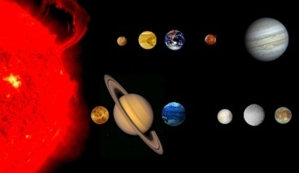
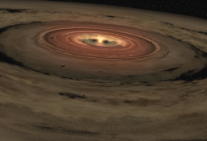
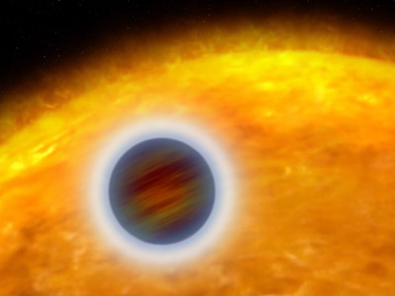
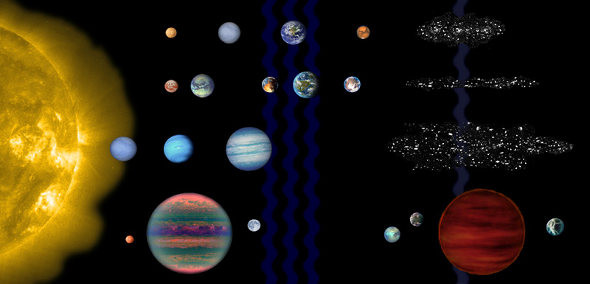
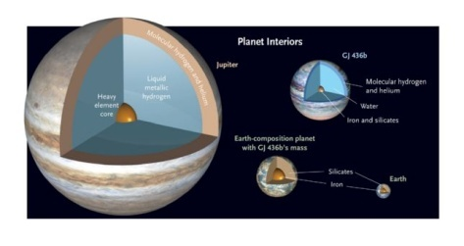
Objectives
  Understand how planet form and evolve: from disks to structured systems
  Explore the diversity of planetary systems (architectures, planet properties)
  Identify planets suitable for life

Slide 3
Neptune-like (NLP)
Super Earths (SE)
Earth twins
Observational exoplanet science is survey science,
and require complementary techniques

Slide 4
Characterizing exoplanets requires different techniques
Planet characteristics | Methods
Mass | RV (min. mass),RV+transits, astrometry
 | imaging (thermal em)+models
Radius | transit phot., imaging(refl)+models
Density,int. struct. | transit phot.
Orbital elements | RV, transit phot., astrom., imaging
Temperature | transit spectro., imaging/spectro
Atmosphere comp. | transit spectro., imaging+spectro
Albedo | transit spectro., imaging, polarimetry
Energy redist. | transit spectro.
Evaporation | transit spectro.
Context | Methods
Architecture, mult. | RV, transit phot. (inc. TTV), imaging,astrometry
Origine | imaging, spectroscopy, polarimetry
 | young disks, transition disks, debris disks
Parent star properties | spectroscopy, imaging
mass,metallicity,mult.

Slide 5
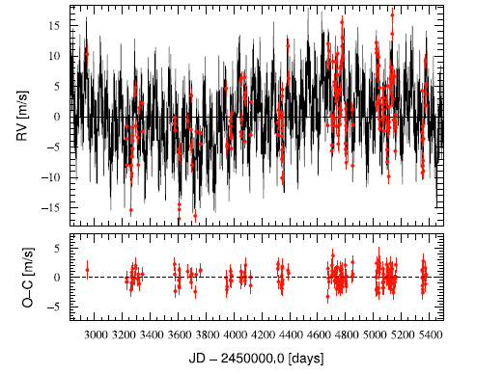
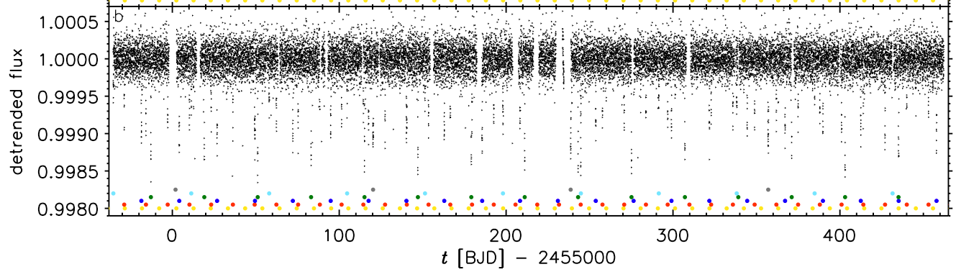
Multiple systems are frequent
Kepler 11
6 planets with 2.3-13ME
TTV
(Lisssauer et al, 2011)
HD10180 multiple (7) system
5 NEP + 1EGP + 1 SEP
(1.4ME)?
Sigma(o-c) 6.5 => 1.3 m/s
(Lovis et al, 2011)
May be even more frequent
(Anglada-Escude et al, 2010; Garcia Melendo et al, 2011; Wright et al, 2011)

Slide 6
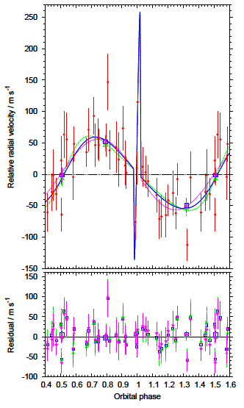
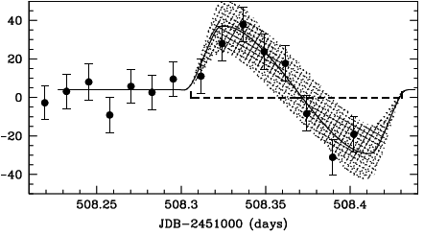
Orbital elements
Rossiter effect during transits
Residuals (m/s)
HD209458
(Queloz et al, 2000)
Complex dynamical history
Also high eccentricities
Wasp17
(Andersen et al, 2010)

Slide 7
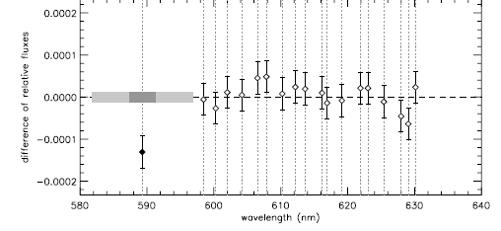
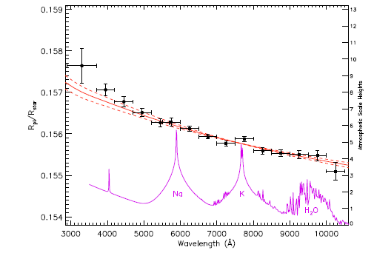
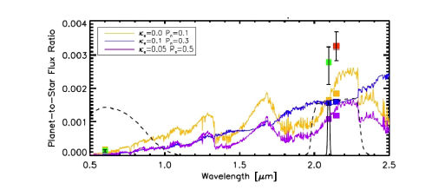
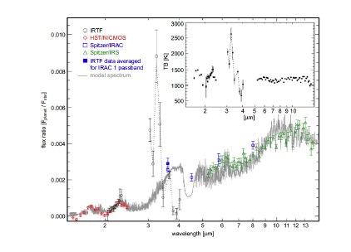
Atmosphere of hot Jupiters
Atomic (NaI, KI, ) and molecular (H20,CO CH4) species; hazes
HD209458 NaI HST (Charbonneau et al, 2002)
HD187933 transm. spectrum HST (Sing et al, 2011)
Corot 1b emission spectrum
(Rodgers et al, 2009)

Slide 8
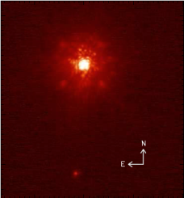
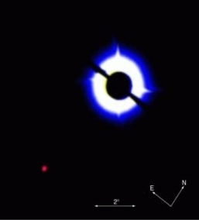
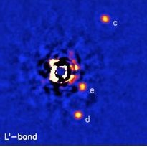
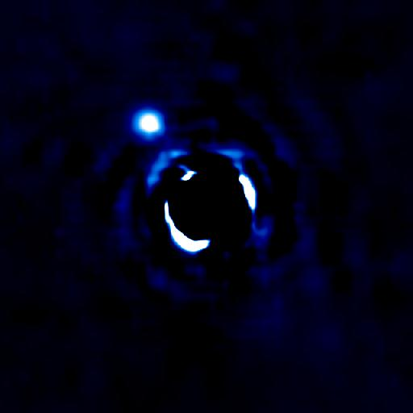
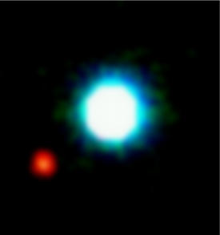
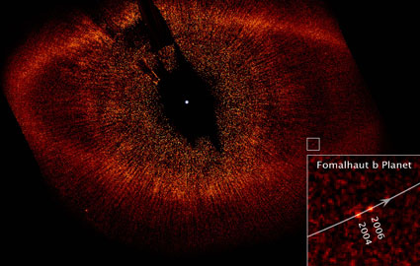
Tahlmann et al. (2009)
Ireland et al.
(2011)
Neuhauser et al. (2005; 2008)
Chauvin et al. (2005a)
1 5 13 Mjup
2003
Marois et al. (2008)
Lafrenière et al.
(2008;2010)
Todorov et al. (2010)
Chauvin et al. (2004;2005)
Kalas et al. (2008)
10-20 AU 20-60 AU 100-350 AU
Notes:
8
8
8
8

Slide 9
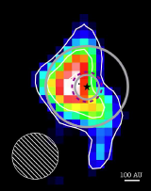
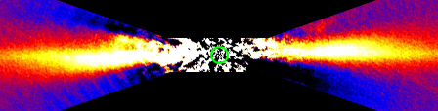
Planets and debris disks
A PsA HST (Kalas et al, 2008)
HR8799 CSO
(Patience et al, 2011)
B pic NaCO (Lagrange et al, 2011)
Lot’s of young/transitional/debris disks : IRAS, Spitzer, Herschel, etc

Slide 10
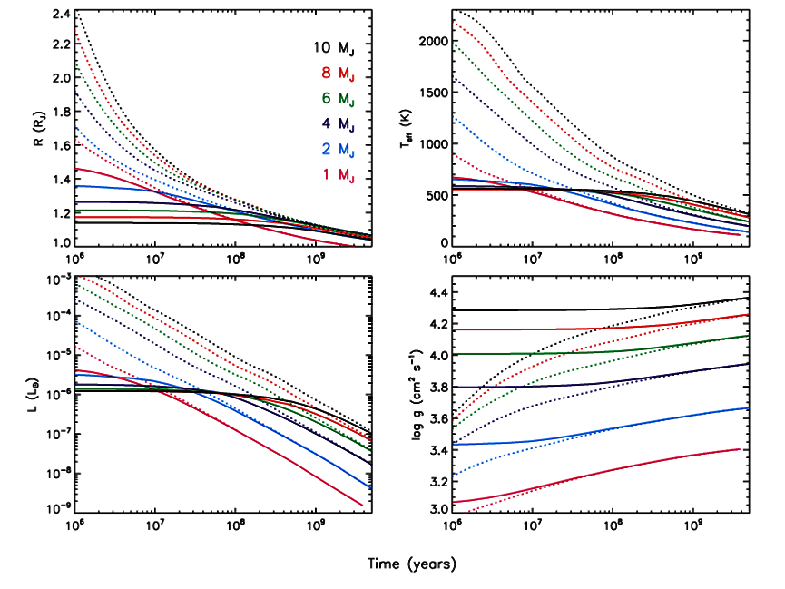
Impact of formation model
(Fortney et al, 2008))
Large uncertainties on the mass of imaged planets
Need for dynamical masses: ex β Pic b Harps upper mass (Lagrange et al, 2011)

Slide 11
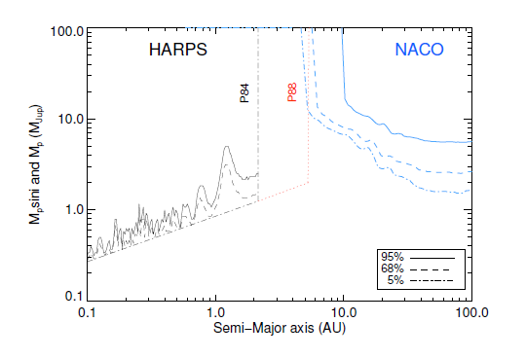
Complementarity imaging/RV solar-type, young stars

Slide 12


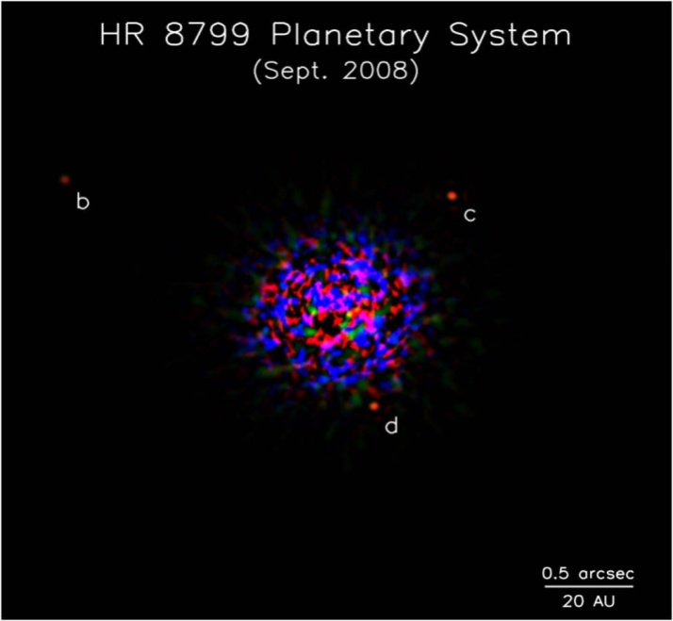
ABPic b (~13MJup; 250AU)
Chauvin et al. (2005a)
2M1207B (~5-8MJup; 50AU)
Chauvin et al. (2004;2005)
Fomalhautb (<3MJup; 115AU)
Kalas et al. (2008)
HR8799 bcd (~7-10MJup; 24,38,64AU)
Marois et al. (2008)
Notes:
12
12
12

Slide 13
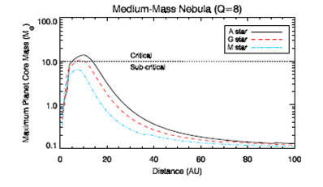
Dodson-Robinson et al, (2008); see also Kennedy & Kenyon (2008)
Formation mechanisms

Slide 14
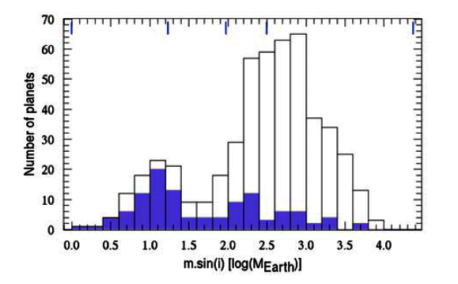
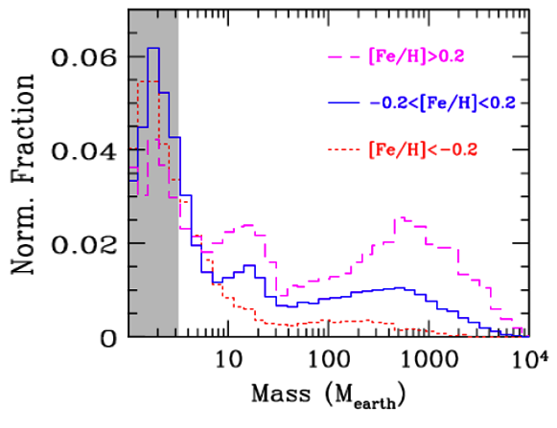
Planet properties and formation mechanisms
RV detections support CA model (mass, metallicity)
(Mayor et al, 2011) (Mordasini et al ,2009)

Slide 15
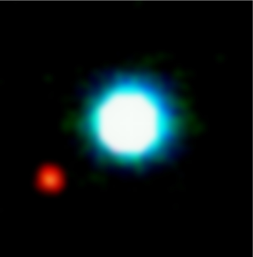
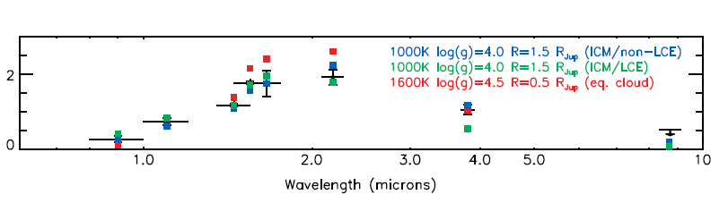

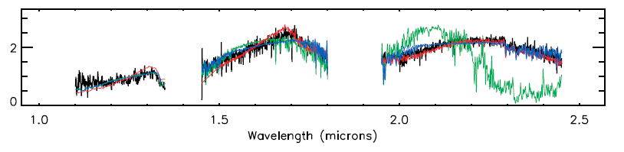
Spectrophotometry and spectroscopy
of young EGPs
2Mass1207
(Barman et al, 2011)
Atmospheric model: degeneracy: (Teff, gravity, R, age, metallicity, clouds)

Slide 16
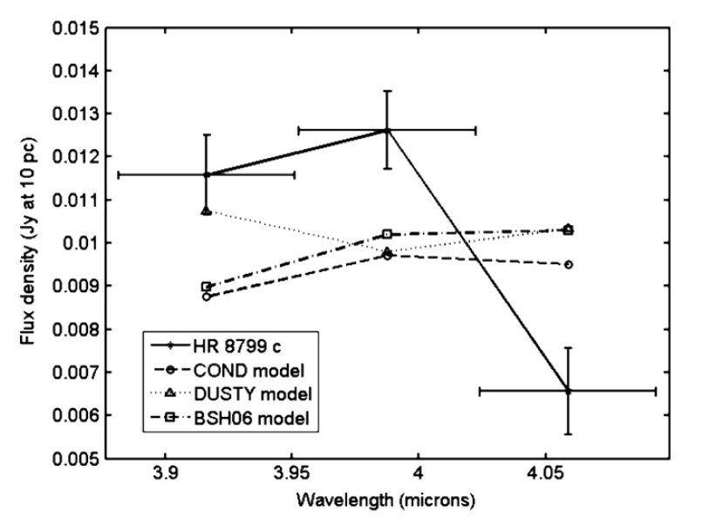
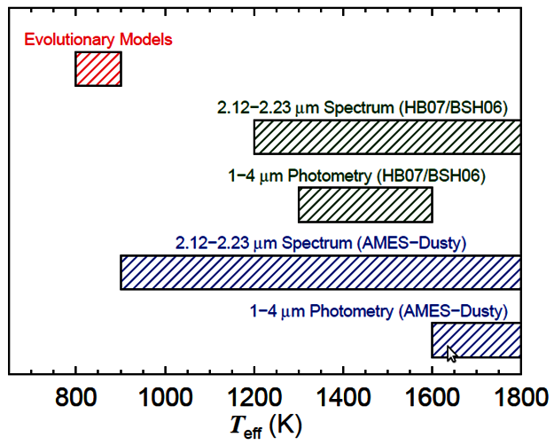
HR8799 c
(Janson et al, 2010)
Teff estimates for HR8799b,
from Bowler et al 2010

Slide 17
Current detections
Colonne1 | N | a | Mp | e | M* | d* | age*
 | (M>14MJ) | (AU) | (MJup) |  | (Msun) | (pc)
RV | 511 | 0.45 | 1.1 | 0.13 | 1.04 | 51 | MS
RV wo transits | 360 | 1.1 | 1.2 | 0.19 | 1.05 | 39 | MS
transits | 144 | 0.04 | 0.9 | 0.0 | 1.04 | 255 | MS
imaging | 11 | 115 | 9. |  | 1.5 | 39 | young
micro-lensing | 13 | 2.3 | 0.2 | (0.15) | 0.49 | 5200 | MS/old
chrono | 132 | 3.6 | 5.2 | 0.02 | 0.84 | 500 | old
Steps for the next 10-15 yrs
Complete population of EGPs at all masses and separations
Insights in exoplanets phys. & chem. properties: internal structures & atmospheric composition
Evidence for planets in the HZ (for later search for life signatures)

Slide 18
Survey projects 2020 that will feed the giants
 | Horizon | Method | Ntargets | Masses | Sep/Per. | Distance range | Age | Constrains
HARPS S, N | Today | RV | thousands | EGP, NLP,SE | 15 yrs? | < 100 pc | Gyr | star activity
VLT/ESPRESSO | 2014? | RV | a few hundreds? | NLP,SE | 15 yrs? | < 100pc | Gyr | star activity
CFHT/SPIROU | 2014 | RV (IR) | 800 | NLP,SE,E | 7 yrs | <100pc | Gyr | star activity
PRIMA | 2012 | A | a few hundreds |  |  | < 100pc | all | ref star
GAIA | 2013 (L) | A | 150000+ | NLP,SE,E | 1-4 AU | < 200pc | all
SWASP,Mearth, etc | today | TP | thousands | EGP,NLP,SE |  |  |  | star activity
Kepler/Corot | Today | TP | 10000 | EGP,NLP,SE | 3.5yr | > 200pc | all | star activity
PLATO (tbc) | 2018 (L) | TP | 245000 | EGP,NLP,SE |  | <100-a few100 | all | star activity
ECHO (tbc) | 2018 (L) | TS
SPHERE,GPI | 2012 | I,S | ~1500 | EGP,NLP | 2-200+AU | < 200 pc | <500Myr | bright stars, AK
JWST | 2018 (L) | I,S | 100? | EGP,NLP | id | id | id | less constrained
Detecting planets is more a matter of precision (RV, astrom. Contrast) than sensitivity
Spectroscopy may require sensitivity

Slide 19
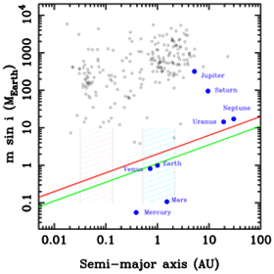
Accurate RV: VLT/Espresso (2016)
- RV precision : <10cm/s
1-4UT
natural and significant improvement wrt Harps
large amounts of obs. time
Will feed ELT/Codex, EPICs
2K=10cm/s
1Msun
2K=40cm/s
0.2 Msun
(from Pasquini et al, 2010)

Slide 20
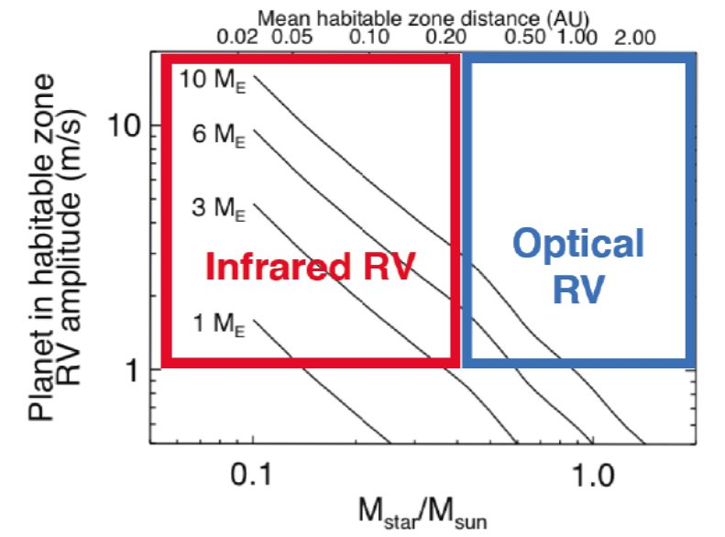
Accurate RV at near-IR
CFHT/SPIROU (2014)
- 0.98-2.4 microns
Precision < 1m/s
SN=150 (1hr) H=11
Late type stars
  Smaller jitter
  Larger K
  HZ closer
800 M stars, 25 visits
=> 80 planets < 20ME

Slide 21
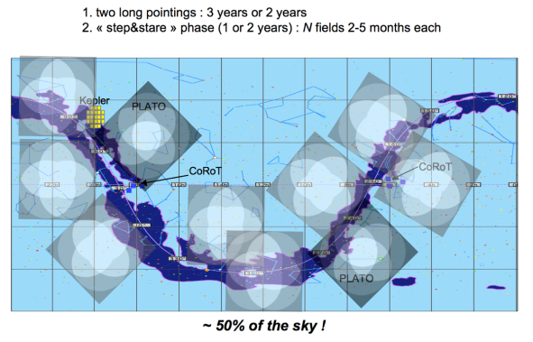
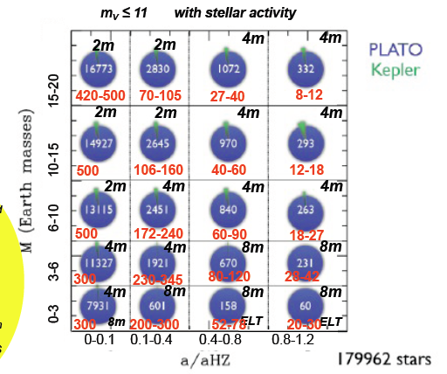
PLATO (L 2018)
- cool dwarfs/subgiant> F5, V<13: 250000+
- V<8: 3000+
- V<11: 20000+
larger overlap with RV surveys
Need for RV follow-up
Sources for ELT Codex, EPICs
(Udry, 2010; courtesy C Catala)

Slide 22

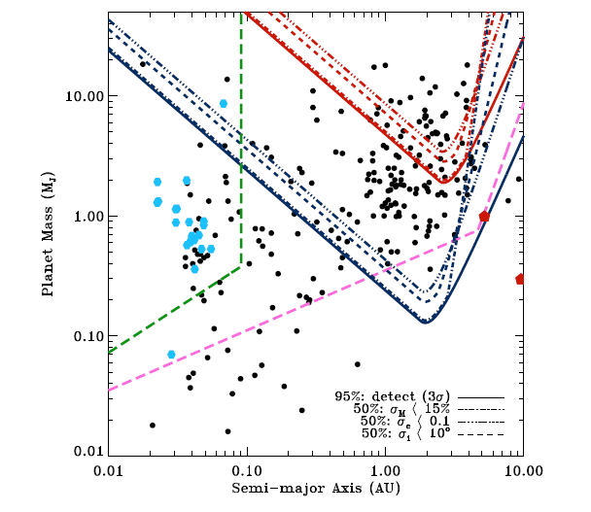
- Astrometric survey:
- ~150,000 FGK stars to ~200 pc
- complete for FGKM stars d<25 pc
- accuracy : 7 (V=10) – 25 (V=15) μas
(Hipparcos: 1mas)
- Photometric survey:
- precision 10e-3
GAIA
EGPs by thousands
1Msun
200 pc
- Expected detections:
- thousands of giants detected:
~1000+ exo-planets
~300 multi-planet systems
- orbits for ~1000 systems
- masses down to NLP at 10 pc
- Photometric transits
5 mmag prec
S/N=9
1Rsun
0.5Msun
25 pc
σrv= 3m/s
det 3* σrv
1Msun
10 yr
  (Lattanzi et al, 2010; Sozetti et al, 2010)

Slide 23

GAIA science & synergies
  Science
  - Statistical properties of EGPs at 1-4 AU (direct masses)
  - Dependance on star (mass, age) => formation/evolution models
  - Test of brightness-mass models
  - Study of multiple systems=> dynamical interactions
  Synergies
    Imagers: SPHERE (young stars), EPICs
  - targets (mass, orbit) for imaging/spectral characterization
  - negative detections for V>6
    RV: Harps, Espresso, Codex
  - mass measurement of EGP in the 1-4 AU region (overlap V>6)
  - targets for orbital refinement or search for longer period GPs
  - information on outer GP pop. in systems surveyed for lighter RV planets
  (also PLATO)

Slide 24
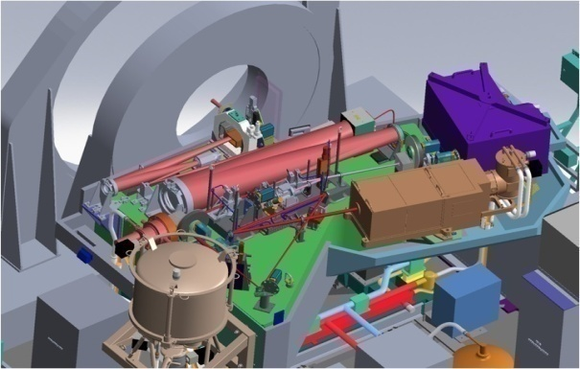
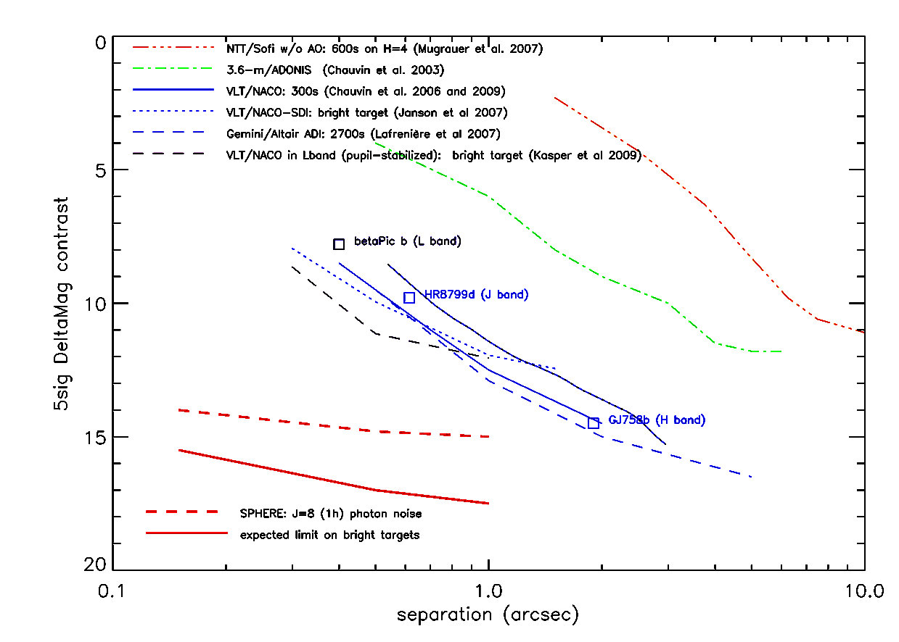
Imaging
VLT/Sphere (2012)
IRDIS
0.95 – 2.32 μm
11’’ FoV
Imaging BB, NB
Spectro (R~ 50/400)
ZIMPOL
0.5 – 0.9 μm
FoV 3.5’’
Imaging BB, NB
=> first reflected light planet ?
IFS
0.95 – 1.35/1.65 μm
FoV 1.77’’
R~30;50
Lagrange et al 09, 10
(Beuzit et al)

Slide 25
Complementarity sphere/RV solar-type, young stars
Sphere IRDIS

Slide 26
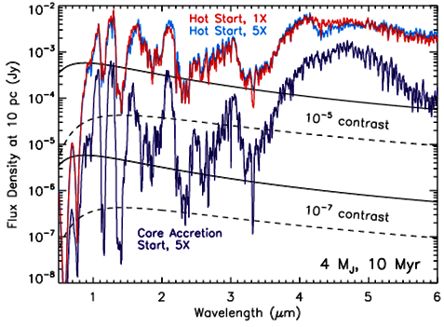
G
G-type
M-type
(Fortney et al, 2008)

Slide 27
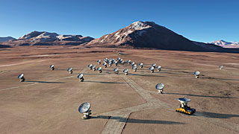
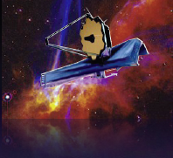
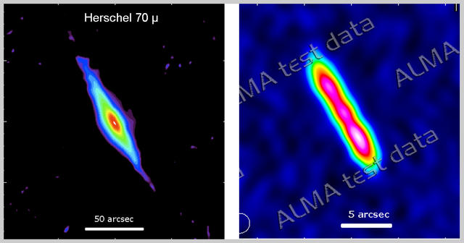
Complementary facilities
- ALMA (Disk science)
- Spatial resolution: 0.02’’
- Signpost of planets
    Giants (gaps)
    Earth-mass (Raymond et al, 2011)
JWST
  Planet detection
  Planet characterization: transit spectra + direct spectra

Slide 28
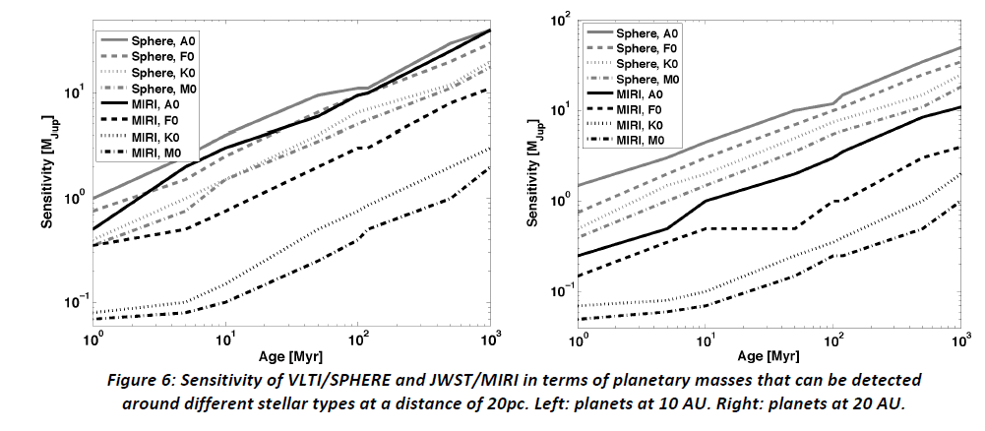
Planet detection with JWST/MIRI
  Sep=10AU
  Sep=20AU
Sphere more sensitive at short separations < 0.5’’
Niche for MIRI: M stars
  (Rouan, Boccaletti)

Slide 29
ELT and exoplanets
Closer, lighter, and fainter
Planet detection
- indirect: low mass planets, down to, in HZ
- direct: GPs,Neptunes
Planet characterization
- transit spectroscopy
- direct spectroscopy
Instruments
- MICADO, SIMPLE, HARMONI, METIS
- Codex, EPICS

Slide 30
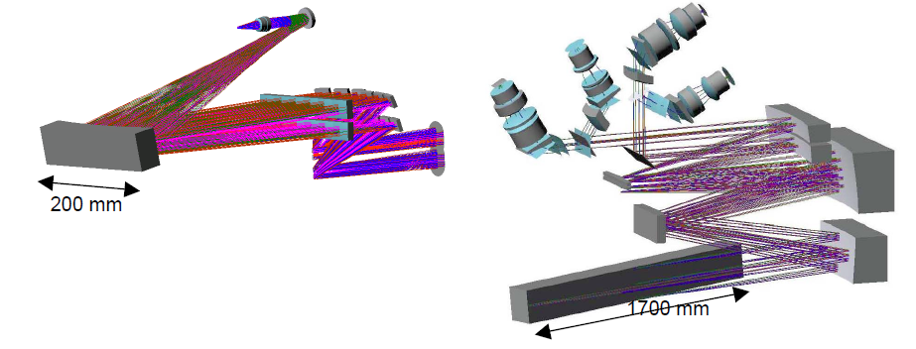
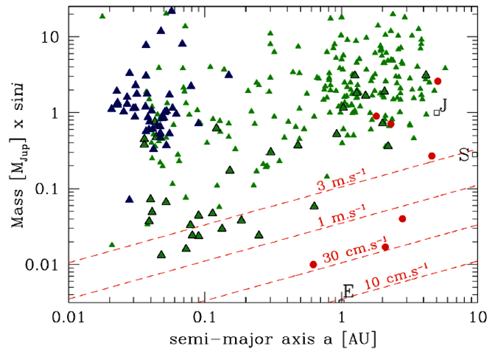
ELT/Codex
  Codex on the ELT: 2cm/s over 30 years
  Main goals:
  - measurement of the acceleration expansion of the Universe
  - Earth twins in the HZ of solar-type stars
G-type star
σ~1m/s
σ~0.3m/s
σ~10cm/s
σ~3cm/s
  (Pasquini et al, 2010)

Slide 31
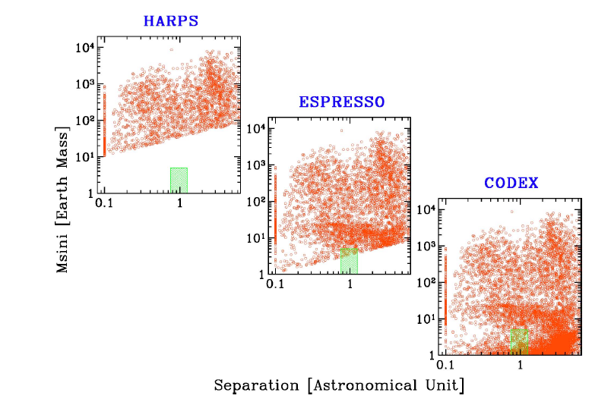
ELTs and exoplanets
Extremely accurate radial velocity
(1m/s)
(10cm/s)
(1cm/s)
  (Pasquini et al, 2010)

Slide 32
Earth-mass exoplanets with RV
Challenges
  Technological:
    high RV accuracy & long term stability
    absolute reproducible wavelength calib=> LFC
    - mechanical & thermal stability (1-10mK)
  Astrophysical:
    external astrophysical sources of RV errors (BERV, coordinates, time: 1cm/s = 0.6sec)
    stellar activity at low level: various origines, associated with various timescales (from mn to decade)
    multiple systems
    Key issue for light planet detection: target selection, observing strategy, observing time available

Slide 33
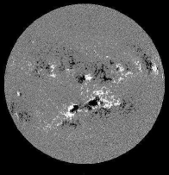
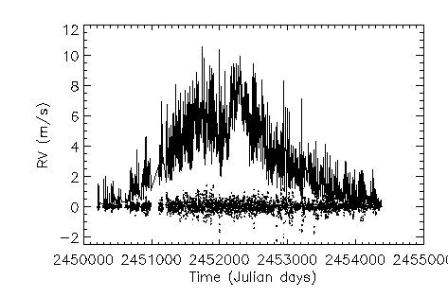
Spots, plages/network & convection
planet detection
expected period
rms=2.5 m/s
1M_{E} planet at 1.2AU
whole cycle
daily monitoring
no noise
(Lagrange et al, 2010; Meunier et al, 2010)

Slide 34

Spots, plages/network & convection
planet detection
convection
wo convection
Sampling (d); 11 years

Slide 35


Fighting stellar activity
- Target selection:
- stars with low levels of activity
- towards late-type stars
(=> prep. surveys: RV, phot.)
Correction: how? how far?
  simultaneous photometry : spots+plages ; timescales Prot (Lanza et al, 2011)
  activity indicators : convection, long term (cycle) (Dumusque et al, 2011b; Lovis et al, 2011) ; how far? timescales?
- In any case, observing strategy important
(Dumusque et al, 2011a)
(Dumusque et al, 2011b)

Slide 36


ELT/EPICs
Exoplanet imaging
Contrast: 10⁻⁹ @ 0.1’’
Sphere instruments (IFS and Polar.) scaled to the ELT
Young (<500Myr)/ near-be (<20d)
Full census of EGP
  Snowline and >
  Compl. GAIA
Detection and spec. of NLP
Detection of a few rocky planets
Sphere
EPICs
(Gratton et al, 2010)
Notes:
impro

Slide 37
Predicted EPICS detections
Target class | # targets | Self-luminous planets | Giant planets | Neptunes | Rocky planets
1. Young stars | 688 | ~100 | (~100) | Dozens | Very few (?)
2. Nearby stars | 512 | Dozen | ~100 | Dozens | Dozen
3. Stars w. planets | >100 | Some | >100 | >Dozen | >2
(Gratton et al, 2010)
See also poster on impact of telescope size

Slide 38

ELT/HARMONI
All ages
< 20 pc
< 500 Myr
< 100 pc

Slide 39
Exoplanets Imaging/spectroscopy
Challenges
- Technological challenges:
- extreme AO
- global stability; error budget
- data extraction with differential/spectral modes
- Astrophysical challenges:
- brightness-mass relations (thermal); reflected planets: need for RV/astrom.
- spectral information:
Earth atmospheric contribution
complexity and diversity of atmospheric composition; impact of star properties (ST, activity, winds), degeneracies, clouds, etc
planet temporal variability

Slide 40

Earth atmosphere (variable)
Advantage for imaging

Slide 41

Planets atmopshere diversity
Reflected flux fractional polarization (p =90)
Earth-like planet
(STAM et al, 2008)_

Slide 42




Planets and temporal variability
Currus, alta-stratus; strato-cumulus
(Tinetti et al, 2007)

Slide 43

Synergies
  SPHERE GPI: confirmation of faint cand., spectral charact.
  Espresso, Codex, GAIA: direct imaging & charact. of identified planets
  PLATO: charac. of identified planets
  ALMA: detection of planets in disks with gaps
  JWST: complementary, mid-IR spectroscopy
GAIA
RV studies
PLATO
(Gratton et al, 2010)

