Slide 1


Feeding a Giant: MANIFEST at GMT
A fiber-based spectrographic survey enabler
Feasibility Study (June 2011)
Feeding The Giants, Ischia, August 2011
/17

Slide 2
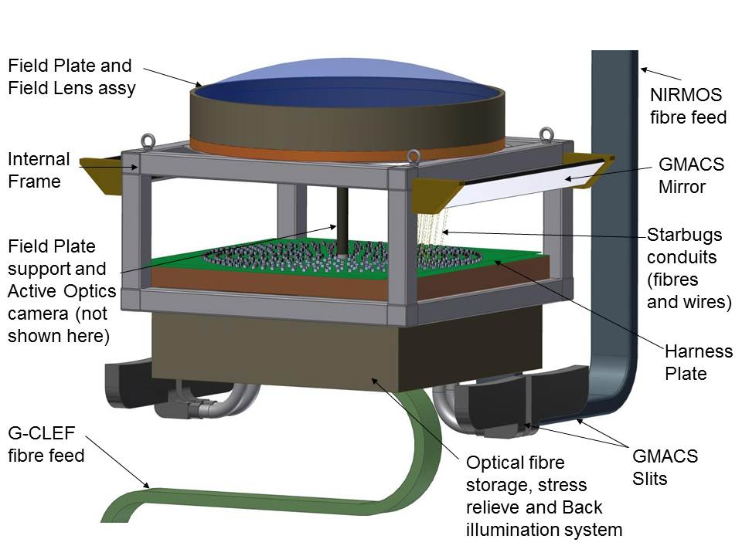
MANy Instrument FibEr SysTem
Sending/Reformatting to instruments slit (multi-object spectrometers GMACS, NIRMOS & G-CLEF)
Picking many science targets in a wide field (> 500 objects in 20’ field)
INTERNAL FRAME
Feeding The Giants, Ischia, August 2011
/17

Slide 3
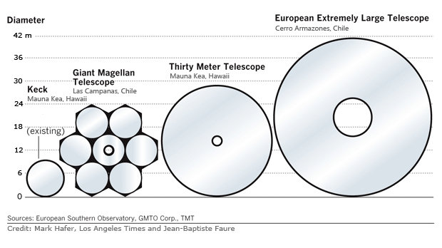
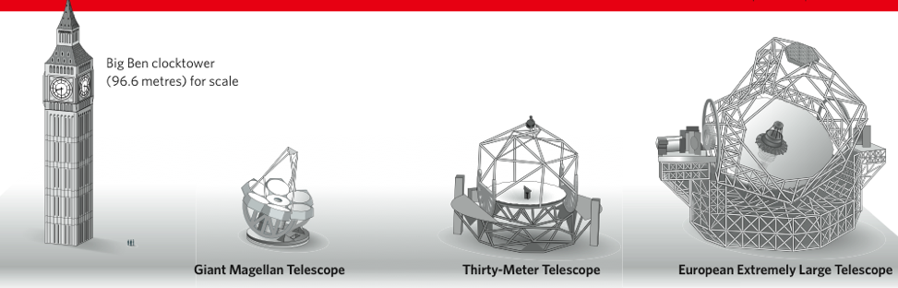
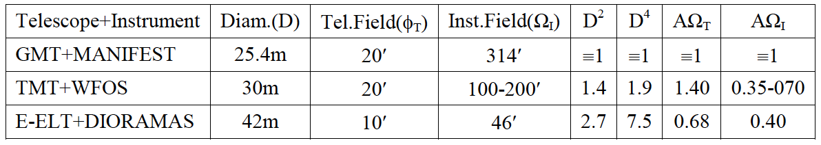
GMT versus TMT & E-ELT
GMT loses by up to 9: on D² and D⁴ science
GMT wins by 1.4 x to 3.0x on AΩ_{I} science
MANIFEST set to fully exploit GMT AΩ advantage (in particular for LSST follow-up)
Feeding The Giants, Ischia, August 2011
/17

Slide 4
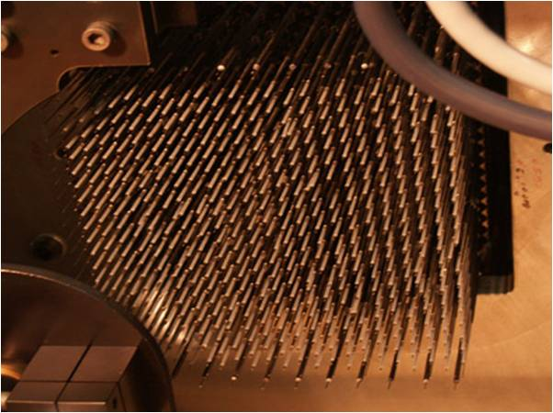
Fiber Positioning Zoo
Pick & place gripper (AAT, VLT)
Flexing (FMOS) / moving (WFMOS) spines
Autonomous walking Starbugs (GMT-proposed)
Echidna
Feeding The Giants, Ischia, August 2011
/17

Slide 5

Starbugs at work
Feeding The Giants, Ischia, August 2011
/17

Slide 6
Fiber Approach Pros … with limitations
‘unlimited’ Field of View  1-m⁺
large probe number  1000⁺
‘dense’ focal plane filling  ~ 10 mm pitch
on-line reconfiguration ~ a few minutes
perfect positioning (closed-loop metrology)
‘easy’ object to slit reformatting
Feeding The Giants, Ischia, August 2011
/17

Slide 7
Fiber Approach Cons … with mitigations
Detector Real-Estate Waste
Sky Background Removal
Transmission Losses
Feeding The Giants, Ischia, August 2011
/17

Slide 8
Detector real-estate waste
Optimal extraction (3 adjacent fibers)
M star
low-z quasar
blank sky
AAΩ spectra 2.4 px FWHM 4 px pitch
60% filling factor with << 1% cross-talk
Sharp & Birchall 2010, PASA 27, 91
Feeding The Giants, Ischia, August 2011
/17

Slide 9
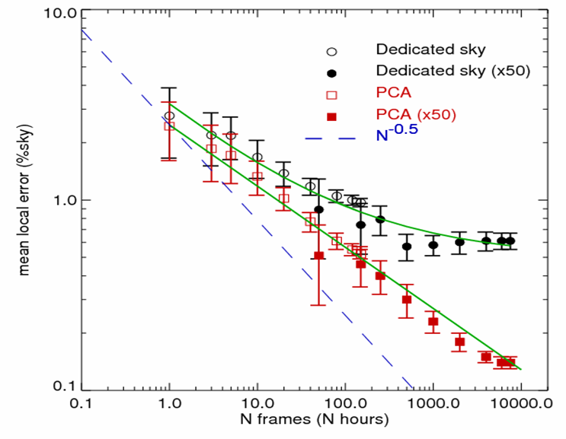
Sky Background Removal
extensive development using AAT/2dF/AA Ω survey data
A crucial need for nearly all (fiber-based) spectrometers
 done with PCA applied first to < 12.5% sky fibers
 photon-noise limited up to T ~ 4 hr. (1.8% precision)
Sharp & Parkinson 2010, MNRAS 408, 2495
 N&S better for T > 150 hr. (better than 0.45% precision)
Similar objects (GC, Stars, Moon) require 25% sky fibers  ICA on sky fibers to reduce overhead (in progress)
Near-IR sky removal much harder; 1% precision ‘proven’  Optimum-EVE, using Davies coherent OH-band algorithm
N^{-0.32}
Sky subtraction accuracy (AAΩ e-line galaxies)
Rodrigues et al. 2010, SPIEE 7735-244
Davies 2007, MNRAS 375, 1099
Or OH-suppression fibers
Feeding The Giants , Ischia, August 2011
/17

Slide 10
Light Transmission Losses
A significant hit, quite hard to reduce
 partially offset by better efficiency at field edge
 partially offset by better ‘slit’ efficiency in seeing-limited case
considered in trade-off with much better survey efficiency
Feeding The Giants, Ischia, August 2011
/17

Slide 11
Survey speed gains
Targets with surface density σ over sky area A observed at fixed S/N  survey speed ~ ε.[Ω/A].[M/σΩ] (ε=efficiency, Ω=FoV, M=multiplex)
Limiting cases...
Field-limited if M>σΩ: speed ~ ε.Ω/A ~ ε.Ω
Multiplex-limited if M<<σΩ: speed ~ ε.M/(A.σ) ~ ε.M
MANIFEST survey field: 20’ (GMACS) & 17.5’ (NIRMOS)
If MANIFEST is about throughput-neutral:
GMACS: ~2× gain for both field-limited and multiplex-limited
NIRMOS: ~4× for field-limited, ~2× gain for multiplex-limited
G-CLEF: ~43× gain for multi-orders, ~4× gain for all orders
Feeding The Giants, Ischia, August 2011
/17

Slide 12
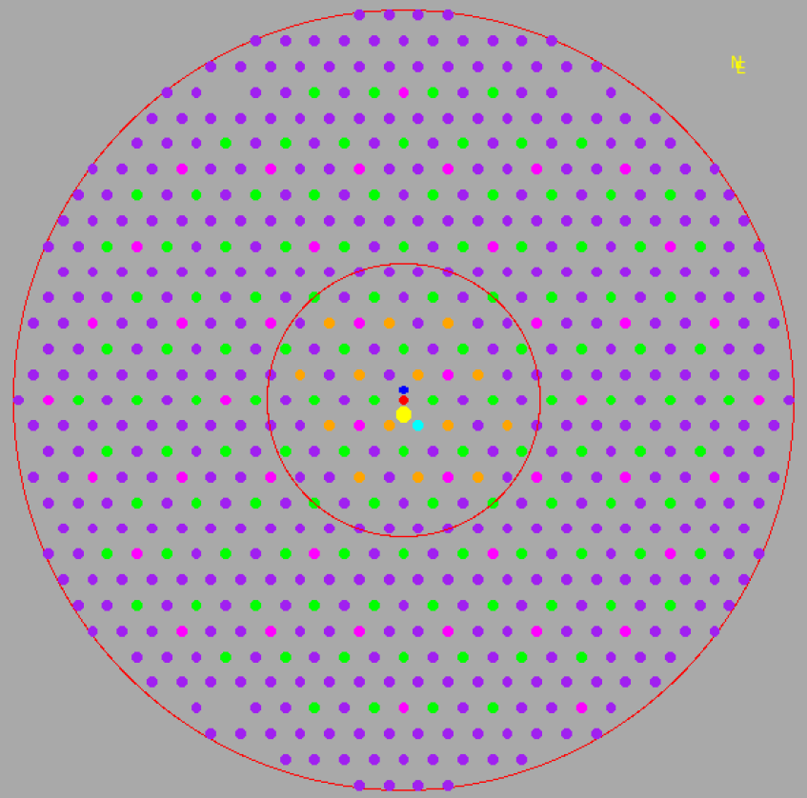
MANIFEST Science Cases
566 Starbugs
Parking position
Science Case | Probes Format
Period of peak stellar formation | 91 x 1” dia. Starbugs
Massive galaxy assembly / AGNs | 14 x 2.5” dia. Starbugs
Evolution of galaxy clustering | 1 x 8.2” dia. Starbugs
IGM Tomography | 436 x 1” dia. Starbugs
Dark Matter Distribution | 1 x 19” dia. IFU
Reionization & 1st lights | 436 X 1”; 1x 8.2”; 91 x 1”
Local galaxies Archaeology | 40 x 1” dia. Starbugs
Feeding The Giants, Ischia, August 2011
/17

Slide 13
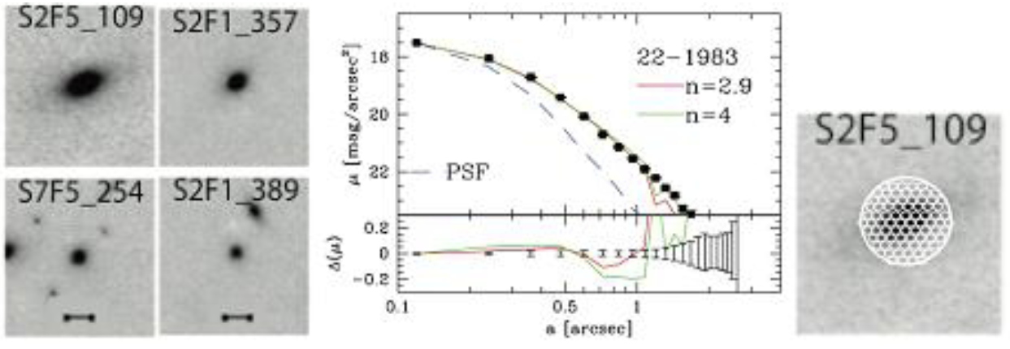
Galaxy mass assembly & physical processes
Spatially resolved spectroscopy (SFR, metallicity & dynamics)
14 x 2” field IFU feeding NIRMOS (1-1.65μm, R ~ 5.10³)  survey of 10³ galaxies in ~ 25 nights
GDDS z~1.5 galaxies
Feeding The Giants, Ischia, August 2011
/17

Slide 14
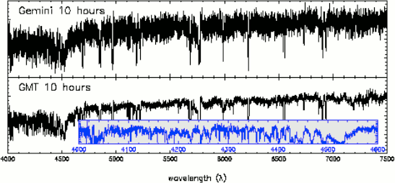
IGM Tomography using Lyman break galaxies
Reconstruct the IGM 3D small-scale structure by densely sampling the Lyα forest over large areas of sky
436 image-slicing IFU feeding GMACS (0.36-0.52μm, R ~ 10⁴)  survey of 4000 LBG over 1 deg² at S/N 10 in 10 nights
Gemini 10hr
Gemini 10hr
Simulated LBG spectrum (z=4) at R=10⁴
GMT 10hr
GMT 10hr
Lyα forest
Feeding The Giants, Ischia, August 2011
/17

Slide 15
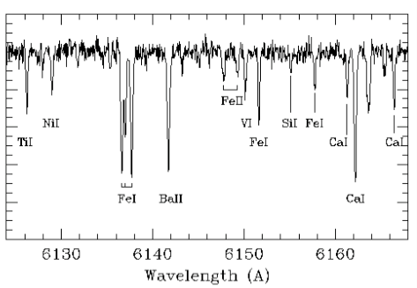
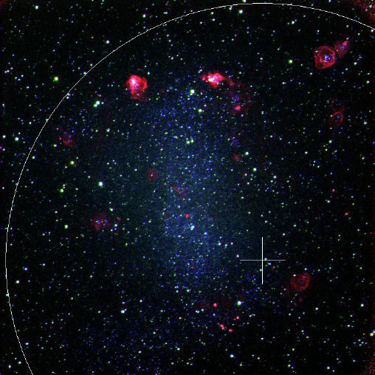
Stellar formation history in Local Group galaxies
Accurate chemical abundances of RGB stars
43 simultaneous spectral chunks with G-CLEF (R ~ 3.10⁴)  100 RGB in 20 LG galaxies at S/N 30 in 30 nights
NGC 6822
HERMES window
Feeding The Giants, Ischia, August 2011
/17

Slide 16
Fiber-fed multi-object spectroscopy is a versatile means of providing a diverse range of capabilities
Conclusions
Fiber-fed multi-object spectroscopy is a versatile means of providing a diverse range of spectroscopic capabilities
MANIFEST allows GMT to benefit from the complementary strengths of both multi-slit and multi-fiber feeds
GMT+MANIFEST will be a powerful tool for a wide variety of seeing-limited and GLAO surveys
HERMES window
Feeding The Giants, Ischia, August 2011
/17

Slide 17
With warm thanks to GMT, the Organizers, the Audience and the MANIFEST Team
Matthew Colless (Principal Investigator)
Guy Monnet (Project Scientist up)
Julia Tims (Project Manager)
Will Saunders (Instrument Scientist)
Andrew Hopkins (Science Analysis)
Michael Goodwin (Instrument Modeling)
Jeroen Heijmans (Mechanical Analysis)
Jurek Brzeski (Mechanical Design)
Tony Farrell (Software Design)
plus various other contributors.
Feeding The Giants, Ischia, August 2011
/17

Slide 18
Feeding The Giants, Ischia, August 2011
/17

