Slide 1
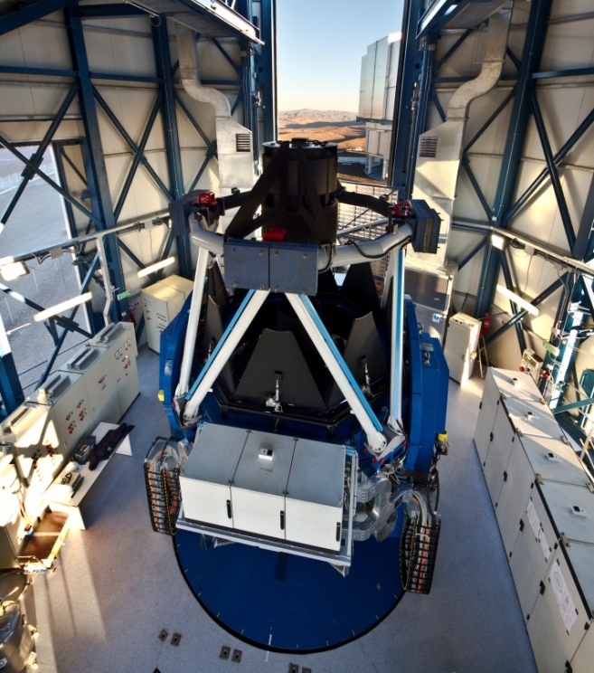
Commissioning the VST: a new survey machine at ESO
P. Schipani¹, M. Capaccioli², C. Arcidiacono³, J. Argomedo³, M. Dall’Ora¹, S. D’Orsi¹, J. Farinato⁴, D. Magrin⁴, L. Marty¹, R. Ragazzoni⁴, G. Umbriaco⁵
¹INAF - OACN, ²University Federico II of Naples, ³INAF-Arcetri, ⁴INAF-OAPD, ⁵University of Padua

Slide 2
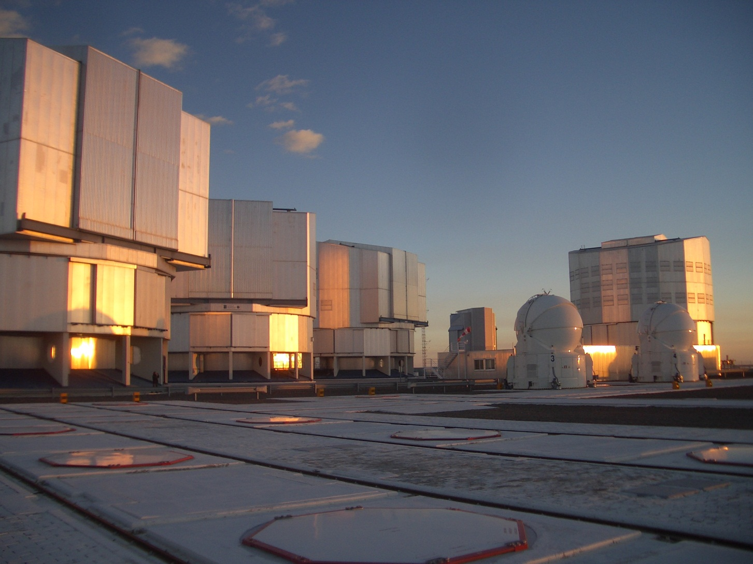
Telescopes @Paranal:
4 UTs + 4 ATs (ESO) +
Survey Telescopes VISTA (UK) + VST (IT)

Slide 3
The VST project
Joint venture (1998) between ESO and OAC (Osservatorio Astronomico Capodimonte) => INAF
OAC provides the telescope, ESO provides the enclosure and operates the telescope for T≥10 years
OmegaCAM consortium (Netherlands, Germany, Italy, ESO) provides the OmegaCAM camera

Slide 4

A big challenge for Italy
VST is the first ground-based active optics telescope designed from scratch by Italian research institutes, not based on replicas of other telescopes. For the Italian community many things were novelties.
The customer is ESO, the leader organization to build ground-based telescopes. A new telescope in Paranal is expected to work as well as the existing ones (selling watches to Rolex?).
VST is the largest INAF project for ESO, all time
Very small engineering staff compared to similar projects

Slide 5
VST in brief
Primary mirror: 2.6m
Secondary mirror: 0.9m
F# 5.5
Field corrector with 3 lenses (2 in the telescope + 1 in the camera)
Field: 1° x 1°
Shack-Hartmann wavefront sensor
Active M1 shape control (81 active axial support + 3 axial fixed points)
Active M2 positioning in 5 dof (hexapod)
Autoguiding with probe in polar coordinates
ADC with counter-rotating doublet of prisms, exchangeable with 2 Lens corrector

Slide 6
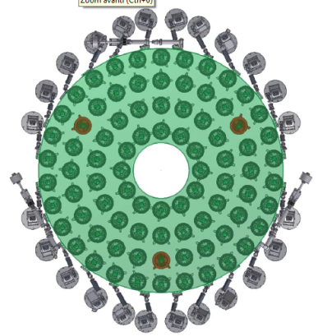
VST in brief
Alt-az mount, 4 motors per axis with glass encoders
ESO standard hardware wherever possible
1 TCS Workstation + 8 LCUs based on VxWorks
10 electrical cabinets
60 TCS sw modules
MANY control loops!
Already totally installed in 2006, but after 2007 CDR, deep modifications to the active optics system design and parts:
primary mirror support system
secondary mirror support system
probe, ADC, rotator
what we have now is VST 2.0

Slide 7
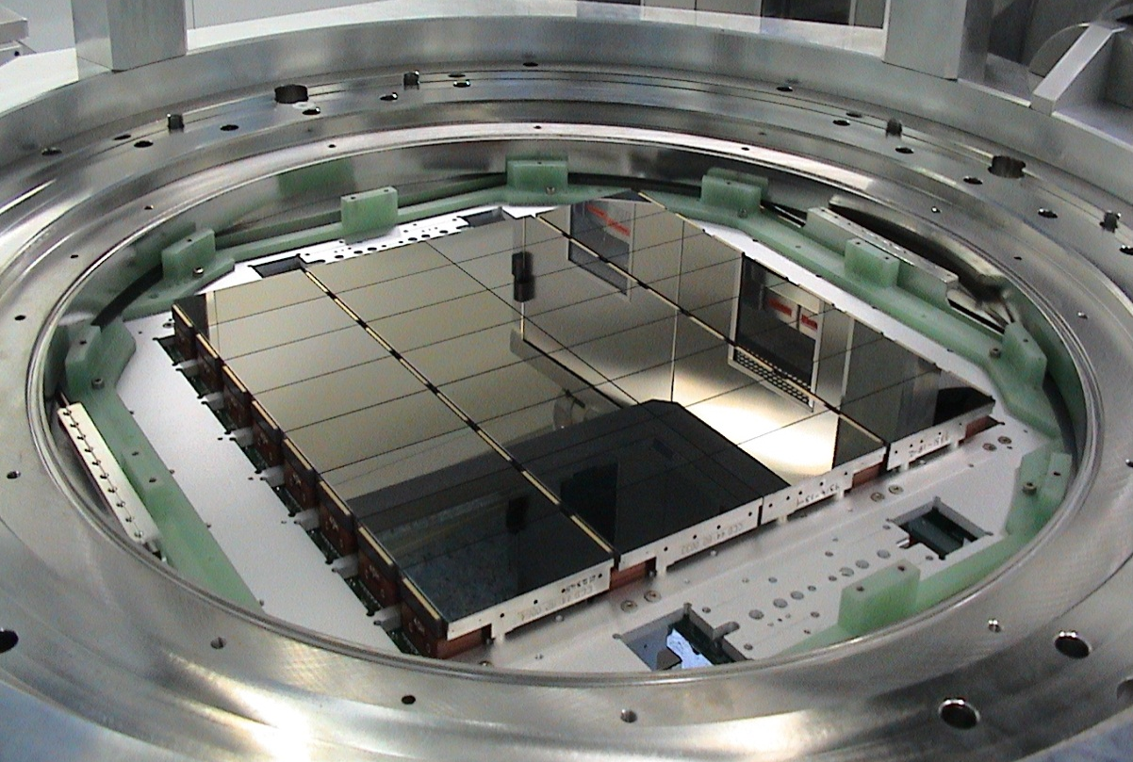
OmegaCAM
268 Mpixel 1°x1°
0.21 arcsec/pixel
32 scientific CCDs + 4 outer CCDs
Autoguiding
Image analysis curvature sensor
PI: K. Kuijken
OmegaCAM Consortium: Netherlands, Germany, Italy, ESO

Slide 8
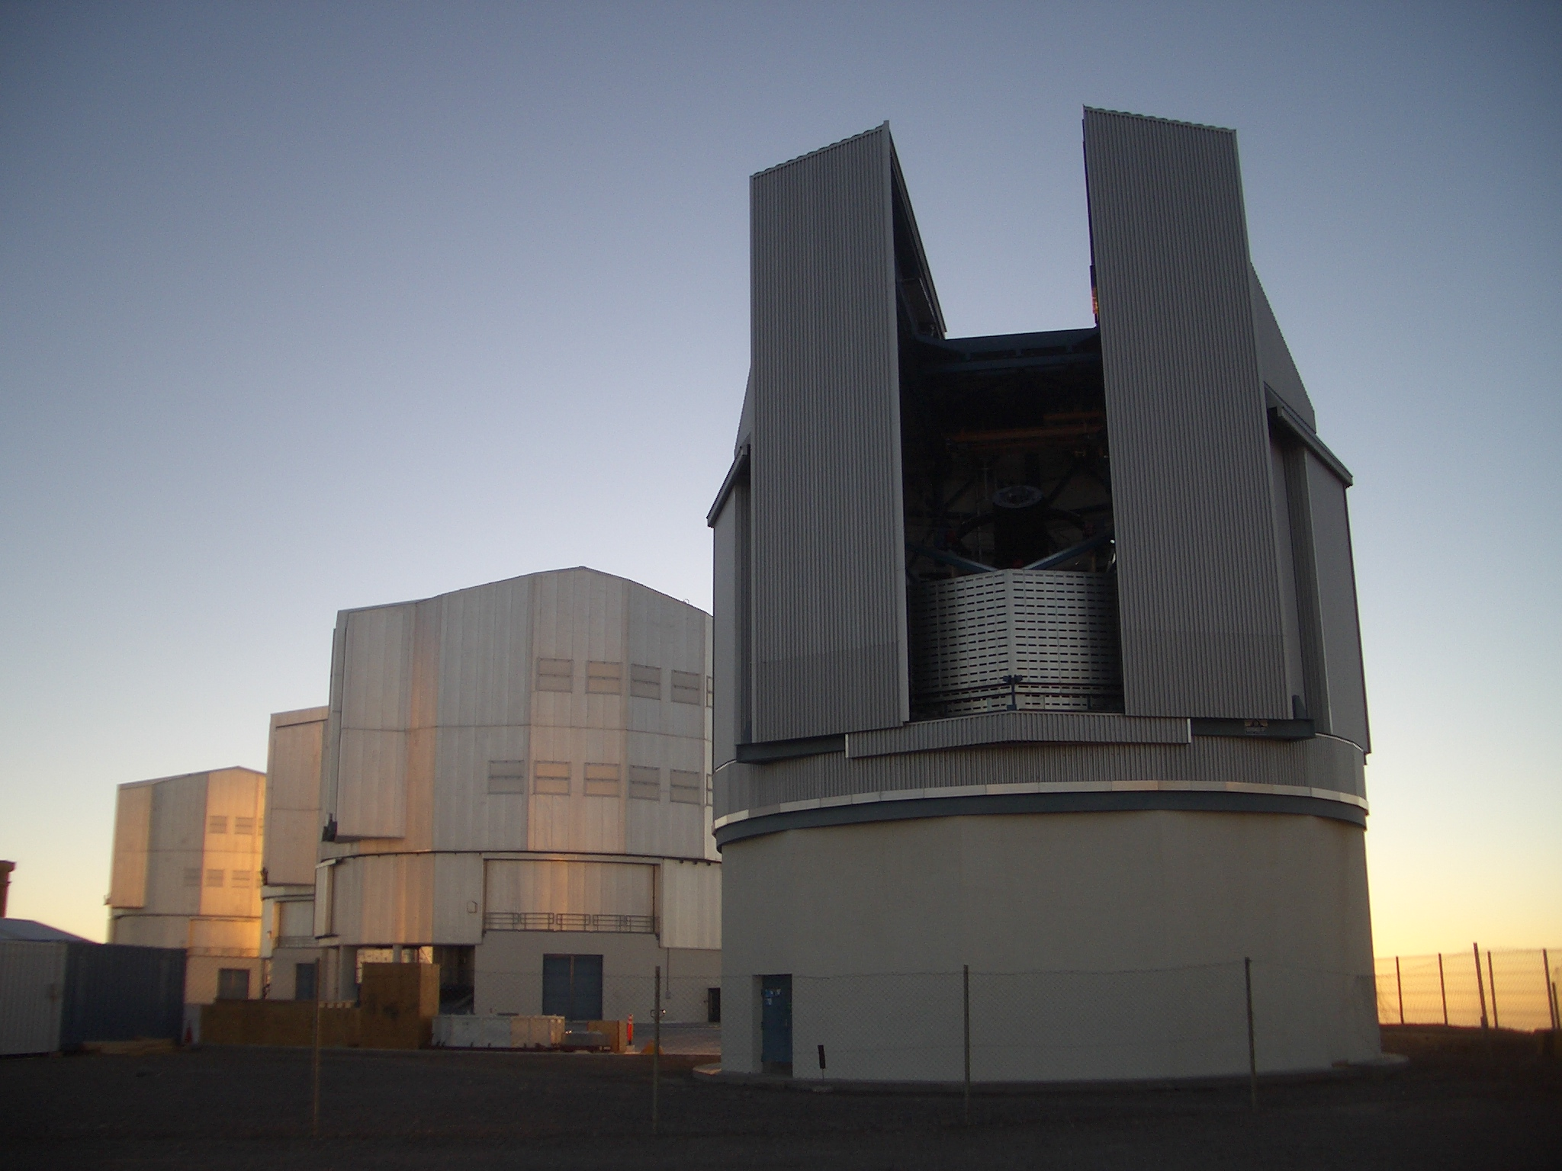
Integration phases
2007-2008: Tel. Mount
2009: M2 system
Break caused by disaster in shipping
2010: M1 cell + AU
2011: OmegaCAM

Slide 9
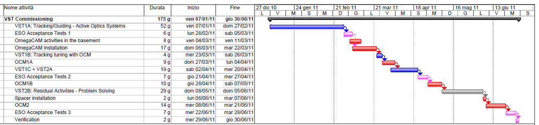
Commissioning 2011
Looking back
6 months foreseen for the commissionings of both telescope and camera with alternating periods
Respected, but for an additional shift postponed to July (shimming of rotator)

Slide 10
Commissioning team
Small. ~5 FTE (most of the people part-time available and relatively new to the project)
Laurent Marty (Napoli)
Sergio D’Orsi (Napoli)
Pietro Schipani (Napoli) VST-C Project Manager
Massimo Dall’Ora (Napoli)
Jacopo Farinato (Padova)
Gabriele Umbriaco (Padova)
Roberto Ragazzoni (Padova)
Demetrio Magrin (Padova)
Carmelo Arcidiacono (Padova-Arcetri-Bologna)
Javier Argomedo (ESO-Arcetri)

Slide 11
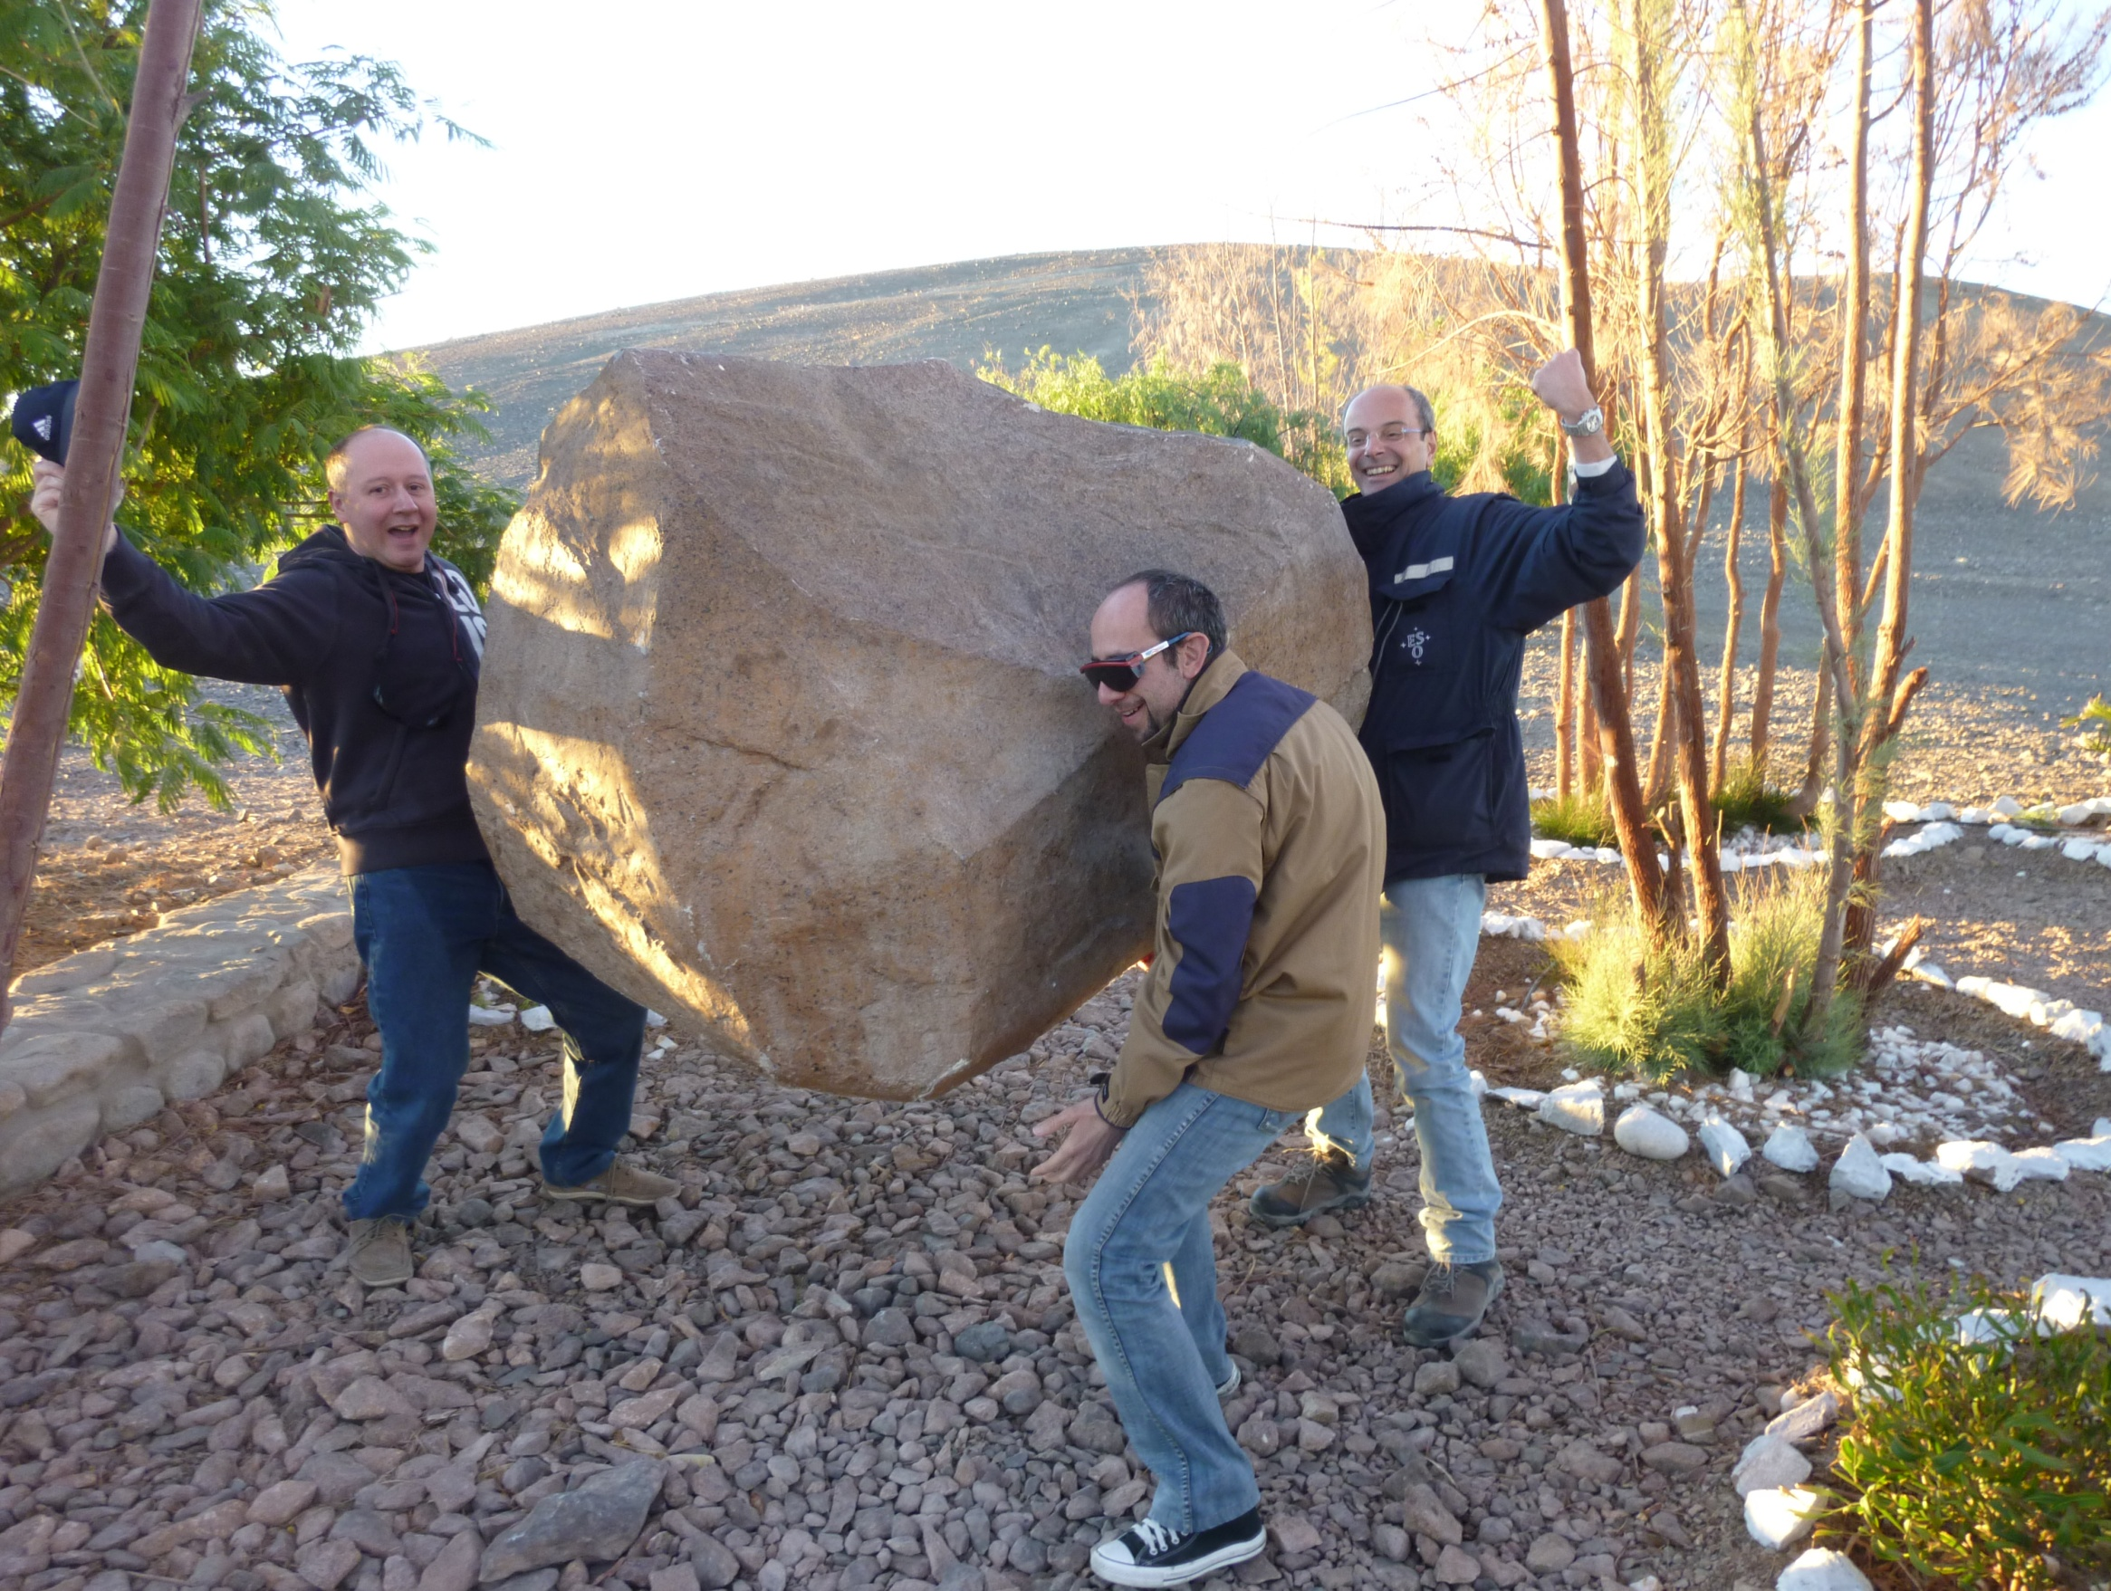
Small team, but strong

Slide 12
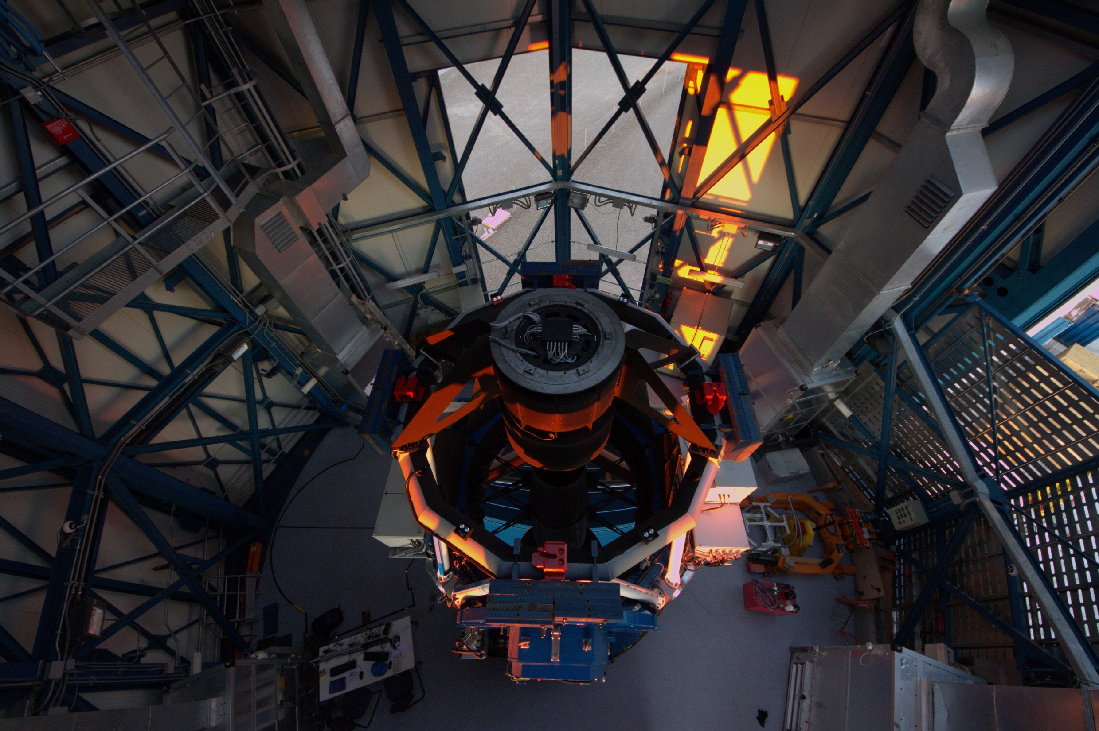

Slide 13
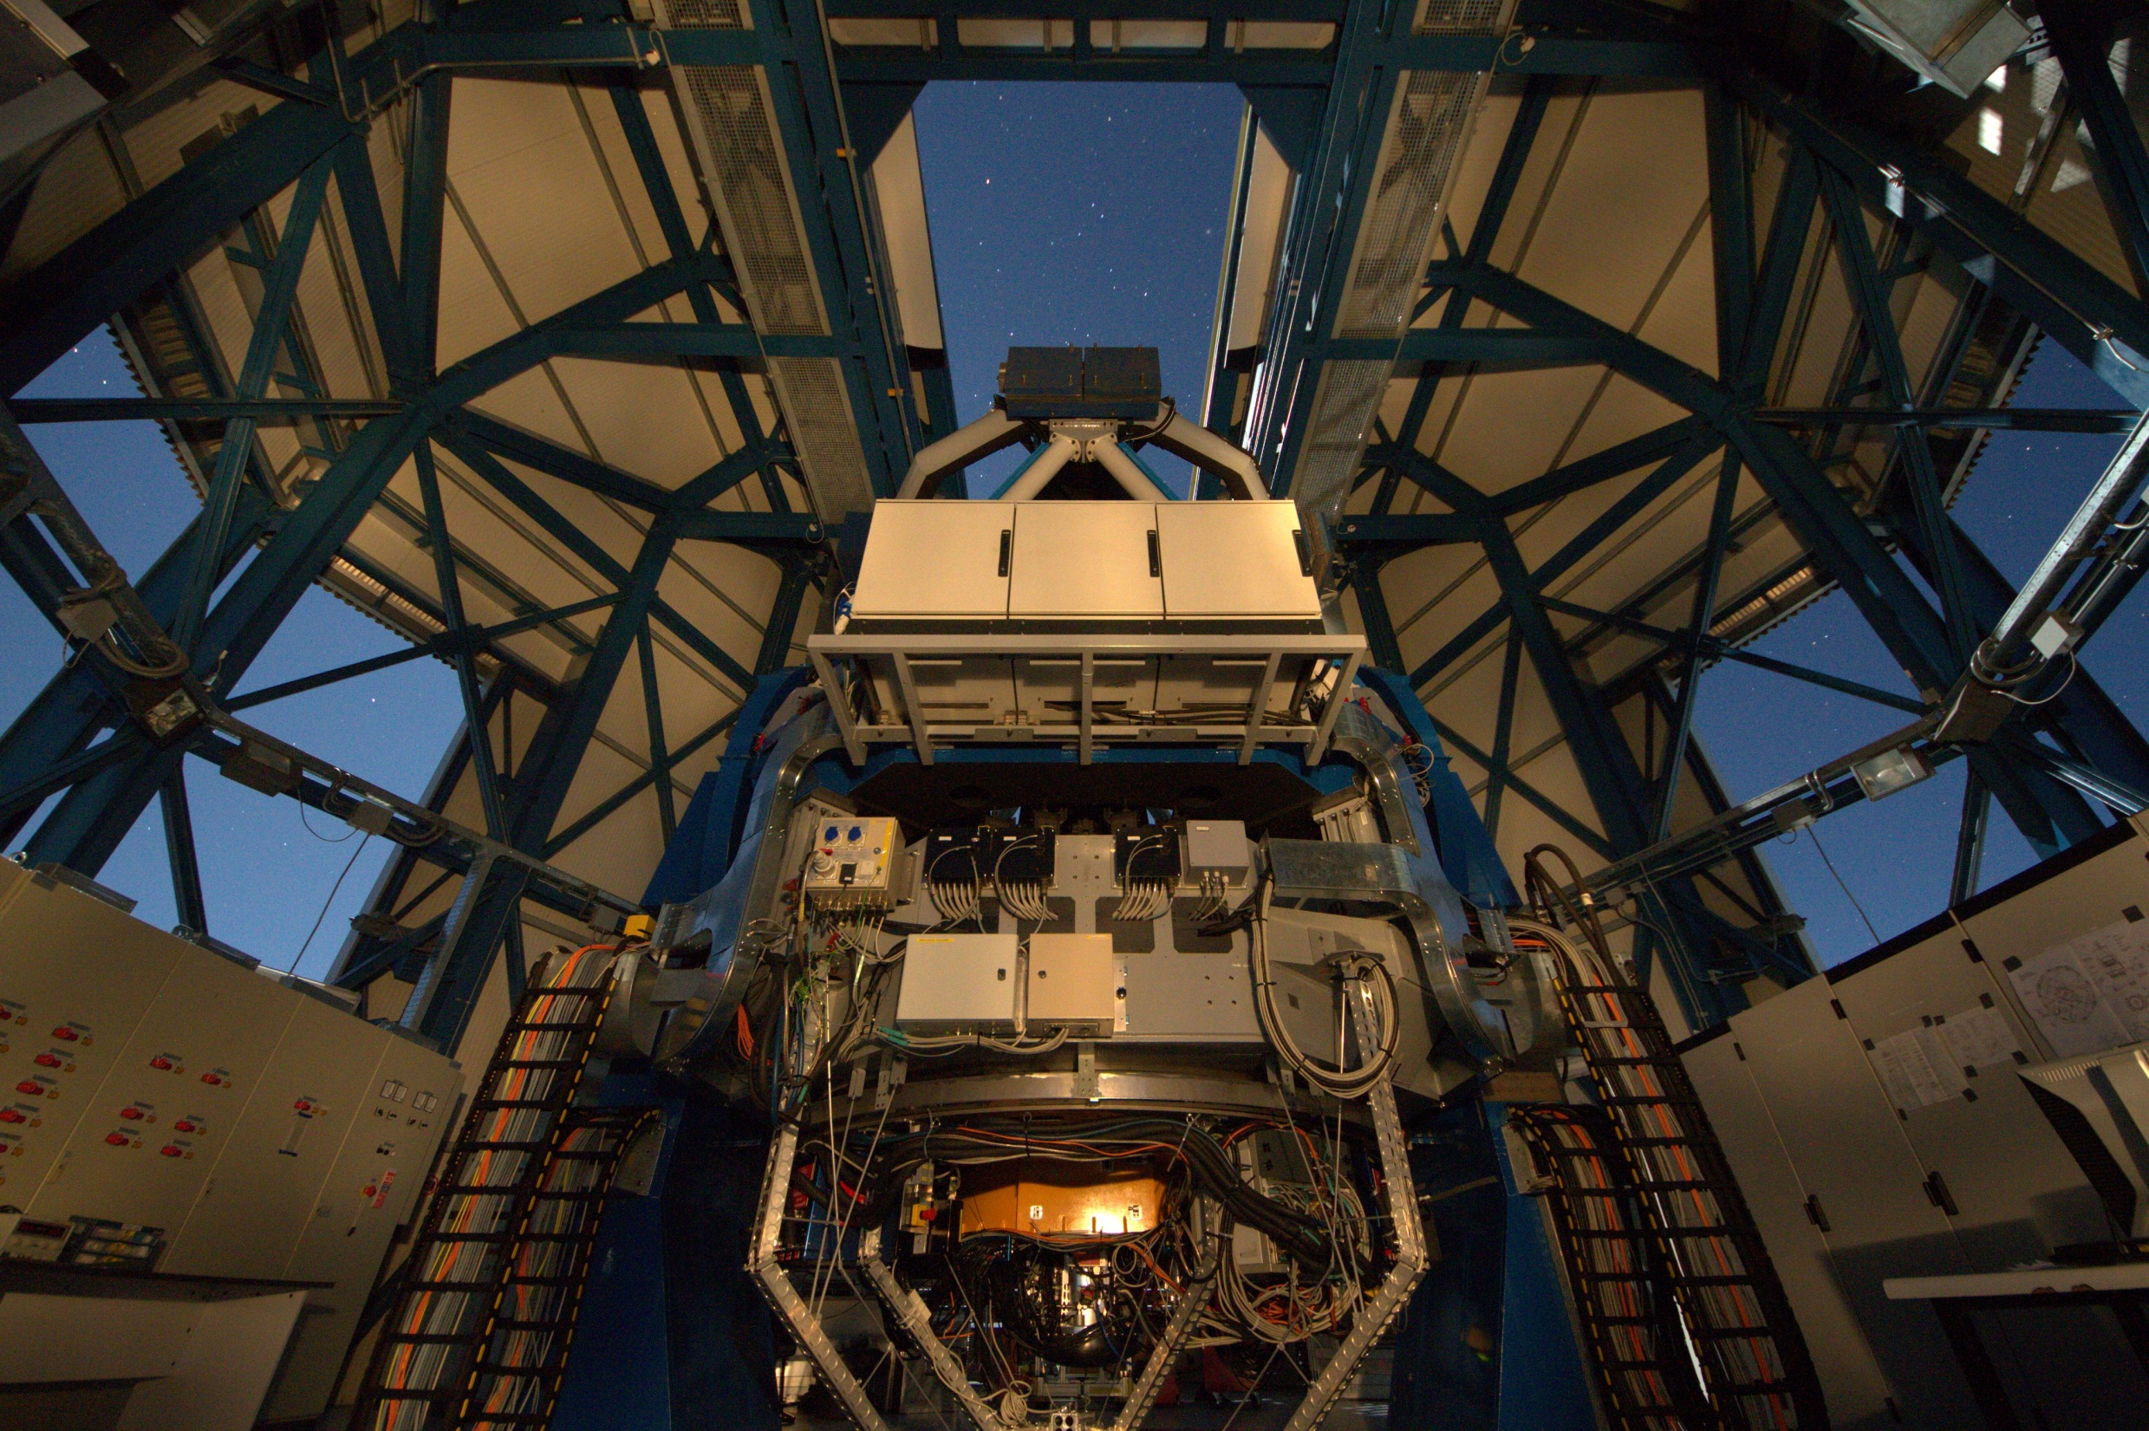

Slide 14
Commissioning activities
Tracking system
Pointing
Tracking
Autoguiding
Alignment
Active Optics
Primary mirror system
Secondary mirror system
Shack-Hartmann
Probe
ADC
Interfaces with camera (sw, electromechanics)

Slide 15
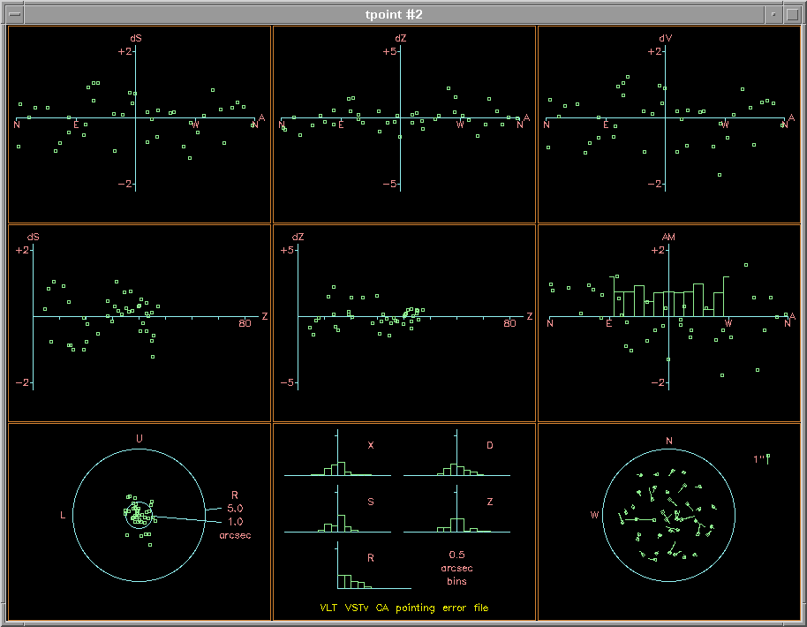
Pointing Model
Pointing error
~1 arcsec RMS
Fit results typically between 0.8 and 1.1 arcsec
A model with 40 stars is built in less than 1 hour

Slide 16
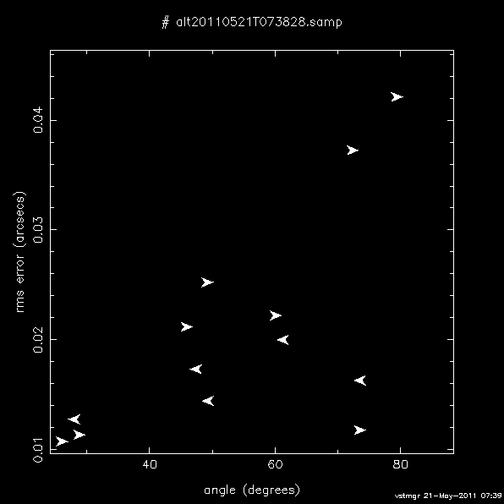
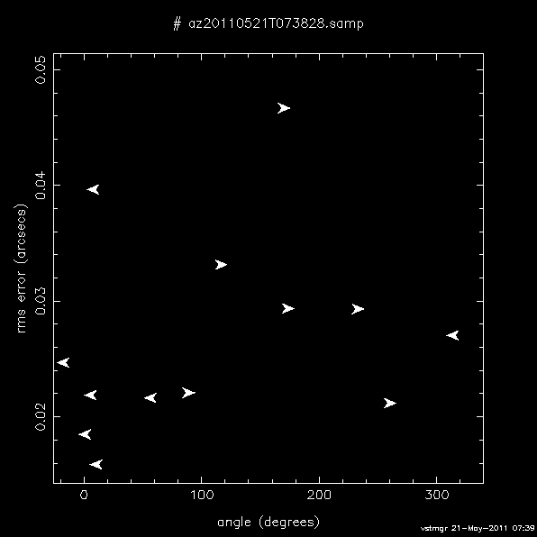
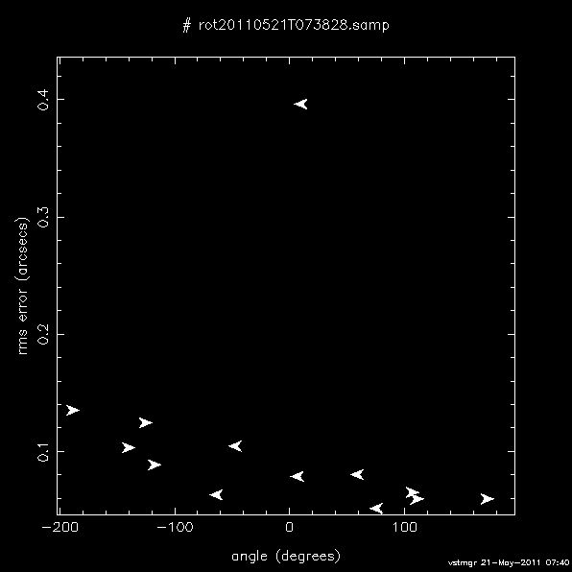
Tracking Map in a windy night

Slide 17
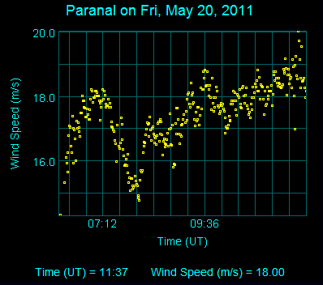
Tracking Map
With proper setting of the enclosure the telescope performance is unaffected also in windy nights

Slide 18
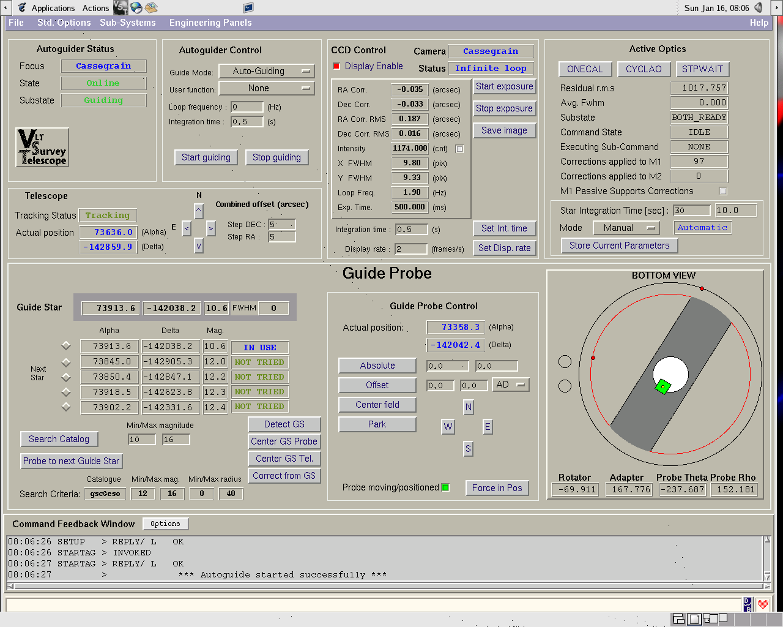
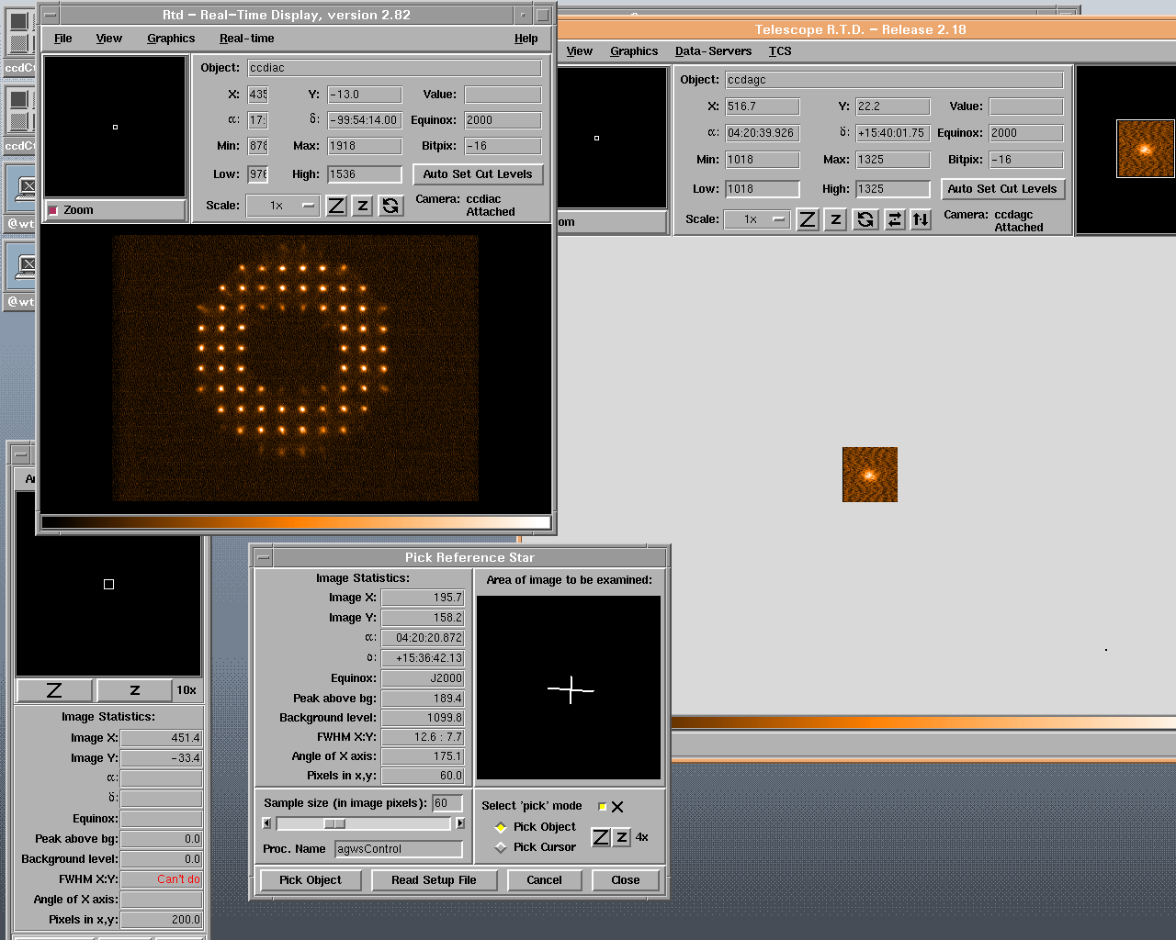
Autoguiding operational
TCCD
Probe system
PII controller

Slide 19
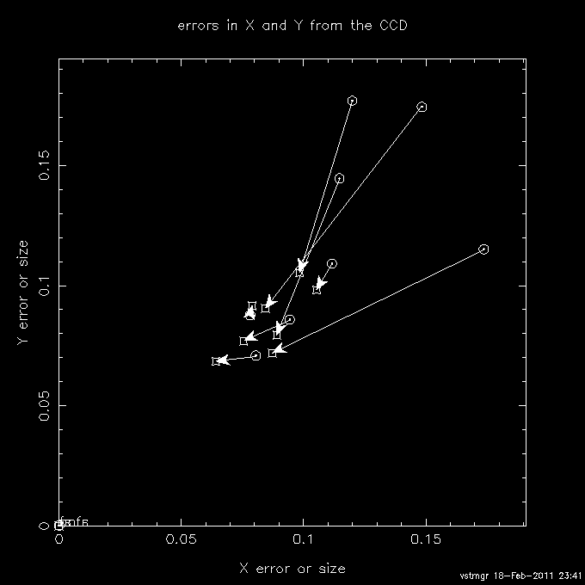
Autoguiding
Tracking performance as measured on the guide probe is ≤ 0.1 arcsec RMS (within spec)

Slide 20
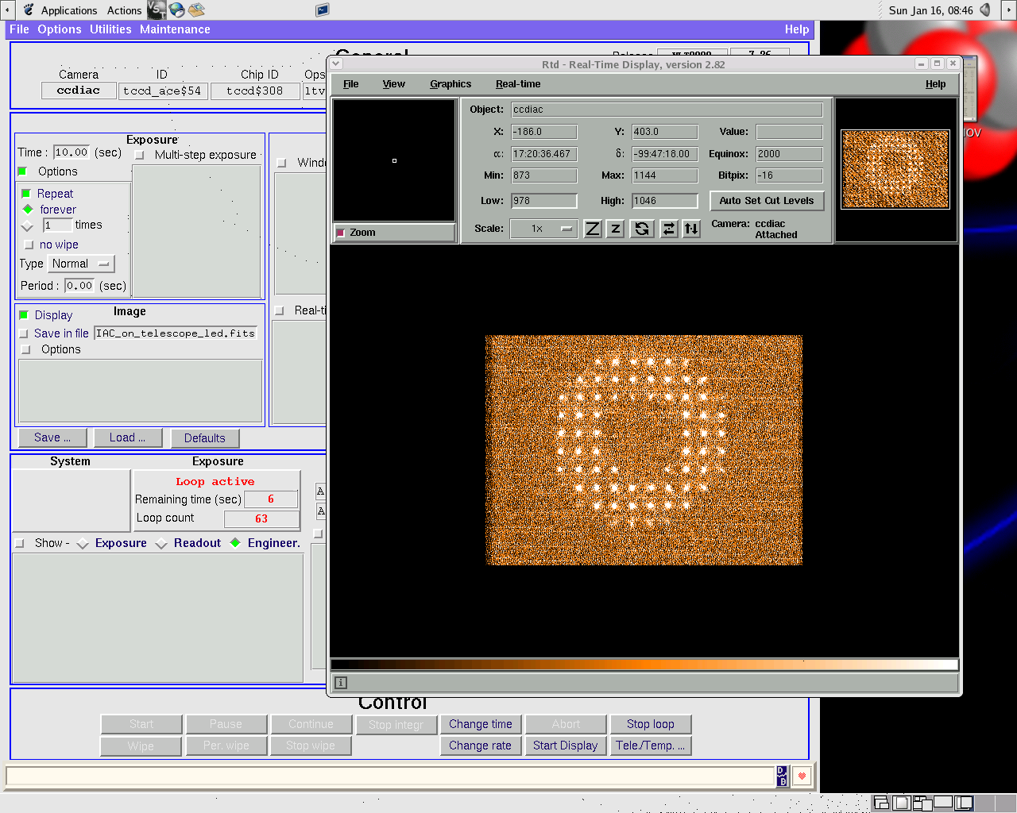
Active Optics
M1 system
M2 system
Shack-Hartmann
Software
Conversion between CCD angles to M1 & M2 system angles

Slide 21
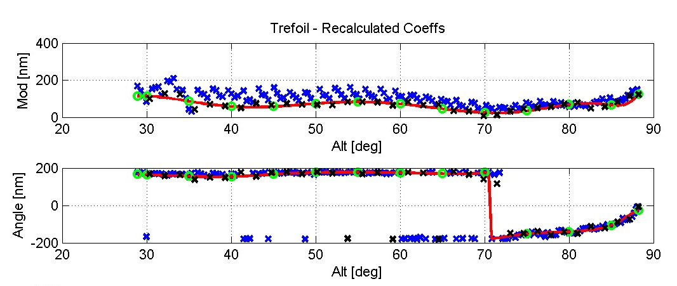
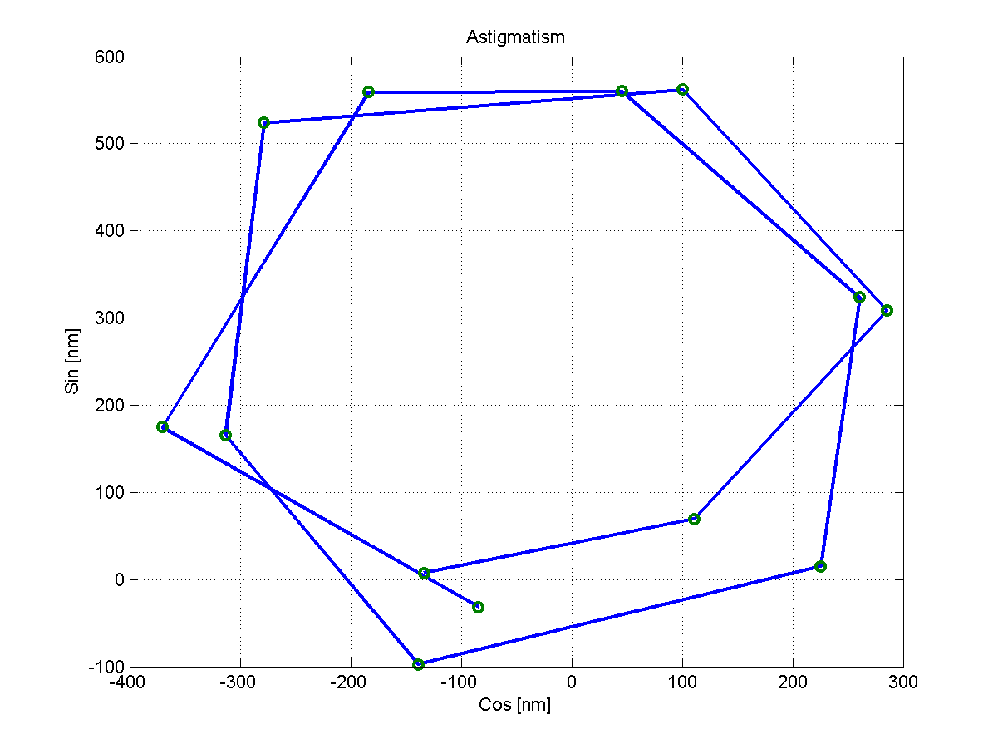
Active Optics
M1 support system not astatic: trefoil to be controlled and removed (not surprisingly)
Aberrations discovered inside the Shack-Hartmann system (non common path)

Slide 22
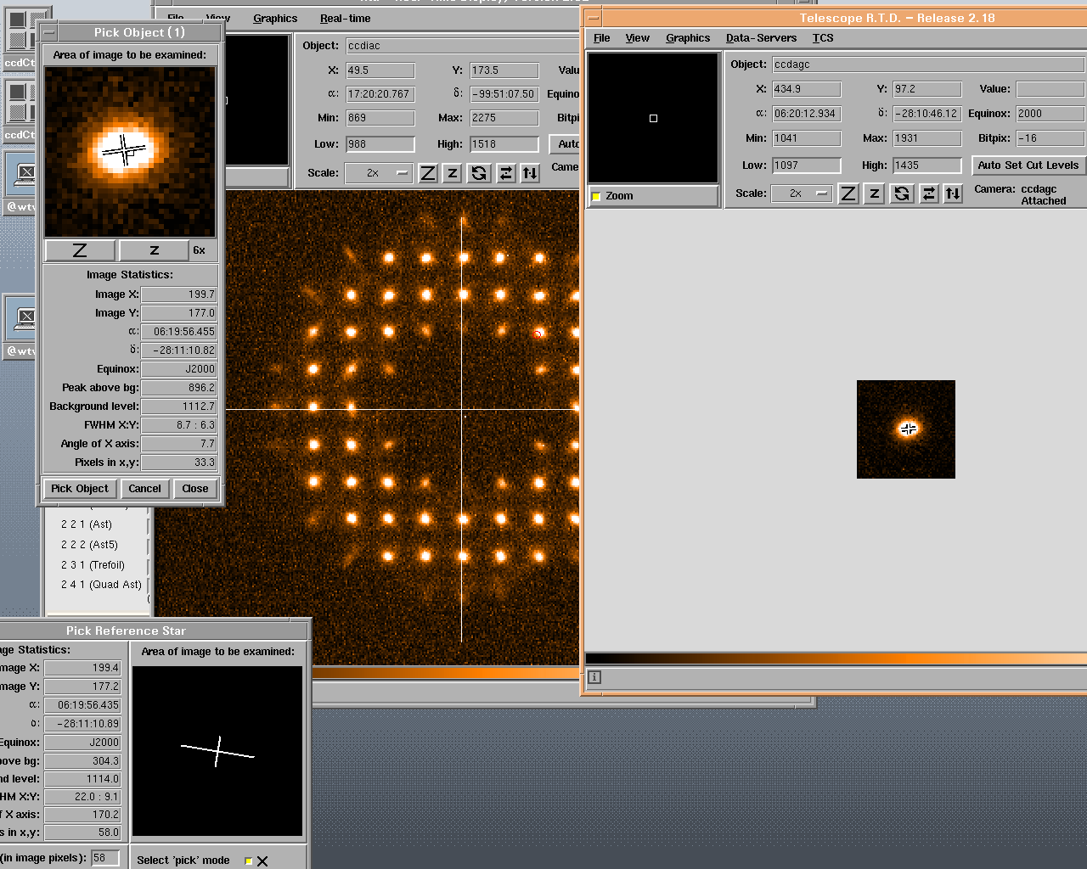
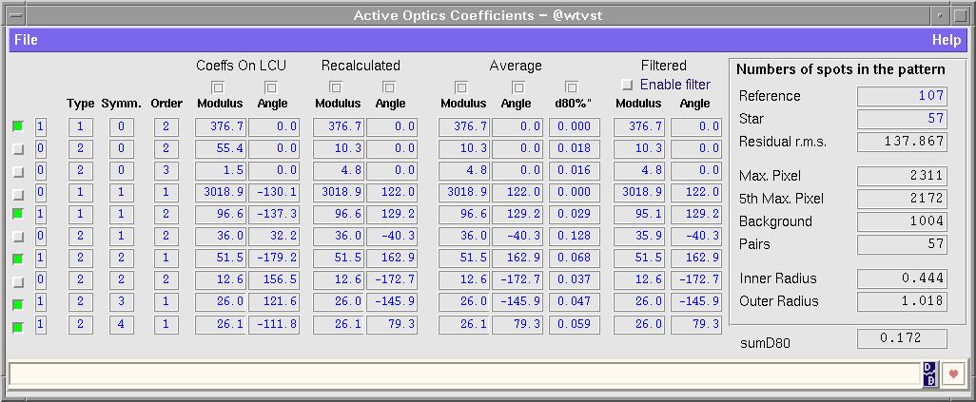
Active Optics
Active optics converges normally with:
1 open loop correction
+ 1-2 closed loop corrections

Slide 23
Alignment
Optical system to be aligned: M1+M2+lenses+camera
M1 vs M2 Alignment corrected in February rotating M2 around its coma-free point (off-axis astigmatism removed)
Camera tilt removed (by OmegaCAM consortium) by shims (not rotating defocus removed)
Rotator axis tilt removed by shims, not enough range with mirrors (rotating defocus removed)
Unexpected additional work-shift

Slide 24
Technical problems!
Active optics
Shack-Hartmann system aberrations (February)
Alignment
Tilt of the camera (smaller, June)
Tilt of the rotator axis (larger, July)
Cabling
cables broken on systems not tested enough in Italy (lesson learned: shipping in advance… means time lost)

Slide 25
Work-sharing…
(Different) responsibles needed at subsystem level
Telescope
Pointing & Tracking System
Active Optics
M1 System
M2 System
Wavefront Sensing
Auxiliary Units
Tracking
Pointing
Autoguiding
Probe
ADC

Slide 26
…overcome with:
Strong team spirit within the commissioning team. All people available to help in areas not under their own responsibility. Great people.
Very good collaboration with ESO and OmegaCAM teams
Support from ESO Paranal and Garching
Accurate and realistic preparation of the commissioning. Few surprises and schedule basically respected.

Slide 27
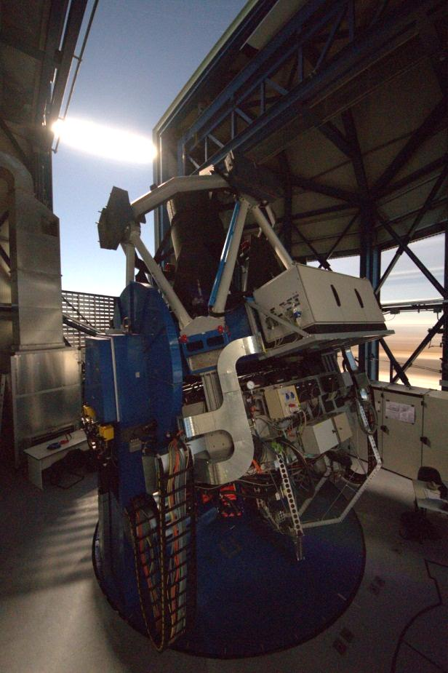
Image quality
Wide-field telescope more complicated than «normal» ones. Normally negligible alignment problems are here visible on the outer edge of the field.
(plan HUGE alignment correction capabilities!)
Image quality has to be assessed over the whole field:
PSF Anisotropy
FWHM map
Ellipticity map

Slide 28
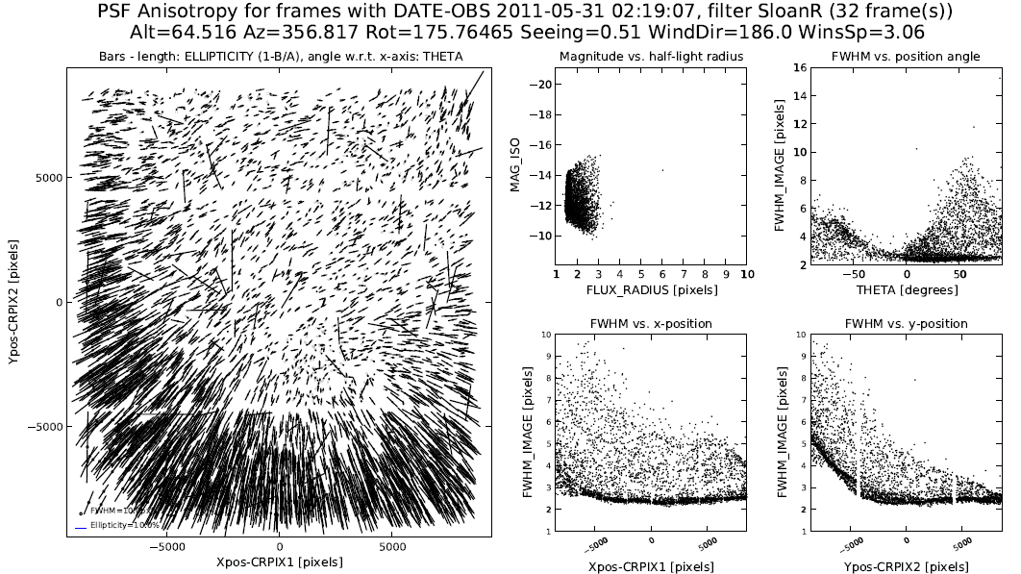
PSF Anisotropy before shimming
Degradation on one side / corner

Slide 29
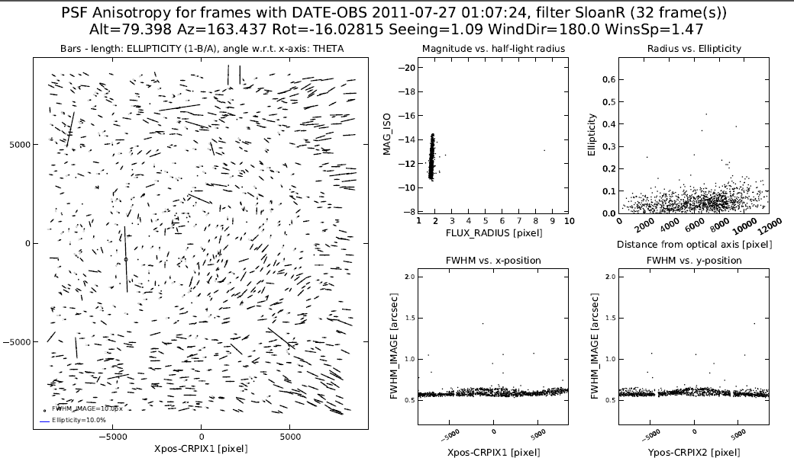
After the shimming

Slide 30
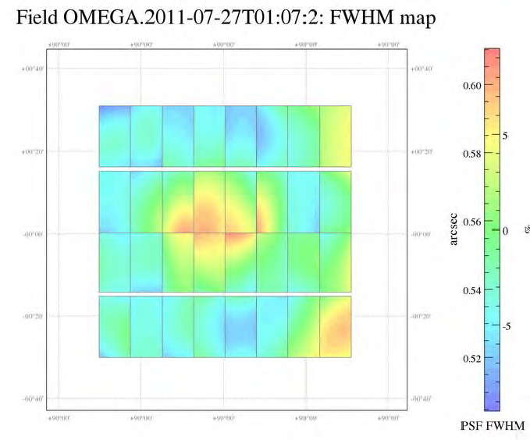
FWHM map

Slide 31
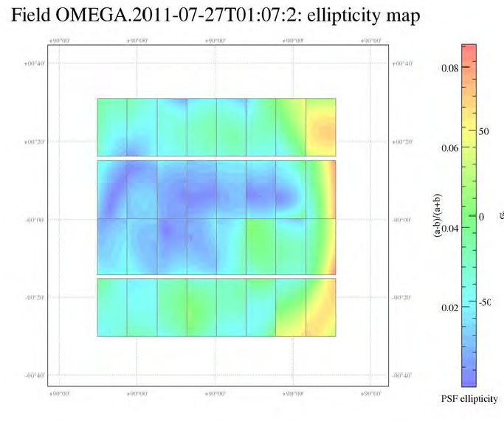
Ellipticity map

Slide 32
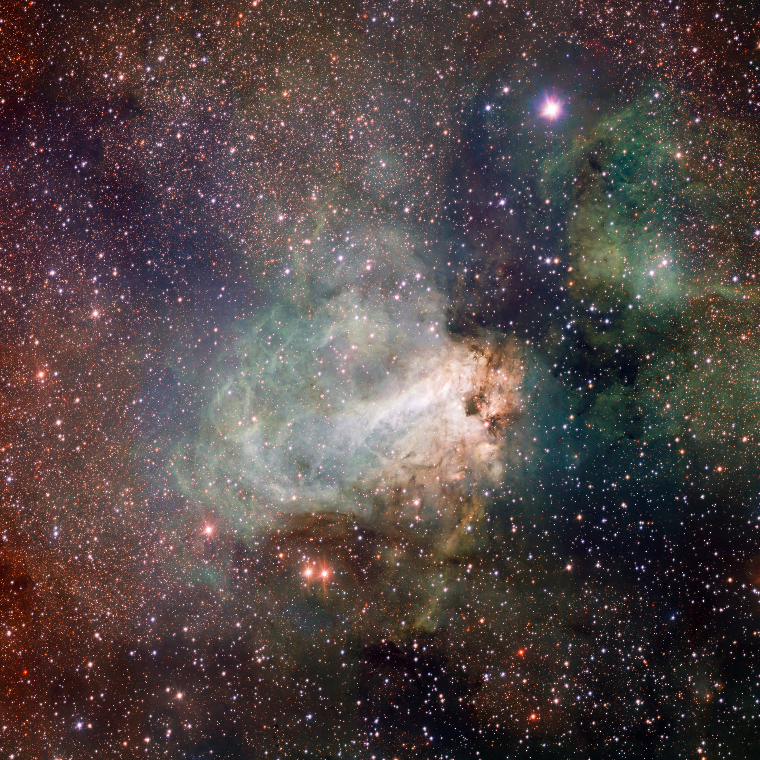

Slide 33
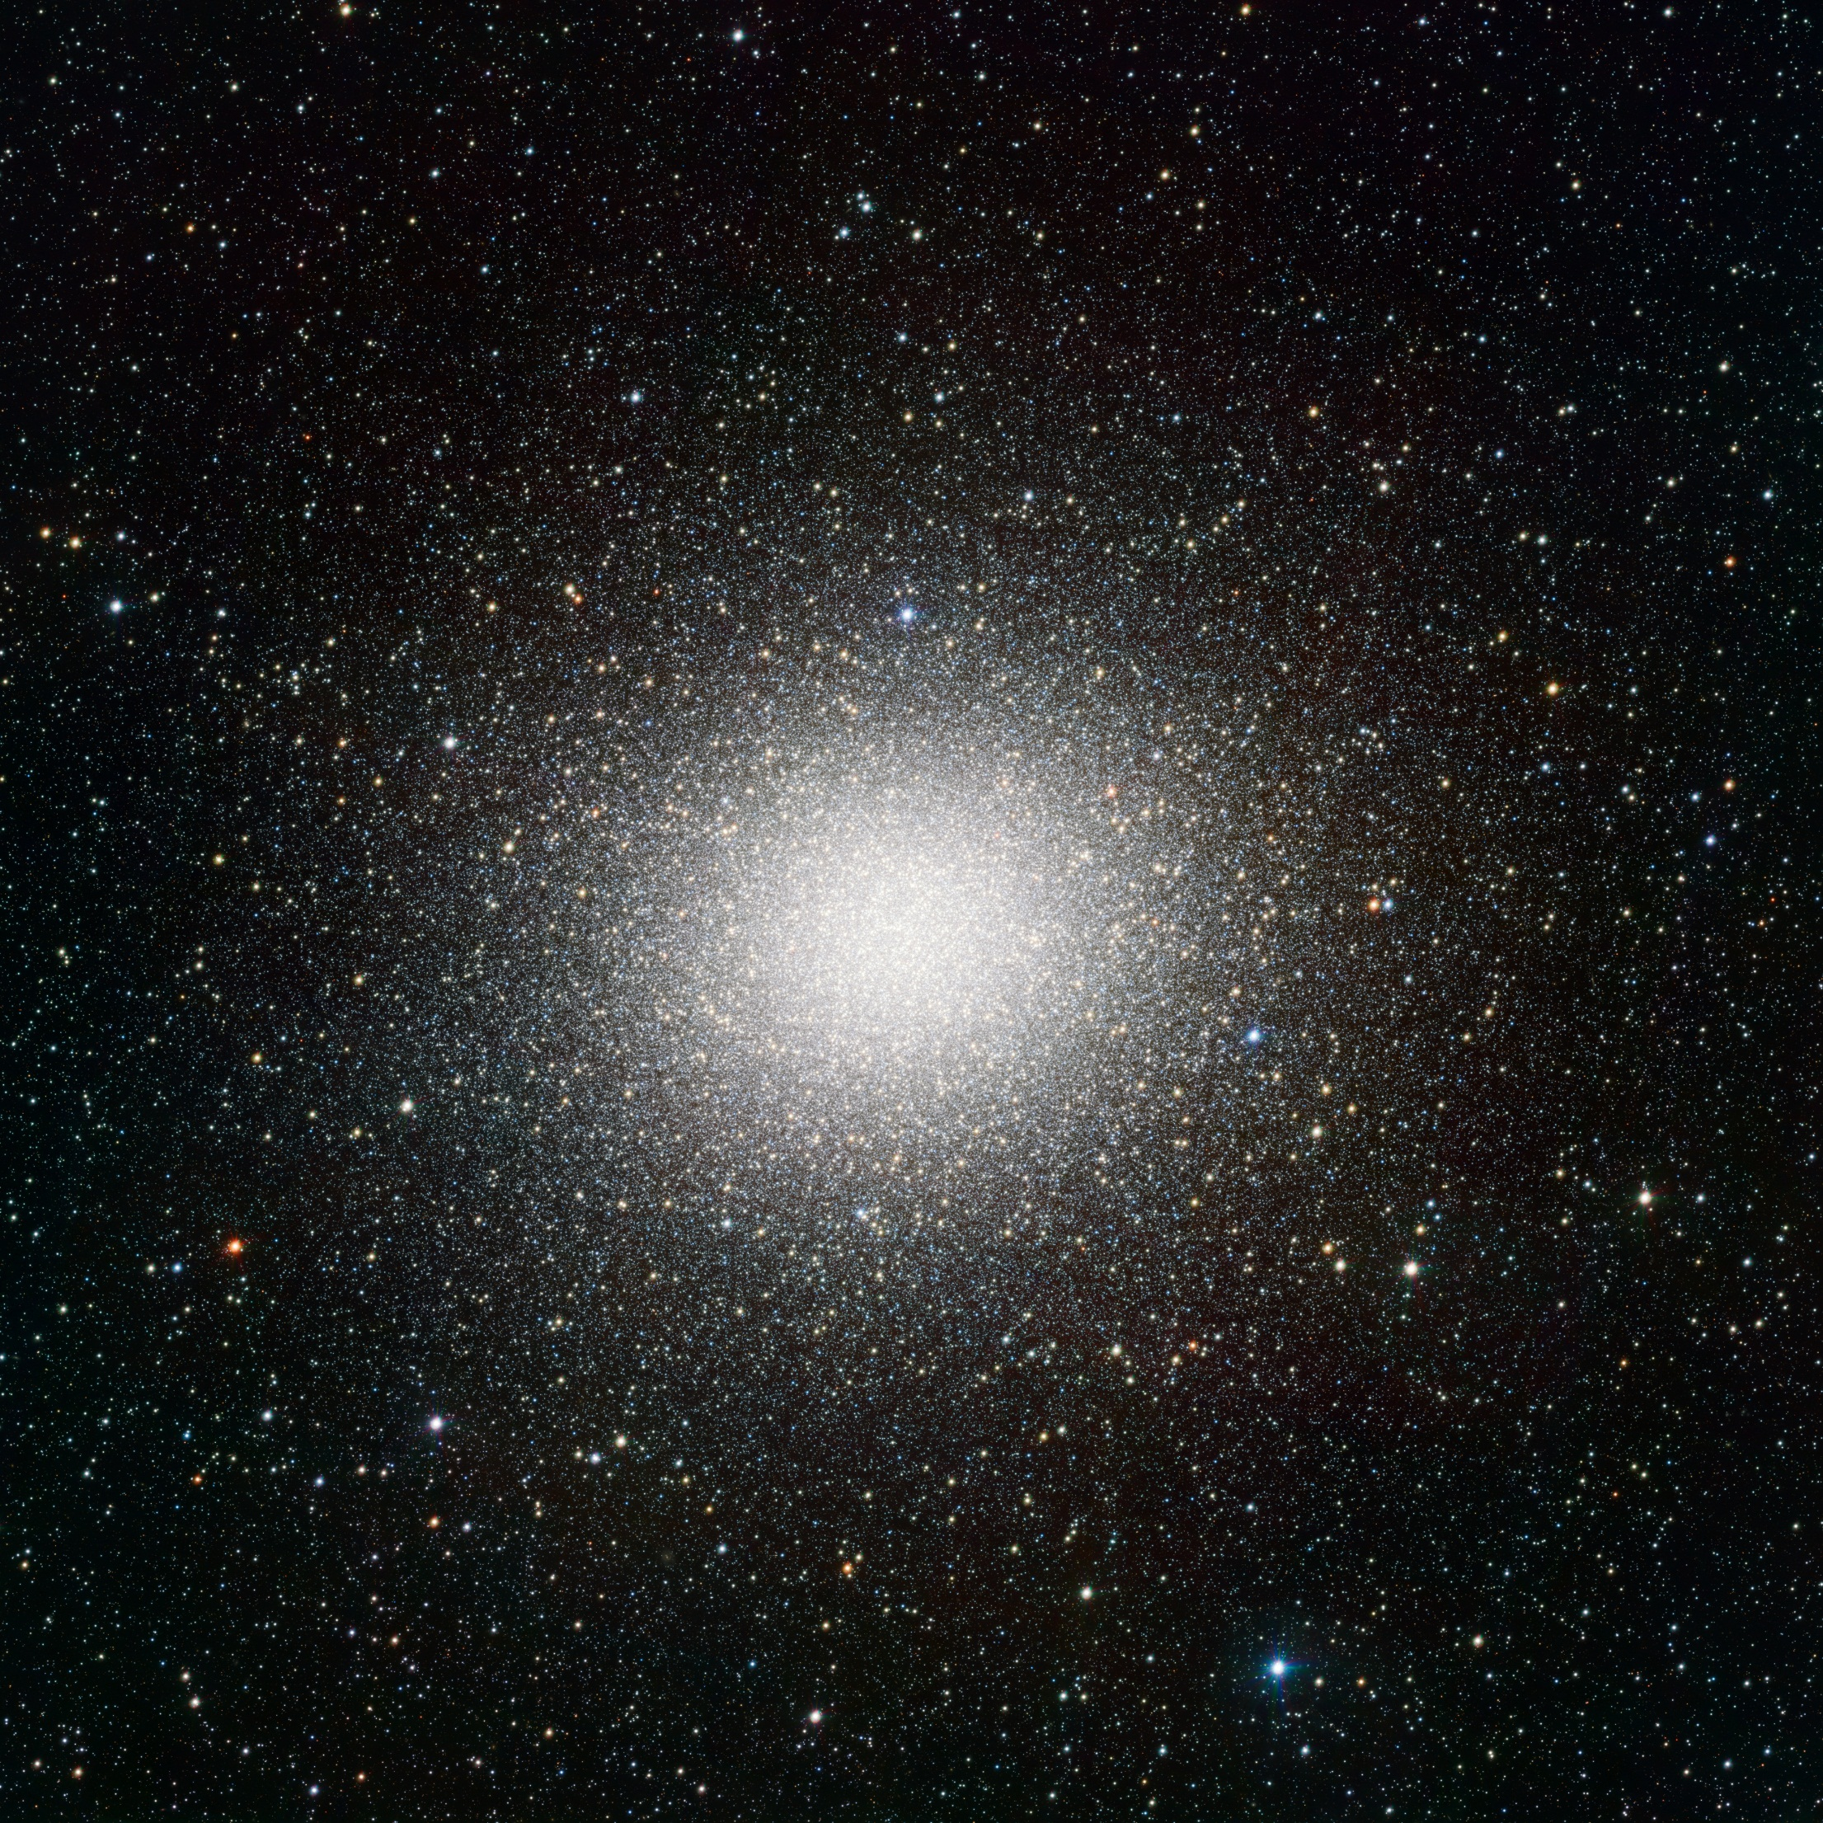

Slide 34
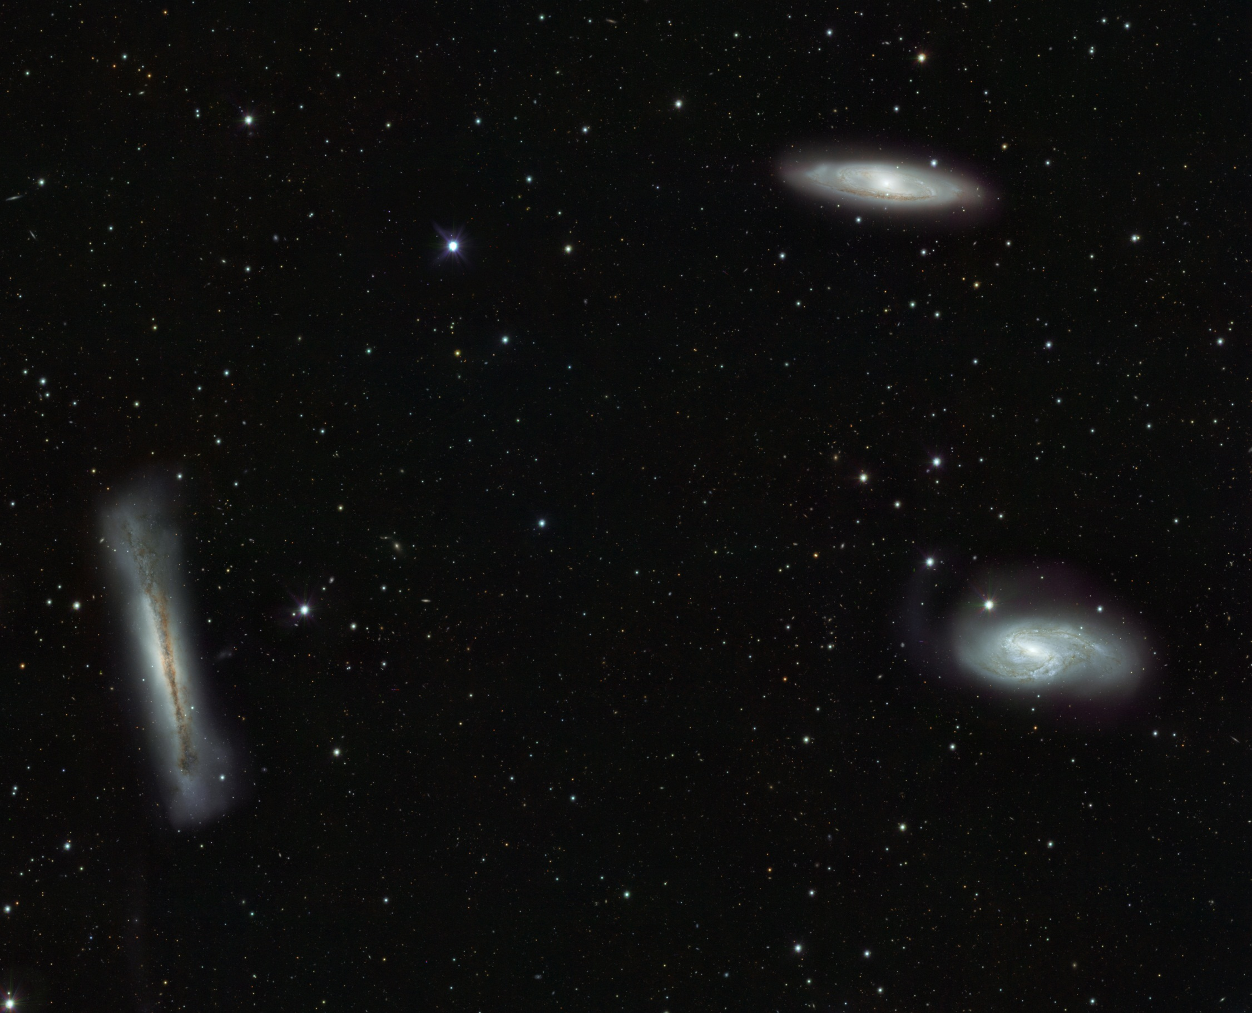

Slide 35
Planned surveys
ESO Public surveys:
KIDS (Kilo-Degree Survey)
ATLAS (Sky Atlas with VST)
VPHAS+ (VST Photometric H-α Survey of the Southern Galactic Plane)
GTO based surveys:
Strega, Step, Access, Vegas, Voice, Sudare, U-Wings, Local Group, …

Slide 36
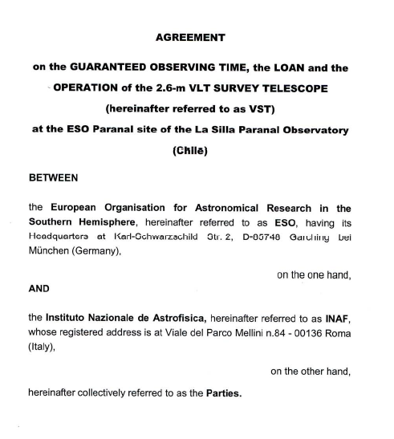
GTO agreement
MOU: 1998
Final agreement: 15/06/2011
VST GTO returns:
10% for years 1-2-3-4,
15% for years 5-6,
20% for years 7-8-9-10

Slide 37
Start of operations
Official start of operations is October, 1
Dry runs
Science data taken in shared risk
SURVEY DATA COMING SOON

