Slide 1
Blue Straggler Stars: the first 40 years, 1953-92
What is a Blue Straggler?
“The Failure of Occam’s Razor?”
(Mario Livio 1993, ASP Conf. 53, ed. R Saffer, p.3)
Why has it taken so long?
Inconclusive and confusing early observations
The real significance of Blue Stragglers
Russell Cannon, AAO
Notes:
“Early observations that failed to solve the problem” seemed a bit too negative.
1992 is a convenient end point for the archaeology of BSs: the STScI meeting was the first devoted to BSs, and the first new results from HST (with the original poor optics) were reported then.
The subtitle of Mario Livio’s article essentially says it all.
Throughout this presentation, I will put linking comments and extra references in the notes section.

Slide 2
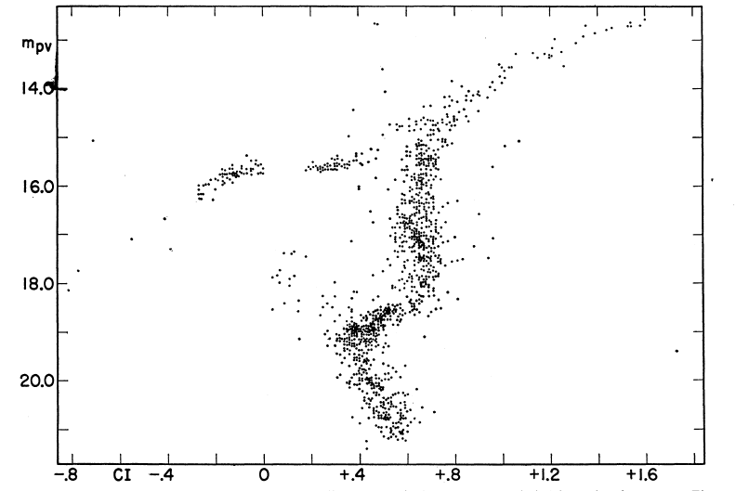
Sandage’s first M3 CMD
Sandage A R 1953, AJ 58 61
Notes:
Based on Allan Sandage’s PhD Thesis at Caltech, supervised by Walter Baade

Slide 3
Sandage’s first M3 CMD
Sandage A R 1953, AJ 58 61
Notes:
Note that the “classical” BSs never looked like a simple second, much younger, stellar population, a concept that is now well illustrated in the CMDs for the Carina and some other dwarf spheroidal galaxies.
Also, M3 has an extended Blue Horizontal Branch, like those seen later in NGC 6752 and other clusters.
In 1962 (ROB 82), Martin Schwarzschild commented that the M3 BSs are bunched in one quadrant of the cluster and Sandage agreed.

Slide 4
The “Classical” Blue Stragglers
Stars which lie on or near the Main Sequence
in a star cluster, but above the turn-off point
Apparently younger or rejuvenated stars, but not a simple second population
Not part of the Horizontal Branch
Not simply unresolved binaries
Hard to define in the general field
Later based on X-ray sources and pulsars
Notes:
1. This empirical definition is purely observational, is curious in that it is based on 3 negative statements rather than positive attributes, and only applies to stars in clusters.

Slide 5
Some key resources
Blue Stragglers: STScI Workshop, Oct 1992
  (ASP Conf. 53, ed. R A Saffer, 1993)
  esp. M Livio, p.3 and V Trimble, p.155
Hut P et al. 1992, Binaries in Globular Clusters
PASP 104 981, based on an informal meeting
Stryker L 1993, BSs review, PASP 105 1081
Bailyn C D 1995, BSs and Dynamics of GCs, ARA&A 33 133
Notes:
These papers give comprehensive references to many relevant early publications, mostly not repeated here.
The STScI workshop was the first, and still the only, meeting devoted to BSs with accessible published proceedings. We are lucky that this one was published, which was not the original intention of the organisers.
Virginia Trimble’s summary gives a discussion of the origin of the name “Blue Straggler”, and offered a glass of wine to anyone who could find an earlier reference than Deutsch 1966. At the present meeting, Javier Ahumada reported the much earlier 1958 paper on the intermediate-age open cluster NGC 7789 by Margaret Burbidge and Allan Sandage.
Piet Hut had 8 distinguished collaborators, including Steve McMillan who is here today, who decided to write up informal discussions held at Princeton one day in the summer of 1991.

Slide 6
An aside on ROB 82
Royal Observatory Bulletin No. 82, 1964 gives a verbatim account of an IAU Colloquium on “Star Clusters and Stellar Evolution”, held at the Royal Greenwich Observatory while it was in Sussex, in August 1962.
It is one of several early references to BSs that are in obscure places and often not available through the ADS.
Pages 89-92 contain a discussion on “blue stars”, involving McCrea, Sandage, Hoyle, Eggen, Schwarzschild, Herbig, Stromgren, Blaauw and Woolley.
Notes:
Royal Observatory Bulletin No. 82 is a transcription of the recorded proceedings of one of the first IAU Colloquia, held at the RGO in Herstmonceux Castle in Sussex in August 1962 and eventually published in 1964. The editors were Olin Eggen and George Herbig, assisted by Bob Dickens and Jennifer Saunders.
The meeting is listed as Coll. 3 by the IAU but incorrectly dated. Bob has confirmed my belief, based on internal evidence, that the meeting was held in 1962, not 1963.

Slide 7
… and some telling quotes
“The few blue stragglers in M67 are usually dismissed – M67 would then make a perfect model for Baade’s Galactic Centre Population” (Hyron Spinrad 1966, PASP 78 367
“Blue stragglers remain one of the unexplained oddities of astronomical lore” (Craig Wheeler 1979, ApJ 234 569)
“All in all, blue stragglers seem to be both inadequately understood and insufficiently appreciated” (Virginia Trimble 1992, PASP 104 p. 4)
“Progress has certainly been made in the last 40y, but BSs remain an intriguing challenge.” Stryker, 1993
“… every kind of object … can be made in at least two different ways, all of which are likely to be significant …” Bailyn, 1995
“Efforts to provide simple explanations for the full range of observed phenomena appear doomed to failure.” Bailyn, 1995
Notes:
1. I found this early very prescient BS reference as an aside in a paper by Spinrad, reviewing Baade’s work.

Slide 8
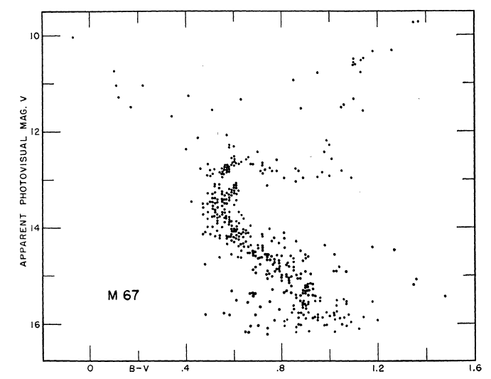
CMD for the old Open cluster M67
Johnson H L & Sandage A R 1955, ApJ 121 616
Notes:
The first modern CMD of M67: potential Blue Stragglers but not mentioned in text
Note the gap at the top of the m.s., which appeared in other clusters and fitted earlly stellar evolution tracks

Slide 9
An improved CMD for M67
Eggen O J & Sandage A R 1964, ApJ 140 130
Notes:
1 Note that the gap in the upper m.s. is still present (but now almost vertical), the small tight RG Clump and the messy “horizontal branch”.

Slide 10
BSs in the old open cluster M67
F81
Eggen O J & Sandage A R 1964, ApJ 140 130
Notes:
This demonstrates the potential for confusion between “young” (or rejuvenated; blue circles) and highly evolved explanations for BSs
The same features were apparent in the earlier less precise data of Johnson & Sandage, 1955, but the BS possibility was not discussed then.
Wal Sargent (1968, ApJ 152 885) found that the very bright F81 had high mass, but the 3 hottest BHB stars had the same mass as t.o. stars.

Slide 11
Early theories for BSs (see Livio, 1993)
Binary stars? – All probably occur
  Algol-type mass exchange
  Merged binaries
  Stellar collisions
Single stars? – Mostly discredited, or rare
  Delayed or late star formation
  Fully mixed stars
  Tidally captured stars
  Bondi-Hoyle accretion from ISM

Slide 12
A personal (British) perspective on BSs
Similar to Algol-type eclipsing binaries
Germ of idea planted by Fred Hoyle
  Frontiers of Astronomy, 1955, Heinemann
  Probably due to Crawford, 1955 ApJ 121 71
Developed for BSs by McCrea, 1964 (MN 128 147)
One aim of my PhD was to understand BSs in old Open clusters.
Notes:
“Frontiers of Astronomy”, a popular book in school libraries, inspired many British astronomers
My PhD on “Intermediate-Age Star Clusters” (Cambridge 1968) used proper motions to select cluster members and investigated three CMD features: gaps at the m.s. turn off, red giant clump stars and BSs. A summary is in an account of the 12th Herstmonceux Conference, in The Observatory 1968, 88 201. Only the RG clump work was published (Cannon 1970, MN 150 111): now I have a rare opportunity to release some of the BS diagrams, 45 years later.

Slide 13
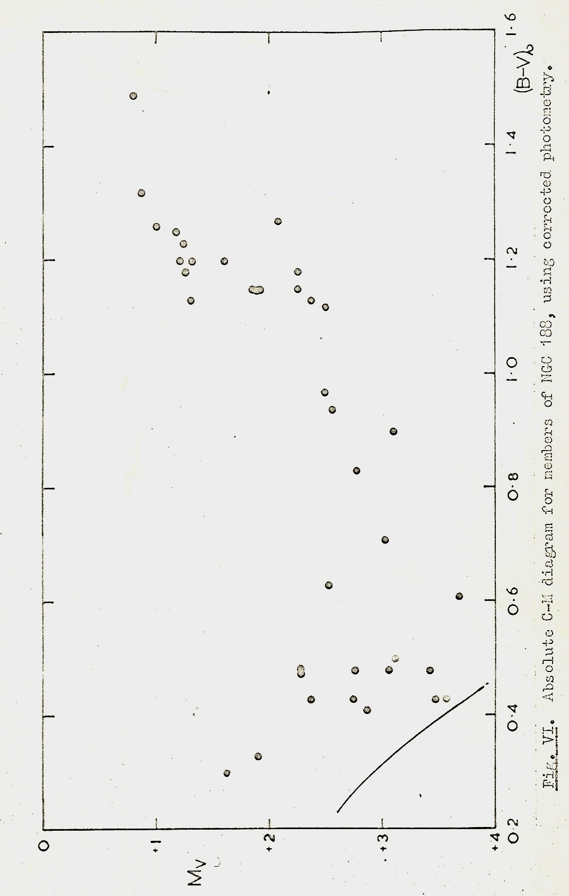
Early NGC 188 CMD
CMD of NGC 188 bright proper motion members
Cannon 1968, PhD
Notes:
Bright stars only, well above main sequence turn-off (using photographs from the Greenwich 13-inch astrograph, used for Carte du Ciel)
Using poorly calibrated photographic photometry, hence unpublished

Slide 14
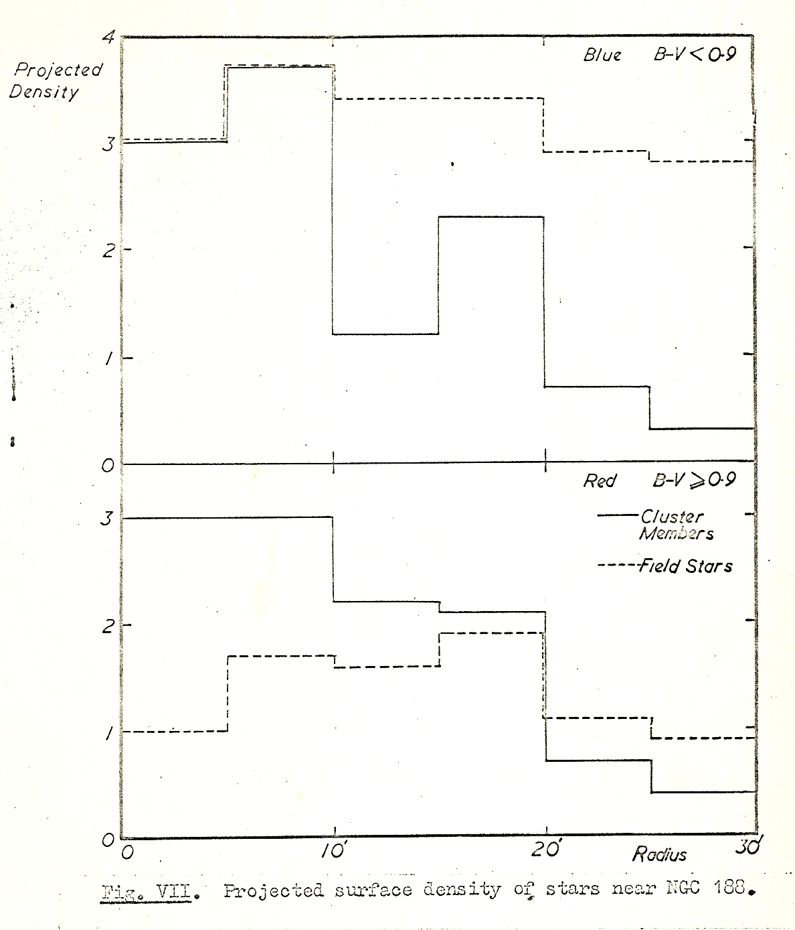
Radial distribution of Blue Stragglers and Red Giants in NGC 188
Solid histograms for cluster members, dashed lines field stars. Upper panel for BSs, lower panel for red giants
Notes:
It was immediately clear that NGC 188 contains a significant number of BSs, comparable to the number of red giants

Slide 15
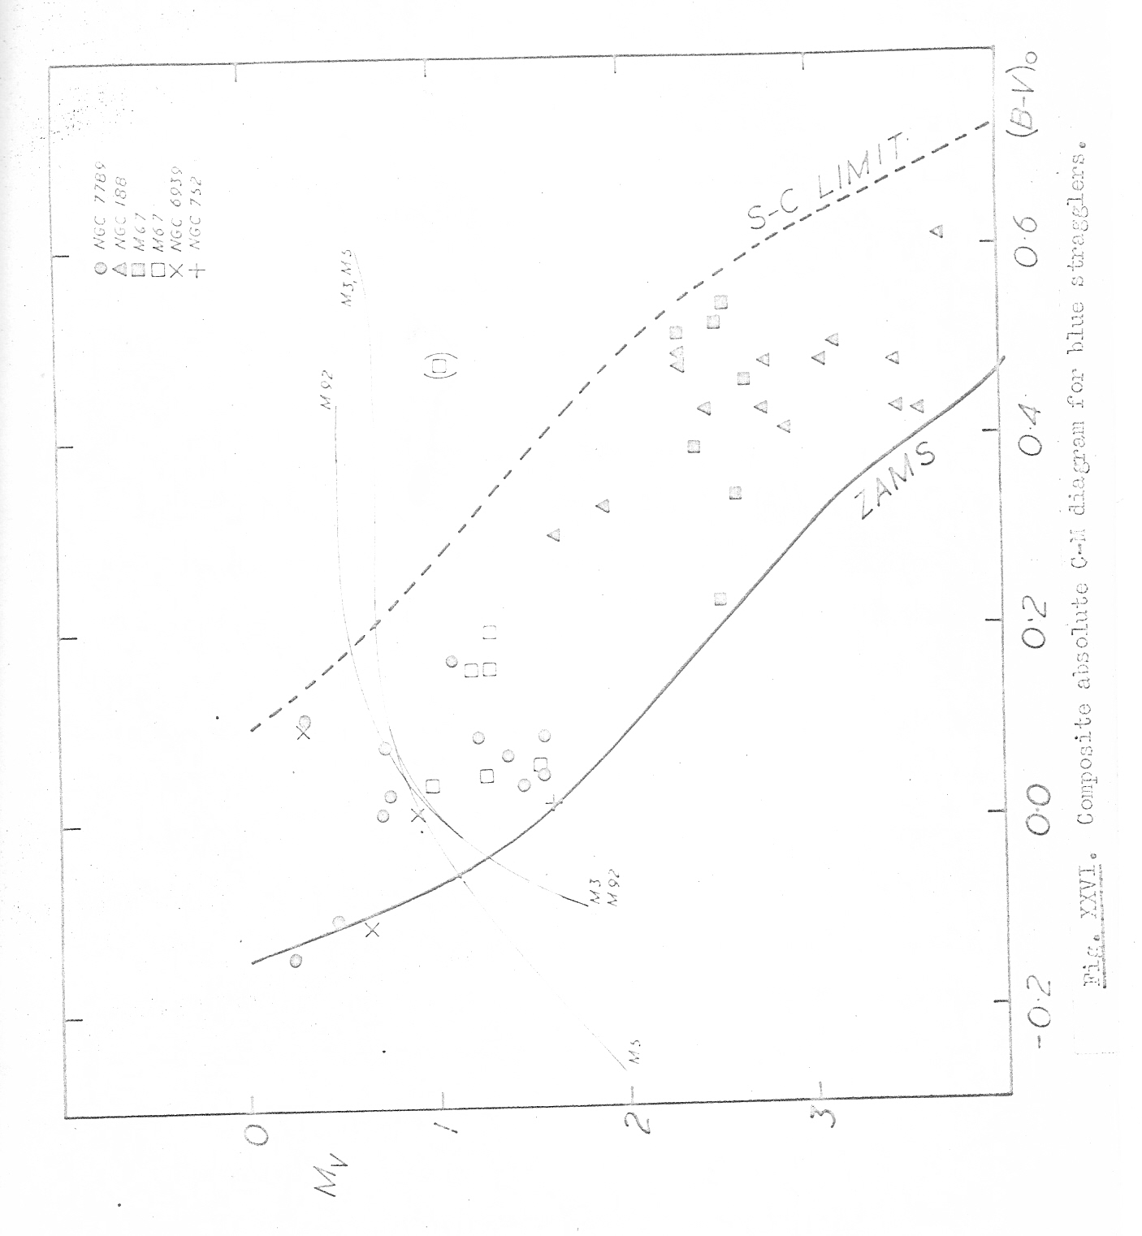
Blue Stragglers in 5 old open clusters
A composite absolute CMD for proper motion members
Nearly all BSs lie between the ZAMS and the blue side of the Hertzsprung Gap.
There is no obvious connection with the globular cluster HB.
Notes:
Combined data for NGC 7789, NGC 188, M67, NGC 6939 and NGC 752, corrected for the reddening and distance to each cluster.
The dashed line represents the Schoenberg-Chandrasekhar limit.
The thin curved lines represent the HBs for M3, M5 and M92.
Apologies for this very poor copy of a copy of a long lost original.

Slide 16
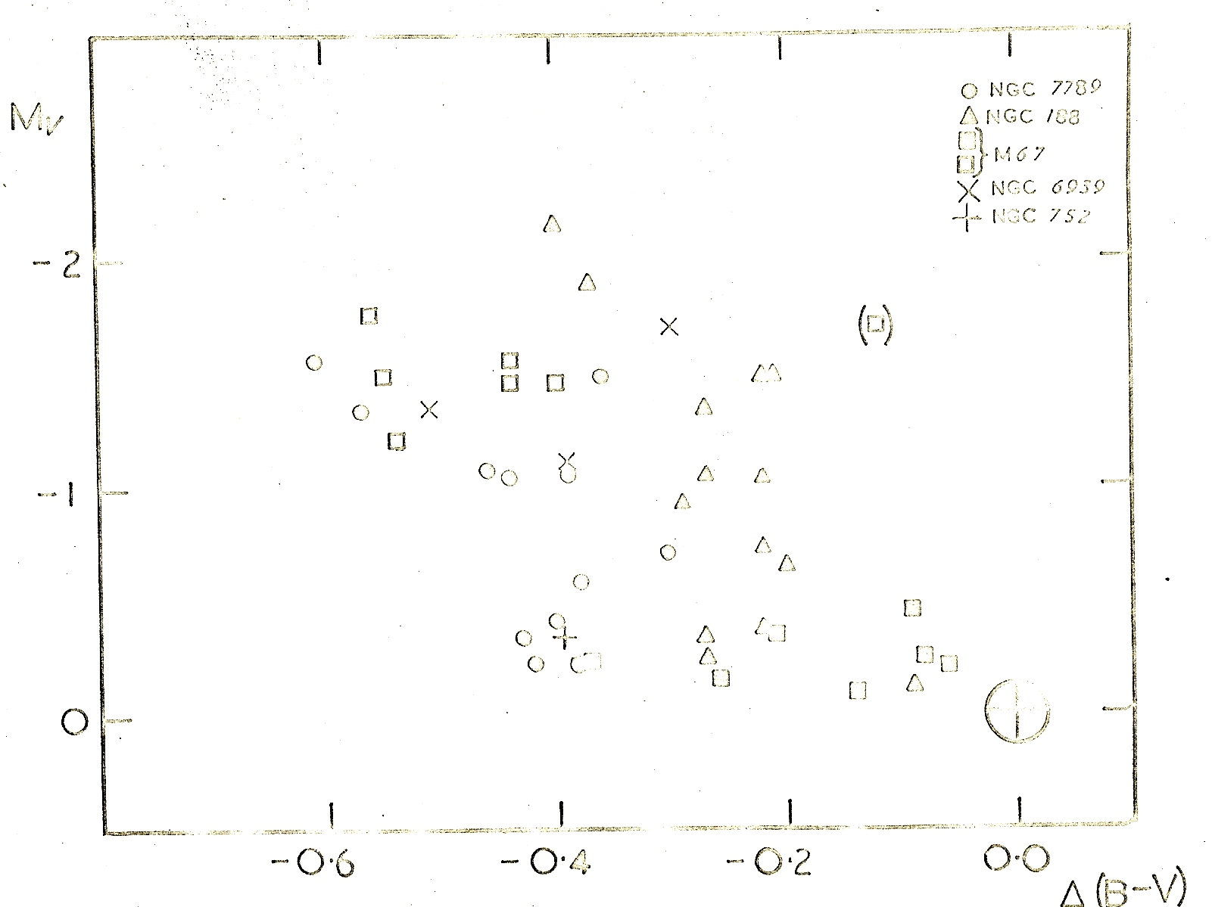
BSs relative to cluster MSTO
CMD for BSs relative to m.s. turn-off in 5 old open clusters
NGC 7789, NGC 188, M67, NGC 6939 and NGC 752
Notes:
1. The horizontal and vertical red dashed lines are tangential to the upper luminosity limit and blue colour limit respectively, for stars on the well-populated upper main sequence in each cluster.
2. Note that the BSs are within 2 magnitudes of the turn-off, as they should be for any binary transfer or coalescence mechanism (but the very bright BS F81 in M67 has been omitted here: an example of the use of “sno-pake” referred to subsequently by George Preston).

Slide 17
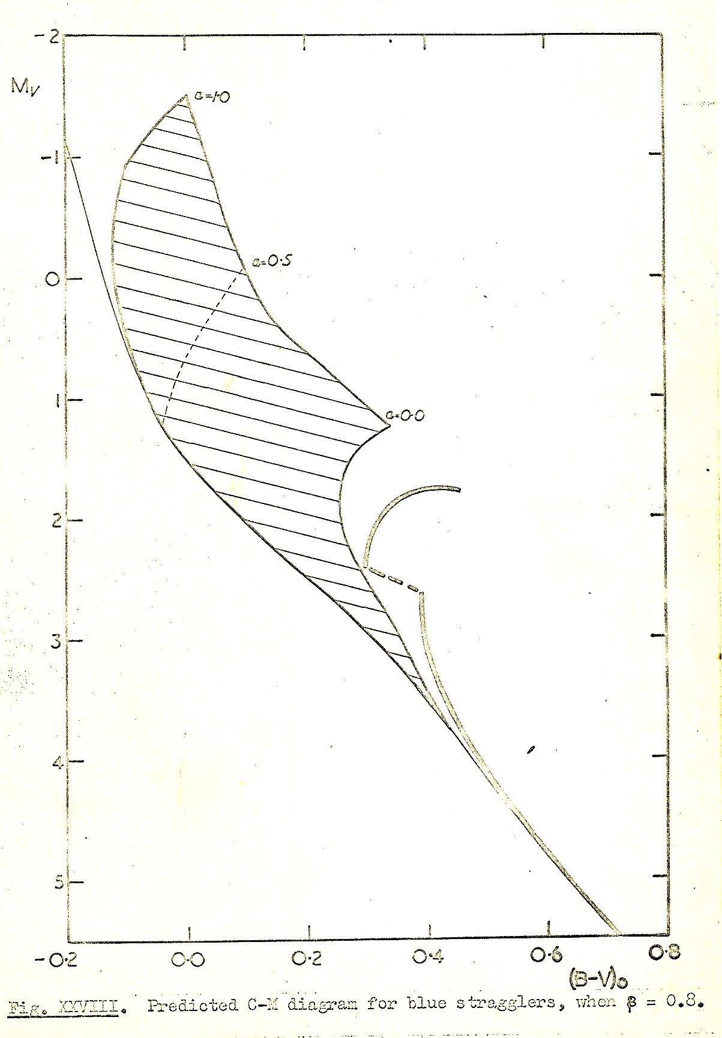
Toy models for mass exchange binaries
Note that there is a lower limit for BSs resulting from mass exchange in binary systems, but not for direct collisional mergers.
Notes:
These models involved a moderately complex interpolation process between a small set of isochrones available at the time, by Icko Iben.
Two free parameters were the mass retained in the system (in this case 80%) and the initial mass ratio (ranging from 1.0 at the upper limit down to 0.0 at the bottom).

Slide 18
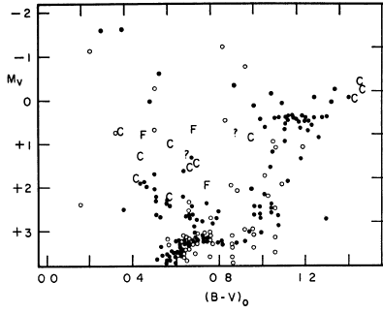
The curious case of NGC 6791
Kinman T D 1965, ApJ 142 655
Notes:
This CMD of an old Open cluster introduced the spectre of “yellow” Blue Stragglers

Slide 19
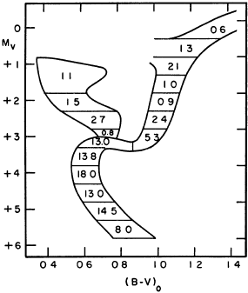
NGC 6791 Schematic CCD
Notes:
Illustrating the use of a schematic diagram to guide the eye in a noisy or contaminated CMD (Kinman, 1965)

Slide 20
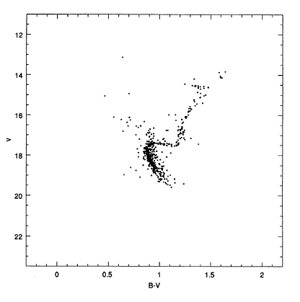
CCD CMD for NGC 6791
Montgomery K A, Janes K A & Phelps R L 1994, AJ 108 585
(p.m. members Cudworth K 1994; cf Kaluzny J 1990)
Notes:
These more precise CMDs confirmed the main features found by Kinman (1965).
The redward shift of the BSs above the turn-off remains unexplained, so far as I am aware.

Slide 21
What is NGC 6791, as seen in 2012?
Globular or old Open cluster?
25 published papers in 2011-12 (ADS)
Happens to be in the Kepler field
Age ~ 8 Gy, [Fe/H] ~ +0.4: unique such cluster
Multiple populations from CN/CH and Na/O
Has binaries, incl. BSs
Also contains hot Blue Horizontal Branch stars
Asteroseismology: core masses and mass loss
On borderline between GC and OC
Notes:
NGC 6791 is right in the corner of one of the outer CCDs of the 100 square degree Kepler field; I suppose this may not be just good luck.

Slide 22
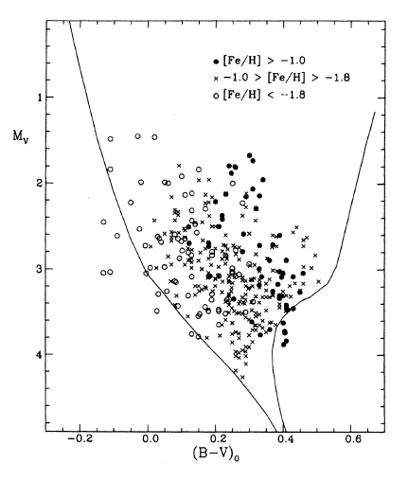
425 BSs in 21 Globular Clusters
Fusi Pecci F et al 1992, AJ 104 1831
Notes:
The scatter in colour is mainly due to metallicity (to be discussed by Francesco Ferrari and others at this ESO meeting).

Slide 23
409 BSs in 22 globular clusters
Sarajedini A 1993, ASP Conf 53 14

Slide 24
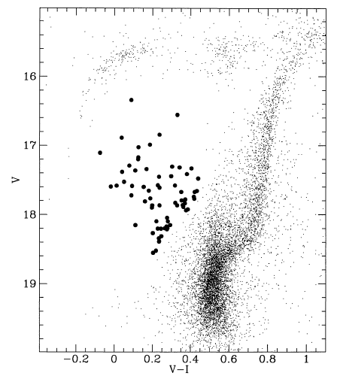
More BSs in M3
Fusi Pecci, Ferraro & Cacciari 1993, ASPConf 53 97
Notes:
1. Used as the cover illustration for the STScI Workshop.

Slide 25
Evidence for two or more BS formation mechanisms in GCs
  Spatial distribution (e.g. in M3, Fusi Pecci, Ferraro & Cacciari, 1993)
  HST discoveries in the cores of dense clusters
  A mix of primordial binaries, with mass exchange or coalescence
  And collisions in dense cores, which may both create and destroy multiple star systems (as well as solving the core collapse dynamical problem)

Slide 26
Environmental effects in GCs – are we being misled?
We now realise that stars in clusters are neither chemically homogeneous nor coeval
There is interdependence between stellar evolution and cluster dynamics
Stellar evolution has been fine-tuned to fit star clusters, esp. globulars
There are still major gaps in standard evolutionary theory (e.g. AGB mass loss)
Notes:
1. The point here is that we may be being misled when synthesising the spectra of distant galaxies at large redshift. Our models lack reliable predictive power, e.g. for Blue Horizontal Branch stars as well as BSs

Slide 27
More on Open clusters
I have ignored the important early work of Ed van den Heuvel, showing that Ap and Am stars in younger open clusters are classical BSs (e.g. van den Heuvel 1968, BAN 19 326)
Mario Mateo gave a good review of work on variable stars, both physical and eclipsing, at the 1992 STScI workshop

Slide 28
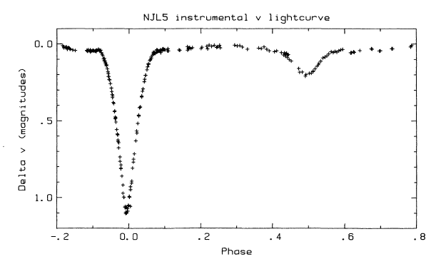
Light curve for NJL 5 in ω Cen
Jensen K S & Jorgensen H E 1985, A&A Supp 60 229
NJL = Niss B, Jorgensen H E & Laustsen S 1978, A&AS 32 387
Notes:
1. NJL 5 is evidently a classical Algol-type eclipsing binary, with two similar sized components. It offers a rare opportunity to determine the mass of a BS.

Slide 29
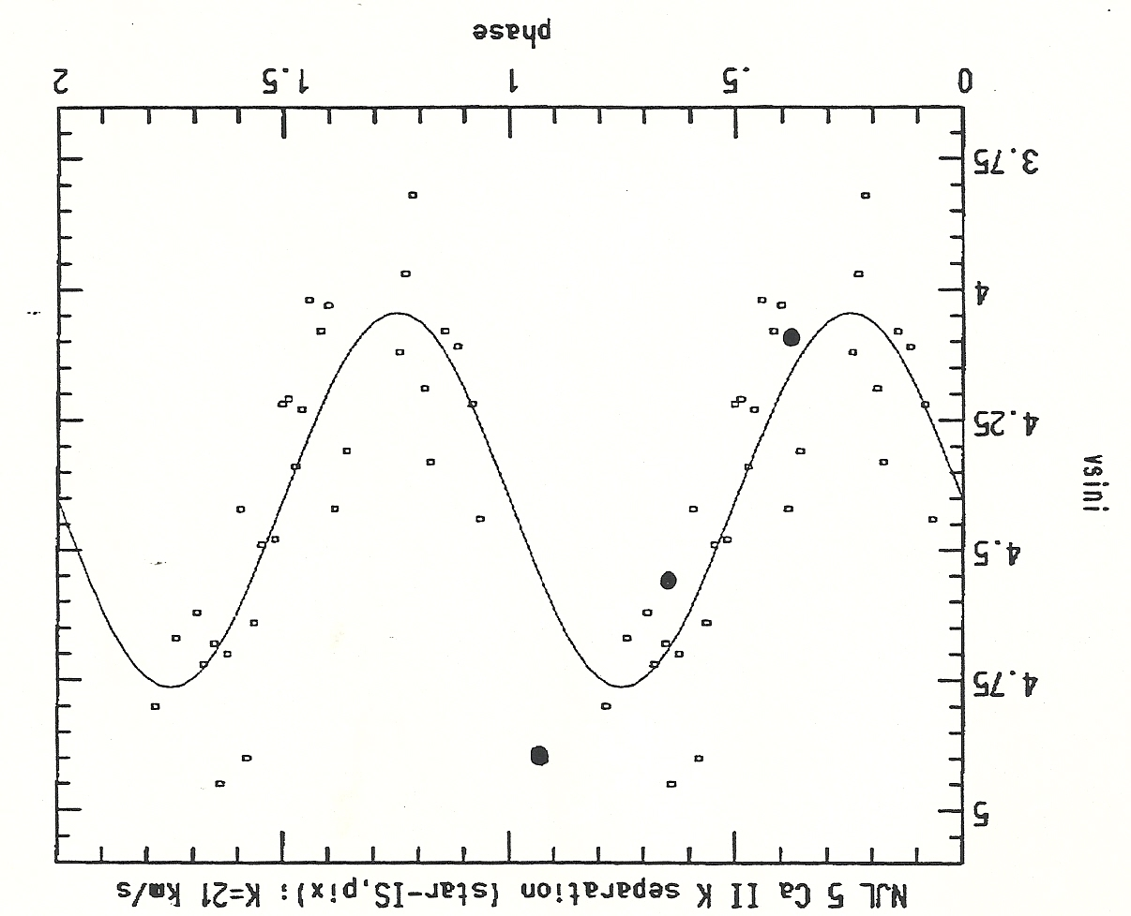
NJL 5 radial velocity curve (1988)
Small dots: CTIO (Margon) Large: AAT (Cannon & Stathakis)
Notes:
1. Bruce Margon came to the AAO on sabbatical in about 1988. We tried for several years to get spectra of NJL 5 on the AAT, using a variety of spectrographs, detectors and wavelength ranges, but were always beaten by bad weather. This diagram comes from one of our time applications, based on Margon’s CTIO 4m spectra.

Slide 30
Why we failed with NJL 5
At ~16 mag, it is one of the brightest BSs in ω Cen but still faint for a 4m in poor weather
We hoped to see double lines, to derive masses
Complicated to schedule the observations
The Calcium triplet lines land on top of hydrogen Paschen lines in the near IR
“We are currently obtaining the necessary spectroscopy at much higher resolution to determine the orbital parameters of NJL 5”
Notes:
We also had to re-determine the ephemeris for NJL 5 using new photometry, to ensure all the data were correctly phased.
One paper did get published, Margon & Cannon 1989, The Observatory 109 82, confirming that NJL 5 is a cluster member

Slide 31
Pros and cons for BSs in Open Clusters
Small sample of older OCs
Few BSs in each cluster
Cluster membership?
Reddening and dust?
Confusion with BHB stars in oldest Ocs
Nearer, with brighter stars
N-body modelling easier for 1000s of stars

Slide 32
Some practical difficulties
For Open clusters, it is still surprisingly difficult to get very precise photometry or positions (for proper motions) across fields of view of 1-2 degrees
In Globular clusters, it is hard to get comparable data for stars in dense cores and sparse outer regions

Slide 33
Future prospects
GAIA (distances and proper motions)
Near IR spectroscopy (better abundances)
Asteroseismology (cores in red giants)
We should be able to model many BSs
Predicting the existence of BSs, and their effect on the integrated spectra of high redshift galaxies, may take a little longer

