Slide 1




ESO from an Italian perspective
30 years of Italian participation to ESO
Monica Tosi
INAF – Osservatorio Astronomico di Bologna
Roma July 2nd 2012

Slide 2
1982:
Italian astronomy enters a new era
March 1982: a new law (DPR 163) introduces a modern organization of the Observatories;
May 1982: Italy enters ESO

Slide 3
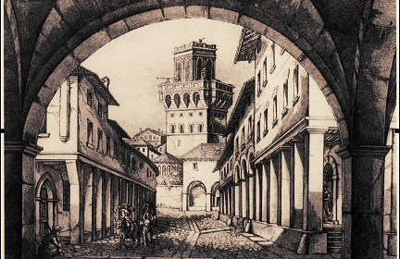
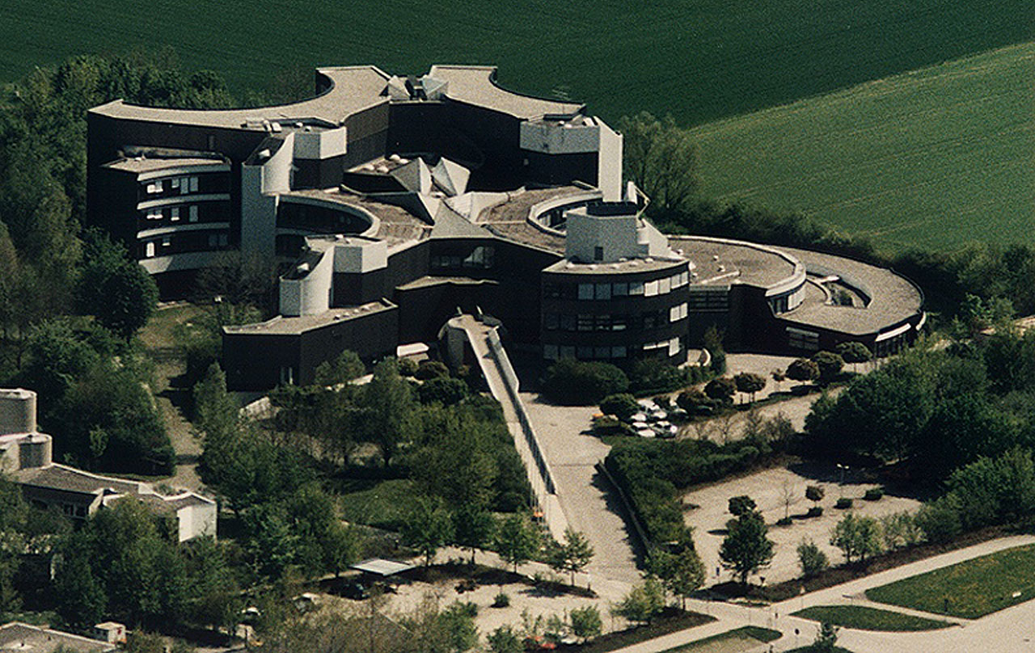
1982:
Italian astronomy enters a new era
From the Middle Ages to the 20th century

Slide 4
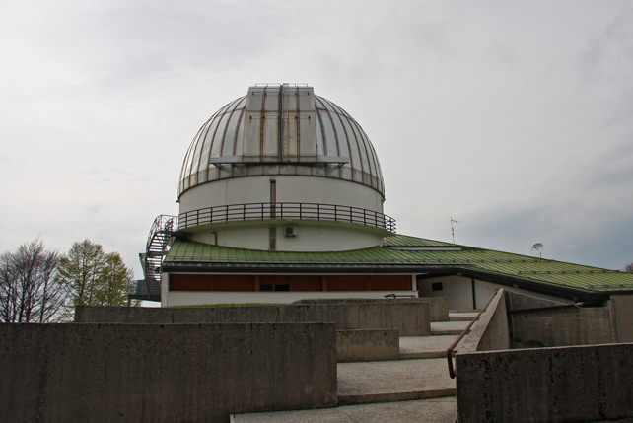
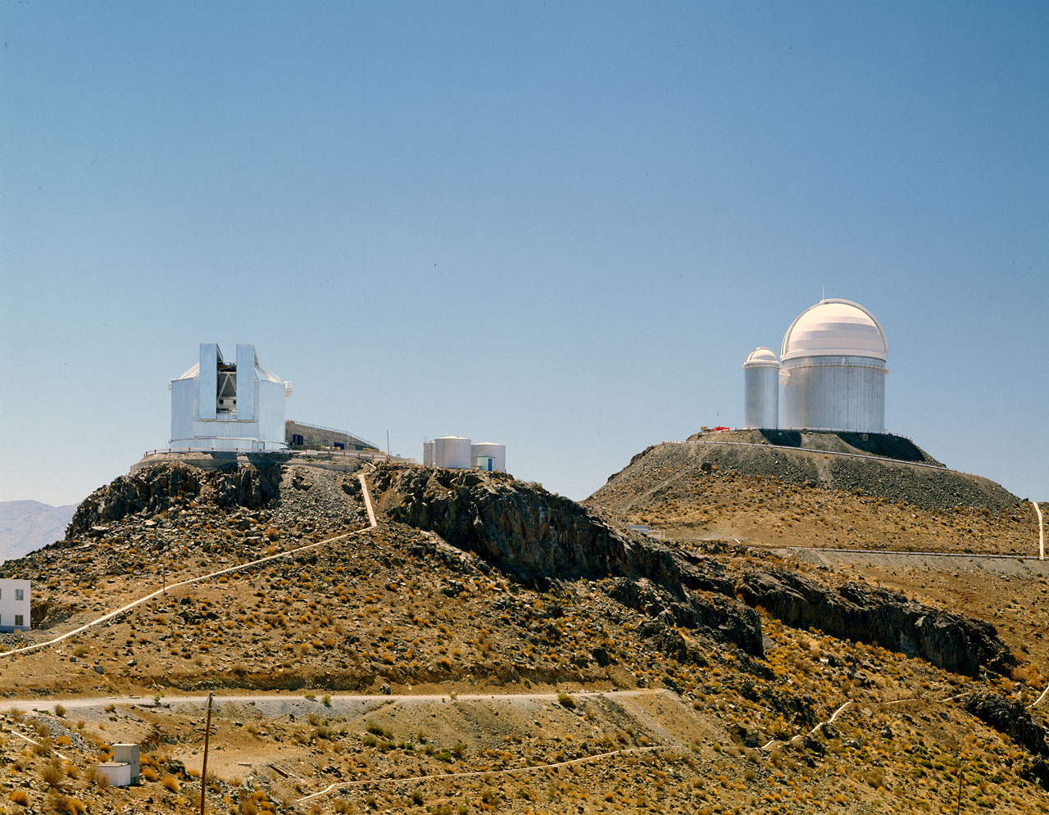
1982:
Italian astronomy enters a new era
From a 1.8m telescope with this sky
To 4m class telescopes with these skies
Asiago
NTT and the 3.6 m in La Silla

Slide 5
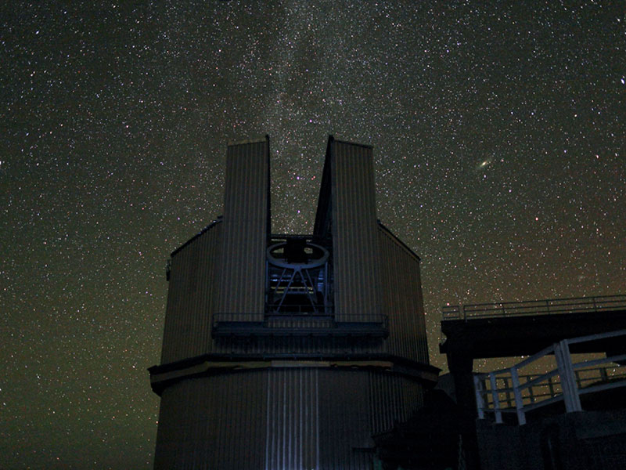
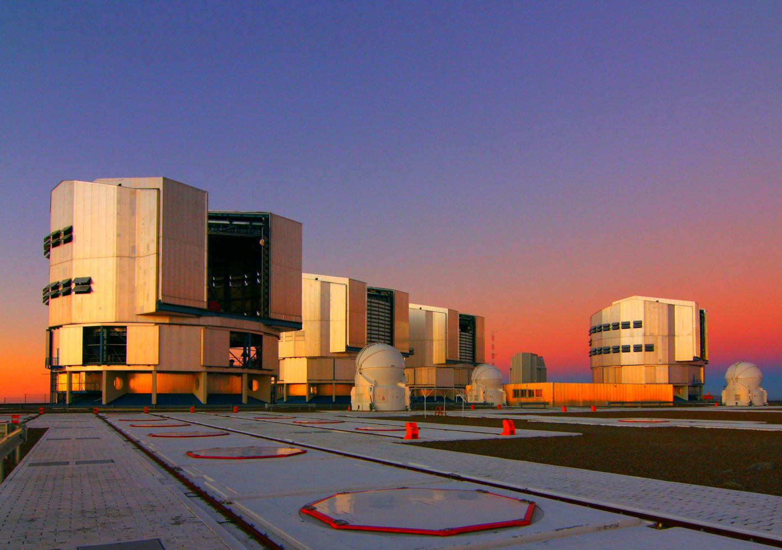
1982:
Italian astronomy enters a new era
And later, from this …
… to these
VLT
TNG

Slide 6
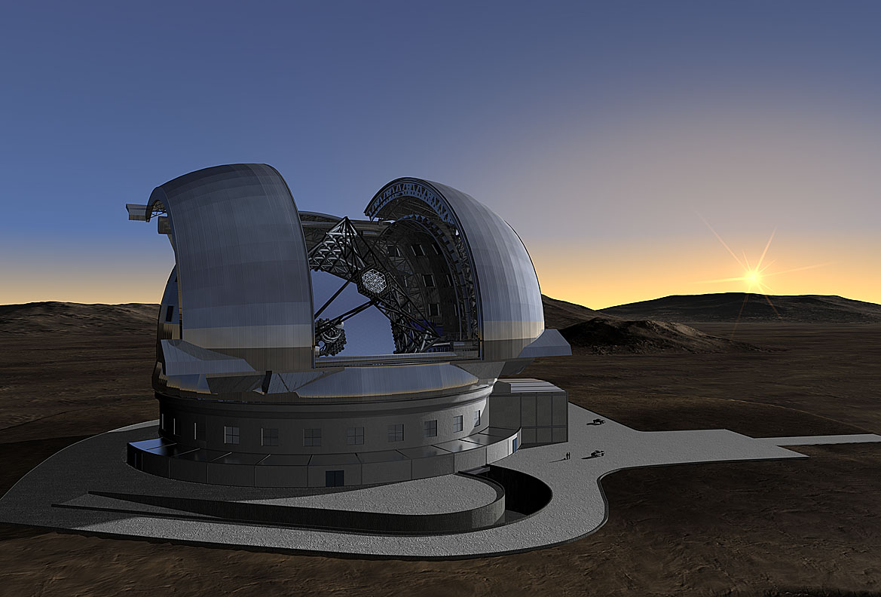
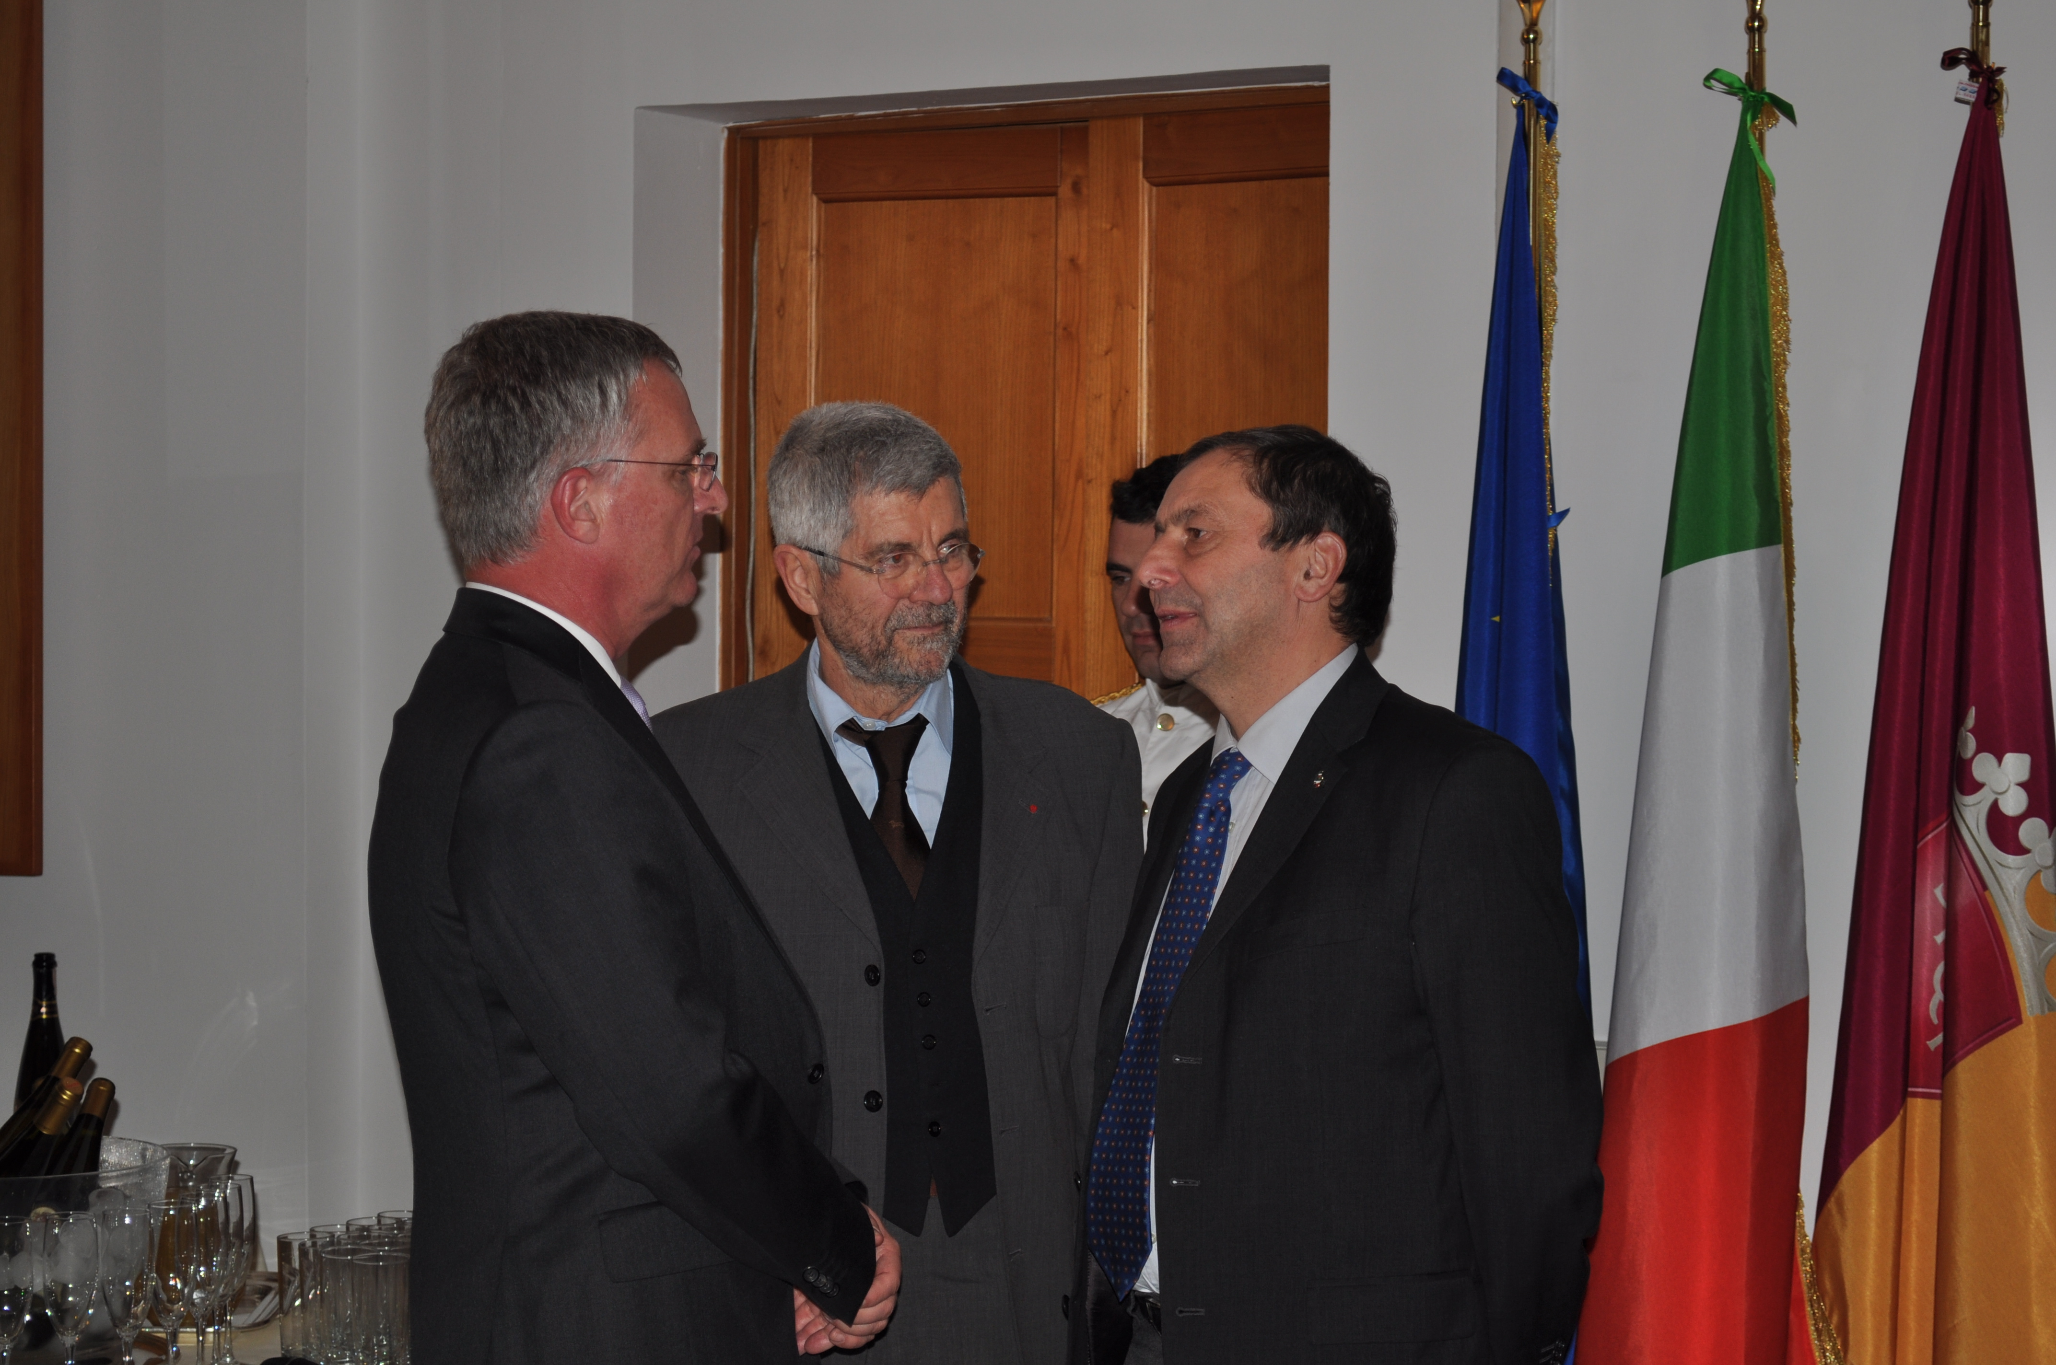
1982:
Italian astronomy enters a new era
… and eventually to this !
E-ELT
February 2012: ESO DG, INAF President and Italian MIUR Minister meet at INAF HQ.
June 2012: Italy votes ad referendum in favor of the E-ELT approval (score 10 to 4)

Slide 7

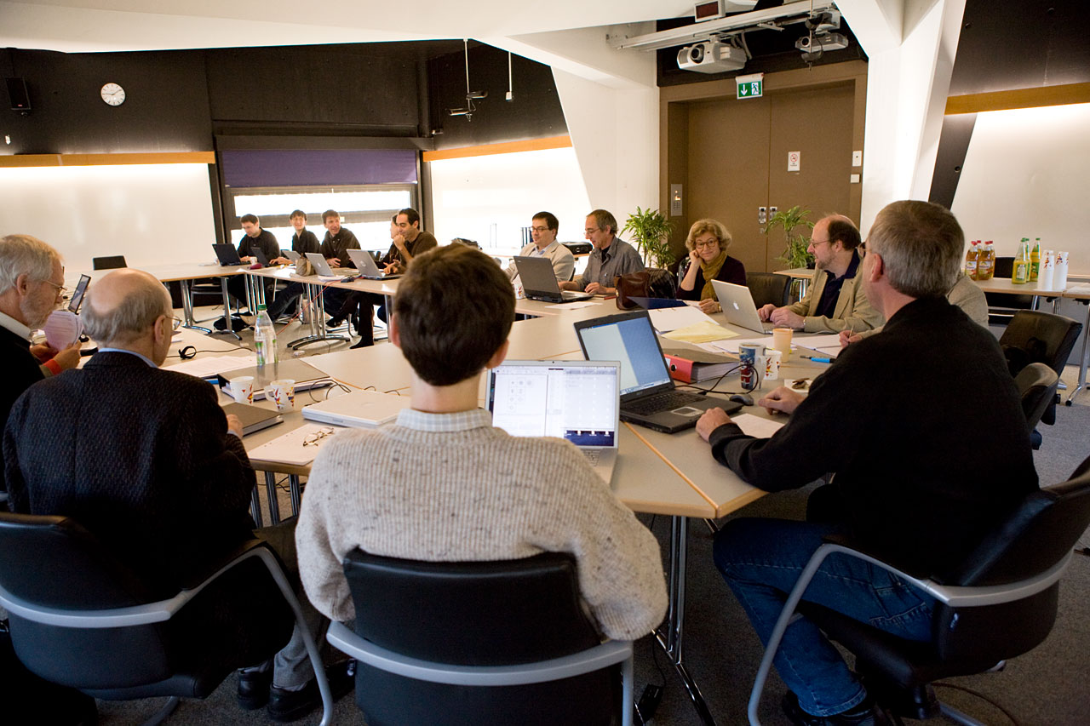
Significant investment and workload
OPC at work (Nov 2006)
2006
L. Wisotzki: OPC chair
Catherine Cesarsky: DG
M.T. (OPC chair in 2008)

Slide 8

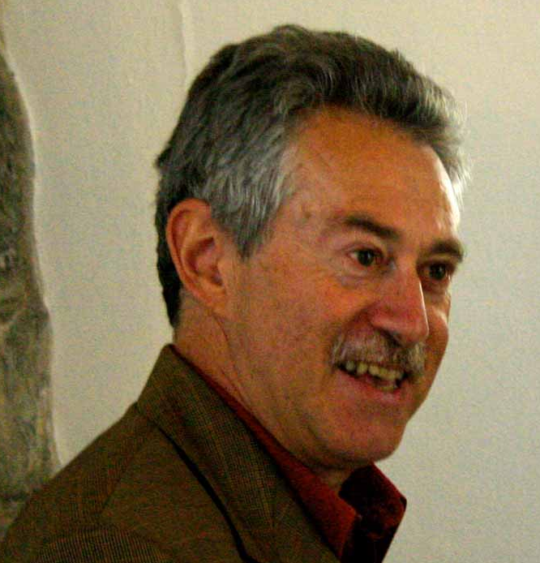
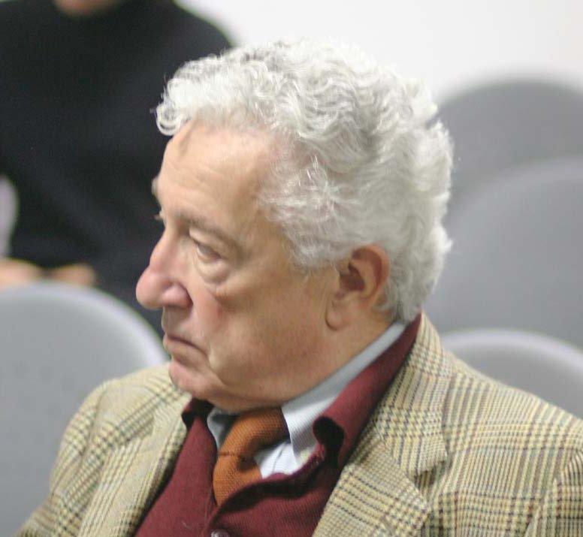
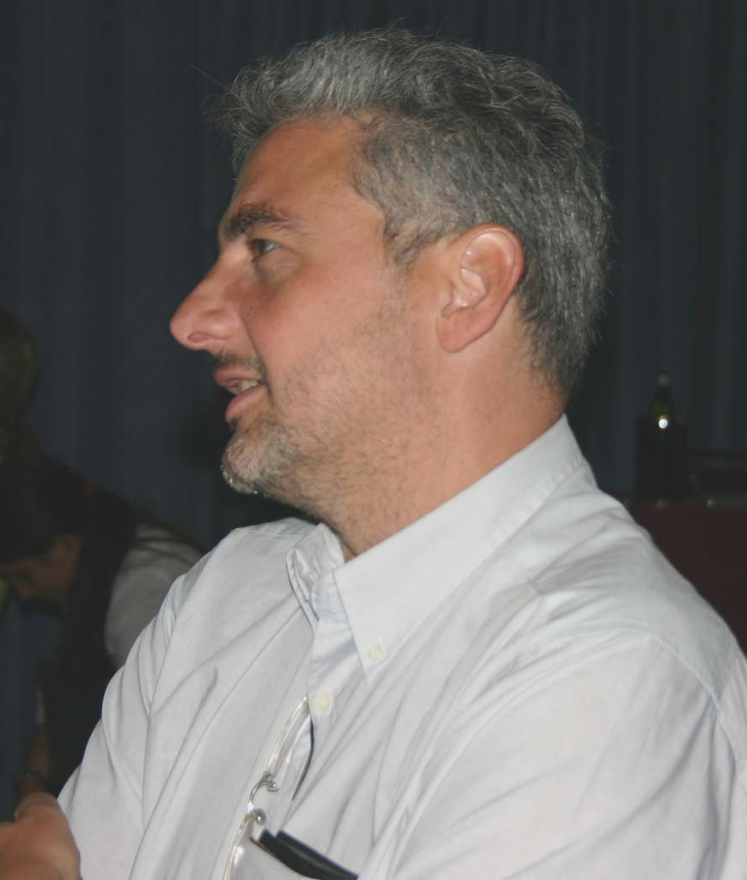
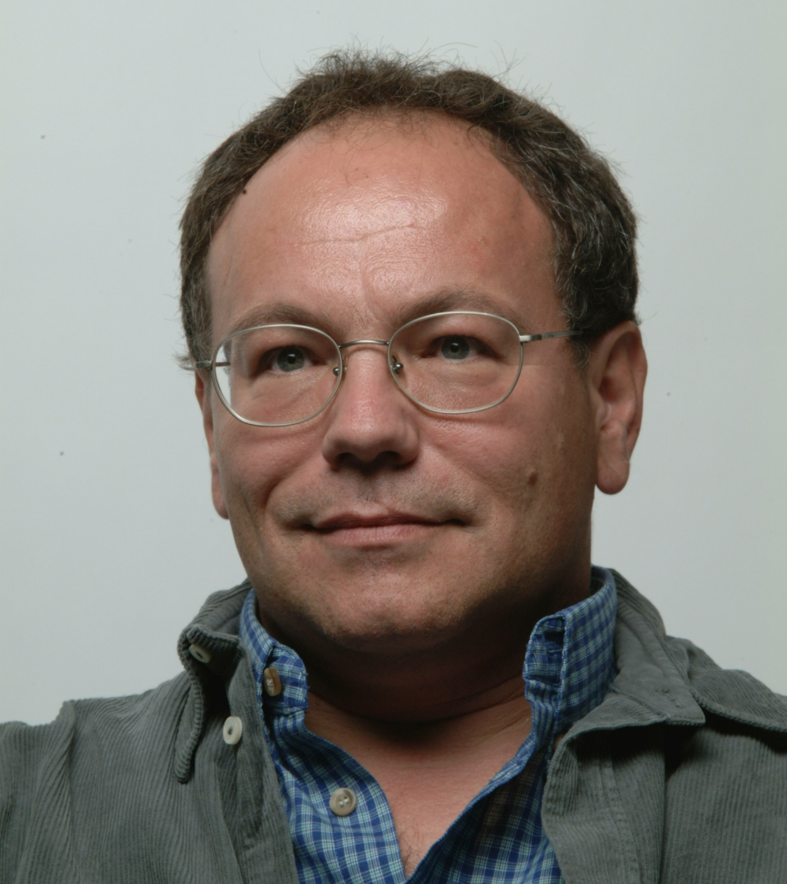






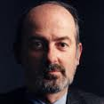
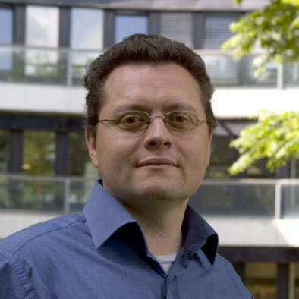



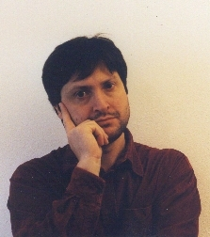
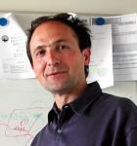




Significant emigration …

Slide 9

Significant return
(not much in - quantitative - terms of immigration …)
in scientific achievements of the Italian astrophysical community
From P59 (April - Oct 1997) until P89 (Apr - Oct 2012) 54 LPs with Italian PIs were submitted, of which 22 were scheduled: about 18% of approved LPs.
To be compared with a current financial contribution of ~13%.
good investment !

Slide 10
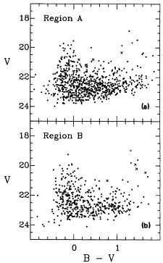
Star formation histories from CMDs of resolved stellar pops compared to synthetic CMDs
The whole business started at ESO, with these (shameful) CMDs. Nowadays it is a very successful worldwide enterprise.
Admittedly thanks mostly to HST …
Sextans B; (m-M)₀=25.6 or 1.3 Mpc.
Data acquired at the old 2.2m ESO-MPI telescope in La Silla in 1988
(Tosi et al 1989, 1991)

Slide 11
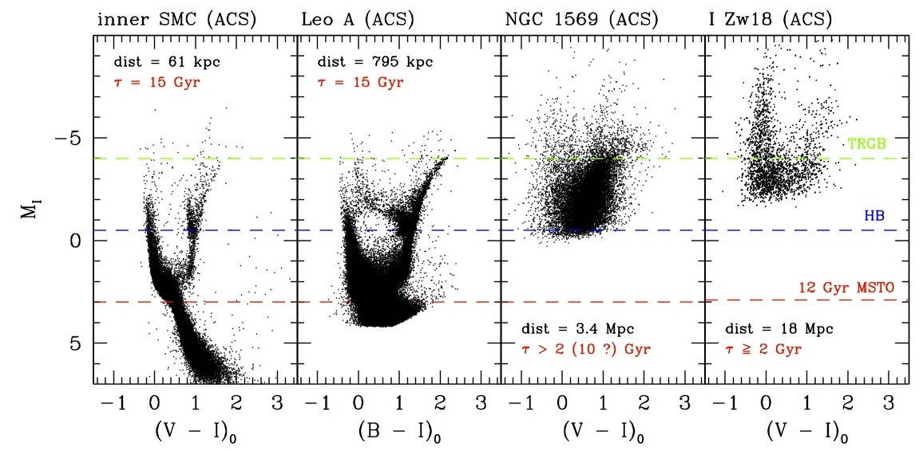
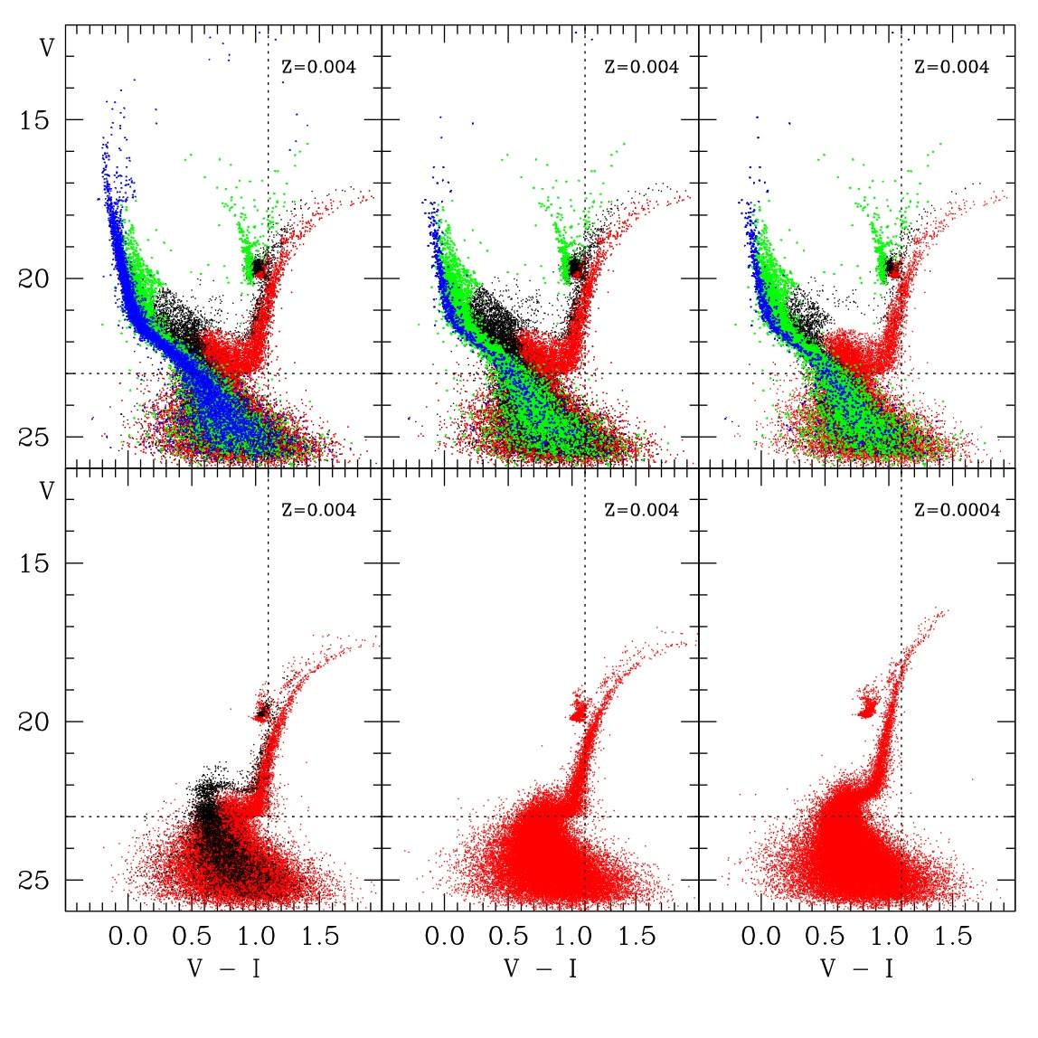
Star formation histories
Admittedly thanks mostly to HST …
Synthetic CMDs
(Cignoni & Tosi 2010)
Tolstoy, Hill, Tosi, 2009 ARAA

Slide 12
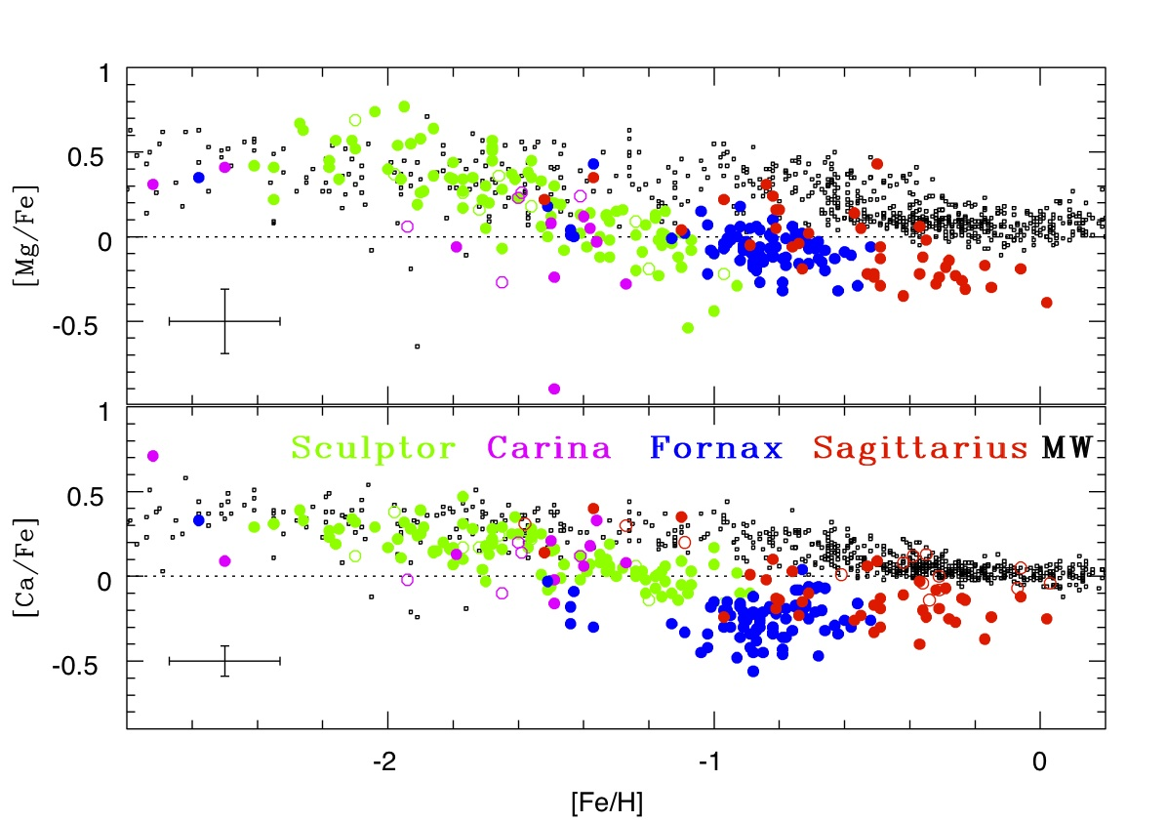
Star formation histories
Synergy with HST
Without Flames@VLT we wouldn’t know the chemistry !!!
Tolstoy, Hill, Tosi, 2009 ARAA

Slide 13
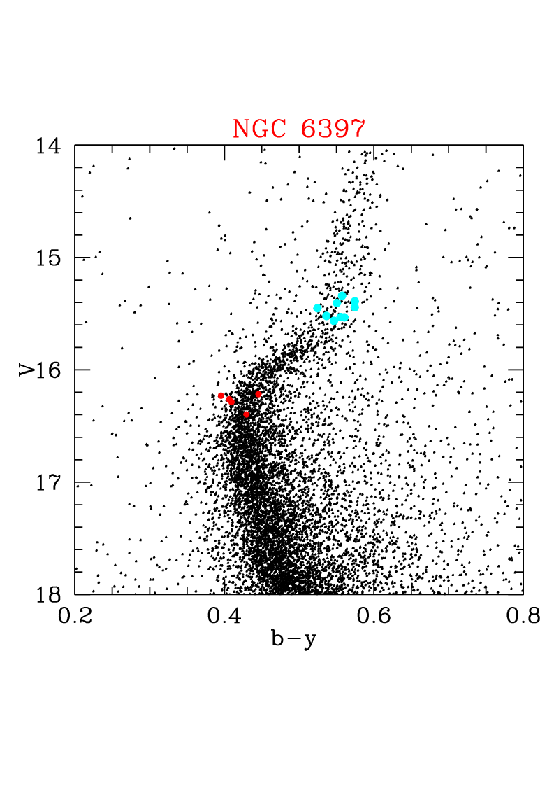
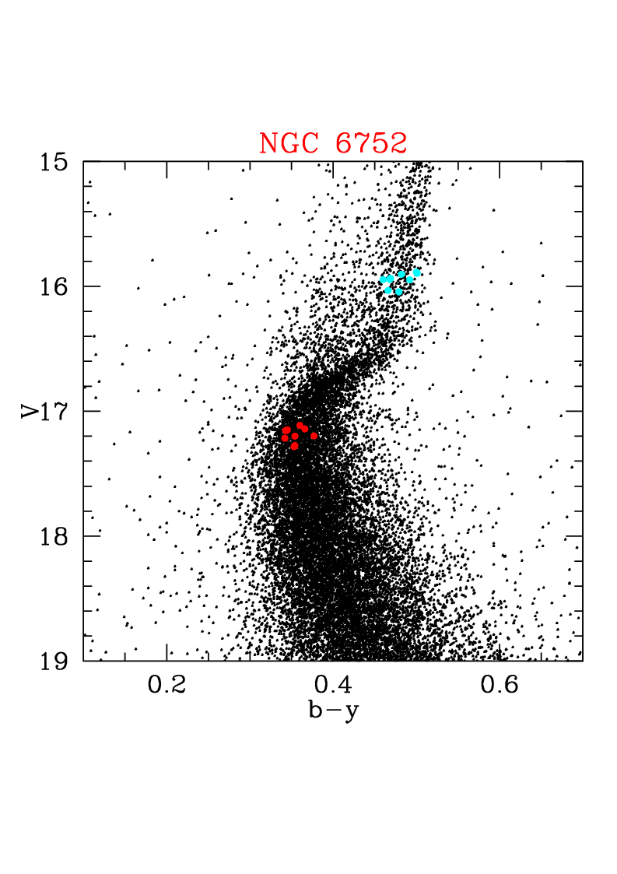
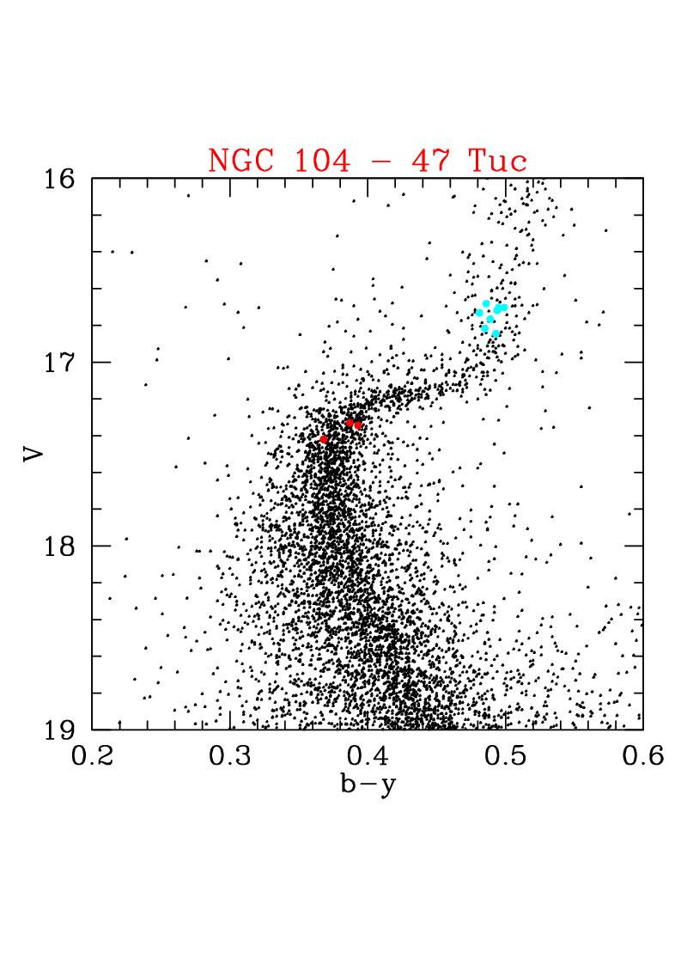
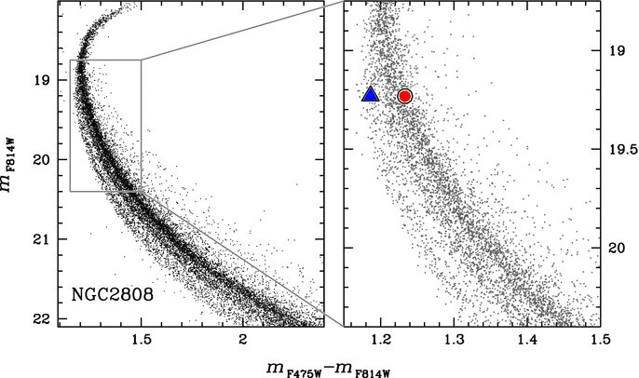
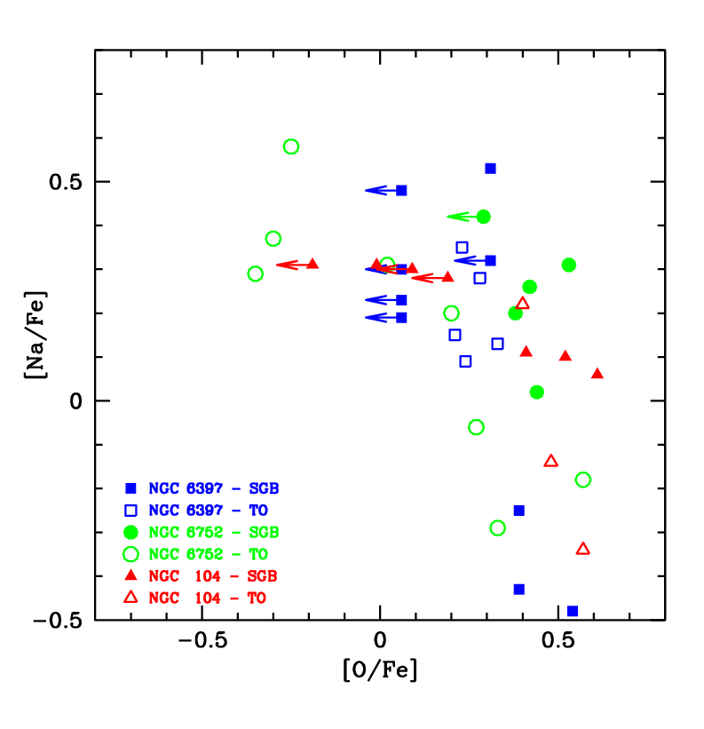
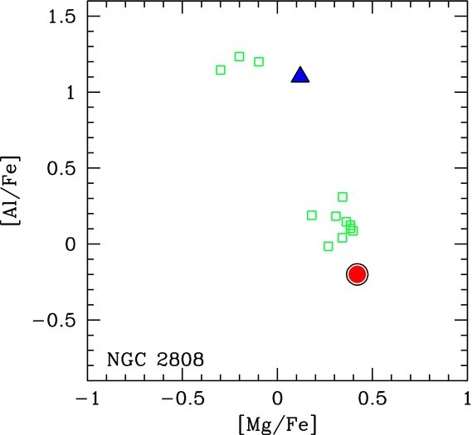
Non evolved GC stars reveal the true nature of clusters: they are composed by multiple generations
F814W
NGC6397 47Tuc NGC6752
Na-O & Al-Mg
anticorrelation :
high-temp H-burning,
not possible in MS
must come from
previous generation
F475W-F814W
NGC2808
165.L-0263 (2000-2002) 20n
LP, UVES, PI Gratton
084.D-0070 (2010) 1.25n
Xshooter GTO (PI Carretta)
Notes:
Large variations in light elements had been found for decades in GCs, showing anticorrelations between C & N, Na & O, Mg & Al.
They are due to high-temperature hidrogen burning in the CNO, NeNa and MgAl cycles; especially the later require T>50 or 70 MK.
When found in giants they could be due to mixing of self-produced elements during core & shell burning or to an external pollution.
When found in low-mass, non evolved stars like the ones on the MS or SGB, the first explanation is excluded, since these stars neither
can reach the temperature required for the nucleosynthsis nor can mix the produced elements to the surface.
A large program on UVES@VLT, lead by Gratton, was able to discover the Na-O and Mg-Al anticorrelations in non evolved stars in 3 nearby GCs, convincingly demonstrating for the first time that the only possible explanation of this chemical signature, seen only in GCs, is that these abundances
have been established by a previous generations of more massive stars (e.g. Gratton et al. 2001, Carretta et al. 2004). Those polluted the material from which a second generation then formed. Other works have confirmed this result (e.g. J.Cohen and collaborators).
Recently FLAMES spectra of about 100 MS stars of 47Tuc (D’Orazi et al. 2010) extended work on the Na-O anticorrelation,
In the case of NGC2808 the presence of multiple population is visible also from the photometry, with the triple MS (here the major effect is the He content). Two stars on the He-normal MS (first generation) ad He-rich MS (second generation) were studied with Xshooter; they confirmed the same pattern of elements found in giants (here the Mg and Al abundances are shown, green for giants, blue & red for MS stars; Bragaglia et al.2010). Six new stars where recently (Jan 2012) observed to extend the sample (088.D-0234, 4 nights, PI Bragaglia)

Slide 14
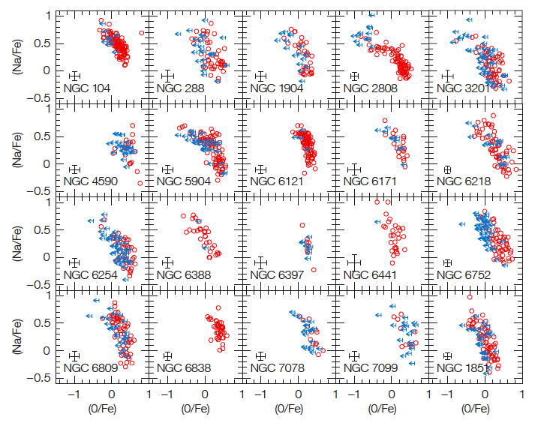
FLAMES survey of ~100 RGB stars in each of 25 MW GCs confirms & quantify universality of
multiple populations in GCs
[Na/Fe]
072.D-0507
073.D-0211
081.D-0286
083.D-0208
085.D-0205
(2004-2010)
FLAMES
PI Carretta
25 GCs :
ALL show
Na-O anti
correlation
➔
ALL have
multiple
populations
➔
defining
property
of GCs
[O/Fe]
Notes:
Using FLAMES it was possible to study the Na-O anticorrelation (hence the presence and properties of multiple population in GCs) in a large sampel of stars in a large sample of GCs. With a series of GO programs amounting to about 15 nights in 7 years, about 100 RGB stars were studied in each of 25 MW GCs (among which M54 and ngc1851). These observations produced data on about 2500 stars, to be compared to the about 400 studied before.
The study permitted to show that the anticorrelation is present in all GCs examined and further confirmed that it is a general property of these clusters.
Furthermore, it showed that there are differences cluster-to-cluster, mainly driven by the total mass and that first and second generation stars coexist in all clusters studied.
(Carretta et al. 2006, 2007ab, 2009abc; 2010ab, 2011; Gratton et al. 2007). An extension to HB stars is now under way (Gratton et al 2011, 2012)

Slide 15
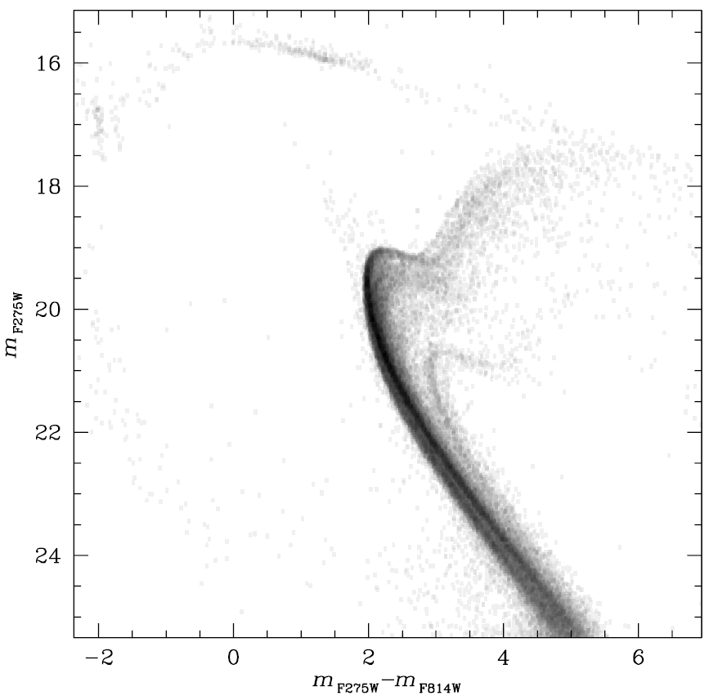
Spectacular
CMD of Omega Centauri from UV data from the WFC3 camera onboard HST.
Try to count the single SGBs. We see at least 11 SGBs!
HST-VLT synergy
Bellini et al., 2010, AJ, 140,631

Slide 16
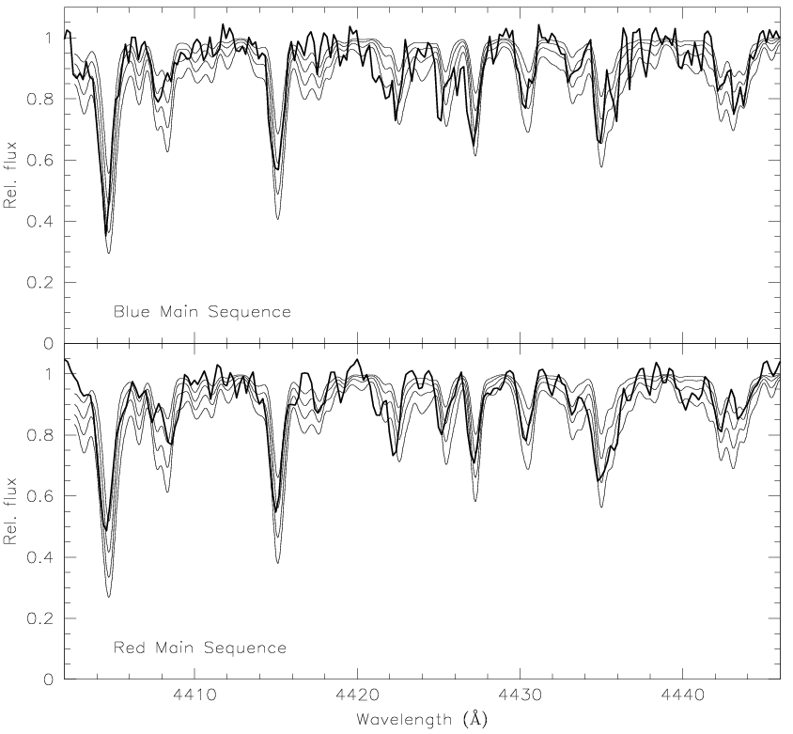
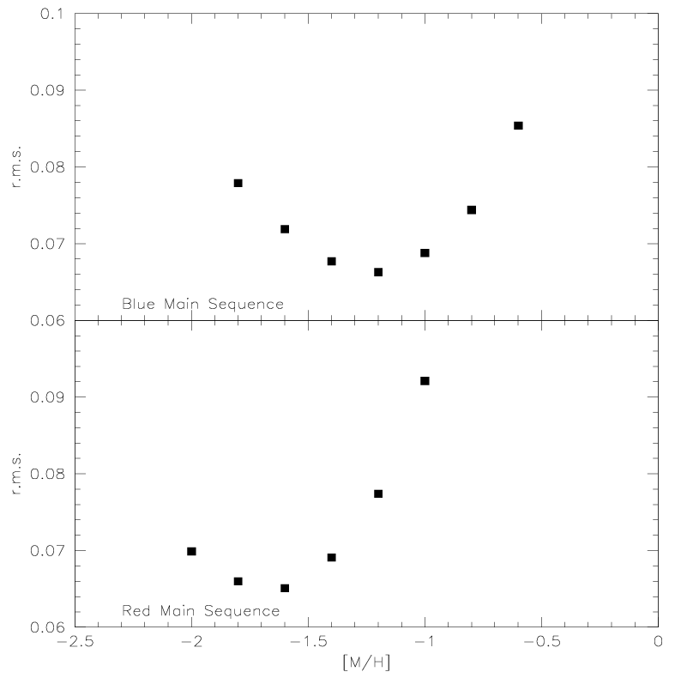
The most surprising discovery: FLAMES+GIRAFFE (DDT time)
RedMS:
Rad. Vel.: 235+-11km/s
[Fe/H]=-1.56
BlueMS:
Rad. Vel.: 232+-6km/s
[Fe/H]=-1.27
It is more metal rich!
17x12=204 hours i.t.
Piotto et al. (2005, ApJ, 621,777)

Slide 17
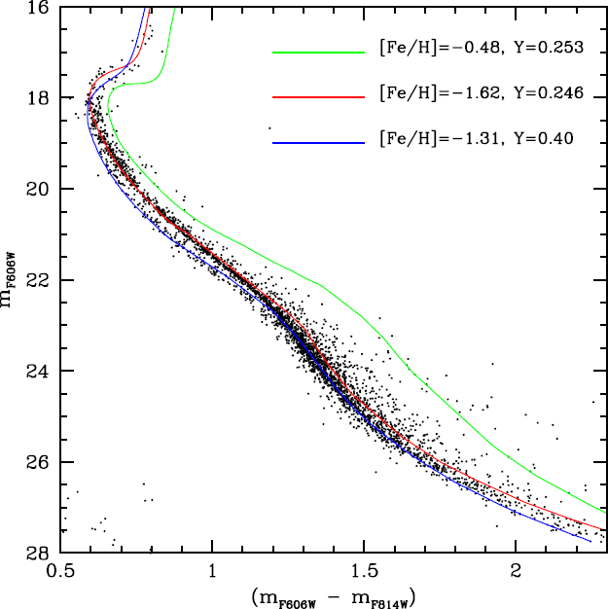
The only way we have to interpret both photometric and spectroscopic observations is to assume a strong He enhancement: Y=0.39±0.02
1.4x10⁵ solar masses of fresh helium are embedded in the second generation of stars

Slide 18
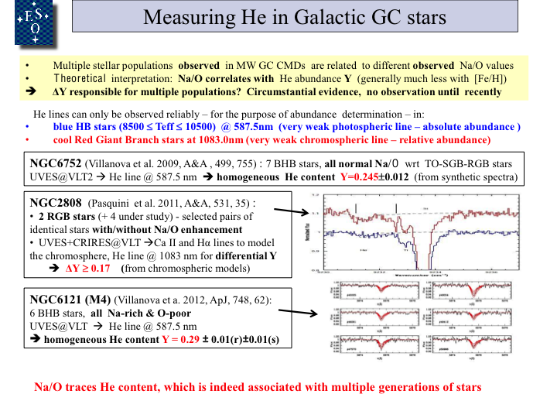
Star formation histories

Slide 19
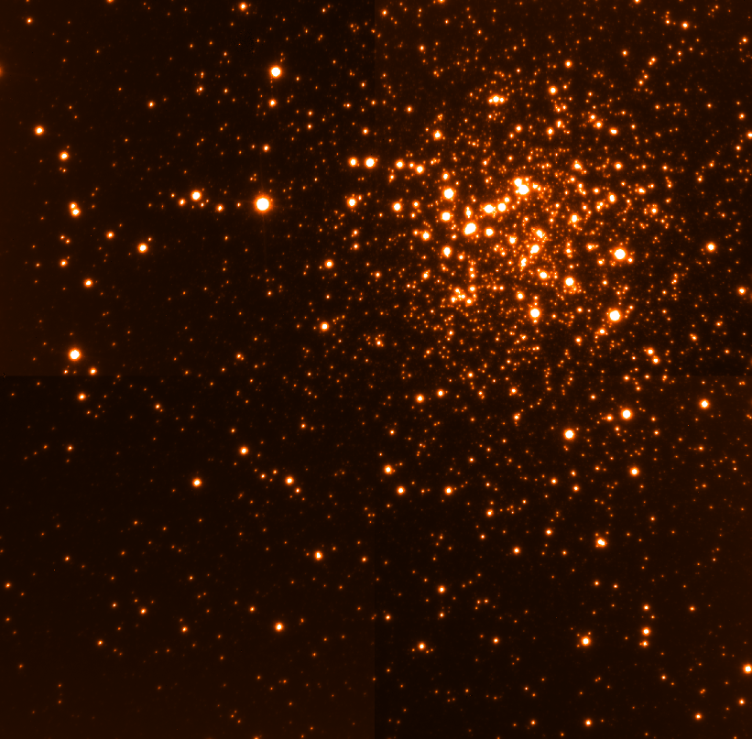
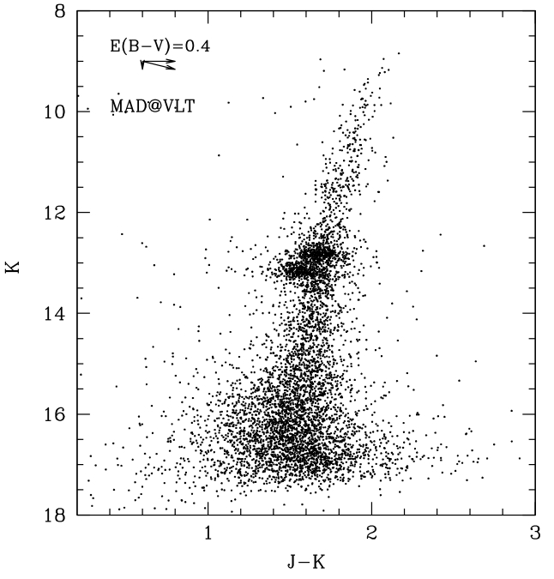
Terzan 5 : a pristine fragment of the Galactic Bulge
The incredibly sharp K-band image of Terzan 5 obtained with MAD@ VLT (FWHM=100mas over the entire FoV)
TWO Red Clumps !!!
Ferraro et al (2009, Nature, 462, 483)

Slide 20
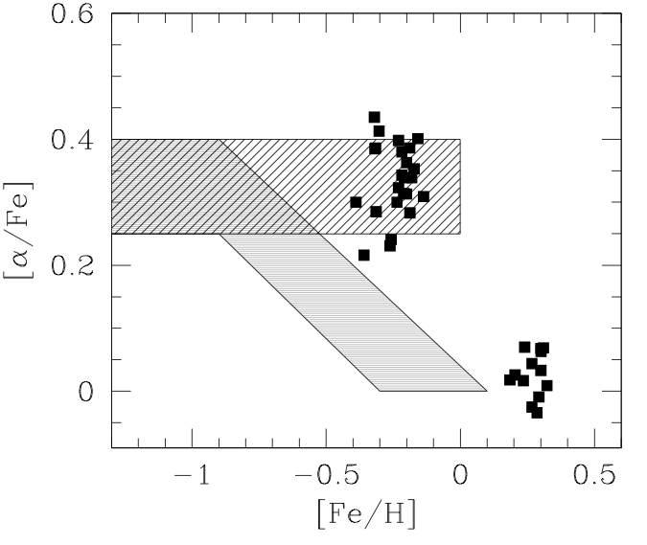
Terzan 5 : a pristine fragment of the Galactic Bulge
High-resolution spectra of 33 giants:
1. the two populations have different
[Fe/H] ( Δ[Fe/H] =0.5 !!) and [alpha/Fe];
2. the proto-Ter5 was much more
massive in the past (to retain ejecta
from both SNIa and SNII)
3. Ter5 and the Bulge shared the
same chemical enrichment history
BULGE
disk
working hypothesis
Ter5 is the remnant of a pristine fragment that contributed to build the Galactic Bulge and that survived the total disruption
The old, metal poor component could trace the early stages of the Bulge formation
The younger (?) metal-rich one could contain crucial information on the Bulge most recent chemical & dynamical evolution
Notes:
20

Slide 21
The Gaia-ESO Survey
Public spectroscopic Survey on
VLT-FLAMES. 300 nights, 5 years
Started on 31-12-2011
Survey Co-PIs:
G. Gilmore & S. Randich; >300 CoIs
GOAL: to provide a fair sample of all
Galactic populations: Halo; Bulge,
Thick & Thin disks; open clusters
in all phases of evolution
Go beyond low-res surveys to deliver
precise radial velocities, good
abundances & astrophysical parameters
[Fe/H] & element ratios for several
species for each star with Giraffe;
precise multi-element abundances with UVES
Exceptional stand-along value;
benefit from and add value to Gaia

Slide 22
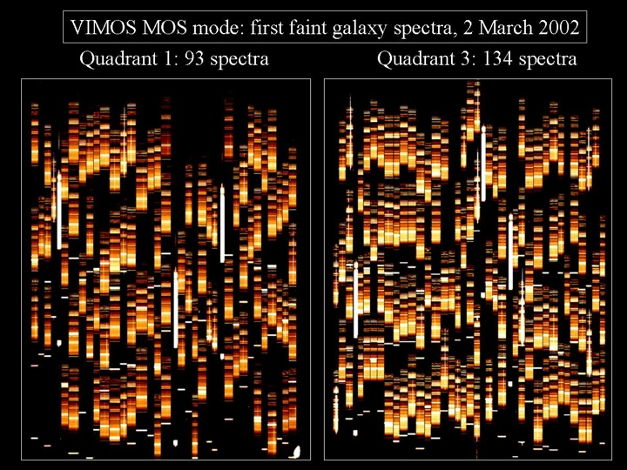
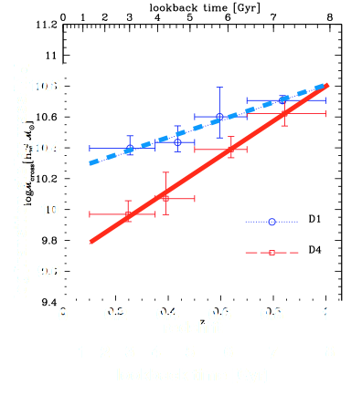
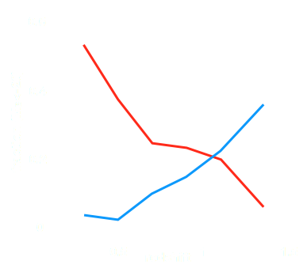
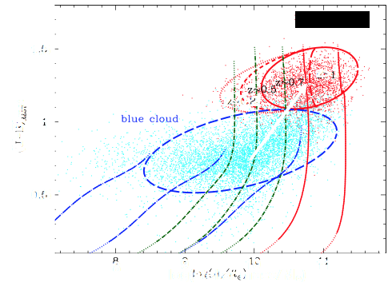
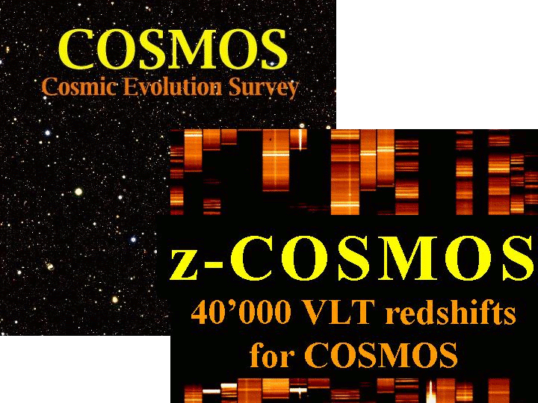

Nature and nurture of galaxy evolution through cosmic time: VVDS & ZCOSMOS
VVDS and zCOSMOS galaxy surveys observed >80 thousands spectra over >10 sq.deg. with VIMOS from redshift 0 to ≳2.
With these data it has been possible to:
reconstruct the galaxy cosmic web
follow the evolution of different galaxy types
Low density environments
→ less massive blue galaxies transform into the massive red sequence galaxies after quenching their star formation
High density environments
Bolzonella et al. 2010
→ the "speed" and cosmic time of this transformation depends on galaxy environments
Zucca et al. 2006
Red sequence
Early type galaxies
Blue cloud
Late type galaxies
Pozzetti et al. 2010

Slide 23

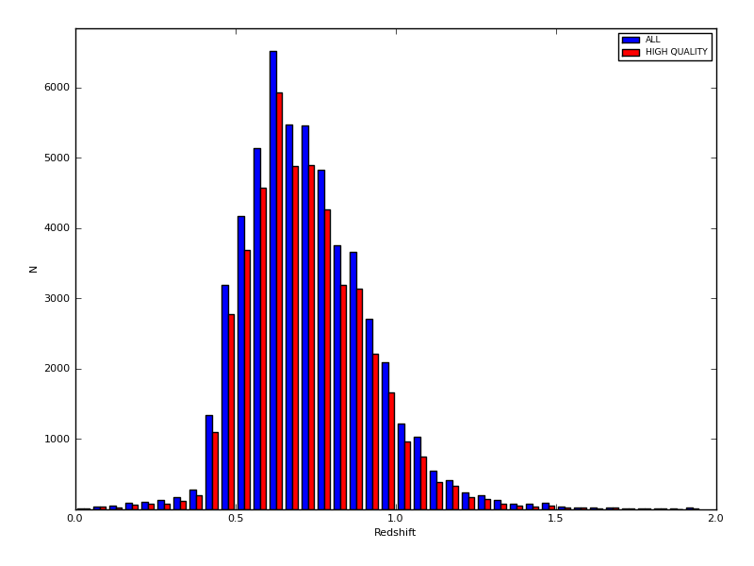
VIPERS in a nut-shell
Large Programme (Guzzo et al. 182.A-0886)
440.5 VLT + VIMOS hours
~24 deg² over W1 and W4 CFHTLS wide fields (~16 deg² + 8 deg²)
I_{AB}<22.5, LR Red grism, 45 min exp.
Mosaic of 288 VIMOS pointings
z>0.5 color-color pre-selection: 40% sampling
Density and volume comparable to 2dFGRS, but at z~0.8
May 2012: ~60% of total area completed, 55359 redshifts measured
At current pace, completion expected by early 2015

Slide 24
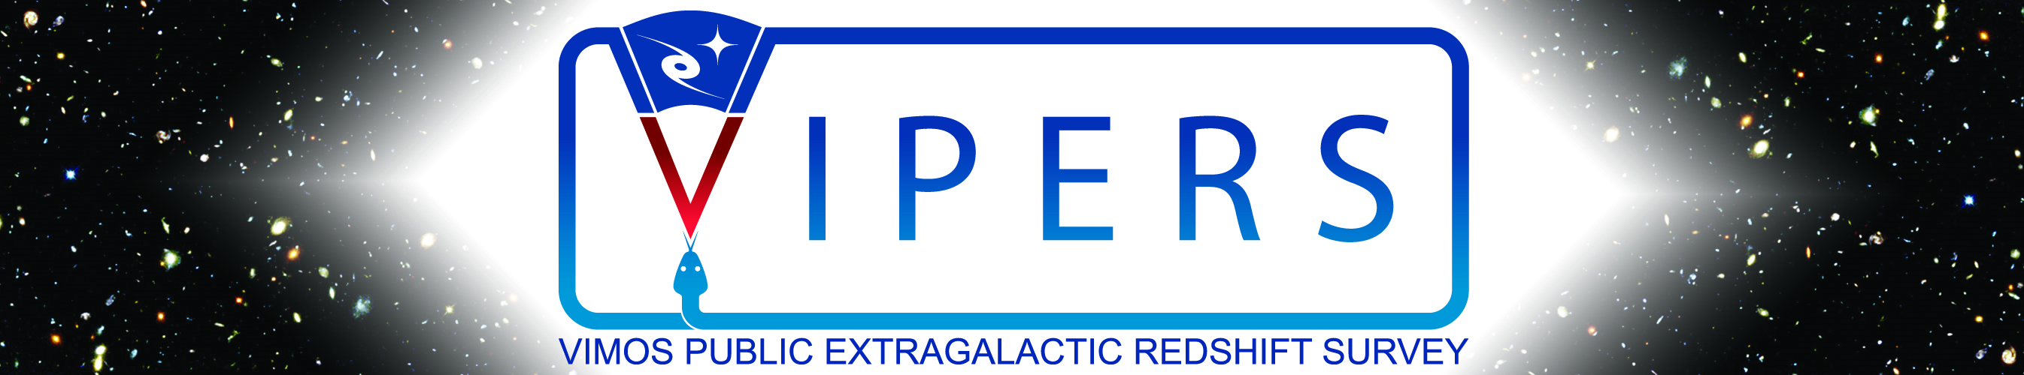
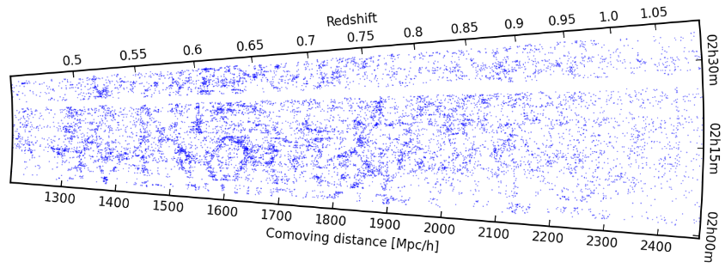
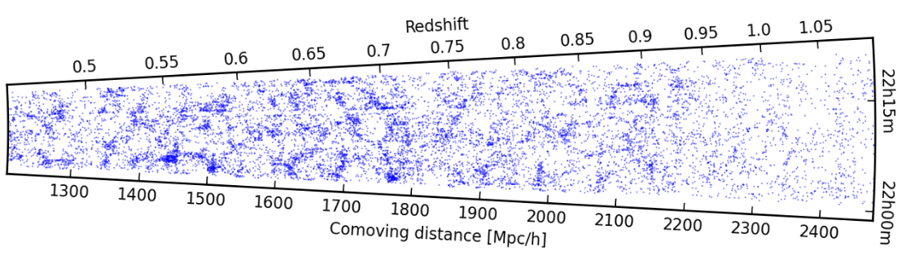
Only ~20,000 z shown (June 2011)
55,000 z already in database
Final goal (2014): 100,000 z
W1
Reconstructing the large-scale structure of the Universe 7 billion years ago: first time structures are seen in such detail and extension at these redshifts
Full 55K distribution will be disclosed in fall 2012
W4

Slide 25
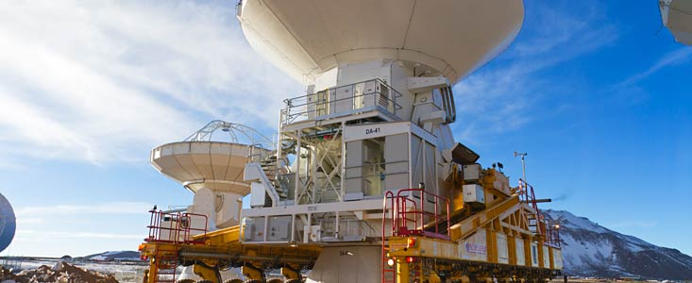
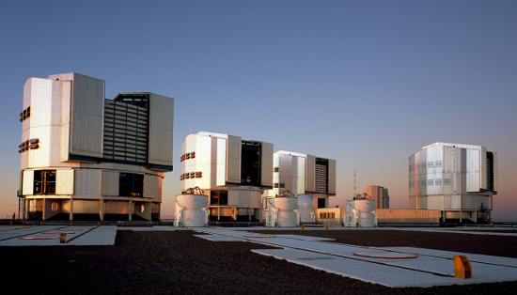
Advantages not only for astronomers
Italian companies contribute significantly and successfully to building these telescopes and their instrumentation
(e.g. Ansaldo, EIE, ADS, Microgate, Medialario, etc.)

Slide 26
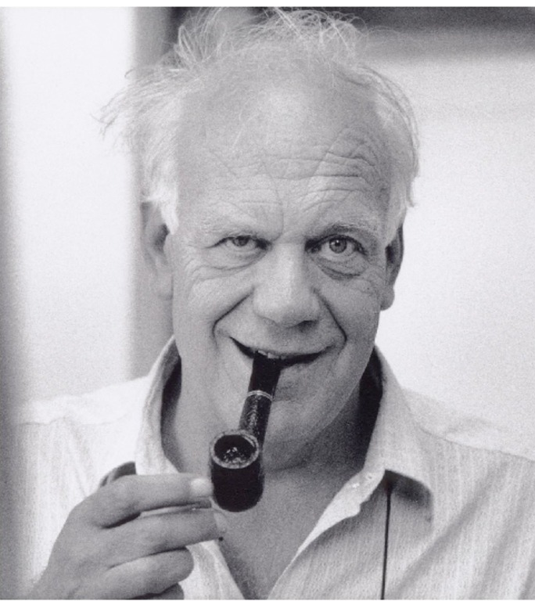
Farewell Franco. Thanks !

Slide 27
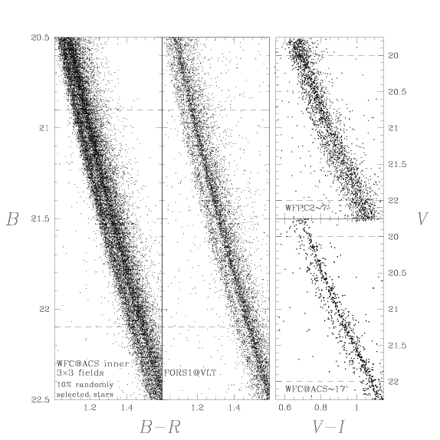
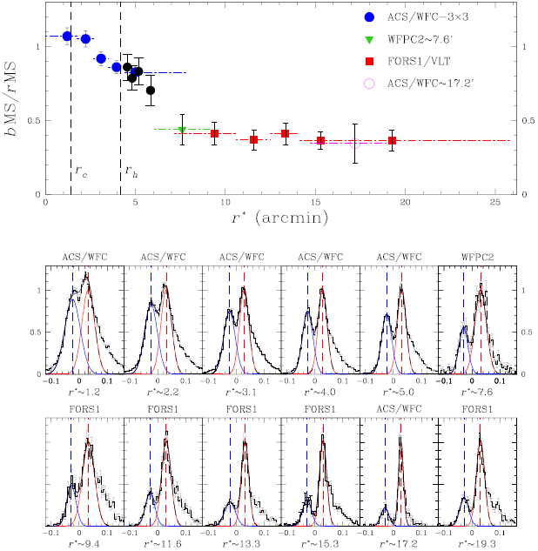
Omega Centauri: Radial distribution of main sequence stars
Bellini et al. 2009, A&A, 507, 1393
The double
MS is present all over the cluster, from the inner core to the outer envelope, but….
…the two MSs have different radial distributions: the blue, more metal rich MS is more concentrated

Slide 28

Lithium and beryllium in open clusters
CASPEC@3.6, UVES and FLAMES on VLT
Internal mixing in stars (e.g, Randich et al. 2000, 2002, 2007,2009; Pasquini et al 1997, 2001; Sestito et al. 2005)
Membership (e.g., Randich et al. 1997, 2001; Sacco et al. 2008)
Age dating (Palla et al. 2005, 2007; Manzi et al. 2008; Sacco et al. 2008; Randich 2009)
Li depletion and SFH in the Orion Nebula Cluster
Li ages similar to isochronal ages
→ independent support to age spread
History of the ONC that
cast doubts on models of
rapid star formation

Slide 29


VIPERS builds upon VVDS unique results on clustering: probing the growth rate of structure via z distortions
Guzzo& VVDS Team, 2008, Nature, 451, 541
Expected final VIPERS
(~100,000 gals)
VVDS F22 (~6000 gals)

