Slide 1


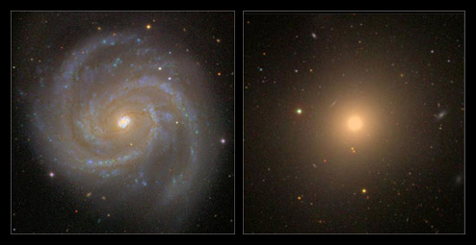
The stellar mass functions of spheroids and discs
Simon Driver
Univ. Western Australia
Univ of St Andrews
Large surveys
Mass fns of ellipticals, bulges, and discs
Inclination and dust attenuation
Energy output of spheroids and discs
A simple two-phase model
Discussion points

Slide 2

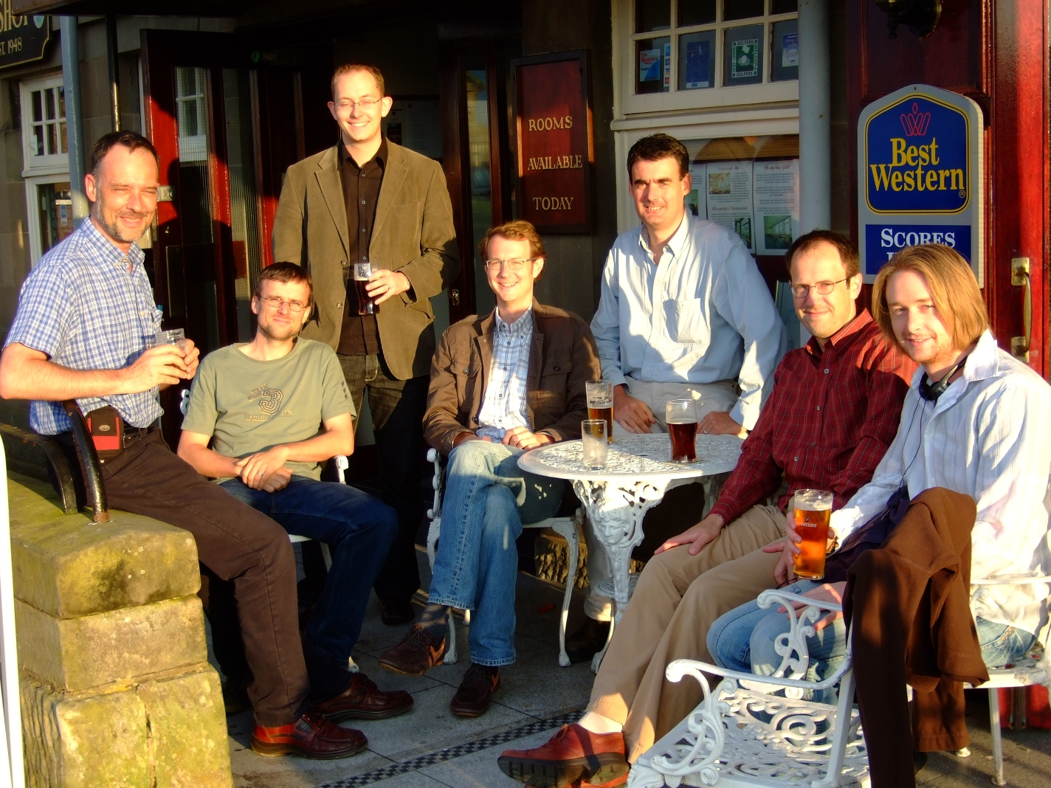
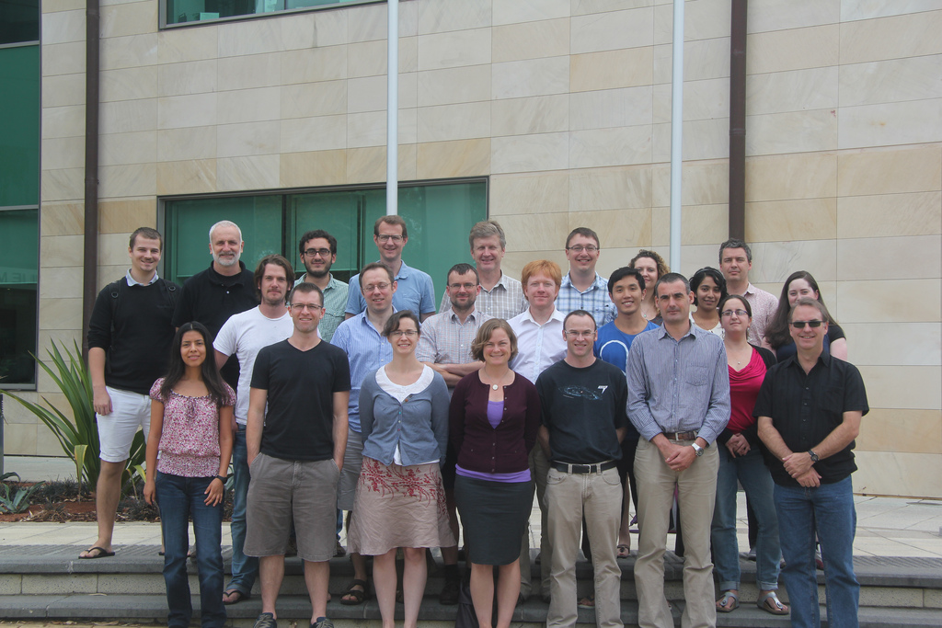






Key collaborators/contributors
Joe Liske (ESO)
Alister Graham (Swinburne)
Paul Allen (City)
Lee Kelvin (Innsbruck)
Rebecca Lange (UWA)
Aaron Robotham (UWA)
Mehmet Alpaslan (St Andrews)
GAMA Team

Slide 3
The stellar mass functions of spheroids and discs
Simon Driver
Univ. Western Australia
Univ of St Andrews
Large surveys
Mass fns of ellipticals, bulges, and discs
Inclination and dust attenuation
Energy output of spheroids and discs
A simple two-phase model
Discussion points

Slide 4

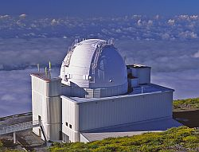

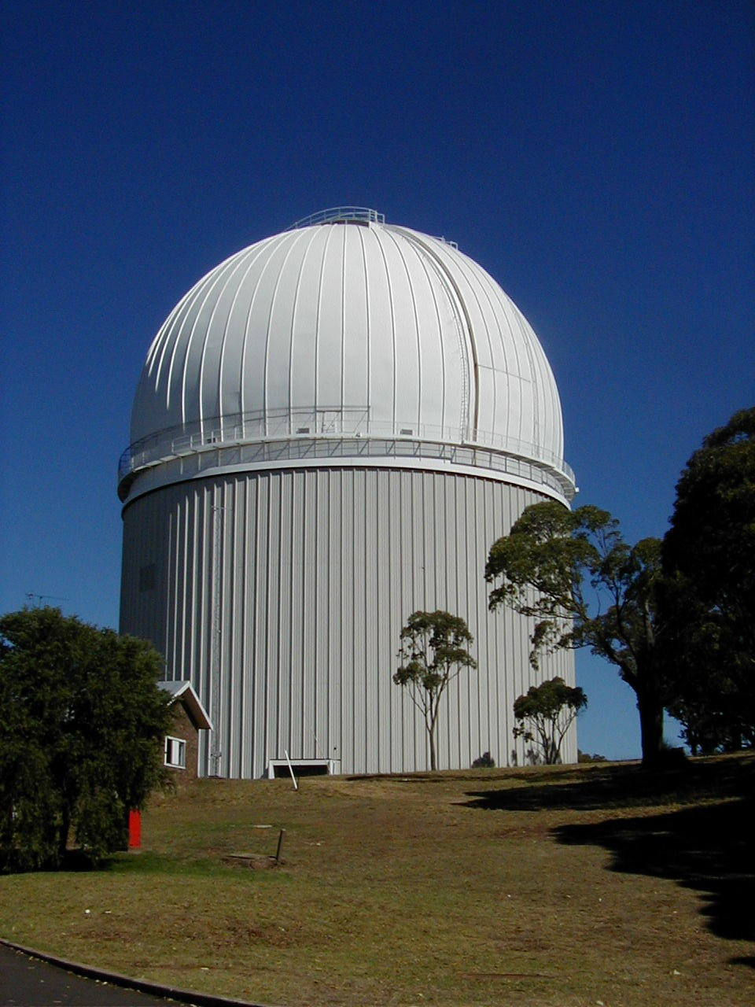
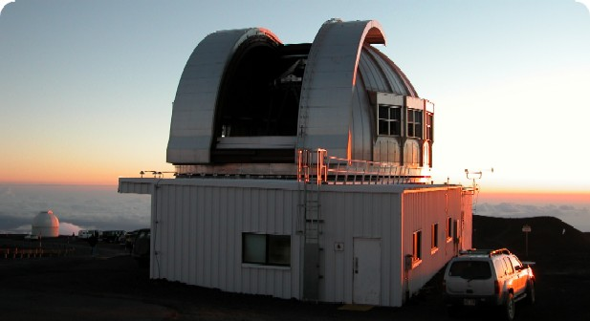
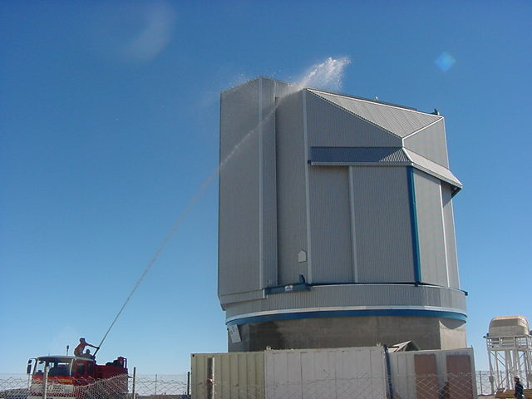
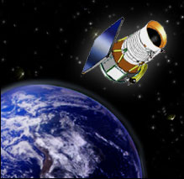

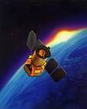
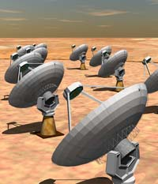

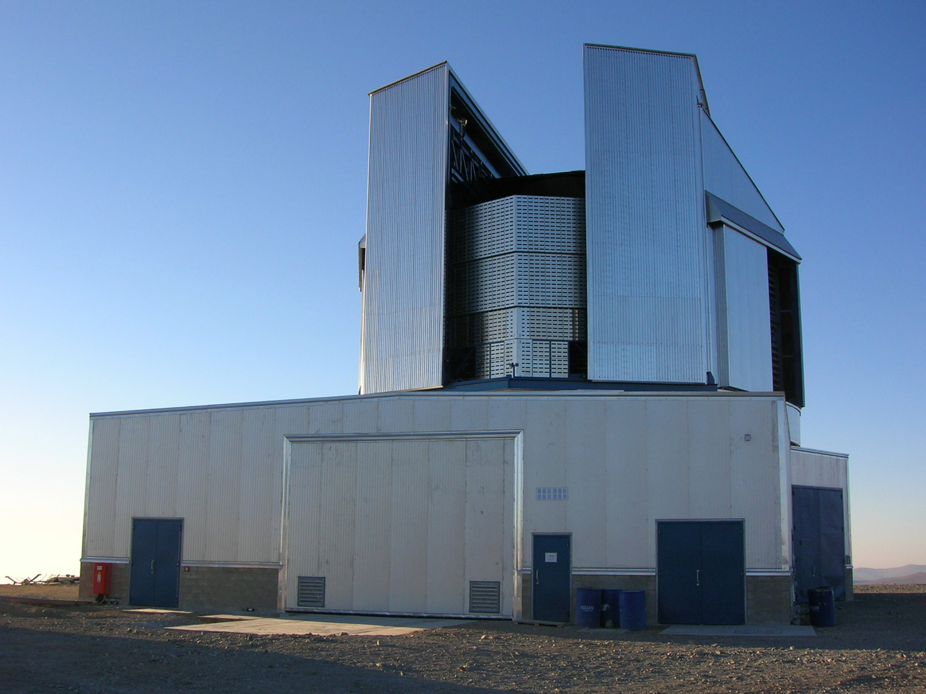
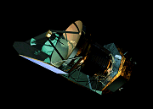
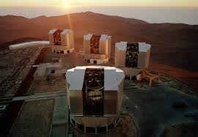
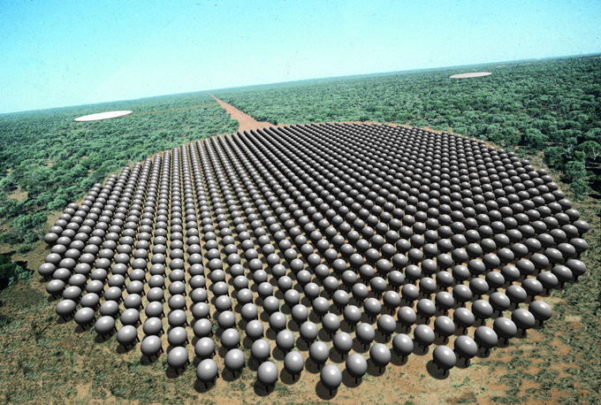
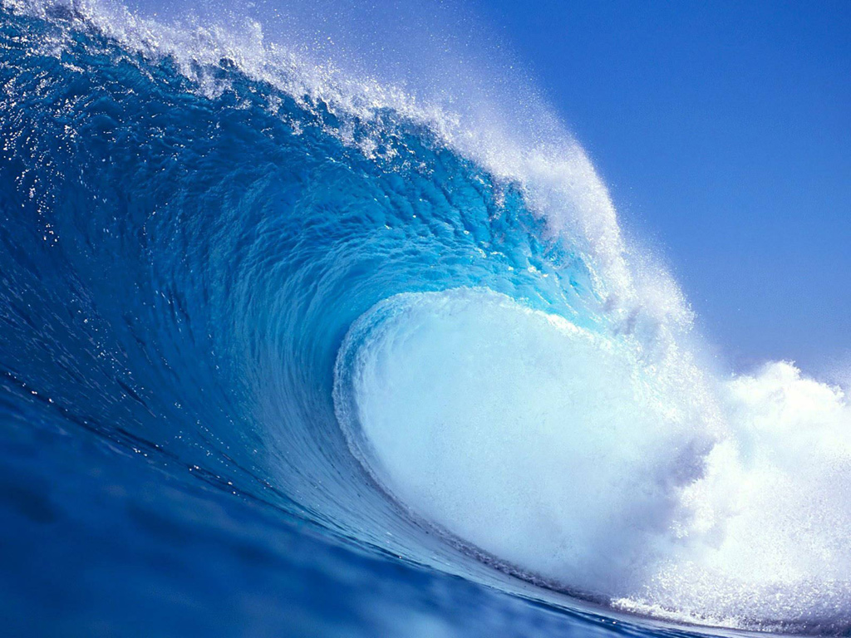

Large Galaxy Surveys: SDSS, MGC, GAMA & WAVES
(with redshifts)
MGC
INT SDSS AAT UKIRT
10k redshifts
uBgrizYJHK
B<20mag
1’’ spatial res, 30 sq deg
http://www.eso.org/~jliske/mgc/
Liske et al (2003)
SDSS
UKIRT
VST
VISTA
WISE
HERSCHEL
GMRT
ASKAP
AAT
GALEX
(MIS)
250k redshifts
UV-Opt-IR-Radio
r<19.8mag
0.7’’ spatial res, 250 sq deg
http://www.gama-survey.org/
Driver et al (2011)
Sept 14
2million redshifts
UV-Opt-IR-Radio
r<22mag & phot-z
0.2’’ spatial res, 1000 sq deg
EUCLID VLT SKA
4MOST
WAVES
Notes:
4

Slide 5
Survey footprints
MGC
10k redshifts
uBgrizYJHK
B<20mag
1’’ spatial res, 30 sq deg
http://www.eso.org/~jliske/mgc/
Liske et al (2003)
250k redshifts
UV-Opt-IR-Radio
r<19.8mag
0.7’’ spatial res, 250 sq deg
http://www.gama-survey.org/
Driver et al (2011)
2million redshifts
UV-Opt-IR-Radio
r<22mag
0.2’’ spatial res, 1000 sq deg
WAVES

Slide 6

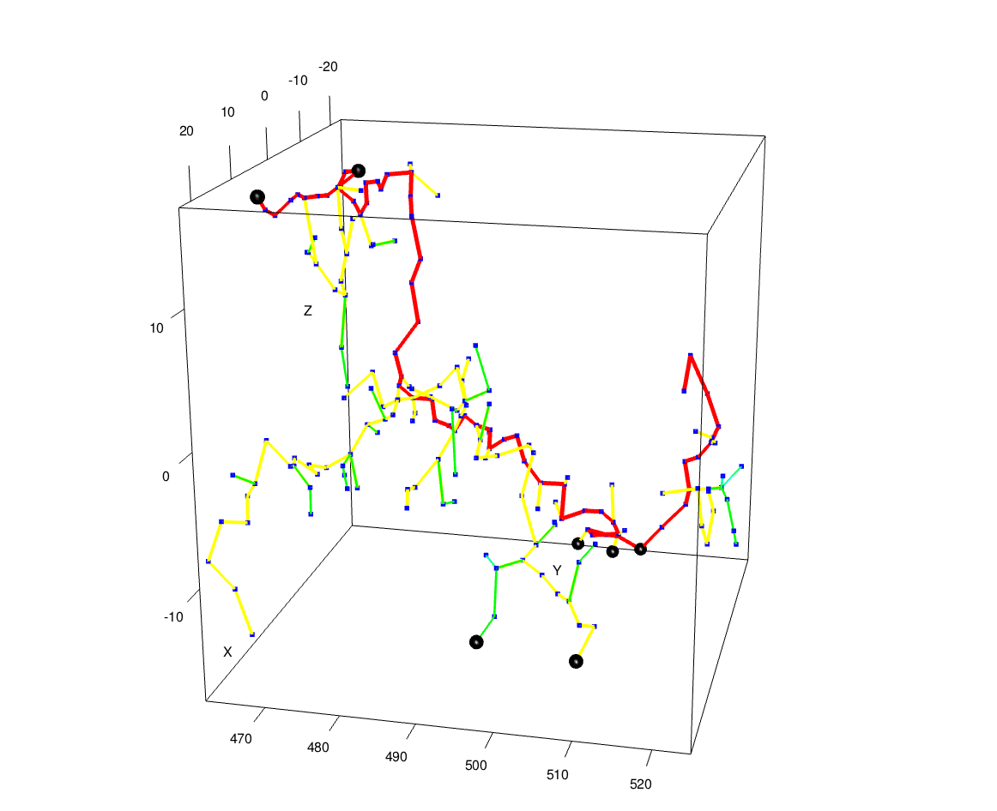
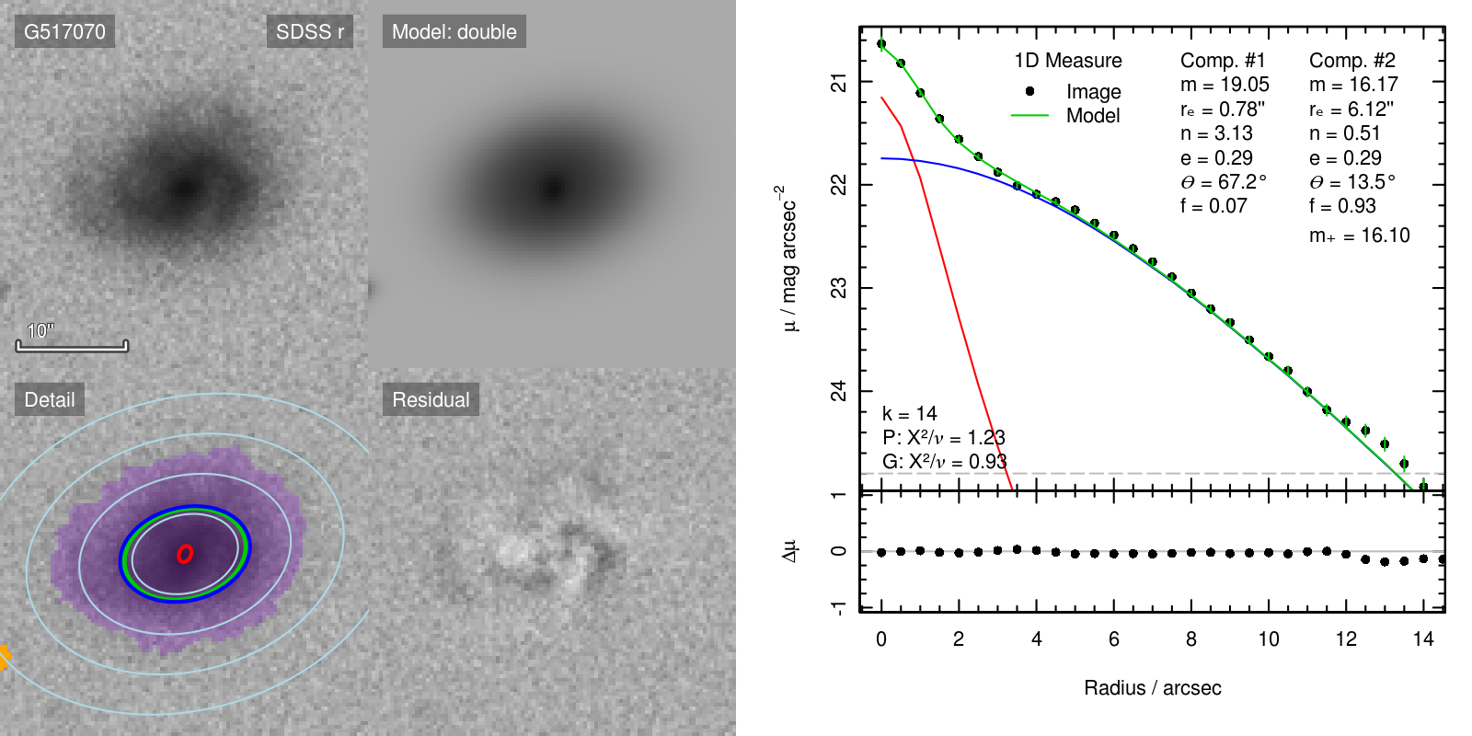
Structure on 1kpc to 100Mpc scales
Cosmology:
Driver & Robotham (2010), cosmic variance
Blake et al (2013), growth of structure tracers
Robotham et al (in prep), halo mass function
Filaments, tendrils and voids (1-100Mpc):
Alpaslan et al (2013), 500 filaments
Alpaslan et al (2013, submitted), Tendril discovery
Galaxy groups (100kpc-1Mpc):
Calvi, Poggianti & Vulcani (2011), 176 groups (PM2GC)
Robotham et al (2011), 14k groups (G³Cv1)
Robotham et al (in prep), 24k groups (G³Cv2)
Galaxy structure (~1-10kpc):
Allen et al (2006), 10k GIM2D bulge-disc decomps
Driver et al (2007), 10k GIM2D, bulge-disc mass densities
Driver et al (2008), 10k GIM2D, dust attenuation
Kelvin et al (2011), 150k Sersic profiles
Kelvin et al (2013a,b), 3k Hubble type Mass Functions
Kelvin et al (in prep), 3k GALFIT3 decomps
Lange et al (in prep), z<0.1 bulge-disc mass-size relations
Lange et al (in prep), 30k GALFIT3 decomps

Slide 7
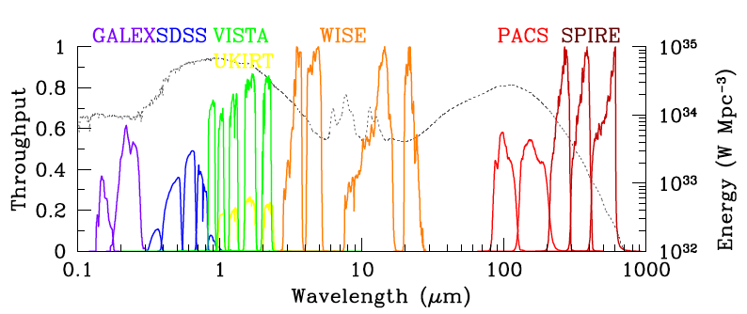
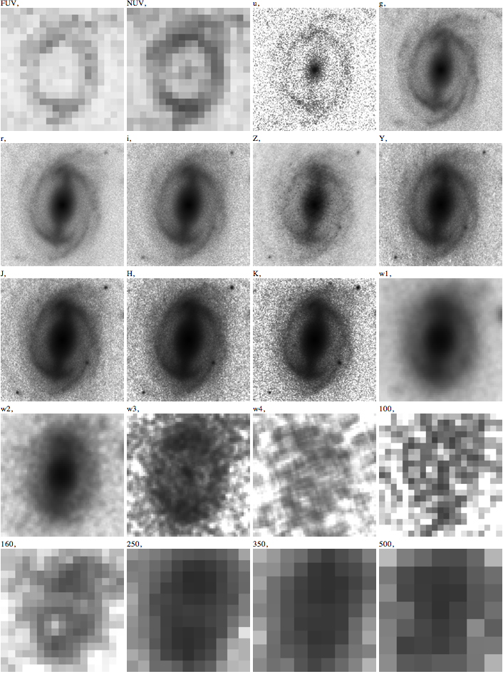
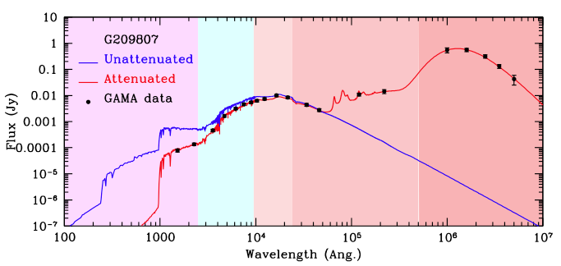
Energy output of galaxies
20 band photometry
FUV-Opt-NIR-MIR-FIR

Slide 8
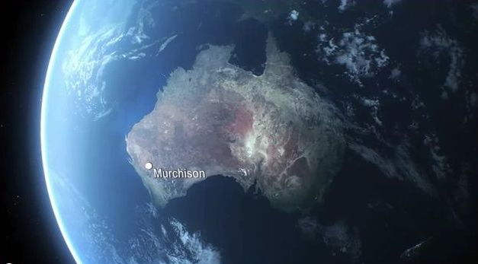
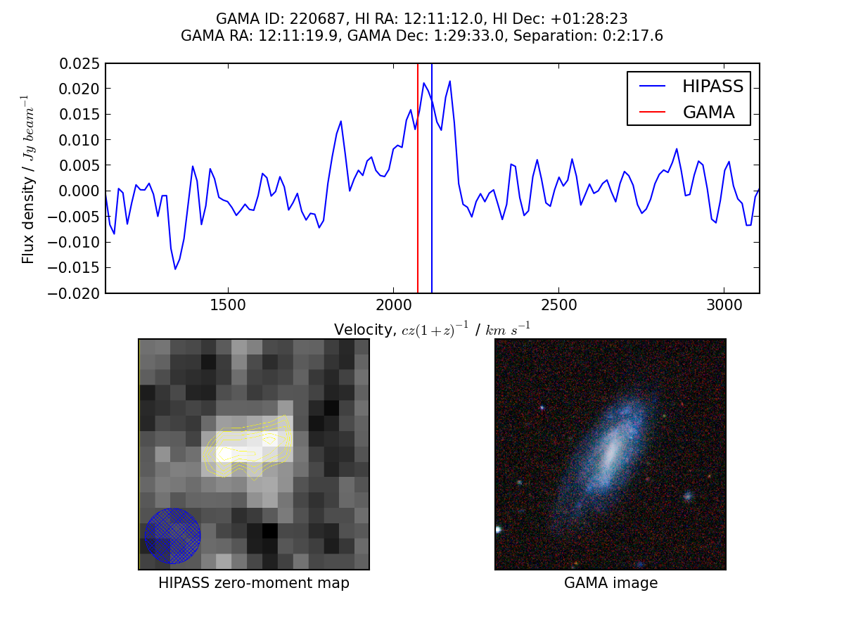
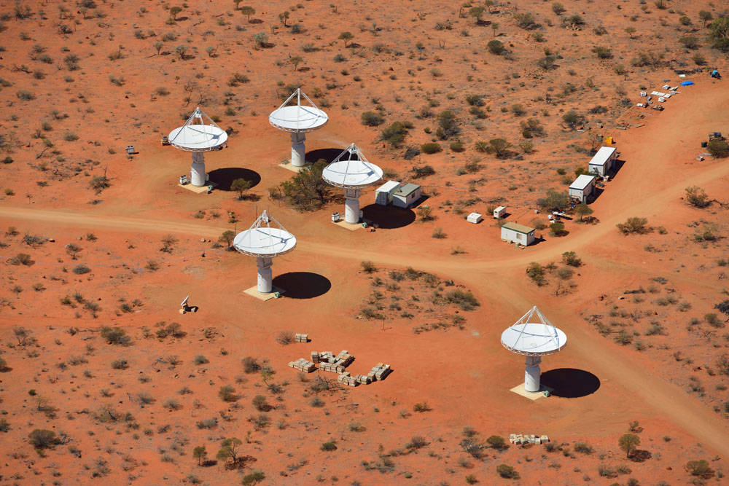
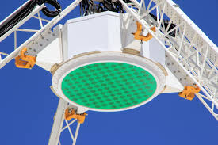
HI gas and dynamics via ASKAP
Australian-SKA Pathfinder
Thirty-six 12m antennas with phase array feeds
30 sq deg field of view
GAMA23 region primary deep target
Operations with 12 antennas comence Dec-2014
HI to z=0.45

Slide 9
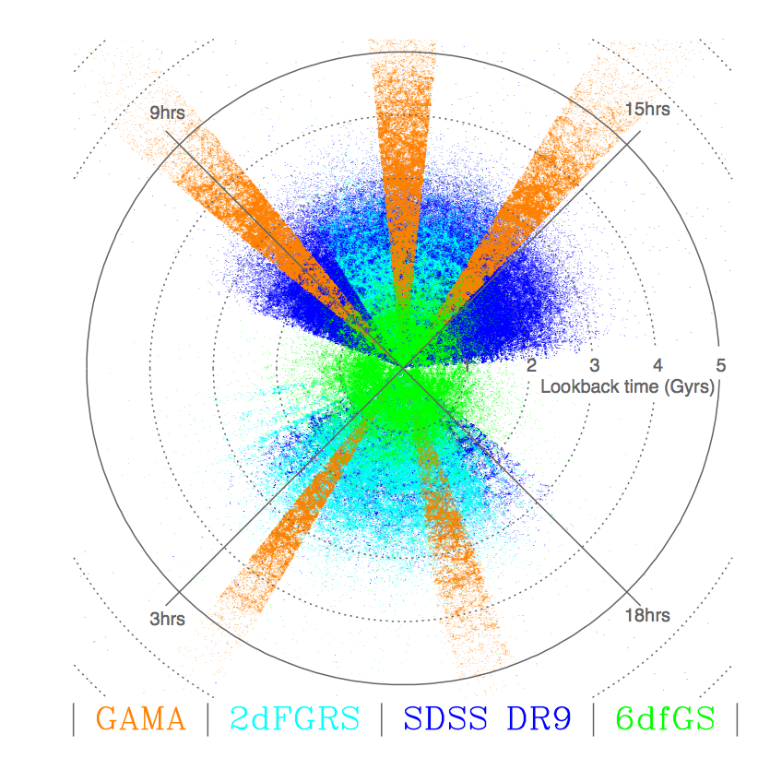
Galaxy And Mass Assembly (GAMA)
240,000 galaxies to r<19.8mag over four 60 sq deg (~98% complete, selected from SDSS)
catalogue of 25,000 groups (halos) to 10¹²M_{o}
20 band photometry + gas (ASKAP) [GALEX+VST+VIKING+WISE+Herschel]
structure on 1kpc to 100Mpc scales to z~0.2
DR2 available via http://www.gama-survey.org/dr2/

Slide 10
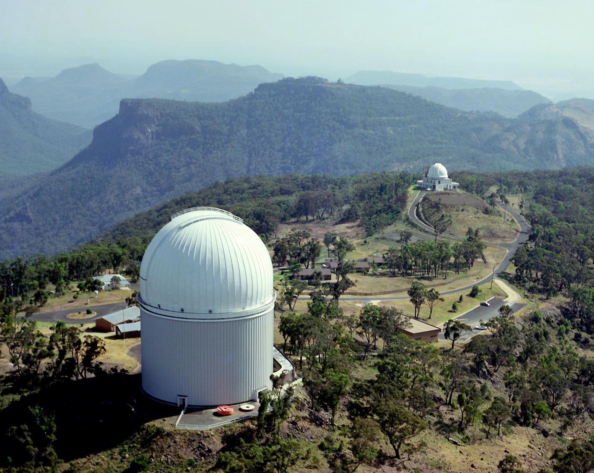
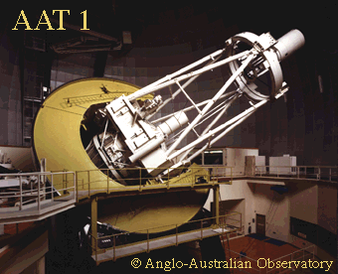
AAO RESPONSIBLE
FOR 35% OF ALL
KNOWN REDSHIFTS
60% SDSS
5% Others
UKST
6dF
TAIPAN
AAT
2dFGRS
WiggleZ
MGC
GAMA
OzDes

Slide 11
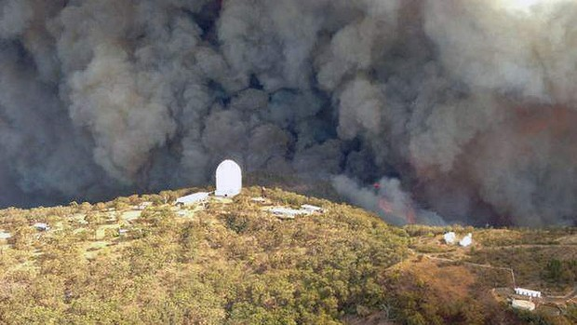
January 2012 Bushfire: No significant damage to AAT
Operations resumed within 1 month

Slide 12
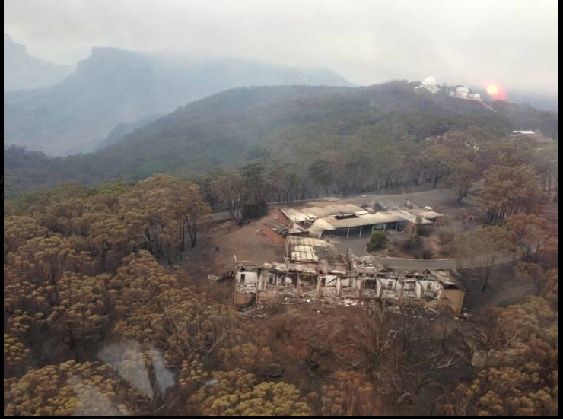
Observers accommodation destroyed
AAO now operated via Sydney

Slide 13
The stellar mass functions of spheroids and discs
Simon Driver
Univ. Western Australia
Univ of St Andrews
Large surveys
Mass fns of ellipticals, bulges, and discs
Inclination and dust attenuation
Energy output of spheroids and discs
A simple two-phase model
Discussion points

Slide 14
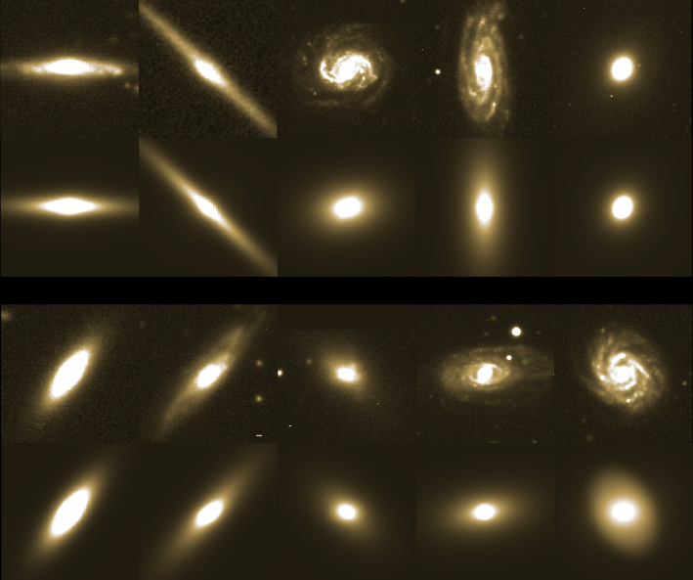
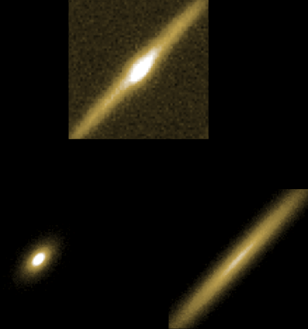
GIM2D bulge/disc decompositions
Sersic+exponential profiles+PSF convolution via GIM2D, Simard et al (1998)
10,095 gals = largest available sample, Allen et al (2006) (robust/reproduceable)
96% redshift completeness (AAT/GEMINI) to B=20.0 mag, Driver et al (2005)
B(INT) + ugriz(SDSS) + YJHK(UKIRT), Liske et al (2003), Hill et al (2009)
All data available online: http://www.eso.org/~jliske/mgc/
MGC04864
BULGE
DISC

Slide 15
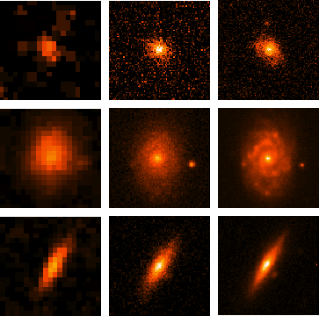
Advantage of MGC
Image quality: B-only, 1’’ resolution
Surface brightness limit: 26 mag/sq arcsec
DSS SDSS MGC
Still the best wide area imaging+z dataset
about to be superseded by GAMA+VST:
ugri, 0.7’’, 26 mag/sq arcsec
Driver et al (2005)

Slide 16
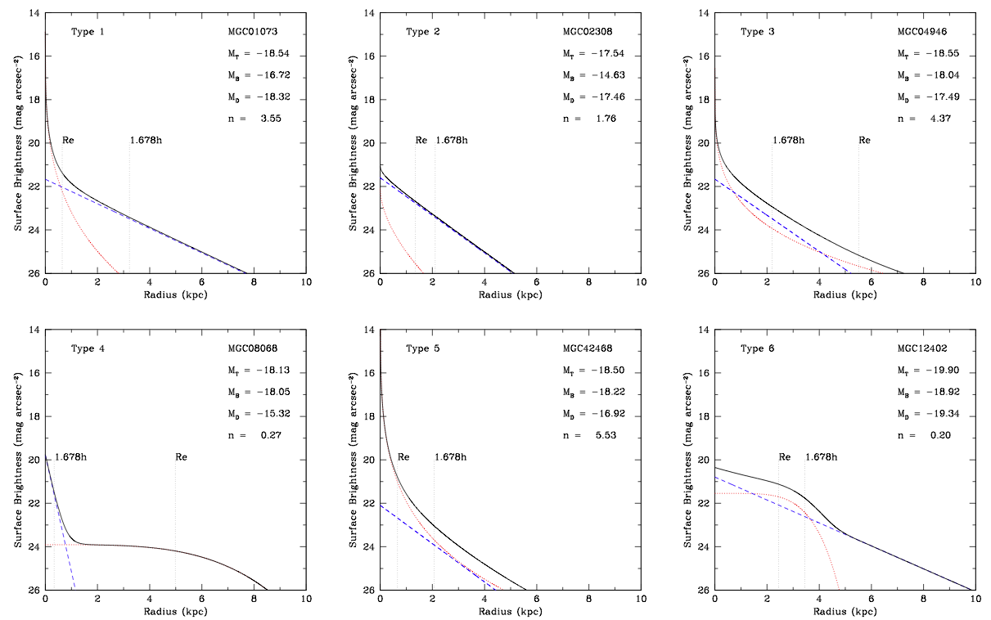
The Logical Filter
Allen et al (2006)

Slide 17
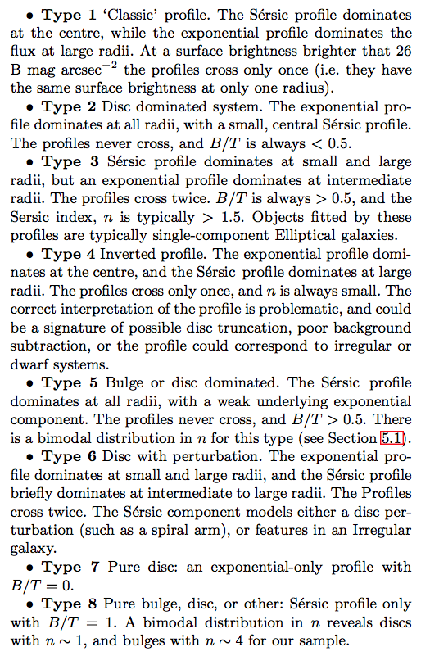
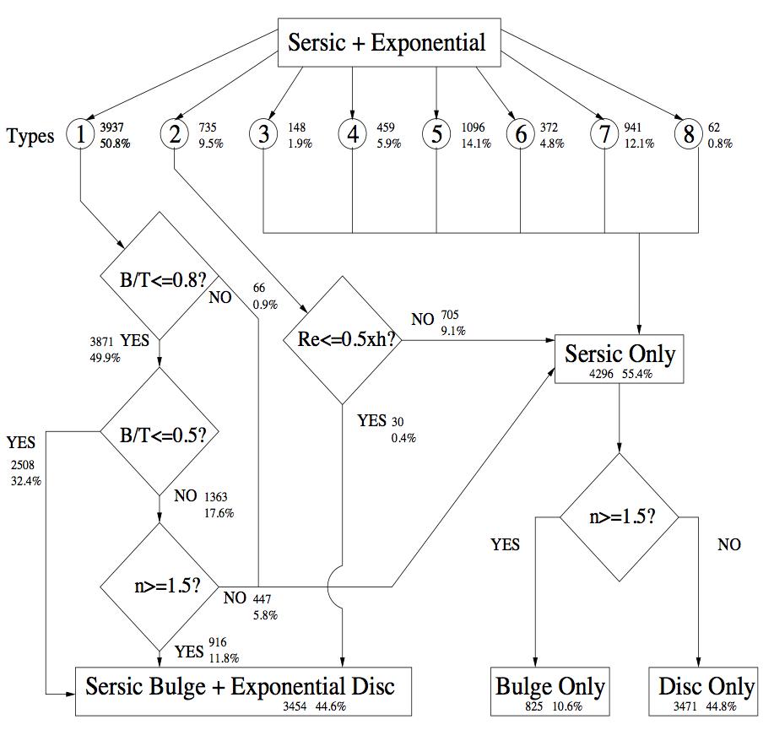
The Logical Filter
Identified 8 characterstic profile shapes:
Type 1 classic bulge+disc
Type 2 suppressed bulge
Type 3 inner & outer bulge
Type 4 inverted
Type 5 suppressed disc
Type 6 inner & outer disc
Type 7 spheroid only
Type 8 disc only
Allen et al (2006)

Slide 18
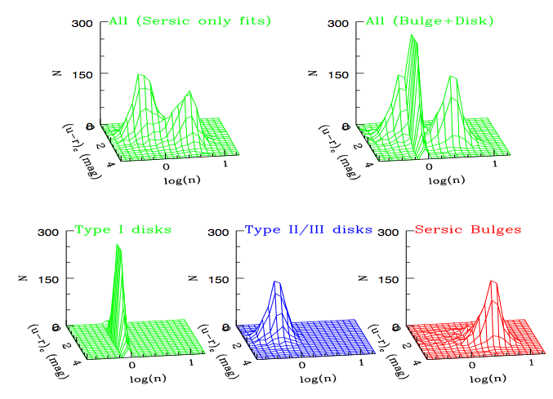
Two pop’s or two components ?
Sersic only fits
Bulge+disc fits
Bridging
population
BULGE
DISK
DECOMP’
No bridging
population
Exponential discs
Truncated discs
Spheroids

Slide 19
Stellar mass functions (dust corrected)
(c2008, unpublished)

Slide 20
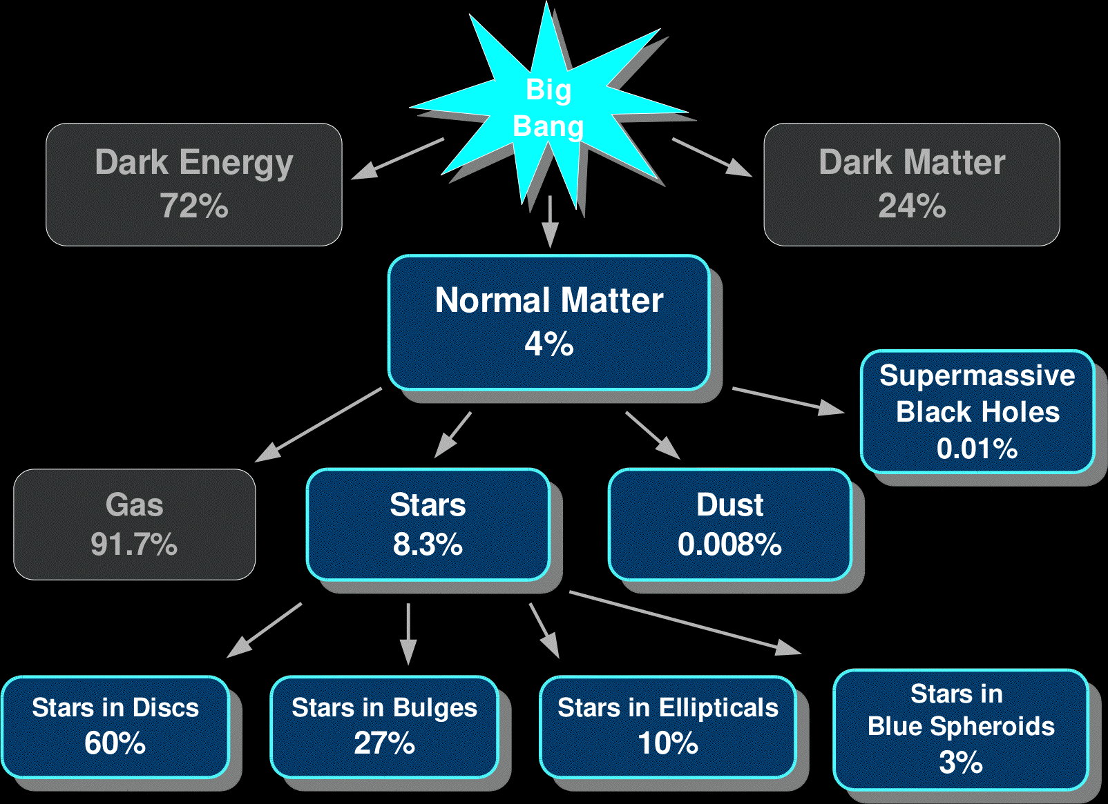
The baryon breakdown at z=0

Slide 21
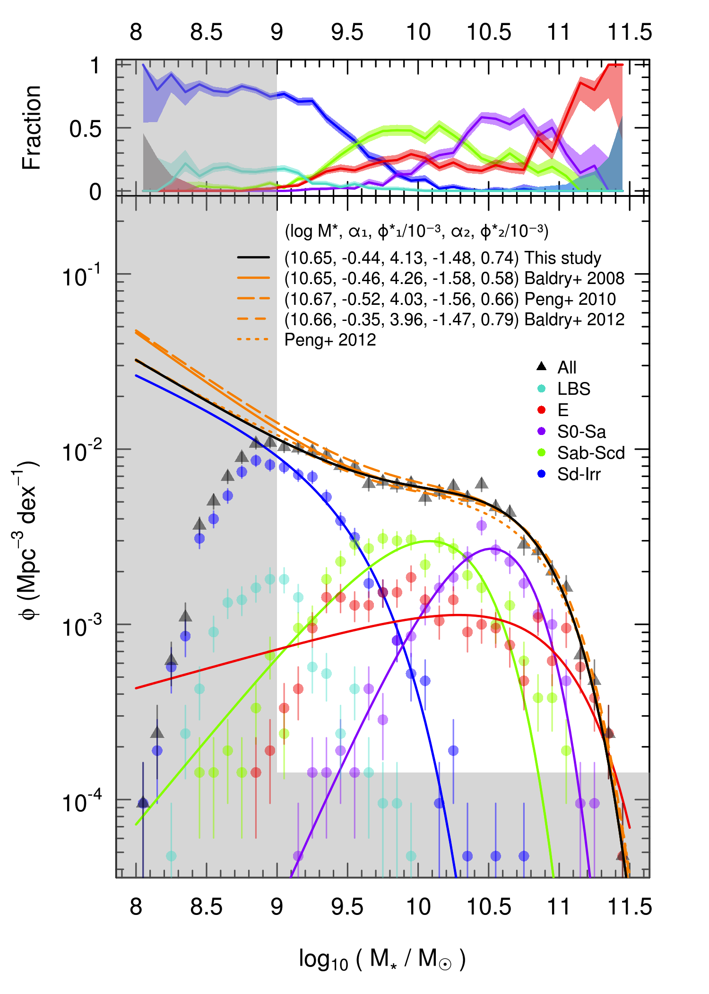
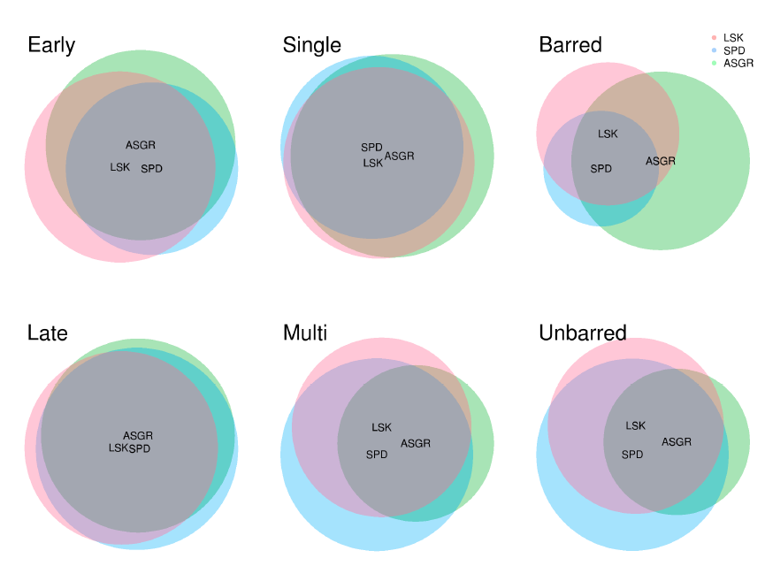
Mass functions by Hubble type
Selection:
0.025 < z < 0.06 - similar to Gadotti (2009)
Mass > 10^{9.5} - deeper than Gadotti (2009)
3000 systems only
Will push deeper once VST KiDS data processed
Classification by eye (3 pairs!):
GALFIT3 profiling based on eye classifications
Kelvin et al (2013)

Slide 22
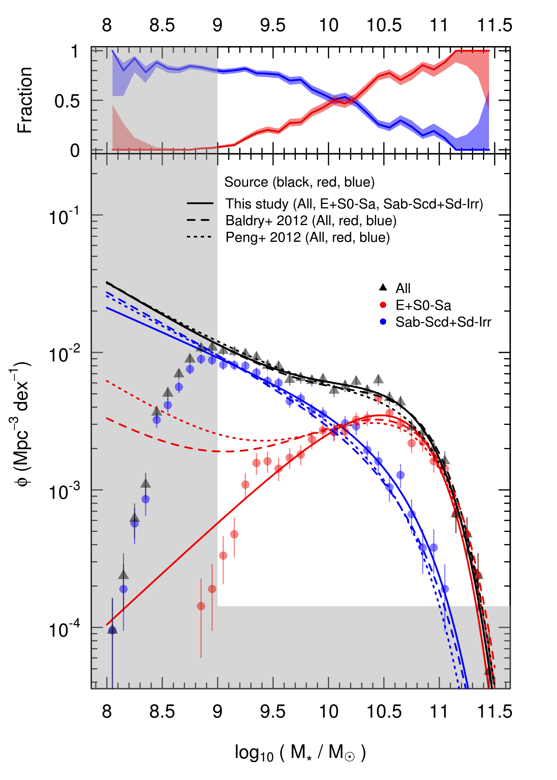
Mass functions by Hubble type
Selection:
0.025 < z < 0.06 - similar to Gadotti (2009)
Mass > 10^{9.5} - deeper than Gadotti (2009)
3000 systems only
Will push deeper once VST KiDS data processed
Classification by eye (3 pairs!):
GALFIT3 profiling based on eye classifications
Kelvin et al (2013)

Slide 23
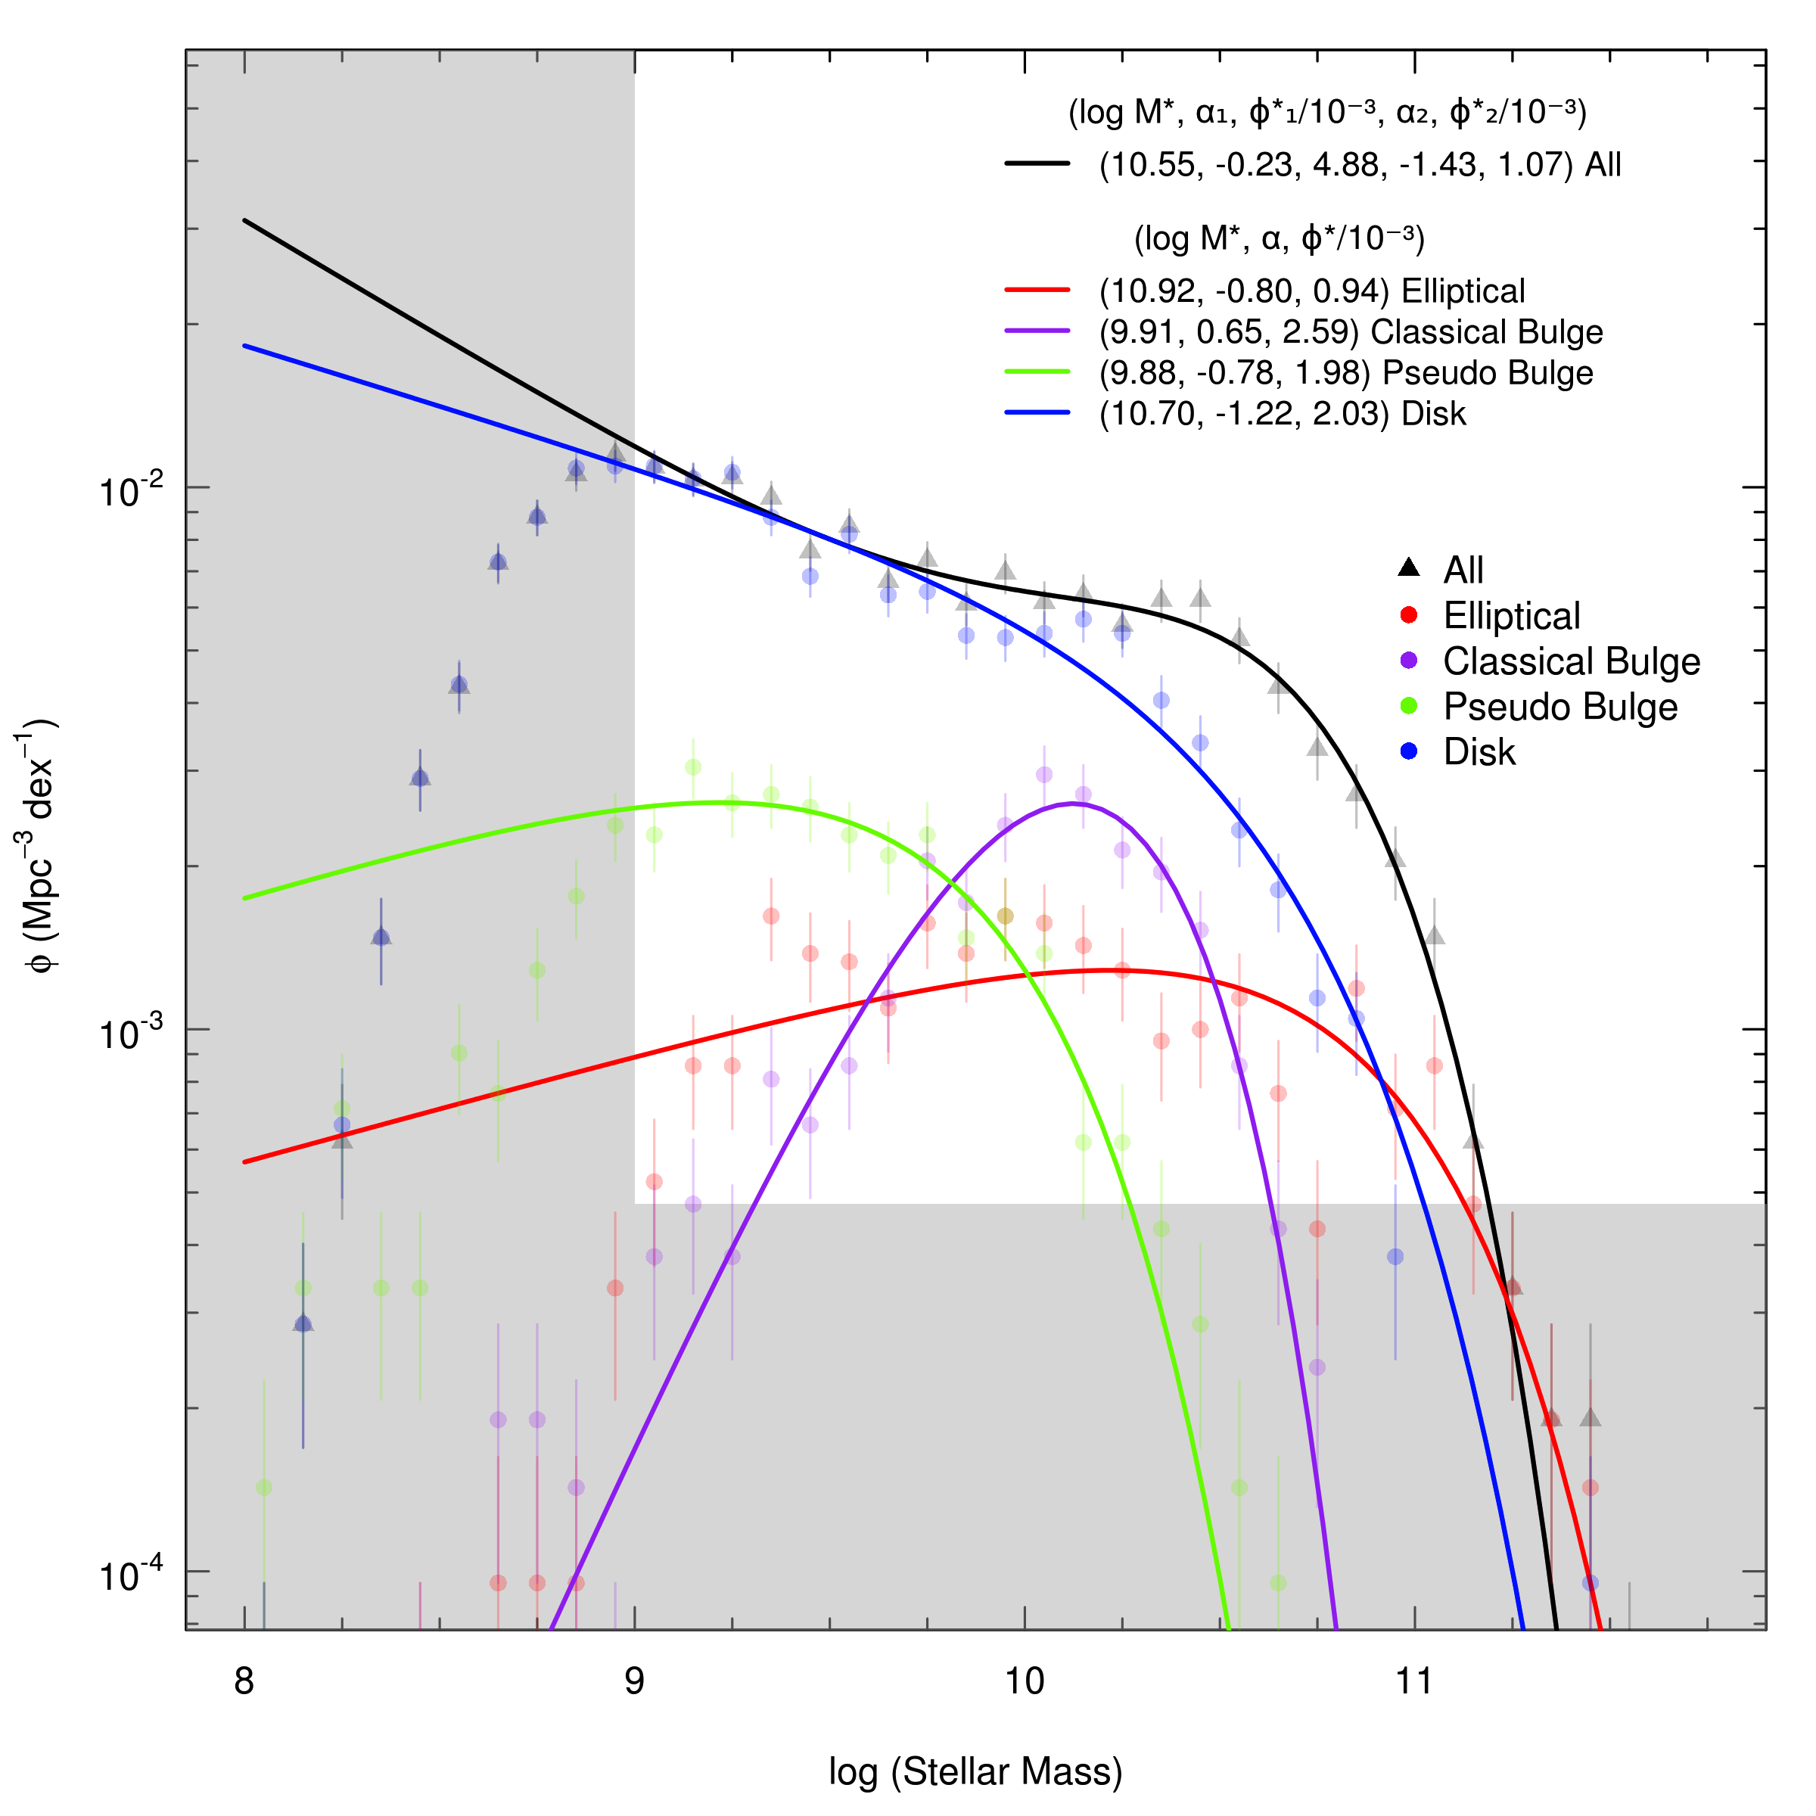
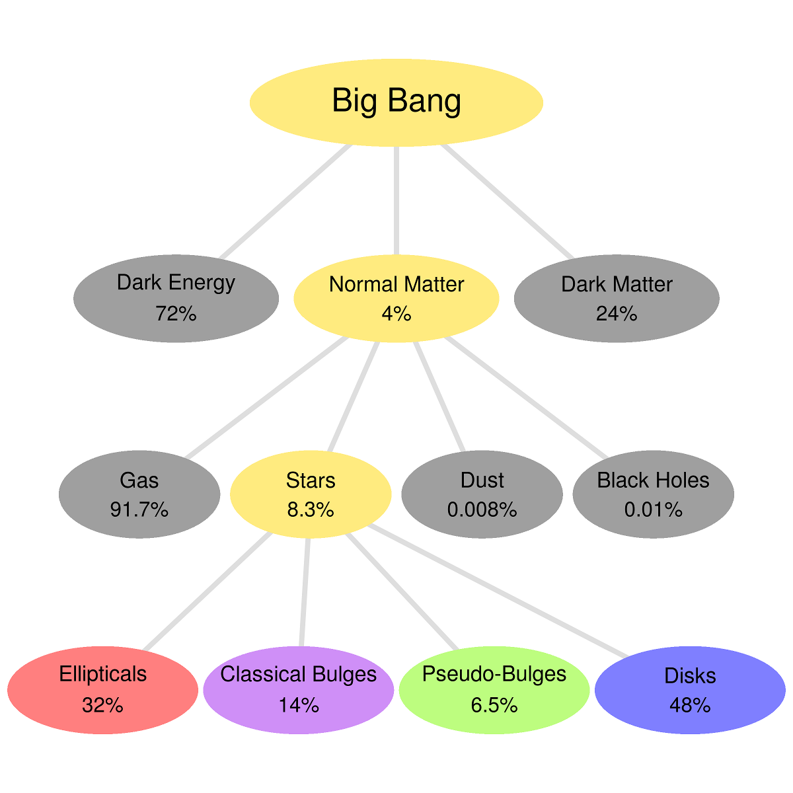
GALFIT3 Bulge-disc decompositions 3000
galaxies (0.025 < z < 0.06)
Kelvin et al (20143, PhD thesis), see talk on friday

Slide 24
Major discrepancy for Es!
MGC: Driver et al (2008) GAMA: Kelvin et al (2013)
Selection by Sersic index > 2.5 Selection by eye

Slide 25
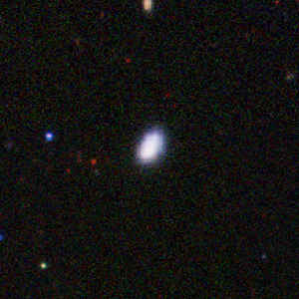
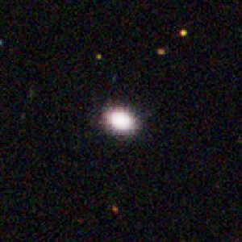
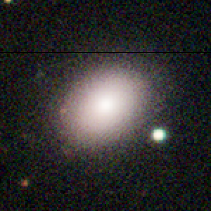
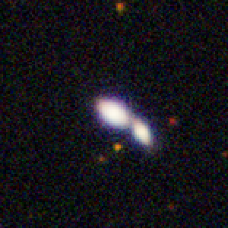
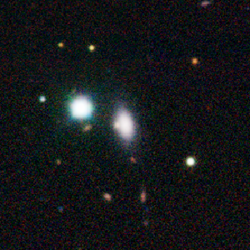
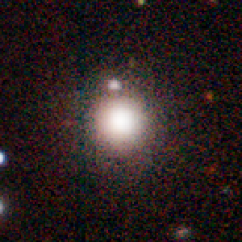
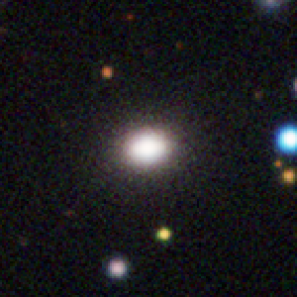
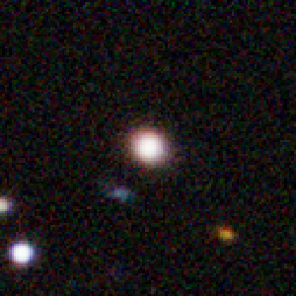



















Can we distinguish E’s from S0’s?

Slide 26




























Can we distinguish E’s from S0’s?
See Lisa Fogarty’s talk)

Slide 27


e.g., eyeball elliptical: G534655

Slide 28

e.g., eyeball elliptical: G534655

Slide 29

e.g., eyeball elliptical: G534655

Slide 30

e.g., eyeball elliptical: G534655

Slide 31

Elliptical, classical bulges and pseudo bulges
Ellipticals,
Classical bulges
Pseudo bulges
appear to lie
in distinct regions
Need high-S/N
Gadotti (2009)

Slide 32

Consensus on the stellar mass budget
Driver et al (2008):
10% E, 27% bulges, 60% discs, 3% BS
Gadotti (2009):
25% E, 20% cbulges, 5% pbulges+bars, 50% discs
Tasca & White (2011):
50% discs 50% spheroids
Kelvin (2012, PhD)
32%E, 14% cbulges, 6.5% pbulges, 48% disc
Lets say 50:50
Upper limit for bulges!
Lower limit for discs!
Kelvin et al (2013, PhD thesis), see talk on friday

Slide 33

Numerical simulation merger tree
Discs and bulges form via two (or more)
distinct process (dynamically hot v cold).
However mergers will convert both the
bulge and disc mass into spheroids.
Some (gas) mass may be returned but stellar
mass of disc and bulge both end up in bulge.
Ergo: z=0 spheroid mass is lower limit to
stellar mass formed in spheroids.
Dominant process by which stars form is the
disc formation process.
Jones et al (2004)

Slide 34
The stellar mass functions of spheroids and discs
Simon Driver
Univ. Western Australia
Univ of St Andrews
Large surveys
Mass fns of ellipticals, bulges, and discs
Inclination and dust attenuation
Energy output of spheroids and discs
A simple two-phase model
Discussion points

Slide 35




Bulge & disc luminosity functions
Bulge and disc luminosity functions versus
inclination, no dust = no change
Driver et al (2007)

Slide 36







Dust attenuation
Dust models above from: Popescu et al (2000, 2011), Tuffs et al (2004)
calibrated to MGC to determine mean opacity of τ_{v} = 3.4!

Slide 37


Dust attenuation severe
Luminosity Function
significantly affected by
dust attenuation
(Driver et al 2008)
Photon escape fraction
Integrated over all viewing angles
Photon escape fraction:
50% of starlight is lost to dust
Driver et al (2008)
(Driver et al 2007)

Slide 38
Dust: Recent (optical) papers
Shao et al (2007)
Choi et al (2007)
Driver et al (2007, 2008)
Graham & Worthy (2008)
Balin & Harris (2008)
Unterborn & Ryden (2008)
Padilla & Strauss (2008)
Cho & Park (2009)
Maller et al (2009)
Ganda et al (2009)
Brice et al (2009)
Masters et al (2009)
Yip et al (2009)

Slide 39

Confirmation via far-IR
Starlight lost = far-IR emission
Little room for any AGN heating
Does this affect the mass estimates?

Slide 40



Significant impact for edge-on systems
Net effect on ratios relatively minor (few %)

Slide 41



How dust affects structural params v inclination
Pastrav et al (2013)
See also:
Mollenhoff, Popescu & Tuffs (2003)

Slide 42

Wavelength dependence of size and Sersic index?
Kelvin et al (2012); Hauβler et al (2013)

Slide 43

Wavelength dependence of size and Sersic index?
Kelvin et al (2012); Hauβler et al (2013)

Slide 44
The stellar mass functions of spheroids and discs
Simon Driver
Univ. Western Australia
Univ of St Andrews
Large surveys
Mass fns of ellipticals, bulges, and discs
Inclination and dust attenuation
Energy output of spheroids and discs
A simple two-phase model
Discussion points

Slide 45
FUV-K LFs by morphological type
Can measure LFs of Elliptical and
non-elliptical systems
Correct non-ellipticals for dust using
MGC photon escape fraction
Integrate LFs to get luminotiy density
Observed energy output of the
combined z=0 galaxy population
Driver et al (2012)

Slide 46
SED of Universe at z=0
Attenuated spectrum for spheroids and discs
Driver et al (2012)

Slide 47
SED of Universe at z=0
Unattenuated spectrum for spheroids and discs
Using photon escape fraction from Driver et al (2008)
Driver et al (2012)

Slide 48
SED of Universe at z=0
Missing energy transferred to dust
Dale & Helou (2002)
Driver et al (2012)

Slide 49
SED of Universe at z=0
PREDICTED far-IR emission
Driver et al (2012)

Slide 50

SED of Universe at z=0
PREDICTION v FIR data
Driver et al (2012)

Slide 51
The stellar mass functions of spheroids and discs
Simon Driver
Univ. Western Australia
Univ of St Andrews
Large surveys
Mass fns of ellipticals, bulges, and discs
Inclination and dust attenuation
Energy output of spheroids and discs
A simple two-phase model
Discussion points

Slide 52





Spheroids & Discs?
Are there 2 distinct evolutionary modes?
Hot mode → spheroids (collapse/mergers)
Cold mode → discs (accretion/gas infall)

Slide 53


AGN and Spheroid formation
Magorian-Gebhardt relation
AGN activity
e.g., near-IR relation from Vika et al (2012)
Richards et al (2007)

Slide 54

Two phase galaxy formation?
Axioms:
AGN activity traces spheroid formation (Richards et al 2007)
Spheroid formation dominates at high-z (Hopkins & Beacom (2006)

Slide 55

Two phase galaxy formation?
Axioms:
AGN activity traces spheroid formation (Richards et al 2007)
Spheroid formation dominates at high-z (Hopkins & Beacom (2006)

Slide 56

Two phase galaxy formation?
Baldry & Glazebrook IMF
PEGASE2.0
Z(t) 0->Local
Driver et al (2013)

Slide 57

Prediction of bulge and disc mass
Mass prediction 50% too high
(as for all models) but mass
ratio agrees well with MGC
i.e., 60%discs 40% spheroids

Slide 58

Implied transition redshift at z~1.5
z~1.5
Hubble types
Ordered
Symmetrical
Disc formation
Asymmetric
Multiple-cored
Disturbed
Spheroid formation

Slide 59








Galaxy Evolution ?
Collapse Thick rotating discs
(z<10+) (proto-Spheroids)
Mergers/AGN Turbulent discs
(1 < z < 8) (proto-Spheroids)
Accretion Compact spheroids
(1 < z < 2)
Gas Infall Minor Merging
(z<1)
Secular Dynamical Relaxation (z<0.5) Adiabatic expansion
HOT
PHASE
Evolution of structure →
COLD
PHASE

Slide 60


What does a spheroid look like while forming?
A. a perfect spheroid but blue (i.e., violent collapse)
B. a thick turbulent disc (i.e., merger---> spheroid)
C. a clumpy thick disc (i.e., clump migration--->spheroid)
D. all of the above!
E. none of the above!!
Figures from Glazebrook (2013)

Slide 61

What does a spheroid look like while forming?
A. a perfect spheroid but blue (i.e., violent collapse)
B. a thick turbulent disc (i.e., merger---> spheroid)
C. a clumpy thick disc (i.e., clump migration--->spheroid)
Likely not to look
like Ellipticals as
SFR is vigorous
Lange et al (see poster)
Figures from Glazebrook (2013)

Slide 62
Legacy surveys
SECULAR
COLD: Accretion/Infall
HOT: AGN/Spheroid formation
WAVES
MOONs
WAVES+JWST
GAMA
z~1.5
SDSS
MGC

Slide 63
The stellar mass functions of spheroids and discs
Simon Driver
Univ. Western Australia
Univ of St Andrews
Large surveys
Mass fns of ellipticals, bulges, and discs
Inclination and dust attenuation
Energy output of spheroids and discs
A simple two-phase model
Discussion points

Slide 64
Key issues
Which components are primary and which are secondary?
Primary: Spheroids (Ellipticals and classical bulges), disc, nucleus?
Secondary: Pseudo-bulges, bars, rings?
How do we decide how many components to fit?
AIC, BIC, reduced χ², eyeball over-ride?
Can we ever distinguish Es from S0s without dynamical info?
Do we detect bulges or bulge complexes?
Sbc=pbulges, Sa=classical bulges, S0=both?
Sbc=pbulge dominant, Sa=classical bulge dominant, S0=either
Structure is strongly wavelength and inclination dependent:
What wavelength do we fit in?
Simultaneous wavelength fitting: GALFIT-M/MEGAMORPH
Build stellar mass maps?

Slide 65



WAVES: Euclid + SKA + Spec z’s
SDSS ~ 1.5’’
VST ~ 0.75’’
EUCLID ~ 0.2’’
HST/ACS ~ 0.1’’
With Euclid bulge-disk decomposition viable to any distance/era if S/N good enough

Slide 66


GAMA:VST observations underway
Imaging resolution & depth
1.5’’ → 0.7’’, r ~22 → r~24
SDSS r band VST KIDS r band

Slide 67
VST data will go 2 mags/sq arcsec deeper
SDSS Data
+ SDSS boundaries
SDSS Data
+ VST boundaries

Slide 68

Wavelength dependence of size and Sersic index?

Slide 69



ASKAP data is coming…
M82
M81
NGC 3077
Optical data (stars) Radio data (hydrogen)

Slide 70

Morphological transformation?

Slide 71



Pseudo-bulges and classical bulges
Drory & Fisher (2007)
Fabricius et al (2012)

Slide 72

Are Es naked bulges gone fat?
Gadotti (2009)
See also poster by Lange et al

Slide 73
Mass size relation of spheroids and discs
Lange et al (2013)

Slide 74
WAVES in context
DEEP: Bridge the z=0.2 to 1.0 gap: 1.2 million galaxies, 50,000 groups, 5,000 filaments
WIDE: Survey the dwarf domain: 0.8 million galaxies, 50,000 low mass groups, 5,000 filaments

Slide 75


Synergy: JWST
z~0.7 compact groups are the best foreground lenses to probe the z>10-12 Universe

Slide 76
Key questions
Which components are primary and which secondary?
Primary: Spheroid, disc, nucleus?
Secondary: Pseudo-bulges, bars, rings?
How do we decide how many components to fit?
AIC, BIC reduced χ², eyeball over-ride?
But can we ever distinguish Es from S0s without dynamical info
Do we detect bulges or bulge complexes
Sbc=pbulges, Sa=classical bulges, S0=both?
Sbc=pbulge dominant, Sa=classical bulge dominant, S0=either
How does the presence of a bulge bias detectability
LSBG discs more readily detectable if surrounding a bulge (Malin1)
Structure is strongly wavelength and inclination dependent
What wavelength do we fit?
Simultaneous wavelength fitting: GALFIT-M/MEGAMORPH
Build stellar mass maps?
At high-z galaxies no longer consistent with B+D
Multiple clump/nodule+disc model

Slide 77


High-Redshift Modelling
Bulge-Disk decomposition essential for a full understanding of galaxy structure and mass breakdown
Wednesday 17 April 2013
Lee Kelvin
University of Innsbruck

Slide 78

Structures & Processes
Collapse (low-w)
Collapse (high-w)
AGN
Dry mergers
Wet mergers
Major mergers
Mass Quenching
Halo Quenching
Minor mergers
Accretion
Infall
Secular
Harassment
Stripping
Threshing
Strangulation
Squelching
Nucleus
Bulge
Pseudo-bulge
Thick Disc
Thin Disc(s)
Bar
Ring
?

Slide 79
Structures & Processes
Collapse (low-w)
Collapse (high-w)
AGN
Dry mergers
Wet mergers
Major mergers
Mass Quenching
Halo Quenching
Minor mergers
Accretion
Infall
Secular
Harassment
Stripping
Threshing
Strangulation
Squelching
Nucleus
Bulge
Pseudo-bulge
Thick Disc
Thin Disc(s)
Bar
Ring
RICH CLUSTER
PROCESSES only?

Slide 80


No simplistic division
Lange et al (2013)

Slide 81

Cannot quench blue to red
Quenching SF cannot cause a galaxy to transition from blue cloud to red sequence
Need structural evolution too
Quenching!
Lange et al (2013)

Slide 82




Slide 83


Wavelength dependence of size and Sersic index?
Similar trends seen by MEGAMORPH team, Hauβler et al (2013)
Gold and Cyan curves from Kelvin et al (2013)

Slide 84




Slide 85
What next?
SDSS → VST
2mags deeper in photometry +photo-z using group priors
Complete Multi-wavelength campaign 20 band photometry
GALEX+VST+VISTA+WISE+PACS+SPIRE
ASKAP (A$180 million), starting on GAMA
Operations commence end of 2014 (36 dishes in WA)
SAMI
IFU follow-up of 2000 GAMA selected galaxies
WAVES (+EUCLID imaging)+4MOST, VLT or ngCFHT?
GAMA but 2mags deeper (VLT, 4MOST or ngCFH?)
zCOSMOS+ERS
Uniform analysis 0 < z < 8 above 10⁸M.
JWST targeting of GAMA groups
Using GAMA groups as lenses into z~10-12 Universe

