Slide 1


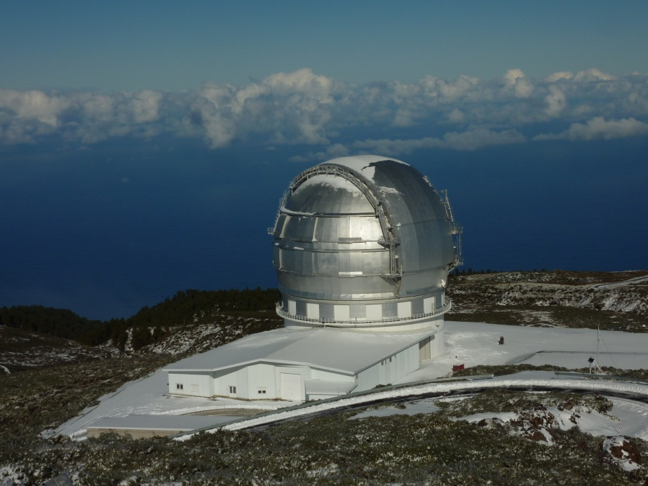
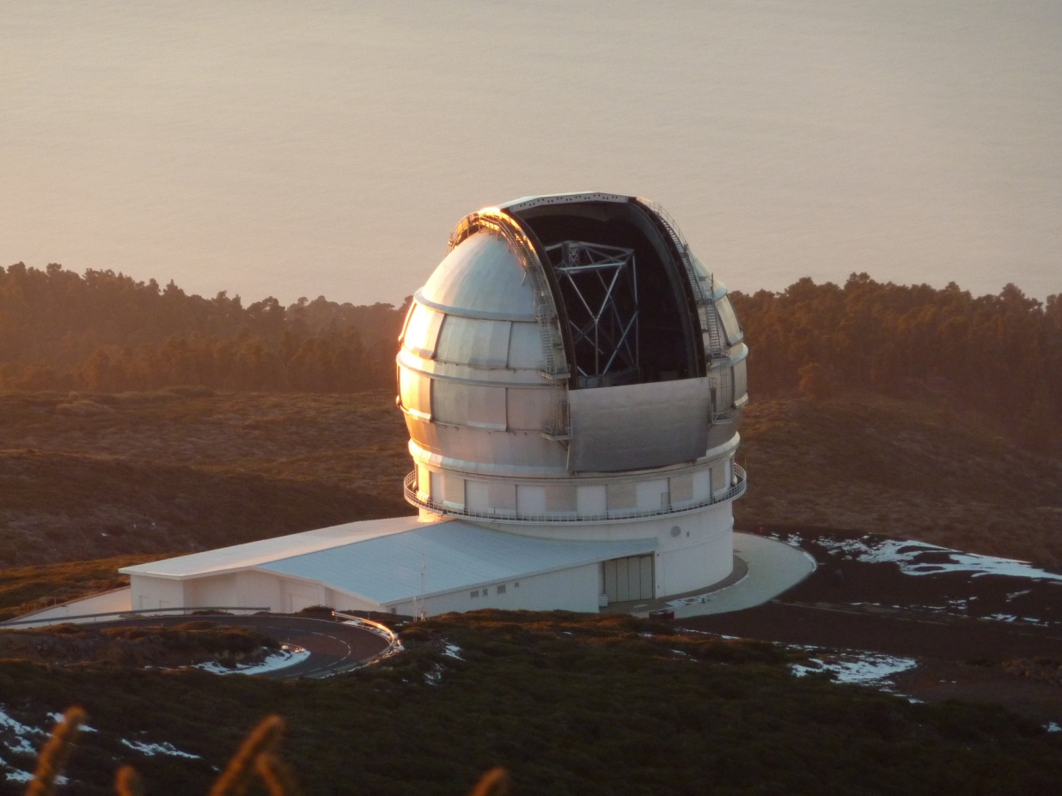
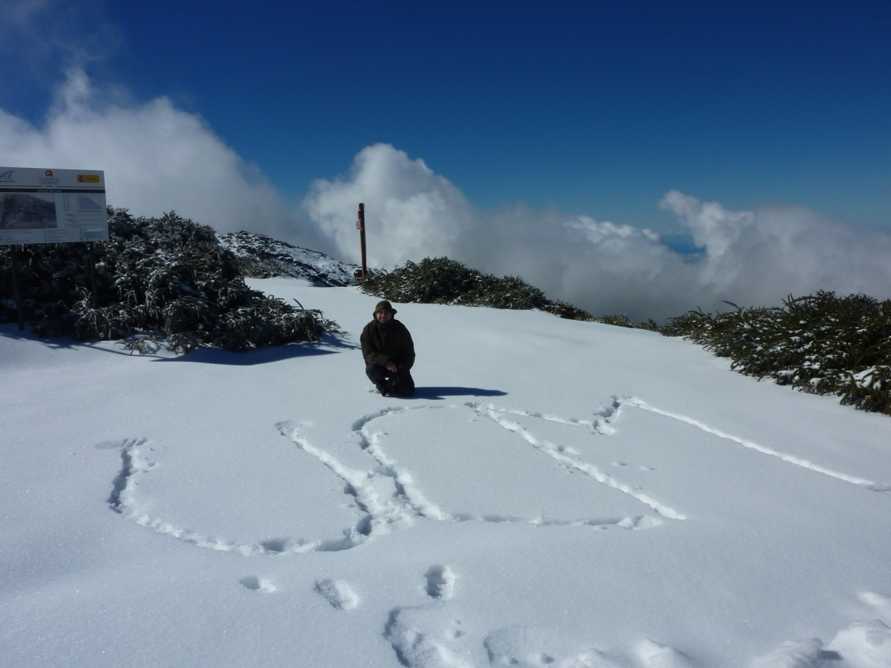
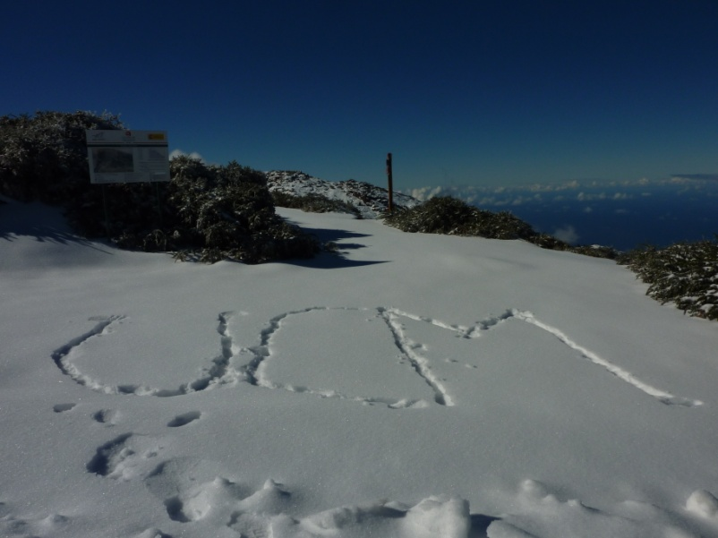
Reconstructing the formation of massive early-type galaxies
from their SHARDS
Pablo G. Pérez-González
Universidad Complutense de Madrid
  SHARDS Team: A. Cava, G. Barro, M. Balcells,
  N. Cardiel, J. Cenarro, J. Cepa, S. Charlot,
  A. Cimatti, C. Conselice, E. Daddi, J. Donley,
  D. Elbaz, I. Ferreras, J. Gallego, R. Gobat,
  R. Guzmán, P.G. Pérez-González (PI), A. Renzini,
  G. Rieke, J.M. Rodríguez-Espinosa, L. Tresse,
  I. Trujillo, V. Villar, J. Zamorano
  Extended SHARDS Team: A. Alonso-Herrero,
  J. de Diego, C. Eliche Moral, O. González-Martín,
  K. Lai, J.A. López Aguerri, J. Masegosa,
  C. Muñoz Tuñón, M. Prieto, J. Rodríguez-Zaurín,
  J. Sánchez Almeida, P. Sánchez Blázquez.

Slide 2
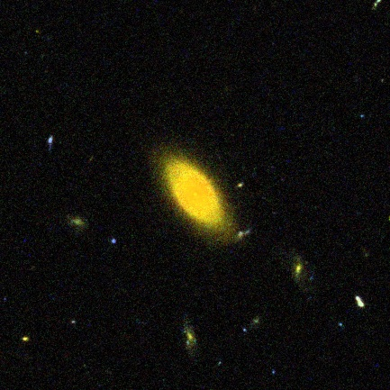
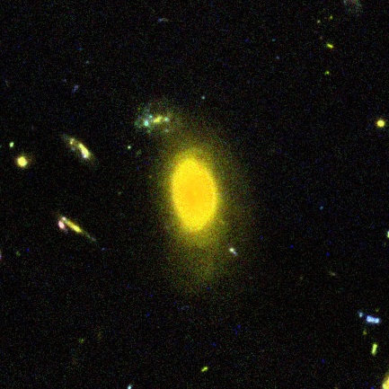
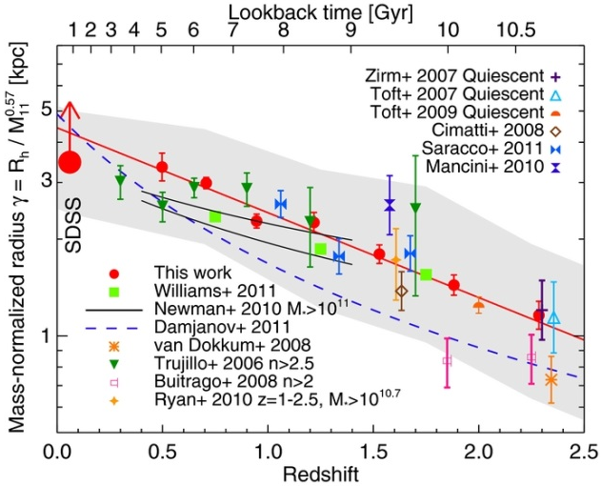
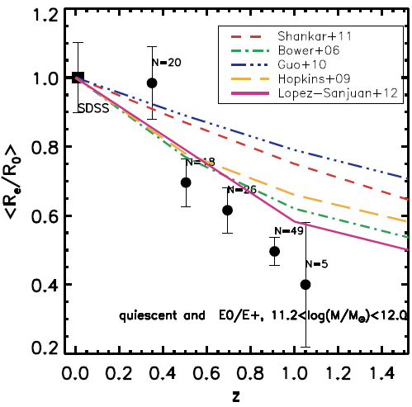
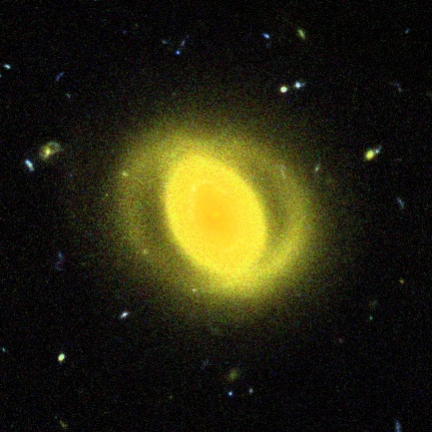
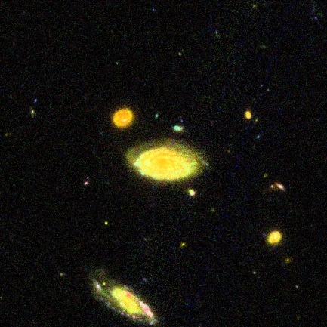
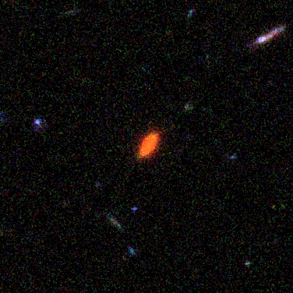

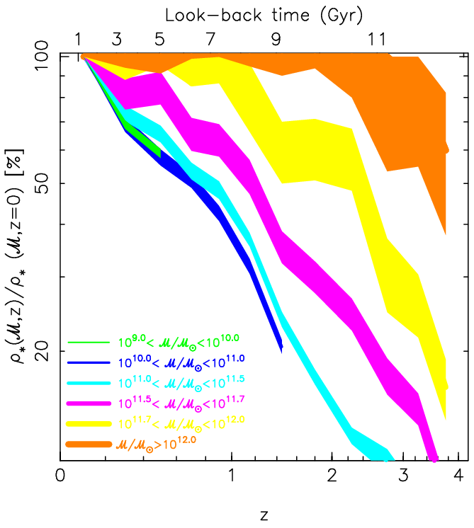
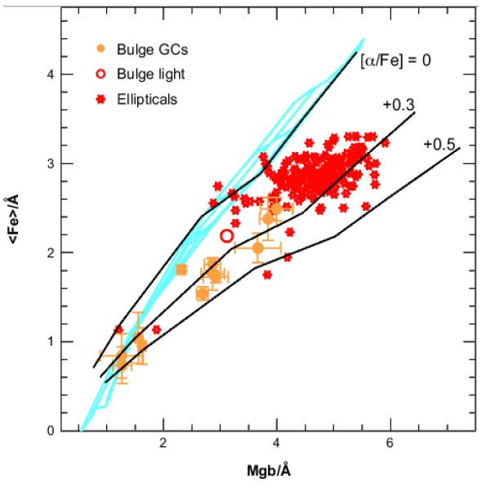
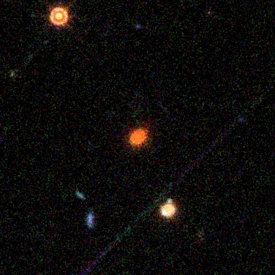
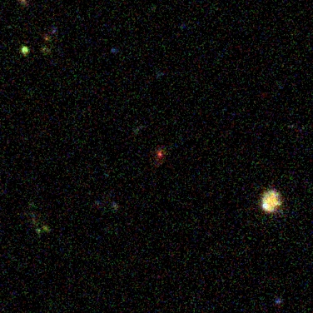

Formation of massive ($M≳10^{11}M_{⨀}$) early-type galaxies : a 2-stage process
z=0.25
z=0.21
Newman+ (2012)
Huertas-Company+ (2013)
90 kpc
z=1.2
10^{11.1} M
z=0.21
z=0.29
z=1.2
10^{11.0} M
z=2.2
10^{11.3} M
90 kpc
Renzini (2006)
P-G+ (2008)
Notes:
2 step process for massive galaxy formation.

Slide 3
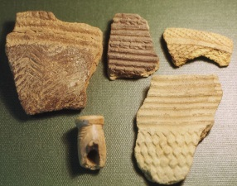
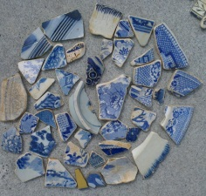
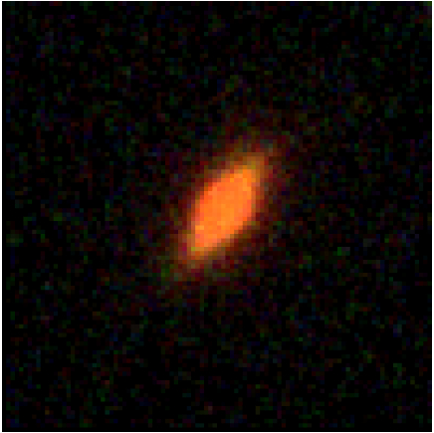
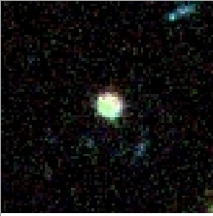
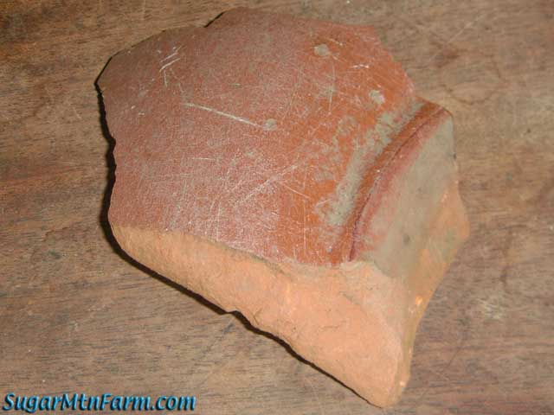
Formation of massive early-type galaxies
2-STAGE FORMATION SCENARIO FOR MASSIVE ETGs
Early phase (in situ?) dominated by a short-lived and intense burst of star formation at z>2, creating a massive, dense core (from early gas-rich mergers, disc instabilities, cold accretion). Good fraction of total mass already in place by z~2.
Late phase (ex situ?) increasing size, decreasing density and maybe affecting average age (not much, ETGs are typically old).
Early phase (in situ?) dominated by a short-lived and intense burst of star formation at z>2, creating a massive, dense core (from early gas-rich mergers, disc instabilities, cold accretion). Good fraction of total mass already in place by z~2.
Early phase (in situ?) dominated by a short-lived and intense burst of star formation at z>2, creating a massive, dense core (from early gas-rich mergers, disc instabilities, cold accretion). Good fraction of total mass already in place by z~2.
STAGE 1: creation of a massive dense core at z>2 (SHARDS view)
SFHs of z~1 compact dead massive galaxies (P-G+ 2013).
Progenitors of those compact DMGs (Barro, Faber, P-G+ 2013).
z=1.2420
z=2.44

Slide 4
How are z>1 red&dead galaxies formed?
STELLAR POPULATIONS IN z>1 MASSIVE GALAXIES
Stellar mass estimates based on SED fitting seem OK now (they behave well). Now we need to move on and determine…
  What are their ages (i.e., clock the in situ stage)?
  More generally, how are their SFHs? (and also Z, A_{V,…})
TECHNICAL ISSUES
Can we trust “classical” SED fitting (i.e., fits to broad-band data) results in terms of mass, SFR, timescale/duty-cycle, age,…?
Do we have all degeneracies under control? What can we do about them?
(ON THE WAY TO) SOLVING THOSE ISSUES…
Using data with proved sensitivity to SFH parameters: spectral indices (i.e., better spectral resolution than broad-band data).
UV-to-NIR coverage important!! (young vs. old pops, A_{V})
Keeping track of (and breaking, if possible) degeneracies and “model dependent artifacts”.
Very detailed study of galaxies in different stages of evolution.

Slide 5
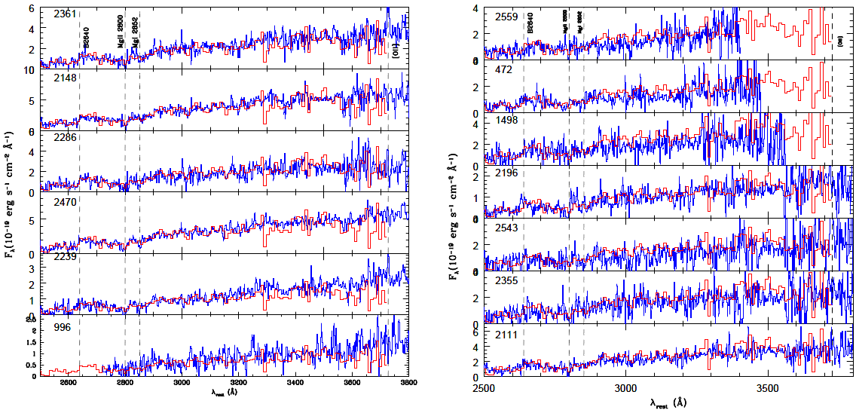
High-z red&dead galaxies in detail: spectra
Cimatti et al. (2008)
Typical magnitudes of $M≳10^{11}M_{⨀}$ galaxies @ z=1-3: (27,26,25)

Slide 6
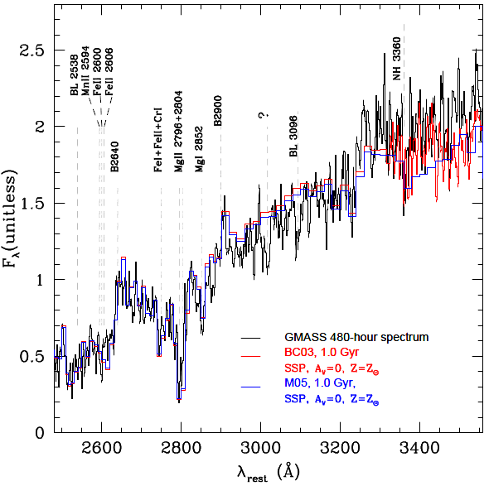
Spectral indices as age indicators: e.g., Mg_{UV}
Cimatti et al. (2008)
13 object stack, 480 hours
with VLT!!!

Slide 7
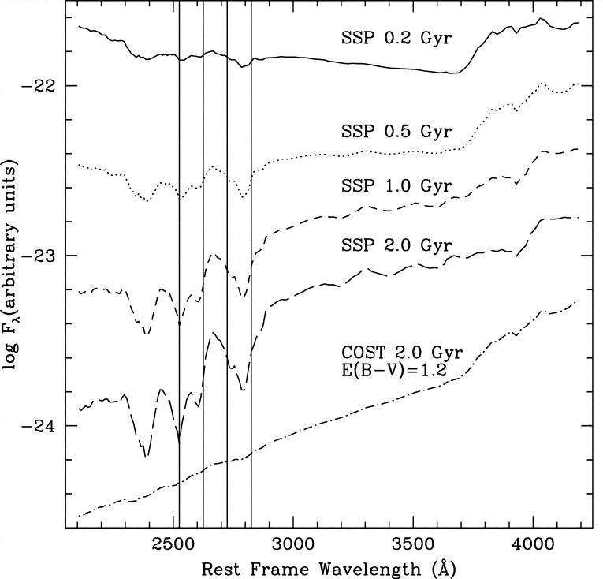
Spectral indices as age indicators: e.g., Mg_{UV}
Broad band:
I-band @z=2
Daddi et al. (2005)
Subaru-like medium band
(e.g., COSMOS)

Slide 8
Spectral indices as age indicators: e.g., Mg_{UV}
Balmer break
Daddi et al. (2005)
D(4000)
100 Å

Slide 9
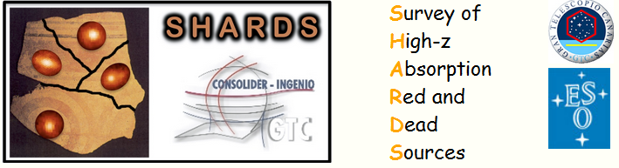
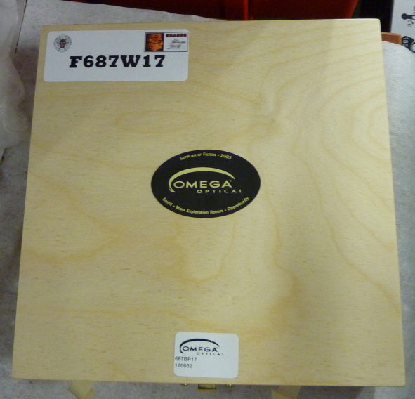
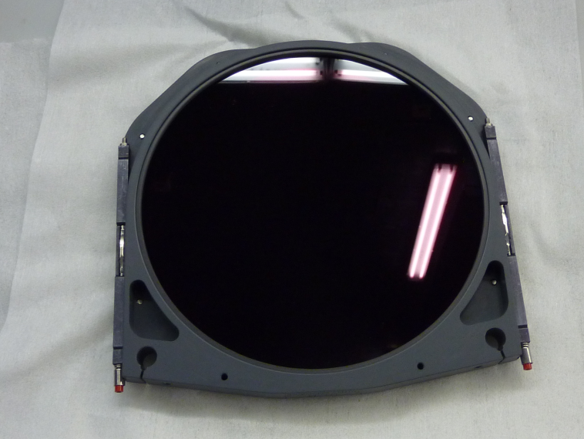
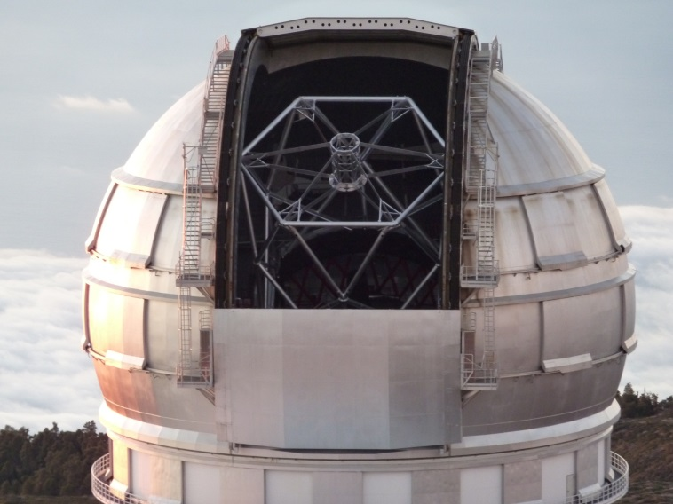
SHARDS: optical absorption indices (and also emission lines) down to magnitude 27 (AB)
http://guaix.fis.ucm.es/~pgperez/SHARDS

Slide 10
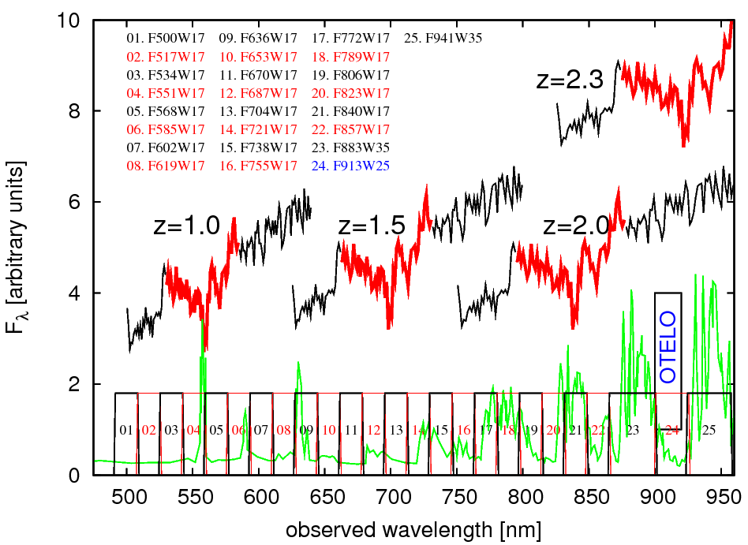
SHARDS: spectro-photometry (27mag) in GOODS-N
?

Slide 11
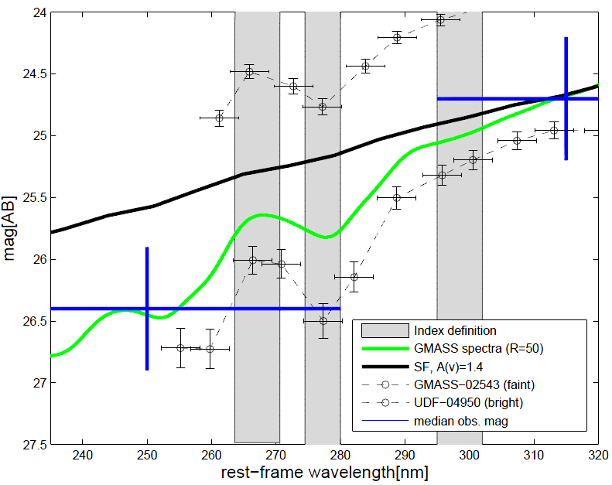

SHARDS: Mg(UV) index with photometry
Stack from
Cimatti+ (2008)

Slide 12
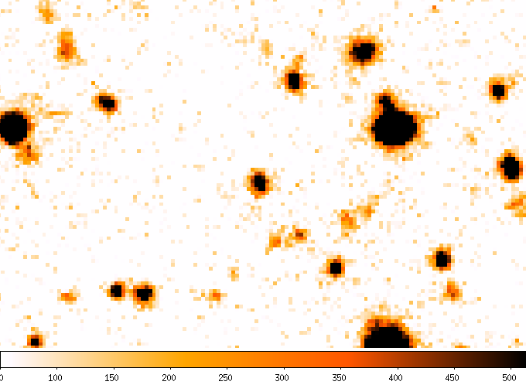
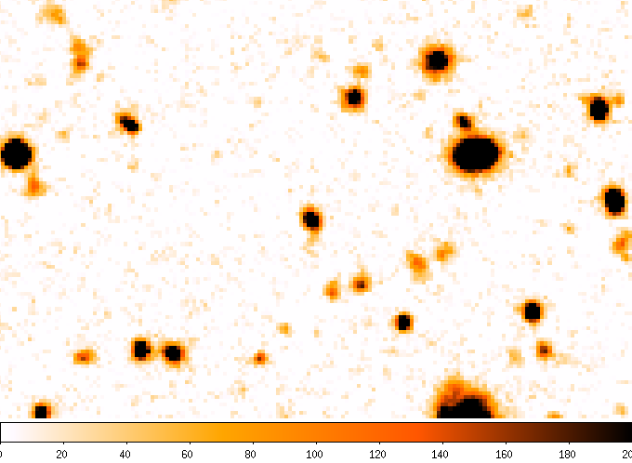
SHARDS data quality
Subaru I
~W17x8
GTC F857W17

Slide 13
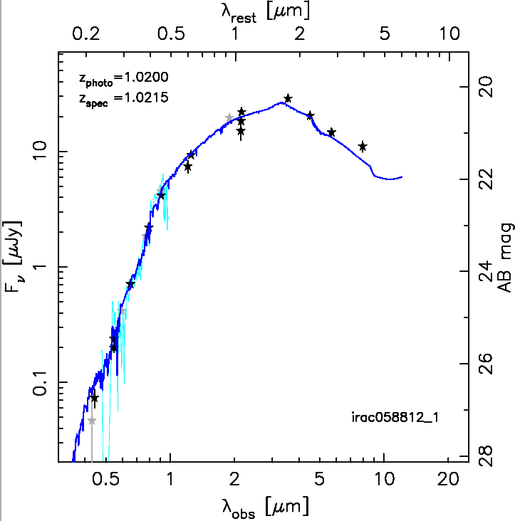
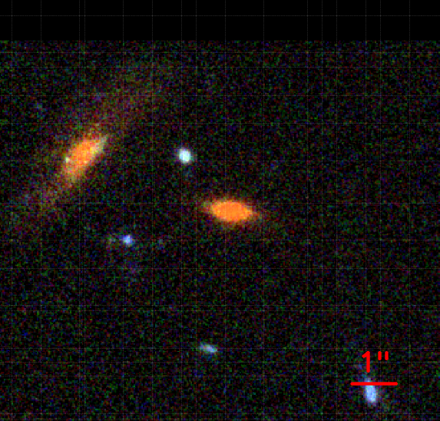
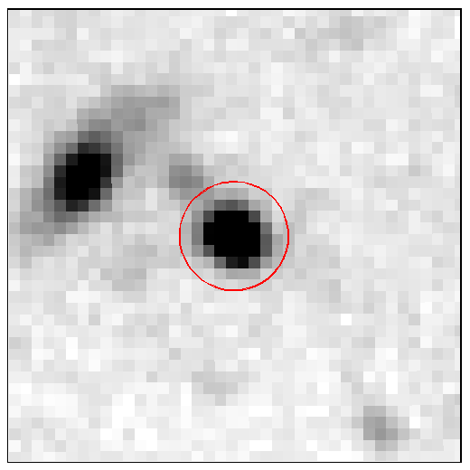
SHARDS: absorption indices at z>1, Ex. # 1
10”x10”
ACS
fit to BB data
SHARDS
Keck spectrum
Pérez-González et al. (2013)

Slide 14
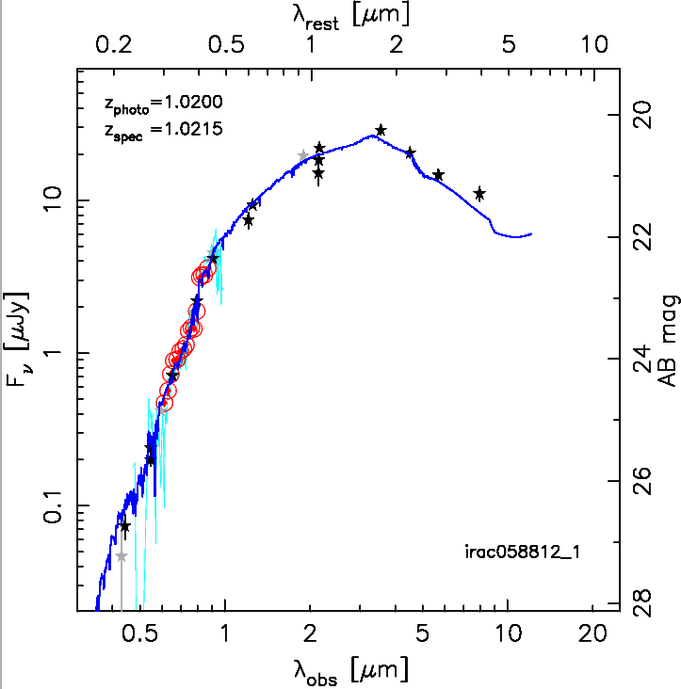
SHARDS: absorption indices at z>1, Ex. # 1
10”x10”
ACS
fit to BB data
SHARDS
SHARDS
Keck spectrum
Pérez-González et al. (2013)

Slide 15
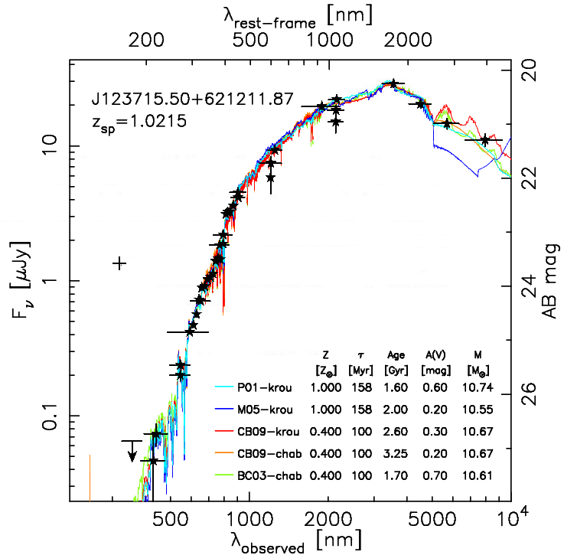
SHARDS: absorption indices at z>1, Ex. # 1
10”x10”
ACS
SHARDS
Pérez-González et al. (2013)

Slide 16
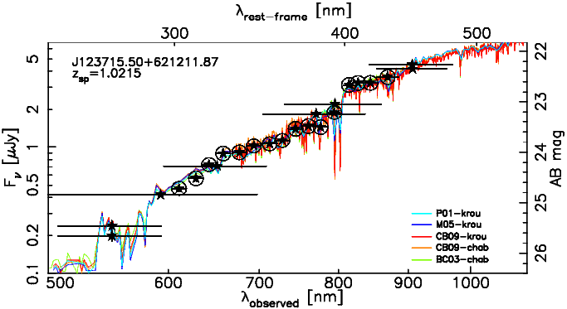
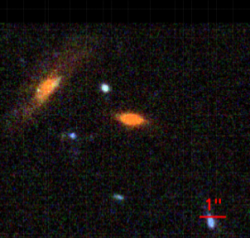
SHARDS: absorption indices at z>1, Ex. # 1
D(4000)
Pérez-González et al. (2013)
See also Hernán-Caballero+ (2013)

Slide 17
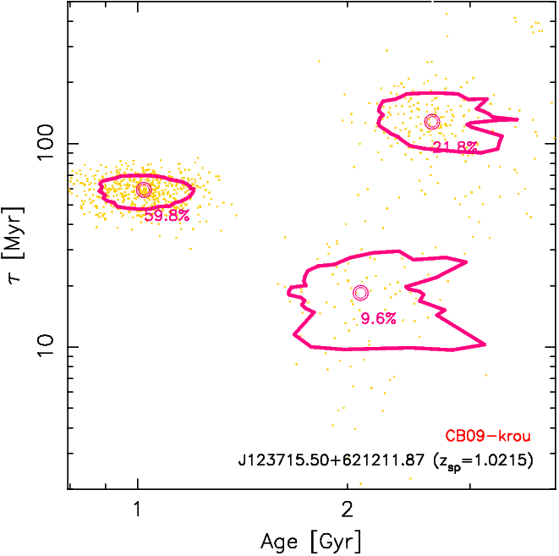
SHARDS: absorption indices at z>1, Ex. # 1
10”x10”
ACS
Only broad-band
Pérez-González et al. (2013)

Slide 18
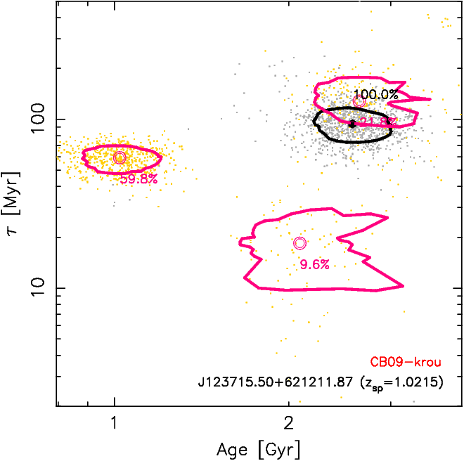
SHARDS: absorption indices at z>1, Ex. # 1
10”x10”
ACS
Only broad-band
SHARDS
M=10^{10.67±0.05} M
M=10^{10.64±0.04} M
Pérez-González et al. (2013)

Slide 19
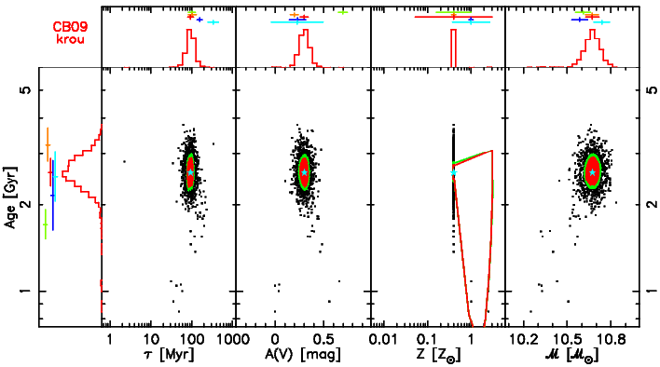
SHARDS: absorption indices at z>1, Ex. # 1
Pérez-González et al. (2013)

Slide 20
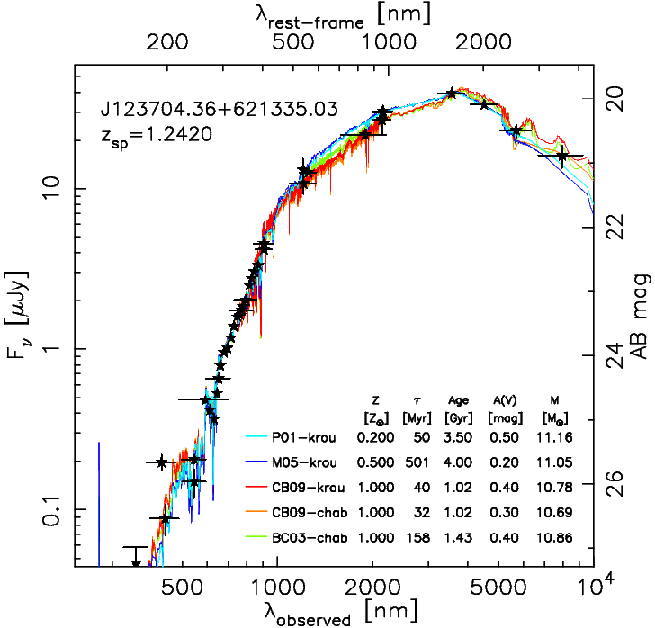
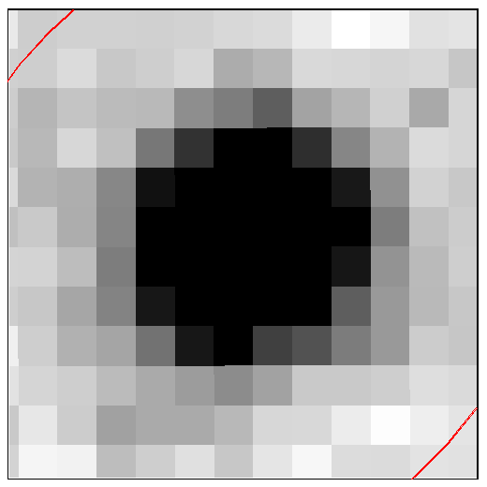
SHARDS: absorption indices at z>1, Ex. # 2
3”x3”
ACS
Pérez-González et al. (2013)
SHARDS

Slide 21
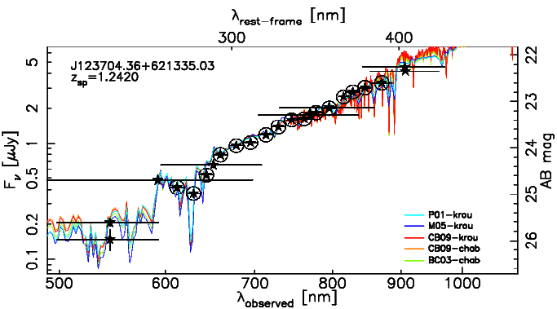

SHARDS: absorption indices at z>1, Ex. # 2
+
GO13420
Mg_{UV}
27!!
Pérez-González et al. (2013)

Slide 22
SHARDS: testing SPS models (at z~1)
Pérez-González et al. (2013)

Slide 23
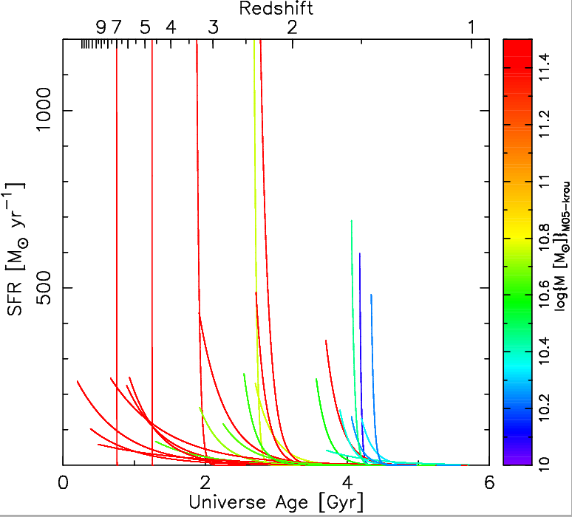
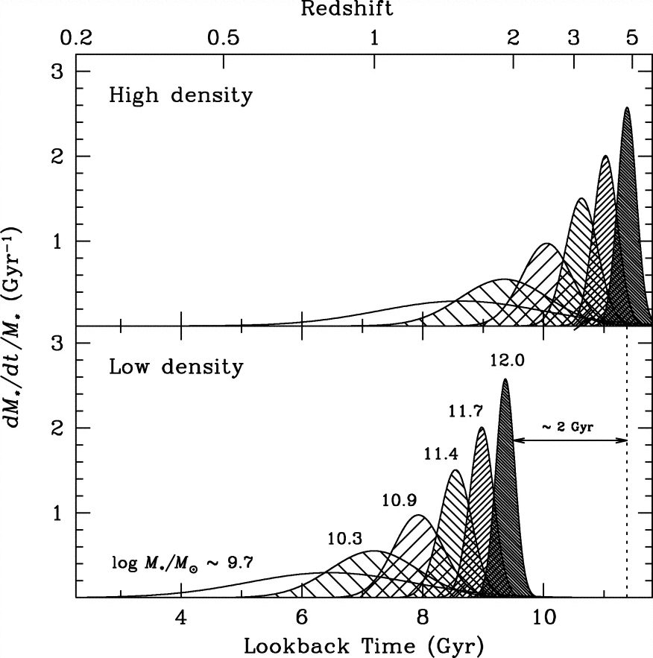
SHARDS: downsizing in detail (at z~1)
Statistical properties of z~1 red&dead sources (lighter-heavier):
Age= 3.0 Gyr → z_{f}=4 (2.0-3.6)→z_{f} (2.5-6)
τ= 162 Myr (158-375)
SFR_{max}=250 M /yr (ULIRG/SMG) (170-350)
Metallicity: 1.0 Z (1.0-1.0)
A(V)= 0.40 mag (0.28-0.51)
M=10^{10.77} M (10^{10.70}-10^{11.11})
Thomas+ (2005)
Pérez-González+SHARDS (2013)

Slide 24
To take away from this talk…
SHARDS (Survey of High-z Absorption Red and Dead Sources): medium-band optical survey with GTC/OSIRIS reaching
27 mag in 25 filters (FWHM~16 nm) covering from 500 to 950 nm in the GOODS-N field. 200 hours (seeing below 0.9”) through ESO/GTC Large Program CfP 2010.
Main goal: spectro-photometric analysis of red&dead z>1 galaxies.
Also extremely useful for: photo-z’s, environment, ELGs, LAEs,…
Data acquisition finished in June 2013.
SFHs of massive quiescent galaxies @z>1. First, z~1 study:
  (Trying to) break degeneracies with SHARDS (plus all other broad-band/grism) data, by measuring Mg_{UV}, D(4000), etc… down to 27.0 AB-mag (well below spectroscopic limit).
  Typical tau-model for (some) z~1 red and dead sources:
  τ=200-400 Myr (duty cycle/quenching timing), Age~2-4 Gyr (z_{f}=3-6), Z≤Z, A(V)<0.5 mag.
  heaviest galaxies start earlier (downsizing) and have longer SF timescales (!?).
  Different SPS models provide quite different results. BC03 models provide best results at SHARDS resolution (i.e., they seem to reproduce the rest-frame UV/optical better).

