Slide 1

Galaxy Bulges and their Super-Massive Black Holes
Alister Graham
Swinburne University
Australia
Notes:
Thank you. Good morning.
I’ve been assigned the topic “…”, although it will naturally contain my own preferences of what is included.

Slide 2
Overview
Part 1
Part 2
Part 3
Galaxy bulge light profiles, and model fitting
The resultant structural properties of bulges
Bulge-(black hole) scaling relations
Summary
Notes:
I will start by reviewing some of the basics of galaxy light profiles…
Modelling these provides us with physical properties, such as sizes and brightnesses, which we use to construct scaling relations.

Slide 3
Part 1
Bulge Light Profiles. I.
de Vaucouleurs (1959) noted departures in some bulge light profiles from his (1948) R^{1/4} model.
Exponential model provides better fits for some bulges than the R ^{1/4} law
(van Houten 1961; Liller 1966; Frankston & Schild 1976; Spinrad et al. 1978).
Shaw & Gilmore (1989) and Wainscoat et al. (1989) re-iterated that not all bulges are well described with de Vaucouleurs R^{1/4} model.
Andredakis & Sanders (1994) showed that many bulges are better fit with an exponential model than the R^{1/4} model.
Andredakis, Peletier & Balcells (1995) – Bulge Sérsic (1963, 1968) indices correlate with bulge mass, following work with Es by Caon et al. (1993).
Notes:
The R^(1/4) model was quite entrenched as a `law’.
Not everyone embraced the Sersic model, claims for a bulge dichotomy of classical R^(1/4) vs. secular exp. bulges.
review article with Simon Driver - Valeria Coenda kindly faxed me. this year is the 50th (Golden) anniversary of his model.
Jose Sersic is also known for a second area of research, his studies of galaxies with peculiar nuclei, including what he called “hot spots”.

Slide 4
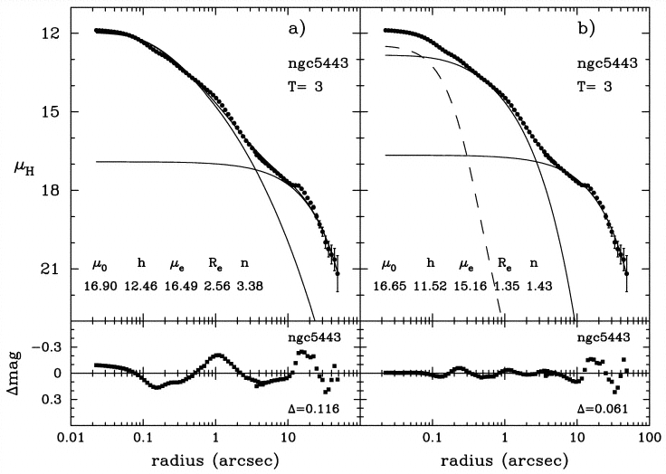
Part 1
Bulge Light Profiles. II.
HST galaxy light profile with a “hot spot”, a nuclear star cluster
(Balcells et al. 2003, ApJ, 582, L79)
Notes:
The impact of additional nuclear features depends on several factors, including the spatial resolution.
Care needed with S/N-weighted fits.

Slide 5
Part 1
Bulge Light Profiles. III.
μ
R
Notes:
The impact of additional nuclear features depends on several factors, including the spatial resolution.
Care needed with S/N-weighted fits.
I note that Paolo Bonfini is working on adding a core-Sersic model to GALFIT

Slide 6
Part 2
Structural Properties of bulges. I.
The size-mass diagram
Filling Up
Graham (Springer review article: arXiv:1108.0997)
Notes:
The prototype cE M32 has a low Sersic index for its inner `bulge’, plus a faint outer exp.-like cpt.

Slide 7
Part 2
Structural Properties of bulges. II.
The density-mass diagram
Graham (Springer review article: arXiv:1108.0997)

Slide 8
Part 2
Structural Properties of bulges. III.
Sirio Belli (arXiv:1311.3317)
Filling Up
See also Newman et al. (2012, ApJ, 746, 162)
Notes:
High z sample: 1 < z < 1.6
Passive evolution of larger Es: Paolo Saracco

Slide 9
Part 2
Structural Properties of bulges. IV.
    Some / most(?) high-z, compact galaxies are very likely to be today’s massive bulges (talk by Bil Dullo)

Slide 10
Part 2
Structural Properties of bulges. V.
Coloured data from Ivana Damjanov et al. (2011)
Figure from Dullo & Graham (2013)
Notes:
One may well then ask: to what extent were the bulge-BH scaling relations established at z ~ 2 if the quiescent bulges were?
Well, I don’t know the answer to that question, but we are learning more about the local relations…

Slide 11
Part 2
Structural Properties of bulges. VI.
    Some / most(?) high-z, compact galaxies are very likely to be today’s massive bulges (talk by Bil Dullo)
    Local massive bulges are old (ask Stephane Courteau),
    they existed at z ~ 1.5 ± 0.5 and should be in our deep images
    The putative discs around some of the high-z, compact massive galaxies supports the notion that they are evolving into S0 galaxies
    Additionally, our local, compact elliptical galaxies may be the bulges of stripped disc galaxies, or were perhaps too small to ever acquire a disc.
    See Graham (Springer review article: arXiv:1108.0997)

Slide 12
Part 2
Structural Properties of bulges. VII.
Passing note:
Cold streams, gas accretion (Alexandre Bouquin; Francoise Combes) builds discs around the compact galaxies / bulges.
The feeding is ultimately coplanar rather than random:
Pichon et al. (2011,MNRAS, 418, 2493);
Stewart et al. (2013, ApJ, 769, 74);
J.Prieto (arXiv:1301.5567).
Notes:
I’ll return to the old ages of bulges later in the talk.
One may well then ask: to what extent were the bulge-BH scaling relations established at z ~ 2 if the quiescent bulges were?
Well, I don’t know the answer to that question, but we are learning more about the local relations…

Slide 13
Part 3
(Black hole)–bulge relations. I.
The M–σ diagram
Ferrarese & Merritt (2000)
Gebhardt et al. (2000)
Offset barred galaxies
Graham (2008a, b)
Jian Hu (2008)
Notes:
Offset barred galaxies (or pseudobulges)

Slide 14
(Black hole)–bulge relations. II.
Graham, Onken, Combes, Athanassoula (2011) : M-σ
Graham (2012, ApJ) : M - M
Graham & Scott (2013, ApJ, 764, 151) : M–σ, M-L
M_{bh}~σ⁵
M_{bh} ~ L^{2.5}
M_{bh}~M² _{bulge}
L~σ²
M/L~L^{1/4}
L^{1.25} ~ M
Notes:
Giulia is working on more accurate bulge luminosities

Slide 15
The luminosity (L) / velocity dispersion (σ) relation for bulges
For luminous spheroids (M_{B} < -20.5 mag): Luminosity ~ σ⁵
(e.g. Schechter 1980; Malumuth & Kirshner 1981; Von Der Linden et al. 2007; Liu et al. 2008; Cappellari et al. 2013)
For the less luminous spheroids: Luminosity ~ σ²
(Davies et al. 1983; Held et al. 1992; de Rijcke et al. 2005; Matkovic & Guzman 2005; Kourkchi et al. 2012; Cappellari et al. 2013)
Given M_{bh} ~ σ⁵
(e.g., Ferrarese & Merritt 2000; Graham et al. 2011; McConnell & Ma 2012):
M_{bh} ~ L¹ (for luminous core-Sérsic spheroids)
M_{bh} ~ L^{2.5} (for the fainter Sérsic spheroids)

Slide 16
Dry merging produces a linear relation
AGN Feedback produces a quadratic relation
Dry Merging
Gaseous
formation processes
Graham (2012, ApJ, 746, 113)
Graham & Scott (2013, ApJ, 764, 151)
Scott et al. (2013, ApJ, 768, 76)

Slide 17
McConnell & Ma (arXiv:1211.2816)
Lasker et al. (arXiv:1311.1531)
Remco van den Bosch et al. (2012, Nature, 491, 729)

Slide 18
The M_{bh} – (Sersic index) relation
Graham & Driver (2007, ApJ, 655, 77)
Giulia Savorgnan et al. (2013, MNRAS, 434, 387)

Slide 19
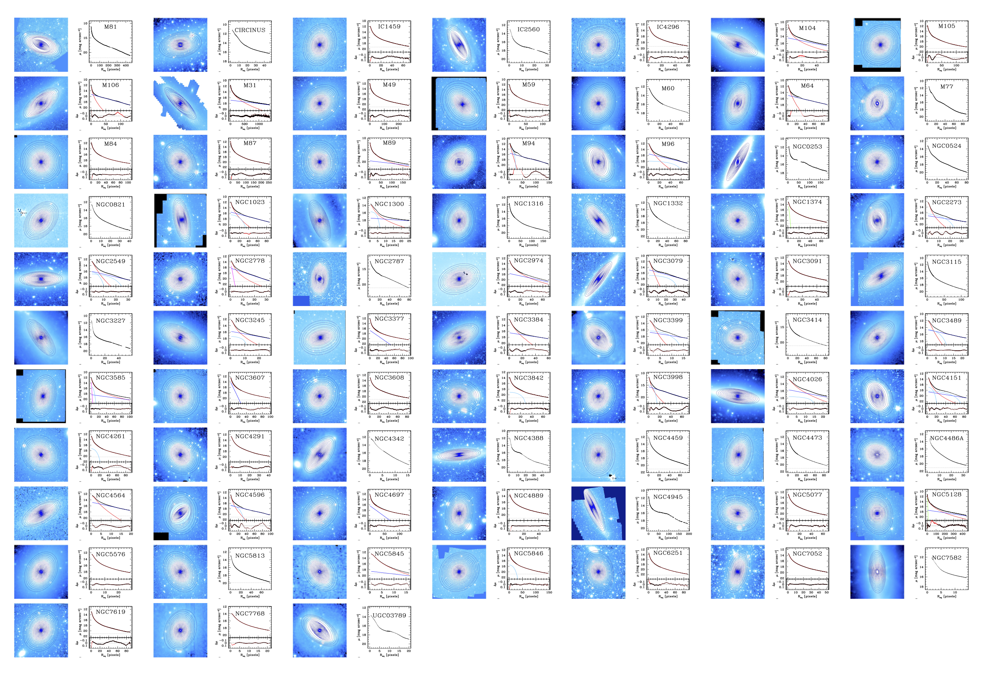
Giulia Savorgnan, in prep.

Slide 20
Implications
New M_{bh}-L relations / predictions for BH masses in other galaxies.
In luminous spheroids the M_{bh}/M_{sph} mass ratio is ~0.5%
The expected BH mass at M_{B} = -19 mag is now 10x smaller.
The expected BH mass at M_{B} = -17 mag is now 100x smaller.
Expect that intermediate mass black holes already discovered
(Graham & Scott 2013)
Need to revise BH mass function derived from the M_{bh}-L relation
(and need to re-compute the associated BH mass density).
Strong impact on expected gravitational radiation signal
(Mapelli et al. 2012; David Merritt and Co.)
Reinvestigate observational claims of M_{bh}/M_{sph} evolution with z
Rethink BH/galaxy formation/feedback theories that predicted M_{bh}~L.
Modify semi-analytic models which programmed in `quasar
mode’ / `cold-gas mode’ BH growth assuming M_{bh}~L .
Notes:
So, what about the apparent offset barred population in the M-sigma diagram, and the connection with pseudobulges…

Slide 21
Summary. I.
We need to be careful with our modelling of bulges (e.g. pec. Nuclei coupled with S/N-weighted fits)
  Bulges are dense and compact. They can be similar to
  a) the low-mass compact Es in the local universe and
  b) the massive compact galaxies in the distant universe.
  Quadratic (black hole)-bulge mass relation.

Slide 22
The End

Slide 23
Appendix
Cappellari et al. (2013,
MNRSA, 432, 1862)

Slide 24
Part 4
Pseudobulges
Pseudobulges are supposed to rotate and have an exponential light profile, akin to the disc material from which they formed.
Bardeen, J.M., 1975, IAU Symp., 69, 297
Hohl, F. 1975, IAU Symp., 69, 349
Hohl & Zhang, 1979, AJ, 84, 585
Combes & Sanders 1981, A&A, 96, 164

Slide 25



Rotation. I.
Bulges have been known to rotate for many years
(e.g. Pease 1918;
Babcock 1938, 1939; ... ;
Rubin, Ford & Kumar 1973; Pellet 1976;
Bertola & Capaccioli 1977; Peterson 1978;
Mebold et al. 1979).
Andromeda rotation curve (Pease 1918).
Merger events can create `bulges’ which rotate (Bekki 2010; Keselman & Nusser 2012), akin to merger simulations which create rotating ellipticals (e.g. Naab, Burkert & Hernquist 1999; Naab, Khochfar & Burkert 2006; González-García et al. 2009; Hoffman et al. 2009).
Notes:
Pease, F.~G.\ 1918, Proceedings of the National Academy of Science, 4, 21
Babcock - also the rotation of Andromeda’s bulge – Lick Observatory
Keselman & Nusser report on their simulations of bulge formation by gas-rich major mergers of pure discs; their bulges rotate and have n<2 (which led them to call them pseudobulges). However the ages of these bulges should be young.
Bekki: the observed rotational kinematics of GCs with different metallicities in M31 can be closely associated with the ancient major merger event, his models generate a rotating stellar bar, which can be morphologically identified as a boxy bulge if seen edge-on.

Slide 26

Rotation. II.
Classical bulges can be spun up by a bar (Saha et al. 2012).
Bar dynamics may give the illusion of rotation in classical bulges (Babusiaux et al. 2010).
Williams et al. (2010): boxy bulges, (previously) thought to be bars seen in projection (Combes & Sanders 1981), do not all display cylindrical rotation and can have stellar populations different to their disc.
Qu et al. (2011) report on how the rotational delay between old and young stars in the disc of our Galaxy may be a signature of a minor merger event.
Rotation is not a definitive sign of “bulges” built via secular disc processes.

Slide 27
Ages. I. Colour
From optical/near-IR colours,
Peletier et al. (1999) concluded (after avoiding dusty regions) that the bulges of S0-Sb galaxies are old and cannot have formed from secular evolution more recently than z = 3.
Bothun & Gregg (1990) had previously argued that bulges in S0 galaxies are typically 5 Gyr older than their discs.
Bell & de Jong (2000) reported that bulges tend to be older and more metal rich than discs in all galaxy types, and Carollo et al. (2007) found that roughly half of their late-type spirals had old bulges.
Gadotti & dos Anjos (2001) found that ≈ 60% of Sbc galaxies have bulge colours which are redder than their discs. [The average Sbc spiral has n < 2, Graham & Worley 2008.]

Slide 28
Ages. II. Spectra
Goudfrooij, Gorgas & Jablonka (1999) reported that bulges in their sample of edge-on spiral galaxies are old (like in Es), and have super-solar α/Fe ratios similar to those of giant Es. They concluded that their observations favor the `dissipative collapse' model rather than the `secular evolution' model.
Thomas & Davies (2006) concluded, from their line strength analysis, that secular evolution is not a dominant mechanism for Sbc and earlier type spirals.
Rosa Gonzales-Delgado reported S0-Sc bulges are old.
MacArthur, González & Courteau (2009) revealed that most bulges in all spiral types have old mass-weighted ages, with <25% “by mass” of the stars being young.
Notes:
READ: MacArthur, González & Courteau (2009) concluded that early-formation processes are common to all bulges and that secular processes or ‘rejuvenated’ star formation generally contributes minimally to the stellar mass budget, but has biased luminosity-weighted age estimates in the past. Such ’frostings’ of young stars, or up to some 25 per cent, have misled some studies into missing the fact that the bulk of the stellar mass in (most) bulges is actually old.
→ Bars may form around a classical bulge, drive in gas and re-juvenate the stellar population, and spin up the pre-existing bulge.

Slide 29
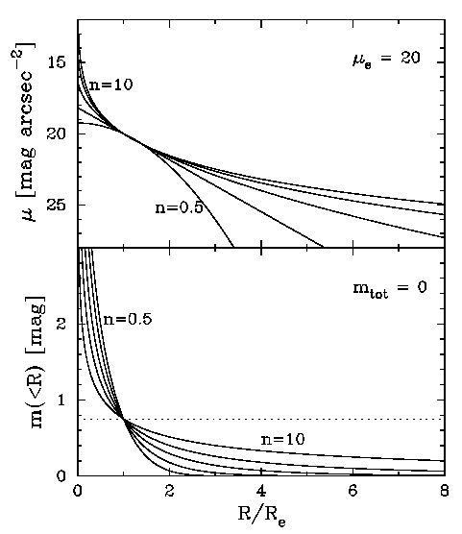
Bulge scaling relations. I.
R/R_{e}
Sérsic (1963, ‘68) R^{1/n} profiles.
1 2 3 4 5 6 7
Model reviewed in
(Graham & Driver
2005, PASA, 22, 118)
Notes:
50 years ago, working in Argentina, Sersic introduced his model.
n = ½, 1, 4 (** n=1 can describe a 3D bulge or a 2D disc).
Higher n equates to more `centrally concentrated’ within R_e, but more extended wings.
Define mu_e and <mu>_e
Point out mu_e – mu_0 difference with n, is not linear
OK, so now we know about light profiles.

Slide 30
Bulge scaling relations. II.
Graham (2013, Springer;
arXiv:1108.0997
Notes:
Continuity
Work from right to left:
No divide at n=2 or M_B = -18 mag between dE and E.
Explain change in panel a) at M_B ~ -20.5 mag.

Slide 31
Bulge scaling relations. III.
c)
Graham & Guzmán (2003)
arXiv:1108.0997
L _{tot} = 2 x (π R_{e}² <I>_{e})
Gadotti (2009)
Notes:
- Explain why curve come about – mention what the straight line is in panel a & b)
- Mention the sample selectionin panel c),
- and where the Kormendy relation is.
- Because the mu_e – R_e, L-mu_e, L-R_e (and FP) relations came first, people took the non-linearity to be a sign that the faint galaxies formed from a different process. We now understand this non-linearity as a result of the linear relations in the more fundamental diagrams of L-n and L-mu_0.
- All plots which use *effective* parameters will give curved relations.

Slide 32
Bulge scaling relations. IV.
No divide at a Sérsic index n equal to 1 or 2.
Domínguez-Tenreiro et al. (1998); Aguerri et al. (2001); Scannapieco et al. (2010) have grown bulges with 1 < n < 2 from minor mergers.
cD galaxy halos have n~1 profiles but are not discs (Seigar et al. 2007).
Bulges with n < 2 will appear to deviate from those with n > 2 in the M–μ_{e} and R_{e}–μ_{e} diagrams, and the Fundamental Plane – but this is not evidence of a dichotomy.
Notes:
Secular processes not thought to have formed big bulges, yet big bulges display continuous linear relations with small bulges, suggestive of a single unifying physical process.
Not a cascade of faint bulges departing from the classical bulges which overlap with bright Es in Fig.c
→ “so we now understand bulge magnitudes a little better, but what about bulge-to-disc ratios”.

Slide 33
Part 4 - Summary
Bulge magnitude, central surface brightness and Sérsic index define single, continuous log-linear relations. Scaling relations involving the `effective” structural parameters are curved, and should not be used to identify bulge (formation) type.
We need to be careful in our identification of pseudobulges.
    Rotation can not be used to identify bulge type.
    Most bulges have old mass-weighted ages.
    Be mindful that linear and curved scaling relations exist for bulges

