Slide 1


Gas and stars in nearby nuclear star clusters
Nadine Neumayer
Anil Seth (Utah), Anja Feldmeier (ESO), Jakob Walcher (AIP), Aaron Barth (Irvine), Torsten Böker (STScI), Hans-Walter Rix (MPIA)

Slide 2
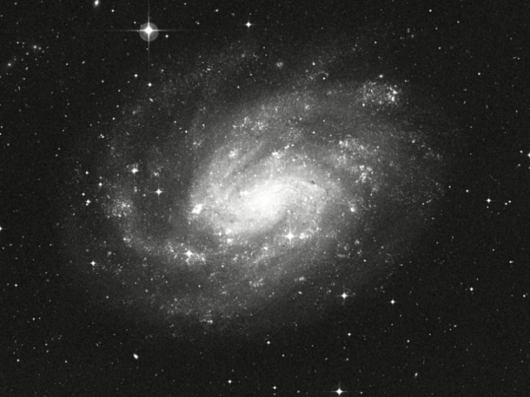
NGC 300
Credit: NASA, Z. Levay and G. Bacon (STScI)
Notes:
What are nuclear star clusters?
Here is a beautiful example of a nuclear star cluster that sits in the nearby galaxy NGC 300 at a distance of only 2.2Mpc.
The NC pops up nicely in the I-Band observations with HST.
Looking at the surface brightness distribution one clearly sees that the cluster is very bright and compact on top of the underlying galaxy.

Slide 3
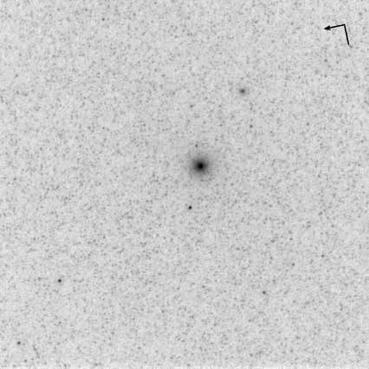
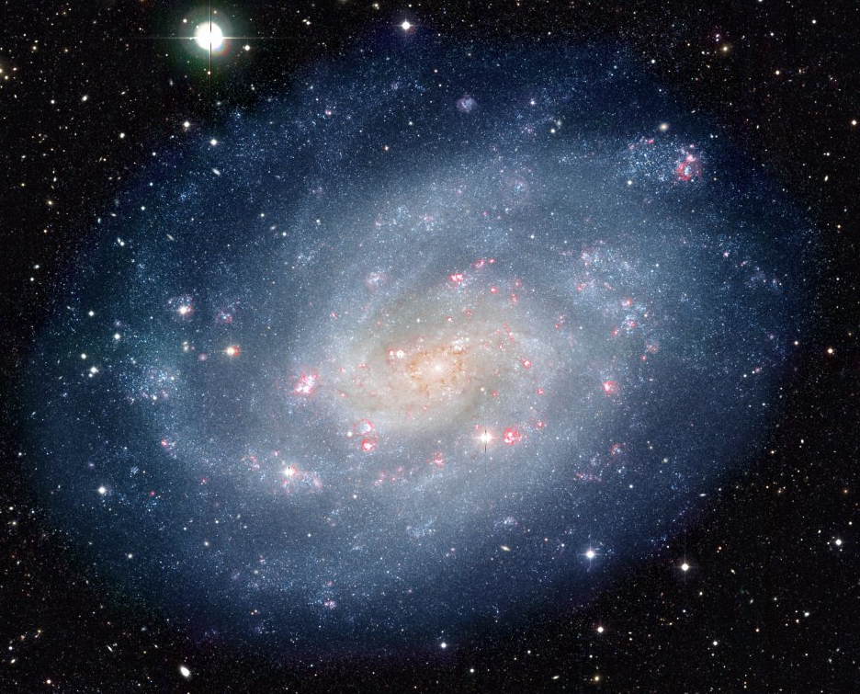
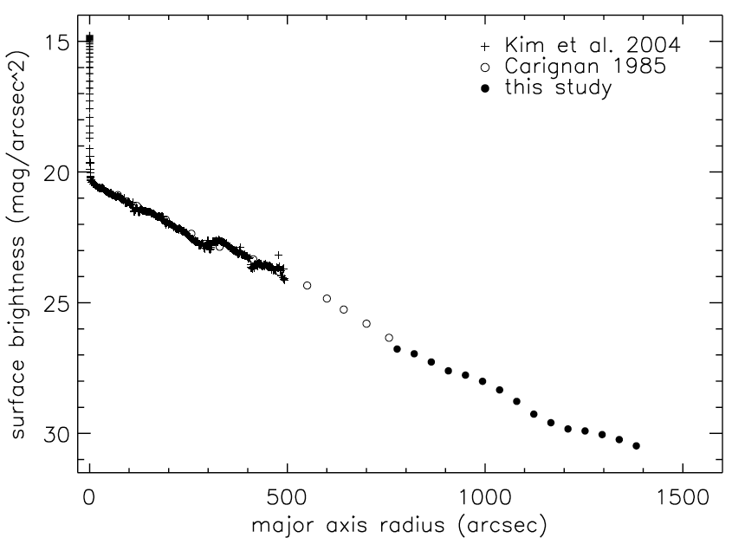
Nuclear Star Clusters
Böker et al. 2002, WFPC2/HST
WFI/MPG/ESO-2.2m
NGC 300
Bland-Hawthorn et al. 2005
Notes:
What are nuclear star clusters?
Here is a beautiful example of a nuclear star cluster that sits in the nearby galaxy NGC 300 at a distance of only 2.2Mpc.
The NC pops up nicely in the I-Band observations with HST.
Looking at the surface brightness distribution one clearly sees that the cluster is very bright and compact on top of the underlying galaxy.

Slide 4
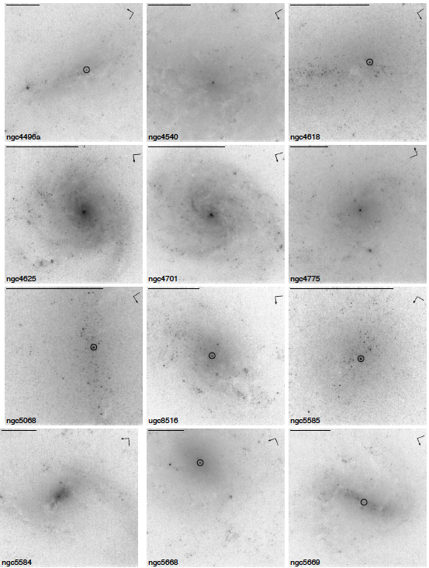
Nuclear Star Clusters
Detected in ~50-75% of all galaxies
Böker et al. 2002, 2004; Carollo et al. 2002; Coté et al. 2006

Slide 5
Nuclear Star Clusters
Detected in ~50-75% of all galaxies
Half-light radii 2-5 pc
Böker et al. 2002, 2004; Carollo et al. 2002; Coté et al. 2006

Slide 6
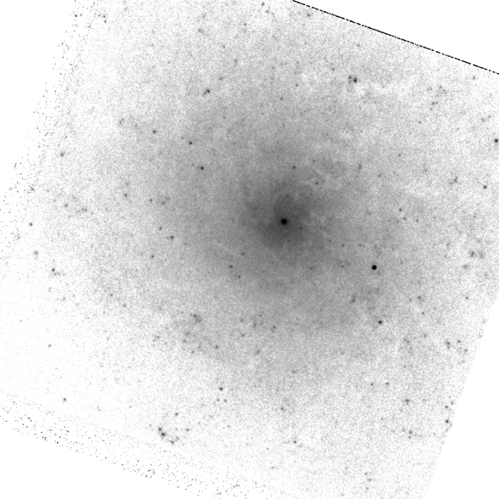
Nuclear Star Clusters
Detected in ~50-75% of all galaxies
Half-light radii 2-5 pc
Truly sit at the center
arcsec
arcsec
Neumayer et al. 2011

Slide 7
Nuclear Star Clusters
Detected in ~50-75% of all galaxies
Half-light radii 2-5 pc
Truly sit at the center
Stars of multiple ages
arcsec
arcsec
Neumayer et al. 2011
Notes:
Comparing the properties of nuclear clusters with Milky Way Globular Clusters, one finds that they are similar in size, but are in genreal brighter and more massive.
Moreover, these NCs are very common. Thery are present in about 75% of very late type galaxies. They are very dense, and it seems they might provide an alternative incarnation of black holes in very late type galaxies… but maybe not alternative, but inclusive?

Slide 8
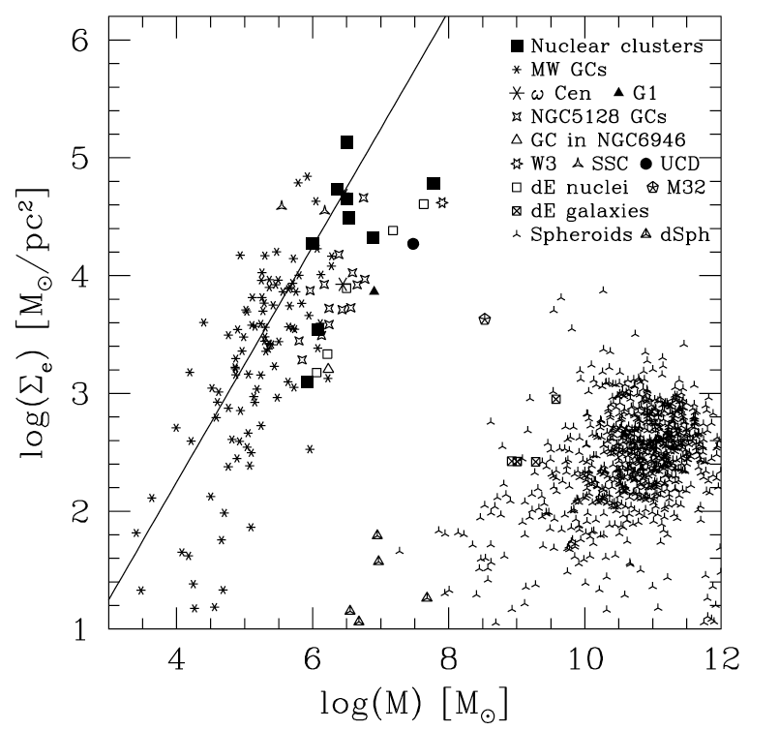
Nuclear Star Clusters
Detected in ~50-75% of all galaxies
Half-light radii 2-5 pc
Truly sit at the center
Stars of multiple ages
Masses 10⁶ - 10⁷ M
They have the highest stellar volume density in the universe
Walcher et al. 2005
Notes:
Comparing the properties of nuclear clusters with Milky Way Globular Clusters, one finds that they are similar in size, but are in genreal brighter and more massive.
Moreover, these NCs are very common. Thery are present in about 75% of very late type galaxies. They are very dense, and it seems they might provide an alternative incarnation of black holes in very late type galaxies… but maybe not alternative, but inclusive?

Slide 9
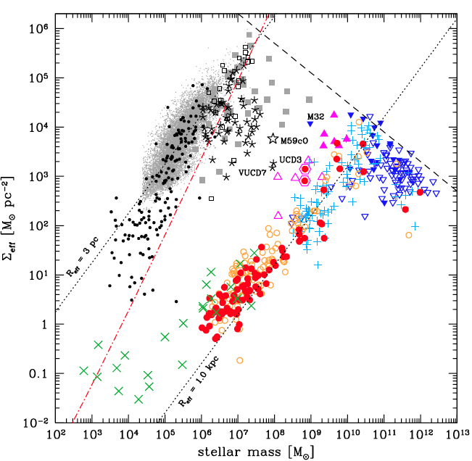
Nuclear Star Clusters
Detected in ~50-75% of all galaxies
Half-light radii 2-5 pc
Truly sit at the center
Stars of multiple ages
Masses 10⁶ - 10⁷ M
They have the highest stellar volume density in the universe
Misgeld & Hilker 2011
Notes:
Comparing the properties of nuclear clusters with Milky Way Globular Clusters, one finds that they are similar in size, but are in genreal brighter and more massive.
Moreover, these NCs are very common. Thery are present in about 75% of very late type galaxies. They are very dense, and it seems they might provide an alternative incarnation of black holes in very late type galaxies… but maybe not alternative, but inclusive?

Slide 10
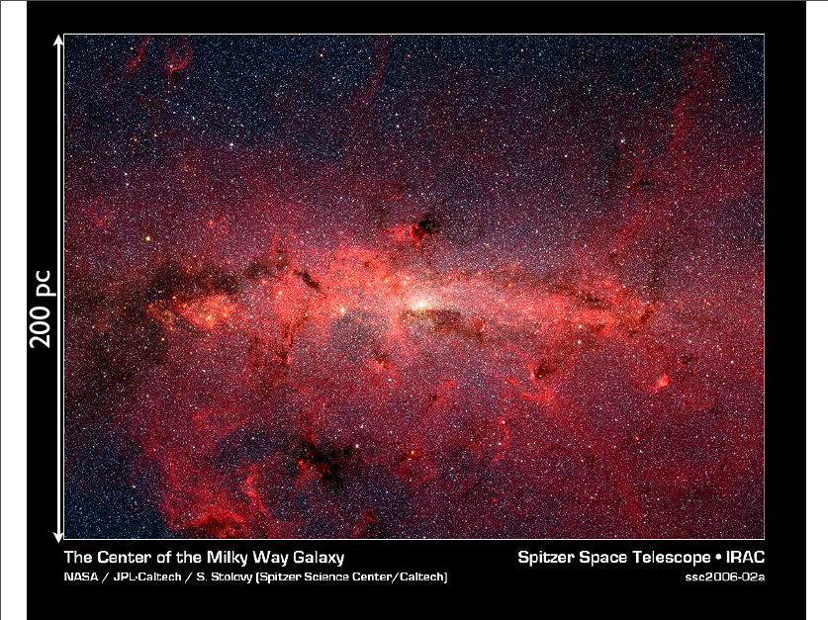
Nuclear Star Clusters
Detected in ~50-75% of all galaxies
Half-light radii 2-5 pc
Truly sit at the center
Stars of multiple ages
Masses 10⁶ - 10⁷ M
Some harbor a BH
Galactic Centre / Spitzer / S. Stolovy
Notes:
Comparing the properties of nuclear clusters with Milky Way Globular Clusters, one finds that they are similar in size, but are in genreal brighter and more massive.
Moreover, these NCs are very common. Thery are present in about 75% of very late type galaxies. They are very dense, and it seems they might provide an alternative incarnation of black holes in very late type galaxies… but maybe not alternative, but inclusive?

Slide 11
Nuclear Star Clusters
Detected in ~50-75% of all galaxies
Half-light radii 2-5 pc
Truly sit at the center
Stars of multiple ages
Masses 10⁶ - 10⁷ M
Some harbor a BH
  M_{BH} scales with galaxy mass
Neumayer & Walcher 2012
Neumayer & Walcher 2012
Notes:
Comparing the properties of nuclear clusters with Milky Way Globular Clusters, one finds that they are similar in size, but are in genreal brighter and more massive.
Moreover, these NCs are very common. Thery are present in about 75% of very late type galaxies. They are very dense, and it seems they might provide an alternative incarnation of black holes in very late type galaxies… but maybe not alternative, but inclusive?

Slide 12
Key Questions
How do nuclear star clusters form?
Are nuclear star clusters connected to black holes?

Slide 13
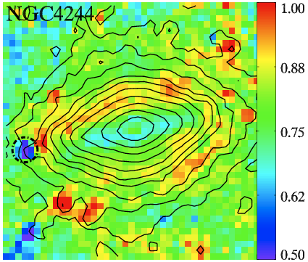
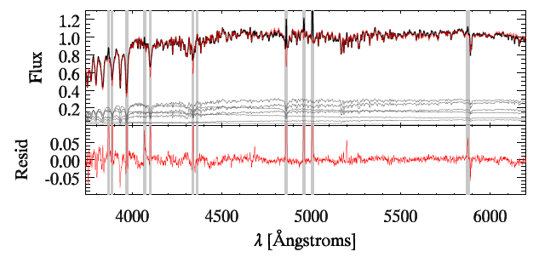
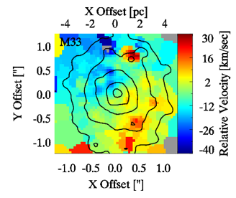
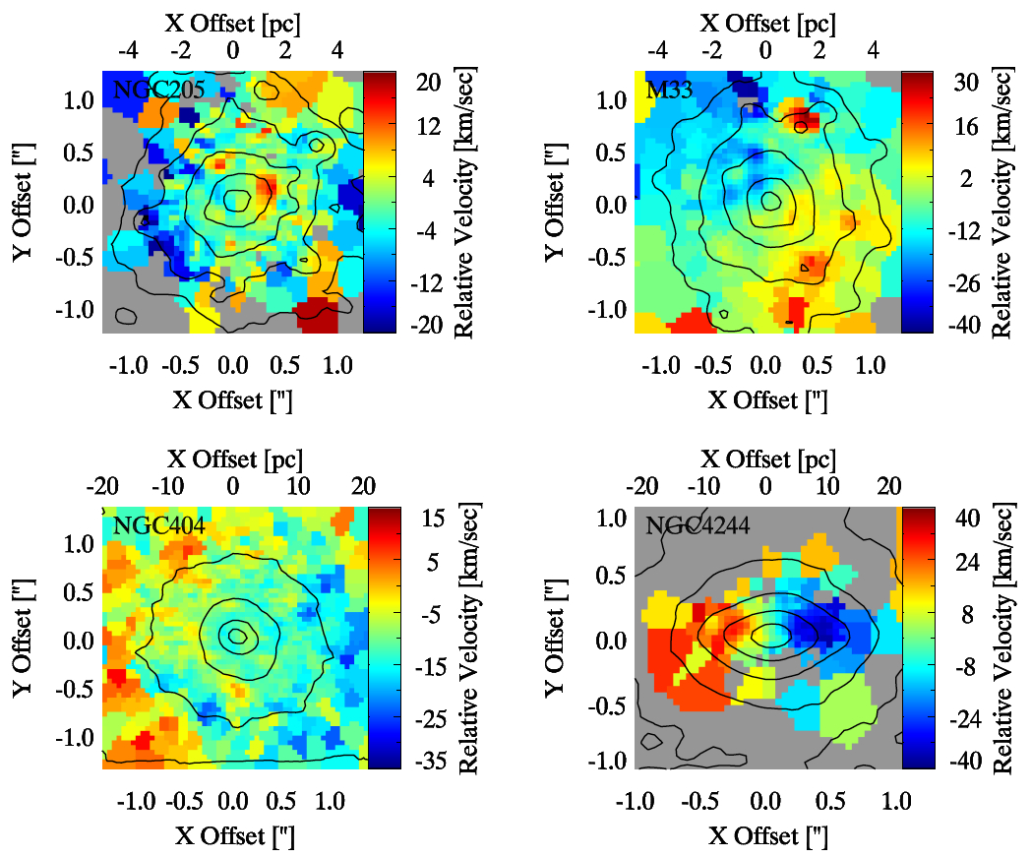
Formation of Nuclear Clusters
Morphology
Stellar Populations
Kinematics
HST Imaging
Optical Spectra
Adaptive Optics Integral Field Unit spectra from SINFONI/VLT & NIFS/Gemini
Neumayer/Seth

Slide 14
Nearby nuclear star clusters
10¹⁰ M
10⁹ M
total stellar mass
10⁸ M
Neumayer/Seth
Notes:
14 targets!
… all clusters show clear rotation, some a flattened structure and complex morphology. NGC 4244 shows a disk of young stars sitting in a shheroidal structure of older stars, but both structures clearly rotate… This suggests that the cluster formed from accreted material from the galaxy disk.

Slide 15
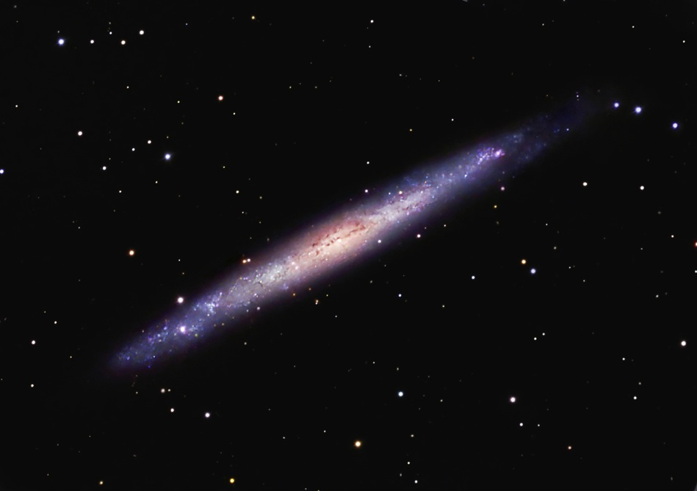
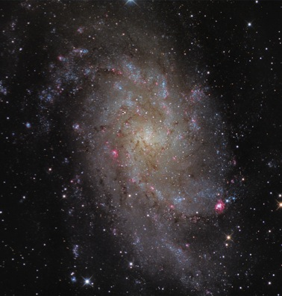
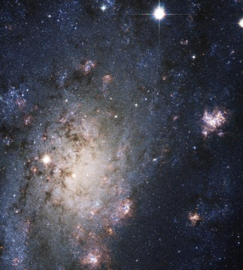
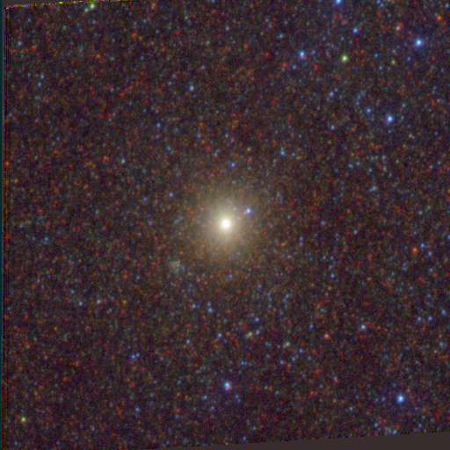
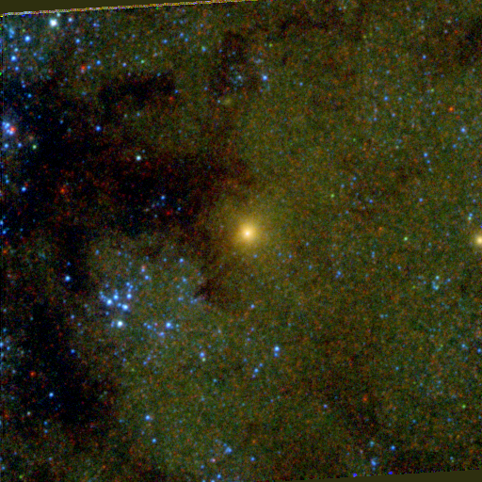
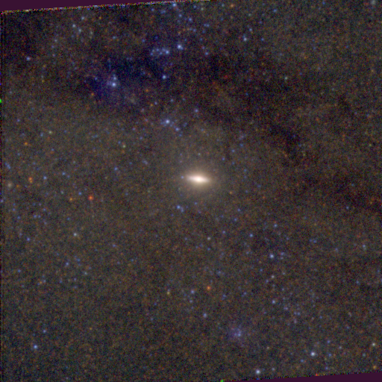
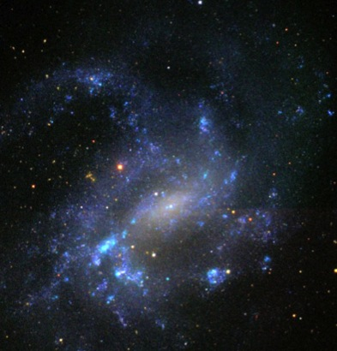
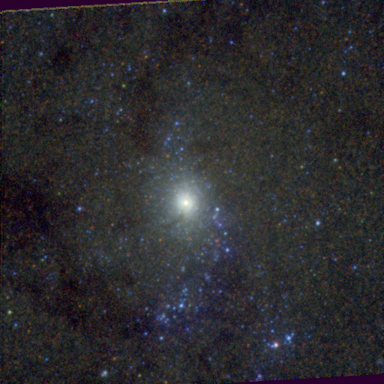
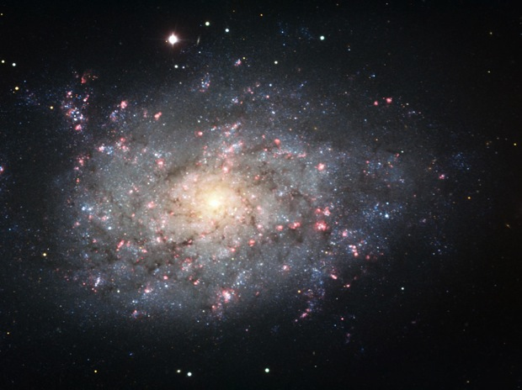
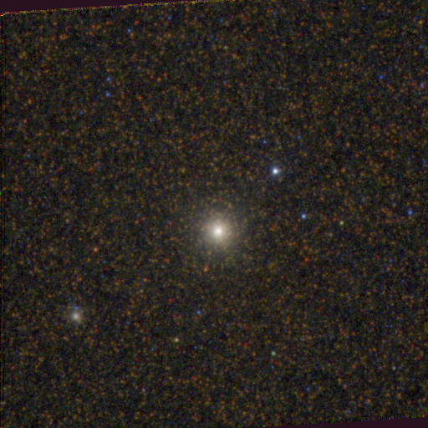
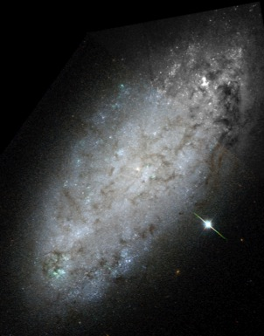
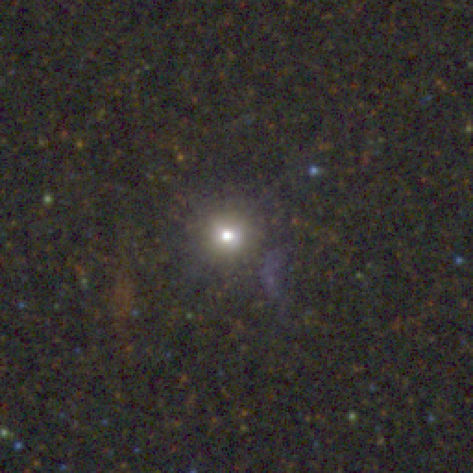
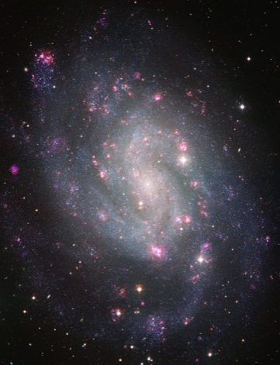
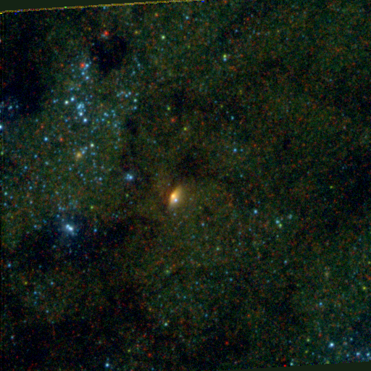
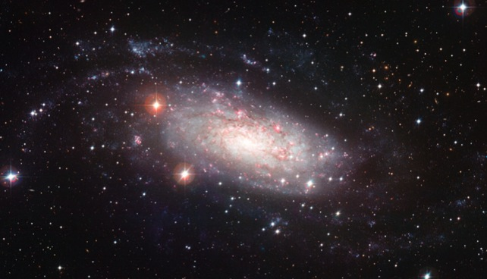
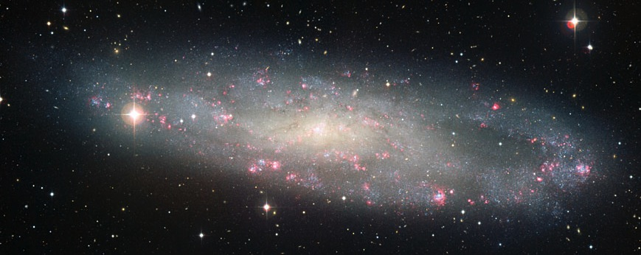
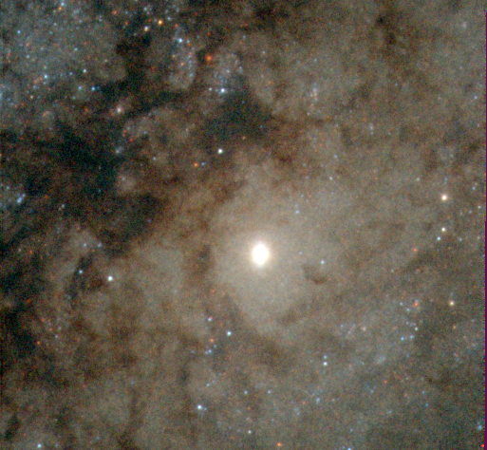
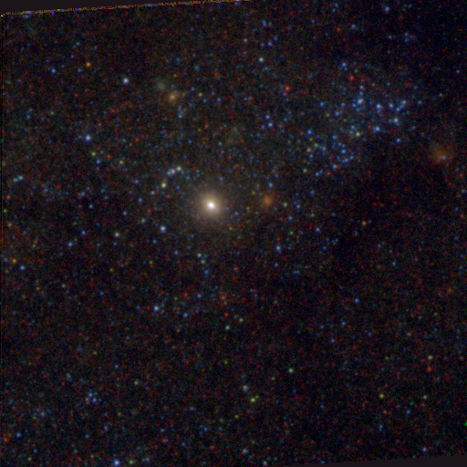
HST/WFC3 images – PI: Barth
First direct dynamical detection of a black hole in a bulgeless galaxy.
ESO, NASA, Gendler, Quattrocchi, Schedler, Seligman
Neumayer, Seth et al. in prep.

Slide 16
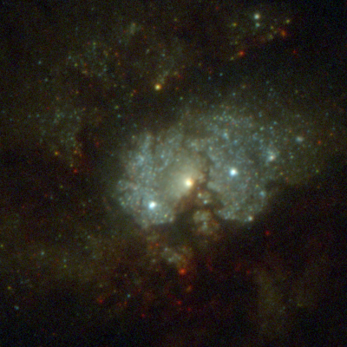
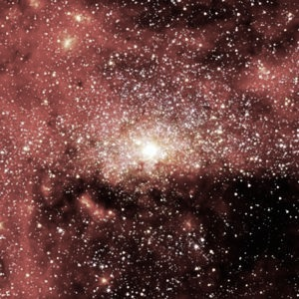
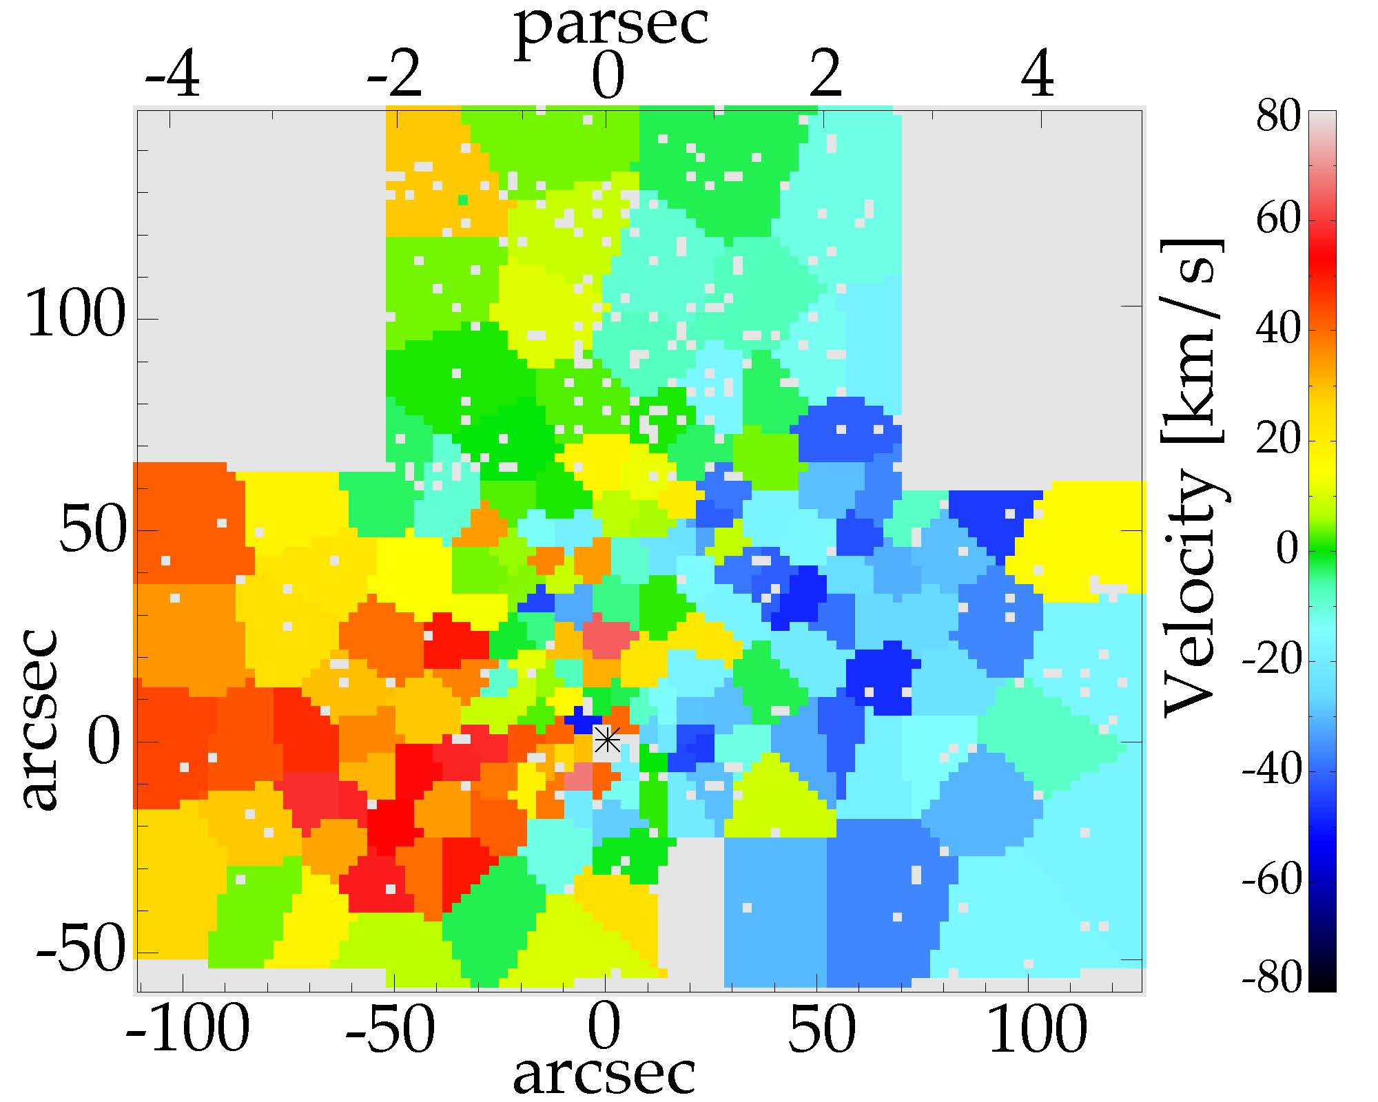
Nearby nuclear star clusters
35 pc
250 pc
PhD thesis of Anja Feldmeier
Seth, Neumayer et al. in prep.
Goals:
1. Study the formation history of the Milky Way Nuclear Cluster
2. Test black hole mass models used for external galaxies
Feldmeier, Neumayer et al. submitted

Slide 17
Nearby nuclear star clusters
35 pc
250 pc

Slide 18
Key Questions
Build-up of galaxy nuclei
    The stellar light from nuclear clusters tells us how and when mass got accreted into the centres of galaxies.
    Why do some galaxies not have nuclear clusters?
Formation of supermassive black holes
    The occupation fraction of black holes in low mass galaxies is a key observable to discriminate between black hole formation models.

Slide 19
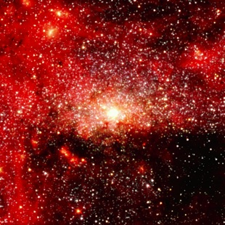
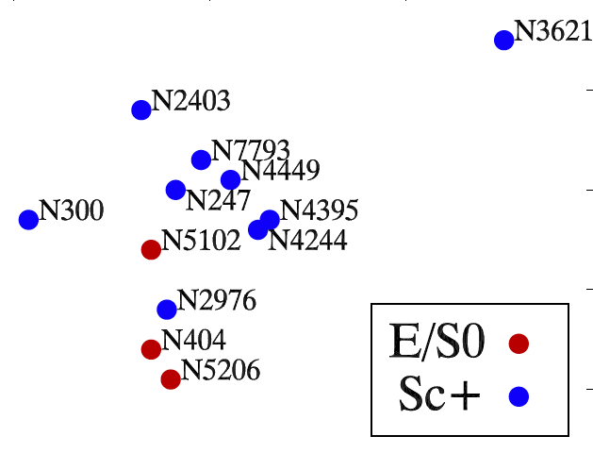
Nuclear Star Clusters
are common: >65% nucleation fraction
sit at the center of the potential well
have the highest stellar densities in the universe
co-exist with black holes
Milky Way NC serves as the perfect local reference
more dynamical black hole mass constraints to come

Slide 21
Backup slides

Slide 22
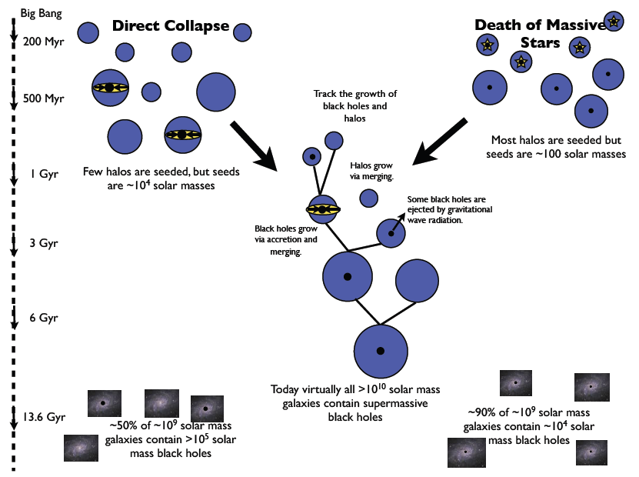
Black hole formation models
Greene, Nature Comm. 2012

Slide 23
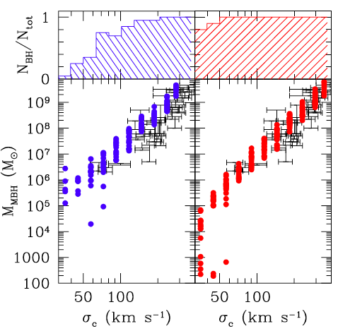
Occupation fraction
low mass black holes help to elucidate the early formation history of black holes
If present day fraction of black holes in galaxies with masses <10⁹ M is low -> seeds are likely to be of high mass
If the occupation fraction at the low mass end is high -> we would expect low mass seeds
High mass seeds
10⁵ M
Low mass seeds
100 M
Volonteri, Lodato & Natarajan 2008
Notes:
local demographics of low-mass BHs can elucidate their early formation history. The figure shows the results of simulations for two extreme cases: one for the scenario of low-mass seeds
from Pop III stars (right, red), and one for 105 M⊙ seeds from the direct collapse mechanism (left, blue). The two cases show markedly different behavior for the predicted BH occupation fraction and MBH –sig relation at low masses. In particular, the MBH -sig relation in the smallest galaxies (< 50 km s-1) can distinguish between high-mass and low-mass seeds, and the BH occupation fraction at low masses is strongly dependent on the efficiency of BH seed formation in high-redshift dark matter halos. Furthermore, small galaxies, with shallow potential wells, are more susceptible to becoming deprived of their central BHs as a result of ejections, providing information on the BH dynamics and merger rate.

Slide 24
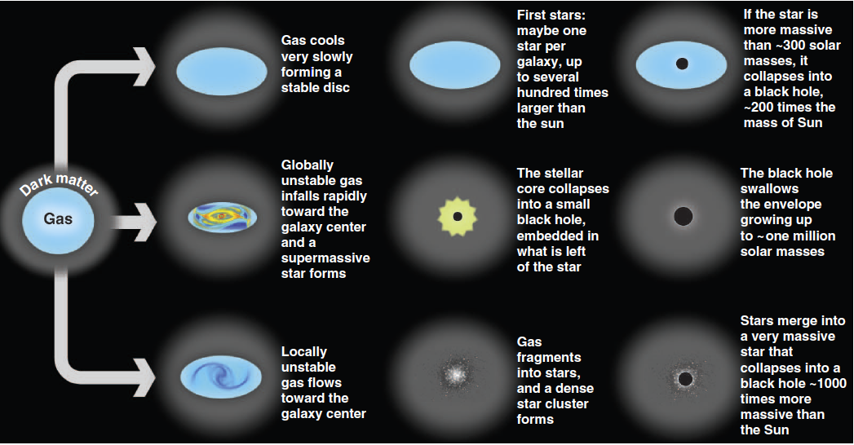
Black hole formation models
Volonteri, Science 2012

Slide 25
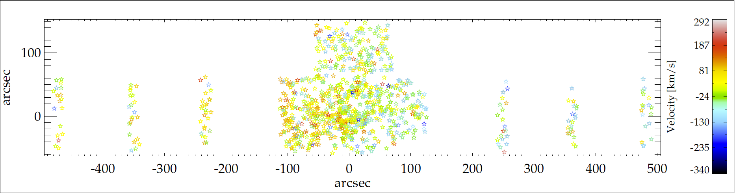
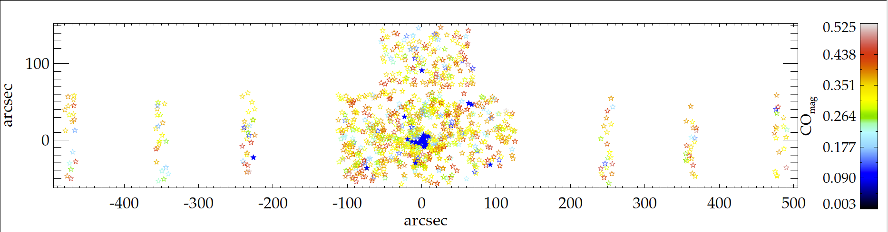
The Milky Way as a reference
35 pc
250 pc
distribution of young stars (blue)
velocity of individual bright stars
Feldmeier, Neumayer et al. submitted
Goals:
1. Study the formation history of the Milky Way Nuclear Cluster
2. Test black hole mass models used for external galaxies

Slide 26
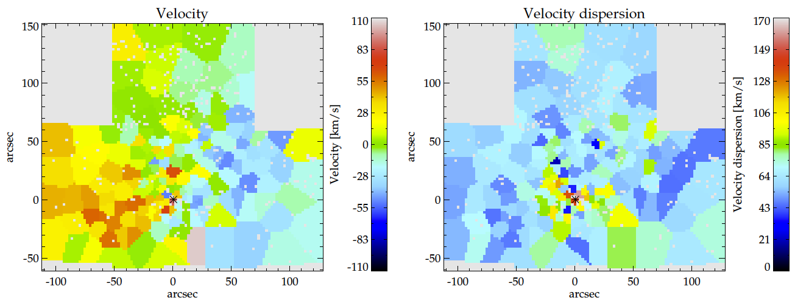
The Milky Way as a reference
35 pc
250 pc
velocity of ensemble of stars
PhD thesis of Anja Feldmeier
IMPRS Student at ESO
Seth, Neumayer et al. in prep.
Goals:
1. Study the formation history of the Milky Way Nuclear Cluster
2. Test black hole mass models used for external galaxies
Feldmeier, Neumayer et al. in prep.

Slide 27
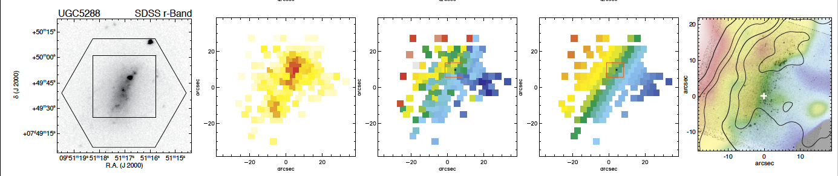
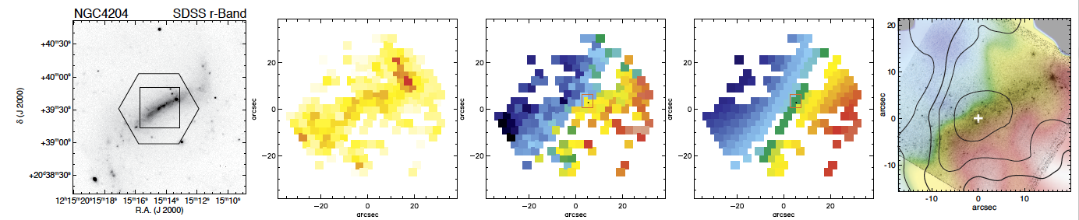
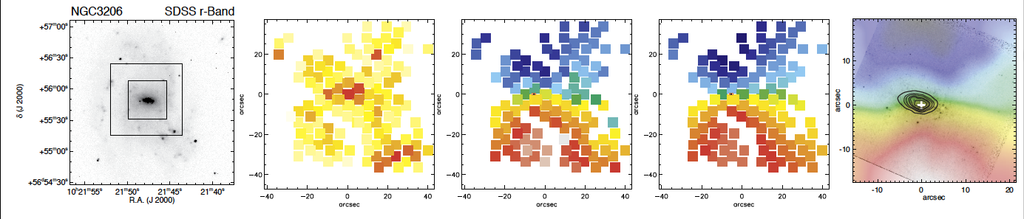
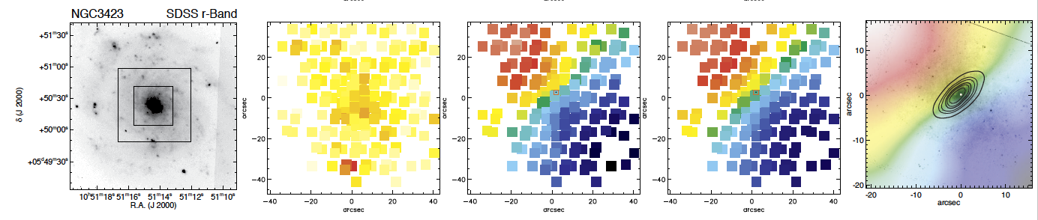
non-nucleated
nucleated
non-nucleated
nucleated
Neumayer et al. 2011

Slide 28
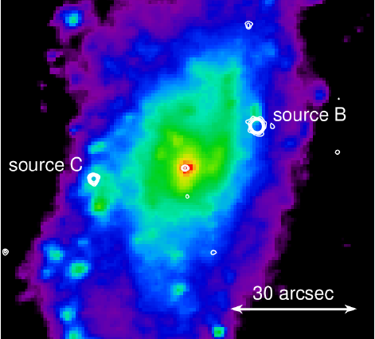
NGC 3621 - Sd galaxy
Bulgeless spiral
hosts nuclear cluster…
…plus detected AGN
  in MIR (Satyapal et al. 2007)
  and X-rays (Gliozzi et al. 2009)
M_{BH} > 2×10⁴ M
M_{BH} < 3×10⁶ M
  Gliozzi et al. 2009

Slide 29
NGC 3621 - Sd galaxy
Bulgeless spiral
hosts nuclear cluster…
…plus detected AGN
  in MIR (Satyapal et al. 2007)
  and X-rays (Gliozzi et al. 2009)
M_{BH} > 2×10⁴ M
M_{BH} < 3×10⁶ M
SINFONI data resolve the cluster

Slide 30
NGC 3621 - Sd galaxy
Bulgeless spiral
hosts nuclear cluster…
…plus detected AGN
  in MIR (Satyapal et al. 2007)
  and X-rays (Gliozzi et al. 2009)
M_{BH} > 2×10⁴ M
M_{BH} < 3×10⁶ M
SINFONI data resolve the cluster
We dynamically detect
M_{BH} ~ 6×10⁵ M

Slide 31
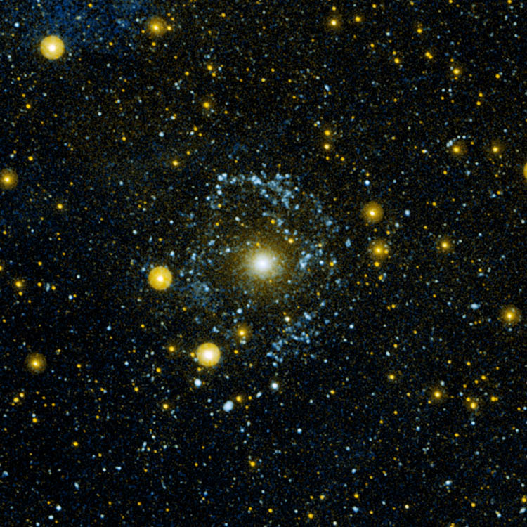
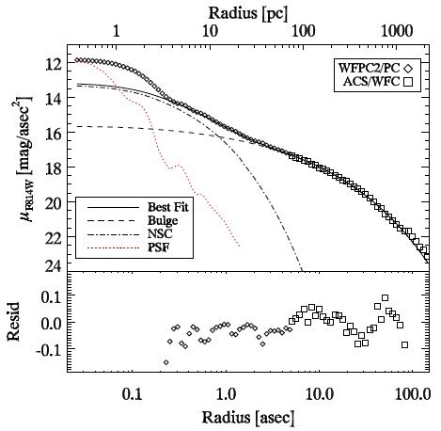
Close look at NGC 404
Nearest S0 galaxy
  D=3Mpc, σ=35km/s
Some evidence for an accreting black hole:
LINER like nucleus (Ho+ 1997)
compact X-ray source (Eracleous+ 2002)
High excitation lines in Mid-IR (Satyapal+ 2004)
variable UV emission (Maoz+ 2005)
compact dust emission (Seth+ 2010)
GALEX Thilker et al. 2010
Notes:
HI observations show a prominent nearly face-on HI disk at radii between 100-400′′, with detectable HI out to 800′′ (del R´ıo et al. 2004). CO observations and optical color maps show the presence of molecular gas and dust within the central 20′′ (300 pc) of the galaxy (Wiklind & Henkel 1990; Tikhonov et al. 2003), lying primarily to the NE of the nucleus. A nuclear star cluster in the central arcsecond of NGC 404 was noted by Ravindranath et al. (2001) from an analysis of NICMOS data. Recent GALEX observations show clear star formation coincident with the ring of HI

Slide 32
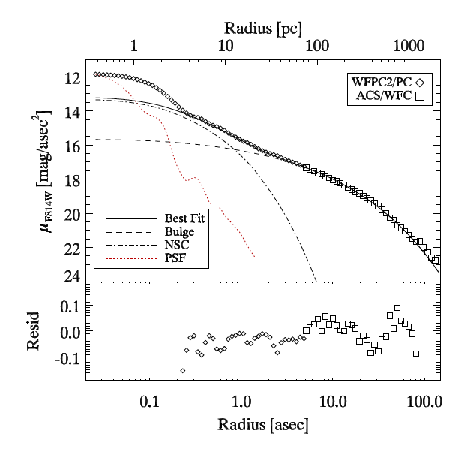
Dynamical black hole detection
Ingredients:
Stellar Mass Profile
  Luminosity Profile
  Mass-to-light ratio
Dynamical Tracer
Seth, Cappellari, Neumayer et al. 2010

Slide 33

NGC404 - Stellar Kinematics
Seth, Cappellari, Neumayer et al. 2010
Notes:
Fig. 7.— Velocity and dispersion of the stellar component derived from the CO bandhead. Contours show contours of the K-band image with contours separated by a magnitude in surface brightness (as in Fig. 2). Radial Velocities are shown relative to the central velocity of -58.9 kms−1.

Slide 34


NGC404 - Stellar Kinematic Model
V_{rms}=(V_{rot}²+σ²)^{½}
Jeans anisotropic model
Fit M_{BH}, β_{z}, M/L
M_{BH} < 1×10⁵ M
(~ 0.5 ×10⁵ M )
Seth, Cappellari, Neumayer et al. 2010

Slide 35

NGC404 - H₂ Gas Kinematics
Seth, Cappellari, Neumayer et al. 2010
Notes:
Fig. 11.— Velocity and dispersion of the molecular hydrogen data determined from the 1-0 S(1) line at 21218°A. Black contours indicate the surface brightness of the K-band image with contours separated by a magnitude in surface brightness. White contours show the H2 total intensity 5, 10, 20, 30, 40, 50, 70,and 90% of the peak. Radial velocities are shown relative to the central stellar radial velocity (-58.9 kms−1).

Slide 36


NGC404 – Gas Kinematic Model
M_{BH} ~ (4.5±3)×10⁵ M
Degeneracy due to
  v_{rot} ~ √M_{BH} × sin(i)
Inclination i~37°±10°

Slide 37

Stellar Kinematic Model
Jeans anisotropic model
Fit M_{BH}, β_{z}, M/L
M_{BH} < 1×10⁵ M
(~ 0.5 ×10⁵ M )
M_{BH} = 4×10⁵ M
Tangentially anisotropic
radially
anisotropic
isotropic
Seth, Cappellari, Neumayer et al. 2010

Slide 38

Nuclear Star Clusters
Detected in ~50-75% of all galaxies
Half-light radii 2-5 pc
Truly sit at the center
Stars of multiple ages
Single age fits
Multiple age fit
Residuals
Walcher et al. 2006; Seth et al. 2006; Rossa et al. 2006
Notes:
Comparing the properties of nuclear clusters with Milky Way Globular Clusters, one finds that they are similar in size, but are in genreal brighter and more massive.
Moreover, these NCs are very common. Thery are present in about 75% of very late type galaxies. They are very dense, and it seems they might provide an alternative incarnation of black holes in very late type galaxies… but maybe not alternative, but inclusive?

