Slide 1
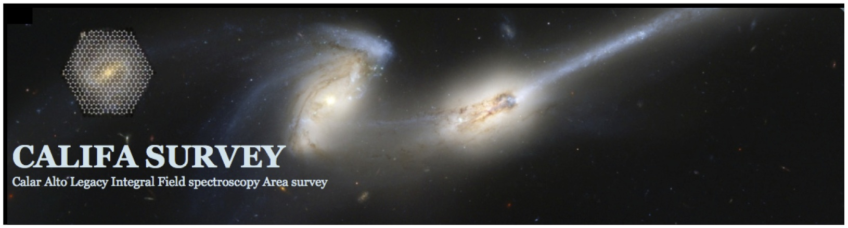

Stellar populations in disc galaxies from the CALIFA survey
Patricia Sánchez-Blázquez (UAM)
Jairo Mendez-Abreu (IAC)
Sebastian F Sánchez (UNAM)
Isabel Perez (UGR)
Fabian Rosales-Ortega (UAM)
And the CALIFA collaboration

Slide 2
Resolved stellar population studies in disk galaxies
Previous works
Stellar population analysis are ideal to test models of disk formation (gives us information about the SFH, gaseous infall, feedback processes)
Very few spectroscopic studies of stellar populations in the disk (long slit –only inner disk -MacArthur et al. 2009, PSB et al. 2011)
Yoachim et al. 2010; 2012 (Mitchell Spectrograph –VIRUS-P)
Changing quickly with CALIFA: Perez et al. (2013); González Delgado et al. (2014); Cid Fernandes et al. 2014 (see highlight talk by E. Pérez & Sebastian Sánchez)
There are not previous studies relating the stellar properties in the disk region with other properties of the galaxies
Stellar populations in disk galaxies P. Sanchez-Blazquez 3D2014
Notes:
.

Slide 3
Radial migration due to bars
Kubryk et al. (2013)
In numerical simulations, stars do not remain where they were born
Bars are the most efficient agents in redistributing material
See Friedli et al. (1998), Minchev & Famey (2010), Minchev et al. (2011, 2012); Shevchenko et al. (2011), Brunetti et al. 2011, Grand et al. (2012)
Stellar populations in disk galaxies P. Sanchez-Blazquez 3D2014

Slide 4
Importance of studying radial migration
→ Ongoing and upcoming surveys (SEGUE, RAVE, HERMES, APOGEE, 4MOST) designed to study the structure of the MW structure require the understanding of the dynamical processes affecting the stellar distribution
Roškar et al. 2008b
PSB et al. 2009
PSB et al. 2009
Without migration
Without
migration
Flattening of the AMR Widening of the MDF
Stellar populations in disk galaxies P. Sanchez-Blazquez 3D2014

Slide 5
Observational consequences of radial migration: flattening of the metallicity gradients
CR
Numerical simulations predict a flattening in the stellar metallicity gradient of more than 50% in 4 Gyr
Di Matteo et al. (2013)
see also Minchev , Chiappini & Martig (2012); Friedli 1998; Minchev & Famaey (2010); Brunetti et al. (2011)
Stellar populations in disk galaxies P. Sanchez-Blazquez 3D2014

Slide 6
Observational consequences of radial migration: flattening of the metallicity gradient
CR
Minchev , Chiappini & Martig (2012)
(see also Friedli 1998; Minchev & Famaey (2010); Brunetti et al. (2011);
Di Matteo et al. 2013)
Stellar populations in disk galaxies P. Sanchez-Blazquez 3D2014

Slide 7
PI. Sebastian F. Sánchez ; project scientist: Jakob Walcher
600 galaxies of all types at z=0.005 to 0.03 diameter selected from SDSS to fit in the PPAK FOV (45”<D25<80”) [not bias for -19> Mr> -23.1]
Covered out to isophotal radius at 25 mag/arcsec² with spatial sampling of 2”~0.5-1kpc (but a dithering scheme with 3 pointing has been adopted)
Spectroscopic coverage of full wavelength range from 3400 to 7400 Å
Legacy survey: reduced data public once quality verified (the first DR has been in Nov. 2012 – see http://califa.caha.es/ --).
Stellar populations in disk galaxies P. Sanchez-Blazquez 3D2014
Notes:
74x65

Slide 8
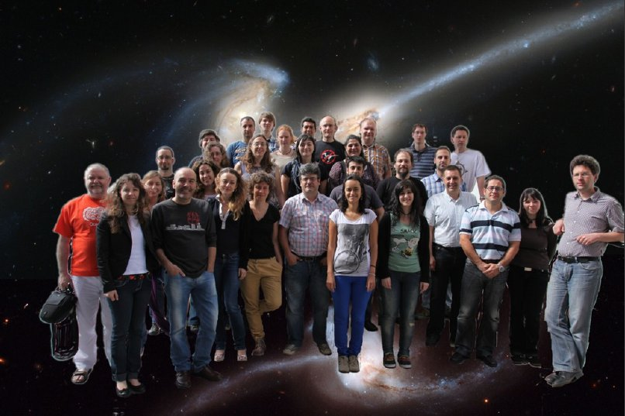

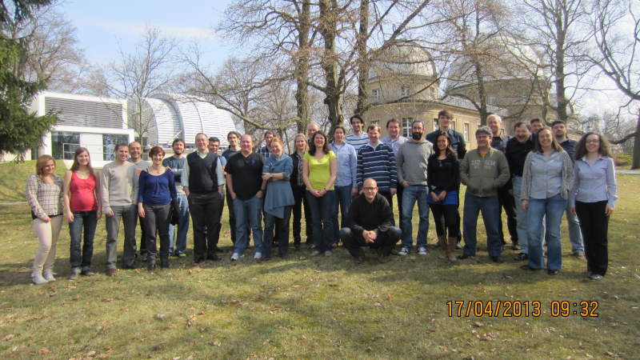
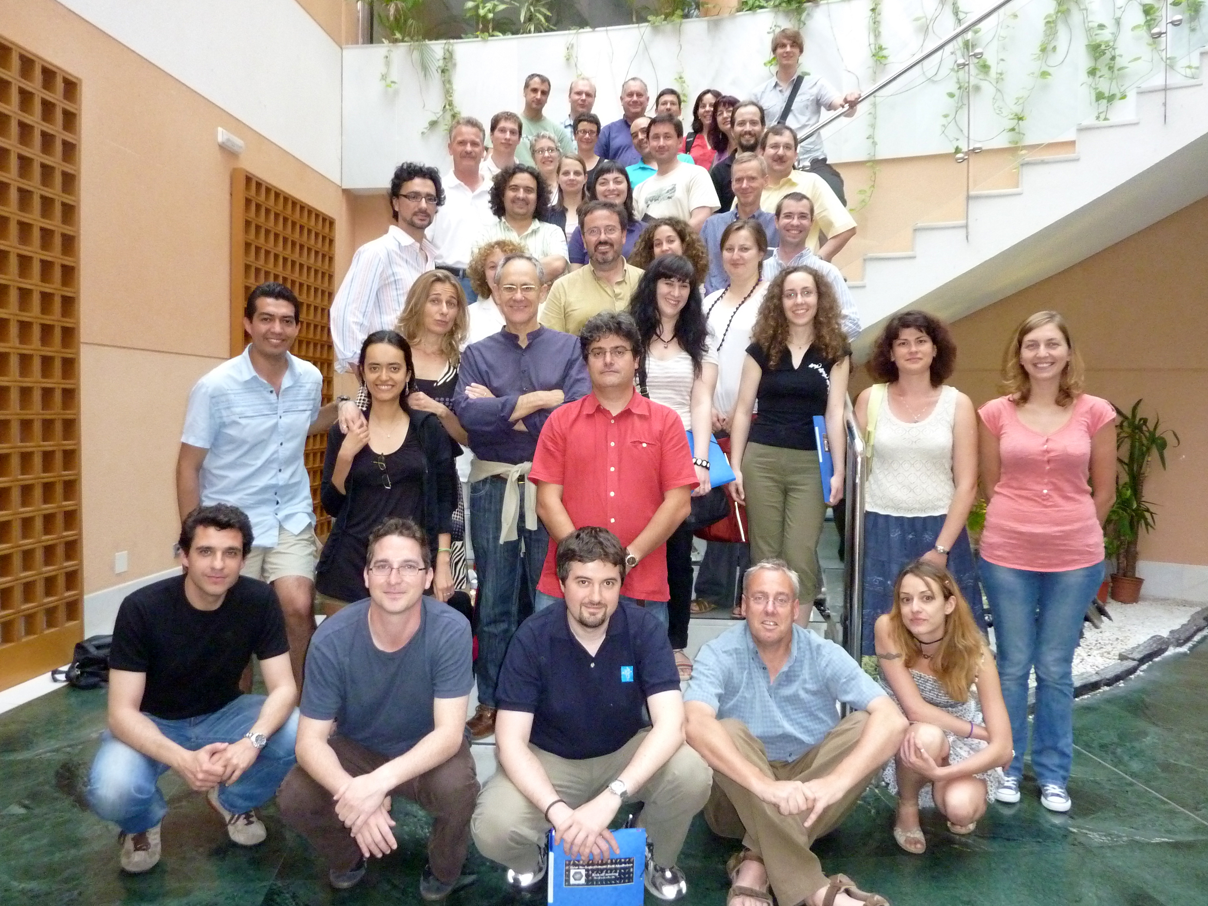
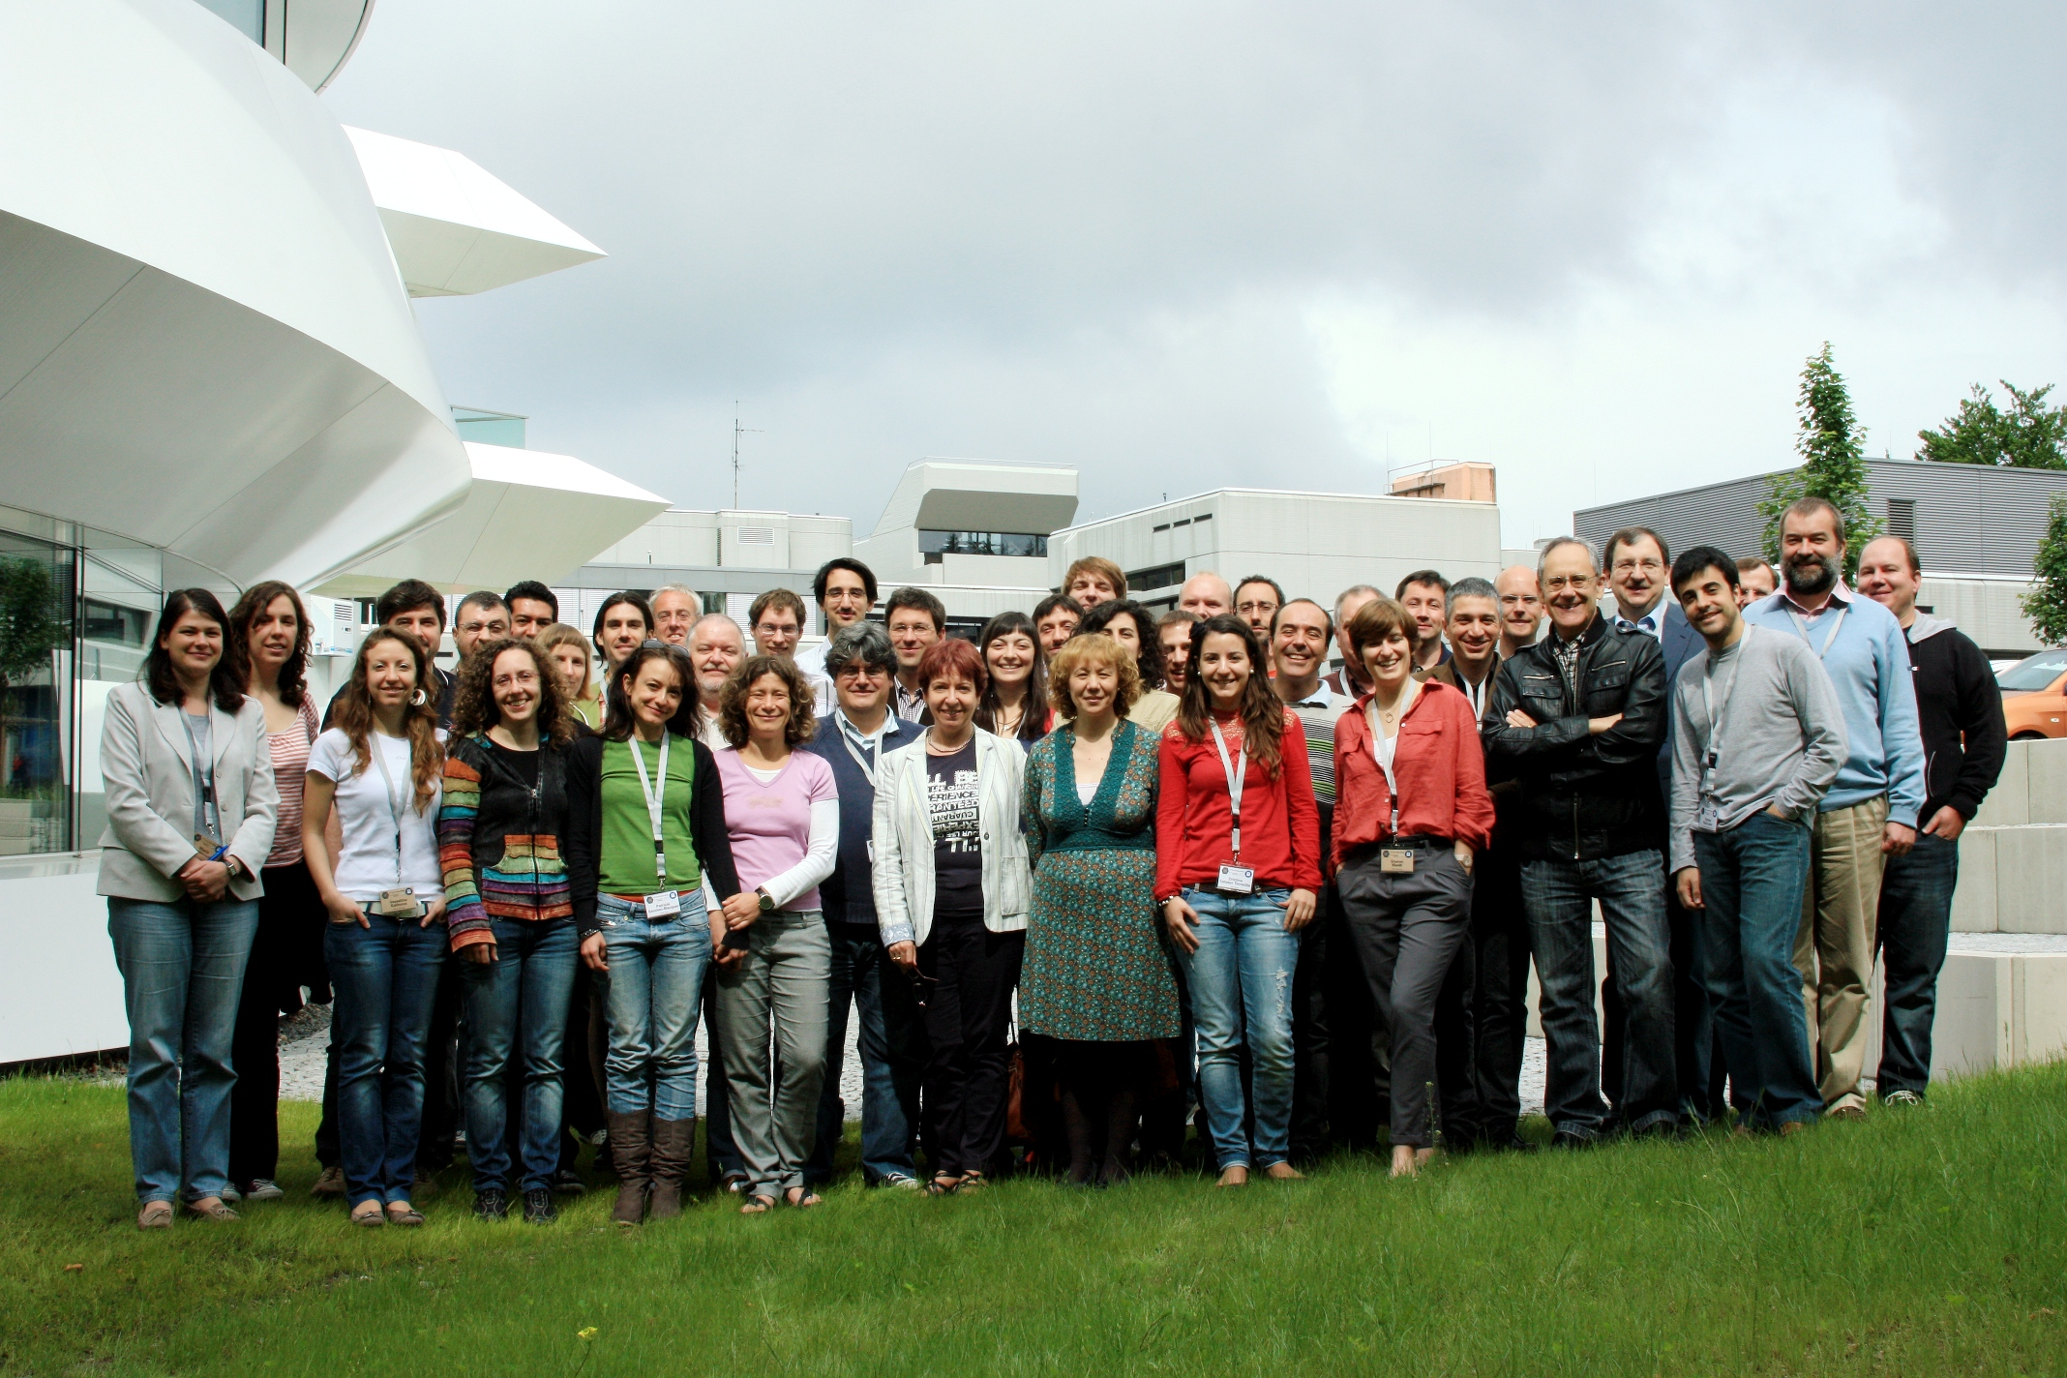
The CALIFA Collaboration
Stellar populations in disk galaxies P. Sanchez-Blazquez 3D2014

Slide 9
The sample
→ 62 face-on spiral galaxies with (34) and without bars (28) and i<60
→ 9.6 < log (M*/M)< 11.15
Stellar populations in disk galaxies P. Sanchez-Blazquez 3D2014

Slide 10
Derivation of stellar population properties
STECKMAP (STEllar Content via Maximum A Posteriori, Ocvirk et al. 2006ab)
It is non parametric, and thus provides properties such as the stellar age distribution with minimal constraints on their shape
The ill-conditioning of the problem is taken into account through explicit regularization.
http://astro.u-strasbg.fr/~ocvirk/STECKMAP
galaxy
fit
Peak to peak variations of the inverse model matrix
Stellar Population models: MILES (Vazdekis et al. 2010; PSB et al. 2006: http://miles.iac.es)
Stellar populations in disk galaxies P. Sanchez-Blazquez 3D2014

Slide 11
Steckmap outputs
Stellar age
distribution
Age-Z relation
input data
recovered
Stellar populations in disk galaxies P. Sanchez-Blazquez 3D2014

Slide 12
Age-metallicity degeneracy
Simulations of a population with 10 Gyr and solar metallicity with a S/N=50
PSB et al. (2011)
The age-metallicity degeneracy is highly reduced using steckmap over the classical
Index-index or multi-index techniques
Stellar populations in disk galaxies P. Sanchez-Blazquez 3D2014

Slide 13
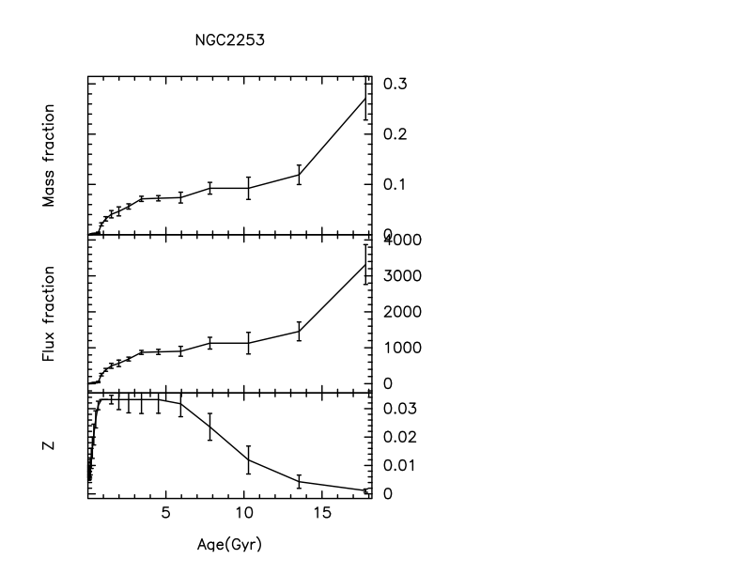


S/N~40 per Å (@ 5800Å)
Mean values
Stellar populations in disk galaxies P. Sanchez-Blazquez 3D2014

Slide 14
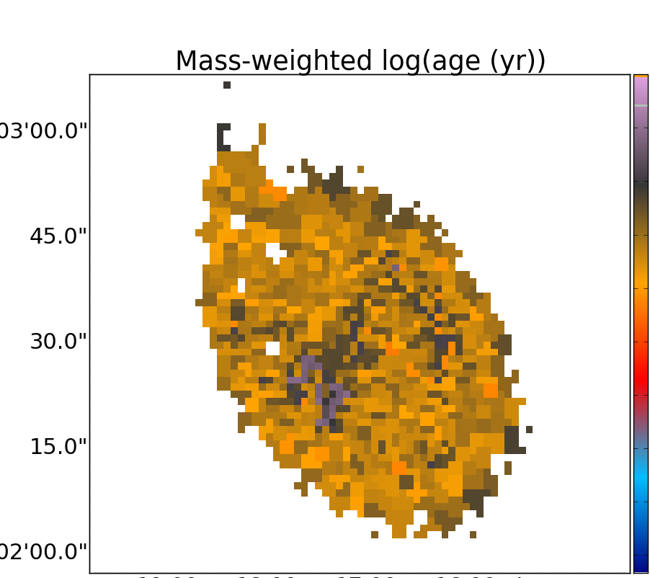
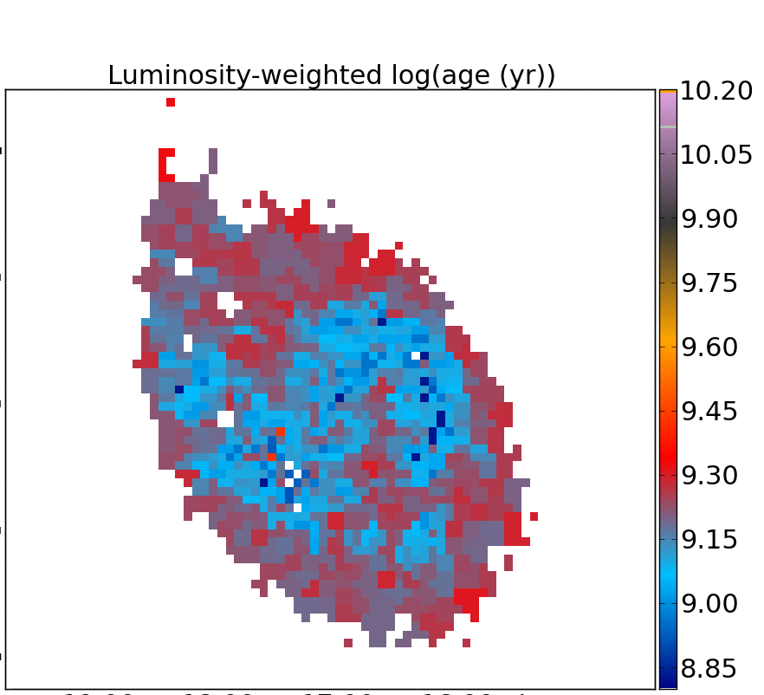
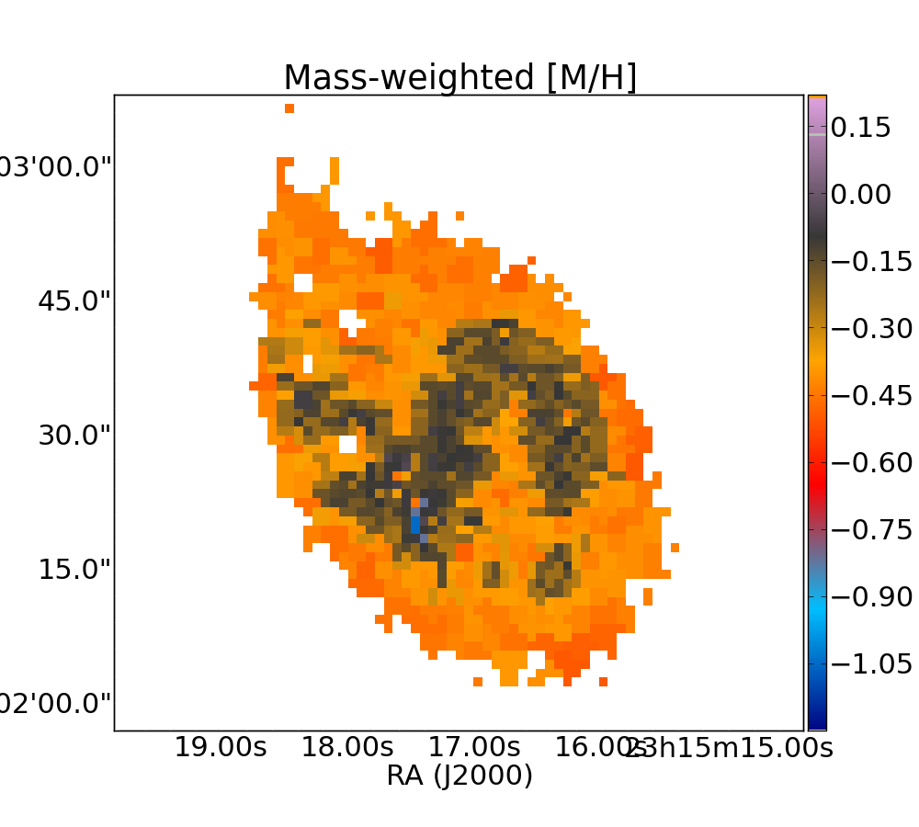
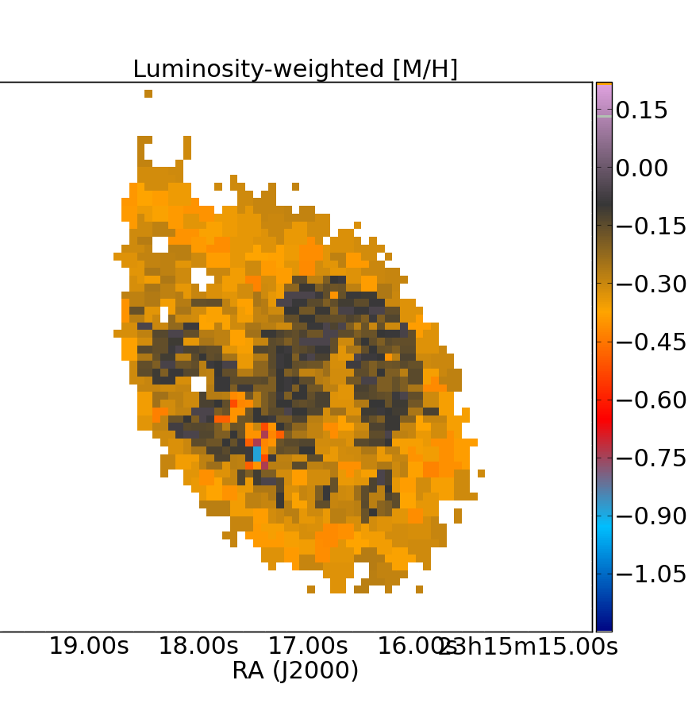
NGC7549
0.15
-1.05
MW [Z/H]
Stellar populations in disk galaxies P. Sanchez-Blazquez 3D2014

Slide 15
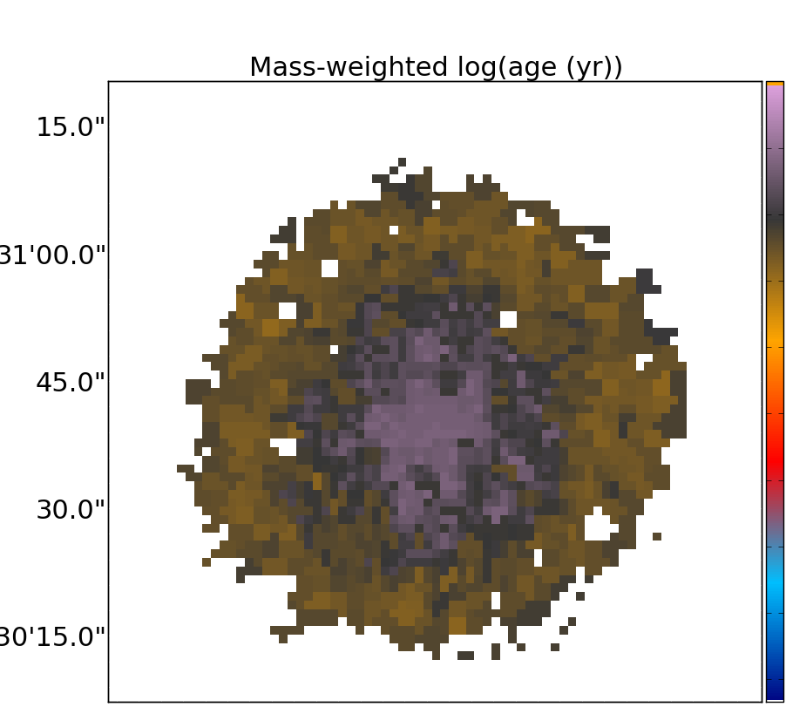
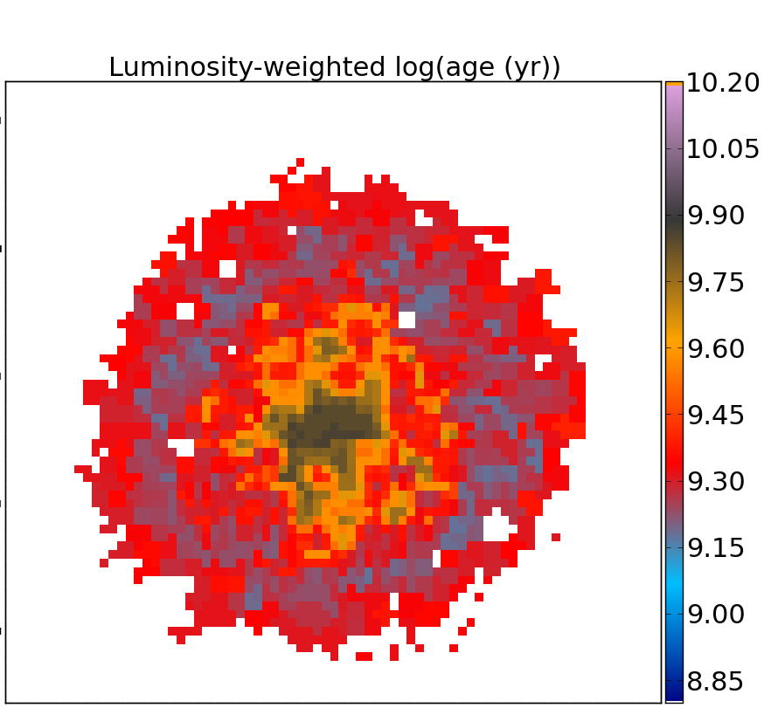
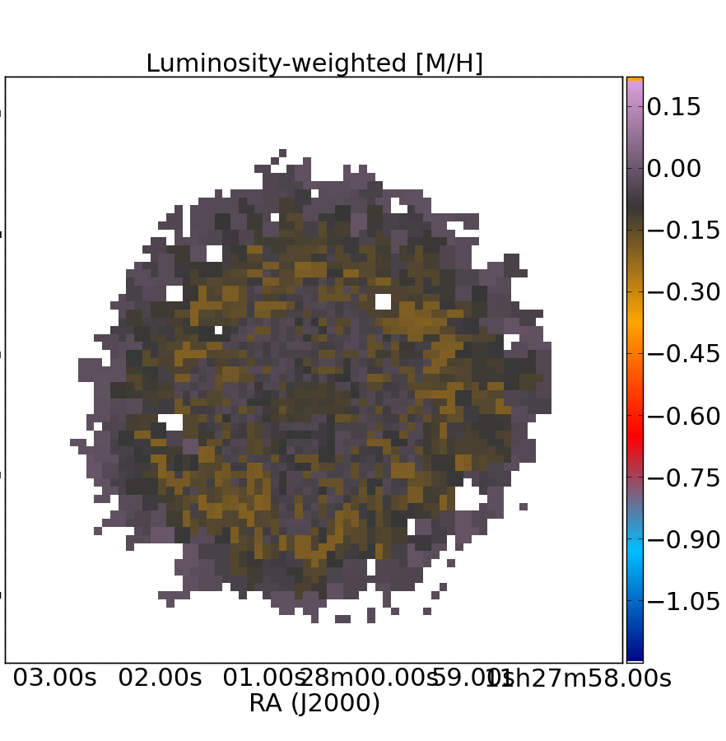
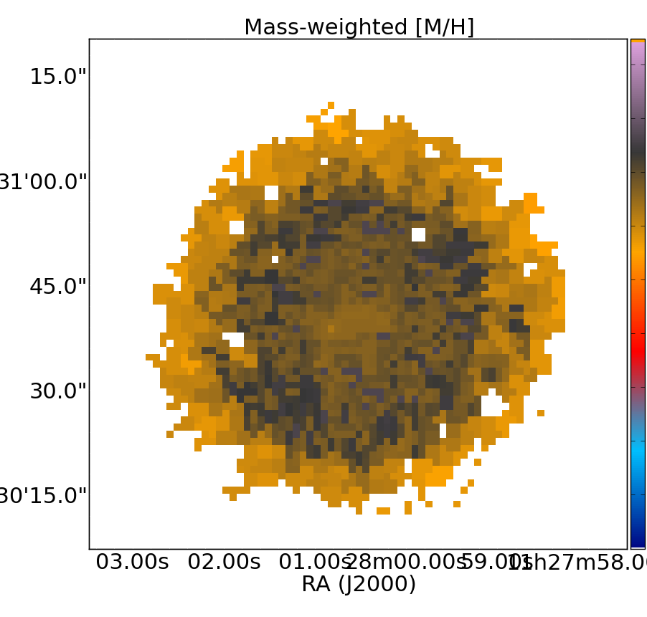
NGC3687
LW log age
MW log age

Slide 16
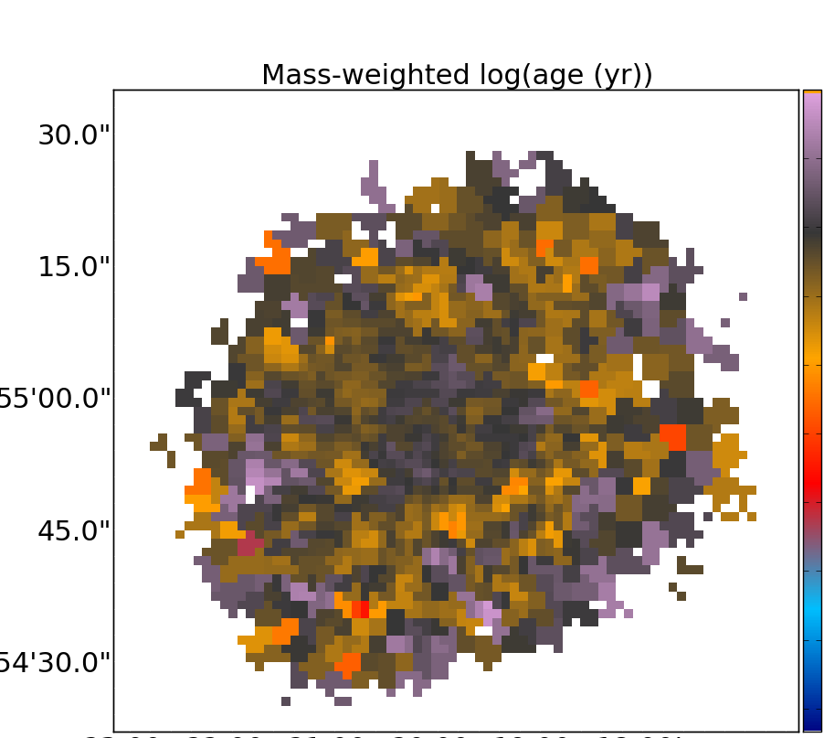
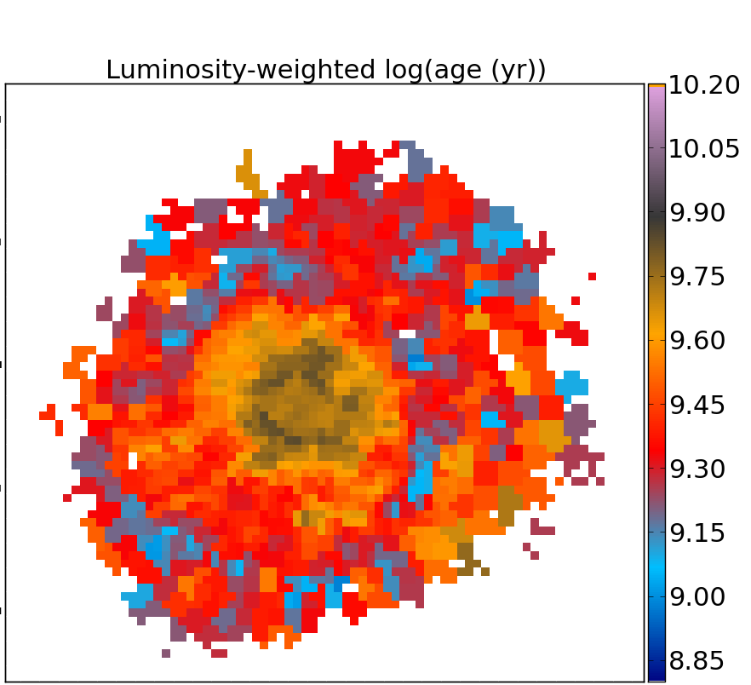
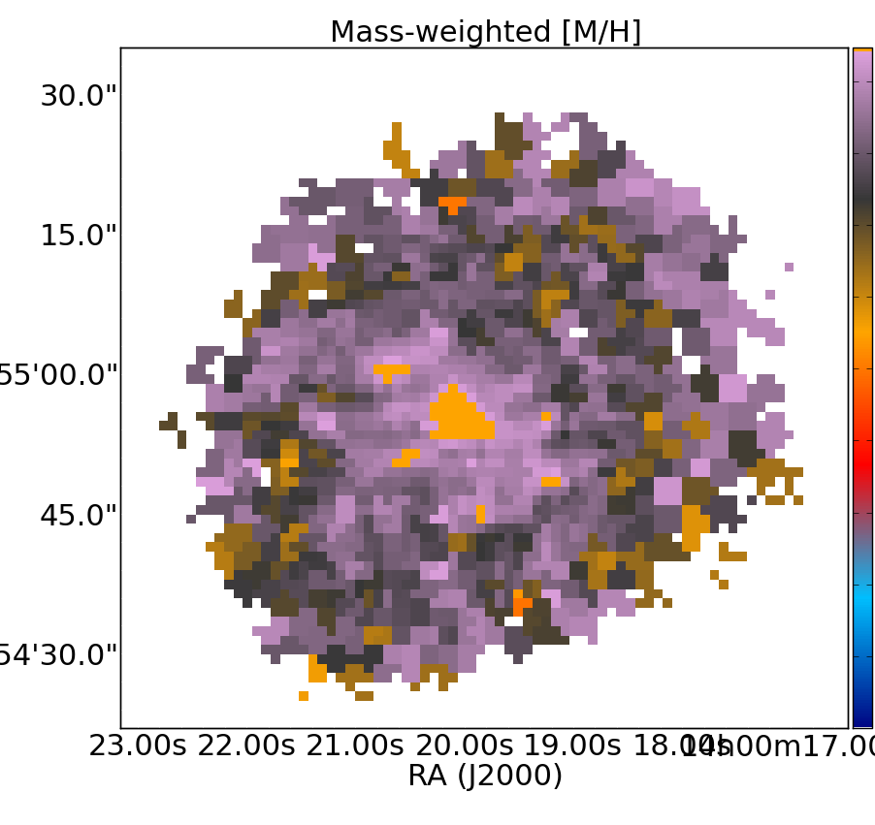
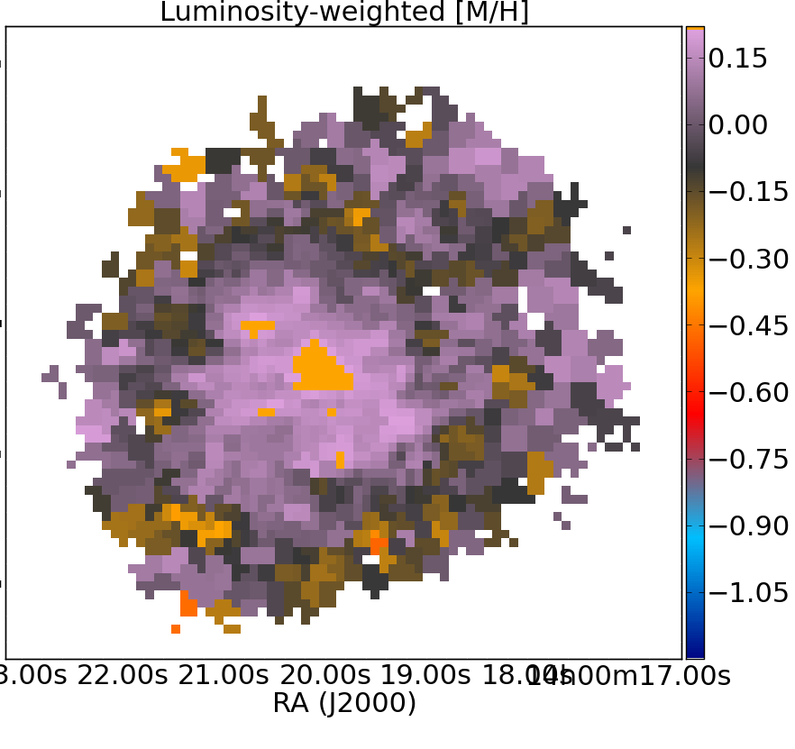
NGC5406
MW log age
Stellar populations in disk galaxies P. Sanchez-Blazquez 3D2014

Slide 17
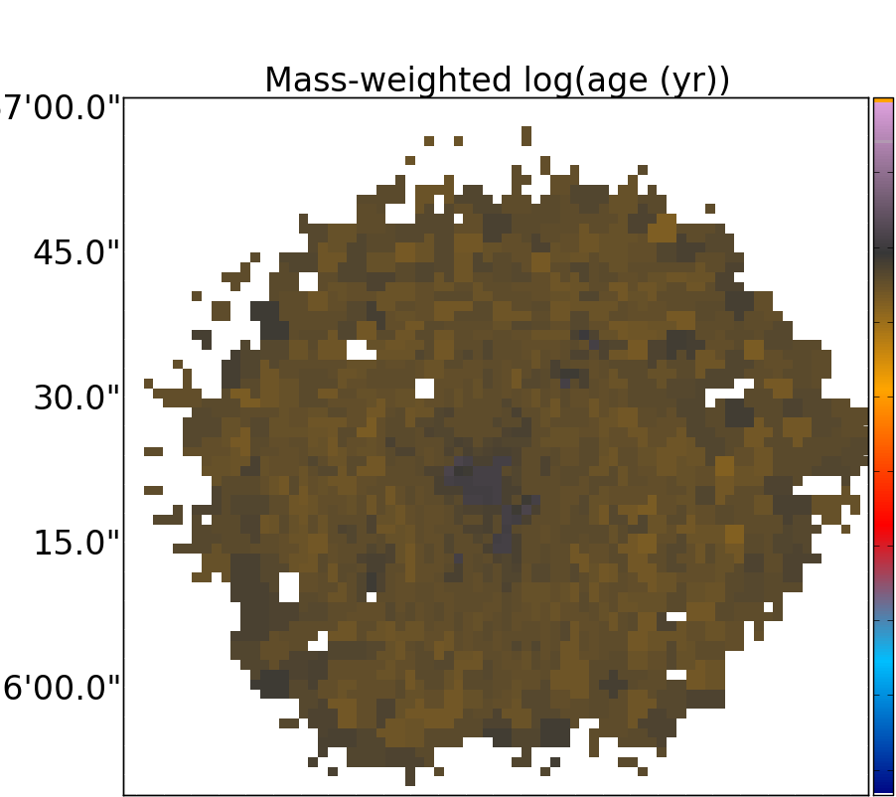
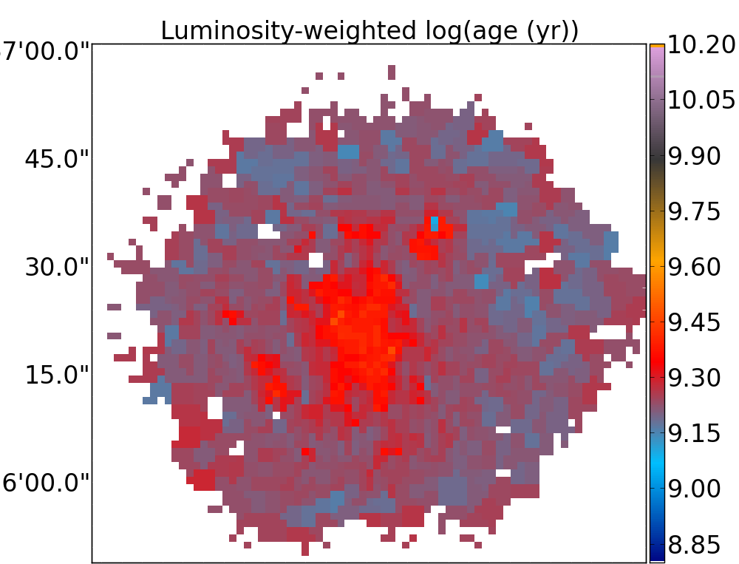
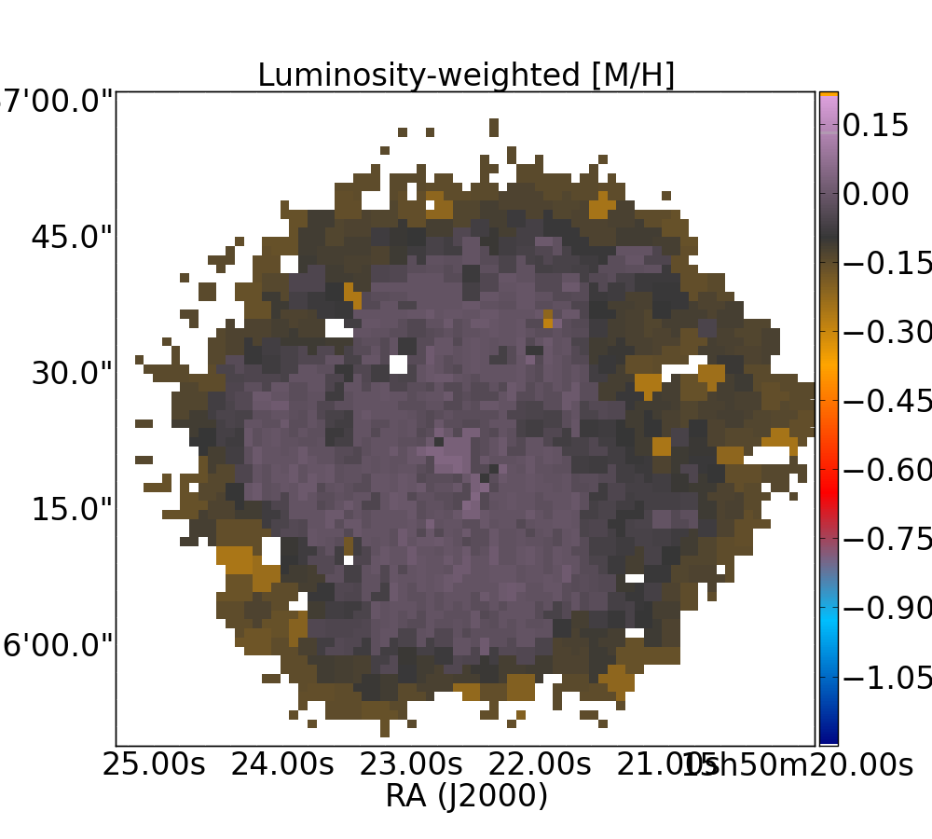
NGC6004
LW [Z/H]
MW [Z/H]
Stellar populations in disk galaxies P. Sanchez-Blazquez 3D2014

Slide 18
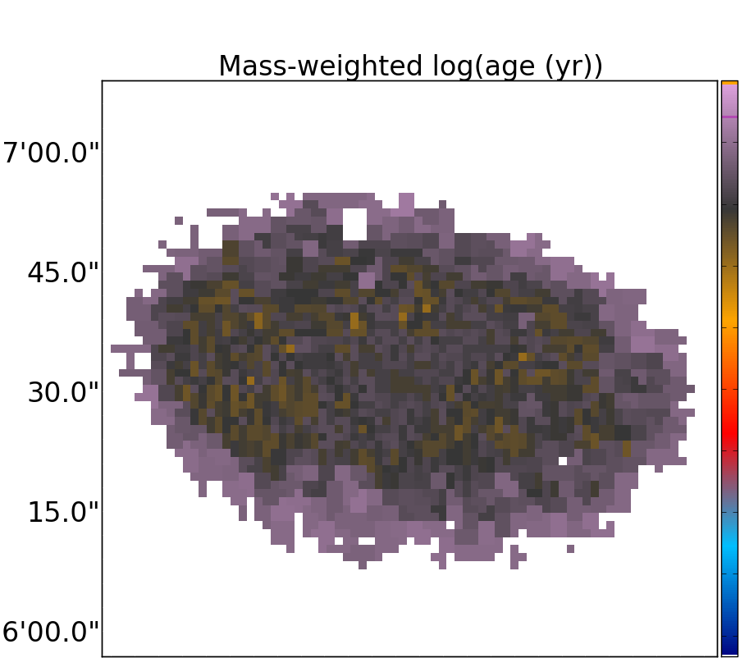
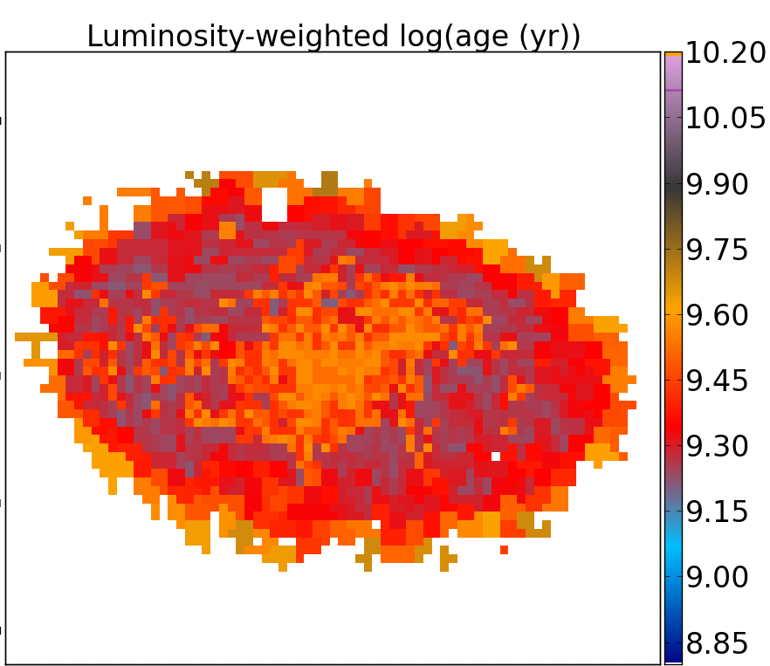
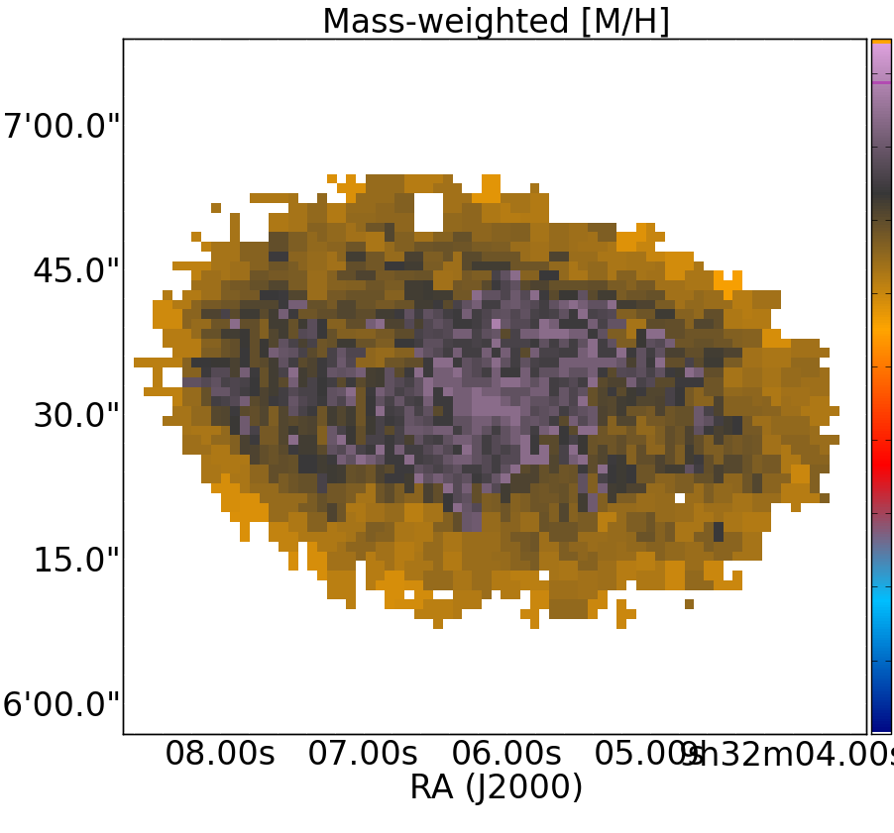
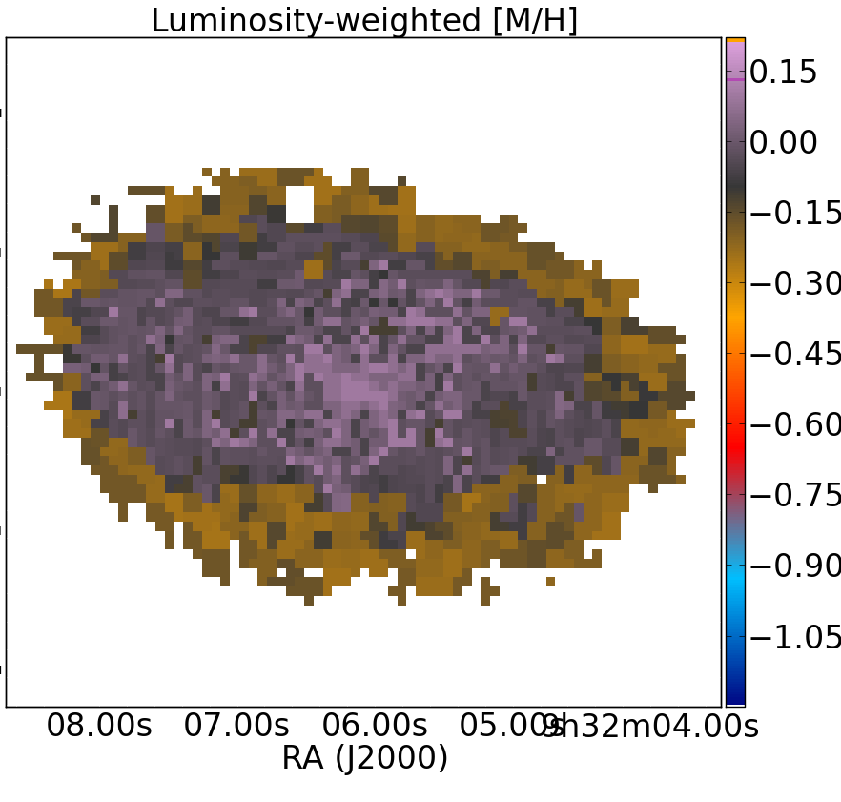
NGC2906
MW log age
Stellar populations in disk galaxies P. Sanchez-Blazquez 3D2014

Slide 19
Age gradients
Luminosity weighted values
Mass weighted values
reff = 1.67835rd
Results:
Mass-weighted age gradient reflect old stellar populations at all sampled radii
Lum-weighted age gradient is always negative in the disk region (although very mild)
Stellar populations in disk galaxies P. Sanchez-Blazquez 3D2014

Slide 20
Metallicity gradients
Results:
The LW metallicity is always larger than the MW
In general, metallicities are very high in the disk region
The slopes of the MW and LW metallicities are very similar
Stellar populations in disk galaxies P. Sanchez-Blazquez 3D2014

Slide 21
Mean gradients
Means (dex/ref):
-0.032±0.006 -0.087±0.008 -0.036±0.010 0.000±0.006
Note: gradients are measured on the disc region
Stellar populations in disk galaxies P. Sanchez-Blazquez 3D2014

Slide 22
Evolution of gradients: comparison of gas-phase and stellar phase metallicity gradients
Stellar [Z/H] (LW)
Gas phase (O3N2)
S0(A), age(reff)=4.7 Gyr
Stellar populations in disk galaxies P. Sanchez-Blazquez 3D2014

Slide 23
Evolution of gradients: comparison of gas-phase and stellar phase metallicity gradients
Stellar [Z/H] (LW)
Gas phase (O3N2)
Sbc(A), age(reff)=1.91 Gyr
Stellar populations in disk galaxies P. Sanchez-Blazquez 3D2014

Slide 24
Evolution of gradients: comparison of gas-phase and stellar phase metallicity gradients
Stellar [Z/H] (LW)
Gas phase (O3N2)
Sbc(A), age(reff)=2.4 Gyr
Stellar populations in disk galaxies P. Sanchez-Blazquez 3D2014

Slide 25
Evolution of gradients: comparison of gas-phase and stellar phase metallicity gradients
Stellar [Z/H] (LW)
Gas phase (O3N2)
Sab(B)
Stellar populations in disk galaxies P. Sanchez-Blazquez 3D2014

Slide 26
Relation of the metallicity gradient with other properties of the galaxies and comparison between barred and unbarred galaxies
Stellar populations in disk galaxies P. Sanchez-Blazquez 3D2014

Slide 27
Differences in the metallicity gradient between barred and unbarred galaxies
We do not find any relation between the stellar population gradients and the mass
We do not find any difference between the gradient of barred and unbarred galaxies
dex/ref
Stellar populations in disk galaxies P. Sanchez-Blazquez 3D2014

Slide 28
Differences in the metallicity gradient between barred and unbarred galaxies
We have not found any relation between the slope of the gradients and M*, σ, B/T, t-type
We have not found any difference between the slope of barred and unbarred galaxies
Stellar populations in disk galaxies P. Sanchez-Blazquez 3D2014

Slide 29
Metallicity gradient as a function of bar properties
Abraham & Merrifield (2000)
Stellar populations in disk galaxies P. Sanchez-Blazquez 3D2014

Slide 30
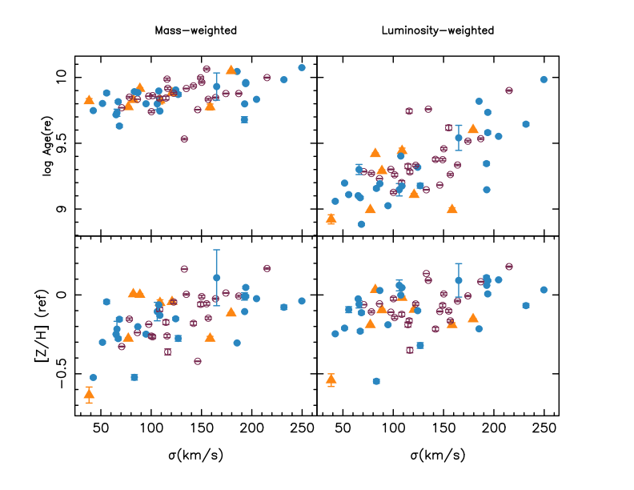
Values at 1ref vs central σ
Stellar populations in disk galaxies P. Sanchez-Blazquez 3D2014

Slide 31
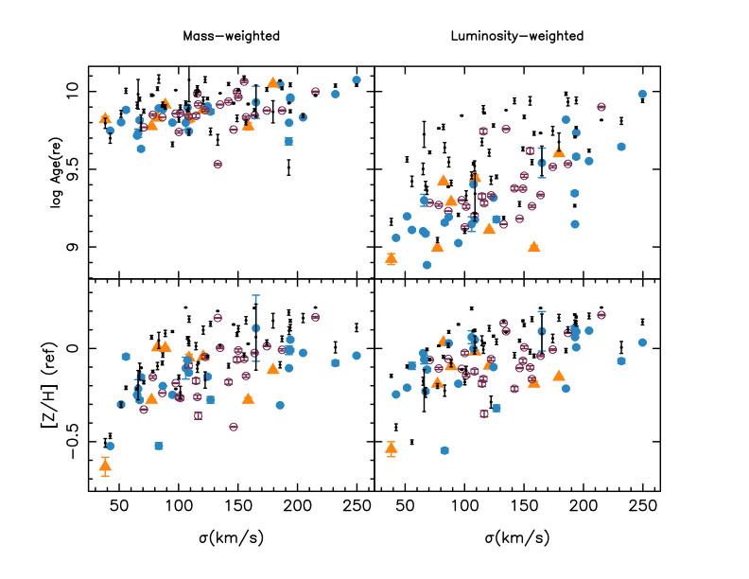
Values at 1ref vs central σ
Stellar populations in disk galaxies P. Sanchez-Blazquez 3D2014

Slide 32
Summary
We are studying the stellar populations in a sample of face-on disk galaxies from the CALIFA survey. We find, in the disk region:
Age gradients:
mass-weighted values very flat. Old stellar populations at all radii (in the majority of galaxies).
Luminosity-weighted values decreasing slightly with radius (inside-out)
→ We do not find any relation between the age gradient and the mass, velocity dispersion, t-type, B/T.
Stellar populations in disk galaxies P. Sanchez-Blazquez 3D2014

Slide 33
Summary
We are studying the stellar populations in a sample of face-on disk galaxies from the CALIFA survey. We find, in the disk region:
Metallicity gradients
Mild metallicity gradients (decreasing metallicity with radius)
High values of metallicity in the disk region (also seen in resolved SP studies)
Very similar slope of the MW and LW and very similar to the slope of the gas (little evolution?)
We do not find any relation between the metallicity gradient and other properties of the galaxies (similar results obtained for gas-phase metallicity)
The flat mass-weighted age gradient and the high metallicity values suggest an early and rapid formation of the disk (similarly to what is seen in resolved stellar population studies (e.g., Gorgarten 2010; William et al. 2009).
Alternatively, radial migration can bring old and metal rich stars from the internal parts.
Stellar populations in disk galaxies P. Sanchez-Blazquez 3D2014

Slide 34
Summary
Theoretical studies predict that bars influence enormously the evolution of the disk galaxies. We are looking for observational evidences.
Barred and unbarred galaxies show similar metallicity (both, stellar and gaseous) and age gradients → Bars are not important agents for stellar migration in disk galaxies?.
→A possibility is that bars are not long-lived, but there are now some evidences at least in early-type galaxies bars seem to be long lived (Seth et al. 2008, PSB et al. 2011; Athanassoula et al. 2013, Kraljic et al. 2012).
We do not see the consequences because the metallicity gradient was flat in the past (however, the best observations of metallicity gradients at high redshift report steep metallicity gradients (Jones et al. 2010, 2012; Yuan et al. 2011). Most recent measurements of the MW (Maciel et al. 2013 do not find evolution)
In any case, this does not mean there is no radial migration. Other mechanisms might be at work (Sellwood & Binney 2002) –--
Stellar populations in disk galaxies P. Sanchez-Blazquez 3D2014

Slide 36
IFU vs Long-slit spectroscopy
IFU data

Slide 37
Recovering the age-Z relation

Slide 38
PSB et al. (2011)

Slide 40
Yuan et al. (2013)

