Slide 1
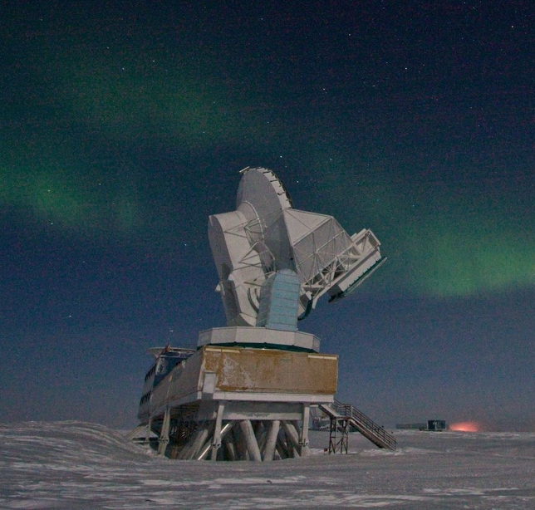
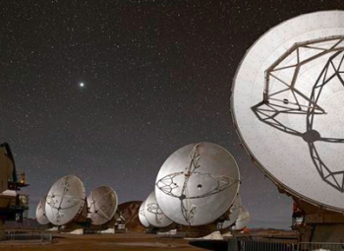
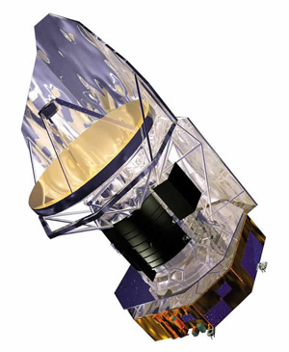
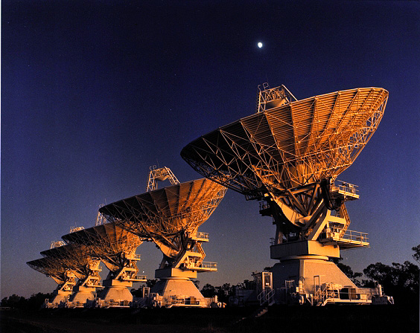
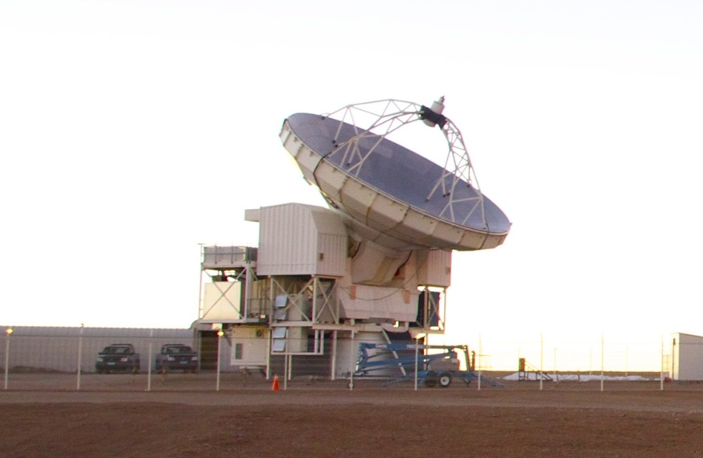
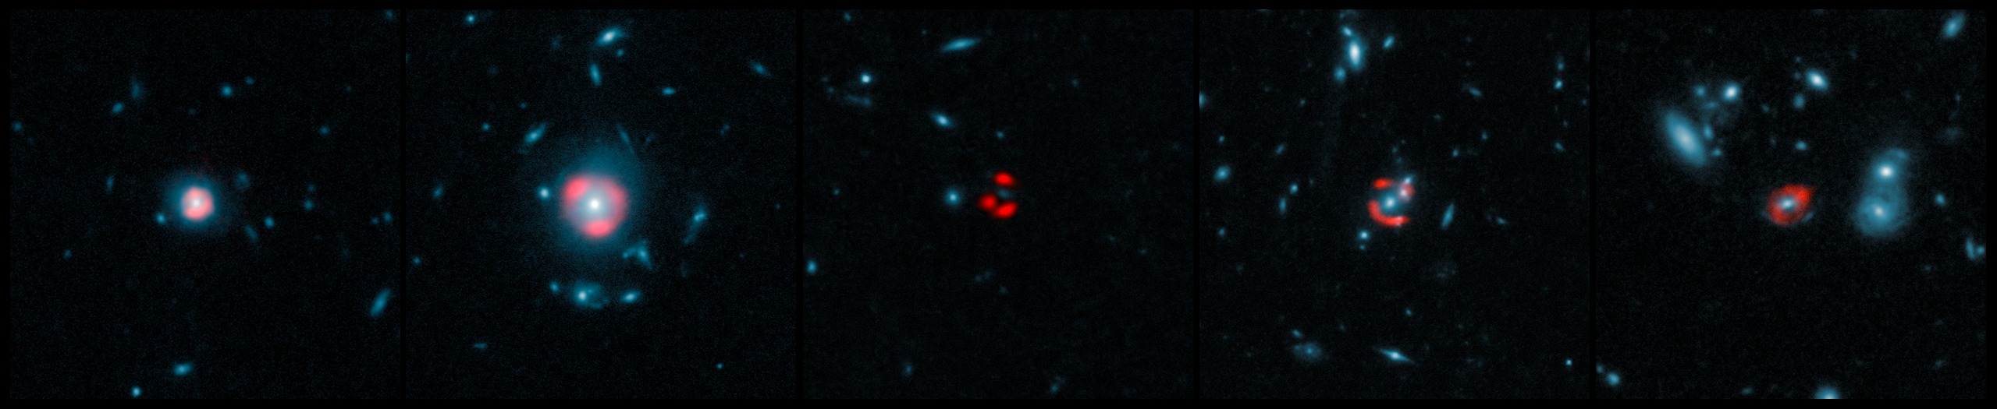
The Properties of the ISM in the Dusty Star-forming Galaxies at z=2-6 discovered by the South Pole Telescope
Manuel Aravena (ESO, UDP)
and the SPT-SMG collaboration
Vieira et al. 2010, ApJ, 719, 763
Greve et al. 2012, ApJ, 756, 101
Vieira et al. 2013, Nature, 495, 344
Weiss et al. 2013, ApJ, 767, 88
Hezaveh et al. 2013, ApJ, 767, 132
Aravena et al. 2013, MNRAS, 433, 498
Bothwell et al. 2013, ApJ, 779, 67
Spilker et al. 2014, ApJ in press, arXiv:1403.1667

Slide 2
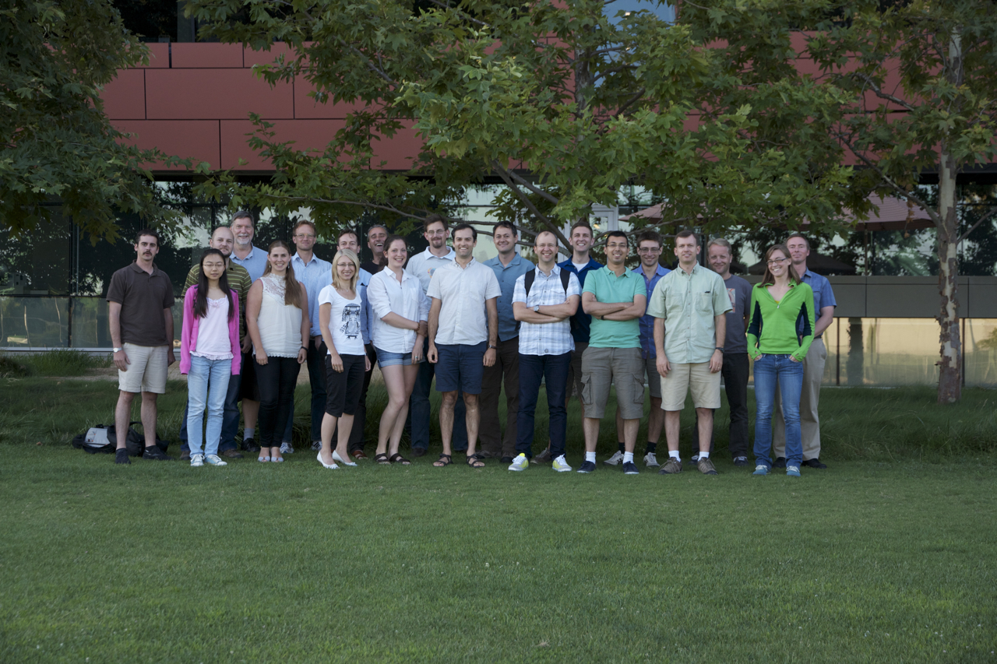
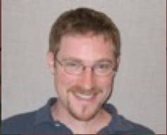
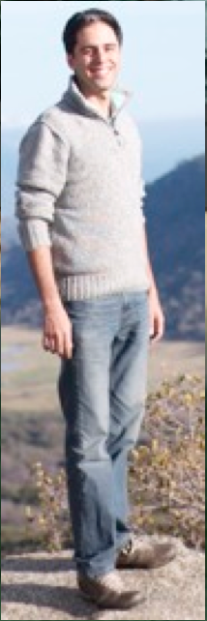
Scott Chapman
Axel Weiss
Anthony Gonzalez
Matthieu Bethermin
Chris Fassnacht
Tony Stark
Thomas Greve
James Aquirre
Tom Crawford
Manuel Aravena
Justin Spilker
Erik Shirokoff
Brian Stalder
Maria Strandet
Kaja Rotermund
Carlos De Breuck
Dan Marrone
Yashar Yezaveh
Jingzhe Ma
Bitten Gullberg
Joaquin Vieira
Niraj Welikala
Wendy Everett

Slide 3
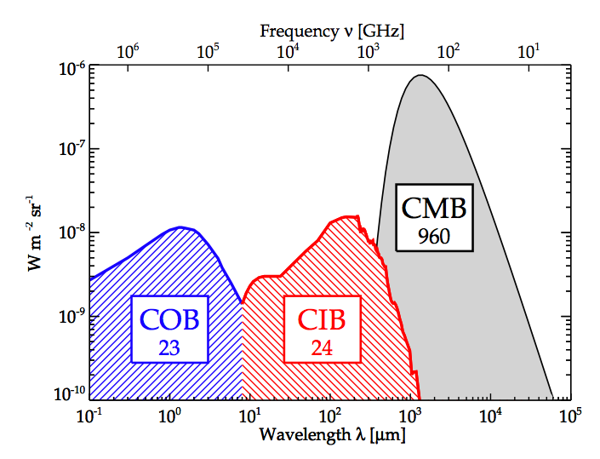
Motivation
Cosmic IR background contributes ~50% of the cosmic background light (COBE 1996).
CIB could not be explained with IRAS local galaxies (z<0.5).
Discovery that SFR history of the Universe increased heavily from z=0 to 1, indicated that CIB had to come from distant dusty galaxies at z>1.
CIB is the 2-dimensional projection of the history of star formation and evolution of structures.
(e.g. Madau+1996; Lilly+1999;
Bouwens et al 2009)

Slide 4
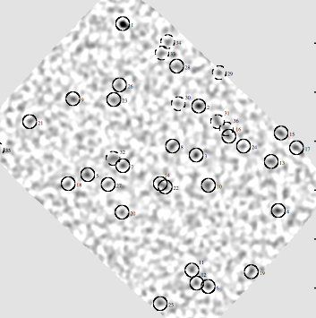
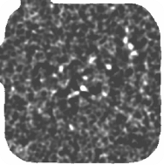

Motivation: resolving the CIB
‘Pencil beam’ surveys covered up to a several hundred arcmin² of sky
First SCUBA map
Hughes et al. (1998)
At 850 μm
SCUBA "super map"
Borys et al. (2003)
AzTEC 1.1mm
Perera et al. (2008)

Slide 5
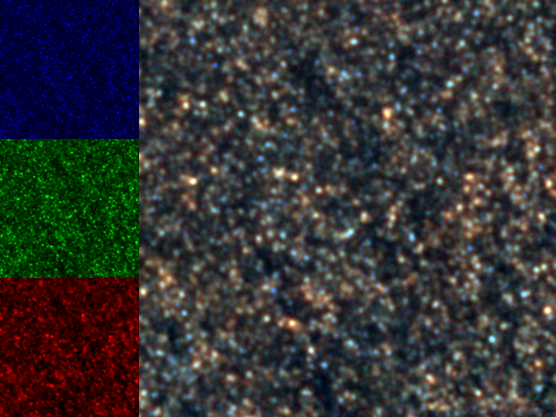
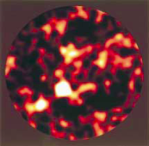
The revolution of 10²-10³ deg² FIR/mm surveys
250 µm
Herschel/SPIRE map of GOODS-N
350 µm
500 µm
HDFN
10 arcmin

Slide 6
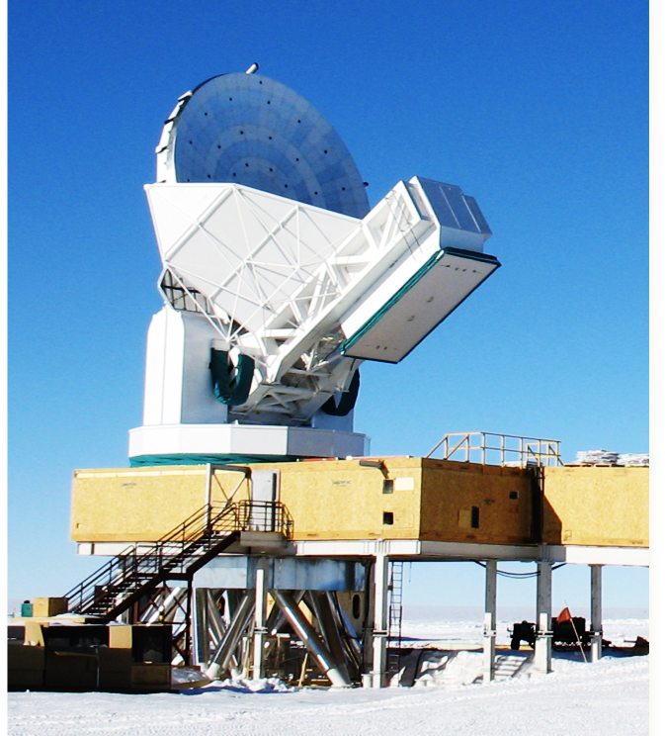
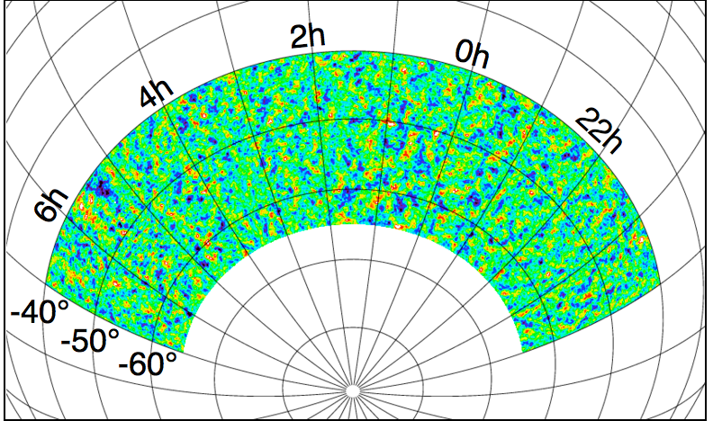
The SPT 2500 deg² mm-wave survey
SPT: 10m dedicated telescope to search for galaxy clusters through SZ decrement.
SPT survey 3 bands: 3mm, 2mm and 1mm.
76 mm bright sources consistent with strongly lensed SMGs at S_{1.4mm} > 20 mJy

Slide 7
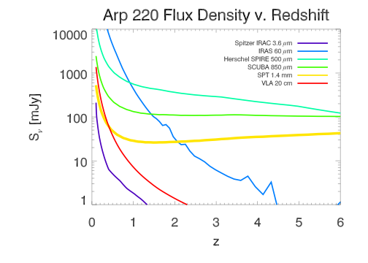
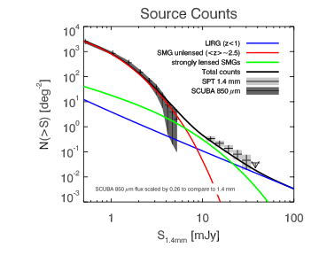
The SPT 2500 deg² mm-wave survey
Vieira et al. (2010)
SPT: flat z-selection, capable of detecting z=6 as if they were at z=2.
SPT covers a larger area than Herschel, but comparatively shallower.
SPT mm number counts indicate all objects are strongly lensed.

Slide 8
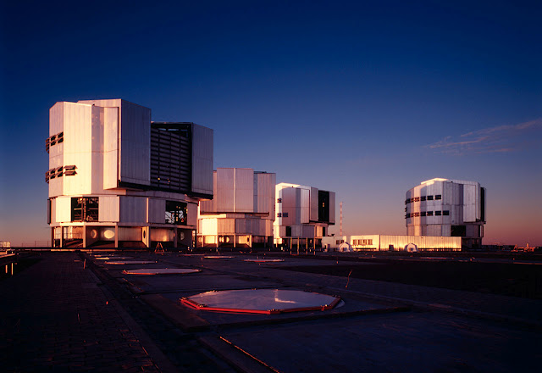
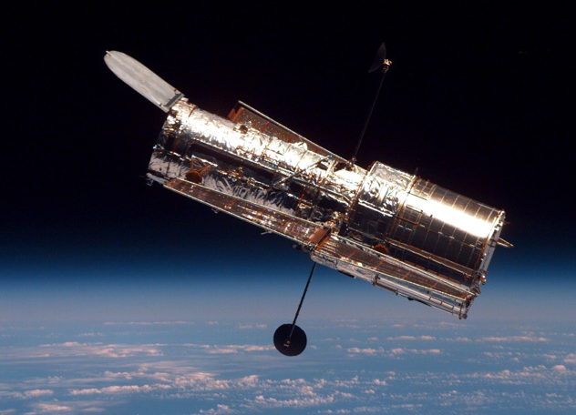
Multi-wavelength follow-up campaign
ATCA
SPT
APEX
ALMA
Herschel
VLT
HST
Ambitious follow-up campaign with all major observatories:
VLT optical imaging and spectroscopy.
HST and Spitzer imaging of lenses.
ALMA, Herschel, APEX and ATCA imaging and spectroscopy of FIR/submm lines.
Determine crucial parameters for the characterization of the sources: redshift, lens models
Necessity to constrain the different components of their host galaxies: star-formation, dust, gas and stars

Slide 9
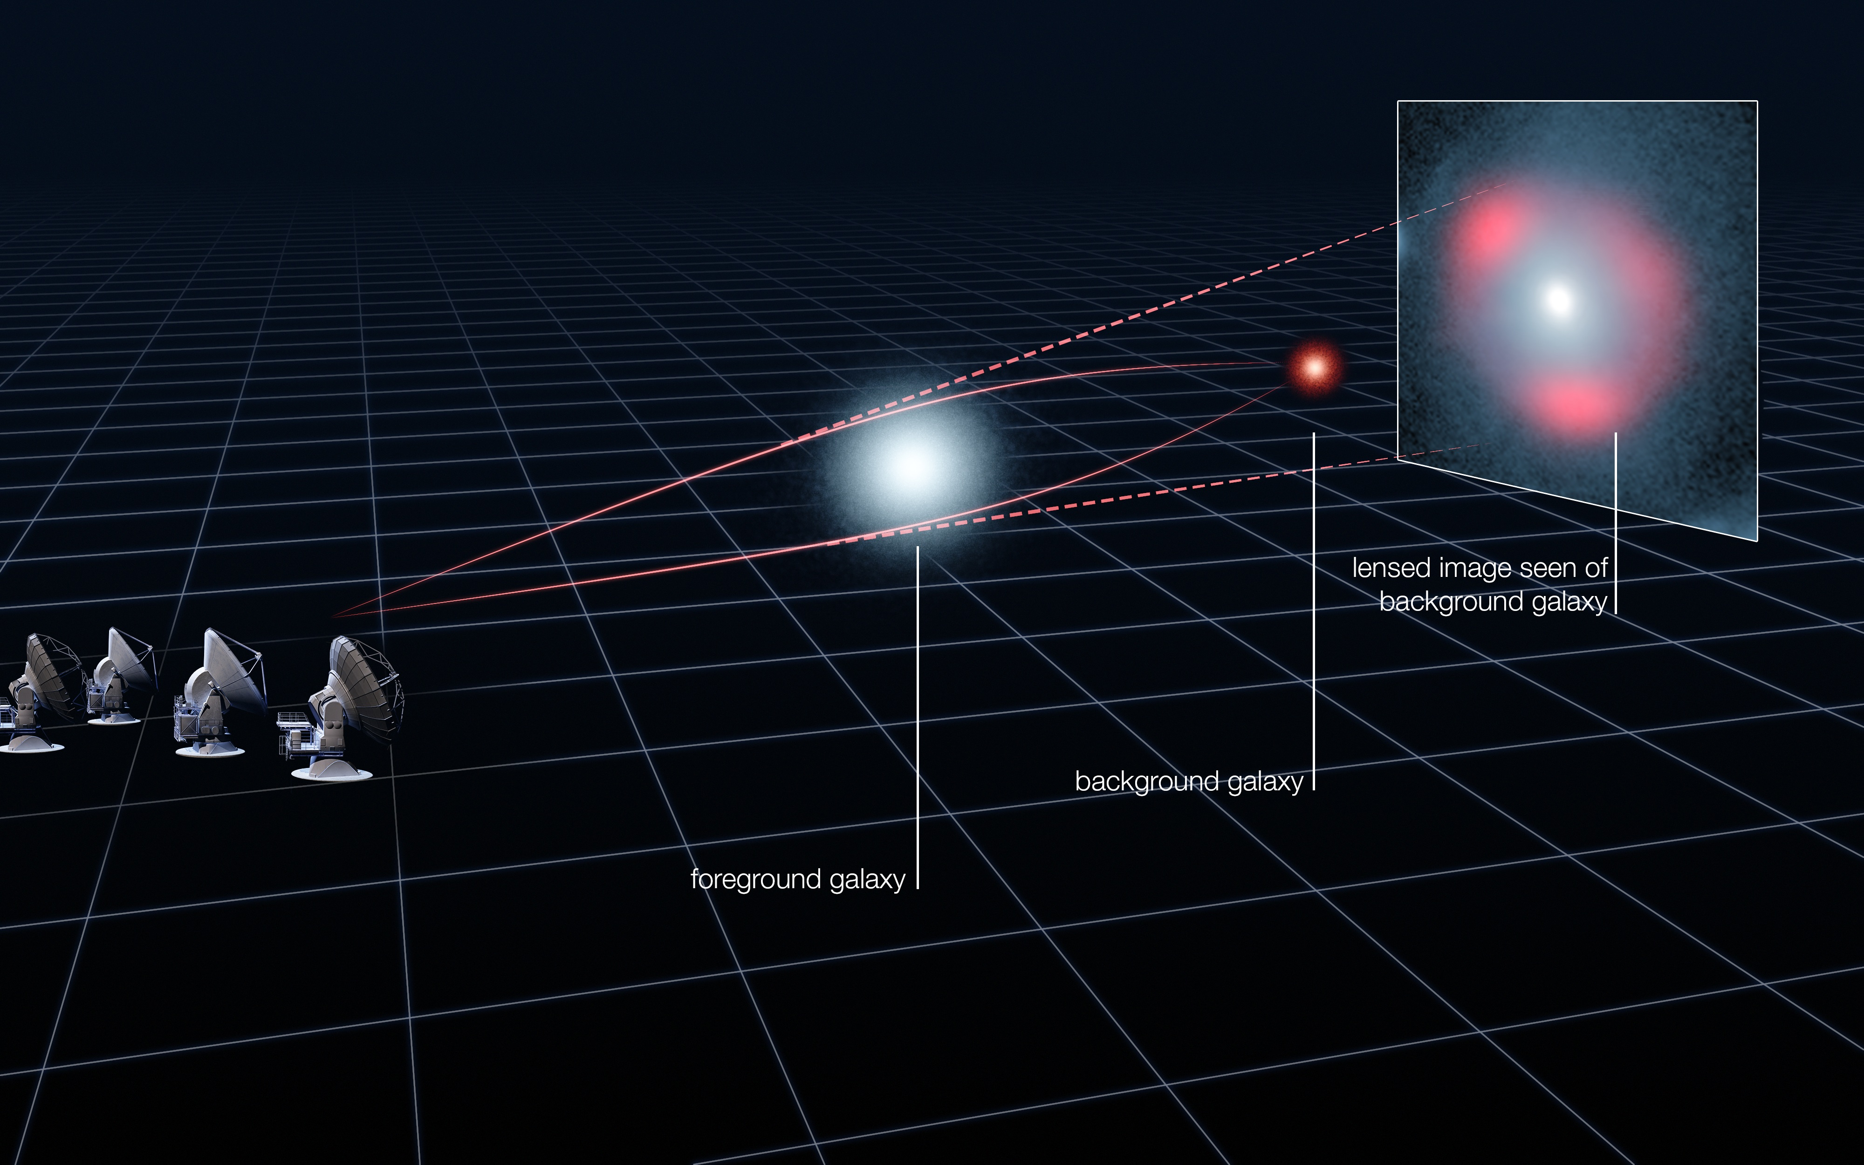
ALMA 870μm high-resolution imaging
Vieira et al. 2013, Nature
Hezaveh et al. 2013, ApJ

Slide 10
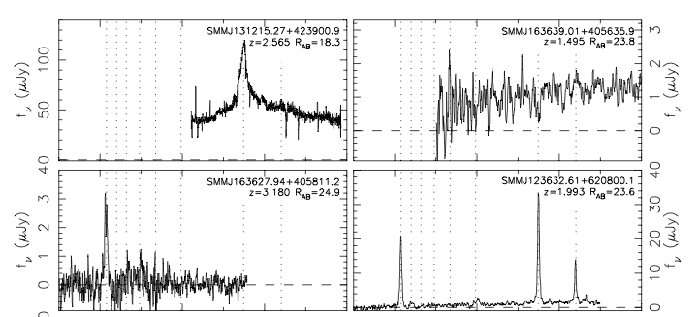
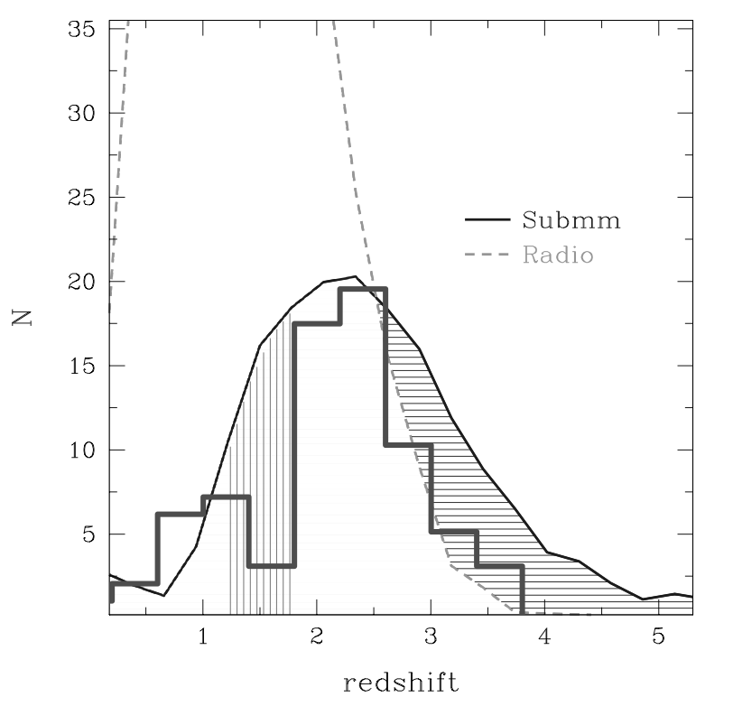
The quest to obtain redshifts for SMGs
2) Find radio counterpart to SMG
Ivison et al. 2002, 2007; Bertoldi et al. 2007
1) Blank field submm survey
4) Estimate n(z)
Chapman et al ApJ 2005
3) Obtain optical spectroscopy
Chapman et al. 2003, 2005

Slide 11
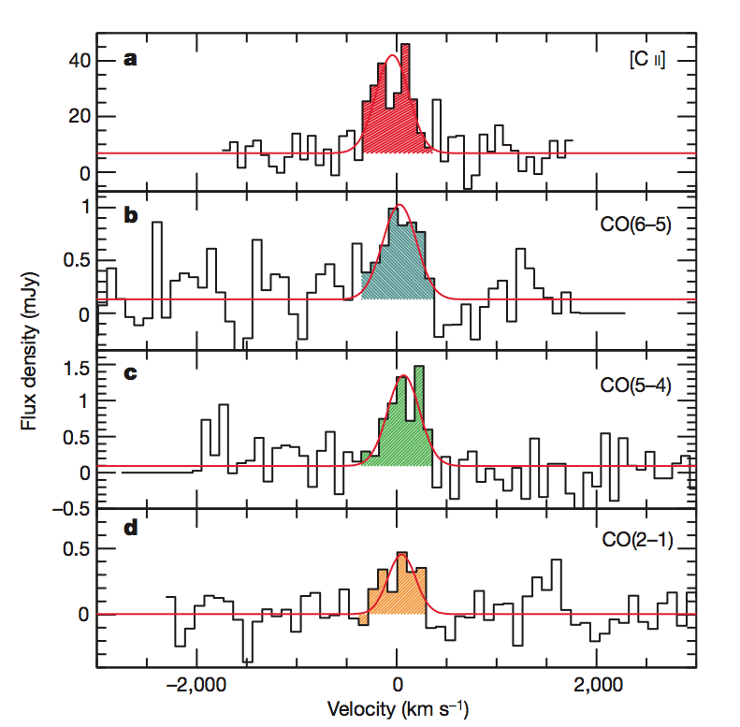
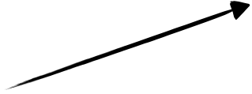
A new era for redshift determination for SFGs
1) Blank field submm survey
HDF850.1 z = 5.2,
brightest SCUBA source on HDF-N
2) Follow-up mm spectroscopy, directly obtain redshifts the molecular gas lines
100 hours with PdBI, VLA
Hughes et al. Nature 1998
Walter et al. Nature 2012
HDF-N SCUBA 850 µm
3'

Slide 12
First blind CO redshift survey with ALMA
ALMA Band 3 3mm - 26 sources - 5 tunings in the 3 mm band
Vieira et al. 2013, Nature; Weiss et al. 2013, ApJ

Slide 13
SPT + ALMA SMG redshift distributions n(z)
Well defined selection function without bias
Sample flux-limited and complete to 90%
Already provides critical constraints to formation models
Vieira et al. (2013), Nature
Weiss et al. (2013), ApJ

Slide 14
Composite submm spectrum of dusty starburst galaxies at high-z
Detection of ¹³CO, HCN, HCO+, HNC, CN, and also CH and CCH (first time at high-z).
Average CO SED
Constraints on physical properties based on multiple molecular lines
Emission from HCN, HNC, HCO⁺ and CN consistent with T_{kin}~55 K and n(H₂)~10^{5.5} cm⁻³.
J. Spilker et al. 2014, ApJ in press, arXiv:1403.1667

Slide 15
ATCA low-J CO follow-up campaign
CO(1-0) and CO(2-1) in SPT SMGs
(Aravena et al. 2013; and in prep.)

Slide 16
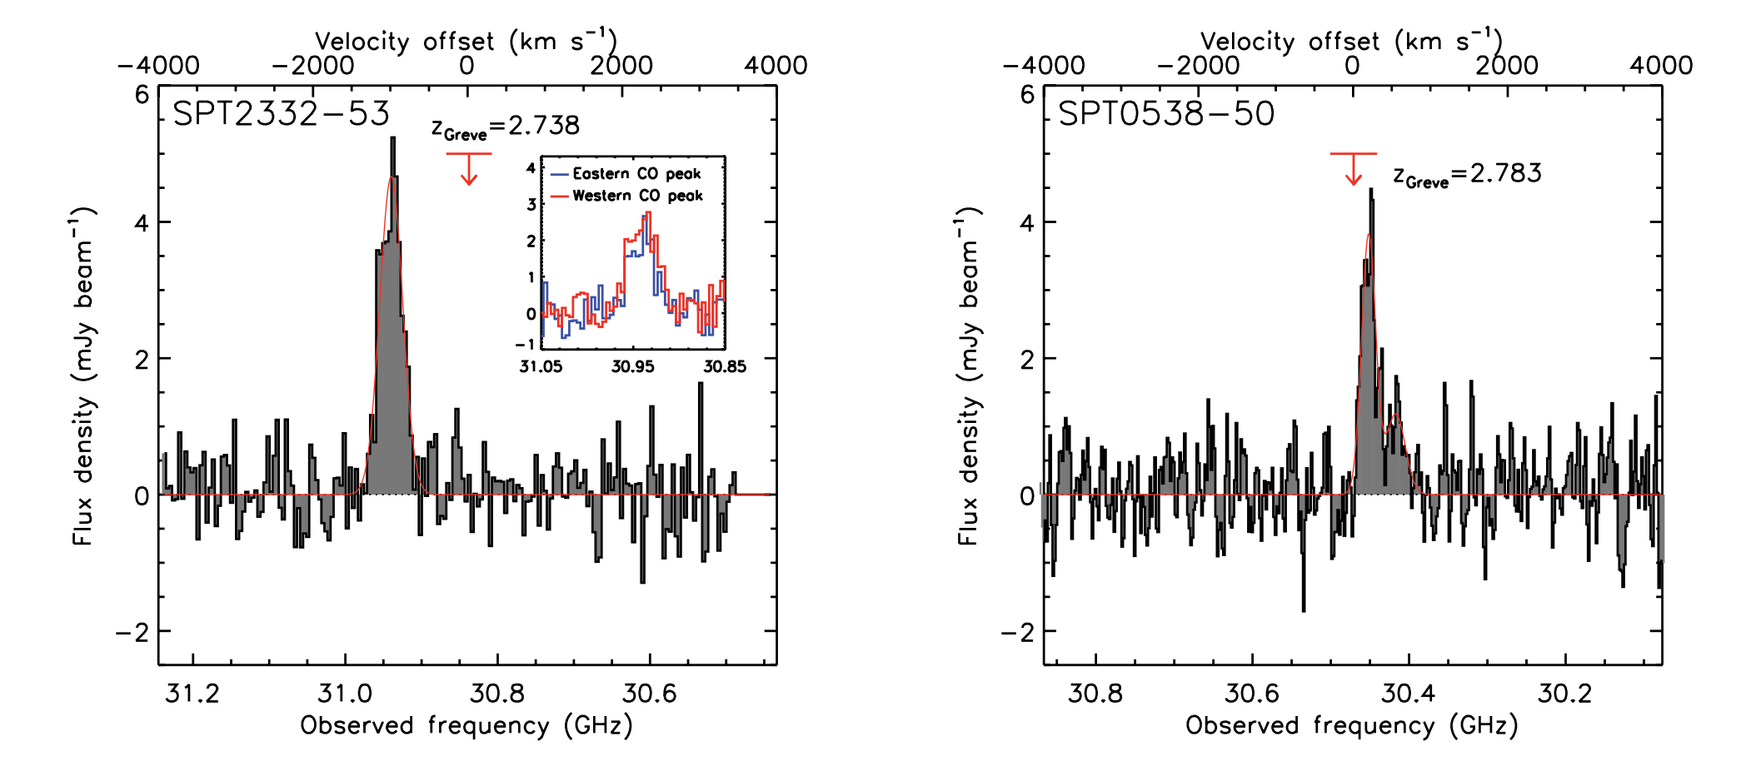
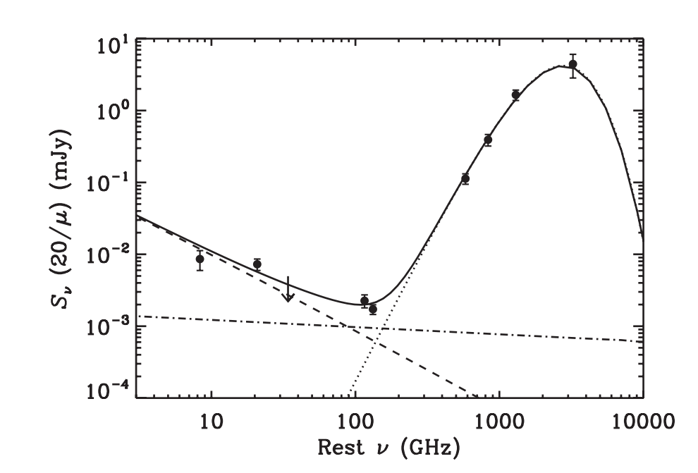
ATCA low-J CO survey
CO(1-0) line emission in SPT0538-50 at z=2.8.
Continuum at these frequencies can be used to model the free-free emission.
One of the 3 high-z galaxies with measured free-free emission.
Aravena et al. (2013)

Slide 17
ATCA low-J CO observations
Aravena+ (2013)
Aravena+ in prep.

Slide 18
[CII] line observations with APEX
B. Gullberg et al. (in prep)

Slide 19
Diagnostic plot: PDR model
SPT sources occupy an area around the
L_{[CII]}/L_{CO(1-0)} ~ 5200 line.
Previous studies relied in J>2 CO lines (large uncertainty).
Unique clean sample for follow-up high resolution studies with ALMA.
B. Gullberg et al. in prep.

Slide 20
More on-going
High-J CO follow-up with APEX: individual modeling of CO SED.
Water lines of subsample with APEX and ALMA.
Redshift search program with ALMA in cycle-1.
Redshift confirmation with ALMA in cycle-1.
Large program for high-resolution CO imaging with ATCA.

Slide 21
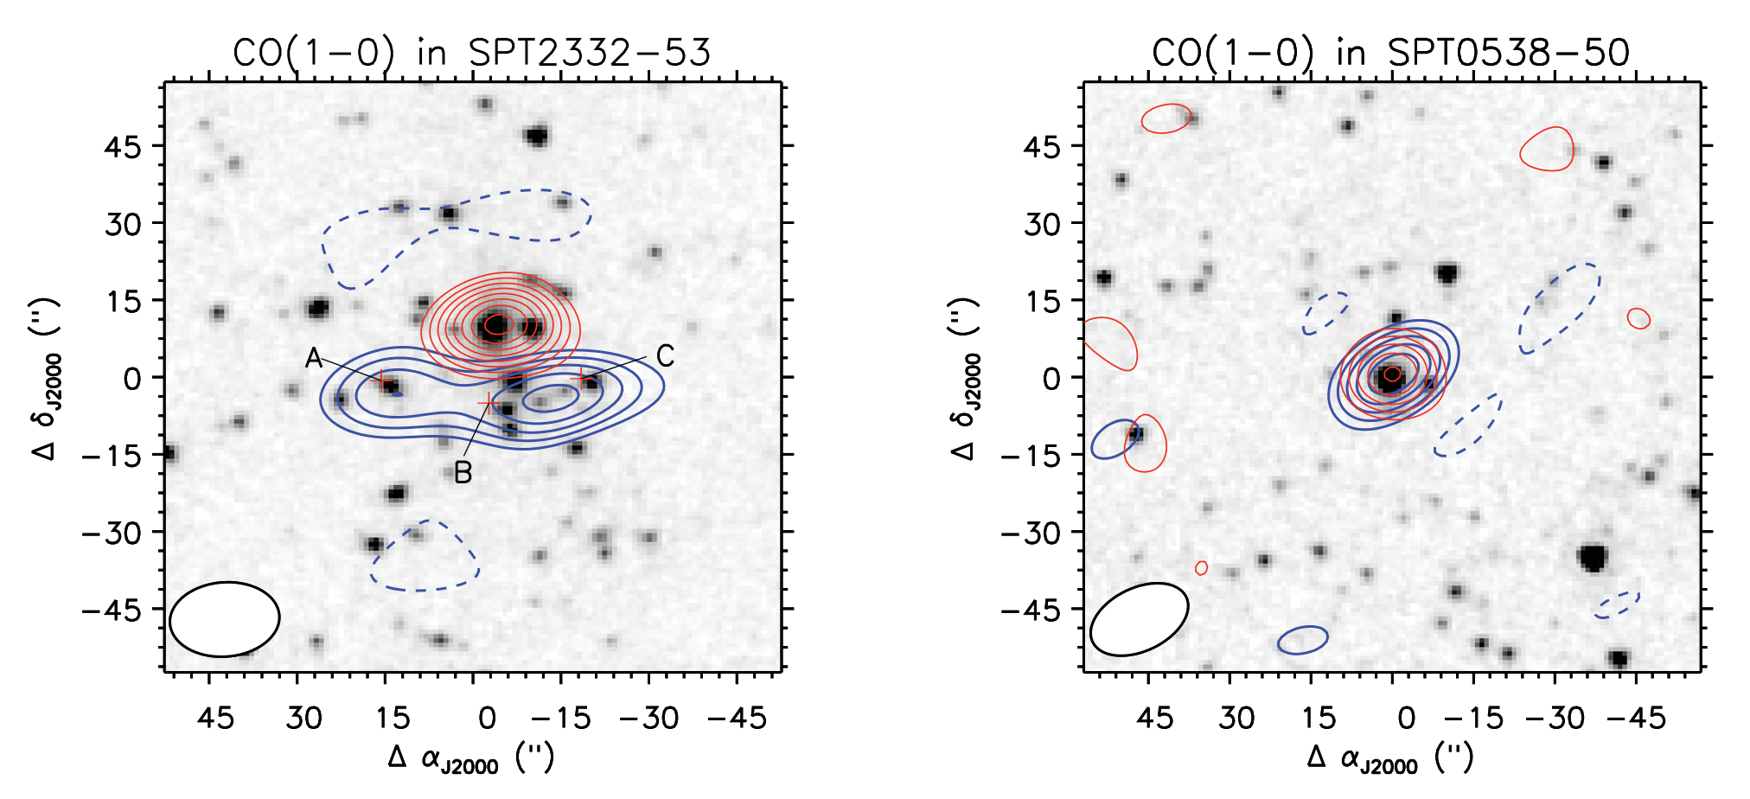
Resolving the lenses in CO with ATCA
SPT0538-50: Bright source at z=2.7 lensed by massive foreground galaxy
CO(3-2) observations with ATCA at 3mm
Intermediate resolution ~2”

Slide 22
Resolving the lenses in CO with ATCA
SPT2332-53: Bright source at z=2.7 lensed by a massive cluster
Small two-point mosaic
ATCA CO(3-2) observations at 3mm
Aravena et al. (2013)

Slide 23
Resolving the lenses in CO with ATCA
SPT0346-52: highest luminosity density galaxy known in the Universe, at z=5.7
S_{SFR} = 4200 M_{SUN} yr⁻¹ kpc⁻²
Hezaveh et al. (2013)
ATCA CO(2-1) observations at 0.5” resolution (Large program)

Slide 24
Concluding remarks
SPT survey discovered dusty starburst galaxies out to the highest redshifts
ALMA imaging and spectroscopy showed these were gravitationally lensed galaxies with z=2-6
On-going follow-up campaign to understand the properties of these sources
Stacked spectrum unveiled new faint molecular lines at high-z
All sources detected with ATCA low-J CO, a fundamental tracer of M(H₂)
Large sample of sources detected in [CII] with APEX and Herschel
On-going (pilot) program to perform high-resolution CO observations of SPT sources with ATCA down to 0.5-1.0” resolution.

