Slide 1
Molecular Gas Kinematics in
Atlas^{3D} (Early-Type) Galaxies
Martin Bureau, Oxford University
CO
(Katey Alatalo, Estelle Bayet, Leo Blitz, Francoise Combes,
Alison Crocker, Timothy Davis, Melanie Krips, Lisa Young)
Optical
(Atlas^{3D} teams)
Plans: Atlas^{3D}: E/S0 formation, gas physics, residual SF
CO: E/S0 H₂ kinematics (distribution, kinematics, TFR, BHs)
CO: E/S0 H₂ origin (kin. misalignement, field vs clusters)
CO + others: E/S0 SF (feedback, diagnostics)
Summary and future

Slide 2
Molecular Gas Kinematics in
Atlas^{3D} (Early-Type) Galaxies
Martin Bureau, Oxford University
CO
(Katey Alatalo, Estelle Bayet, Leo Blitz, Francoise Combes,
Alison Crocker, Timothy Davis, Melanie Krips, Lisa Young)
Optical
(Atlas^{3D} teams)
Plans: Atlas^{3D}: E/S0 formation, gas physics, residual SF
CO: E/S0 H₂ kinematics (distribution, kinematics, TFR, BHs)
CO: E/S0 H₂ origin (kin. misalignement, field vs clusters)
CO + others: E/S0 SF (feedback, diagnostics)
Summary and future

Slide 3

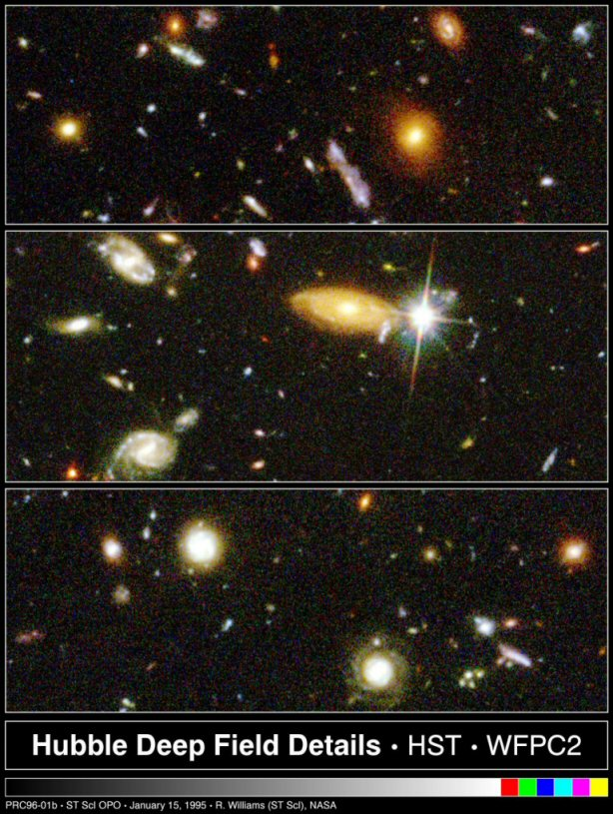
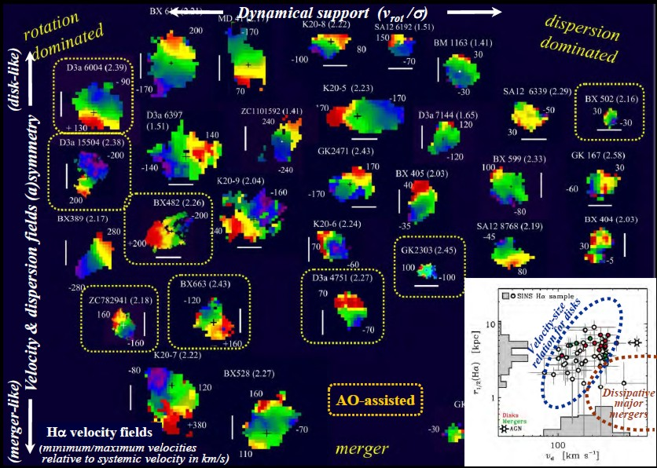
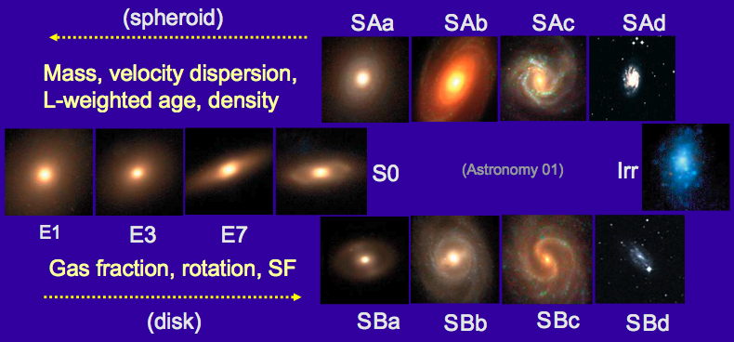
Broad Aims
Goals:
Mass assembly history
(gas, stars, dark matter)
Chemical enrichment history
(SFH, age, metallicity)
Context:
Hierarchical structure formation
(merging, harassment, ...)
Internal dynamical evolution
(BH/triaxiality-driven, ...)
Feedback
(AGN, SF, ...)
(HST HDF)
(SINS)

Slide 4
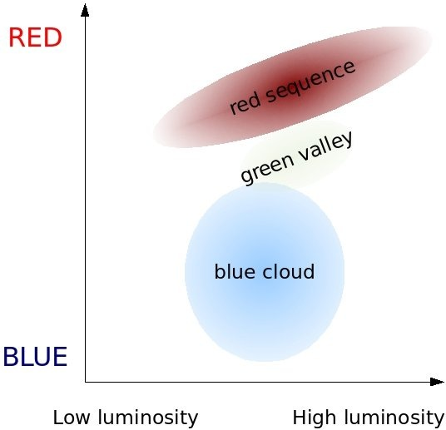
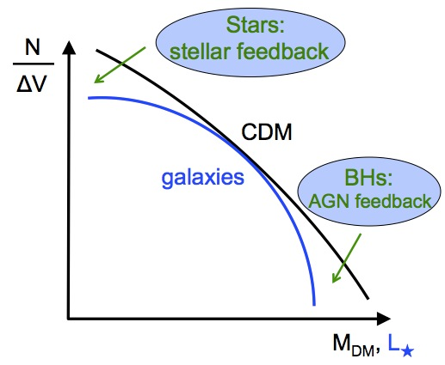
Broad Aims
Colour-magnitude diagram:
Goals:
Mass assembly history
(gas, stars, dark matter)
Chemical enrichment history
(SFH, age, metallicity)
Context:
Hierarchical structure formation
(merging, harassment, ...)
Internal dynamical evolution
(BH/triaxiality-driven, ...)
Feedback
(AGN, SF, ...)
Mass / luminosity function:

Slide 5
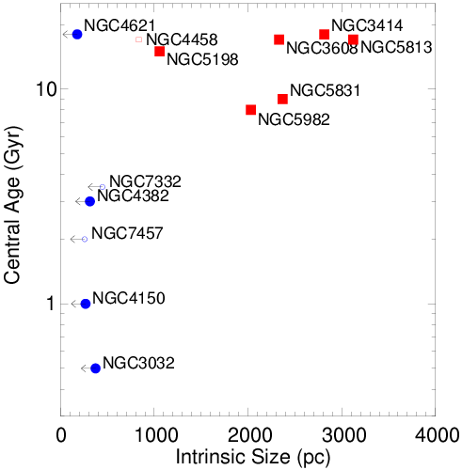
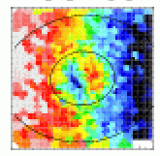
SAURON: Stellar Linestrengths
(Kuntschner et al. 06, 10; McDermid et al. 06)
  Main results:
  Standard:
  Homogeneously old,
  decreasing metallicity
  Occasional:
  Young core/body,
  varied metallicity
  KDC Dichotomy:
  Small, young, distinct
  (in fast rotators; dissipation?)
  Large, homogeneously old
  (in slow rotators)
V★

Slide 6
Molecular Gas Kinematics in
Atlas^{3D} (Early-Type) Galaxies
Martin Bureau, Oxford University
CO
(Katey Alatalo, Estelle Bayet, Leo Blitz, Francoise Combes,
Alison Crocker, Timothy Davis, Melanie Krips, Lisa Young)
Optical
(Atlas^{3D} teams)
Plans: Atlas^{3D}: E/S0 formation, gas physics, residual SF
CO: E/S0 H₂ kinematics (distribution, kinematics, TFR, BHs)
CO: E/S0 H₂ origin (kin. misalignement, field vs clusters)
CO + others: E/S0 SF (feedback, diagnostics)
Summary and future

Slide 7
Complete Survey of ETGs
(Cappellari et al. 2011)
Complete, volume-limited sample:
260 E/S0s (no spiral structure), M_{K} < -21.5, D < 41 Mpc
Low-z census; fast/slow rotators; wet/dry mergers; SF + feedback
Datasets:
Optical integral-field spectroscopy: WHT/SAURON (38 nights)
Optical photometry: Multi-bands (SDSS, INT), deep (CHFT)
Single-dish CO: IRAM 30m (¹²CO(1-0) + (2-1))
CO interferometry: CARMA (¹²CO detections only; 40+ galaxies)
HI interferometry: WSRT (~150 galaxies excl. Virgo), ALFALFA
Archival data: Chandra, XMM, GALEX, HST, Spitzer, 2MASS, …
Simulations:
Cosmological, individual galaxies/binary mergers, SAMs

Slide 8
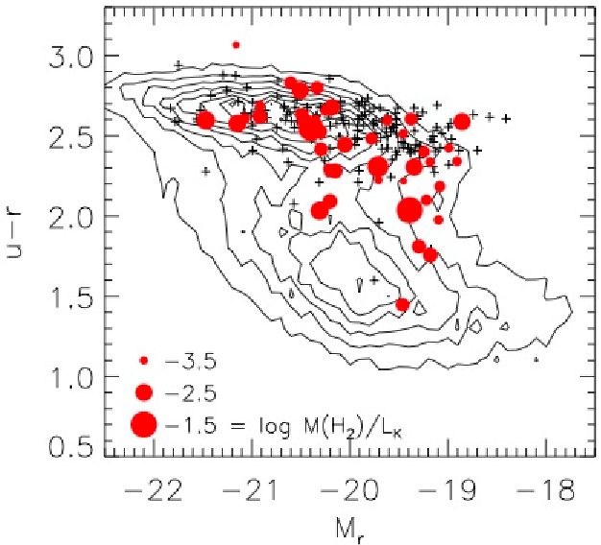
CO: Single-Dish Survey
(Combes, Young & Bureau 07; Young et al. 11, 13)
Optical CMD + CO
IRAM 30m Survey:
CO(1-0, 2-1), 23/12” FWHM
Sensitivity: 3 mK (30 km s⁻¹)
3 x 10⁷ M⊙
Results:
22% detection rate
M_{H2} = 10^{7.1-9.3} M⊙
CO(2-1)/CO(1-0) ≈ 1 – 2
⇒ Independent of structure, dynamics, environment… but not SF
Consistent with COLDGASS threshold (Saintonge et al. 11, 12; see also Crocker et al. 11)
(Previously: Welsh, Sage, …)
(Assumption: X_{CO}…)

Slide 9
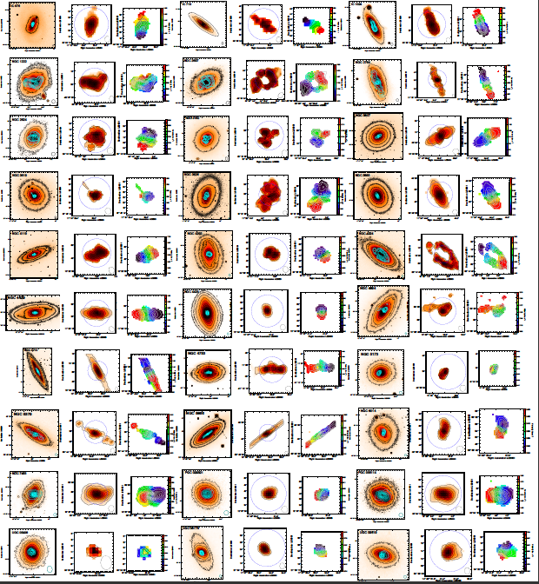
CO: Morphology
(Alatalo et al. 2012; Davis et al. 2012)
Atlas^{3D} (CARMA):
> 40 objects so far
(CARMA, PdBI, BIMA)
Centrally-concentrated H₂ (physical size)
Diverse morphologies
(disks, rings, bars, …)
(origin, accretion time)
Regular kinematics
(CO best V_{c} tracer)
(T-F, M/L, BH mass, …)

Slide 10
CO: Morphology
(Alatalo et al. 2012; Davis et al. 2012)
Atlas^{3D} (CARMA):
> 40 objects so far
(CARMA, PdBI, BIMA)
Centrally-concentrated H₂ (physical size)
Diverse morphologies
(disks, rings, bars, …)
(origin, accretion time)
Regular kinematics
(CO best V_{c} tracer)
(T-F, M/L, BH mass, …)

Slide 11
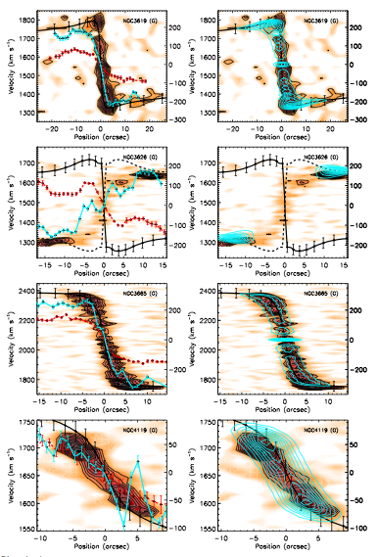
CO: Kinematics tracer
(Davis et al. 2012)
CO vs. V_{c}:
CO rotating faster (colder) then ionised gas (and stars)
Nearly perfect tracer of the circular velocity
⇒ Best (and excellent) tracer
of dynamical mass
■ : CARMA CO (1-0)
■ : Modeled CO (1-0) from JAM model
--- : SAURON JAM model
+ : SAURON stars
+ : SAURON ionised gas
Velocity
Position

Slide 12
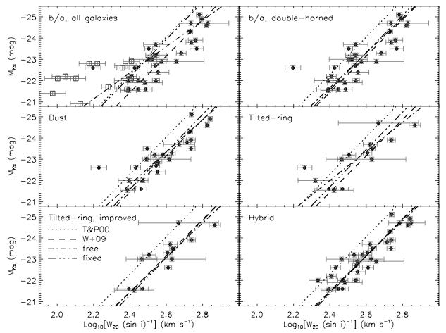
Large Scale: Tully-Fisher Relation
(Davis et al. 2011a)
CO Tully-Fisher:
Many (potential) pitfalls
Many better than expected
Many simple workarounds
Slope and zero-point
robustly recovered
Standard intrinsic scatter
⇒ Stellar / Jeans T-F
easily recovered
⇒ No or minimum efforts !
⇒ Great prospect to probe
M/L(z) with LMT+ALMA…
CO Tully-Fisher relations:
M_{K}
Log (W₂₀ / sin i)

Slide 13
Tully-Fisher: M/L evolution
Scaling:
We have:
G M / R² = V² / R
M α V² R
We define:
M/L
Σ = M / πR²
We get:
L = V⁴ / πG² (M/L) Σ
L α V⁴ (M/L)⁻¹ Σ⁻¹
M/L:
Stellar populations
- Age
- Metallicity
- Non-Solar abundance ratio
- Star formation history (SFH)
- Initial mass function (IMF)
- …
Dark matter
Size scale
…
(Gas-rich) disk galaxies

Slide 14
Large Scale: Tully-Fisher Relation
(Torii et al. 14; Tiley et al. 14)
CO Tully-Fisher relations:
NANTEN2 (4m):
Nearby galaxies
True integrated profile (reliable I_{CO}, ΔV)
Distances uncertain
Low S/N
COLD-GASS (30m):
Non-local galaxies
True integrated profile (reliable I_{CO}, ΔV)
Low S/N
Reliable distances
M_{K}
Log (W₅₀ / sin i)

Slide 15
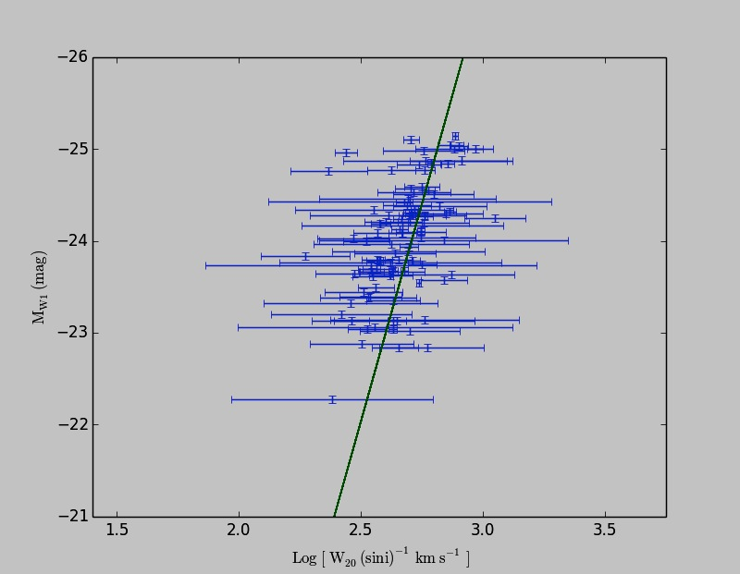
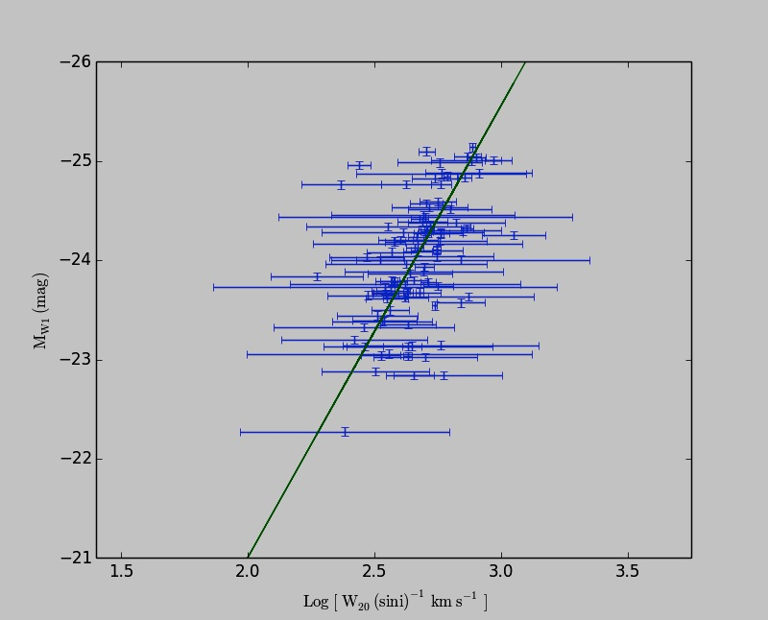
Large Scale: Tully-Fisher Relation
(Torii et al. 14; Tiley et al. 14)
CO Tully-Fisher relations:
NANTEN2 (4m):
Nearby galaxies
True integrated profile (reliable I_{CO}, ΔV)
Distances uncertain
Low S/N
COLD-GASS (30m):
Non-local galaxies
True integrated profile (reliable I_{CO}, ΔV)
Reliable distances
Low S/N
WISE_1
Log (W₂₀ / sin i)

Slide 16
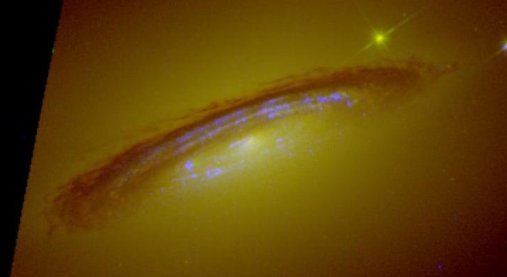
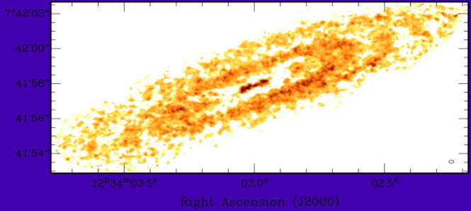
Small Scale: Black hole mass
(Davis et al. 2013)
HST WFC3 NUV-optical data:
High-res CO (<0.5”):
Challenging with existing interferometers
Routine with ALMA
Regular (central) disk kinematics
Free M/L* and M•
⇒ Strong constraints on M•
(smallest formal errors)
⇒ Great prospects across Hubble sequence with ALMA…
(Kaviraj et al. ??)
CARMA high-res (0.25” = 20 pc) data:

Slide 17
Small Scale: Black hole mass
(Davis et al. 2013)
HST WFC3 NUV-optical data:
High-res CO (<0.5”):
Challenging with existing interferometers
Routine with ALMA
Regular (central) disk kinematics
Free M/L* and M•
⇒ Strong constraints on M•
(smallest formal errors)
⇒ Great prospects across Hubble sequence with ALMA…
(Kaviraj et al. ??)
See talk by Tim Davies
(Wednesday 14:50)
CARMA high-res (0.25” = 20 pc) data:

Slide 18
Molecular Gas Kinematics in
Atlas^{3D} (Early-Type) Galaxies
Martin Bureau, Oxford University
CO
(Katey Alatalo, Estelle Bayet, Leo Blitz, Francoise Combes,
Alison Crocker, Timothy Davis, Melanie Krips, Lisa Young)
Optical
(Atlas^{3D} teams)
Plans: Atlas^{3D}: E/S0 formation, gas physics, residual SF
CO: E/S0 H₂ kinematics (distribution, kinematics, TFR, BHs)
CO: E/S0 H₂ origin (kin. misalignement, field vs clusters)
CO + others: E/S0 SF (feedback, diagnostics)
Summary and future

Slide 19
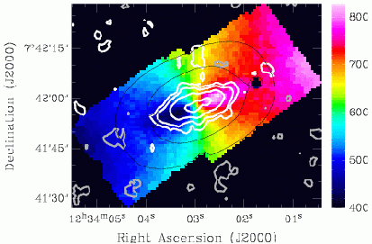
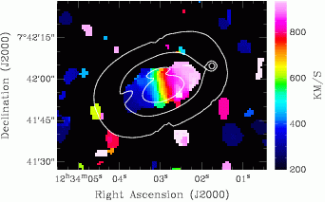
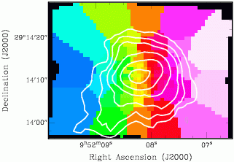
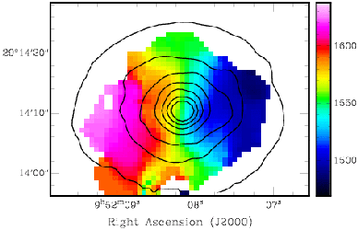

mm-optical Synergy: CO origin
(Young, Bureau & Cappellari 08; Crocker et al. 08, 09, 11)
SAURON
CO
Stars vs. CO:
Kinematic misalignment: clean diagnostic of molecular gas origin
Aligned: Internal
(stellar mass loss)
Mis-aligned: External
(accretion/merger)
V★+CO
V_{CO}
V★+CO
V_{CO}

Slide 20
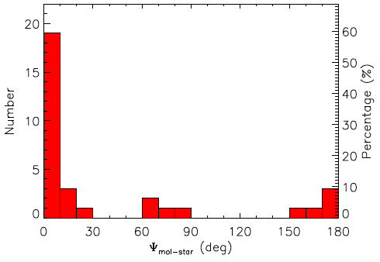
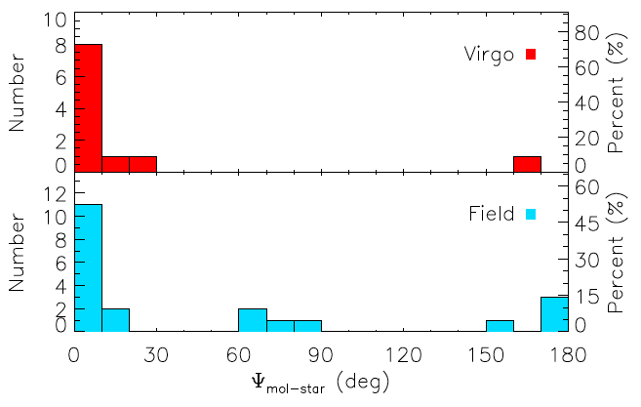
CO: Origin
(Davis et al. 11b)
Atlas^{3D} (CARMA):
H₂ and stars often misaligned:
> 35% external
< 65% internal gas origin
H₂ and ionised gas always aligned: common origin
H₂ and stars always aligned in clusters/Virgo:
internal gas origin
(e.g. stellar mass loss, leftover)
H₂ and stars very often misaligned in field:
significant external gas accretion
H₂ - stars
H₂ - stars
Misalignment angle

Slide 21
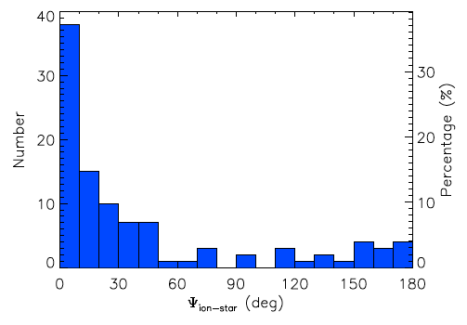
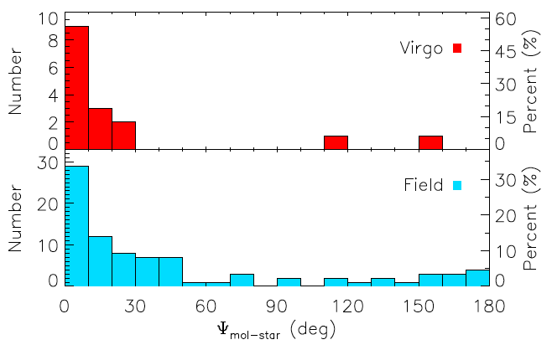
CO: Origin
(Davis et al. 11b)
Atlas^{3D} (CARMA):
H₂ and stars often misaligned:
> 35% external
< 65% internal gas origin
H₂ and ionised gas always aligned: common origin
H₂ and stars always aligned in clusters/Virgo:
internal gas origin
(e.g. stellar mass loss, leftover)
H₂ and stars very often misaligned in field:
significant external gas accretion
Ionised gas - stars
Ionised gas - stars
Misalignment angle

Slide 22
CO: Origin
(Davis et al. 11b)
Atlas^{3D} (CARMA):
H₂ and stars often misaligned:
> 35% external
< 65% internal gas origin
H₂ and ionised gas always aligned: common origin
H₂ and stars always aligned in clusters/Virgo:
internal gas origin
(e.g. stellar mass loss, leftover)
H₂ and stars very often misaligned in field:
significant external gas accretion
Ionised gas - stars
Ionised gas - stars
Misalignment angle

Slide 23
Gas Accretion: Timescales
Hand-waving argument:
t_{gas_depletion} < t_{torque}
< few t_{dynamical}
< few 3x10⁷ yr
< 100 Myr
t_{gas_replenishment} ≈ t_{gas_depletion} / detection_rate
< few t_{dynamical} / 0.22
< 0.5 Gyr
⇒ Rapid gas replenishment (gas accretion, mergers)
✗ Problem: t_{gas_depletion} expected to be 1-2 Gyr …

Slide 24
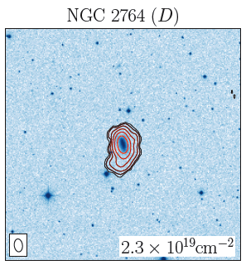
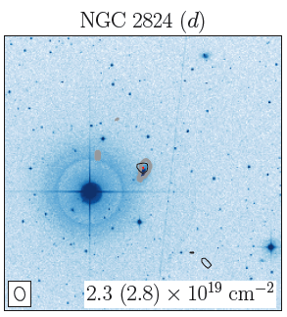
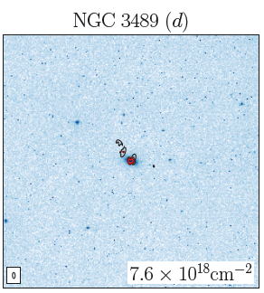
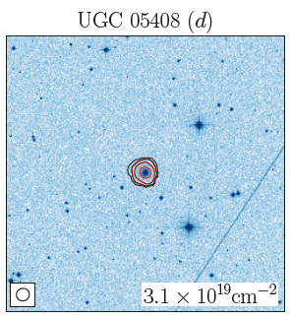
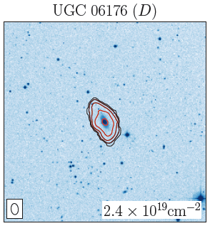
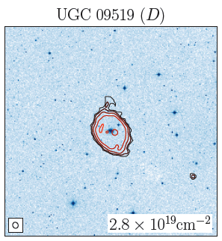
mm-HI Synergy: CO origin
(Morganti et al. 06; Oosterloo et al. 10; Serra et al. 12)
WSRT: Undisturbed HI
HI facts:
CO detections:
≈50% undisturbed,
moslty isolated
≈50% disturbed,
clear companions
⇒ HI (and CO/ionised gas) of external origin in at least ½ of CO-rich ETGs
⇒ Circumstantial evidence for cold accretion and/or minor mergers
(gas-rich dwarfs ?)
(Supported S0 counter-rotation studies)
(e.g. Bureau & Chung 06)

Slide 25
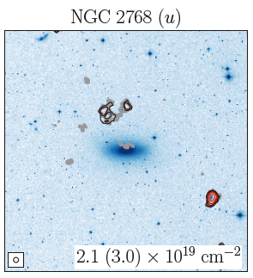
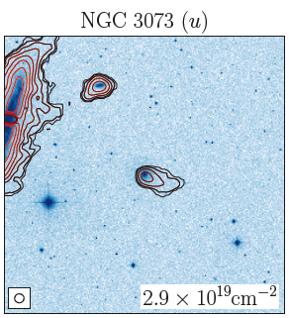
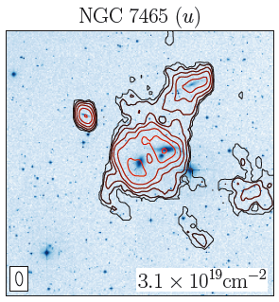
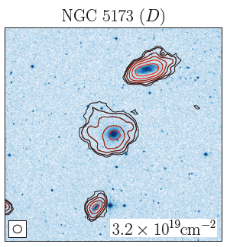
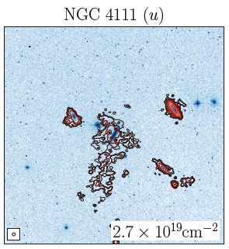
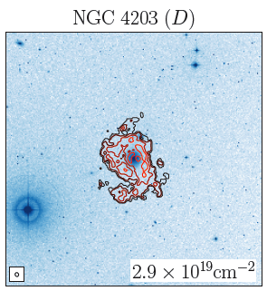
mm-HI Synergy: CO origin
(Morganti et al. 06; Oosterloo et al. 10; Serra et al. 12)
WSRT: Disturbed HI
HI facts:
CO detections:
≈50% undisturbed,
moslty isolated
≈50% disturbed,
clear companions
⇒ HI (and CO/ionised gas) of external origin in at least ½ of CO-rich ETGs
⇒ Circumstantial evidence for cold accretion and/or minor mergers
(gas-rich dwarfs ?)
(Supported S0 counter-rotation studies)
(e.g. Bureau & Chung 06)

Slide 26
Molecular Gas Kinematics in
Atlas^{3D} (Early-Type) Galaxies
Martin Bureau, Oxford University
CO
(Katey Alatalo, Estelle Bayet, Leo Blitz, Francoise Combes,
Alison Crocker, Timothy Davis, Melanie Krips, Lisa Young)
Optical
(Atlas^{3D} teams)
Plans: Atlas^{3D}: E/S0 formation, gas physics, residual SF
CO: E/S0 H₂ kinematics (distribution, kinematics, TFR, BHs)
CO: E/S0 H₂ origin (kin. misalignement, field vs clusters)
CO + others: E/S0 SF (feedback, diagnostics)
Summary and future

Slide 27
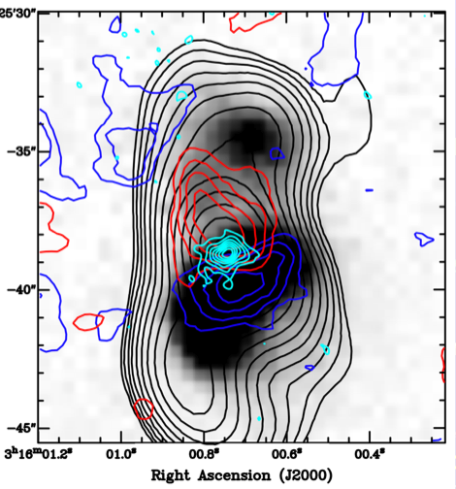
Low-luminosity AGN: Feedback
(Alatalo et al. 11, 14; Davis et al. 12; Nyland et al. 13)
CARMA + SMA + VLA:
NGC1266:
CO, HI, and ionised gas
bi-polar/bi-conical outflow
Alignment with radio continuum and X-rays
(T_{b} > 10⁷ K, d <1 pc core)
Clear shock signatures
Mass outflow rate > SFR
(13 M yr⁻¹; t_{dep} ≈ 85 Myr)
Post-SB stellar pops
(SF quenching)
⇒ Clear evidence for AGN feedback (via jet) on molecular gas
M_{H2, nucleus} ≈ 4x10⁸ M⊙ (R ≤ 60 pc)
Highly
red-shifted
H₂
M_{H2, outflow}
≈ 2x10⁷ M⊙
(R ≤ 500 pc)
Narrow-
band
Hα
1.4 GHz radio
cont.
Highly
blue-shifted
H₂
M_{H2, total} ≈ 1x10⁹ M⊙
(see also Davis et al. 12)

Slide 28
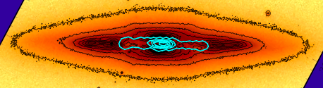
Molecular Line Diagnostics
(Topal et al. 14)
Temperature: ¹²CO(2-1) / ¹²CO(1-0)
Opacity: ¹²CO(2-1) / ¹³CO(2-1)

Slide 29
Molecular Line Diagnostics
(Topal et al. 14)
Temperature: ¹²CO(2-1) / ¹²CO(1-0)
Opacity: ¹²CO(2-1) / ¹³CO(2-1)

Slide 30
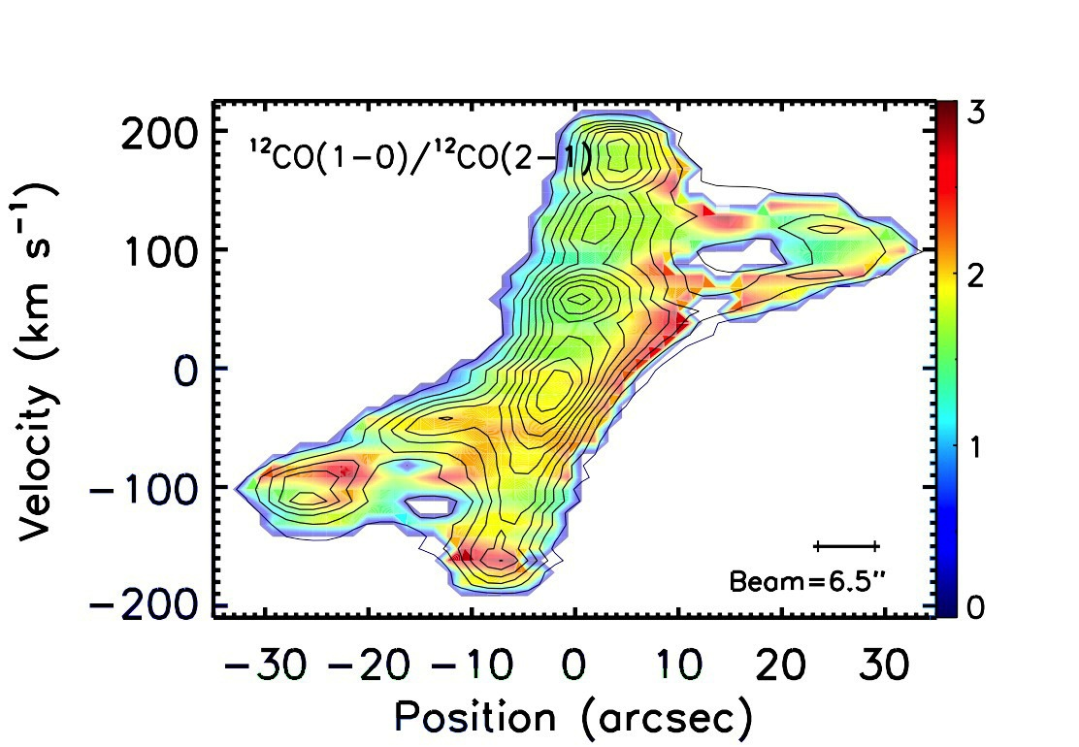
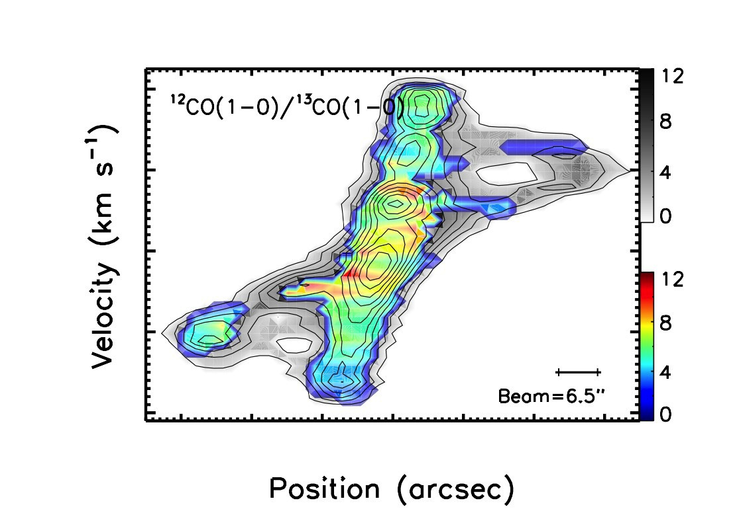
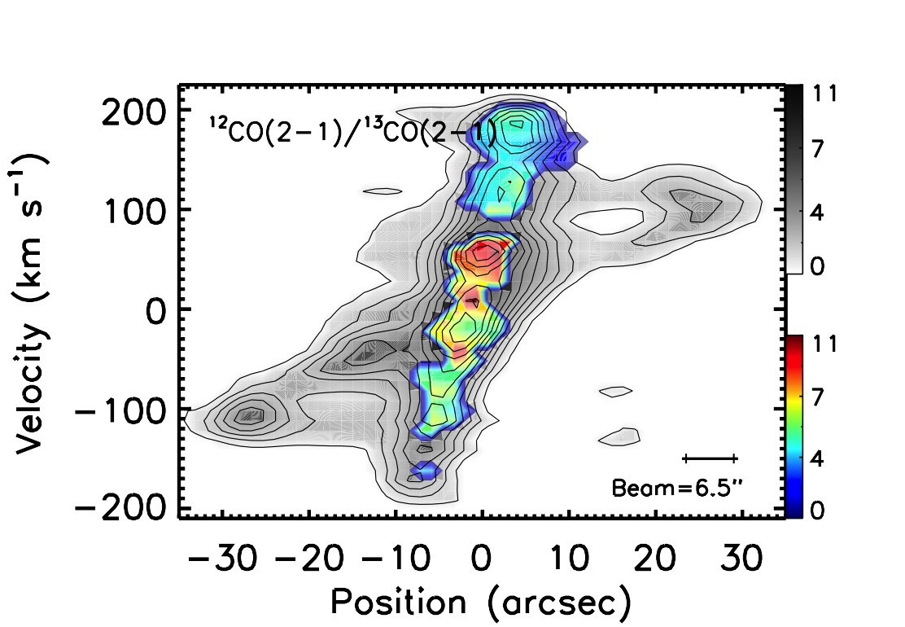
Molecular Line Diagnostics
(Topal et al. 14)
Temperature: ¹²CO(2-1) / ¹²CO(1-0)
Opacity: ¹²CO(2-1) / ¹³CO(2-1)

Slide 31
Molecular Line Diagnostics
(Topal et al. 14)
Temperature: ¹²CO(2-1) / ¹²CO(1-0)
Opacity: ¹²CO(2-1) / ¹³CO(2-1)

Slide 32
Molecular Gas Kinematics in
Atlas^{3D} (Early-Type) Galaxies
Martin Bureau, Oxford University
CO
(Katey Alatalo, Estelle Bayet, Leo Blitz, Francoise Combes,
Alison Crocker, Timothy Davis, Melanie Krips, Lisa Young)
Optical
(Atlas^{3D} teams)
Plans: Atlas^{3D}: E/S0 formation, gas physics, residual SF
CO: E/S0 H₂ kinematics (distribution, kinematics, TFR, BHs)
CO: E/S0 H₂ origin (kin. misalignement, field vs clusters)
CO + others: E/S0 SF (feedback, diagnostics)
Summary and future

Slide 33
Conclusions
- CO: Atlas^{3D} unprecedented 3D survey/database (optical, CO, HI, …)
≅22% incidence; independent of most properties
Compact, varied morphologies; “self-similar” to spirals
Regular kinematics (centre, overall); excellent mass tracer
Very promising for TF studies (near and far); SMBH masses
- Origin: > ⅓ external overall (> ½ external in field, none in clusters)
Survival and accretion timescales very short (≤ 100 Myr, ≤ 500 Myr)
Strong support for gas-rich minor mergers
- ISM: Clear signs of AGN-driven molecular outflows
Spatially-resolved line-ratio diagnostics…
Determination of physical properties through modeling (great future)
⇒ High resolution observations very promising

Slide 34
Conclusions
- CO: Atlas^{3D} unprecedented 3D survey/database (optical, CO, HI, …)
≅22% incidence; independent of most properties
Compact, varied morphologies; “self-similar” to spirals
Regular kinematics (centre, overall); excellent mass tracer
Very promising for TF studies (near and far); SMBH masses
- Origin: > ⅓ external overall (> ½ external in field, none in clusters)
Survival and accretion timescales very short (≤ 100 Myr, ≤ 500 Myr)
Strong support for gas-rich minor mergers
- ISM: Clear signs of AGN-driven molecular outflows
Spatially-resolved line-ratio diagnostics…
Determination of physical properties through modeling (great future)
⇒ High resolution observations very promising
Great synergy
optical IFU – mm interferometry

Slide 35
Extras...

Slide 36
SF Physics: Differences
Dynamics:
Toomre’s Q :
Q α σ κ / Σ
σ velocity dispersion
(effective sound speed)
κ epicyclic frequency
(function of V_{c} or Φ)
Σ surface density
⇒ Much more freedom in ETGs
than in disk galaxies
(esp. central vs. outer parts)
(high κ, decreased disk self-gravity)
⇒ Morphological quenching ?
(Kawata et al. 07; Martig et al. 09,...)
Physical Conditions:
Stellar populations:
Old (> 8 - 10 Gyr)
High metallicities (> Z)
Non-Solar abundances ([α/Fe])
…
Radiation Field:
Frequent hot gas (10⁶ K)
Frequent AGN
UV-upturn (dep. on Z, age)
…
⇒ Different abundances, excitation
SFR indicators contaminated…

Slide 37
SF Physics: SF tracers
Obscured SF tracers:
UV:
Contamination / heating by
old stellar pops (UV-upturn)
AGN
Assumption about SFH
⇒ Upper limit ?
(Optical) ionised gas
Ionisation dominated by old
stars (P-AGB, EHB, …)
⇒ Upper limit ?
Unobscured SF tracers:
MIR - FIR:
Heating by old stellar pops
AGN
⇒ Upper limit
Radio continuum:
Contamination by AGN + jets
⇒ Promising
(requires high resolution)

Slide 38
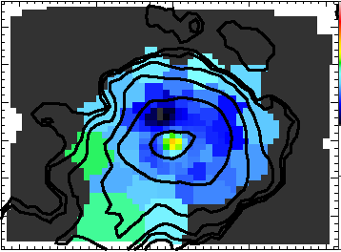
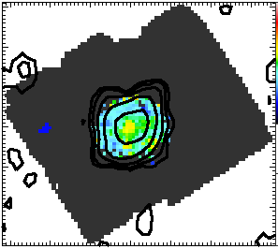
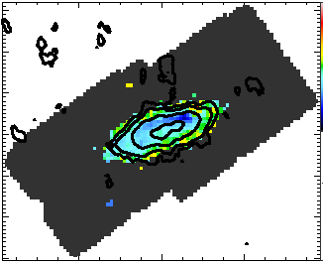
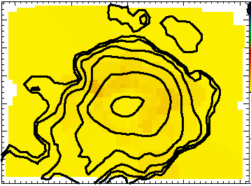
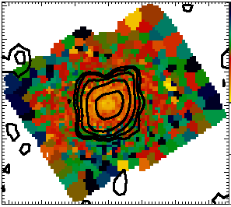
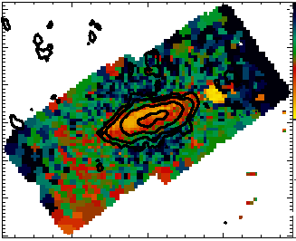
Type 1: Currently Star-Forming
(Crocker et al. 11)
NGC3032
NGC4459
NGC4526
Ionised gas:
log(OIII/Hb)
-1.0
1.0
Star-forming
Stellar population:
Age (Gyr)
1.0
18.0
Star-forming
Ionization dominated by young stars, and young stars are present

Slide 39
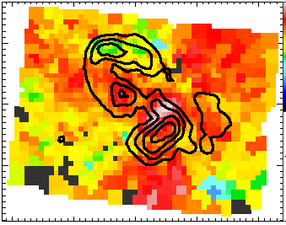
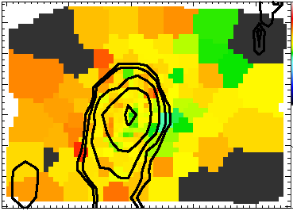
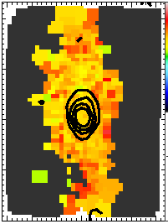
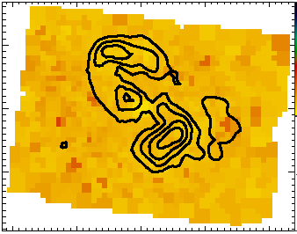


Type 2: Recently Star-Forming ?
(Crocker et al. 11)
NGC3489
NGC4150
NGC4550
Ionised gas:
log(OIII/Hb)
-1.0
1.0
Star-forming
Stellar population:
Age (Gyr)
1.0
18.0
Star-forming
Ionization not dominated by young stars, but young stars are present (pervasive)

Slide 40






Type 3: Not Star-Forming ?
(Crocker et al. 11)
NGC2320
NGC2768
NGC4477
Ionised gas:
log(OIII/Hb)
-1.0
1.0
Star-forming
Stellar population:
Age (Gyr)
1.0
18.0
Star-forming
Ionization not dominated by young stars, and young stars are not present

Slide 41

CO: Star Formation Laws
(Crocker et al. 11)
SAURON:
Star formation sequence ?
Possible offset from Schmidt-Kennicutt law (≈ 1σ ; lower SFE)
TIR enhanced over 8 and 24 mm
FIR – radio correlation not respected: too many FIR-excess
⇒ SF possibly slightly different from that in disk/starburst galaxies
⇒ Need to probe gas dynamics and physical conditions…
Old


Slide 42

CO: Star Formation Laws
(Crocker et al. 11; Martig et al. 13; Davis et al. 14)
SAURON:
Star formation sequence ?
Possible offset from Schmidt-Kennicutt law (≈ 1σ ; lower SFE)
TIR enhanced over 8 and 24 mm
FIR – radio correlation not respected: too many FIR-excess
⇒ SF possibly slightly different from that in disk/starburst galaxies
⇒ Need to probe gas dynamics and physical conditions…
Σ_{SFR}
Σ_{gas}

Slide 43


CO: Star Formation Laws
(Crocker et al. 11; Martig et al. 13)
SAURON:
Star formation sequence ?
Possible offset from Schmidt-Kennicutt law (≈ 1σ ; lower SFE)
TIR enhanced over 8 and 24 mm
FIR – radio correlation not respected: too many FIR-excess
⇒ SF possibly slightly different from that in disk/starburst galaxies
⇒ Need to probe gas dynamics and physical conditions…
(Saintonge et al. 12)

Slide 44



CO: Star Formation Laws
(Crocker et al. 11)
E/S0s vs SINGS spirals:
SAURON:
Star formation sequence ?
Possible offset from Schmidt-Kennicutt law (≈ 1σ ; lower SFE)
TIR enhanced over 8 and 24 mm
FIR – radio correlation not respected: too many FIR-excess
⇒ SF possibly slightly different from that in disk/starburst galaxies
⇒ Need to probe gas dynamics and physical conditions…
TIR
bright
TIR
bright

Slide 45


CO: Star Formation Laws
(Crocker et al. 11)
E/S0s vs Condon et al. (2002):
SAURON:
Star formation sequence ?
Possible offset from Schmidt-Kennicutt law (≈ 1σ ; lower SFE)
TIR enhanced over 8 and 24 mm
FIR – radio correlation not respected: too many FIR-excess
⇒ SF possibly slightly different from that in disk/starburst galaxies
⇒ Need to probe gas dynamics and physical conditions…
q = log (FIR / radio)

Slide 46
Molecular Gas and Star Formation in Early-Type Galaxies
Martin Bureau, Oxford University
CO
(Katey Alatalo, Estelle Bayet, Leo Blitz, Francoise Combes,
Alison Crocker, Timothy Davis, Melanie Krips, Selcuk Topal, Lisa Young)
Optical
(SAURON + Atlas^{3D} teams)
Plans: SAURON+Atlas^{3D}: E/S0 formation, residual SF
CO: E/S0 H₂ content (incidence, distribution, kinematics)
CO: E/S0 H₂ origin (kin. misalignement, field vs clusters)
SF: E/S0 SF (tracers, sequence, laws)
SF: E/S0 molecular ISM (physical properties, high-res)
Summary and future

Slide 47



CO: Line Diagnostics
(Krips et al. 10; Crocker et al. 12)
CO-Brightest Galaxies:
Ratios: ¹²CO/¹³CO occ. low
HCN/¹³CO low
HCN/HCO⁺ often high
⇒ ¹³CO occasionally enhanced,
HCO⁺ often suppressed
* Usual IR-CO and IR-HCN trends
Corr.: M_{H2}/M_{HI}, f₆₀/f₁₀₀, dust morph.
Star L_{K}, age, metallicity, …
⇒ Consistent with downsizing?

Slide 48

CO: Line Diagnostics
(Krips et al. 10; Crocker et al. 12)
CO-Brightest Galaxies:
Ratios: ¹²CO/¹³CO occ. low
HCN/¹³CO low
HCN/HCO⁺ often high
⇒ ¹³CO occasionally enhanced,
HCO⁺ often suppressed
* Usual IR-CO and IR-HCN trends
Corr.: M_{H2}/M_{HI}, f₆₀/f₁₀₀, dust morph.
Star L_{K}, age, metallicity, …
⇒ Consistent with downsizing?

Slide 49


CO: Line Diagnostics
(Krips et al. 10; Crocker et al. 12)
CO-Brightest Galaxies:
Ratios: ¹²CO/¹³CO occ. low
HCN/¹³CO low
HCN/HCO⁺ often high
⇒ ¹³CO occasionally enhanced,
HCO⁺ often suppressed
* Usual IR-CO and IR-HCN trends
Corr.: M_{H2}/M_{HI}, f₆₀/f₁₀₀, dust morph.
Star L_{K}, age, metallicity, …
⇒ Consistent with downsizing?
¹²CO(1-0) / ¹³CO(1-0)
¹²CO(1-0) / ¹³CO(1-0)

Slide 50


CO: Line Modeling
(Bayet et al. 13)
χ²:
LVG Modeling:
Usual models but:
High metallicities (> Z)
Non-Solar abundances ([α/Fe])
…
Frequent hot gas (10⁶ K)
Frequent AGN
UV-upturn (dep. on Z, age)
…
Likelihood:

Slide 51
CO: Line Modeling
(Bayet et al. 13)
Physical Conditions:
“CO” gas: T_{K} = 10 - 110 K
n(H₂) = 10 ³ ⁻ ⁴ cm⁻³
N(CO) = 10 ¹¹ ⁻¹⁹ cm⁻²
⇒ Similar to Milky Way SF?
“HCN” gas: Unconstrained
LVG Modeling:
Usual models but:
High metallicities (> Z)
Non-Solar abundances ([α/Fe])
…
Frequent hot gas (10⁶ K)
Frequent AGN
UV-upturn (dep. on Z, age)
…

Slide 52
SF Physics: Gas-phase metallicity
Common tracers:
(Old) stellar linestrengths:
Unrepresentative ([α/Fe])
Gas often external
⇒ Total failure
(young pops may work)
Optical ionised gas
Ionisation dominated by old
stars (P-AGB, EHB, …)
⇒ Restricted use
(star-forming galaxies ok)
(custom-made diagnostic ?)
Novel possibilites:
Gas / dust ratio:
Dust production poorly
understood
⇒ Valid but approximate
(need reliable FIR data)
Molecular tracers:
CS promising but untested
(first obs./paper now out)
⇒ Promising
(models rather primitive)

Slide 53



Molecular Line Diagnostics
(Topal et al. 14)
Optical PVD:
CO PVD:
Temperature: ¹²CO(2-1) / ¹²CO(1-0)
Velocity
[N II]
Velocity
Opacity: ¹²CO(2-1) / ¹³CO(2-1)
Hα
Velocity
Position
Position

Slide 54



NGC4710: MW similarities
(Topal et al., in prep; Torii et al., in prep)
CO PVD:
CO PVD:
Temperature: ¹²CO(2-1) / ¹²CO(1-0)
Velocity
Velocity
Position
Position

Slide 55


CO: High resolution
(Davis, Kaviraj, Bureau, ...)
HST WFC3 NUV-optical (0.1”) data:
NGC4459:
High resolution (1”) CARMA CO(2-1) data
Regular (central) disk distribution + kinematics
⇒ Great prospects for
(sub-) GMC scale studies
(radio, optical, UV)
⇒ MW-type studies in external galaxies
⇒ Self similarity of disks ?
(Kaviraj et al., in prep)
BIMA low-res (7” = 560 pc ) data:

Slide 56

CO: High resolution
(Davis, Kaviraj, Bureau, ...)
HST WFC3 NUV-optical (0.1”) data:
NGC4459:
High resolution (1”) CARMA CO(2-1) data
Regular (central) disk distribution + kinematics
⇒ Great prospects for
(sub-) GMC scale studies
(radio, optical, UV)
⇒ MW-type studies in external galaxies
⇒ Self similarity of disks ?
(Kaviraj et al., in prep)
CARMA low-res (1” = 80 pc ) data:

Slide 57
Molecular Gas and Star Formation in Early-Type Galaxies
Martin Bureau, Oxford University
CO
(Katey Alatalo, Estelle Bayet, Leo Blitz, Francoise Combes,
Alison Crocker, Timothy Davis, Melanie Krips, Selcuk Topal, Lisa Young)
Optical
(SAURON + Atlas^{3D} teams)
Plans: SAURON+Atlas^{3D}: E/S0 formation, residual SF
CO: E/S0 H₂ content (incidence, distribution, kinematics)
CO: E/S0 H₂ origin (kin. misalignement, field vs clusters)
SF: E/S0 SF (tracers, sequence, laws)
SF: E/S0 molecular ISM (physical properties, high-res)
Summary and future

Slide 58
Conclusions
- CO: Atlas^{3D} unprecedented 3D survey/database (optical, CO, HI, …)
≅22% incidence; independent of most properties
Compact, varied morphologies; “self-similar” to spirals
Regular kinematics (centre, overall)
- Origin: > ⅓ external overall (> ½ external in field, none in clusters)
Survival and accretion timescales very short (≤ 100 Myr, ≤ 500 Myr)
Strong support for gas-rich minor mergers
- SF: Conditions very different from disk galaxies; SF tracers problematic
Sequence (current, recent, no/weak SF) ?
Likely offset from K-S law; FIR-bright; new SF laboratory ?
- ISM: ¹³CO enhanced, HCO⁺ suppressed; correlated with galaxy properties
First determination of physical properties, great future
High resolution observations very promising

Slide 59
Conclusions
- CO: Atlas^{3D} unprecedented 3D survey/database (optical, CO, HI, …)
≅22% incidence; independent of most properties
Compact, varied morphologies; “self-similar” to spirals
Regular kinematics (centre, overall)
- Origin: > ⅓ external overall (> ½ external in field, none in clusters)
Survival and accretion timescales very short (≤ 100 Myr, ≤ 500 Myr)
Strong support for gas-rich minor mergers
- SF: Conditions very different from disk galaxies; SF tracers problematic
Sequence (current, recent, no/weak SF) ?
Likely offset from K-S law; FIR-bright; new SF laboratory ?
- ISM: ¹³CO enhanced, HCO⁺ suppressed; correlated with galaxy properties
First determination of physical properties, great future
High resolution observations very promising
Great synergy
optical IFU – mm interferometry

Slide 60
CO in ETGs: Future
Evolution with redshift and environment (ALMA + LMT):
- Detection rates, masses, kinematics, physical properties, etc…
- Tully-Fisher (high-mass end, M/L evolution, diff. tracers, etc…)
M• - σ★ relation survey using CO:
- Follow-up of promising targets for black-hole mass measurements
(interferometers… ALMA)
Physical conditions and SF in molecular gas:
- Spatially-resolved high-density tracer/molecular diagnostic maps
(¹³CO, HCN, HCO⁺,…; density, opacity, temperature, excitation, …)
(interferometers… ALMA)
Cold / warm ISM properties (Herschel):
- Dust temperature, mass, heating, origin; SFR, SF relations, …
- Warm ISM physical conditions, CO excitation

Slide 61
Extras...

Slide 62
Molecular Gas and Star Formation in Early-Type Galaxies
Martin Bureau, Oxford University
CO
(Katey Alatalo, Estelle Bayet, Leo Blitz, Francoise Combes,
Alison Crocker, Timothy Davis, Melanie Krips, Selcuk Topal, Lisa Young)
Optical
(SAURON + Atlas^{3D} teams)
Plans: SAURON+Atlas^{3D}: 8
CO: 15
CO: 7
CO: 9
CO: 9
Summary and future: 2

Slide 63
Cold + Warm ISM:
Herschel
Herschel: (approved; Young)
24/10 of brightest detections, PACS/SPIRE FTS spectroscopy
Constraints on ISM parameters (density, temperature, UV/X field, …) through the [CII], [OI], [NII] lines and high-J CO ladder
(within galaxies; function of environment, dynamics, origin, AGN/SF, UV-upturn, …)
Herschel: (not approved)
All ≈60 CO detections, 5-band PACS + SPIRE photometry
Constraints on dust content (temperature, mass), physical properties
(blue cloud -> red sequence migration; heating from evolved stellar pops)
Spatially-resolved SF studies, tracers, laws (70 μm, FIR-radio)
Gas-to-dust ratio
(relation to X_{CO}; function of origin, environment, stellar pops, ionisation, HI, …)
17/60 objects in other programmes (HRS, HeViCS, KINGFISH)

Slide 64
Cold + Warm ISM:
ALMA
ALMA: Better angular resolution, bandwidth, sensitivity
Better spatially-resolved molecular gas distributions,
spatial correlations with other λ, UV-upturn, SF regions, …
Detection and mapping of multiple molecular line tracers
(physical conditions, excitation, …)
Exploration of denser environments, evolution with redshift
(SF laws, T-F and thus M/L, …)
Approved Cycle 0 programmes:
Shock (SiO) imaging of AGN-driven molecular outflow (Alatalo)
First mapping of multiple lines in an ETG (Bayet)

Slide 65
Molecular Gas and Star Formation in Early-Type Galaxies
Martin Bureau, Oxford University
CO
(Katey Alatalo, Estelle Bayet, Leo Blitz, Francoise Combes,
Alison Crocker, Timothy Davis, Melanie Krips, Selcuk Topal, Lisa Young)
Optical
(SAURON + Atlas^{3D} teams)
Plans: SAURON+Atlas^{3D}: E/S0 formation, residual SF
CO: E/S0 H₂ content (incidence, distribution, kinematics)
CO: E/S0 SF (tracers, sequence, laws)
CO: E/S0 molecular ISM (physical properties, high-res)
CO: Active E/S0s (low-l AGN, radio galaxies, BCGs)
Summary and future

Slide 66


Low-luminosity AGN: Feedback
(Alatalo et al. 11)
IRAM 30m:
NGC1266:
Ordinary looking S0
Highest CO flux
Broad wings
(± 500 km s⁻¹; > V_{escape})
Double Gaussian profile
⇒ M_{H2} ≈ 2x10⁹ M
(if all optically thick)
(roughly 50%/50%)
⇒ Evidence of outflow (analogy with stellar outflows)
Large-scale or nuclear ?

Slide 67




Low-luminosity AGN: Feedback
(Aalto et al. 12)
SMA:
NGC1377:
Small, featureless S0
Extreme FIR-excess (q > 3.9) and Si absorption
Double Gaussian profile
No Hα, Brγ, Paα
Faint [NII], [NeII], PAHs
Outflow perp. to disk
⇒ Mass outflow rate
dM / dt = 8 - 38 M yr⁻¹,
t_{dep} ≈ 5 - 25 Myr
⇒ Power source uncertain
(obscured AGN ?)
(nascent starburst ?)
CO (contours)
σ_{V, CO} (greyscale)
M_{H2, total} ≈ 1x10⁹ M⊙
M_{H2, outflow} ≈ 1-6 x10⁷ M⊙

Slide 68




Radio Galaxies: Outflows
Examples:
Outflows:
Cold gas (HI and molecular
gas) outflows. Dominant?
dM / dt similar to weak starburst winds
(10-50 M yr⁻¹)
Outflow coincident with bright radio features
Predominantly in young / rejuvenated radio sources
(evolutionary stage?)
Ė_{out} / L_{Edd} ≈ 10⁻³ – 10⁻⁴
No systematic search !
(Morganti et al. 03, 05)
✕
(Morganti et al. 98)

Slide 69

Radio Galaxies: Outflows
NGC1266:
Outflows:
Cold gas (HI and molecular
gas) outflows. Dominant?
dM / dt similar to weak starburst winds
(10-50 M yr⁻¹)
Outflow coincident with bright radio features
Predominantly in young / rejuvenated radio sources
(evolutionary stage?)
Ė_{out} / L_{Edd} ≈ 10⁻³ – 10⁻⁴
No systematic search !
(Alatalo et al. 11)

Slide 70


Radio Galaxies: Outflows
H₂ distribution:
3C326N:
P_{jet} ≈ 10^{44 – 45} erg s⁻¹
Age_{jet} ≈ 2 x 10⁸ yr
SF < 0.07 M yr⁻¹
M_{H2,warm} ≈ M_{H2,cold} ≈ 2 x 10⁹ M
L_{H2} ≈ 100 L_{X}
⇒ Wind without starburst or
X-ray AGN
⇒ Turbulence key to SF
absence ?
Radio Galaxies SFE:
Radio galaxies systematically offset (low SFE)
SFR indicators reliable ?
(Nesvadba et al. 10)
(Nesvadba et al. 11)

Slide 71

Radio Galaxies: Outflows
3C326N:
P_{jet} ≈ 10^{44 – 45} erg s⁻¹
Age_{jet} ≈ 2 x 10⁸ yr
SF < 0.07 M yr⁻¹
M_{H2,warm} ≈ M_{H2,cold} ≈ 2 x 10⁹ M
L_{H2} ≈ 100 L_{X}
⇒ Wind without starburst or
X-ray AGN
⇒ Turbulence key to SF
absence ?
Radio Galaxies SFE:
Radio galaxies systematically offset (low SFE)
SFR indicators reliable ?
H₂ SFE:
(Nesvadba et al. 10)

Slide 72


Radio Galaxies: Outflows
H₂ constraints:
H₂ excitation:
CO: 10 K (mm/sub-mm)
H₂ rot. lines: 100 K (MIR)
H₂ rot-vib. lines: 1000 K (NIR
H₂ diagnostics:
Line ratios: PDR models fail, shocks fit
Energy (SF, AGN): dE/dt < L_{H2}
Geometry: Offset SF – gas
⇒ H2 likely shock excited
(4 - 40 km s⁻¹, 10³ ⁻ ⁴ cm⁻³)
(mechanical energy, turbulence)
(Nesvadba et al. 10)
PDRs
Shocks
(Nesvadba et al. 10)

Slide 73



BCGs: Feedback
BCGs:
Hot ICM (10⁷⁻⁸ K) short cooling time in cores (few 10⁸ yr)
Cooling flows: Gas accretion, galaxy formation
AGN feedback: SF regulation/
quenching
dM/dt ≈ 10²⁻³ ⇒ 10¹⁻² M yr⁻¹
SFR ≈ 1 – 50 M yr⁻¹
≈ 40 CO single-dish detections
(Salome, Edge, REFLEX, MACS)
⇒ M_{H2} ≈ 10^{10-11.5} M at R< 50 kpc
H₂ and atomic lines also detected (Herschel)
(L.P. David, J.M. Vrtilek)

Slide 74



BCGs: Feedback
Radio - Xray overlays:
BCGs:
Hot ICM (10⁷⁻⁸ K) short cooling time in cores (few 10⁸ yr)
Cooling flows: Gas accretion, galaxy formation
AGN feedback: SF regulation/
quenching
dM/dt ≈ 10²⁻³ ⇒ 10¹⁻² M yr⁻¹
SFR ≈ 1 – 50 M yr⁻¹
≈ 40 CO single-dish detections
(Salome, Edge, REFLEX, MACS)
⇒ M_{H2} ≈ 10^{10-11.5} M at R< 50 kpc
H₂ and atomic lines also detected (Herschel)
(Chandra X-ray Center)

Slide 75



BCGs: Feedback
NGC1275:
Molecular Gas:
Evidence of positive
feedback: filaments
⇒ Most molecular gas in
central disk
⇒ Rotating ?
Mid-IR and warm H₂ gas
⇒ Shock, cosmic-ray, X-ray
heating (in addition to
UV from SF)
(see Salome, Lim, Edge, …)
(Fabian et al. 03)
(Conselice et al. 01)
(Salome et al. 11)

Slide 76


BCGs: Feedback
NGC1275:
Molecular Gas:
Evidence of positive
feedback: filaments
⇒ Most molecular gas in
central disk
⇒ Rotating ?
Mid-IR and warm H₂ gas
⇒ Shock, cosmic-ray, X-ray
heating (in addition to
UV from SF)
(see Salome, Lim, Edge, …)
(Fabian et al. 03)
(Conselice et al. 01)
(Salome et al. 06)
(Lim et al. 08)

Slide 77
Extras...

Slide 78

NGC1266: CO profile
(Alatalo et al. 10)
DSS:
NGC1266:
Ordinary looking S0
Highest CO flux
Broad wings
(± 500 km s⁻¹; > V_{escape})
Double Gaussian profile
⇒ M_{H2} ≈ 2x10⁹ M (roughly 50%/50%)
⇒ Evidence of outflow (analogy with stellar outflows)
Large-scale or nuclear ?

Slide 79

NGC1266: CO profile
(Alatalo et al. 10)
IRAM 30m:
NGC1266:
Ordinary looking S0
Highest CO flux
Broad wings
(± 500 km s⁻¹; > V_{escape})
Double Gaussian profile
⇒ M_{H2} ≈ 2x10⁹ M (roughly 50%/50%)
⇒ Evidence of outflow (analogy with stellar outflows)
Large-scale or nuclear ?

Slide 80
NGC1266: CO profile
(Alatalo et al. 10)
IRAM 30m:
NGC1266:
Ordinary looking S0
Highest CO flux
Broad wings
(± 500 km s⁻¹; > V_{escape})
Double Gaussian profile
⇒ M_{H2} ≈ 2x10⁹ M (roughly 50%/50%)
⇒ Evidence of outflow (analogy with stellar outflows)
Large-scale or nuclear ?

Slide 81

NGC1266: CO profile
(Alatalo et al. 10)
Stellar Outflow:
NGC1266:
Ordinary looking S0
Highest CO flux
Broad wings
(± 500 km s⁻¹; > V_{escape})
Double Gaussian profile
⇒ M_{H2} ≈ 2x10⁹ M (roughly 50%/50%)
⇒ Evidence of outflow (analogy with stellar outflows)
Large-scale or nuclear ?
(Bally & Lada 1983)

Slide 82

NGC1266: Molecular extent
(Alatalo et al. 10)
CARMA: CO, 5”
NGC1266:
Central peak (still) essentially unresolved
(≈1” = 150 pc)
Wings clearly (slightly)
extended
⇒ Need firm evidence for AGN (jet-driven) outflow !

Slide 83
NGC1266: Molecular extent
(Alatalo et al. 10)
CARMA:
CO(1-0)
13CO(1-0)
HCN
CS
SiO
HNC
SMA:
CO(3-2)
CO(2-1)
¹³CO(2-1)
HCO⁺(3-2)
NGC1266:
Central peak (still) essentially unresolved
(≈1” = 150 pc)
Wings clearly (slightly)
extended
⇒ Need firm evidence for AGN (jet-driven) outflow !
Spatial Resolution:
5” – 0.3” ⇒ 750 – 50 pc

Slide 84

NGC1266: Molecular extent
(Alatalo et al. 10)
SMA: CO, 5”
NGC1266:
Central peak (still) essentially unresolved
(≈1” = 150 pc)
Wings clearly (slightly)
extended
⇒ Need firm evidence for AGN (jet-driven) outflow !

Slide 85

NGC1266: Molecular extent
(Alatalo et al. 10)
SMA: CO(3-2)
NGC1266:
Central peak (still) essentially unresolved
(≈1” = 150 pc)
Wings clearly (slightly)
extended
⇒ Need firm evidence for AGN (jet-driven) outflow !

Slide 86

NGC1266: Molecular extent
(Alatalo et al. 10)
CARMA: CO(2-1), A+B arrays (0.3”-0.5”)
NGC1266:
Central peak (still) essentially unresolved
(≈1” = 150 pc)
Wings clearly (slightly)
extended
⇒ Need firm evidence for AGN (jet-driven) outflow !

Slide 87

NGC1266: AGN feedback
(Alatalo et al. 10)
SINGS: Ha
NGC1266:
Ionised gas (Ha) outflow,
bi-polar/bi-conical
(aligned with CO outflow)
Clear shock signature
(SiO)
Clear alignment of radio continuum jet (1.4 GHz)
⇒ Clear effect/feedback of AGN (via jet) on molecular gas (fuel for star formation)

Slide 88

NGC1266: AGN feedback
(Alatalo et al. 10)
SINGS + CARMA: Ha + CO
NGC1266:
Ionised gas (Ha) outflow,
bi-polar/bi-conical
(aligned with CO outflow)
Clear shock signature
(SiO)
Clear alignment of radio continuum jet (1.4 GHz)
⇒ Clear effect/feedback of AGN (via jet) on molecular gas (fuel for star formation)

Slide 89

NGC1266: CO profile
(Alatalo et al. 10)
CARMA: SiO
NGC1266:
Ionised gas (Ha) outflow,
bi-polar/bi-conical
(aligned with CO outflow)
Clear shock signature
(SiO)
Clear alignment of radio continuum jet (1.4 GHz)
⇒ Clear effect/feedback of AGN (via jet) on molecular gas (fuel for star formation)

Slide 90
NGC1266: CO profile
(Alatalo et al. 10)
CARMA: SiO
NGC1266:
Ionised gas (Ha) outflow,
bi-polar/bi-conical
(aligned with CO outflow)
Clear shock signature
(SiO)
Clear alignment of radio continuum jet (1.4 GHz)
⇒ Clear effect/feedback of AGN (via jet) on molecular gas (fuel for star formation)
M_{H2} ≈ 1x10⁹ M⊙ at V_{systemic} ,
within R = 150 pc
Highly
red-shifted
H₂
Narrow-
band
Ha
Highly
blue-shifted
H₂
1.4 GHz radio
continuum

Slide 91
NGC1266: AGN-driven outflow ?
(Alatalo et al. 11)
CARMA + SMA:
NGC1266:
CO and ionised gas (Hα)
bi-polar/bi-conical outflow
Alignment with radio continuum and X-rays
Clear shock signature
(SiO)
Mass outflow rate > SFR
⇒ Clear evidence for AGN feedback (via jet) on molecular gas
M_{H2, nucleus} ≈ 4x10⁸ M⊙ (R ≤ 60 pc)
Highly
red-shifted
H₂
M_{H2, outflow}
≈ 2x10⁷ M⊙
(R ≤ 500 pc)
Narrow-
band
Ha
1.4 GHz radio
cont.
Highly
blue-shifted
H₂
M_{H2, total} ≈ 1x10⁹ M⊙

Slide 92
Molecular AGN-Driven Outflows
(Alatalo et al., in prep)
M_{H2} = 2x10⁹ M⊙
at V_{systemic} ,
within R = 150 pc
Highly
red-shifted
H₂
Narrow-band
Ha
Highly
blue-shifted
H₂
1.4 GHz radio
continuum

Slide 93
Extras...

Slide 94
Molecular Gas, Star, and Disk Formation in Local Early-Type Galaxies
Martin Bureau, Oxford University
CO
(L.M. Young, L. Blitz, F. Combes)
(Alison Crocker, Timothy Davis, Katey Alatalo)
GALEX
(Hyunjin Jeong, S. Yi)
Optical
(SAURON + Atlas3D teams)
Plans: Optical/SAURON, UV/GALEX: Stellar populations in E/S0s
CO/30m: H₂ census (L, dynamics, environment)
CO/BIMA+PdBI+CARMA: H₂ origin, star formation
UV/GALEX, HI: Star formation, H₂ – HI relation
Summary

Slide 95

SAURON: Dynamics and Stellar Populations of Early-Type Galaxies in 3D
Martin Bureau
(Oxford University)
Team
Plan: Introduction: Team, Goals, Instrument, Sample, Data
Tools: Pixel fitting, Binning, Kinemetry
Stellar Kinematics: Examples, KDCs, Slow/Fast Rotators
Gas Kinematics: Examples, Bars, Interactions, Line Ratios, ...
Linestrengths: Examples, Line Indices, KDCs Dichotomy
Dynamical Modeling: Schwarzschild, Examples, Dark Matter
Conclusions: Summary, Future

Slide 96
Broad Aims
Goals:
Mass assembly history
(gas, stars, dark matter)
Chemical enrichment history
(SFH, age, metallicity)
Context:
Hierarchical structure formation
(merging, harassment, ...)
Internal dynamical evolution
(BH/triaxiality-driven, ...)
⇒ Exploit "fossil record"
(near-field cosmology)
(HST HDF)
(SINS)

Slide 97
Gastrophysics
Colour-magnitude diagram:
Mass / luminosity function:

Slide 98













Hubble Sequence
(spheroid)
S Aa
S Ab
S Ac
S Ad
Mass, velocity dispersion,
L-weighted age, density
S0
(Astronomy 01)
Irr
E1
E3
E7
Gas fraction, rotation, SF
(disk)
S Ba
S Bb
S Bc
S Bd
Sauron + Atlas^{3D}

Slide 99

Hierarchical Context
Downsizing:
Star formation history
anti-hierarchical …
More massive galaxies form
their stars earlier and faster
(age, metallicity, a-elements)
Star formation earlier overall
in denser environments
⇒ Are the star formation and
mass assembly histories of
early-type galaxies truly
over at z = 0 ?
SSFR
(Thomas et al. 05)

Slide 100

UV C-M Relations: Residual SF
(Yi et al. 05; Schawinski et al. 06; Kaviraj et al. 07)
GALEX-SDSS Data:
UV CMDs:
Correlations nearly absent
Red sequence indistinct, blue cloud significant
even for E/S0s
⇒ Low-level (residual) SF
pervasive
(≥ 30% of objects;
few % by mass)
⇒ Significant support for
hierarchical formation
(Kaviraj et al. 07)

Slide 101






Early-Types: Stellar Linestrengths
(Kuntschner et al. 06, 10)
  Main results:
  Standard:
  Homogeneously old,
  decreasing metallicity
  (larger spread among S0s)
  Occasional:
  Young core/body,
  varied metallicity
  Isoindices:
  Mg_{b} isoindex countours
  often flatter than light
  (40%; fast rotators)

Slide 102
Molecular Gas and Star Formation in Early-Type Galaxies
red and dead
dynamically simple… boring
Where When How Why
does star formation take place in ETGs ????
( What are the origin, dynamics, physical conditions, chemistry, … of the molecular gas ? )

Slide 103
Molecular Gas and Star Formation in Early-Type Galaxies
red and dead
dynamically simple… boring
alive and kicking

Slide 104
More intro material…

Slide 105



(SAURON+Atlas^{3D}): Broad Aims
Goals:
Mass assembly history
(gas, stars, dark matter)
Chemical enrichment history
(SFH, age, metallicity)
Context:
Hierarchical structure formation
(merging, harassment, ...)
Internal dynamical evolution
(BH/triaxiality-driven, ...)
⇒ Exploit "fossil record"
(near-field cosmology)
(Moore et al. 98)
(Juneau et al. 05)

Slide 106

SAURON+Atlas3D: Broad Aims
Goals:
Mass assembly history
(gas, stars, kinematics)
Chemical enrichment history
(age, metallicity, SFH)
Context:
Hierarchical structure formation
(merging, harassment, ...)
Internal dynamical evolution
(BH/triaxiality-driven, ...)
⇒ Exploit "fossil record"
(near-field cosmology)
(Juneau et al 05)

Slide 107
(SAURON+Atlas3D:) Broad Aims
Goals:
Mass assembly history
(gas, stars, kinematics)
Chemical enrichment history
(age, metallicity, SFH)
Context:
Hierarchical structure formation
(merging, harassment, ...)
Internal dynamical evolution
(BH/triaxiality-driven, ...)
⇒ Exploit "fossil record"
(near-field cosmology)

Slide 108
Gastrophysics
Stars:
stellar feedback
N
ΔV
CDM
galaxies
BHs:
AGN feedback
M_{DM}, L★
MM

Slide 109

Hierarchical Context
Goals:
Mass assembly history
Chemical enrichment (SF) history
Downsizing:
More massive galaxies form
their stars earlier and faster
(age, metallicity, a-elements)
UV CMDs:
Correlations nearly absent,
red sequence indistinct
⇒ Low-level (residual) SF pervasive
(≥ 30% of objects; few % by mass)
SSFR
(Thomas et al. 05)
(Kaviraj et al. 07)

Slide 110
Hierarchical Context
Downsizing:
Star formation history is
anti-hierarchical …
More massive galaxies form
their stars earlier and faster
(age, metallicity, a-elements)
UV CMDs:
Correlations nearly absent,
red sequence indistinct
⇒ Low-level (residual) SF
pervasive
(≥ 30% of objects; few % by mass)
SSFR
(Thomas et al. 05)
(Kaviraj et al. 07)

Slide 111
SAURON: Stellar Linestrengths
(Kuntschner et al. 06, 10; McDermid et al. 06)
  Main results:
  Standard:
  Homogeneously old,
  decreasing metallicity
  Occasional:
  Young core/body,
  varied metallicity
  KDC Dichotomy:
  Small, young, distinct
  (in fast rotators; dissipation?)
  Large, homogeneously old
  (in slow rotators)

Slide 112
SAURON: Stellar Linestrengths
(Kuntschner et al. 06, 10; McDermid et al. 06)
  Main results:
  Standard:
  Homogeneously old,
  decreasing metallicity
  Occasional:
  Young core/body,
  varied metallicity
  KDC Dichotomy:
  Small, young, distinct
  (in fast rotators; dissipation?)
  Large, homogeneously old
  (in slow rotators)
V★

Slide 113
KDCs: Age-Size Dichotomy
(McDermid et al. 06)
SAURON-OASIS Data:
Compact KDCs:
Small: 100 pc's (≤ 0.1 R_{e})
Young: distinct, increasingly
young toward center
Fast-rotators
Recent dissipative minor
merging/accretion?
Classic KDCs:
Large: kpc's (0.3-0.4 R_{e})
Coeval: homogeneously old
Slow-rotators
Early (dissipative) or recent dissipationless major merging (dry mergers)?
V★

Slide 114


Stellar Pops.: NGC4365 vs 4150
(Davies et al. 01; Kuntschner et al. 06)
I
NGC4365: Large KDC
No age gradient
Central enrichment
I
NGC4150: Small KDC
Young KDC
Post starburst

Slide 115



SAURON: Specific Goals
Principal Goals: (spheroids)
Internal velocity distributions:
Distribution of intrinsic shapes,
orbital structures, frequency
of decoupled components
Age/metallicity distributions:
Star formation history
Relation between gaseous/stellar
kinematics and stellar populations
Dichotomy of central cusp slopes
Dynamical role of massive BHs (global vs. nuclear properties)
⇒ Constraints on galaxy formation
and evolution scenarios

Slide 116


SAURON: Requirements
Spectroscopy Requirements:
Complete spatial coverage
Wide-field ( 1 Re )
Large bandpass
High throughput
Complementary data on nuclear/large scales
(BHs, dark matter; STIS, OASIS/GMOS, HI, PNS)
Homogeneous data reduction and analysis
(XSAURON, PALANTIR, web-based database)
Y
Y
X

Slide 117


SAURON: Characteristics
(Bacon et al. 01)
Specifications:
Structure:
≈ 49 / 21 %

Slide 118
(SAURON+Atlas^{3D}): Specs
(Bacon et al. 01; de Zeeuw et al. 02; Cappellari et al. 11)
Requirements:
  Wide-field (½ -1 Re) ⇒ 33"x41"
  Full spatial coverage ⇒ 100 %
  Large l range ⇒ 550 A
  High throughput ⇒ 21 %
  Data: (homogeneous and many)
  Large, well-selected sample
  Complementary multi-l data
  Complementary data on
  nuclear + large scales
  Homogeneous reduction/analysis
  Diverse team + modeling
Specifications:
51 / 21 %

Slide 119
SAURON: Project + Specs
(Bacon et al. 01; de Zeeuw et al. 02)
Requirements:
  Wide-field (½ -1 Re) ⇒ 33"x41"
  Full spatial coverage ⇒ 100 %
  Large l range ⇒ 550 A
  High throughput ⇒ 21 %
  Data: (homogeneous and many)
  24 E / 24 S0 / 24 Sa; cluster / field
  Homogeneous reduction/analysis
  Complementary datasets
  (OASIS, STIS; WFPC2, GALEX, MDM;
  CO, HI; ...)
  EU team, 35/56 WHT nights
  (>180 000 spectra)
Specifications:
51 / 21 %

Slide 120

SAURON: Optics
(Bacon et al. 01)
VPH Gr.

Slide 121



SAURON: Representative Sample(de Zeeuw et al. 02)
Constraints:
-6˚ ≤  ≤ 64˚ (instrument flexure)
∣b∣ ≥ 15˚ (Galactic extinction / crowding)
cz  3000 km s⁻ ¹ (spectral coverage)
M_{B} ≤ -18 (exposure time)
T ≤ Sab (spheroids)
Categories:
24 E / 24 S0 / 24 Sa
Cluster / Field
Six  - M_{B} planes homogeneously populated
⇒ Representative sample of spheroids covering the full range of environment, nuclear cusp slope, rotational support, ...

Slide 122

SAURON: DSS
(Emsellem et al. 04)

Slide 123
SAURON: Team
Team:
PIs:
R. Bacon (Lyon), R.L. Davies (Oxford), P.T. de Zeeuw (Leiden)
Members:
M. Bureau, M. Cappellari, E. Emsellem, J. Falcon-Barroso,
D. Krajnovic, H. Kuntschner, R. McDermid, R.F. Peletier, M. Sarzi
Associates:
R.C.E. van den Bosch, Y. Copin, K. Fathi, K. Ganda, B. Gerken,
J. de Jong, E. Jourdeuil, B.W. Miller, G. Monnet, T. Statler,
G. van de Venn, A.-M. Weijmans, H. Wozniak, ...
www.strw.leidenuniv.nl/sauron

Slide 124
SAURON: Data
Whole Dataset:
WHT/SAURON: Entire sample (IFU, 41"x33" FOV, 0.94"/pix)
WHT+CFHT/OASIS: Entire sample (IFU, 11"x 9" FOV, 0.27"/pix)
HST/STIS: 25% sample (long-slit, 0.0455"/pix)
MDM/1.3 m: Entire sample (17'x17' FOV, 0.5" pix)
HST/WFPC2: 90% sample (35"x35" FOV, 0.0455" pix)
GALEX/Imaging: Entire sample (1.2^{O} FOV, 2.5-4.5'' pix)
Complementary Projects:
Individual objects: NGC221, 224, 936, 1068, 4406, 4365, ...
Early-type bulges: Peletier-Balcells sample
Late-type bulges: Sbc-Sm
Starburst galaxies: Mundell sample
...
SAURON: 35/56 nights, >180 000 ind. spectra and counting ...

Slide 125
SAURON: Basic Results
(SAURON Team)
Conclusions: Early-type galaxies
Stellar kinematics exhibits rich variety: Axisymmetry rare
(central disks pervasive; KDCs/CRs numerous; triaxiality common)
(E/S0 dichotomy? Fast/slow rotators, correlation with anisotropy)
Ionized-gas pervasive, generally messy but often coherent kinematics
(75% detection rate; both internal and external origin; diverse excitation)
(Luminosity-weighted) ages generally homogeneously old,
with central metal enrichment, but KDCs dichotomy
(large/massive KDCs: old, non-rotator; early wet/late dry major merger)
(small/lightweight KDCs: young, rotator; [minor] wet merger)
Schwarzschild modeling provides first view of orbital structure,
suggestive dark matter results
(mass/dynamics-related M/L variations; 30% median DM content)
Great database available (SAURON, OASIS, STIS; MDM, WFPC2, GALEX; CO, HI)

Slide 126
Spatially-Resolved Molecular Gas, Dust and Star Formation in Early-Types
Martin Bureau, Oxford University
CO
(Katey Alatalo, Leo Blitz, Francoise Combes,
Alison Crocker, Timothy Davis, Lisa Young)
Optical
(SAURON + Atlas^{3D} teams)
(Bois, Bournaud, Cappellari, Davies, de Zeeuw, Emsellem, Khochfar, Krajnovic, Kuntschner, Lablanche, McDermid, Morganti, Naab, Oosterloo, Sarzi, Scott, Serra, Weijmans)
Plans: SAURON+Atlas3D: E/S0 formation, residual SF, surveys
CO: E/S0 H₂ incidence, distribution, kinematics, origin
CO: E/S0 SF tracers, sequence, laws, ISM
Summary
Posters: Parma (CO in radio galaxies)
Garcia-Appadoo (CO in HI-rich early-types)

Slide 127








Stellar populations
Cosmological simulations
Semi-analytic models
Dynamical models
Binary mergers
HI + CO imaging
Stellar +gas kinematics
Notes:
127

Slide 128

Complete Survey of ETGs
(Cappellari et al. 2011)
Science goals:
Distribution of fast + slow rotators
Fraction of wet + dry mergers
Role of SF + AGN feedback
Strong low-z constraints for simulations
Sample selection:
M_{K} < -21.5 (M★ ≥ 6x10⁹ M)
D < 41 Mpc
|δ-29°| < 35°, |b| > 15°
All E/S0s, no spiral structure
Atlas^{3D}
Red
g-r
Blue
M_{r}
⇒ 260 galaxies

Slide 129

Complete Survey of ETGs
(Cappellari et al. 2011)
Datasets:
Optical integral-field spectroscopy: WHT/SAURON
Optical photometry: Multi-bands (SDSS, INT), deep (CFHT)
Single-dish CO: IRAM 30m (¹²CO(1-0, 2-1))
CO interferometry: CARMA (¹²CO detections only; 40+ galaxies)
HI: WSRT (~150 galaxies excl. Virgo), ALFALFA
Archival data: Chandra, XMM, GALEX, HST, Spitzer, 2MASS, …
Simulations:
Cosmological, binary mergers, individual galaxies, SAMs, …

Slide 130
Complete Survey of Early-Type Galaxies
Complete, volume-limited sample:
260 E/S0s (no spiral structure), M_{K} < -21.5, D < 41 Mpc
Low-z census; fast/slow rotators; wet/dry mergers; SF + feedback
Datasets:
Optical integral-field spectroscopy: WHT/SAURON (38 nights; done)
Optical photometry: Multi-bands (SDSS, INT; done)
Single-dish CO: IRAM 30m (¹²CO(1-0) + (2-1); done)
HI interferometry: WSRT (~150 North galaxies excl. Virgo; ongoing)
CO interferometry: CARMA (¹²CO detections only; done)
Archival data: Chandra, XMM, GALEX, HST, Spitzer, 2MASS, …
Simulations:
Cosmological, individual galaxies/binary mergers, SAMs

Slide 131
Multi-l Approach
Optical integral-field spec.: Large program with SAURON@WHT
  (38 nights over 3 semesters, 4 runs: done)
Optical + NIR photometry: Multi-bands (SDSS, 2MASS, INT: done)
HI survey: ≈150 northern galaxies with WSRT (excl. Virgo)
¹²CO single-dish: Complete survey with IRAM 30m (done)
¹²CO interferometry of detections with CARMA
Archival data (Chandra, XMM, GALEX, HST, Spitzer)
Simulations: Cosmological, SAMs, individual/binary mergers

Slide 132
SAURON: Dynamics and Stellar Populations of Early-Type Galaxies in 3D
Martin Bureau
(Oxford University)
Team
Plan: Introduction: Team, Goals, Instrument, Sample, Data
Tools: Pixel fitting, Binning, Kinemetry
Stellar Kinematics: Examples, KDCs, Slow/Fast Rotators
Gas Kinematics: Examples, Bars, Interactions, Line Ratios, ...
Linestrengths: Examples, Line Indices, KDCs Dichotomy
Dynamical Modeling: Schwarzschild, Examples, Dark Matter
Conclusions: Summary, Future

Slide 133

SAURON: Data Analysis
(de Zeeuw et al. 02; Emsellem et al. 04; Sarzi et al. 06//////)
Algorithm: For every spectrum...
1) Obtain V and  from PPXF and single stellar
template (e.g. K0; emission lines masked).
2) Construct optimal template from synthetic
stellar spectra library (linear combination,
properly convolved, emission lines masked).
3) Subtract optimal template to yield emission-line
only spectrum (entire  range, extrapolation).
4) Fit all emission lines simultaneously with
Gaussians of equal (or variable) V and .
5) Subtract fitted emission-line spectrum from
observed spectrum to yield absorption-line
only spectrum (linestrengths).
6) Iterate if needed ...
In practice, Gauss-Hermite moments, simultaneous emission-line fits for gas, observed spectra, ...
λ

Slide 134
SAURON: Data Products
(de Zeeuw et al. 02; Emsellem et al. 04; Sarzi et al. 06)
Absorption Lines:
Total flux: Morphology, photometry
(≈V image)
Stellar kinematics: LOSVD
(V, , h₃,h₄)
Lines indices: Hβ, Mgb, Fe5015, Fe5270
(age/metallicity)
Emission Lines:
Gas distribution: Hβ, [OIII], [NI]
(fluxes, line ratios)
Gas kinematics: V(Hβ), V([OIII])
((Hβ), ([OIII]))
λ

Slide 135

Stellar Kin.: Data
(Emsellem et al. 04)

Slide 136

Gas Kin.: Data
(Sarzi et al. 06)

Slide 137

Stellar Pop.: Data
(Kuntschner et al. 06)

Slide 138





SAURON: Stellar Kinematics
(Emsellem et al. 04)

Slide 139





SAURON: Gas Kinematics
(Sarzi et al. 06)

Slide 140
SAURON: Stellar Linestrengths
(Kuntschner et al. 06)

Slide 141


Binning: Requirements
(Cappellari & Copin 03)
I
S/N Maps:
Irregular domains
S/N jumps
Goals: Uniform (minimum) S/N
Topological: No overlap/holes
Morphological: Compact round bins
Uniformity: Minimal S/N scatter
S/N

Slide 142


Binning: Methods
(Cappellari & Copin 03)
I
QuadTree:
Regular bins
Large S/N Scatter
Border problems
Centroidal Voronoi Tesselation:
Compact round bins
Small S/N scatter
No border problem
Directly reproducible

Slide 143


Binning: Methods
(Cappellari & Copin 03)
I
QuadTree:
Regular bins
Large S/N Scatter
Border problems
Centroidal Voronoi Tesselation:
Compact round bins
Small S/N scatter
No border problem
Directly reproducible

Slide 144

Binning: Results
(Cappellari & Copin 03)
V
σ

Slide 145
Kinemetry: Formalism
(Krajnovic et al. 2006)
Formalism:
K(r,θ) = c₀(r) + c_{n}(r) cos [n (θ - ϕ_{n}(r)) ]
Velocity Field:
c₁ ⇒ velocity amplitude (rotation curve)
ϕ₁ ⇒ kinematic angle (kinematic twists)
c₃ ⇒ opening angle (morphology)
Usefulness:
Simplified description (although many orders usually needed)
Filtering: Bisymmetry: V(x,y) = -V(-x,-y) (a₀= 0, c_{2n}= 0)
Axisymmetry: V(x,y) = V( x,-y) (ϕ_{2n+1}= PA)

Slide 146

Kinemetry: Results
(Copin et al. 2003)
NGC1023:
: V

Slide 147

Kinemetry: Results
(Copin et al. 2003)
NGC4365:
: V

Slide 148

Kinemetry: Filtering
(Krajnovic et al. 2006)
NGC2273:
V
σ
h₃
h₄

Slide 149


Oasis: Data
(McDermid et al. 06)
Sample:
Goals: Zoom on nuclei
Nuclear structure/kinematics
Central stellar populations
BH mass
Data: CFHT + WHT
Natural seeing (0.5-1.0")
11" ✕ 10" FOV
0.27" ✕ 0.27" pix
> 50 000 ind. spectra (CFHT)!


Data:

Slide 150

Oasis: Data
(McDermid et al. 06)
Goals: Zoom on nuclei
Nuclear structure/kinematics
Central stellar populations
BH mass
Data: CFHT + WHT
Natural seeing (0.5-1.0")
11" ✕ 10" FOV
0.27" ✕ 0.27" pix
> 50 000 ind. spectra (CFHT)!
OASIS-SAURON Comparison:

Slide 151
SAURON: Dynamics and Stellar Populations of Early-Type Galaxies in 3D
Martin Bureau
(Oxford University)
Team
Plan: Introduction: Team, Goals, Instrument, Sample, Data
Tools: Pixel fitting, Binning, Kinemetry
Stellar Kinematics: Examples, KDCs, Slow/Fast Rotators
Gas Kinematics: Examples, Bars, Interactions, Line Ratios, ...
Linestrengths: Examples, Line Indices, KDCs Dichotomy
Dynamical Modeling: Schwarzschild, Examples, Dark Matter
Conclusions: Summary, Future

Slide 152

Stellar Kin.: -M_{B} Plane
I:
(Field ellipticals)

Slide 153

Stellar Kin.: -M_{B} Plane
V:
(Field ellipticals)

Slide 154

Stellar Kin.: -M_{B} Plane
:
(Field ellipticals)

Slide 155

Stellar Kin.: -M_{B} Plane
h3:
(Field ellipticals)

Slide 156


Stellar Kin.: Central Stellar Disks(Emsellem et al. 04; Krajnovic et al., in prep)
Strong/weak: (NGC3384, 4459)
Central Disks:
I: Disky isophotes
V: Pinched isovelocities
Double-hump
: Max along minor axis
Min along major-axis
h₃: Anti-correlated with V
Kin. Twists: (Triaxiality)
V: Kin. twist/misalignment
KDCs:
V: Abrupt kin. twist
Abrupt V change
Peculiarities

Slide 157


Stellar Kin.: Kin. Twists and KDCs(Emsellem et al. 04; Krajnovic et al., in prep)
Kinematic Twist: (NGC1023)
Central Disks:
I: Disky isophotes
V: Pinched isovelocities
Double-hump
: Max along minor axis
Min along major-axis
h₃: Anti-correlated with V
Kin. Twists: (Triaxiality)
V: Kin. twist/misalignment
KDCs:
V: Abrupt kin. twist
Abrupt V change
Peculiarities
KDC: (NGC4365)
I
V
σ

Slide 158


Stellar Kin.: Sub-Structures
(Emsellem et al. 04; Krajnovic et al., in prep)
Counter-Rotation: NGC4473, 4550
Counter-Rotation:
I: Disky isophotes
V: Reduced or counter-
rotation
: Increasing with radius
  ⇒ Disk galaxies
CR KDCs: (Triaxiality)
I: Round/boxy isophotes
V: Abrupt kin. twist
Abrupt V change
Peculiarities
  ⇒ Elliptical galaxies

Slide 159


Stellar Kin.: Sub-Structures
(Emsellem et al. 04; Krajnovic et al., in prep)
CR KDCs: NGC3414, 3608
Counter-Rotation:
I: Disky isophotes
V: Reduced or counter-
rotation
: Increasing with radius
  ⇒ Disk galaxies
CR KDCs: (Triaxiality)
I: Round/boxy isophotes
V: Abrupt kin. twist
Abrupt V change
Peculiarities
  ⇒ Elliptical galaxies

Slide 160
Stellar Kin.: Comp. Incidence
Incidence: (lower limits)
CD KDC KT CR TC AXI
EC (/ 12) 5 ( 9) 2 ( 3) 6 ( 9) 1 ( 1) 0 ( 0) 3 ( 6)
EF (/ 12) 9 (11) 4 ( 6) 6 ( 9) 1 ( 1) 3 ( 3) 2 ( 4)
LC (/ 12) 10 (10) 2 ( 2) 4 ( 5) 3 ( 3) 4 ( 4) 2 ( 5)
LF (/ 12) 8 ( 9) 2 ( 4) 5 ( 7) 2 ( 4) 2 ( 4) 3 ( 6)
Tot (/ 48) 32 (39) 10 (15) 21 (30) 7 ( 9) 9 (11) 10 (21)
Tot ( % ) 67 (81) 21 (31) 44 (63) 15 (19) 19 (23) 21 (44)
Central stellar disks pervasive (65-80%)
KDCs and counterrotation numerous (20-30%; 15-20%)
Non- axisymmetries very common (45-65%)
Regular axisymmetric objects rare (20-45%)

Slide 161

Stellar Kin.: I vs. V
velocity field
An image is worth a thousand words ...

Slide 162

Stellar Kin.: I vs. V

Slide 163

SAURON: Stellar Kinematics
(Emsellem et al. 04)

Slide 164

Stellar Kin.: E Dichotomy?
(Emsellem et al. 06)
Fast Rotators: (40% classified as E by RC3)

Slide 165

Stellar Kin.: E Dichotomy?
(Emsellem et al. 06)
Slow Rotators: (general agreement with RC3)

Slide 166



Stellar Kin.: E Dichotomy?
(Emsellem et al. 06; Cappellari et al. 06)
Distribution:
E Dichotomy:
Two classes of early-type galaxies ?
1) Flattened disk-like fast rotators
(some with bars)
⇒ True S0s/Ss ?
⇒ Anisotropic !
2) Triaxial slow rotators
(many KDCs)
⇒ True Es ?
⇒ Isotropic !
● Fast
▴ Slow
● Fast
▴ Slow
V

Slide 167


Dynamics: E Dichotomy?
(Emsellem et al. 07; Cappellari et al. 07)
Specific angular momentum l_{R}:
Fast rotators: common
Flattened disk-like rotation (some with bars)
Aligned kinematics
True S0s/Ss ?
Anisotropic !
Slow rotators: rare
Mildly triaxial
Decoupled cores, misalignments, twists, …
True Es ?
Isotropic !
● Fast
▴ Slow
V
l_{R}
R/R_{e}
e

Slide 168
SAURON: Dynamics and Stellar Populations of Early-Type Galaxies in 3D
Martin Bureau
(Oxford University)
Team
Plan: Introduction: Team, Goals, Instrument, Sample, Data
Tools: Pixel fitting, Binning, Kinemetry
Stellar Kinematics: Examples, KDCs, Slow/Fast Rotators
Gas Kinematics: Examples, Bars, Interactions, Line Ratios, ...
Linestrengths: Examples, Line Indices, KDCs Dichotomy
Dynamical Modeling: Schwarzschild, Examples, Dark Matter
Conclusions: Summary, Future

Slide 169
Gas Kin.: -M_{B} Plane
I:
(Field ellipticals)

Slide 170

Gas Kin.: -M_{B} Plane
F ([OIII]):
(Field ellipticals)

Slide 171

Gas Kin.: -M_{B} Plane
V ([OIII]):
(Field ellipticals)

Slide 172








Ionised Gas: Diversity in Es
(Emsellem et al. 04; Sarzi et al. 06)
  NGC4278:
NGC4536:
I
V★
I
V★
[OIII]
V_{g}
[OIII]
V_{g}
Suggests triaxial figures, self-gravitating gaseous disks, external gas accretion, star formation, shocks ...

Slide 173




Ionised Gas: Gaseous Bars in Es
(de Zeeuw et al. 02; Sarzi et al. 06)
  NGC4278:
NGC4374:
I
V
[OIII]
V_{g}
Suggests triaxial figures or self-gravitating gaseous disks ...

Slide 174




Ionised Gas: Ongoing Accretion
(de Zeeuw et al. 02; Sarzi et al. 06)
  NGC2768:
NGC4546:
I
V
[OIII]
V_{g}
Suggests (mild) interactions and ongoing disk formation ...

Slide 175

Ionised Gas: Star Formation
(de Zeeuw et al. 02; Emsellem et al. 04; Sarzi et al. 06)
  NGC7742:

Slide 176

Ionised Gas: Starbursts
(Emsellem et al. 06)
  NGC1068:
stars
stars V
stars σ
[OIII]
V
σ

Slide 177

SAURON: NGC7332
(Falcon-Barroso et al. 04)
Stellar Kinematics:

Slide 178



SAURON: NGC7332
(Falcon-Barroso et al. 04)
Stellar + Ionised-Gas Kinematics:

Slide 179


SAURON: NGC7332
(Falcon-Barroso et al. 04; Chung et al., in prep)
Stellar + Ionised-Gas + HI Kinematics:
HI

Slide 180




SAURON: NGC4546
(Emsellem et al. 04)
Stellar Kinematics:
(DSS, 30” ✕ 30”)
I
V
σ

Slide 181




SAURON: NGC4546
(Emsellem et al. 04; Sarzi et al. 06)
Stellar + Ionised-Gas Kinematics:
(DSS, 30” ✕ 30”)
I
V
σ
F_{[OIII]}
V_{[OIII]}
σ_{[OIII]}
EW_{[OIII]}

Slide 182
Ionised Gas: Results E/S0s
Distribution and Kinematics:
Sensitivity: 0.1 Å equivalent width (template mismatch)
75% detection rate (maginally higher for S0s and field; 55% in Virgo)
Dust implies ionised gas, converse not true
Variety of distributions and kinematics
(rarely coplanar circular; generally coherent, smooth L_{Z} variations)
Variety of [OIII]/Hβ ratios, within galaxies and across sample
(variety of excitation mechanisms and/or heterogeneous metallicities)
(Kinematic) Misalignment:
Generally decoupled, 50% implying external accretion, but inconsistent with purely external origin
Distribution strongly dependent on apparent flattening, L_{z}
(flat systems preferentially co-rotating)

Slide 183
Extras...

Slide 184

CO: Single-Dish Survey
(Combes, Young & Bureau 07)
Luminosity/type dependence:
• SAURON: 28%
○ Sage & Welch 03: 78% (lower L, type)
 Sage et al. 06: 33% (higher L)
IRAM 30m Survey:
CO(1-0), 23” FWHM
(2-1), 12” FWHM
39/48 SAURON E/SOs
Sensitivity: 2-4 mK (30 km s⁻¹)
1-5 x 10⁷ M⊙
Literature results
Results:
28% detection rate (12/43)
As expected for L, type
<CO(2-1)/CO(1-0)> ≈ 1.4

Slide 185


CO: Dust, FIR, SF
(Combes, Young & Bureau 07)
(Ext'd) Correlations:
M_{H2} – FIR correlation
Extension of Kennicutt-Schmidt relation
M_{H2} – FIR
M_{H2} – M_{dust}
Low T_{dust}
High SFE

Slide 186

CO: Dust, FIR, SF
(Combes, Young & Bureau 07)
(Ext'd) Correlations:
M_{H2} – FIR correlation
Extension of Kennicutt-Schmidt relation
M_{H2} – FIR
M_{H2} – M_{dust}
Low T_{dust}
High SFE

Slide 187



CO: Dust, FIR, SF
(Combes, Young & Bureau 07)
Correlations:
M_{H2} – FIR correlation
(and normalised)
Extension of Kennicutt-Schmidt relation
High SFE

Slide 188

CO: Dust, FIR, SF
(Combes, Young & Bureau 07)
Correlations:
More CO for ...
Low L, σ , Fe, Mg,
B-V, age
High type, Hβ, Hα
Extension of:
M_{H2} – FIR correlation
Kennicutt - Schmidt relation
SF:
High SFE
IR-excess

Slide 189



CO: L, Linestrengths, SF
(Combes, Young & Bureau 07)
Correlations:
More CO for ...
⇒ Low type, L, σ
⇒ High Hβ, low Fe and Mg
⇒ High Hα, low B-V, age
No clear trend with kinematic substructures(although many small/young KDCs and disks do have CO)
Trends appear ultimately “driven” by SF
Confirmed by FIR/radio continuum ratio

Slide 190


CO: L, Linestrengths, SF
(Combes, Young & Bureau 07)
Correlations:
More CO for ...
⇒ Low type, L, σ
⇒ High Hβ, low Fe and Mg
⇒ High Hα, low B-V, age
Trends appear ultimately “driven” by SF
Confirmed by FIR/radio continuum ratio

Slide 191

CO: L, Linestrengths, SF
(Combes, Young & Bureau 07)
Correlations:
More CO for ...
⇒ Low type, L, σ
⇒ High Hβ, low Fe and Mg
⇒ High Hα, low B-V, age
No clear trend with kinematic substructures(although many small/young KDCs and disks do have CO)
Trends appear ultimately “driven” by SF
Confirmed by FIR/radio continuum ratio

Slide 192


CO: Single-Dish Survey
(Combes, Young & Bureau 07; Young et al. 11,13)
IRAM 30m Survey:
CO(1-0,2-1), 23/12” FWHM
Sensitivity: 3 mK (30 km s⁻¹)
3 x 10⁷ M⊙
Results:
22% detection rate
M_{H2} = 10^{7.1-9.3} M⊙
⇒ Independent of most parameters…
Consistent with COLDGASS
(Saintonge et al. 11, 12)
Threshold at M_{H2}/M* = 0.01
(also in Crocker et al. 11)
High S/N:
Low S/N:

Slide 193
CO: Single-Dish Survey
(Combes, Young & Bureau 07; Young et al. 11,13)
Optical CMD + CO
IRAM 30m Survey:
CO(1-0,2-1), 23/12” FWHM
Sensitivity: 3 mK (30 km s⁻¹)
3 x 10⁷ M⊙
Results:
22% detection rate
M_{H2} = 10^{7.1-9.3} M⊙
⇒ Independent of most parameters…
Consistent with COLDGASS
(Saintonge et al. 11, 12)
Threshold at M_{H2}/M* = 0.01
(also in Crocker et al. 11)
(Previously: Welsh, Sage, …)
(Assumption: X_{CO}…)

Slide 194

CO: Single-Dish Survey
(Combes, Young & Bureau 07; Young et al. 11,13)
f_{H2}:
IRAM 30m Survey:
CO(1-0,2-1), 23/12” FWHM
Sensitivity: 3 mK (30 km s⁻¹)
3 x 10⁷ M⊙
Results:
22% detection rate
M_{H2} = 10^{7.1-9.3} M⊙
⇒ Independent of most parameters…
Consistent with COLDGASS
(Saintonge et al. 11, 12)
Threshold at M_{H2}/M* = 0.01
(also in Crocker et al. 11)
(A. Saintonge)
(Previously: Welsh, Sage, …)
(Assumption: X_{CO}…)

Slide 195




CO: Single-Dish Main Results
(Young et al. 11)
IRAM 30m Results:
Detection rate largely independent of:
Luminosity
Dynamics (l_{R})
Environment (Virgo)
…
Slow-rotator H₂ poor
Expected correlations with linestrengths
(but no simple CO-SF relation; SF sequence?)

Slide 196
CO: Single-Dish Survey
(Combes, Young & Bureau 07; Young et al. 11,13)
IRAM 30m Survey:
CO(1-0,2-1), 23/12” FWHM
260 Atlas^{3D} E/SOs
Sensitivity: 3 mK (30 km s⁻¹)
3 x 10⁷ M⊙
Results:
22% detection rate
M_{H2} = 10^{7.1-9.3} M⊙
CO(2-1)/CO(1-0) ≈ 1 – 2
⇒ Independent of most structural, dynamical, environmental parameters…
High S/N:
Low S/N:

Slide 197


CO: Single-Dish Main Results
(Young et al. 11)
IRAM 30m Results:
Detection rate largely independent of:
Luminosity
Dynamics (l_{R})
Environment (Virgo)
…
Slow-rotator H₂ poor
Expected correlations with linestrengths
(but no simple CO-SF relation; SF sequence?)

Slide 198
CO: Single-Dish Survey
(Combes, Young & Bureau 07; Young et al. 11,13)
IRAM 30m Survey:
CO(1-0,2-1), 23/12” FWHM
260 Atlas^{3D} E/SOs
Sensitivity: 3 mK (30 km s⁻¹)
3 x 10⁷ M⊙
Results:
22% detection rate
M_{H2} = 10^{7.1-9.3} M⊙
CO(2-1)/CO(1-0) ≈ 1 – 2
⇒ Independent of most structural, dynamical, environmental parameters…
Optical CMD + CO

Slide 199
CO: Morphology
(Alatalo et al. 2012; Davis et al. 2012)
Atlas^{3D} (CARMA):
> 40 objects so far
(CARMA, PdBI, BIMA)
Centrally-concentrated H₂ (physical size)
Diverse morphologies
(disks, rings, bars, …)
(origin, accretion time)
Regular kinematics
(CO best V_{c} tracer)
(T-F, M/L, BH mass, …)

Slide 200


CO: Extent
(Davis et al. 2012)
Atlas^{3D} – BIMA-SONG:
BIMA-SONG spiral galaxy comparison sample
(properly redshifted)
H₂ extent smaller in E/S0s in absolute term
H₂ extent similar in relative terms (R_{e}, R₂₅, M_{K}, …)
absolute
CO extent
normalised

Slide 201
CO: Morphology
(Alatalo et al. 2012; Davis et al. 2012)
Atlas^{3D} (CARMA):
> 40 objects so far
(CARMA, PdBI, BIMA)
Centrally-concentrated H₂ (physical size)
Diverse morphologies
(disks, rings, bars, …)
(origin, accretion time)
Regular kinematics
(CO best V_{c} tracer)
(T-F, M/L, BH mass, …)

Slide 202

CO: Morphology
(Alatalo et al. 2012; Davis et al. 2012)
CO Structures:
Disk: 50%
Ring: 15%
Bar + ring: 10%
Spiral: 5%
Mildly disturbed: 12%
Strongly disturbed: 8%

Slide 203
CO: Morphology
(Alatalo et al. 2012; Davis et al. 2012)
Atlas^{3D} (CARMA):
> 40 objects so far
(CARMA, PdBI, BIMA)
Centrally-concentrated H₂ (physical size)
Diverse morphologies
(disks, rings, bars, …)
Regular kinematics
(CO best circular velocity and thus mass tracer)

Slide 204

CO: Morphology
(Alatalo et al. 2012; Davis et al. 2012)
Atlas^{3D} (CARMA):
> 40 objects so far
(CARMA, PdBI, BIMA)
Centrally-concentrated H₂ (kpc size)
Diverse morphologies
(disks, rings, bars, …)
Regular kinematics
(CO best circular velocity tracer)

Slide 205





CO: Central Disks
(Young, Bureau & Cappellari 08; Crocker et al. 08, 09, 10)
BIMA-SAURON Data: NGC4459
Central Disks:
CO cospatial with young stars
and central stellar/gas disk
CO and stars/gas co-rotating
CRs:
CO roughly cospatial with young stars and CR/gas
(generally less extended)
CO and stars/gas kinematics
unrelated ? (triggered SF?)
DSS+CO
“age”
Hβ
SAURON
CO
V★+CO
V_{CO}

Slide 206



mm-optical Synergy: Central Disks
(Young, Bureau & Cappellari 08; Crocker et al. 08, 09, 11)
BIMA-SAURON Data: NGC4526
Central Disks:
CO cospatial with young stars
and central stellar/gas disk
CO and stars/gas co-rotating
CRs:
CO roughly cospatial with young stars and CR/gas
(generally less extended)
CO and stars/gas kinematics
not always related ?
(triggered SF?)
DSS+CO
“age”
Hβ
SAURON
CO
V★+CO
V_{CO}

Slide 207




mm-optical Synergy: Central Disks
(Young, Bureau & Cappellari 08; Crocker et al. 08, 09, 11)
BIMA-SAURON Data: NGC3032
Central Disks:
CO cospatial with young stars
and central stellar/gas disk
CO and stars/gas co-rotating
CRs:
CO roughly cospatial with young stars and CR/gas
(generally less extended)
CO and stars/gas kinematics
not always related ?
(triggered SF?)
DSS+CO
“age”
Hβ
SAURON
CO
V★+CO
V_{CO}

Slide 208






CO: Central Disks
(Young, Bureau & Cappellari 08; Crocker et al. 08, 09, 10)
BIMA-SAURON Data: NGC4150
Central Disks:
CO cospatial with young stars
and central stellar/gas disk
CO and stars/gas co-rotating
CRs:
CO roughly cospatial with young stars and CR/gas
(generally less extended)
CO and stars/gas kinematics
unrelated ? (triggered SF?)
DSS+CO
“age”
Hβ
SAURON
CO
V★
V_{CO}

Slide 209

CO: Kinematic Misalignment
(Davis et al. 11)
Atlas^{3D} (CARMA):
H₂ and stars often misaligned:
> 35% external
< 65% internal gas origin
H₂ and ionised gas always aligned: common origin
H₂ and stars always aligned in clusters/Virgo:
internal gas origin
(stellar mass loss, leftover)
H₂ and stars very often misaligned in field:
significant external gas accretion
H₂ - stars
H₂ - ionised gas
Misalignment angle

Slide 210
CO: Kinematic Misalignment
(Davis et al. 11)
Atlas^{3D} (CARMA):
H₂ and stars often misaligned:
> 35% external
< 65% internal gas origin
H₂ and ionised gas always aligned: common origin
H₂ and stars always aligned in clusters/Virgo:
internal gas origin
(stellar mass loss, leftover)
H₂ and stars very often misaligned in field:
significant external gas accretion
ionised gas - stars
H₂ - ionised gas
Misalignment angle

Slide 211
CO: Kinematic Misalignment
(Davis et al. 11)
Atlas^{3D} (CARMA):
H₂ and stars often misaligned:
> 35% external
< 65% internal gas origin
H₂ and ionised gas always aligned: common origin
H₂ and stars always aligned in clusters/Virgo:
internal gas origin
(stellar mass loss, leftover)
H₂ and stars very often misaligned in field:
significant external gas accretion
H₂ - stars
ionised gas - stars
Misalignment angle

Slide 212


Ionised Gas: Kin. Misalignment
(Sarzi et al. 06)
Kinematic Misalignment:
E + S0s
E + S0s

Slide 213


CO: Kinematic Misalignment
(Davis et al., in prep)
Atlas3D (CARMA):
H₂ and ionised gas always aligned: common origin
H₂ and stars often misaligned: external gas origin
H₂ and stars always aligned in clusters/Virgo:
internal gas origin
(stellar mass loss)
H₂ and stars randomly misaligned in field:
external gas accretion
H₂ - stars
gas - stars
Misalignment angle

Slide 214




CO: NGC2768 (PdBI)
(Crocker, Bureau, Young & Combes, 08)
CO(1-0):
CO vs. SAURON:
CO in a centrally-concentrated rotationally-supported polar disk (rotates like ionised gas)
CO traces Hβ (SF) gas
CO traces dip in (stellar) σ
No evidence of young stars!
I_{CO}
V_{CO}
CO(2-1):
I_{CO}
V_{CO}

Slide 215




CO: NGC2768 (PdBI)
(Crocker, Bureau, Young & Combes, in prep)
SAURON stars:
CO vs. SAURON:
CO in a centrally-concentrated rotationally-supported polar disk (rotates like ionised gas)
CO traces dip in (stellar) σ
CO traces Hβ (SF) gas
No evidence of young stars!
V★+V_{CO}
σ★+I_{CO}
SAURON ionised gas:
σ_{Hβ}+I_{CO}
V_{Hβ}+V_{CO}

Slide 216




CO: NGC2768 (PdBI)
(Crocker, Bureau, Young & Combes, 08)
SAURON EW(Hβ):
SAURON EW([OIII]):
CO vs. SAURON:
CO in a centrally-concentrated rotationally-supported polar disk (rotates like ionised gas)
CO traces Hβ (SF) gas
CO traces dip in (stellar) σ
No evidence of young stars!
EW(Hβ)+I_{CO}
σ★+I_{CO}
SAURON Hβ/[OIII]:
SAURON Hβ abs.:
[OIII]/Hβ+I_{CO}
Hβ abs.

Slide 217


NGC2685: HI + CO
(Schinnerer & Scoville 02)
VLA HI:
OVRO (+IRAM) CO + HI + Hα:

Slide 218





NGC2685: SAURON + CO
(Schinnerer & Scoville 02; Emsellem et al. 04; Sarzi et al. 06; Kuntschner et al. 06)
SAURON:
OVRO (+IRAM) CO:
Hβ
V_{Hβ}
V
[OIII]/Hβ
“age”

Slide 219




CO: External Accretion
(Crocker et al. 08; Young, Bureau, & Cappellari 08)
HI:
NGC2685, NGC2768:
Generic accretion model for polar rings (although likely polar disks)
Generally:
Disturbed HI (Morganti et al. 06)
Lack of strong correlations CO - optical
Some galaxies with CO but no HI!
CO:
(Morganti et al. 06)

Slide 220

CO: External Accretion
NGC2685, NGC2768:
Generic accretion model for polar rings (although likely a polar disk)
Generally:
Disturbed HI (Morganti et al. 06)
Lack of strong correlations CO-optical (e.g. scale, L, ...)
Many galaxies with CO but no HI!
(Combes)

Slide 221



CO: HI imaging
(Morganti et al. 06; Oosterloo et al. 10; Serra et al. 12)
WSRT: Undisturbed HI
HI facts:
CO detections:
≈50% undisturbed,
moslty isolated
≈50% disturbed,
clear companions
⇒ HI (and CO/ionised gas) of external origin in at least ½ of CO-rich ETGs
⇒ Circumstantial evidence for cold accretion and/or minor mergers
(gas-rich dwarfs ?)

Slide 222



CO: HI imaging
(Morganti et al. 06; Oosterloo et al. 10; Serra et al. 12)
WSRT: Disturbed HI
HI facts:
CO detections:
≈50% undisturbed,
moslty isolated
≈50% disturbed,
clear companions
⇒ HI (and CO/ionised gas) of external origin in at least ½ of CO-rich ETGs
⇒ Circumstantial evidence for cold accretion and/or minor mergers
(gas-rich dwarfs ?)

Slide 223



Gas Counter-Rotation: S0s
(Bureau & Chung 06; Chung et al. 06, 12)
VLA + ATCA:
Ionised Gas:
Literature compilation:
15±4% total
23±5% with gas
⇒ Accretion of external gas non-negligible in at least half of S0s
HI:
⇒ Circumstantial evidence for cold accretion and/or minor mergers
(gas-rich dwarfs ?)

Slide 224






Ionized-Gas CR: S0s
(Bureau & Chung 06)
Spectro: DBS long-slit, 2.3m SSO
30 objects; s_{ins} ≈ 21/27 km s⁻¹
Observations:
CR in 3/30 objects, S0-Sc
(compact ionized-gas disks/rings)
3/14 S0s (21±11%)
3/11 S0s w/gas (27±13%)
(highest fractions to date)
⇒ Literature compilation:
15±4% total
23±5% w/gas
⇒ Accretion of external gas (through minor mergers?) non-negligible in at least half of S0s ...
(DSS: 10'x10')
Z
V
V
X

Slide 225
HI: NGC128, 3203,1596
(Chung et al. 06; Chung et al., in prep)
VLA + ATCA:
HI Structure:
NGC128: Interacting ?
HI-rich companion
NGC3203: Interacting ?
HI-rich companion
NGC1596: Interacting
HI-rich companion
⇒ Circumstantial evidence for cold accretion and/or minor mergers

Slide 226


HI: NGC128, 3203, 7332
(Chung, Bureau & van Gorkom, in prep)
VLA: D array
(robust=1; FWHM ≈ 35”)
HI Structure:
NGC128: Distant
HI-rich companion
NGC7332: Nearby
HI-rich companion
NGC3203: Interacting?
HI-rich companion
⇒ Circumstantial evidence for cold accretion and/or minor mergers

Slide 227



HI: NGC128, 3203, 7332
(Chung et al., in prep)
VLA: D array
(robust=1; 38” ✕ 44”, 32” ✕ 32”)
HI Structure:
NGC128:
Undetected
NGC3203:
Nearby HI-rich companion
NGC7332:
HI-rich companion
⇒ Tidally/interaction-induced accretion and/or minor mergers
Westerbork (Oosterloo et al., in prep)

Slide 228
Ionized-Gas CR: Statistics
Statistics:
Bertola et al. (1992): 3/15 S0s w/gas
Kuijken et al. (1996): 4/28 highly-inclined S0s (4/17 w/gas)
Kannappan & Fabricant (2001): 5/67 representative local galaxies
(2/33 S0s; 2/11 S0s w/gas)
Pizzella et al. (2004): 2/50 S0/a-Scd w/gas (2/10 S0s w/gas)
Bureau & Chung (2006): 3/30 S0-Sbc (3/14 S0s; 3/11 S0s w/gas)
⇒ Total CR: 15 ± 4 % of S0s (14/94)
23 ± 5 % of S0s w/gas (14/60)
Roughly twice accreted external gas (assuming random infall)
True fractions likely higher (sensitivity, pre-existing co-rotating gas)

Slide 229



HI: NGC1596
(Chung et al. 06)
ATCA: EW352, 750A, 1.5D arrays
(robust=1; 82” ✕ 66”)
HI Structure:
NGC1602 main reservoir
2 tidal tails (NW, NE)
11.9' ✕ 13.4'
(62 ✕ 70 kpc²)
2.5 ✕ 10⁹ M☉
NGC1602: 1.5 ✕ 10⁹ M☉
NW tail: 0.5 ✕ 10⁹ M☉
NE tail: 0.4 ✕ 10⁹ M☉
NGC1596: 0.3 ✕ 10⁹ M☉
Clear accretion
Merging uncertain

Slide 230




HI: NGC1596
(Chung et al. 06)
ATCA: EW352, 750A, 1.5D arrays
(robust=1; 82” ✕ 66”)
HI Structure:
NGC1602 main reservoir;
2 tidal tails (NW, NE)
11.9' ✕ 13.4'
(62 ✕ 70 kpc²)
2.5 ✕ 10⁹ M☉
NGC1602: 1.5 ✕ 10⁹ M☉
NW tail: 0.5 ✕ 10⁹ M☉
NE tail: 0.4 ✕ 10⁹ M☉
NGC1596: 0.3 ✕ 10⁹ M☉
Interaction-driven bar formation/evolution?

Slide 231


HI: NGC1596
(Chung et al. 06)
ATCA: EW352, 750A, 1.5D arrays
(robust=1; 82” ✕ 66”)
HI Dynamics:
Two tidal tails (NW, NE):
High/low velocities
Opposite orientations LOS
Different orbital planes
2 interactions/passages;
NE tail younger?
Timescales plausible
Tidal dwarf formation?
(stellar counterpart in NW)
⇒ Ongoing tidally/interaction-induced accretion

Slide 232


HI: NGC1596
(Chung et al. 06)
ATCA: EW352, 750A, 1.5D arrays
(robust=1; 82” ✕ 66”)
HI Dynamics:
Two tidal tails (NW, NE):
High/low velocities
Opposite orientations LOS
Different orbital planes
2 interactions/passages;
NE tail younger?
Timescales plausible
Tidal dwarf formation?
(stellar counterpart in NW)
⇒ Ongoing tidally/interaction-induced accretion

Slide 233




CO: Mass, V_{c} Determination
(Young, Bureau & Cappellari 08)
NGC4526:
NGC4459:
CO Velocities:
CO rotating faster (colder) then ionised gas
(and stars)
Nearly perfect tracer of
circular velocity
Excellent tracer of dynamical mass
■ : BIMA CO (1-0)
--- : SAURON Schwarzschild model
+ : SAURON stars
+ : SAURON Hβ ionised gas
+ : SAURON [OIII] ionised gas
NGC3032:
NGC4150:

Slide 234




CO: NGC3032 Mass Model
(Young, Bureau & Cappellari 08)
NGC3032: Obs. + Model
PVD: Fixed M/L
CO vs. Ionised Gas:
CO rotating faster (colder)then ionised gas (and stars)
Nearly perfect tracer of the circular velocity
Better (and excellent) tracer of dynamical mass
Great prospects for ALMA
 : BIMA CO (1-0)
--- : Modeled V_{c}
+ : Modeled PVD
PVD: Variable M/L
PVD: Best Fit V_{c}

Slide 235
CO: Tully-Fisher relation
(Davis et al. 2011)
CO vs. V_{c}:
CO rotating faster (colder) then ionised gas (and stars)
Nearly perfect tracer of the circular velocity
⇒ Best (and excellent) tracer
of dynamical mass
■ : CARMA CO (1-0)
■ : Modeled CO (1-0) from JAM model
--- : SAURON JAM model
+ : SAURON stars
+ : SAURON ionised gas
CO Tully-Fisher relations:

Slide 236

Stellar: Tully-Fisher Relation
(Williams, Bureau & Cappellari 10a,b)
Tully-Fisher:
At high-mass end, traditionally only available through stellar dynamical modelling:
need V_{circ} tracer
(time consuming)
(stellar kinematics hard,
esp. at high-z)
⇒ S0s 0.5 mag fainter than Sas
⇒ (Passive) stellar population evolution ruled out;
S0s ≈20% more compact
Jeans axisymmetric modelling:

Slide 237


Stellar: Tully-Fisher Relation
(Williams, Bureau & Cappellari 10a,b)
Tully-Fisher:
At high-mass end, traditionally only available through stellar dynamical modelling:
need V_{circ} tracer
(time consuming)
(stellar kinematics hard,
esp. at high-z)
⇒ S0s 0.5 mag fainter than Sas
⇒ (Passive) stellar population evolution ruled out;
S0s ≈20% more compact
Tully-Fisher offsets:

Slide 238
CO: Tully-Fisher Relation
(Davis et al., in prep)
Tully-Fisher:
A priori, many (potential) pitfalls to CO-derived velocities
Many simple workarounds,
easy to improve
⇒ Stellar / Jeans T-F recovered
⇒ CO appears to work with no or minimum efforts !
⇒ Great prospect to probe M/L (z) with ALMA…
CO Tully-Fisher relations:

Slide 239
CO: Tully-Fisher Relation
(Davis et al. 2011)
Tully-Fisher:
High-mass end traditionally available only through stellar dynamical modelling:
hard, time-consuming
Many (potential) pitfalls to
CO-derived velocities: simple workarounds, easy to improve
⇒ Stellar / Jeans T-F recovered
⇒ CO appears to work with no or minimum efforts !
⇒ Great prospect to probe M/L (z) with ALMA…
CO Tully-Fisher relations:
M_{K}
Log (W₂₀ / sin i)

Slide 240


CO: Mass, V_{c} Determination
(Young, Bureau & Cappellari 08)
V_{CO} vs V_{Re}, V_{flat}:
CO vs. Ionised Gas:
CO rotating faster (colder) then ionised gas
(and stars)
Nearly perfect tracer of the circular velocity
Better (and excellent) tracer of dynamical mass

Slide 241

CO: Black hole mass
(Davis et al. 2013)
HST WFC3 NUV-optical data:
NGC4526:
High resolution (0.25”) CARMA CO(2-1) data
Regular (central) disk kinematics
Free M/L* and M•
⇒ Strong constraints on M•
(M• = 4.1 x 10⁸ M)
(consistent with M• - σ)
⇒ Great prospects across Hubble sequence with ALMA…
(Kaviraj et al. ??)
BIMA low-res (4.5”) data:

Slide 242
CO: Black hole mass
(Davis et al. 2013)
CARMA high-res (0.25” = 20 pc) data:
NGC4526:
High resolution (0.25”) CARMA CO(2-1) data
Regular (central) disk kinematics
Free M/L* and M•
⇒ Strong constraints on M•
(M• = 4.1 x 10⁸ M)
(consistent with M• - σ)
⇒ Great prospects across Hubble sequence with ALMA…
BIMA low-res (4.5”) data:

Slide 243

CO: Black hole mass
(Davis et al. 2013)
CARMA high-res (0.25” = 20 pc) data:
NGC4526:
High resolution (0.25”) CARMA CO(2-1) data
Regular (central) disk kinematics
Free M/L* and M•
⇒ Strong constraints on M•
(M• = 4.1 x 10⁸ M)
(consistent with M• - σ)
⇒ Great prospects across Hubble sequence with ALMA…
(Nieten et al. 06)
M31
BIMA low-res (4.5”) data:

Slide 244

CO: Black hole mass
(Davis et al. 2013)
CARMA high-res (0.25” = 20 pc) data:
NGC4526:
High resolution (0.25”) CARMA CO(2-1) data
Regular (central) disk kinematics
Free M/L* and M•
⇒ Strong constraints on M•
(M• = 4.1 x 10⁸ M)
(consistent with M• - σ)
⇒ Great prospects across Hubble sequence with ALMA…
(Nieten et al. 06)
M31
Model PVD and major-axis trace:
Velocity
Position

Slide 245


CO: Black hole mass
(Davis et al. 2013)
CARMA high-res (0.25” = 20 pc) data:
NGC4526:
High resolution (0.25”) CARMA CO(2-1) data
Regular (central) disk kinematics
Free M/L* and M•
⇒ Strong constraints on M•
(M• = 4.1 x 10⁸ M)
(consistent with M• - σ)
⇒ Great prospects across Hubble sequence with ALMA…
(Nieten et al. 06)
M31
BH mass χ² and likelihood:

Slide 246

CO: Black hole mass
(Davis et al. 2013)
CARMA high-res (0.25” = 20 pc) data:
NGC4526:
High resolution (0.25”) CARMA CO(2-1) data
Regular (central) disk kinematics
Free M/L* and M•
⇒ Strong constraints on M•
(M• = 4.1 x 10⁸ M)
(consistent with M• - σ)
⇒ Great prospects across Hubble sequence with ALMA…
(Nieten et al. 06)
M31
ALMA BH mass measurement prospects:

Slide 247
CO: High resolution
(Davis et al. 2013)
HST WFC3 NUV-optical (0.1”) data:
NGC4526:
High resolution (0.25”) CARMA CO(2-1) data
Regular (central) disk distribution + kinematics
⇒ Great prospects for
(sub-) GMC scale studies
(radio, optical, UV)
⇒ MW-type studies in external galaxies
⇒ Self similarity of disks ?
(Kaviraj et al., in prep)
BIMA low-res (4” = 320 pc) data:

Slide 248
CO: High resolution
(Davis et al. 2013)
HST WFC3 NUV-optical (0.1”) data:
NGC4526:
High resolution (0.25”) CARMA CO(2-1) data
Regular (central) disk distribution + kinematics
⇒ Great prospects for
(sub-) GMC scale studies
(radio, optical, UV)
⇒ MW-type studies in external galaxies
⇒ Self similarity of disks ?
(Kaviraj et al., in prep)
CARMA high-res (0.25” = 20 pc) data:
M31

Slide 249





CO: SF Sequence?
(Crocker et al. 09)
PdBI-SAURON Data: NGC524
SF sequence:
Current SF
(low [OIII]/Hβ, high Hβ abs)
Recent SF
(high [OIII]/Hβ, high Hβ abs)
No/weak SF
(high [OIII]/Hβ, low Hβ abs)
“age”
CO
[OIII]/Hβ
SAURON
CO
V★
V_{CO}

Slide 250






CO: SF Sequence?
(Crocker et al. 09)
PdBI-SAURON Data: NGC4477
SF sequence:
Current SF
(low [OIII]/Hβ, high Hβ abs)
Recent SF
(high [OIII]/Hβ, high Hβ abs)
No/weak SF
(high [OIII]/Hβ, low Hβ abs)
“age”
CO
[OIII]/Hβ
SAURON
CO
V★
V_{C}

Slide 251






Type 1: Currently Star Forming
(Crocker et al. 09)
NGC4459
NGC3032
NGC4526
Ionised gas:
log(OIII/Hb)‏
-1.0
1.0
Starforming
Stellar population:
Hb linestrength (A)
1.0
2.9
CO extent
Onging star formation and young stars

Slide 252






Type 2: Recently Star Forming ?
(Crocker et al. 09)
NGC3489
NGC4150
NGC4550
Ionised gas:
log(OIII/Hb)‏
-1.0
-1.0
-1.0
1.0
1.0
1.0
Starforming
Stellar population:
Hb linestrength (A)
1.0
1.0
1.0
2.9
2.9
2.9
CO extent
Ionization not dominated by young stars, but young stars are present

Slide 253






Type 3: Not Star Forming ?
(Crocker et al. 09)
NGC2768
NGC4477
NGC2320
Ionised gas:
log(OIII/Hb)‏
-1.0
1.0
Starforming
Stellar population:
Hb linestrength (A)
1.0
2.9
CO extent
Ionization not dominated by young stars, and no young stars

Slide 254
SF Physics: Dynamics
One possibility: Toomre’s (in)stability parameter Q
Q α σ κ / Σ
σ velocity dispersion (effective sound speed)
κ epicyclic frequency (function of V_{c} or Φ)
Σ surface density
⇒ Much more freedom in ETGs (esp. in central parts)
than in disk galaxies (esp. outer parts)
⇒ Morphological quenching ?
(Martig et al. 09)

Slide 255


Gas Excitation: UV
(Jeong et al. 09, 12; Bureau et al. 11)
UV-linestrength relations:
EHB:
Old (> 8 - 10 Gyr)
High metallicities (> Z)
Non-Solar abundances ([α/Fe])

Slide 256


CO: Star Formation Laws
(Crocker et al. 10)
SAURON:
FIR-radio correlation not fully respected: too many FIR-excess
Star formation efficiency not constant (but power-law)
Schmidt-Kennicutt law well respected ? Many low SFR galaxies
(even SF-dominated ones!)
⇒ SF possibly slightly different from that in disk/starburst galaxies
⇒ Hβ too low, not understood…
⇒ Need to probe gas dynamics and physical conditions…
log (RC)
E/S0s
SF-dominated E/S0s
Other ionisation E/S0s
log (Hβ)
log (FIR)

Slide 257
CO: Star Formation Laws
(Crocker et al. 10)
SAURON:
FIR-radio correlation not fully respected: too many FIR-excess
Star formation efficiency not constant (but power-law)
Schmidt-Kennicutt law well respected ? Many low SFR galaxies
(even SF-dominated ones!)
⇒ SF possibly slightly different from that in disk/starburst galaxies
⇒ Hβ too low, not understood…
⇒ Need to probe gas dynamics and physical conditions…
q = log (FIR / radio)

Slide 258
CO: Star Formation Laws
(Crocker et al. 10)
SAURON:
Star formation sequence ?
Schmidt-Kennicutt (or constant SFE) well respected
TIR enhanced over 8 and 24 mm
FIR – radio correlation not respected: too many FIR-excess
⇒ SF possibly slightly different from that in disk/starburst galaxies
⇒ Need to probe gas dynamics and physical conditions…
E/S0s vs Condon et al. (2002):
q = log (FIR / radio)

Slide 259
CO: Star Formation Laws
(Crocker et al. 09)
Atlas3D:
Schmidt-Kennicutt – type laws
not well respected:
many galaxies have too low SFR
(even SF-dominated ones!)
FIR-radio correlation not well-respected:
too many FIR-excess galaxies
⇒ SF regime different from that in disk/starburst galaxies
⇒ Need to probe dynamics and physical conditions…
q = log (FIR / radio)

Slide 260

CO: Star Formation Laws
(Crocker et al. 10)
SAURON:
Star formation sequence ?
Schmidt-Kennicutt (or constant SFE) well respected
TIR enhanced over 8 and 24 mm
FIR – radio correlation not respected: too many FIR-excess
⇒ SF possibly slightly different from that in disk/starburst galaxies
⇒ Need to probe gas dynamics and physical conditions…
E/S0s vs Condon et al. (2002):
q = log (FIR / radio)

Slide 261


CO: Star Formation Laws
(Crocker et al. 09)
Ha – H₂
Atlas3D:
Schmidt-Kennicutt - type laws
not well respected:
many galaxies have too low SFR
(even SF-dominated ones!)
FIR-radio correlation not well-respected:
too many FIR-excess galaxies
⇒ SF regime different from that in disk/starburst galaxies
⇒ Need to probe dynamics and physical conditions…
FIR – H₂

Slide 262


CO: Star Formation Laws
(Crocker et al. 10)
SAURON:
FIR-radio correlation not fully respected: too many FIR-excess
Star formation efficiency not constant (but power-law)
Schmidt-Kennicutt law well respected ? Many low SFR galaxies
(even SF-dominated ones!)
⇒ SF possibly slightly different from that in disk/starburst galaxies
⇒ Hβ too low, not understood…
⇒ Need to probe gas dynamics and physical conditions…
log (SFR_{FIR})
log (SFR_{Hα})
log (M_{H2})

Slide 263


CO: Star Formation Laws
(Crocker et al. 10)
SAURON:
FIR-radio correlation not fully respected: too many FIR-excess
Star formation efficiency not constant (but power-law)
Schmidt-Kennicutt law well respected ? Many low SFR galaxies
(even SF-dominated ones!)
⇒ SF possibly slightly different from that in disk/starburst galaxies
⇒ Hβ too low, not understood…
⇒ Need to probe gas dynamics and physical conditions…
log (Σ _{SFR FIR})
log (Σ _{SFR Hα})
log (Σ _{H2})

Slide 264

CO: Star Formation Laws
(Crocker et al. 11)
SAURON:
Star formation sequence ?
Offset from Schmidt-Kennicutt
(≈ 1σ ; lower SFE)
TIR enhanced over 8 and 24 mm
FIR – radio correlation not respected: too many FIR-excess
⇒ SF possibly slightly different from that in disk/starburst galaxies
⇒ Need to probe gas dynamics and physical conditions…

Slide 265


CO: Line Diagnostics
(Krips et al. 10; Crocker et al., in prep)
4 CO-Brightest Galaxies:
Detections: 4/4 ¹³CO(1-0)+(2-1)
3/4 HCN
0/4 HCO+
Ratios: ¹³CO/¹²CO enhanced
HCN/CO normal
HCN/HCO+ enhanced
⇒ ¹³CO enhanced,
HCO+ suppressed
⇒ IR-HCN and IR/CO-HCN/CO
SF laws followed
HCN(1-0)
¹³CO(1-0)
¹³CO(2-1)
(warning!)

Slide 266



CO: Line Diagnostics
(Krips et al. 10; Crocker et al., in prep)
4 CO-Brightest Galaxies:
Detections: 4/4 ¹³CO(1-0)+(2-1)
3/3 HCN
0/3 HCO+
Ratios: ¹³CO/¹²CO enhanced
HCN/CO normal
HCN/HCO+ enhanced
⇒ ¹³CO enhanced,
HCO+ suppressed
⇒ IR-HCN and IR/CO-HCN/CO
SF laws followed
(warning!)

Slide 267


CO: Line Diagnostics
(Krips et al. 10; Crocker et al., in prep)
4 CO-Brightest Galaxies:
Detections: 4/4 ¹³CO(1-0)+(2-1)
3/3 HCN
0/3 HCO+
Ratios: ¹³CO/¹²CO enhanced
HCN/CO normal
HCN/HCO+ enhanced
⇒ ¹³CO enhanced,
HCO+ suppressed
⇒ IR-HCN and IR/CO-HCN/CO
SF laws followed
FIR
HCN
FIR/CO
(warning!)
HCN/CO

Slide 268


CO: Line Diagnostics
(Krips et al. 10; Crocker et al., in prep)
CO-Brightest Galaxies:
Detections: 15/15 ¹³CO(1-0,2-1)
9/11 HCN
6/11 HCO⁺
Ratios: ¹²CO/¹³CO occ. low
HCN/CO normal
HCN/HCO⁺ often high
⇒ ¹³CO occasionally enhanced,
HCO⁺ often suppressed
⇒ IR-CO and IR-HCN
SF trends followed

Slide 269



CO: Line Diagnostics
(Krips et al. 10; Crocker et al., in prep)
CO-Brightest Galaxies:
Detections: 15/15 ¹³CO(1-0/2-1)
9/11 HCN
6/11 HCO⁺
Ratios: ¹²CO/¹³CO occ. low
HCN/CO normal
HCN/HCO⁺ often high
⇒ ¹³CO occasionally enhanced,
HCO⁺ often suppressed
⇒ IR-CO and IR-HCN
SF trends followed

Slide 270
CO: Line Diagnostics
(Krips et al. 10; Crocker et al., in prep)
CO-Brightest Galaxies:
Detections: 15/15 ¹³CO(1-0/2-1)
9/11 HCN
6/11 HCO⁺
Ratios: ¹²CO/¹³CO occ. low
HCN/CO normal
HCN/HCO⁺ often high
⇒ ¹³CO occasionally enhanced,
HCO⁺ often suppressed
⇒ IR-CO and IR-HCN
SF trends followed

Slide 271
(Preliminary) Conclusions
KDCs: - Young stars common in local E/S0s: ≅30%
- Classic large/massive KDCs: SRs, early wet/late dry merger
Compact lightweight KDCs: FRs, recent wet merger/gas accretion
CO: - Common in local E/S0s: ≅23%; independent of most properties
- Decoupled structures: CO cospatial/corotating with gas/young stars
- Origin: Internal in clusters, external in field; probable cold accretion
- SF: Sequence (current, recent, no/weak SF) ?, E/S0s FIR-bright
- ISM: ¹³CO enhanced, HCO⁺ suppressed
✗ Great prospects for spatially-resolved molecular line diagnostics,
high-z Tully-Fisher studies as probe of M/L, …
✗ Still in exploratory phase, building up sample...

Slide 272
(Preliminary) Conclusions
KDCs: - Young stars common in local E/S0s: ≅30%
- Classic large/massive KDCs: SRs, early wet/late dry merger
Compact lightweight KDCs: FRs, recent wet merger/gas accretion
CO: - Common in local E/S0s: ≅23%; independent of most properties
- Decoupled structures: CO cospatial/corotating with gas/young stars
- Origin: Internal in clusters, external in field; probable cold accretion
- SF: Sequence (current, recent, no/weak SF) ?, E/S0s FIR-bright
- ISM: ¹³CO enhanced, HCO⁺ suppressed
✗ Great prospects for spatially-resolved molecular line diagnostics,
high-z Tully-Fisher studies as probe of M/L, …
✗ Still in exploratory phase, building up sample...
Great synergy
optical IFU – mm interferometry

Slide 273
Cold + Warm ISM:
ALMA + Herschel
ALMA:
Better spatially-resolve molecular gas distributions, spatial correlations with other λ, UV-upturn, SF regions, …
Detect and map multiple molecular line tracers
(physical conditions, excitation, …)
Probe SF laws as a function of environment and redshift
Herschel: (approved)
24/10 of brightest detections, PACS/SPIRE FTS spectroscopy
(3x3 rasters/single pointings)
Constrain ISM parameters (density, temperature, UV/X field, etc) through the [CII], [OI], [NII] lines and high-J CO ladder
(within galaxies; function of environment, dynamics, origin, AGN/SF, UV-upturn, …)
Modeling (UCL_PDR, UCL_Chem, SMMOL; Bayet)
Complementary to Herschel key project on cooling flows

Slide 274
Cold + Warm ISM:
ALMA + Herschel
ALMA:
Better spatially-resolve molecular gas distributions, spatial correlations with other λ, cold accretion, …
Explore denser environments, evolution with redshift / time
Probe T-F and M/L variations to high z
Herschel: (not approved)
All ≈60 CO detections, 5-band PACS + SPIRE photometry
Constrain dust content (temperature, mass), physical properties
(blue cloud -> red sequence migration; heating from evolved stellar pops)
Spatially-resolved SF studies, tracers, laws (70 μm, FIR-radio)
Gas-to-dust ratio
(relation to X_{CO}; function of origin, environment, stellar pops, ionisation, HI, …)
17/60 objects in other programmes (HRS, HeViCS, KINGFISH)

Slide 275
CO: Future
Complete volume-limited E/SO sample: Census
- CARMA CO follow-up ongoing... 1-2 more terms ?
(D array; broader bandwidth/upgraded correlator now available)
- Further interferometric follow-up of individual objects
(CARMA, SMA, PdBI; molecular outflows)
Physical conditions in molecular gas:
- Spatially-resolved high-density tracer/molecular diagnostic maps:
(¹³CO, HCN, HCO+,…; density, opacity, temperature, excitation, …)
- Interferometers… ALMA !
Evolution with redshift and environment (ALMA + LMT):
- Detection rates, masses, kinematics, physical properties, etc…
- Tully-Fisher (high-mass end, M/L evolution, diff. tracers, etc…)

Slide 276
SAURON: Dynamics and Stellar Populations of Early-Type Galaxies in 3D
Martin Bureau
(Oxford University)
Team
Plan: Introduction: Team, Goals, Instrument, Sample, Data
Tools: Pixel fitting, Binning, Kinemetry
Stellar Kinematics: Examples, KDCs, Slow/Fast Rotators
Gas Kinematics: Examples, Bars, Interactions, Line Ratios, ...
Linestrengths: Examples, Line Indices, KDCs Dichotomy
Dynamical Modeling: Schwarzschild, Examples, Dark Matter
Conclusions: Summary, Future

Slide 277



Stellar Pop.: Line Indices
(Kuntschner et al. 06)
Goals: SF History
Luminosity-weighted age/Z
Abundance ratios ([Mg/Fe])
Indices:
H: Age
Mg b: Age +metallicity
Fe 5015: Age + metallicity
Fe 5270: Fe
(Lick/WortheySAURON/Vazdekis)
Context:
SSPs models (age/Z)
Model dependent

Slide 278
Stellar Pop.: -M_{B} Plane
I:
(Field ellipticals)

Slide 279

Stellar Pop.: -M_{B} Plane
H:
(Field ellipticals)

Slide 280

Stellar Pop.: -M_{B} Plane
Fe5015:
(Field ellipticals)

Slide 281

Stellar Pop.: -M_{B} Plane
Mg b:
(Field ellipticals)

Slide 282
SAURON: SF ?
(Kuntschner et al. 06, 08)

Slide 283

SAURON: SF ?
(Kuntschner et al. 06, 08)

Slide 284




Stellar Pop.: KDCs
(Kuntschner et al. 06)
KDCs: Generally old
[Mg/Fe] ≠ 0
Central [Mg/Fe] increase
V
I
[Fe/H]
V
I
[Fe/H]

Slide 285

Stellar Pop.: NGC4365
(Davies et al. 01)
NGC4365: No age gradient despite KDC (metal enrichment?)

Slide 286

Stellar Pop.: NGC4150
(Kuntschner et al. 06)
NGC4150: Young (post-starburst?) KDC

Slide 287

Stellar Pop.: Compact KDCs
(McDermid et al. 06)
SAURON-OASIS Data: R_{e}/8 apertures
Compact KDCs:
Small: 100 pc's (≤ 0.1 R_{e})
Lightweight
Young: distinct, younger
toward center
(contrary to ionized gas)
Rotators
Formation:
Recent dissipative minor
merging/accretion?

Slide 288

Stellar Pop.: Classic KDCs
(McDermid et al. 06)
Classic KDCs:
Large: kpc's (0.3-0.4 R_{e})
Massive
Coeval: homogeneously old
Non-rotators
Formation:
Early (dissipative) major
merging, then quiescent?
Recent dissipationless major
merging (dry mergers)?
SAURON Data:

Slide 289

Stellar Pop.: Compact KDCs
(McDermid et al. 06)
SAURON-OASIS Data:
Compact KDCs:
Small: 100 pc's (≤ 0.1 R_{e})
Lightweight
Young: distinct, younger
toward center
(contrary to ionized gas)
Rotators
Formation:
Recent dissipative minor
merging/accretion?

Slide 290


M/L Ratios: Correlations
(Cappellari et al. 06)
Correlations:
M/L ∝ σ_{e}^{0.84±0.07}
(scatter 18%; intrinsic 13%)
Tilt of FP mostly due to real
M/L variations
(non-homology negligible)
Virial mass estimates reliable

Slide 291


M/L Ratios: Correlations
(Cappellari et al. 06)
Correlations:
M/L ∝ σ_{e}^{0.84±0.07}
(scatter 18%; intrinsic 13%)
Tilt of FP mostly due to real
M/L variations
(non-homology negligible)
Virial mass estimates reliable

Slide 292


M/L Ratios: Dark Matter
(Cappellari et al. 06)
Dark Matter:
Median dark matter fraction
≈ 30% within 1 R_{e}
(little IMF variation)
Variation of M/L at constant
(M/L)pop
(faster rotators have lower DM)
⇒ Assembly history – DM
structure connection
(Salpeter)
(Kroupa)

Slide 293
SAURON: Dynamics and Stellar Populations of Early-Type Galaxies in 3D
Martin Bureau
(Oxford University)
Team
Plan: Introduction: Team, Goals, Instrument, Sample, Data
Tools: Pixel fitting, Binning, Kinemetry
Stellar Kinematics: Examples, KDCs, Slow/Fast Rotators
Gas Kinematics: Examples, Bars, Interactions, Line Ratios, ...
Linestrengths: Examples, Line Indices, KDCs Dichotomy
Dynamical Modeling: Schwarzschild, Examples, Dark Matter
Conclusions: Summary, Future

Slide 294

Modeling: Schwarzschild
(Cretton et al. 99; Verolme et al. 02; Cappellari et al. 05)
Requirements:
No restriction on potential
(arbitrary geometry, many components)
No restriction on DF
Full range of velocity anisotropy
No need for analytic I_{i}
⇒ Schwarzschild modeling
(orbit-superposition method)
Tools:
Potential: MGE expansion
Orbit library: E , L_{z} , I₃
Minimization: NNLS (M/L, M●, i)
Extension to triaxiality completed
(M/L, i)
( M● )

Slide 295







Modeling: Schwarzschild
(Cretton et al. 99; Verolme et al. 02; Cappellari et al. 05)
Requirements:
No restriction on potential
(arbitrary geometry, many components)
No restriction on DF
Full range of velocity anisotropy
No need for analytic I_{i}
⇒ Schwarzschild modeling
(orbit-superposition method)
Tools:
Potential: MGE expansion
Orbit library: E , L_{z} , I₃
Minimization: NNLS (M/L, M●, i)
Extension to triaxiality completed
•

Slide 296

Modeling: NGC821
(McDermid et al. 06)

Slide 297

Modeling: NGC821
(McDermid et al. 06)
I₃

Slide 298

Modeling: NGC821
(McDermid et al. 06)

Slide 299

Modeling: NGC821
(McDermid et al. 06)
Primary/bulge:
Nearly spherical
≈ 90% of total mass
Rotation: V ≈ 30 km s⁻¹
Dispersion:  ≈ 200 km s⁻¹
Secondary/disk:
Flattened
≈ 10% of total mass
Rotation: V ≥ 100 km s⁻¹
Dispersion:  ≈ 100 km s⁻¹
I
V
σ

Slide 300




Modeling: NGC4570, 4660
(Cappellari et al. 05, 06)
V
σ
h₃
h₄
NGC4570: S0
NGC4660: E
I₃
L_{z}

Slide 301

Modeling: NGC4473
(Cappellari et al. 05, 06)
V
σ
h₃
h₄
2D binned data:
Symmetrized data:
Axisymmetric model:

Slide 302

Modeling: NGC4473
(Cappellari et al. 05, 06)
I₃
L_{z}

Slide 303

Modeling: NGC4550
(Cappellari et al. 05, 06)
V
σ
h₃
h₄
2D binned data:
Symmetrized data:
Axisymmetric model:

Slide 304

Modeling: NGC4550
(Cappellari et al. 05, 06)
NGC4550:
2 counter-rotating components
(roughly equal mass, different scaleheight)
Accurate recovery of phase-space
(known double-peaked LOSVDs)
I₃
L_{z}

Slide 305


Modeling: M32
(de Zeeuw et al. 02; Joseph et al. 01)
Sauron: (HR)
STIS:

Slide 306


Modeling: M32
(Verolme et al. 02)
Sauron + STIS: (HR)
Multi-slits + STIS:
•
•

Slide 307


Modeling: Importance of 2D Data
2D vs. 1D: (orbital view)
Greatest contribution to observables near singularities
Major/minor-axes only weakly constrain orbital structure

Slide 308
Extras...

Slide 309






GALEX: UV Emission in E/S0s
(Jeong et al. 09)
Normal:
UV Upturn:

Slide 310
Gas Excitation: UV
(Jeong et al. 09, 12; Bureau et al. 11)
UV Upturn:
EHB:
Old (> 8 - 10 Gyr)
High metallicities (> Z)
Non-Solar abundances ([α/Fe])

Slide 311






GALEX: Standard
(Jeong et al. 09)
UV Morphologies: Standard

Slide 312



GALEX: Exceptional
(Jeong et al. 09)
UV Morphologies: Exceptional
E4
SBa(r):
(R)SBab(r)

Slide 313


NGC2974: Colours
(Jeong et al. 07)
Optical-UV Imaging:
Distribution:
UV bright in centre and outer ring
Possible larger partial ring
Spheroid + disk
Colours:
Blue in centre and outer ring
⇒ Young stars and RSF in centre and outer ring

Slide 314


NGC2974: UV Morphology - Kin.
(Jeong et al. 07)
Optical-UV Imaging:
Distribution:
Young stars and RSF (UV bright and blue) in centre + outer ring
Possible larger partial ring
Barred Dynamics:
[OIII] nuclear and inner rings
Imply unique pattern speed
⇒ Bar-driven SF
(single pattern speed)

Slide 315


NGC2974: Colours
(Jeong et al. 07)
Optical-UV Imaging:
Distribution:
UV bright in centre and outer ring
Possible larger partial ring
Spheroid + disk
Colours:
Blue in centre and outer ring
⇒ Young stars and RSF in centre and outer ring

Slide 316






NGC2974: Stellar Pop. Modeling
(Jeong et al. 07)
FUV-V
NUV-V
Age YC
Fraction YC
SED
χ² fit

Slide 317

NGC2974: Stellar Pop. Modeling
(Jeong et al. 07)
SED Fits:
Two-Burst Models:
Old metallicity-composite component
(12 Gyr; with UVX)
Instantaneous burst /
young component
(age and mass fraction free)
Total mass
⇒ Young stars and RSF in centre and outer ring
≤ 1% by mass
Young component:
SED
χ² fit
No young component:
SED
χ² fit

Slide 318

NGC2974: Stellar Pop. Modeling
(Jeong et al. 07)
Maps:
Radial profiles:
Two-Burst Models:
Old metallicity-composite component
(12 Gyr; with UVX)
Instantaneous burst /
young component
(age and mass fraction free)
Total mass
⇒ Young stars and RSF in centre and outer ring
≤ 1% by mass

Slide 319

NGC2974: Stellar Pop. Modeling
(Jeong et al. 07)
Maps:
Two-Burst Models:
Old metallicity-composite component
(12 Gyr' with UVX)
Instantaneous burst /
young component
(age and mass fraction free)
Total mass
⇒ Young stars and RSF in centre and outer ring
≤ 1% by mass
Total surface density

Slide 320


NGC2974: Kinematics
(Jeong et al. 07)
Kinematics:
Barred Dynamics:
[OIII] nuclear and inner rings
(UV outer ring)
Imply unique pattern speed (78±6 km s⁻¹)
Consistent with S0s, slightly slow
⇒ Dynamics and SF driven by large-scale bar
(but E4 galaxy!)
Log (EW[OIII])
Resonances

Slide 321

NGC2974: UV Morphology - Kin.
(Jeong et al. 07)
Optical-UV Imaging:
Distribution:
Young stars and RSF (UV bright and blue) in centre + outer ring
Possible larger partial ring
Barred Dynamics:
[OIII] nuclear and inner rings
Imply unique pattern speed
⇒ Bar-driven SF
(single pattern speed)
Log (EW[OIII])
Resonances

Slide 322



Other Cases: NGC2273
(Jeong et al., in prep)
GALEX-MDM:
HI
Hα
(Noordermeer et al. 05)

Slide 323






Other Cases: NGC2273
(Jeong et al., in prep)
GALEX-MDM:
I
V*
Hβ
V_{Hβ}
UM
[OIII]/Hβ
(Falcon-Barroso et al. 06)

Slide 324


Other Cases: NGC2273
(Jeong et al., in prep)
GALEX-MDM:
I
V*
CO
(Petitpas & Wilson 02)
Hβ
V_{Hβ}
UM
[OIII]/Hβ
(Falcon-Barroso et al. 06)

Slide 325


Other Cases: NGC4274
(Jeong et al., in prep)
GALEX-MDM:
Hα
(Noordermeer et al. 05)

Slide 326

Other Cases: NGC4274
(Jeong et al., in prep)
GALEX-MDM:
I_{CO}
V_{CO}
Hα
(Noordermeer et al. 05)
(Koda et al. 05)

Slide 327

Other Cases: NGC4274
(Jeong et al., in prep)
GALEX-MDM:
I_{CO}
V_{CO}
(Noordermeer et al. 05)
(Koda et al. 05)

Slide 328





Other Cases: NGC4274
(Jeong et al., in prep)
SAURON:
I_{CO}
V*
σ*
V_{Hβ}
σ_{Hβ}
V_{CO}
(Noordermeer et al. 05)
[OIII]/H
[OIII]/Hβ
(Koda et al. 05)
(Falcon-Barroso et al. 06)

Slide 329



Other Cases: NGC4314
(Jeong et al., in prep)
GALEX-MDM:
(Jogee et al. 05)
(Noordermeer et al. 05)

Slide 330


Other Cases: NGC4314
(Jeong et al., in prep)
SAURON:
(Jogee et al. 05)
(Noordermeer et al. 05)
(Falcon-Barroso et al. 06)

Slide 331



Other Cases: NGC4369
(Jeong et al., in prep)
SAURON:
I_{CO}
(Koda et al. 05)
V_{CO}
(Noordermeer et al. 05)
(Falcon-Barroso et al. 06)

Slide 332







Textbook Case: NGC5953
SAURON:
HI
V_{HI}
(Iono et al. 05)
CO
V_{CO}
CO
V_{CO}
(Falcon-Barroso et al. 06)

Slide 333

HI Accretion: NGC1023
(Sheen, Jeong, Bureau, …)
GALEX-MDM:

Slide 334


HI Accretion: NGC1023
(Sheen, Jeong, Bureau, …)
GALEX-MDM-HI:
FUV
NUV
DSS
HI
(Morganti et al. 06)
FUV
NUV
DSS
HI

Slide 335

Tidally-Triggered SF: NGC1023
(Iono et al. 05)
GALEX-MDM-HI:
FUV
NUV
DSS
HI
(Noordermeer et al. 05)
(Morganti et al. 06)

Slide 336



Tidally-Triggered SF: NGC1023
(Iono et al. 05)
GALEX-MDM-HI:
FUV
NUV
DSS
HI
FUV
NUV
DSS
HI
(Morganti et al. 06)
(Noordermeer et al. 05)
FUV
NUV
DSS
HI

Slide 337

Tidally-Triggered SF: NGC4278
(Iono et al. 05)
GALEX-MDM-HI:
FUV
NUV
DSS
HI
(Noordermeer et al. 05)
(Morganti et al. 06)

Slide 338


Tidally-Triggered SF: NGC4278
(Iono et al. 05)
GALEX-MDM-HI:
FUV
NUV
DSS
HI
(Morganti et al. 06)
FUV
NUV
DSS
HI
(Noordermeer et al. 05)

Slide 339
CO: HI imaging
(Morganti et al. 06; Oosterloo et al. 10; Serra et al. 12)
WSRT: Undisturbed HI
HI facts:
CO detections:
≈50% undisturbed,
moslty isolated
≈50% disturbed,
clear companions
⇒ HI (and CO) of external origin in at least half of CO-rich ETGs
⇒ Circumstantial evidence for cold accretion and/or minor mergers
(gas-rich dwarfs ?)

Slide 340
CO: HI imaging
(Morganti et al. 06; Oosterloo et al. 10; Serra et al. 12)
WSRT: Disturbed HI
HI facts:
CO detections:
≈50% undisturbed,
moslty isolated
≈50% disturbed,
clear companions
⇒ HI (and CO) of external origin in at least half of CO-rich ETGs
⇒ Circumstantial evidence for cold accretion and/or minor mergers
(gas-rich dwarfs ?)

Slide 341


SF Effects: Scaling Relations
(Jeong et al. 09)
Scaling relations:
Select SF galaxies from NUV – V
Increased scatter and tilt of slope:
CMDs
Faber-Jackson relation
Fundamental plane
(even at optical)
(significant contribution to FP tilt,
M/L effect)

Slide 342

SF Effects: Scaling Relations
(Jeong et al. 09)
Scaling relations:
Select SF galaxies from NUV – V
Increased scatter and tilt of slope:
CMDs
Faber-Jackson relation
Fundamental plane
(even at optical)
(significant contribution to FP tilt,
M/L effect)

Slide 343

SF Effects: Scaling Relations
(Jeong et al. 09)
Scaling relations:
Select SF galaxies from NUV – V
Increased scatter and tilt of slope:
CMDs
Faber-Jackson relation
Fundamental plane
(even at optical)
(significant contribution to FP tilt,
M/L effect)

Slide 344

SF Effects: Scaling Relations
(Jeong et al. 09)
Scaling relations:
Select SF galaxies from NUV – V
Increased scatter and tilt of slope:
CMDs
Faber-Jackson relation
Fundamental plane
(even at optical)
(significant contribution to FP tilt,
M/L effect)

Slide 345

UVX: Burstein Relation
(Burstein et al. 88)
Burstein relation:
Observations:
Correlations:
FUV-V vs. Mg
FUV-V vs. σ
Metallicity, α-element (SF clock), age, ... relation ?
UV and V apertures 10”x20”;
Mg and σ central
(Burstein et al. 88)

Slide 346

UVX: Burstein Relation
(Rich et al. 05)
Burstein relation:
Emission (SF) Cuts:
Quiescent Es:
No correlation
Possible “anti”-correlation !
Effect of recent (but not necessarily current) SF ?
NUV- r < 5.4 (RSF) cut yields back Burstein...
Pipeline data...
(Rich et al. 05)

Slide 347

UVX: Burstein Relation
(Donas et al. 07)
Burstein relation:
Morphological Cuts:
Nearby E/S0s:
Burstein recovered !
UV (NGS) and V total (independent photometry);
Mg and σ still central
(Donas et al. 07)

Slide 348

UVX: Burstein Relation
(Bureau, Houghton, Schawinski, Jeong, et al., in prep)
Burstein relation:
SF Cuts:
SAURON E/S0s
Cuts on B-V, Hα, CO, Hβ, age, ....
⇒ Burstein recovered !
⇒ Scatter caused by RSF
All quantities within Re
(TBD)
(Bureau, Houghton, Schawinski, Jeong, et al., in prep.)

Slide 349

UVX: Burstein Relation
(Bureau, Houghton, Schawinski, Jeong, et al., in prep)
Burstein relation:
SF Cuts:
SAURON E/S0s
Cuts on B-V, Hα, CO, Hβ, age, ....
⇒ Burstein recovered !
⇒ Scatter caused by RSF
All quantities within Re
(TBD)
(Bureau, Houghton, Schawinski, Jeong, et al., in prep.)

Slide 350

UVX: Burstein Relation
(Bureau, Houghton, Schawinski, Jeong, et al., in prep)
Burstein relation:
SF Cuts:
SAURON E/S0s
Cuts on B-V, Hα, CO, Hβ, age, ....
⇒ Burstein recovered !
⇒ Scatter caused by RSF
All quantities within Re
(TBD)
(Bureau, Houghton, Schawinski, Jeong, et al., in prep.)

Slide 351

UVX: Burstein Relation
(Bureau, Houghton, Schawinski, Jeong, et al., in prep)
Burstein relation:
SF Cuts:
SAURON E/S0s
Cuts on B-V, Hα, CO, Hβ, age, ....
⇒ Burstein recovered !
⇒ Scatter caused by RSF
All quantities within Re
(TBD)
(Bureau, Houghton, Schawinski, Jeong, et al., in prep.)

Slide 352

UVX: Burstein Relation
(Bureau, Houghton, Schawinski, Jeong, et al., in prep)
Burstein relation:
SF Cuts:
SAURON E/S0s
Cuts on B-V, Hα, CO, Hβ, age, ....
⇒ Burstein recovered !
⇒ Scatter caused by RSF
All quantities within Re
(TBD)
(Bureau, Houghton, Schawinski, Jeong, et al., in prep.)

Slide 353

UVX: 2D Burstein Relation
(Jeong et al., in prep)
Burstein relation: 2D
Radial Profiles:
SAURON E/S0s
NGC4552: Classic UVX
NGC4374:
NGC4473:
NGC0821:
NCC4550: Young pop.
⇒ Gobal relation holds
⇒ Local relation only in
extreme UVX galaxies
⇒ Mg/Fe depedence only in extreme UVX galaxies
(Jeong et al., in prep.)

Slide 354

UVX: 2D Burstein Relation
(Jeong et al., in prep)
Burstein relation: 2D
Radial Profiles:
SAURON E/S0s
NGC4552: Classic UVX
NGC4374:
NGC4473:
NGC0821:
NCC4550: Young pop.
⇒ Gobal relation holds
⇒ Local relation only in
extreme UVX galaxies
⇒ Mg/Fe depedence only in extreme UVX galaxies
(Jeong et al., in prep.)

Slide 355
Extras...

Slide 356
SAURON: Dynamics and Stellar Populations of Early-Type Galaxies in 3D
Martin Bureau
(Oxford University)
Team
Plan: Introduction: Team, Goals, Instrument, Sample, Data
Tools: Pixel fitting, Binning, Kinemetry
Stellar Kinematics: Examples, KDCs, Slow/Fast Rotators
Gas Kinematics: Examples, Bars, Interactions, Line Ratios, ...
Linestrengths: Examples, Line Indices, KDCs Dichotomy
Dynamical Modeling: Schwarzschild, Examples, Dark Matter
Conclusions: Summary, Future

Slide 357
SAURON: In Preparation
Papers in Preparation:
Data: E/S0 (Sa) Stellar kinematics
Data: E/S0 (Sa) Linestrengths
Data: E/S0 (Sa) Ionized-gas distribution and kinematics
Parallel papers for OASIS, ground-based imaging, GALEX, ...
Incidence of disk (and rotational support) in E/S0s
KDCs and kinematic twists in E/S0s (intrinsic shapes)
Age and metallicity of E/S0s
Schwarzschild modeling of E/S0s (axisymmetric subsample)
Detailed modeling of individual objects, ...
Structure and dynamics of elliptical galaxies
Chemical enrichment (and star formation history) of E/S0s

Slide 358



Future: B/PS, SAURON, et al.
(SAURON Team; Maier; Young; Combes; Ganda)
NGC936:
  High-Resolution Follow-Up:
  WHT/OASIS+Gemini/GMOS sample
  Synthesis CO/HI at similar resolution
  Stellar Populations: Obs+models
  Stellar pop. in bars, relationship to kinematics: self-consistent evolution
  (dedicated SAURON project)
  Extension of SAURON work to late-type bulges: local galaxy population
  (dedicated SAURON project)
  Flavoured Schwarzschild code and/or N-body code with SF and evolution
  (high performance computing)
Colored orbits:

Slide 359
Modeling: "Colored" Orbits
Model extension:
Assign spectral type to orbits ⇒ Kinematics + age/metallicity

Slide 360
Conclusions
SAURON:
Gas: - Incidence: 75% detection rate (maginally higher for S0s and field)
- Properties: Varied distributions, kinematics, [OIII]/Hβ ratios
(although kinematics generally regular)
- Kinematic misalignment: Strongly dependent on flattening, inconsistent with pure external origin
KDCs: - Classic KDCs: Large, massive, homogeneously old, non-rotator
(early dissipational/late dissipationless major merger)
- Compact KDCs: Small, lightweight, young, rotator
(minor merger)

Slide 361
(Preliminary) Conclusions
Star Formation:
CO: - Central disks: CO cospatial/corotating with gas/young stars
- Central CRs: CO roughly cospatial with gas/young stars
(generally less extended), unrelated to CRs ?
✗ Still in exploratory phase, building up sample...
UV: - Resolved UV-optical colors: Constraints on age, mass fraction,
and surface density of young stars
- Recent SF correlated with dynamics (disk formation ?)
(both secular and externally-triggered SF)
✗ Statistical and UV-upturn analyses to come...

Slide 362
(Preliminary) Conclusions
KDCs: - Young stars common in local E/S0s: ≅30%
- Classic KDCs: Large, massive, homogeneously old, SR
(early dissipational/late dissipationless major merger)
Compact KDCs: Small, lightweight, young, FR
(recent minor merger/gas accretion)
CO: - Common in local E/S0s: ≅23%; internal in clusters, external in field
- Central disks: CO cospatial/corotating with gas/young stars
Central CRs: CO roughly cospatial with gas/young stars
(generally less extended), unrelated to CRs ?
- SF sequence? Current, recent, no/weak SF, ...
✗ Still in exploratory phase, building up sample...
UV: - Resolved UV-optical colors: Age, mass fraction of young stars
- Recent SF correlated with stellar/ionised-gas/CO dynamics

