Slide 1
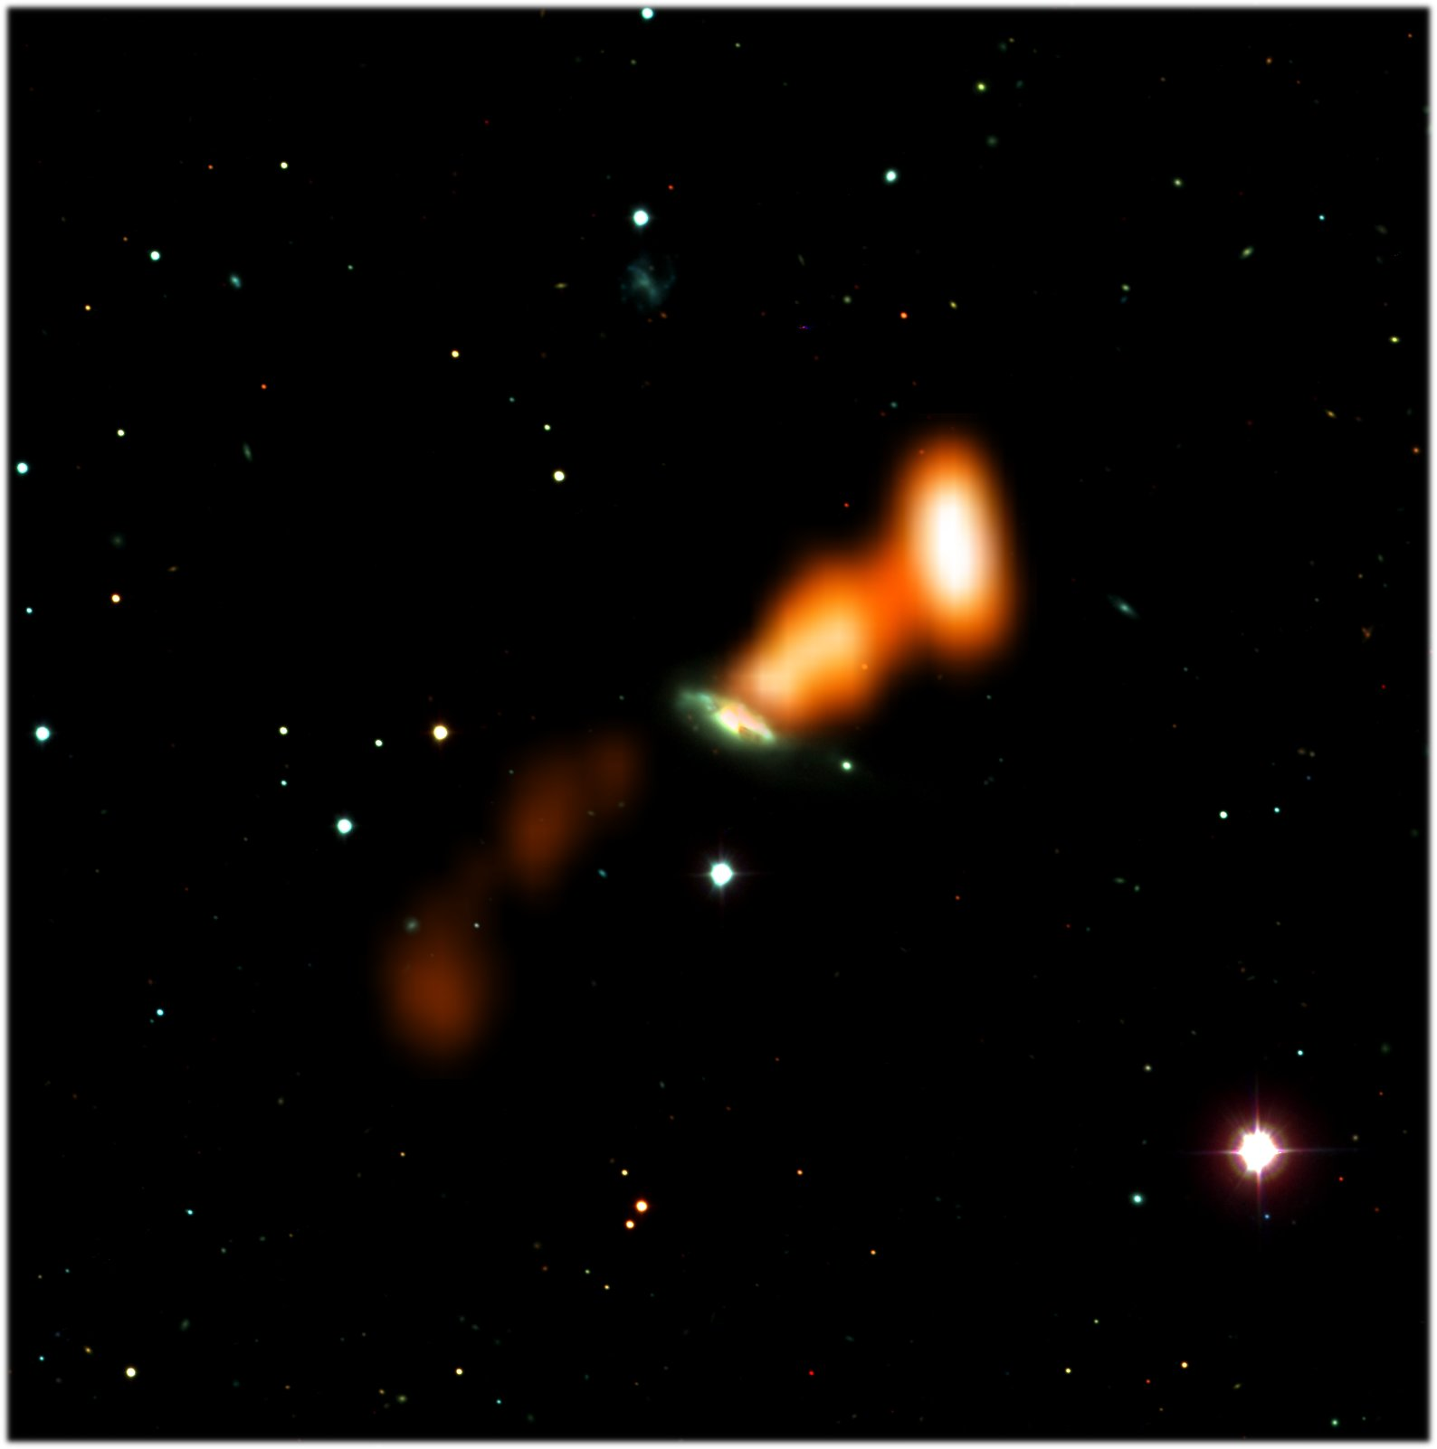
Evidence for jet-driven outflows: 3C293 in 3D
Elizabeth Mahony (ASTRON, the Netherlands Institute for Radio Astronomy)
Raffaella Morganti (ASTRON, Univ. of Groningen), Raymond Oonk (ASTRON), Tom Oosterloo (ASTRON, Univ. of Groningen), Bjorn Emonts (CAB, Madrid) + Clive Tadhunter (Sheffield)

Slide 2
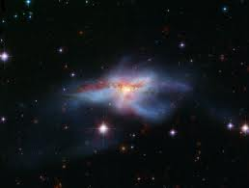
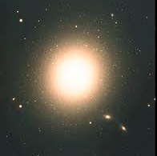
Motivation: feedback
Important for galaxy formation + evolution
  Need to get rid of the gas to stop stars forming
  Simulations can do this, only by introducing feedback
Notes:
Important for galaxy formation + evolution
Simulations require feedback processes to quench star formation in galaxies so we end up with red and dead ellipticals at z=0
We are focused on feedback processes within the host galaxy – i.e. interaction between the radio jets and the ISM of the galaxy

Slide 3
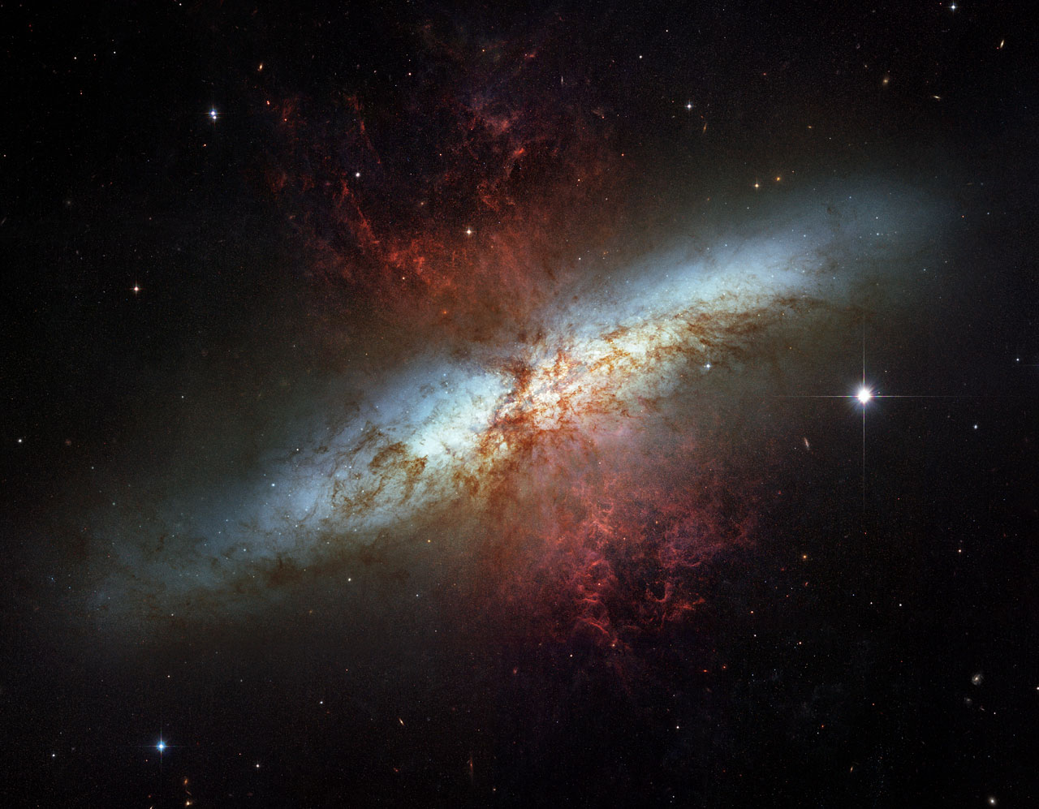
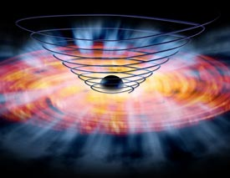
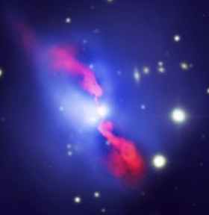
Motivation: feedback
Gas outflows driven by:
  Starburst driven wind
  Accretion disc wind
  Radio jets
Notes:
Many observational examples of feedback – etc. driven by SF, QSO
For today I’m going to focus on the radio driven outflows

Slide 4
Introducing 3C293
z=0.045
M_{BH}=10⁸ M (Wu 2009)
Eddington ratio - 0.017 (Wu 2009)
P(1.4 GHz)=2x10²⁵ W/Hz
Restarted radio galaxy
core
Notes:
z=0.045
M_{BH}=10⁸ M (Wu 2009)
Eddington ratio - 0.017 (Wu 2009)
P(1.4 GHz)=2x10²⁵ W/Hz
Restarted radio galaxy

Slide 5
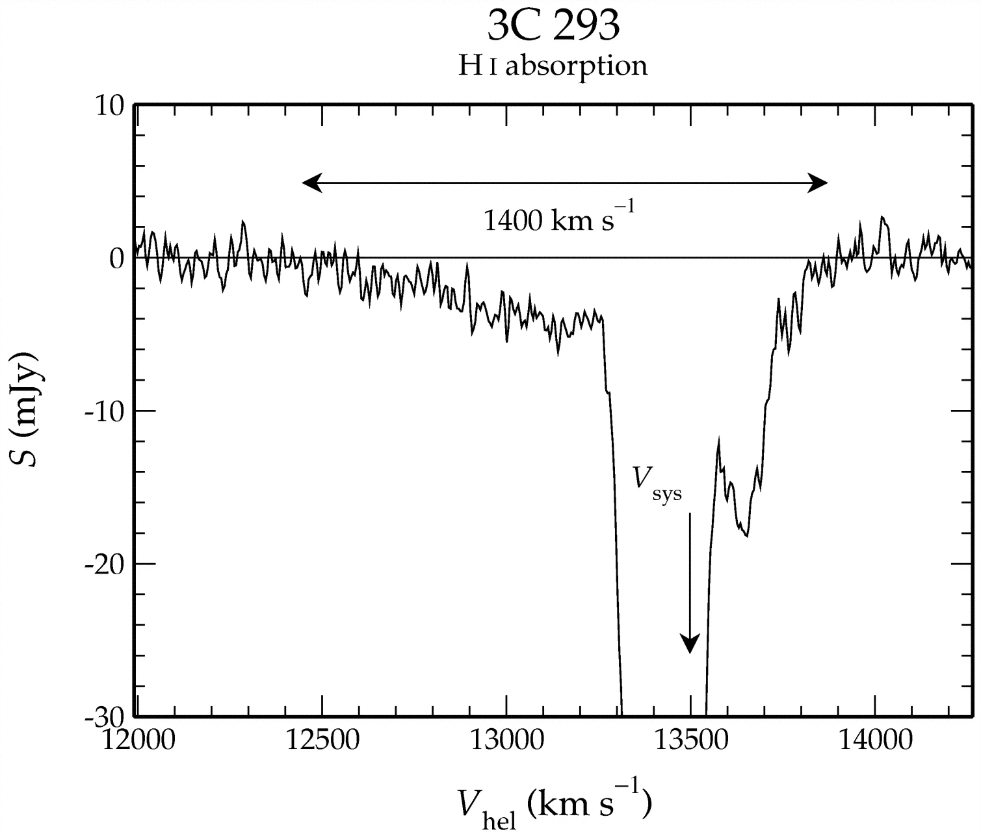
Introducing 3C293
z=0.045
M_{BH}=10⁸ M (Wu 2009)
Eddington ratio - 0.017 (Wu 2009)
P(1.4 GHz)=2x10²⁵ W/Hz
Restarted radio galaxy
Morganti et al., 2003
core
Notes:
z=0.045
M_{BH}=10⁸ M (Wu 2009)
Eddington ratio - 0.017 (Wu 2009)
P(1.4 GHz)=2x10²⁵ W/Hz
Restarted radio galaxy

Slide 6
3C293 - observations
Mahony et al., 2013
JVLA A-array
  Wide bandwidth allows us to detect very broad features
  Fast outflows (~1200 km/s) of neutral hydrogen are detected coming from the western inner lobe
~0.5 kpc
Notes:
Spatial resolution – 1arcsec
Spectral resolution- 14 km/s

Slide 7
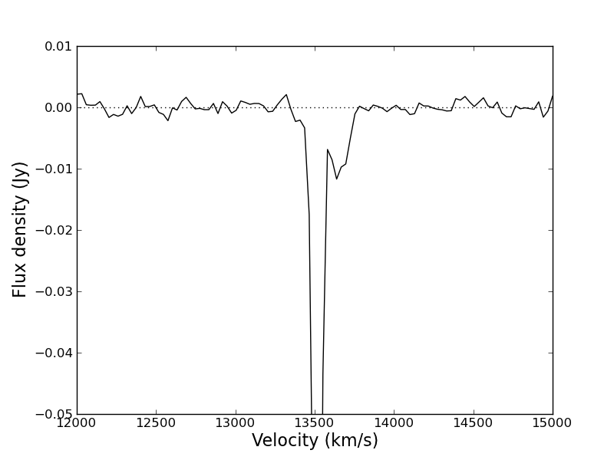
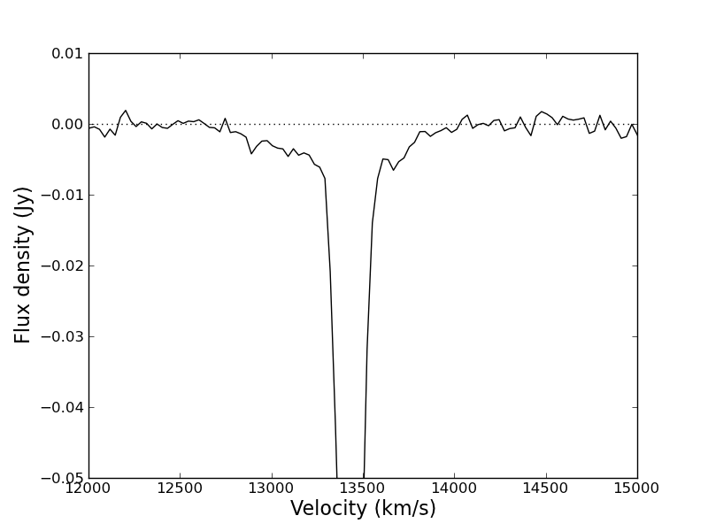
3C293 - observations
~1200 km/s
Outflow rate:
Ṁ ~ 8 - 50 M/yr
-> 0.01 – 0.08% L_{edd}
EVLA continuum image
Notes:
Don’t resolve the core from western jet – but the optical depth would be very high if in front of the core.

Slide 8
3C293 - observations
~1200 km/s
Outflow rate:
Ṁ ~ 8 - 50 M/yr
EVLA continuum image

Slide 9
What about other gas phases?
Looked for evidence of outflows in ionised gas
  OASIS IFU on WHT
  1.5 hrs in 2 grisms:
    MR661 (6210 – 7010 Å)
      Ha/[NII] lines (+ [OI])
    MR735 (6940 – 7760 Å)
      [SII] lines
    resolution 2.13/2.16 Å
1”

Slide 10
Ha/[NII] lines

Slide 11
[SII] lines

Slide 12
How does the ionised gas compare with the HI?
~1500 km/s

Slide 13
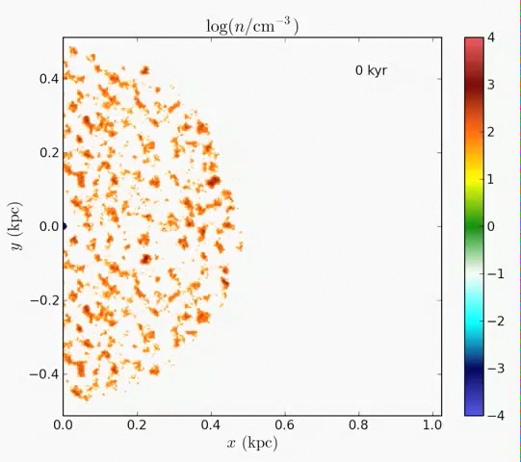
How are these outflows generated?
Entrainment of material by the jet?
Wagner et al., 2011
Notes:
Shocks would most likely ionise the medium
FIX VIDEO

Slide 14
Conclusions
Fast outflows of neutral hydrogen are detected coming from the western inner radio lobe of the nearby galaxy 3C293
  Suggestive of jet-ISM interaction on scales of 0.5 kpc from the core
Outflow rate ~ 8 - 50 M/yr = 0.01-0.08% of L_{edd}
Fast outflows of ionised gas detected along the radio jet axis (both east and western)

Slide 15
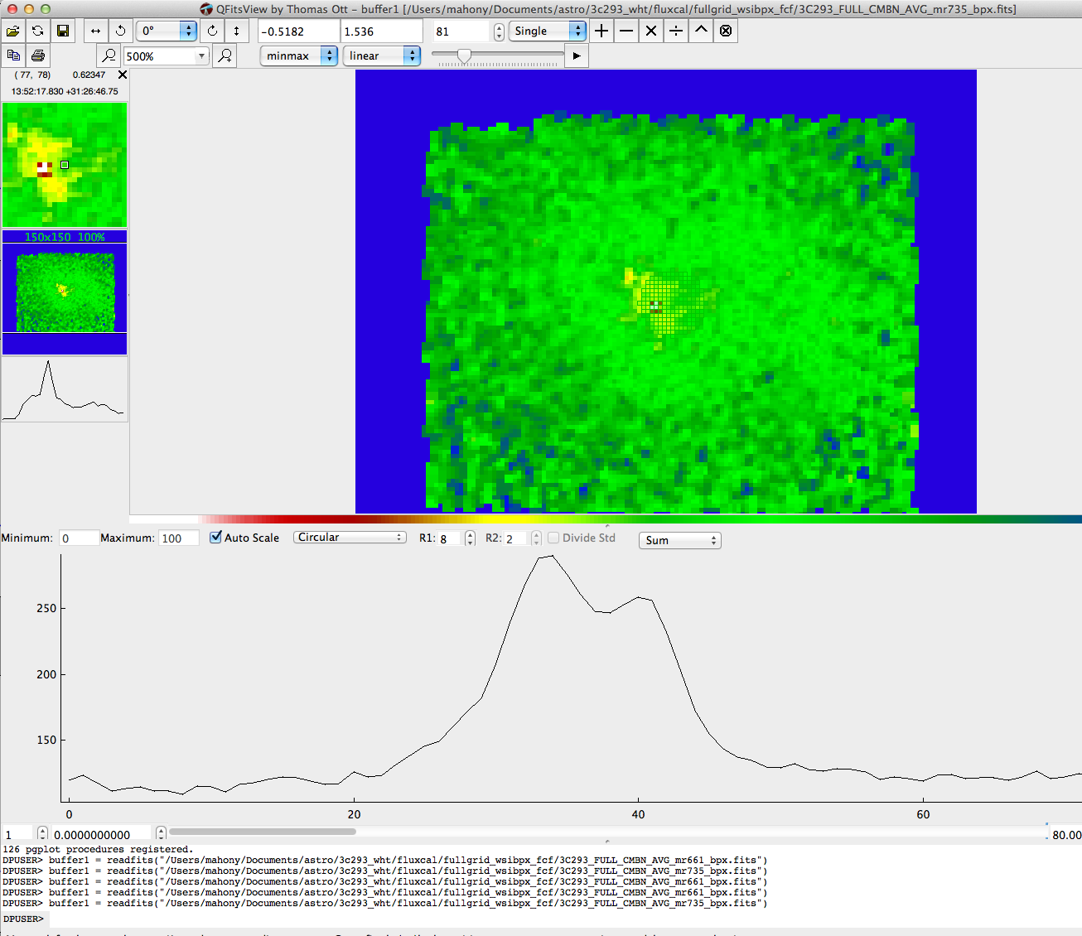

Slide 17
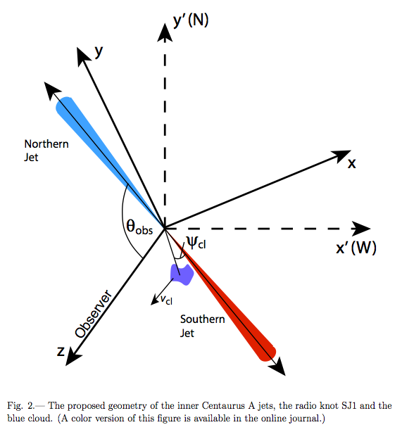
How are these outflows generated?
Or perhaps HI cloud kicked by the jet?
Bicknell et al., 2013

Slide 18

3C293 Outflow rates
Outflow rate of HI in 3C293: M_{dot}~ 8 - 50 M/yr
  For comparison, SFR is ~ 4 M/yr (Papadopoulos+ 2010)
Energy loss rate: E_{dot}= 1.38 × 10⁴² - 1 × 10⁴³ erg/s ~ 0.01 – 0.08% of L_{edd}
2-phase model of Hopkins+Elvis (2010) needs about 0.5% L_{edd} driven out in outflows
Notes:
Optical depth = 0.006
Nh=6.6x10^21 (using Tspin=1000K)
SFR in this galaxy is only about 4Mo/yr
although Hopkins & Elvis (2010) only needs 0.5%.
Most simulations need 5-10% of L_{bol} in outflows.

Slide 19
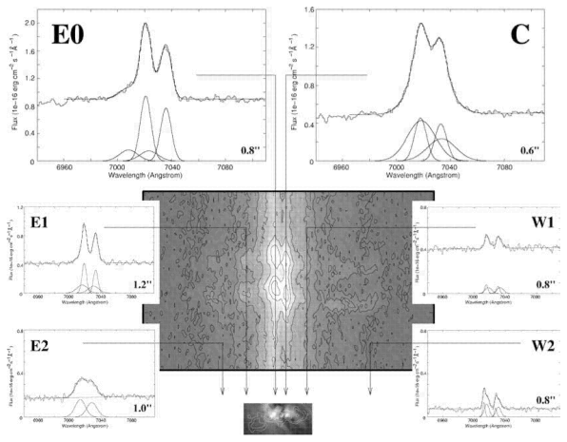
Outflows of ionised gas in 3C293
Emonts et al., 2005

