Slide 1
Dissecting ram-pressure stripping through integral-field spectroscopy of cluster spirals Chris Haines (Universidad de Chile) Paula Merluzzi, Gianni Busarello, Amata Mercurio (Naples), Nobuhiro Okabe (IPMU), Luis Campusano (U.Chile)
ESO: Dissecting Galaxies Near and Far, 26th March 2015

Slide 2
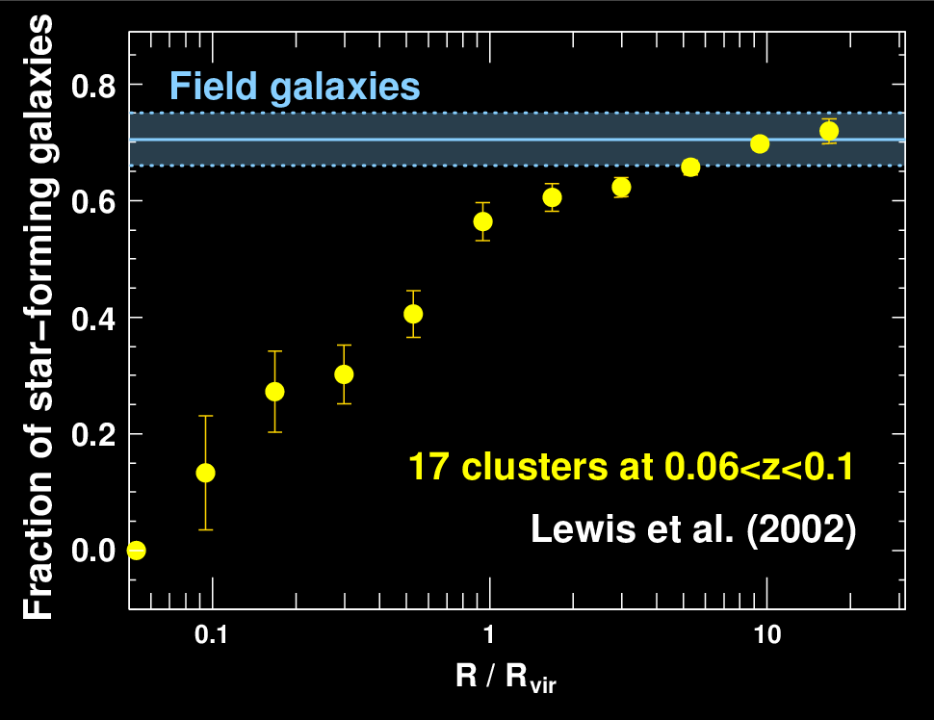
Introduction: The SF-density relation
The ability of galaxies to continue forming stars is well known to strongly depend on their local environment
While isolated field galaxies are mostly star-forming, almost all galaxies in the cores of rich clusters are now passively-evolving
Mechanisms such as ram-pressure stripping, starvation, harassment, tidal interactions, pre-processing have been proposed to remove gas and quench star formation in cluster galaxies (e.g. Boselli & Gavazzi 2006)

Slide 3
Impact as the galaxy is accreted into a massive cluster
Hot intra-cluster medium
GALAXY FALLS INTO CLUSTER
AND PASSES THROUGH ICM

Slide 4
Impact as the galaxy is accreted into a massive cluster
Hot intra-cluster medium
Loosely bound hot gas halo may be easily stripped, preventing cold gas disk from being replenished - STARVATION
GALAXY FALLS INTO CLUSTER
AND PASSES THROUGH ICM

Slide 5
Impact as the galaxy is accreted into a massive cluster
Hot intra-cluster medium
Cold gas reservoir is progressively stripped from the outside-in by ram-pressure produced by passage of the galaxy through the ICM
GALAXY FALLS INTO CLUSTER
AND PASSES THROUGH ICM
P_{ram}=ρ_{ICM} v²_{ICM} > 2πGΣ_{star}Σ_{gas}

Slide 6
Impact as the galaxy is accreted into a massive cluster
Hot intra-cluster medium
Star-formation is quenched, leaving a
passively-evolving cluster galaxy
GALAXY FALLS INTO CLUSTER
AND PASSES THROUGH ICM

Slide 7
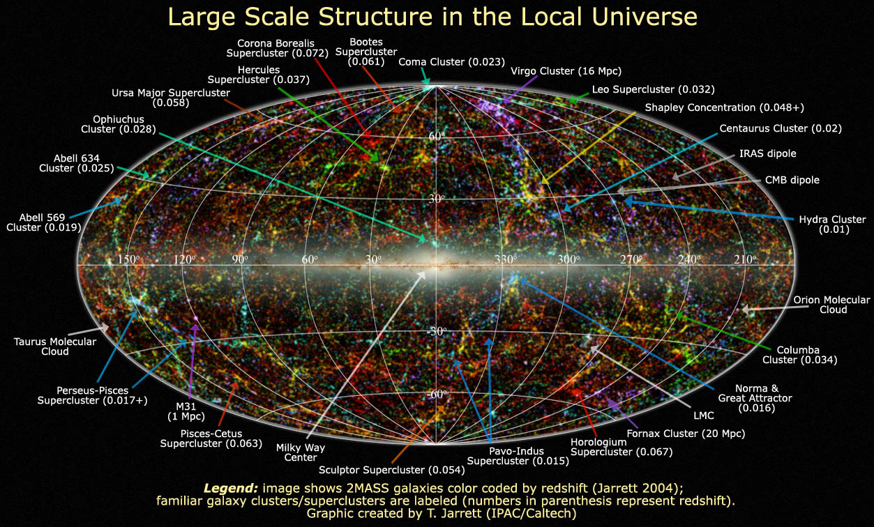
The Shapley supercluster
Shapley supercluster
The Shapley supercluster at z=0.048 is the most massive concentration of matter in the local Universe

Slide 8
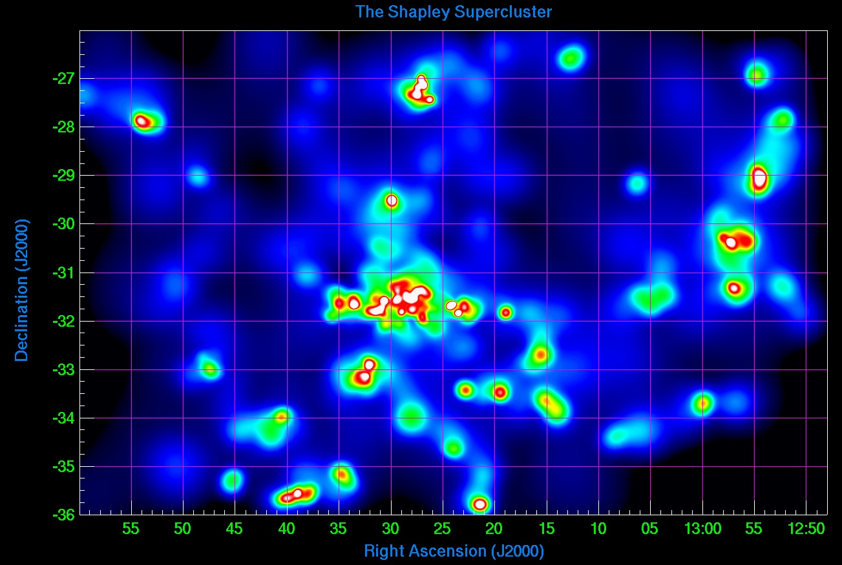
The full extent of the Shapley supercluster
A3558
K-band luminosity density of 0.04<z<0.06 galaxies with redshifts from 6dFGRS, Quintana et al. 2000, Drinkwater et al. 2004, Proust et al. 2006

Slide 9
The full extent of the Shapley supercluster
A3577
A1736
A3559
A3528
A3562
A3558
A3532
A3530
A3556
A3552
A3572
SC1329
SC1327
AS0724
RX J1252
A3560
AS0726
A3568
A3566
AS731
A3554
AS0718
A3564
AS0729
A3542
25 Abell clusters at z~0.05 over a 15x10 deg² region, centred on Abell 3558 (z=0.048, richness class 4)

Slide 10
The Shapley supercluster core
A3577
A1736
A3559
A3528
A3562
A3558
A3532
A3530
A3556
A3552
A3572
SC1329
SC1327
AS0724
RX J1252
A3560
AS0726
A3568
A3566
AS731
A3554
AS0718
A3564
AS0729
A3542
The supercluster core contains multiple cluster-mergers and galaxies infalling at ~2000 km/s (Reisenegger et al. 2000), an environment where infalling spirals will encounter extremely strong ram pressures

Slide 11
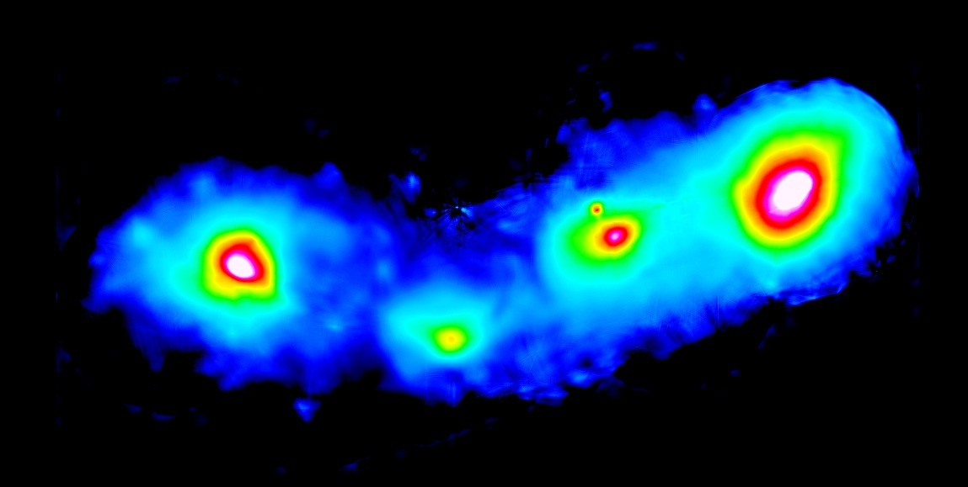
X-ray view of the Shapley supercluster core
Mosaic of 12 XMM images
r₅₀₀
1 Mpc
Abell 3558
Abell 3562
SC 1327-312
SC 1329-313

Slide 12
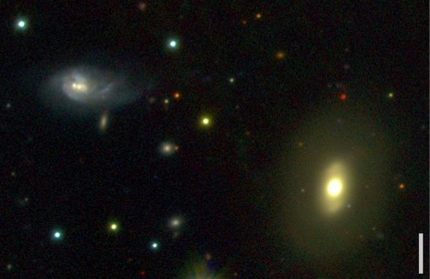
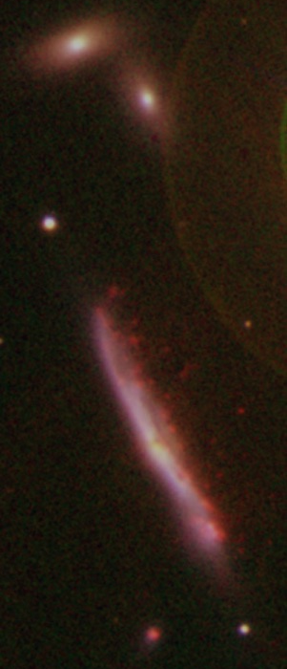
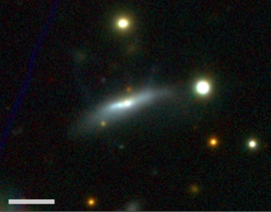
Three spiral galaxies interacting with the SSC environment
Detailed IFU and Hα imaging study of ~L* spirals in SSC
r₅₀₀
1 Mpc
7x10¹⁰M
1x10¹⁰M
2x10¹⁰M

Slide 13
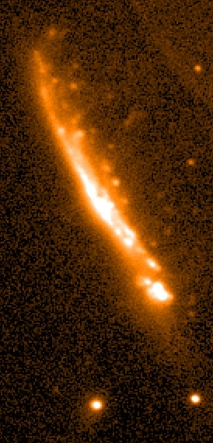
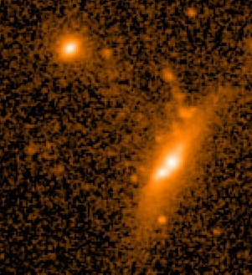
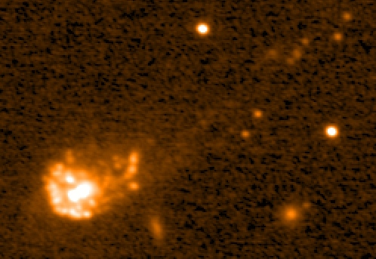
Extra-planar Hα emission from ram-pressure stripped gas
Hα imaging using MMTF tunable filter on 6.5m Magellan telescope
reveals several “jellyfish” galaxies!
r₅₀₀
1 Mpc
7x10¹⁰M
50 kpc
SB
SB
1x10¹⁰M
2x10¹⁰M
SB

Slide 14
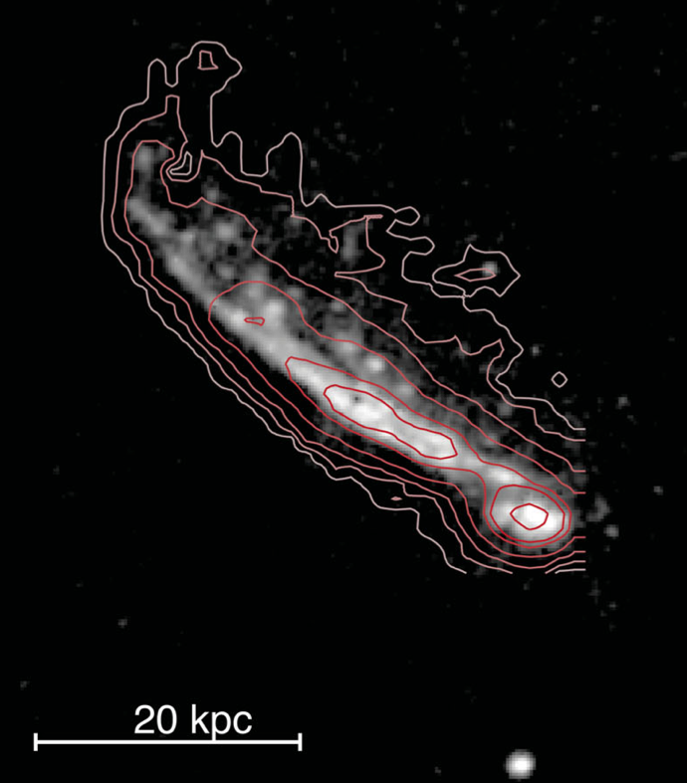
IFU spectroscopy with WiFeS on 2.3m ANU telescope
Wide Field Spectrograph:
25’’x38’’ IFU, 25 slices, 1”x1” pixels
3600-9000Å, σ_{inst}=40 km/s, t_{exp}=4.5 hours
r₅₀₀
Hα emission
7x10¹⁰M
One-sided extra-planar ionized gas along full extent of disk, out to 13 kpc
SB
SB

Slide 15
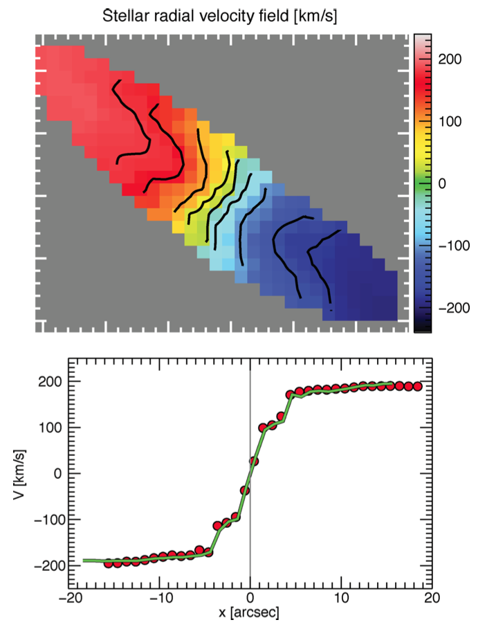
Stellar kinematics
Wide Field Spectrograph:
25’’x38’’ IFU, 25 slices, 1”x1” pixels
3600-9000Å, σ_{inst}=40 km/s, t_{exp}=4.5 hours
r₅₀₀
Stellar velocity map is regular and symmetric, with some twisting indicative of a bar. No signs of perturbation from tidal interactions
7x10¹⁰M
SB
SB

Slide 16
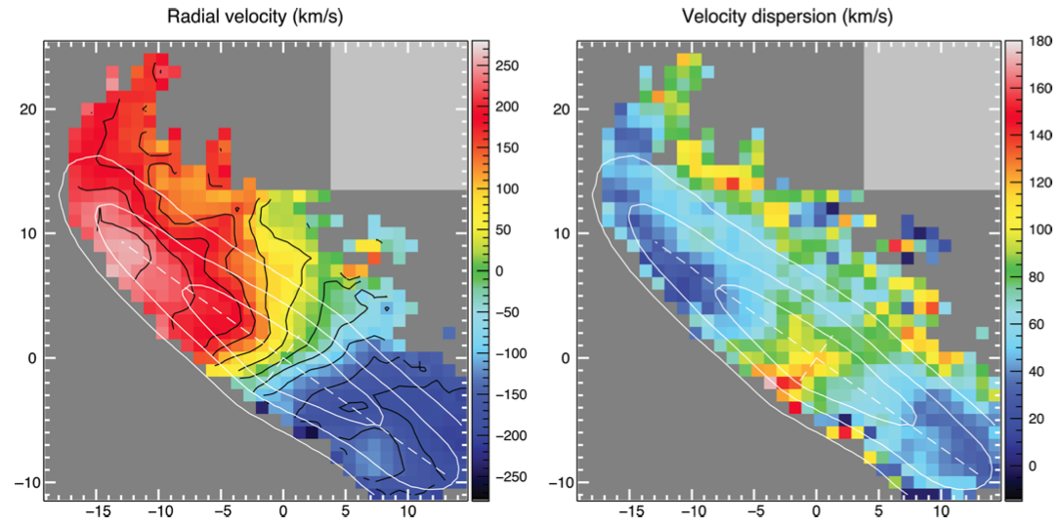
Gas kinematics
Highest velocity dispersions seen in extra-planar gas suggesting turbulent flow, while within galaxy gas appears as rotating disk
r₅₀₀
7x10¹⁰M
SB
Is the gas being compressed on leading edge by ram pressure?
SB

Slide 17
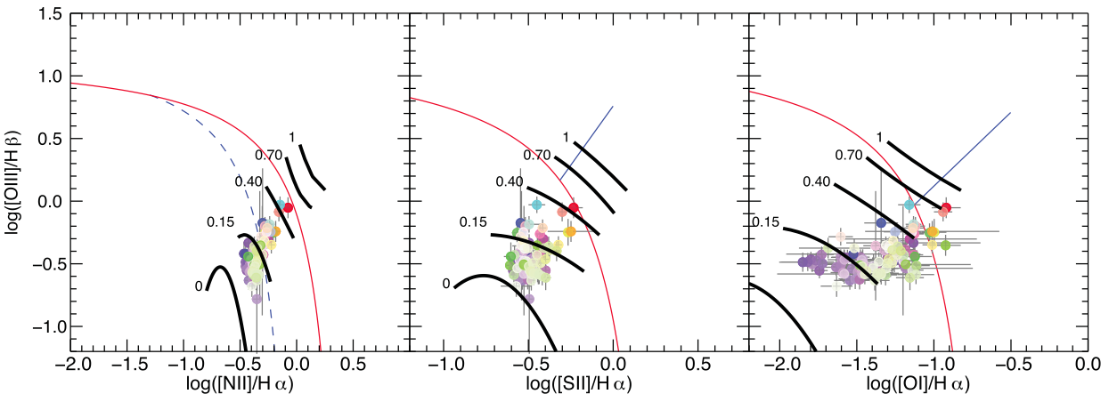
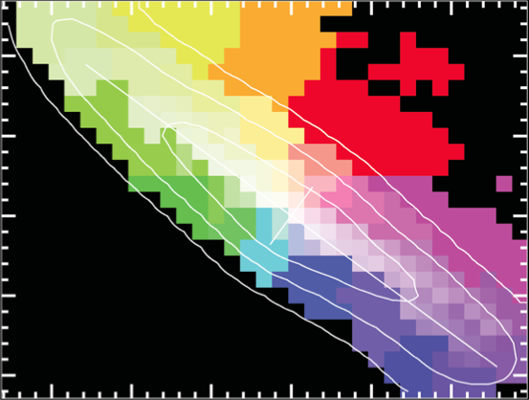
Shock excited or photoionized gas
Kewley et al. model limits for HII regions
Fraction of Hα from
100-200 km/s shocks
r₅₀₀
Stellar velocity map is regular and symmetric, with some twisting indicative of a bar. No signs of perturbation from tidal interactions
7x10¹⁰M
SB
SB
Colour coding for points

Slide 18
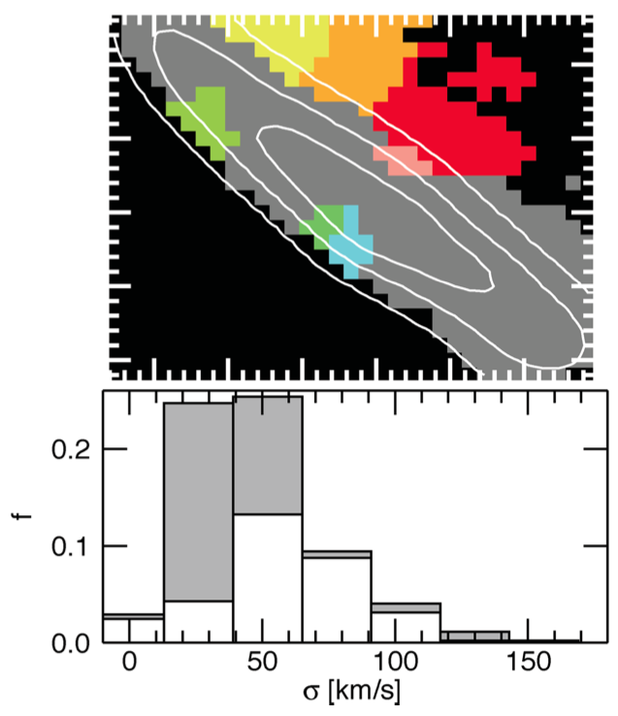
Shock excited or photoionized gas
Kewley et al. model limits for HII regions
Fraction of Hα from
100-200 km/s shocks
r₅₀₀
Stellar velocity map is regular and symmetric, with some twisting indicative of a bar. No signs of perturbation from tidal interactions
Regions of galaxy where >50% of Hα emission is due to shock-ionized gas also have higher velocity dispersions
Ram-pressure compresses and strips gas, forming tail of turbulent, shock-ionized gas and dust
7x10¹⁰M
SB
SB

Slide 19
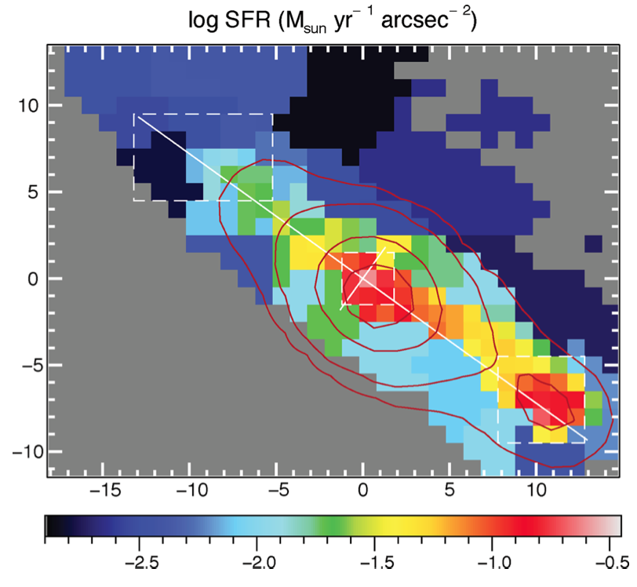
Star formation and quenching
Localized star bursts in the nucleus and the leading edge of the galaxy, triggered as gas compressed by ram pressure. Global SFR~8 M yr⁻¹, galaxy lies on the main star-formation sequence
r₅₀₀
7x10¹⁰M
SB
SB

Slide 20
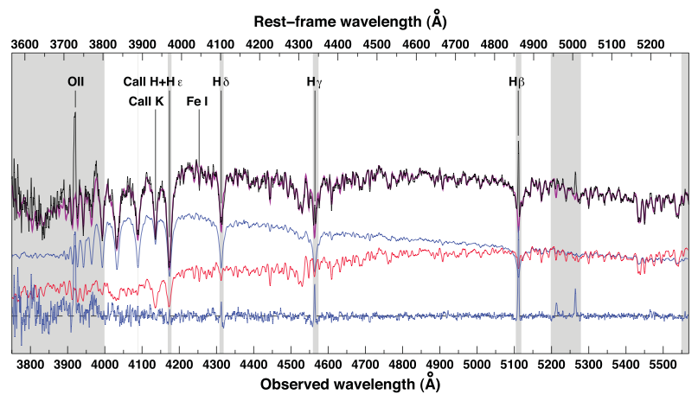
Star formation and quenching
Post-starburst signatures in integrated spectrum from trailing edge of galaxy. Star formation is being quenched as gas is removed
r₅₀₀
7x10¹⁰M
SB
SB

Slide 21
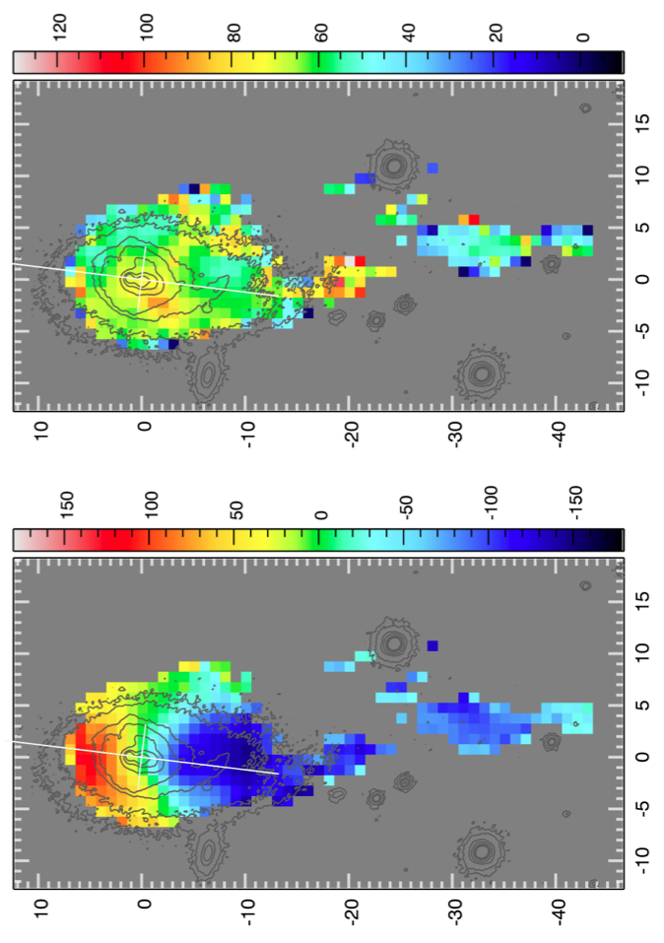
IFU spectroscopy of a jellyfish galaxy
r₅₀₀
Velocity dispersion (km/s)
Radial velocity (km/s)
50 kpc
SB

Slide 22
Summary
Hα imaging and IFU spectroscopy can identify “jellyfish” galaxies with trails of gas being removed by ram-pressure stripping, provide details of the gas properties (e.g. shock-heating), while at the same time characterise the impact on star formation in the galaxies, revealing both starbursts and quenching (Merluzzi et al. 2013, MNRAS, 429, 1747)
Ram pressure can be effective at removing gas from the most massive spirals even out at r₅₀₀ (1Mpc from cluster cores)
MUSE can provide much higher resolution IFU spectroscopy, allowing ram-pressure stripped galaxies to be studied at z~0.2-0.5.

