Slide 1
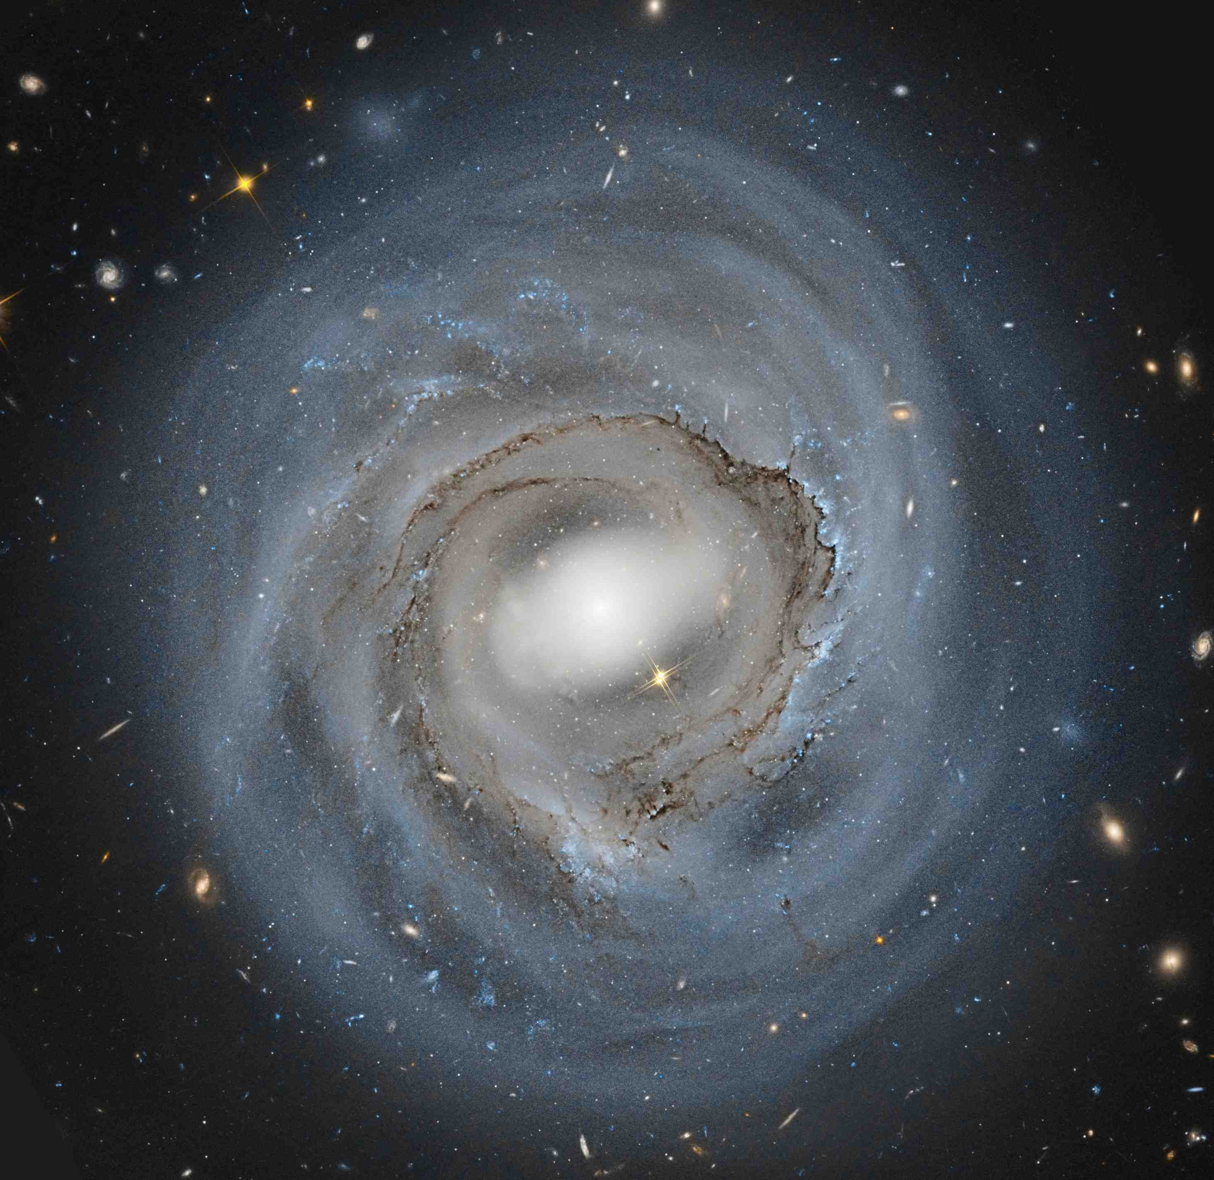
Strong ram pressure stripping in the Coma cluster galaxy NGC 4921 : dense cloud decoupling & evidence for magnetic binding in the ISM
Jeff Kenney (Yale)
Anne Abramson
Hector Bravo-Alfaro
Jacqueline van Gorkom

Slide 2
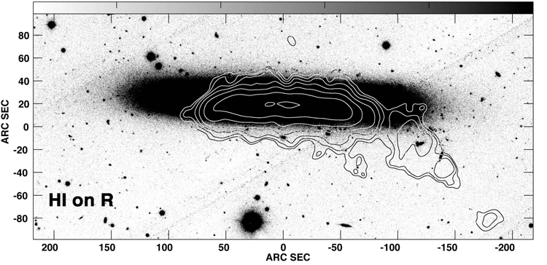
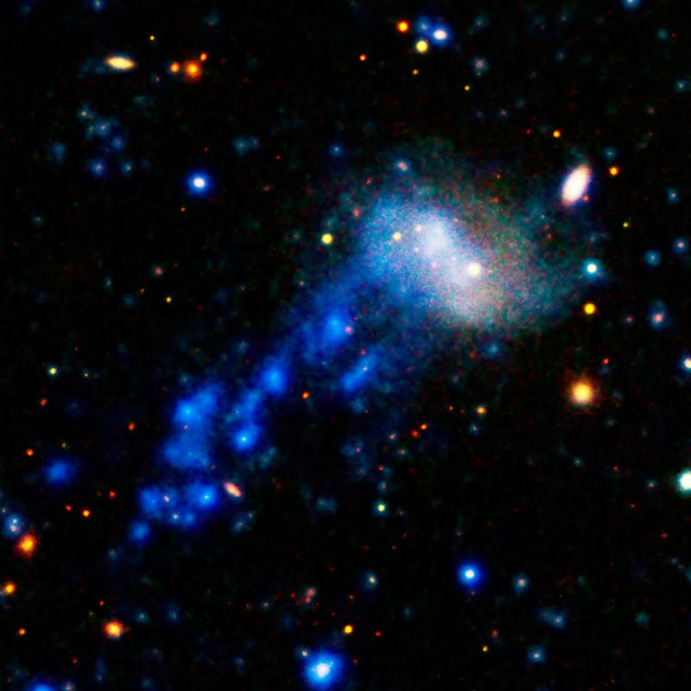
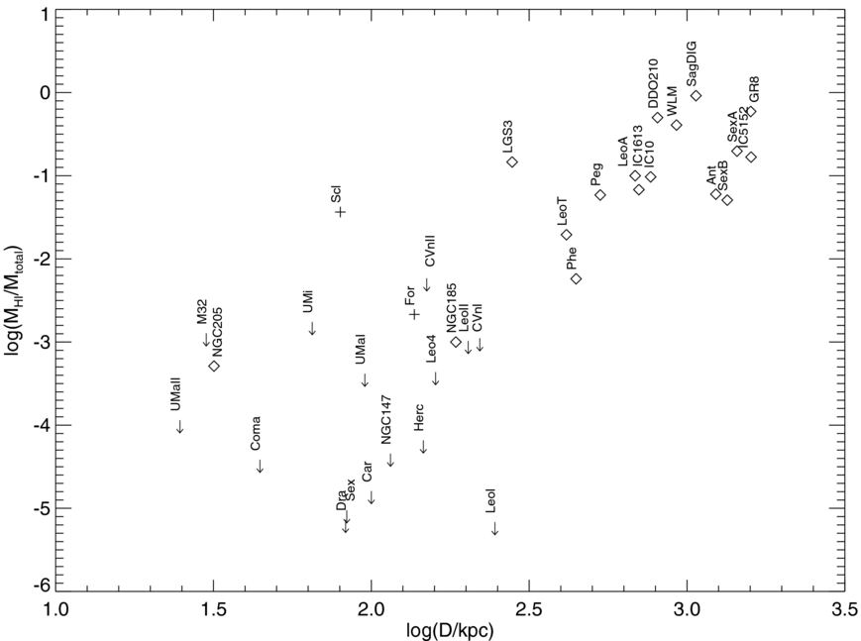
Ram Pressure Stripping does these things:
partially strips large spirals in Virgo-like clusters (M~10¹⁴ M_{sun})
~completely strips dwarf galaxies in Virgo-like clusters
~completely strips massive galaxies in Coma-like clusters (M~10¹⁵ M_{sun})
~completely strips (small) dwarf satellite galaxies close enough to their (large) host galaxy
must be important starvation mechanism in high and medium density environments-- gas removed from outer galaxy or halo by r.p. will not settle to inner disk & form stars
HI in local
group
M(HI)/M(tot)
R ->
Notes:
Rps is major driver of galaxy evolution & transformation.
I will talk about 2 galaxies today

Slide 3
RPS partially strips large spirals in Virgo (M~10¹⁴ M_{sun})
NGC 4330
Abramson+11
Truncated gas disks with normal stellar disks;
one-sided extraplanar gas features; outside-in gas removal
RPS is dominant SF quenching mechanism for large spirals in Virgo but large spirals not completely stripped

Slide 4
RPS completely strips dwarf galaxies in Virgo (M~10¹⁴ M_{sun})
Virgo Dwarf IC3418: “Smoking Gun” example of
dI -> dE Transformation by Ram Pressure Stripping
Kenney+14
IC 3418
UV (GALEX)
+ OPTICAL
No gas or star formation
in main body:
SF quenched 300 Myr ago
1-sided tail of
gas (HI, Hα) & young stars
with “fireball”
morphology
Chung+09; Hester+10; Fumagalli+11; Kenney+14

Slide 5
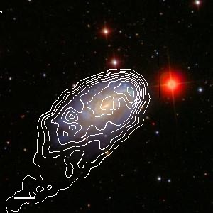
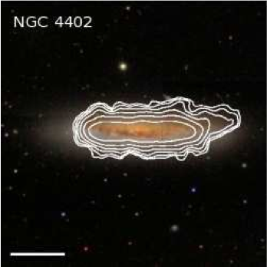
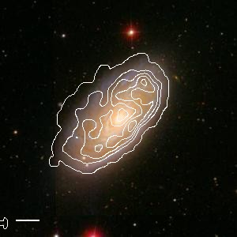
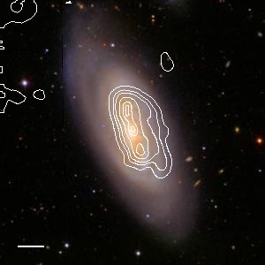
RPS completely strips massive galaxies in Coma (M~10¹⁵ M_{sun}) Peak ram pressure ~100x stronger in Coma than Virgo
Coma
Virgo
Hα on optical
Hα
Yagi+10
HΙ on optical
Abramson+11
Chung+09
Truncated gas disks & normal stellar disks
& one-sided extraplanar gas features

Slide 6
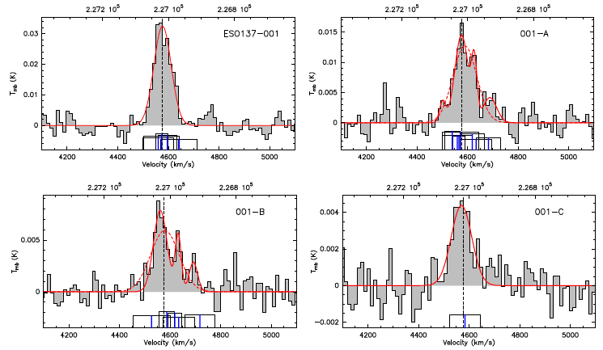
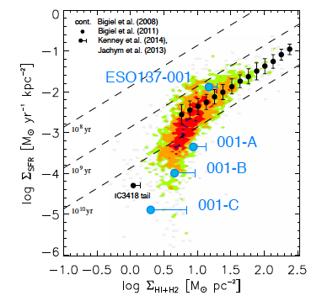
CO in Stripped Gas Tail of ESO137-001 (Norma Cluster M~10¹⁵ M_{sun})
CO(2-1)
Tail has:
~10⁹ M_{sun} hot gas (X-Ray)
~10⁹ M_{sun} cold gas (CO)
Low SFE
Color: HST optical
Blue: Chandra X-Ray (Sun+10)
Circles: APEX CO(2-1) (Jachym+14)

Slide 7
RPS ~completely strips (small) dwarf satellite galaxies close enough to their (large) host galaxy Local Group Dwarfs: HI content vs. distance from MW or M31
~All dwarfs D>300 kpc are gas-rich
~All dwarfs D<300 kpc are gas-poor
log M_{HI}/M_{tot}
Similar effect seen in SDSS
dwarf satellites:
Quenched dwarfs are only
near massive host
(Geha 2012)
Grcevich+09
log D(kpc)
Dwarfs get their gas r.p.stripped by the gaseous halo of their host galaxy just as spirals get their gas r.p.stripped by the gaseous halo of their host cluster
BUT: is ram pressure strong enough to do this? (Nichols & Bland-Hawthorn 2011)

Slide 8
Gunn & Gott (1972) criterion for rps
ram pressure which will push the ISM gas if:
ρ_{ICM}v² > Σ_{ISM} dΦ/dz
Ram pressure
Gravitational
Restoring force
(per area)
Efficiency of rps relative to GG72 depends on:
Duration of ram pressure
Disk-wind angle
Galaxy rotation
Shielding of disk gas from halo gas
ISM substructure
Magnetic fields
Explored by several papers
Not well understood but
can be studied in NGC 4921

Slide 9
Center of Coma cluster
Most massive spiral galaxy in Coma
M_{V} = -22
at R = 0.35R_{vir} = 700 kpc
NGC 4889
NGC 4874
Center of cluster
NGC 4921
NGC 4911
Optical Image: Dean Rowe

Slide 10
Stripping the most massive Coma spiral
NGC 4921
HST VI
Clearest view of
effects of strong
ram pressure
on dense ISM
in spiral disk
HST resolution
0.05” = 30 pc at
Coma (D=100 Mpc)
Deep image (17 hrs)
V (F606W) 62 ksec
I (F814W) 37 ksec
HST data obtained by K. Cook for Cepheid program Image by Roberto Colombari

Slide 11
HI gas (VLA)on HST image of NGC 4921
projected
wind direction
Kenney+15, submitted
HI disk is truncated & asymmetric; compressed in NW, extended in SE

Slide 12
“Dust front” in Coma spiral NGC 4921
Extends 90 deg
= 20 kpc
Kenney+2015
“Dust front” = Swept-up gas and dust along leading edge of ram pressure interaction

Slide 13
V-shaped & ~Linear head-tail filaments protruding from dust front
Proposed evolutionary sequence of dense cloud decoupling
young star complexes at heads
Dense gas clouds too dense to strip are decoupling from
lower density gas which is accelerated downstream by rp
BUT decoupling inhibited by magnetic(?) binding

Slide 14
C-shaped filaments along dust front & elsewhere in galaxy
Kenney+2015
~semi-circular features anchored one both sides by dense clouds;
similar PA throughout galaxy
Lower density gas pushed by ram pressure remains connected by magnetic fields(?) to decoupling higher density gas clouds

Slide 15
gas
young stars
No magnetic fields

Slide 16
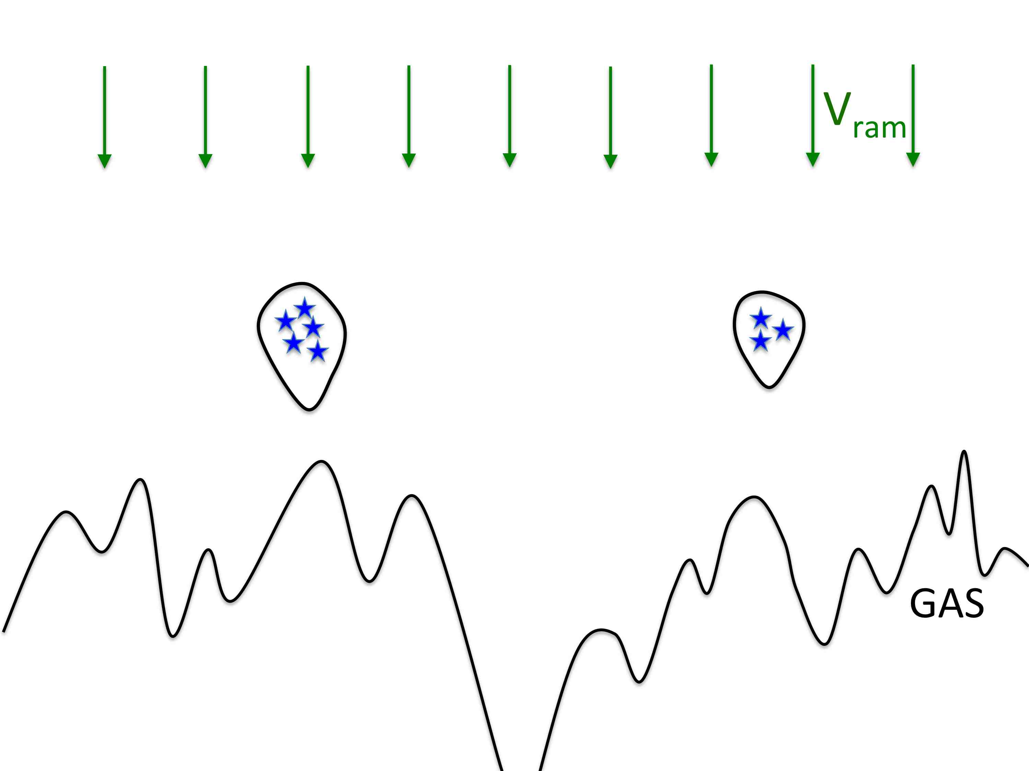
No magnetic fields

Slide 17
Wind impacting a fractal (multi-density) cloud
without magnetic fields
Fractal
cloud
before
wind
0.13 Myr after
start of wind
0.33 Myr
Cooper+2009
0.53 Myr
Leading edge of cloud
has irregular shape

Slide 18
Magnetic fields

Slide 19
V_{ram}
GAS
B

Slide 20
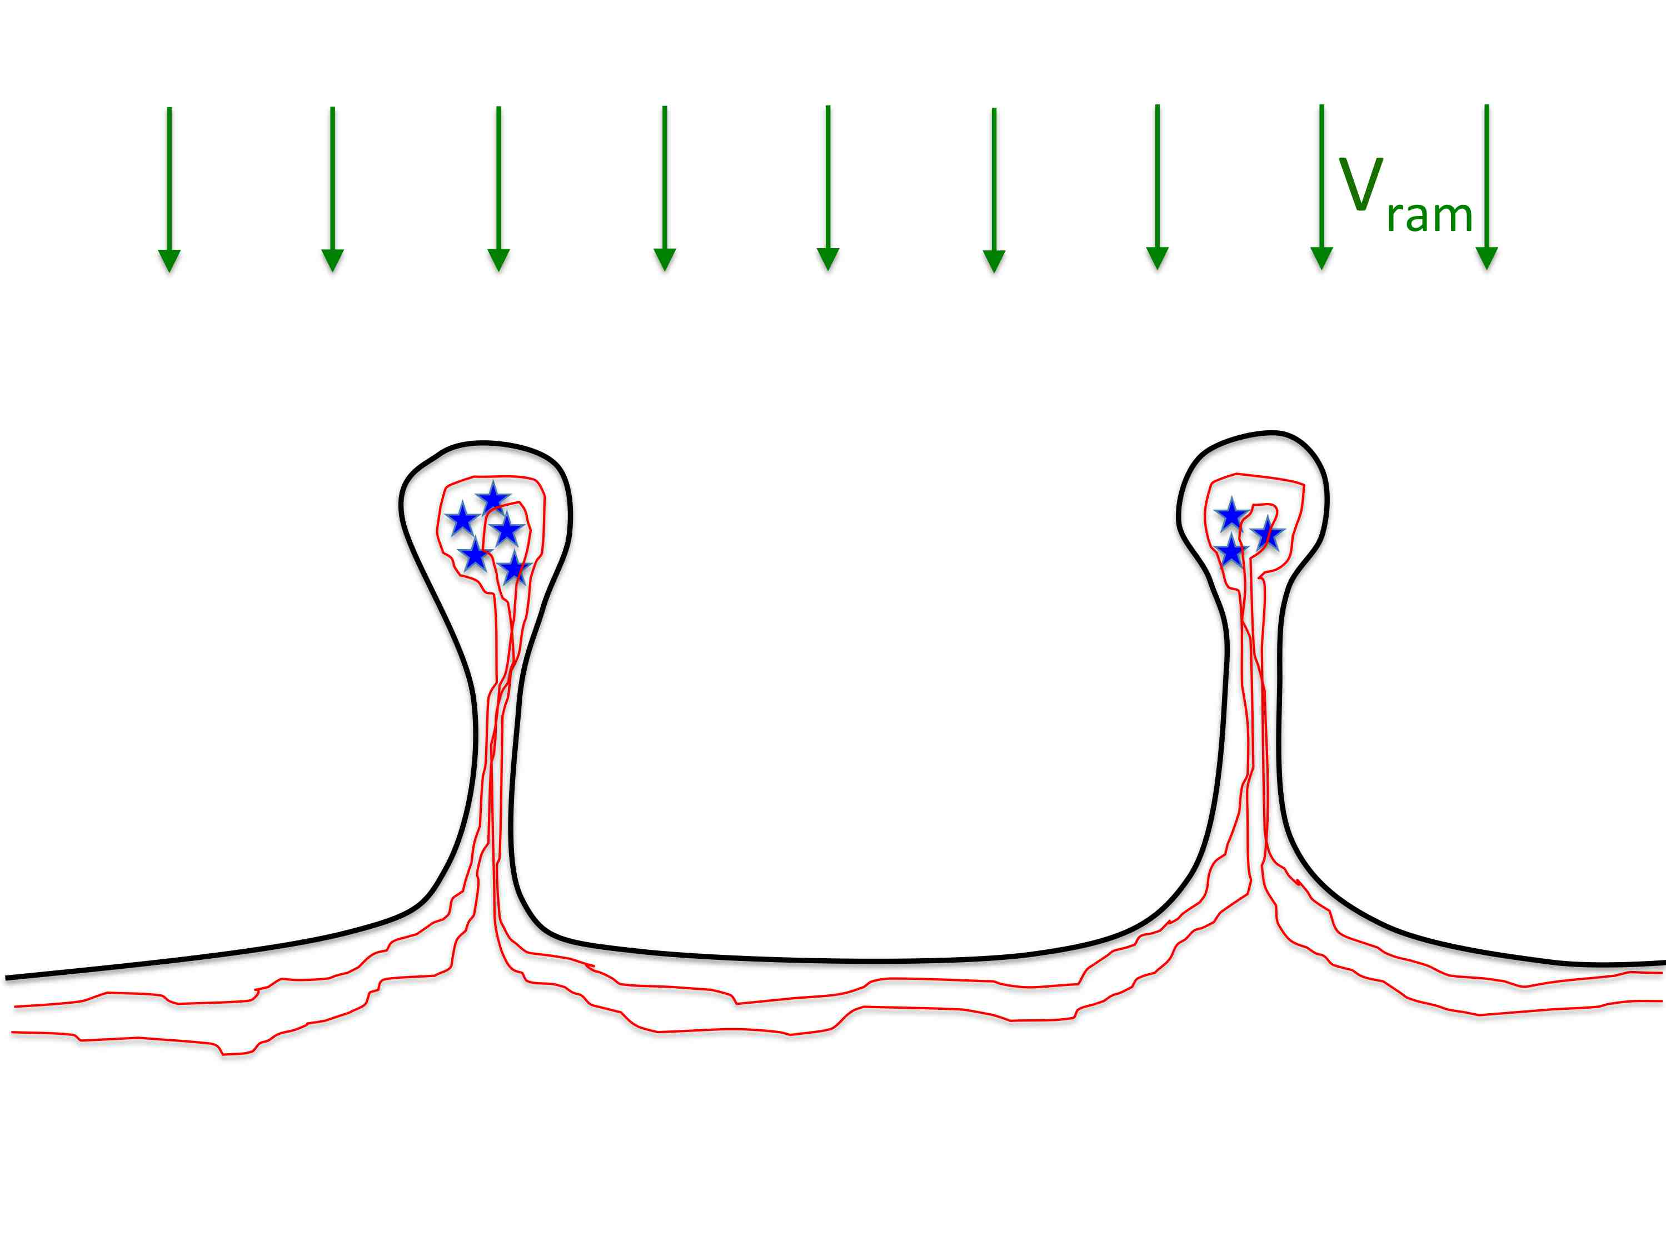

Slide 21
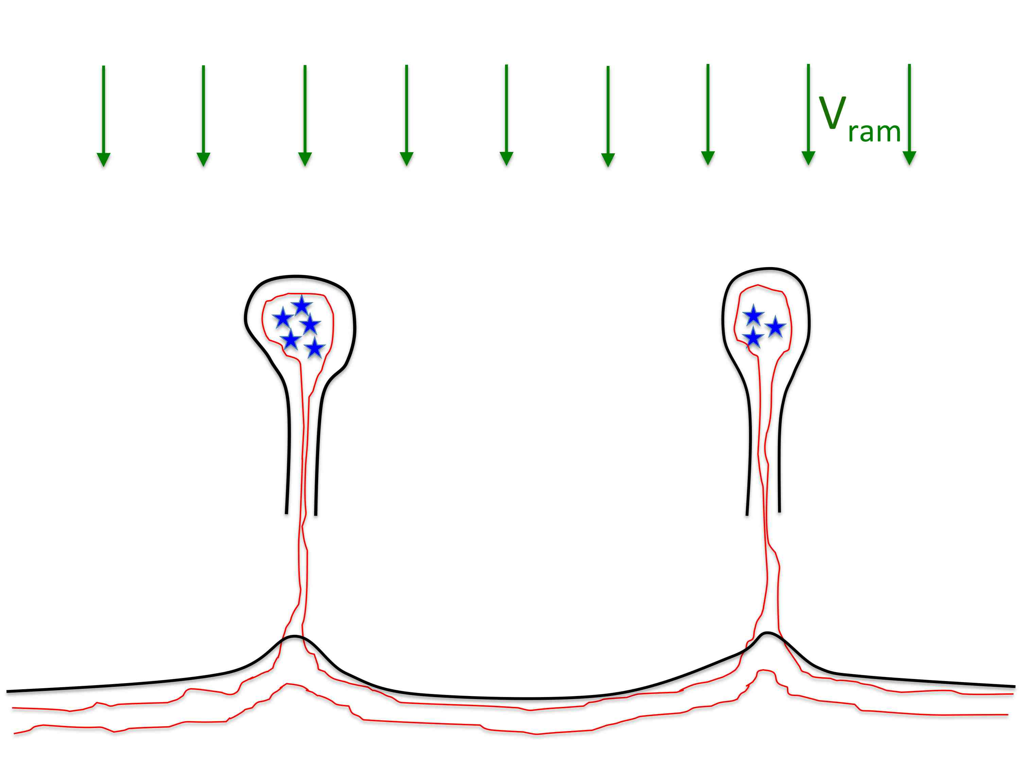

Slide 22
Virgo spiral NGC 4501
Chung+2009
HI on opt
Polarized radio 6cm
on HI
8um on 3um
Vollmer+2009
Ridge of strong radio polarization at leading edge
magnetic fields aligned with edge
r.p. compresses gas & magnetic fields
Notes:
I wasn’t looking for magnetic fields. I didn’t want magnetic fields. I’m not a magnetic field denier, but I have been a magnetic field avoider … like most of you. But I don’t see how to avoid them in this case.

Slide 23
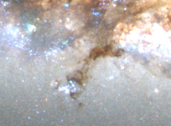
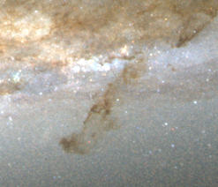
Decoupling dense clouds during rps
HST
Virgo spiral NGC 4402
Head-tail dust filaments:
Length ~ 1000 pc
Width ~ 100 pc
M_{gas} ~ 10⁷ M_{sun}
Abramson & Kenney 2014
Filament morphology not consistent with ablation or shadowing but is consistent with magnetic binding

Slide 24
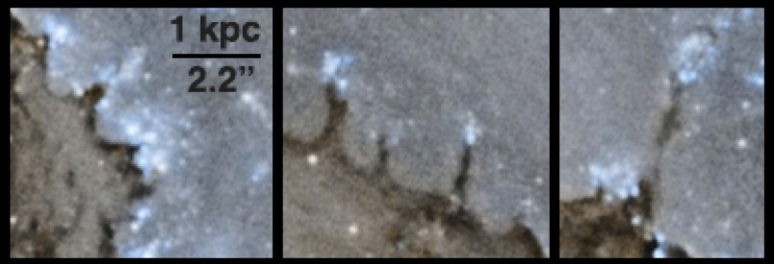
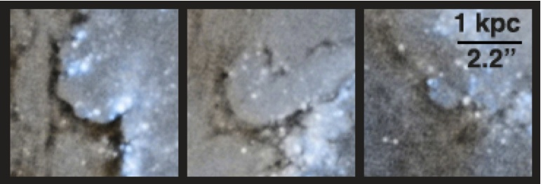
summary
The HST image of dust in the Coma spiral NGC 4921 clearly shows several effects of ram pressure on the disk ISM: dense cloud decoupling moderated by magnetic binding, far-side shielding, galaxy rotation, spiral arm resistance.
Successfully modeling these details will allow us to estimate the efficiency of r.p.s. and therefore its importance as a quenching mechanism throughout the universe.

Slide 26
A magnetic web links the ISM.
Normally we don't see it but a strong disturbance can reveal it.

Slide 27
Disturbed HI
Kinematics in N

Slide 28
Combined effects of ram pressure (with far side shielding) plus rotation create large azimuthal variations in ISM morphology

Slide 29
Increasing pressure side (S)
Strong & increasing ram pressure
due to rotation
Leading side (S)
Strong impact from r.p.
v_{rot}
v_{ram}
Trailing side (W)
Less impact from ram pressure
due to shielding
Decreasing pressure side (W)
Weak and decreasing r.p.
due to rotation

Slide 30
Trailing side (Weak)
Less impact from RP due to shielding
Most interarm gas unaffected
Some r.p. formations
Stripping through holes
Leading side (Strong)
Strong impact from RP
Continuous dust front wIth filamentary substructure
ICM wind perp to spiral arm

Slide 31
Increasing pressure side (Strong) Strong & increasing ram pressure due to rotation Interarm regions stripped → Stripping through holes ICM wind ~par to spiral arm
Decreasing pressure side (Weak)
Weak and decreasing r.p. due to rotation
Interarm gas pushed but not stripped
C-shaped filaments in Interarm regions

Slide 33
Peak ram pressure ~100x stronger in Coma than Virgo
Coma
Virgo
Hα
HΙ on optical
Abramson+11
Hα on optical
Yagi+10
Chung+09
Truncated gas disks & normal stellar disks
& one-sided extraplanar gas features

Slide 34
Stripping the most massive Coma spiral
Clearest view of
effects of strong
ram pressure
on dense ISM
in spiral disk
Hubble Space Telescope
Image obtained
by K. Cook for
Cepheid program

