Slide 1
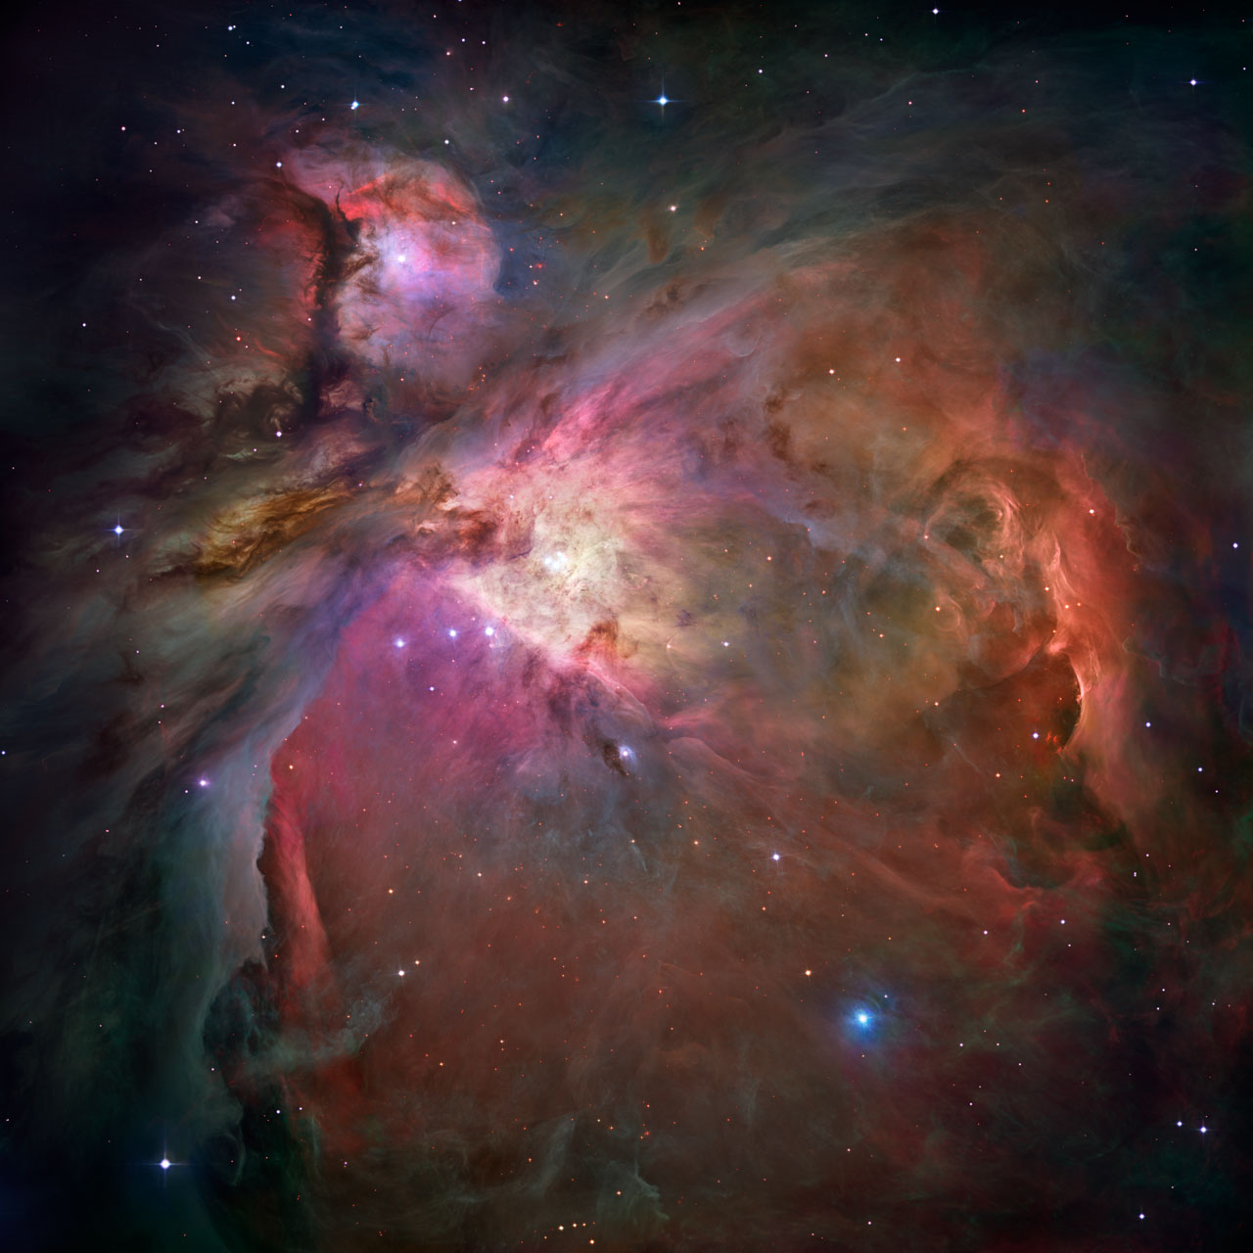
IZI: INFERRING METALLICITIES AND IONIZATION PARAMETERS WITH BAYESIAN STATISTICS
Guillermo A. Blanc
Universidad de Chile

Slide 2
OUTLINE
MEASURING ABUNDANCES IN IONIZED GAS
SEL METHOD SYSTEMATICS AND CHALLENGES
IZI: THE BAYESIAN APPROACH
THE ABUNDANCE SCALE DISCREPANCY
CONCLUSIONS

Slide 3



In collaboration with:
Liza Kewley
ANU
Frederic Vogt
ANU
Mike Dopita
ANU

Slide 4
MEASURING ABUNDANCES IN IONIZED GAS
The Direct Method
The Recombination Lines Method
The Strong Emission Lines Method

Slide 5
MEASURING ABUNDANCES IN IONIZED GAS
The Direct Method:
  Collisionally excited line emissivity depends strongly on T_{e}
  Measure n_{e} and T_{e} from density/temperature sensitive line ratios
  Solve for ionic abundance using directly measured T_{e} and n_{e} to calculate collisionally excited line emissivities
  Apply ionization correction factors (ICF) to get elemental abundances
  Temperature sensitive lines are faint (10¹⁻² fainter then Hβ). Hard to observe in distant and high metallicity (i.e. low temperature) objects.
  Systematic uncertainties associated with temperature inhomogeneities.
c.f. Aller 1954, Peimbert 1967, Stasinska 2004, Osterbrock & Ferland 2006

Slide 6
MEASURING ABUNDANCES IN IONIZED GAS
Recombination Lines (RL) Method:
  RL intensities scale primarily with ionic abundance
  They only have a mild dependence on T_{e} and n_{e}
  Also need ICF to go from ionic abundances to elemental abundances
  Very faint RL for elements heavier then He (~10⁻⁴ fainter then Hβ)
  Only measured for C and O in ~20 HII regions in the MW and the Local Group
  Good agreement with OB stellar abundances (e.g. Bresolin et al. 2009)
c.f. Peimbert et al. 1993, Esteban et al. 2004, Lopez-Sanchez et al. 2007

Slide 7
MEASURING ABUNDANCES IN IONIZED GAS
Strong Emission Lines (SEL) Method (e.g. R23, N2O2, N2, etc.):
  Collisionally excited lines are strong but sensitive to T_{e} , n_{e} , abundances, and ionization state of the gas.
  Correlations between T_{e} , ionization parameter (q), and abundance ratios (N/O) with metallicity make certain SEL ratios particularly sensitive to metallicity.
  SEL ratios can be calibrated as abundance diagnostics:
    Empirical calibrations against local samples of HII regions with direct T_{e}
    Theoretical calibrations against photo-ionization models
  Only method applicable for individual objects beyond the Local Group.
  Large discrepancies seen between different calibrations.
e.g. Shields & Searle 1978, Pagel et al. 1979, Alloin et al. 1979, McAll et al. 1985, McGaugh 1991, Kewley & Dopita 2002, Kobulnicky & Kewley 2004, Pettini & Pagel 2004, Pilyugin et al. 2012, Dopita et al. 2013, Perez-Montero et al. 2014, Blanc et al. 2015

Slide 8
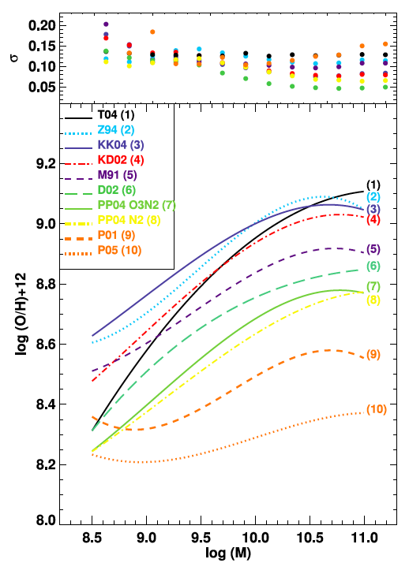
SEL METHOD SYSTEMATIC UNCERTAINTIES AND CHALLENGES
Large differences between SEL calibrations are seen of up to 0.6 dex
Empirical calibrations give abundances ~0.3 dex lower then theoretical calibrations.
Empirical calibrations suffer from underestimations in the abundances due to temperature fluctuations.
Theoretical calibrations are subject to all systematic affecting photo-ionization models (abundance patterns, geometry, stellar population models, etc.).
Kewley & Ellison 2008
see also Lopez-Sanchez et al. 2012
Notes:
Fundamental limitations versus technical imitations

Slide 9
SEL METHOD SYSTEMATIC UNCERTAINTIES AND CHALLENGES
Calibrations using a single SEL ratio neglect dependences on ionization which contributes to non-linearities and non-Gaussian scatter.
Two SEL ratios are sometimes used to simultaneously constrain abundance and ionization (Kobulnicky & Kewley 2004, Pilguyin et al. 2012, Dopita et al. 2013).
Differently calibrated diagnostics are accessible at different redshifts .
Kewley & Ellison 2008
see also Lopez-Sanchez et al. 2012

Slide 10
IZI: THE BAYESIAN APPROACH
Calculate joint PDF for the metallicity (Z) and the ionization parameter (q) given an arbitrary set of observed emission lines and a model of how line fluxes depend on Z and q.
We use photo-ionization models, but could also use an empirical model based on grids of direct T_{e} abundance measurements (c.f. Pilyuguin et al. 2012).

Slide 11
IZI: THE BAYESIAN APPROACH
Advantages:
  Remove the arbitrary choice of a particular SEL diagnostic (i.e. method choice does not depend on available data).
  Use all information available, including upper limits on line fluxes.
  Not married to a particular photo-ionization model. The user provides the input model (IZI comes with a few default choices).
  Full knowledge of the PDF allows the identification of degenerate solutions and the estimation of realistic errors.
  Can input prior information. IZI assumes Jeffreys maximum ignorance.
  User friendly IDL implementation:
  IDL> output=IZI(flux, error, id, GRIDFILE=‘mygrid.fits’, /PLOT)
c.f. Tremonti et al. 2004, Perez-Montero et al. 2014

Slide 12
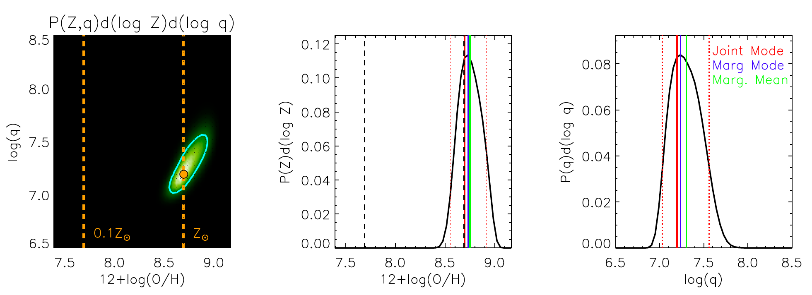
IZI: THE BAYESIAN APPROACH
HII region in van Zee et al. 1998 catalog
Blanc et al. 2015
All Lines: [OII]3727, Hβ, [OIII]4959,5007, Hα, [NII]6548,6583, [SII]6717,6731
MAPPINGS-IV, SB99, n=10 cm⁻³, κ=20 (Dopita et al. 2013)

Slide 13
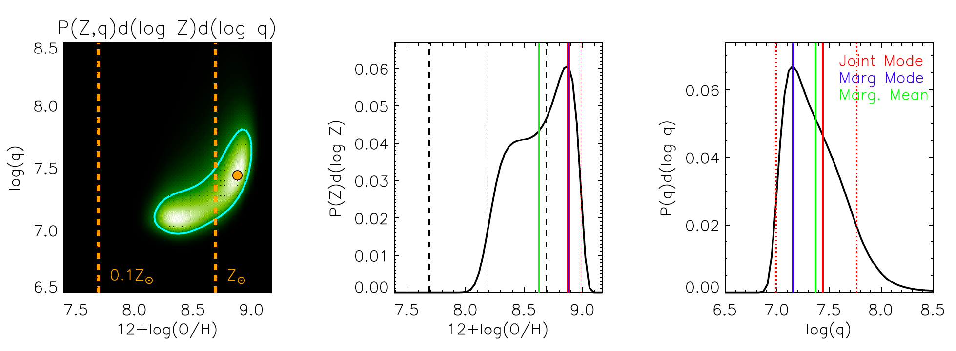
IZI: THE BAYESIAN APPROACH
HII region in van Zee et al. 1998 catalog
Blanc et al. 2015
R23: [OII]3727, Hβ, [OIII]4959,5007
MAPPINGS-IV, SB99, n=10 cm⁻³, κ=20 (Dopita et al. 2013)

Slide 14
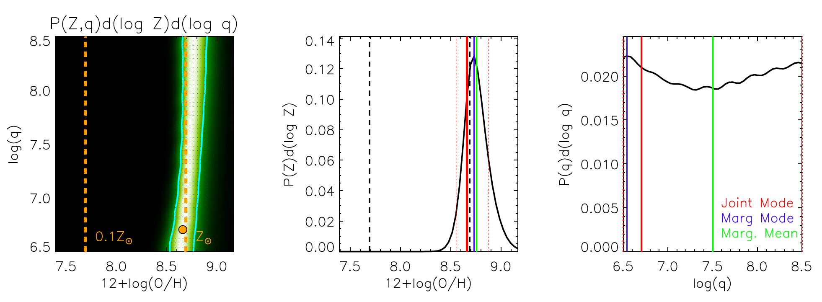
IZI: THE BAYESIAN APPROACH
HII region in van Zee et al. 1998 catalog
Blanc et al. 2015
N2O2: [OII]3727, [NII]6548,6583
MAPPINGS-IV, SB99, n=10 cm⁻³, κ=20 (Dopita et al. 2013)

Slide 15
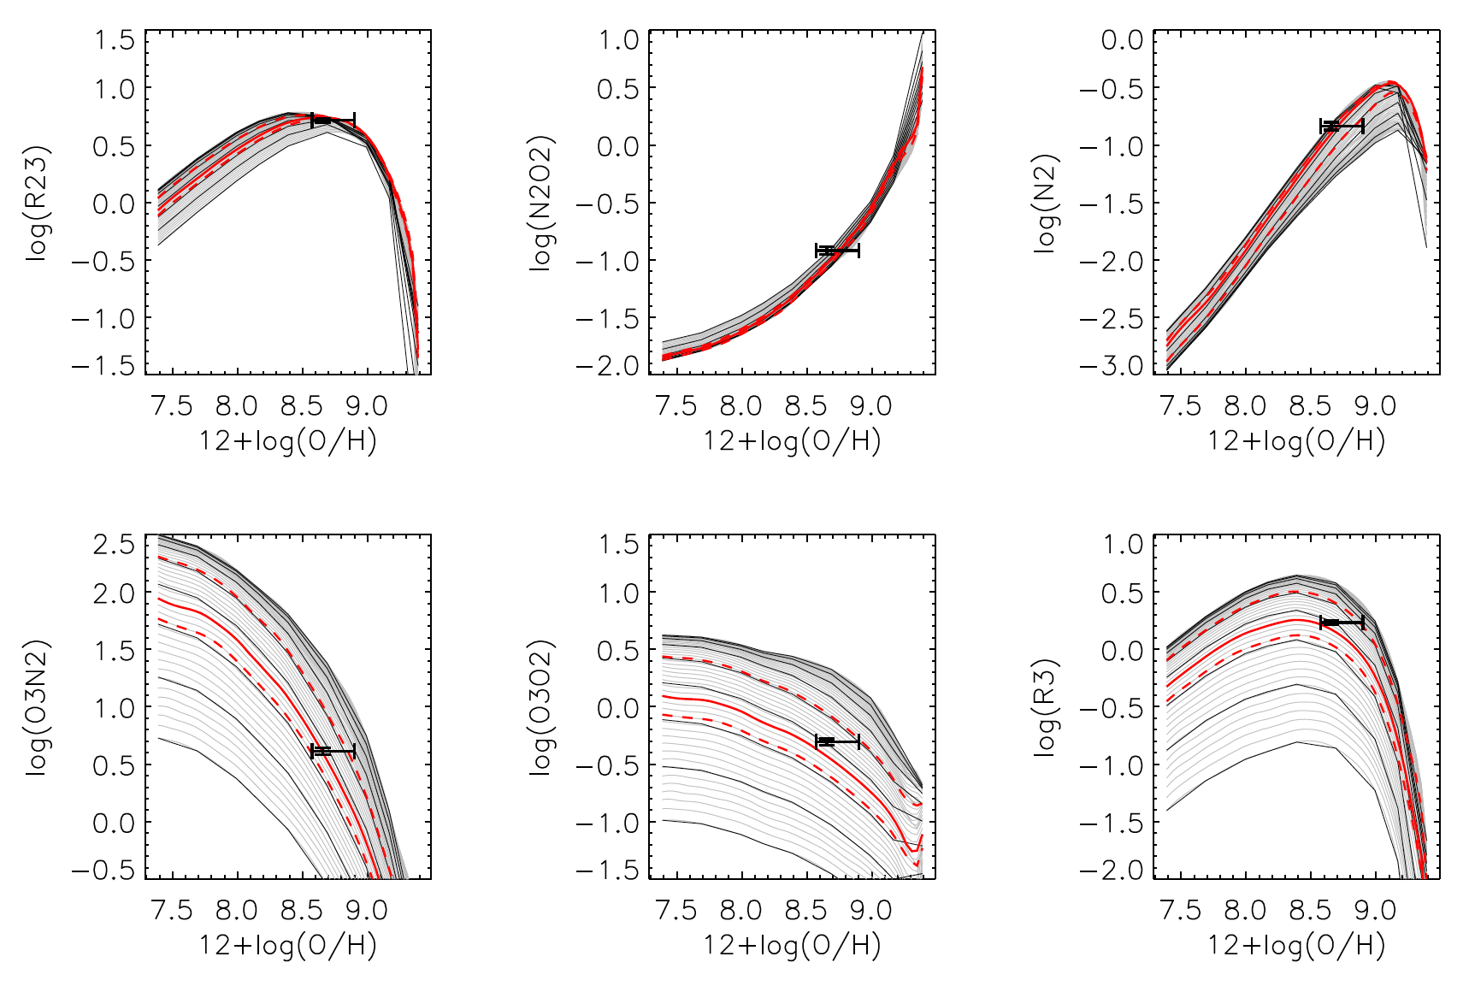
IZI: THE BAYESIAN APPROACH
Blanc et al. 2015

Slide 16
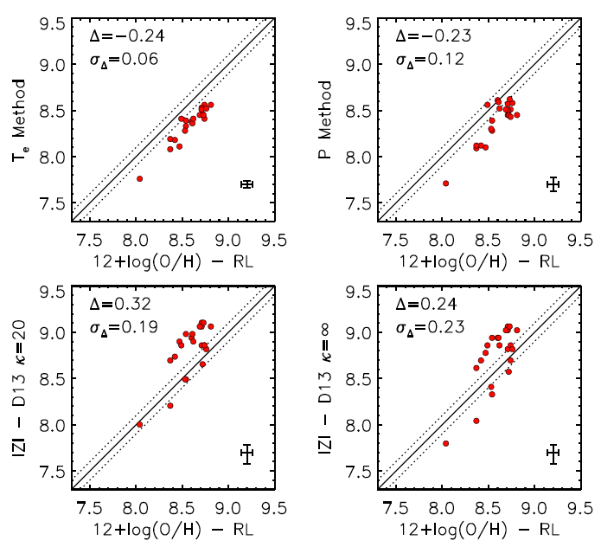
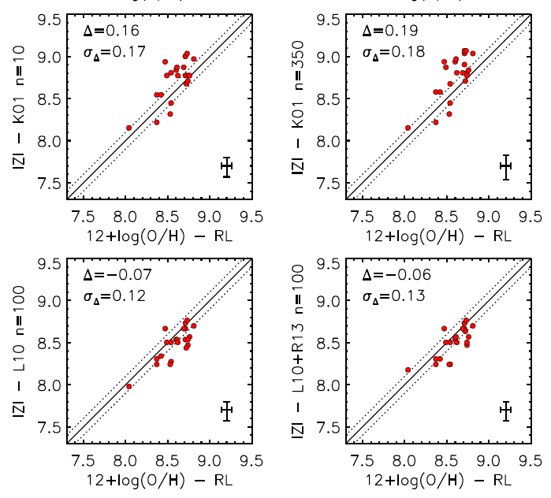
THE ABUNDANCE SCALE DISCREPANCY
Direct method
P-method
Kewley 2001
Dopita 2013
Blanc et al. 2015
Levesque 2010
Using compilation of 22 HII regions with RL measurements (Lopez-Sanchez et al. 2012)
Direct method (RED) abundances are ~0.2 dex below RL abundances
Photo-ionization models (BLUE) show 0.2 dex scatter among them in abundance
Levesque et al. 2010 models show best agreement with RL abundances (<0.1 dex)

Slide 17
THE ABUNDANCE SCALE DISCREPANCY
Temperature fluctuations explain direct method abundances being 0.2 dex low.
Direct method abundances are shifted up by ~0.2 dex when including temperature r.m.s. corrections (t²) (e.g. Esteban et al. 2004, Lopez-Sanchez et al. 2007)
It is not as simple as photo-ionization models being higher then the RL and direct methods.
There are a lot of systematics in the photo-ionization models:
  Stellar atmosphere models.
  Abundance patterns. N/O dependence with O/H, M*, SFH, accretion history, etc.
  They model HII regions, not galaxies!!! What about the WIM and shocks??
  Redshift dependences
IZI is an improvement over classical diagnostics but there is a LOT of room for improvement.

Slide 18
CONCLUSIONS
IZI’s Bayesian formalism to measure SEL metallicities removes the need of choosing particular line ratio diagnostics and allows the user to take advantage of all the available information.
Uncorrected direct method abundances are lower then RL abundances by 0.2 dex, while Bayesian inference using photo-ionization models of Levesque et al. 2010 match RL abundances to 0.1 dex.
IZI is publicly available at: http://users.obs.carnegiescience.edu/gblancm/izi

