Slide 1
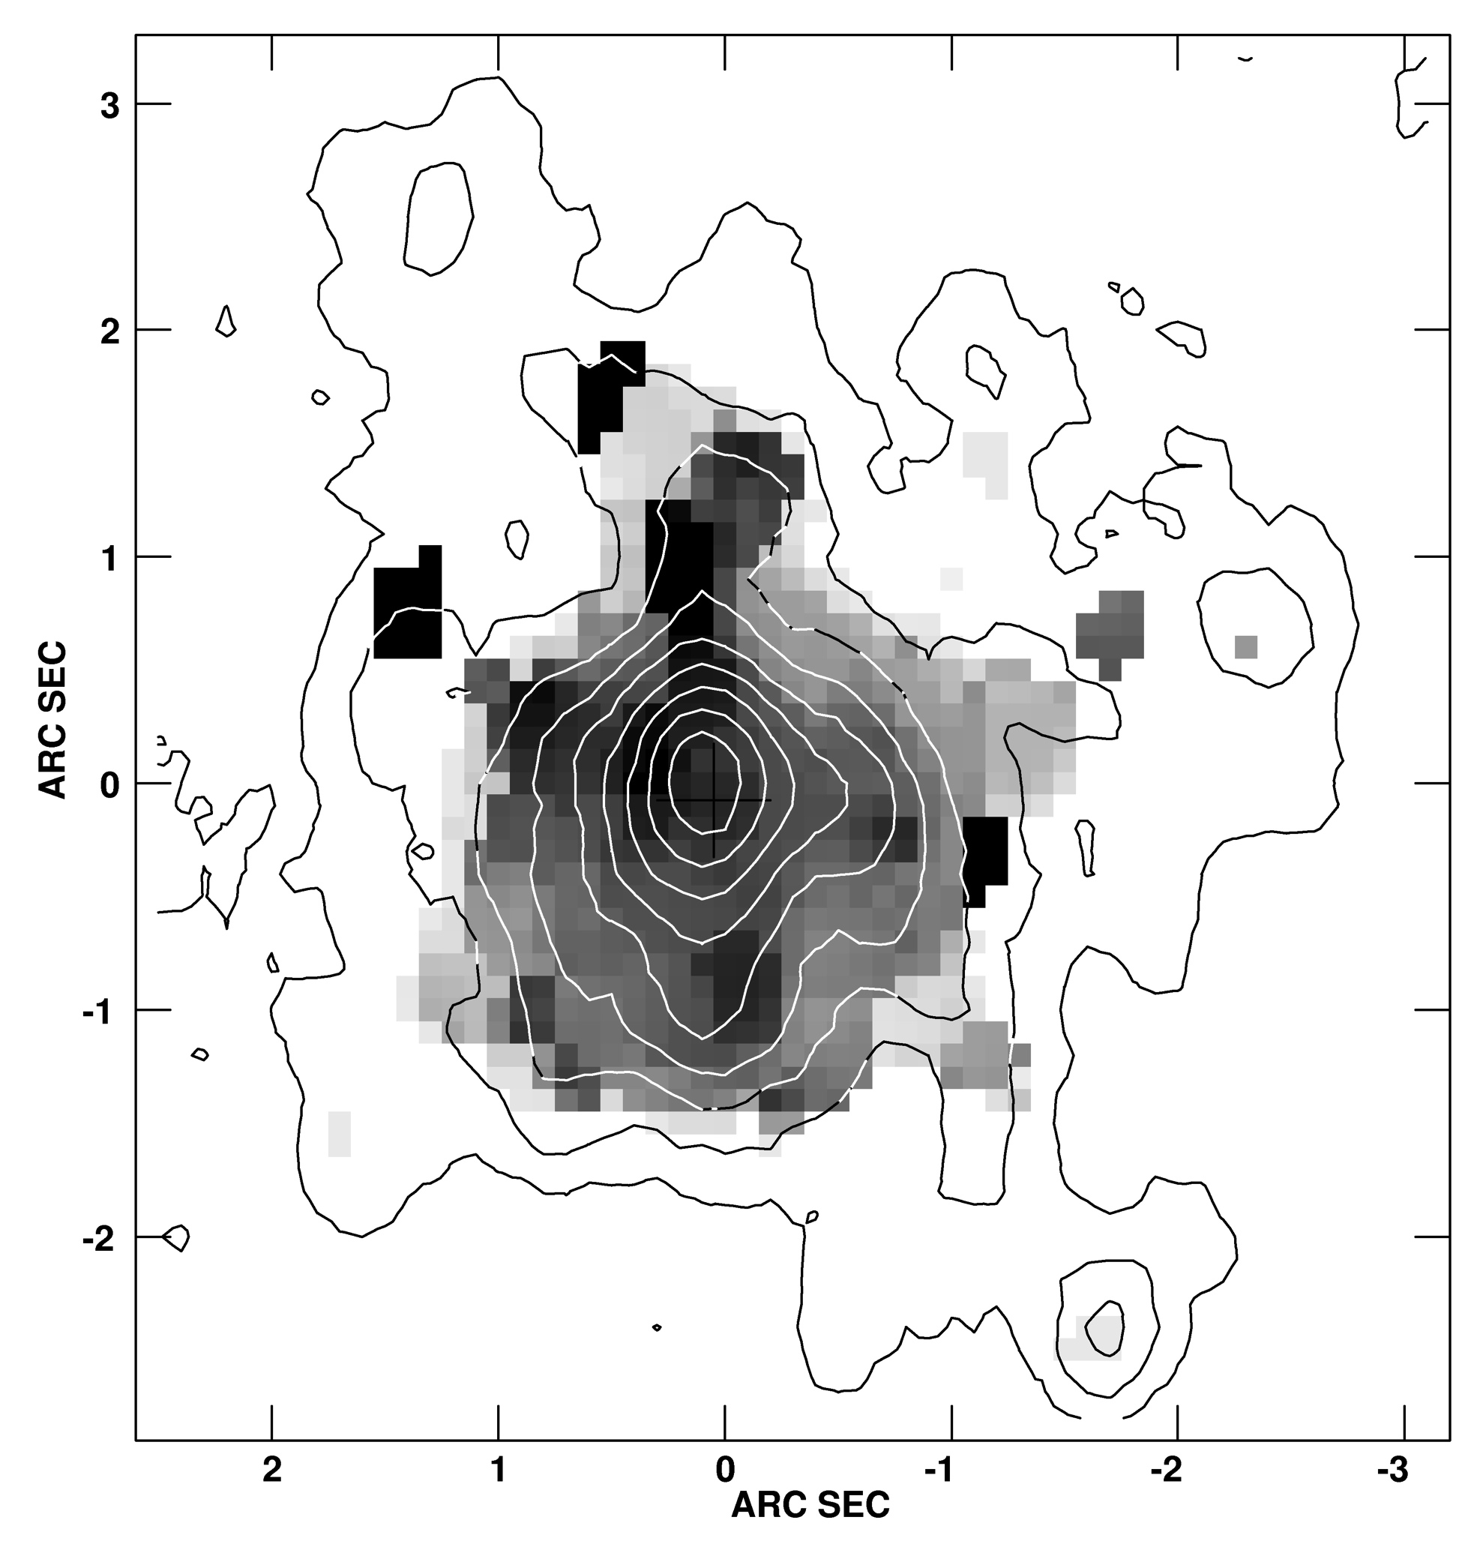
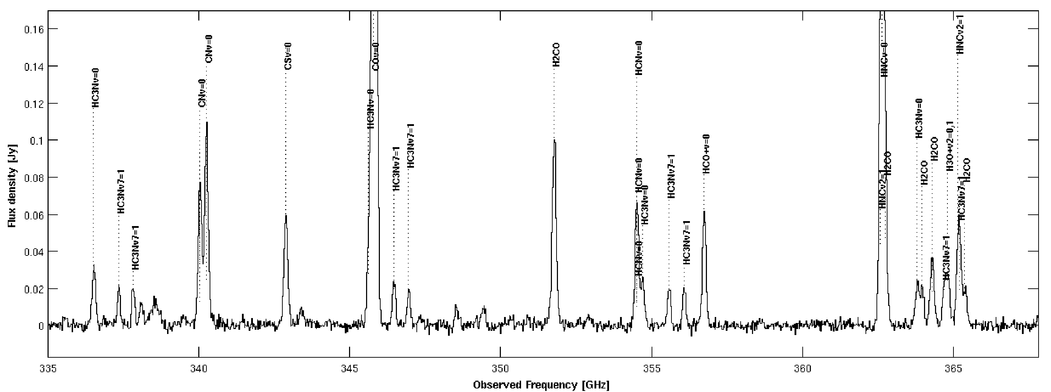
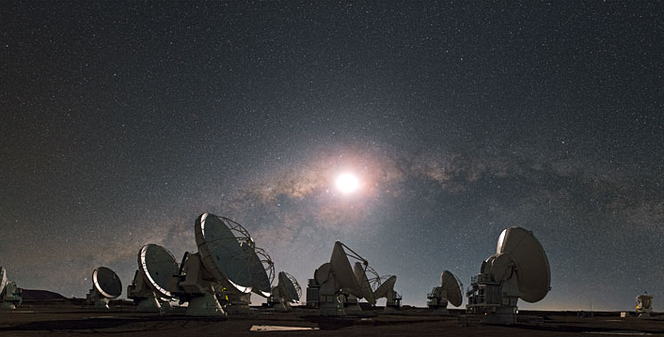

Physical conditions and chemistry -”hot cores” and cold outflows
Susanne Aalto
Department of Earth and Space Sciences, Chalmers

Slide 2
Outline
Tracers of chemistry and physical conditions
Nuclei
  AGN
  Obscured nuclei
    Extreme nuclei
Molecular outflows
  Physical conditions and chemistry in outflows
(Mergers, interactions and extended star formation
  Physical conditions – stellar nucleosynthesis)

Slide 3
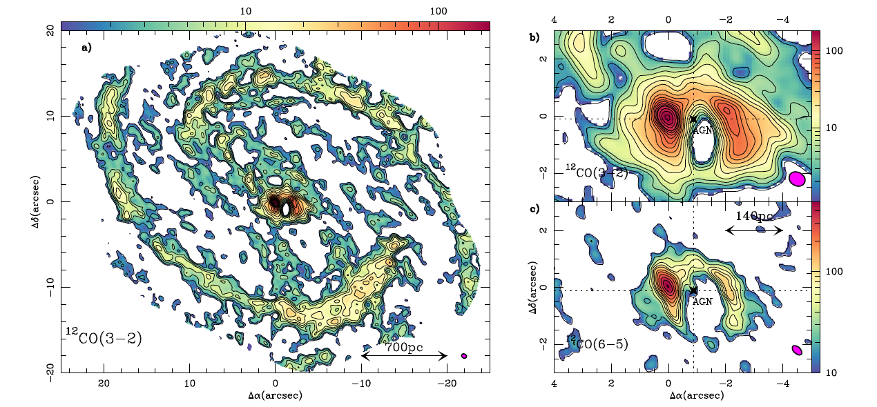

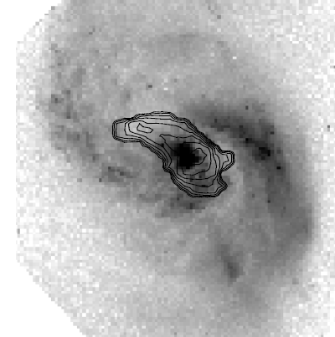
Driving the gas to the center…
Spiral arms
  Flocculent
  Grand design
Bars
  Strong/weak
  Nested
Interacting galaxies
  Polar rings, dust lanes counterrotating and infalling gas
  Tidal gas
  ”Overlap regions”
Garcia-Burillo et al 2014
NGC1068
Major merger NGC3256
Sakamoto et al 2014
…where it collects in: disks, rings, mini-bars, compact obscured nuclei
(Santiago’s talk)
…and feeds AGNs, starbursts, driving
outflows and winds
Minor merger NGC1614
600 pc
starbursting
molecular ring
(König et al 2013, Xu et al 2014)
Molecular gas fundamentally important parameter for galaxy evolution
Olsson et al 2010

Slide 4
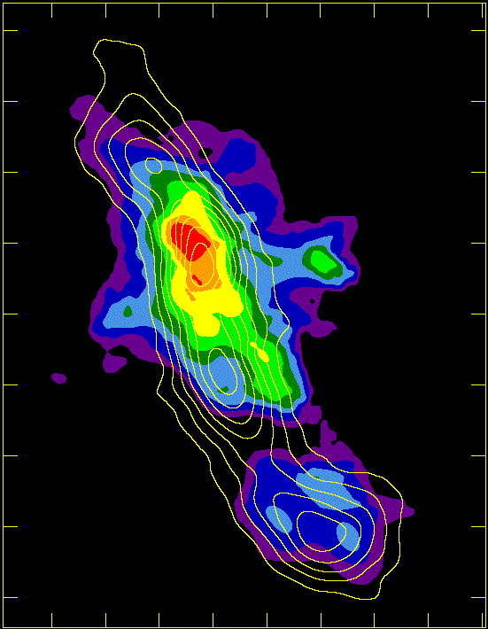
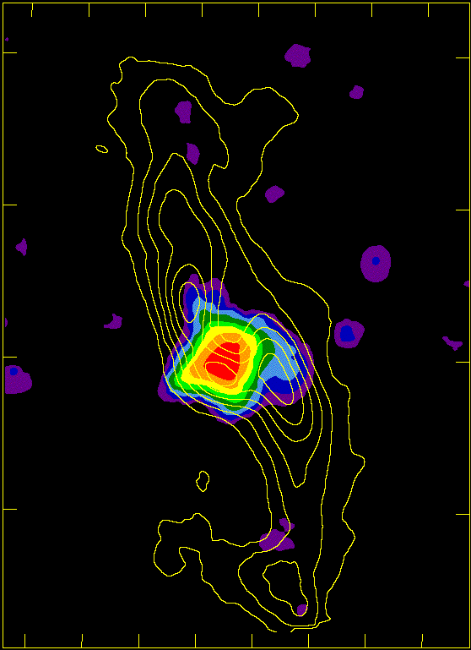
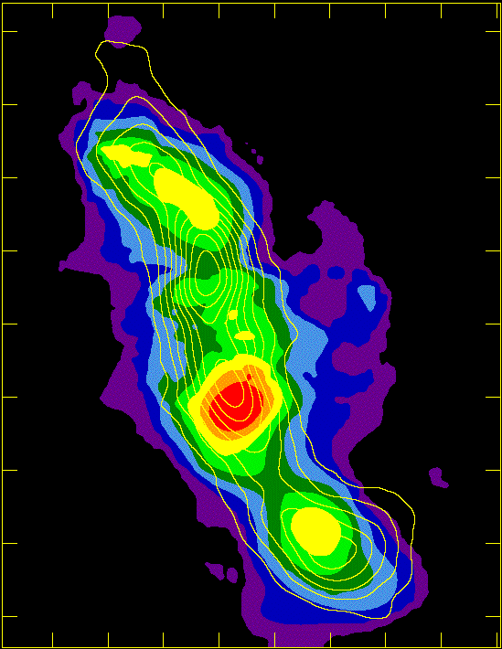
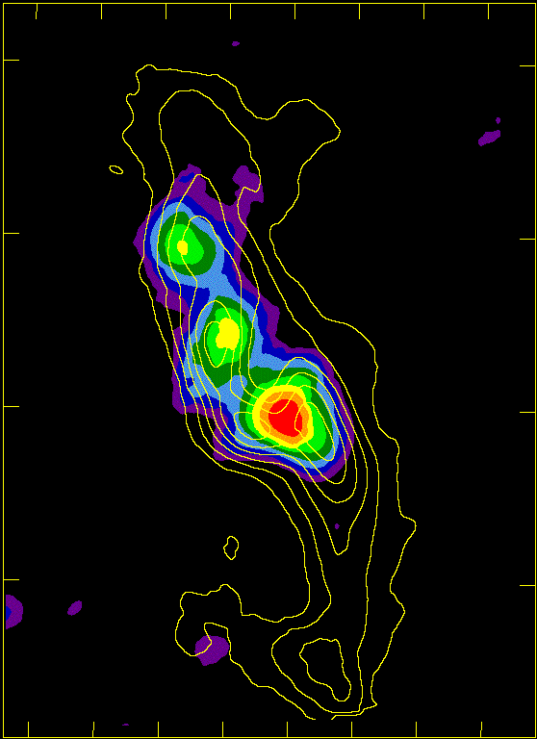
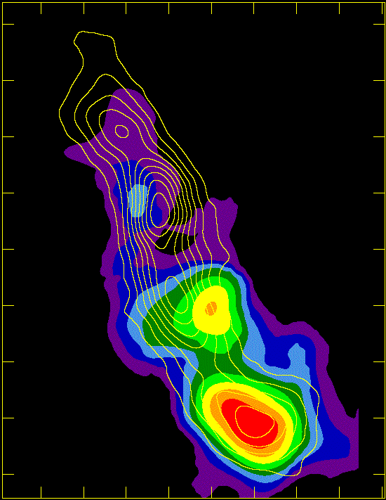
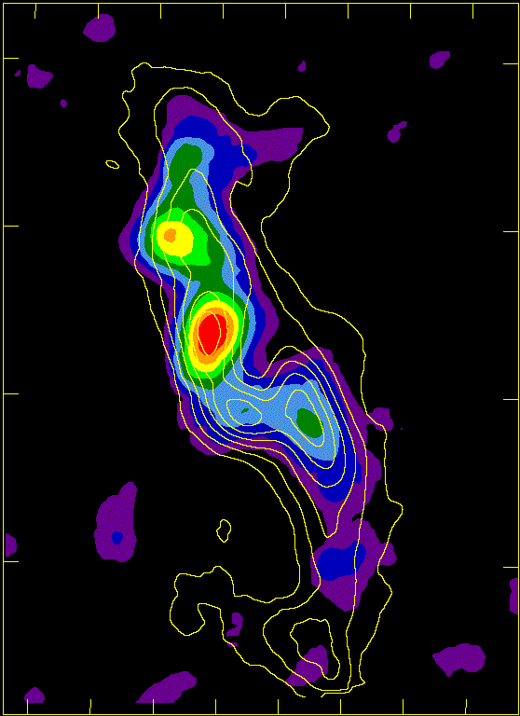
Diagnosing Starburst/AGN activity
H₂CO: High T in the Milky Way nucleus
Gas distribution and dynamics
  Dynamical masses
  Non circular motions – out/inflows
Physical conditions
  Temperature and density tracers
  Impact of radiative pumping
Astrochemistry
    AGN vs starburst; evolution; outflow mechanisms; impact of dynamics on ISM
    Stellar nucleosynthesis?
We are searching for key diagnostic molecular species and lines
Ginsburg et al submitted
MAFFEI 2 IC 342
C₂H
N₂H⁺
Meier & Turner
2006, 2012
-CH3OH tracing
bar shocks
CH₃OH

Slide 5
Chemistry diagnostics
Scenarios:
  X-ray dominated region (XDR) – large bulk temperatures > 100 K (e.g. Maloney et al 96; Lepp & Dalgarno 96; Meijerink and Spaans 05)
  Photon dominated region (PDR) – large surface temperatures 300-1000 K – moderate bulk temperatures 20-50 K (e.g. Hollenbach & Tielens 97)
  Cosmic ray dominated region (CDR) (e.g. Suchkov et al 93; Meijerink et al 11)
  Dense shielded regions – dusty hot core-like chemistry (IR pumping), 50-300 K (see e.g. work by Viti, Millar)
  Mechanically dominated region – shock-chemistry (e.g. Viti et al 11; Kazandjian et al 11)
Popular diagnostic species: CO, HCN, HCO⁺, HOC⁺, HNC, CN, CS, HC₃N, SiO, HNCO, CH₃OH, CH₃CN, C₂H – just to mention a few + their isotopic variants.

Slide 6
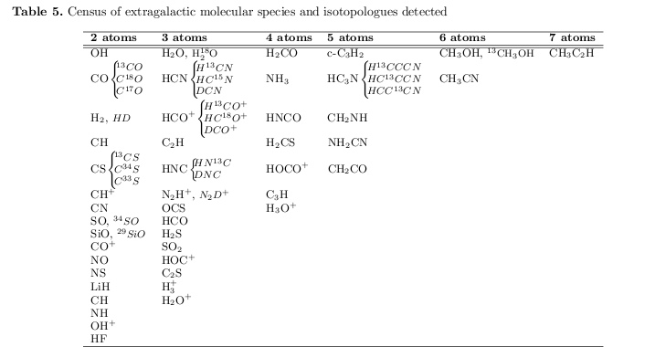
Extragalactic molecules: >50 detected
From: Martin et al 2011

Slide 7
What lines are good indicators?
UV, X-ray, CR:
  HCN/HCO⁺ - XDR tracer?
    Is this line ratio an indicator of ”warm chemistry” – rather than a tracer of X-ray driven chemistry?
    Tracing compact vs extended activity?
  CN – should be good tracer of XDR/PDR. Disappointing results in LIRG/ULIRG survey (Aalto et al 2002) – CN anticorrelated with LFIR? Elevated CN in outflows (e.g. Mrk231, NGC3256) a problem?
  HOC⁺, CO⁺, H₃O⁺, H₂O⁺, OH⁺, N₂H⁺ - how do we combine them for best diagnostic value? Is H₃O⁺ formation pumped?
Shocks
  SiO, HNCO, CH₃OH, H₂O – classical shock tracers
  HCN – shock enhanced?

Slide 8
IR radiative feedback
  Dusty (U)LIRG nuclei: IR radiative excitation will be important.
  Lines that can be IR pumped : HCN, HNC, HC₃N, H₂O, OH etc
  HC₃N - bright in dusty nuclei. Tracing young activity? IR pumped? Correlates with HNC
  Vibrational lines serve as important tracers and can peek behind the optically thick screen
General Complications and challenges
  Separating chemistry from excitation, radiative transfer
  Dichotomy between X-ray, PDR, CR and mechanical impact.
  Environment (e.g. pressure, dynamics, metallicity) impacts which ”tracers” should be used
    We need spatial resoluion – and multi-species/transitions.

Slide 9
Galaxy nuclei

Slide 10
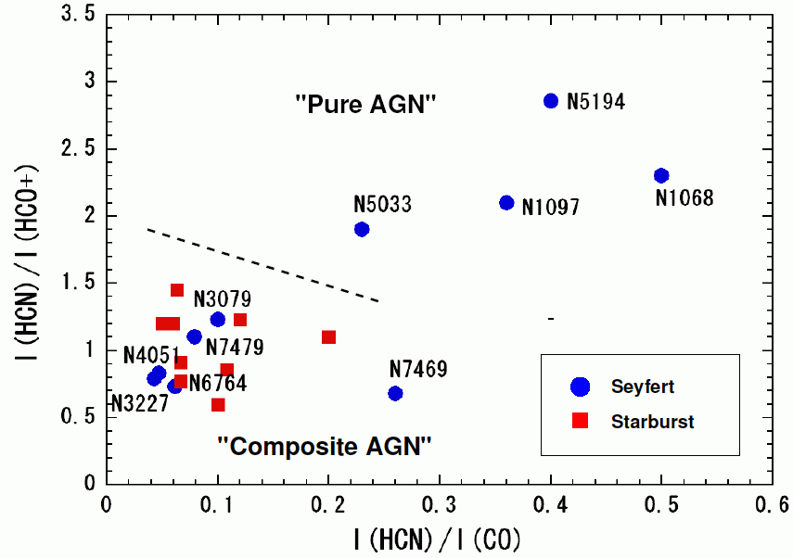
Hunting for the AGN
HCN/HCO⁺ plot of Kohno et al (2001) – is it an AGN tracer?
Many studies underway to explore the diagram and expand it to other molecules

Slide 11
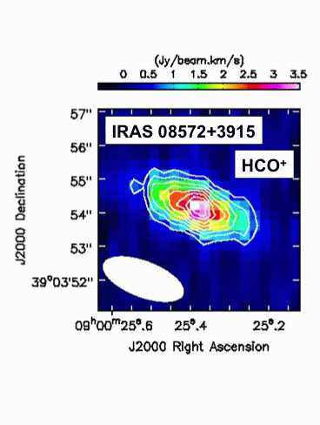
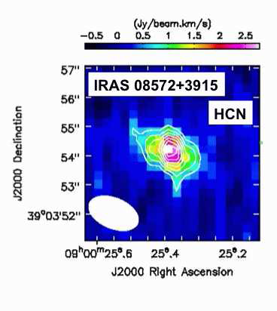
HCN/HCO⁺ observations of LIRGs
Costagliola+11
Surveys show elevated ratios in ULIRGs (e.g. Gracia-Carpio +08, Krips +o8,Costagliola+11.
Privon +15 find elevated HCN/HCO+ in both starburst and AGN ULIRGs
ALMA observations of six (U)LIRGs suggest that HCN/HCO+ 4-3 ratio greater in AGN –dominated sources. (Imanishi +14)
Imanishi and Nakanishi 2013
Need high spatial resolution to understand the meaning of the HCN/HCO+ tracer

Slide 12
High resolution ALMA observations of the Seyfert galaxy NGC1068
Garcia-Burillo et al 2014, Viti et al 2014

Slide 13
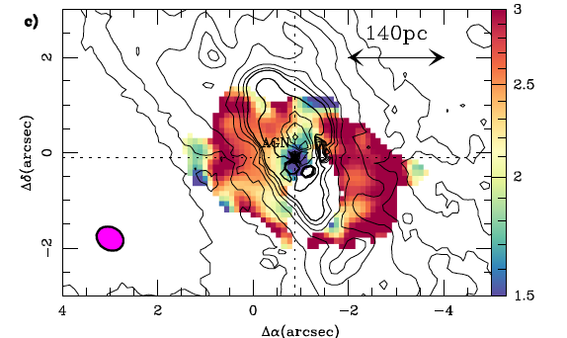
The HCN/HCO⁺ 4-3 ratio in the CND
HCN/HCO⁺ ratio high in CND – drops again at the actual AGN

Slide 14
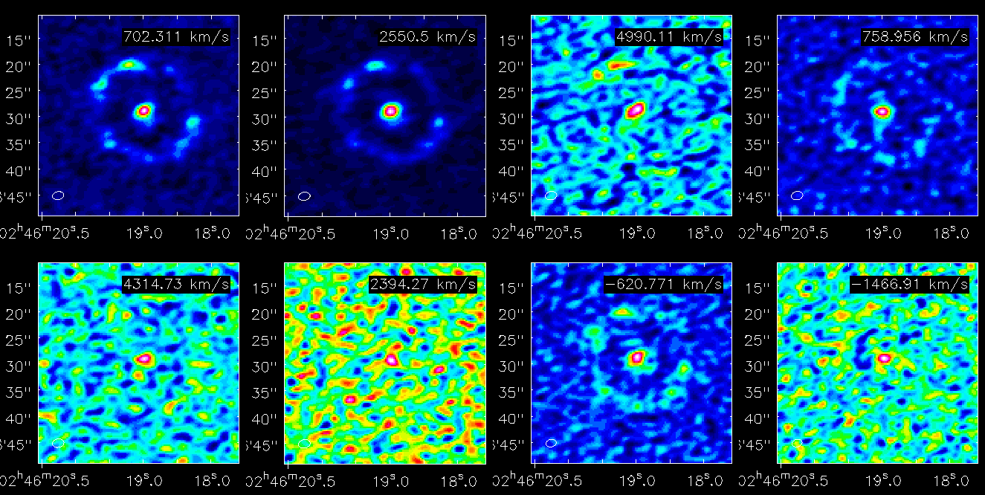
ALMA Multi-molecular view of the Seyfert NGC 1097 (Martin et al 2014)
HCO⁺(1-0)
HCN(1-0)
HNCO
C₂H(1-0)
H¹³CN(1-0)
SiO(2-1)
CS(2-1)
HC₃N(11-10)
Starburst ring is detected in HCN, HCO⁺, C₂H, CS, and partly in HNCO

Slide 15
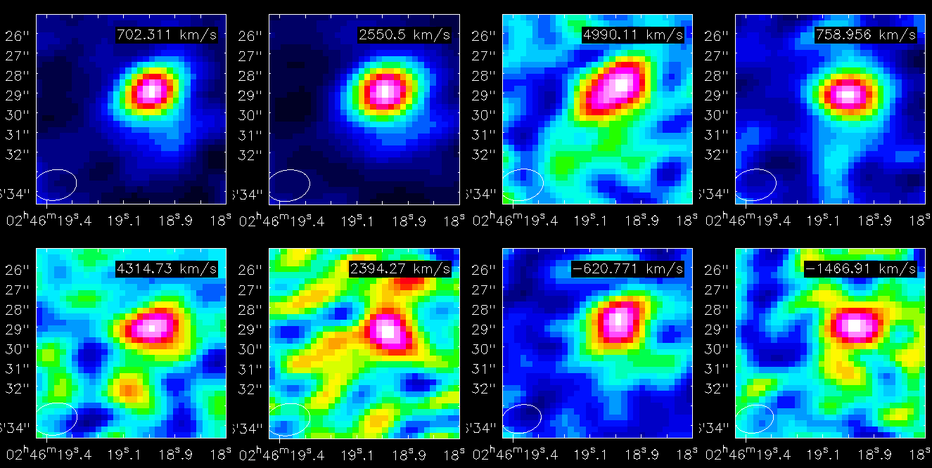
Nuclear emission
HCO⁺(1-0)
HCN(1-0)
HNCO
C₂H(1-0)
2.42 Jy/b km/s
3.78 Jy/b km/s
0.58 Jy/b km/s
1.22 Jy/b km/s
H¹³CN(1-0)
SiO(2-1)
CS(2-1)
HC₃N(11-10)
0.36 Jy/b km/s
0.37 Jy/b km/s
0.99 Jy/b km/s
0.40 Jy/b km/s
Comparison of 3mm line survey data in starburst galaxies
➔ striking HCN enhancement w. r. t. CS !?

Slide 16
Compact Obscured Nuclei
A hidden AGN population – or extreme starbursts?

Slide 17
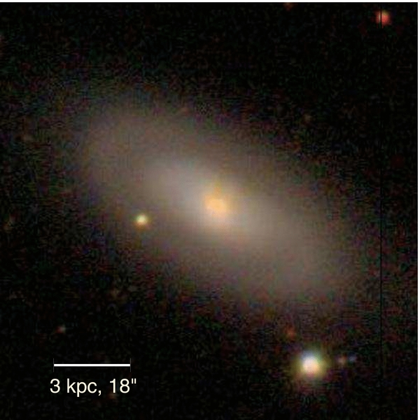
Some (U)LIRGs harbour compact obscured nuclei (CONs) of N(H₂)>10²⁴ cm⁻², and gas surface densities >10⁴ M_{sun} pc⁻²
  Still unknown how common they are
  Extremely important to understand obscured phase:
    AGN statistics (e.g. Lusso et al 2013).
    Growth of stellar spheroid.
Example:
NGC4418 (e.g Sakamoto et al +13, Costagliola et al +13)
mm/submm continuum
<0. “1 (<20 pc) nuclear emission
Core luminosity: 10^{11.0} L⊙ - bulk of total FIR luminosity of NGC4418.
T_{B}(860 μm)=120-210 K, τ(860 μm) = 1 (i.e., N_{H}>10²⁵ cm⁻²).
NGC4418

Slide 18
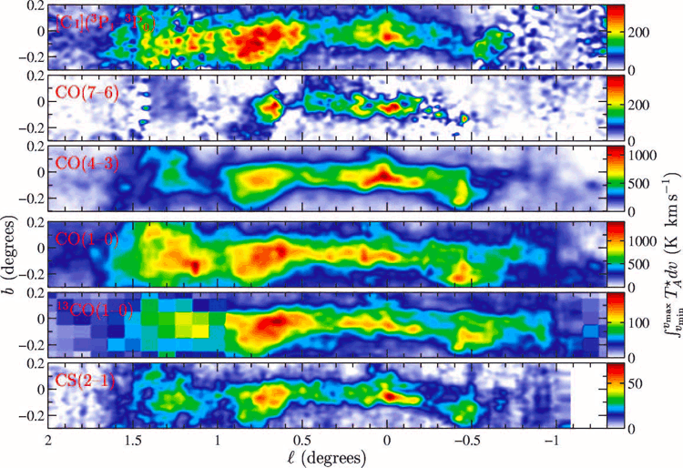
Central Molecular Zone (CMZ) of the Milky Way
Size - 450 x 150 pc
M(H₂) - 5x10⁷ M_{sun}
(Martin et al. 2004, ApJS, 150, 239-262).
In comparison:
Extreme properties
of NGC4418 hot core.
10⁸ M_{sun}
20 pc
100 pc

Slide 19
AGNs or compact starbursts?
Vibrationally excited HCN
  mid-IR diagnostics are compromised by extreme dust obscuration. X-rays severely attenuated when N(H2)>10²⁴ -10²⁵ cm⁻²
  Use:
    High resolution mm/submm continuum imaging –
    Maser lines
    Spectral scans: physical conditions and astrochemistry
    Recombination lines (Scoville&Murchikova 2013)
    IR-excited lines – probe inside optically thick shell for dynamics and IR-field mapping
ν=0 ladder
ν₂=2 ladder
14 μm IR field

Slide 20
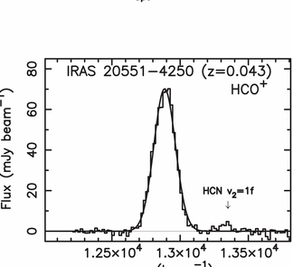
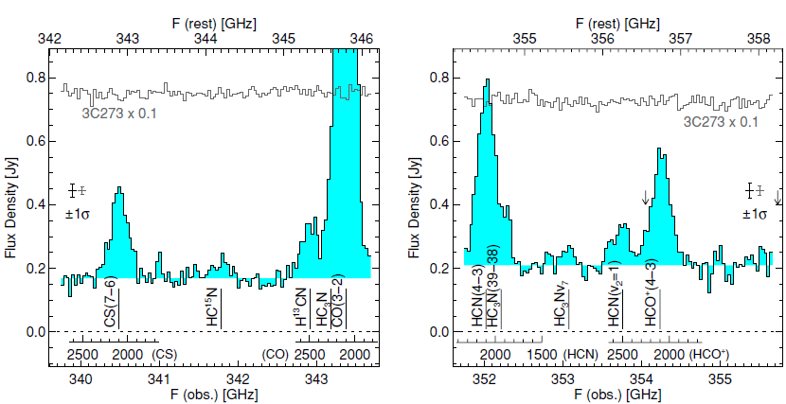
Radiative excitation and pumping
Requires
  T_{B}(14 micron) > 100 K for HCN
Combining vibrational lines from IR-pumped species let us probe the inner regions of dusty active galaxies:
  The size, temperature, optical depth of the mid-IR continuum – addressing the nature of the buried source
  Dynamics of buried gas
SMA: Sakamoto et al. 2010
ALMA cycle 0: Imanishi and Nakanishi 2013
NGC 4418
PdBI: Aalto et al. 2014
Mrk 231

Slide 21
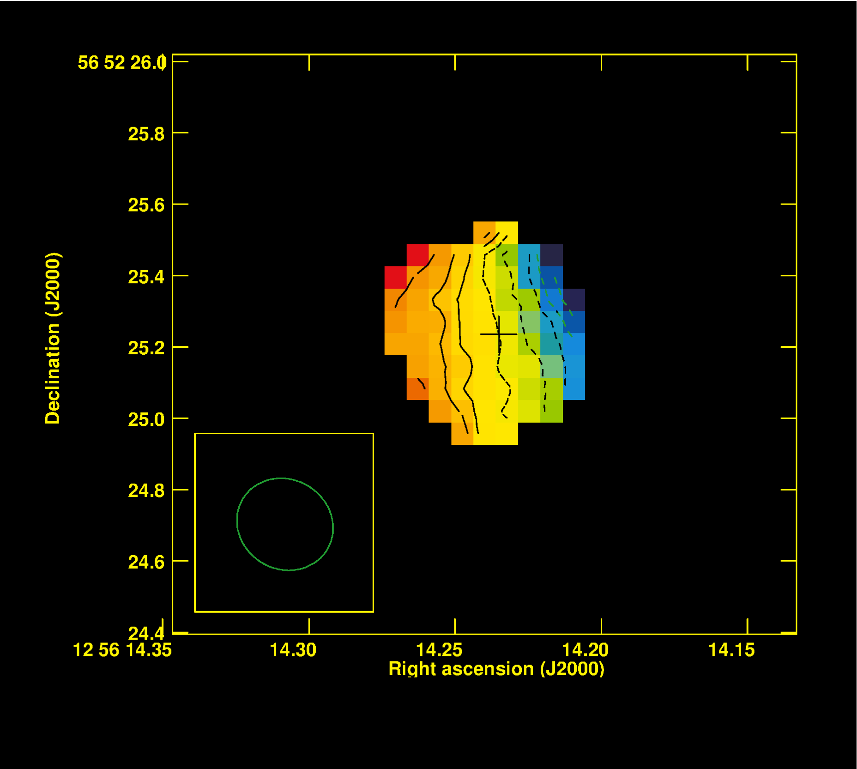
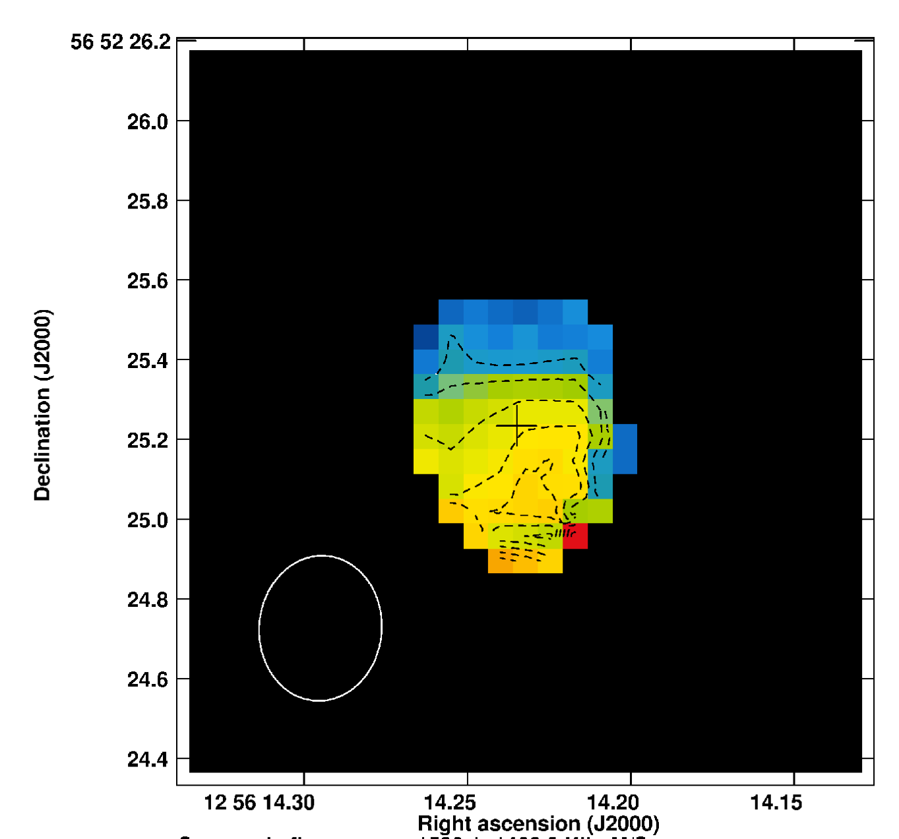
Mrk231: HCN vibrational dynamics – tracing the nuclear warped disk
HCN 3-2 v=0
HCN 3-2 v₂=1
Extended near face-on stellar and molecular disk
Tracing inner (0.”2 – 0.”3) warped disk (Klöckner et al 2003, Davies et al 2004).
HCN 3-2 v2=1 line emerging from inside r< 75 pc.
HCN v=0 and v₂=1 appear not to be cospatial – v₂=1 tracing nuclear optically thick mid-IR
dust structure - obscuring the AGN? (Aalto et al 2014)

Slide 22
S. Aalto, S. Martín, E. Gonzalez-Alfonso, S. Muller , F. Costagliola, K. Sakamoto,
S. García-Burillo, P van der Werf,
M. Spaans, F. Combes, S. Viti, G. Fuller, S. Mühle, L. Armus, A. Evans, E. Sturm, J. Cernicharo, , C. Henkel, T. Greve
HCN, HCO+ and HCN-VIB 3-2, 4-3 in
the (U)LIRGs
IC860, Zw049, Arp220, IRAS17208
HCN and HCO⁺ strongly self- and continuum absorbed in nuclear region - due to steep temperature gradient and large column densities
Luminous vibrationally excited HCN line emission emerging from buried, compact (r<17-70 pc) nuclei
Reversed P-Cygni in HCO+ for IC860 – infall? – rapidly evolving nuclei
Rich chemistry with- for example - HC₃N, CH₂NH, CH₃OH, HOC+

Slide 23
ALMA cycle 1: HCN, HCO⁺ HCN-VIB 4-3 in the ULIRGs Arp220 and IRAS17208
Again – strongly self- and continuum absorbed HCN and HCO⁺ toward compact nuclei.
For LIRGs and ULIRGs alike: r(HCN-VIB)<<r(HCN) – HCN-VIB unresolved emerging from compact high IR-surface brightness cores

Slide 24
Buried nucleus - better traced by vibrationally excited HCN?
VIB-HCN emerging
from buried core
inside HCN-HCO⁺
self-absoprtion.
VIB-HCN pumped by
intense 14 μm emission
VIB-HCN allows
us to reconstruct SED
and reveal a buried
hot dust core – absorbed
by cooler dust

Slide 25
Position-velocity diagrams: Vibrationally excited HCN reveal rotating torus?
Or are we seeing
yet another layer
of self-absorption?
HCN 3-2
Vibrationally excited
HCN - inside HCN 3-2

Slide 26
What is buried at the core?
Starburst?
  This is possible – but the VIB-HCN requires a mid-IR surface brightness > 5x10¹³ L_{sun}/pc² - ”Hot” , optically thick starburst
  Buildup of stellar spheroid?
AGN?
  Results would be consistent with a SMBH accreting at near-Eddington
Need high resolution and sensitivity offered by ALMA to probe the very inner regions
of ULIRGs and LIRGs – vibrationally excited lines are excellent tools to peek inside the veil
of dust

Slide 27
Spectral scans
Classifying dominant chemistry – looking for fainter lines

Slide 28
ALMA spectral scans
VV114 – Saito et al
NGC 253- Meier et al
Arp220 – Martin et al
NGC4418 –Costagliola et al
NGC4418:
317 emission lines; 45 molecular species (15 isotopic substitutions) and six vibrationally excited variants.
Tk range from 20 to 350 K
n=10⁵ - 10⁷ cm−3.
The spectrum is dominated by vibrationally excited HC₃N, HCN, and HNC, whith vibrational temperatures from 300 to 450 K.
NGC 4418 and Arp 220 seem very similar
See also emerging paper by Aladro on single dish spectral scans of active galaxies

Slide 29
Molecular outflows and winds

Slide 30
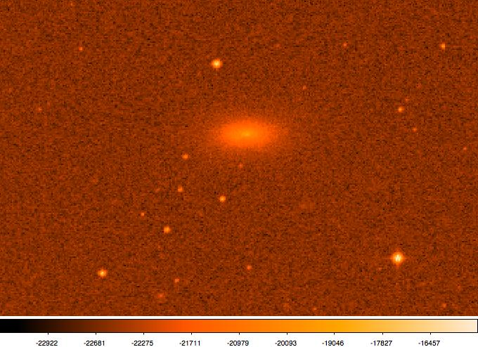
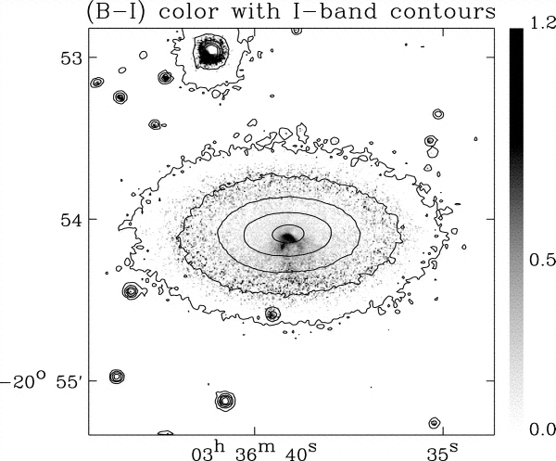
A molecular outflow in the most extreme FIR-excess, radio-quiet galaxy NGC1377
Small, lenticular galaxy
L_{FIR}=5x10⁹ Lsun
Excess FIR emission with q>3.9 – off
FIR-Radio correlation by factor >37
The most extreme silicate absorption galaxy to date (Spoon et al 2007).
No Pα, Br γ − Faint Hα, [N II] and [Ne II] lines, Faint PAH (Roussel et al 2003),2006)
Roussel et al 2006
Featureless morphology
apart from southern
minor axis dust structure
Post starburst/LINER
optical characteristics
What is powering the compact IR luminosity - Obscured AGN or nascent starburst?

Slide 31
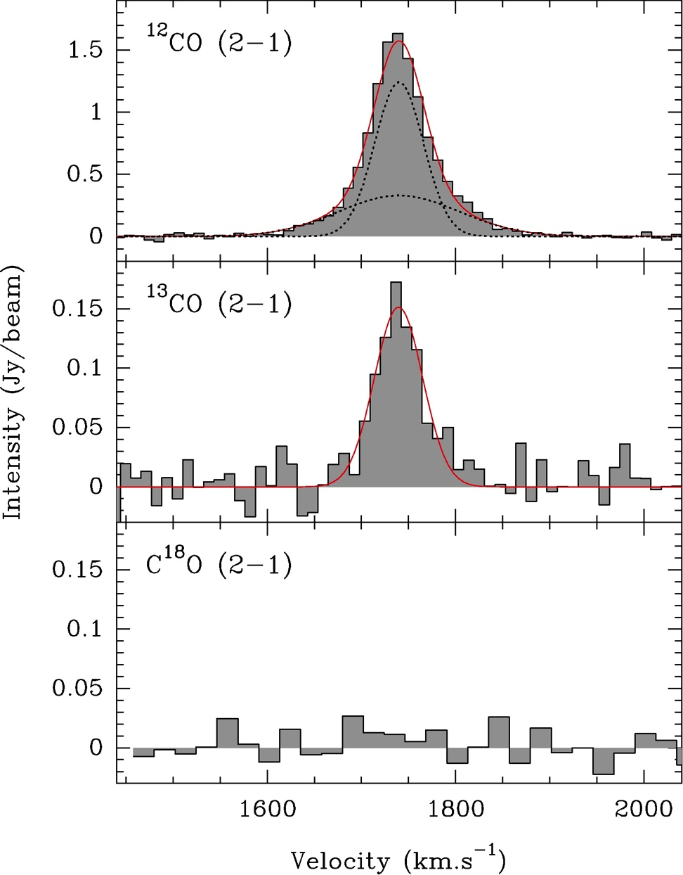
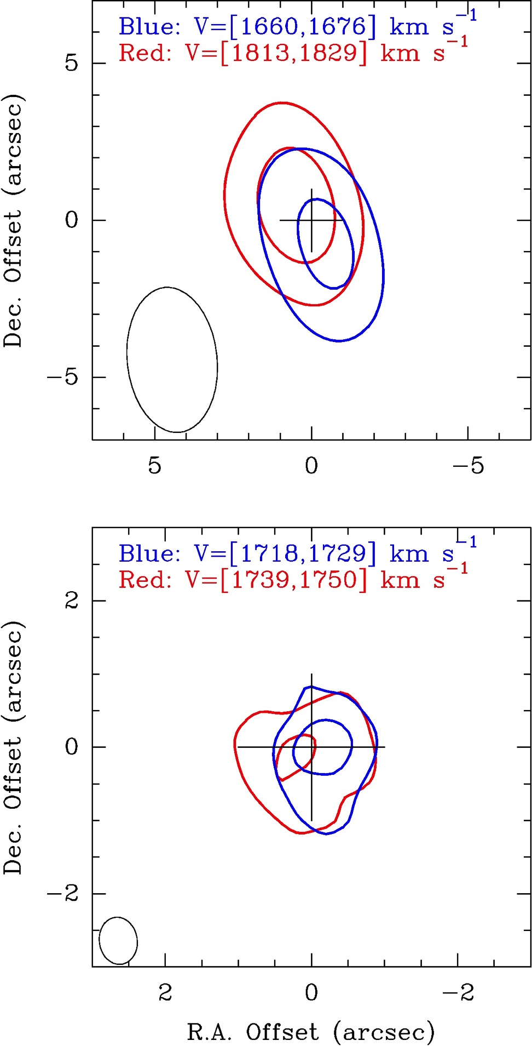
SMA CO and ¹³CO 2-1 observations
(Aalto, Muller, Sakamoto, Gallagher, Martin, Costagliola 2012b)
Line wings (top panel)
and disk rotation (lower panel) reveal a disk-outflow system
Nondetection of C¹⁸O
consistent with lack of
processed gas?

Slide 32
ALMA cycle 2 imaging of NGC1377
Work in progress
Aalto, Muller, Sakamoto, Martin, Gallagher, Combes, Wada, Garcia-Burillo, van der Werf
CO 3-2, H¹³CN, HCO^{+,} HCN v₂=1f 4-3 - 0.”17 beam = 17 pc
CO 3-2 imaging reveals jet-like high velocity, clumpy molecular gas. Extended systemic
velocity emission - needs zero-spacing.
Blue wing
Center
Red wing

Slide 33
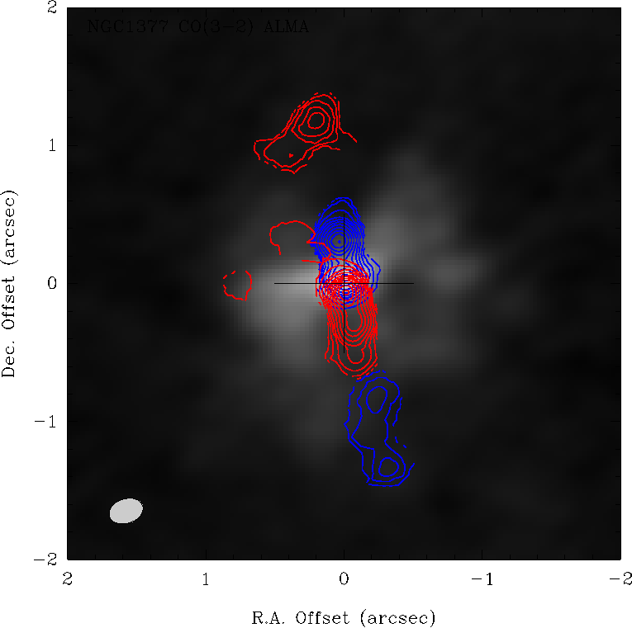
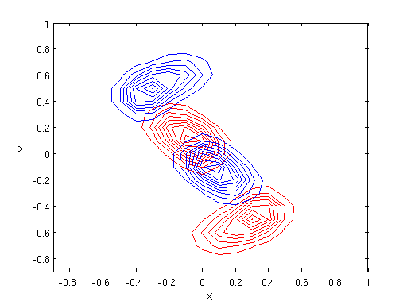
The ALMA twist: A Precessing outflow?, deflection? infall? – or?
Work in progress
New ALMA result: Outflow
appears to flip near the nucleus.
Origin unclear – high velocity gas
extremely well aligned along
line-of-sight
100 pc
Toy model
cone?
A molecular jet rotating around
An axis perpendicular to the line of sight could tentatively reproduce observations
Grey scale: Systemic velocities
Red and blue: High velocity gas

Slide 34
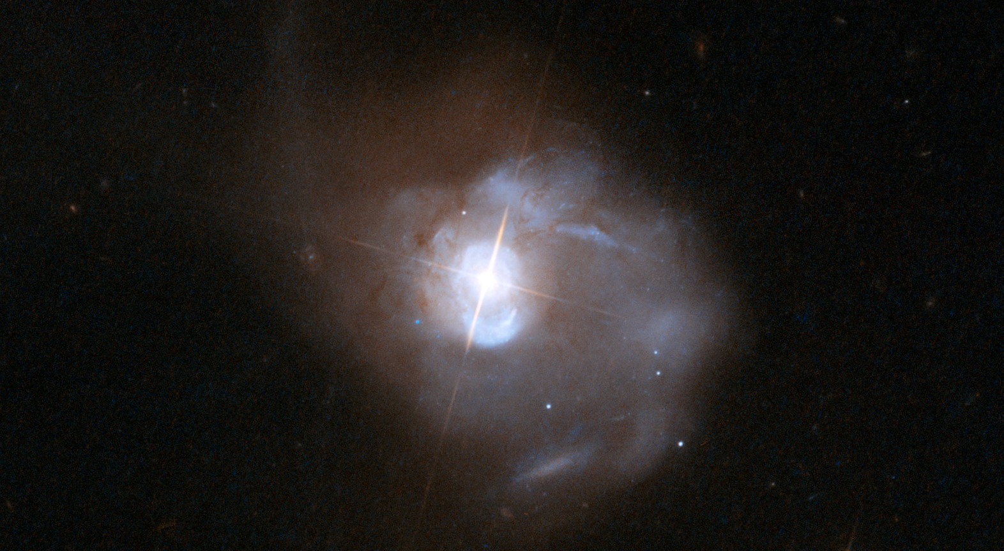
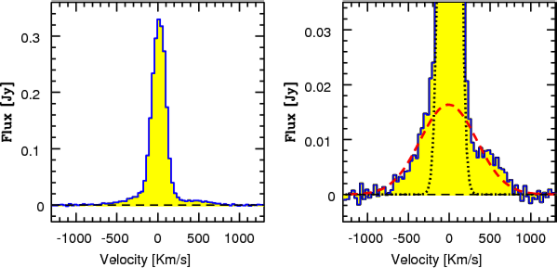
At the other end of the scale: Mrk231- high velocity gas in the QSO outflow
ULIRG (log(LIR) = 12.37). Nearby infrared QSO + starburst with extreme SFR ≈ 200 M⊙yr⁻¹
Wide, kpc-scale, high-velocity (≈ 1000 kms⁻¹) outflow seen in neutral gas (Rupke and Veilleux 2011). Herschel observations of OH outflow (Fischer et al 2010, Gonzalez-Alfonso 2013)
Line wings in CO 1-0 are v≈ 750 kms⁻¹ (Feruglio et al 2011)
Molecular mass loss rate estimated to 700 M⊙yr⁻¹

Slide 35
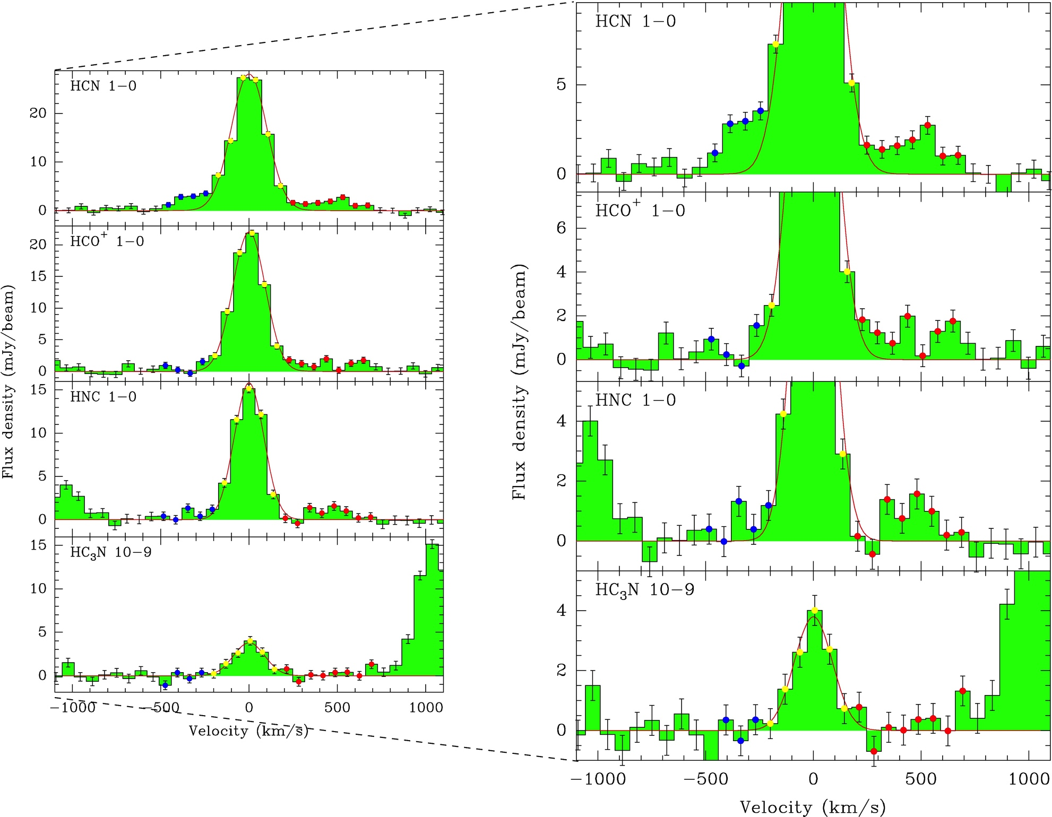
First detection of HCN, HCO⁺, HNC 1-0 in an AGN wind.
Dense (n>10⁵ cm⁻³) gas
I(HCN)>I(HCO+)>I(HNC)
HCN 1-0 wings appear spatially extended on scales of 700 pc
IRAM Plateau de Bure – (Aalto et al 2012b)
Outflow also detected in OH and H₂O absorption by Herschel (Fischer et al 2010, Gonzalez-Alfonso 2010)

Slide 36
Is the outflow in Mrk231 clumpy?
HCN 2-1, 3-2 detected in the outflow – extent 400 pc
Aalto et al 2015
Lindberg et al in prep
A two-phase molecular medium?
Dense clumps/filaments of 10⁴−10⁵ cm⁻³ traced by HCN, CS, HCO⁺,HNC etc
Low density diffuse molecular gas traced by e.g. low-J CO , [C I], [C II|
Evolution of gas properties in the outflow?
r(HCN 3-2)<r(HCN 1-0)<r(CO 2-1)r<(CO 1-0)
-Extent of dense gas emission seems less
than that of the low densitygas (Cicone et al 2012; Feruglio et al 2015)

Slide 37
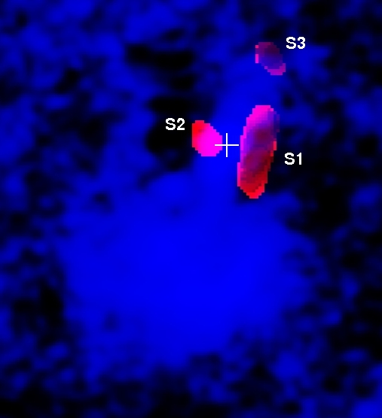
Physical conditions/chemistry in outflows
HCN enhancement in outflow also in: NGC1068 (Garcia-Burillo+14), M51 (Matsushita+14), NGC7469 (Izumi+15.), NGC1266 (Alatalo et al in prep)
    HCN/HCO+ in Mrk231: Signatures of ”pile-ups” and clumpiness in velocity space. HCN and HCO⁺ velocity –differentiated . (Lindberg et al in prep)
CN detected in NGC3256 outflow (Sakamoto+14)
CO 2-1/1-0 ratio in Mrk231 outflow (Cicone+12), 3-2/1-0 ratio in N3256 outflow (Michiyama et al)
Red: HCN(1-0)/CO(1-0) ratio map
Blue: 6 cm continuum
Matsushita et al 2014 – see posterB8

Slide 38
CONCLUSIONS
ALMA reveals a stunning chemical richness in AGN and starburst nuclei – combine molecular lines for diagnostic.
  HCN/HCO+ tracing compactness – rather than XDR?
We have found extremely compact (<10-50 pc) luminous vibrationally excited HCN in highly obscured (U)LIRGs.
  Self-and continuum absorbed HCN, HCO+ 4-3, 3-2 emission – use vibrationally excited molecules to probe nuclei and SMBH mass.
Molecular outflows seem to be everywhere
  A new one: NGC1377: Jet-like molecular outflow seems to ”flip” – precessing?
  Gas physical conditions and chemistry enable better mass and driving mechanism determinations
    HCN often enhanced in outflows – shocks? Clumpy gas?

Slide 39
Extended starbursts

Slide 40
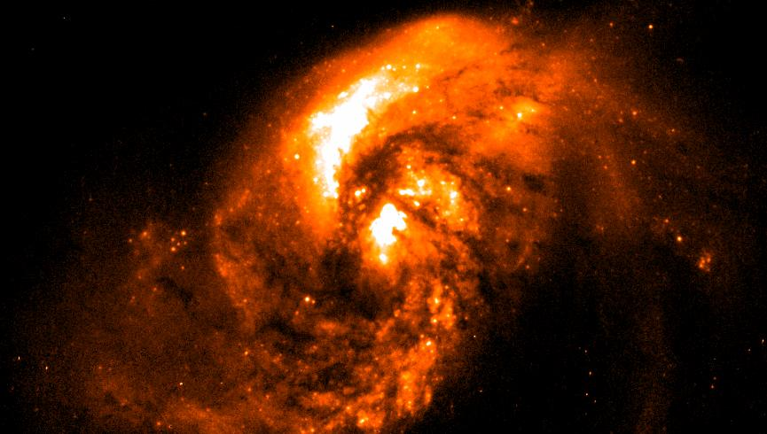
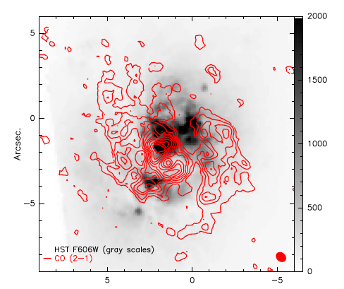
Extended starbursts in Minor mergers with dust lanes and polar rings
NGC4194
”The Medusa”
(HST+ Chandra
Image)
CO tracing minor axis dust lane – spatially
shifted from star formation
- tidal gas returning to merger center?
NGC1614
(HST ACS
image)
SMA CO 2-1
(König et al 2014)
OVRO CO 1-0 contours on HST
WPC2 image (Olsson et al 2010)
SMA CO 2-1 600 pc
starbursting
molecular ring
(König et al 2013)
See posters B9 and B10 - König

