Slide 1
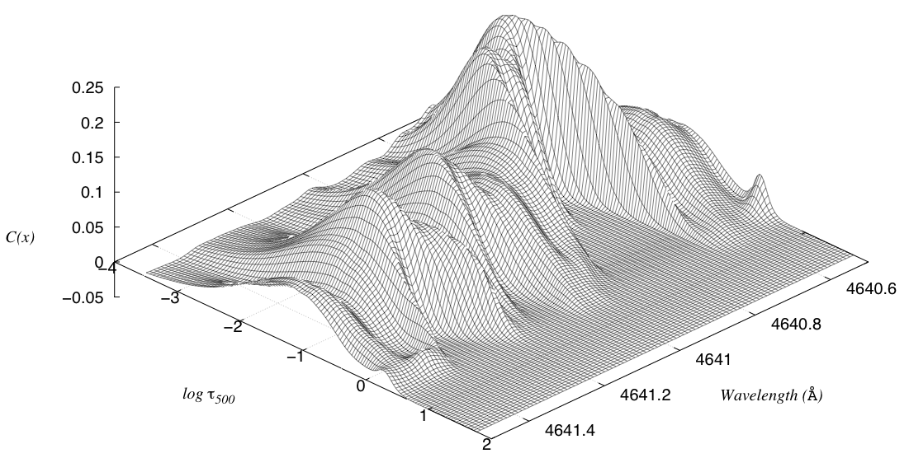
Atmospheric tomography of supergiant stars
(starring μ Cep)
Stellar End Products ESO, Garching, 2015
Alain Jorissen, Sophie Van Eck, Kateryna Kravchenko
(Université Libre de Bruxelles)
Andrea Chiavassa
(Observatoire de la Côte d’Azur, Nice)
Bertrand Plez
(Université de Montpellier II)
Based on observations carried out with the HERMES spectrograph on the Mercator 1.2m telescope
Notes:
Radial velocity determination: cross correlating a mask (matched with the spectral type of the observation) with the observed spectrum.
Very powerfull: the CCF combines information coming from thousands of spectral lines
Conts: mix lines (information) originating from very different layers in the atmosphere. For supergiant stars, ccf analysis is not a good tool to analyze atmospheric velocity fields.
Tomography tends to remedy this situation: it uses the cross-correlation techinque, but on specific sets of lines, forming at defined depth in the atmosphere.

Slide 2
Tomography: I.1 technique
Aim is to probe velocity fields in stellar atmospheres
Alvarez et al. (2000, A&A 362,655; 2001 A&A379, 288; 2001, A&A 379, 305)
➔ cross-correlate the observed spectrum with numerical masks
  probing layers of increasing depth
Construction of the numerical masks :
    Computation of the depth function: τ_{500nm} = C (λ; where τ_{λ} = 2/3)
Region I (innermost)
Region II (middle)
X = log(τ₅₀₀)
Region III (outermost)
⬅Holes in mask II
probing middle layer
Notes:
The Depth function provides the reference optical depth (a proxy for the geometrical optical depth) where the monochromatic optical depth reaches 2/3

Slide 3
Tomography: I.2 technique (improved)
Instead of imposing τ_{λ} = 2/3 for defining the mask holes,
computation of « contribution function » expressing the depth of formation of spectral lines :
    Albrow & Cottrell (1996, MNRAS 278, 337):
    contribution function to the spectral-line flux depression:
  with S_{l}, I_{c}, μ, τ, κ_{l}, κ_{c} taken from TURBOSPECTRUM (Alvarez & Plez 1998)
  using MARCS (1D) model atmospheres.

Slide 4
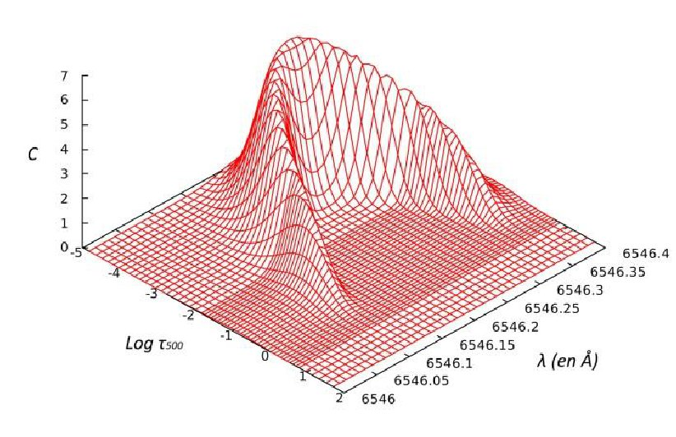
Tomography: I.3 technique (improved)
  S_{l}, I_{c}, μ, τ, κ_{l}, κ_{c} taken from TURBOSPECTRUM (Alvarez & Plez 1998)
  using MARCS (1D) model atmosphere:
Contribution function C(λ,τ) for the Fe I λ6546.245 line:
Albrow & Cottrell 1996
Same spectral line, this work

Slide 5
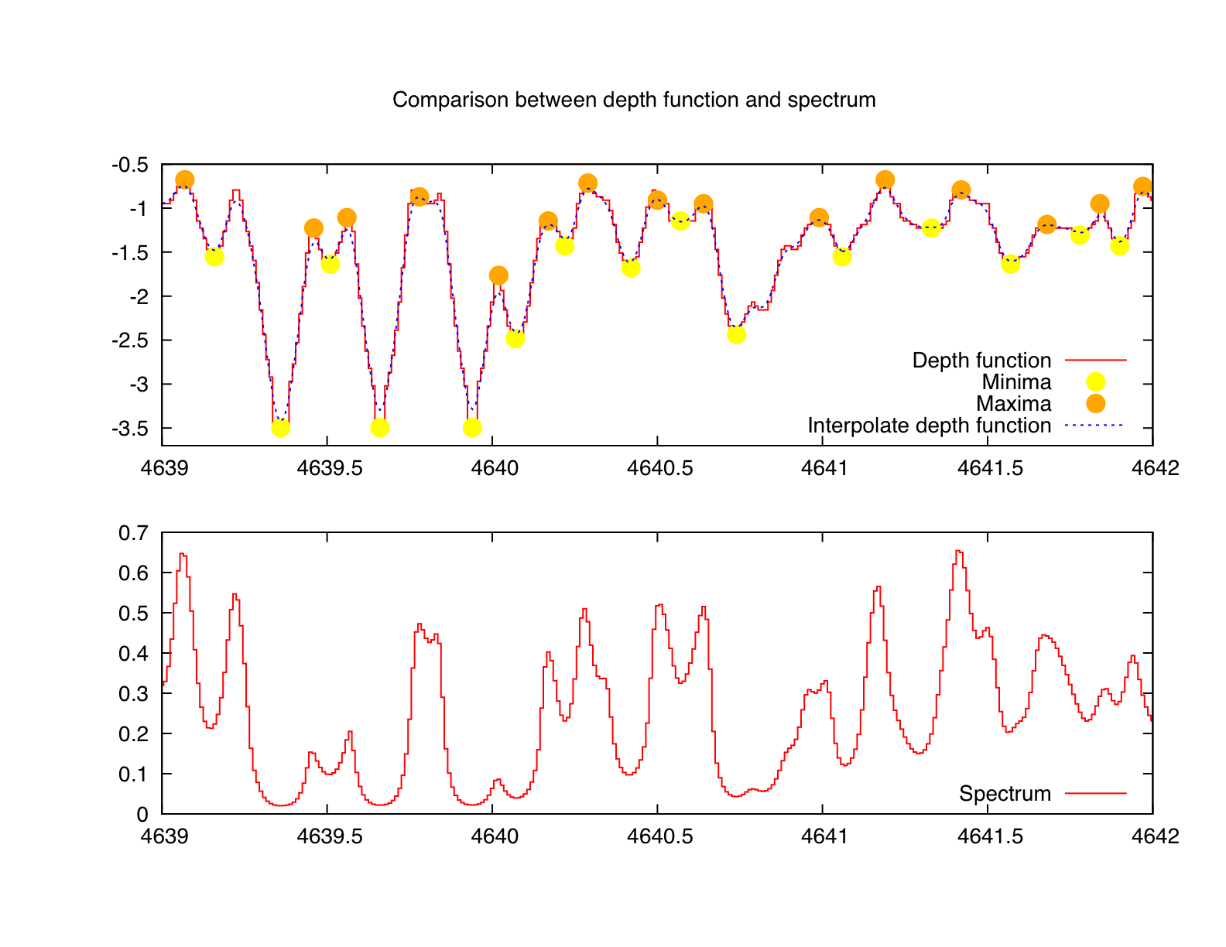
Tomography: I.4 technique
For RSG:
  Teff = 3490 K
  log g = -0.6
  M = 12 M
  Solar composition
  Microturbulence 2 km/s
  Spectral resolution: Δλ = 0.01Å
Contribution function C(λ,τ_{500 nm})
Computation of depth function:
C_{max}(λ) = τ₅₀₀ of max C(λ,τ₅₀₀)
on all τ
Crest line
C_{max}(λ)
log(τ₅₀₀)
Synthetic spectrum
Relative flux
Wavelength (Å)

Slide 6
Tomography: I.5 technique (improved)
Computation of depth function:
C_{max}(λ)= max C(λ,τ) (370 < λ (nm) < 910 )
for all τ
Atmosphere split in 8 vertical layers
In each layer, when C_{max}(λ) is minimum (in τ₅₀₀)
mask hole
C_{max}(λ)
Mask #1
Log(τ₅₀₀)
Mask #2
…
Mask #8
Synthetic spectrum
Relative flux
Wavelength (Å)

Slide 7
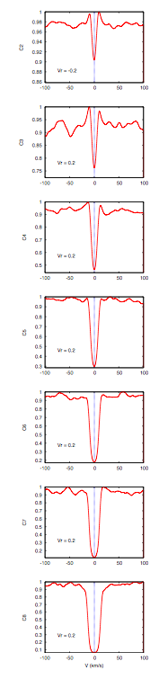
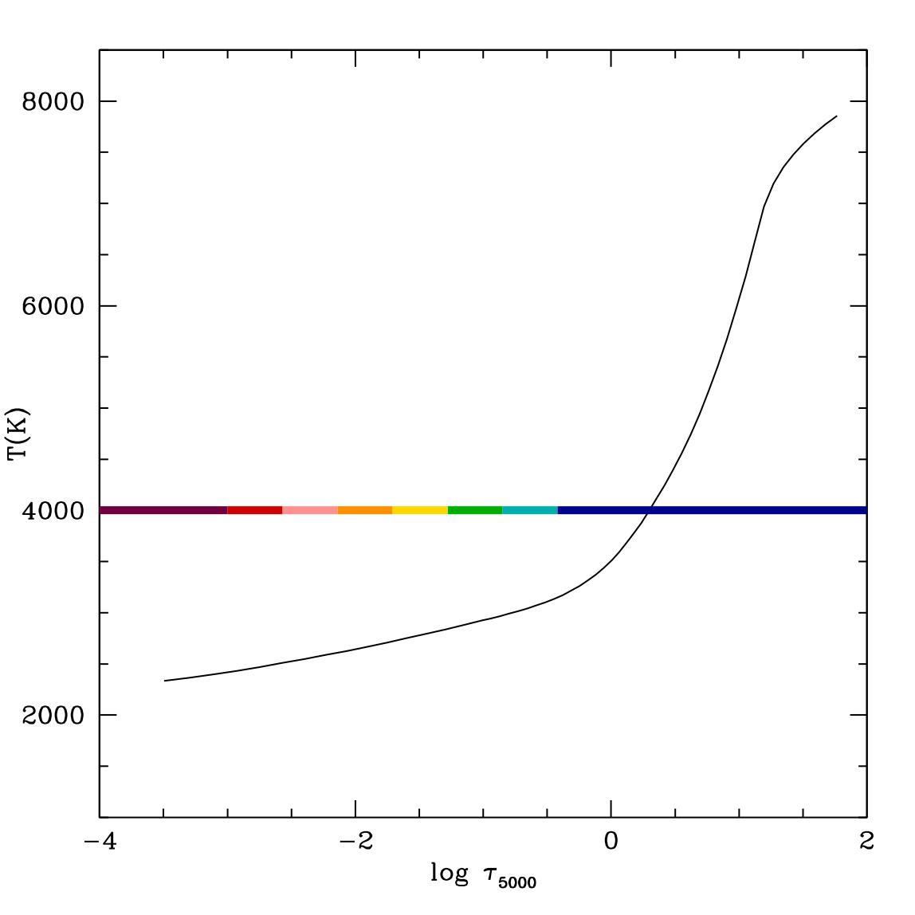
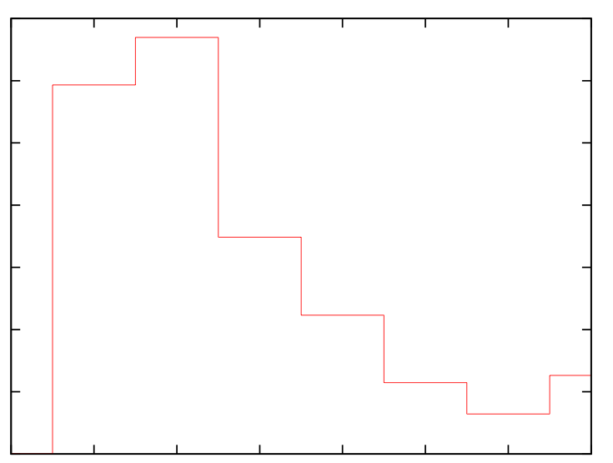
Tomography: I.6 technique
0.0
-0.5
-1.0
-1.5
-2.0
-2.5
-3.0
-3.5
1
0.9
1
0.7
1
0.5
1
0.4
1
0.2
1
0.2
1
0.1
inner
log(τ₅₀₀)
Atmosphere temperature distribution
Masks limits
MARCS synthetic spectrum
Outermost
Innermost
log(τ₅₀₀)
-∞ -3 -2.5 -2 -1.5 -1 -0.5 0 +∞
Distribution of lines
in masks:
3000
2000
N
1000
0
outer

Slide 8
Tomography: II. Application to Miras
Alvarez et al. 2000, A&A 362,655
Cross-correlation of observed spectrum with mask function
= CCF (Cross Correlation Function)
Follow the progression of a shock wave in the atmosphere
    Spatially
    temporally
inner
double-peak CCF
atmospheric
depth
outer
CCF
time

Slide 9
Tomography: III. Interpretation
Alvarez et al. 2000, A&A 362,655
The Schwarzschild mechanism
Evolution of
Mira star CCF
with depth
Lagrangian description
of the pulsating atmosphere

Slide 10
Tomography: III. Interpretation
Alvarez et al. 2000, A&A 362,655
The Schwarzschild mechanism
inner
Evolution of
Mira star CCF
with time at
given depth
Lagrangian description
of the pulsating atmosphere
atmospheric
depth
outer
time

Slide 11
Tomography: IV. Application to sg
Josselin & Plez 2007, A&A 469, 671
  Same technique and masks, applied to supergiant stars
  No cyclic behaviour
  Steep velocity gradients are observed on time scales of ~ 150 days
inner
outer

Slide 12
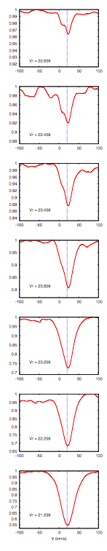
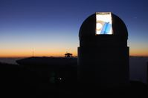
V. Application to μ Cep
0.0
-0.5
-1.0
-1.5
-2.0
-2.5
-3.0
-3.5
inner
μ Cep
MARCS synthetic spectrum
  66 high-resolution
  (R = 86 000) spectra of μ Cep
  obtained on the HERMES spectrograph (Raskin et al. 2011) on MERCATOR telescope (La Palma)
  Δt = 1505 d
outer
Compute CCF (Radial Velocity)
log(τ₅₀₀)

Slide 13
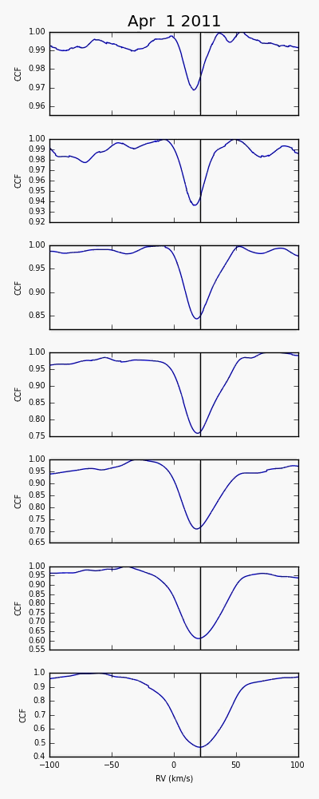
0.0
-0.5
-1.0
-1.5
-2.0
-2.5
-3.0
-3.5
Innermost mask
The dance of the supergiant:
Time lapse μ Cep
April 2011 – Jan 2015
(see the attached file
tomo.mov)
Outermost mask
log(τ₅₀₀)

Slide 14
Phase relation between velocities and line depth (ratio)
Hysteresis (caused by convective cells?)
LDR = Line Depth(VI)/Line Depth(FeI)
(km/s)
Gray, 2008, AJ 135, 1450
Betelgeuse
Typical time 400 d
μ Cep
Observation: 550 d

Slide 15
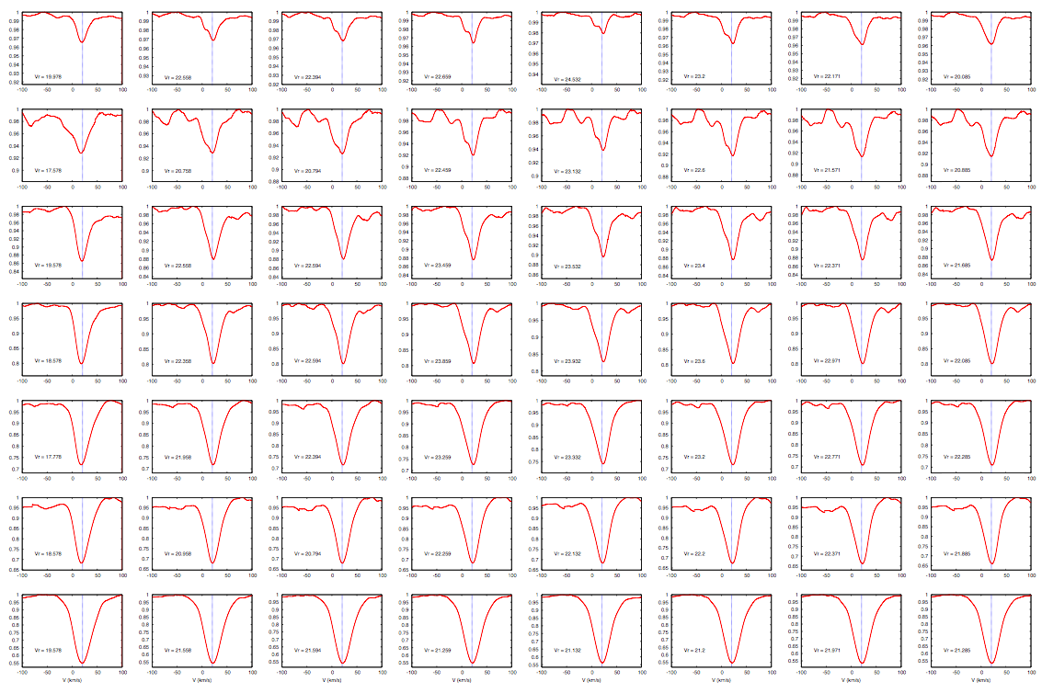

t= 0 +90 +92 +133 +151 +161 +178 +190 d
Not quite the same behaviour as in Miras (above):
In supergiants, the blue peak (ascending matter) never dominates
→ in supergiants, the shock wave dies off rapidly, or is it a shock wave ?

Slide 16
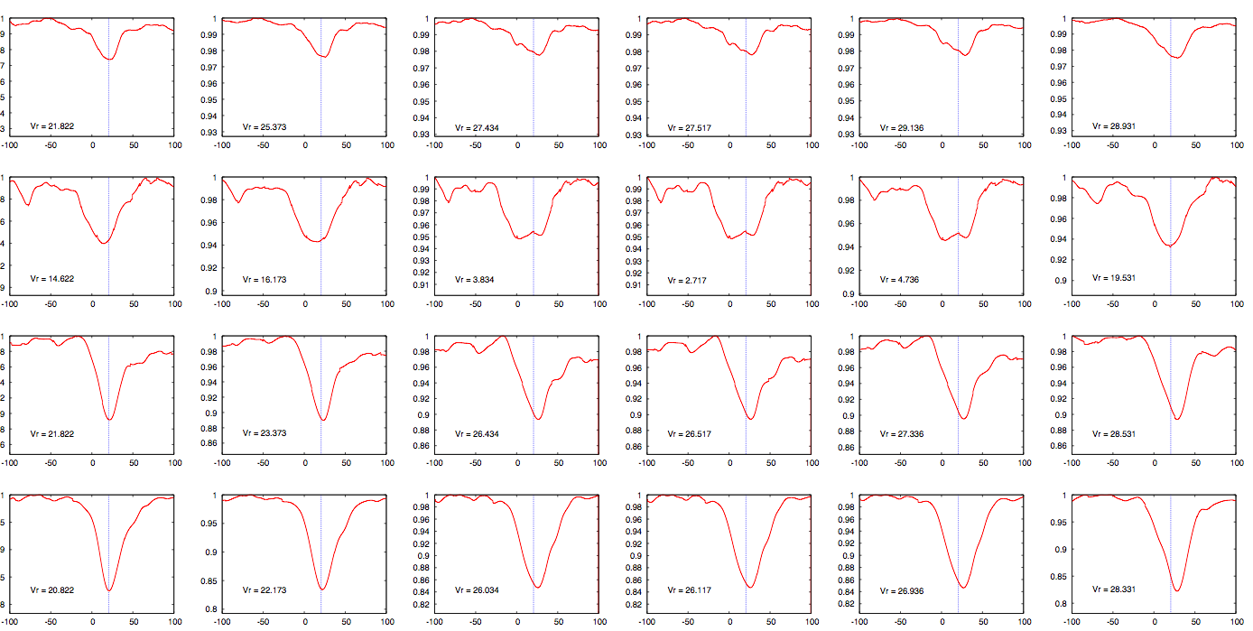
Another example, 450 d later
t= 0 +18 +65 +67 +80 +161 d

Slide 17
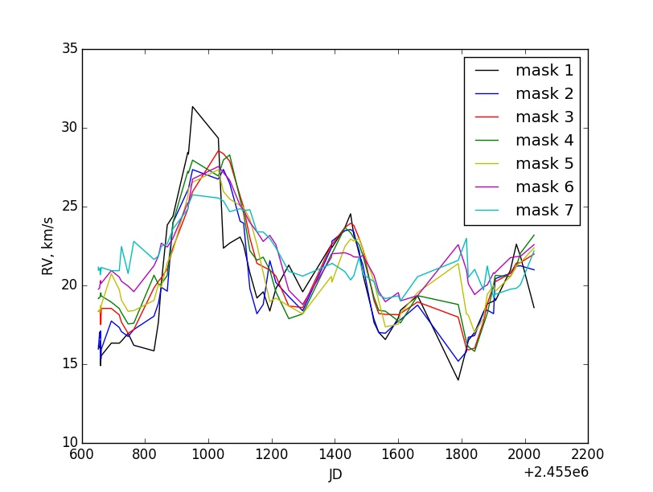
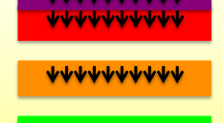
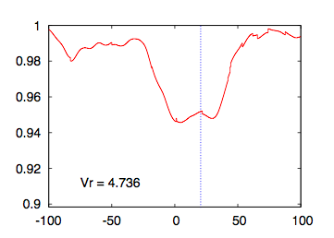
Tomography: V. Velocity curve of μ Cep
inner
Line doubling in deepest masks
matter
falling
down
outer
CoM velocity?
matter
rising
Max R
Min R
v = 0 km/s on the left scale !

Slide 18
Tomography: V. Velocity & light curves of μ Cep
Line doubling in deepest masks
no data
occurs during the
rising part
of the light curve

Slide 19
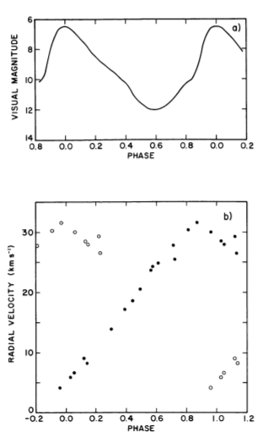
Tomography: VI. Situation in Mira variables (R Cas)
Line doubling around max light
receding
approaching
CO Δv = 3 lines
Max
radius
Hinkle, Scharlach & Hall, 1984, ApJS 56, 1

Slide 20
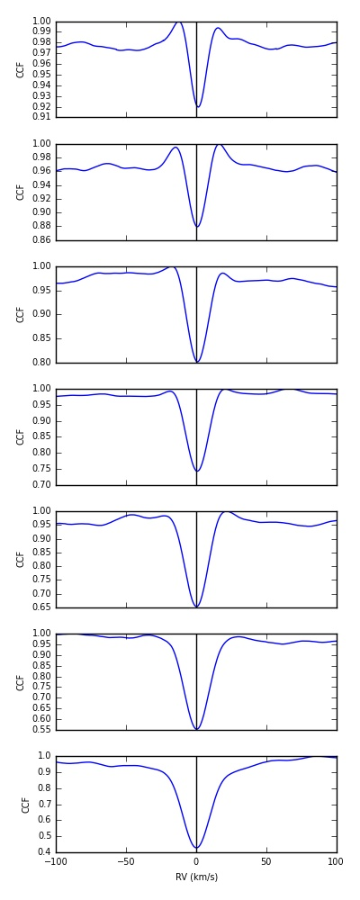
Synthetic MARCS 1D
Synthetic CO⁵BOLD 3D
Observed μ Cep
Tomography:
VII. Comparison
with
3D models

Slide 21
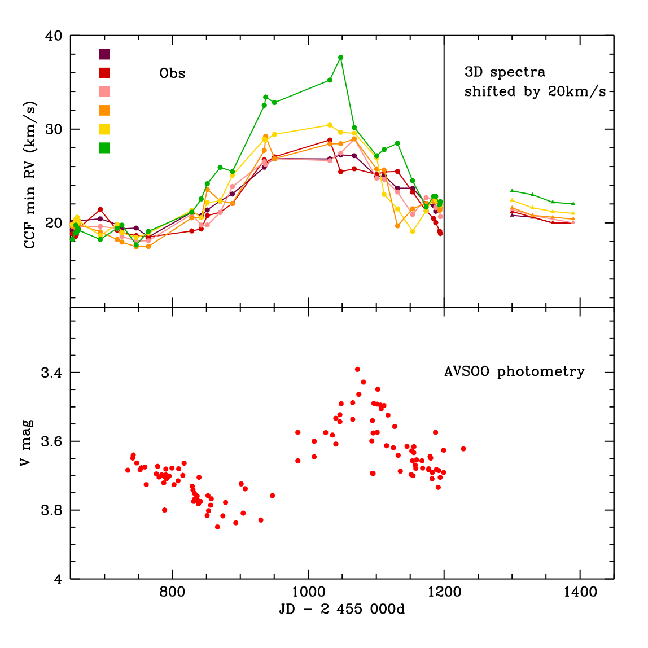
Tomography: VII. Comparison with 3D models
Outer
Line doubling
All masks show consistent variations following radial-velocity curve
Inner
  3D spectra:
  4 OPTIM3D snapshots
  from CO⁵BOLD 3D models
  (Chiavassa et al. 2011, A&A 535, A22)
  T_{eff} = 3430 K
  M = 12 M
  R = 846 R
  log g = -0.35
AAVSO photometry

Slide 22
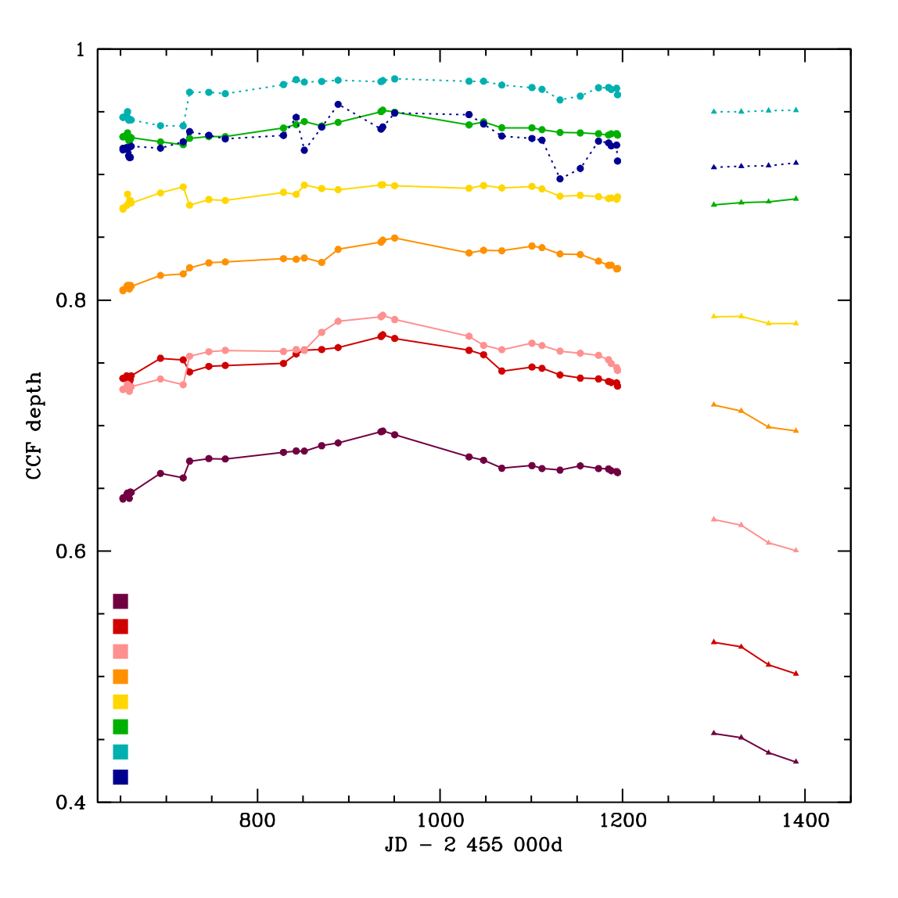
CCF depth
Depth
Inner masks sample weak lines
Outer masks sample strong lines
Comparison with 3D CO⁵BOLD
(4 snapshots):
for outer masks especially:
3D CO⁵BOLD lines are deeper
(factor ~1.5 to 2)
Observations
Outer
models
Inner

Slide 23
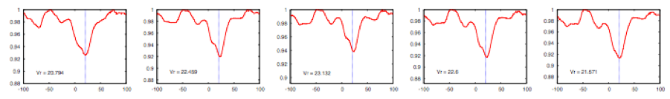
Summary
OBSERVED FEATURES:
In the supergiant μ Cep, line doubling systematically occurs
  on the rising part of the light curve;
  in the innermost masks;
  is never seen in the outermost masks;
  with the red component stronger.
Hysteresis between CCF/line depth and velocity
The evolution of line doubling is different in Miras and supergiants
COMPARISON WITH 3D MODELS:
Some discrepancies for line depths, widths, & velocities (τ)
currently being investigated by increasing numerical resolutionof models (Chiavassa et al.)
A close collaboration with 3D-modellers is needed to make the models reproduce all these data
Notes:
Already suggested by Gray 2001

