Slide 1
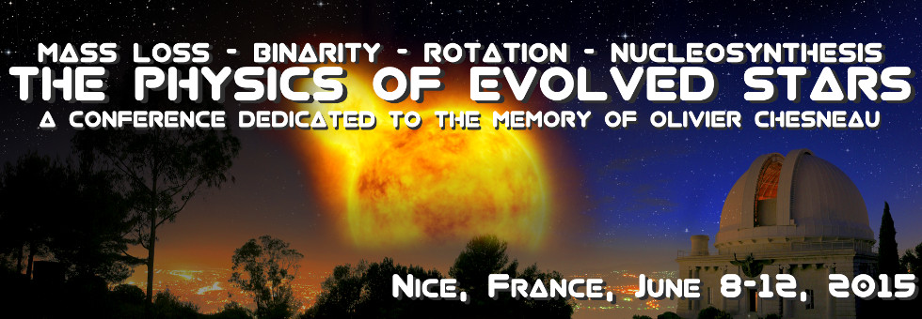
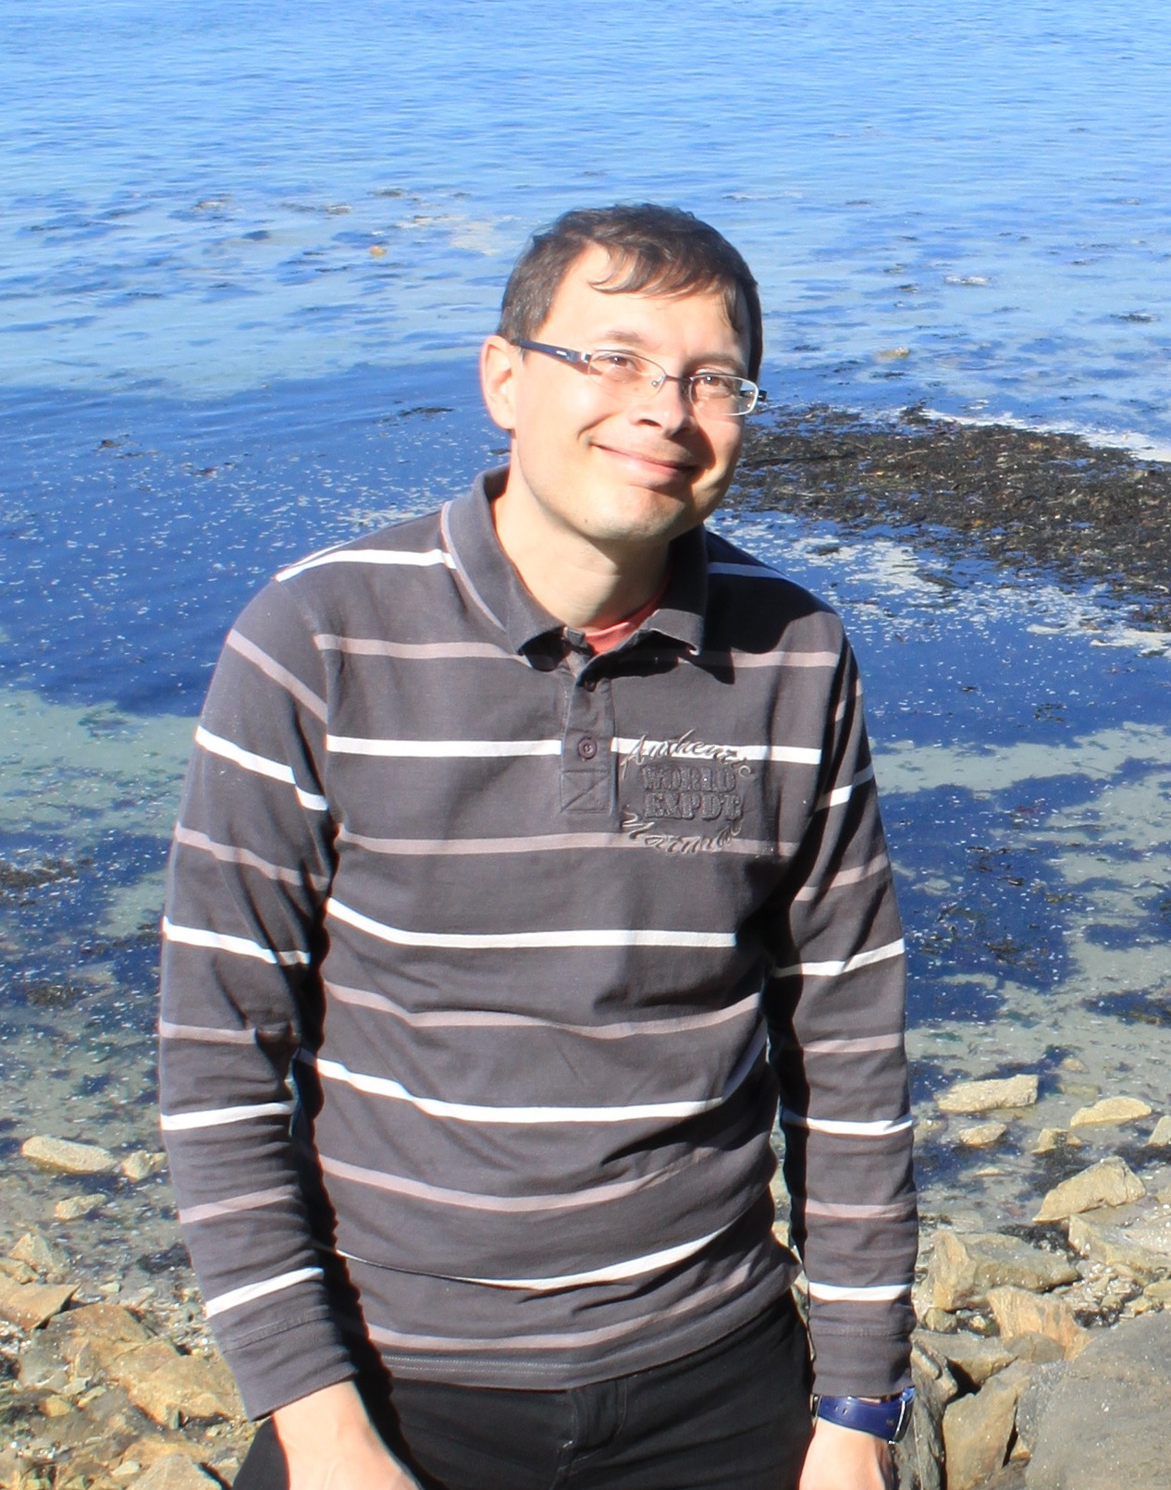
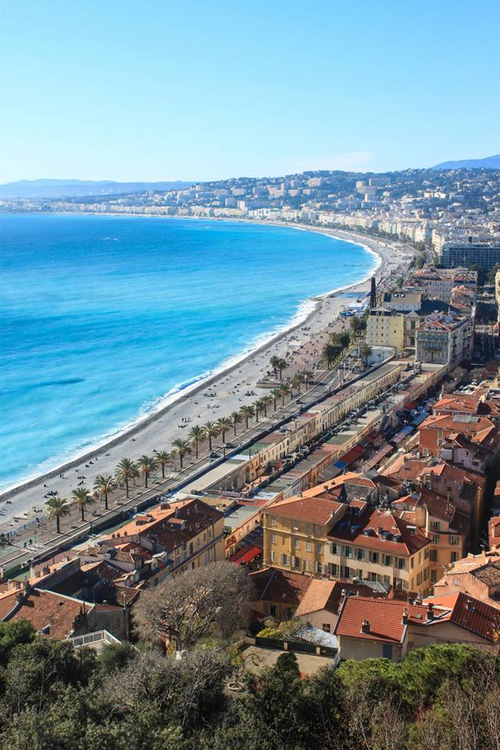
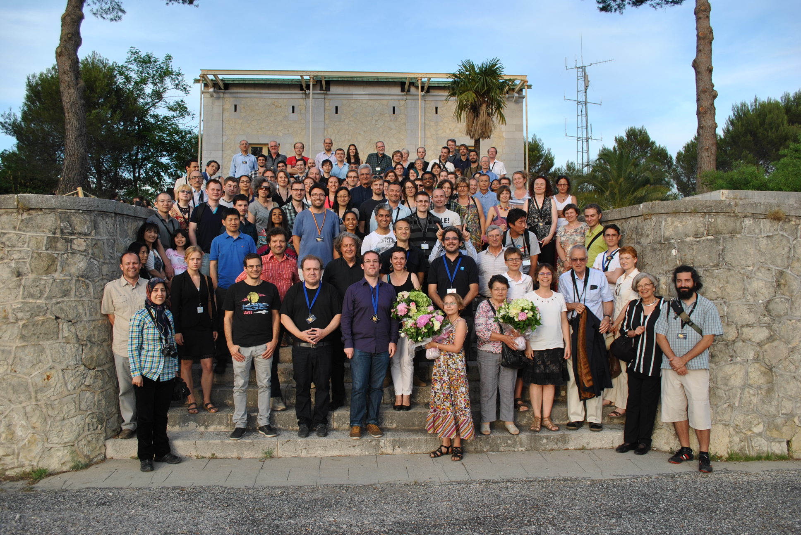

Summary
Eric Lagadec
(Observatoire de la Côte d’Azur)

Slide 2
Conference’s motivations
Tribute to Olivier Chesneau (1972-2014)

Slide 3
Conference’s motivations
Gather different communities to discuss the physics of Evolved stars

Slide 4
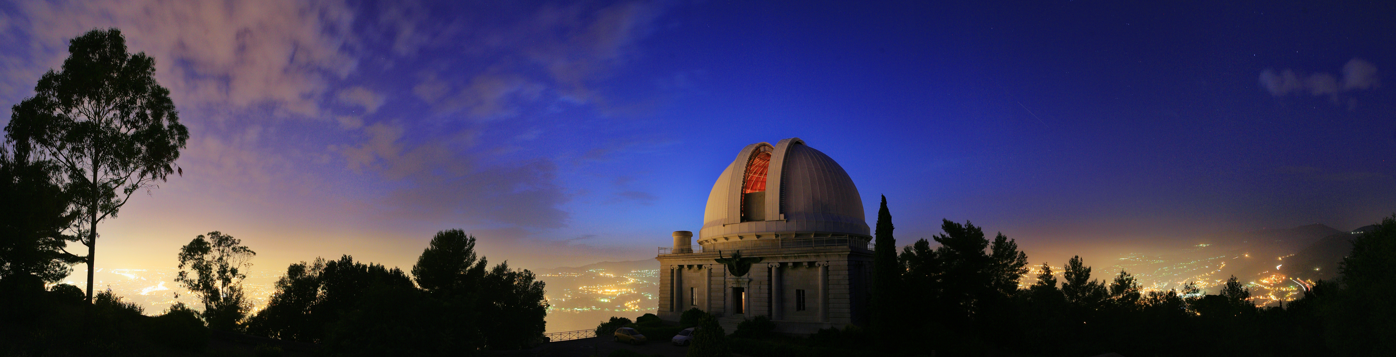
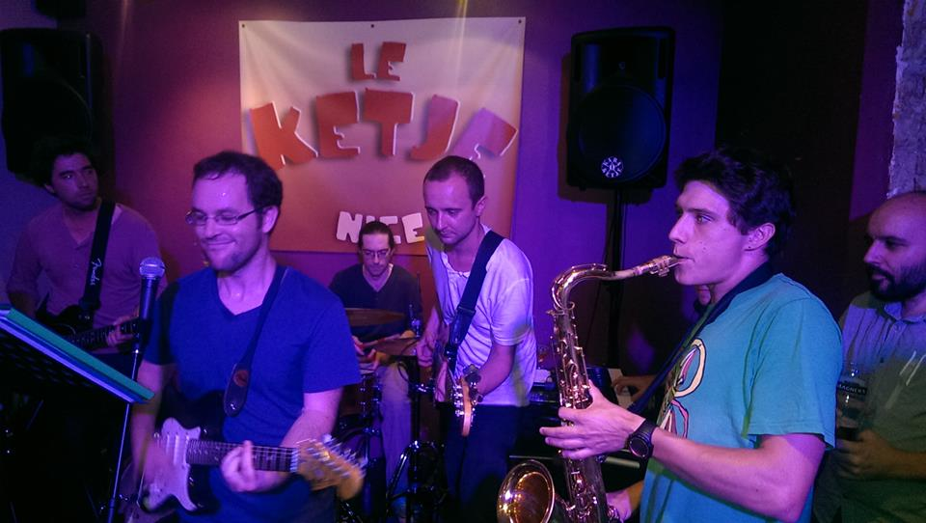
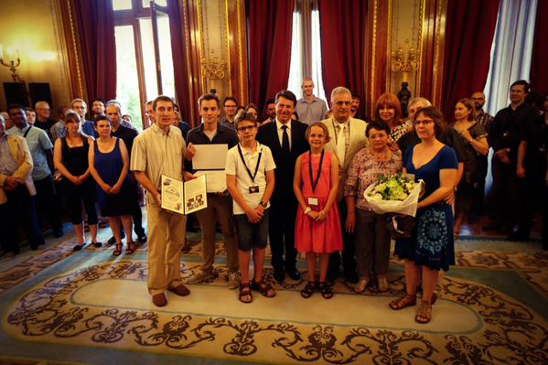
A Nice conference to celebrate his life

Slide 5
A Nice conference
130 participants

Slide 6
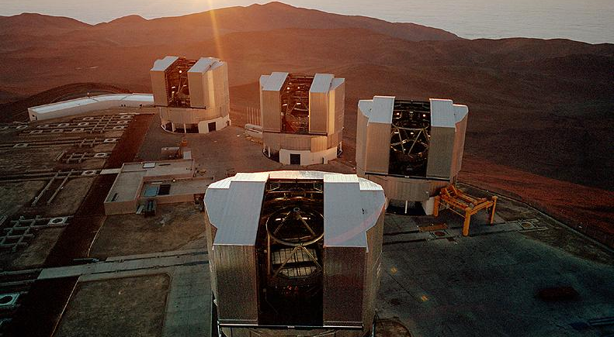
Quick overview of Olivier’s work

Slide 7
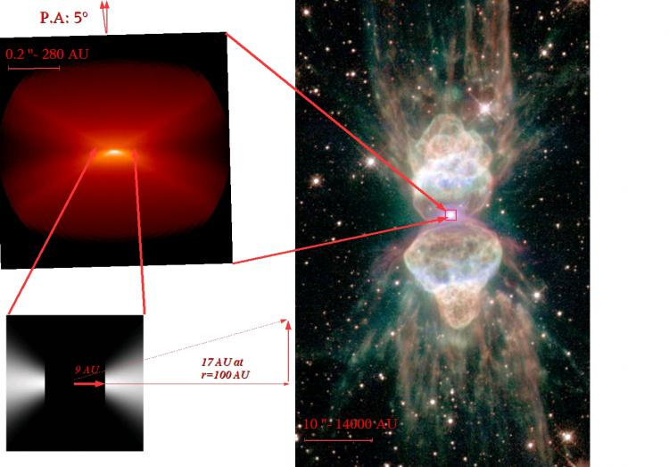
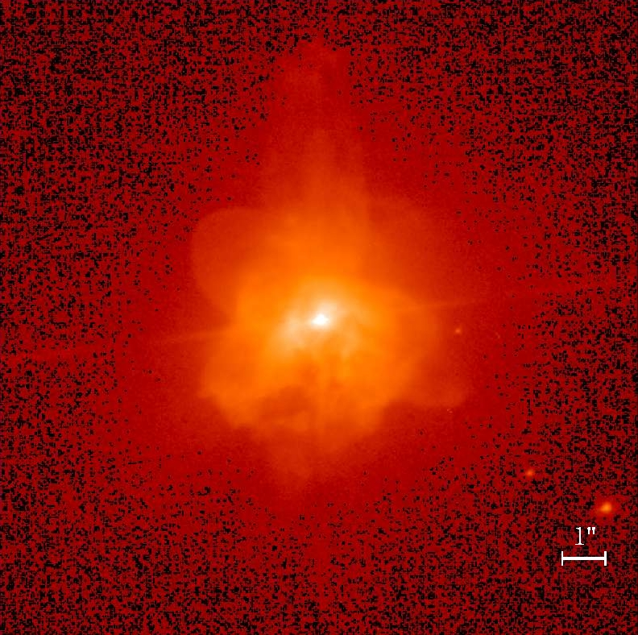
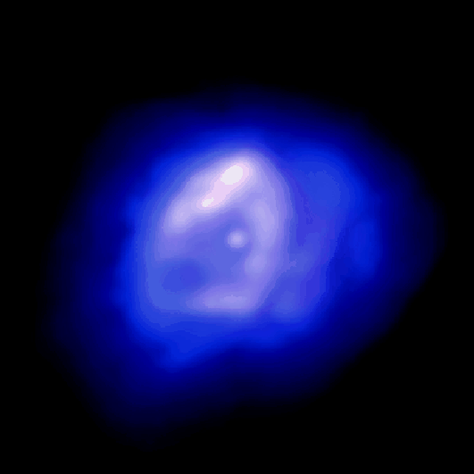
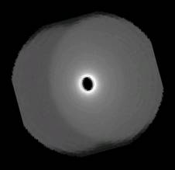
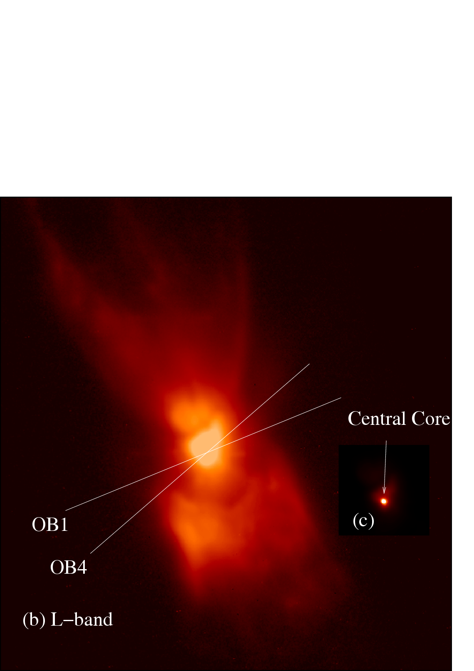
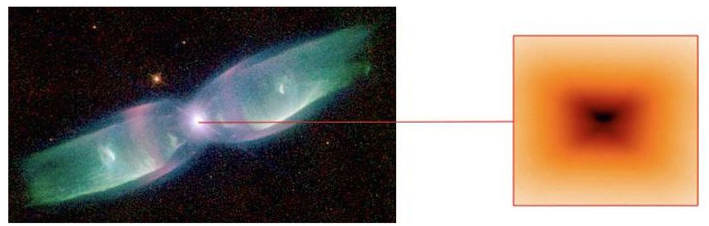
Olivier: the disc hunter with MIDI
Mz 3, The Ant
CPD -568032
Hen 2-113
Chesneau et al., 2007
Lagadec et al., 2006
Chesneau et al., 2007
QX Pup, the Rotten Egg
M2-9, The Butterfly
MIDI visibilities for different baselines orientations
Matsuura et al., 2006
Lykou et al., 2010

Slide 8
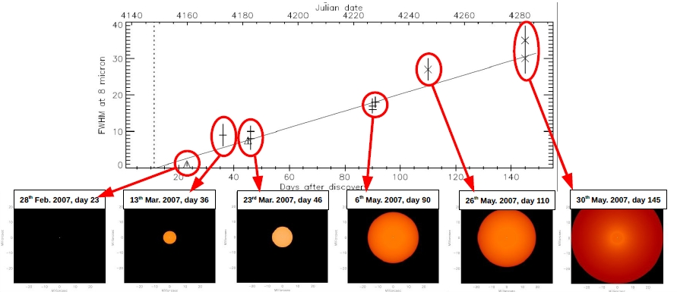
Novae and the VLTI:
Nova V1280 Sco: MIDI observations just after the event
Fast dust creation! (10⁻⁶ M_{ʘ} in 140 days)
Expansion: 0.35 mas per day
Chesneau et, 2008

Slide 9
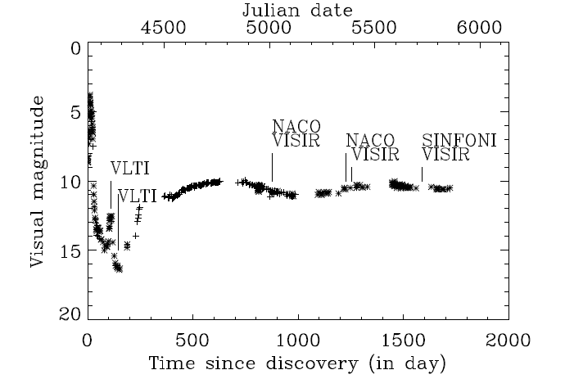
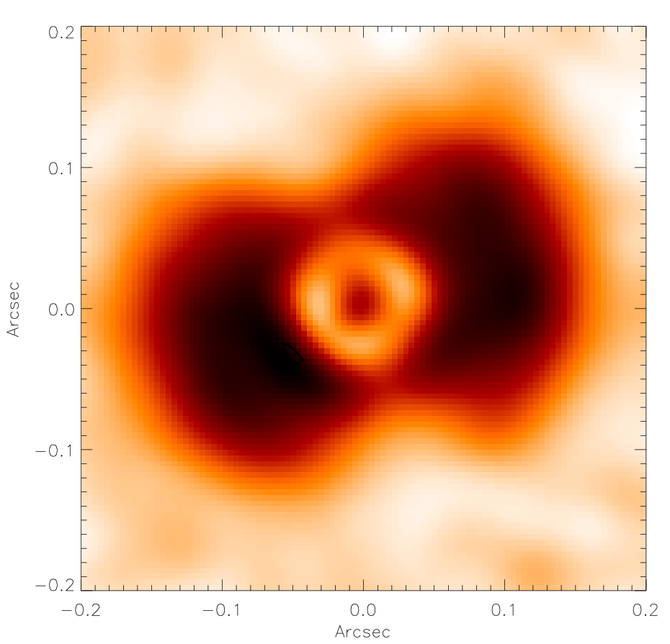
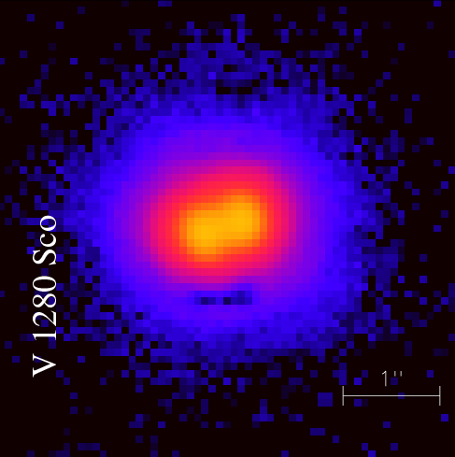
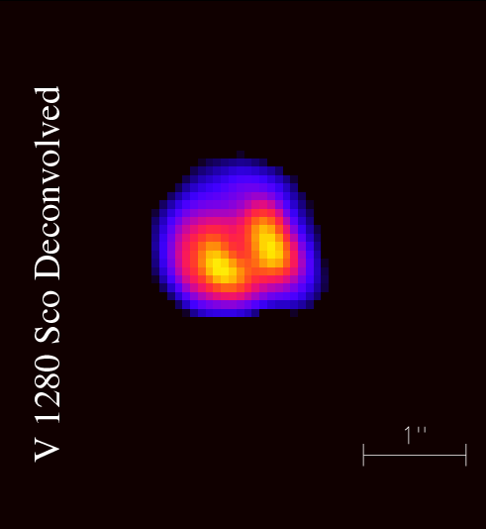
Nova and the VLTI:
Live formation of a bipolar nebula
2010, NACO
2009, VISIR 2011, VISIR
V1280 Sco
Chesneau et al. , 2012

Slide 10
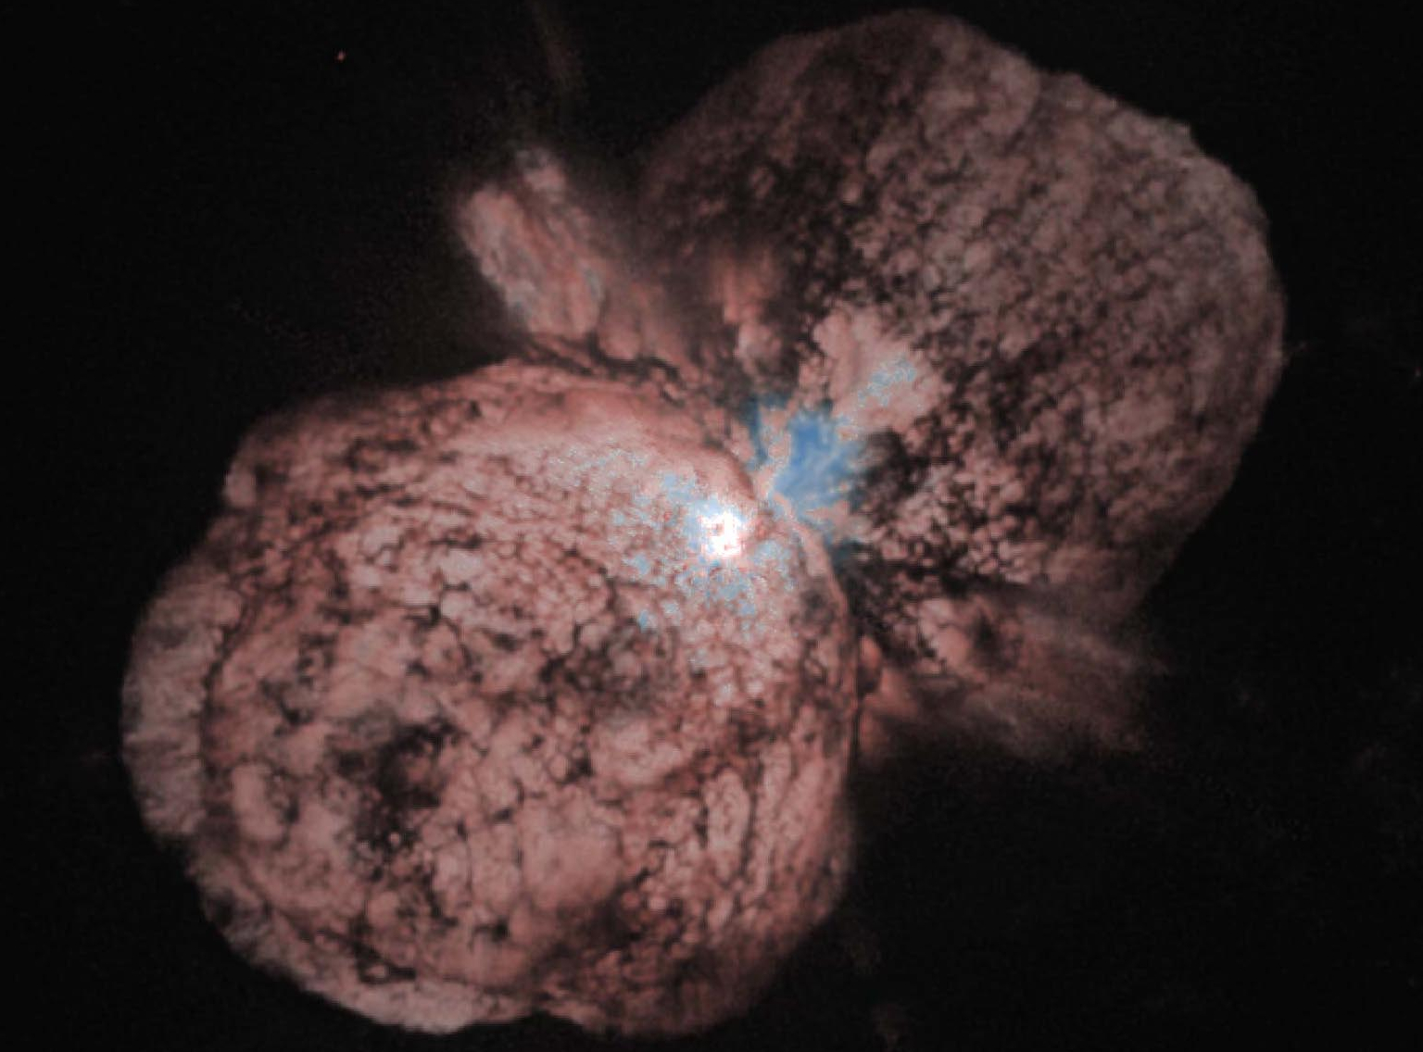
Clos environment of massive evolved stars
Eta Carinae
HST
VLT/NACO GEMINI/NICI
1 arcsec
1 arcsec
VLT/NACO, VLTI/VINCI, VLTI/MIDI, VLTI/AMBER, GEMINI/NICI
Chesneau et al. 2005 A&A, 435, 1043; Artigau et al. 2011 AJ, 141, 202

Slide 11
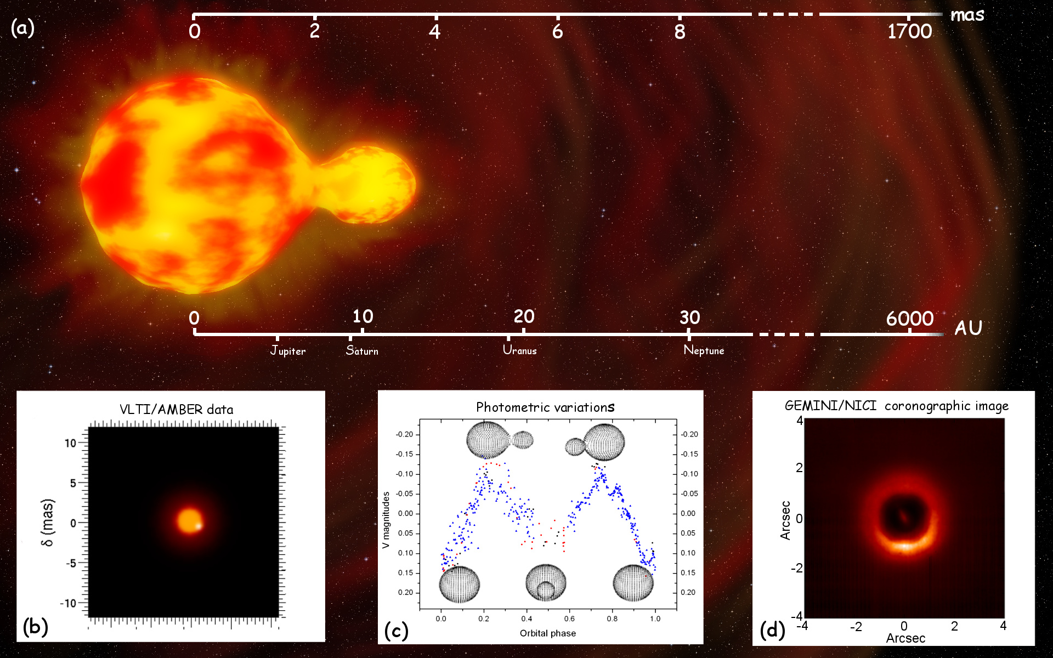
HR5171 A : the peanut star
An evolved binary system in the common envelope phase
VLTI/AMBER + Photometry+ GEMINI/NICI…
Chesneau et al. 2014, A&A, 563, 71

Slide 12
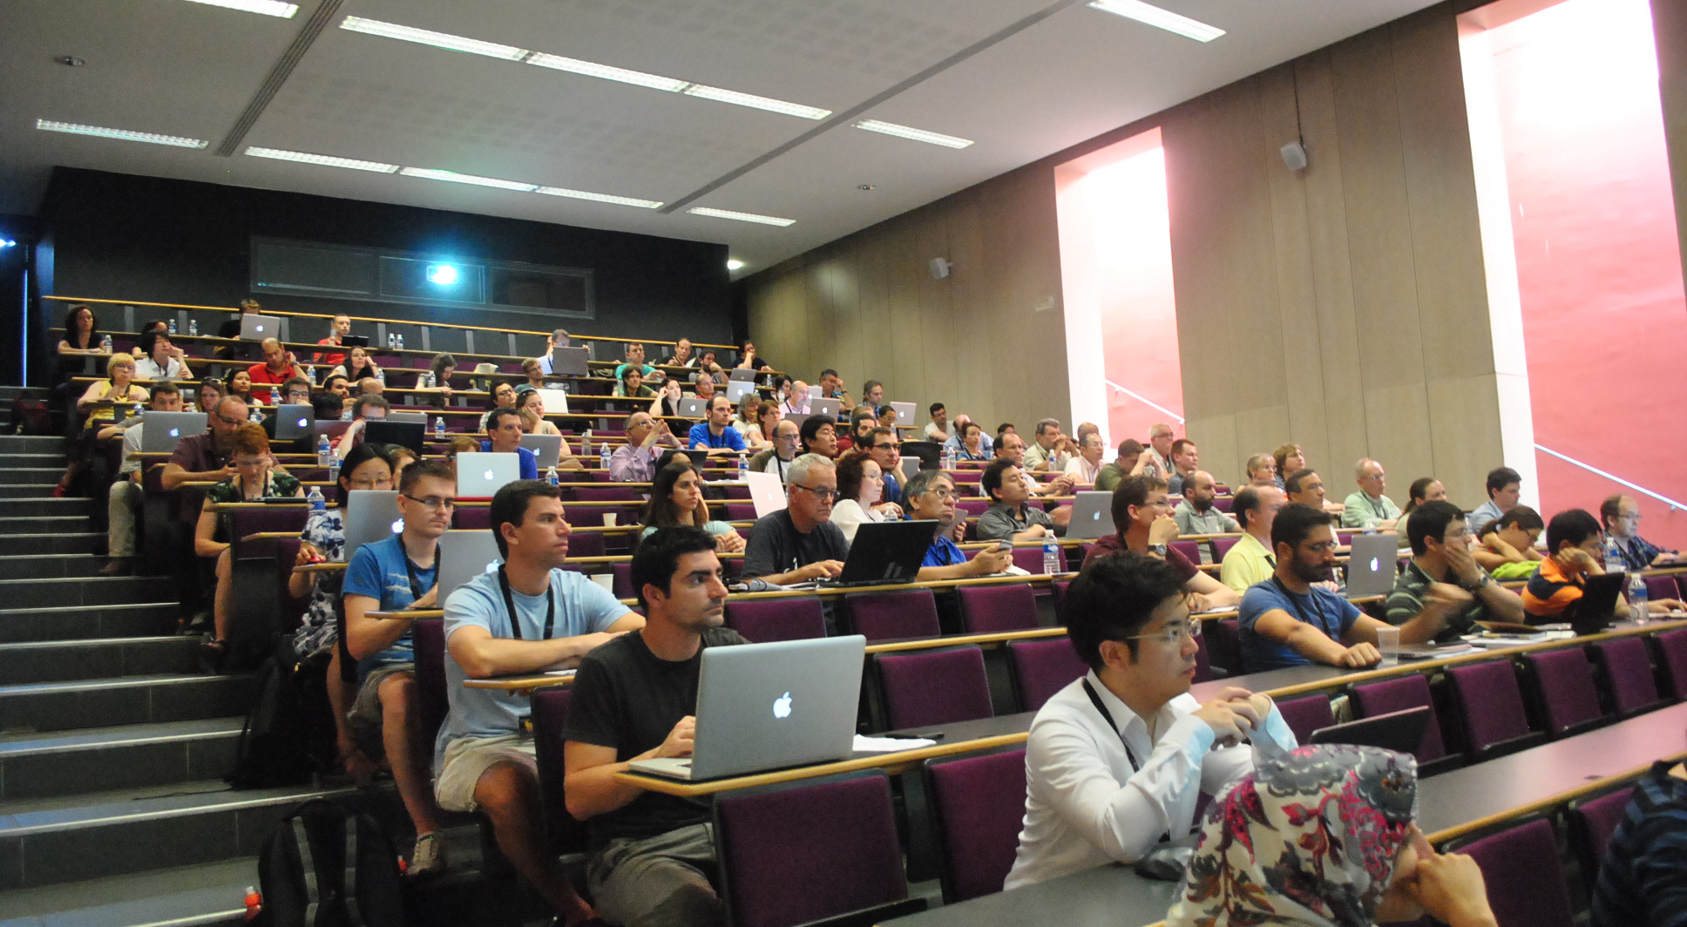
Conference’s highlights

Slide 13
Conference’s sessions
Winds, mass loss, jets
Binaries
Discs
Circumstellar environments
Modeling, evolution

Slide 14
Types of objects discussed
AGBs
Post-AGBs/Planetary Nebulae
Symbiotics
Novae
Red supergiants
Post-RSG
Supernovae

Slide 15
Key discussions
Mass loss: measurement, effect on stellar and Galactic evolution, dust
Binaries: effect on mass loss, shaping, jets etc…
Progress in theoretical studies (3D) and observations (ALMA, PIONIER/VLTI, SPHERE/VLT)

Slide 16
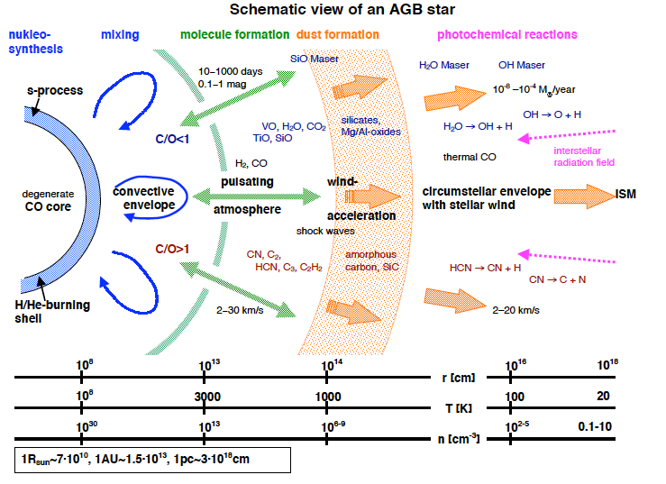

Slide 17
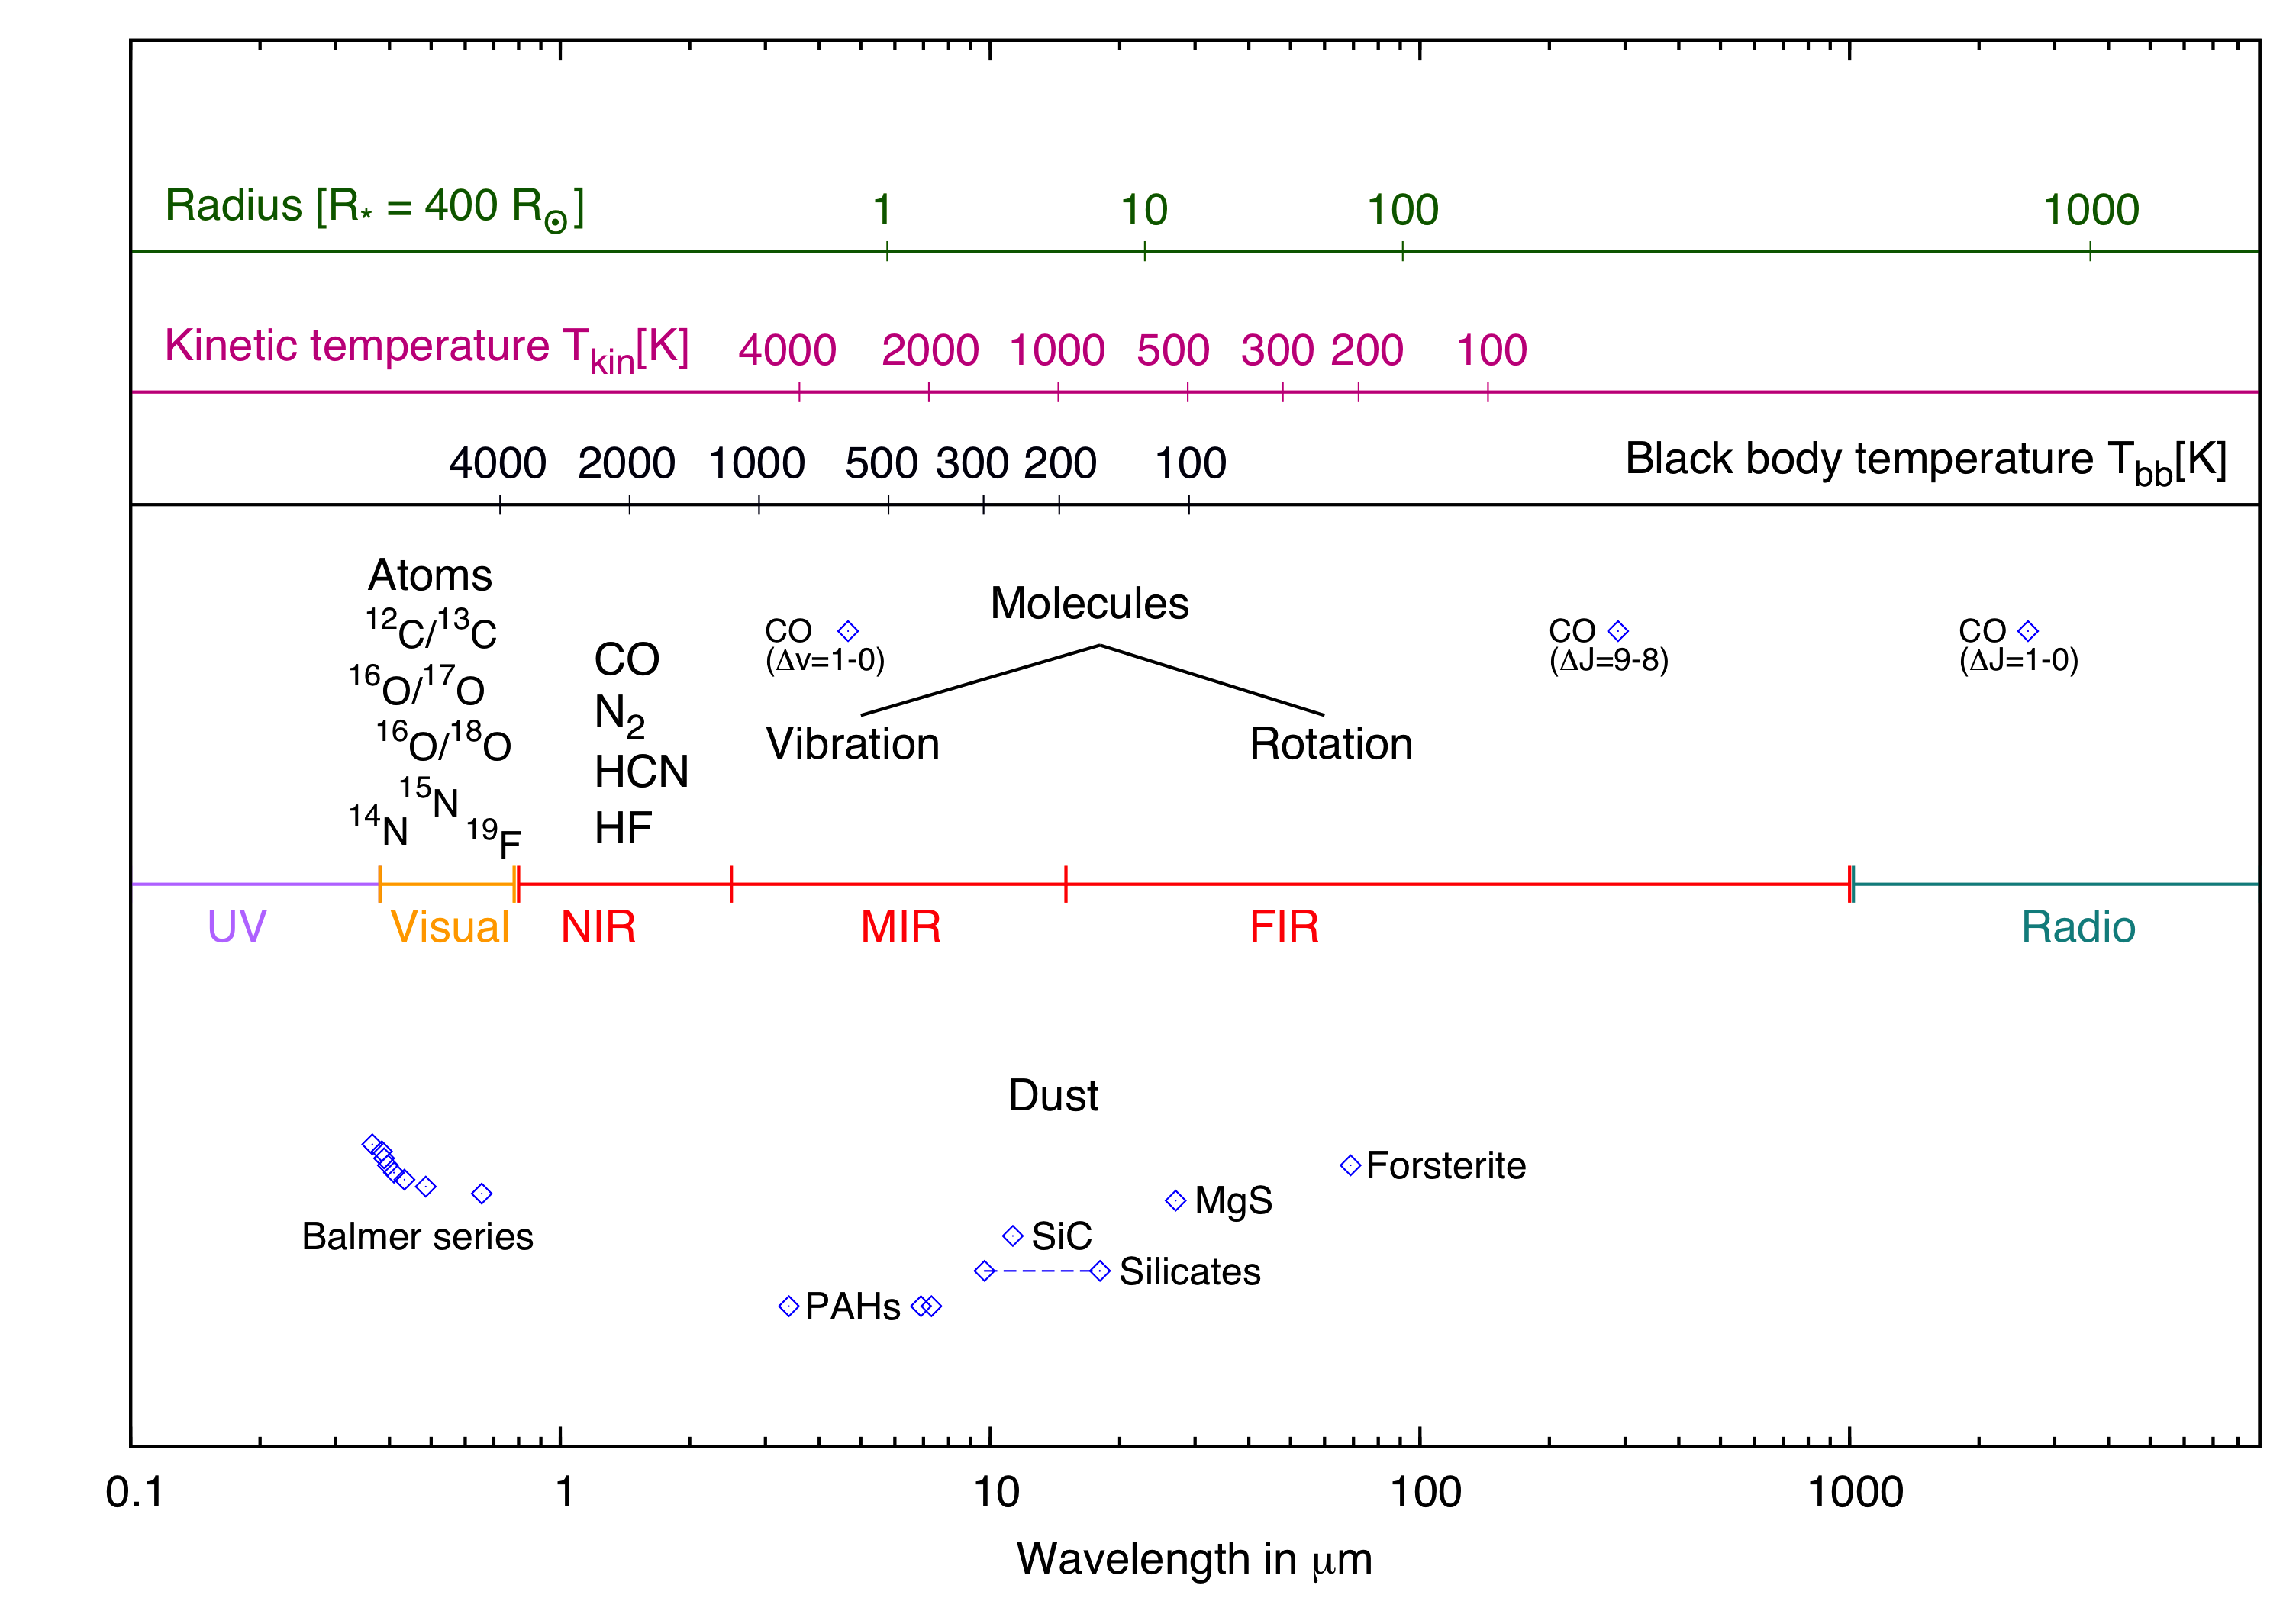
D. Gobrecht

Slide 18
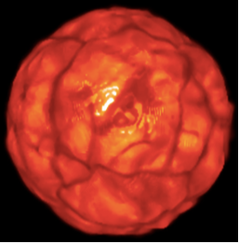
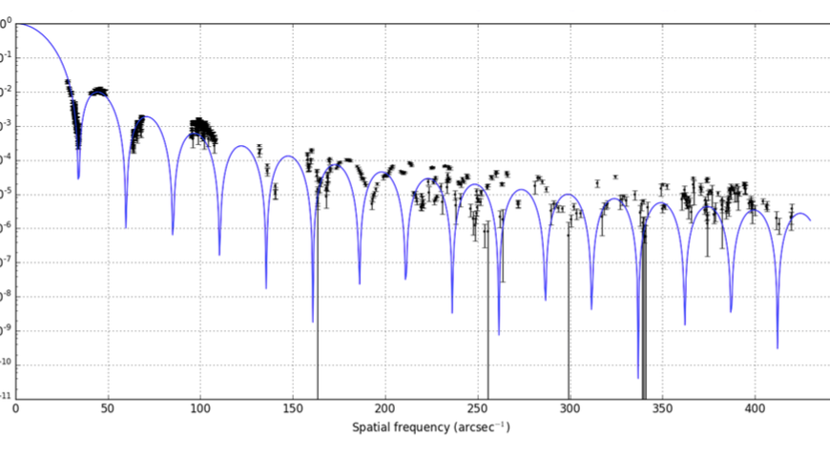
The surface of Antares!
3D simulation
VLTI: 16 visibility lobes!
M. Montarges
A. Chiavassa

Slide 19
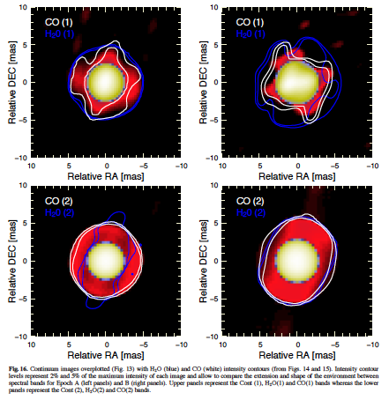
VLTI imaging of the Mira star X Hya
Angular scale variations within pulsation cycle (Hautbois et al., 2015)
M. Wittkowski

Slide 20
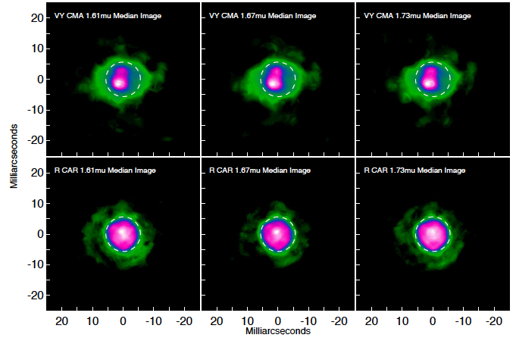
VLTI Pionier imaging (RSG/AGB)
M. Wittkowski

Slide 21
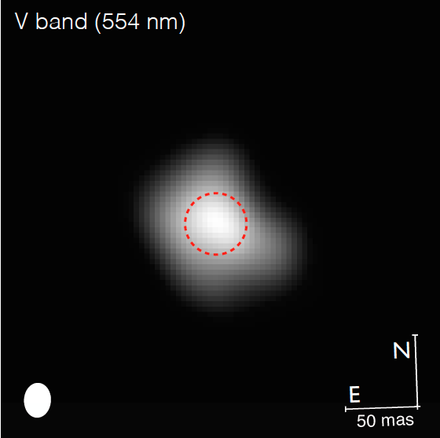
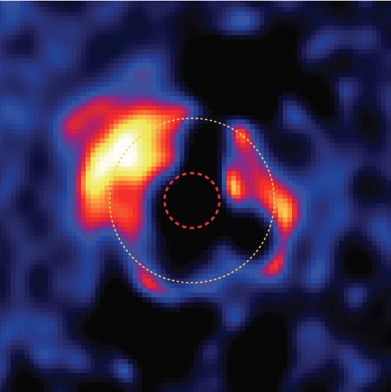
SPHERE/VLT: Betelgeuse
Dust within 3 stellar radii!
P. Kervella

Slide 22
Mass-loss mechanisms and rates
Study of shell layers (M. Wittkowski)
Nucleation models of dust in AGB winds mostly unconstrained (D. Gobrecht)
Durations of AGB superwind? (R. Lombaert)
LMC: no evidence of reduced mass‐loss rate (M. Matsuura)
Mass loss key for late stages of massive stars (but poorly constrained) (J. Groh)
Theoretical MLR for RSG and WR needed! (J. Groh,C. Georgy)
~2/3 of massive stars will experience binary interaction (N. Smith)
New constraints on nucleosynthesis (S. van Eck)

Slide 23
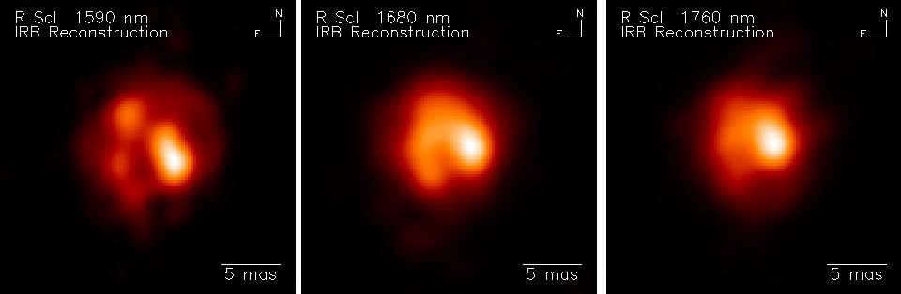
Close environment of R Scl
M. Wittkowski

Slide 24
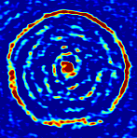
Binary interaction?

Slide 25
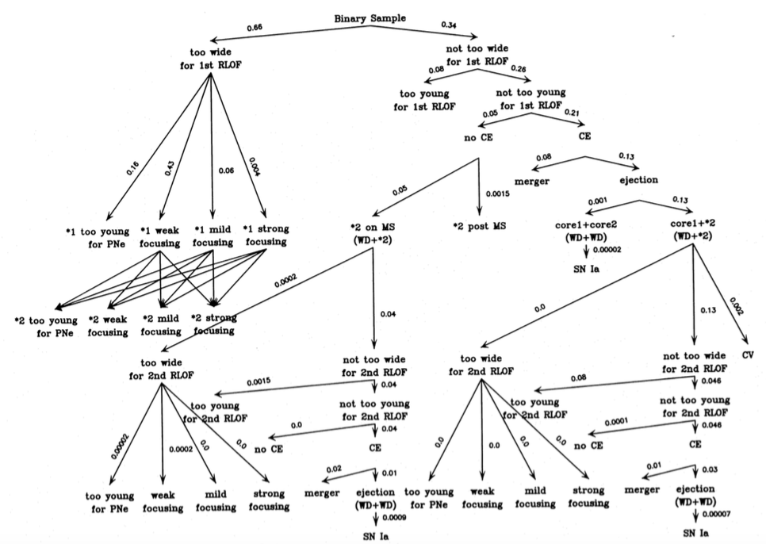
O. De Marco
From Han et al., 1995
Binary Zoo

Slide 26
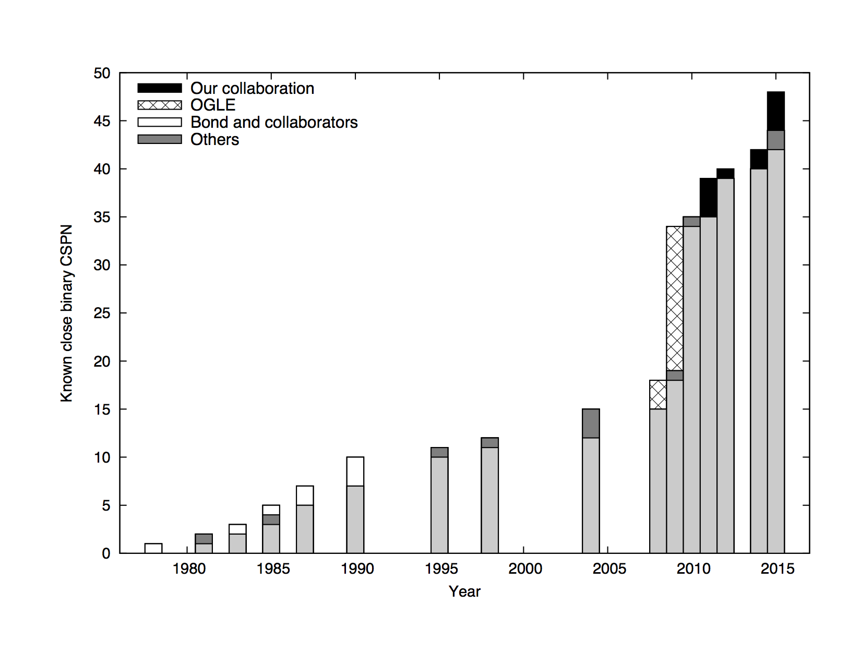
More and more binaries found in PNe! (D. Jones)

Slide 27
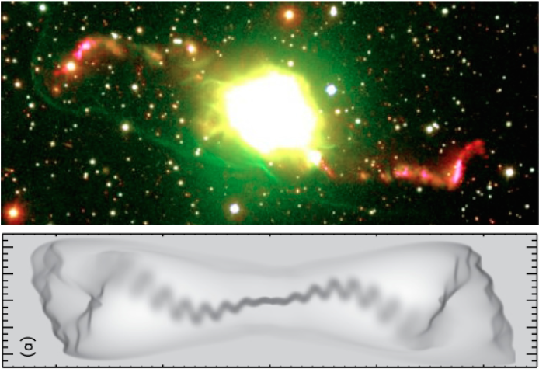
Binaries can launch jets/shape PNe
Boffin et al. (2012)
Jones, Miszalski

Slide 28
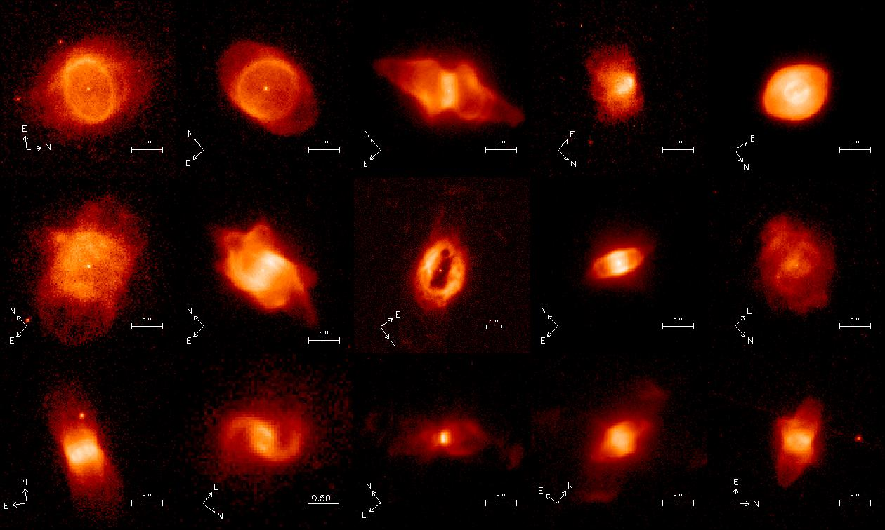
Binaries can affect the dust composition
L. Guzman, N. Evans

Slide 29

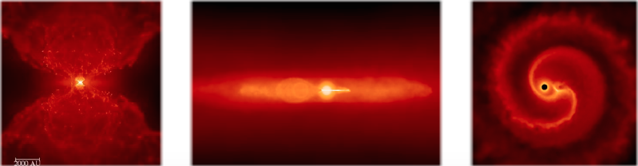
Wind Roche lobe overflow in many systems: complex morphologies
High mass tranfer rates!
S. Mohamed

Slide 30
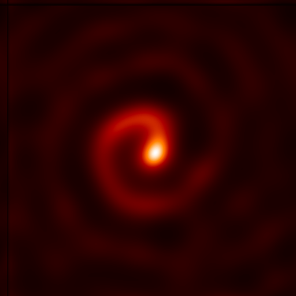
Spirals everywhere!
WC stars in binary systems:
DUSTARS : 10⁻⁶ M_{sun}/yr!
T. Moffat

Slide 31
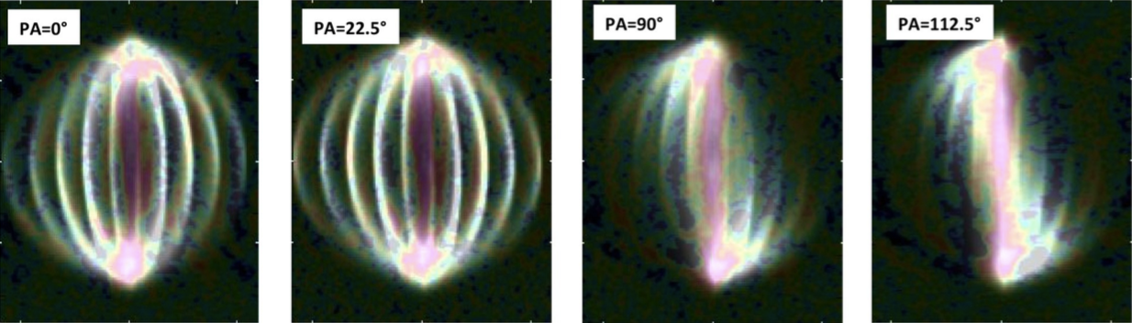
IRC +10216: spiral sideway!
Binary system?
L. Decin

Slide 32
Jets everywhere!
Jets play a major role in shaping objects from PNe to clusters of galaxies (Soker)
New process: Grazing Envelope Evolution (Soker)
Jets in common envelopes (Jones, Miszalski)
Tenuous jets in post-AGB binaries (van Winckel)
Discs common too (Lykou, Hillen, Vos, van Winckel)

Slide 33
The AGB star L2 Pup:
A bipolar PN in the making!
SPHERE/VLT
P. Kervella

Slide 34
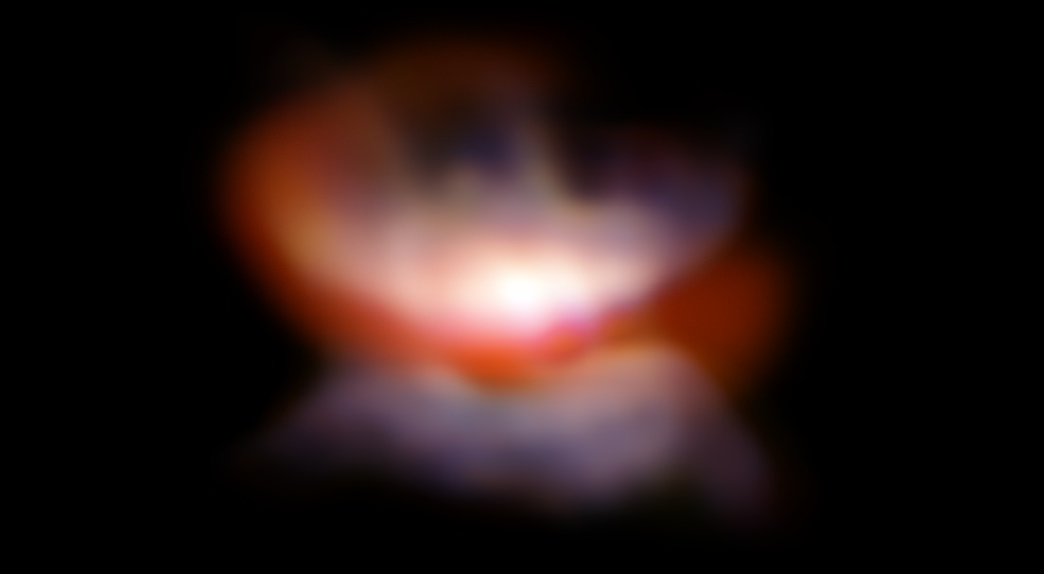
The AGB star L2 Pup:
A bipolar PN in the making!
Kervella et al. (2015)

Slide 35
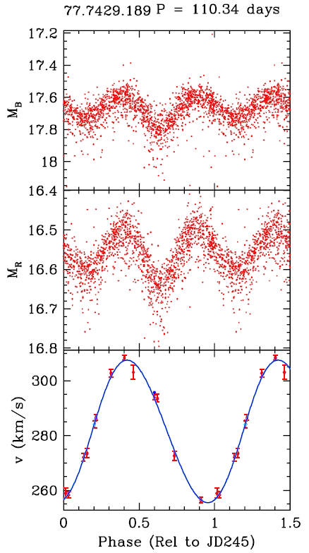
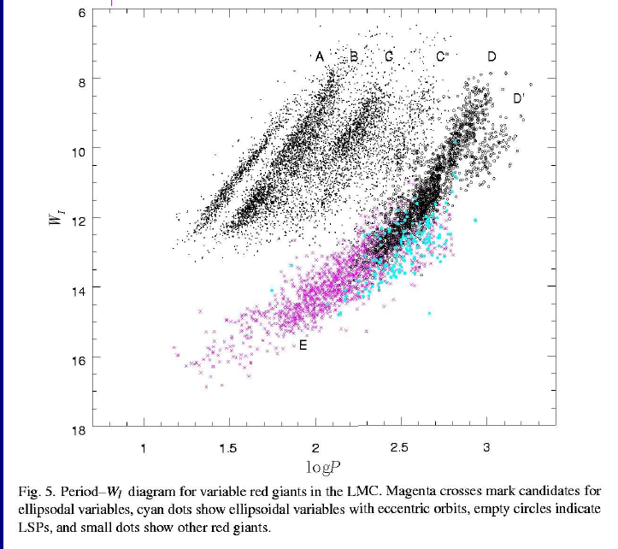
Binaries in the LMC/SMC
Distance known: P-L relation, orbits…
7-9%
Of PNe precursors
Binaries
Wood et al., 1999
Many objects are post-RGB!!!!!: due to binaries?
Nicholls et al., 2010
Kamath

Slide 36
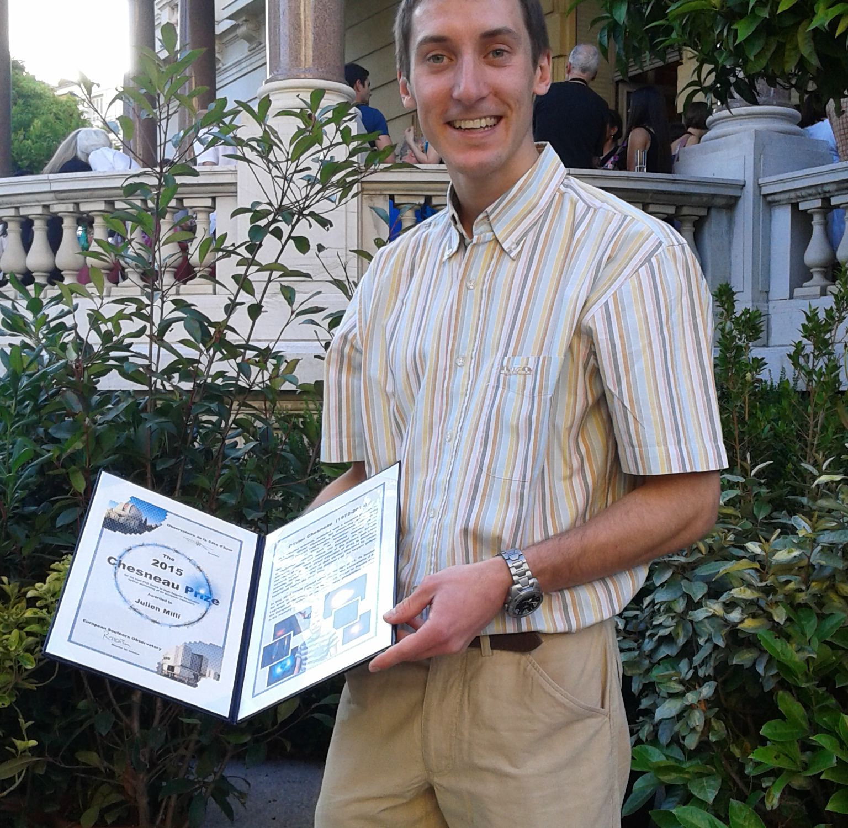
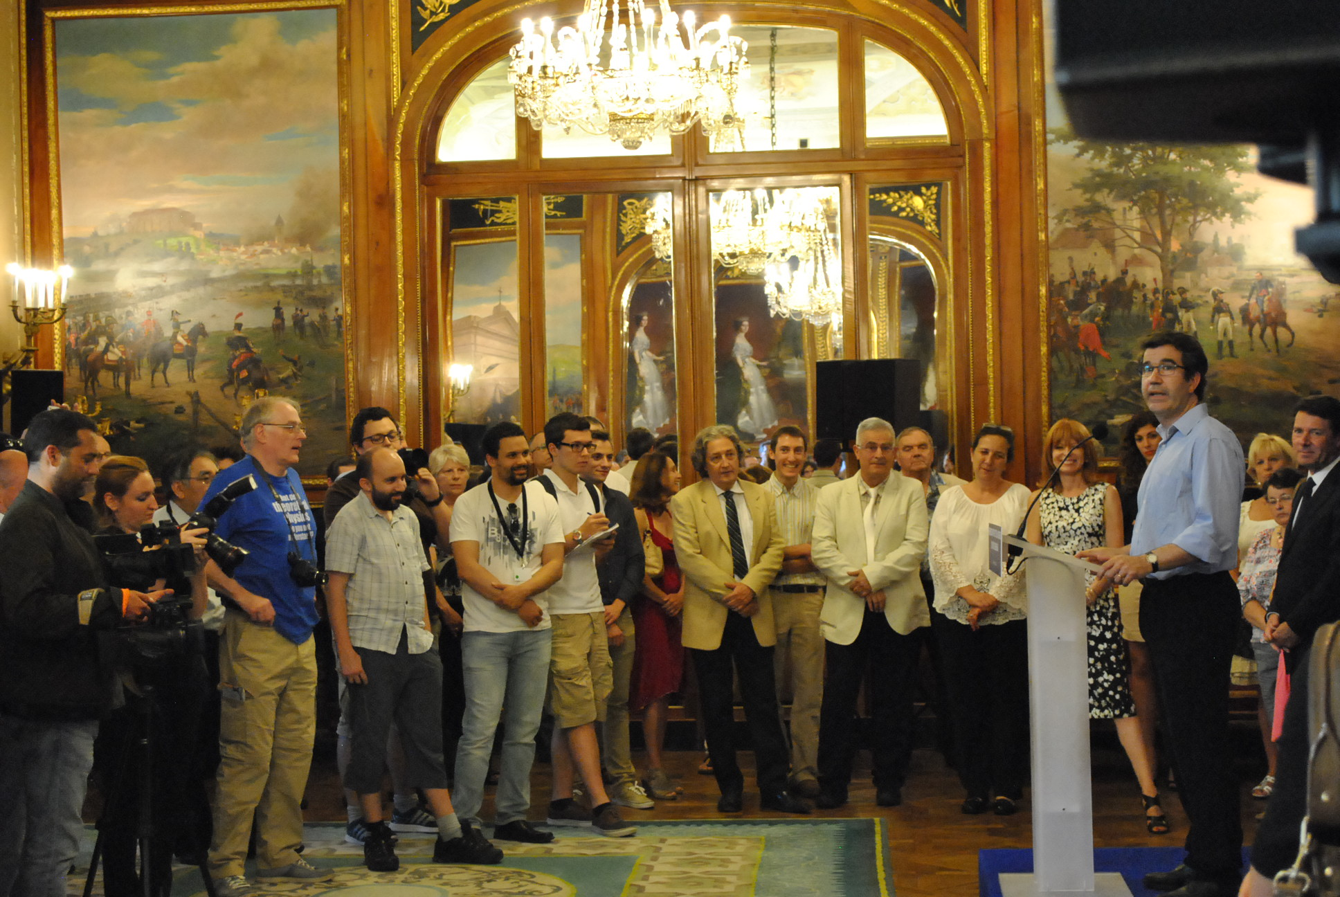
Olivier Chesneau Prize
Best PhD in high angular resolution astronomy
First laureate: Julien Milli (ESO/Chile)
To be awarded in 2017

