Slide 1
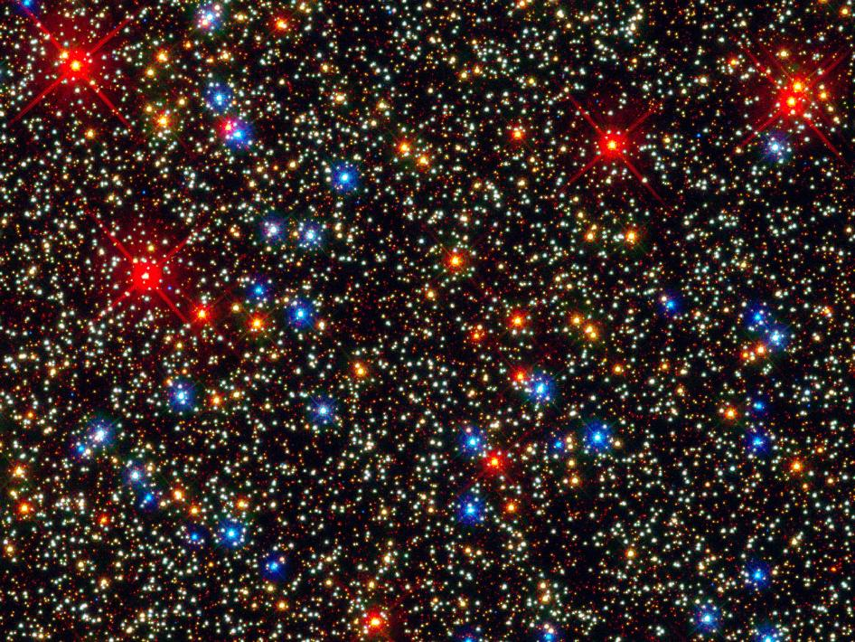
Mixed modes in red giants: a window on stellar evolution
Stellar End Products: The Low Mass - High Mass Connection
Benoît Mosser
Observatoire de Paris
LESIA

Slide 2
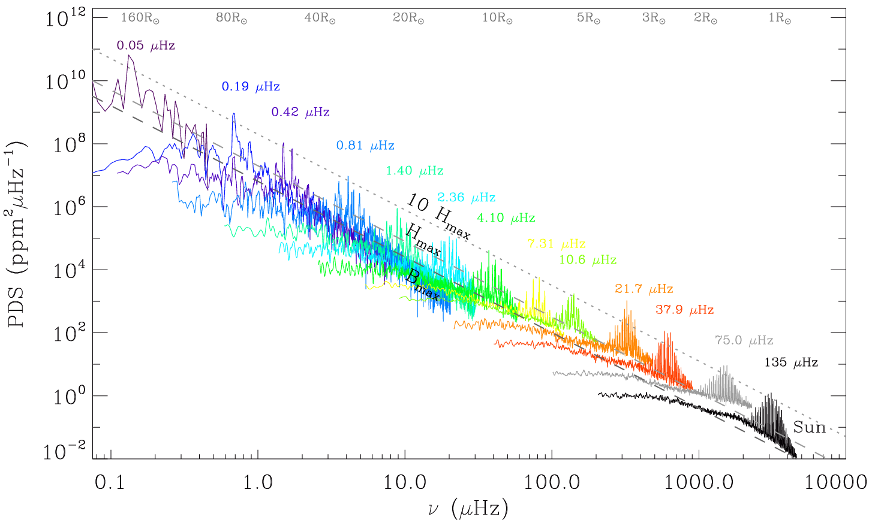
Solar-like oscillations…
= stochastically excitedoscillations in stars with a convective envelope

Slide 3
From the Sun to the whole Galaxy
Radial modes
Global seismic parameters of the pressure modes
→ Mean density, surface gravity
→ M and R scaling relations
Mixed modes
Global seismic parameters of the gravity modes
→ Evolutionary stage, core size
→ Rotation, transfer of angular momentum
Solar-like oscillations
From the Sun to RGB and AGB
Mass loss

Slide 4
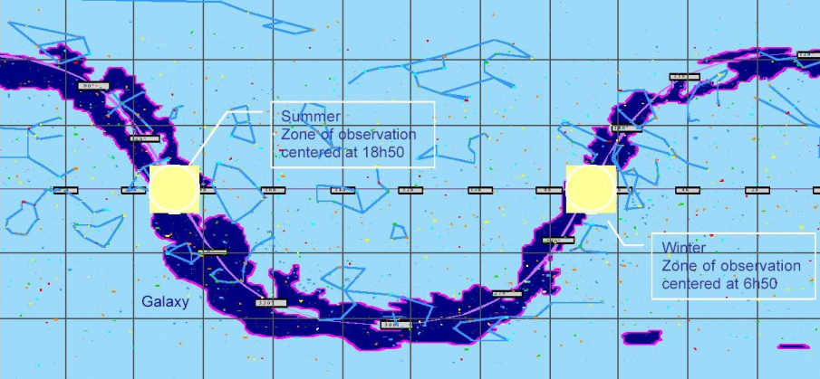
CoRoT 5-month continuous observations
The 2 eyes of CoRoT, in the direction of the ~ center and ~ anticenter of the Galaxy

Slide 5
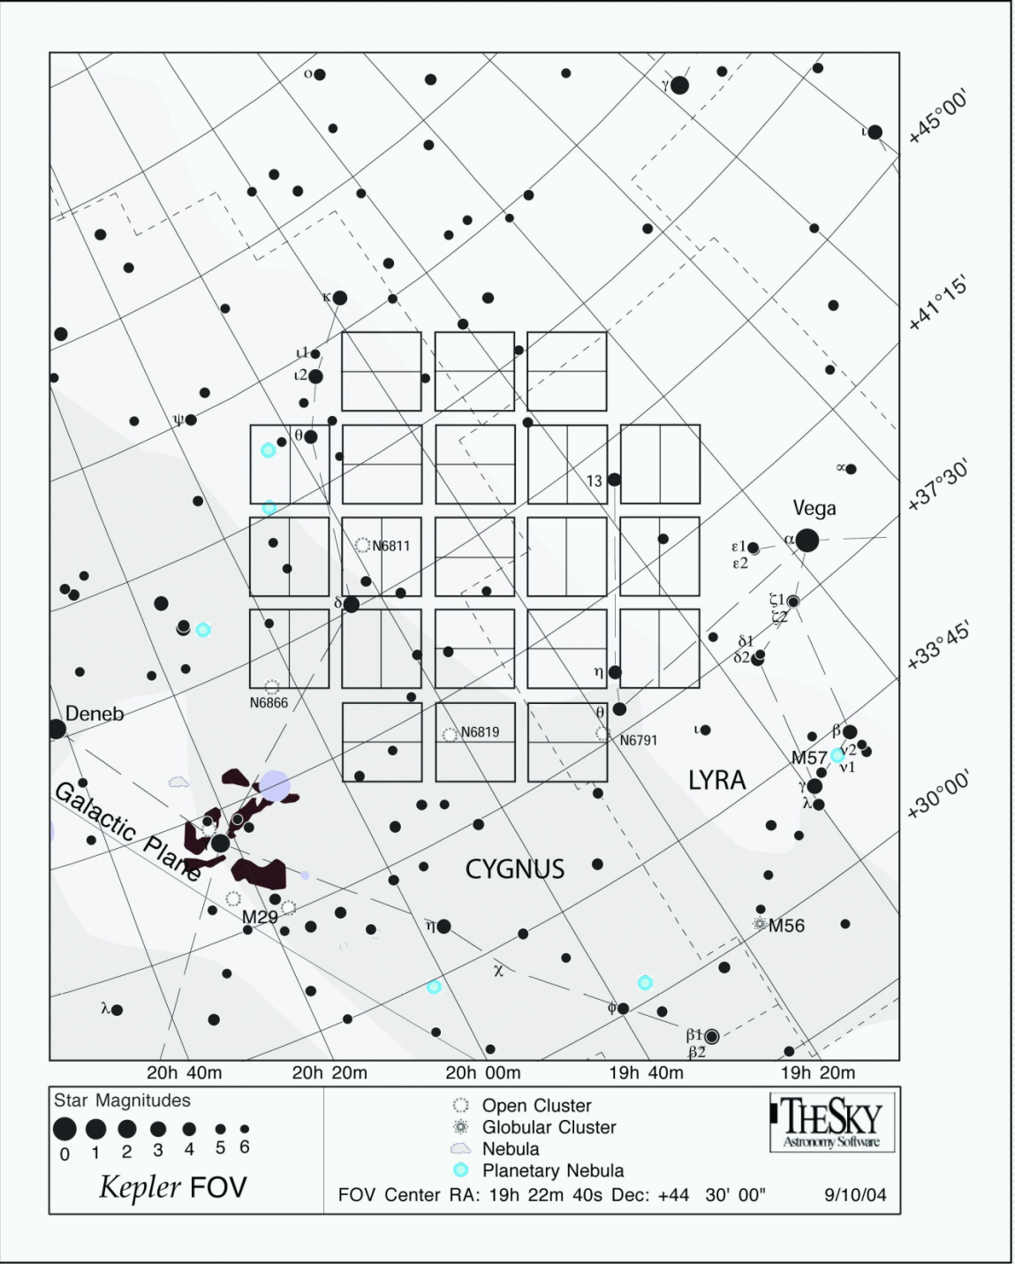
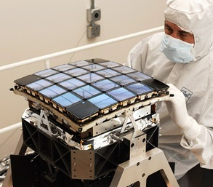
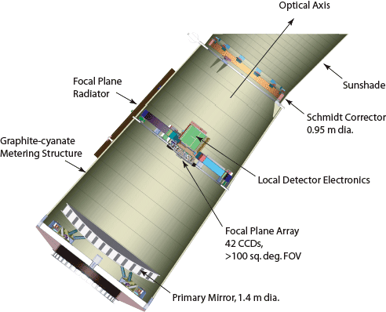
Kepler 4-year continuous observations
Focal plane with 42 CCD

Slide 6
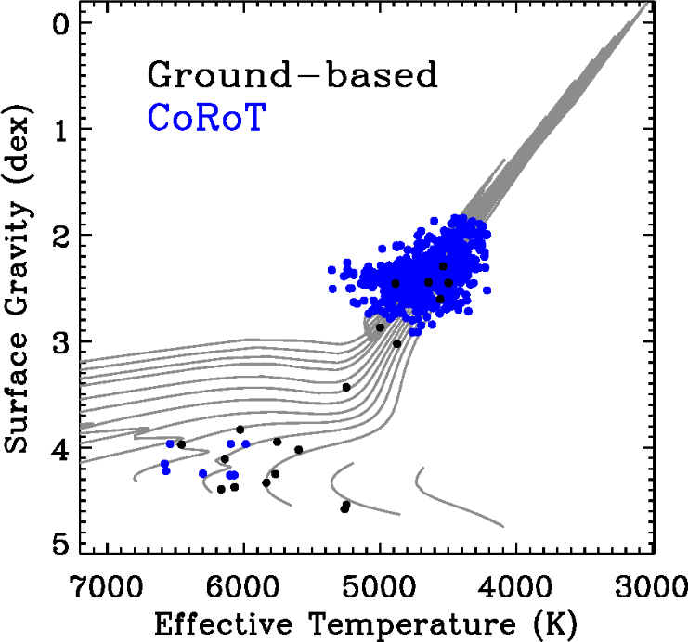
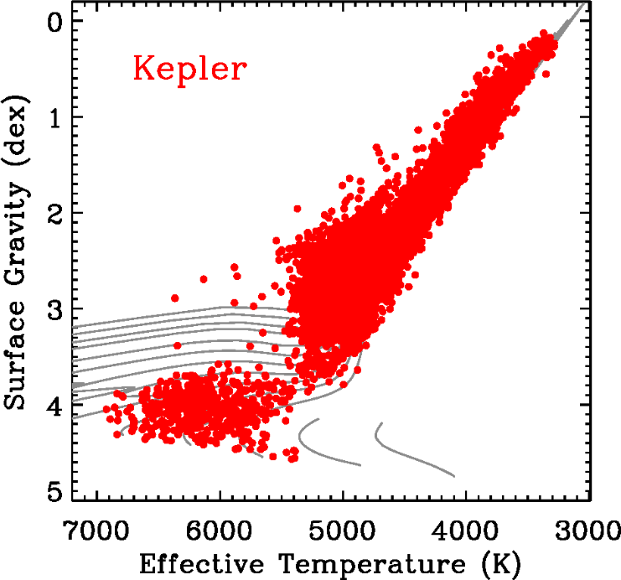
CoRoT & Kepler
Hekker et al. 2009, Huber et al. 2014

Slide 7
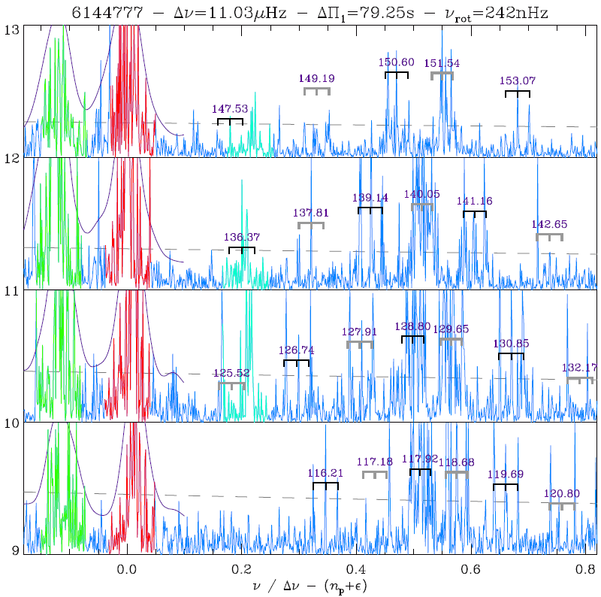
Seismic scaling relations
Seismic
scaling relations
ℓ=2
ℓ=0

Slide 8
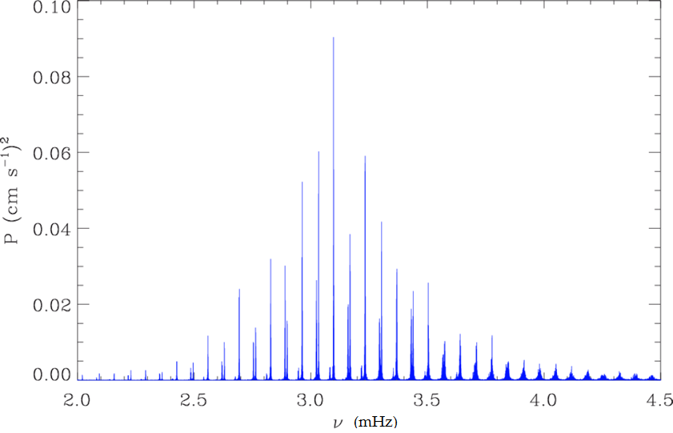
Solar oscillation spectrum
ν_{max}
Δν

Slide 9
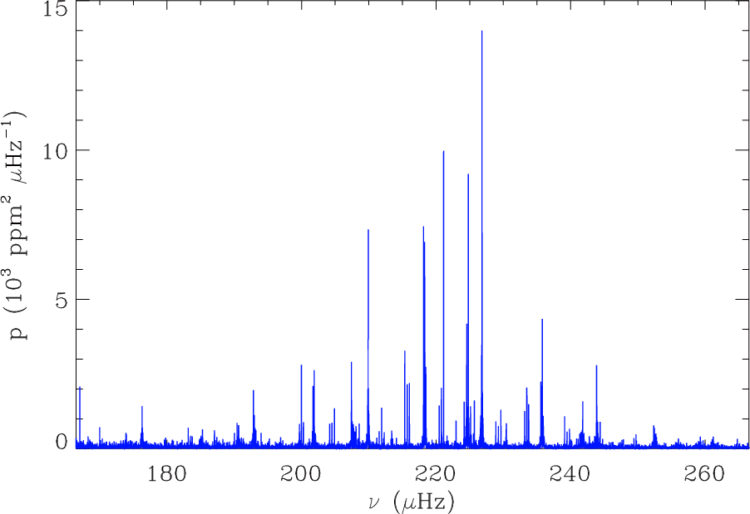
Global seismic parameters
ν_{max}
Δν
Δν scales with the mean density ν_{max} scales with the cutoff frequency in the photosphere
Δν ~ <ρ>^{0.5} ~ (M/R³)^{0.5} ν_{max}~ ν_{c} ~ g/T_{eff}^{0.5} ~ M/R² /T_{eff}^{0.5}
Seismic estimates of the stellar mass and radius

Slide 10
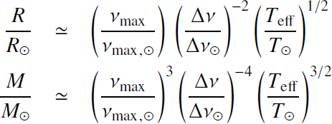
Seismic scaling relations
From the global seismic parameters stellar masses and radii,
with ν_{max,ʘ} ~ 3100 µHz; Δν_{ʘ}~ 135 µHz; T_{ʘ} ~ 5777 K
Seismic scaling relations used since the CoRoT red giant paper
Kallinger et al. 2010, A&A 509, A77
Estimates are relevant, precise, but more calibration effort is needed
Conservative uncertainties | Statistical | Systematic
dR/R | 2-5 % | 5 %
dM/M | 5-15 % | 10 %

Slide 11
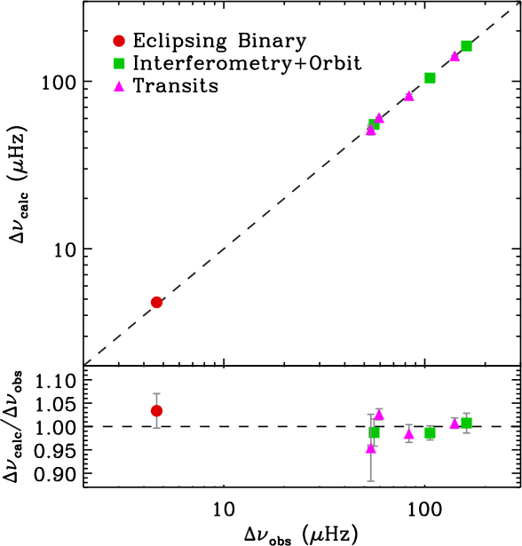
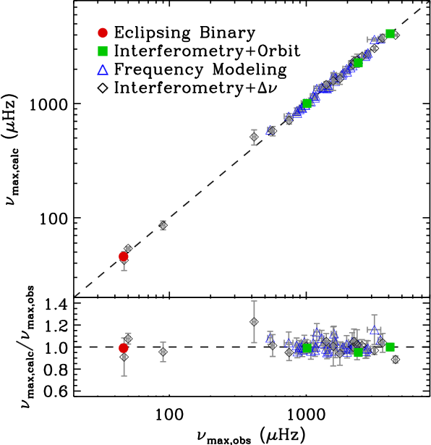
Calibration of the scaling relations
Comparison of ν_{max} and Δν measured from asteroseismology and calculated using independent measurements of R, M, and T_{eff}
Eclipsing binaries
Gaulme et al. 2013, , ApJ 767, 82
Interferometry
Huber et al. 2011, ApJ 760, 32
Clusters
Corsaro et al. 2012, ApJ 757, 190
Miglio et al. 2012, MNRAS 419, 2077
Astrometry
Silva-Aguirre et al. 2012, ApJ 757, 99

Slide 12
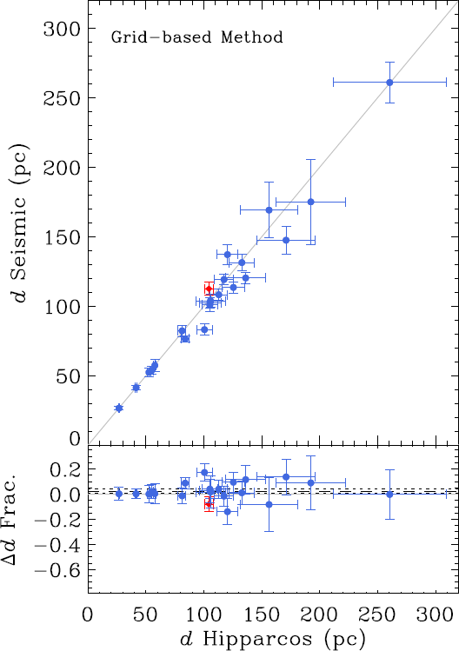
Calibration of the scaling relations
Comparison of inferred seismic distance and Hipparcos distances
R ,T_{eff} and black body
→
Luminosity L
L, m_{V} and dereddening
→
Distance d
Silva-Aguirre et al. 2012, ApJ 757, 99

Slide 13
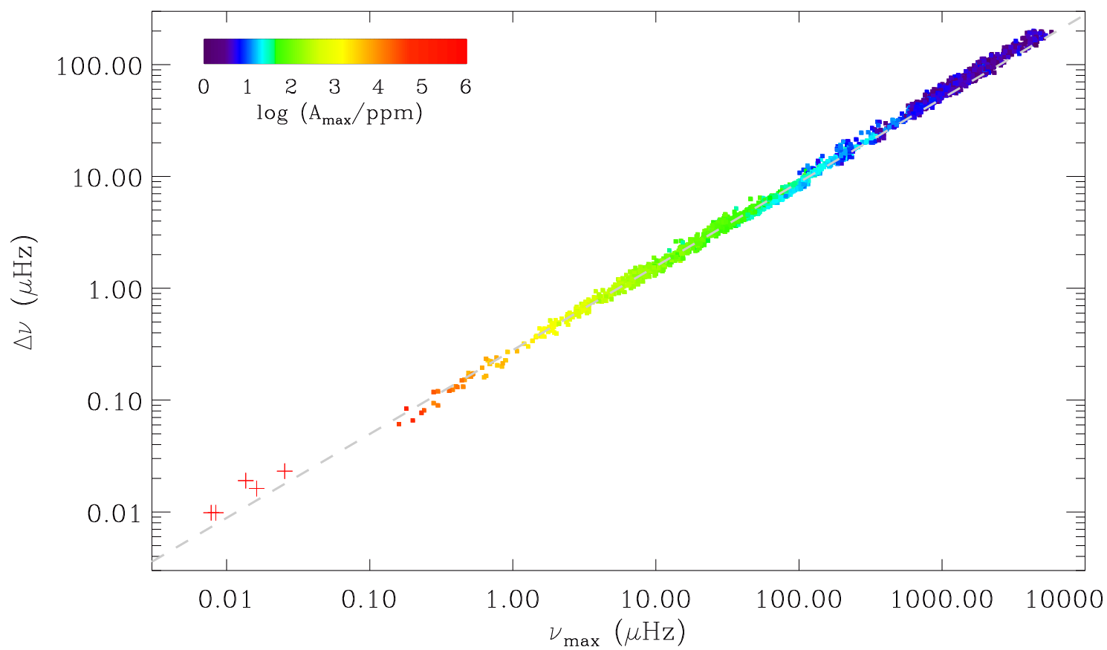
Stellar evolution
Sun
Subgiants
Low RGB
Red clump
Δν ~ ν_{max}^{3/4}
^{stellar evolution @ constant M}
Semi-regular variables
Mosser et al. 2013, A&A 559, A137
Stello et al 2014, ApJ 788, L10
Red supergiants
Kiss et al. 2006, MNRAS, 372, 1721

Slide 14
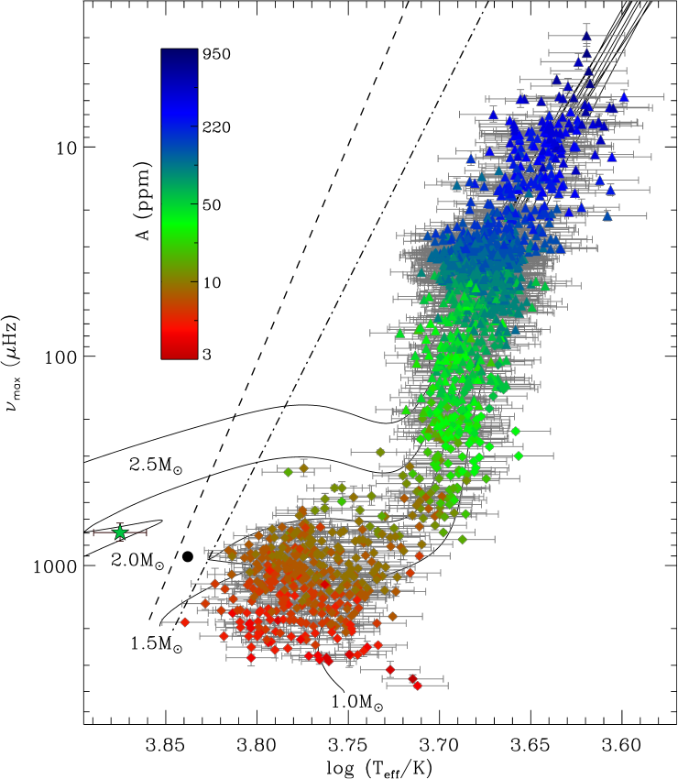
1/ν_{max} ←→ logg ←→ luminosity
ν_{max} and log g provides the same information
ν_{max} ± 2 %
logg ± 0.3 dex
→Seismic logg are used instead of photometric logg
The luminosity scales as 1/ ν_{max}
L ~ M T^{3.5} ν_{max}⁻¹
Oscillation amplitudes vary as
A ~ L^{0.8} / M^{1.3}
(empirical scaling relation in L/M is obsolete)
Huber et al. 2011, ApJ 743, 143

Slide 15
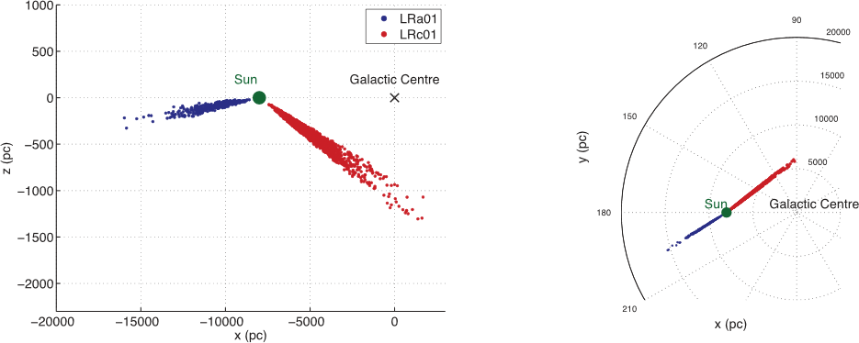
Galactic archaeology using pulsating giants
Miglio et al. 2013, MNRAS 429

Slide 16
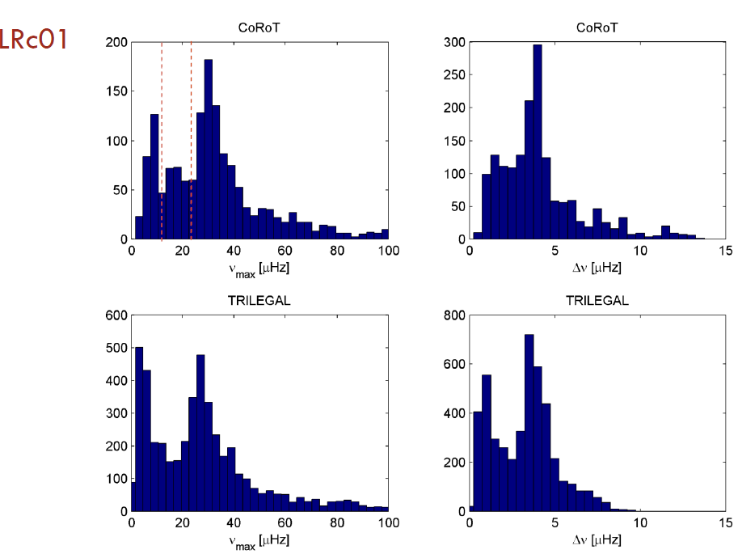
Population study
Miglio et al. 2009, A&A 503
Miglio et al. 2013, MNRAS, 429,423

Slide 17
Dipole mixed modes
DIPOLE
MIXED MODES
ℓ=2
ℓ=0

Slide 18
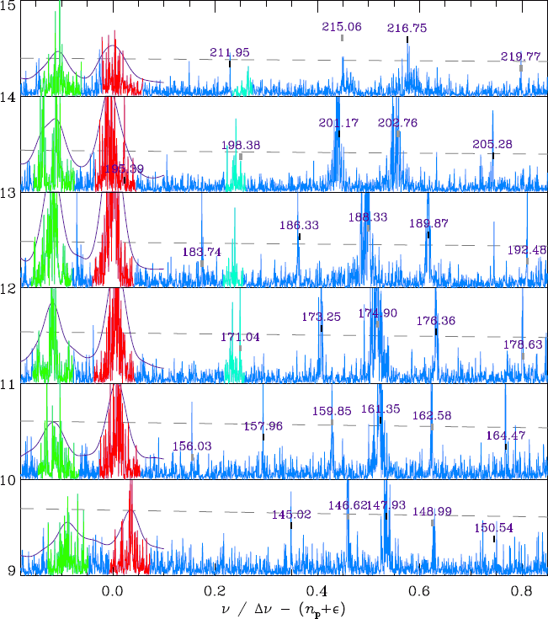
2 0 1 3 1 1 1 1

Slide 19
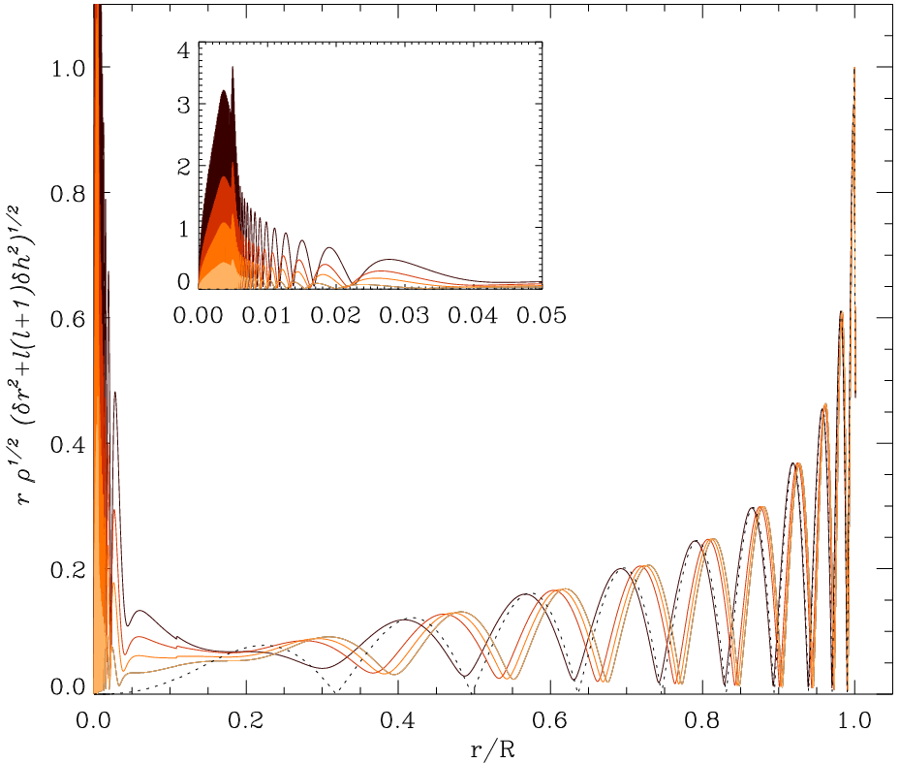
Two cavities + coupling → mixed modes
Mixed modes result from the coupling of
Gravity (G-) waves in the radiative core
Pressure (P-) waves in the convective envelope
Asympotic relations
Gravity modes evenly spaced in period
P_{ng,ℓ=1} = (-n_{g}+ε_{g}) ΔΠ₁
Pressure modes evenly spaced in frequency
ν_{ng,ℓ=1} = (n_{p}+1/2+ ε_{p}) Δν
(Tassoul 1980):
G P
G P
Beck et al, 2011, Science, mars 2011

Slide 20
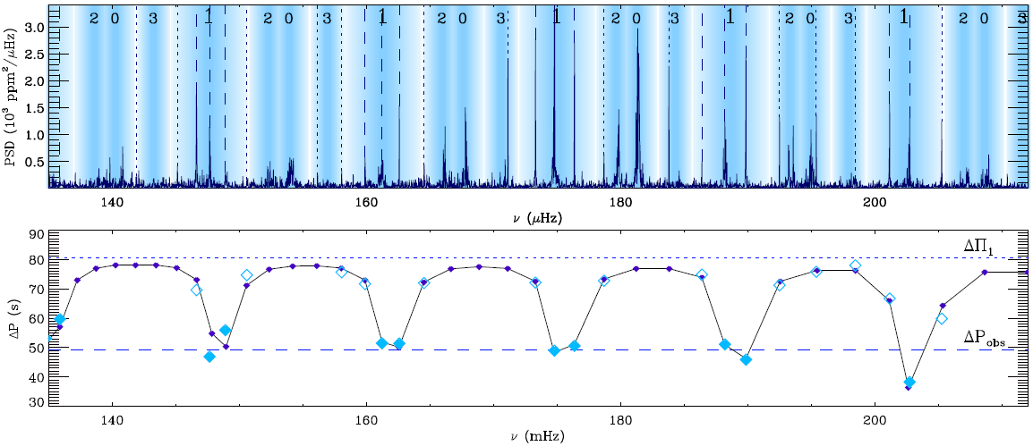
Asymptotic expansion of mixed modes
Second-order asymptotic expansion (Unno et al. 1989; Mosser et al. 2012)
ν mixed modes q coupling
ν_{p} pure pressure modes Δν second-order large separation
ν_{g} pure gravity modes ΔΠ₁ period spacing

Slide 21
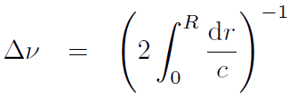
Pressure / gravity modes in mixed modes
Modes | Restoring force | Asymptotic spacing | Interior parameter | Structure
P | Pressure |  | Sound speed | Mean density
G | Buoyancy |  | BruntVaïsälä frequency | Core size

Slide 22
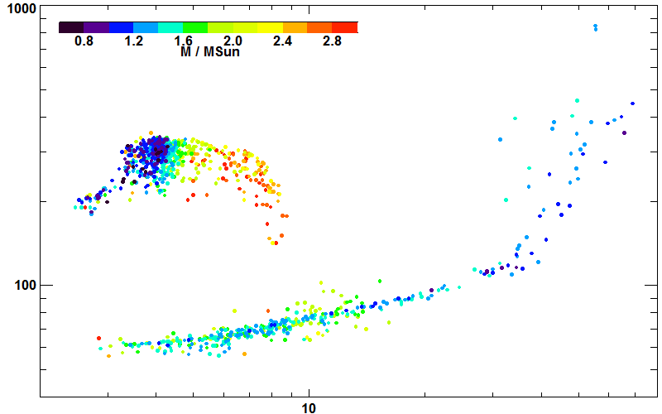
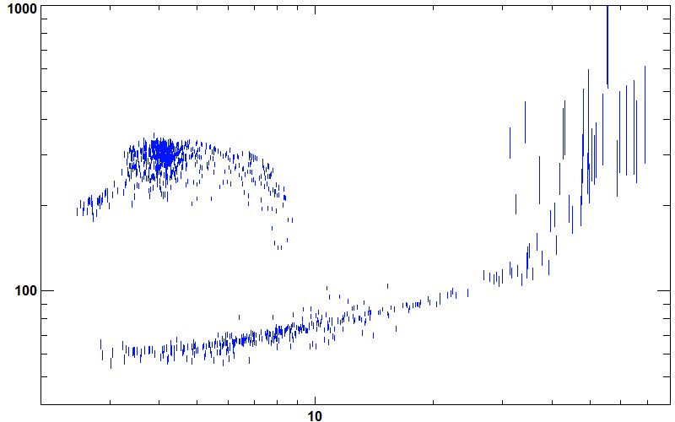
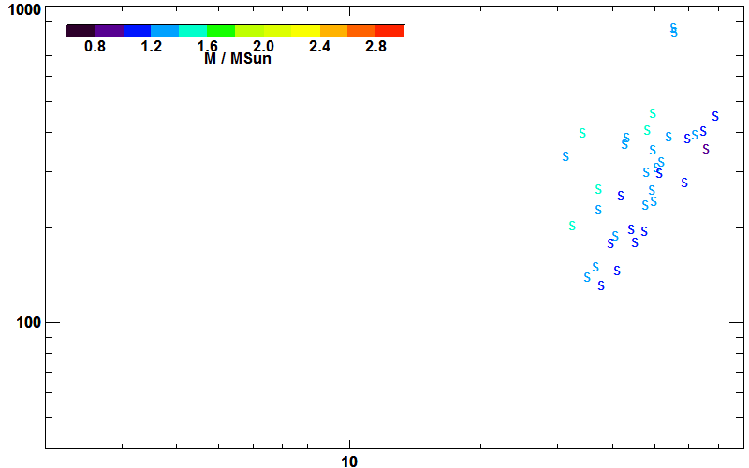
ΔΠ₁ − Δν diagram
ΔΠ₁ (s)
Mosser et al. 2014, A&A 572, L5
Δν (µHz)

Slide 23
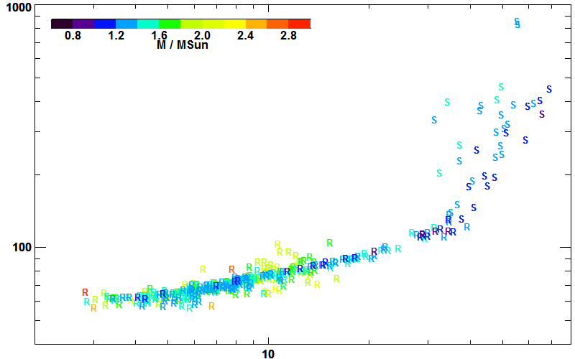
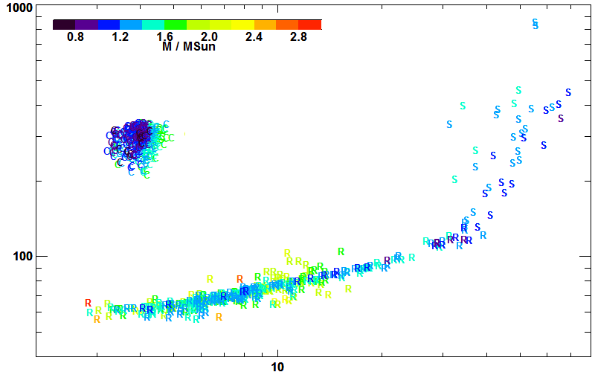
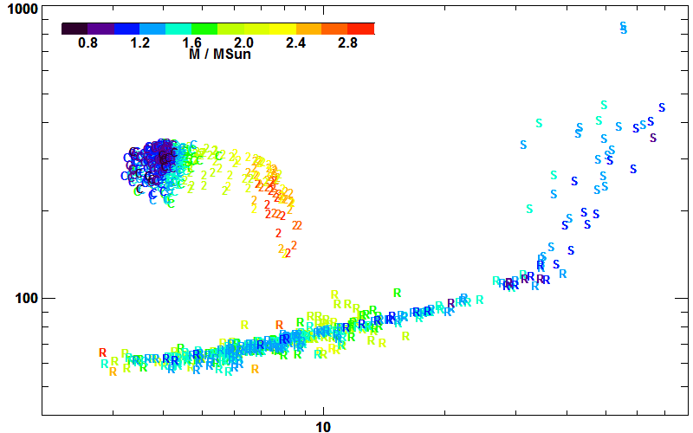
ΔΠ₁ − Δν diagram
ΔΠ₁ (s)
Mosser et al. 2014, A&A 572, L5
Δν (µHz)

Slide 24
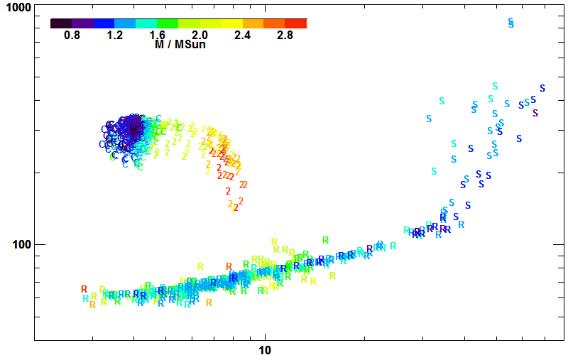
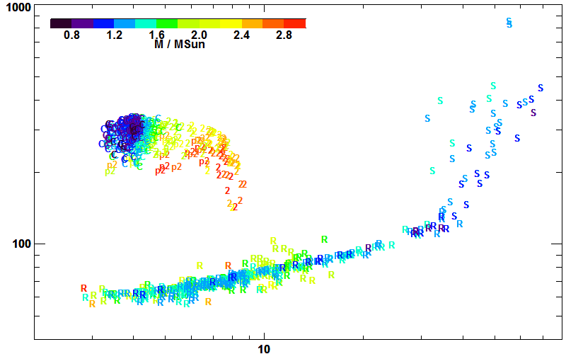
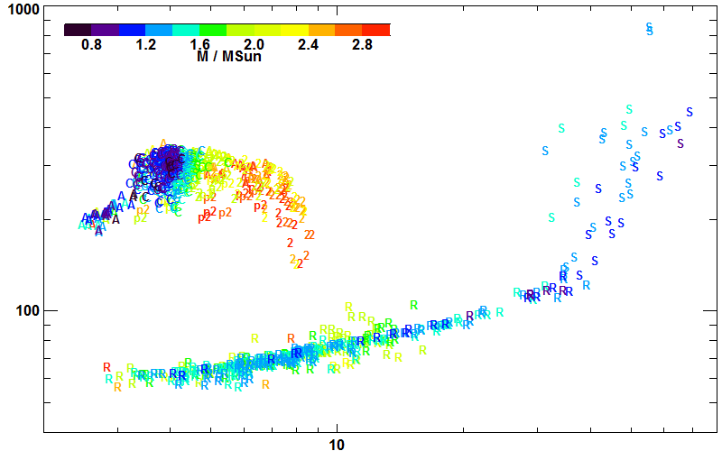
ΔΠ₁ − Δν diagram
ΔΠ₁ (s)
Mosser et al. 2014, A&A 572, L5
Δν (µHz)

Slide 25
Helium flash
ΔΠ₁ (s)
Mosser et al. 2014, A&A 572, L5
Δν (µHz)

Slide 26
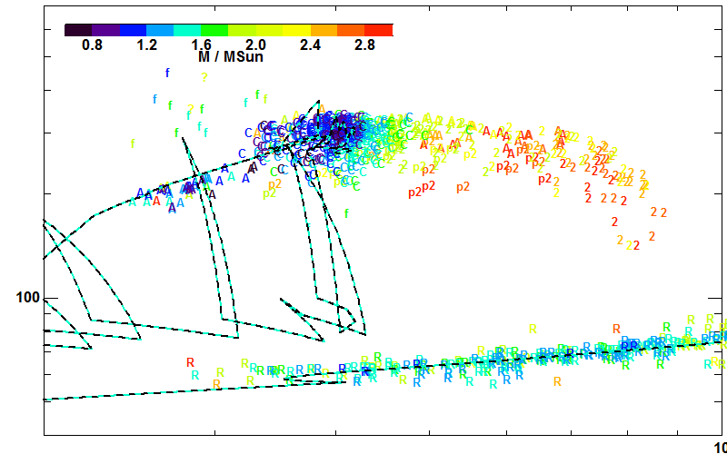
Observations / modelling
ΔΠ₁ (s)
Lagarde et al. 2012, A&A 543, A108
Evolution code: STAREVOL
Δν (µHz)

Slide 27
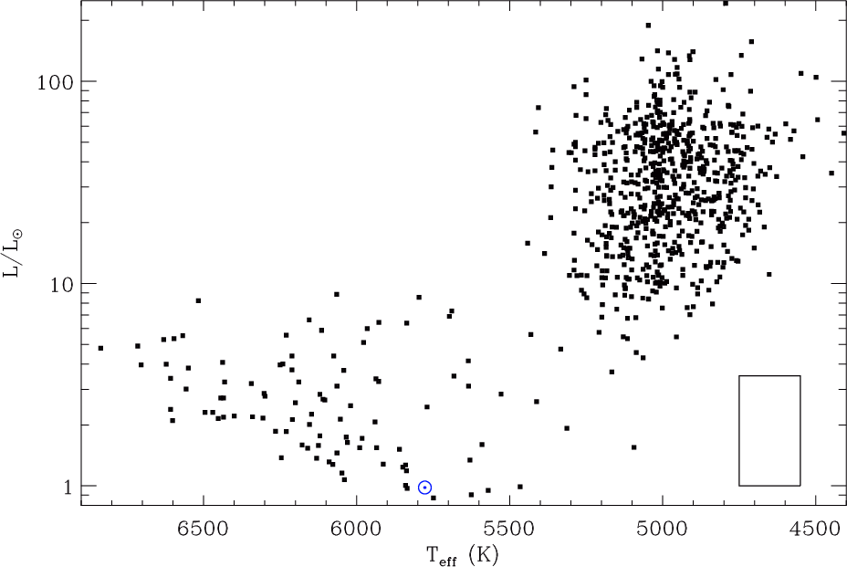
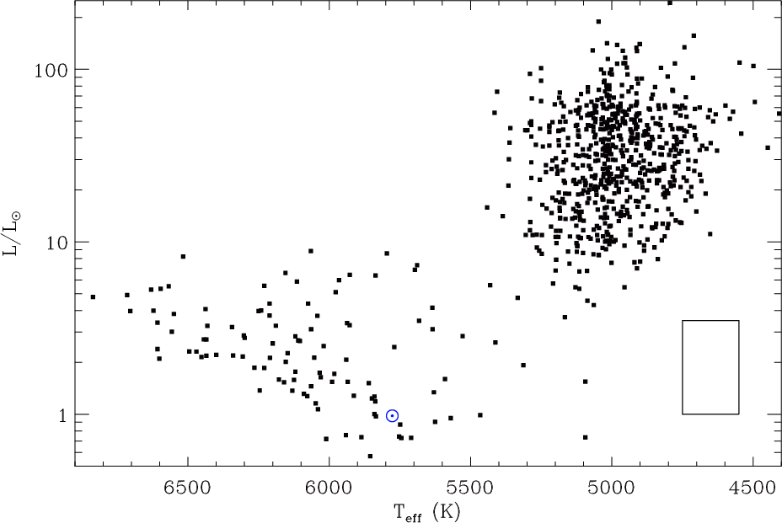
From the classical HR diagram…

Slide 28
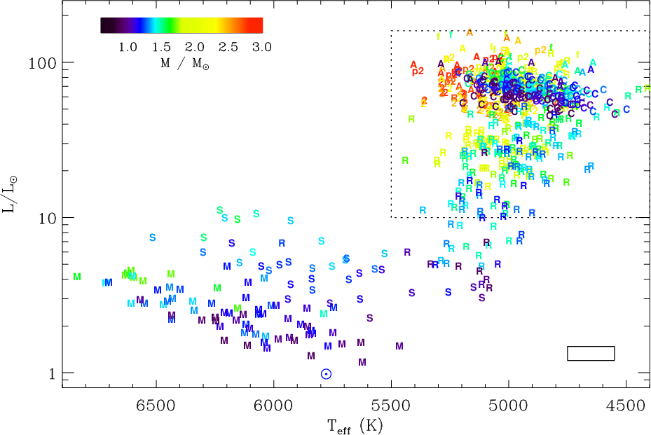
… to the seismic enriched HR diagram

Slide 29
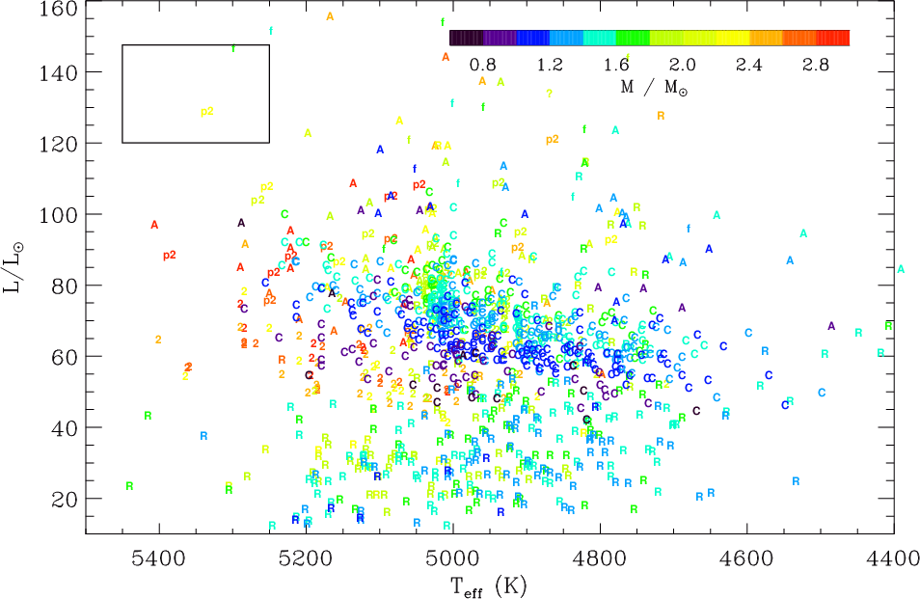
Using clump stars as stellar candles

Slide 30
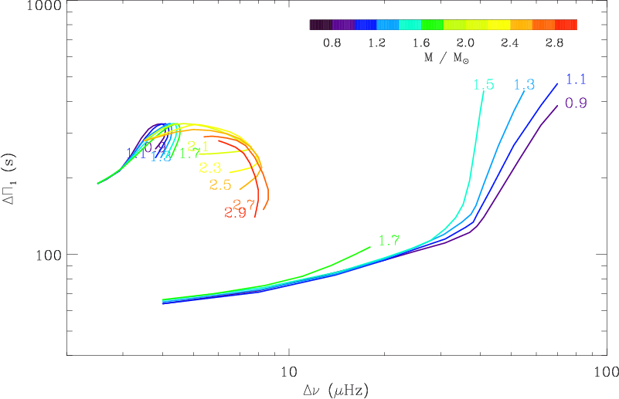
Observed evolutionary tracks
Mosser et al. 2014, A&A 572, L5

Slide 31
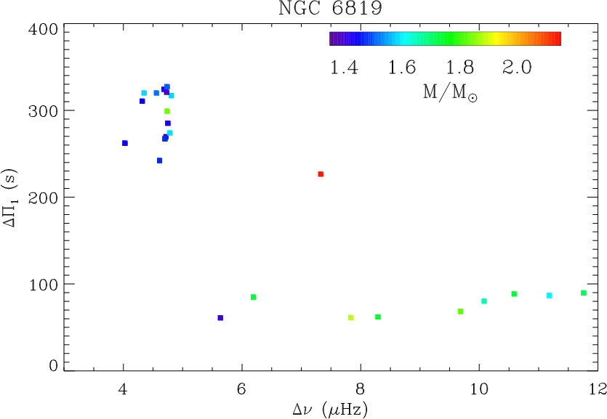
Evolutionary tracks in NGC 6819
Vrard et al. 2015, PhD thesis

Slide 32
Mixed modes & rotation
MIXED MODES
& ROTATION
ℓ=2
ℓ=0

Slide 33
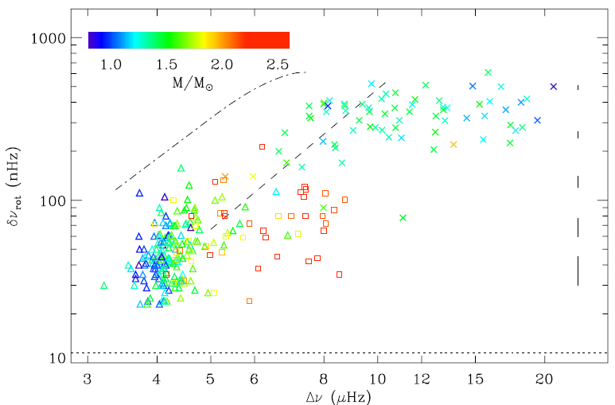
Observed rotational splittings
Mosser et al, 2012, A&A 548, A10

Slide 34
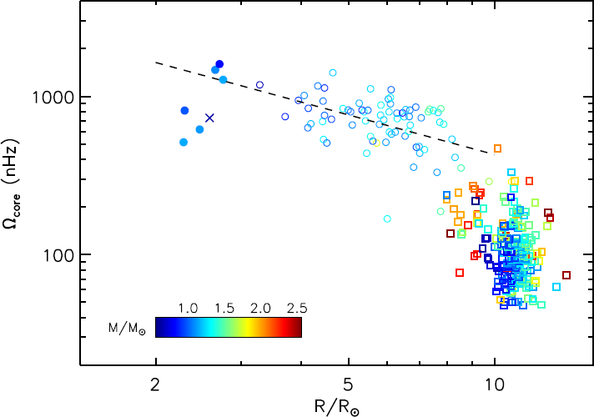
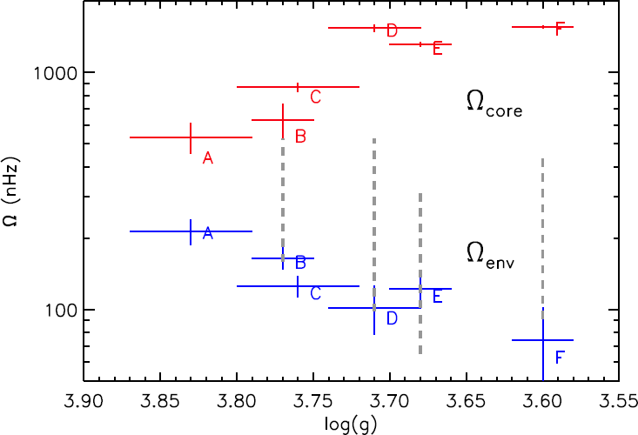
Core rotation / stellar radius
Ensemble asteroseismology: the cohort of red giants depicts stellar evolution
Despite the core contraction, angular momentum is efficient transferred to speed down the core rotation
Red-clump star cores rotate more slowly than RGB
High-mass star cores rotate more rapidly than low-mass stars
T_{core} (j)
Mosser et al, 2012, A&A 548, A10
Goupil et al, 2013, A&A 549, 75
Deheuvels et al, 2014, A&A 564, A27

Slide 35
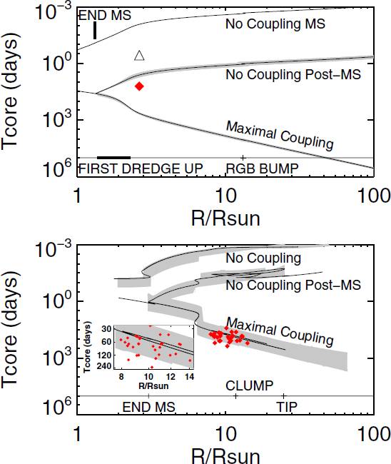
Transfer of angular momentum
Which transport of angular momentum?
Meridional circulation or shear instability?
Eggenberger et al 2012
Marques et al 2013, A&A 549, A74
Ceillier et al 2013, A&A 555, A54
Internal gravity waves?
Fuller et al 2014, ApJ 796, 17
Magnetic fields?
Cantiello et al 2014, ApJ 788, 93
Rüdiger et al 2015, A&A573, 180
Mixed modes!
Belkacem et al 2015a,b, arxiv
Tayar & Pinsonneault 2013, ApJL 775, L1

Slide 36
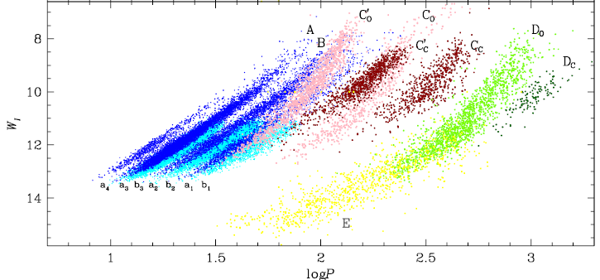
Period-luminosity relations in M giants
Wood et al. 1999, Soszynski et al. 2007
Infrared microlensing surveys (e.g. MACHO, OGLE, DENIS)
Variability in M giants lightcurves → Period – Luminosity relations
Pending questions:
Radial / non radial oscillations?
Solar-like oscillations? (= stochastically excited by turbulent convection)

Slide 37
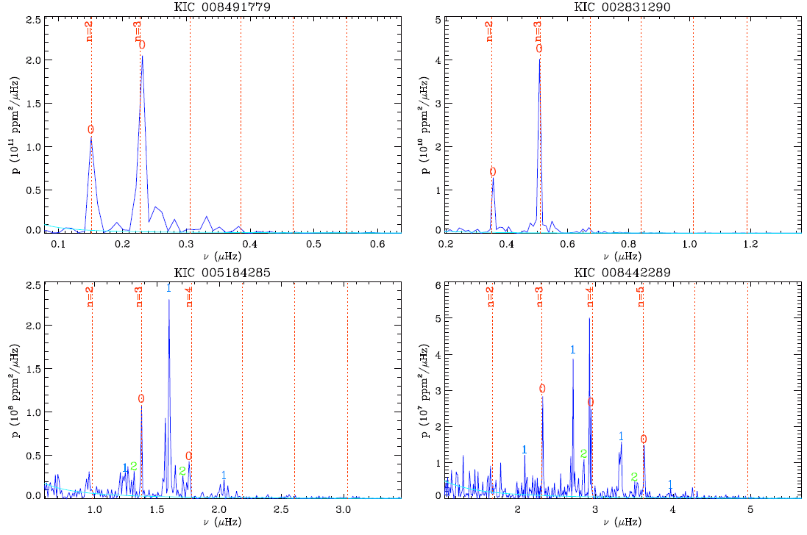

Slide 38
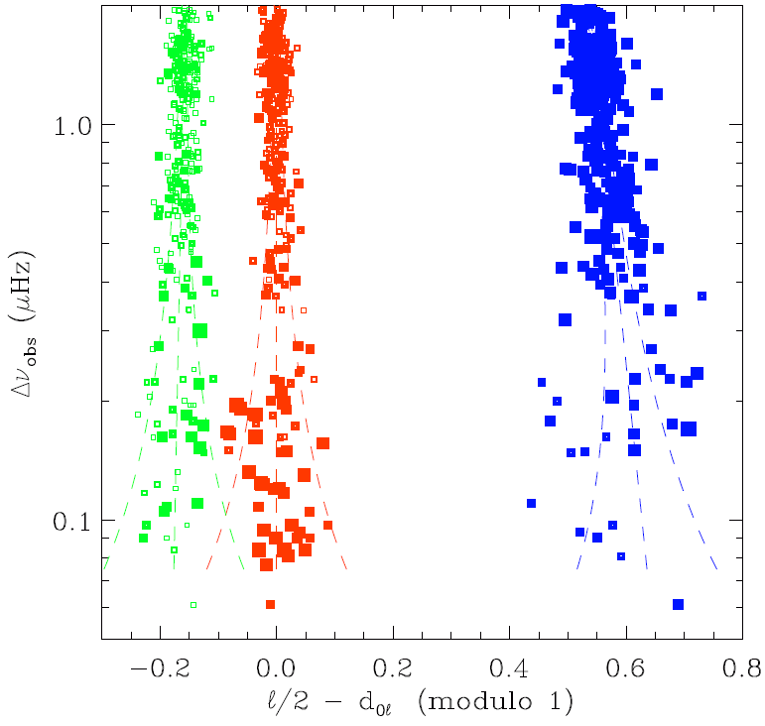
Mode identification, Kepler data at low Δν
ℓ = 2 0 1
Energy equipartition between the different degrees
Quadrupole, radial and dipole modes all present in the spectrum
At low frequency
Dipole, quadrupole and radial modes form triplets
Stello et al 2014, ApJ 788, L10
Mosser et al. 2013, A&A 559, A137

Slide 39
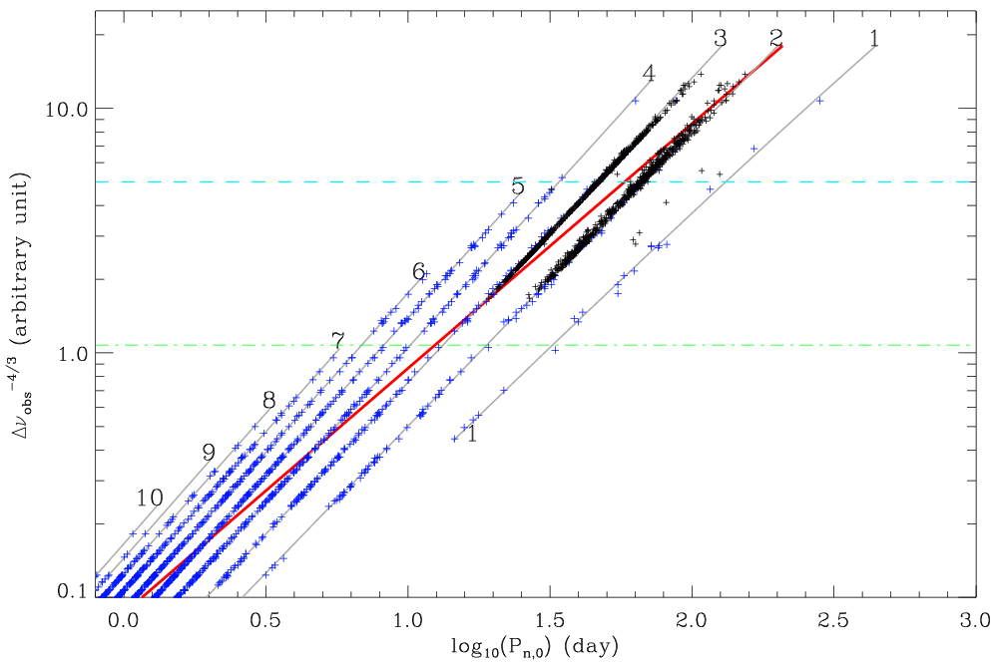
PL sequences / oscillation pattern
+ OGLE data
Mosser et al. 2013, A&A 559, A137
+ Kepler data

Slide 40
Solar and non-solar like oscillations
OGLE infrared microlensing survey
Mira-like oscillations
Long periods
Soszynski et al. 2007, Acta Astron., 57, 201
n = 3
n = 2
n = 1

Slide 41
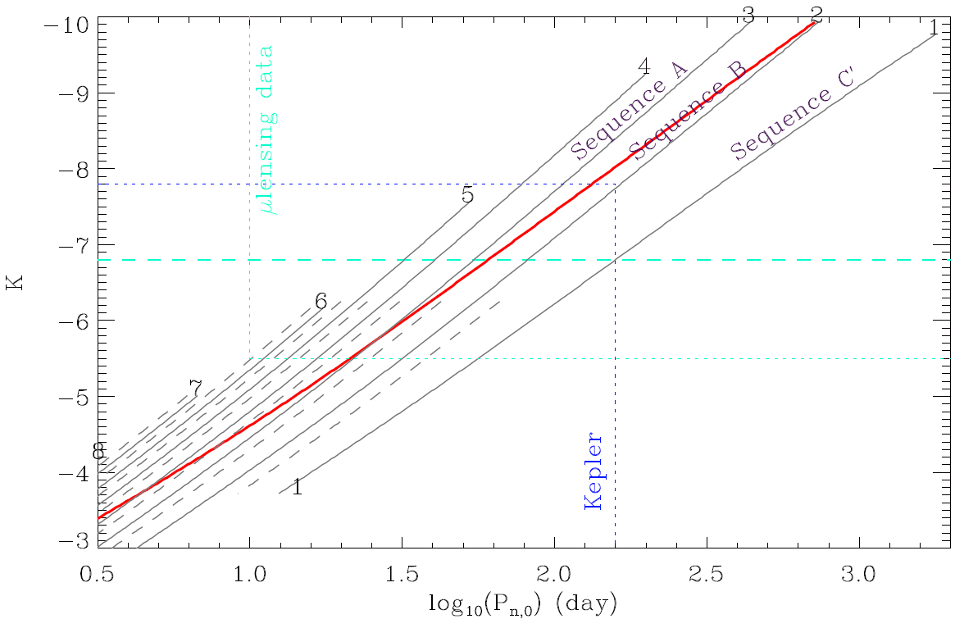
Period luminosity sequences in M giants
Tip of the RGB
K ~ 7.2
Mosser et al. 2013, A&A 559, A137
Calibration of the period-luminosity relations based on physics
Precise identification of the tip of the RGB
Seismic scaling relations: stellar masses and radii
Distance measurement

Slide 42
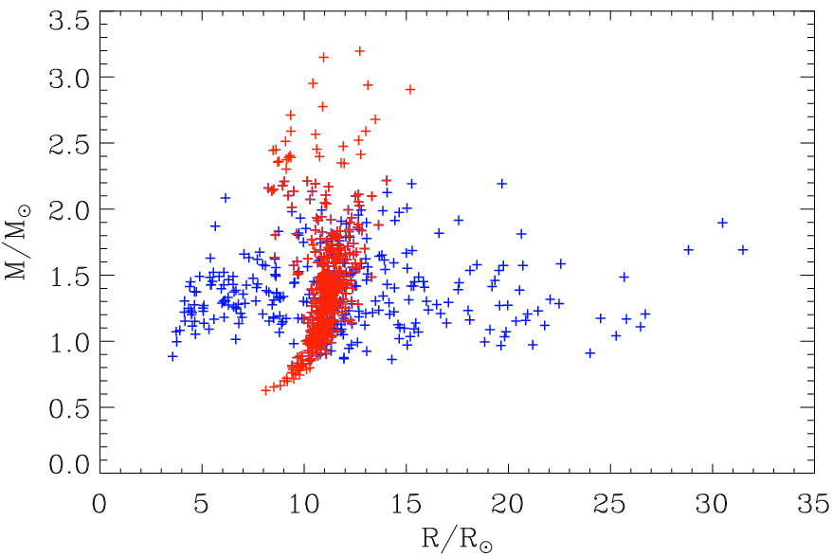
Mass loss
Mosser et al. 2012, A&A 537
Clump stars RGB stars

Slide 43
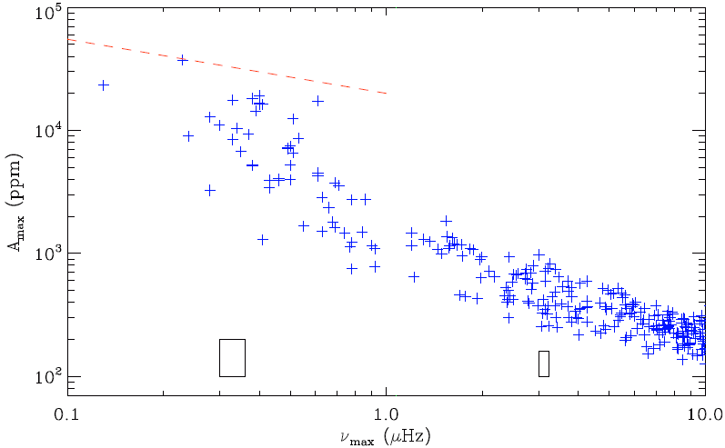
Mass loss
Wave acceleration = gravity field

Slide 44
A golden age of stellar physics
Seismic space-borne observations with CoRoT and Kepler
Seismic determination of R, M
+ mass loss
Seismically enriched Hertzsprung-Russell diagram
+ precise markers of stellar evolution
Link with semi-regular variables
… Everything about stars before they reach the AGB
Plato, selected today as ESA's third medium-class science mission.
Search of exoplanets and detailed analysis of the host stars

