Slide 1
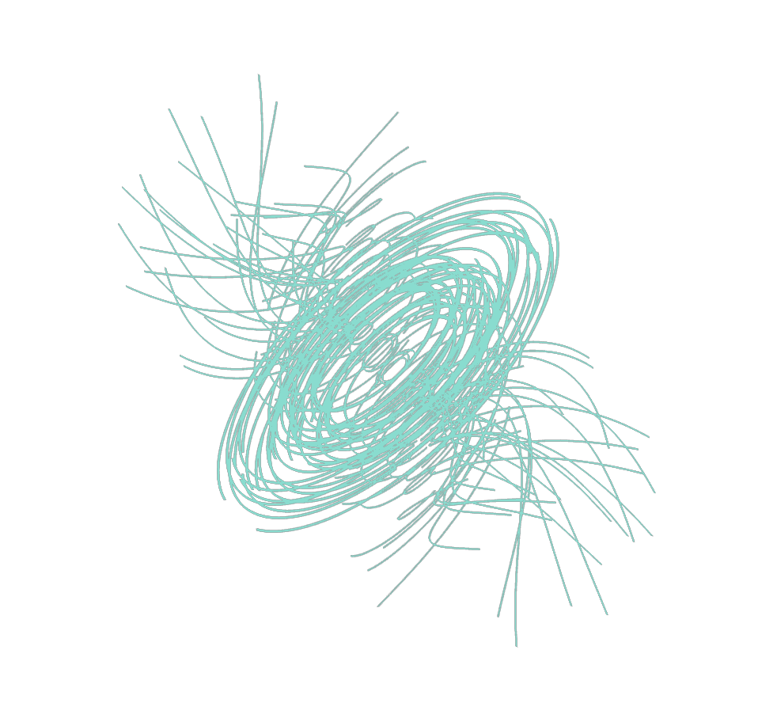


Detection of Magnetic Fields in Evolved Stars: from the envelope to the photosphere.
Laurence Sabin
Instituto de Astronomía
UNAM, Ensenada, México

Slide 2
Outline
1 – Detection de Magnetic Fields in the envelope:
sub-mm/mm polarimetry
2 – Detection de Magnetic Fields at the stellar surface:
optical spectropolarimetry
3 – Masers as links between the Envelope & Surface
4 – Conclusion & Future works

Slide 3
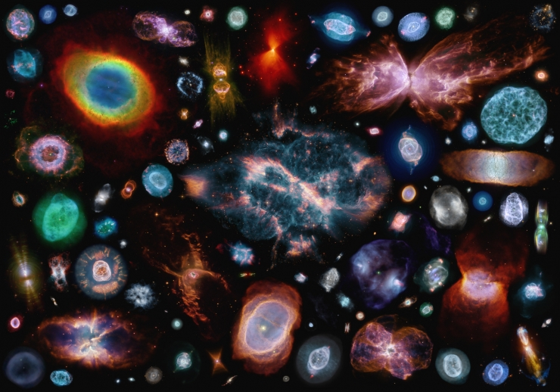
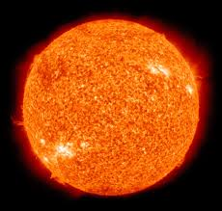
Stellar Evolution: B-fields are key ingredients
Channelling
Collimation
Jets production/launch
This is why it matters when working on the late stages of stellar evolution

Slide 4
1st Phase
Question: Do magnetic fields play a leading role in the shaping of the nebulae in evolved stars ?
Answer: After several APN conferences the community (nearly) reached a consensus:
► Binarity is the underlying cause. It can produce/maintain accretion disks and jets, envelope rotation, common-envelope ejection and magnetic fields, all of which can potentially lead to aspherical structures.

Slide 5
2nd Phase
Question: What is the role of magnetic fields (by-product or not) in the dynamics and even chemistry of evolved stars ?
Answer: Not clear at all ► Low Detection Rate !!
(also compared to binaries e.g. De Marco et al. 2006,2012, Miszalski et al. 2011)

Slide 6
Observing programs based on polarimetric analysis

Slide 7
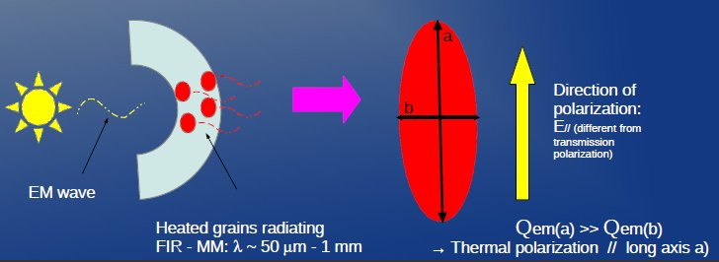
I - (Sub)-millimeter polarimetry
Method: Detection and study of dust thermal emission ► Dust grain alignment ► Indication for the presence/distribution of Bfields.
→
→
B
B
→
E
Non spherical aligned spinning (paramagnetic) dust grains

Slide 8
I - (Sub)-millimeter polarimetry
Method: Detection and study of dust thermal emission ► Dust grain alignment ► Indication for the presence/distribution of Bfields.
Telescopes:
SMA ► 8x6m , Compact conf., Max Baseline : 77m, 345 GHz, resolution: ~2”
CARMA ► 6x10.4m + 9x6.1m + 8x3.5m, Config. E; Max Baseline : 148m, 220 GHz, resolution: ~2.5”

Slide 9
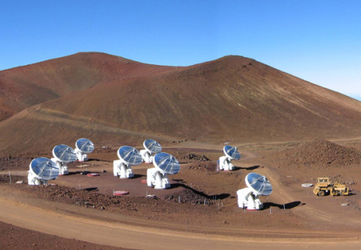
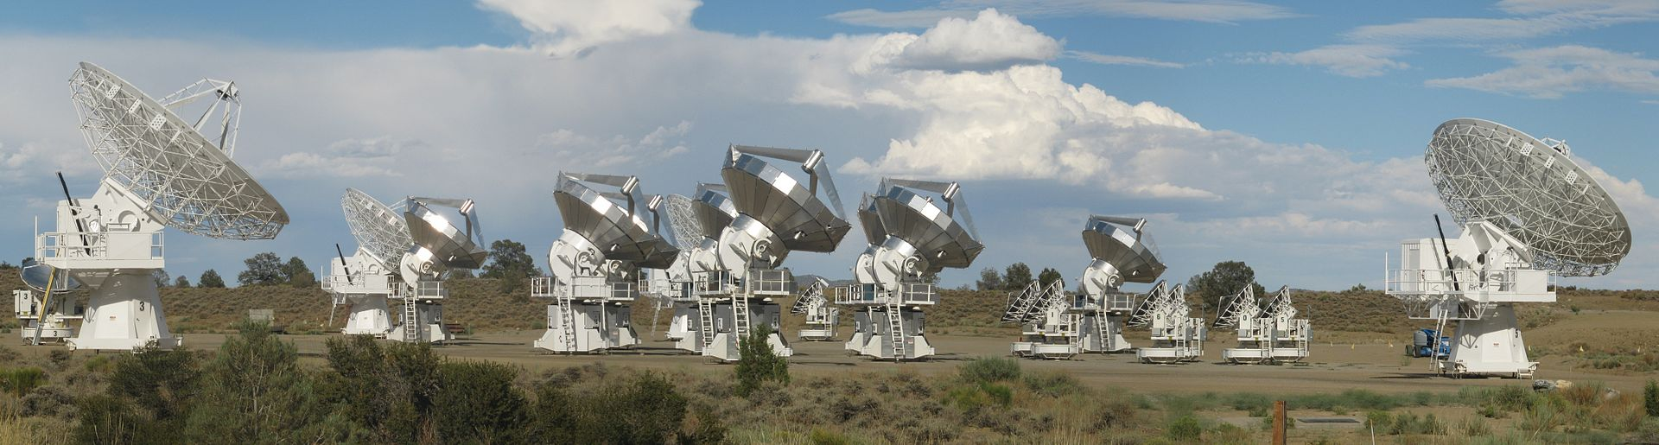
Submm Array Telescope &
Combined Array for Research in Millimeter-wave Astronomy
Mauna Kea
Hawaii
Cedar Flat, CA

Slide 10
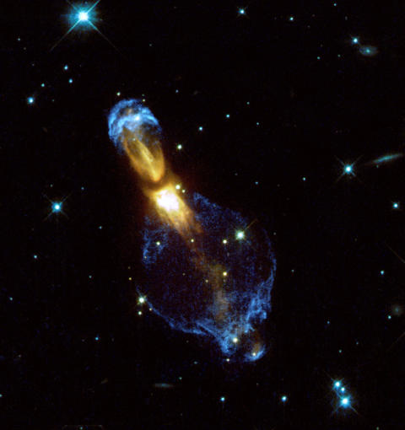
Results for the PAGB
OH 231.8+4.2
HST, WFPC2
- Optical

Slide 11
Team
Zhang Q. (CfA,US) ; Zijlstra A. A. (Manchester,UK); Patel N. A.(CfA,US) ; Vázquez, R.(UNAM,MEX) ; Zauderer, B. A.(CfA,US), Contreras, M. E.(USon,MEX); Guillén, P. F.(UNAM,MEX); Hull, C. L. H.(CfA,US) ; Plambeck, R. L. (Berkeley,US) Navarro, S. G.(UdeG,MEX).
Sabin et al., MNRAS, 438, 1794, 2014 Sabin et al., MNRAS, 449, 2368, 2015

Slide 12
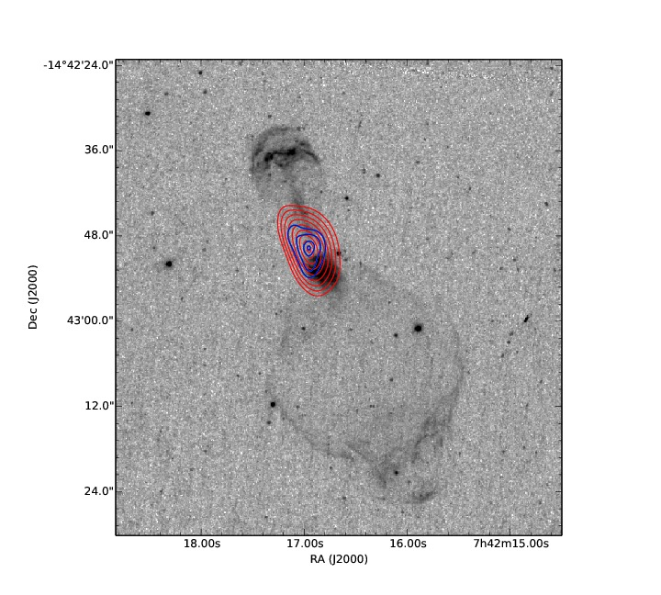
Thermal Continuum
SMA:
~7.3×5.7 arcsec²
Peak: 0.78 Jy/beam
Mean: 0.31 Jy/beam
CARMA:
~15.3 × 8.8 arcsec²
Peak: 0.24 Jy/beam
Mean: 0.076 Jy/beam

Slide 13
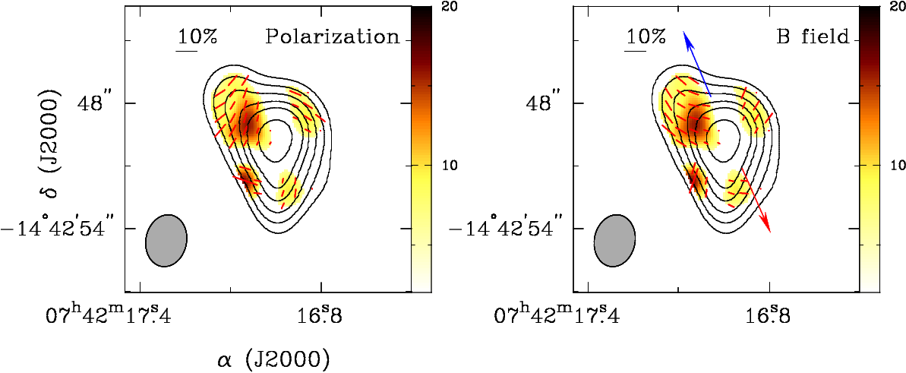
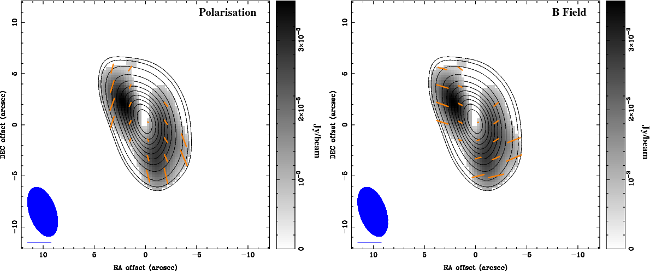
SMA
CARMA

Slide 14
Dust polarization characteristics
SMA CARMA
Linear polarization | Detected > 3σ across the source Peak: 16 mJy/bm Mean: 11 mJy/bm. | Detected > 3σ across the source Peak: 3.6 mJy/bm Mean: 1.7mJy/bm
Fractional polarization (P%) | Mean: 4.3 % | Mean: 3.4 %
No detection of line polarization (e.g. in molecules) !!

Slide 15
Magnetic field in OH 231.8+4.2
Allowed us to “constrain” the distribution of the magnetic field:
X-shaped structure ► Polar MF configuration
+ Coexistence of a toroidal structure at larger scale
Or a single helical component
The “magnetic vectors” also follow the molecular outflows
► Proof of a magnetic launching mechanism ?
Detect the magnetic field much closer to the launch-zone
of the jets/outflows = higher resolution = ALMA (0.5”)

Slide 16
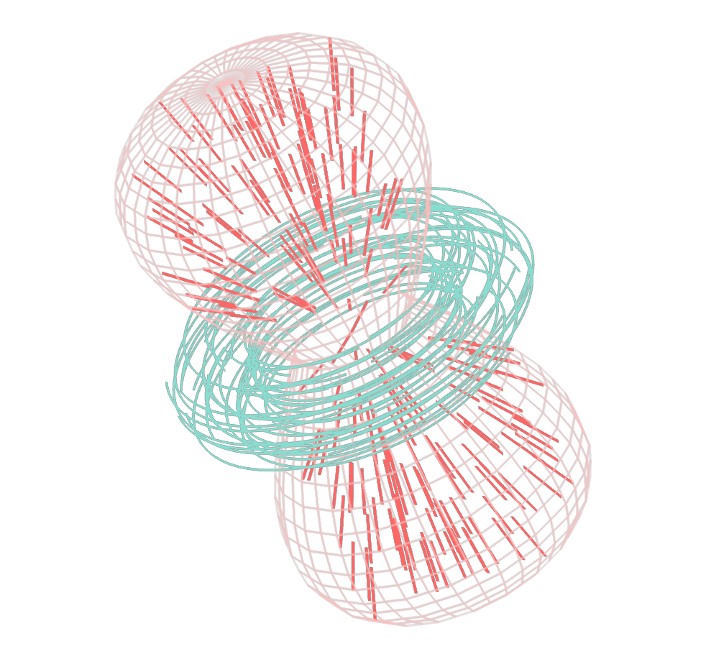

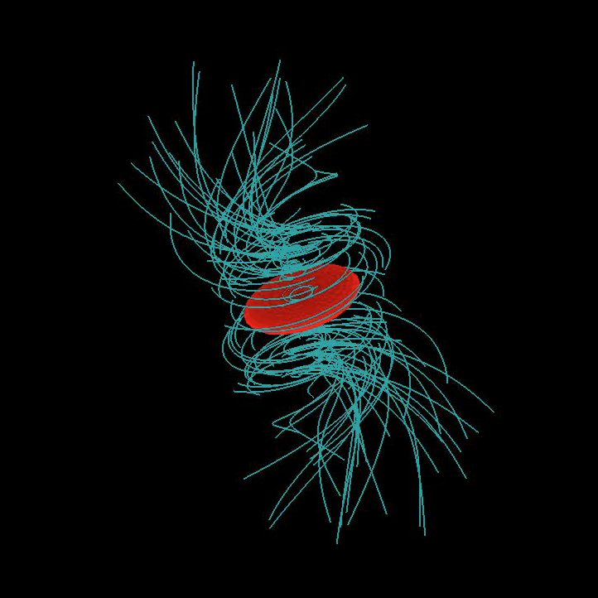
Models
Toroidal + Poloidal Helical
Credits: W. Steffen (SHAPE)

Slide 17
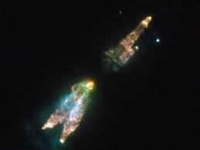
About CRL 618...
C-rich object
SMA → Problem with the spatial resolution of the polarization emission. Ppeak ~ 0.7%
CARMA → Dynamical range issues: bright object at
1.3mm [∼2 Jy/beam] with very weak polarization
Ppeak ∼ 0.5% : problem with leakage solution.
NASA, HST
► C-rich nebulae are not the best candidates for such method: smaller dust grains
→ Not a lost cause ! see talk by Alizée Duthu

Slide 18
II- Optical spectropolarimetry
Goal: Detection and measurement of Bfields at the stellar surface of post-AGB stars.
→ So far not possible with PNe due to the high number of emissions lines (Leone et al. 2011,2014).
→ post-AGBs have few emissions lines and the bright (hot) ones have sharp absorption lines.
Good for Bfield diagnostics !!!

Slide 19
Team
Wade G. (RMC, Can.) & Lèbre A. (CNRS/Univ. Montpellier, Fra)
Sabin, Wade & Lèbre, MNRAS, 446,1988, 2015

Slide 20
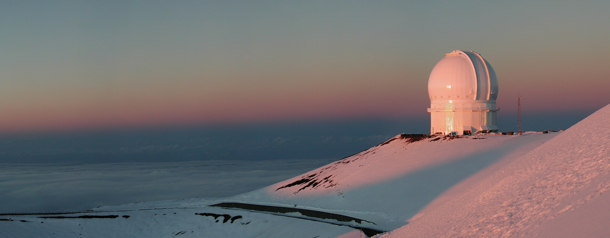
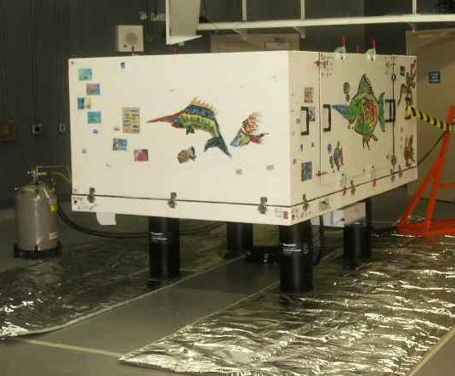
II- Optical spectropolarimetry
Goal: Detection and measurement of Bfields at the stellar surface of post-AGB stars
Method: High resolution spectropolarimeters (R= 65000) ESPaDOnS and Narval
3.6m
CFHT+
Espadons
MK,Hawaii

Slide 21
Analysis
→ LSD (not the one you are thinking about !!!) for “Least Squared Deconvolution” technique (Donati et al. 1997)
→ Improve S/N by “adding up lines linearly”

Slide 22
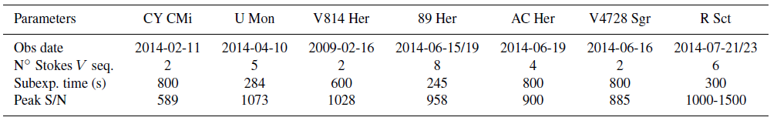
II- Optical spectropolarimetry
Goal: Detection and measurement of Bfields at the stellar surface of post-AGB stars
Method: High resolution spectropolarimeters (R= 65000) ESPaDOnS and Narval
Sample: Seven well known bright objects : CY CMi, U Mon, V814 Her, 89 Her, AC Her, V4728 Sgr and R Sct (see A. Lèbre, B. Tessore P.34 )

Slide 23

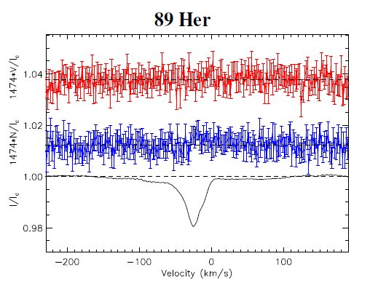
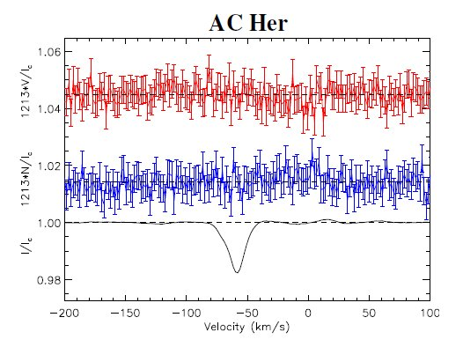
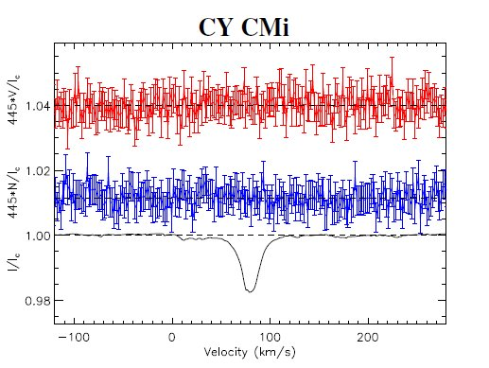
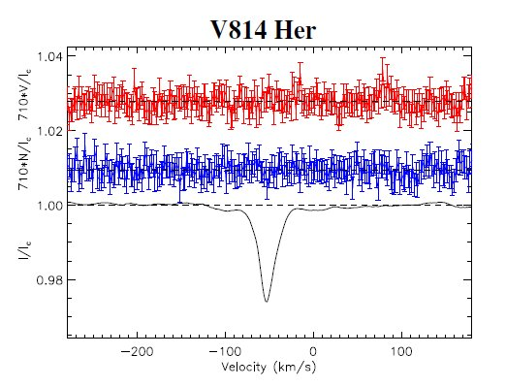
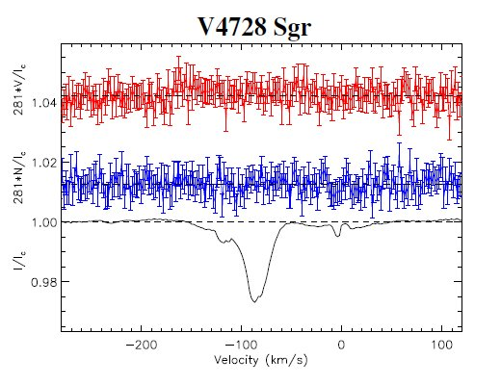
Results

Slide 24

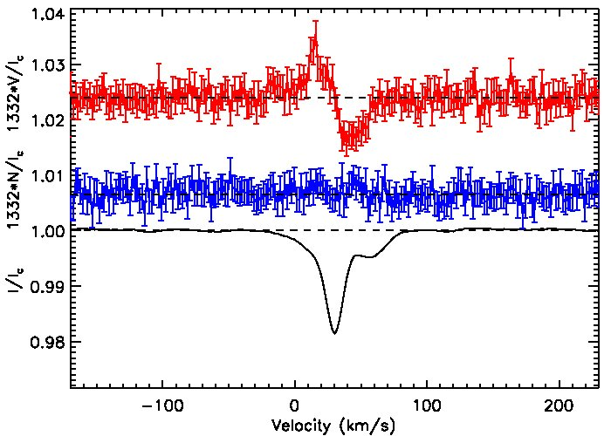
U Mon
LSD flag: Definite Detection
Bl ±σB = 10.2 ± 1.7 G

Slide 25
Spectropolarimetric results
First clear discovery of weak magnetic fields at the stellar surface of PAGB stars
Adding R Sct, both PAGB stars are RV Tauri. So far no clear discriminant in the presence of Bfield has been found.
Possible association of the magnetic field with the dynamical state of the atmosphere (Stokes I double line)
► will vary with the pulsational phase of the star
Monitoring is therefore needed !

Slide 26
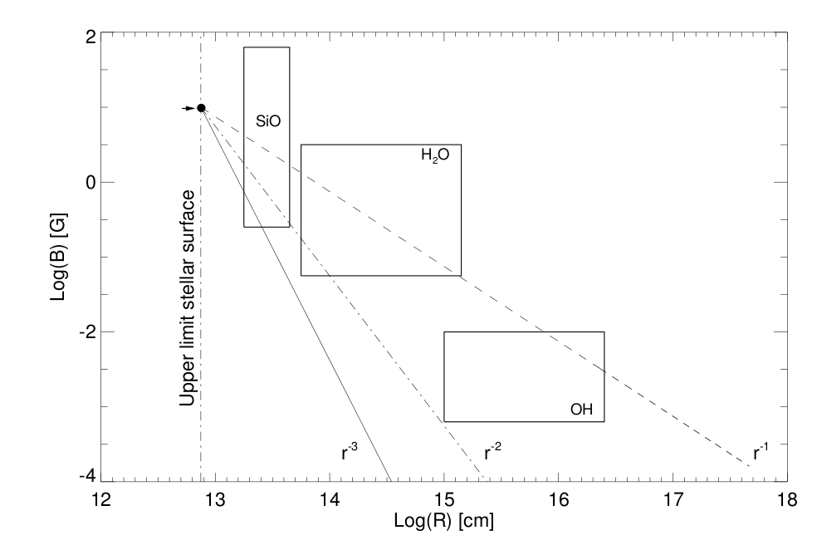
III- Masers: Linking Envelope & CS
Map for U Mon, but we deal with a RV Tauri star...
( Based on graph by Vlemmings, 2011)

Slide 27
Conclusion & Future works
New observational advances in the characterization of the magnetic field in evolved stars:
→ From the envelope: probing the capability of the field to launch and collimate the flows.
→ To the central star: new results will lead to more observations (statistics, unveil the parameters linked to the field, commonality of the field … etc.) and monitoring (variability, interaction with the atmosphere dynamics).
→ Study of Masers to link both methods, achieve completeness !

Slide 28
First steps in the full investigation of Magnetic Field as mechanism playing an important role in the structure, dynamics and chemistry of these evolved intermediate mass stars.

Slide 30
Rotation Mechanisms:
(a) Collisional processes: These include: (i) Thermal rotation of grains induced by random collisions with interstellar gas atoms, as originally considered by Davis & Greenstein (1951). (ii) Suprathermal rotations induced by collision with the ambient hydrogen gas with formation and ejection of H2 from non spherical and irregular surface features of the grains, as considered by Purcell (1979).
(b) Radiation pressure induced torques
(i) Torques due to radiation pressure on grains by radiation from the sun or the interstellar radiation field has been considered as an effective mechanism for spinning dust grains to high spe eds (e . g., Paddack , 1969, 1975; Harwit, 1970 ; Dohnanyi, 1978 ; Misconi, 1993 ).
(ii) A detailed theory of suprathermal spin-u p and alignment of interstellar dust grains by radiative torques induced by anisotropic starlight has been presented by Draine and Weingartner (1996, 1997) and Weingartner and Draine (2003).

Slide 31
Alignment Mechanisms:
Davis-Greenstein Mechanism: Involves paramagnetic dissipation in the grains and tends to ends to drive a grain to rotate along its principal axis of maximum moment of inertia, which then approaches alignment along the interstellar magnetic field (Davis and Greenstein, 1951)
Paramagnetic grains have unpaired electrons which are orientated in presence of a magnetic field.
The orientation of the spin causes the grains (rotating via thermal collision) magnetization→
Paramagnetic loss/dissipation/relaxation at the expense of grain rotation energy: decrease of component ω (rotational velocity) perpendicular to B until ω // B
Short axis (rotation axis) aligned with magnetic field / Long axis perpendicular to Magnetic field

