Slide 1
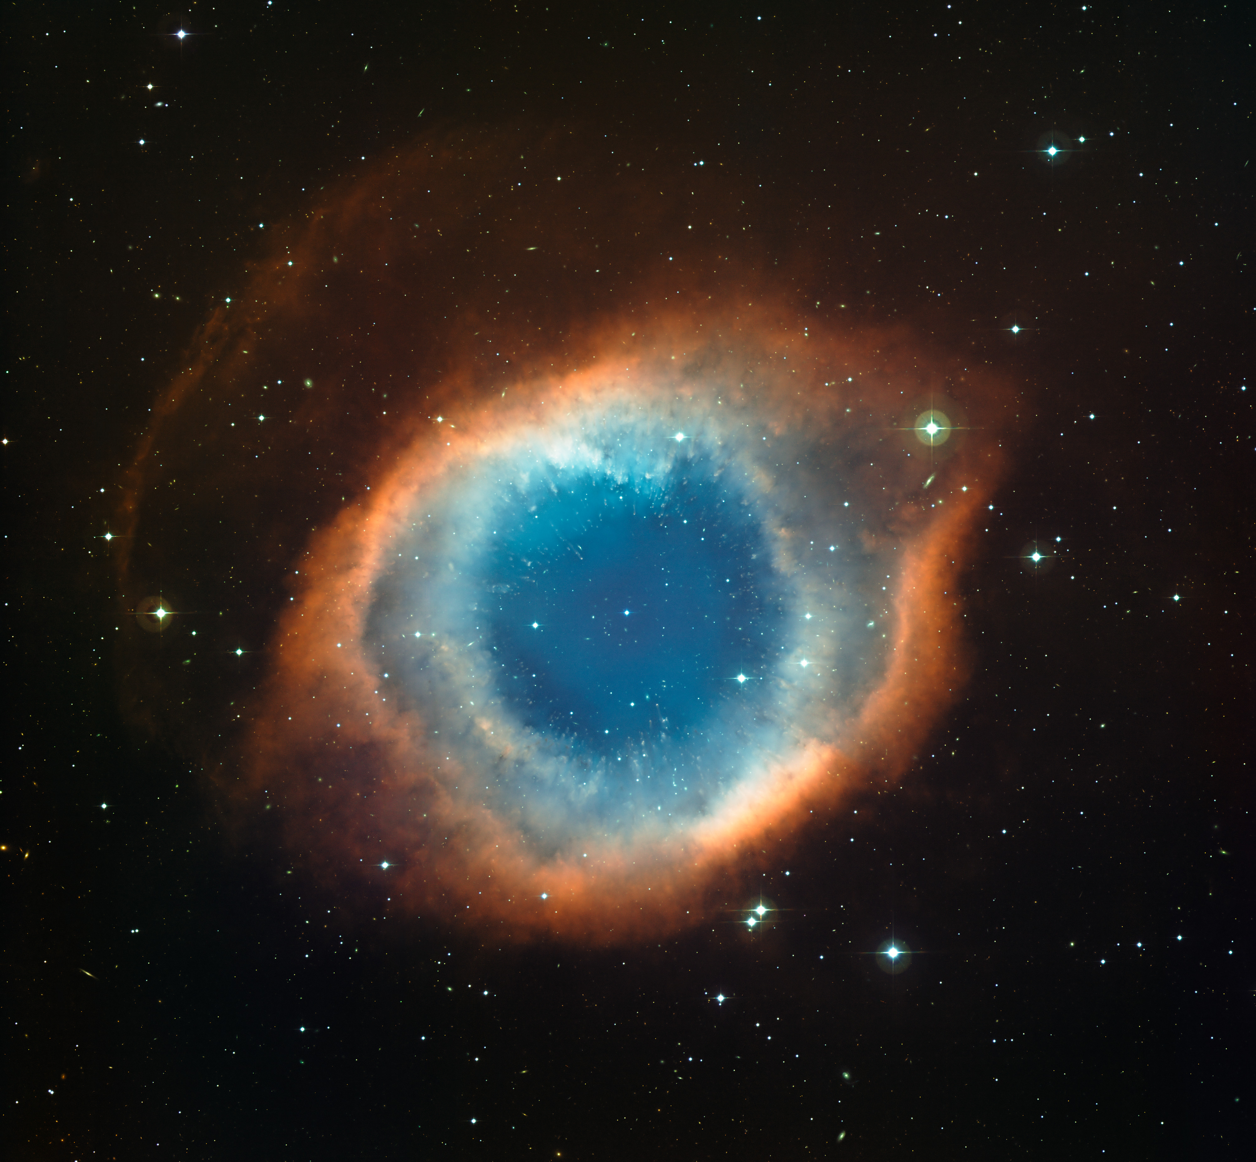
16 October 2023
Title of talk
John Smith
Affiliation

Slide 2
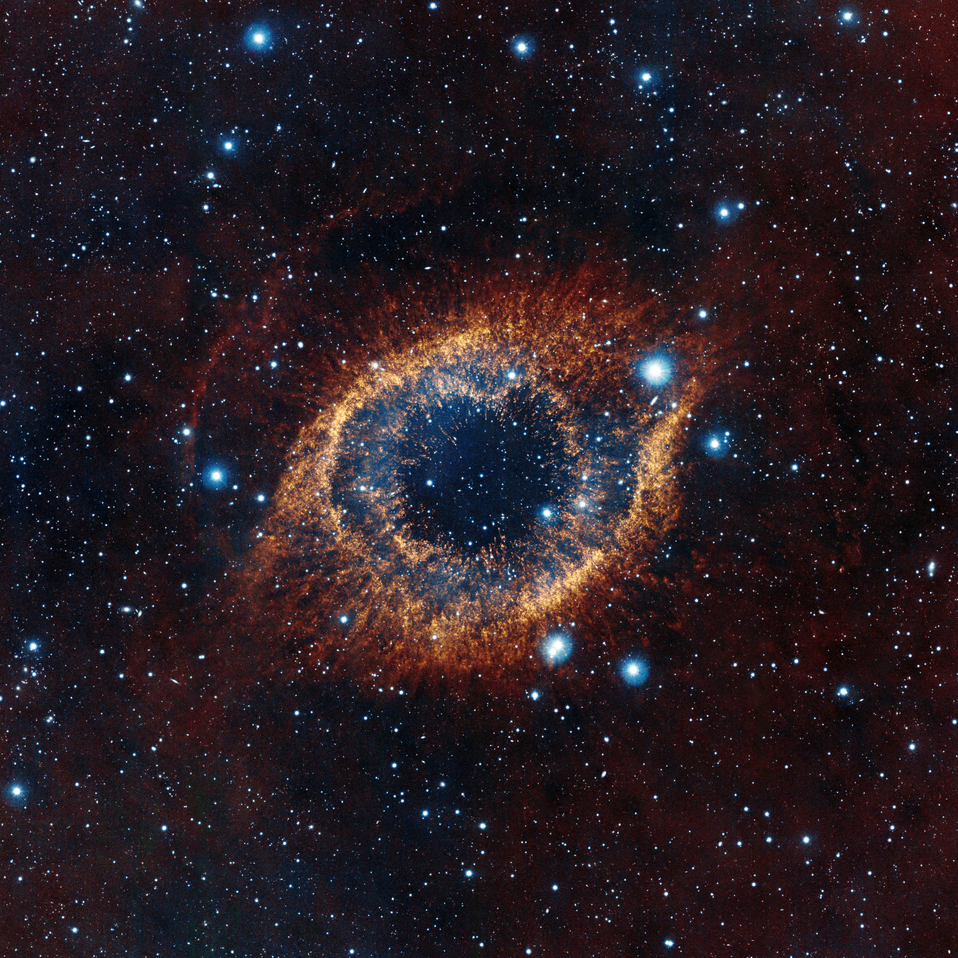
16 October 2023
Title of talk
John Smith
Affiliation

Slide 3
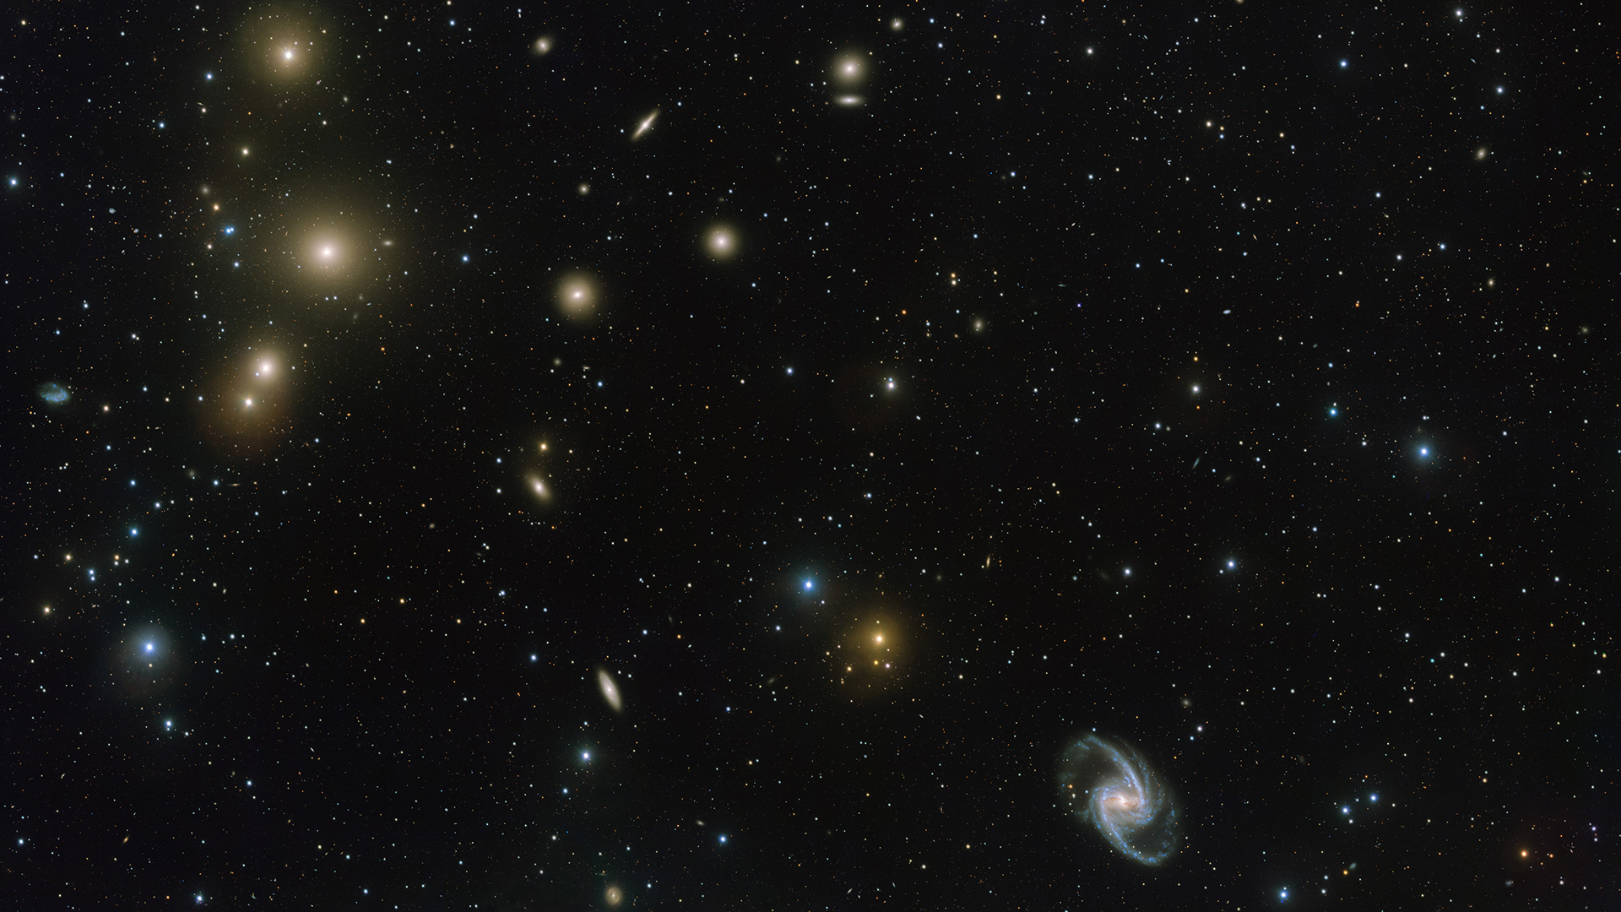
16 October 2023
Title of talk
John Smith
Affiliation

Slide 4
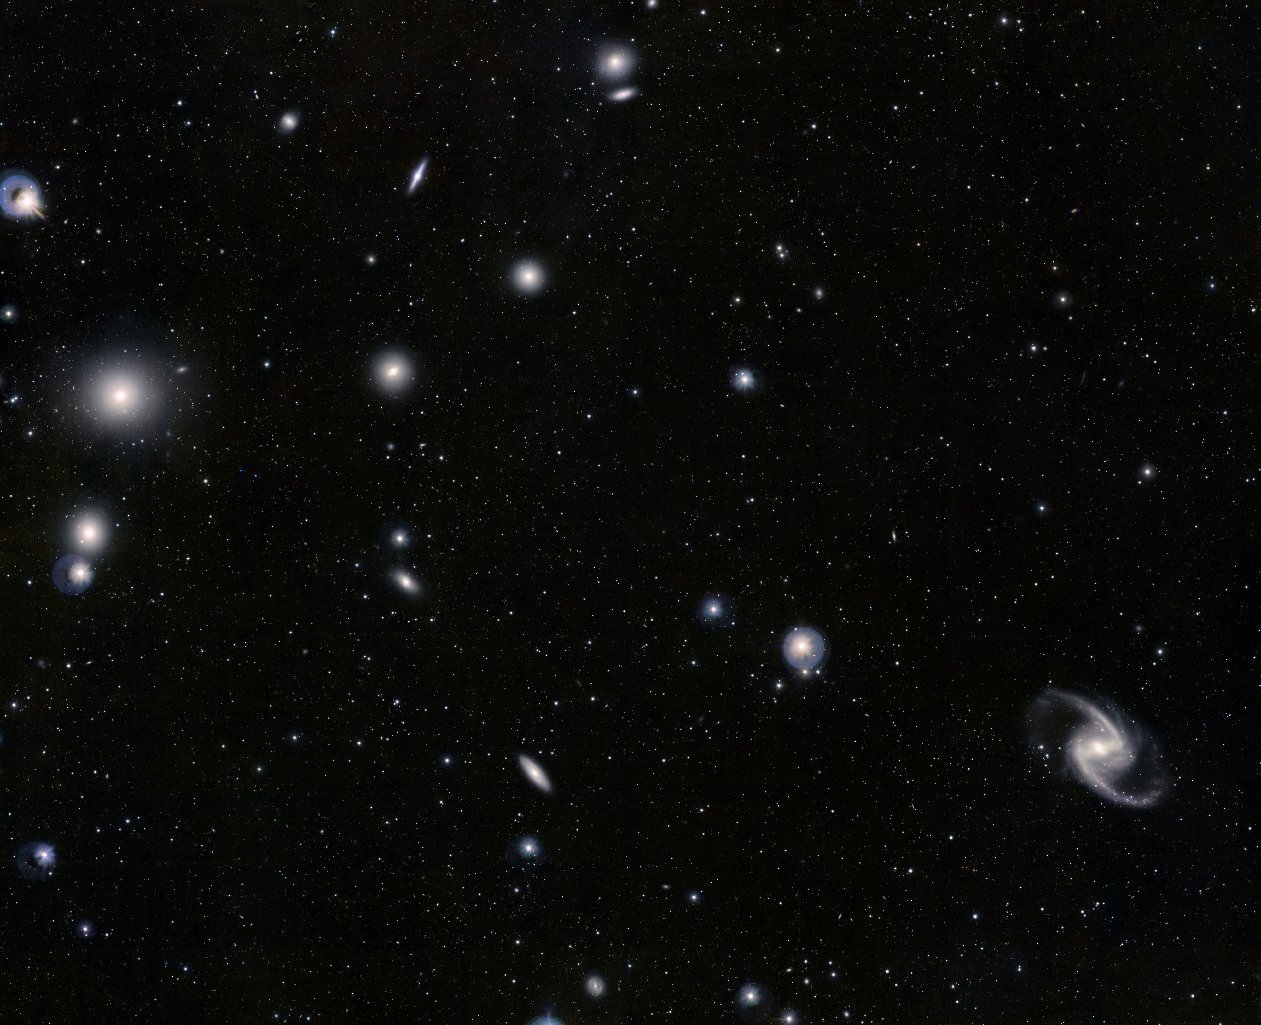
16 October 2023
Title of talk
John Smith
Affiliation

