Slide 1
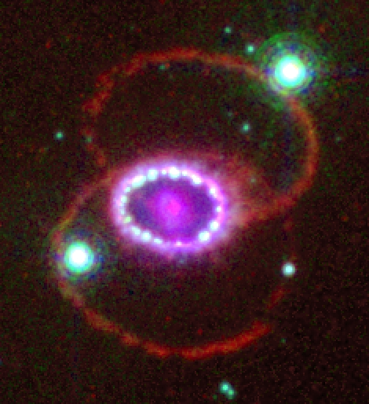
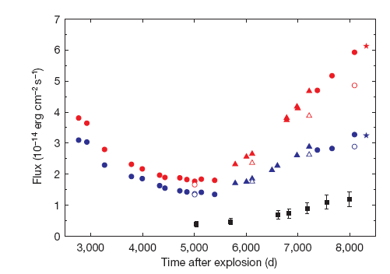
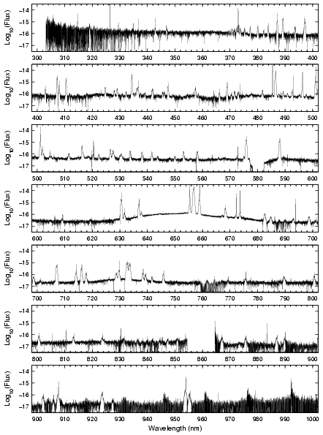
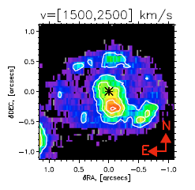
SN 1987A the excitement continues
Bruno Leibundgut
ESO

Slide 2
SN 1987A – a great collaboration
Monitoring over the past two and a half decades
  Claes Fransson (Stockholm)
  Bob Kirshner (CfA) → SINS and SAINTS (HST)
  Jason Spyromilio (ESO)
  Karina Kjær (Augsburg), Per Grőningsson (Stockholm), Anders Jerkstrand (Stockholm)

Slide 3
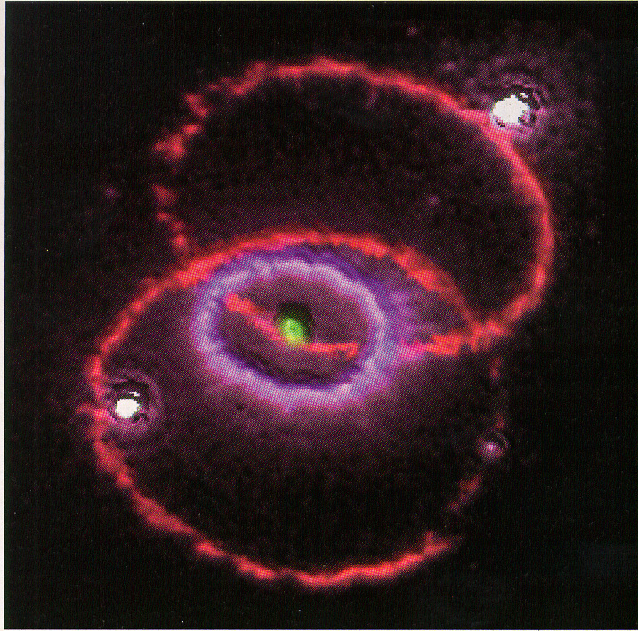
The exciting SN 1987A today
(9167 days since explosion)
Fluorescing rings
Shocks
  outer ejecta reached
  the inner ring
Radioactively heated
material
  inner ejecta
Dust
  in and around the supernova

Slide 4
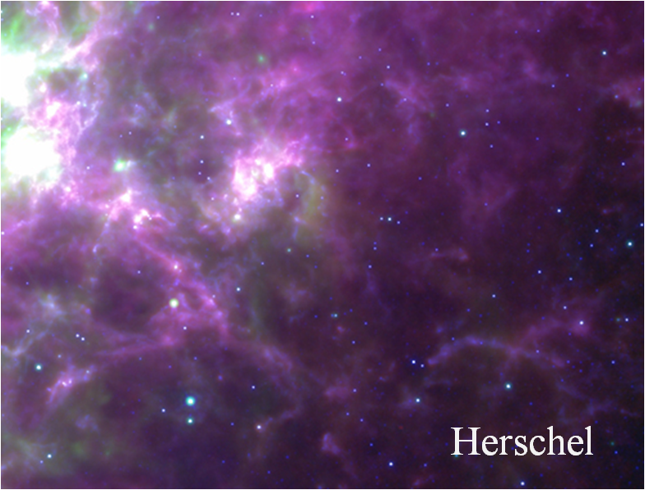
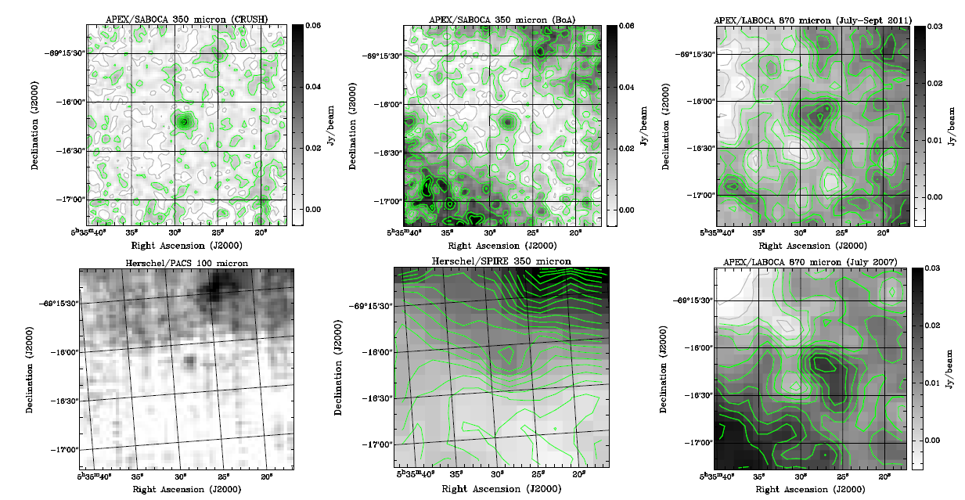
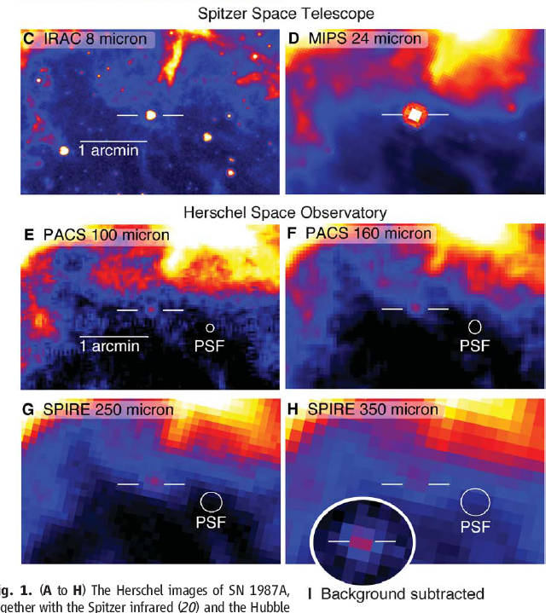
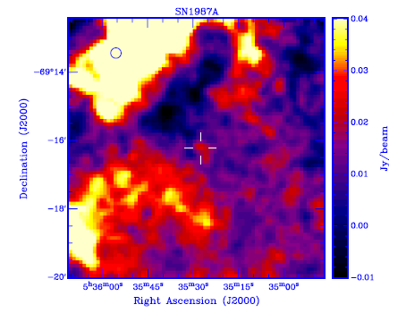
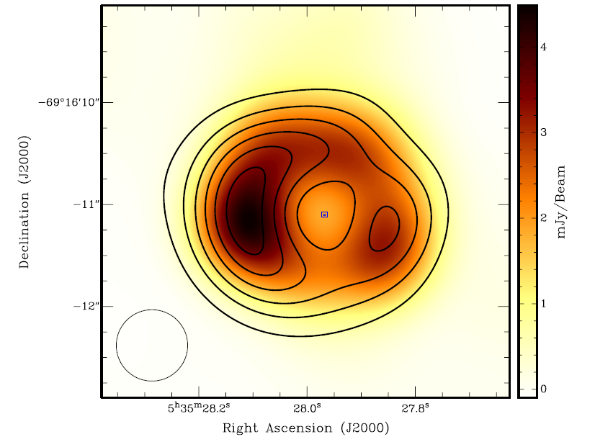
Exciting developments 2011/12
Detections by Spitzer and Herschel
Detection at mm wavelengths
Start to resolve the radio image
Lakićević et al. 2012
0.87mm - APEX
3mm
3cm (contours)
Lakićević et al. 2011
Lakićević et al. 2012
Matsuura et al. 2011

Slide 5
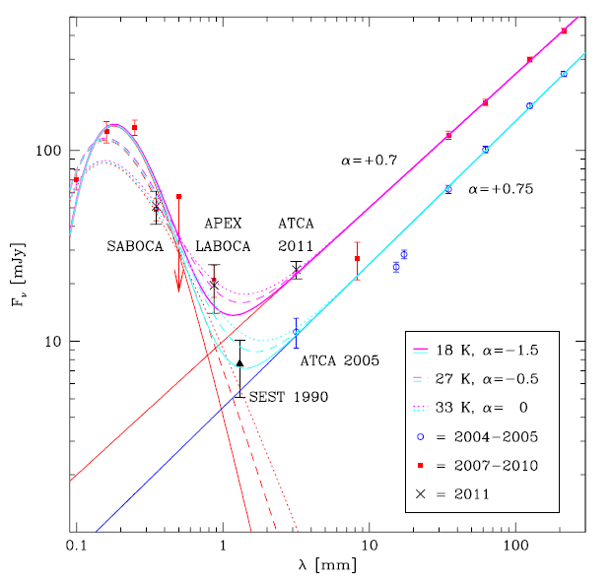
Dust - where is it?
Herschel fluxes indicate cold dust (~20K)
                Matsuura et al. 2011
  ~0.5 M dust in the ejecta
    strongly depends on the temperature
    location in the ejecta not completely obvious
IR/radio SED
  dust – black body emission
  synchrotron emission
Lakićević et al. 2012
Notes:
synchrotron emission with spectral index alpha
second alpha is the dust emission coefficient (kappa/kappa_0)=(lambda/lambda_0)^alpha

Slide 6
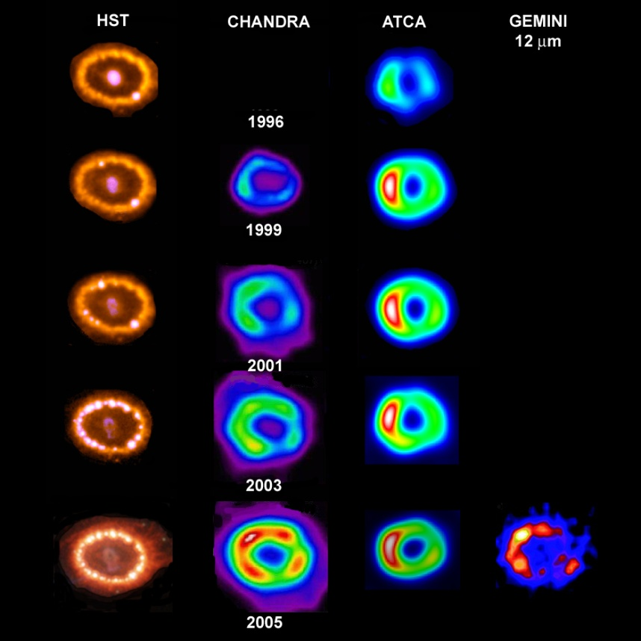
Optical, X-rays and Radio
Park et al
Manchester et al

Slide 7
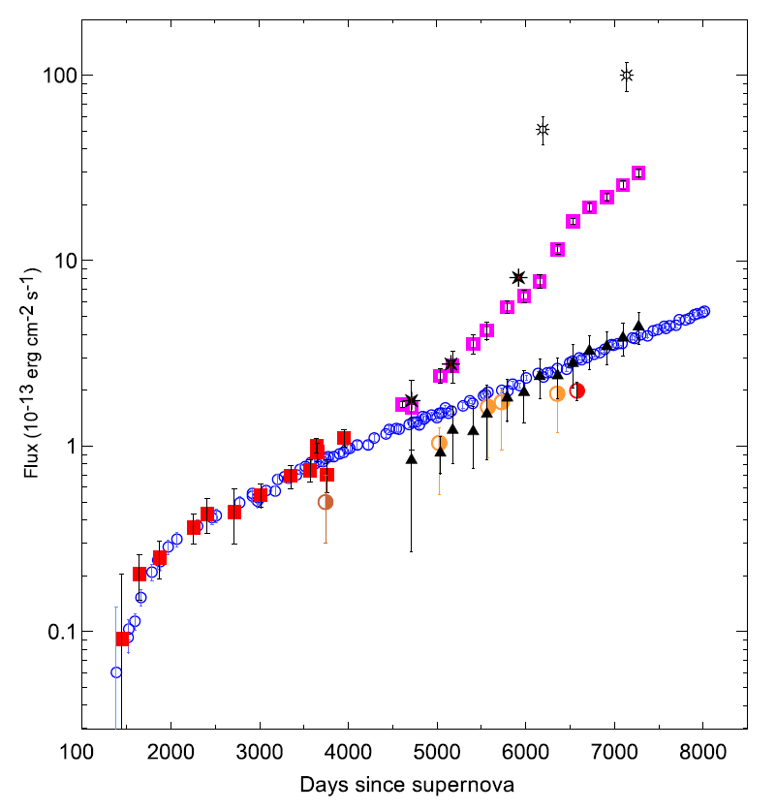
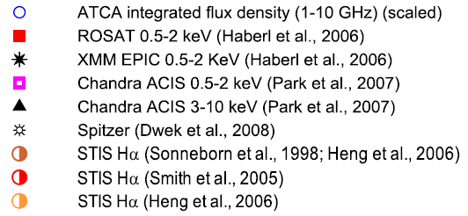
SN 1987A is brightening at all wavelengths
Larsson et al. 2011
Zanardo et al. 2010

Slide 8
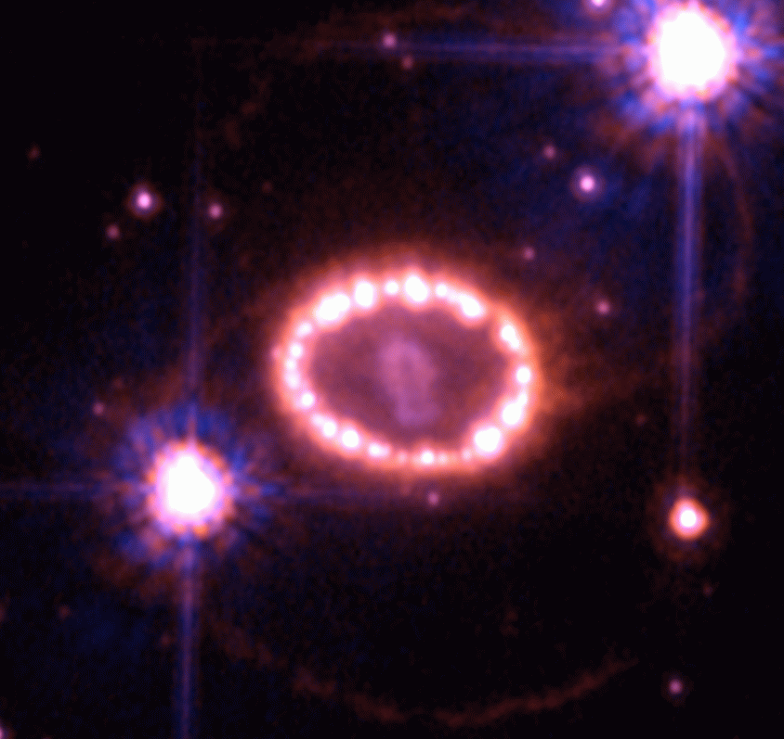
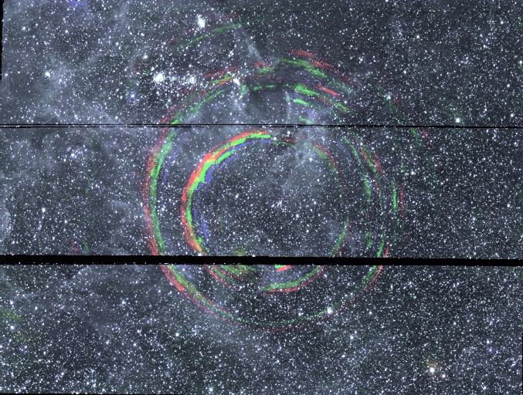
The complex SN 1987A @ 25 years
Combination of several emission sites
  inner ejecta
  shocked ejecta
  shocked inner ring
  ionised inner ring
  outer rings
  light echoes
Courtesy P. Challis, CfA

Slide 9
The different emission sites in SN 1987A
SN ejecta
  radioactively heated material (‘inner ejecta’)
  X-ray heated ejecta
  dust?
Rings
  density enhancements in equatorial (?) plane
  shock physics
    forward shock (into the ring)
    reverse shock (into the ejecta)
  dust?

Slide 10
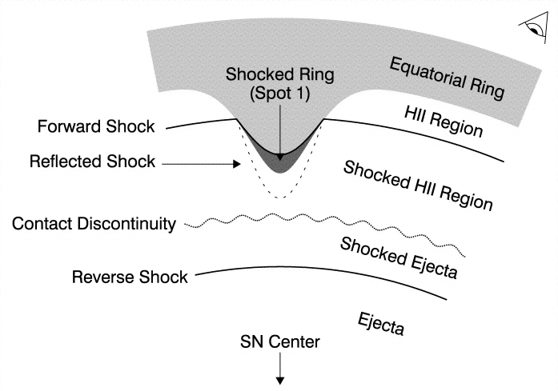
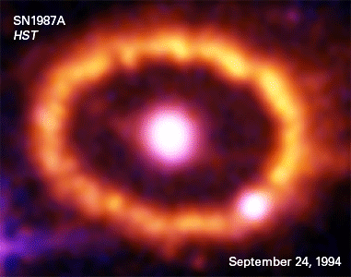
The ring collision
Dominating at all wavelengths
  shock emission increasing for the past 10 years
Emission from the stationary ring
  narrow lines (FWHM ≈ 10 km/s)
  known since 1987 - fading
Shocked ring region (forward shock)
  intermediate lines (~300 km/s)
Reverse shock
  ejecta (~15000 km/s)

Slide 11
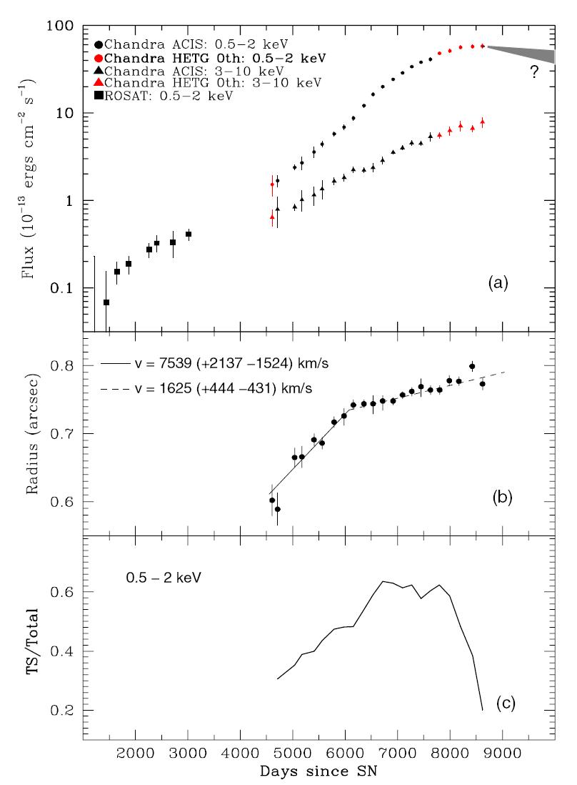
New phase in the X-rays?
Turnover of the soft X-rays
signature of decreasing density structure?
Park et al. 2011

Slide 12
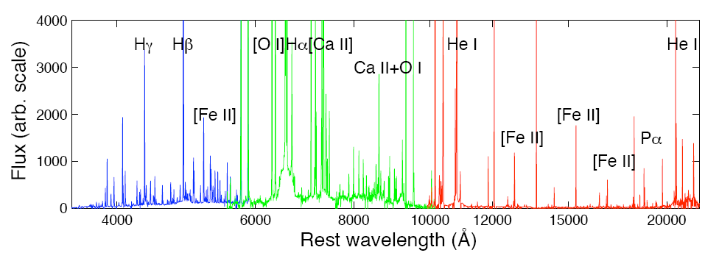
Emission line components
SN 1987A in Dec 2010
  Xshooter

Slide 13
The emission line components
4
Hα
2002
2000
3
Flux
2
1
0
-20000
-15000
-10000
-5000
0
5000
10000
15000
20000
velocity (km/s)
Michael et al. HST/STIS
1999

Slide 14
Reverse shock
Forward shock is ionizing the ejecta
  At some point all H atoms will be ionized before they reach the reverse shock and the emission will turn off
  X-rays give the amount
  of ionizing photons
  Monitoring the Hα
  emission will tell
Smith et al. 2005

Slide 15
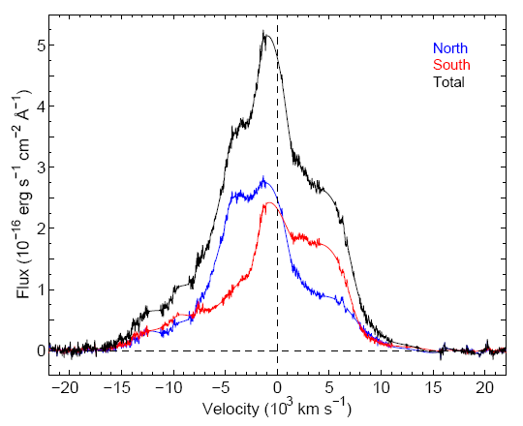
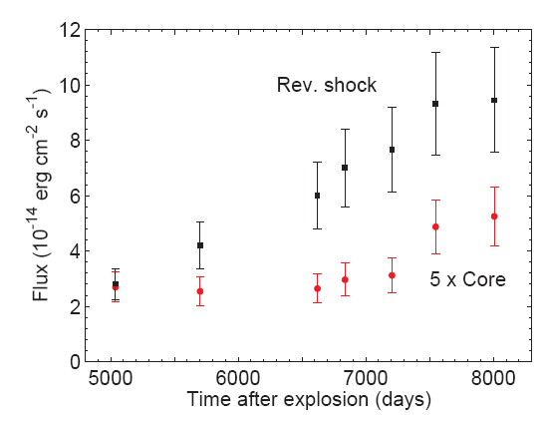
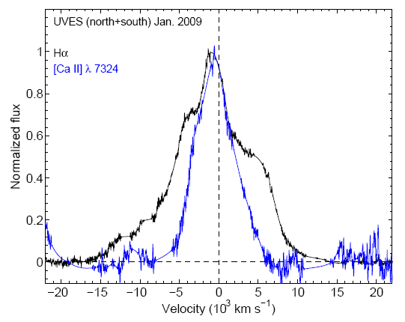
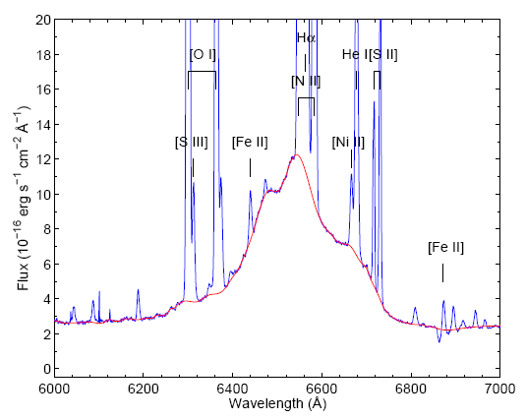
Hydrogen in SN 1987A
‘Clean Hα’
Flux increase by ~3.5 from 2000 to 2009
v_{max}>11000 km/s
  larger than possible in equatorial ring
  anisotropic expansion
ejecta brightened
asymmetry indicates dust
Day 7998
Fransson et al. 2012

Slide 16
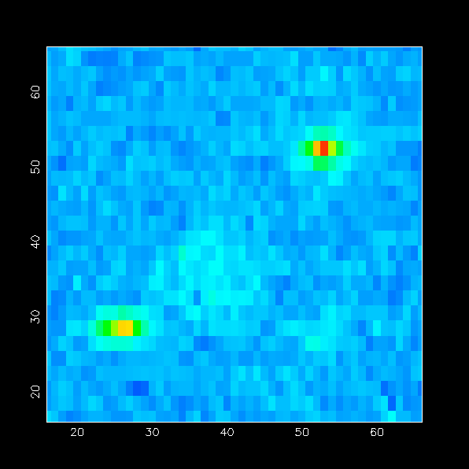
Spatially resolved infrared spectroscopy
separate ring from ejecta
trace the ring in individual lines
get spectra from separate regions
photometry of selected regions

Slide 17
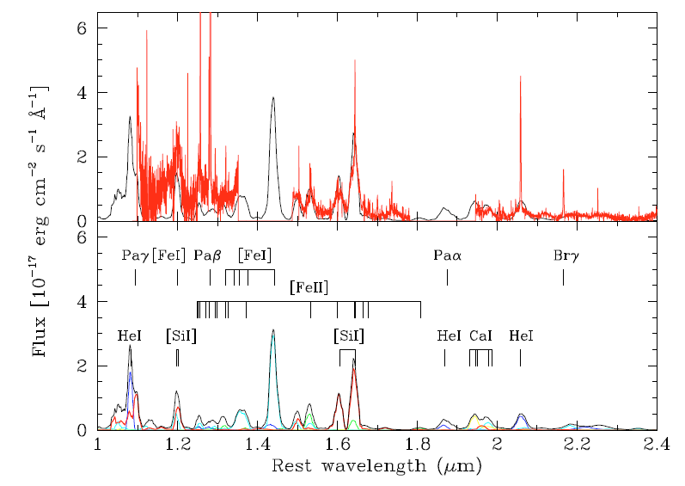
Ejecta resolved
Ground-based near-IR data show spatially
resolved ejecta
Kjær et al. 2010

Slide 18
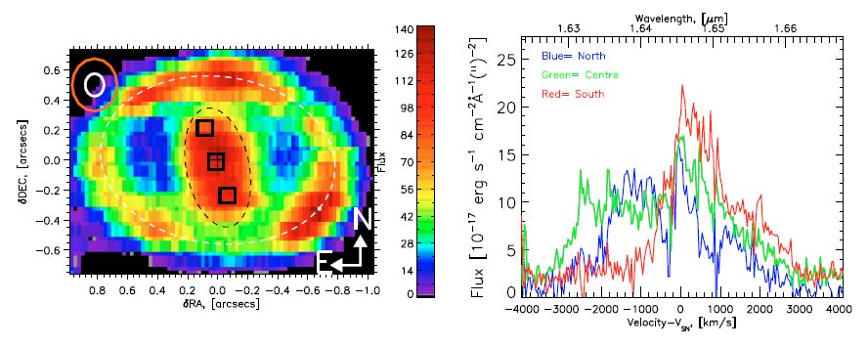
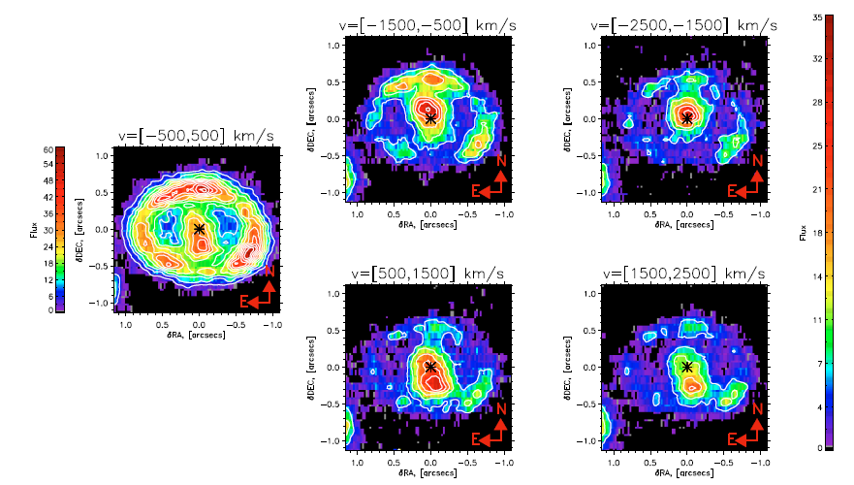
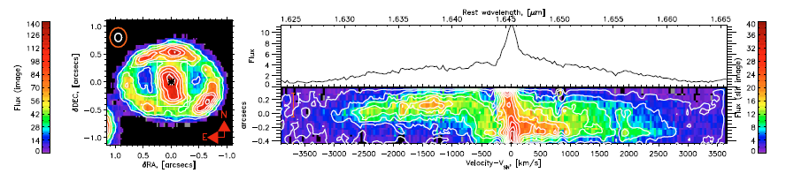
Asymmetry in the ejecta
[Si I] +[Fe II]
[Si I] +[Fe II]
1.64 μm

Slide 19
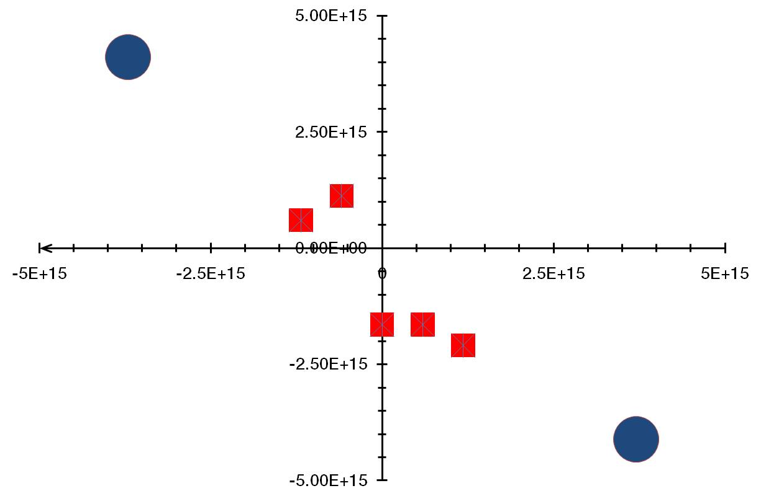
Ejecta kinematics
Southern part is redshifted, northern ejecta are blueshifted
Expansion velocity roughly 3000 to 4000 km/s
This is the same orientation
as the inner ring!
Ejecta lies in the
same plane as the
ring!

Slide 20
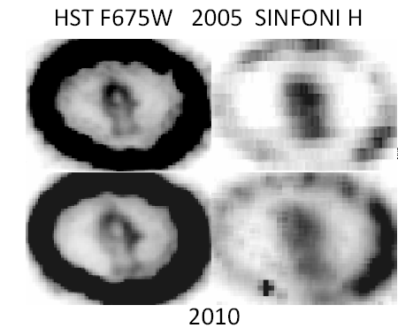
The inner ejecta
Comparison optical vs. IR
  optical
    heated by X-rays
  IR
    radioactive heating

Slide 21
Summary
SN 1987A is as interesting as ever
  ring collision is in full swing
    forward shocks in/past(?) the ring
    reverse shock in the debris (outer ejecta)
    heating of the inner ejecta
  first direct look at the inner parts of an explosion
    resolved inner ejecta are the immediate result of the explosion mechanism
    confirmation of the standing accretion shock instability (SASI) → neutrino convection in the explosion

Slide 22
More to come
Complete destruction of the ring
Disappearance of the reverse shock
Illuminating the outside
  beyond the inner ring
Detailed mapping of the inner ejecta
  details on explosion mechanics and distribution of synthesized material
  dust formation
    ALMA!
Where is the neutron star?

