Slide 1
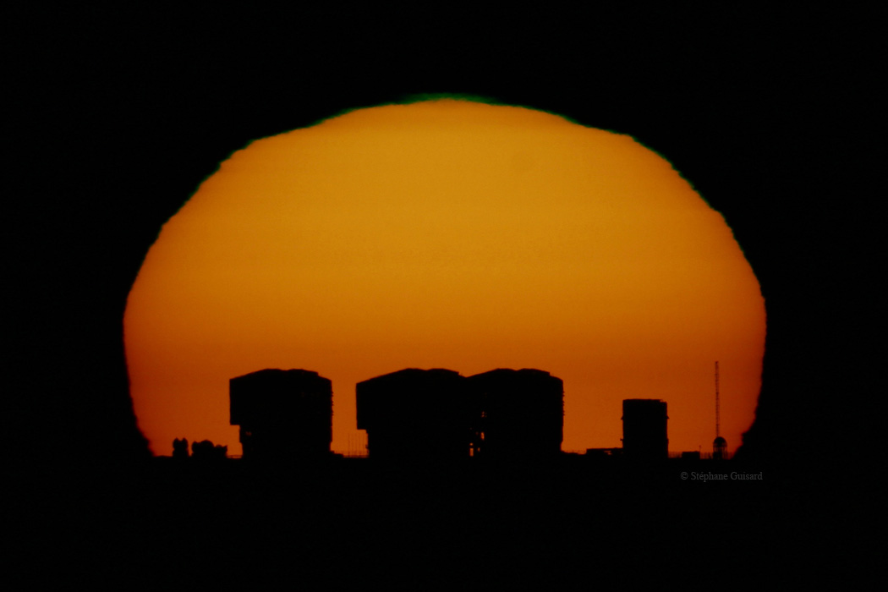
From the VLT to ALMA and to the E-ELT

Slide 2
European Southern Observatory
Mission
  Develop and operate world-class observing facilities for astronomical research
  Organize collaborations in astronomy
Intergovernmental treaty-level organization
  Founded in 1962 by 5 countries
  Currently 14 member states
Observatories in Chile
  Optical/infrared: La Silla and Paranal
  Sub-mm: APEX and ALMA partnerships: Chajnantor
HQ in Garching and Office in Santiago

Slide 3
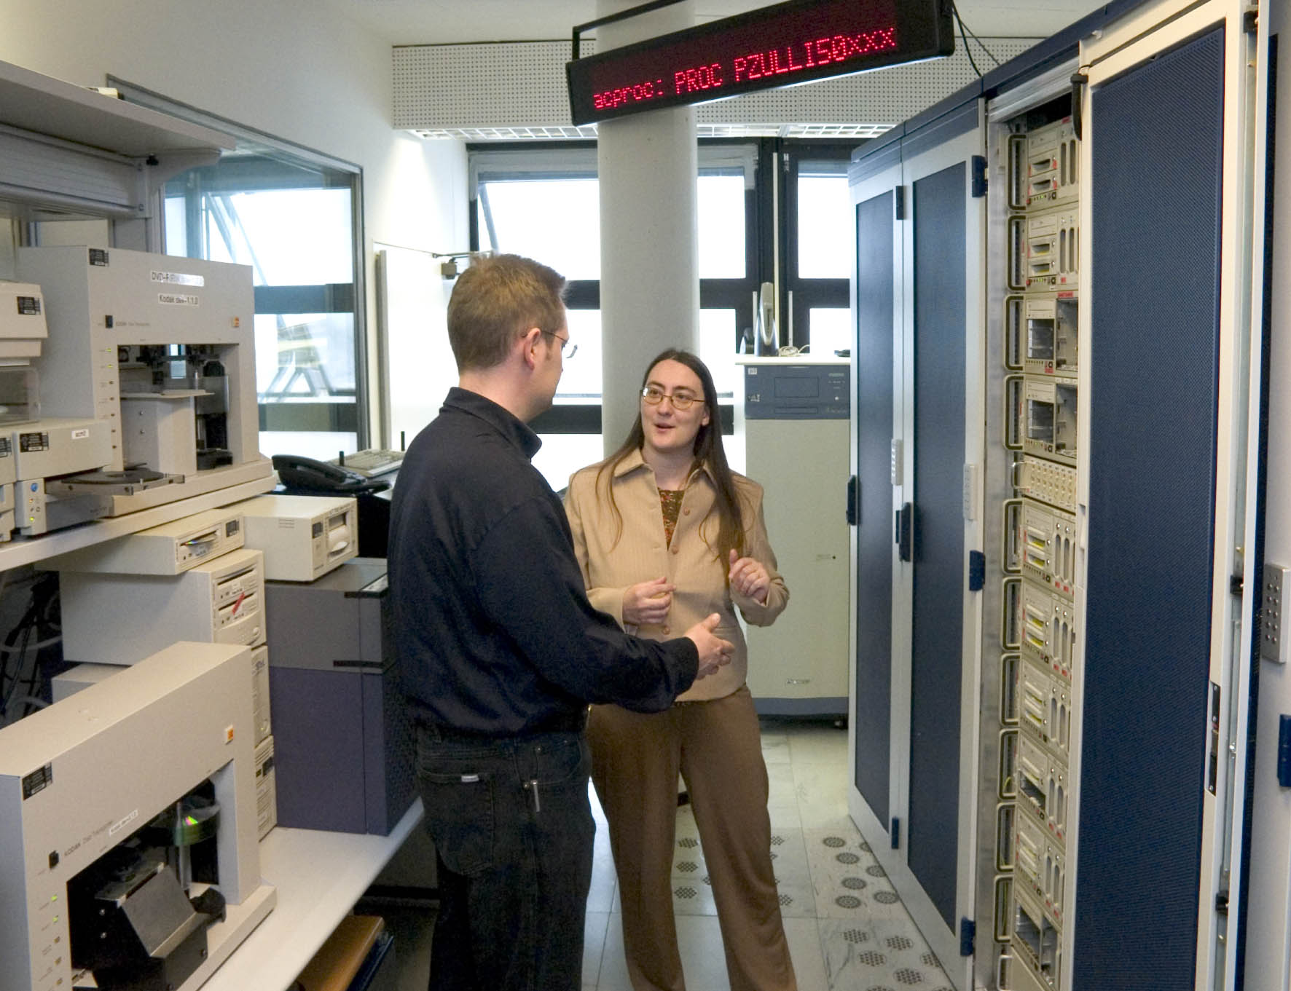
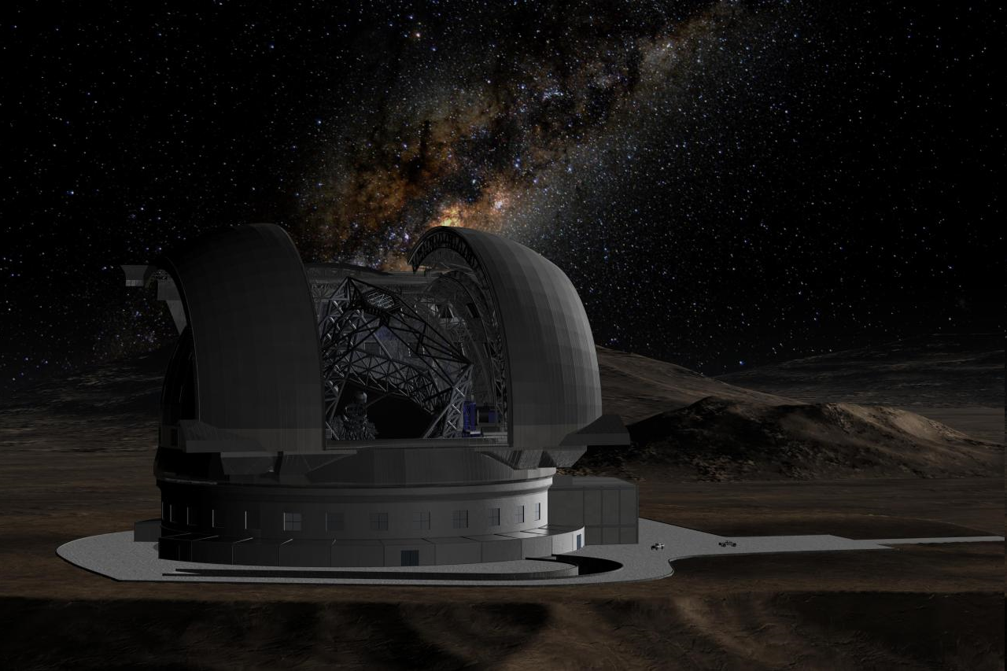
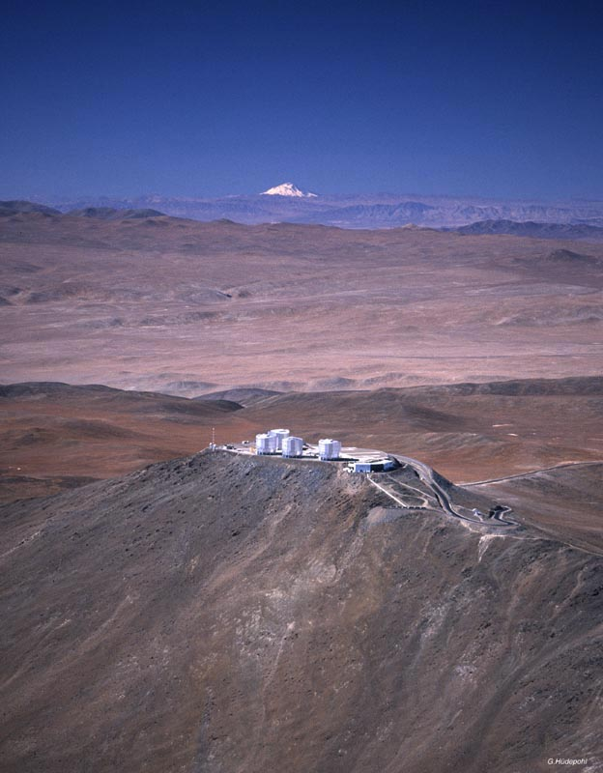
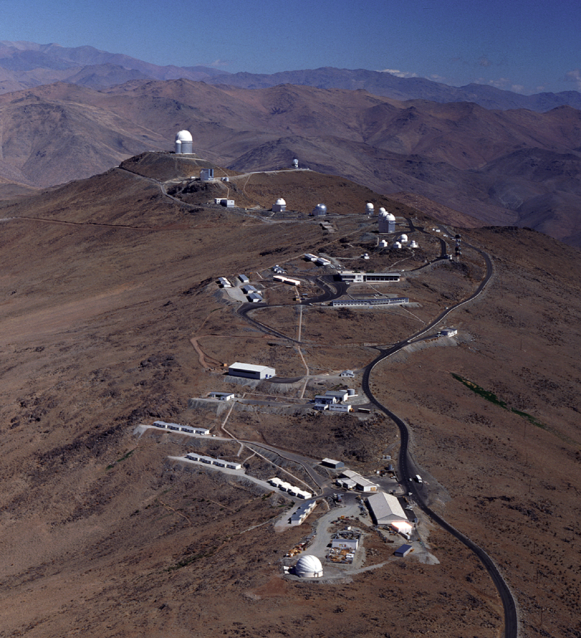
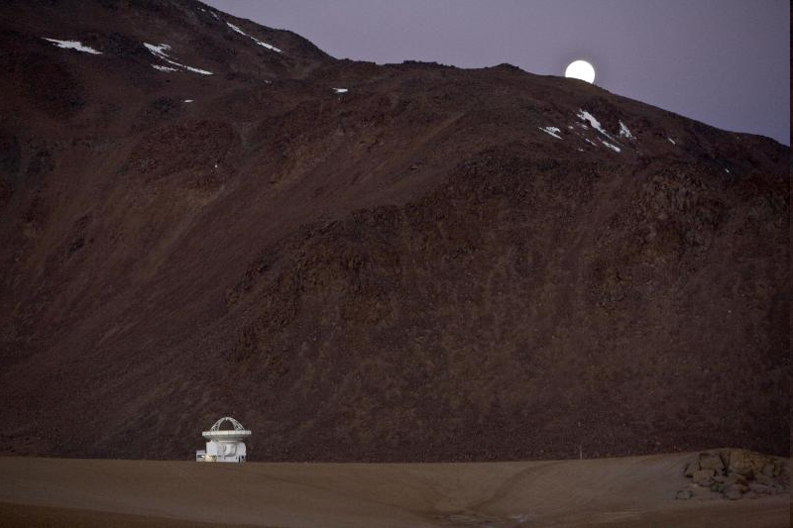
ESO Today
La Silla and Paranal Observatory in full operations
(8 telescopes in 2010, plus 4 telescopes for interferometry)
APEX operating on Chajnantor
ALMA under construction (early science in 2011, full operations in 2013)
Operational data archive
European Extremely Large Telescope in design phase

Slide 4
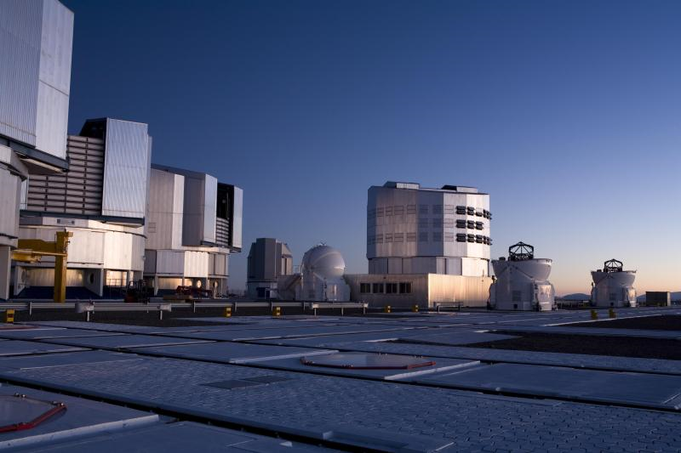
La Silla Paranal Observatory
Very Large Telescope (Paranal)
  9 telescopes operational, one in commissioning
  14 instruments in use, 7 in development
  Instrumentation covers the available optical infrared wavelengths from 300nm to 20μm
  Angular resolution from seeing limit (0.8 arcseconds) to 50 micro-arcseconds
  Imagers and wide-field imagers
    survey telescopes
  Spectrographs
    resolution from ~5 < λ/∆λ < 150000
  Interferometric array (VLTI)
  Laser Guide Star Facility

Slide 5
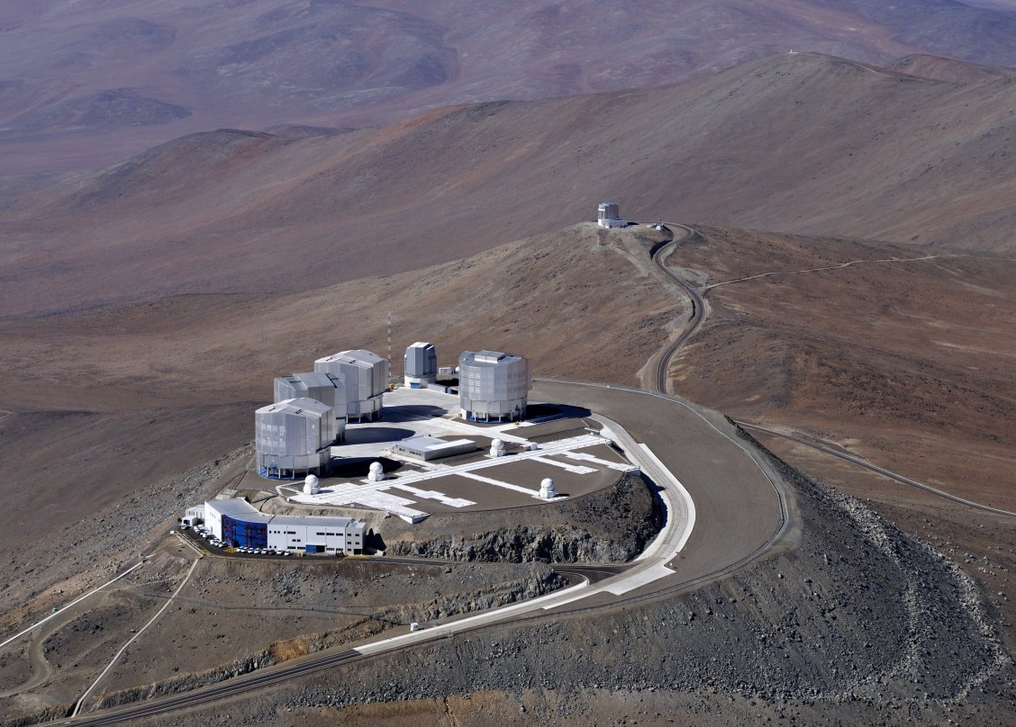

Slide 6
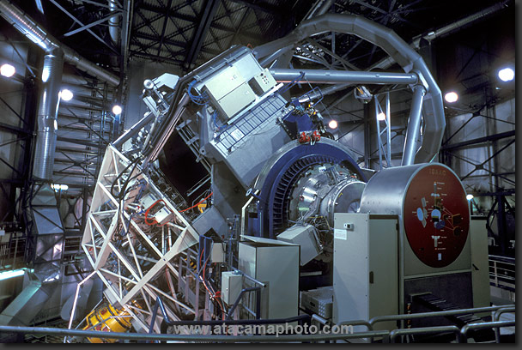

Slide 7
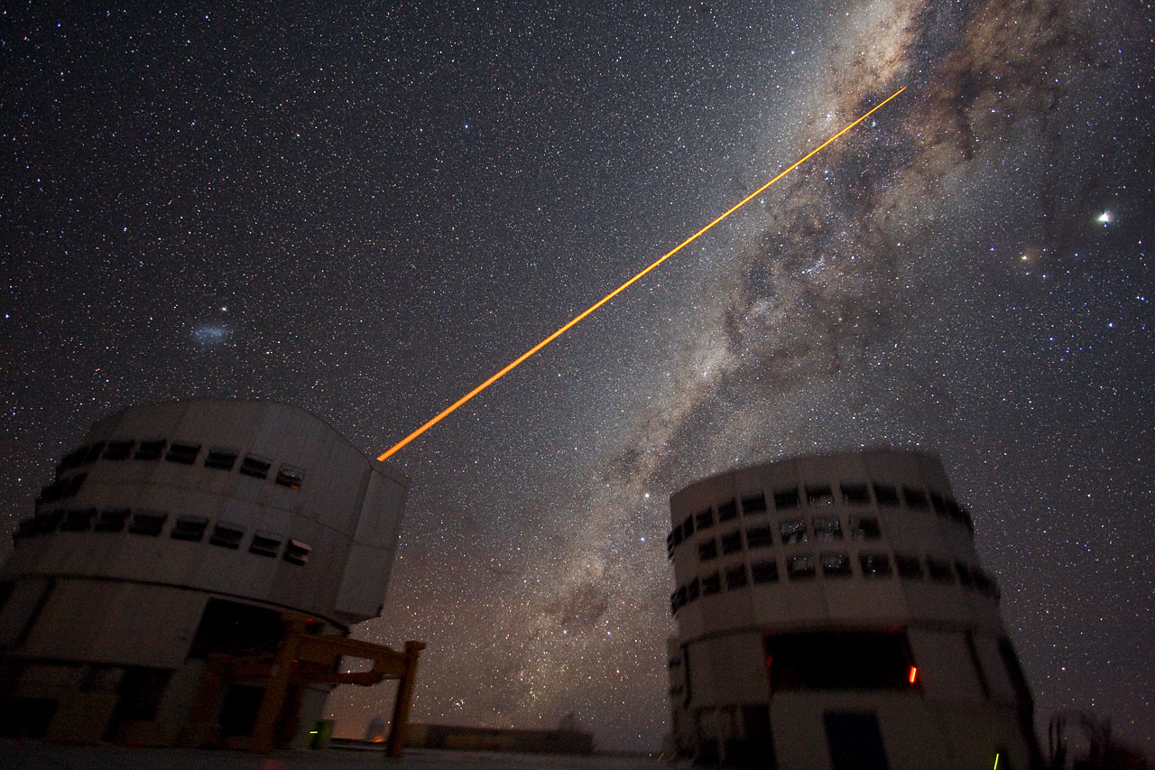
Laser Guide Star Facility

Slide 8
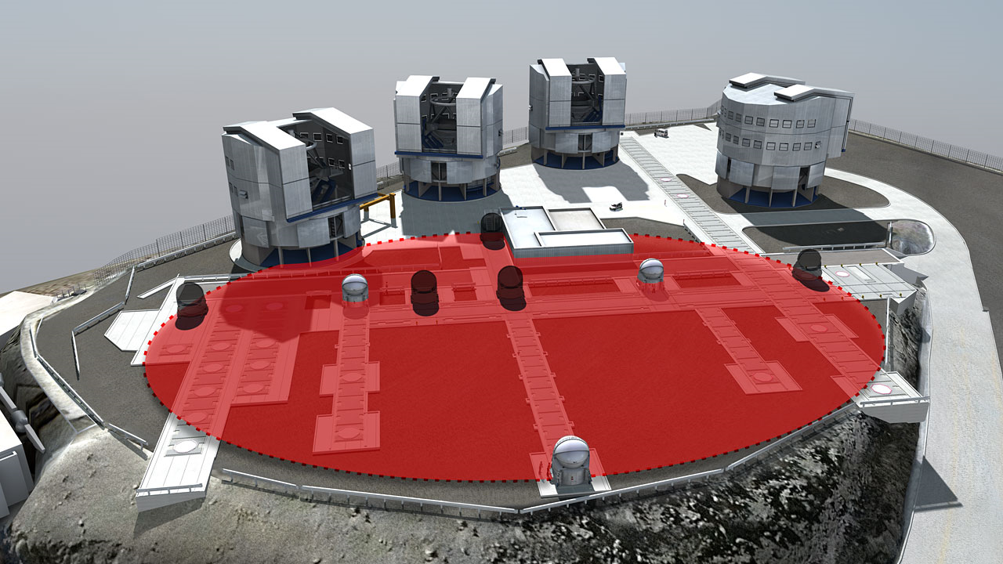
The VLT Interferometer

Slide 9
Top list of ESO science
Galactic Centre
  Supermassive black hole
  Measure gravity in its strong regime
Extrasolar planets
  Images and spectroscopy
  Characterise other worlds
Accelerating Universe
  Spectroscopy of distant supernovae
Gamma-Ray Bursts/Supernovae
  Explosion physics
  Tracers of the distant universe

Slide 10
Other top science from ESO
Metal-poor stars
  Finding the oldest known stars
  Trace Big Bang nucleosynthesis
Stellar populations in nearby galaxies
  Stellar archeology
Massive galaxies in the distant Universe
  Formation and evolution of galaxies
Varying physical constants?
  Measure the fine-structure constant over time
Testing the cosmological model
  Cosmic background temperature

Slide 11
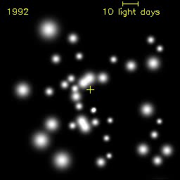
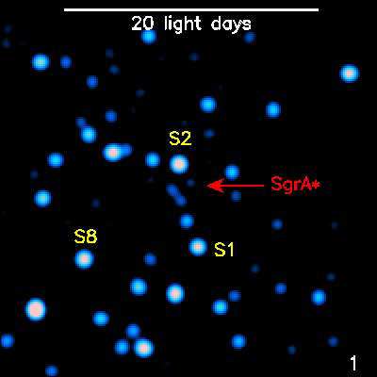
Black hole at the Galactic Centre
Mass determination
through stellar orbits
Structure around the
black hole revealed
through flashes
Coordinated studies
with other
wavelengths
Multi-year study
  use of AO instruments (SHARP on NTT, ISAAC NACO, SINFONI on VLT)

Slide 12
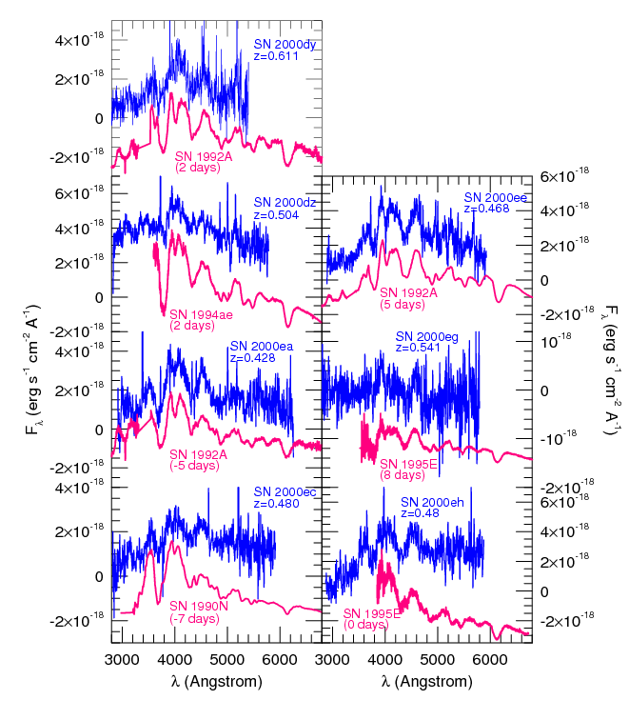
Accelerating Universe
Contribution of most of the early photometry and spectroscopy of High-z SN Search Team
  difference between a 4m and a 8m telescope
Riess et al. 1998, AJ, 116, 1009
Leibundgut & Sollerman 2001

Slide 13
Gamma-Ray Bursts
Identification relies on optical data
  redshifts, explosion energies, explosion physics
Cosmological probes
  the most distant observable stars
  light houses to measure the intergalactic medium
  tracers of chemical enrichment?
Very short duration
  required special instrumentation and software to observe adequately

Slide 14
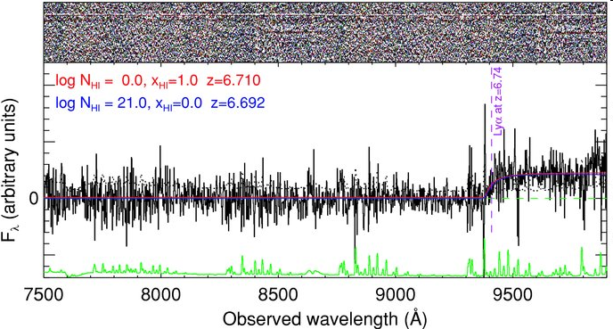
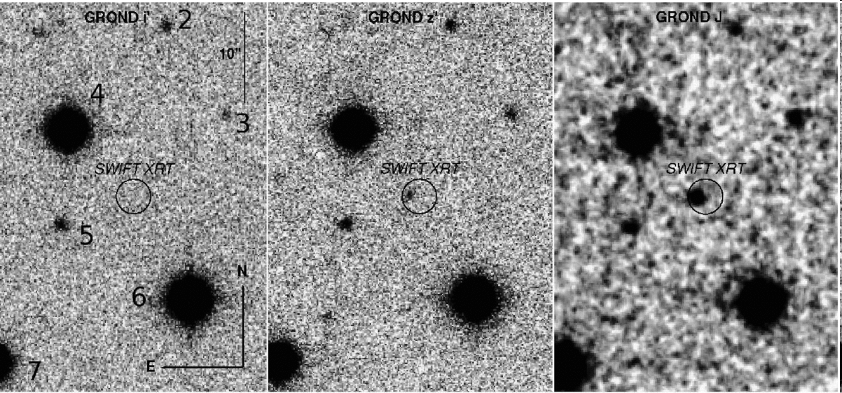
Gamma-Ray Bursts
Most distant stellar objects ever observed
  redshifts 6.7 and 8.2 (tentative)
  lookback time of nearly 12.5 billion years (or 95% of the age of the universe)
VLT equipped with rapid response mode
  allows to observe a gamma-ray burst 10 minutes after detection
i
z
J
GRB080913

Slide 15
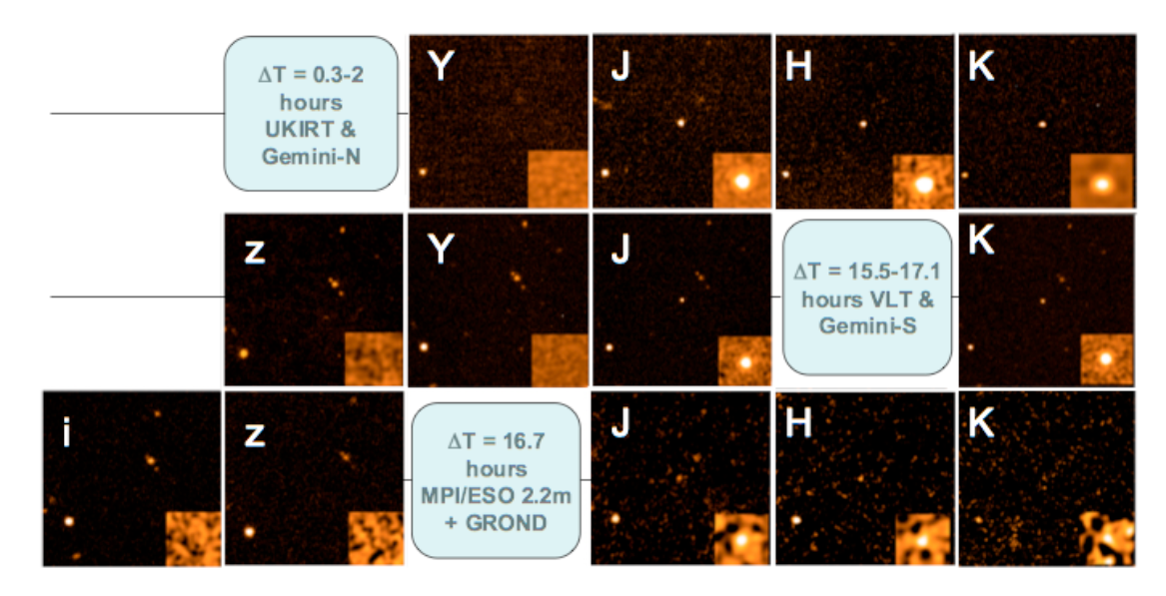
Most distant stellar object yet observed – GRB 090423
Tanvir et al., Nature submitted
Optical drop-out, bright in the near-infrared
Rapid decline

Slide 16
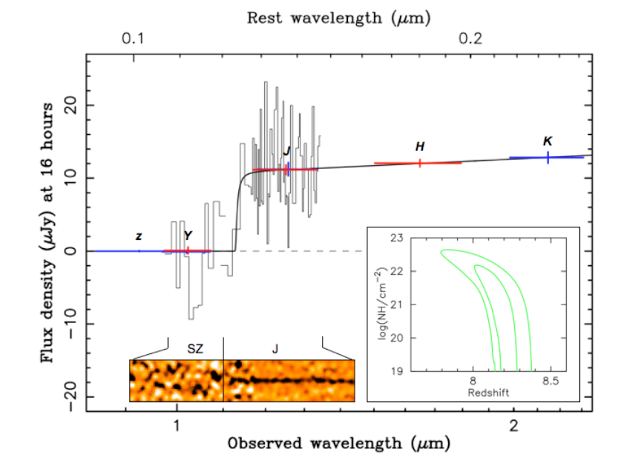
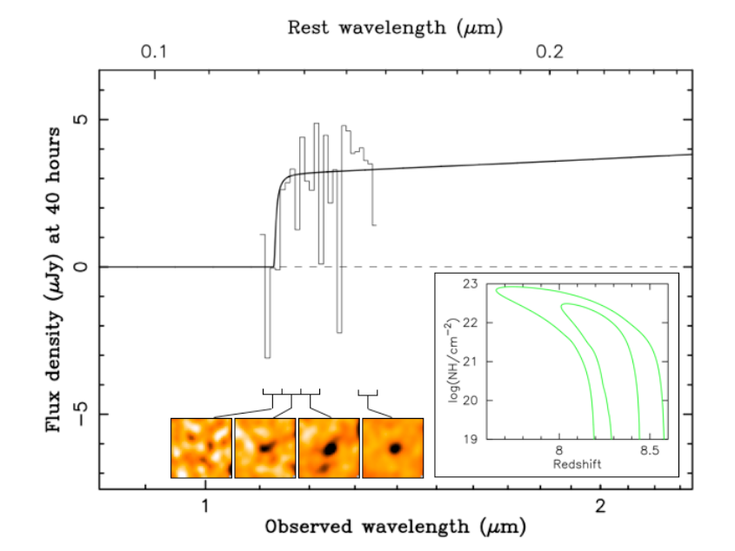
GRB 090423
ISAAC
SINFONI
Spectroscopy 17 hours after outburst
Lyman break indicates a redshift of z≈8.2

Slide 17
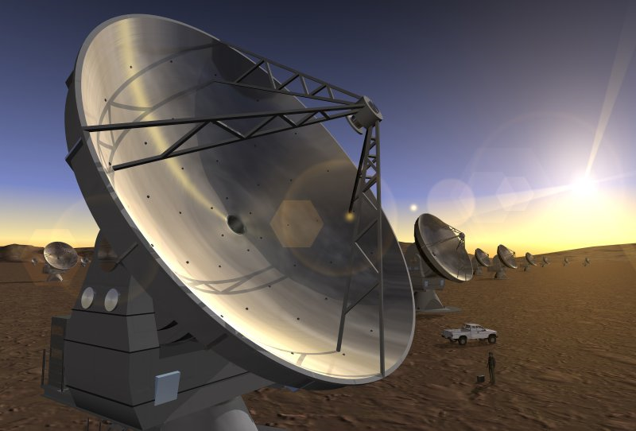
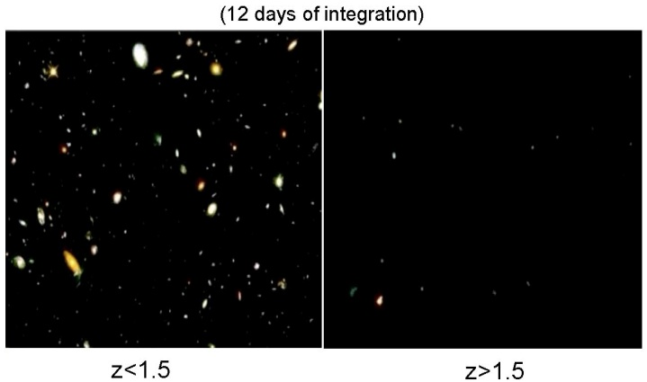
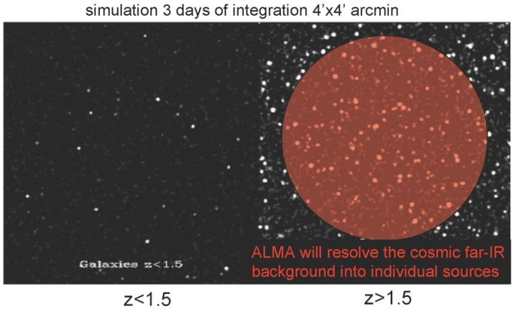
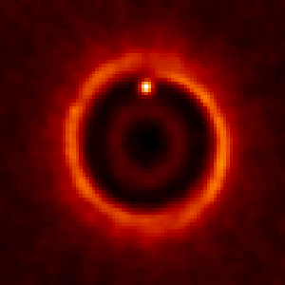

Atacama Large Millimeter Array
Global project with Europe, North America and East Asia as partners
Science requirements
  Detect CO and [CII] in Milky Way galaxy at z=3 in < 24 hr
  Dust emission, gas kinematics in proto-planetary disks
  Resolution to match Hubble, JWST and 8-10m with AO
  Complement to Herschel
Specifications
  66 antennas (54x12m, 12x7m)
  14 km max baseline (< 10mas)
  30-1000 GHz (10–0.3mm), up to 10 receiver bands
HST
ALMA
5AU
850 GHz

Slide 18
ALMA
ALMA will explore the cold universe
  typical gas temperatures` 10 K < T_{gas} < 500 K
  molecular astrophysics
ALMA has great capabilities to observe the distant universe
  ‘inverse’ K-correction
  detection of the cold gas in distant galaxies as tracers of star formation
    [C II] 157μm is the strongest coolant in most galaxies
    CO amongst the most abundant molecules in the universe
  Sunyaev-Zeldovich effect directly measurable

Slide 19
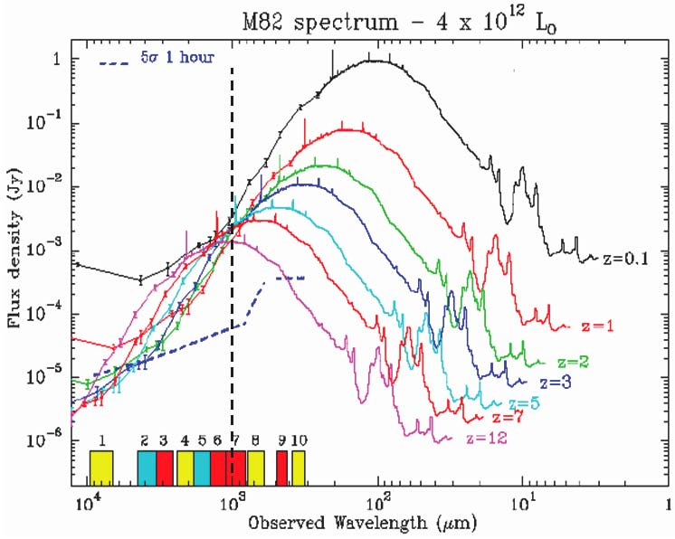
K-corrections due to redshift
In the (sub-)millimeter the inverse K-correction compensates for the distance as redshift increases

Slide 20
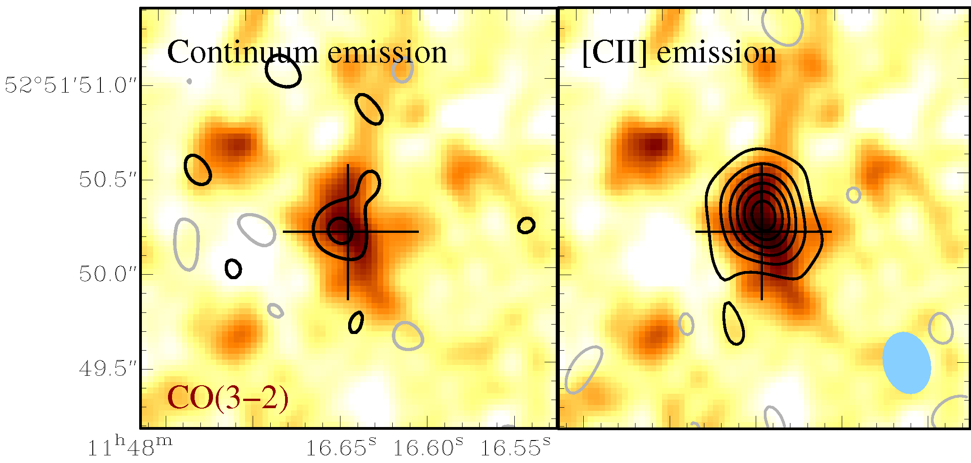
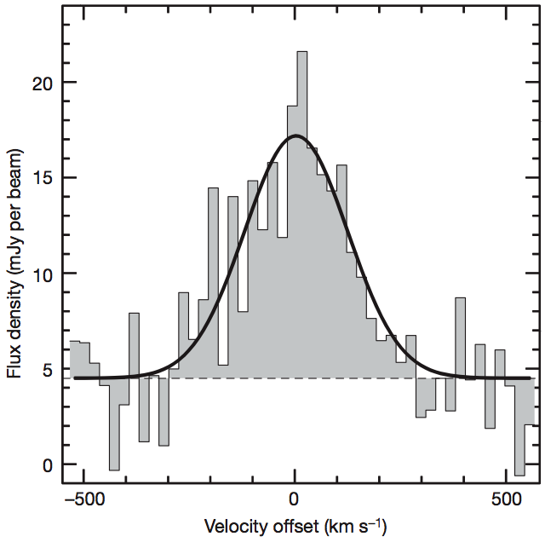
Starburst at z=6.4
Detection of [C II] in the distant universe
  [CII] size ~ 1.5 kpc => SFR/area ~ 1000 M_{o} yr⁻¹ kpc⁻²
1”
PdBI – 0.25” res
Maiolino et al. 2005
Walter et al. 2009
FIR continuum
[CII]

Slide 21
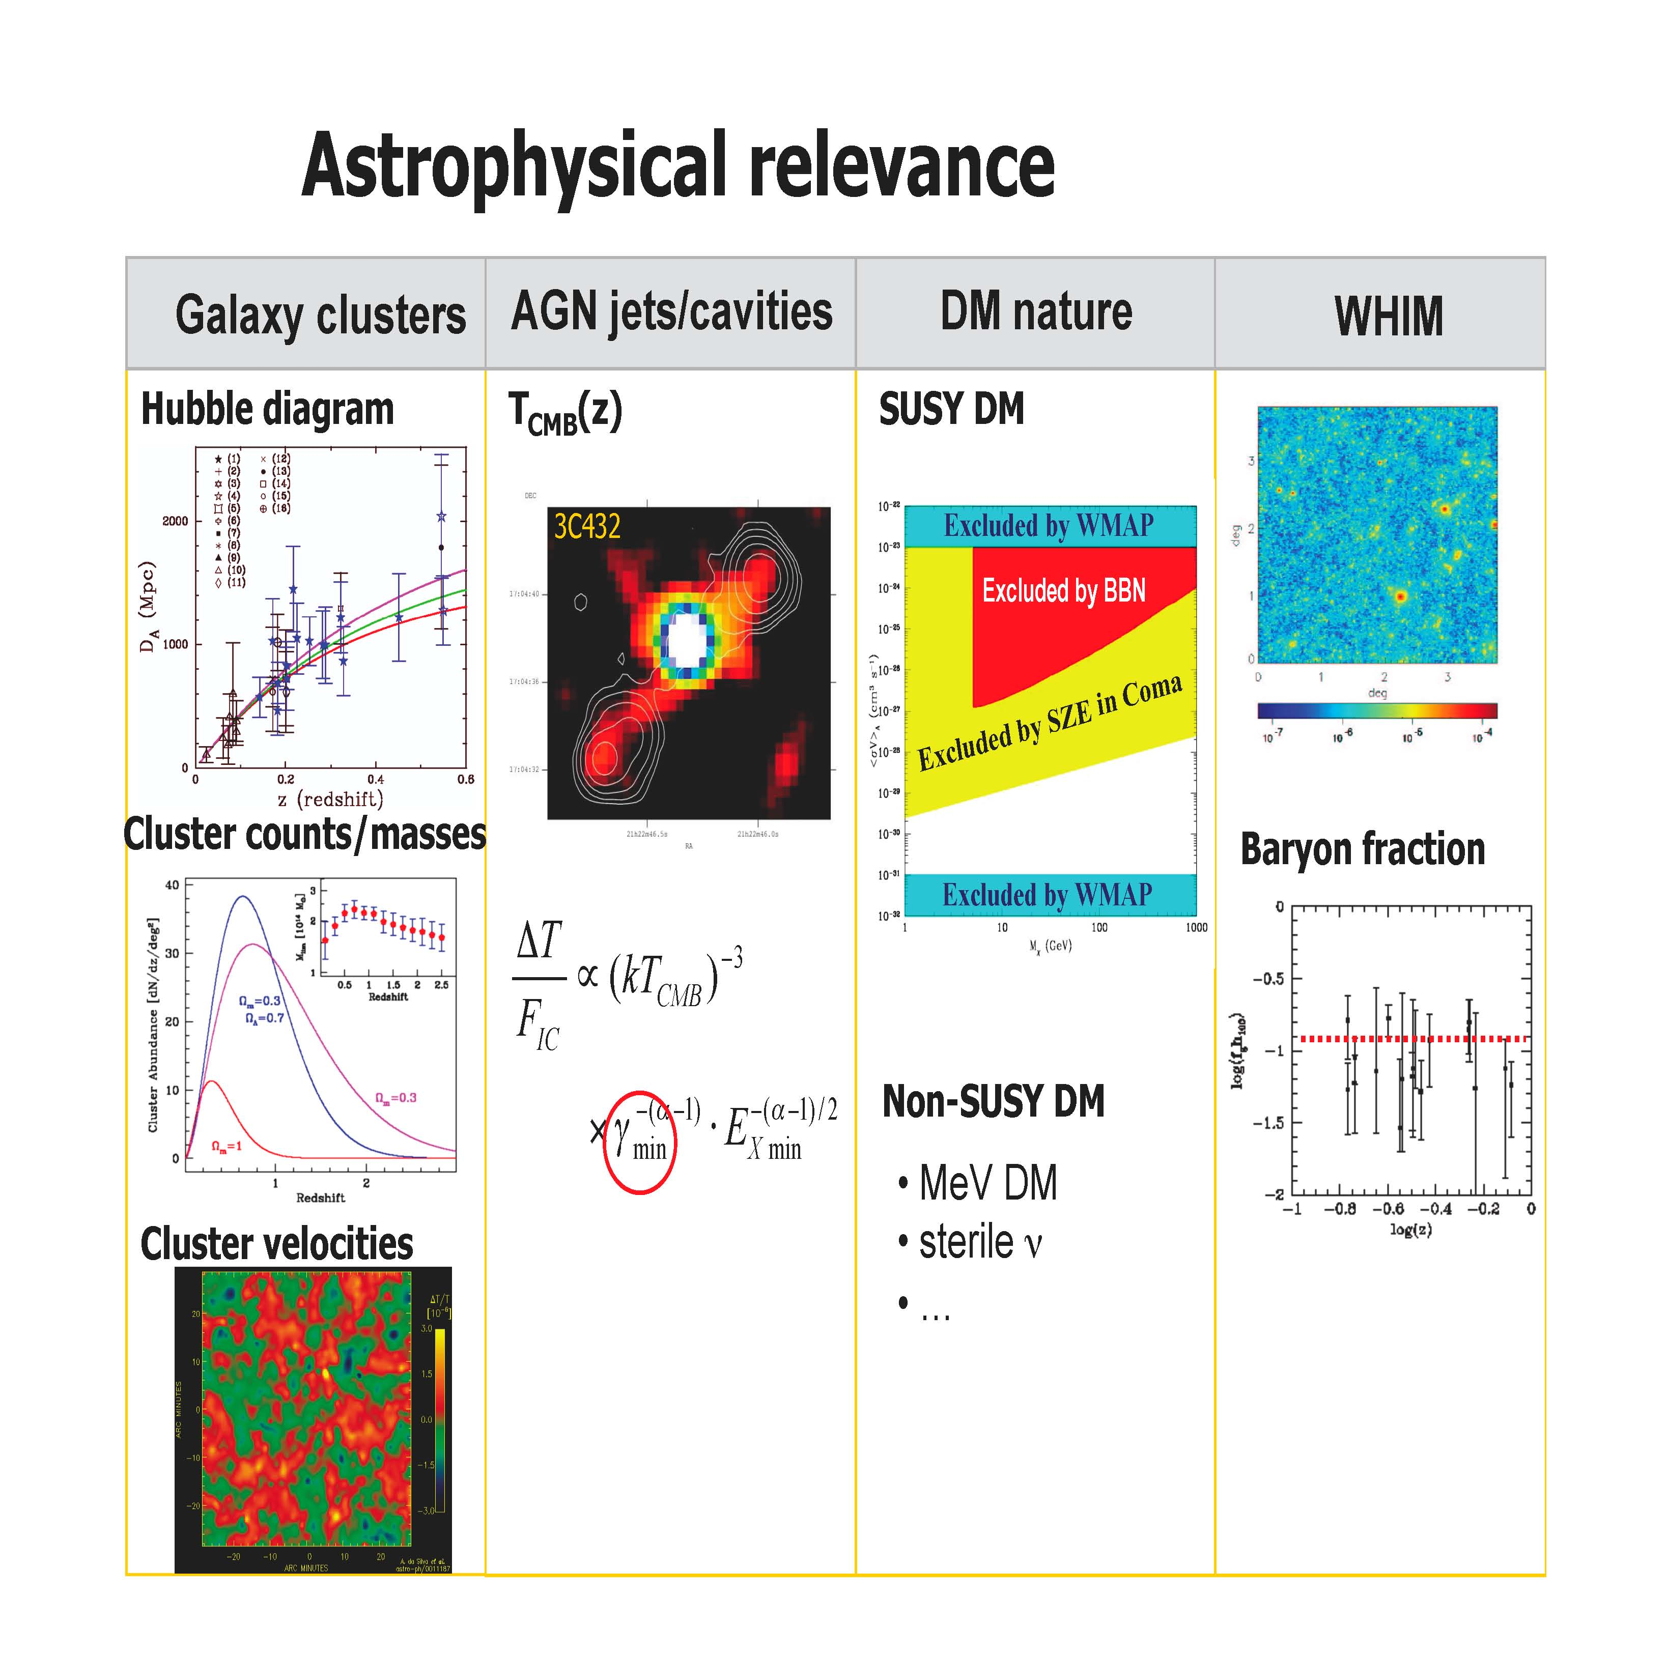
Astrophysical relevance

Slide 22
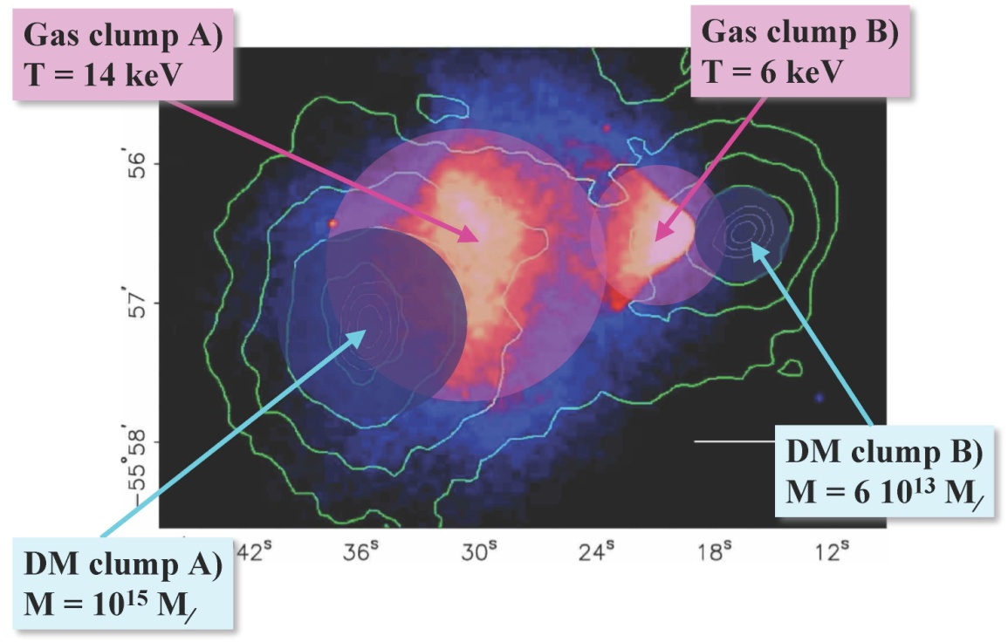
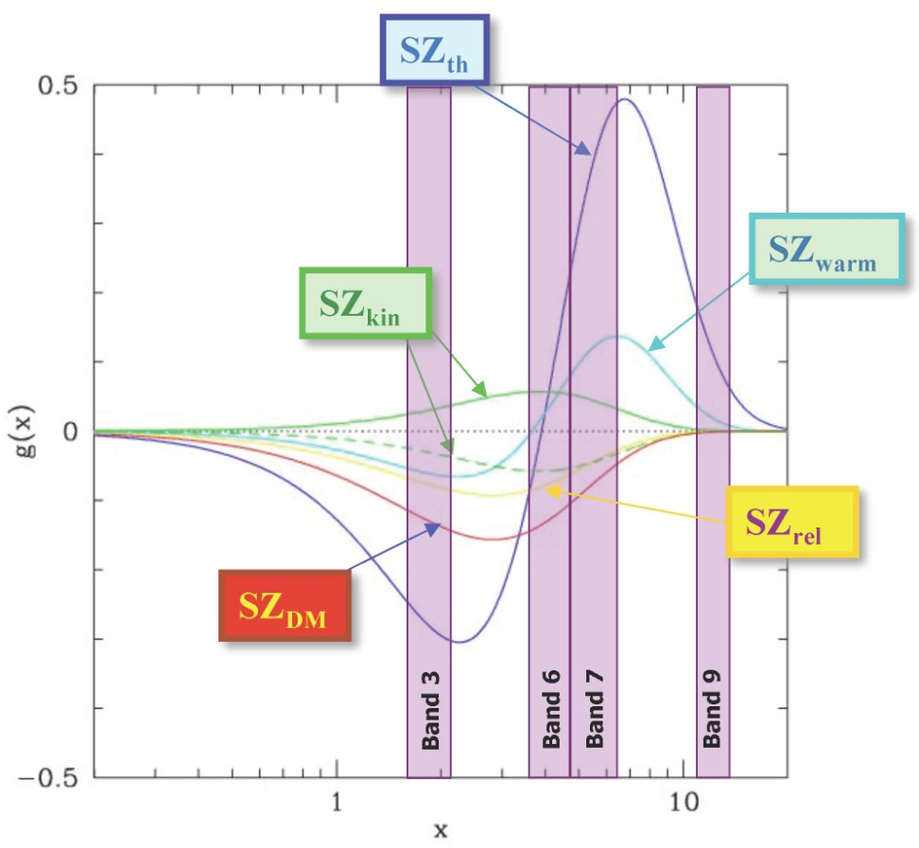
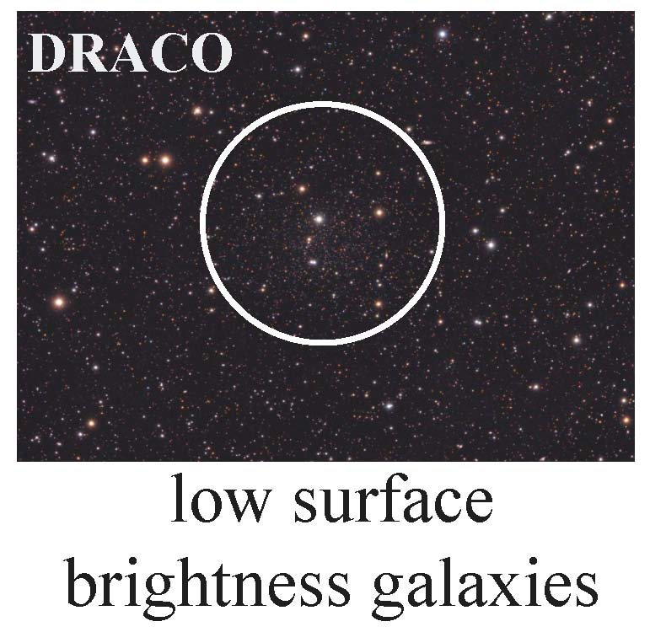
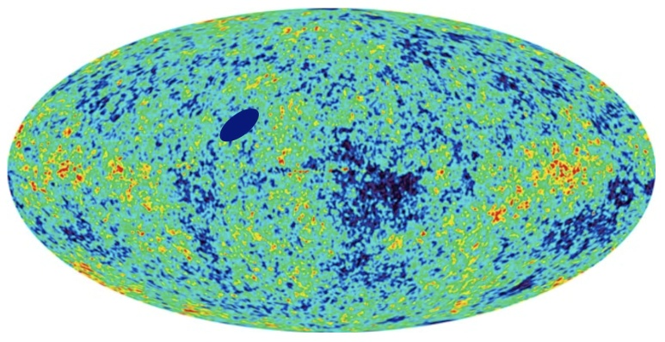
Observing the Sunyaev-Zeldovich effect with ALMA
Observing Dark Matter signatures in SZ effect with ALMA

Slide 23
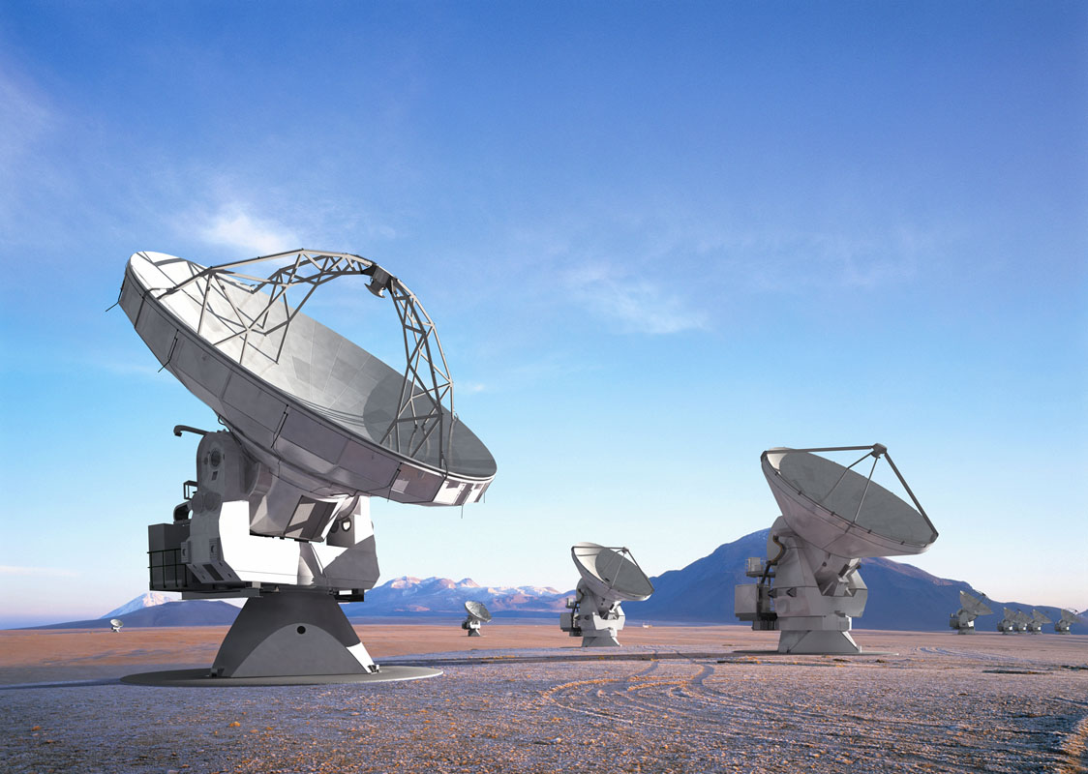
ALMA 2013

Slide 24
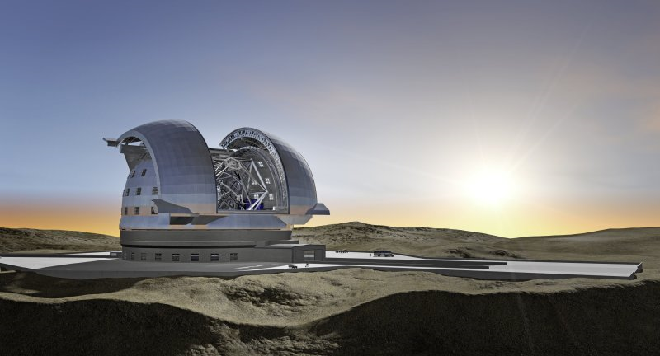
E-ELT
Detailed design study
  Baseline 42m primary mirror
  Adaptive optics built-in
  8 instrument studies and 2 adaptive optics modules → selection of the first generation of instruments (~ 6 instruments)
  Community strongly engaged
  Study complete in 2010
Project
  Builds on entire expertise at ESO and in the member states
  Construction 2011-2018
  Synergy: JWST/ALMA/SKA

Slide 25
Science cases for the E-ELT
Observe Earth-like planets in the habitable zone
  characterisation, e.g. atmosphere
  observe planetary systems
Measure the dynamics of the cosmic expansion
  see Joe Liske’s presentation
Measure any evolution in the value of the fine-structure constant α
  also Joe’s talk
Observe the stellar population (individual stars) out to the Virgo cluster
Explore the high-redshift universe
  ‘first objects’

Slide 26
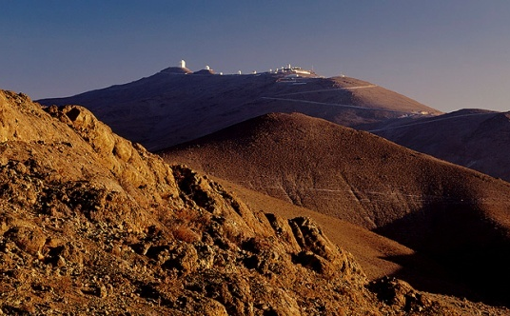
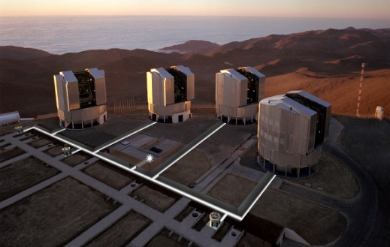
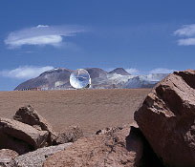
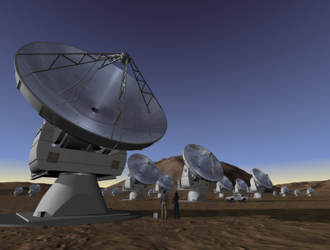
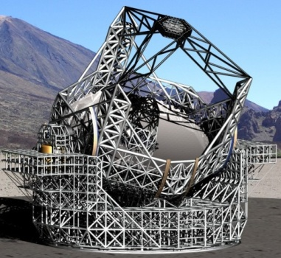
ESO telescopes have plenty to contribute to cosmology
The La Silla Paranal Observatory continues to be upgraded
  Second generation instruments (VLT/VLTI)
  Key surveys with VST and VISTA
Key science themes:
  strong gravity → black hole in the Galactic Centre
  distant universe → galaxy formation, first stars
ALMA provides access to the cold stages of matter
E-ELT will open the possibility to directly measure
  dynamics of cosmic expansion
  address the constancy of the fine-structure constant

