Slide 1
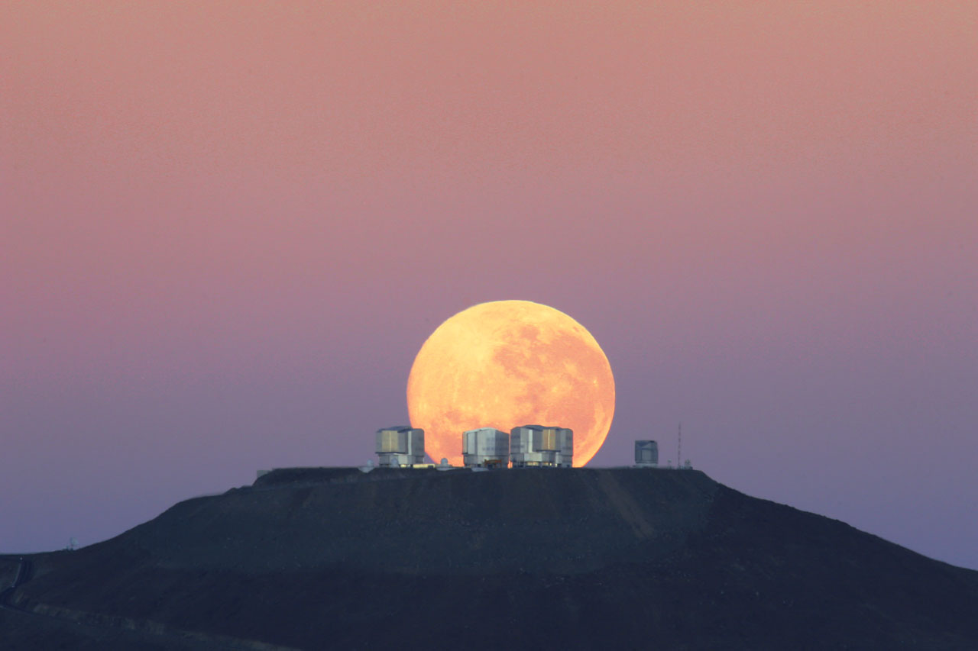
ESO Paranal
VLT and Survey Telescopes
Bruno Leibundgut

Slide 2
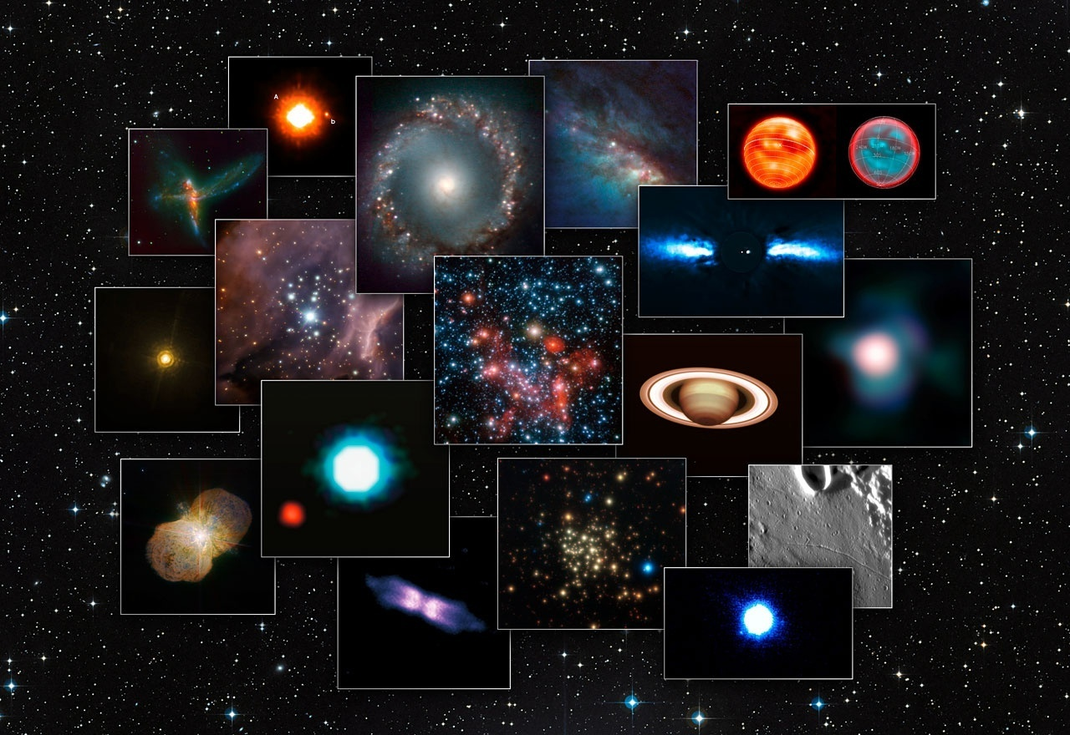

Slide 3
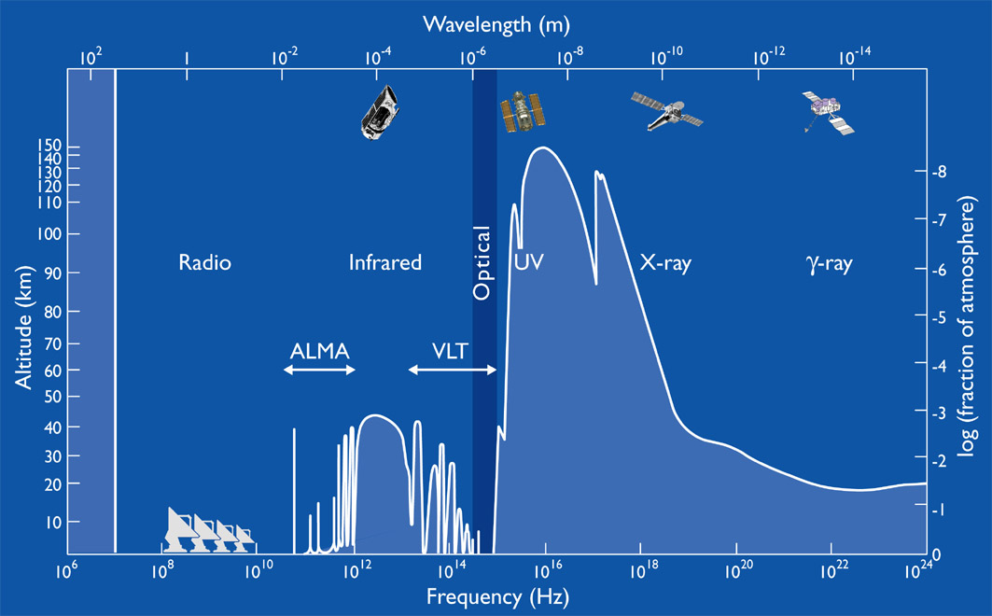
Astrophysics in a Golden Age
Full coverage of electro-magnetic spectrum
      MAGIC/HESS/VERITAS →Fermi/INTEGRAL → XMM/Chandra/Swift/Rossi XTE → Galex → HST/Gaia → ground-based optical/IR → ISO/Spitzer → Herschel → Planck→ IRAM/JCMT/APEX/ALMA/NOEMA → radio telescopes
      Astro-particles joining
        cosmic rays, neutrinos, gravitational waves,
        dark matter searches

Slide 4
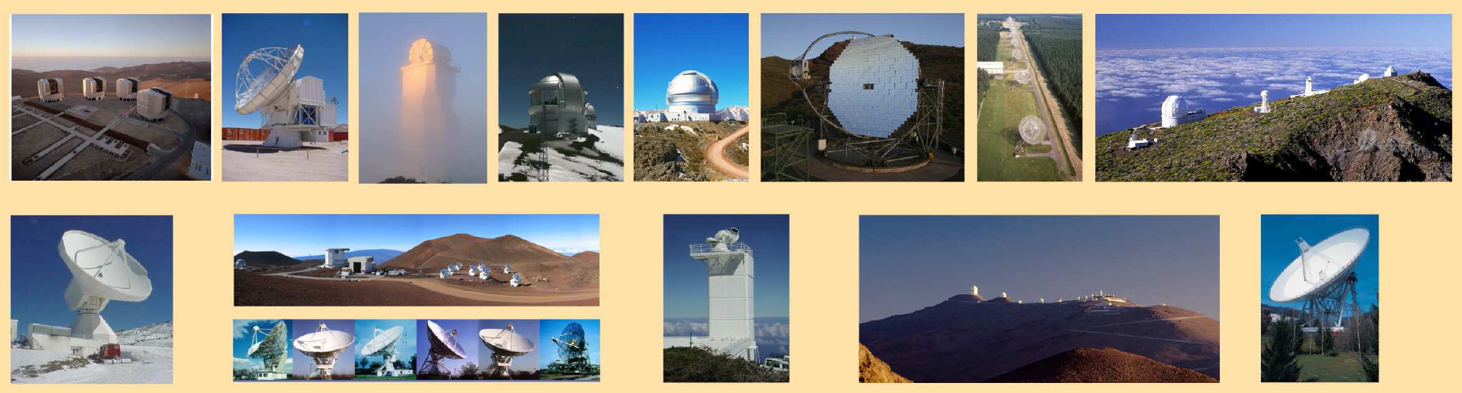
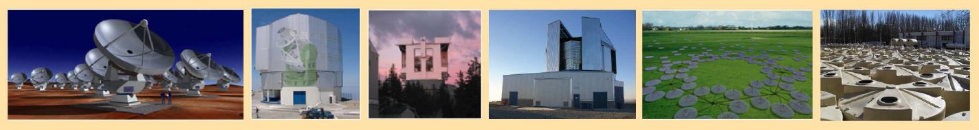
Current ground-based facilities
Large telescopes for a wide variety of investigations

Slide 5
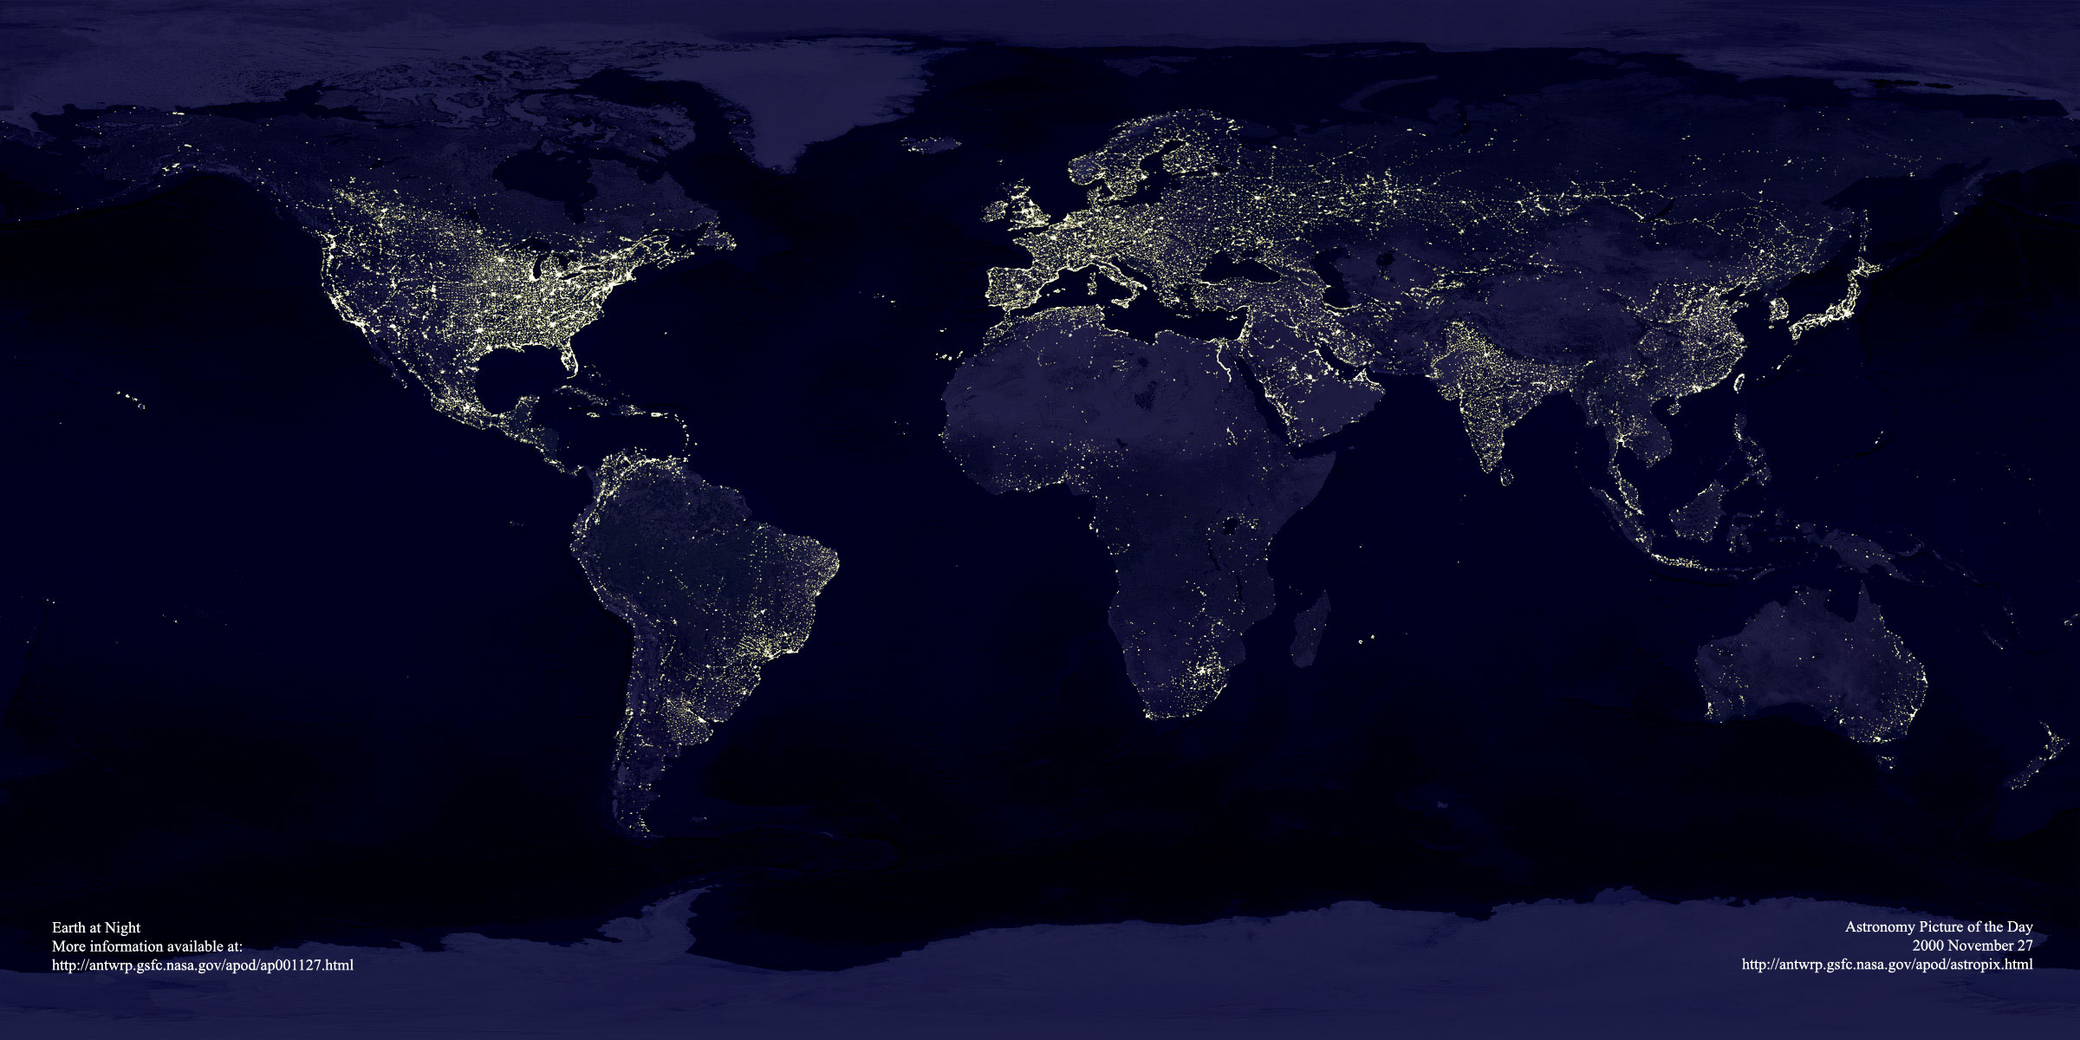
ESO’s World
Garching bei München
Chajnantor
Paranal
La Silla
Santiago

Slide 6
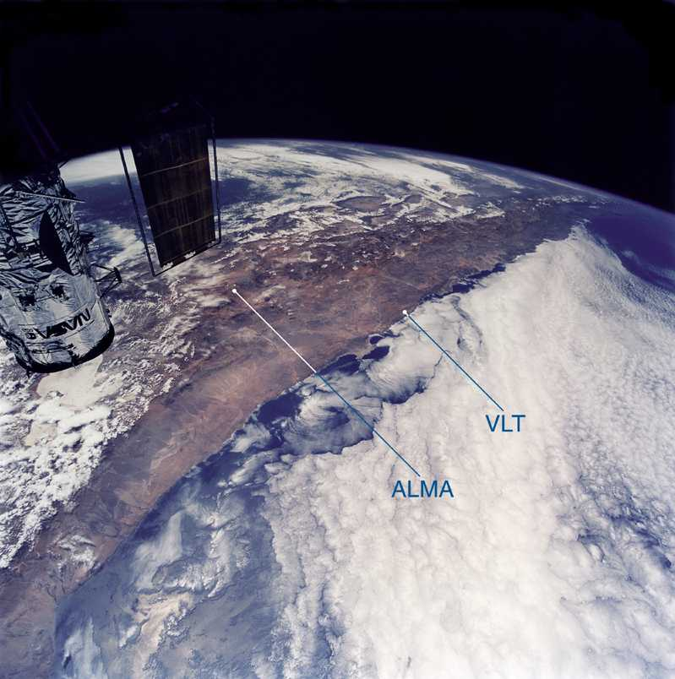

Slide 7
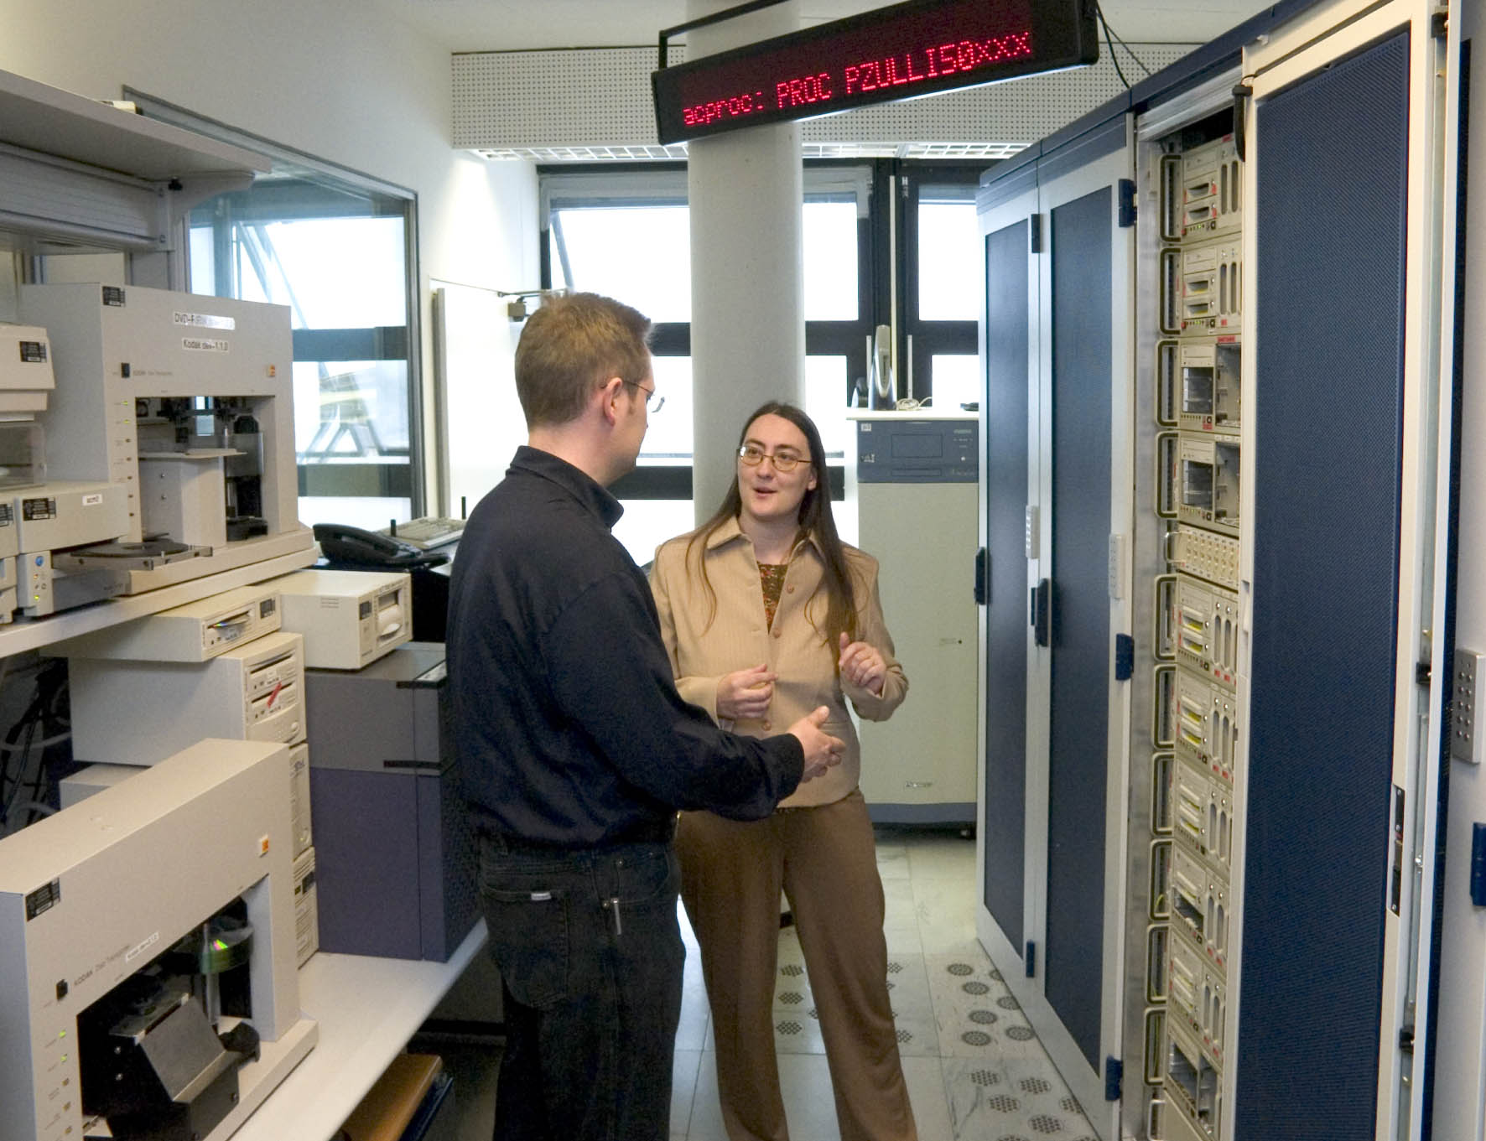
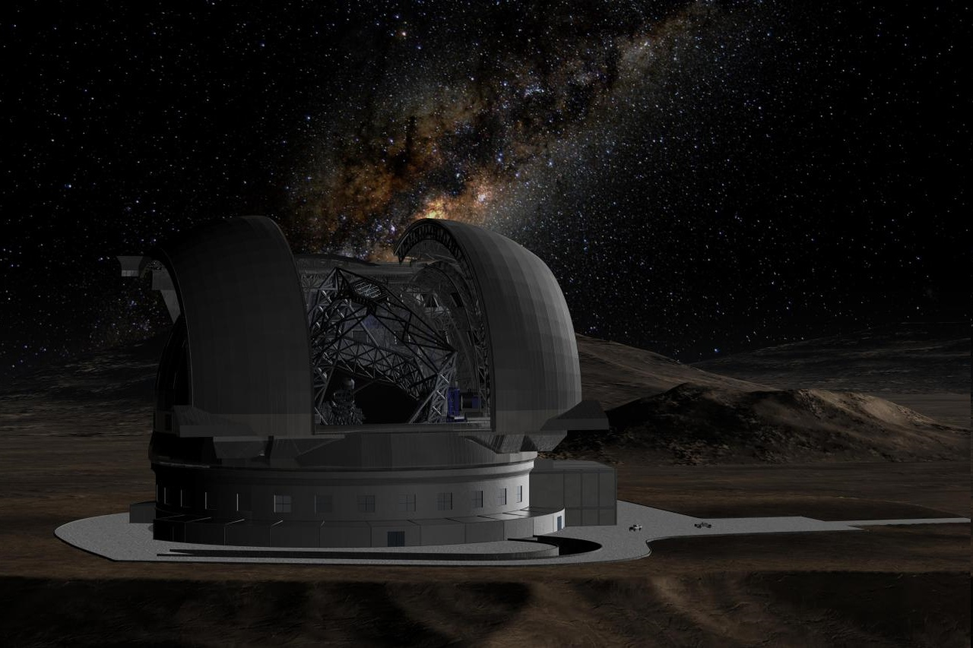
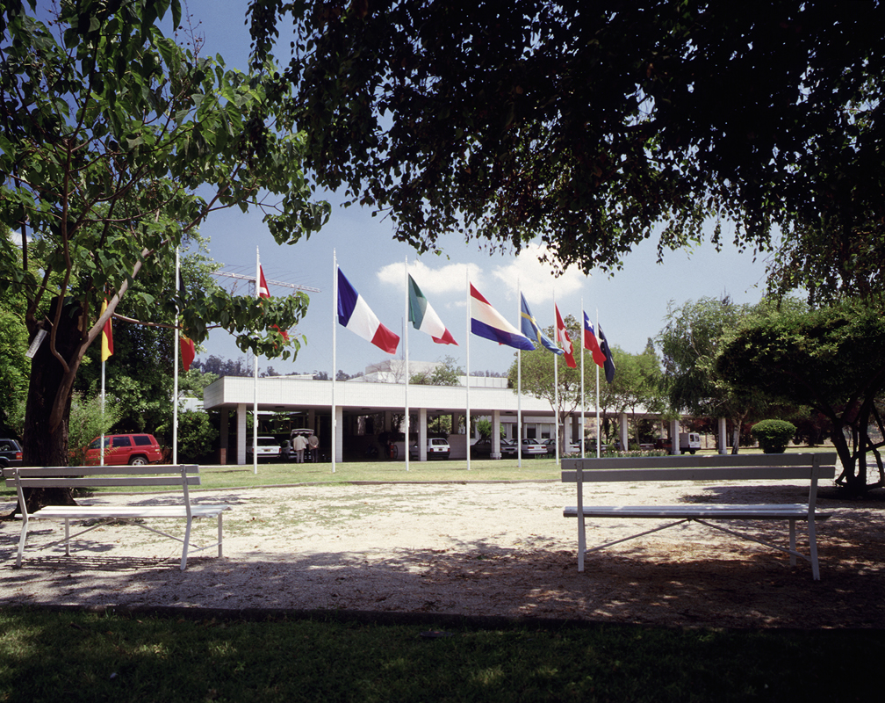
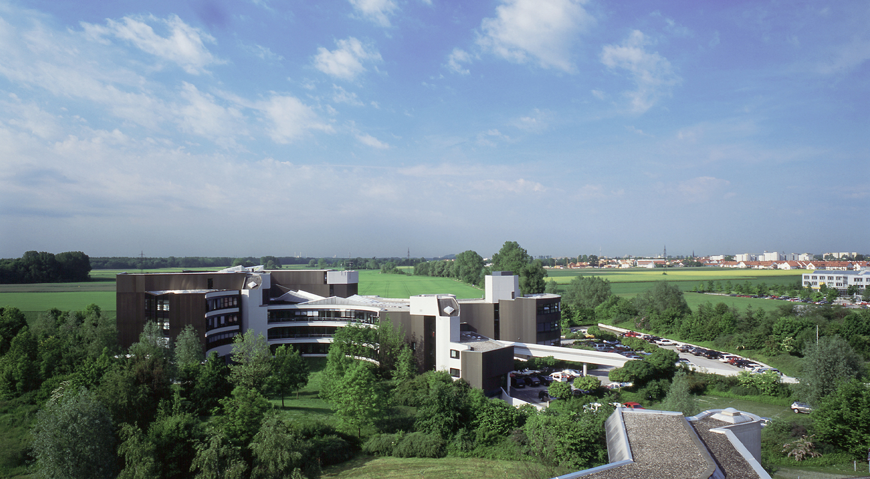
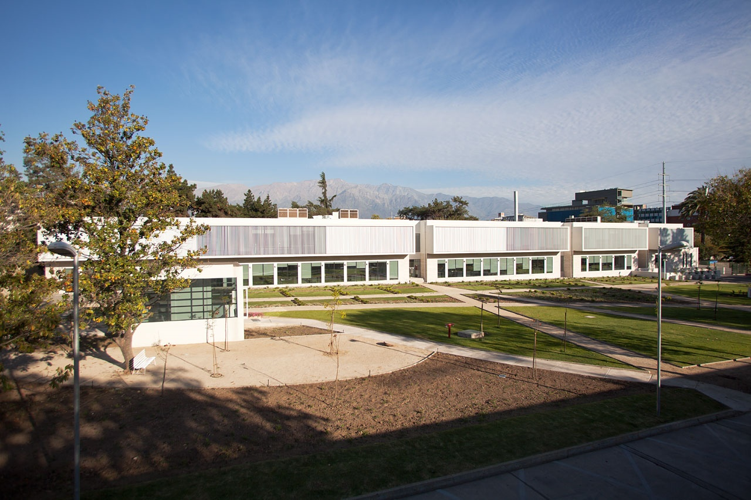
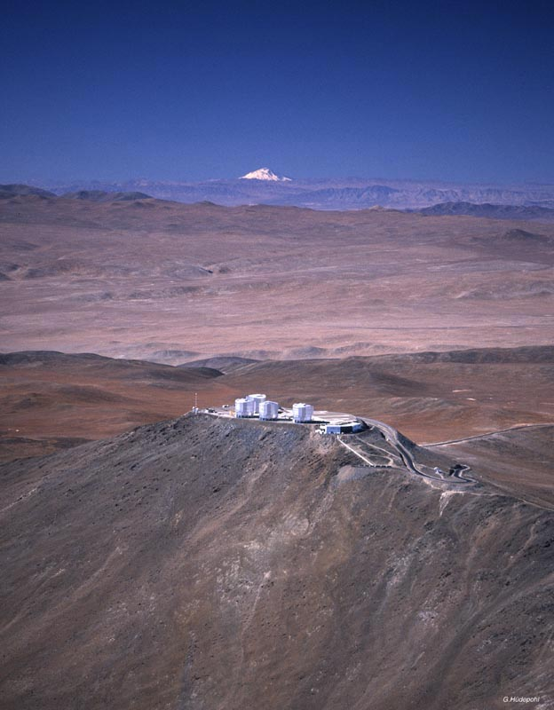
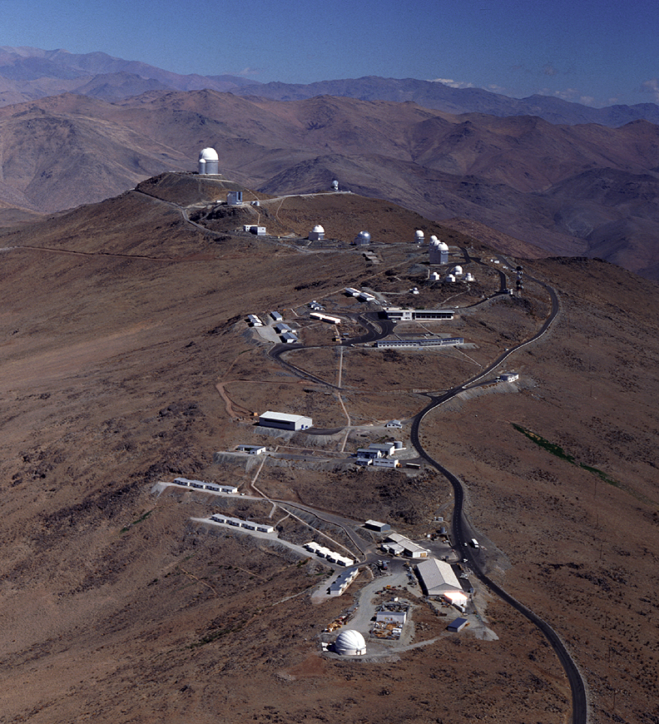
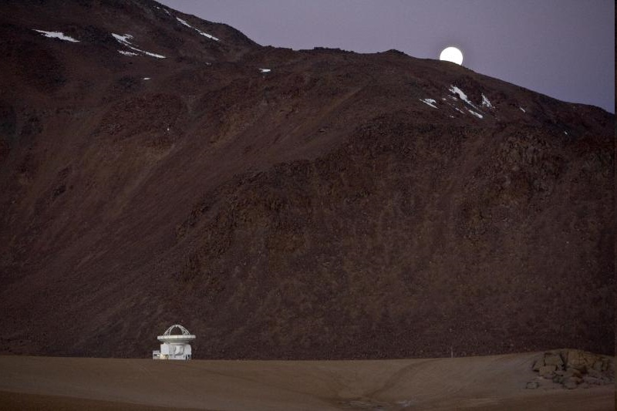
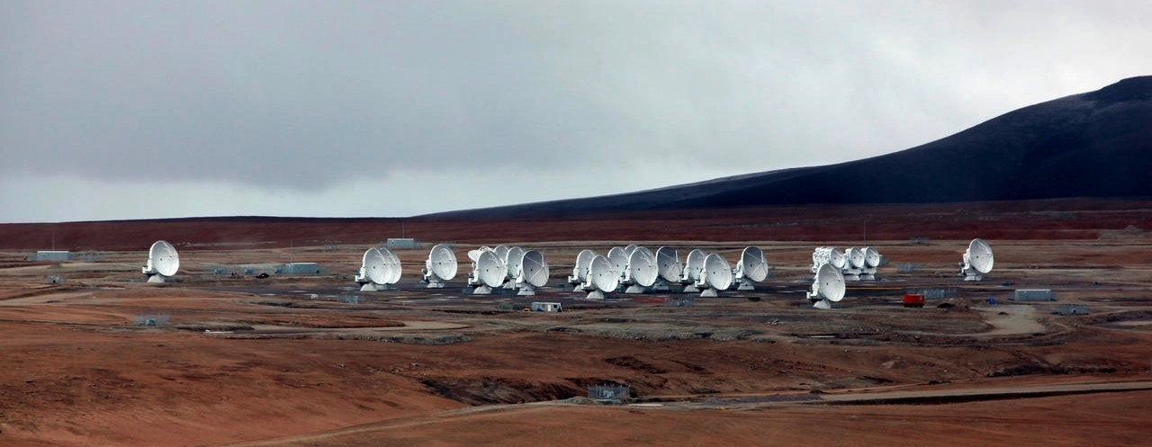
ESO
Observatories La Silla and Paranal in operation
8 Telescopes, plus 4 telescopes for Interferometry
APEX in operation on Chajnantor
Atacama Large Millimeter Array (ALMA)
Public data archive
ESO Extremely Large Telescope under construction
Headquarters in Garching, Germany
Representation in Santiago de Chile
Joint ALMA Office in Santiago

Slide 8
Your entry to ESO
Start with this page for the ESO science information

Slide 9
ESO Science Newsletter
Regular electronic newsletter with latest information
  Topics in September
    Call for Proposals P97
    User Support Feedback
    Campaign
    ERC Starting Grants
    hosted at ESO
    Data Reduction
    Packages as RPM for
    Linux
    New GIRAFFE gratings
    characterised
    GRAVITY integration
    Data releases for VVV,
    VPHAS+ and PESSTO
    ESO Fellowships

Slide 10
Paranal and Armazonas
M. Tarenghi

Slide 11
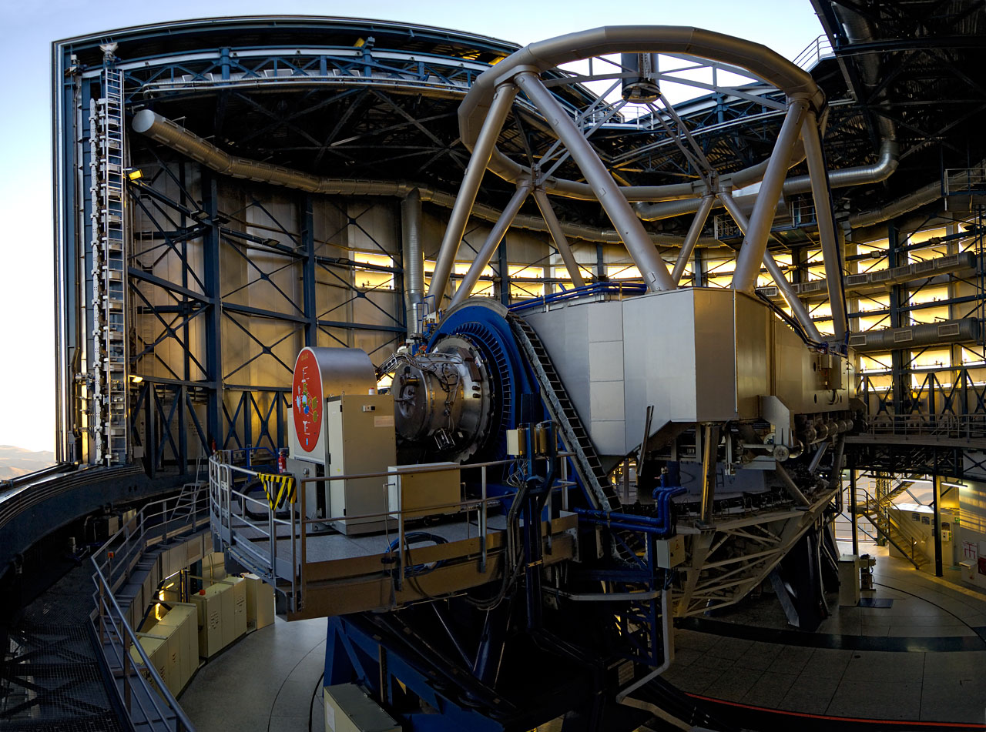
One of the 8m telescopes

Slide 12
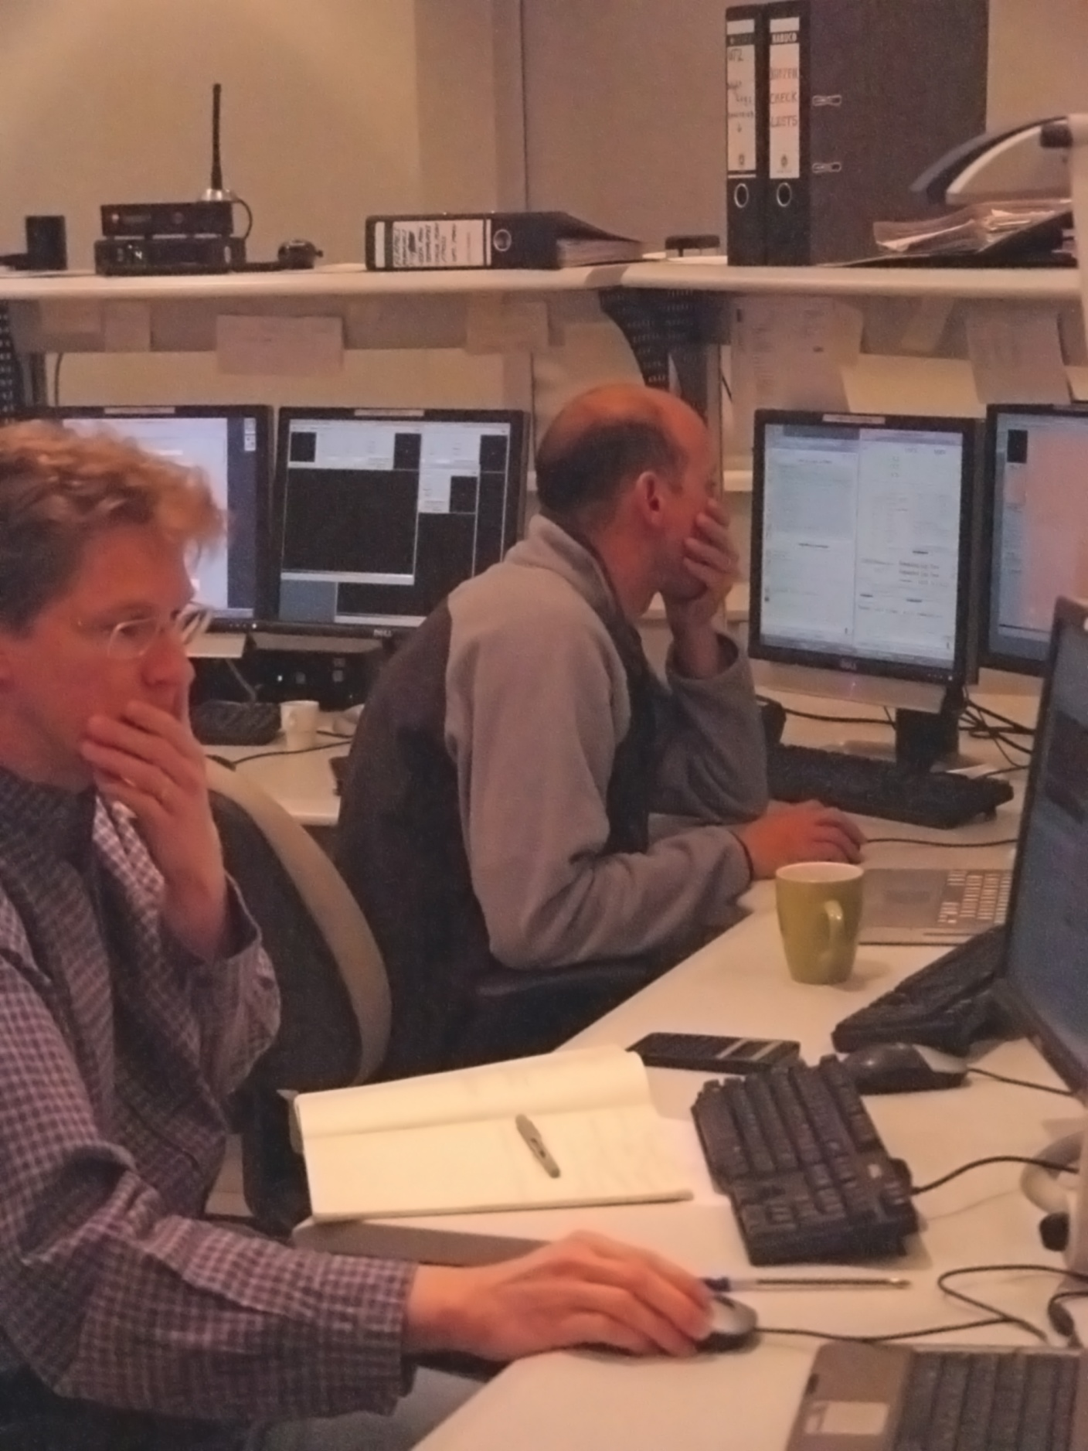
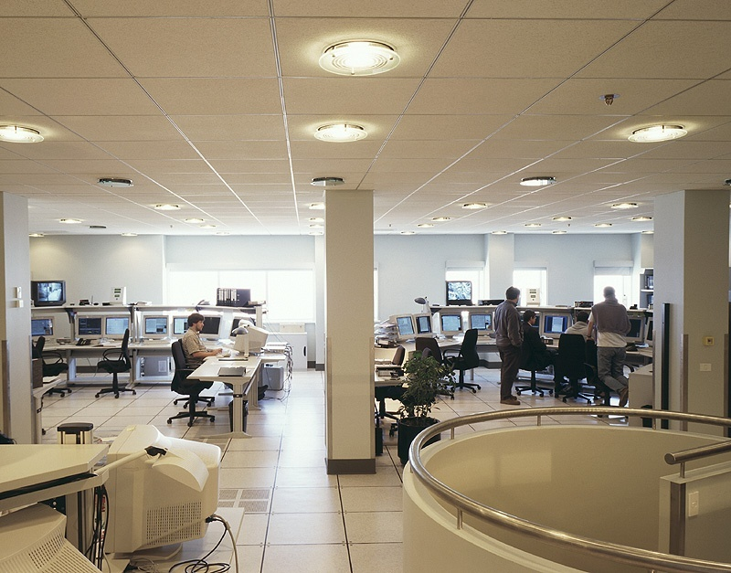

Slide 13
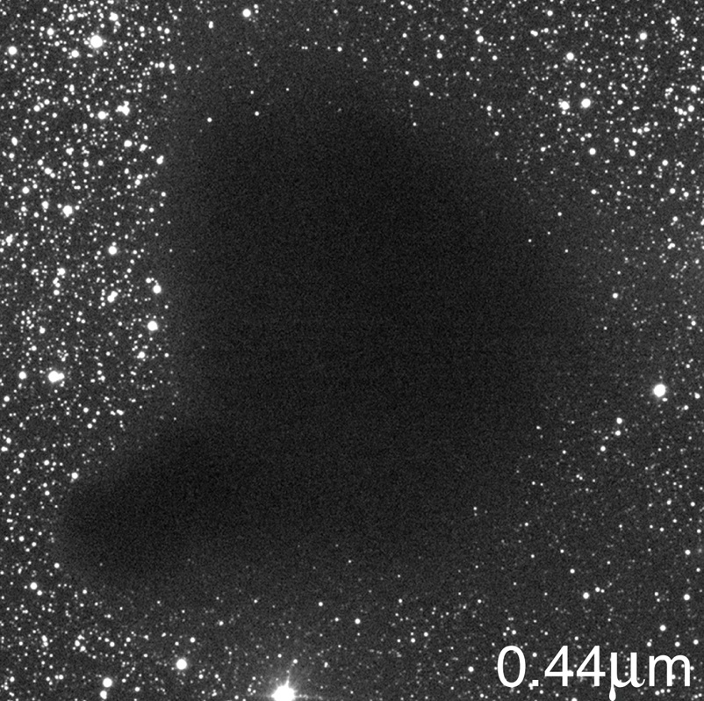
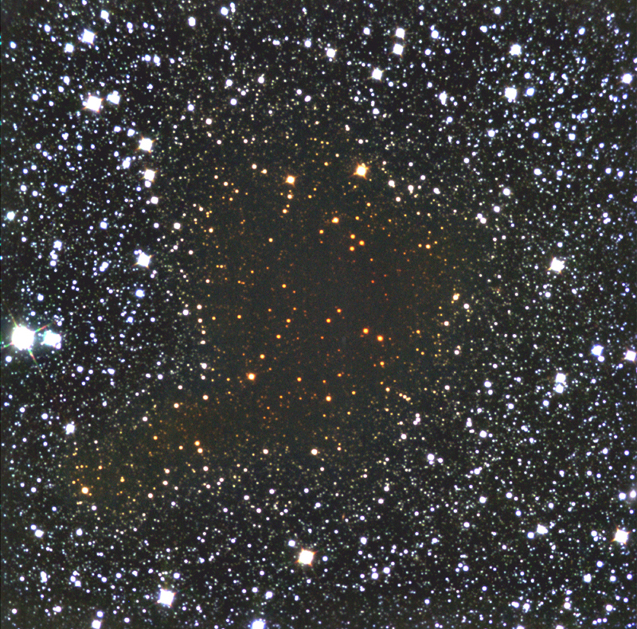
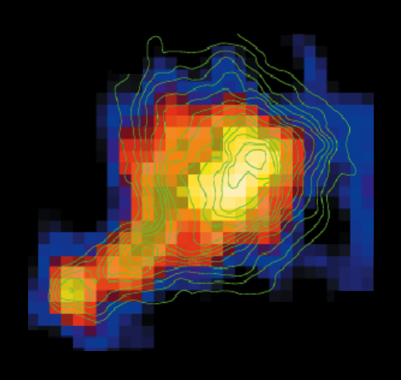
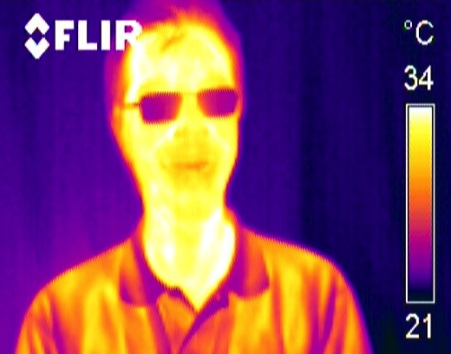
Why telescopes and antennas?
The strengths of black bodies
Example: heat images
2.2μm
3mm

Slide 14
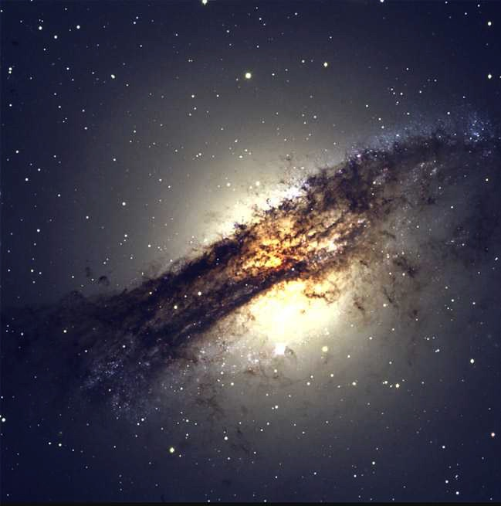
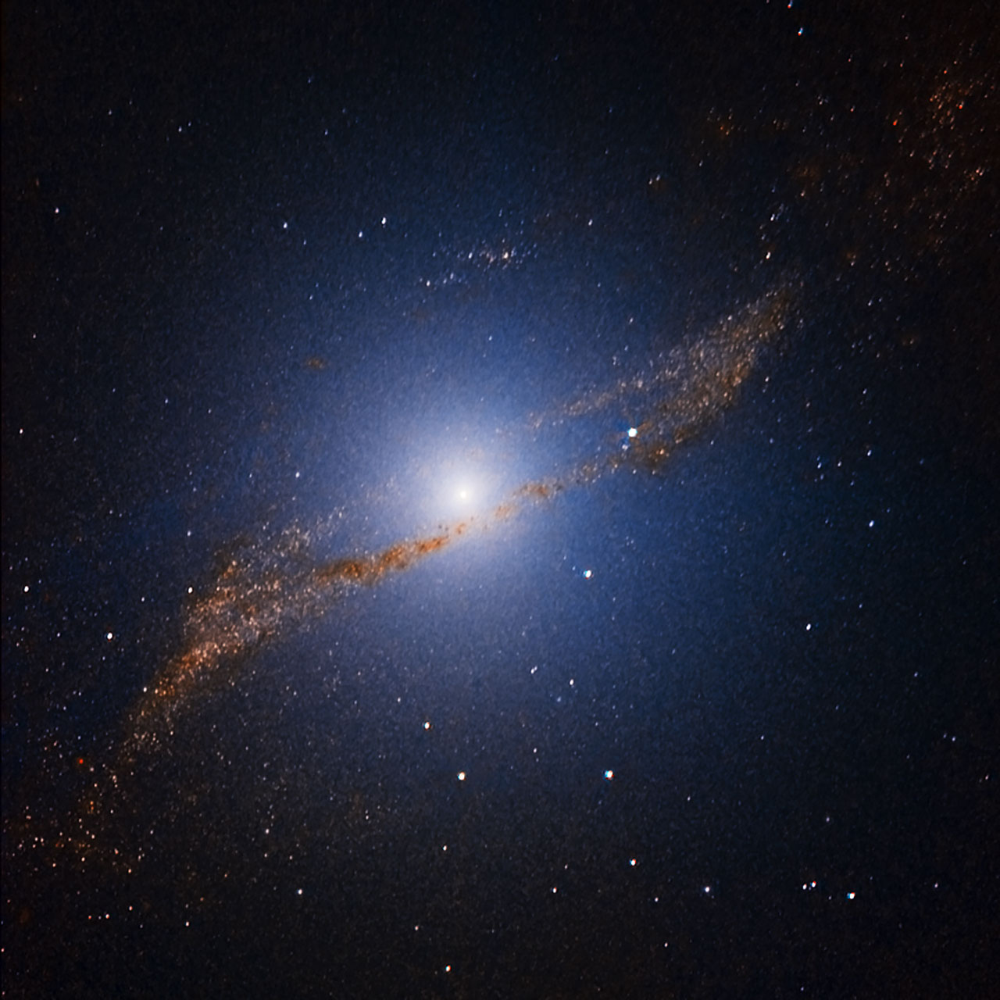
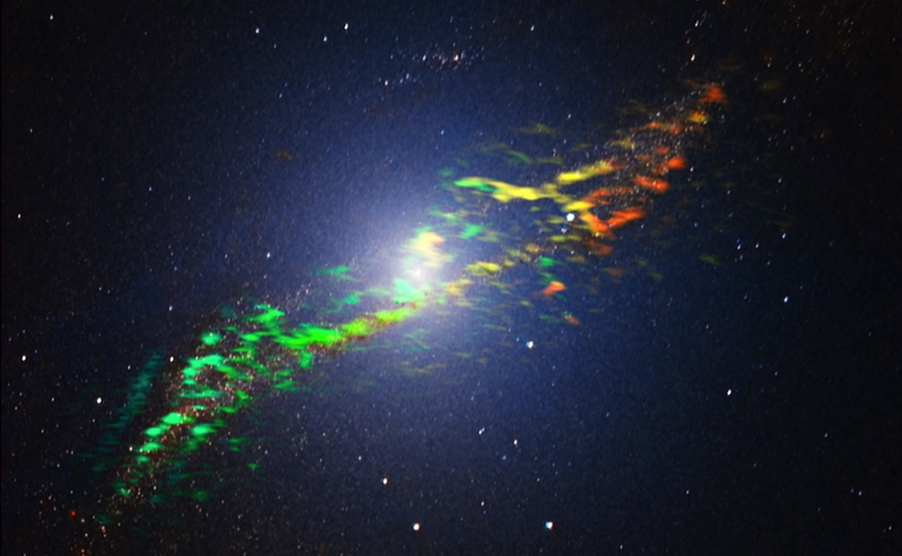

Slide 15
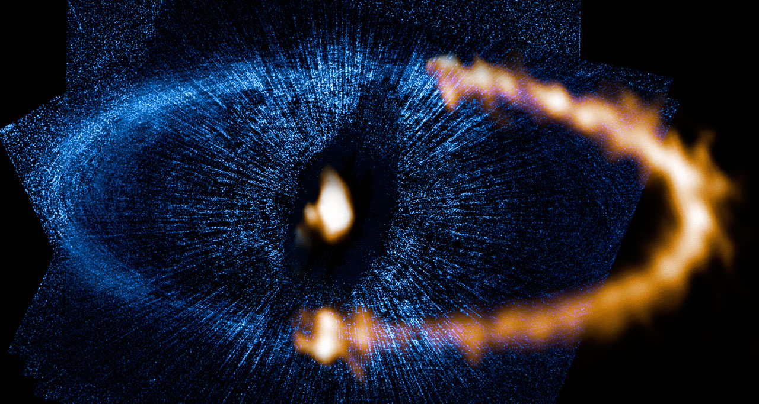
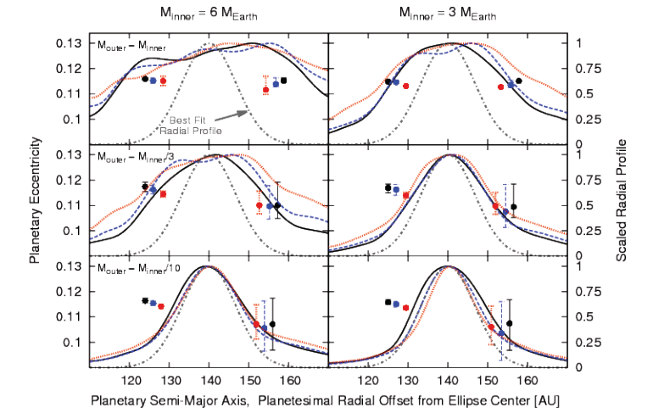
Planet dust rings
Dust ring around Fomalhaut
Hints for two planets → a few Earth masses
Boley et al. 2012

Slide 16
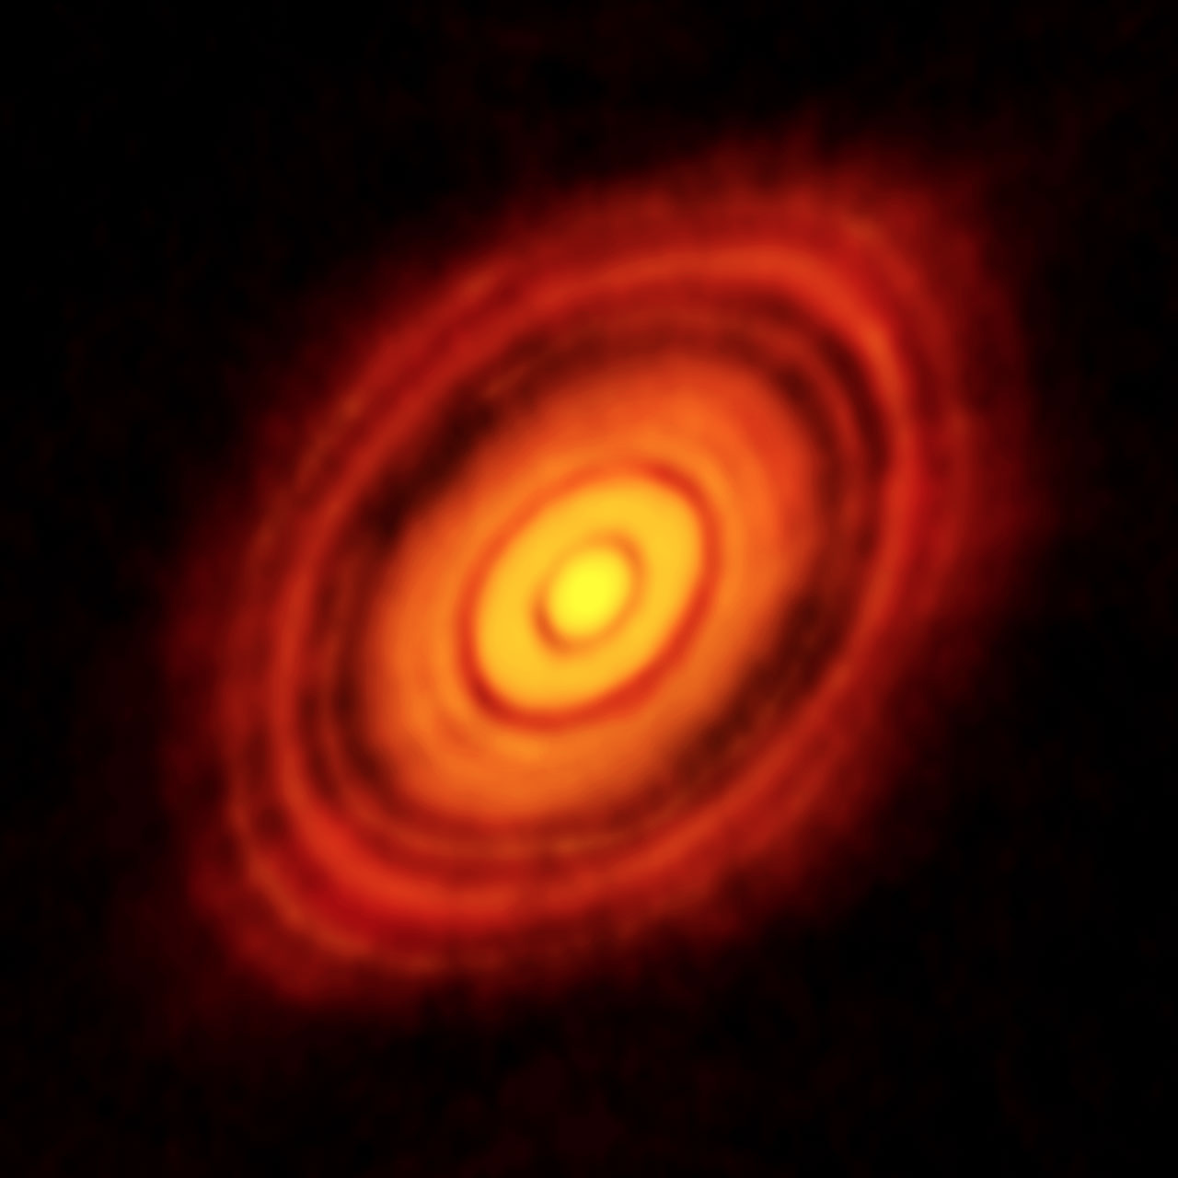
HL Tau
ALMA

Slide 17
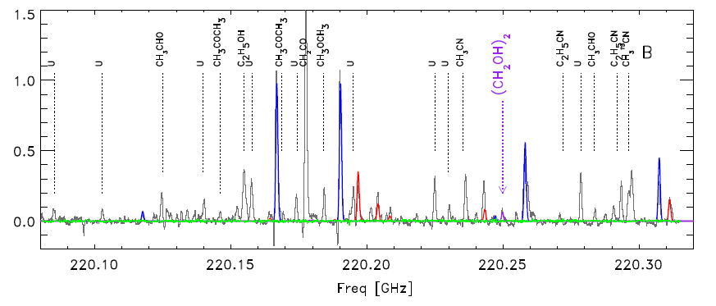
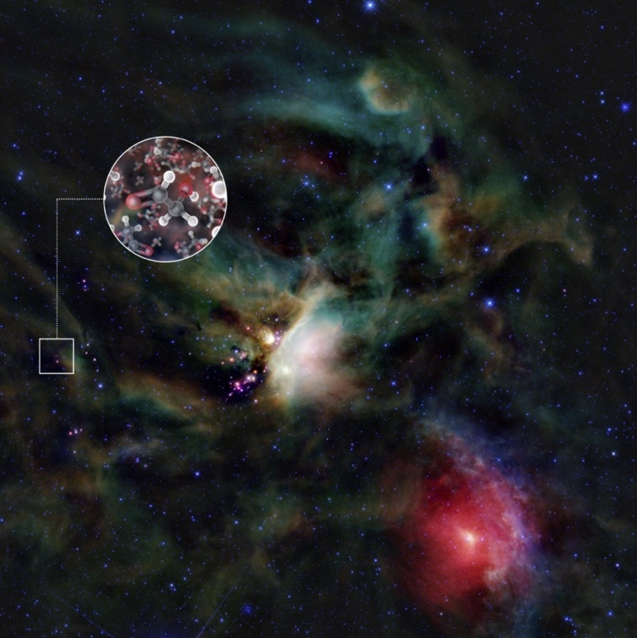
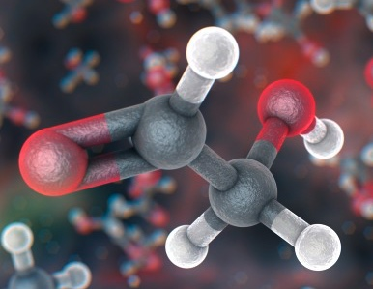
Complex molecules in space
Detection of sugar molecule
  glycolaldehyde HCOCH₂OH and several alcohols
    e.g. methyl formate, ketene (CH₂CO), trans-ethanol (t-C₂H₅OH)
  Class 0 binary proto-star with about solar mass
ρ Oph
Jørgensen et al. 2012
Jørgensen et al. 2012

Slide 18
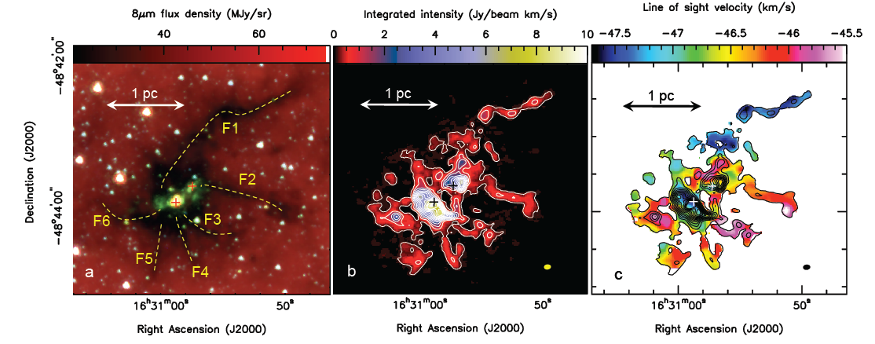
Formation of supermassive stars
Infrared Dark Cloud SDC335.579-0.272
  5500±800 M complex
  Two massive star forming cores
M1: M core
  mass infall rate: M/yr
  will yield 750±300 M in a freefall time (3 10⁴ years)
Perreto et al. 2013
ALMA
N₂H⁺(1-0)
Spitzer
ALMA

Slide 19
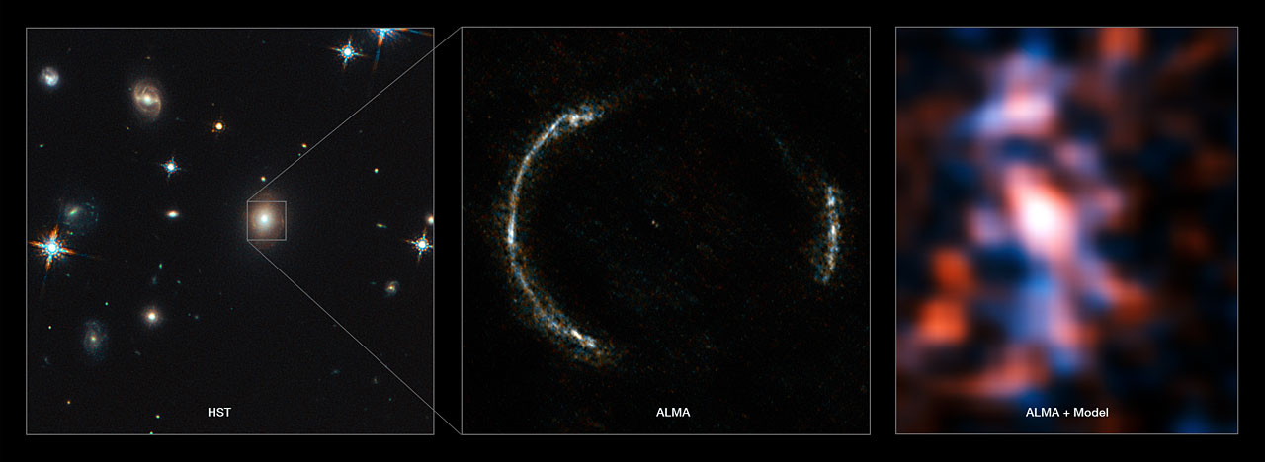
Lensed galaxy image
Cold gas in a lensed galaxy observed with ALMA
  source redshift: z_{S}=3.042
  lens redshift: z_{L}=0.299

Slide 20
Lensed galaxy
Detection of carbon monoxide
Vlahakis et al. 2015

Slide 21
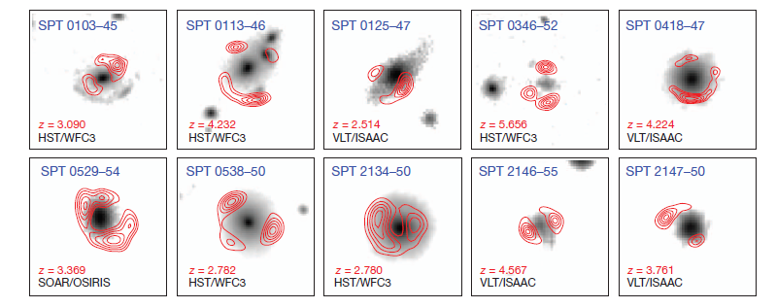
Distant galaxies with ALMA
Follow-up of mm sources discovered with the South Pole Telescope (SPT)
  Detected many high-redshift galaxies (<z>=3.5)
  860μm ALMA imaging (Cycle 0 – 16 antennas)
    47 candidates → several clearly lensed sources
    Integration times 1 minute
    2 objects at z=5.7 with high star formation rate > 500 M yr⁻¹
Viera et al. Nature 2013; Hezaveh et al. ApJ 2013
Notes:
Figure 1 | Near-infrared and ALMA submillimetre-wavelength images of
SPT targets. Images are 80380. We show 10 sources for which we have
confirmed ALMA spectroscopic redshifts, deep near-infrared (NIR) imaging,
and well-resolved structure in the ALMA 870 mmimaging; source names are in
blue in each panel. The greyscale images are NIR exposures from the Hubble
Space Telescope Wide Field Camera 3 (HST/WFC3, co-added F160W and
F110W filters), the Very Large Telescope Infrared Spectrometer and Array
Camera (VLT/ISAAC: Ks band) or the Southern Astrophysical Research
Telescope Ohio State Infrared Imager/Spectrometer (SOAR/OSIRIS: Ks band),
and trace the starlight fromthe foreground lensing galaxy. The NIR images are
shown with logarithmic stretch, and each panel shows at bottom left in black
the telescope/instrument used to obtain the image. The red contours areALMA
870 mmimaging showing the background source structure, clearly indicative of
strong lensing from galaxy-scale haloes. In all cases, the contours start at 5s and
are equally spaced up to 90% of the peak significance, which ranges from 12 to
35. Spectroscopic redshifts of the background sources are shown in red in each
panel, above the NIR telescope/instrument names. The ALMA exposures were
approximately 2-min integrations, roughly equally divided between the
compact and extended array configurations. The resulting resolution is 0.50.
SPT 0103–45 shows a rare lensing configuration of one lens and two
background sources at different redshifts, one visible with ALMA and one with
HST. SPT 0346–52, with a CO-derived redshift of z55.656, is among the
highest-redshift starbursts known.

Slide 22
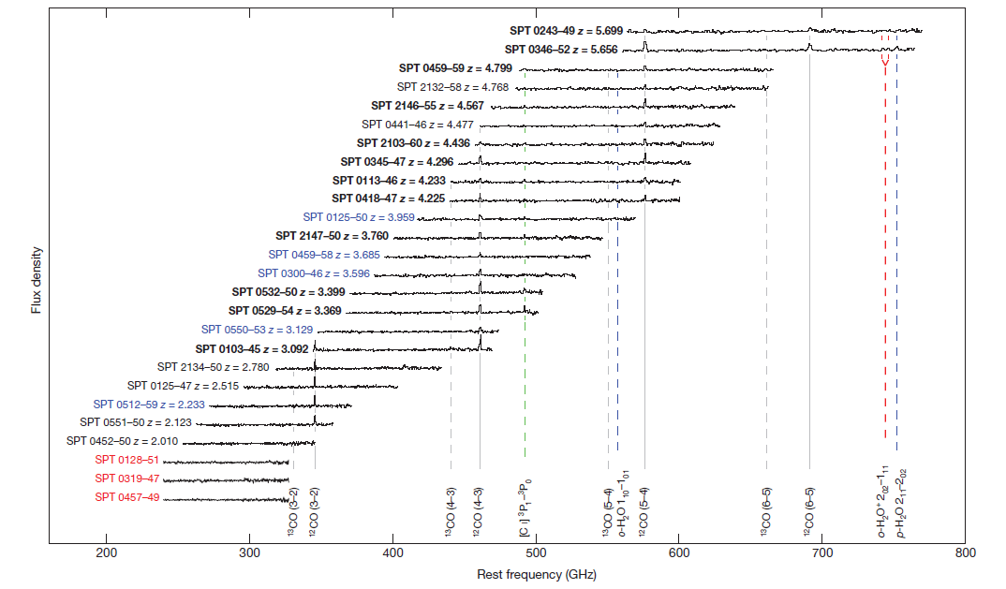
Distant galaxies with ALMA
Secure redshifts for many sources
  ALMA 3mm spectroscopy
  Integration times about 10 minutes
    Lines detected of ¹²CO, ¹³CO, Ci, H₂O
Viera et al. Nature 2013
Weiss et al. ApJ 2013
Notes:
Figure 2 | ALMA 3 mm spectra of 26 SPT sources. The vertical axis is
observed flux density in units of mJy, with 30 mJy offsets between sources for
clarity. Spectra are continuum-subtracted. The strong CO lines are indicative of
dust-enshrouded active star formation. The spectra are labelled by source and
redshift. Black labels indicate unambiguous redshifts (18), with the subset in
bold font (12) having been derived from the ALMA data alone. Sources labelled
in blue (5) are plotted at the most likely redshift of multiple options, based on
the dust temperature derived from extensive far-infrared photometry. Three
sources with no lines detected are placed at z=1.85, in the middle of the
redshift range for which we expect no strong lines, and labelled in red. Total
integration times for each source were roughly ten minutes. The synthesized
beamsize ranges from 7”x5” to 5”x3” over the frequency range of the search,
which is inadequate to spatially resolve the velocity structure of the lensed
sources. Transitions of species detected in at least one source are indicated by
vertical lines. Rotational transitions of the 12CO (solid) and 13CO (dashed)
isotopologues are shown in grey. Water lines are marked by blue dashed lines,
ionized water lines by red dashed lines, and atomic carbon ([CI]) by the green
dashed line.

Slide 23
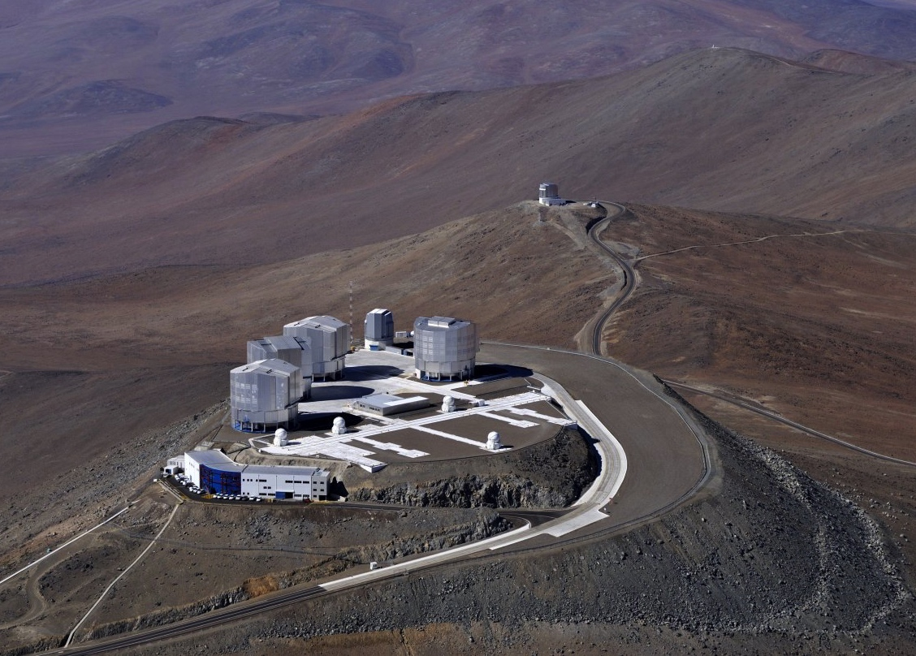

Slide 24
The three modes of the VLT
Incoherent combined
focus
(ESPRESSO)
Coherent combined
focus
Interferometry
(PIONIER, GRAVITY,
MATISSE)
Individual use of the
unit telescopes
(Cassegrain and
Nasmyth foci)

Slide 25
Early instrument planning
M. Tarenghi

Slide 26
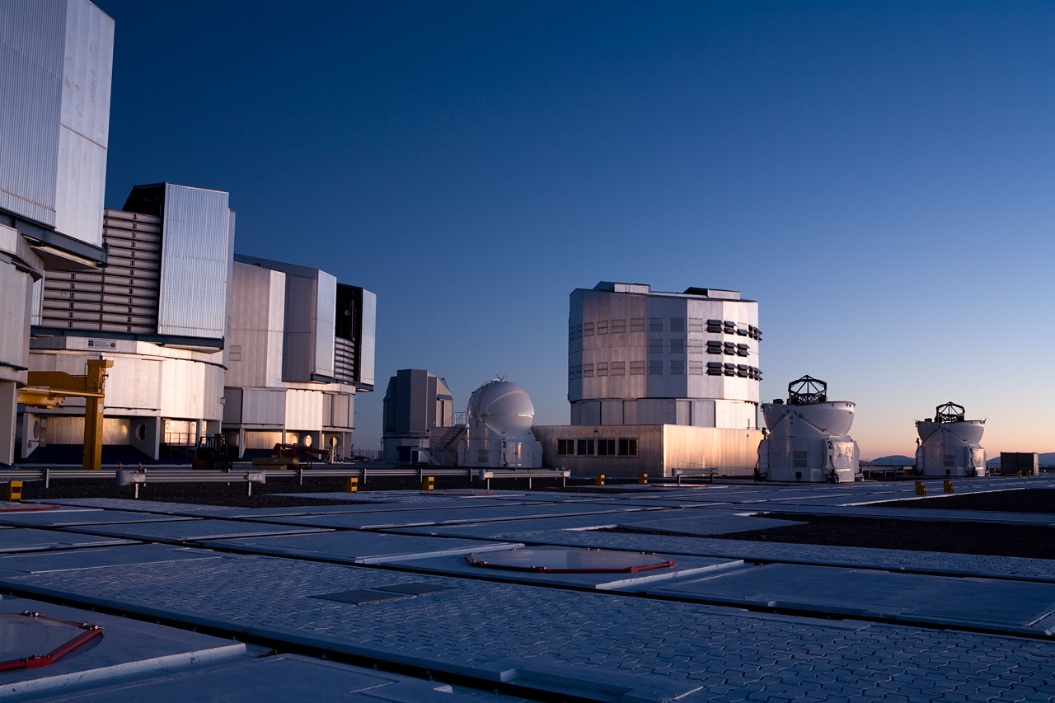
Paranal Facilities
VLT
  Instrumentation operating, in assembly and planned
    Covers the available optical infrared wavelengths
    300nm to 20μm
    Angular resolution from seeing limit to 50 μ-arcseconds
    FORS2, UVES, FLAMES, NACO, SINFONI, VISIR, HAWK-I, VIMOS, X-Shooter, laser guide star facility, KMOS, MUSE, SPHERE, Adaptive Optics Facility, CRIRES+, ESPRESSO, MOONS, ERIS
VLTI
  PIONIER, GRAVITY, MATISSE
VISTA
  VIRCAM, 4MOST
VST
  ΩCam

Slide 27
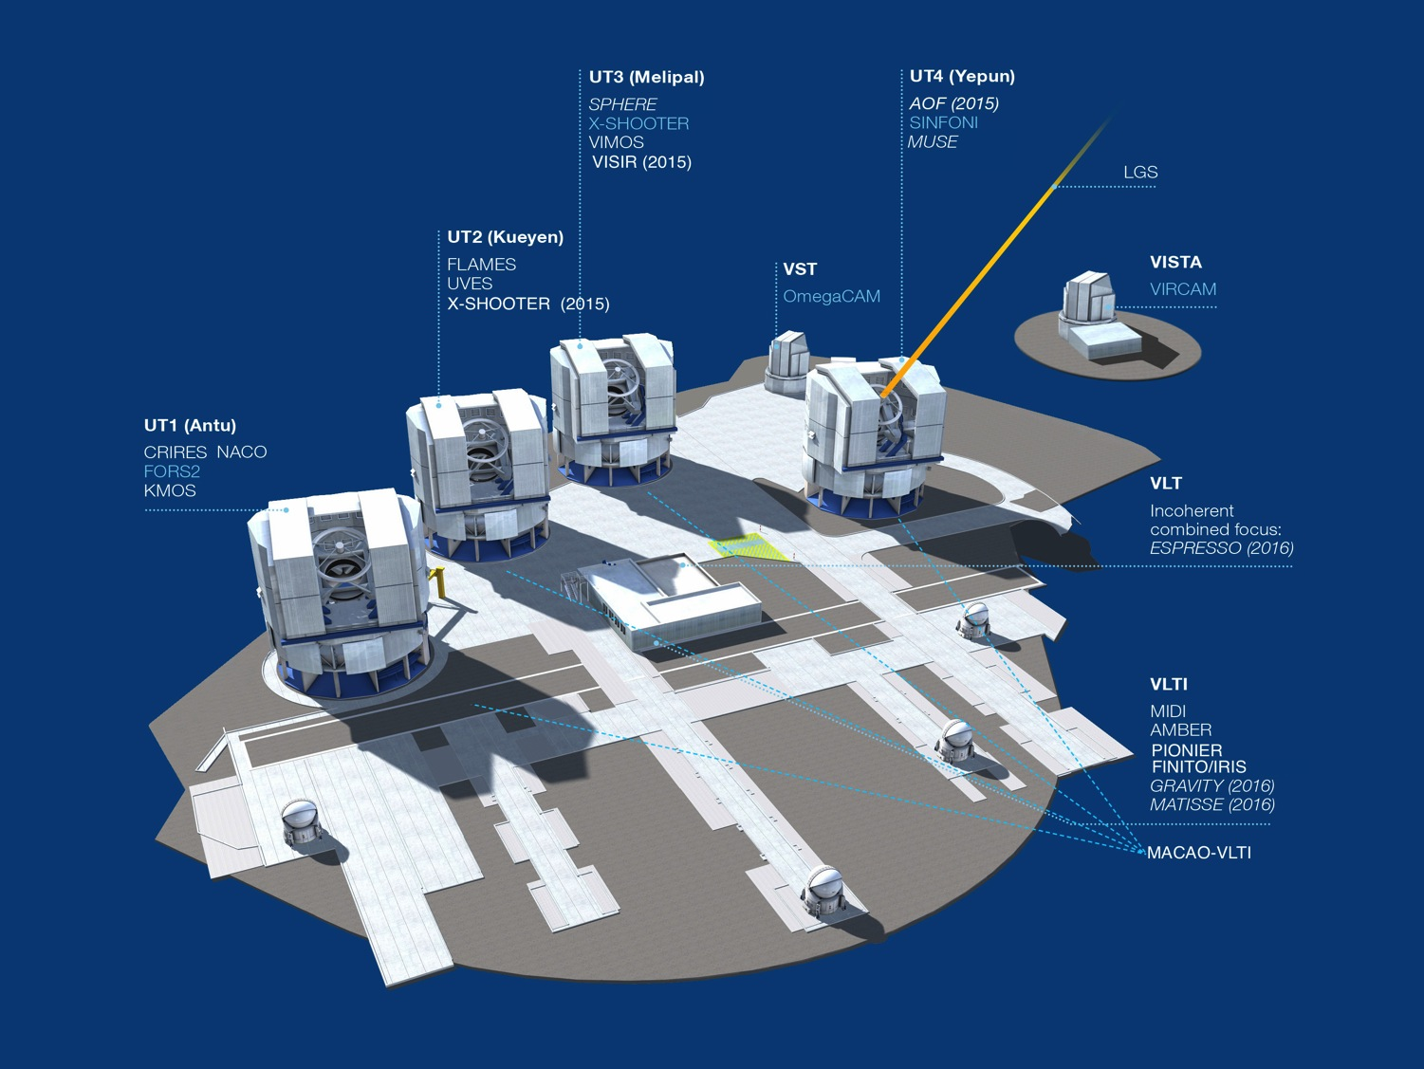

Paranal 2015

Slide 28
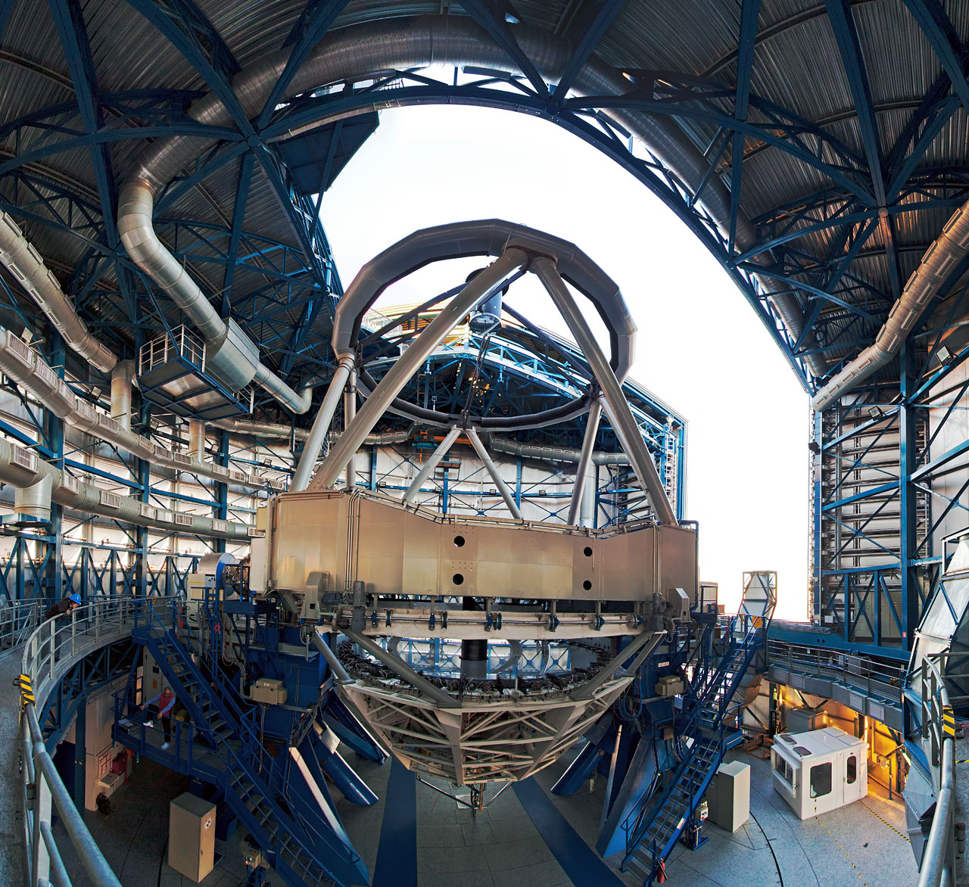
VLT Unit Telescope

Slide 29
VLT Opportunities
Four 8m telescopes
  flexibility
  scientific throughput
    1200 observing nights/year
Successful operational model
  expand existing model to allow new modes
    high time resolution photometry and spectroscopy
    faster turnaround (currently DDT)
    closer interaction with user, e.g. remote observing
Telescope system
  spatial resolution from 1 degree to 2 mas
  wavelength coverage from 320nm to 20μm
  spectral resolutions from a few to 100000
Notes:
spatial coverage over 12 orders of magnitude
spectral coverage over 2 orders of magnitude could be simultaneous

Slide 30
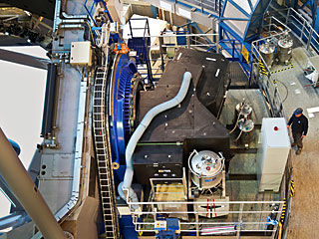
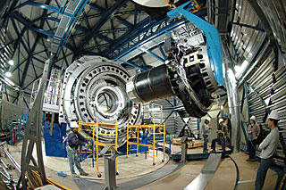
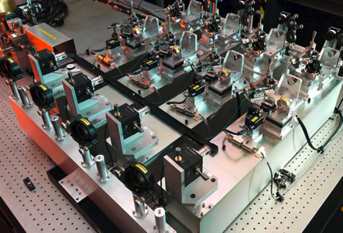
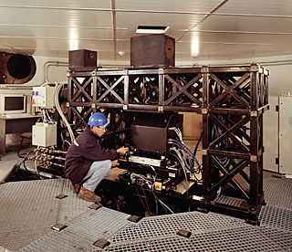
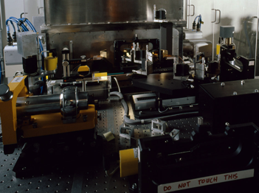
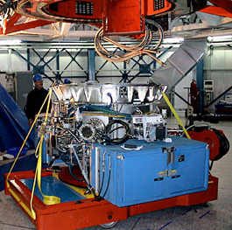
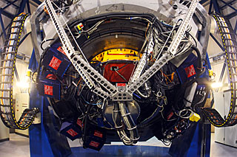
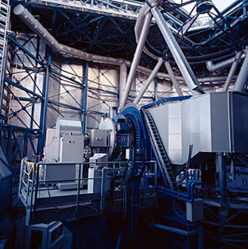
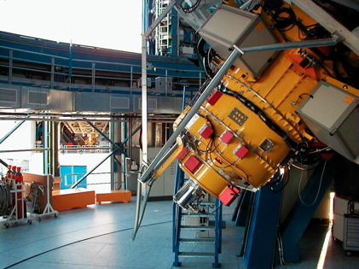
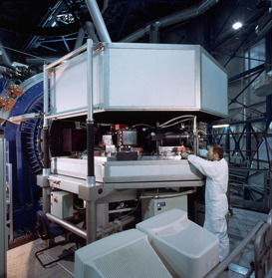












Slide 31
















VLT Instruments 2015
FORS2
FLAMES
VISIR
SINFONI
CRIRES
UVES
VIMOS
MUSE
KMOS
X-shooter
SPHERE
HAWK-I

Slide 32


VLTI - Very Large Telescope Interferometry
The VLTI is a virtual 100-Meter Telescope

Slide 33


Our own black hole
Mass determination through
stellar orbits
  about 4 10⁶ M
Structure around the black
hole revealed through flashes
Testing General Relativity
in the strong gravitational
field

Slide 34

Galactic Center
40 orbits known
S2 Orbit
Gillessen et al. 2009

Slide 35



Galactic Center
Pericenter shift probes the nature of the black hole
  measure post-Newtonian effects
Higher order terms necessary to take into account
GR in the strong gravity regime
GRAVITY aims at constraining them

Slide 36

What matters in the Universe?
Characterisation of dark matter and dark energy
  Requires large samples
    sample a large fraction of the universe
  Multi-year and (often) multi-telescope projects
  Measure the distribution of matter and the expansion history of the universe
    Baryonic acoustic oscillations
    Weak lensing
    Supernovae
    Galaxy clusters
    Redshift distortions

Slide 37


Planets, planets, planets
Planets everywhere
  Radial velocities
  Direct imaging
  Transits
Characterisation
  Planetary systems,
  masses,
  chemical composition,
  temperatures

Slide 38


A planet with 1.9M⊕ and one in the habitable zone
Mayor et al. 2009

Slide 39

Richest planetary system known
Five planets with 12M⊕ < M < 25M⊕ at distances 0.06AU < D < 1.4AU
One candidate with
M=1.4M⊕ at
D=0.02AU and
another with
M=65M⊕ at 3.4AU
Lovis et al. 2010

Slide 40



The ESO exo-planet machinery
HARPS at 3.6m telescope (NIRPS)
  best radial velocity machine at a 4m telescope extremely stable spectrograph
  ESPRESSO at VLT in the future
NACO/SPHERE
  adaptive optics supported
  imaging and spectroscopy
VLTI
  highest spatial resolution for follow-
  up observations of known systems
NACO/SINFONI/FORS2
  transit measurements, atmospheres of
  exo-planets
CRIRES+
  spectroscopy of atmospheres

Slide 41

ESO results on exo-planets
Most radial velocity detections through HARPS
  lowest-mass planets known so far
    rocky planets, earth-mass planets
  planetary systems
First direct image of a planet
  around a brown dwarf
  now innermost planet directly
  imaged (β Pic)
Combination with transits
  characterization of planets
    mass, density, temperatures

Slide 42


β Pic planet
Planet (~10 M_{jup}) within the massive dust disk
Orbit only a few AU
NACO imaging
SPHERE imaging
  planet – star separation
    ~350 mas
Lagrange et al. 2009, A&A, 493, L21

Slide 43

Exo-Planets
Emphasis is shifting
  most discoveries expected through transits
  characterisation of atmospheres
  discovery of Earth-like planets
  characterisation of hot Jupiters
Requires different instruments
  Many global ongoing surveys
    Next Generation Transit Surveys (NGTS – Paranal)
    other hosted telescopes under discussion
    future space missions (TESS, CHEOPS, PLATO)
  Continued radial velocity surveys
    masses through the combination with the transits
  Atmosphere characterisation

Slide 44
Exo-Planets
Observational requirements
  continued long time series
    radial velocities (HARPS, ESPRESSO, ELODIE/Euler)
  long monitoring runs
    transits to be covered over many hours at very specific times
    dedicated instruments (NIRPS, dedicated hosted telescopes - ExTRa)
  expect thousands of transiting planets
    currently about 1000 known
    (mostly in the Kepler field in the Northern Hemisphere)
    many projects under way – global collaborations
      WASP, HAT, MASCARA, NGTS
      TESS, CHEOPS, PLATO

Slide 45




Exciting SPHERE Results
VY Cam
R Dor
MWC758

Slide 46

Exciting SPHERE Results
(93) Minerva
(130 Elektra)

Slide 47
Transient Sky
Changing sky – next frontier
  Solar system objects
    near-Earth objects
  Exo-planets
  Variable stars
    window into stellar physics
    distance indicators
    VVV, VMC, VIDEO, VST/SUDARE, (La Silla/QUEST), PESSTO
  Gravitation
    time scale depends on the strength of the gravitational field
      X-ray binaries
      black holes
    electro-magnetic counterparts of sources of gravitational waves
      merging white dwarfs, neutron stars, black holes
      core-collapse supernovae

Slide 48
Transient Sky
Dedicated telescopes
Dedicated operational modes
  large Target of Opportunity fraction
  flexible scheduling
  variable timescales
Database requirements
  systematic archiving
  time series
  correlation analyses

Slide 49


Gamma-Ray Bursts
Most distant stellar objects ever observed
  redshifts 6.7 and 8.2 (tentative)
  lookback time of nearly 12.5 billion years (or 95% of the age of the universe)
VLT equipped with rapid response mode
  allows to observe a gamma-ray burst 10 minutes after detection
i
z
J
GRB080913

Slide 50

Most distant stellar object yet observed – GRB 090423
Tanvir et al., Nature submitted
Optical drop-out, bright in the near-infrared
Rapid decline

Slide 51


GRB 090423
ISAAC
SINFONI
Spectroscopy 17 hours after outburst
Lyman break indicates a redshift of z≈8.2

Slide 52


The Survey Telescopes
VST 2.6m for optical and VISTA 4.1m für infrared observations
Coordinated sky surveys in 5-year projects

Slide 53


Helix Nebula

Slide 54


Public Surveys

Slide 55
ESO Science Archive
Rich resource

Slide 56
Recent new VLT instruments
SPHERE – extreme adaptive optics system in the NIR and optical
MUSE – largest integral field unit available
  see Dimitri’s results yesterday
KMOS – multi-IFU system in the NIR
  examples in Dimitri’s talk yesterday
X-shooter – new workhorse instrument for individual objects
  covers 400nm to 1.8μm simultaneously

Slide 57
Planned new VLT instruments
ESPRESSO – extremely stable high-resolution spectrograph
  can use all four unit telescopes together
Adaptive Optics Facility (AOF)
  “seeing improver” for HAWK-I (ground-layer AO)
  optical AO for MUSE
  4 laser guide stars
ERIS – new NIR AO imager (NACO replacement)
  includes SINFONI upgrade
4MOST (VISTA) – high multiplex optical spectroscopy
MOONS – high multiplex NIR spectroscopy
CUBES – UV high-resolution spectroscopy

Slide 58
New VLTI instruments
(Existing) PIONIER – closure-phase NIR imager
GRAVITY – highest angular resolution system in K-band
MATISSE – highest angular resolution system in infrared

Slide 59
Paranal 2020

Slide 60


Slide 61

ESO’s next project - E-ELT

