Slide 1


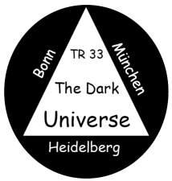
Supernova Cosmology
Bruno Leibundgut
European Southern Observatory

Slide 2
Take away messages
Supernovae are complicated astrophysical objects
  explosions!
  old stars, i.e. end of stellar evolution
  this also applies to Type Ia supernovae
The universe experiences accelerated expansion
  measured through cosmological distances by Type Ia Supernovae
    SNe Ia can be used to determine accurate distances

Slide 3
Presentation in two parts
Physics of (Type Ia) supernovae
  latest results on evolutionary path towards supernovae
  explosion physics
Cosmology with Type Ia supernovae
  SNe Ia as distance indicators
  cosmological consequences
    accelerated expansion

Slide 4
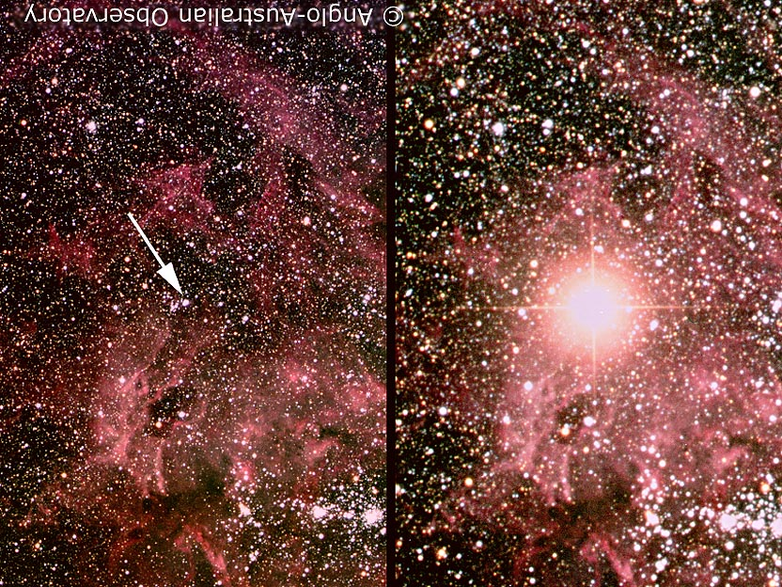
Supernova!
© Anglo-Australian Telescope

Slide 5
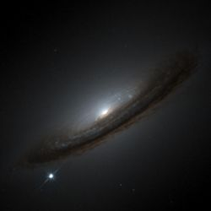
SN 1994D

Slide 6
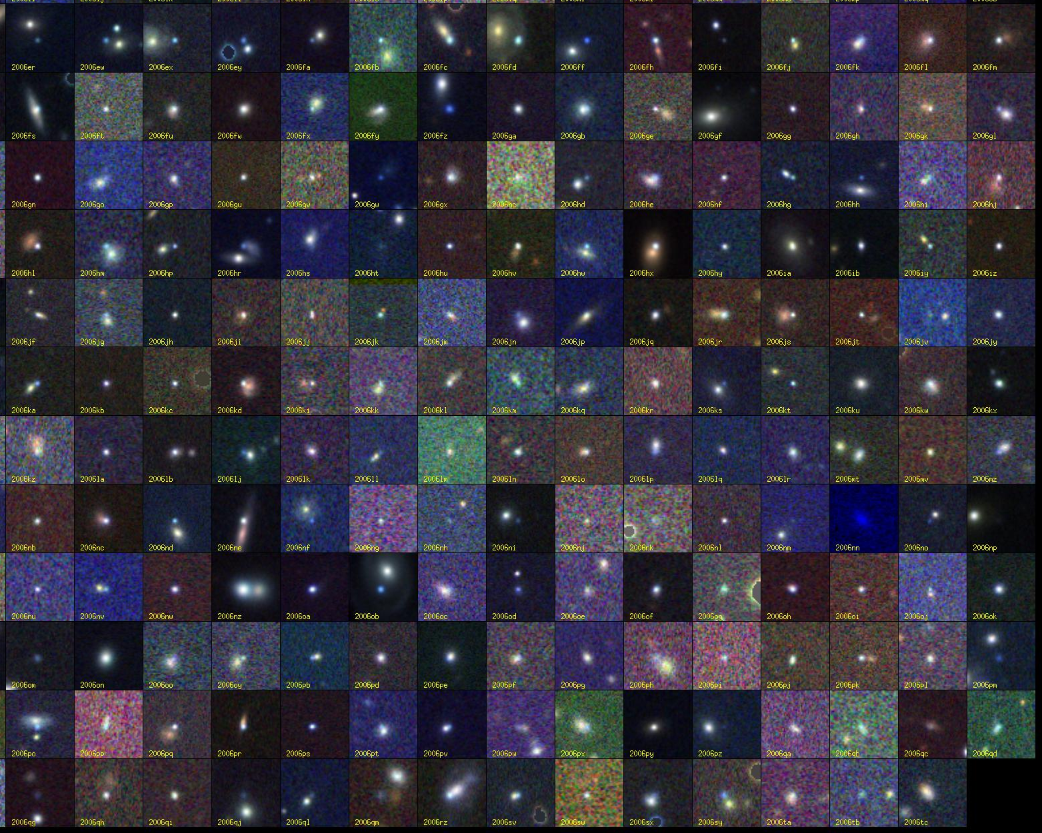
Supernovae!
© SDSSII

Slide 7
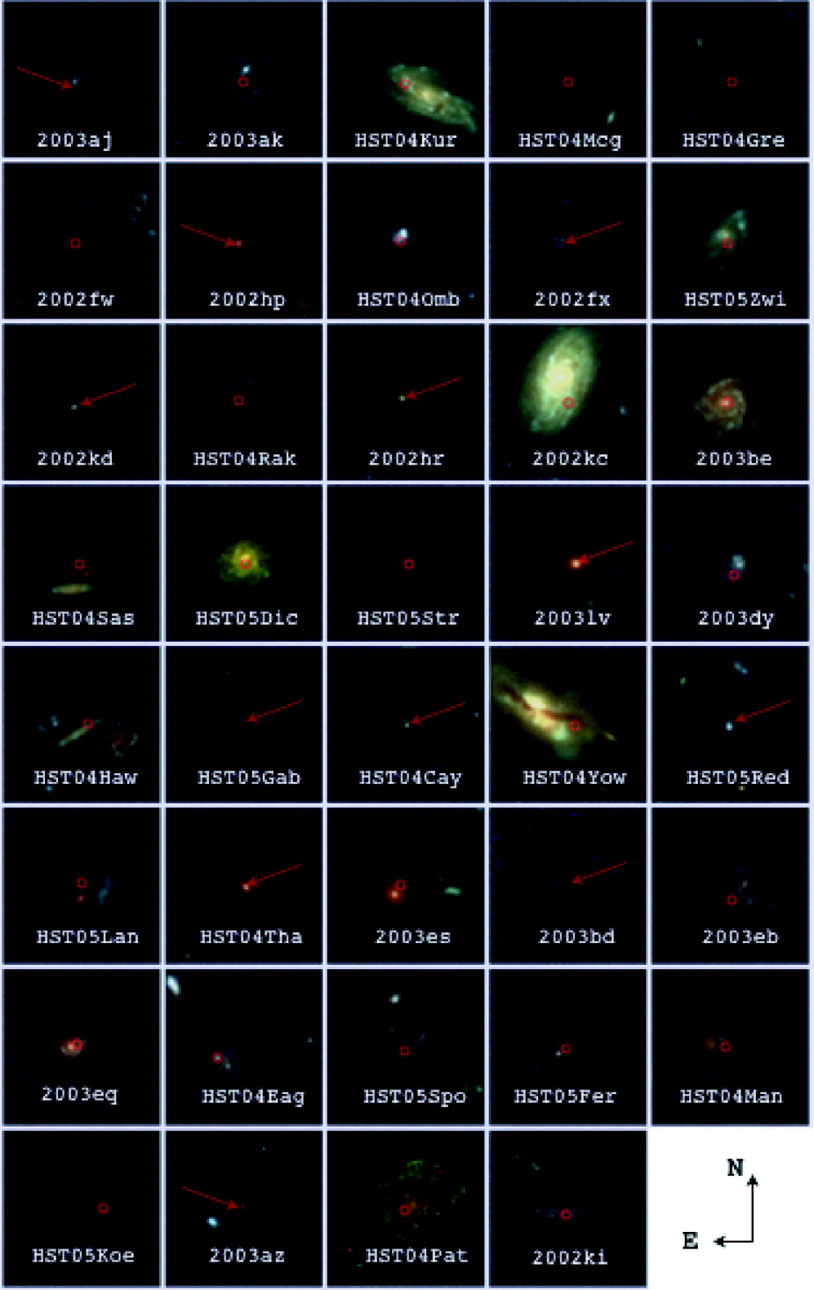
Supernovae!
Riess et al. 2007

Slide 8
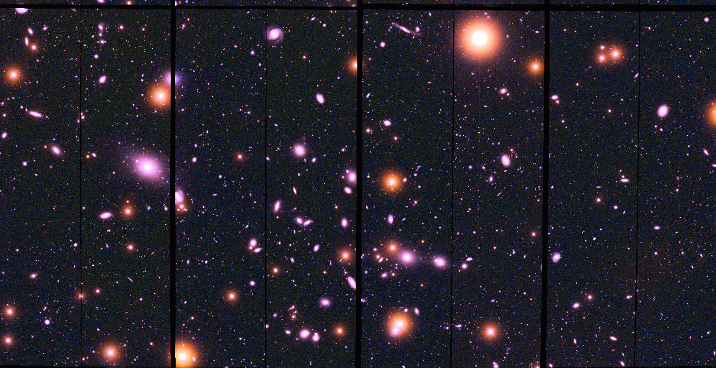
Supernova Search

Slide 9
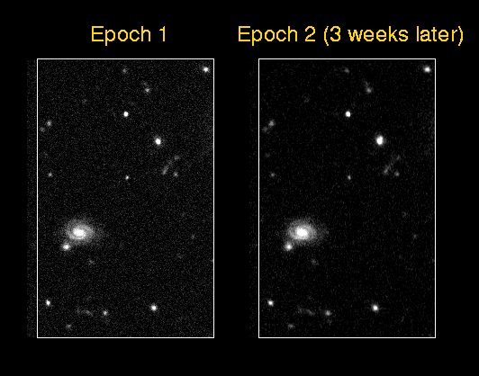
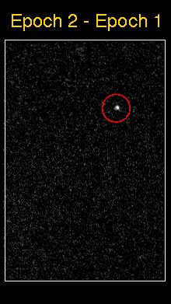
Supernova Search
(High-z Supernova Team)

Slide 10
Supernova classification
Based on spectroscopy
core collapse
in massive stars
SN II (H)
SN Ib/c (no H/He)
Hypernovae/GRBs
SN Ia (no H)
thermonuclear
explosions

Slide 11
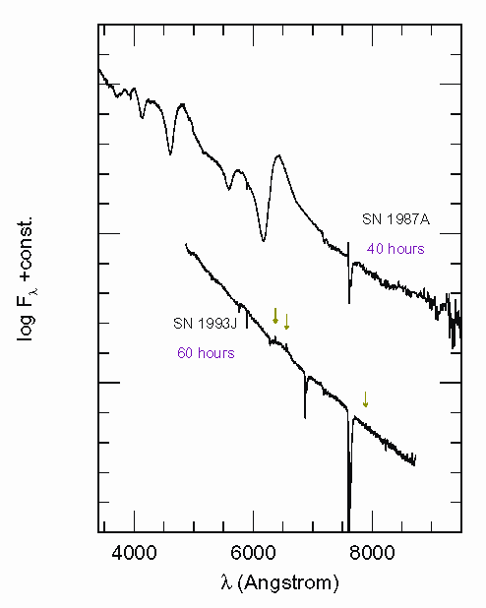
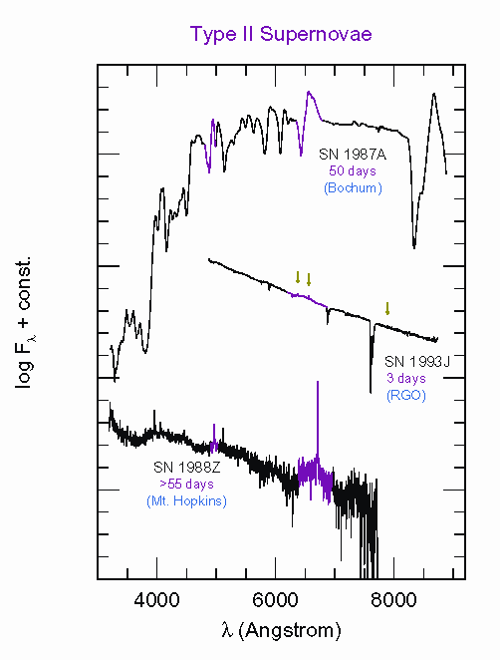
Supernova Spectroscopy
Type II

Slide 12
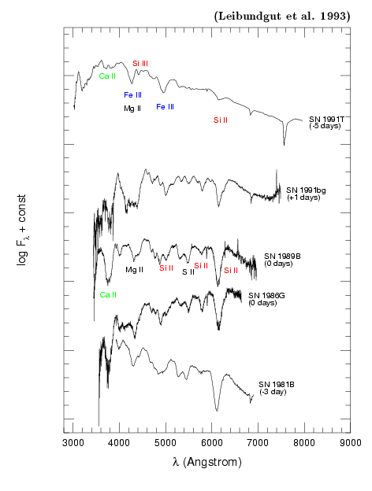
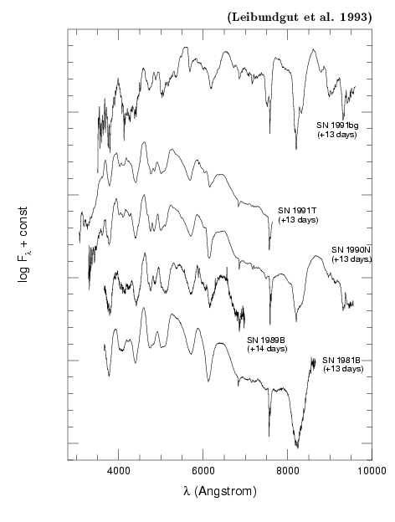
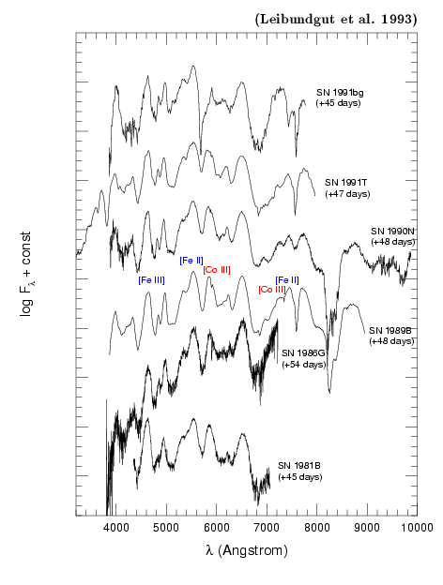
Supernova
Spectroscopy
Type Ia

Slide 13
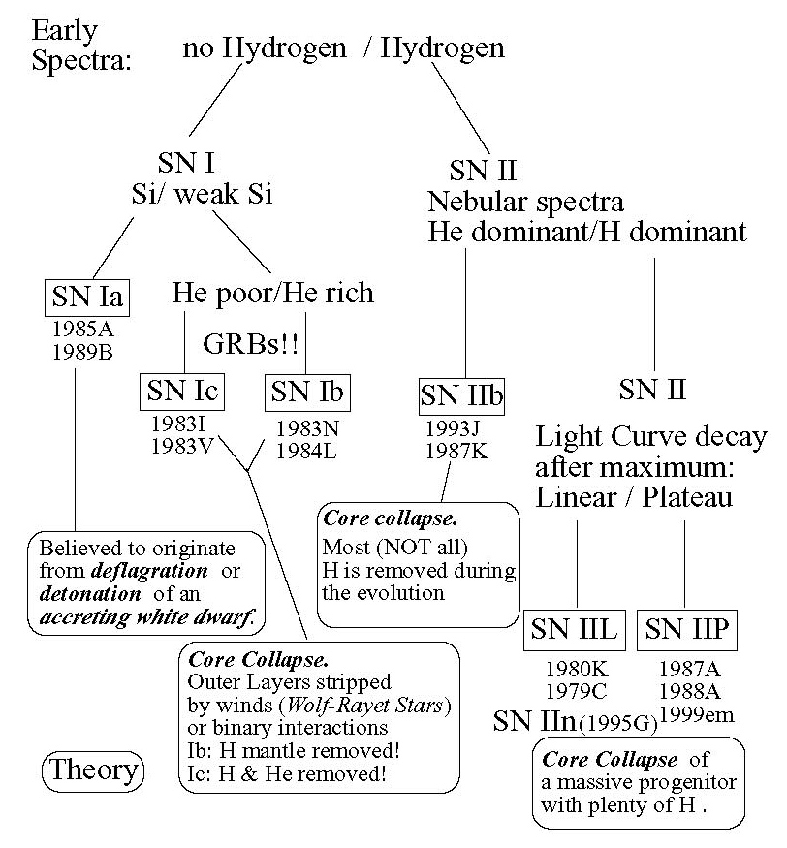
SN Classification

Slide 14
What do we want to learn about supernovae?
What explodes?
  progenitors, evolution towards explosion
How does it explode?
  explosion mechanisms
Where does it explode?
  environment
    local and global
  feedback
What is left behind?
  remnants
  compact remnants
  chemical enrichment
Other uses of the explosions
  light beacons
  distance indicators
  chemical factories

Slide 15
Supernova Types
Thermonuclear SNe
  Progenitor stars have small mass (<8M)
  highly developed stars (white dwarfs)
  Explosive C und O burning
  Binary star systems
  Complete destruction
Core collapse SNe
  Progenitor stars have large mass (>8M)
  large envelope (Fusion still ongoing)
  Burning because of the high density and compression
  Single stars (double stars for SNe Ib/c)
  Neutron star as remnant

Slide 16
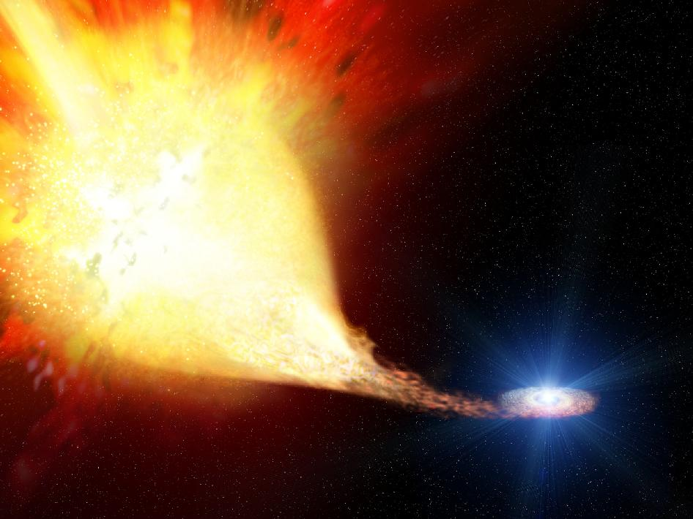
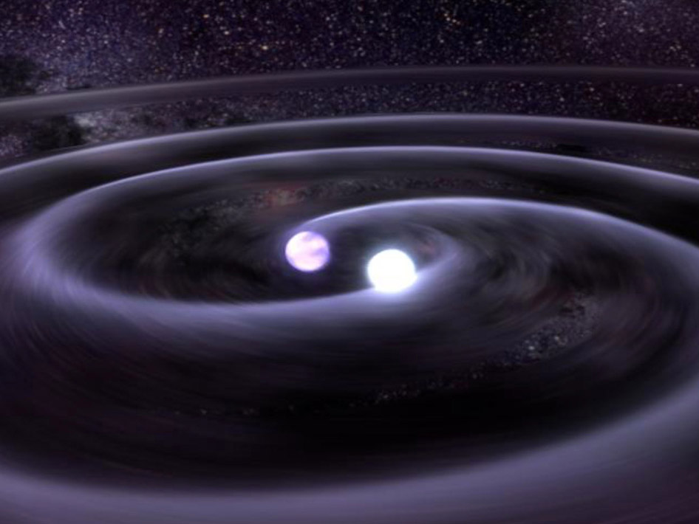
What do we know about
Type Ia supernovae?
What explodes?
  progenitors, evolution towards explosion
    white dwarfs, several channels
How does it explode?
  explosion mechanisms
    thermonuclear explosions
    several channels
      deflagrations
      detonations
      delayed detonations
      He detonations
      mergers
What is left behind?
  remnants
    Tycho, SN 1006, LMC
  compact remnants
    none, companion (?)
  chemical enrichment
    Fe group elements
Churazov et al. 2014

Slide 17
What do we know about
Type Ia supernovae?
Where does it explode?
  environment
  (local and global)
    some with CSM (?)
    all galaxy morphologies
    dependencies on host galaxies?
  feedback
    little
Other uses of the explosions
  light beacons
    little use as background source
  distance indicators
    ha!
  chemical factories
    no significant dust
Notes:
Mention work by Ariel’s group on the CSM dust
Mention Lundqvist H and He studies around 2000cx and 1998bu

Slide 18
Possible progenitors
Single Degenerate
Double Degenerate
‘life’ star
  young systems (>10⁸ yr)
‘long’ mass transfer
‘messy’ environment
  expect hydrogen, helium, oxygen, dust
companion left behind
2 ‘dead’ stars
  Old systems (>10⁹ yr)
mergers
‘clean’ environment
no companion remnant

Slide 19
The “standard model”
Explosion energy:
Fusion of
C+C, C+O, O+O
⇒ "Fe“
He (+H)
from binary
companion
C+O,
M ≈ M_{ch}
Density ~ 10⁹ - 10¹⁰ g/cm
Temperature: a few 10⁹ K
Radii: a few 1000 km
There is a lot more to this – you need to contact your explosive theory friends

Slide 20
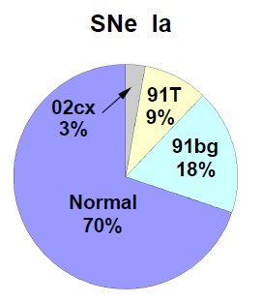
Type Ia Supernovae
Complicated story
  observational diversity
  many models
  need more constraints
Pakmor et al. 2012
Wang et al. 2011

Slide 21
Historical importance of supernovae
Historical supernova observations in Asia (China, Korea)
  Interpreted (together with comets) as heavenly signs (typically as bad omens)
Appeared in the part of the fixed stars
  In contradiction ot the Ptolemaic world view with the heavenly spheres

Slide 22
Historical importance of supernovae
SN1572 observed by Tycho Brahe
  De stella nova
  No measurable parallax → outside of the solar system
SN1604 Kepler’s Supernova
Observations of S Andromeda (SN1885B) in the Andromeda galaxy
  Lundmark (1925) proposed that Andromeda is outside our Milky Way

Slide 23
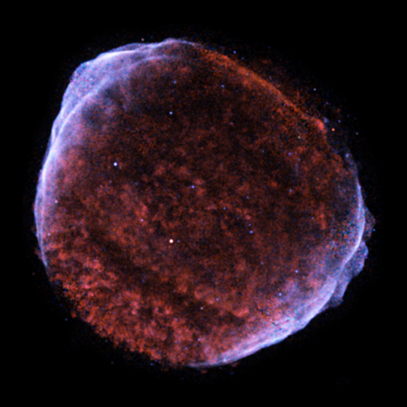
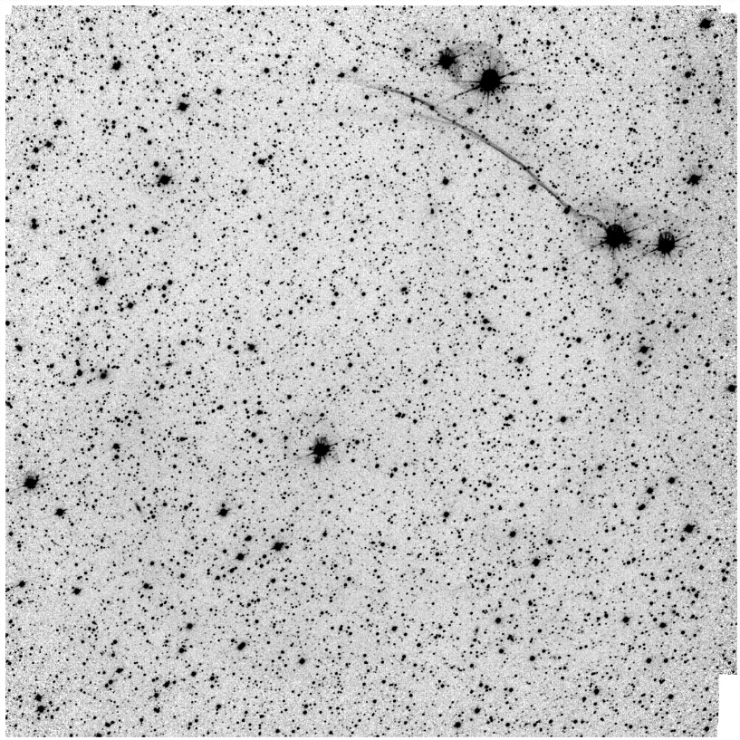
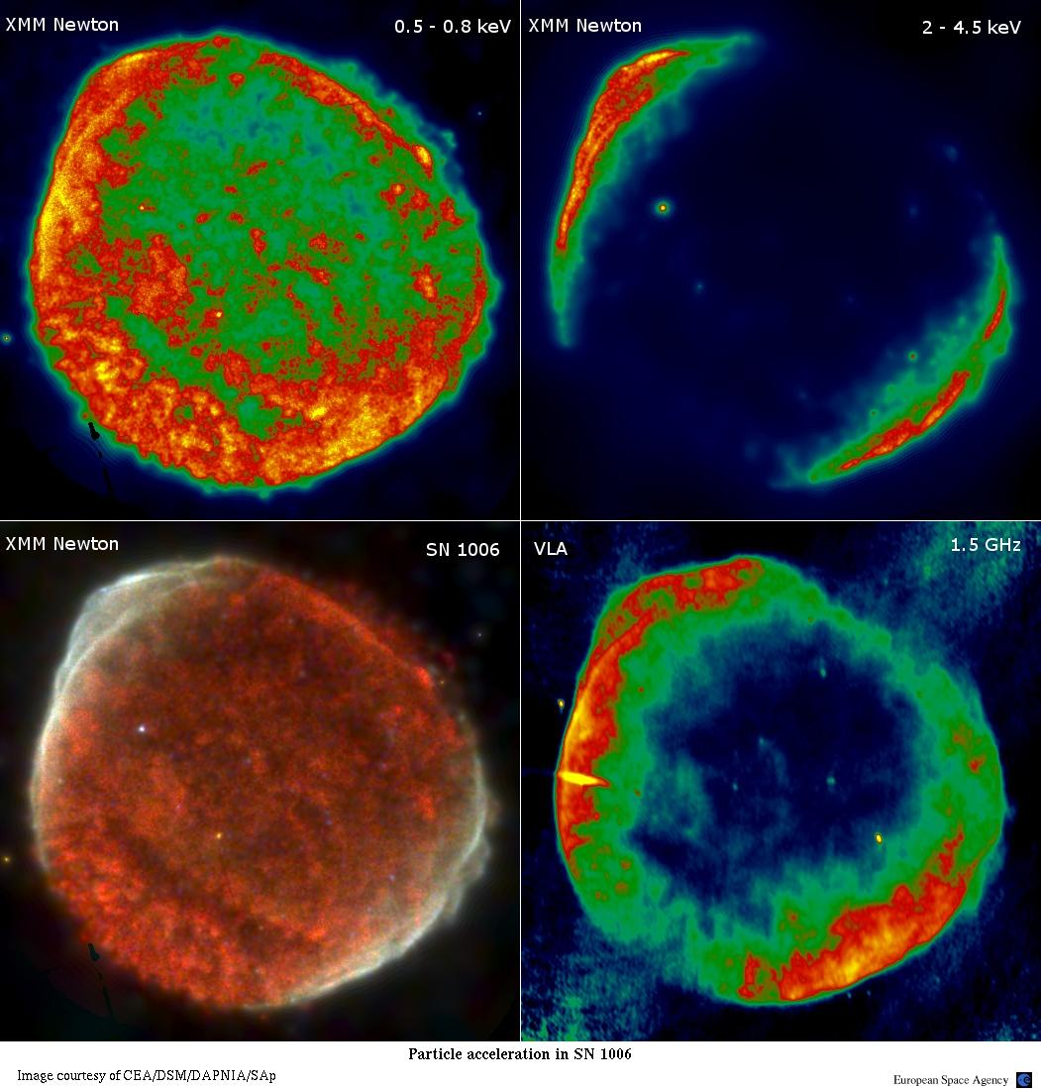
SN 1006 today

Slide 24
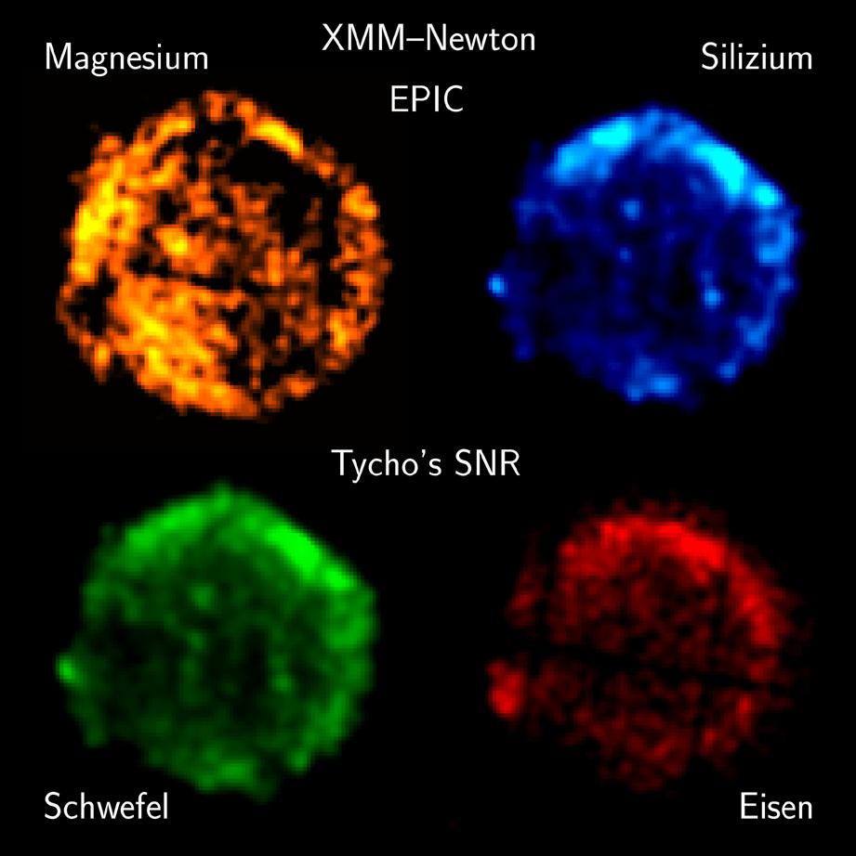
Silicon
Sulphur
Iron

Slide 25
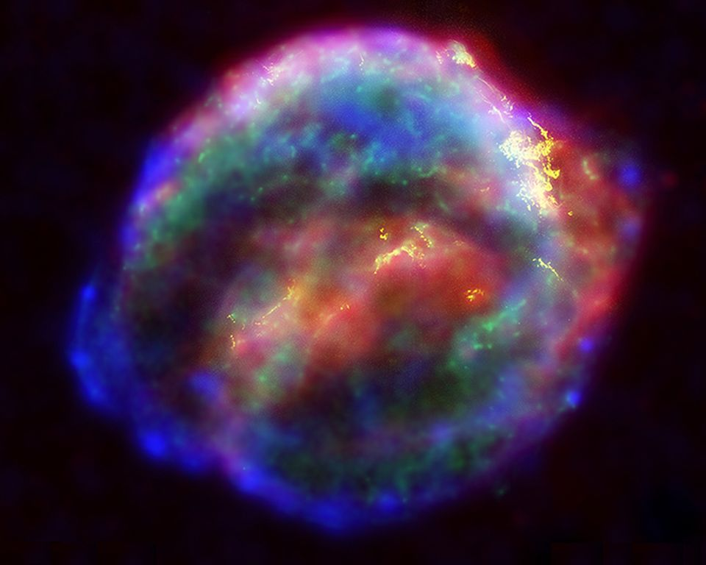
Kepler’s Supernova today
NASA/ESA

Slide 26
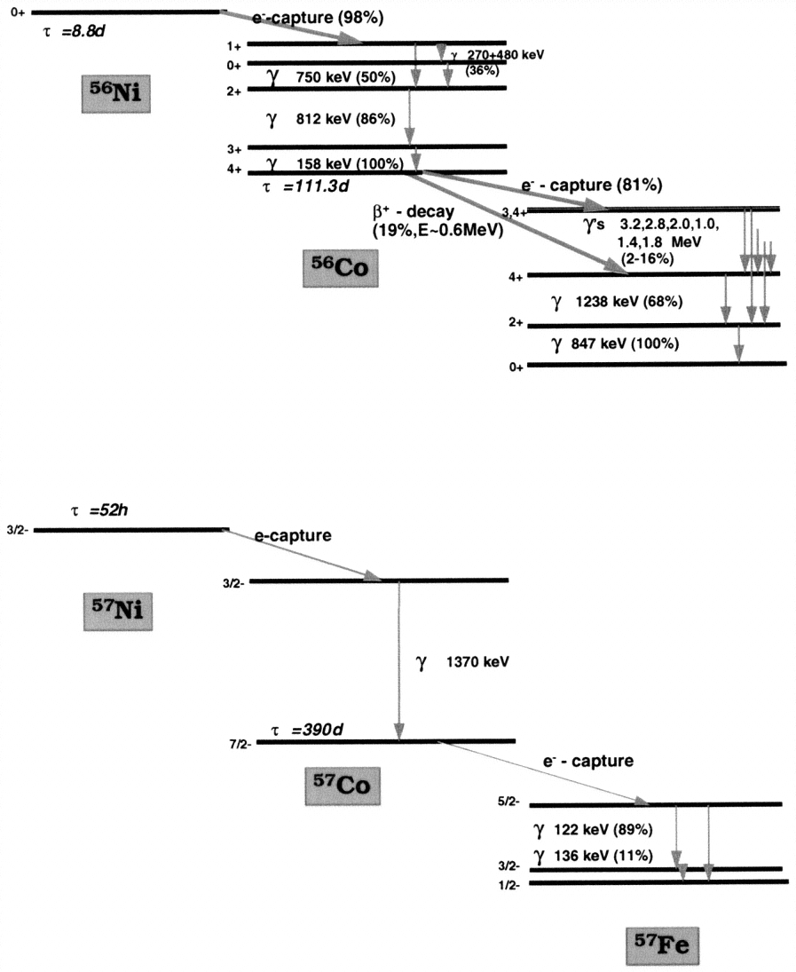
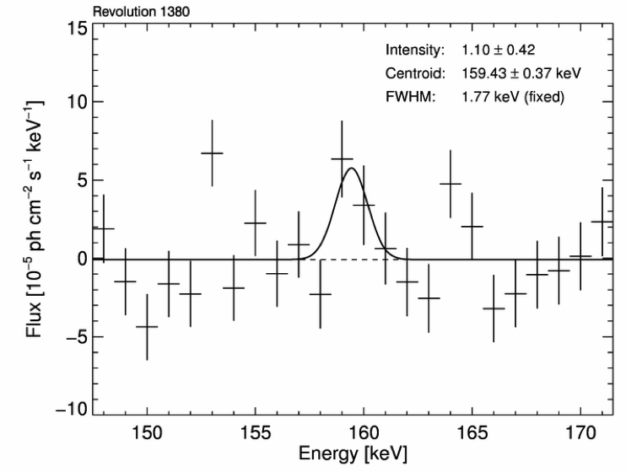
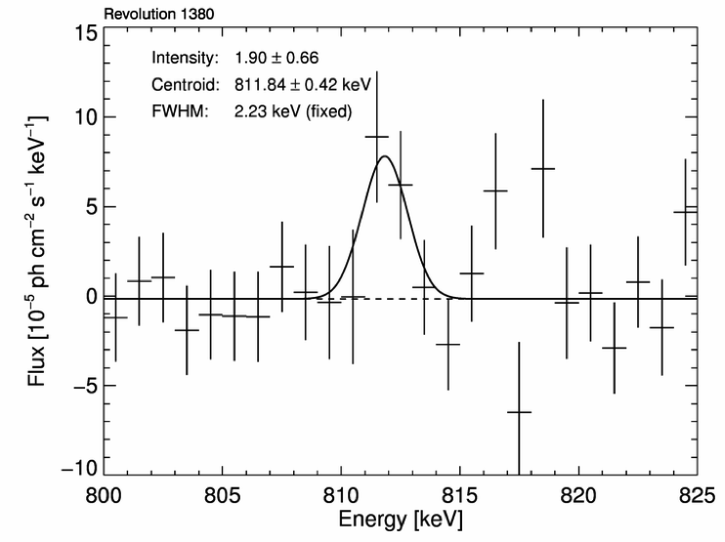
Radioactivity
Isotopes of Ni and other elements
  conversion of
  γ-rays and positrons into heat and optical photons
Churazov et al. 2014
Diehl et al. 2014
Contardo (2001)
Diehl and Timmes (1998)

Slide 27
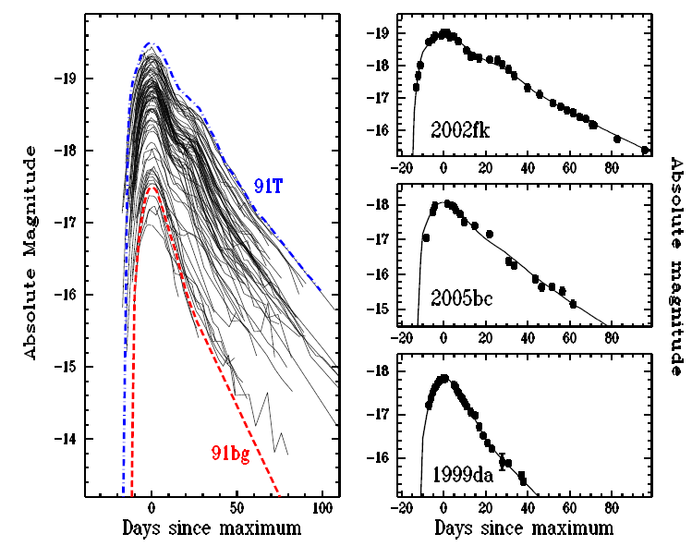
Luminosity distribution
Li et al. 2010

Slide 28
SNe Ia are not a homogeneous class
Proliferation of information
  Large samples produce many peculiar and special objects
  Difficulty to assess what are generic features of the class and what are peculiar modifications to the norm
    Subluminous
    Superluminous
    CSM/no CSM
    Environmental effects
What should we give up?
  evidence for multiple progenitor channels
  indications for several explosion mechanisms
  uniform metalicity

Slide 29
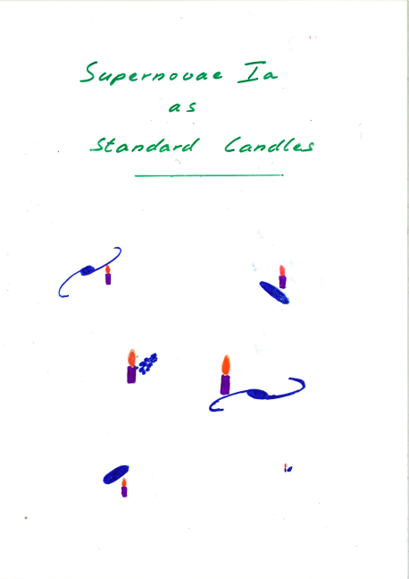
Type Ia SNe are not standard candles
They are not even standardizable
Maybe some of them can be normalised to a common peak luminosity

Slide 30
Radioactivity
Isotopes of Ni and other elements
  conversion of γ-rays and positrons into heat and optical photons
Churazov et al. 2014
Contardo (2001)
Diehl and Timmes (1998)

Slide 31
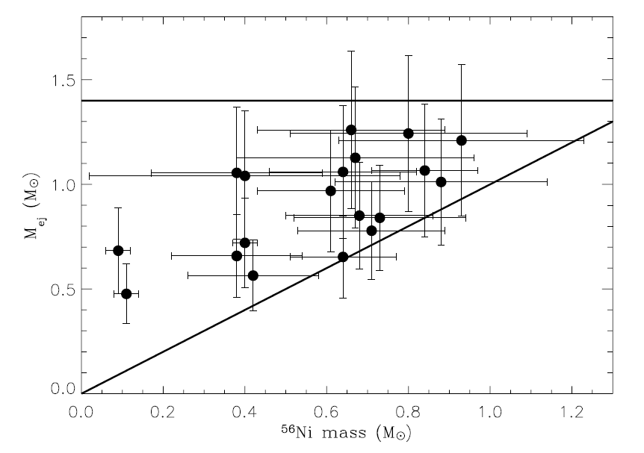
Ejecta masses
Large range in nickel and ejecta masses
  no ejecta mass at 1.4M
  factor of 2 in ejecta masses
  some rather small
  differences
  between
  nickel and ejecta
  mass
Stritzinger et al. 2007

Slide 32
Ejecta masses
Scalzo et al. 2014
SNFactory

Slide 33
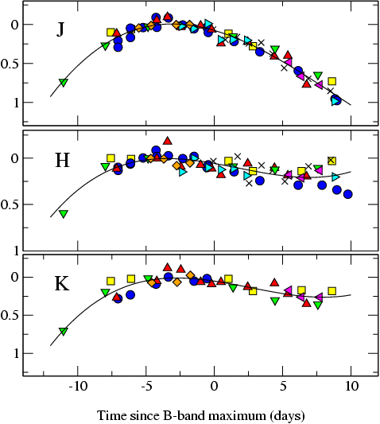
The promise of the (near-)infrared
Extinction is much reduced in the near-IR
  A_{H}/A_{V} ≅ 0.19 (Cardelli et al. 1989)
SNe Ia much better behaved
SN | Δm₁₅(B)
1980N | 1.29
1986G | 1.79
1998bu | 1.05
1999aw | 0.81
1999ee | 0.94
2000ca | 1.01
2001el | 1.15
Krisciunas et al. (2004)
Mark Phillips

Slide 34
Large literature sample
Scatter minimal at first maximum in
Y (1.04μm), J (1.24μm),
H (1.63μm) and
K (2.14μm)
~90 objects in J and H
  58 in Y, 22 in K
Mostly Carnegie SN Project data
(Contreras et al. 2010, Stritzinger et al. 2011)
Dhawan et al. 2015

Slide 35
Diversity after maximum
4 days
14 days
30 days
Dhawan et al. 2014
maximum
minimum
second maximum

Slide 36
Late decline (t>40 days)
Dhawan et al. 2015

Slide 37
Correlations
Phase of the second maximum appears to be a strong discriminator among SNe Ia

Slide 38
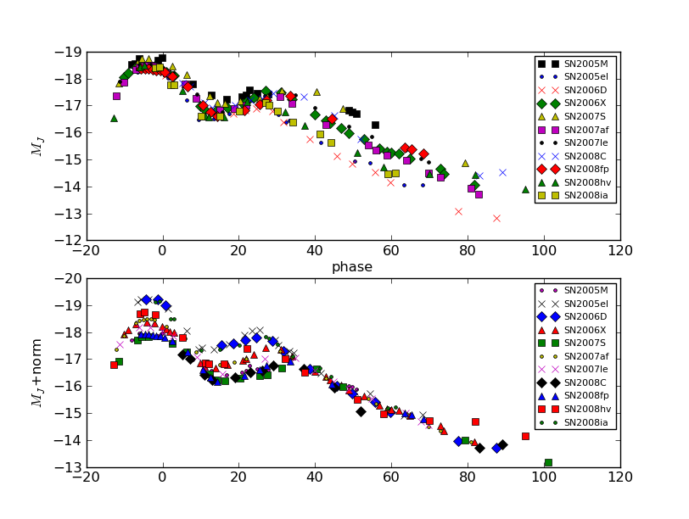
Correlations
Luminosity of late decline and the phase of the second maximum are linked

Slide 39
Correlations with the optical
Biscardi et al. 2012
Dhawan et al. 2014
IR properties correlate with optical decline rate
Phase of secondary maximum strongly correlated with Δm₁₅

Slide 40
Correlation with optical colour
Phase of second maximum and beginning of the Lira relation are also tightly linked
Dhawan et al. 2014
Phillips et al. 1999

Slide 41
Consistent picture emerging
Second peak in the near-IR is the result of the recombination of Fe++ to Fe+ (Kasen 2006)
  he predicted a later second maximum for larger Ni masses
Optical colour evolution faster for objects with lower nickel mass
(Kasen & Woosley 2007)
Ejecta structure uniform
  late declines very similar
higher luminosity indicates a higher Ni mass
later secondary peak also indicates higher Ni mass
Ni mass and (optical) light curve parameters correlate (Scalzo et al. 2014)

Slide 42
Nickel masses
Dhawan et al. subm.
Using a timing parameter for nickel masses
  completely independent on reddening and multiple light curves
Test with a sample of unreddened SNe Ia
Explore different methods to calculate the nickel mass
(currently still all Chandrasekhar-mass progenitors)

Slide 43
Luminosity and mass functions
Reddening independent distribution functions
  fails for super-Chandra objects
    SN 2007if
  potential shock interaction at peak might create additional luminosity
Dhawan et al. subm.

Slide 44
Summary
Nickel seems the dominant parameter for the light curves of SNe Ia
  phase of second maximum, start of uniform B-V colour evolution (Lira law), optical light curve shape (Δm₁₅), luminosity of the late decline phase
Second maximum in the IR light curves strong parameter for SN Ia characterisation → simple way to measure nickel mass

Slide 45
Type Ia supernova cosmology
Excellent distance indicators!

Slide 46
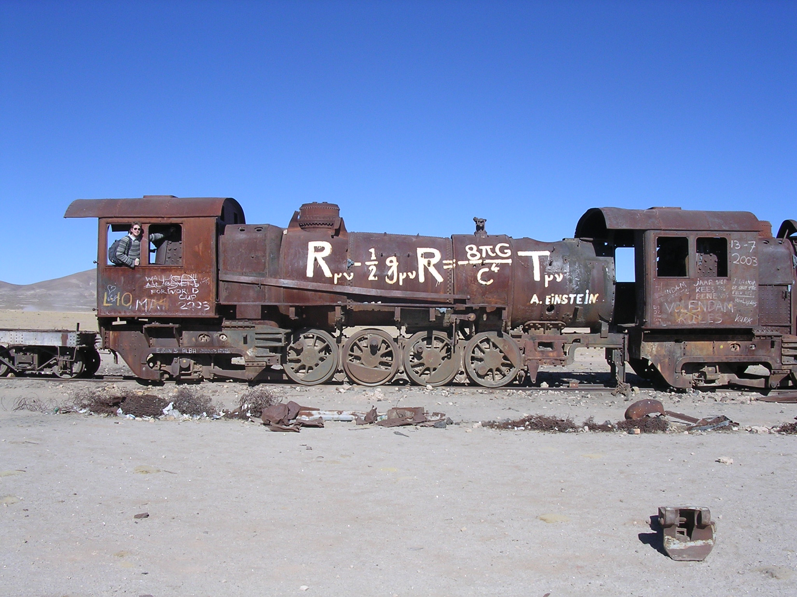
Supernova Cosmology

Slide 47
The expansion of the universe
Luminosity distance in an isotropic, homogeneous universe as a Taylor expansion
Hubble’s Law
deceleration
jerk/equation of state

Slide 48
Friedmann cosmology
Assumption:
homogeneous und isotropic universe
Friedmann-Robertson-Walker-Lemaître metric:
Ω_{M}: matter density
Ω_{k}: curvature
Ω_{Λ}: cosmological constant

Slide 49
The equation of state parameter ω
General luminosity distance
  with and
  ω_{M}= 0 (matter)
  ω_{R}= ⅓ (radiation)
  ω_{Λ}= -1 (cosmological constant)

Slide 50
Ω=0
Scale factor
‘Mean distance between galaxies’
Ω=1
Ω>1
- 14
- 9
- 7
Time
today
billion years

Slide 51
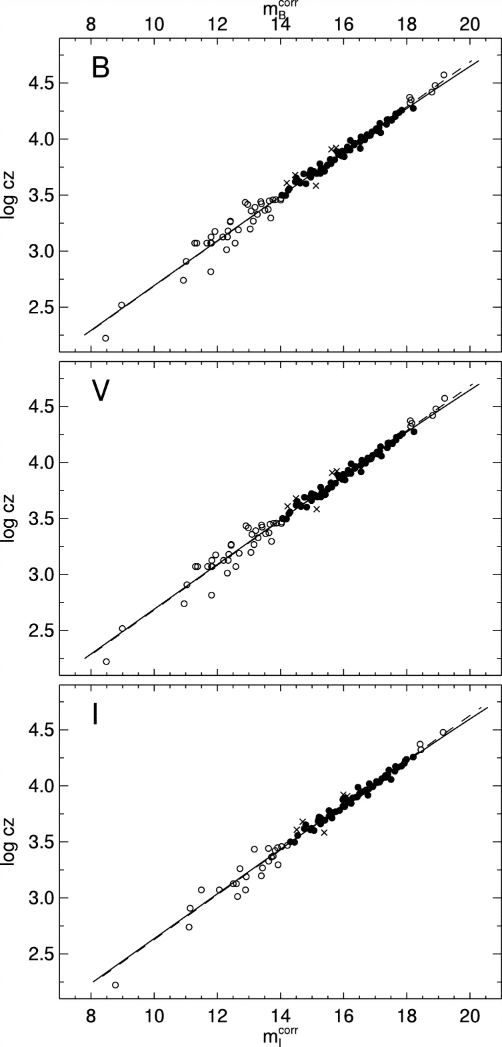
SN Ia Hubble diagram
Excellent distance indicators
Experimentally verified
Work of several decades
Best determination of
the Hubble constant
Reindl et al. 2005

Slide 52
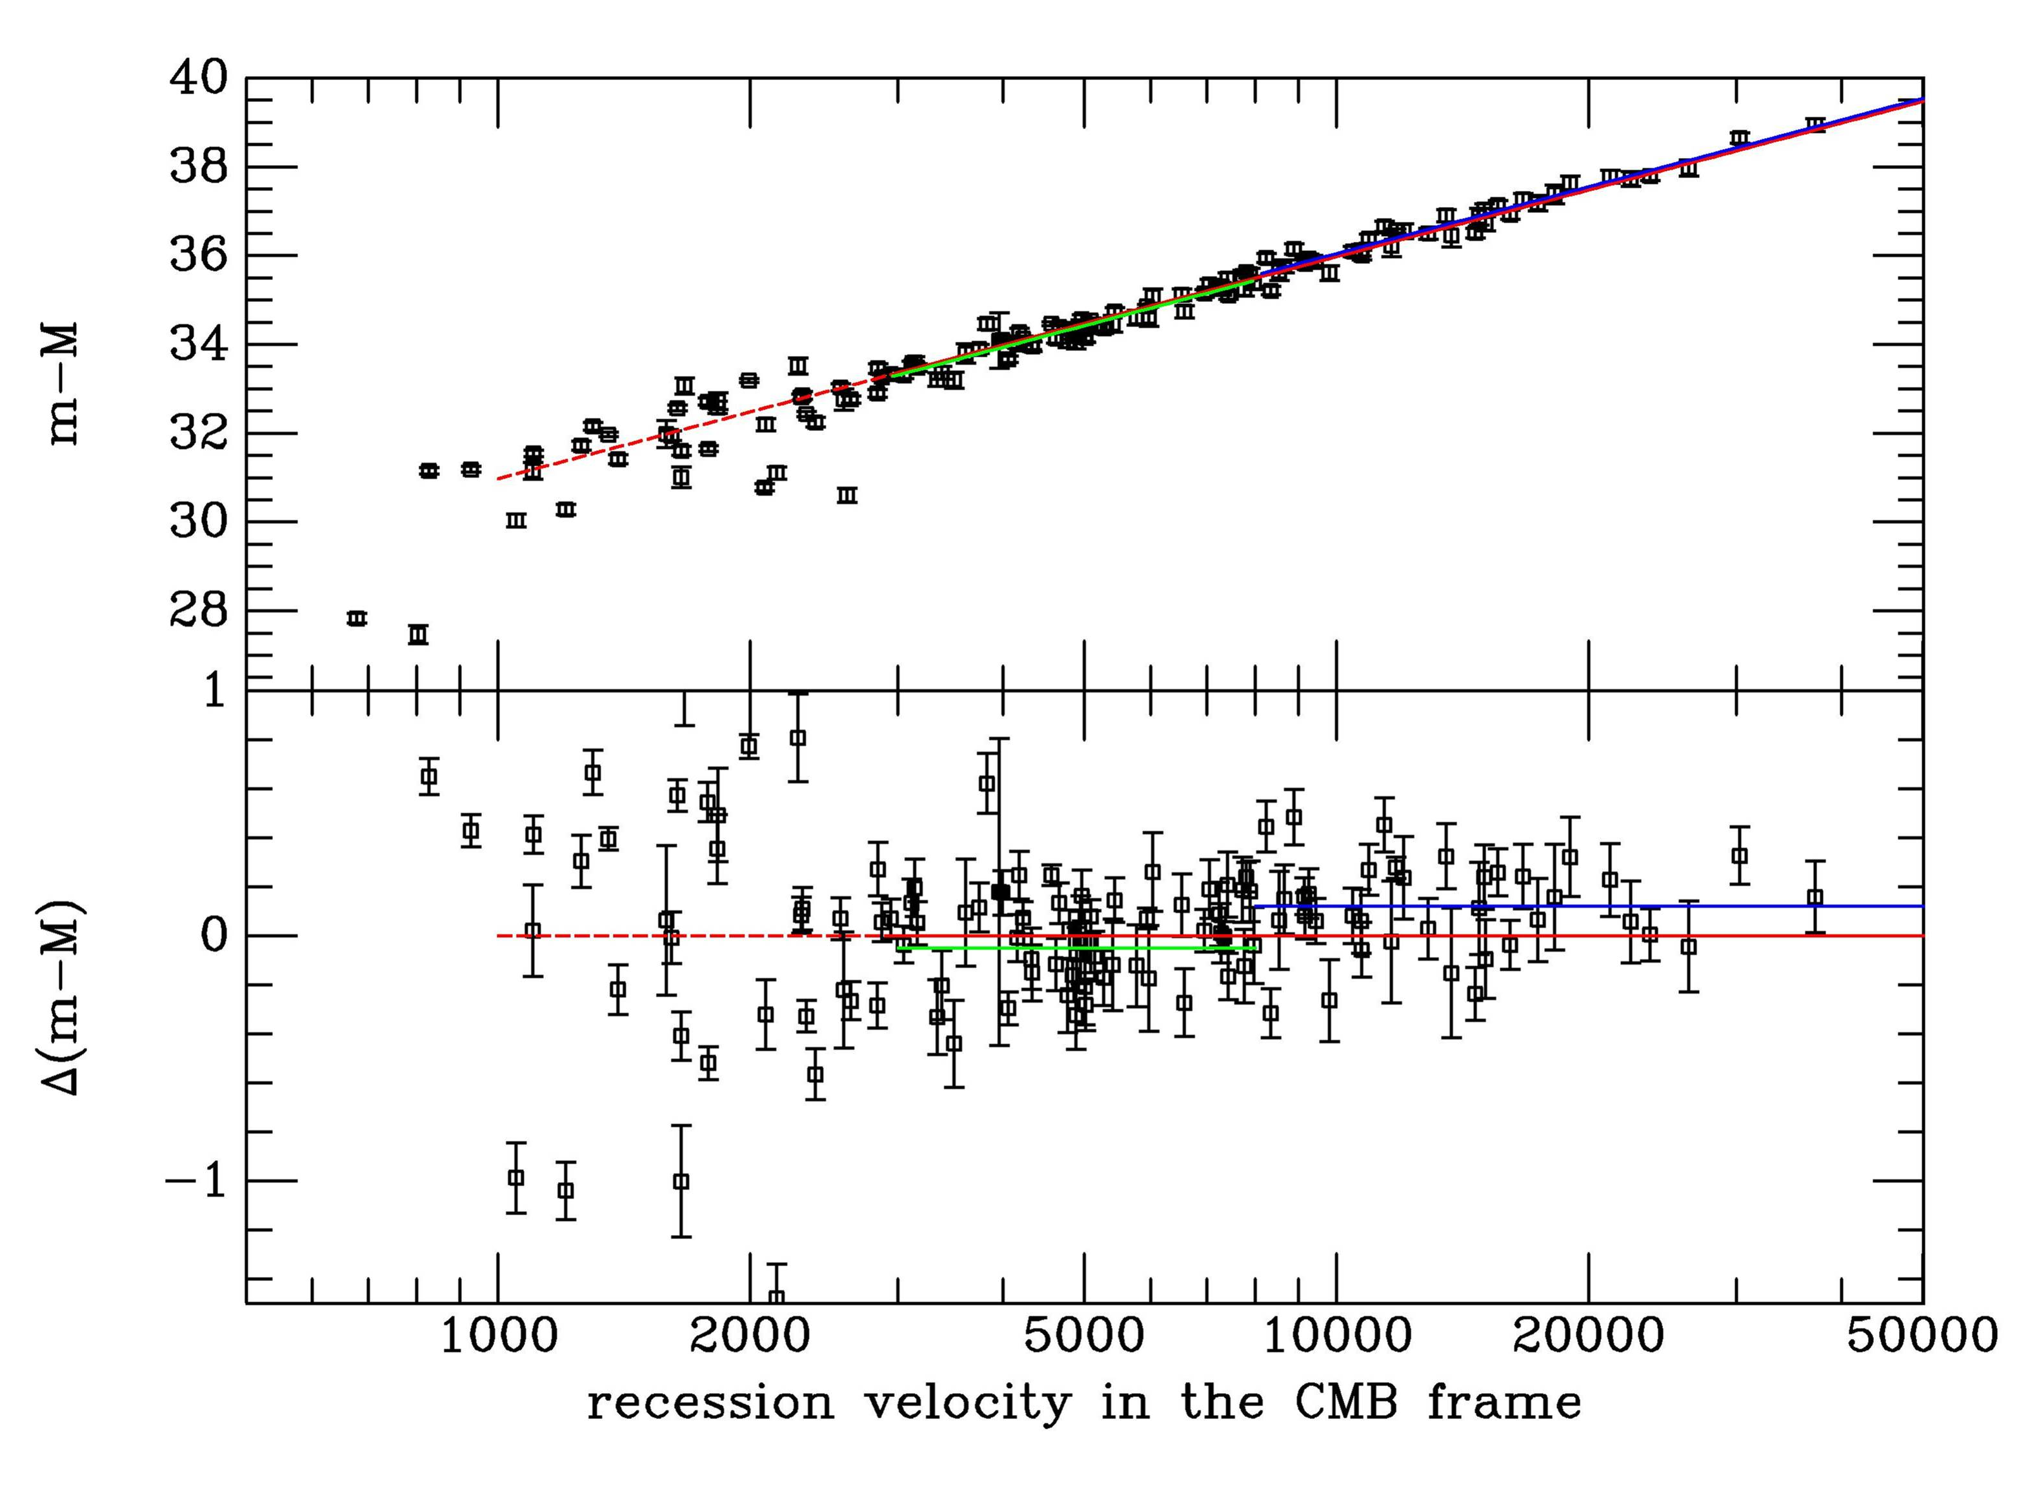
Distance indicator!
Distance
Expansion velocity

Slide 53
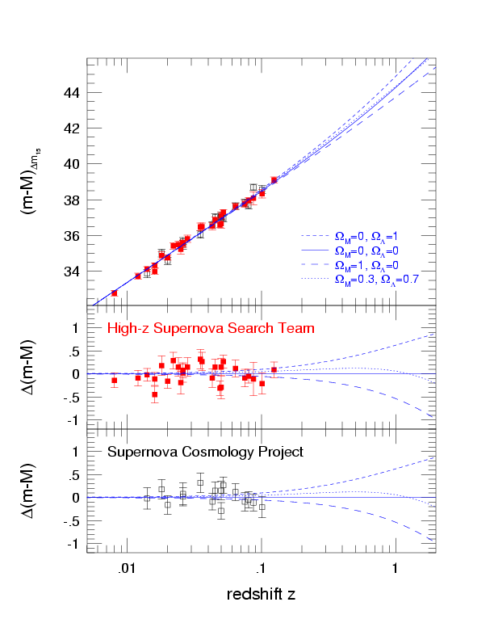
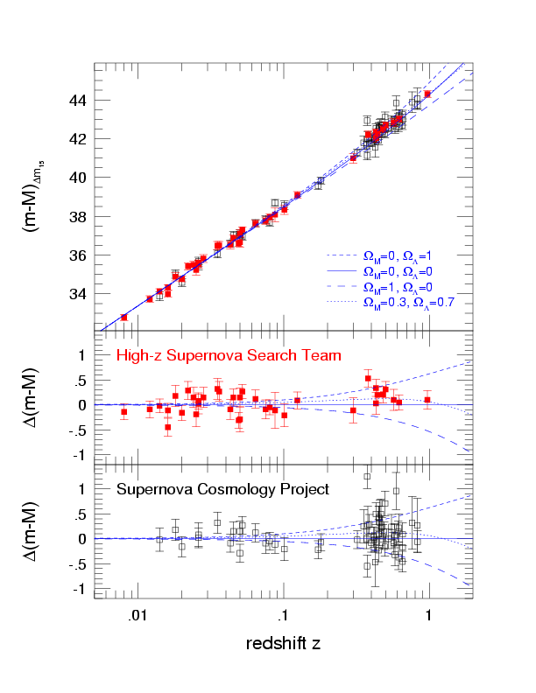
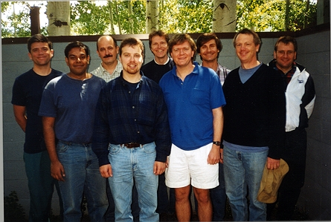
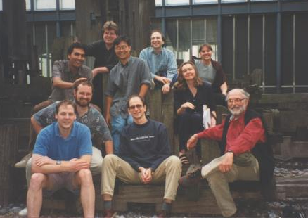
The SN Hubble Diagram

Slide 54
?
Ω=0
Scale factor
‘Mean distance between galaxies’
Ω=1
Ω>1
- 14
- 9
- 7
Time
today
billion years

Slide 55
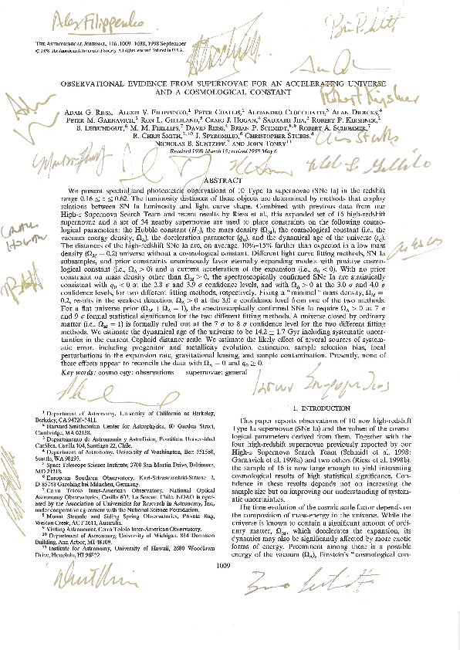

Slide 56
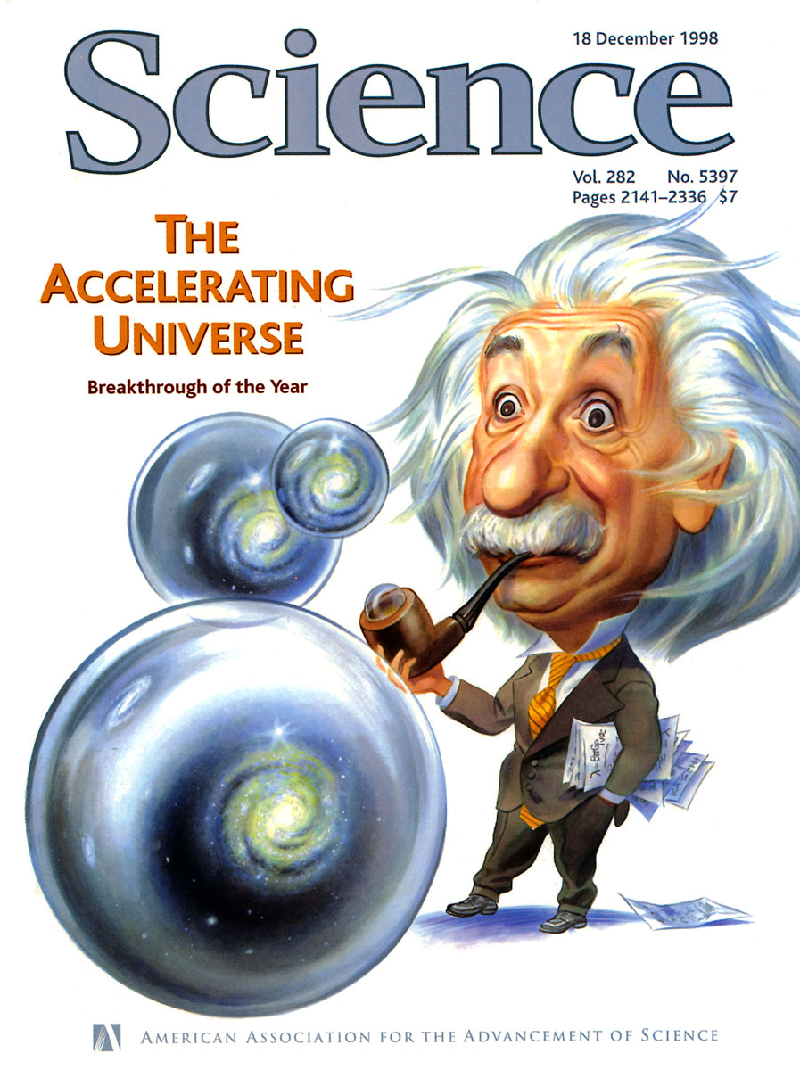
What does this mean?
Distant supernovae are further away than in a freely expanding, emtpy universe
This requires a repulsive component

Slide 57
Einstein zur
Kosmologischen Konstante
[Die Kosmologische Konstante] haben wir nur nötig, um eine quasi-statische Verteilung der Materie zu ermöglichen, wie es der Tatsache der kleinen Sterngeschwindigkeiten entspricht.
Einstein (1917)

Slide 58
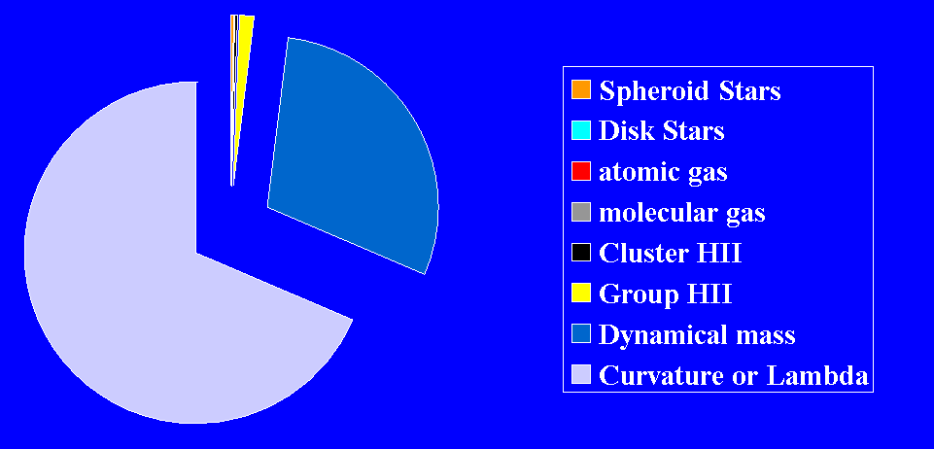
Contents of the universe
Dark Matter and Dark Energy are the dominant energy components in the universe.

Slide 59
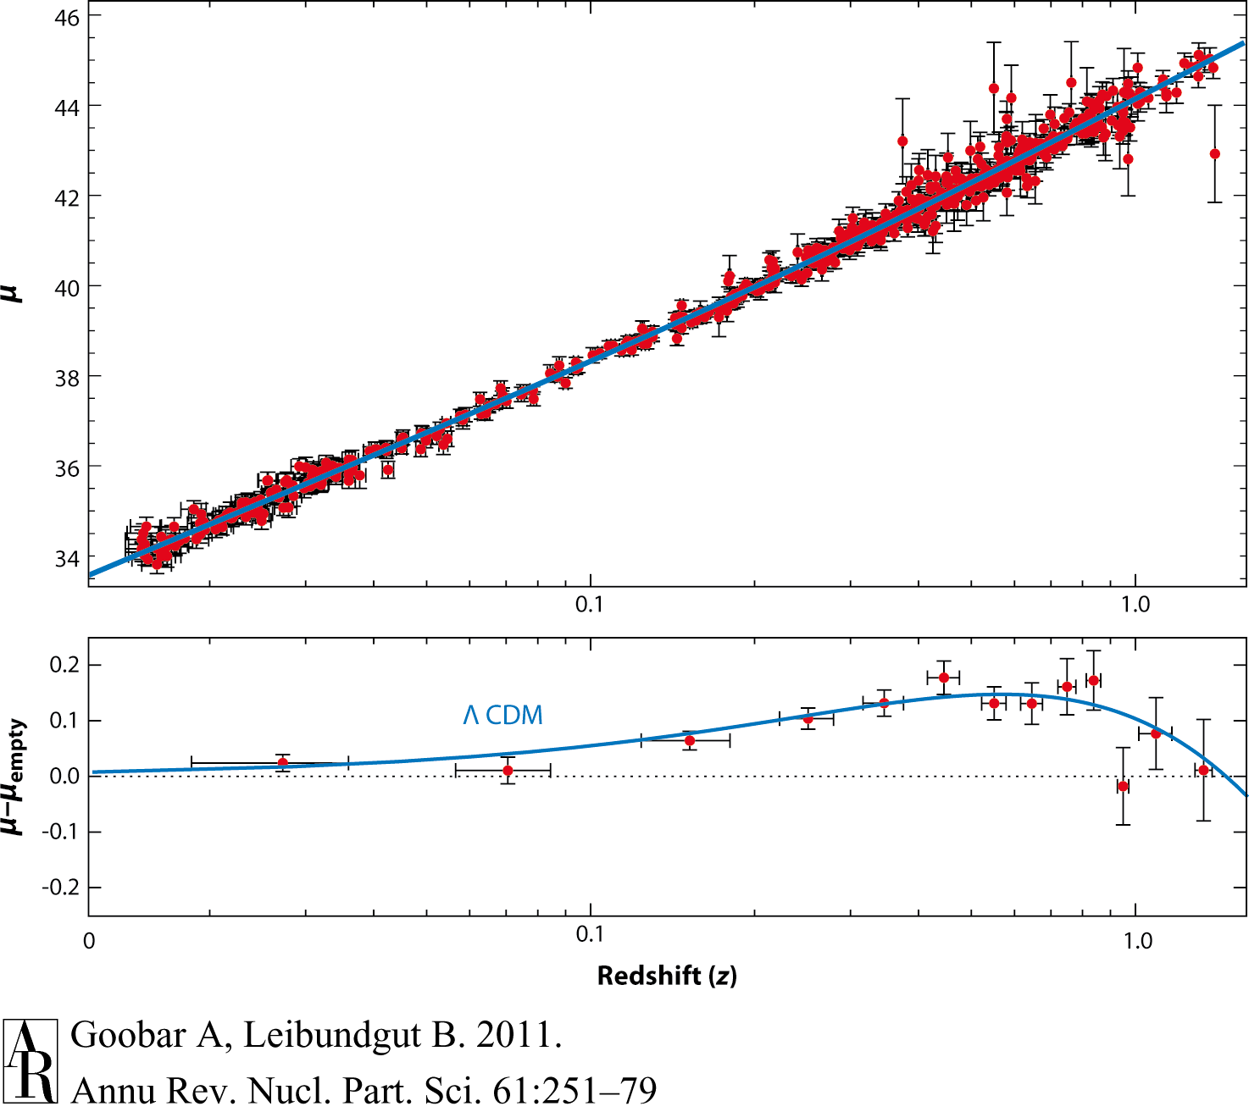
Supernova Cosmology
Goobar & Leibundgut 2011
560 SNe Ia

Slide 60
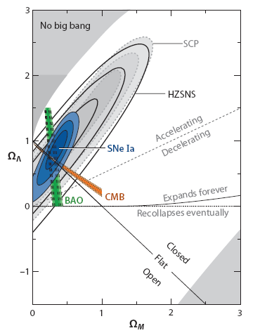
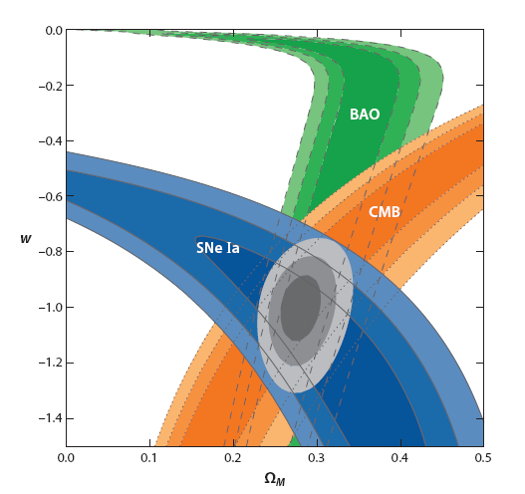
et voilà ...
10 years of progress
Goobar & Leibundgut 2011

Slide 61
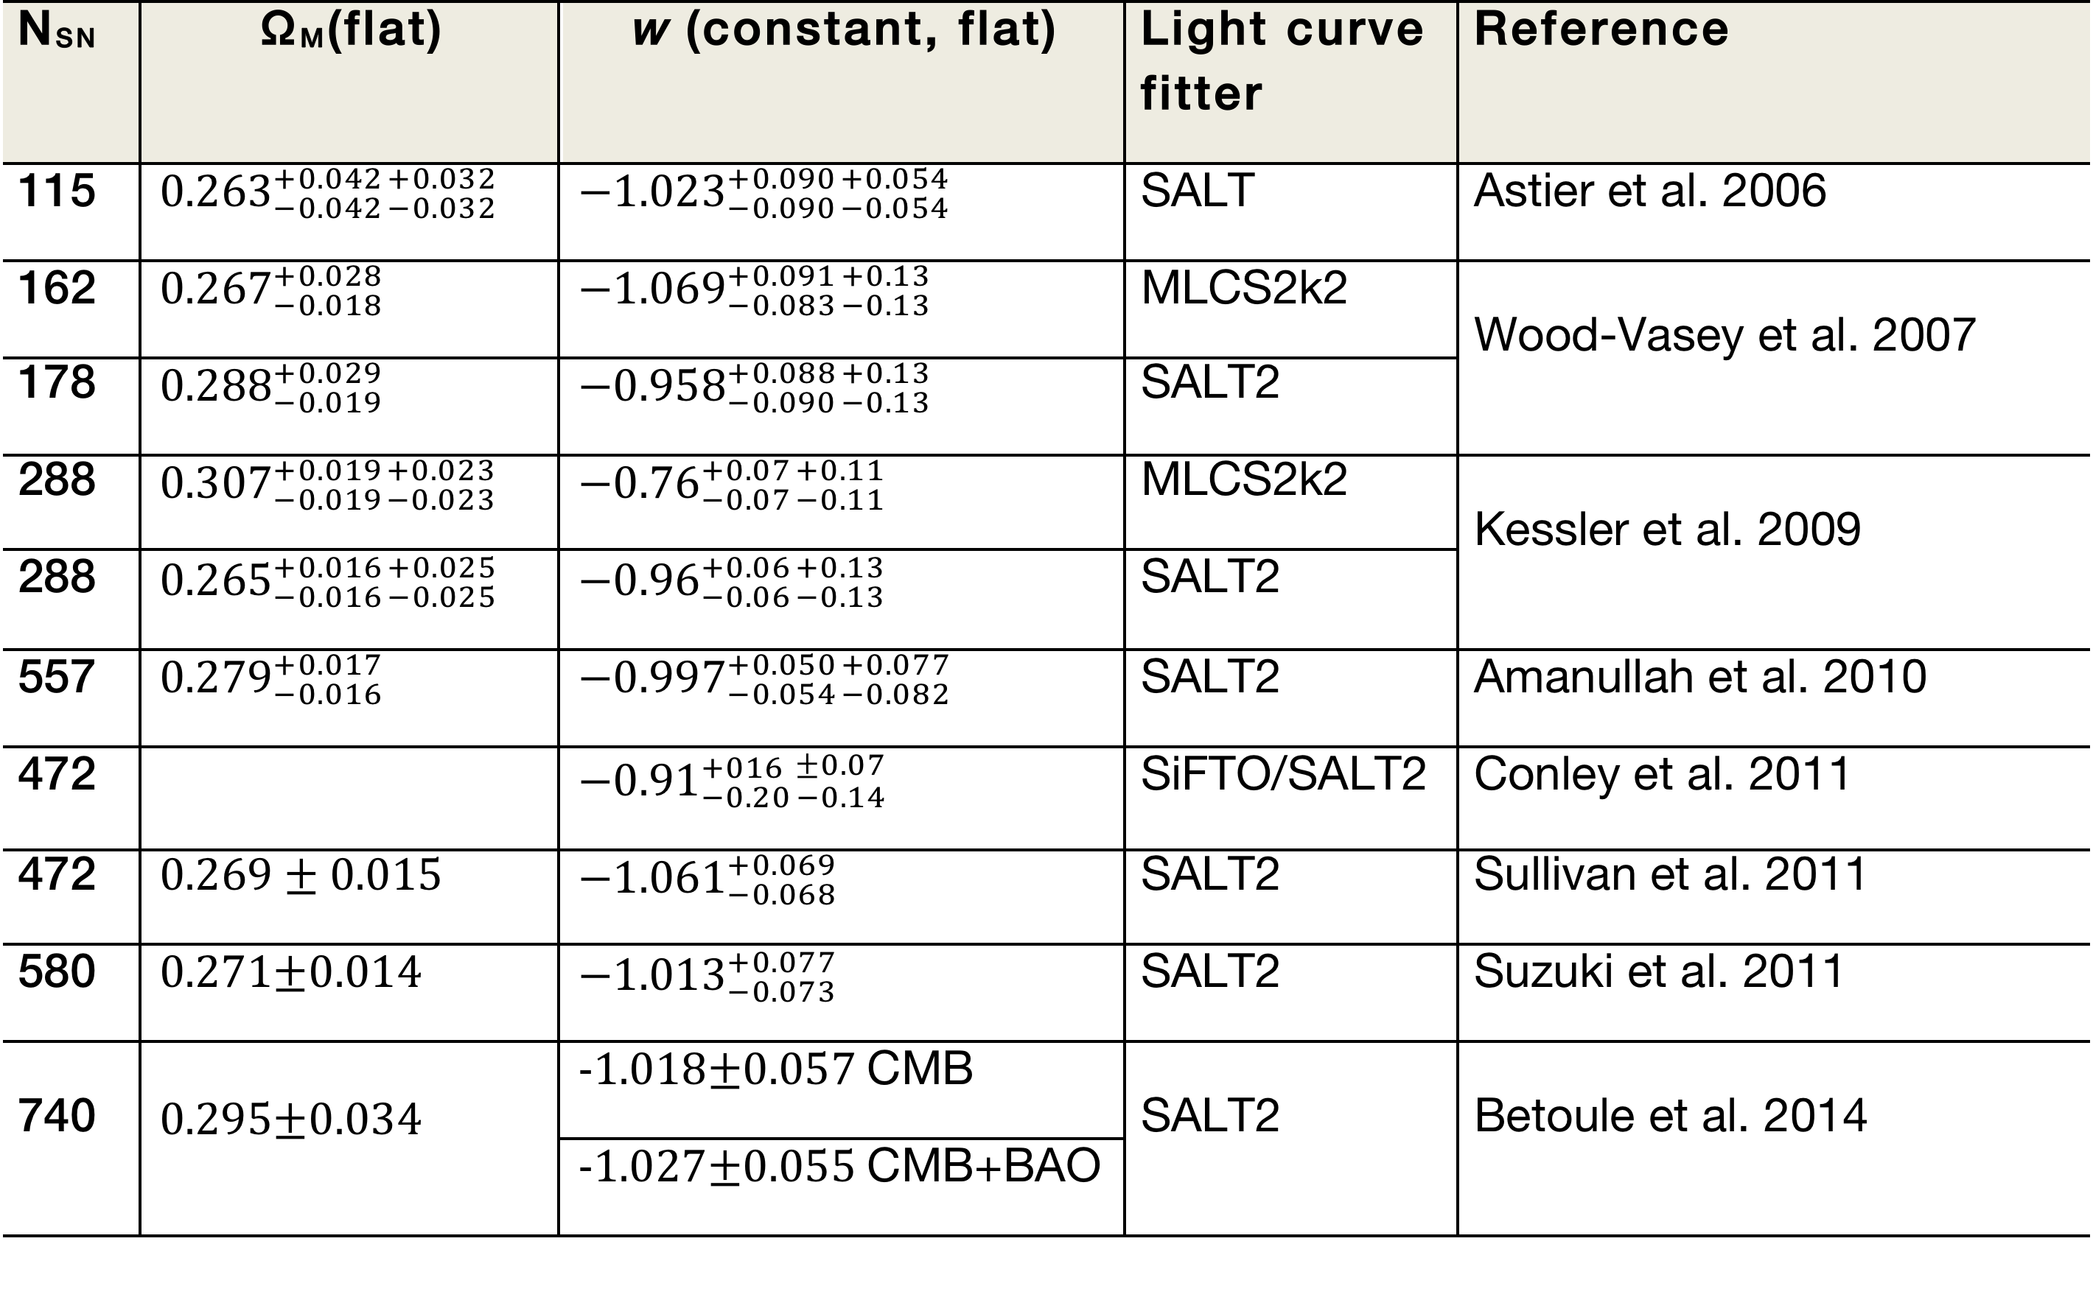
Constant ω firmly established

Slide 62
Status 2014
Betoule et al. 2014

Slide 63
Systematic uncertainties
Current questions
  calibration
  reddening and absorption
    detection
      through colours or spectroscopic indicators
    correction
      knowledge of absorption law
  light curve fitting
  selection bias
    sampling of different populations
  gravitational lensing
  brightness evolution

Slide 64
What next?
Already in hand
  >1000 SNe Ia for cosmology
  constant ω determined to 5%
  accuracy dominated by systematic effects
Missing
  good data at z>1
    light curves and spectra
  good infrared data at z>0.5
    cover the restframe B and V filters
    move towards longer wavelengths to reduce absorption effects

Slide 65
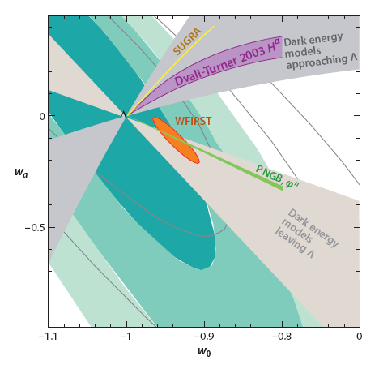
Cosmology – more?
Goobar & Leibundgut 2011
(courtesy E. Linder and J. Johansson)

Slide 66
Speculations
Einstein’s cosmologal constant
  No explanation in particle physics theories
Quintessence
  Quantum mechanical particle field releasing energy into the universe
Signatures of high dimensions
  Gravity is best described in theories with more than four dimensions
Phantom Energy
  Dark Energy dominates and eventually the universe end in a (Big Rip)

Slide 67
Supernova Cosmology – do we need more?
Test for variable ω
  required accuracy ~2% in individual distances
  can SNe Ia provide this?
    can the systematics be reduced to this level?
    homogeneous photometry?
    further parameters (e.g. host galaxy metalicity)
    handle >100000 SNe Ia per year?
Euclid
  SNe Ia with IR light curves (deep fields)
  → restframe I (z<1.2), J (z<0.8) and H (z<0.4)
  several thousand SNe to be discovered

